Slide 1
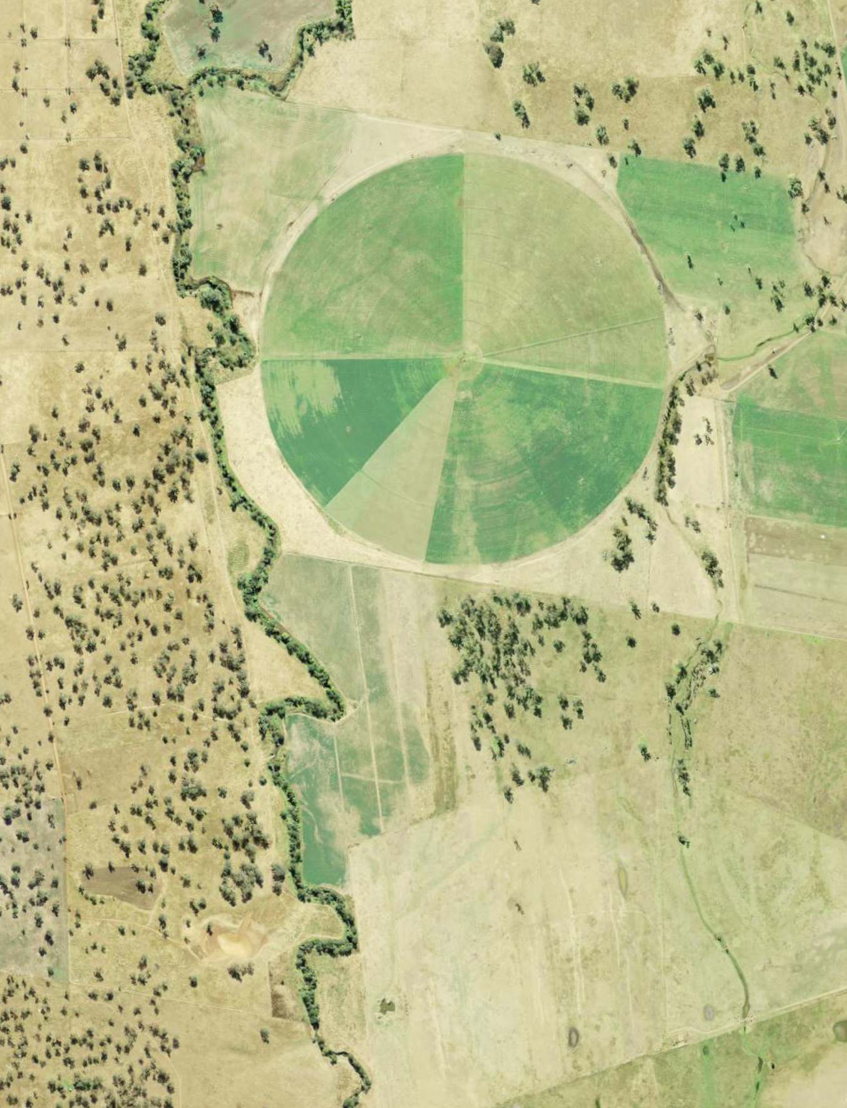
iSTEM AgriTech
Stage 5
Week 3 and 4
Resource: AGT PPT2

Slide 2
Instructions for use
This resource has been created to provide additional support for teachers and students in the delivery of the iSTEM AgriTech program of learning.
Week 3 of this AgriTech program revises student understanding of microcontrollers from the STEM fundamentals topic. Student prior knowledge of these technologies and available microcontrollers will vary based on individual students and schools. Assess this learning sequence within the context of your school and class and adjust where appropriate.
Delivery instructions and comments are provided in the notes section of the document.
Notes:
To convert the PowerPoint into Google Slides:
Upload the file into Google Drive and open it.
Go to File > Save as Google Slides.

Slide 3
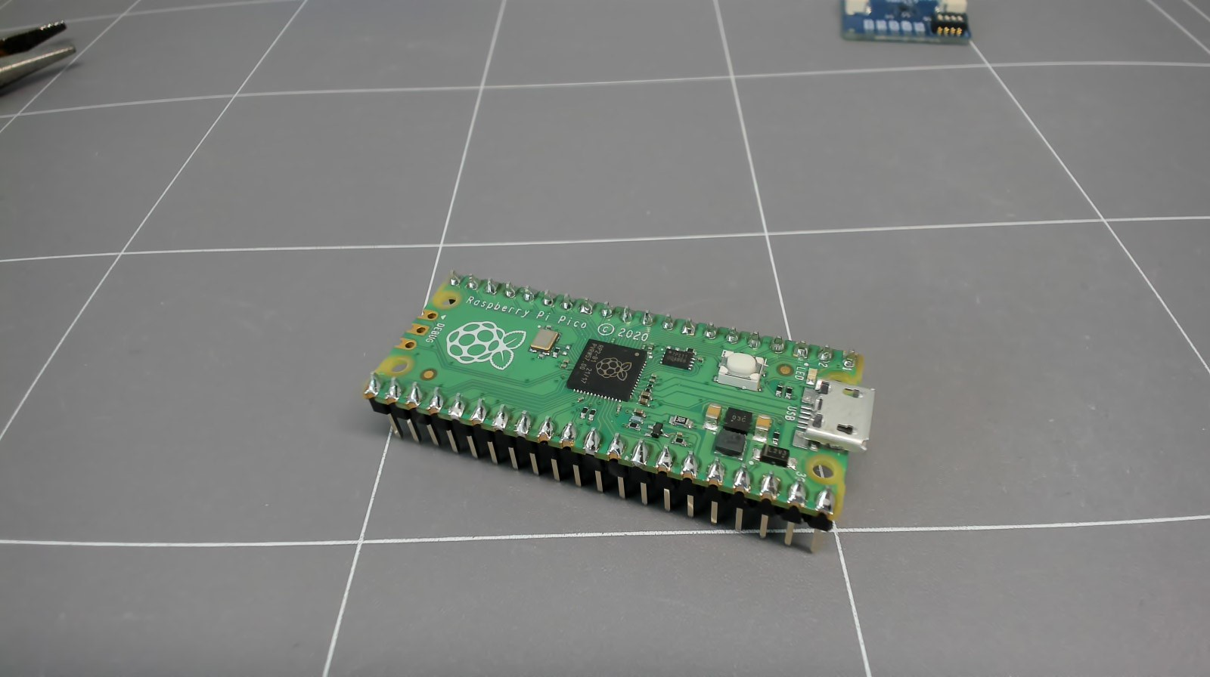
Instructions for use - Micropython
MicroPython and Raspberry Pi Pico
The following lessons use MicroPython code on the Raspberry Pi Pico (Pico) microcontroller board.
“MicroPython is a full implementation of the Python 3 programming language that runs directly on embedded hardware like Raspberry Pi Pico.” (Raspberry Pi foundation Ltd, 2024)
Raspberry Pi Pico microcontroller
Notes:
Teacher note: The programming language, software and microcontrollers used will vary in different schools. Adapt and adjust to meet the needs of the students and the context.
Consider deleting these ‘instructions for use’ notes before using slides with students.

Slide 4
Instructions for use – pin out diagram
Raspberry Pi Pico microcontroller
Refer to support documentation on the Raspberry Pi Pico and Pico W page. Important features to note:
  multiple ground pins
  Power input: 3.3V NOT 5V
  GPIO numbering is different to physical pin numbering, GP25 is the onboard LED
  multiple UART, I2C and SPI options (with a default)
  view Board walkthrough & pinout (3:35) for more information.
Pico pinout diagram from Raspberry Pi Ltd is licensed under CC BY-SA 4.0
Notes:
Teacher note: More information can be found on the Raspberry Pi Pico and Pico W page.

Slide 5
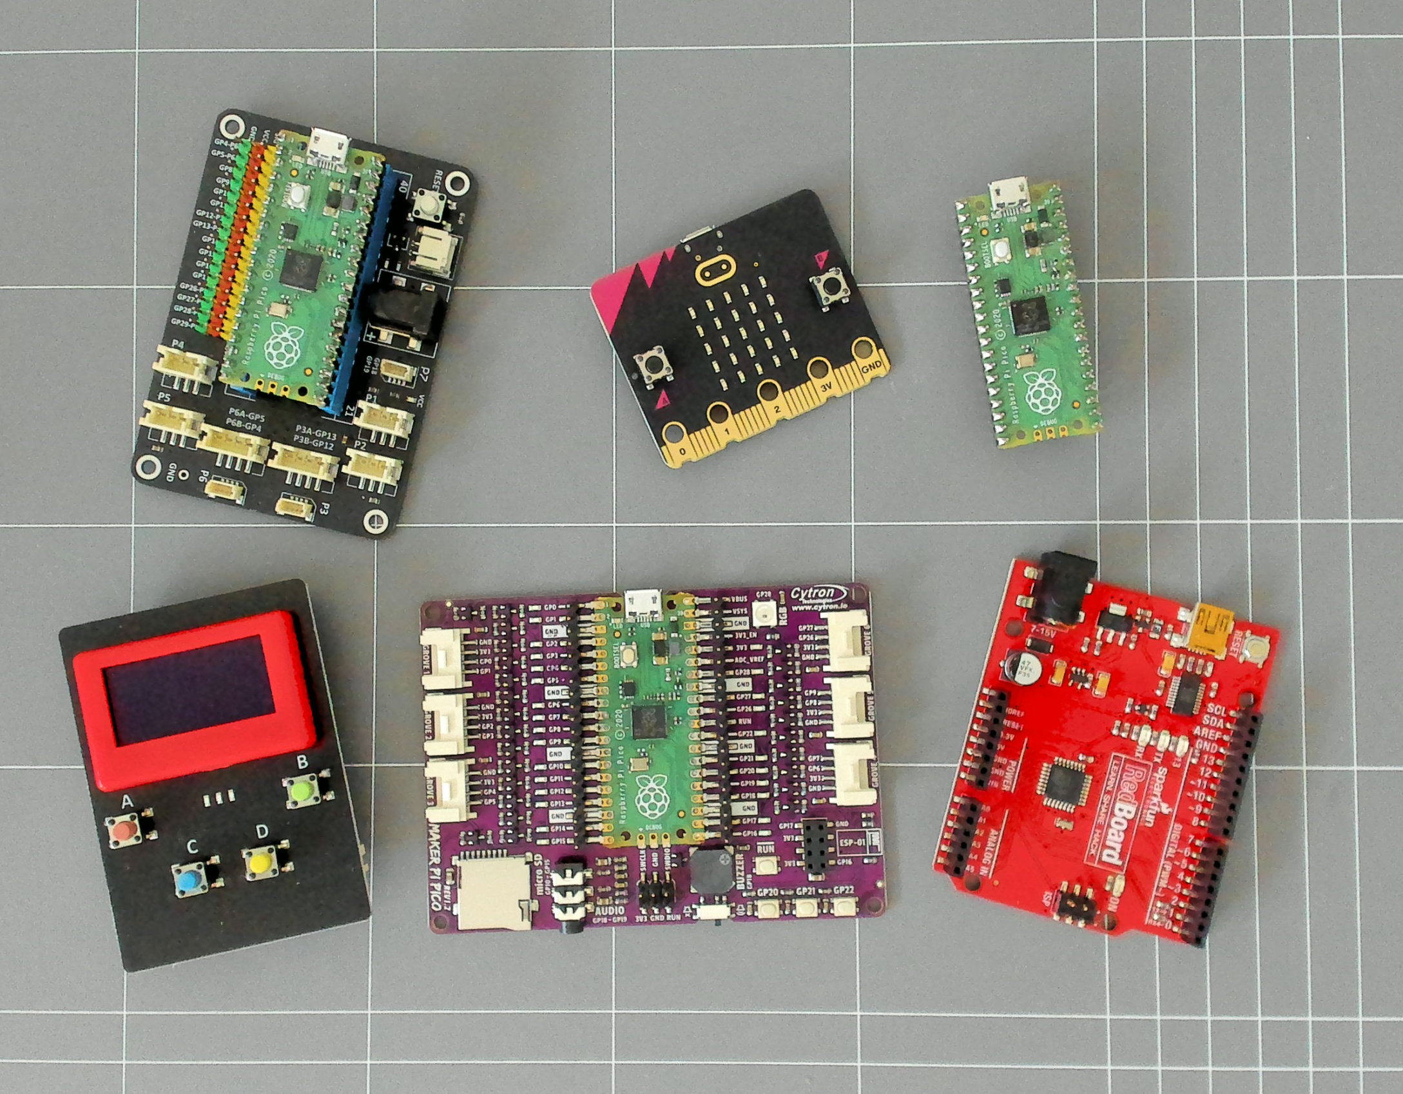
Instructions for use - alternatives
Alternative hardware
This lesson sequence uses a particular microcontroller, for illustrative purposes.
Available microcontroller boards will vary in schools.
Use stimulus videos and webpages to assist with alternative microcontroller background knowledge if required, for example:
Smart greenhouse kit for the BBC Micro:bit (3:11)
Micro:bit environment data logger
Raspberry Pi Pico workshop for beginners.
Microcontroller boards
Notes:
Teacher note: This lesson plan supports the example iSTEM AgriTech learning Sequence. There are many ways to deliver AgriTech and are large variety of devices you could use. This PPT illustrates one example of many different options.

Slide 6
Instructions for use - sensors
Alternative sensors
Use stimulus videos and webpages to assist with alternative equipment if you require this, for example:
science experiments 04 soil moisture sensor (6:42)
PiicoDev precision temperature sensor TMP117 | Micro:bit guide (5:15)
How to use temperature sensors on the Arduino (20:22)
Plant IO sensor guide (12:43)
Atmospheric sensor BME280 (6:48)
Micro:bit environment data logger
Micro:bit automatic plant watering system (5:49)
Sensors, input devices and microcontrollers (10:27)
Notes:
Teacher note: There are many ways to deliver AgriTech and are large variety of devices you could use. The above links are potential source material for different components.

Slide 7
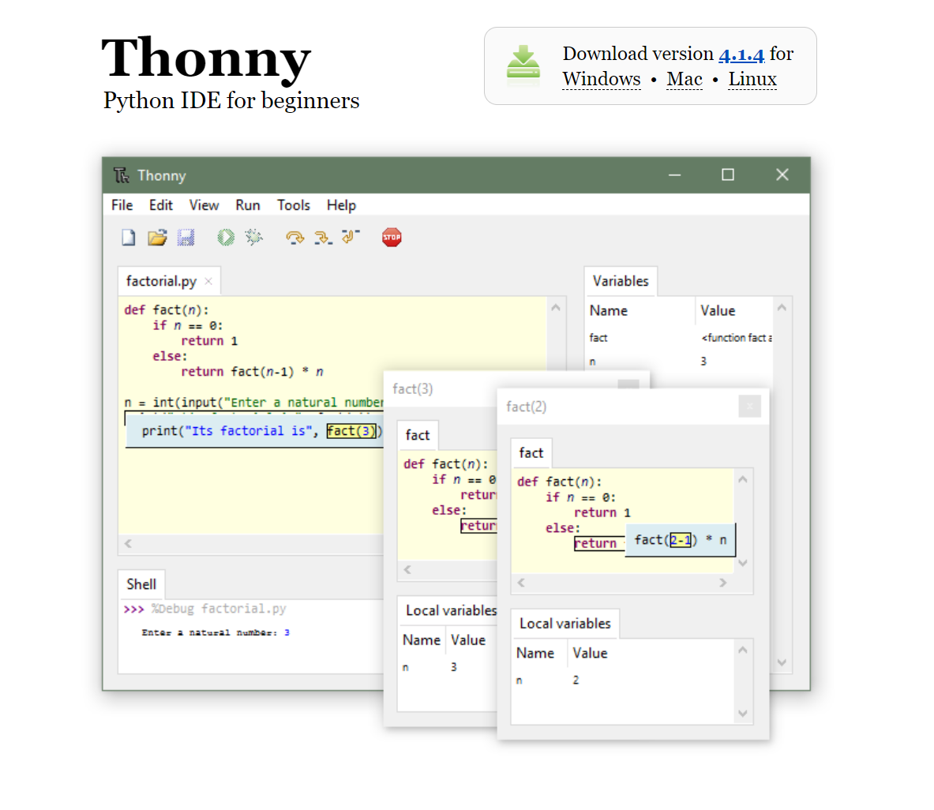
Instructions for use - Thonny
Thonny IDE
In week 3 lessons we refer to the Thonny integrated development environment (IDE).
If you choose to use Thonny and do not have it already installed on devices, you can download and install Thonny from the company portal or software catalogue.
Videos supporting the use of Thonny or Microsoft Visual Studio Code can be found on the Smart greenhouse webpage.
Screenshot from Thonny.org
Notes:
Teacher note: More information can be found on the Thonny page (https://thonny.org/).

Slide 8
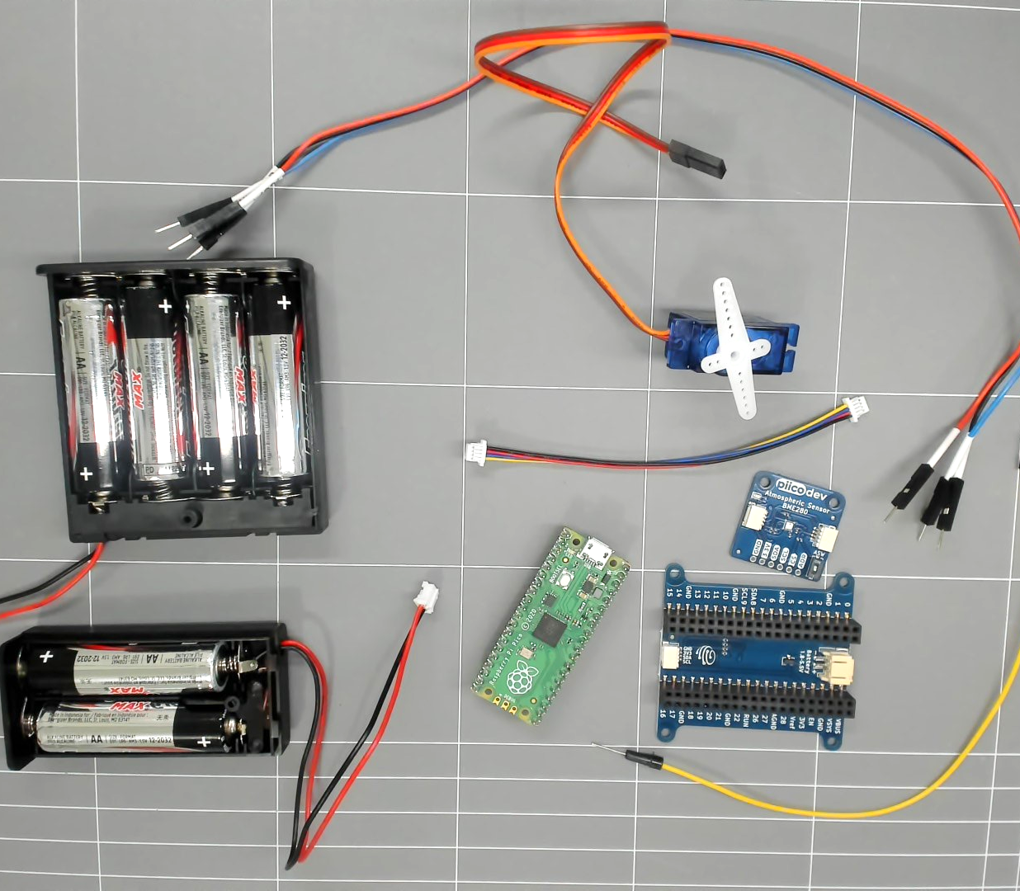
Instructions for use - equipment
Equipment for lessons 3.1, 3.2 and 3.3
Raspberry Pi Pico with soldered pins
USB-A to Micro-USB cable
Computer with USB-A port and Thonny IDE software
Piicodev Expansion board for Raspberry Pi Pico
Piicodev atmospheric sensor BME280
Piicodev cable
9g MicroServo
A 2xAA battery pack and a 4xAA battery pack
Pin to Pin jumper wires
Microcontroller, servo and sensor equipment
Notes:
Teacher note: The materials/equipment above has been used for the week 3 lessons. Equipment selection is for illustrative purposes. Equipment will vary based on school context.
The use of this Piicodev expansion board has been chosen for ease of connection to the sensor and connection to a power source for untethered operation. Alternatively, a breadboard may also be used to connect an additional power supply to the servo.

Slide 9
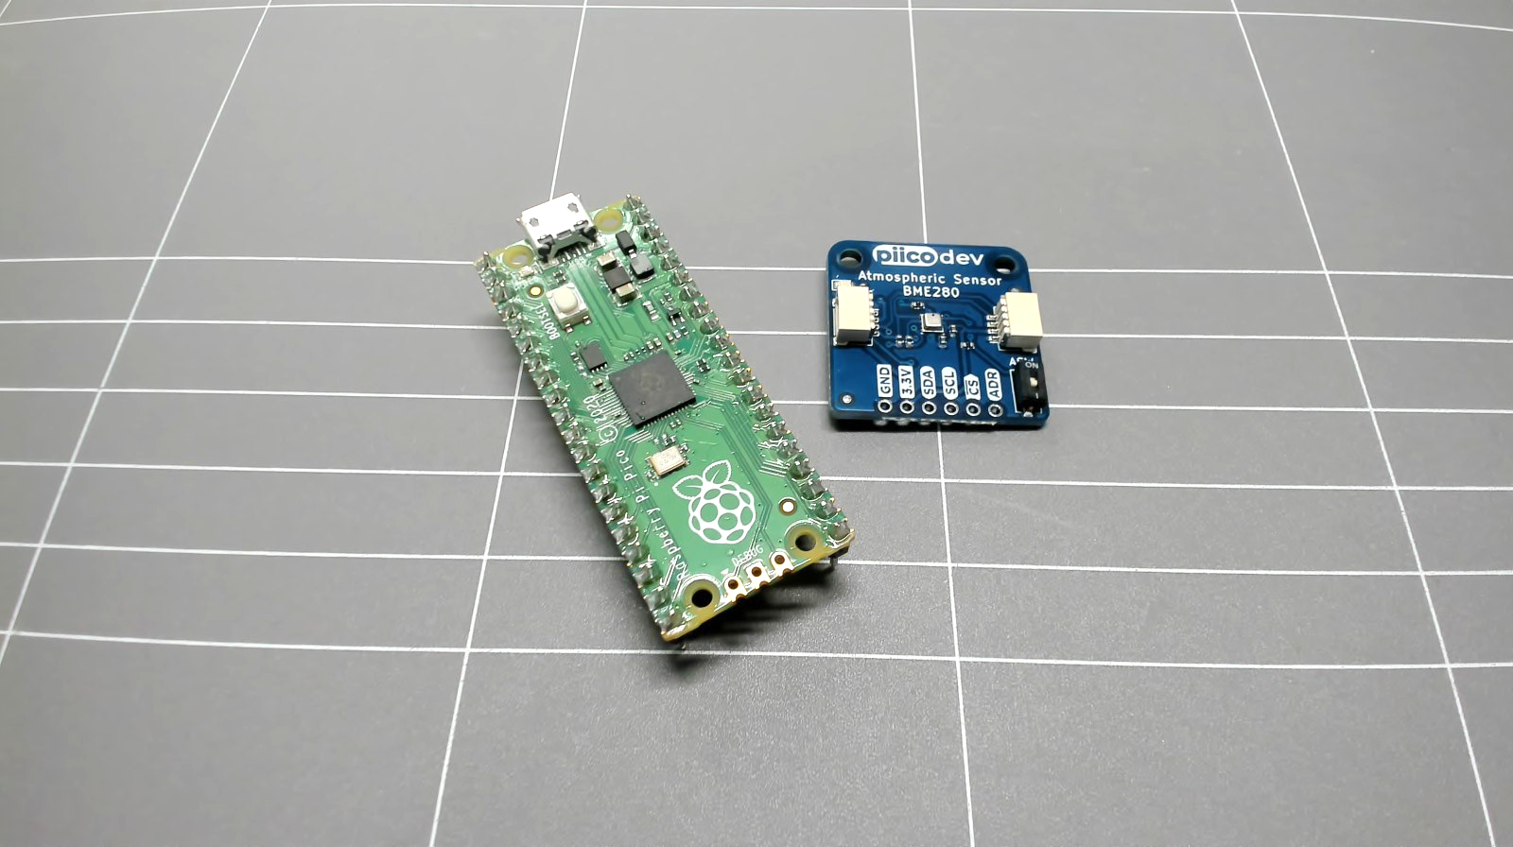
Instructions for use - files
Files
Lesson 3.2 uses a particular sensor and expansion board.
You will need to download two python files from PiicoDev atmospheric sensor BME280 – raspberry pi pico guide, they are:
PiicoDev_Unified.py
PiicoDev_BME280.py
We will call upon these files in our main code. Share files with students.
Microcontroller and atmospheric sensor
Notes:
Teacher note: Different sensor packages will have different driver files and libraries. The Unified file in this example is a library that drives I2C connections for PiicoDev packages. The BME280 file is a specific device driver for this specific BME280 sensor.

Slide 10
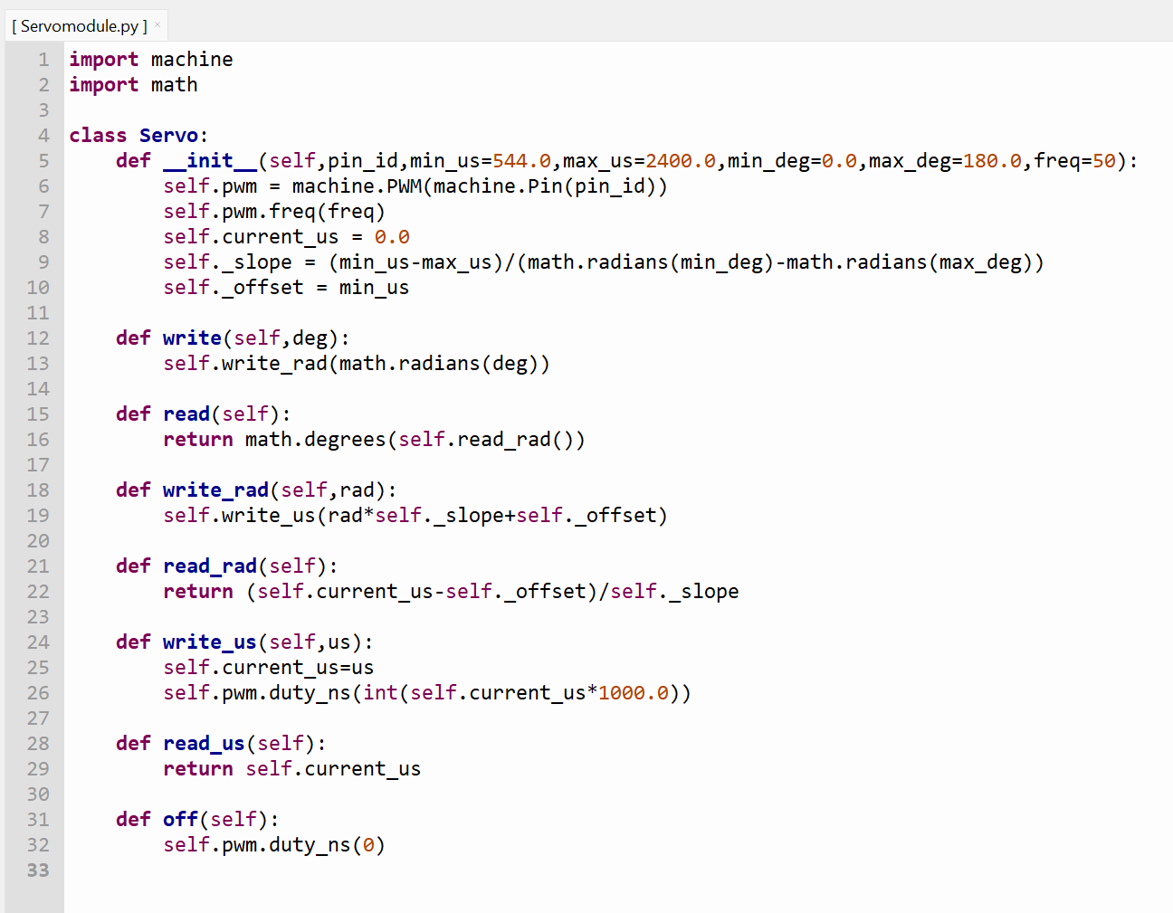
Instructions for use – download files
Files
Lesson 3.3 uses a 9g MicroServo, BME280 sensor and a Raspberry Pi Pico
You will need to download a Micropython servo library from Micropython-servo 1.0.1.
We will call upon this module when running the microservo.
Share this file with students.
Screenshot of Servo library in Thonny from Micropython-servo 1.0.1 is licensed under CC BY-SA 4.0
Notes:
Teacher note: If downloading of py files is not successful, copy the script from the links and create the file.

Slide 11
Week 3 and 4 lessons
3.1
4.1
Microcontroller boards
Brainstorm and design
3.2
4.2
Microcontroller and sensor
Refine the design
3.3
4.3
Microcontroller and response
Designing and planning
Notes:
Teacher notes:
Click lesson numbers to go to specific lessons
Interactive features can be viewed in slide show

Slide 12
3.1 Microcontroller boards
Learning intentions and success criteria
We are learning to:
use coding environments to produce code that runs on a microcontroller.
We can:
use a coding environment to program actions on a microcontroller.
Notes:
Notes for teachers:
Adapt the learning intention as required and add matching success criteria.
For more information see ⁠NSW Department of Education explicit teaching strategies https://education.nsw.gov.au/teaching-and-learning/curriculum/explicit-teaching.
LISC is not necessarily presented at the beginning of the lesson. Teacher needs to consider most effectual time to introduce.
LISC should be revisited during the lesson to support students' evaluation of their learning.
Point out to students that the terms microcontroller and microcontroller boards tend to be used interchangeably by people. Point out that you will be using (insert type) of microcontroller board.

Slide 13
Microcontroller review
Raspberry Pi Pico
Today we will be revising the use of the Raspberry Pi Pico microcontroller board.
Pico microcontroller board
Notes:
Teacher note: Revise microcontroller technologies from the STEM fundamentals topic. Adapt this slide to include activities you have engaged in that have used microcontroller boards.
Point out to students that the terms microcontroller and microcontroller boards tend to be used interchangeably by people. Point out that you will be using (insert type) of microcontroller board.
A microcontroller is a single Integrated Circuit (IC) or "chip." It is often called a "computer on a chip" because it contains a processor core, memory, and programmable input/output peripherals all baked into one piece of silicon.
A microcontroller board (or development board) is a printed circuit board (PCB) that houses the microcontroller and supporting hardware to make it easy to use.
Recall questions
What did we use the microcontroller for in (insert topic)? (we made a movement data logger)
Did we collect data? What data did we collect and what sensor did we use? (we collected acceleration data) (it told us about movements)(we used an accelerometer)

Slide 14
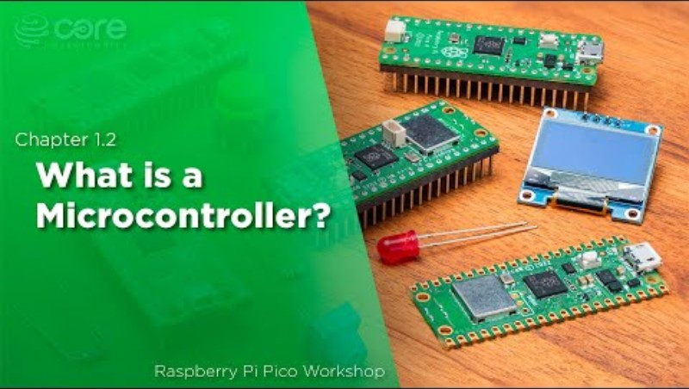
Raspberry Pi Pico review
What is a microcontroller board?
A circuit board that contains a microcontroller, which is a small computer used to control the operation of electronic devices.
The board typically has memory, programmable input/output peripherals, and is used to execute specific control programs, such as managing motor speed or reading sensors in an elevator system.
What is a microcontroller?
Notes:
Teacher note: Revise microcontroller technologies from the STEM fundamentals topic, or other topics. This is an example of a Raspberry Pi Pico introduction video to assist with student recollection. Adapt this lesson and slide deck to suit your context.

Slide 15
Microcontrollers, sensors and actuators
Sensors
There is a wide range of sensors we can connect to microcontrollers.
What sensors have we used in other topics so far?
What data did we collect?
Why did we collect this data?
Example
We used a temperature sensor in STEM fundamentals to collect temperature data from inside a dark-coloured box and a light-coloured box.
We did this to test the effect of colour on heat absorption.
Notes:
Teacher note: Revise the use of microcontrollers and sensors from STEM fundamentals or other topics. This slide is a guide for discussions.
What did we use the microcontroller for in (insert topic)? (we made a movement data logger)
Did we collect data? What data did we collect and what sensor did we use? (we collected acceleration data) (it told us about movements)(we used an accelerometer)

Slide 16
Raspberry Pi Pico
Pinout
In today's lesson reference will be made to the:
BOOTSEL button
Micro- USB port
Pin GP25 which is the onboard LED
‘Pinout diagram’ from Raspberry Pi Ltd is licensed under CC BY-SA 4.0
Notes:
Teacher note: Refer students to the pinout of the microcontroller you are using. In this case we have the pinout diagram for the Raspberry Pi Pico. Make specific reference to the features, ports or pins of the microcontroller you will be using.
In this example components will be outlined on the mouse click.
Using a wireless mouse students could point at different components.
Or if students have their microcontrollers you could say:
Please point to the following on your pico -
BOOTSEL button,
USB port
GP 25 - Possibly remind students that GPIO stands for General Purpose Input/Output. It's a programmable digital pin on an electronic circuit board that can be used as an input, output, or both. GP 25 is an onboard LED output. This means that the LED is built into the microcontroller board and uses GP 25.

Slide 17
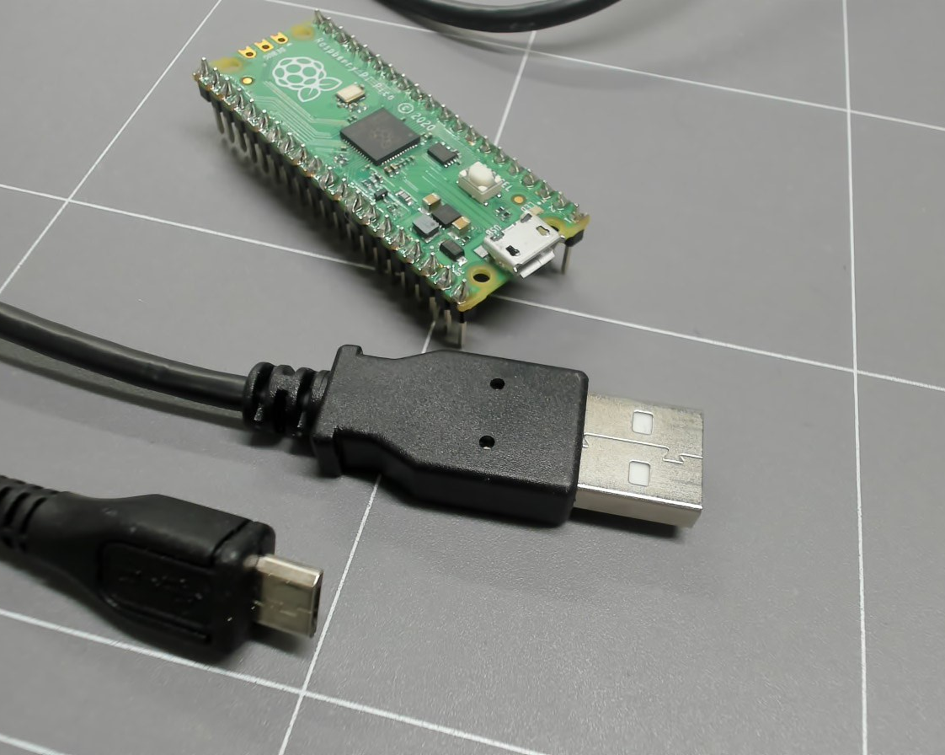
Microcontroller connection
Equipment
Equipment:
Raspberry Pi Pico with soldered pins
USB-A to Micro-USB cable
Computer with USB-A port and Thonny installed.
Pico and USB
Notes:
Teacher note: Make explicit reference to equipment that will be used. Revise how this equipment has been used in previous topics. The following video will model use.
Use the following video or following slides (or both) to walk students through Pico connection.

Slide 18
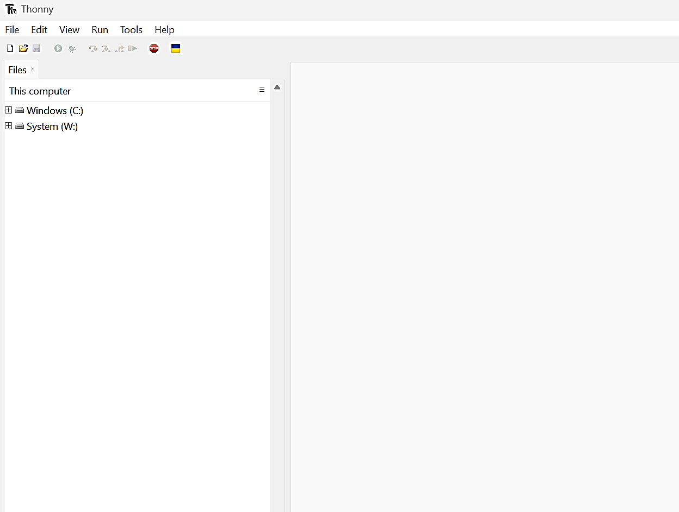
Software
Revising Thonny IDE
Open Thonny on your computer.
The Thonny window should appear like that shown.
The editor section will be empty the first time using Thonny.
Note: If the file pane is not visible, left click the ‘View’ tab and select files. The files pane will appear.
Screenshot of ‘Thonny’ from Thonny.org
Notes:
Teacher note: Direct students to Thonny (or other IDE). When they are ready present the following video to show how to connect the Pico to the computer. Ask students to take hands off mice when they are complete. Possibly use another nonverbal indication system if needed see https://app.education.nsw.gov.au/digital-learning-selector/LearningActivity/Card/560?clearCache=54cf3396-a5db-1117-1820-9482474b65d6 and ask students are they on track? Use yes no cards (Yes, No)

Slide 19
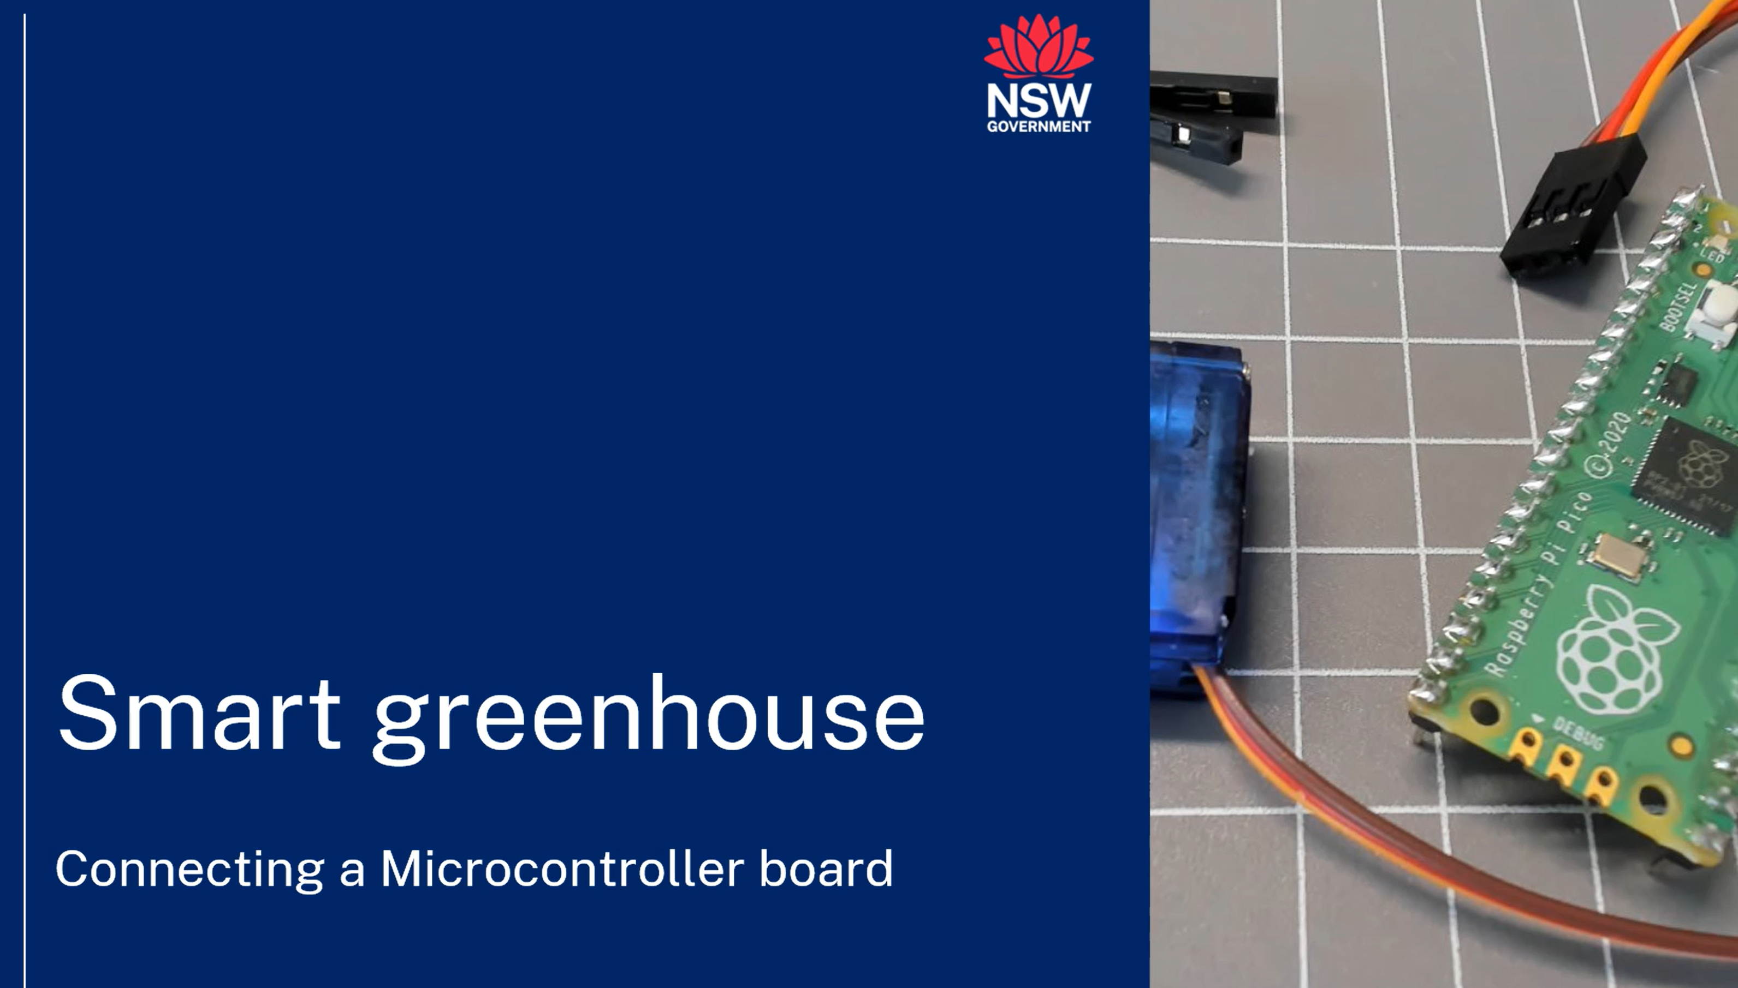

Connecting the Raspberry Pi Pico
We will now use the USB cable to connect the computer and the Pico using instructions from the Smart greenhouse webpage.
Notes:
Teacher note: This video demonstrates one way to connect the Pico to a computer using the Thonny IDE.
Explore the Smart greenhouse webpage and present the video to the class before stepping through the following slides which detail the steps or play and pause video for students to follow. The Smart greenhouse webpage also has video instructions for using Microsoft VS code.
https://education.nsw.gov.au/teaching-and-learning/curriculum/stem/stem-curriculum-resources/stem-smart-greenhouse
Possibly students remember the basics from STEM fundamentals but please consider using this revision and adjust to suit your setting.

Slide 20
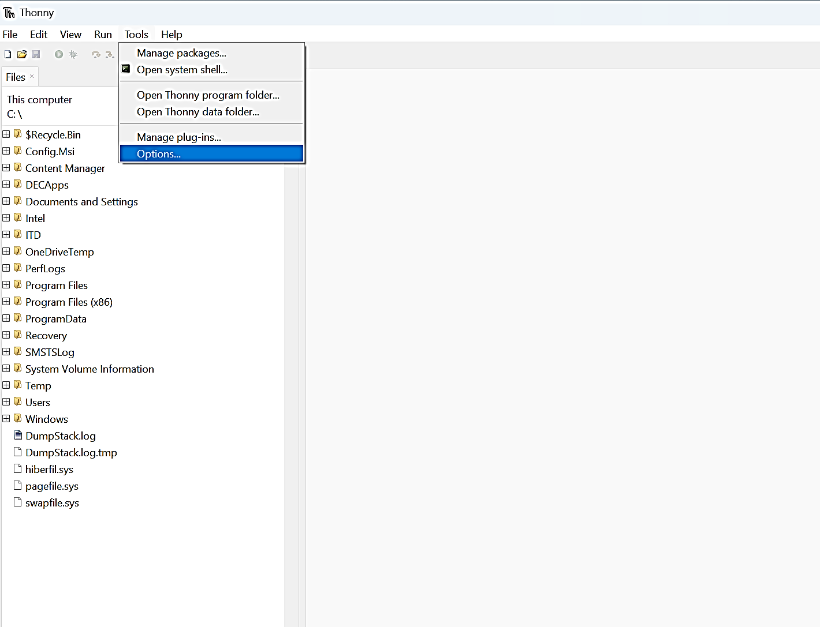
Connection - pico
Connecting the Pico
Connect the USB cable to your computer.
Hold down the BOOTSEL button on the Pico and connect the USB to the Pico.
Left click the ‘Tools’ tab and select Options.
Screenshot of ‘Thonny’ from Thonny.org
Notes:
Teacher note: Direct students to follow instructions. Ask students to take hands off mouse when they are complete. Possibly use another nonverbal indication system if needed see https://app.education.nsw.gov.au/digital-learning-selector/LearningActivity/Card/560?clearCache=54cf3396-a5db-1117-1820-9482474b65d6 and ask students are they on track? (Yes, No).
You could also give students a version of this slide deck and they can follow it at their own pace, consider your context and adjust accordingly.

Slide 21
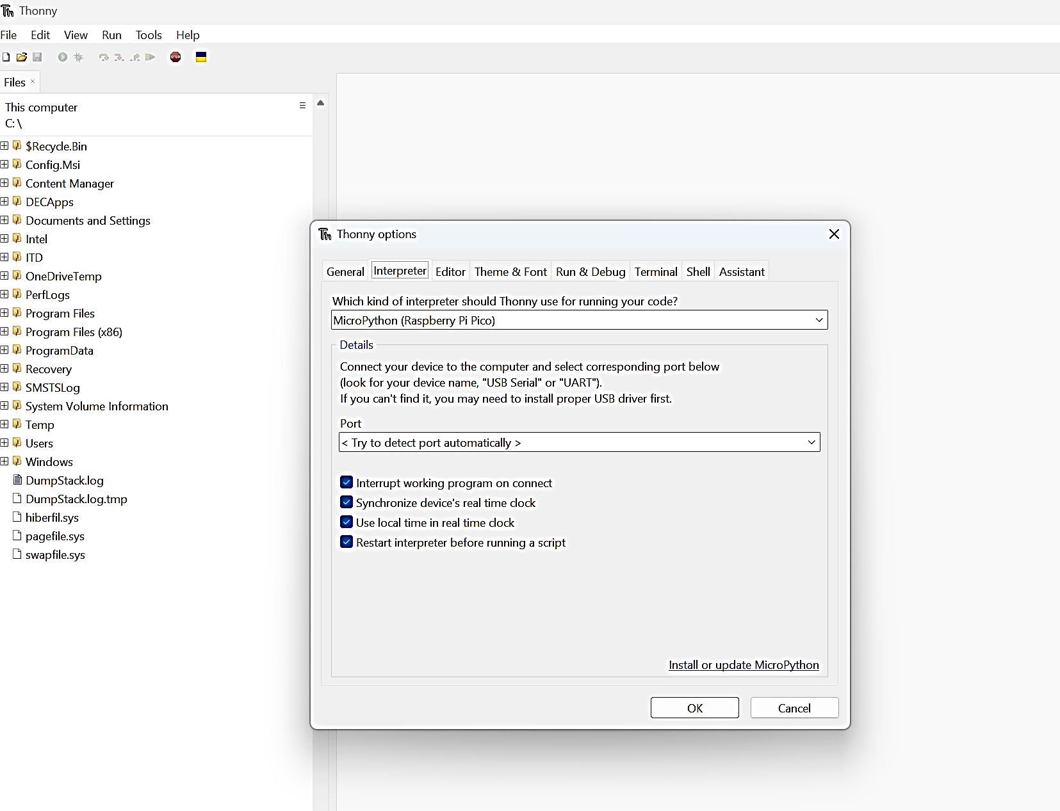
Connection - interpreter
Connecting the Pico
Select the ‘Interpreter’ tab. The pop up should appear as shown.
Select the ‘Micropython (Raspberry Pi Pico) in the first drop down box.
Leave automatic detection in the ‘Port’ drop down box.
Left click ‘Install or update Micropython’.
Screenshot of ‘Thonny’ from Thonny.org
Notes:
Teacher note: Direct students to follow instructions.

Slide 22
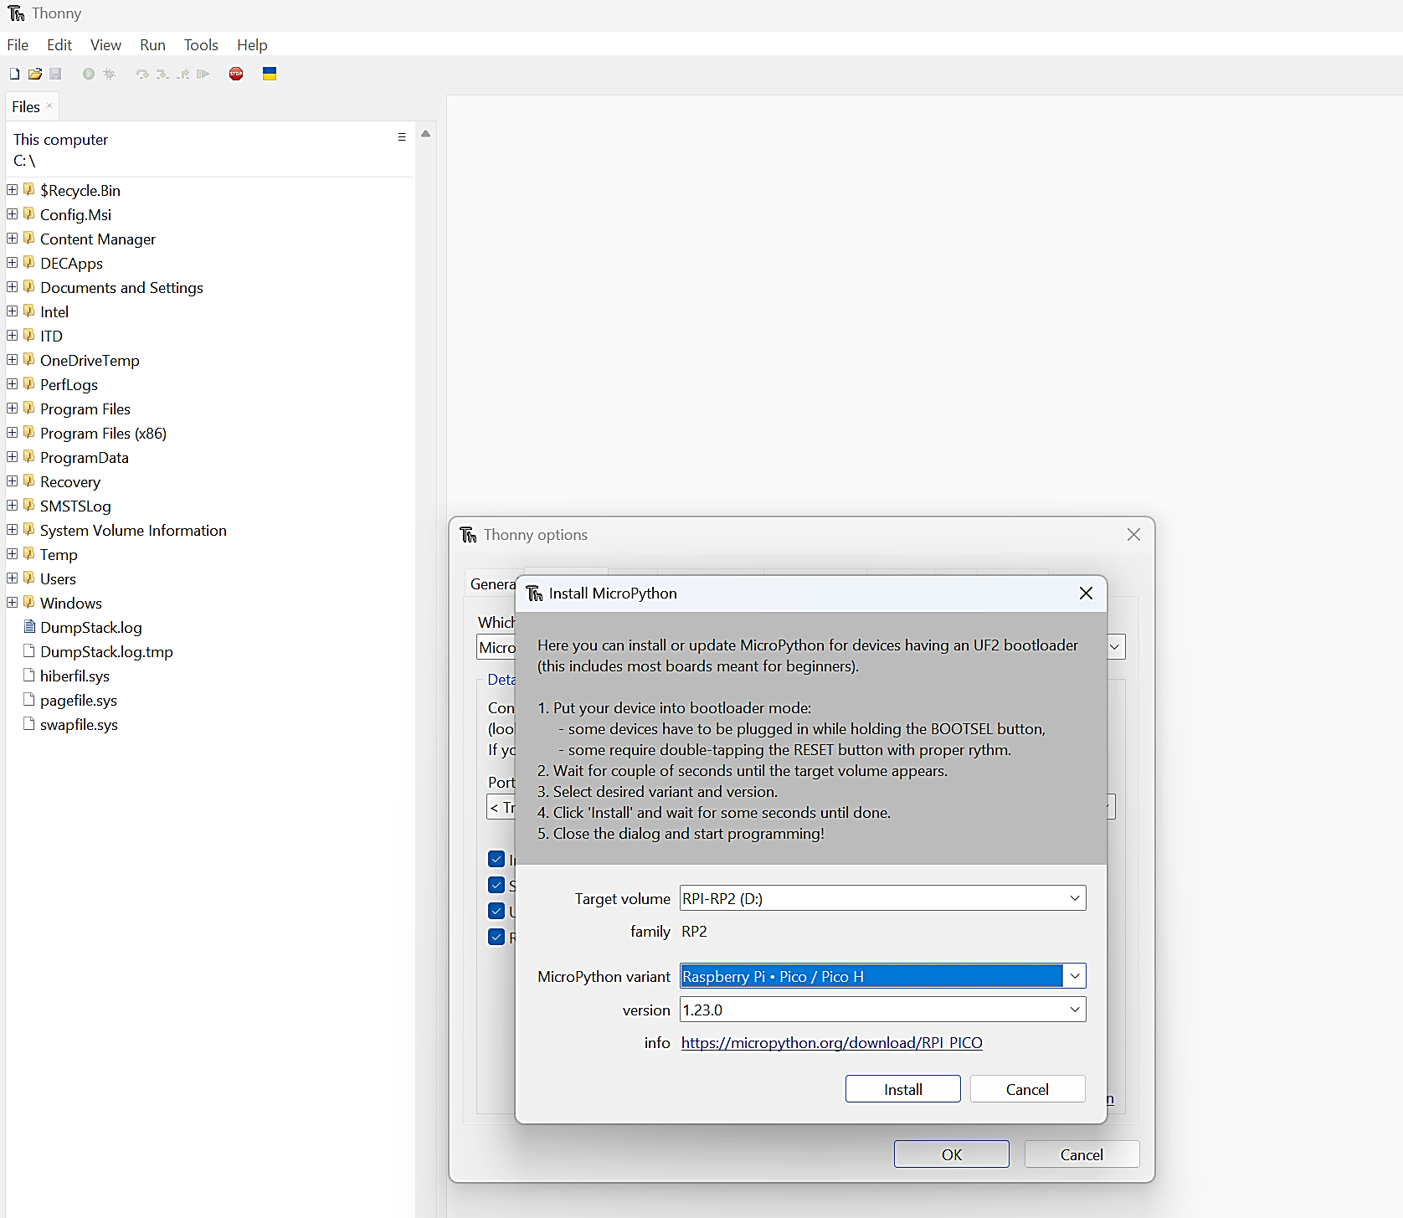
Connection – Pico versions
Connecting the Pico
‘Target volume’ should show RPI.
In the ‘MicroPython variant’ drop down select the Pico connected. In this instance select Raspberry Pi Pico.
Select the MicroPython version. In this instance select the latest version.
Select Install.
When completed close the pop up and select ‘OK’ in the next pop up.
Screenshot of ‘Thonny’ from Thonny.org
Notes:
Teacher note: Direct students to follow instructions.

Slide 23
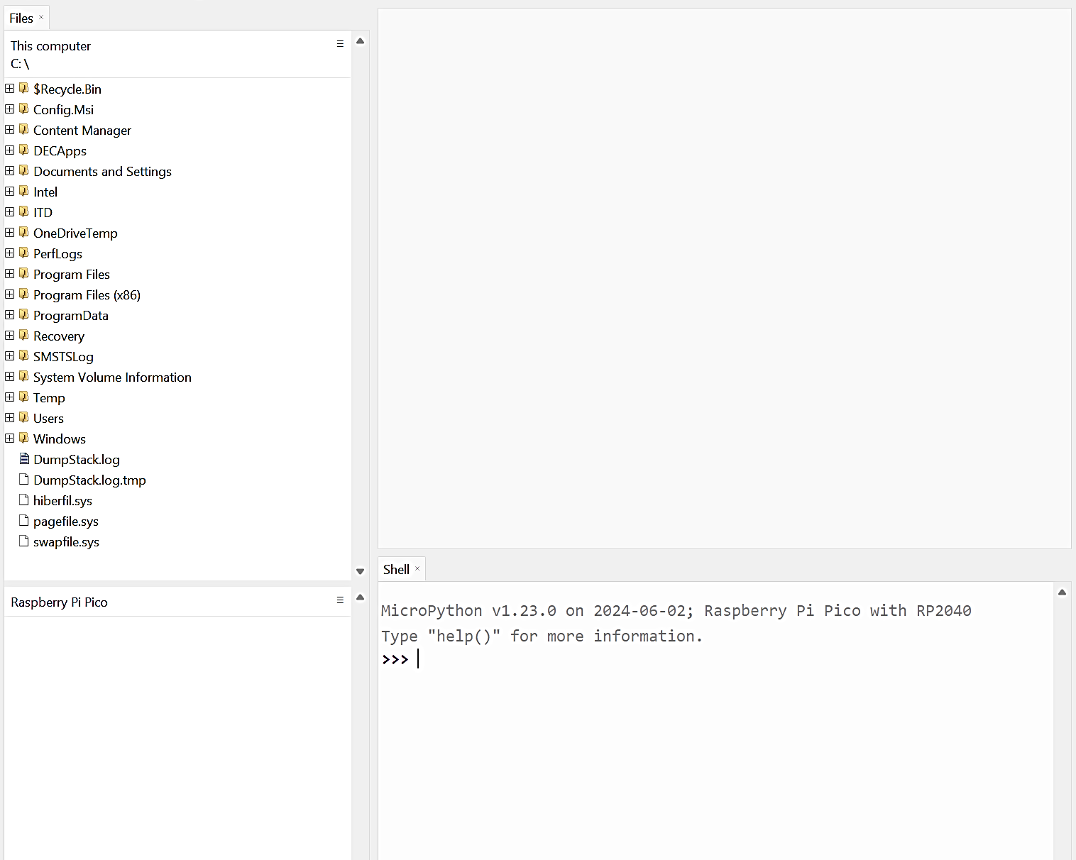
Connection - Thonny
Connecting the Pico
A ‘Raspberry Pi Pico’ pane appears in the ‘Files’ pane of Thonny.
Screenshot of ‘Thonny’ from Thonny.org
Notes:
Teacher note: Confirm with students. Ask students to check with a peer.
The next slide will model a basic code.

Slide 24
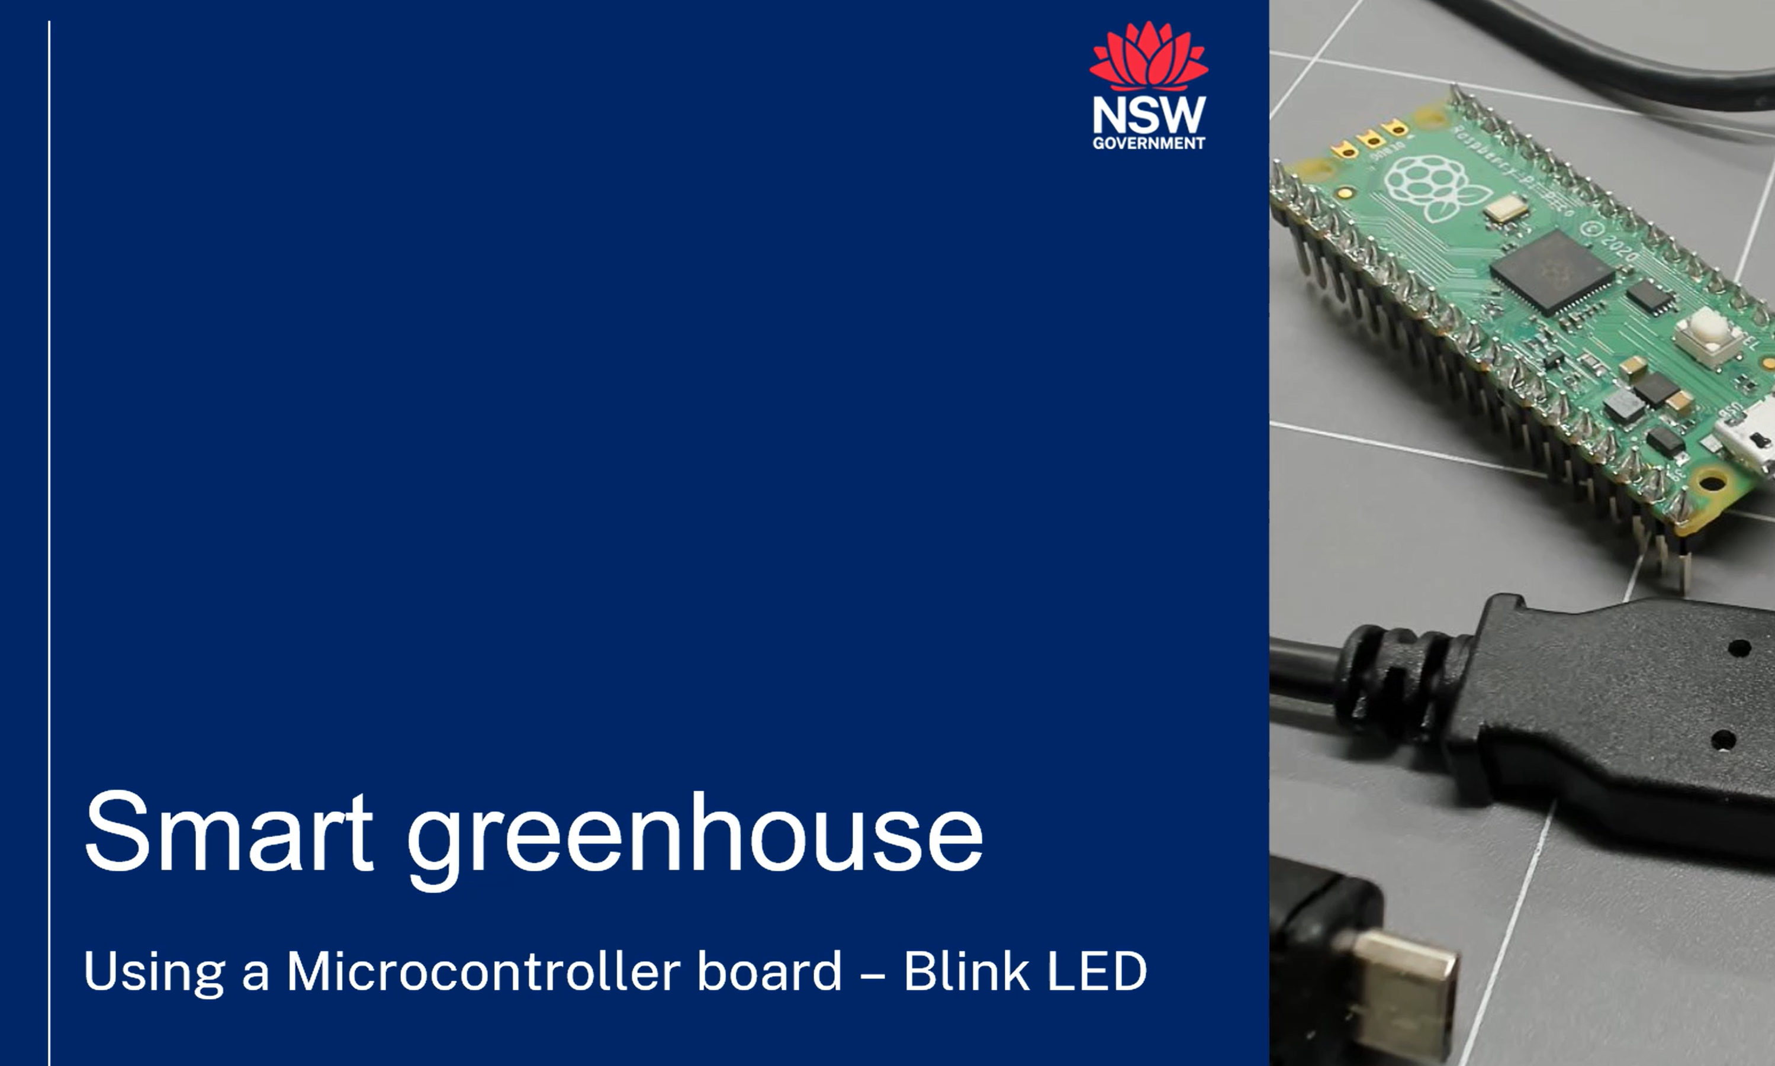
‘Blink LED’ code
We will create a short code to use the onboard LED and revise our coding skills.
Notes:
Teacher note: This video demonstrates making a new file, then writing and using a test Blink code on the microcontroller.
Explore the Smart greenhouse webpage and present the video to the class before stepping through the following slides which detail the steps or play and pause the video for students to follow. The Smart greenhouse webpage also has video instructions for using Microsoft VS code.
https://education.nsw.gov.au/teaching-and-learning/curriculum/stem/stem-curriculum-resources/stem-smart-greenhouse
The following slide has the code and code explanation.

Slide 25
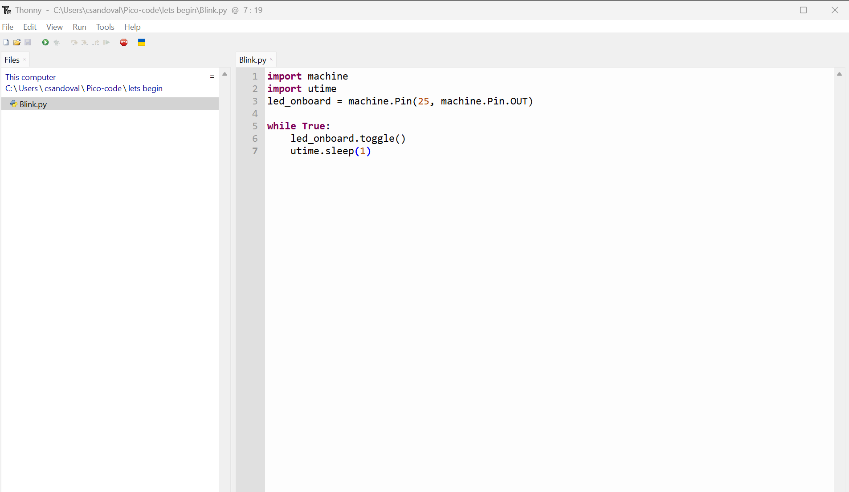
Blink LED
MicroPython code
We will create a short code to create an action on the Pico.
Type this code into the editor and save as ‘Blink.py’.
Select the green run button.
Screenshot of ‘Thonny’ from Thonny.org
Notes:
Teacher note: Ask students to enter and use the ‘Blink’ code. Explain the code to students' line by line.
Ask students to demonstrate the code and resulting blink to a peer or you as the teacher.
Example explanation provided.
import machine
This line imports the machine library in MicroPython. This library provides functions for interacting with the hardware of the microcontroller board, including General Purpose Input/Output (GPIO) pins.
import utime
This line imports the utime library in MicroPython. This library provides functions for measuring time and delaying program execution.
led_onboard = machine.Pin(25, machine.Pin.OUT)
This line creates a variable named led_onboard. It uses the machine.Pin function to configure to a specific pin on the microcontroller board. In this case, it sets the pin number to 25 and sets its mode as output (OUT), meaning the program can control the voltage level on that pin.
while True:
This line starts an infinite loop. The code within the indented block following this line will be executed repeatedly until the program is stopped.
led_onboard.toggle()
This line calls the toggle method on the led_onboard variable. The toggle method switches the state of the LED connected to that pin between on (1) and off(0).
utime.sleep(1)
This line calls the sleep function from the utime library. It pauses the program execution for one second before continuing to the next line in the loop.

Slide 26
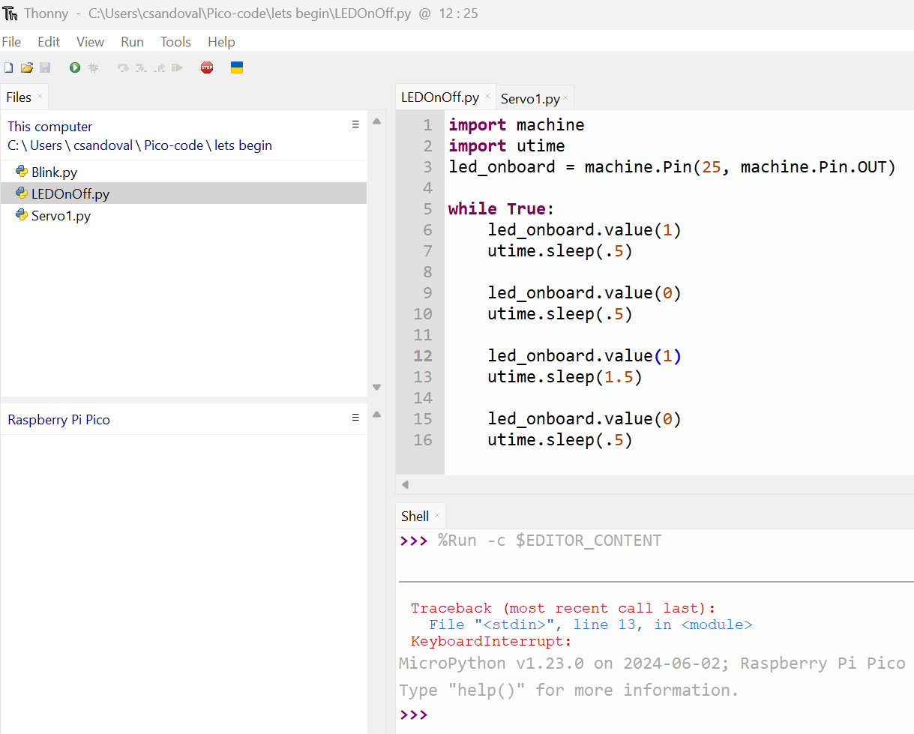
LED on off
MicroPython code
We will alter the code to display morse code.
Type this code into the editor and save as ‘LEDOnOff.py’.
Select the green run button.
Interesting note: morse code is a communication system that uses short and long signals to represent letters, numbers, and punctuation. In this code we are repeating the letter ‘A’ with the LED.
Screenshot of ‘Thonny’ from Thonny.org
Notes:
Teacher note: Ask students to enter and use the ‘Blink’ code. Before explaining the code to students ask them to try and explain it to a peer or have a class discussion. Ask questions such as “what does led_onboard.value(1) do to the LED?”.
When students have demonstrated they can use the microcontroller and IDE, move on to discussing the uses for the microcontroller in the smart greenhouse.
The morse code link could become a research and extension task. Judge the timing based on student progress.
Example explanation provided.
import machine
This line imports the machine library in MicroPython. This library provides functions for interacting with the hardware of the microcontroller board, including General Purpose Input/Output (GPIO) pins.
import utime
This line imports the utime library in MicroPython. This library provides functions for measuring time and delaying program execution.
led_onboard = machine.Pin(25, machine.Pin.OUT)
This line creates a variable named led_onboard. It uses the machine.Pin function to configure to a specific pin on the microcontroller board. In this case, it sets the pin number to 25 and sets its mode as output (OUT), meaning the program can control the voltage level on that pin.
while True:
This line starts an infinite loop. The code within the indented block following this line will be executed repeatedly until the program is stopped.
led_onboard.value(1): This line sets the value of the led_onboard pin to 1 (high voltage level). This turns the LED connected to that pin on.
utime.sleep(.5)
This line calls the sleep function from the utime library. It pauses the program execution for one second before continuing to the next line in the loop.
led_onboard.value(0): This line sets the value of the led_onboard pin to 0 (low voltage level). This turns the LED connected to that pin off.

Slide 27
Microcontrollers and sensors
Sensors
There is a wide range of sensors we can connect to microcontrollers, for example we could use a:
temperature, humidity and pressure sensor
temperature sensor
light sensor
moisture sensor.
When we place a sensor in our smart greenhouse, the data may show that it is too hot or humid inside.
What could we do to decrease the temperature or humidity?
How could we automate this?
Notes:
Teacher note: Following on from discussions in weeks 1 and 2 discuss the use of microcontrollers and sensors to collect data and how this can be used in a smart greenhouse,
Use or create questions to query the use of sensor application.
When we place a sensor in our smart greenhouse, the data may show that it is too hot or humid inside.
What could we do to decrease the temperature or humidity?
How could we automate this?

Slide 28
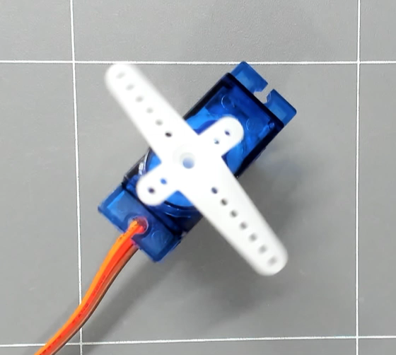
Microcontrollers, sensors and effectors
In a potential smart greenhouse, what actions could we program with different effectors?
using a microservo motor to open and close a vent
activating a fan to increase air flow
using a microservo motor to move a shade cloth.
Notes:
Teacher note: Discuss the use of microcontrollers, sensors and actuators to program actions in potential smart greenhouse designs.
This slide focuses on the temperature or humidity in the greenhouse to prepare students for lessons later in this prepared learning sequence.
Discuss design ideas that best suit your class and equipment.

Slide 29
3.2 Microcontroller and sensor
Learning intentions and success criteria
We are learning to:
use coding environments, microcontrollers and sensors.
We can:
use a coding environment to program a microcontroller and collect measurements with a sensor.
Notes:
Notes for teachers:
Adapt the learning intention as required and add matching success criteria.
For more information see ⁠NSW Department of Education explicit teaching strategies https://education.nsw.gov.au/teaching-and-learning/curriculum/explicit-teaching.
LISC is not necessarily presented at the beginning of the lesson. Teacher needs to consider most effectual time to introduce.
LISC should be revisited during the lesson to support students' evaluation of their learning.

Slide 30
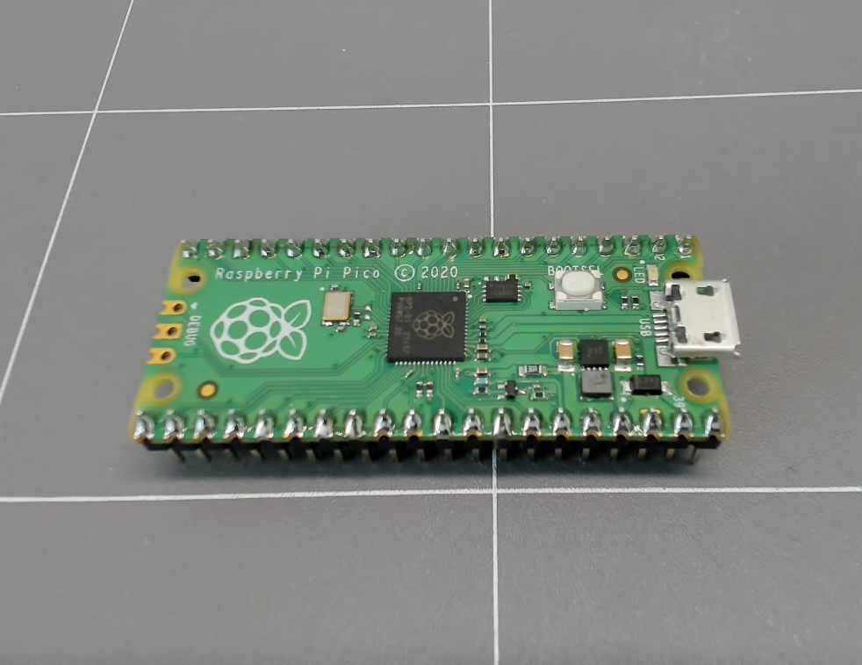
Microcontroller recall
Raspberry Pi Pico
In the last lesson we connected the microcontroller and programmed an action. What did we program?
Microcontroller board
Blink LED code
Notes:
Teacher note: Activate prior knowledge - revise microcontroller from previous lesson.
What did we program on the microcontroller last lesson? (Blink code for the onboard LED)
Click once to display previous code.
Discuss the onboard LED and what was programmed.
Check for understanding
What line would we edit in this example to change the timing of the blinking? (line 7)

Slide 31
Microcontroller activate
What line would we edit in this example to change the timing of the blinking LED?
Line 3.
Line 7.
Thumbs up, thumbs down
Blink LED code
Notes:
Teacher note: Activate prior knowledge - revise microcontroller from previous lesson.
What did we program on the microcontroller last lesson? (Blink code for the onboard LED)
Click once to display previous code.
Discuss the onboard LED and what was programmed.
Check for understanding
What line would we edit in this example to change the timing of the blinking? (line 7)

Slide 32
Microcontroller reminder
Raspberry Pi Pico
In the last lesson we programmed the on-board LED.
Today we will be using the Pico and BME280 atmospheric sensor to measure temperature and humidity.
The sensor can also measure atmospheric pressure, but we will not be collecting that data today.
Microcontroller and atmospheric sensor
Notes:
Teacher note: Revise microcontroller from previous lesson. Introduce the focus of the lesson – using a microcontroller with sensor. Discuss the sensor and how it can be used.
The sensor board has ports, circuitry and the actual sensor in the middle (the small silver cube). We will be connecting to the 4 pin port today. The 4 pin port communicates using I2C with the microcontroller.
Discussion.
The BME280 is quite complex, but in general it uses changes in electrical properties to estimate/measure atmospheric changes.
Temperature: It uses a built-in element whose resistance changes with temperature. By measuring resistance, the sensor can determine temperature.
Pressure: It utilises piezoresistive pressure sensors. As pressure changes, the physical shape of the sensor elements slightly deform, causing a shift in their electrical resistance. This resistance change is then converted to pressure.
Humidity: The exact method is not publicly disclosed by Bosch, but it may use a capacitive humidity sensor. This sensor has a layer that absorbs water vapor, which changes its capacitance. By measuring capacitance, the sensor estimates humidity.
This is one microcontroller and sensor combination. School equipment will vary, please adjust based on your context.

Slide 33
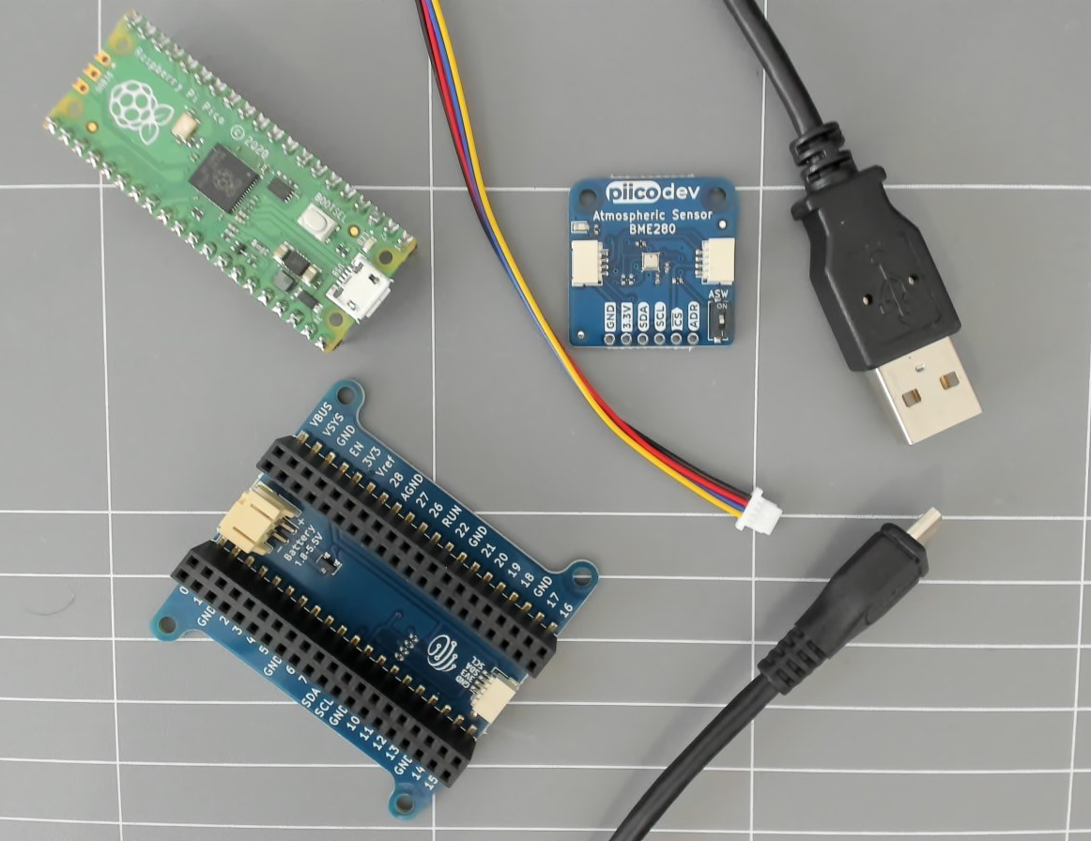
Equipment
You will need:
Raspberry Pi Pico with soldered pins
USB-A to Micro-USB cable
computer with USB-A port and Thonny
expansion board
BME280 atmospheric sensor
cable.
Microcontroller and sensor equipment
Notes:
Teacher note: Make explicit reference to equipment that will be used. Revise how this equipment has been used in previous lessons and draw attention to significant parts or connections.
Highlight location of equipment in the room (if equipment is not already with students).

Slide 34
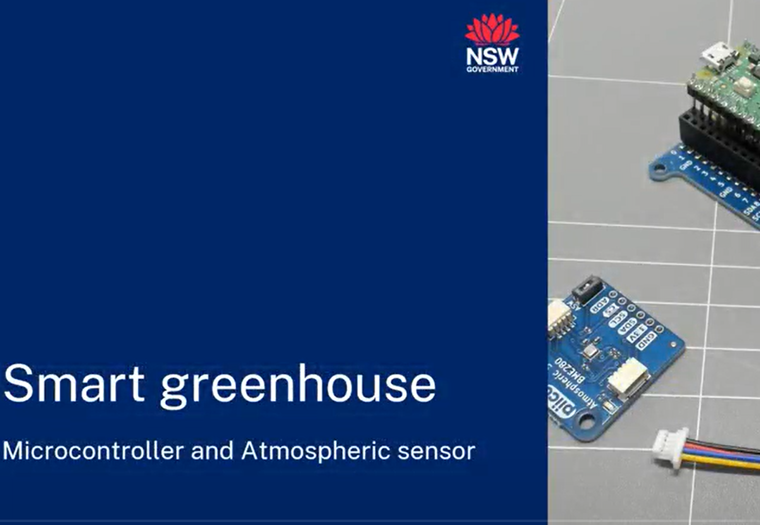
Connecting and using a sensor
This video models the connection and use of an atmospheric sensor and microcontroller.
Notes:
Teacher notes: This video models the connection and use of the sensor, it is an opportunity to view lesson objectives and preteach concepts. The video could also be used as a watch-pause-follow. Watch a section, pause the video, students follow the code and build.
Adjust timing of use based on lesson structure that suits your students. The end of the video may give an answer to a co-construction activity that is planned for the end of the lesson. Stop the video at this point if co-construction of a code will occur.
The following slides also step through the instructions for using a sensor.
The Smart greenhouse webpage also has video instructions for using Microsoft VS code.
https://education.nsw.gov.au/teaching-and-learning/curriculum/stem/stem-curriculum-resources/stem-smart-greenhouse

Slide 35
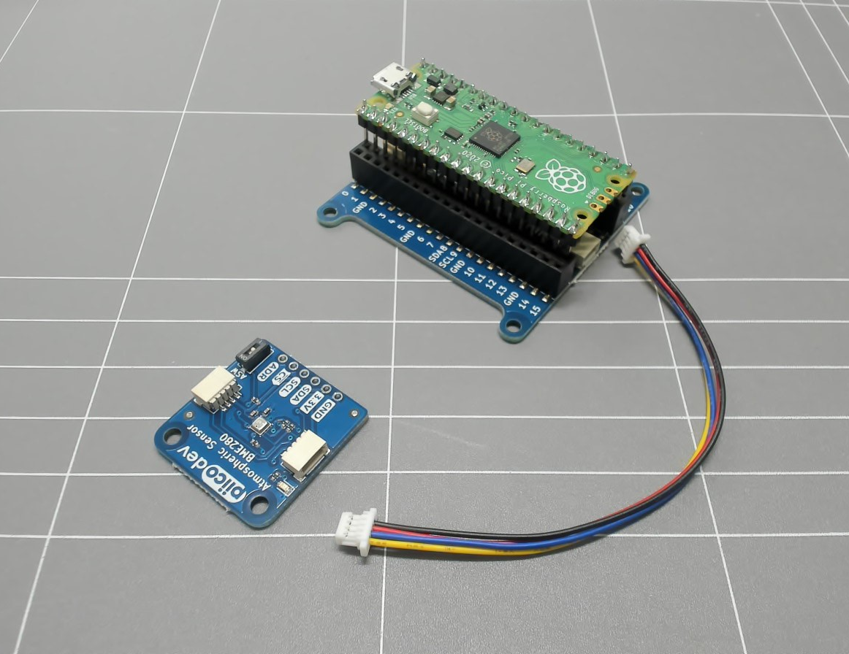
Assembly
Assemble
Insert the pins of the Pico into the expansion board.
Note: the Micro USB port should be aligned with the top of the expansion board.
Connect the cable from the expansion board 4 pin connection port to the sensor port.
Microcontroller and sensor equipment assembly
Notes:
Teacher note: Demonstrate the connection to the devices.
Notes:
The Micro USB of the pico aligns with the 2 pin power connector on the expansion board.
The 4 wire cable connects to the 4 pin ports on the sensor and expansion board.
Note – If you used the video to watch-pause-follow then this slide (and following instruction slides) may be unnecessary. Adapt slide show to suit delivery method.

Slide 36
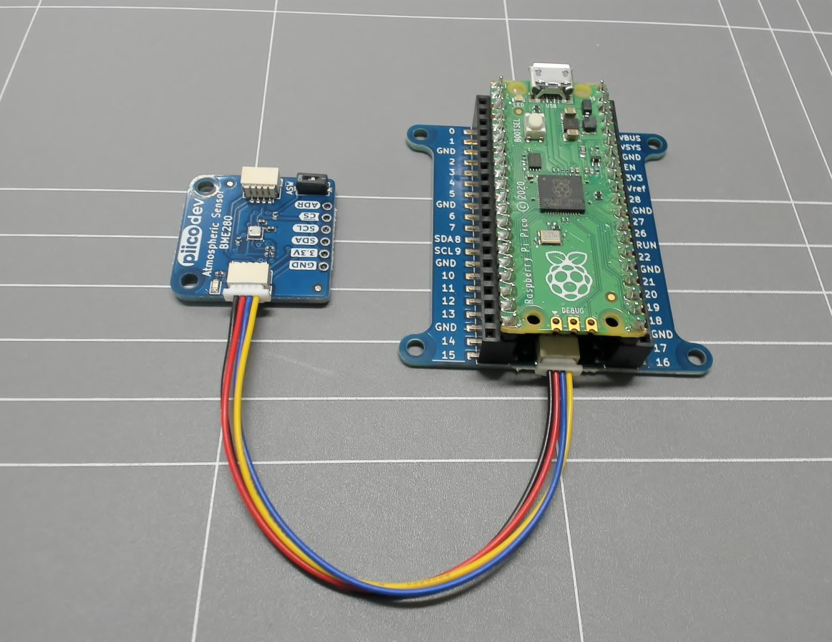
Verification
Connections
Your equipment connections should look like this.
Check a fellow class member setup and ask for assistance if needed.
Once this is setup connect the microcontroller to your computer with the micro USB to USB-A cable.
Microcontroller and sensor connected
Notes:
Teacher note: Allow students the option to physically check peer connection or demonstrate to you if preferred.

Slide 37
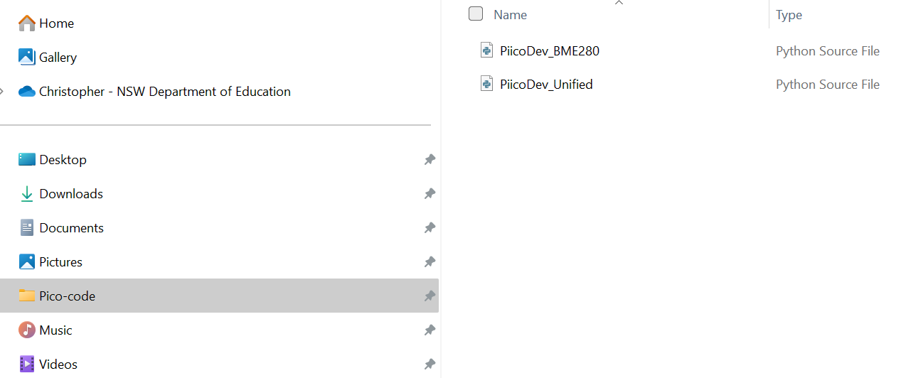
Files
Library and device driver
To use this sensor, we will need to use two additional python files. These files are located in (add location of files here).
Create a folder named BME280 Sensor in your iSTEM AgriTech folder.
Save ‘PiicoDev_BME280’ and ‘PiicoDev_Unified’ files in this folder.
Screenshot of file folder from Microsoft Windows 11 Pro
Notes:
Teacher note: Adjust slides based on current practices and sensor being used. It is a good opportunity to talk to students about file and folder structure. Discuss the purpose of the files and point out that different sensor packages will have different driver files and libraries. The Unified file in this example is a library that drives I2C connections for PiicoDev packages. The BME280 file is a specific device driver for this specific BME280 sensor.

Slide 38
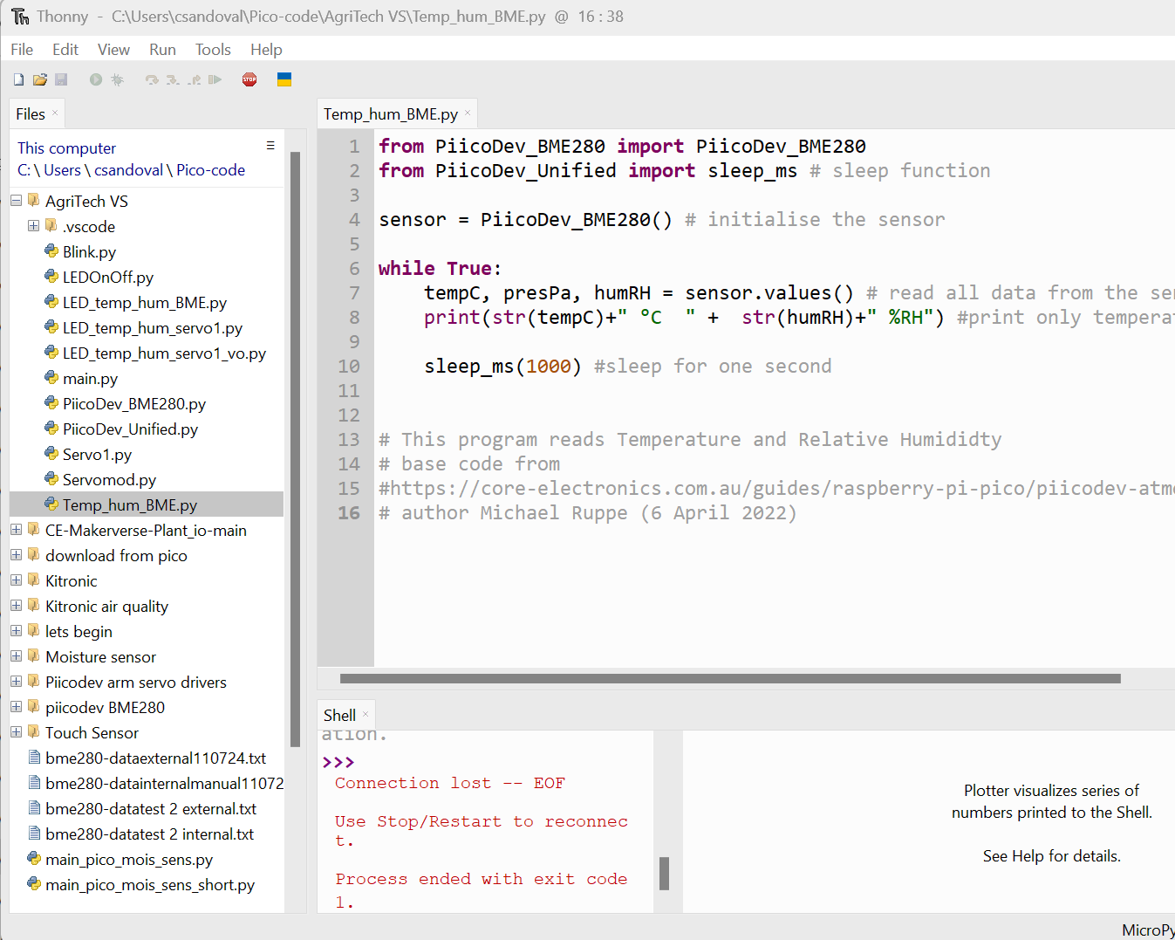
Operational Code
Open Thonny.
Open your AgriTech folder. Select the file tab, open folder, and select your folder from last lesson.
Create a new file titled ‘Temp_hum_BME.py’ to denote we will be making a file that collects temperature and humidity data with the BME280 sensor.
Construct the code displayed in the image. Do not copy comments (# text). These are for explanation and attribution.
Screenshot of ‘Thonny’ from Thonny.org
Notes:
Teacher note: Open the software used to create python files and communicate with the pico.
Use terminology that suits your students.
(larger image in next slide) Explain code to students or ask students to describe the lines of code, for example:
from PiicoDev_BME280 import PiicoDev_BME280
imports the code needed to interact with the BME280 sensor from the library/file called PiicoDev_BME280.
from PiicoDev_Unified import sleep_ms
imports a sleep function named sleep_ms from another library, PiicoDev_Unified. This function allows the program to pause its execution for a set amount of time.
sensor = PiicoDev_BME280()
creates a new object for interacting with the BME280 sensor and stores it in the variable sensor. This initializes communication with the sensor.
while True
loop
tempC, presPa, humRH = sensor.values()
reads temperature, pressure, and humidity data from the sensor using the values method of the sensor object. It then stores these values in separate variables: tempC for temperature in Celsius, presPa for pressure in Pascals, and humRH for relative humidity percentage.
print(str(tempC)+" °C " + str(humRH)+" %RH")
builds a message string that combines the temperature and humidity readings with their units (degrees Celsius and percent relative humidity) for display.
sleep_ms(1000)
calls the sleep_ms function to pause the program for one second (1000 milliseconds) before repeating the entire process within the loop. This creates a continuous cycle of reading sensor data, displaying it, and then waiting for a second before doing it again.

Slide 39
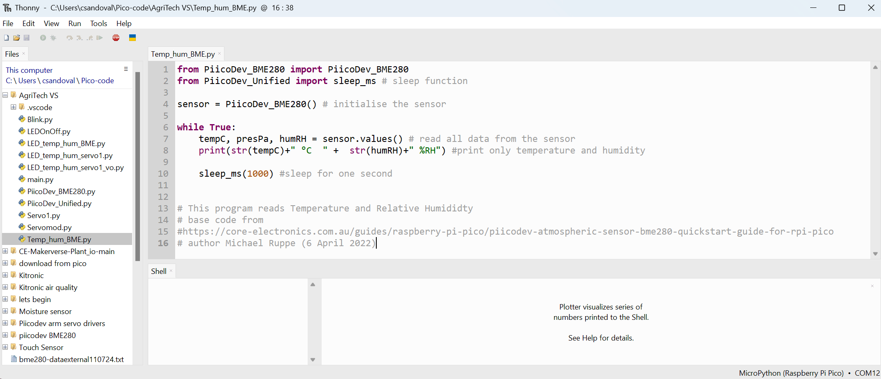
Construct the code displayed in the image. Do not copy comments (# text). These are for explanation and attribution.
Screenshot of ‘Thonny’ from Thonny.org
Notes:
Teacher note: larger version of previous image.
Suggestion, create this file for students so that they can save and use.
Explain code to students or ask students to describe the lines of code, for example:
from PiicoDev_BME280 import PiicoDev_BME280
imports the code needed to interact with the BME280 sensor from the library/file called PiicoDev_BME280.
from PiicoDev_Unified import sleep_ms
imports a sleep function named sleep_ms from another library, PiicoDev_Unified. This function allows the program to pause its execution for a set amount of time.
sensor = PiicoDev_BME280()
creates a new object for interacting with the BME280 sensor and stores it in the variable sensor. This initializes communication with the sensor.
while True
loop
tempC, presPa, humRH = sensor.values()
reads temperature, pressure, and humidity data from the sensor using the values method of the sensor object. It then stores these values in separate variables: tempC for temperature in Celsius, presPa for pressure in Pascals, and humRH for relative humidity percentage.
print(str(tempC)+" °C " + str(humRH)+" %RH")
builds a message string that combines the temperature and humidity readings with their units (degrees Celsius and percent relative humidity) for display.
sleep_ms(1000)
calls the sleep_ms function to pause the program for one second (1000 milliseconds) before repeating the entire process within the loop. This creates a continuous cycle of reading sensor data, displaying it, and then waiting for a second before doing it again.

Slide 40
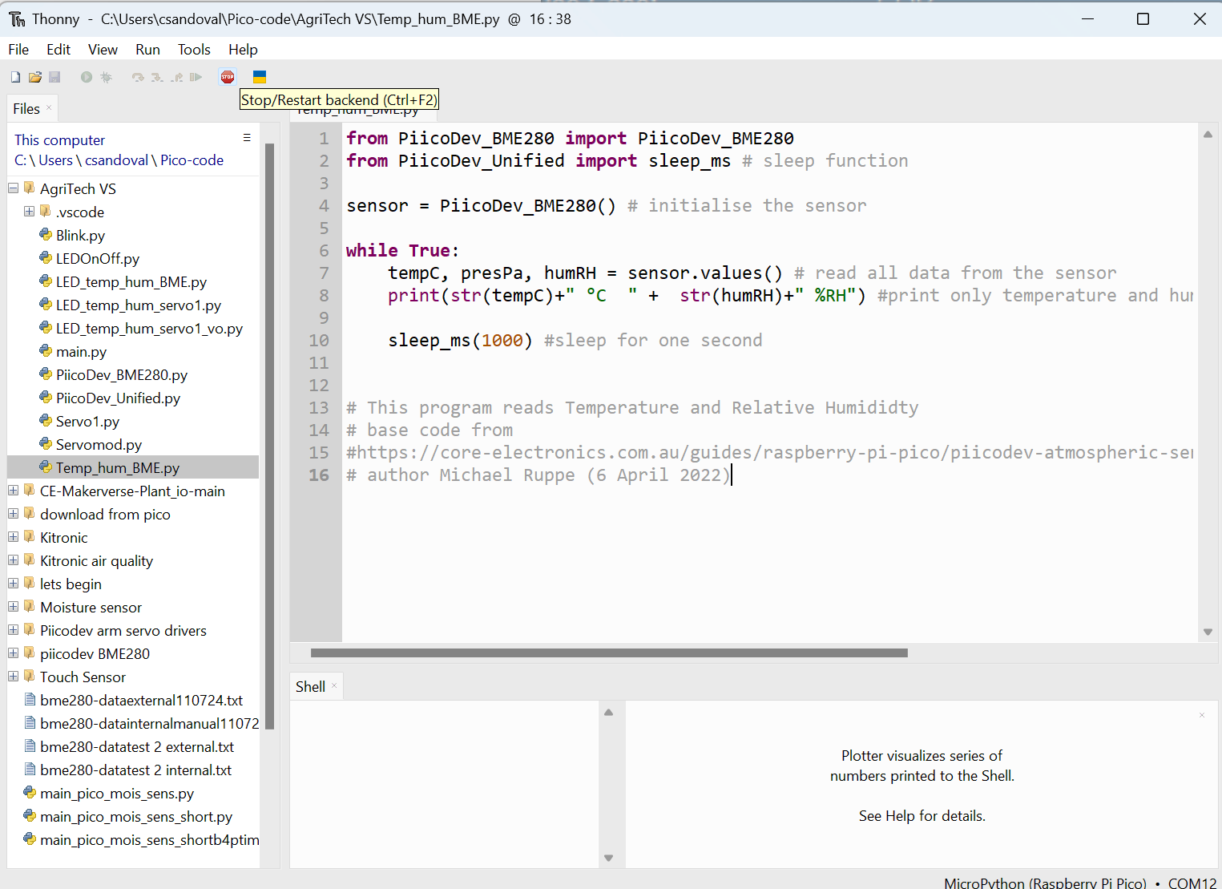
Connect microcontroller
Connect your sensor to the Pico, then connect the USB from your computer to the Pico.
Connect Thonny to your microcontroller by clicking the stop button.
You will see ‘Raspberry Pi Pico’ in the files pane.
Screenshot of ‘Thonny’ from Thonny.org
Notes:
Teacher note: This instruction will change if using a different software package or extension.

Slide 41
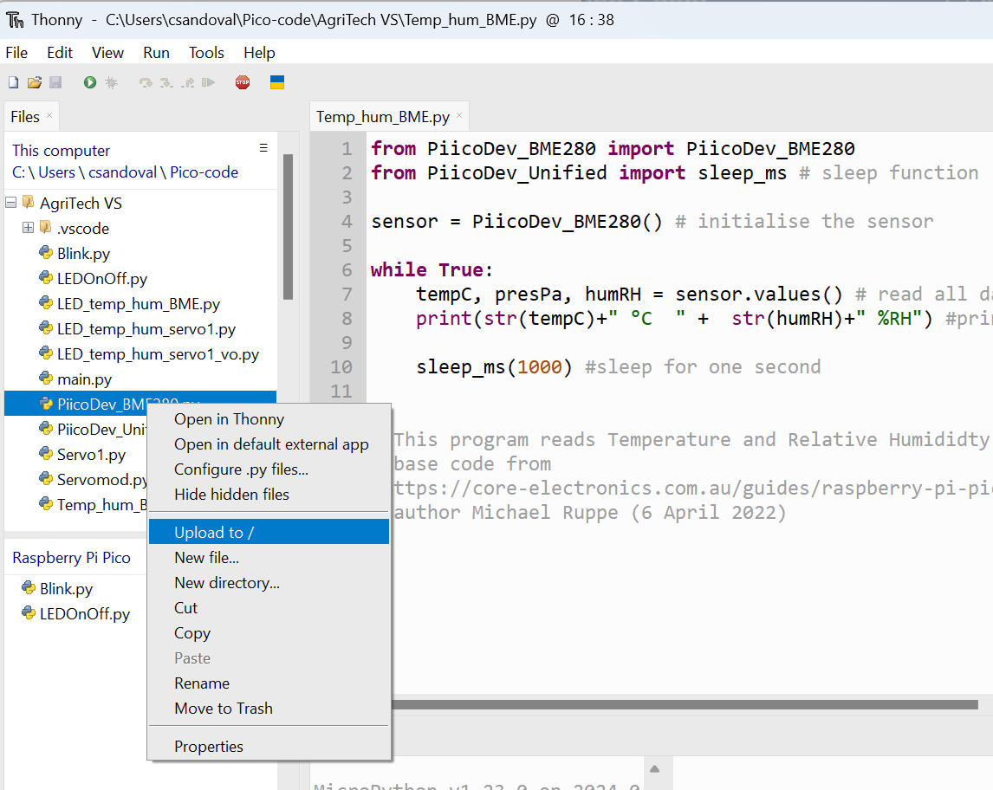
Upload to microcontroller
Send your python code to your microcontroller by right clicking on the file and selecting ‘Upload to /’.
This step copies the selected file to the Pico.
Upload ‘PiicoDev_BME280’ and ‘PiicoDev_Unified’ files to the Pico.
This is necessary because ‘PiicoDev_BME280’ and ‘PiicoDev_Unified’ files need to be on the microcontroller for the ‘Temp_hum_BME.py’ file to access them.
Screenshot of ‘Thonny’ from Thonny.org
Notes:
Teacher note: Explain that the two libraries need to be on the microcontroller for the read script to function.

Slide 42
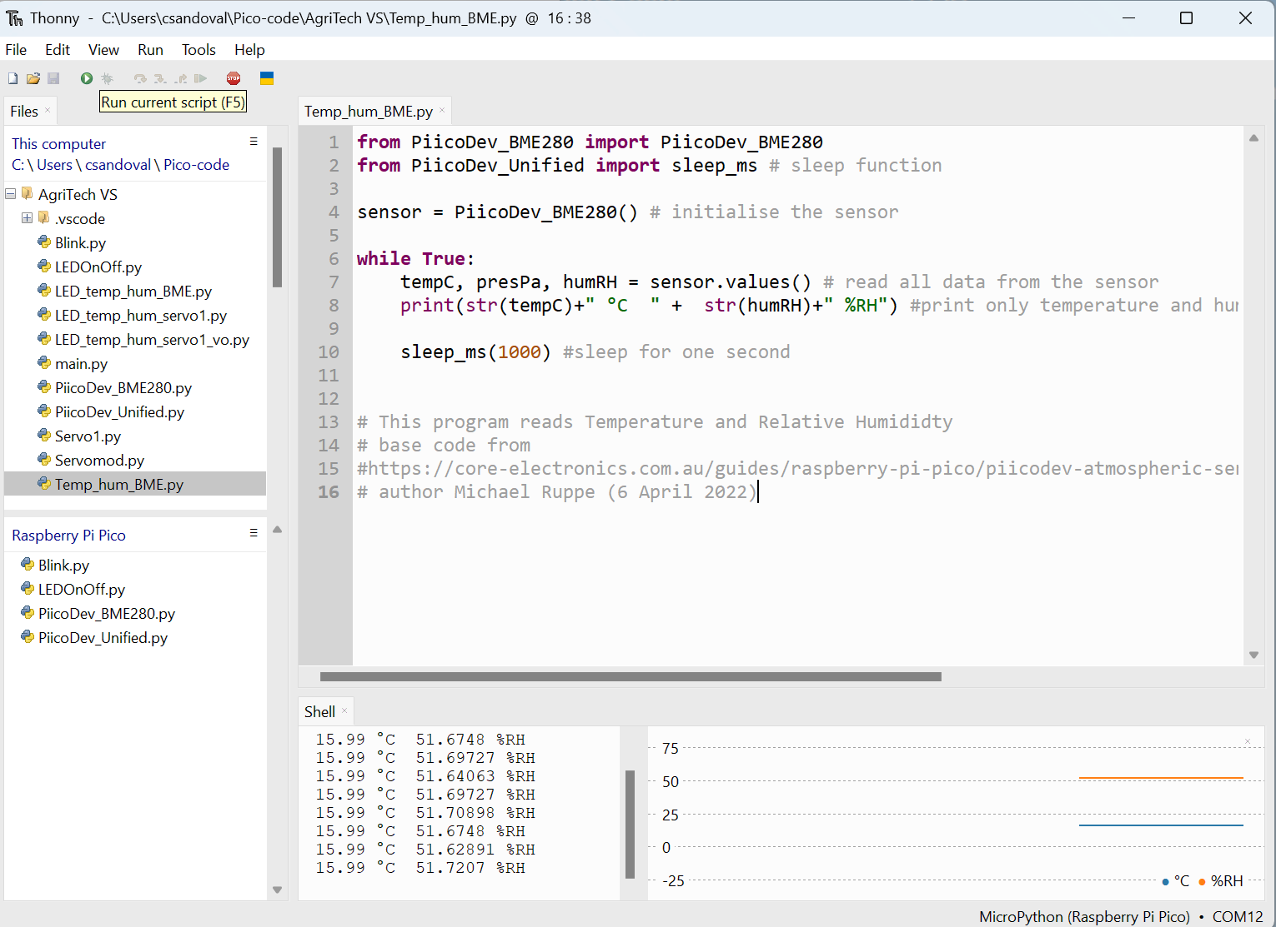
Run
Run your python code to your microcontroller by selecting the green ‘Run current script’ button.
You will see temperature and humidity readings in the ‘Shell’ window.
Place your hand over the sensor, what happens?
Stop the code when finished testing.
Screenshot of ‘Thonny’ from Thonny.org
Notes:
Teacher note: Ask students to share with class members or demonstrate function to you.

Slide 43
Adding a Blink
In the future we will want our microcontroller to run when disconnected from the computer but connected to a power source.
How do we know the code is running?
Possible answer: We can add an LED screen to our build, or we can make the onboard LED blink when data is captured.
Notes:
Teacher note: In this part we are preparing for untethered operation. You can choose a different build or challenge for your class.
Adding LEDOnOff allows for students to try and move from guided to independent practice, you can share the following code with them gradually or co construct it as a class. Combining the two codes allows students to trial code and understand functioning.

Slide 44
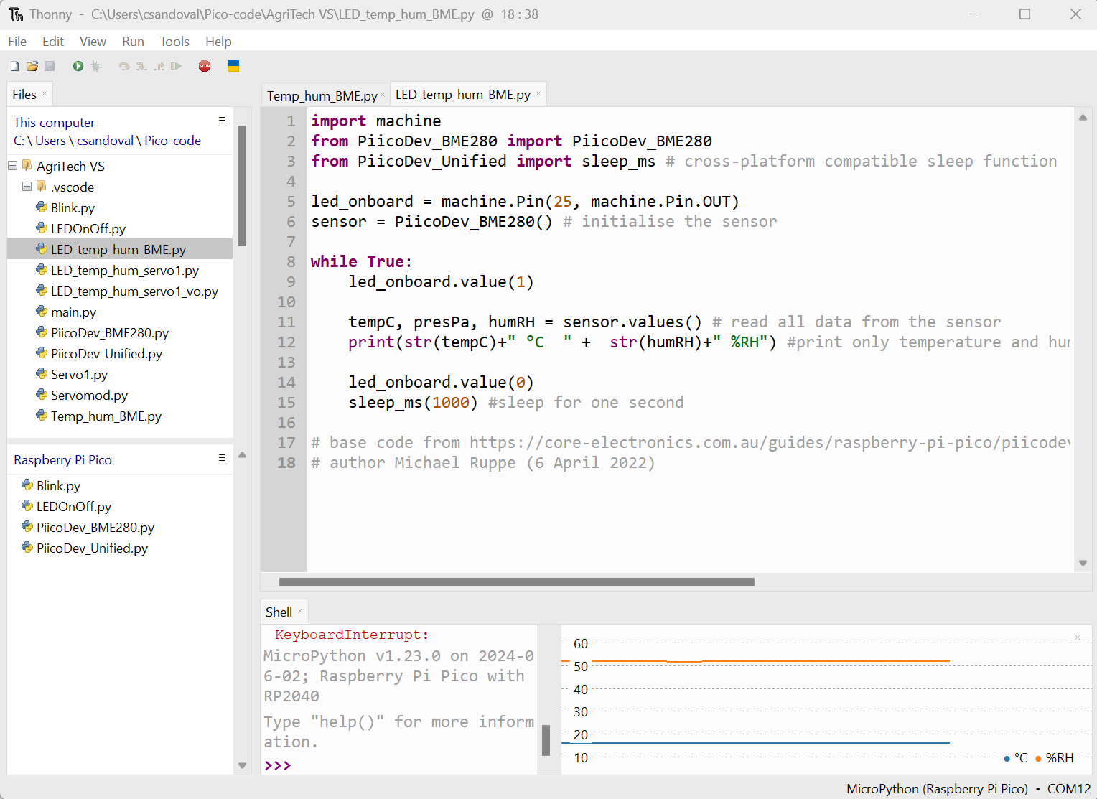
Combine LED and sensor function
Optional indicator
Create a new file titled LED_temp_hum_BME.py to denote we will be making a file that blinks when collecting temperature and humidity data with the BME280 sensor.
Construct the code displayed in the image. Do not copy comments (# text). These are for explanation and attribution.
Screenshot of ‘Thonny’ from Thonny.org
Notes:
Teacher note:
Optional indicator strategy.
Adding LEDOnOff allows for students to try and move from guided to independent practice, you can share the following code with them gradually or co-construct it as a class. Combining the two codes allows students to trial code and understand functioning.
Notice that sleep is different in this code. It is using sleep milliseconds and is linked to the unified library.

Slide 45
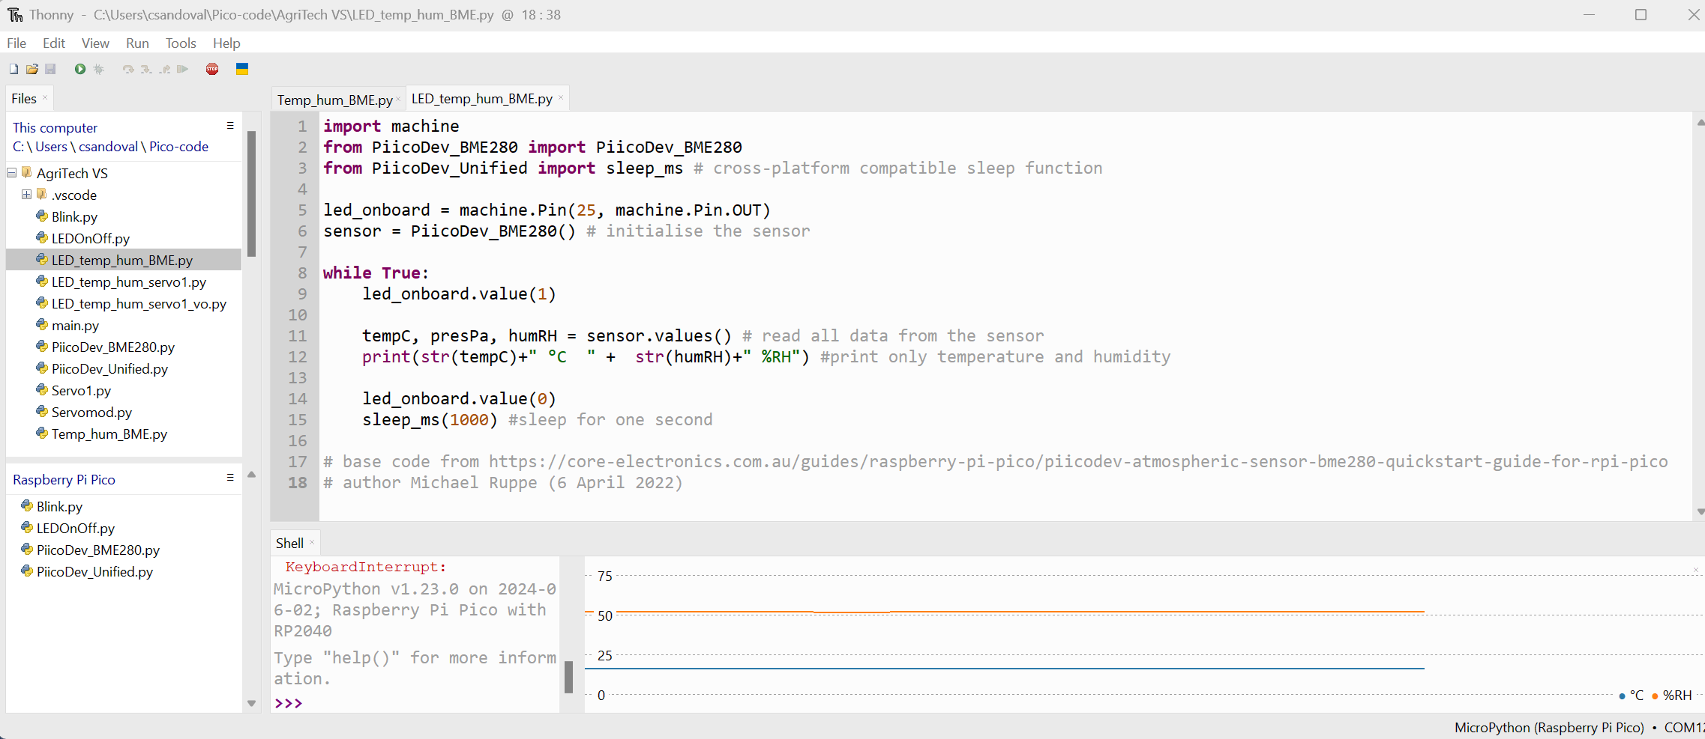
LED with temperature and humidity
Screenshot of ‘Thonny’ from Thonny.org
Notes:
Teacher note: Adding LEDOnOff allows for students to try and move from guided to independent practice, you can share the following code with them gradually or co construct it as a class. Combining the two codes allows students to trial code and understand functioning.

Slide 46
Run LED and sensor
Run your python code to your microcontroller by selecting “Run current script’.
You will see temperature and humidity readings in the ‘Shell’ window and the LED blinking.
Stop the code when finished testing.
Question:
What happens if you change line 15 sleep_ms(1000) to sleep_ms(250)?
Notes:
Teacher note: Ask students to share with class members or demonstrate function to you. Allow students to try different code variations to see what happens, such as the example given above.
Answer above: Smaller time delay between blinks so therefore the blinks will be more rapid.

Slide 47
Reflection
Will we need to put the sensor inside the greenhouse? Will we put the microcontroller inside the greenhouse?
What have we learned today about microcontrollers and coding for sensor use?
What questions do we have about the application of this sensor in our smart greenhouse?
Notes:
Teacher note: Connect learning to the design brief. Reflect on coding and use of sensor.
Possibly use the following template to capture ideas.

Slide 48

Reflections
What did I learn today?
What connections have I made?
How will I use this knowledge?
Notes:
This slide can be used to facilitate student self-reflection or as an exit ticket for any lesson. Adapt step 3 to suit the lesson and your context.
Students could capture ideas in their logbooks or design folio.
More exit ticket ideas can be found at https://app.education.nsw.gov.au/digital-learning-selector/LearningActivity/Browser?cache_id=2f830

Slide 49
3.3 Microcontroller and responses
Learning intentions and success criteria
We are learning to:
use coding environments, microcontrollers, microservo and a sensor/s.
We can:
use a coding environment to program a microcontroller to coordinate microservo positioning based on sensor data
collect data using a microcontroller and sensor.
Notes:
Notes for teachers:
Adapt the learning intention as required and add matching success criteria.
For more information see ⁠NSW Department of Education explicit teaching strategies https://education.nsw.gov.au/teaching-and-learning/curriculum/explicit-teaching.
LISC is not necessarily presented at the beginning of the lesson. Teacher needs to consider most effectual time to introduce.
LISC should be revisited during the lesson to support students' evaluation of their learning.

Slide 50
Microcontroller and sensor review
Raspberry Pi Pico
In the last lesson we connected the microcontroller to a atmospheric sensor.
What did we measure with the sensor?
Microcontroller and sensor equipment assembly
Notes:
Teacher note:
Reminder – this slide deck is an example of microcontroller board use. Hardware and software will be specific to your school. Please adapt lessons accordingly.
Revise microcontroller from previous lesson. Discuss the atmospheric sensor and what was measured and collected.
What did we measure with the sensor? Temperature and atmospheric pressure.

Slide 51
Microcontroller and servo review
Raspberry Pi Pico
Today we will be using the Pico with a microservo.
Then we will be coding a microservo response to temperature measurements.
In our smart greenhouse we could use this to open a vent if the greenhouse become too hot.
GIF of a moving microservo
Notes:
Teacher note: Revise microcontroller from previous lesson. Introduce the focus of the lesson – using a microcontroller with microservo. Discuss the servo and how it can be used with the sensor.
Discuss the functioning of a microservo within the context of your class. For example, a 9g micro servo translates a coded signal (pulse width) into a precise shaft position, making it a good motor for creating controlled movements in various settings, such as opening a vent.

Slide 52
Equipment for the lesson
Equipment you will need
Raspberry Pi Pico with soldered pins
USB-A to Micro-USB cable
Computer with USB-A port and Thonny
Piicodev expansion board for Raspberry Pi Pico
Piicodev atmospheric sensor BME280
Piicodev cable
9g MicroServo
2AA battery pack and 4AA battery pack
Pin to pin jumper wires
Microcontroller, servo and sensor equipment
Notes:
Teacher note: Equipment will vary based on school context. Equipment selection is for illustrative purposes.
Alter equipment and battery pack depending on build. A breadboard may also be needed to connect an additional power supply to the servo.

Slide 53
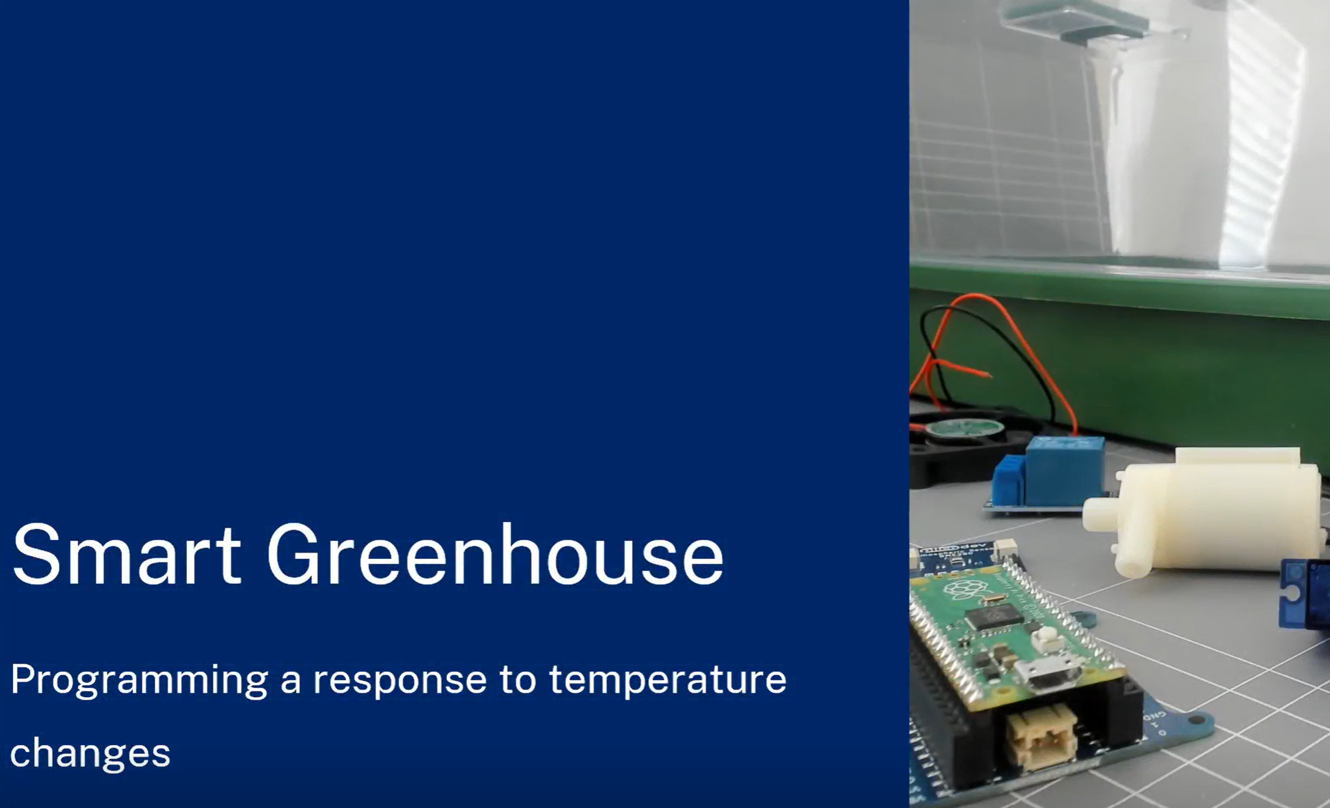
Connecting and using a servo
This video models the connection and use of the sensor, servo and microcontroller.
Notes:
Teacher notes: This video models the connection and use of the servo and sensor, it is an opportunity to view lesson objectives and preteach concepts. The video could be used as a watch-pause-follow. Watch a section, pause the video, students follow the code and build.
Adjust the use of the video based on the lesson structure that suits your students. The video gives answers to co-construction activities at the end.
The following slides also step through the instructions for using a sensor and servo.
The Smart greenhouse webpage has additional video instructions for using Microsoft VS code.
https://education.nsw.gov.au/teaching-and-learning/curriculum/stem/stem-curriculum-resources/stem-smart-greenhouse

Slide 54
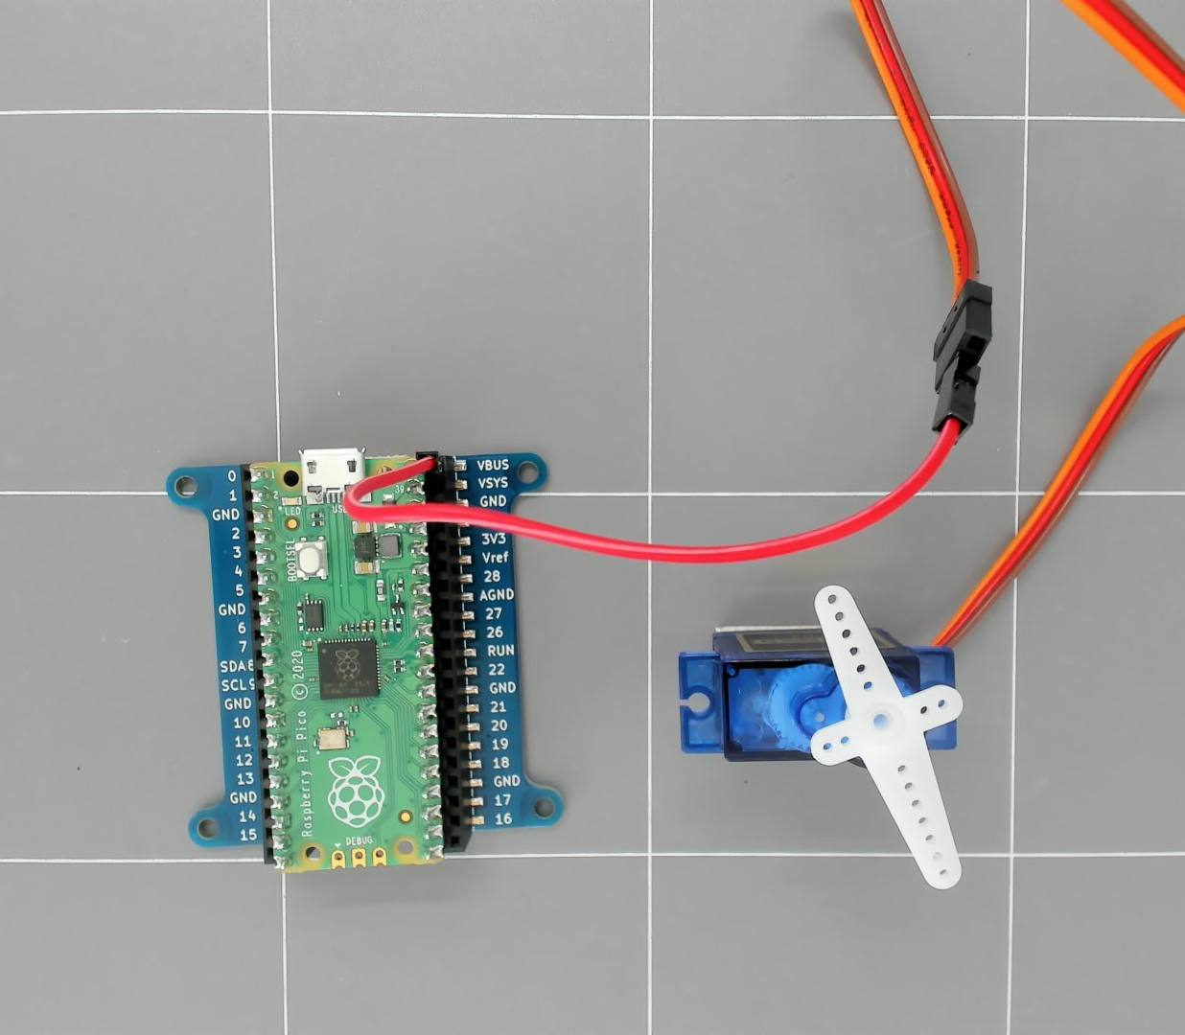
Assemble
Insert the pins of the Pico into the expansion board.
Note: the Micro USB port should be aligned with the top of the expansion board.
For tethered operation connect red servo pin socket to the VBUS socket on the expansion board.
Note: this configuration is used to test the microservo. If applying a load to the microservo use a power source external to the pico.
Microcontroller and microservo power assembly
Notes:
Teacher note: Demonstrate the connection to the devices.
Notes:
The Micro USB of the pico aligns with the 2 pin power connector on the expansion board.
Connect red socket of servo to VBUS when pico tethered to USB
Note – If you used the video to watch-pause-follow then this slide (and following instruction slides) may be unnecessary. Adapt slide show to suit delivery method.

Slide 55
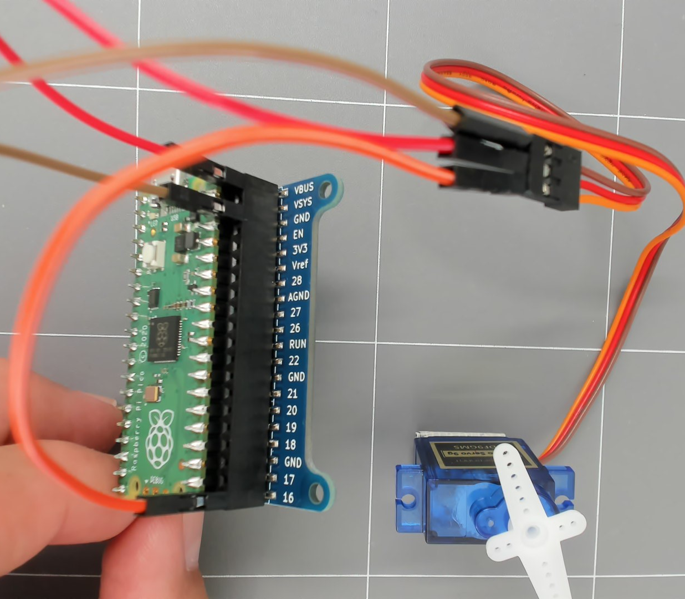
Assembly with the expansion board
Connecting the Pico and servo
Insert the pins of the Pico into the expansion board.
Note: the Micro USB port should be aligned with the top of the expansion board.
Connect orange servo pin socket to the GPIO16 socket on the expansion board.
Connect brown servo pin socket to a ground (GND) socket on the expansion board.
Microcontroller and microservo assembly
Notes:
Teacher note: Demonstrate the connection to the devices. Notes:
The Micro USB of the pico aligns with the 2 pin power connector on the expansion board.

Slide 56
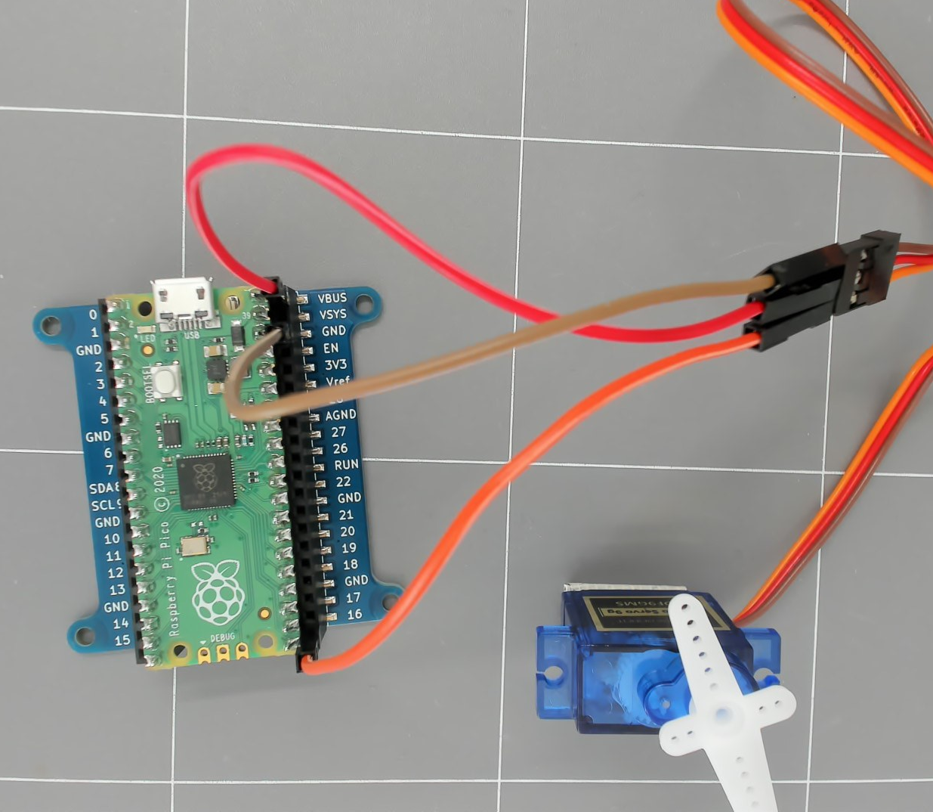
Verify
Connections
Your equipment connections should look like this.
Check a fellow class members setup and ask for assistance if needed.
Once this is setup connect the microcontroller to your computer with the micro-USB to USB-A cable.
Microcontroller and servo connected
Notes:
Teacher note: Allow students the option to physically check peer connection or demonstrate to you if preferred.

Slide 57
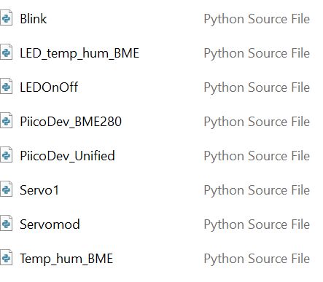
Files needed
Library and device driver
To use this servo, we will use an additional python file called Servomod.py. These files are located in (add location of files here).
Save the file Servomod to your iSTEM AgriTech folder.
We will have a number of python files in this folder now.
Screenshot of file folder from Microsoft Windows 11 Pro
Notes:
Teacher note: Adjust slides based on current practices and sensor being used. It is a good opportunity to talk to students about file and folder structure. Discuss the purpose of the files and that different sensor packages will have different driver files and libraries. The Unified file in this example is a library that drives I2C connections for PiicoDev packages. The BME280 file is a specific device driver for this specific BME280 sensor.

Slide 58
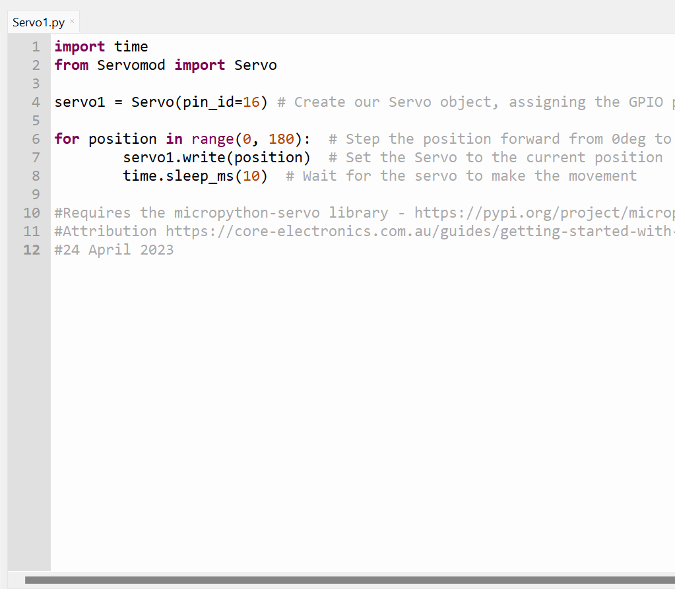
Operational script
Open Thonny.
Open your AgriTech folder in the files pane.
Create a new file titled ‘Servo1.py’ to denote we will be making a file that runs a microservo.
Construct the code displayed in the image. Do not copy comments (# text). These are for explanation and attribution.
Screenshot of code in Thonny from Thonny.org
Notes:
Teacher note: Open the software used to create python files and communicate with the pico.
Use terminology that suits your students.
Explain code to students or ask students to describe the code, for example:
from PiicoDev_BME280 import PiicoDev_BME280
imports the code needed to interact with the BME280 sensor from the library/file called PiicoDev_BME280.
from PiicoDev_Unified import sleep_ms
imports a sleep function named sleep_ms from another library, PiicoDev_Unified. This function allows the program to pause its execution for a set amount of time.
sensor = PiicoDev_BME280()
creates a new object for interacting with the BME280 sensor and stores it in the variable sensor. This initializes communication with the sensor.
while True
loop
tempC, presPa, humRH = sensor.values()
reads temperature, pressure, and humidity data from the sensor using the values method of the sensor object. It then stores these values in separate variables: tempC for temperature in Celsius, presPa for pressure in Pascals, and humRH for relative humidity percentage.
print(str(tempC)+" °C " + str(humRH)+" %RH")
builds a message string that combines the temperature and humidity readings with their units (degrees Celsius and percent relative humidity) for display.
sleep_ms(1000)
calls the sleep_ms function to pause the program for one second (1000 milliseconds) before repeating the entire process within the loop. This creates a continuous cycle of reading sensor data, displaying it, and then waiting for a second before doing it again.

Slide 59
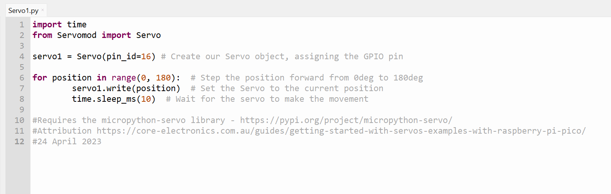
Script
Screenshot of code in Thonny from Thonny.org
Notes:
Teacher note: larger version of previous image.
Suggestion, create this file for students so that they can save and use.

Slide 60
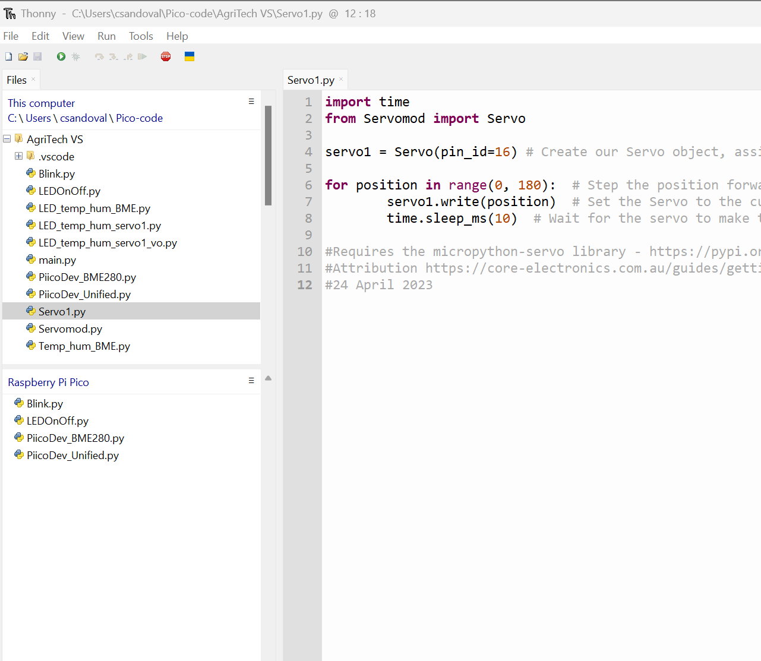
Connect the microcontroller
Connect the USB from your computer to the Pico.
Connect Thonny to your microcontroller by clicking the stop button.
You will see ‘Raspberry Pi Pico’ in the files pane.
Screenshot of code in Thonny from Thonny.org
Notes:
Teacher note: This instruction will change if using a different software package or extension.

Slide 61
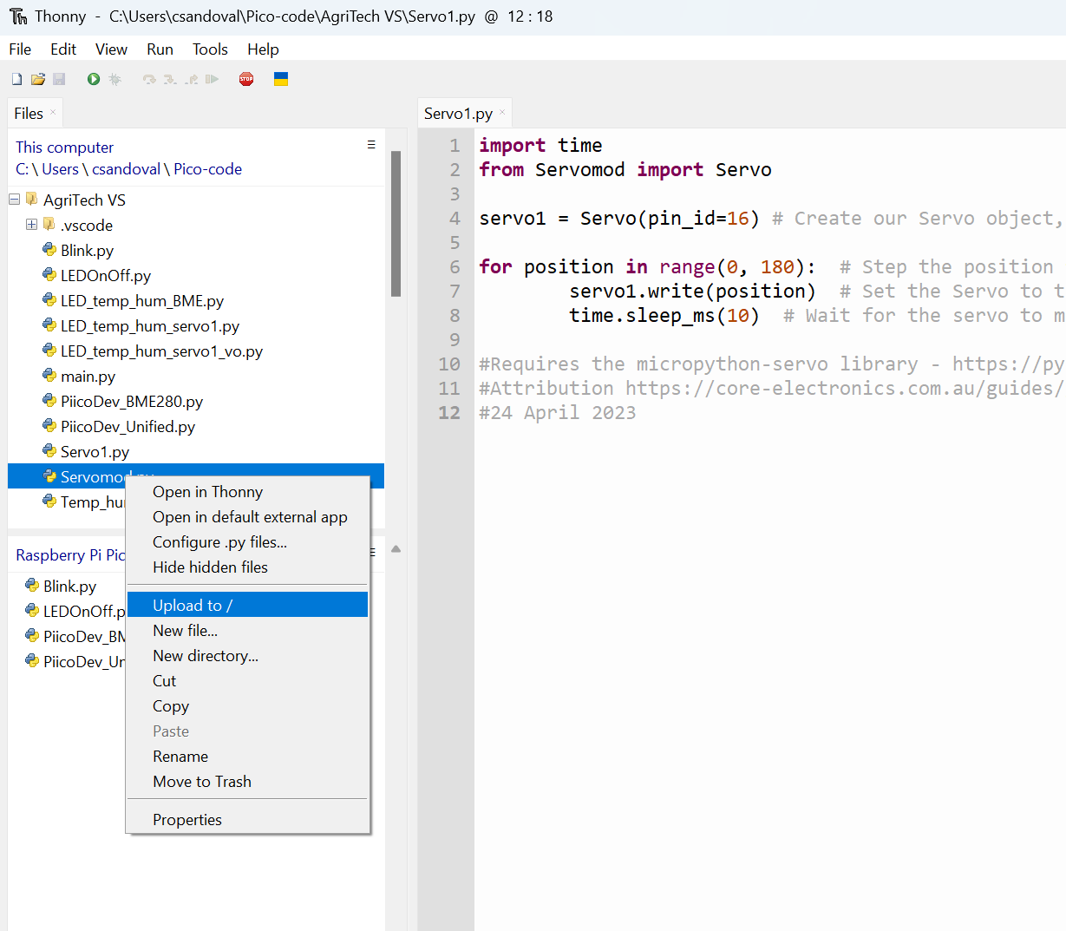
Upload to the microcontroller
Send your python code to your microcontroller by right clicking on the file and selecting ‘Upload to /’.
This step copies the selected file to the Pico.
Upload ‘Servomod’ to the Pico.
This step copies all current project files to the Pico. This is necessary because ‘Servomod’ library needs to be on the microcontroller for the ‘Servo1.py’ file to access it.
Screenshot of code in Thonny from Thonny.org
Notes:
Teacher note: Explain that libraries need to be on the microcontroller for the read script to function.

Slide 62
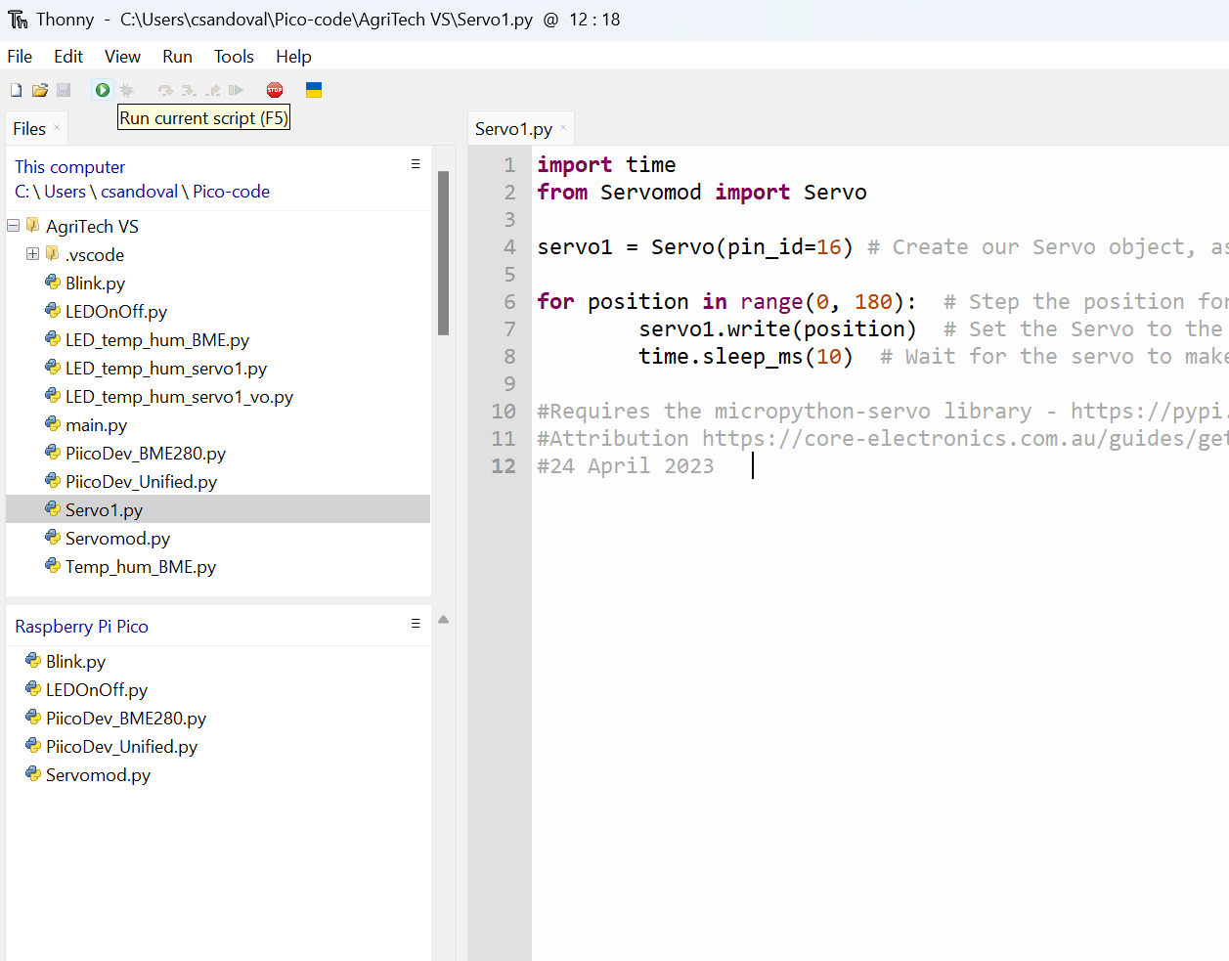
Run script
Run your python code with the microcontroller by selecting the green ‘Run current script’ button.
The servo will move through 180 degrees.
The code will stop after one sweep.
Screenshot of code in Thonny from Thonny.org
Notes:
Teacher note: Ask students to share with class members or demonstrate function to you.

Slide 63
Changing the code
What happens if we change time.sleep_ms(10) in line 8 to time.sleep_ms(100)?
(Count the time it takes the servo to move through 180 degrees)
Answer: The servo takes longer to move through the sweep. Instead of moving 1 degree every 0.01 seconds, it moves 1 degree every 0.1 seconds.
Notes:
Teacher note: Ask students to share with class members or demonstrate function to you. Allow students to try different code variations to see what happens, such as the example given above.

Slide 64
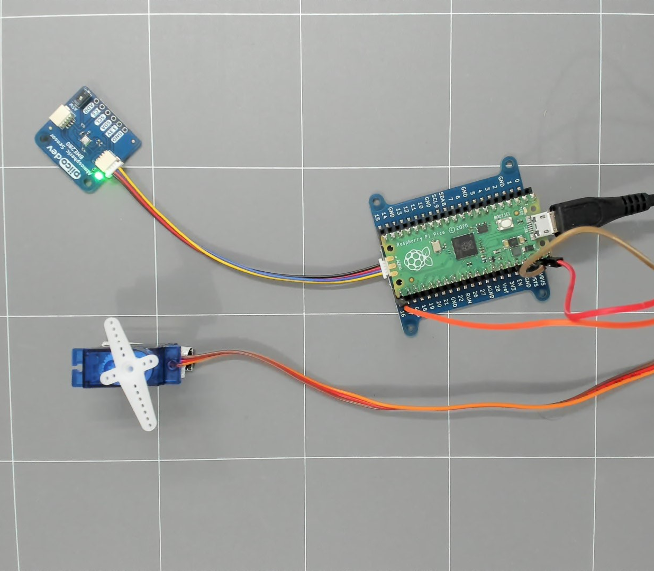
Microcontroller, sensor and microservo assembly
Assemble
We will now combine the sensor from last lesson to our assembly.
Connect the cable from the expansion board 4 pin connection port to the sensor port.
Connect the USB cable.
Microcontroller, sensor and microservo assembly
Notes:
Teacher note: Demonstrate the connection of components.

Slide 65
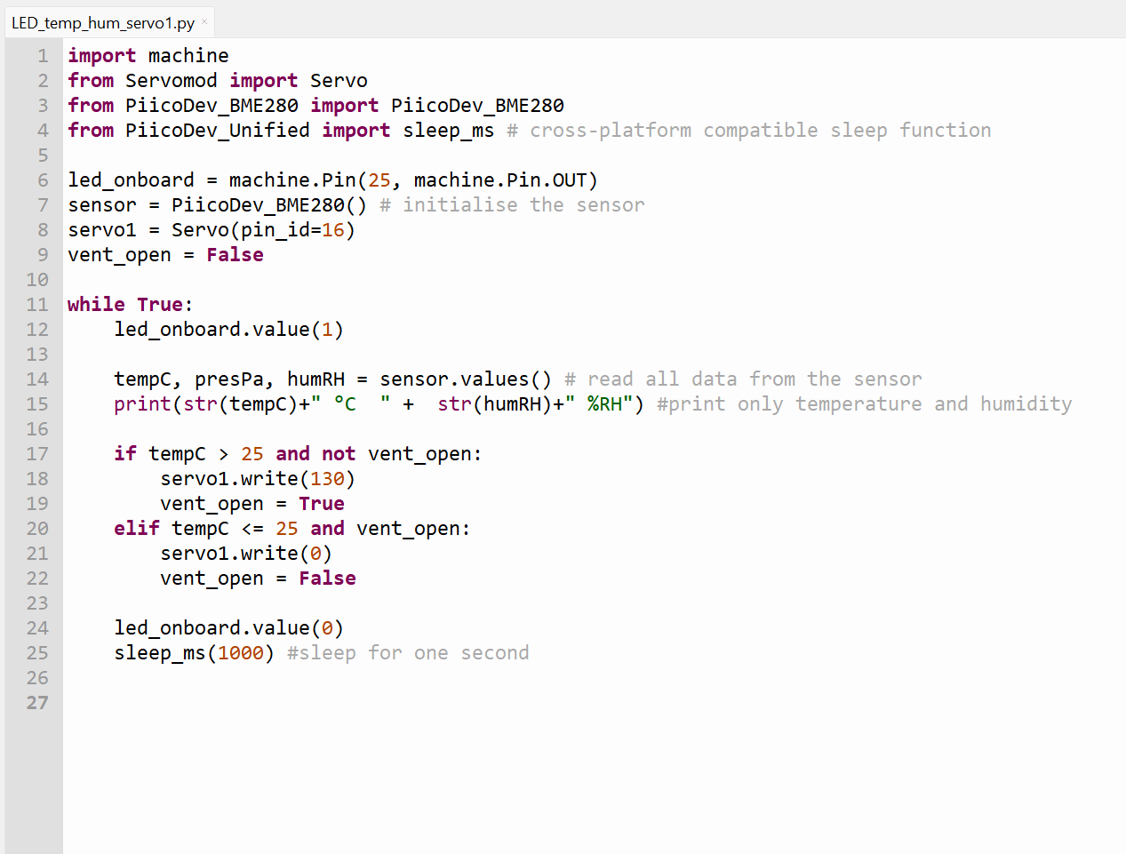
Combine LED, microservo and sensor function
Create a new file titled LED_temp_hum_servo1.py to denote we will be making a file that combines our sensor, blink and servo control codes.
Construct the code displayed in the image. Do not copy comments (# text). These are for explanation and attribution.
Screenshot of code in Thonny from Thonny.org
Notes:
Teacher note: Ask students to create the combined code from the example given.

Slide 66
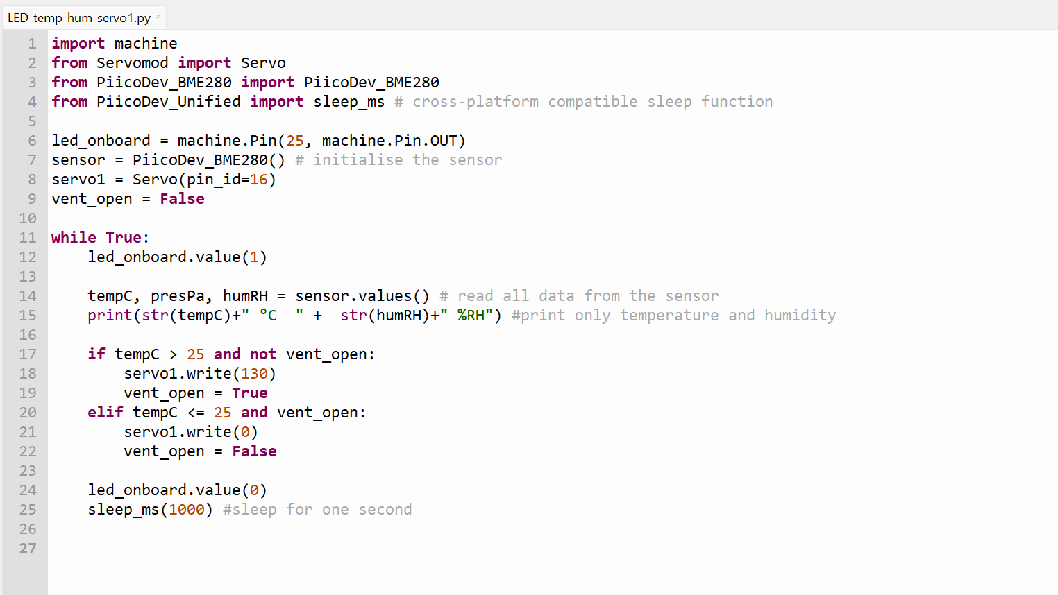
Servo controlled with temperature and humidity
Screenshot of code in Thonny from Thonny.org
Notes:
Teacher note: This is the same code, just larger format. Walk through the code with students and assess understanding through discussion. Explain the logic.
Optional: The teacher can prepare the code before hand and provide it to students to save time typing, and spend more time testing the code and changing values.

Slide 67
Files required
Note the files needed for this code to function.
The ‘machine’ library is a part of Micropython installed on the pico.
‘Servomod’, ‘PiicoDev_BME280, and ‘PiicoDev_Unified’ are libraries or drivers that should already be installed on the pico at this point.
Screenshot of code in Thonny from Thonny.org
Notes:
Teacher note: Libraries will change based on the hardware and components you use – change this slide accordingly.

Slide 68
Sensor script
Sensor controlled Microservo
Run your python code with the microcontroller by selecting the green ‘Run current script’ button.
You will see temperature and humidity readings in the ‘Shell’ window and the LED blinking on the Pico.
When you place a hand on the sensor and the temperature reading passes the set temperature, the servo should move to the set position.
What happens if I change the set temperature or the servo degrees?
Notes:
Teacher note: Ask students to share with class members or demonstrate function to you. Allow students to try different code variations to see what happens, such as the example given above.
The teacher can think aloud about different scenarios, such as the one mentioned.

Slide 69
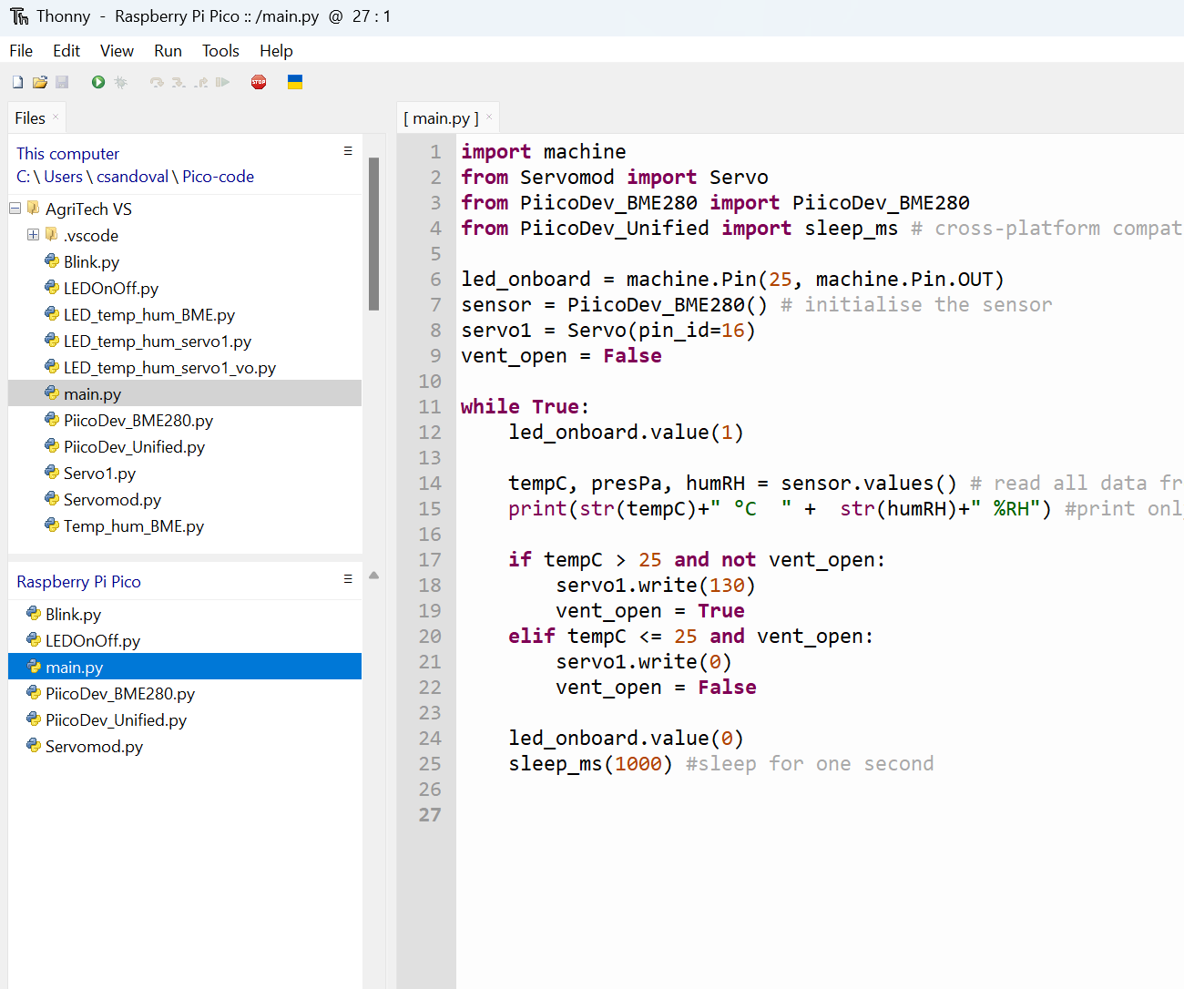
Untethered
Disconnecting from the computer
The Pico can function when disconnected from the computer, but it needs three things (in this situation).
We need to save our operational file as ‘main.py’ on the Pico. Then disconnect your USB.
Move the red jumper wire from the ‘VBUS’ on the expansion board to the ‘3V3’ pin on the expansion board.
Then we need to connect to an appropriate power source.
Screenshot of code in Thonny from Thonny.org
Notes:
Teacher note: Note to students that if there is a load on the Microservo we should use an external power source.

Slide 70
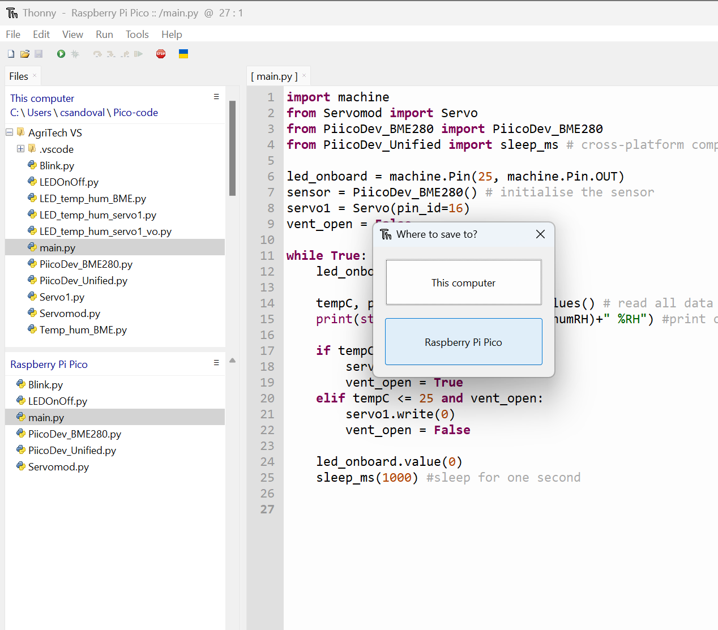
Create main.py
Prepare to disconnect
Save the operational file as ‘main.py’.
Select ‘file’ and then ‘save as’.
Select Raspberry Pi Pico on the pop up window.
The file will save to the Raspberry Pi Pico.
Screenshot of code in Thonny from Thonny.org
Notes:
Teacher note: Students follow steps provided.
If you are using MS VS code students can verify Pico contents by clicking the ‘Toggle Pico-W-FS’ at the bottom of the window.

Slide 71
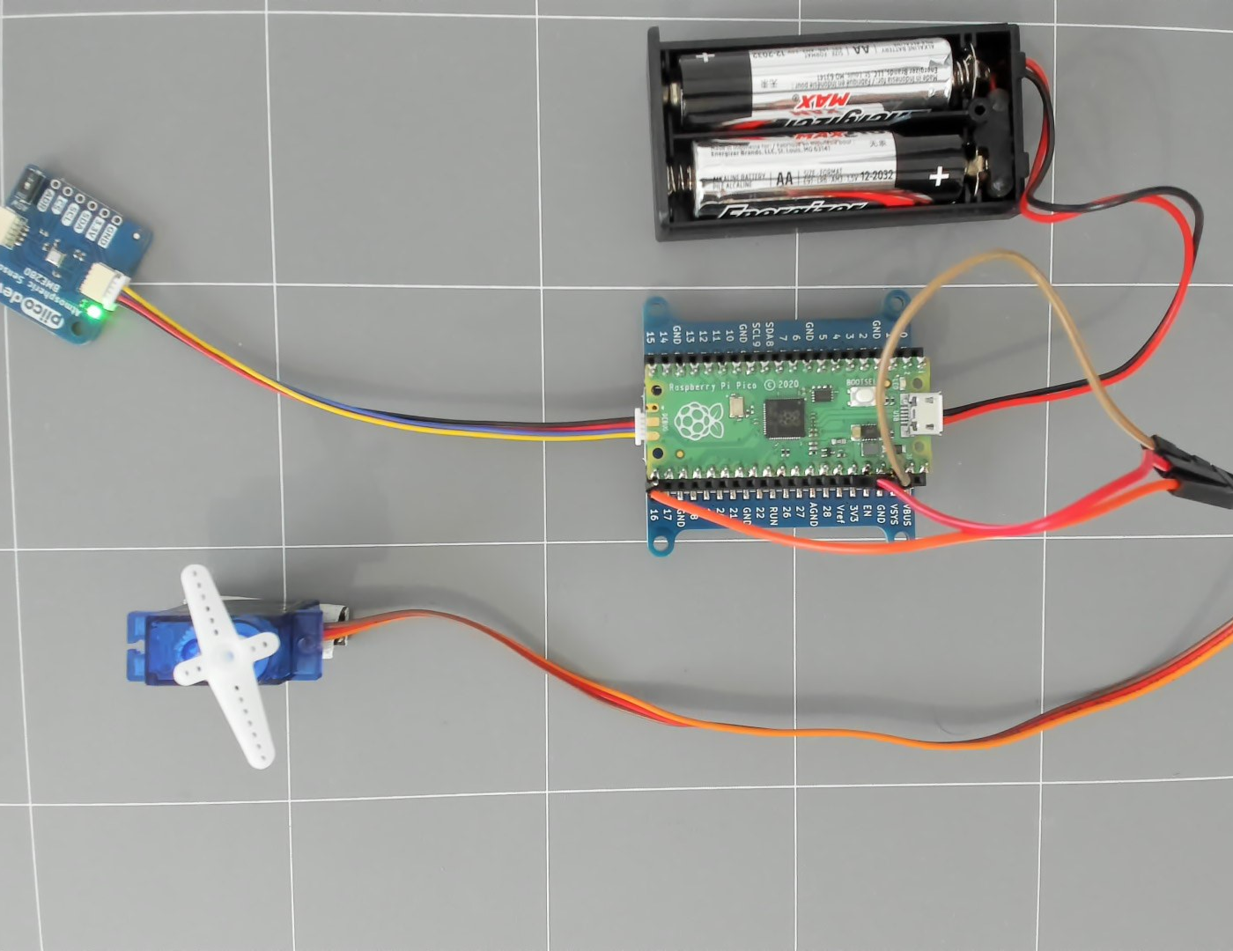
Power source
Disconnecting from the computer
Connect the red wire from the servo to the 3V3 socket on the expansion board.
The following setup has the microservo powered by the Pico. This is a proof of concept for the code, and we will move past this once we see the code works.
Note: It is often preferred to run a microservo with a separate power source to the Pico.
Pico, power, servo and sensor
Notes:
Teacher note: To assist with a gradual increase in complexity we are doing a simple untethered setup, with the microservo powered by the Pico. This is suboptimal and students should move onto an additional power source as soon as the code is proven to work.
When considering power supply, a power timer module could be used to conserve energy. See the power timer section of this guide - https://core-electronics.com.au/guides/plant-io/plant-io-basic-setup-guide-automatically-water-a-seedling-based-on-soil-moisture/

Slide 72
Power source - untethered
Disconnecting from the computer
Disconnect your Pico from the USB.
Connect your power pack to the 2-pin plug on the expansion board.
Turn on the power. The file ’main.py’ will activate on power up.
The Pico LED will start blinking and the sensor LED should light up.
Place hand on sensor to activate servo movement to ‘vent open’ position.
Pico, power, servo and sensor
Notes:
Teacher note: Students follow steps provided. Students can demonstrate operation to you or another student.
Troubleshooting: If setup does not function then students should troubleshoot with a peer before asking you as the teacher. Common reasons for nonfunctioning could be: batteries not properly mounted, power pack not switched on, servo power not connected to 3V3, hands too cold to activate minimum temperature, broken pins or cables, or main.py is not on the pico.

Slide 73
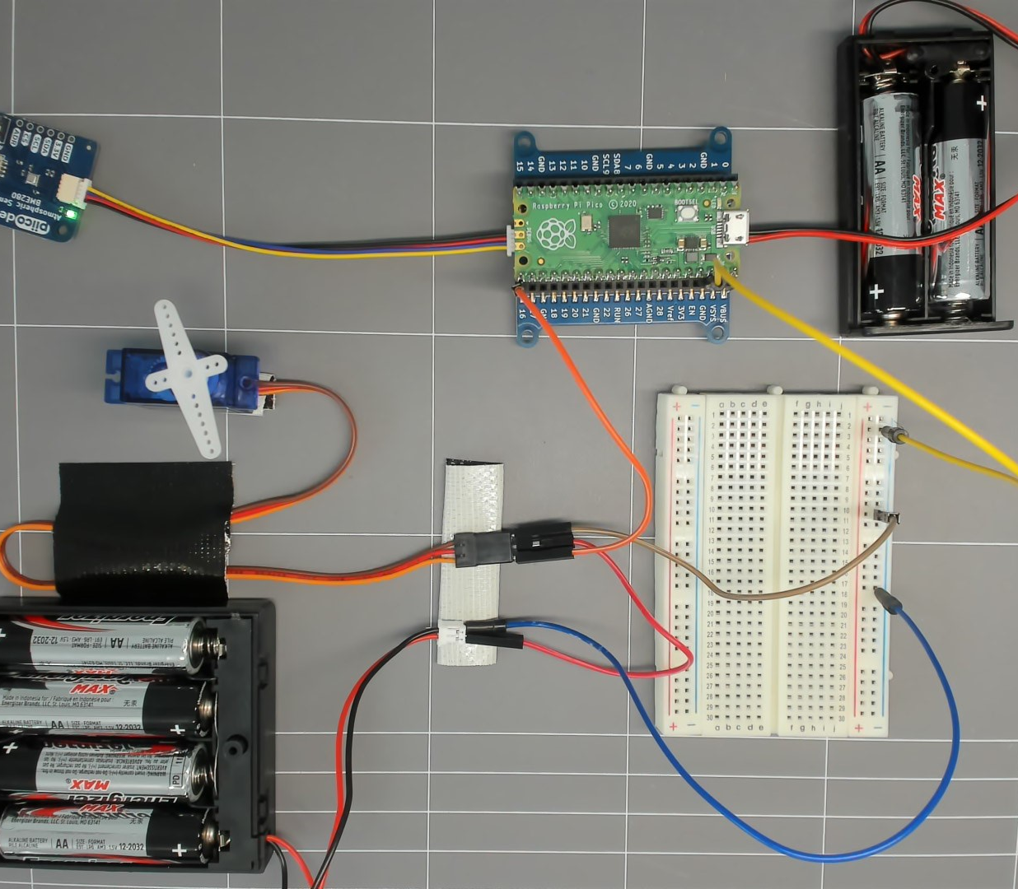
Moving a load – optional setup for extra power
Powering the Microservo
Your microservo will move a load, therefore an extra power source is required.
We will prototype this connection with a breadboard and extra power source.
Powering the microservo
Notes:
Teacher note: (OPTIONAL) This image shows an optional power setup to assist in moving a load. Power supply options will be dictated by available hardware. The key point is a common ground. A 4.5-volt power pack is preferable to the 6-volt shown in the image.

Slide 74
Moving a load – optional extra power
Powering the Microservo
Connect the Pico ground to the breadboard negative rail.
Connect the black wire from the battery pack to the breadboard negative rail.
Connect the red wire from the battery pack to the red wire of the microservo.
Connect the black wire from the microservo to the negative breadboard rail.
Power up and test the setup.
Powering the microservo
Notes:
Teacher note: (OPTIONAL) This image shows an optional power setup to assist in moving a load. Power supply options will be dictated by available hardware. The key point is a common ground. A 4.5-volt power pack is preferable to the 6-volt shown in the image.

Slide 75
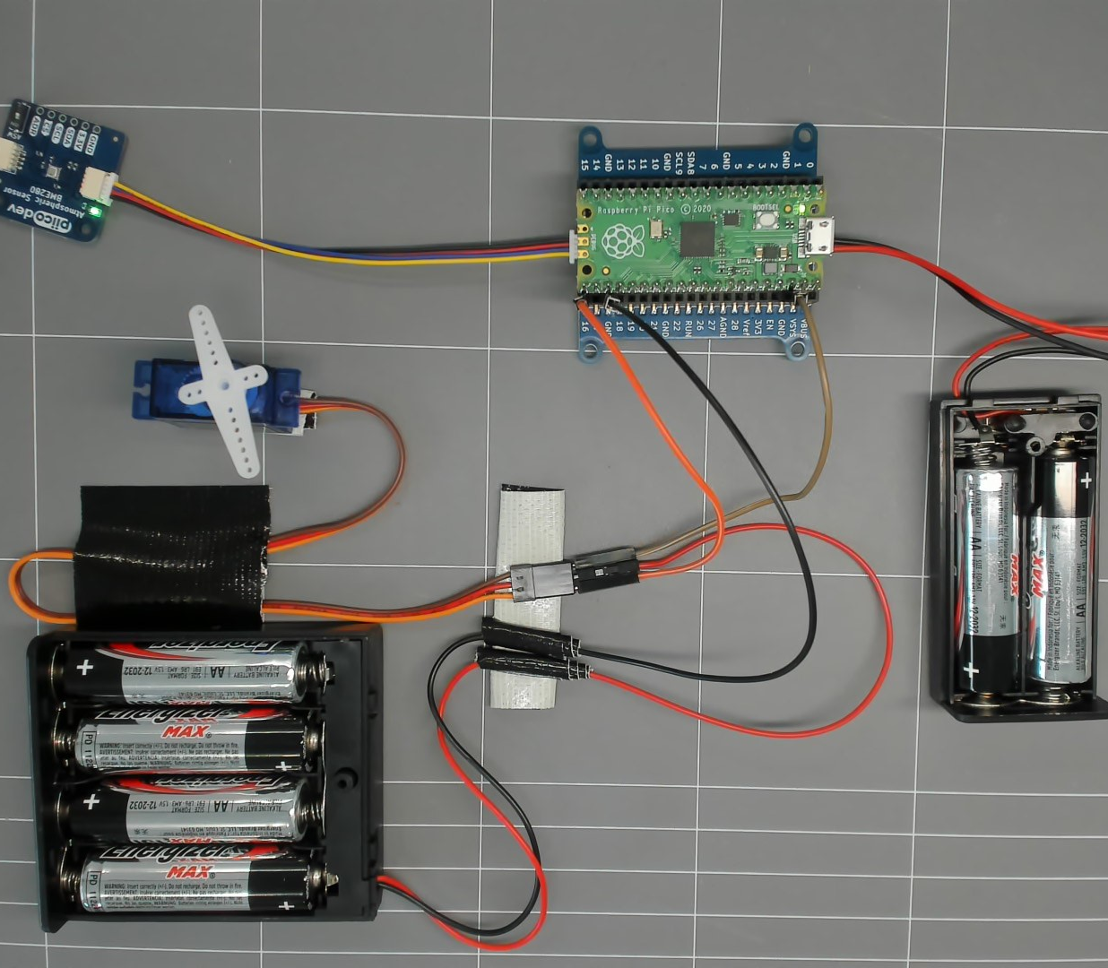
Moving a load – extra power option 2
Powering the Microservo
We can simplify the previous setup by doing the following:
Connect a Pico ground to the microservo ground.
Connect the black wire from the battery pack to a ground socket on the Pico expansion board.
Connect the red wire from the battery pack to the red wire of the microservo.
Power up and test the setup.
Powering the microservo
Notes:
Teacher note: (OPTIONAL) Once prototyping is complete students can tidy up connections as seen in this second option. Power supply options will be dictated by available hardware. Key point is a common ground. A 4.5-volt power pack is preferable to the 6-volt shown in the image.

Slide 76
Temperature controlled vent – extra power option 2
Ready to design
We now have a data-controlled vent system. We can use this system to create a greenhouse that responds to conditions.
Powering the microservo
Notes:
Teacher note: (OPTIONAL) Once prototyping is complete students can tidy up connections. Power supply options will be dictated by available hardware. Key point is a common ground. A 4.5-volt power pack is preferable to the 6-volt shown in the image.
When considering power supply, a power timer module could be used to conserve energy.

Slide 77
Temperature range
What temperature do plants like?
Research the optimum temperature, or humidity, for growing a common herb, such as parsley.
The temperature range you set in your greenhouse code will affect the operation of your greenhouse.
This may affect the design.
The size of the vent, placement of the vent, number of vents, maximum temperature and the frequency of data collection may impact greenhouse functioning.
Notes:
Teacher note: Discuss the forward deployment of this technology into the student's smart greenhouse in terms of temperature ranges and vent design.

Slide 78
Timing
How often do we want to measure the temperature?
The sleep delay is currently set at one second, or 1000 milliseconds. This has allowed us to rapidly test our system.
During functioning we may want to measure temperature every minute or every 30 minutes.
Consider the timing you may want and adjust the code accordingly.
How rapidly does the temperature increase in the greenhouse?
78
Notes:
Teacher note: Discuss the forward deployment of this technology into the student's smart greenhouse, regarding the timing and functioning of data collection.
Students should note ideas in design logbooks or folios.
Teachers may wish to change coding and timing from milliseconds to seconds. Alter code accordingly in instructional material.

Slide 79
Changing timing
÷ 1000
÷ 60
Milliseconds (ms) | Seconds (s) | Minutes (min)
60000 | 60 | 1
 |  | 10
1800000
 | 3600
x 1000
x 60
Notes:
Teacher note: This table could help inform timing conversions for common duration requirements.
Use modelled and guided practice for the first 2 and then allow students to help you complete the table or complete it independently.

Slide 80
Optional extension
How could this ‘if statement’ change if we want to open the vent when the temperature is above twenty-five degrees, or the humidity is above 80%?
If we want to use humidity measurements to create an action, what would the ‘if statement’ look like?
if tempC > 25 and not vent_open:
Notes:
Teacher note: (Optional) If time permits, this optional extension can be used to further assess student understanding of the if statement or could be a learning opportunity for the class. Delete if not needed.

Slide 81

Optional extension answer
If we want to use humidity measurements to create an action what would the ‘if statement’ look like?
if tempC > 25 and not vent_open:
becomes
if tempC > 25 or humRH > 80 and not vent_open:
Screenshot of code in Thonny from Thonny.org
Notes:
Teacher note: This optional extension can be used to assess student understanding of the if statement or could be a learning opportunity for the class. Delete if not needed.

Slide 82


4.1 Brainstorm and design
Learning intentions and success criteria
We are learning to:
communicate design ideas using sketches and notes.
We can:
communicate ideas for our smart greenhouse designs
produce sketches and notes to capture and communicate design ideas.
Notes:
Notes for teachers:
Adapt the learning intention as required and add matching success criteria.
For more information see ⁠NSW Department of Education explicit teaching strategies https://education.nsw.gov.au/teaching-and-learning/curriculum/explicit-teaching.
LISC is not necessarily presented at the beginning of the lesson. Teacher needs to consider most effectual time to introduce.
LISC should be revisited during the lesson to support students' evaluation of their learning.

Slide 83

Design brief
Minimum viable product
Create a desktop smart greenhouse that can help manage internal temperature autonomously.
The smart greenhouse should include at least one:
microcontroller board
sensor (e.g. temperature sensor)
Actuator and effector (e.g. servo moving a vent)
Possible smart greenhouse components
Notes:
Teacher note: Review the design brief you are using with the class.
It is important to change the design brief to suit your school context and available resources (if appropriate).
This learning sequence will focus on temperature. You could change the focus to water, light, or humidity.

Slide 84

Design
In this lesson we will:
review our previous brainstorm ideas
adjust our ideas based on our knowledge of microcontrollers, sensors and actuators
begin to draw/sketch diagrams of our chosen solution
Image of example brainstorm on Smart greenhouse webpage
Notes:
Teacher note: Possibly rewatch the brainstorm video to demonstrate ideation in action from .

Slide 85

Drawing
Concepts
We will be taking our brainstorm ideas further today and creating concept sketches.
This video will introduce ideas regarding the sketching of design ideas.
Design and drawing a smart greenhouse
Notes:
Teacher note: Present the video on designing a smart greenhouse on the smart greenhouse webpage. Pause, repeat and discuss the section on concept sketches.
Discuss what is shown and seek confirmation of student understanding.
The video illustrated 3 mechanisms for moving a vent with a servo, what were the 3 types of movement? (push, pull, axial)
Emphasise the process involves capturing ideas and not trying to create perfect images (in this instance).

Slide 86

Drawing sketches
Concept sketches
Consider an element of your design.
Draw a sketch that illustrates the movement, mechanism or other consideration of that element.
Add notes to the sketch to help explain the sketch.
Example of a smart greenhouse vent
Notes:
Teacher note: Based on notes and ideas ask students to capture a design and annotations. Capture notes and sketches in design folio or journal.
Give students opportunities to work individually or in pairs, depending on your context. Provide support and guidance for students and encourage sketching.
Encourage collaboration and assure students they are not competing. Remind students that they are a class team and helping others, sharing ideas and collaboration helps the entire team trial ideas and concepts.
Guide students with design and planning as required.
Ask students to adjust ideas based on knowledge of microcontrollers, sensors and actuators.
After a given amount of time allow students to share concepts, possibly using think-pair-share.
Think-Pair-Share involves students thinking independently about a prompt or problem, pairing up and discussing their sketches with a classmate, and then sharing their combined knowledge with the class.

Slide 87
4.2 Refine the design
Learning intentions and success criteria
We are learning to:
communicate design ideas using notes and sketches.
We can:
communicate ideas for our smart greenhouse designs
produce orthographic and concept sketches to capture and communicate design ideas.
Notes:
Notes for teachers:
Adapt the learning intention as required and add matching success criteria.
For more information see ⁠NSW Department of Education explicit teaching strategies https://education.nsw.gov.au/teaching-and-learning/curriculum/explicit-teaching.
LISC is not necessarily presented at the beginning of the lesson. Teacher needs to consider most effectual time to introduce.
LISC should be revisited during the lesson to support students' evaluation of their learning.

Slide 88
Remember the design brief
Minimum viable product
Create a small desktop smart greenhouse that can help manage temperature autonomously.
The smart greenhouse should include at least one:
microcontroller board
sensor (e.g. temperature sensor)
Actuator and effector (e.g. servo moving a vent)
Possible smart greenhouse components
Notes:
Teacher note:
It is important to change the design brief to suit your school context and available resources.
This learning sequence will focus on temperature. You could change the focus to water, light, or humidity.

Slide 89

Drawing orthographic projections
Orthographic
We will be creating orthogonal drawings of our smart greenhouse today.
An orthogonal drawing is a method of representing a three-dimensional object in two dimensions using a series of separate views. These views typically include:
Front view: A depiction of the object as seen from the front.
Top view: A view of the object as seen from above.
Side view: A view of the object as seen from the side.
Design and drawing a smart greenhouse
Notes:
Teacher note: Review the video on designing a smart greenhouse. Pause, repeat and discuss the section on orthogonal drawings. Discuss what is shown and seek confirmation of student understanding.
Emphasise the process of capturing ideas and not trying to create perfect images (in this instance).

Slide 90

Drawing projections
Orthographic
Using our brainstorm ideas let's make a drawing together.
Designing a smart greenhouse
Notes:
Teacher note: Based on class notes and discussion, choose a simple rectangle shape and make an orthogonal drawing of a simple rectangular greenhouse. Emphasise the capturing of ideas to assist with planning. Use notes and measurements to capture ideas.
Confirm understanding by pointing at representations and asking students to describe what is represented and what view is shown.
A range of templates are provided in the following slides. Select those that may be useful to your context.

Slide 91

Orthogonal representations 1
Notes:
Teacher note: If you can project on to a whiteboard, this could be a good template to use to quickly demonstrate concepts and ideas. Use a white board marker to quickly add notes and concepts. This is to model the process for students.
Check for understanding:
Ask students if someone is comfortable to label or point out the (clockwise from top left) top, isometric, side and front drawings.
Or use choral response: Ask students to state the ‘view’ when you point at different drawings. i.e. top view, front view, side view.
Also: possibly provide a template such as this if needed. This is a standard house design. However, the onus of this lesson is to have fun capturing design ideas. We are looking to communicate concepts, not to be perfect.

Slide 92

Orthogonal representations 2
Notes:
Teacher Note: Example template is the same as previous but with note space on the left and right.

Slide 93

Orthogonal representations 3
Notes:
Potential example template (Optional) Rectangular container example/template.

Slide 94

Orthogonal representations 4
Notes:
Potential example template (Optional) Rounded rectangular object template/example.

Slide 95

Orthogonal representations 5
Notes:
Potential example template (Optional) Round bottle template/example.
Note the bottle orientation is on its side with the base as the front.

Slide 96

Orthogonal representations 6
Notes:
Potential example template (Optional) Square bottle template/example. Note the bottle orientation is on its side with the base as the front.

Slide 97

Orthogonal representations 7
Notes:
Potential example template (Optional) tunnel greenhouse.

Slide 98

Orthogonal representations 8
Notes:
Potential example template (Optional) Lean-to greenhouse example.

Slide 99


Example
Orthographic with ideas
Notes:
Teacher note: This example demonstrates an orthographic drawing of a 4L bottle, it includes positioning of components and notes on movement.

Slide 100
Drawing your design
Orthographic
Your turn.
Capture the idea you wish to create in an orthographic drawing.
Start simple and start adding features notes, materials, mechanical movements and measurements.
Designing a smart greenhouse
Notes:
Teacher note: Based on notes and ideas ask students to capture a design. Use materials students have access to.
Give students opportunities to work individually or in pairs, depending on your context. Provide support and guidance for students and encourage sketching.
Encourage collaboration and assure students they are not competing. Remind students that they are a class team and helping others, sharing ideas and collaboration helps the entire team trial ideas and concepts.
Guide students with design and planning as required.

Slide 101
4.3 Designing and planning
Learning intentions and success criteria
We are learning to:
communicate design ideas using sketches and notes
use project management and communication techniques to plan and document design ideas.
We can:
produce orthographic and concept sketches to capture and communicate design ideas
identify material requirements for prototyping.
Notes:
Notes for teachers:
Adapt the learning intention as required and add matching success criteria.
For more information see ⁠NSW Department of Education explicit teaching strategies https://education.nsw.gov.au/teaching-and-learning/curriculum/explicit-teaching.
LISC is not necessarily presented at the beginning of the lesson. Teacher needs to consider most effectual time to introduce.
LISC should be revisited during the lesson to support students' evaluation of their learning.

Slide 102

The goal
Minimum viable product
Create a small desktop smart greenhouse that can help manage temperature autonomously.
The smart greenhouse should include at least one:
microcontroller board
sensor (e.g. temperature sensor)
effector (e.g. servo)
Potential greenhouse components
Notes:
Teacher note: It is important to change the design brief to suit your school context and available resources.
This learning sequence will focus on temperature. You could change the focus to water, light, or humidity.

Slide 103
Orthographic drawings
Orthographic
In this lesson we will:
refine your greenhouse solution and communicate the design as an orthographic drawing
plan for prototyping.
Designing a smart greenhouse
Notes:
Teacher note:
Point out key steps for the lesson.
Give students opportunities to work individually or in pairs, depending on your context. Provide support and guidance for students and encourage sketching.
Encourage collaboration and assure students they are nor competing. Remind students that they are a class team and helping others, sharing ideas and collaboration helps the entire team trial ideas and concepts.
Guide students with design and planning as required.

Slide 104
Revise example
Orthographic with ideas
Notes:
Teacher notes: Assist students to finalise their orthographic drawing/projection. Capture key points of the design.
Check for understanding:
Use choral response: Ask students to state the ‘view’ when you point at different drawings. i.e. top view, front view, side view.

Slide 105
Planning
In the next fortnight we will be prototyping and building our solutions.
Consider the materials you will need for prototyping. Think about the structures, movements and mechanisms.
Sticky tape, plastic, wood, bottles, electronics, wire, glue, scissors…
105
Notes:
Teacher note: Assist students in considering what materials and equipment they will need based on their designs and previously established constraints.

Slide 106
Planning materials
Name:
Feature | Materials, quantity, equipment
Notes:
Teacher note: This table could help inform planning of material needs
This slide can be printed and used for student requisitions if needed.

Slide 107
References
Outcomes referred to in this document are from the iSTEM course document © NSW Department of Education for and on behalf of the Crown in the State of New South Wales (2024).
Cover image: 'Aerial image of pivot irrigation crop' screenshot from SIX MAPS from the State of New South Wales (Department of Customer Services, Spatial Services).
Core Electronics (20 July 2021) ‘Atmospheric sensor BME280’ [video], Core Electronics, YouTube, accessed 28 May 2024.
Core Electronics (20 July 2021) ‘PiicoDev precision temperature sensor TMP117 | Micro:bit guide’ [video], Core Electronics, YouTube, accessed 28 May 2024.
Core Electronics (24 January 2024) ‘Board walkthrough and Pinout’ [video], Core Electronics, YouTube, accessed 28 June 2024.

Slide 108
References 2
Core Electronics (19 June 2024) Raspberry Pi Pico workshop for begineers, Core Electronics website, accessed 21 June 2024.
Core Electronics (20 July 2023) ‘Plant IO sensor guide’ [video], Core Electronics, YouTube, accessed 28 May 2024.
Core Electronics (24 April 2024) ‘Sensors, input devices and microcontrollers’ [video], Core Electronics, YouTube, accessed 28 May 2024.
Kitronik (9 April 2021) ‘Smart greenhouse kit for the BBC micro:bit’ [video], Kitronik, YouTube, accessed 28 May 2024.
Michael Klements (8 December 2020) ‘Micro:bit automatic plant watering system’ [video], Michael Klements, YouTube, accessed 28 May 2024.
Micro:bit Educational Foundation (2024) Microbit environment data logger, Micro:bit Educational Foundation website, accessed 28 May 2024.
Micro:Bit (2024) Micro:bit environment data logger, Micro:bit Educational Foundation website, accessed 28 May 2024.
Microsoft MakeCode (3 January 2020) ‘Science experiments 04 soil moisture sensor’ [video], Microsoft MakeCode, YouTube, accessed 28 May 2024.

Slide 109
Copyright
© State of New South Wales (Department of Education), 2026
The copyright material published in this resource is subject to the Copyright Act 1968 (Cth) and is owned by the NSW Department of Education or, where indicated, by a party other than the NSW Department of Education (third-party material).
Copyright material available in this resource and owned by the NSW Department of Education is licensed under a Creative Commons Attribution 4.0 International (CC BY 4.0) licence.
This licence allows you to share and adapt the material for any purpose, even commercially.
Attribution should be given to © State of New South Wales (Department of Education), 2026.
Material in this resource not available under a Creative Commons licence:
the NSW Department of Education logo, other logos and trademark-protected material
Material owned by a third party that has been reproduced with permission. You will need to obtain permission from the third party to reuse its material.
Links to third-party material and websites
Please note that the provided (reading/viewing material/list/links/texts) are a suggestion only and implies no endorsement, by the New South Wales Department of Education, of any author, publisher, or book title. School principals and teachers are best placed to assess the suitability of resources that would complement the curriculum and reflect the needs and interests of their students.
If you use the links provided in this document to access a third party’s website, you acknowledge that the terms of use, including licence terms set out on the third-party’s website apply to the use which may be made of the materials on that third-party website or where permitted by the Copyright Act 1968 (Cth). The department accepts no responsibility for content on third-party websites.

