Slide 1
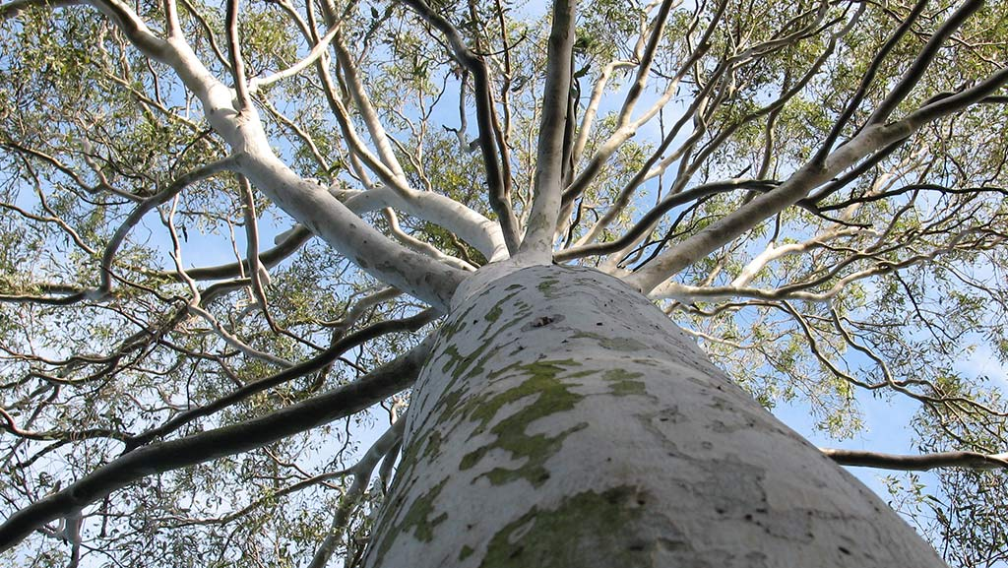
Becoming more.
Presentation to NSW AEDC Research Symposium 2025
Summary of Research Project into AEDC and First Nations in Queensland 2023
Tony Dreise

Slide 2
Purpose
Provide an overview of a research project undertaken in Queensland in 2023 on First Nations communities and the AEDC.
The research project report was called ‘Becoming more’.

Slide 3
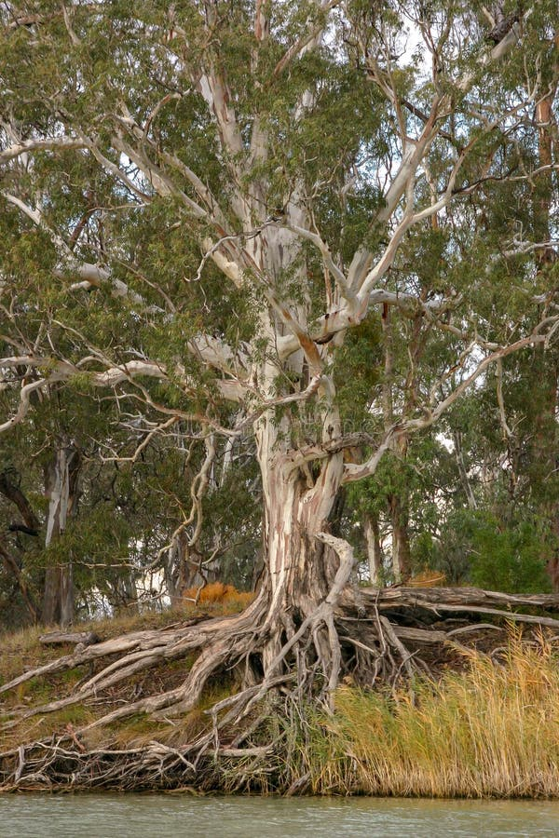
Conceputal framing by Indigenising the AEYLF
Becoming
Being
Belonging

Slide 4
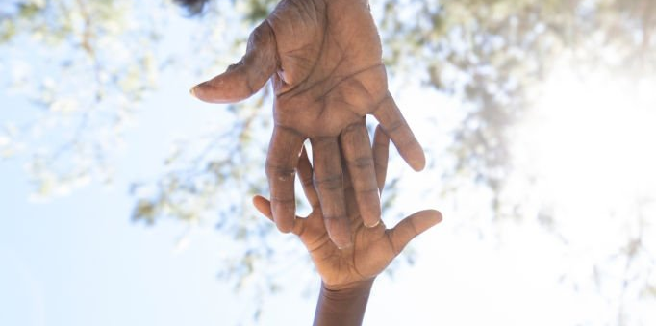
“The AEDC is important, but it can - and must - become more.”
#1 finding

Slide 5
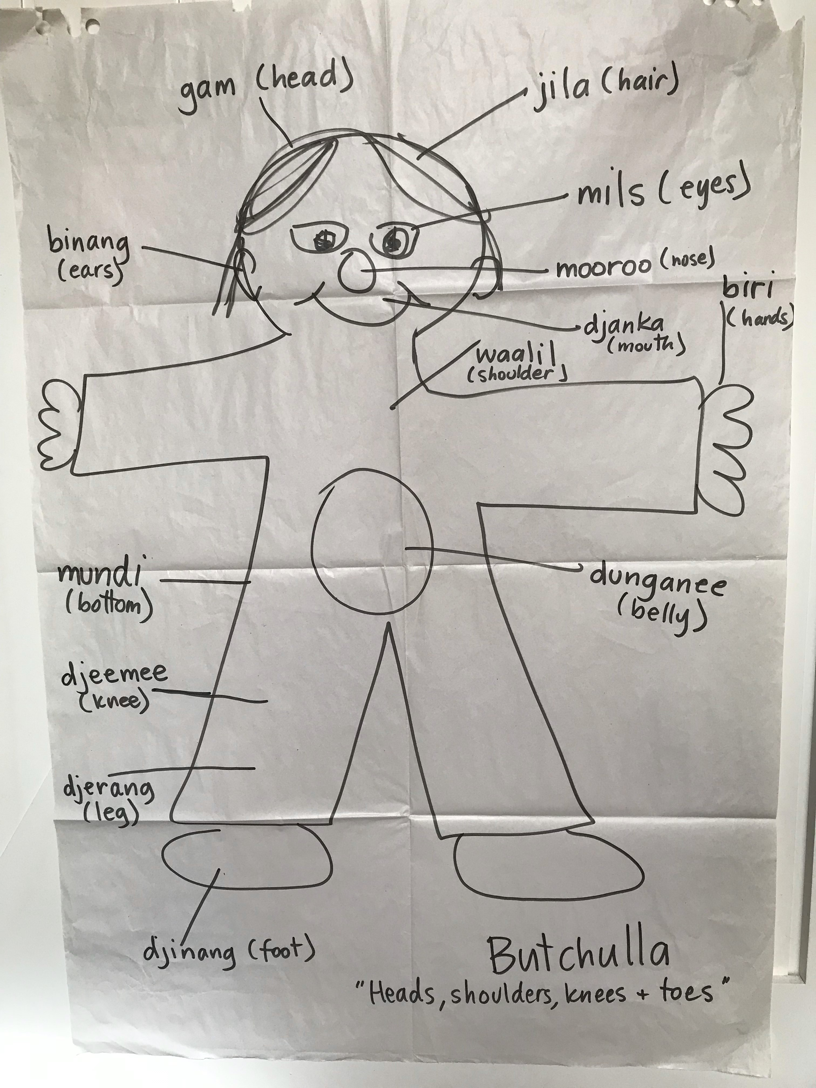
Unpacking the report
The project brief
The research approach
The findings
The ‘so what’ and ‘what next’
Acknowledgement: Jodie Burns, Butchalla

Slide 6
The research objectives & methods

Slide 7
The research approach
Orientation
Briefings with Department.
Desktop
Rapid literature and prior data review.
Fieldwork
Interviews and focus groups in situ or virtually.
Analysis
Report
Presentation of summary findings.
Final Report to the Department.

Slide 8
The project brief
National
Close the gap # 4
55% on-track across all 5 domains by 2031
State
Increase understanding to drive partnerships, programs, and service provision
Departmental
Build data confidence
Local
Enable data ownership among First Nations

Slide 9

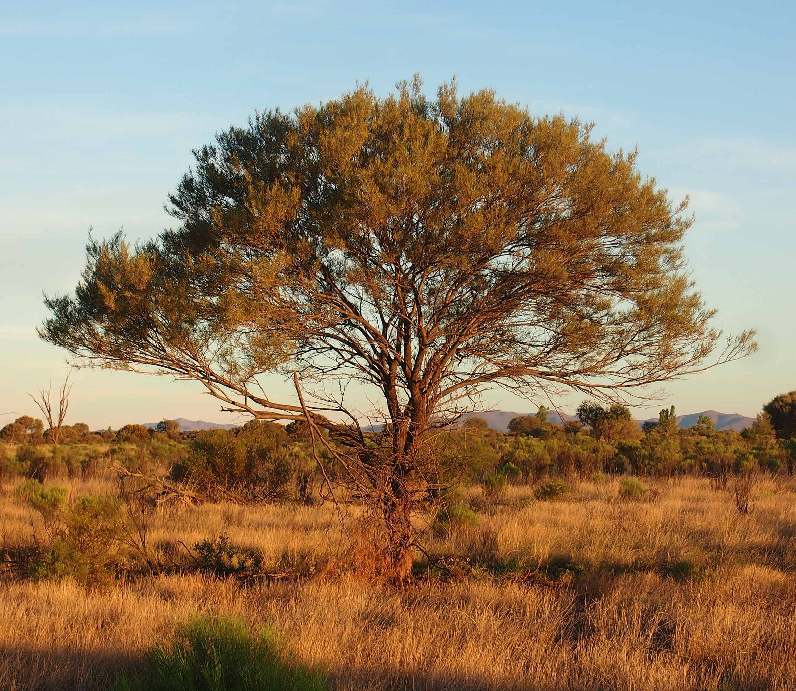

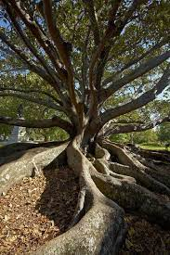
Places
NQ + FNQ
Bindal
Wulgurukaba
Kaurareg
Far SWQ
Kunja
Kullilli
South Burnett
Wakka Wakka
SEQ
Yuggerah
Turrbal

Slide 10
Methods
Qualitative, not quantitative
Most interviews were structured (some semi)
Evidence gathered at a point in time (not longitudinal)
Engagement was with ‘end-users’ at local levels, not with ‘producers’ (regional | state | national)

Slide 11
In-depth vrs wide
Torres – focus group
North Qld – 2 x focus groups / 2 x interviews
SWQ – 2 x interviews / 1 x focus group
South Burnett – 4 x interviews
SEQ – 3 x interviews
Principals
Deputies
Heads of Studies
Deadly Kindies (3 sites)
ECE teachers
School partnerships personnel
Indigenous health providers
Kindies & other providers
40 per cent First Nations

Slide 12
Outside scope but important
Workforce development was a major recurring theme in the field
Concerns that Kindy teachers will be hard to recruit given ECEs can’t compete with school teacher conditions and salaries
Transition Statements aren’t always accurate given the focus on strengths-based
Parental engagement remains a big challenge (but sometimes for positive reasons)

Slide 13
The questions about AEDC
awareness
understanding
thoughts
involvement
needs
resources + support
information (receiving and sharing it)
future
strategic use

Slide 14
The findings

Slide 15
Key findings 1
Some educators (including principals) knew little about AEDC
Others are highly strategic in using it
Staff are time poor
Prefer to have information delivered face to face (including having a yarn)
“Gotta see it to learn from it” (Aboriginal principal)
One school has partnership with QUT optometry; as well as ears, eyes, heart, skin
Invest in local level (place); one size doesn’t fit all

Slide 16
Key findings 2
Kids aren’t going to Kindy (Covid may have impacted attitudes to attendance)
Issues in communities including DV, poverty, social isolation, trauma (not just Indigenous)
Uncertainty about what ‘the Covid kids’ will mean in terms of outcomes in 2024 Census
Qualified teachers hard to attract to Kindies (difficulty in competing with school salaries and conditions)

Slide 17
Key findings 3
“We pulled the AEDC data apart. We developed an Action Plan.”
Presentation of data should be de-jargonised and developed in an easy-to-follow way including for parents
Timing of AEDC is off. Should assess in Kindy and then again at end of Prep. “Interventions are often too late.”
Major increases of learning difficulties including ASD, ADHD, etc.
ECE are more aware of cultural matters than 20 years ago (including sorry business, yarnin, etc.) but still a long way to go

Slide 18
The findings 1
Schools are responding to the data in a number of ways, including one school creating a breakfast club and daily fitness program
In one school only one of the three Prep teachers had prior experience with AEDC
Future AEDC presentation should illustrate trends over time, and provide an experts list (so schools are supported in taking action)
Schools need more PD (f2f, A.V.) on how to interpret and respond to First Nations outcomes (including links to networks)
Regional offices in some places are doing a tremendous support role

Slide 19

In focus: Deadly Kindies
Kindies using data at local and regional levels
Kindies partnering with IUIA: Speech, O/T, dental, audiology, optometry, and more recently pursuing psychology through play therapy
Data often puts too positive a spin on how kids are tracking
Whilst AEDC is presented well and is easy to follow, it needs to be culturally tailored
ECEC policy often does not recognise the ‘whole Indigenous child’, more holistic models not appreciated
The sector is struggling with workforce issues

Slide 20
So what + Next steps
Awareness/understanding of AEDC in the sector is patchy: very strong among some principals who use the data strategically, almost zero awareness among other principals. Investment in a larger survey could test this
AEDC resources need translating and customising, especially for parents and community organisations
The presentation and dissemination of AEDC data needs to systematically expand beyond the domain of education: to health, community services, and more importantly, parents and caregivers (as first teachers)

Slide 21
So what + Next steps 2
Strengths-based principles should not blinker needs-based realities

Slide 22
So what + Next steps 3
Local level results disputed as being too favourable, or overlooking challenges
AEDC is too narrow as it lacks a cultural dimension
Up to 2 year waiting list for allied health services

Slide 23
So what + Next steps 4
Educators want to get together f2f for professional development
Parents are not getting information about AEDC
AEDC is too often a one-off event, then forgotten
Greater care must be taken in avoiding value judgements (rigour in PD training)
Raw data useless. Needs value adding (interpretation, analysis, and translation)

Slide 24
Fast forwarding to now

Slide 25
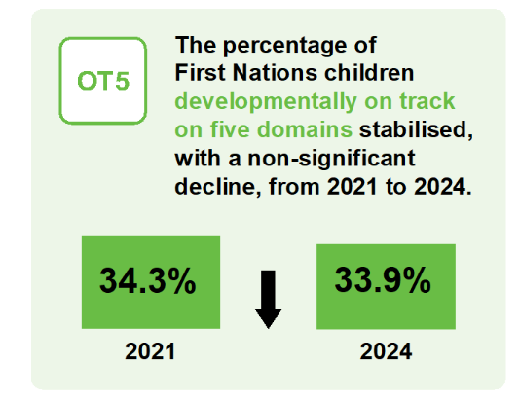
First Nations National AEDC results 2024

Slide 26
First Nations National AEDC results 2024 2
The fact remains that about 66 per cent of First Nations children are not on track across the 5 domains

Slide 27







Risk factors
out of home care
one in five children with an incarcerated parent
overcrowded housing
poorer health
lower incomes
racism

Slide 28


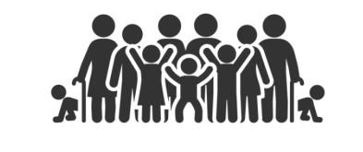
Protective factors
Connection to Country
Language and identity
Extended family

Slide 29


Is weaving the way forward?
Co-designing and co-producing
Black palm fibre
Delissa Walker (Kuku Yalanji people), Kakan mat, 2018

Slide 30
Becoming more
Professor Tony Dreise
Questions

