Slide 1


Student mental health and wellbeing:
Findings from the
NSW Child Development Study
Professor Kristin Laurens (QUT & UNSW)
https://www.unsw.edu.au/research/nsw-cds

Slide 2
Acknowledgement

Slide 3





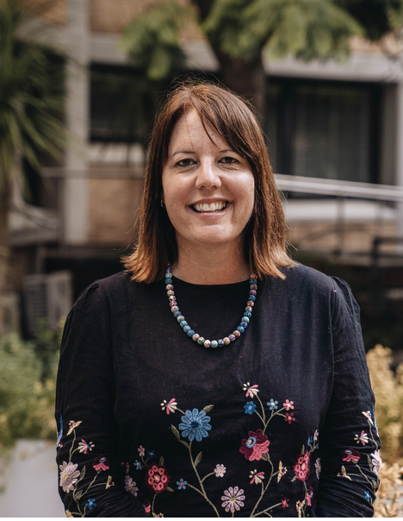












https://www.unsw.edu.au/research/nsw-cds
Prof Melissa Green
Prof Kimberlie Dean
Prof Kristin Laurens
A/Prof Stacy Tzoumakis
Prof Vaughan Carr
Dr Emma Carpendale
Dr Tyson Whitten
Dr Oliver Watkeys
Dr Melissa Cheung
Dr Emma McKenzie
Dr Ken Zulumovski
Ms Felicity Harris
Ms Jeanti Profaca
Ms Lauren Piltz
Ms Caity Macblundell
Dr Kirstie O’Hare

Slide 4
Plan for the talk
Using multidimensional profiles of developmental vulnerability from the AEDC to provide clues for preventing later mental health problems
Using AEDC data in studies that show the role of social-emotional skills in supporting children’s academic learning at school

Slide 5
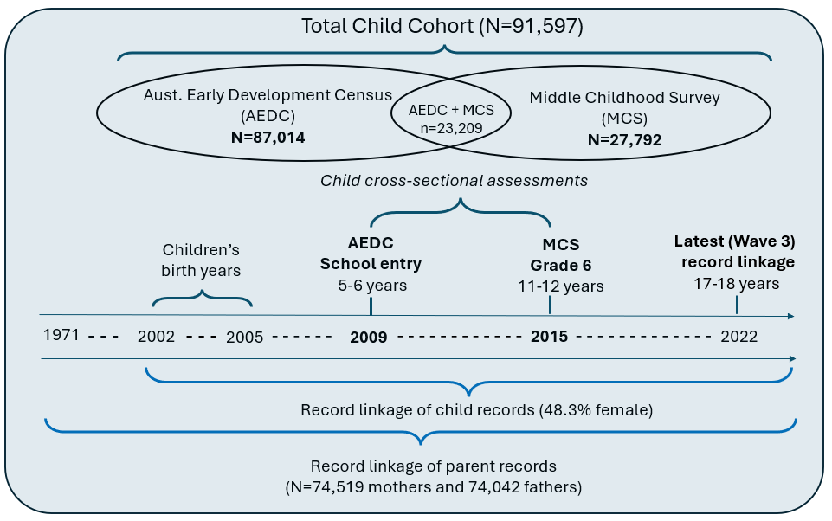






The NSW Child Development Study
An intergenerational population cohort study combining administrative records with two child developmental assessments
Principal
Survey
N=598
Records linked:
Health
Child protection
Police
Criminal Justice
Education
Welfare

Slide 6
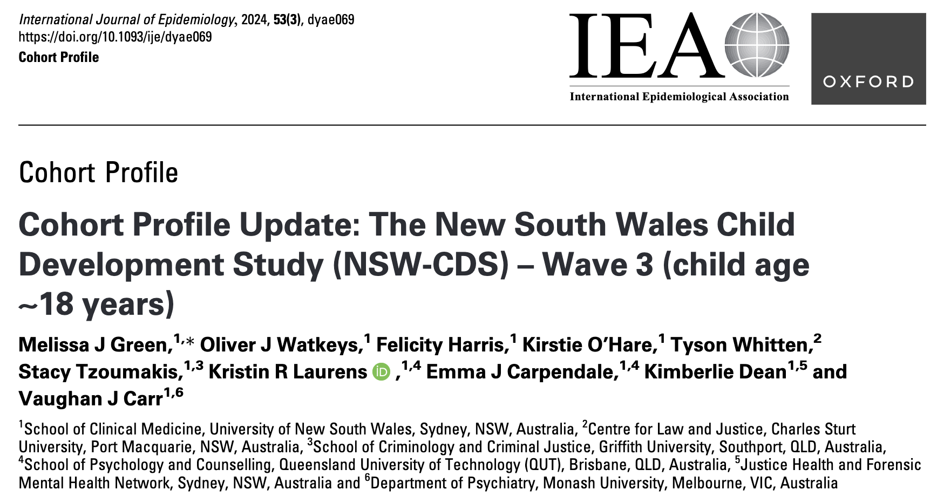
Cohort profile
https://www.unsw.edu.au/research/nsw-cds

Slide 7
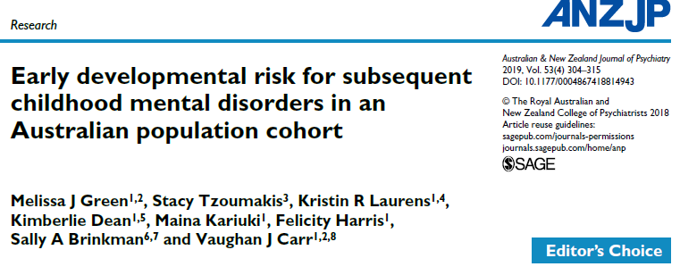
Research paper

Slide 8
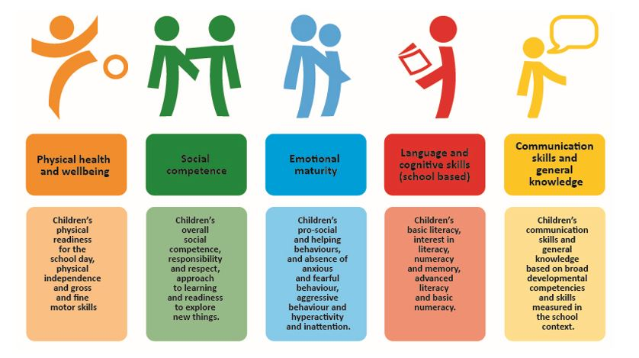
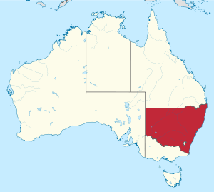
AEDC data
AEDC: a population measure of early childhood vulnerability at school entry (age 5-6 years) assessed on 5 domains (16 subdomains)
Those scoring in the lowest 10% of each domain on the national 2009 census are deemed developmentally vulnerable.

Slide 9
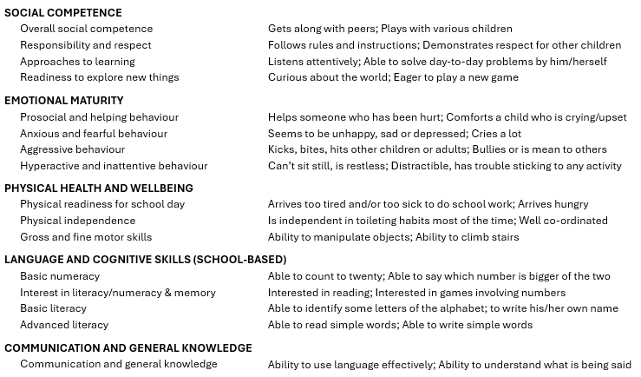
16 Subdomains of the AEDC

Slide 10
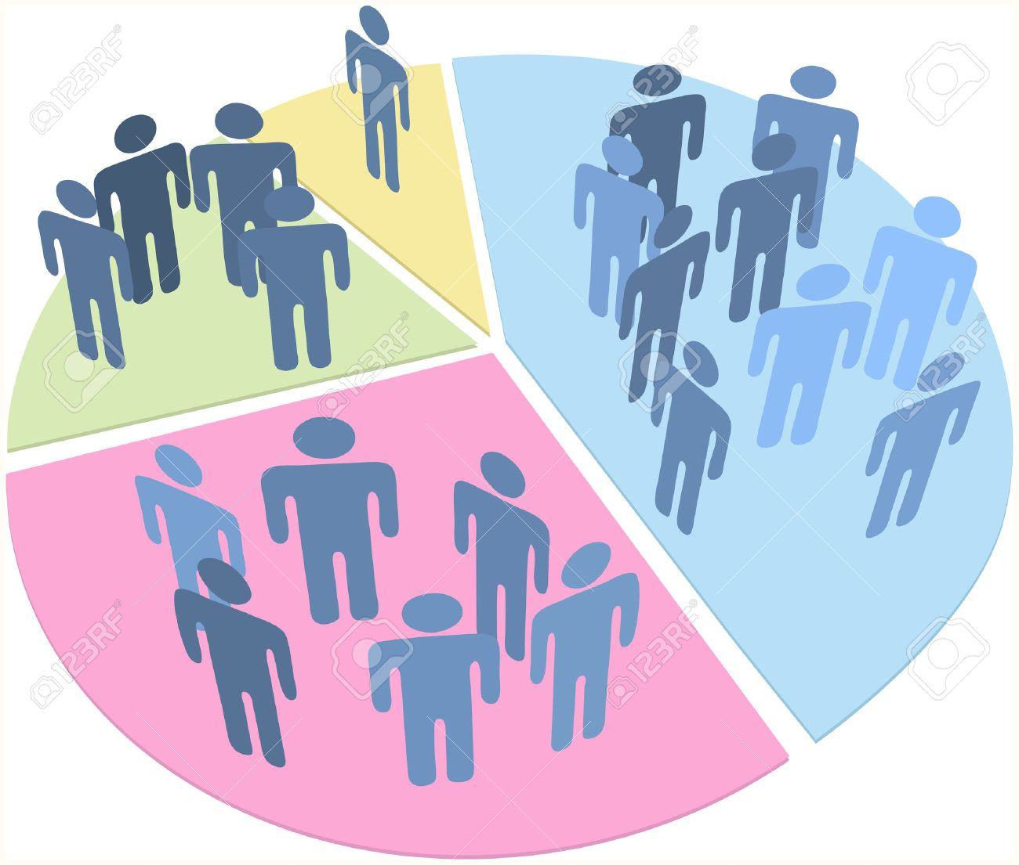
Population patterns of early childhood developmental vulnerability
Using subdomain data from the 2009 NSW Australian Early Development Census (AEDC) cohort (87,000 children),
we delineated four distinct patterns of developmental vulnerability in the general population, associated with mental illness in middle childhood

Slide 11
Early childhood developmental risk classes

Slide 12
Any mental disorder recorded in health records between 6-13 years, according to early childhood developmental risk class
  Relative to the no-risk group, and after adjusting for other factors, mental health disorders were:
    2 times as likely among children in the ‘pervasive risk’ group (95% increase in risk)
    2 times as likely among the ‘misconduct risk’ group (117% increase in risk)
    1.2 times as likely in the ‘mild generalised risk’ group (20% increase in risk)
*Adjusted for sex, socioeconomic disadvantage, child protection contacts, and parental mental illness

Slide 13
Types of mental disorder diagnoses (age 6-13 years) according to early childhood developmental risk class
*Adjusted for sex, socioeconomic disadvantage, child protection contacts, and parental mental illness

Slide 14
Other factors (covariate odds ratios)

Slide 15
Community needs: mapping the proportion of children with “pervasive” and “misconduct” developmental risk across regions of NSW
Mapping the geographical distribution of AEDC early childhood developmental risk can inform the regional allocation of family supports, childhood mental health and allied health services
Harris et al. (2022) Early Intervention in Psychiatry, 16(12), 1269-1277

Slide 16
Key Messages (part 1)
The multidimensional AEDC data on developmental vulnerabilities across each of the 16 subdomains identify different profiles of risk in the first year of full-time school for later use of health services for mental health problems (between 6-13 years of age).
  A ‘pervasive risk’ profile and ‘misconduct risk’ profile show increased chance (compared to the ‘no risk’ profile) of a wide variety of mental health diagnoses
Mapping the prevalence of these profiles to regional areas can help identify where local supports might best be implemented to support children at risk for mental health problems, including school-based supports

Slide 17
What about the links between student wellbeing and learning?

Slide 18
How can we support academic achievement?
Students’ early language and cognitive skills (school-based), as described by the AEDC in children’s first year of full-time school, explain about 13-18% of later reading and numeracy performance on the NAPLAN (Years 3, 5, and 7) (Brinkman et al., 2013).
See also Laurens et al., 2020 (NSW Child Development Study)
Social-emotional skills are being increasingly recognised as important contributors to students’ academic achievement (Oberle et al., 2014; OECD, 2021).
A reciprocal relationship, in which social-emotional skills and academic achievement influence each other, has also been proposed (Denham & Brown, 2010).
Early Cognitive Skills
Later Academic Achievement
Social-Emotional Skills
Later Academic Achievement
Academic Achievement
Social-Emotional Skills

Slide 19

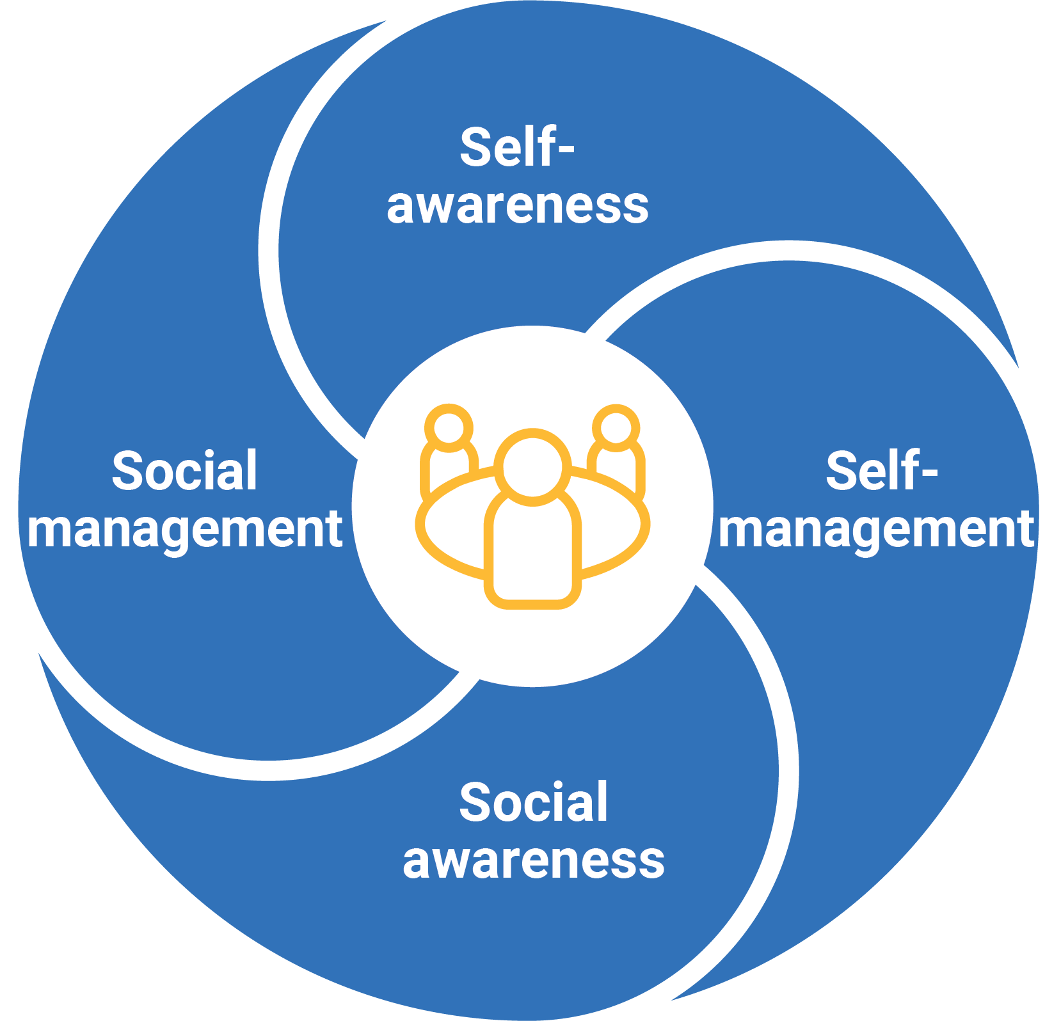

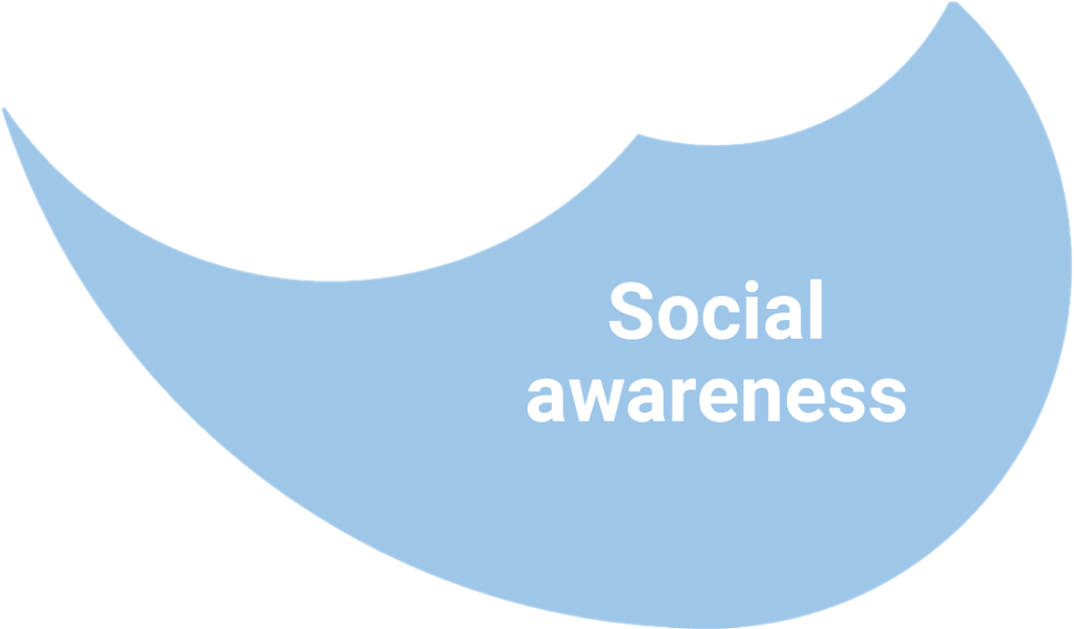
Social-emotional competencies in Australian schools
Personal and Social Capability
Carpendale et al. (2025) British Journal of Educational Psychology, 95, 496-512.

Slide 20

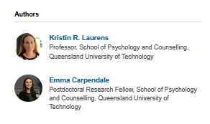
Screenshots of articles
https://theconversation.com/schools-today-also-teach-social-and-emotional-skills-why-is-this-important-and-whats-involved-253342

Slide 21
Social-Emotional Learning programs
Carpendale et al. (2025) Journal of School Psychology, 110, 101447.
Students receiving evidenced programs had skills that were
7-10 percentile points better than other students
Evidenced programs with explicit teaching

Slide 22
Primary school social-emotional competencies (Yr 6) relate to high school academic achievement (Yr 7)
Self- Awareness
Self- Awareness
Reading
Explains 17% of the difference in students’ scores
Numeracy
Explains 26% of the difference in students’ scores
Self-Management
Self-Management
Reading
Explains 4% of the difference in students’ scores
Numeracy
Explains 4% of the difference in students’ scores
Carpendale EJ et al (2025) British Journal of Educational Psychology, 95(2), 496-512

Slide 23
Measures
Early Cognitive Skills
Kindergarten: Language and cognitive skills (school-based) measured by teacher-report the 2009 Australian Early Development Census (AEDC)
Year 6 (late primary school): Self-Awareness and Self-Management measured by student-report on the 2015 Middle Childhood Survey – Social-Emotional Learning (MCS-SEL)
Year 7 (early secondary school): Reading and Numeracy domains of the 2016 National Assessment Program – Literacy and Numeracy (NAPLAN) tests
Self- Awareness
Self-Management
Reading
Numeracy

Slide 24
Results
Self- Awareness
Self- Awareness
Approximately one-third (33-36%) of the relationship between school-entry cognition and Year 7 reading and numeracy is because of students’ Year 6 Self-Awareness.
Cognitive Skills
Reading
Cognitive Skills
Numeracy
Self- Management
Self- Management
School-entry cognition and Year 6 Self-Management independently predict Year 7 academic achievement.
Cognitive Skills
Reading
Cognitive Skills
Numeracy

Slide 25
Key Messages (part 2)
School-entry language and cognitive skills predict early secondary school academic achievement, so investing in early childhood education can help set children up for successful learning at school
Late primary school social-emotional skills also predict secondary school academic achievement, so teaching these skills to all students can support their academic success.
Self-awareness partly explains the association of early cognition with later achievement, while Self-Management predicts later achievement independently of school-entry cognition
Integrated social-emotional and academic learning at school may maximise student achievement

Slide 26
Acknowledging our data custodians
NSW-CDS research uses population data owned by:
NSW Department of Education
NSW Education Standards Authority
NSW Department of Communities and Justice
NSW Ministry of Health
NSW Registry of Births, Deaths and Marriages
NSW Bureau of Crime Statistics and Research
NSW Police Force
Australian Government Departments of Health and Aged Care, Social Services, and Education and Training (AEDC)
Australian Coordinating Registry (on behalf of Australian Registries of Births, Deaths and Marriages, Australian Coroners, and the National Coronial Information System)
Australian Bureau of Statistics
The findings and views reported are those of the authors and should not be attributed to these Departments or the NSW or Australian Governments.
Record linkages for the NSW Child Development Study have been conducted by the Centre for Health and Record Linkage and the Australian Institute of Health and Welfare.

