Slide 1



AEDC 2024 National outcomes and its implications
Elizabeth Hickey
Early Childhood Data & Preschool Branch

Slide 2

Why the AEDC Matters
Provides a national evidence base for how children are developing at school entry
Supports early identification, place-based planning and cross-sector coordination.
Highlights patterns and emerging needs, ensures children aren't overlooked

Slide 3
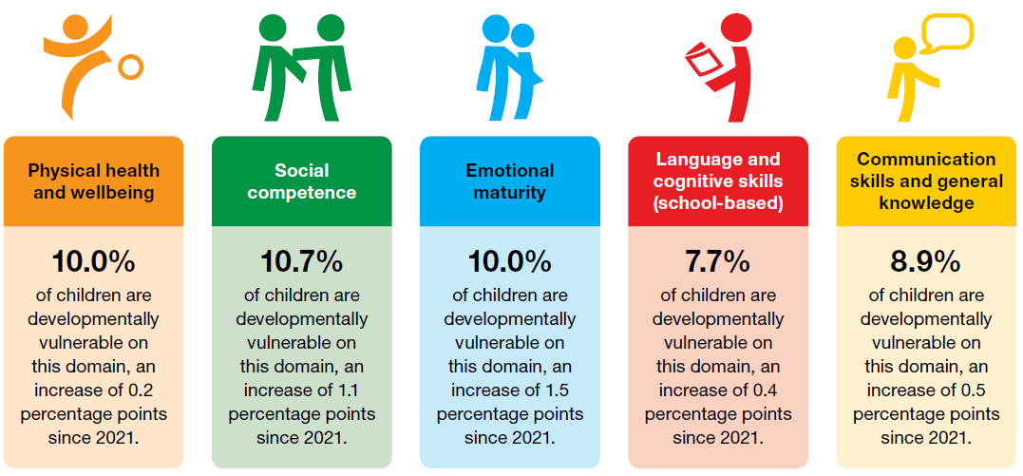
2024 AEDC National Picture

Slide 4
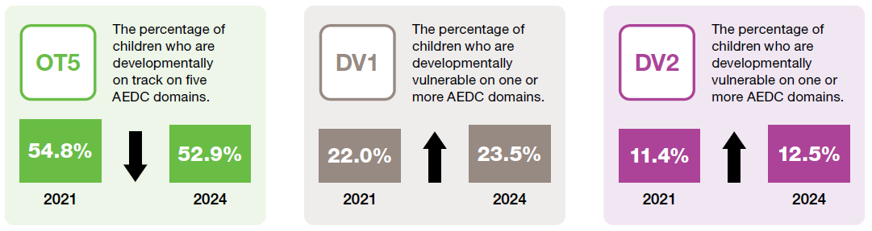
2024 AEDC summary indicators – National
Changes in AEDC summary indicators from 2021 to 2024

Slide 5

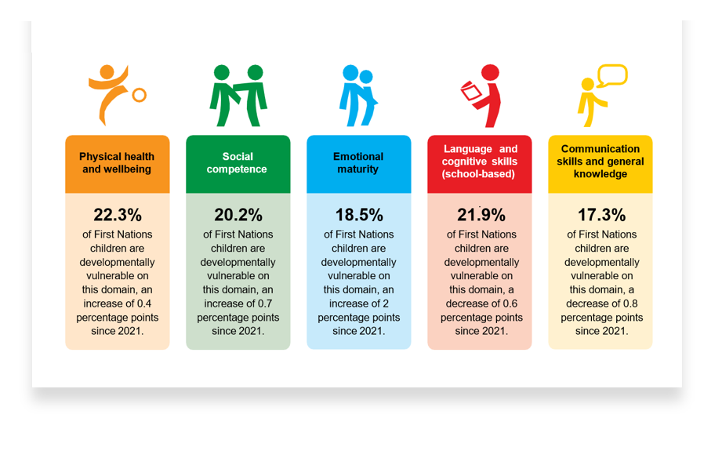
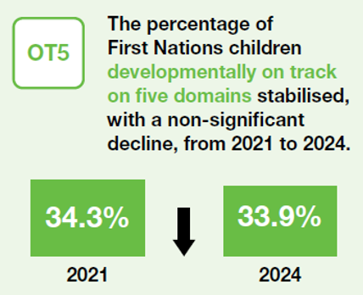
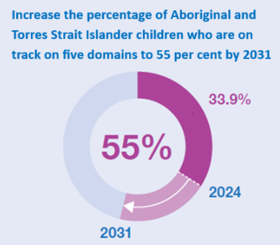
2024 AEDC – First Nations

Slide 6
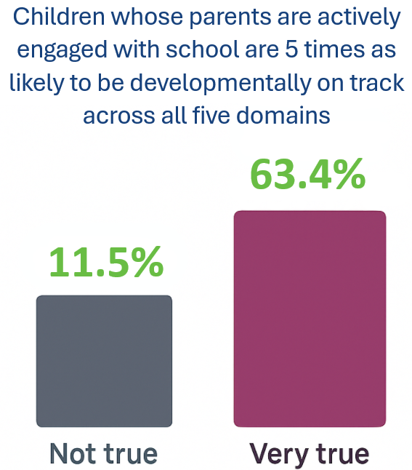
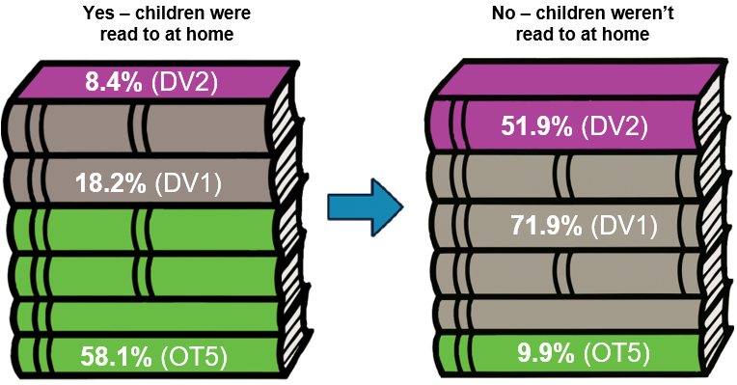
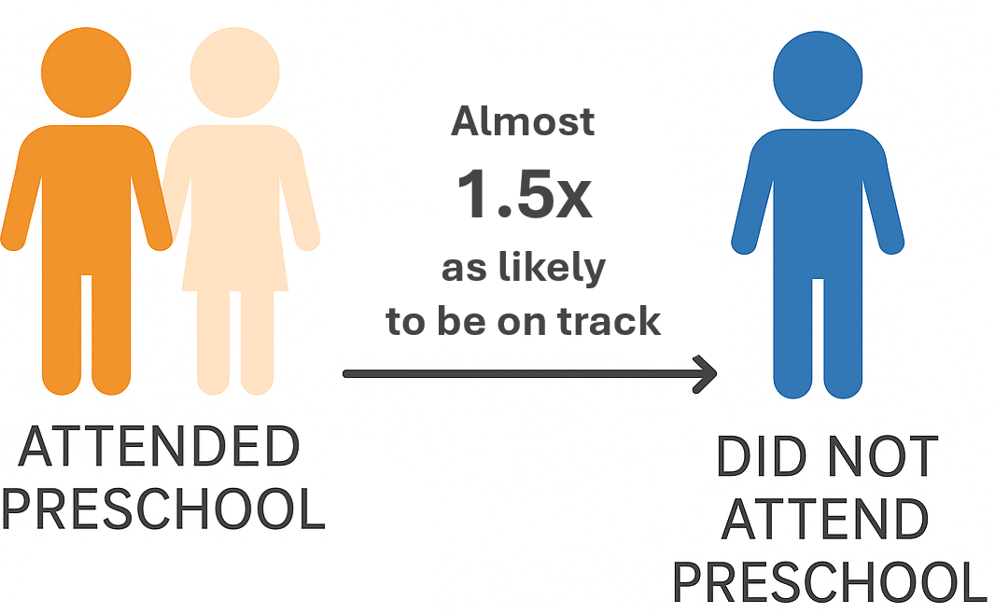
2024 AEDC – Critical Protective Factors

Slide 7
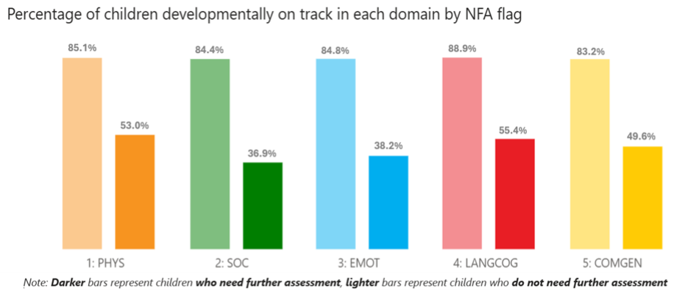
2024 AEDC – Needing Further Assessment

Slide 8



System and Sector Challenges
Rising rates of developmental vulnerability, particularly in social and emotional development
Persistent inequities for First Nation children and those living in remote areas
Significant increase in the percentage of children needing further assessment
Inconsistent use of AEDC data to inform early intervention and planning
Limited system capacity to respond to increased referrals for developmental assessment
Variability in service access and system responsiveness across jurisdictions
Funding pressures and inflation impacting participation and delivery
Early childhood workforce shortages affecting quality and continuity of care

Slide 9
What the Department is doing
Focus Area | Key Actions
Preschool Reform | • Preschool Reform Agreement & Outcomes Measure (POM) • Builds evidence on access, participation & outcomes
Workforce | • Workforce Strategy and WPR • Improves supply, stability & quality of early childhood educators
Infrastructure & Access | • Building Better Early Learning Fund (BEEF) • From 2026: 3 days/week subsidised preschool for all children
Inclusion & First Nations | • Inclusion Support & Connected Beginnings • Place-based and culturally safe approaches
Children in School | • AEDC data informs school-level responses • Student Wellbeing Boost & school profiles
Data Linkages | • Linking AEDC with NDIS, health, and preschool data • Supports visibility and coordination across systems

Slide 10

Where to Next – Working Together
AEDC highlights where to focus
Strong work is already happening across jurisdictions and communities
The Early Years Strategy provides a national framework to align efforts
Real change happen when we connect data, policy and practice

Slide 11

Turning Insight into Action
The AEDC shows us where we must act
More children are starting school developmentally vulnerable
We have ethe tools , partnerships and momentum to act
Every child, regardless of their background or postcode, has the best possible start in life.

Slide 12
Thanks for your attention
Questions
​
© 2025 Commonwealth of Australia
Since 2002, the Australian Government has worked in partnership with eminent child health research institutes, the Centre for Community Child Health at The Royal Children’s Hospital and the Murdoch Children’s Research Institute, and The Kids Research Institute Australia to deliver the Australian Early Development Census program to communities nationwide. The Australian Government continues to work with its partners and with state and territory governments to implement the AEDC.’

