Slide 1
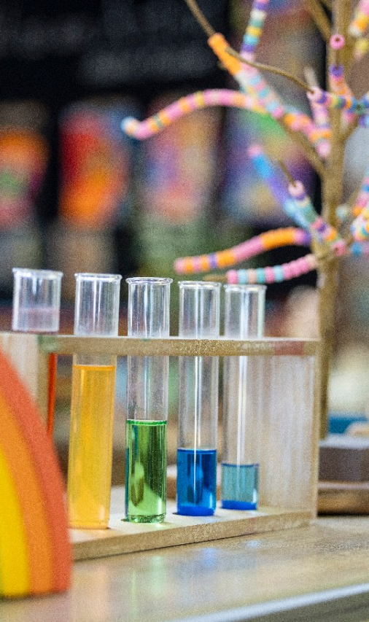
Transition to preschool
Early Learners
Notes:
Welcome to this recorded session focused on transition to preschool.

Slide 2
Agenda
Topic
1. Introduction
2. Links to key preschool documents
3. An evidence-based and planned approach
4. Transition in practice
6. Further reading
Notes:
Facilitator notes:
Facilitator to read agenda. After this presentation, you will be able to discuss these practices with your preschool advisor/officer.

Slide 3

Acknowledgement of Country
We recognise the Ongoing Custodians of the lands and waterways where we work and live. We pay respect to Elders past and present as ongoing teachers of knowledge, songlines and stories.
We strive to ensure every Aboriginal and Torres Strait Islander learner in NSW achieves their potential through education.

Slide 4
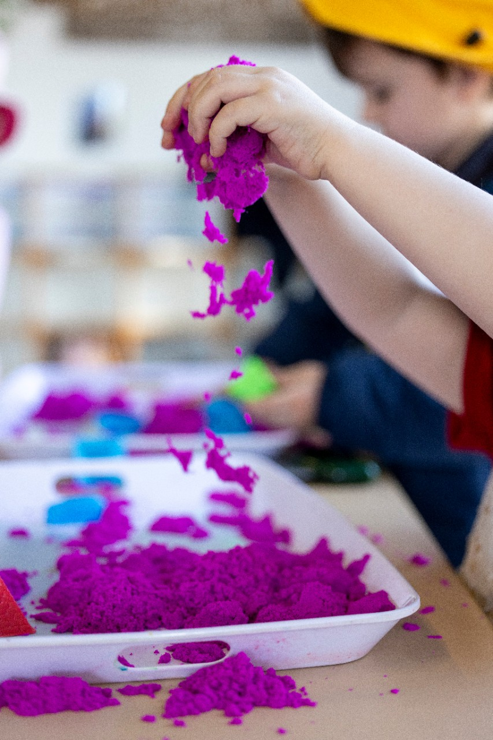
Session Outcomes
Participants will:
Understand that continuity of learning and transitions are aligned to the National Quality Standard
Develop an understanding of evidence-based practices and how to implement effective transition to preschool strategies
Explore practical approaches and resources relating to transition to preschool
Notes:
Facilitator script:
Participants will:
Understand that continuity of learning and transitions are aligned to the National Quality Standard
Develop an understanding of evidence-based practices and how to implement effective transition to preschool strategies
Explore practical approaches and resources relating to transition to preschool

Slide 5
Links to key documents
1

Slide 6
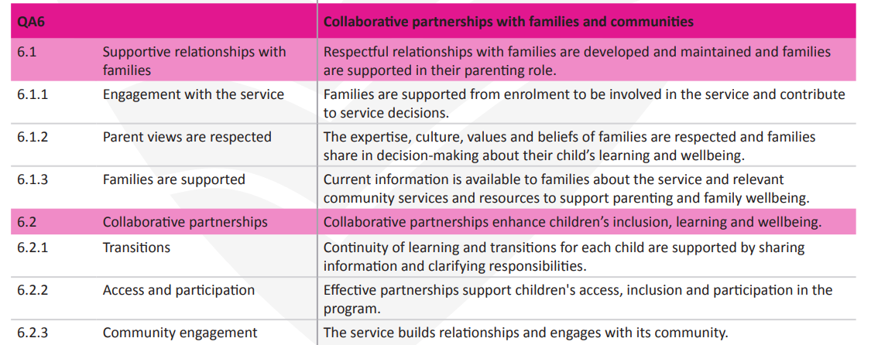
National Quality Standards: Quality Area 6
Notes:
Facilitator script:
The National Quality Standard (NQS) sets a high national benchmark for early childhood education and care and outside school hours care services in Australia.
Quality Area 6, Collaborative partnerships with families and communities includes the element 6.2.1 which specifically calls out transitions.
Transitions refers to transitioning into a preschool/service and transitioning from a preschool/service.
During this session, we will be exploring transition into preschool and how the evidence-based research can support best practice and also be used as evidence for quality area six for your quality improvement plan.

Slide 7

Early Years Learning Framework
Partnerships
Practices
Continuity of learning and transitions
Principles
Notes:
Facilitator script:
​Transition and continuity are highlighted in the Early Years Learning Framework:
In practices we can see Continuity of learning and transitions where Educators commit to sharing information about each child's knowledge and skills so learning can build on foundations of earlier learning. ​Continuity of learning and transitions is one of they key practices in the framework.​
​
And In Principles:​
Partnerships-​
In partnerships with families, early childhood educators ensure that children have an active role in preparing for transitions. In the updated EYLF Partnerships is broadened to include children, other professionals,​ communities, including schools.

Slide 8
An evidence-based and planned approach
2
Notes:
Facilitator script:
We are now going to unpack what the evidence-based research is telling us about supporting young children transitioning into preschool and the implications for practice. All sources are hyperlinked in the presentation.

Slide 9

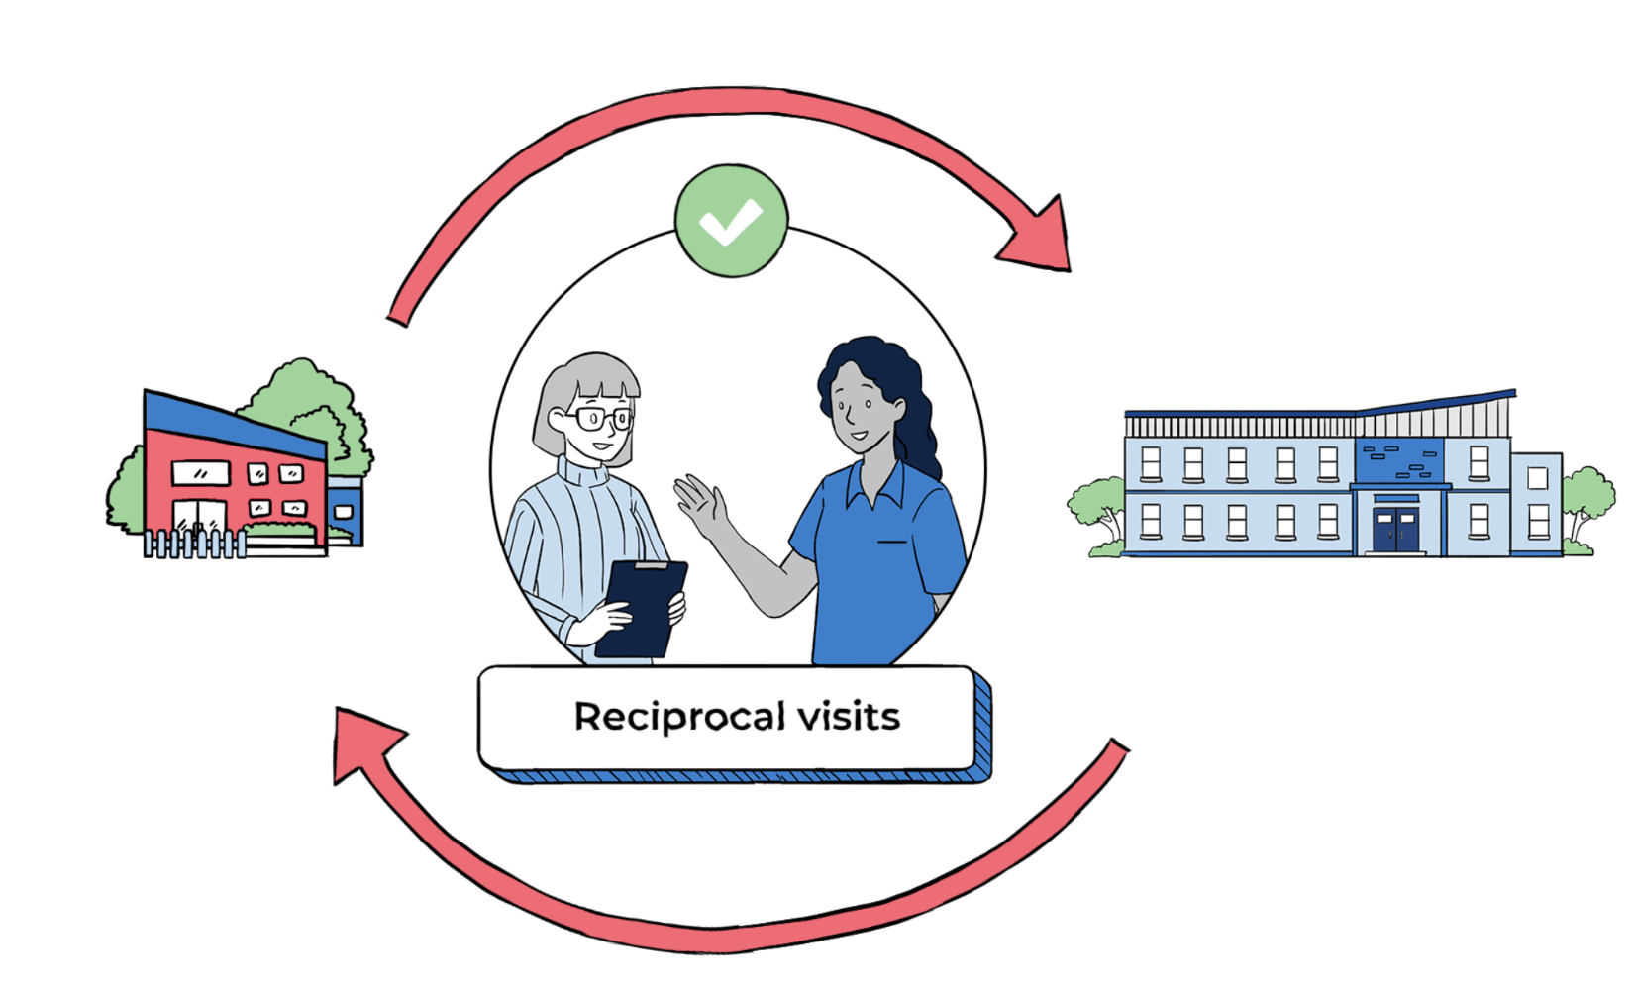

What is the research telling us?
Children entering preschool can experience various transition points
Use of shared goals facilitates continuity of learning
Children’s holistic development informs transition practices
Collaborative partnerships with the key players in children’s lives inform transition
Notes:
Facilitator script:
It is important to note that planning for transition in this context refers to a change process that children go through from one educational stage to another over time.
This can include horizontal and vertical transitions.
Horizontal transitions involve children’s transitions during their everyday lives between, for instance, a pre-primary education setting or primary school and an after-school centre.
Vertical transitions refer to the transitions between different educational settings, such as between an ECEC setting and primary school.
Transitions might also refer to children's transitions between the home-learning environment and the ECEC setting.
This also relates to transition practices of staff that intentionally attempt to support children during their transition period across settings, and to training that seeks to prepare staff for their work on transitions (e.g. co-operation with parents, attitudes and reflection on transitions).
A key document exploring the evidence about transition is the OECD: Starting Strong VI: Supporting Meaningful Interactions in Early Childhood Education and Care, Starting Strong.
The key messages from the evidence are included on the slide:
Children’s holistic development informs transition practices
Use of shared goals facilitates continuity of learning
Children entering preschool can experience various transition points
Collaborative partnerships with the key players in children’s lives inform transition

Slide 10
Collaboration is essential for a successful transition
Child
Family
Preschool
Educators partner with children and families to ensure that all children have an active role in preparing for transitions and the changes that are expected.
Educators assist children to understand the traditions, routines and practices of the settings to which they are moving and to feel comfortable with the process of change.
Notes:
Facilitator script:
Children bring their individual, family and community ways of being, belonging and becoming, often called funds of knowledge, to their early childhood settings. Educators who know and build on children’s funds of knowledge help them to feel secure, confident and connected to familiar people, places, events and understandings. This reinforces each child’s sense of belonging. Children, families, educators all contribute to successful transitions between settings.
When children and their families play an active role in preparing for transitions, there are many benefits:
Children:
When children know what to expect they are better prepared for change and may be less afraid of the ‘unknown’
When children feel safe and secure with their educators they tend to be more involved in play experiences and thus likely to learn and develop to their full potential
Children’s needs are recognised and therefore supported
Family:
Feel at ease knowing their child is being supported during a potentially stressful process
When educators and families work together to ensure smoother transitions for children, families are likely to feel valued and respected and supported in their role as parents
Families are more in tune with their children’s needs and understand how they can be better supported
Preschool:
When children are prepared for transitions they are more likely to settle easily into your preschool and allow for a smoother day
Families gain insight into your role and the benefits of working together to support better outcomes for their child during transitions is highlighted
Working in partnership with families to ensure smooth transitions for children means your preschool is demonstrating the requirements of the NQS QA 6.

Slide 11




Transition to preschool planning timeline
Review sources of data including EOIs, enrolment forms, questionnaires and other information provided by families and/or other ECEC services, allied health
Plan and implement sessions for families and children to attend onsite orientation programs
Programming and planning including setting up the learning environment to meet the needs of the children
Reflect on the effectiveness of the transition to preschool program and adjust as needed as part of continuous improvement
Notes:
Facilitator script:
Another consideration for high quality transition apart from the evidence base is having a planned approach. This slide provides a timeline or sequence for how you might plan for and implement a high quality transition to preschool.
This could include:
Reviewing sources of data including EOIs, enrolment forms, questionnaires and other information provided by families and/or other ECEC services, allied health
Planning and implementing sessions for families and children to attend onsite orientation programs
Programming and planning including setting up the learning environment to meet the needs of the children
Reflecting on the effectiveness of the transition to preschool program and adjust as needed as part of continuous improvement
With various preschools opening at different times, there is no sets dates indicated on this timeline. It is important to plot out the who and when for each milestone within transition to preschool. This may be achieved through using a school system (such as Sentral/ school bytes) to mark out upcoming tasks and events related to transition. Where possible involve a planning team/committee to support coordinating transition to preschool.

Slide 12


Questions to consider when planning
What opportunities are there for children to visit their new preschool and meet with educators?
How are children and their families prepared for the transition that is about to occur?
What information are children given about where they are going and what will they do there? (Think of visual communication – photos of the staff and the preschool).
What information do you ask families for (at enrolment) and how is this information used to support the transition from home to your preschool? (What do you know about the child’s home routine, cultural traditions/values, likes/dislikes).
How do you create a sense of belonging in your preschool for each child and their family?
How do you ensure that each child feels safe and secure in their new environment?
What intentional teaching strategies are adopted by all educators working with children who are transitioning to your preschool?
Notes:
Faciltator script:
Similar to transition to kindergarten, transition to preschool is a shared responsibility within the school.
Enrolment and orientation procedures must be planned, delivered and reflected on.
With this mind, take a moment now to consider who is involved or who could be involved? Beyond the preschool and admin team, can the school counsellor, AEO or other support staff be involved in the planning.
As part of the procedures your preschool officer or advisor will support you with, the enrolment and orientation procedure outlines the processes contextualised to your school. It is an opportunity to reflect before and after as part of a continuous improvement cycle.
Consider the following questions when planning:
What opportunities are there for children to visit their new preschool and meet with educators?
How are children and their families prepared for the transition that is about to occur?
What information are children given about where they are going and what will they do there? (Think of visual communication – photos of the staff and the preschool).
What information do you ask families for (at enrolment) and how is this information used to support the transition from home to your preschool? (What do you know about the child’s home routine, cultural traditions/values, likes/dislikes).
How do you create a sense of belonging in your preschool for each child and their family?
How do you ensure that each child feels safe and secure in their new environment?
What intentional teaching strategies are adopted by all educators working with children who are transitioning to your preschool?

Slide 13
Transition in practice
3

Slide 14

Preschool story: Riverstone Public School Gulyangarri Preschool
Working as a P-6 school
Play based learning and a familiar environment
Family engagement
Enrolment and orientation
Other tips
Collaboration and support
Notes:
Facilitator script:
We are now going to hear from a school story presented by Snezana the preschool Assistant Principal and ECT from Riverstone Public School Gulyangarri Preschool. Click each speaker icon to hear Snezana speak about different aspects of transition to preschool.

Slide 15

Resources to support children: Social narrative
Notes:
Facilitator script::
A social narrative can support the child to become familiar with the preschool. This social narrative can be edited with your own photos and text. You may like to provide printed copies to families, other ECE services, allied health or make it available on your school webpage/ social media. This resource is also available as a translated copy in multiple languages.

Slide 16

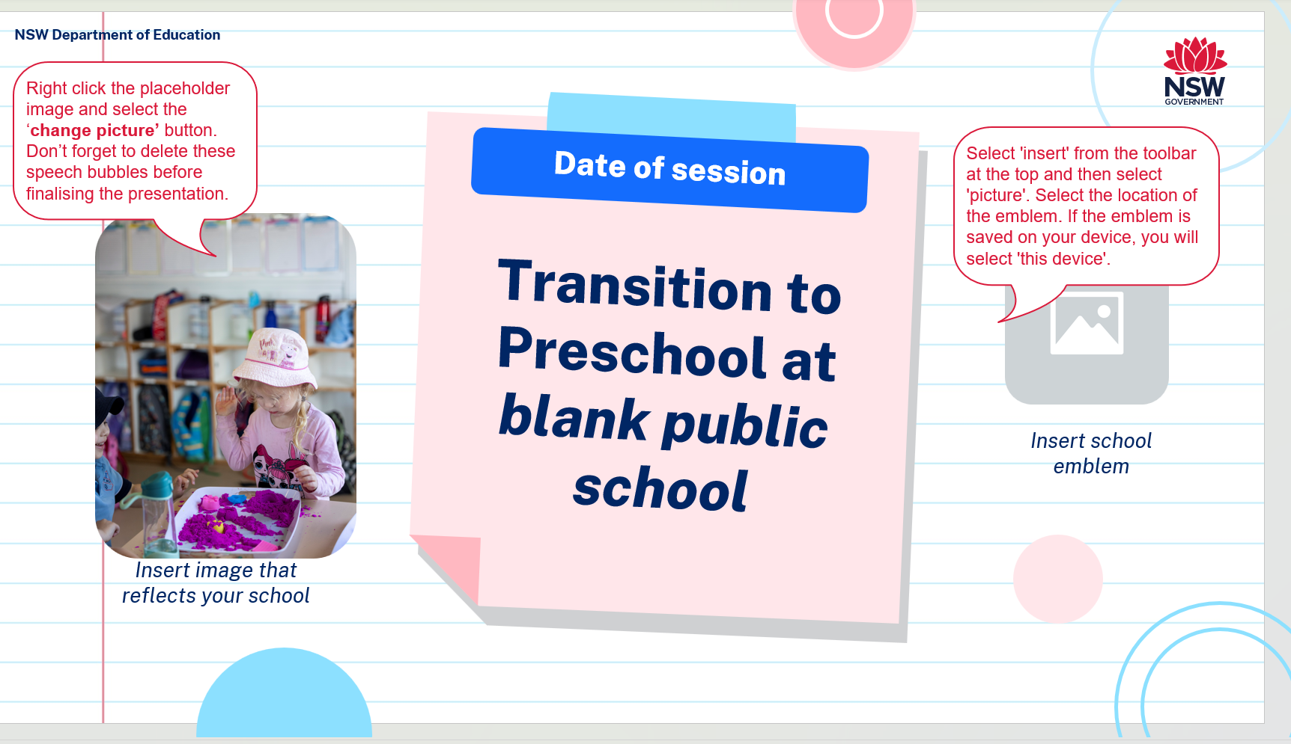

Resources to support families: Sharing information
Getting ready for preschool guide
Transition to preschool family slides
EYLF information for families
Notes:
Facilitator script:
These resources can be used to share information with families about your preschool and school. The slide deck can be edited to include contextualised photos and information.

Slide 17
Further reading
6

Slide 18


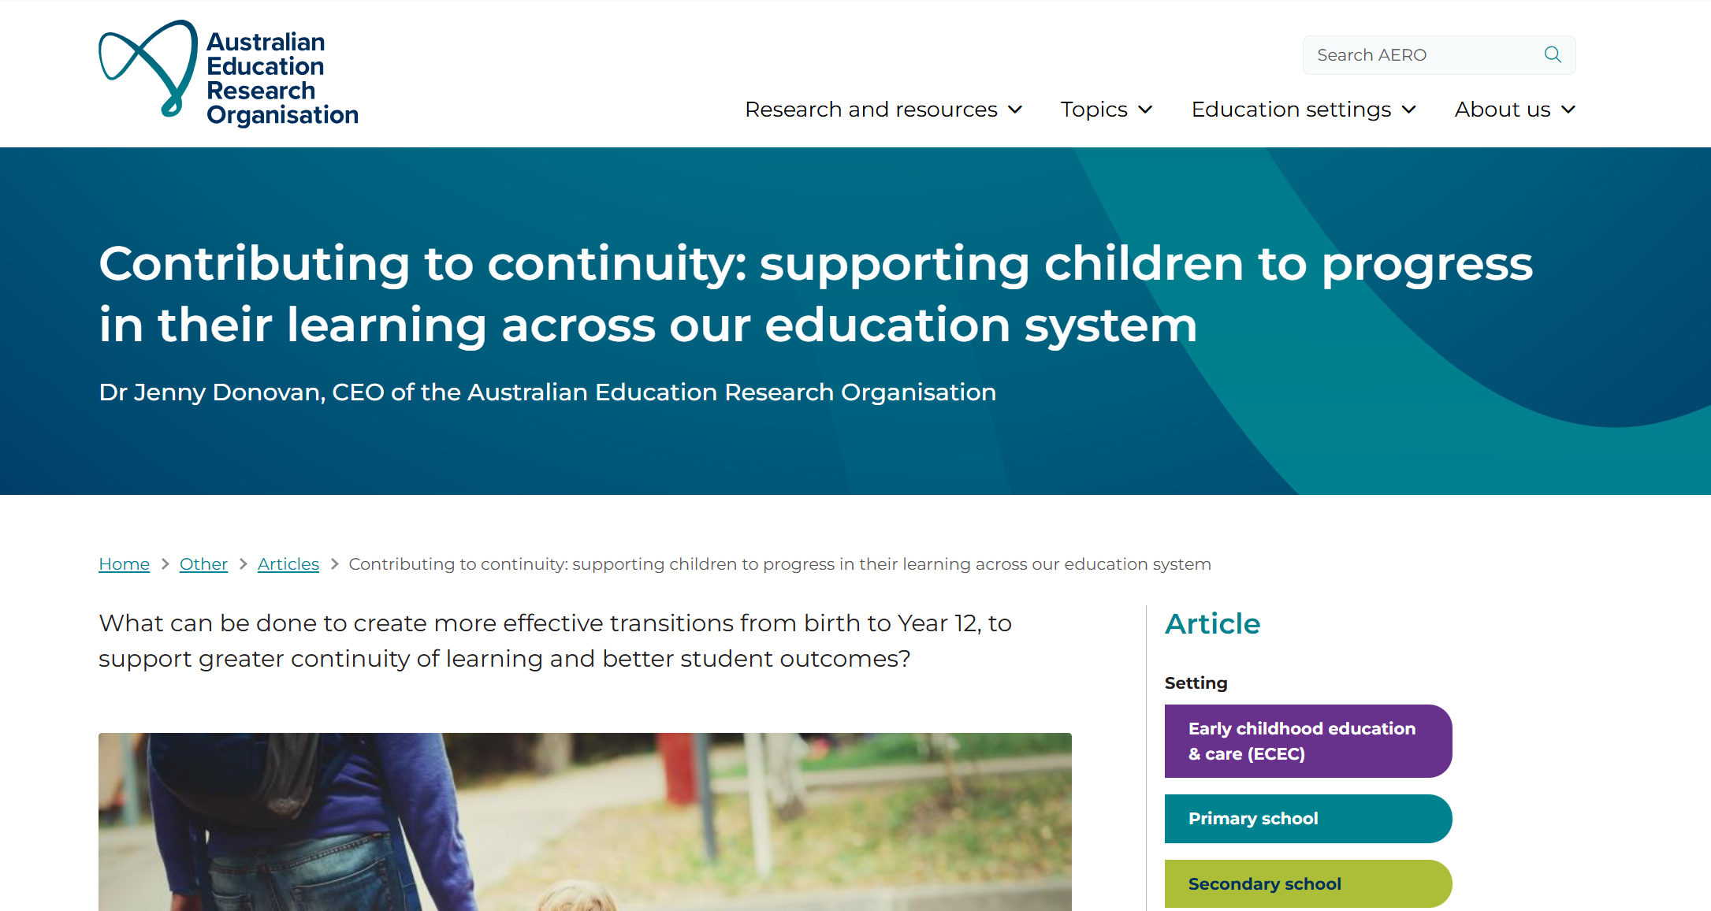

Further reading for educators
Notes:
Facilitator script:
These resources may support your preschool team when reflecting on and planning for transition.

Slide 19
Contact Information
Early Learners
Ph: 1300 083 698
earlylearning@det.nsw.edu.au
Early Learners webpage

