Slide 1
Spotlight on the 2024 AEDC results in NSW – what we know about children starting school
AEDC NSW Research Symposium 2025
Associate Professor Tess Gregory and Associate Professor Yasmin Harman-Smith

Slide 2
Acknowledgement

Slide 3

Trends in holistic child development

Slide 4
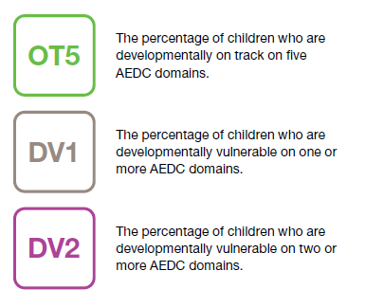
AEDC summary indicators

Slide 5
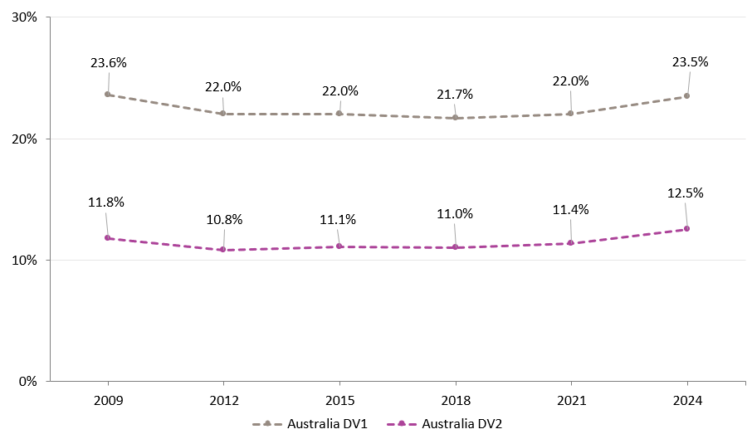
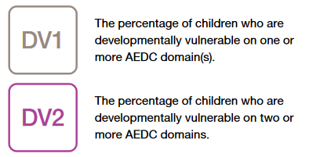
Summary indicators – DV1 and DV2

Slide 6
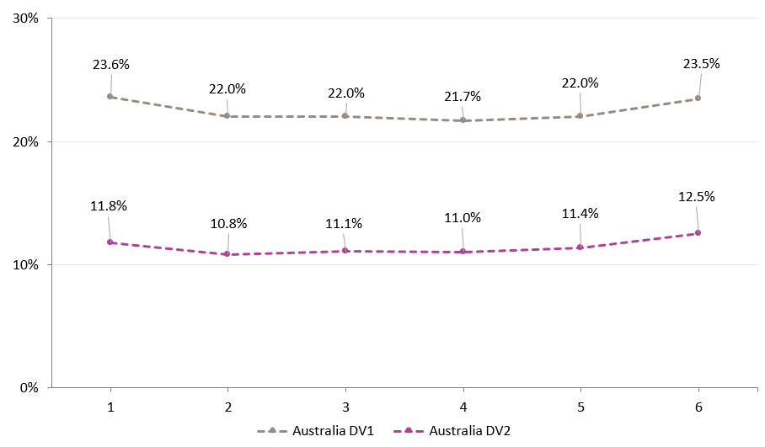
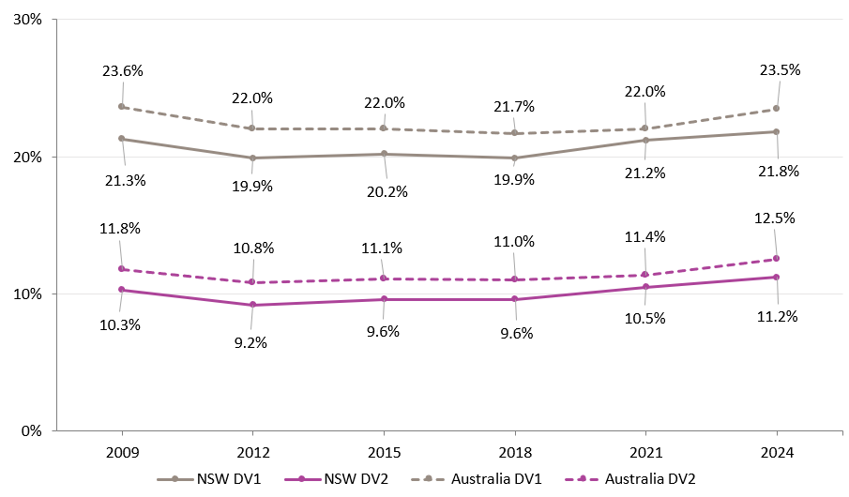
Summary indicators – DV1 and DV2 (1)

Slide 7
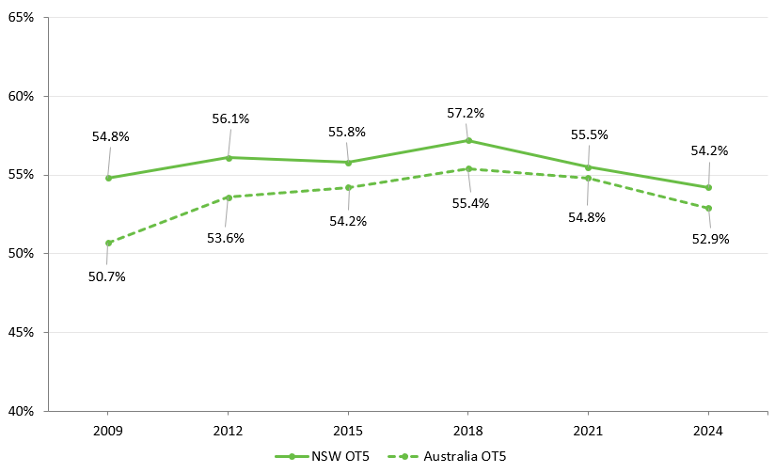

Summary indicators – OT5

Slide 8
Trends in specific domains of development

Slide 9
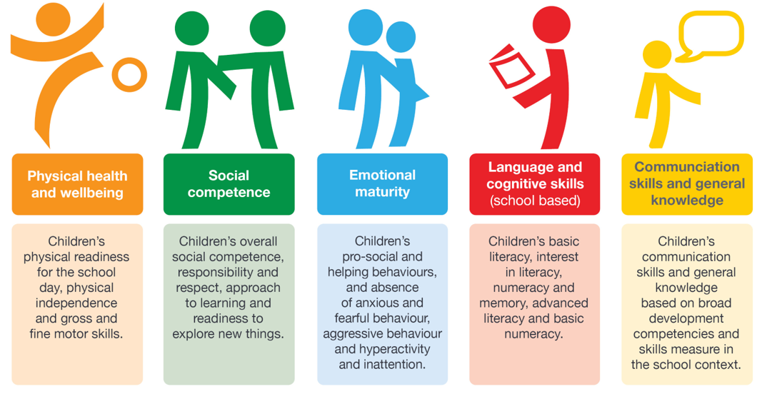
AEDC domain results

Slide 10
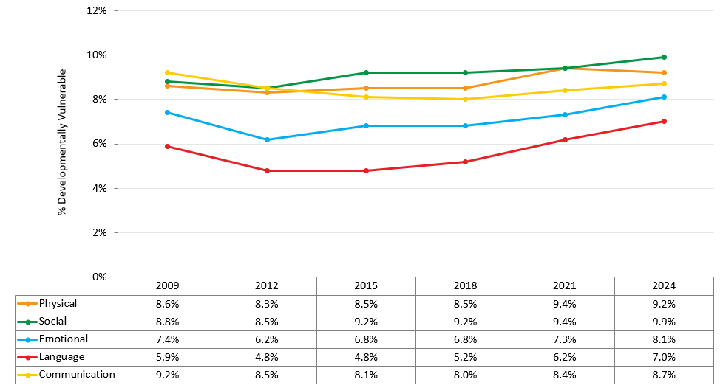
Trends on each developmental domain

Slide 11
Trends on each developmental domain (1)
↑ 0.5
↑ 0.8
↑ 0.8
↑ 0.3

Slide 12
Drilling down: Emotional maturity

Slide 13
AEDC sub-domain results

Slide 14
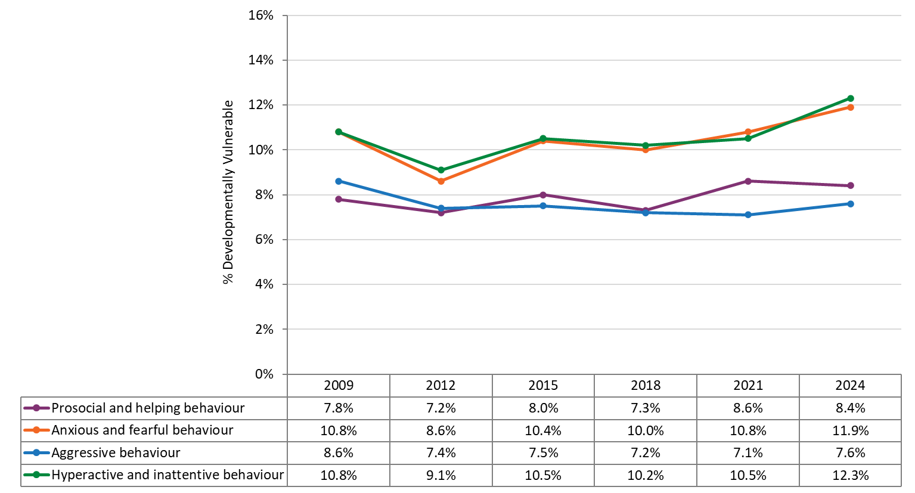
Emotional maturity sub-domains
↑ 1.1
↑ 0.5
↑ 1.8

Slide 15
What does this mean for children?

Slide 16
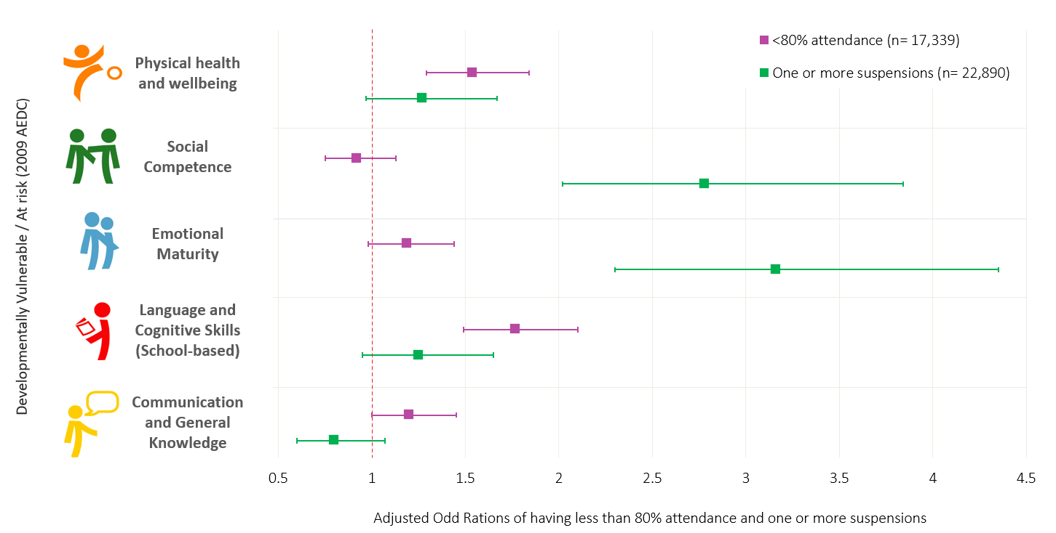

Vulnerability in emotional maturity predicts suspensions (1)
Bell, M. (2017). Developmental Vulnerabilities at School Entry Predicted Early Indicators of Disengagement [Doctoral dissertation, University of Western Australia. University of Western Australia Research Repository.
16
16

Slide 17
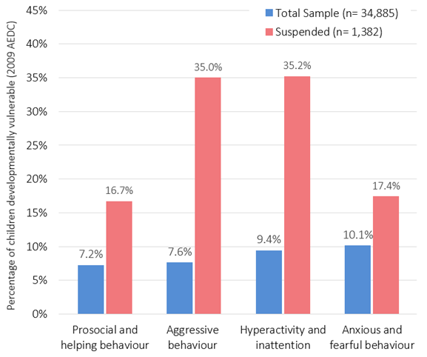
Vulnerability in emotional maturity predicts suspensions
Laurens, K. R., Dean, K., Whitten, T., Tzoumakis, S., Harris, F., Waddy, N., Prendergast, T., Taiwo, M., Carr, V. J., & Green, M. J. (2021). Early childhood predictors of elementary school suspension: An Australian record linkage study. Journal of Applied Developmental Psychology, 77, 101343.
17
17

Slide 18
Drilling down: Language and cognitive skills (school-based)

Slide 19
AEDC sub-domain results (1)

Slide 20
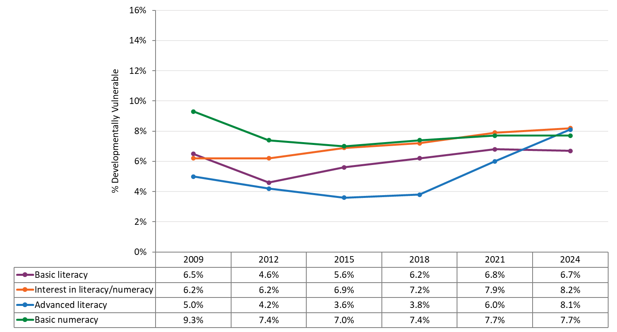
Language and Cognitive Skills (school-based) sub-domains
↑ 2.1

Slide 21
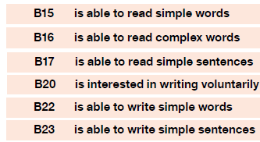
Language and Cognitive Skills (school-based) sub-domains (1)
Advanced literacy

Slide 22
What does this mean for children? (2)

Slide 23
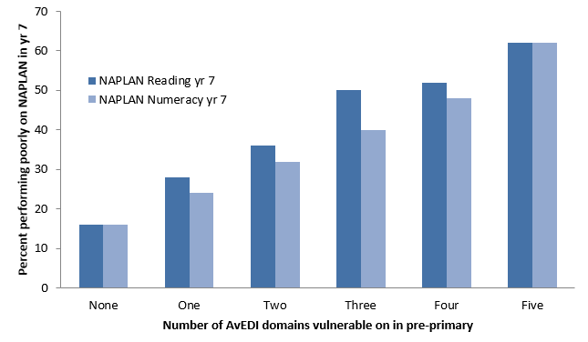
Vulnerability in language and cognitive skills predicts poor NAPLAN results (1)
Brinkman, S., Gregory, T., Harris, J. et al. Associations Between the Early Development Instrument at Age 5, and Reading and Numeracy Skills at Ages 8, 10 and 12: a Prospective Linked Data Study. Child Ind Res 6, 695–708 (2013). https://doi.org/10.1007/s12187-013-9189-3
23
23

Slide 24
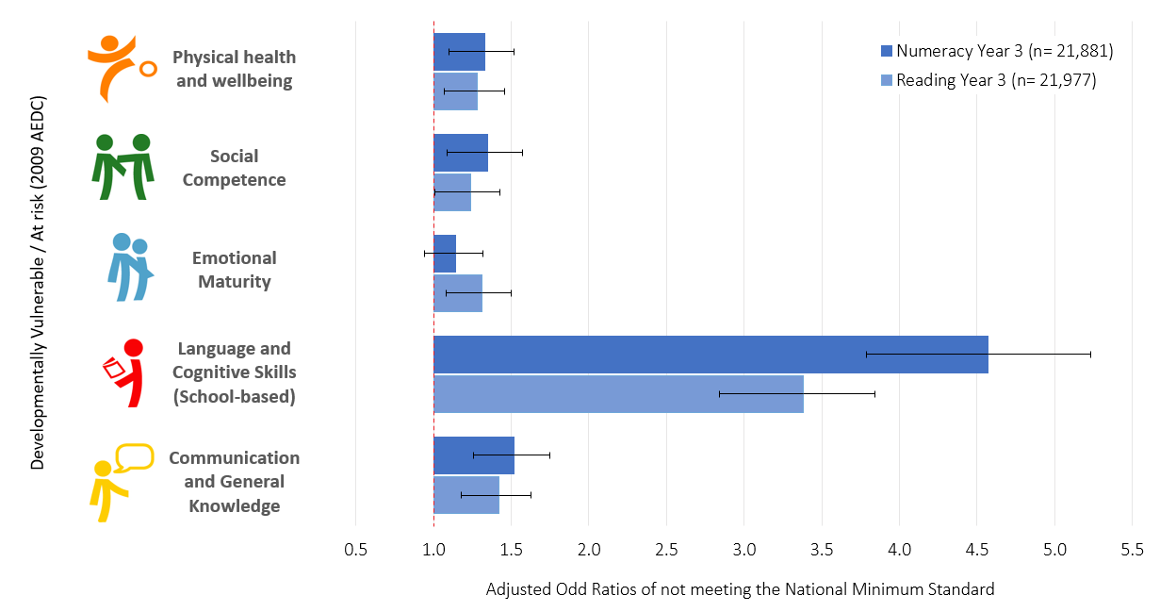
Vulnerability in language and cognitive skills predicts poor NAPLAN results (2)
Bell, M. (2017). Developmental Vulnerabilities at School Entry Predicted Early Indicators of Disengagement [Doctoral dissertation, University of Western Australia. University of Western Australia Research Repository.
24
24

Slide 25
What might be sitting behind these trends?

Slide 26
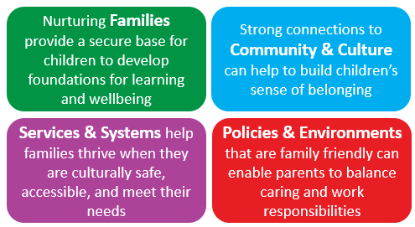
Ecological model
Harvey, E., Sechague Monroy, N., Gregory, T., & Harman-Smith, Y. (2023). Parent’s Guide to the AEDC: What works to improve outcomes for children (AEDC 2021 Data Story). Australian Government, Canberra. Available at www.aedc.gov.au

Slide 27

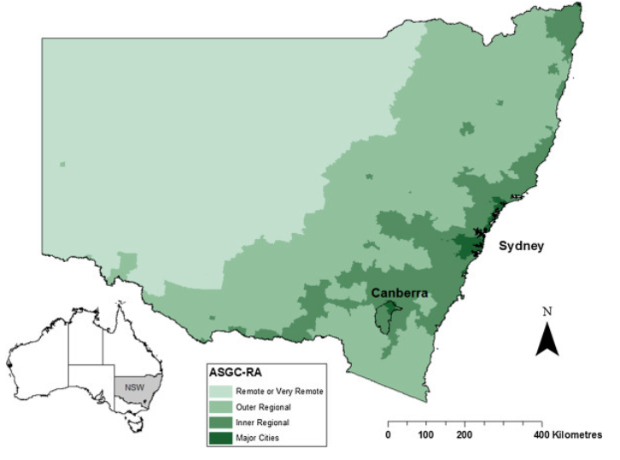


Page 27

Slide 28

Trends in DV1 by socio-economic status

Slide 29
Trends in DV1 by geographical location

Slide 30
Changes over time in parental education

Slide 31
Changes over time in parental engagement in early learning

Slide 32
What could we do to change this story?

Slide 33
Building connections with community
Non-government organisations
Early childhood education and care
Local government
Schools
See Using your school’s AEDC data Fact Sheet for more information and guidance on crafting appropriate responses tailored to your school's outcomes and establishing connections with local services.
Child and family services
Community organisations

Slide 34
Building a complete picture
Listen to leaders and Elders share their vision for children in the community
Document what you know about families from your experience
Consider enrolment interviews, conversations with parents, and your knowledge of the area
Investigate population data sources
Speak to
local service providers about the issues they are seeing for children and families
Consider the Social Health Atlas and the ABS website
Speak to parents
about their
strengths and challenges and how they would like to be supported
Consider how your values, beliefs and experiences shape how you interpret data about children in your community

Slide 35
Contact page
Since 2002, the Australian Government has worked in partnership with eminent child health research institutes, the Centre for Community Child Health at The Royal Children’s Hospital and the Murdoch Children’s Research Institute, and The Kids Research Institute Australia to deliver the Australian Early Development Census program to communities nationwide. The Australian Government continues to work with its partners and with state and territory governments to implement the AEDC.

