Slide 1

How the Australian Early Development Census data reveal the building blocks of future reading, writing and numeracy performance
Christine Jackson

Slide 2
Acknowledgement of Country

Slide 3
Overview
Aims of the study and Research questions
Background
Project design, data sources and methodology
Findings
Opportunities

Slide 4
Aim of the study and Research questions

Slide 5
Aims of the study
The study aimed to understand the relationship between:
The skills, knowledge and resources children demonstrate on entry to school and their academic success as they move through stages of schooling.
The evidence of sequencing of early literacy and numeracy skills on a progressive continuum.
How these skills align with the Australian Curriculum (English and Mathematics) and the National Literacy and Numeracy Learning Progressions.

Slide 6
Research questions
Broad research question
‘What is the evidence of early childhood development of language and cognitive skills (school-based) that impacts children’s academic achievement in later years?’
Question 1
Does a child’s ability to successfully complete Basic and Advanced Literacy and Basic Numeracy tasks provide an indication of future performance in NAPLAN?
Question 2
How do the responses to the items from the Language and Cognitive Skills domain within the AEDC demonstrate a sequenced progression of early literacy and numeracy skill acquisition on a progressive scale?
Question 3
Does the progression of Language and Cognitive Skills, derived from AEDC data, align to the Australian Curriculum (for English and Mathematics) and the National Literacy and Numeracy Learning Progressions (NLNLP)?

Slide 7
Background

Slide 8
Context
Australian Education Development Census (AEDC)
Periodic snapshot (collected every three years)
Nationally between May and July
Commitment to understand how children are developing
National Assessment Program Literacy and Numeracy (NAPLAN)
Regular snapshot (every year for targeted year levels)
Measures children’s learning progress in literacy and numeracy
Years 3,5,7 and 9

Slide 9
Literature – what do we know about foundational literacy and numeracy skills?
‘the critical window for the development of early literacy and numeracy skills is before children arrive at school; hence major differences in early academic, learning and behavioural regulation skills can emerge at preschool or school entry’ (He et al., 2021, p. 3).
Children’s ability levels as they enter school, then, are key factors in setting their academic trajectories and may have implications across the life course (Brinkman et al., 2013).

Slide 10
What is the role of schools and the curriculum?
Formal schooling provides an opportunity for all children to move from biologically primary literacy and numeracy skills to biologically secondary skills which must be explicitly taught
The Australian Curriculum along with the National Literacy and Numeracy Learning Progressions maps the development of biologically secondary skills to enable literacy and numeracy development

Slide 11
Aligning the AEDC, Australian Curriculum and the NLNLP for teaching and learning
AEDC
Australian Curriculum
National Literacy and Numeracy Learning Progressions
Teaching and Learning

Slide 12
Project Design, Data sources and Methodology

Slide 13
Data Sources
The Longitudinal Study of Australian Children (LSAC)
Sample: 2,459 children who started school in Australia in 2009
Australian Early Development Census (AEDC), 2009 K cohort
  -triennial national census with 96 items
  -5 Key areas (domains)
NAPLAN
Years 3, 5, 7 and 9. The analysis focused on Reading, Numeracy and Writing in Years 3 and 5.

Slide 14
Project Design
The study described in this report uses mixed methods to analyse pre-existing datasets linked by a common ID that incorporates both AEDC and NAPLAN results, as well as demographic information.
Understanding how children progress from the level of competency they held in their first year of school to their later performance on NAPLAN literacy and numeracy measures can help practitioners identify and target key skills, to support children in reaching their potential.
This study also situates the analysis of the Language and Cognitive Skills AEDC domain in the context of the Australian Curriculum and National Literacy and Numeracy Learning Progressions (NLNLP).

Slide 15



Mixed methods
A series of sequential quantitative analysis and qualitative techniques
Stage 1
SEM
Stage 2
Rasch model
Stage 3 Multilevel model
Stage 4
Qualitative
Structural equation modelling tested direct and indirect impacts of AEDC domains on later NAPLAN outcomes
Difficulty of AEDC indicators in the language and cognitive skills domain to inform the sequence in which skills are acquired
Impact of individual indicators on NAPLAN literacy and numeracy (background variables and school level variance controlled).
Aligned the AEDC item progression to the Australian Curriculum and Learning Progressions

Slide 16
Findings

Slide 17
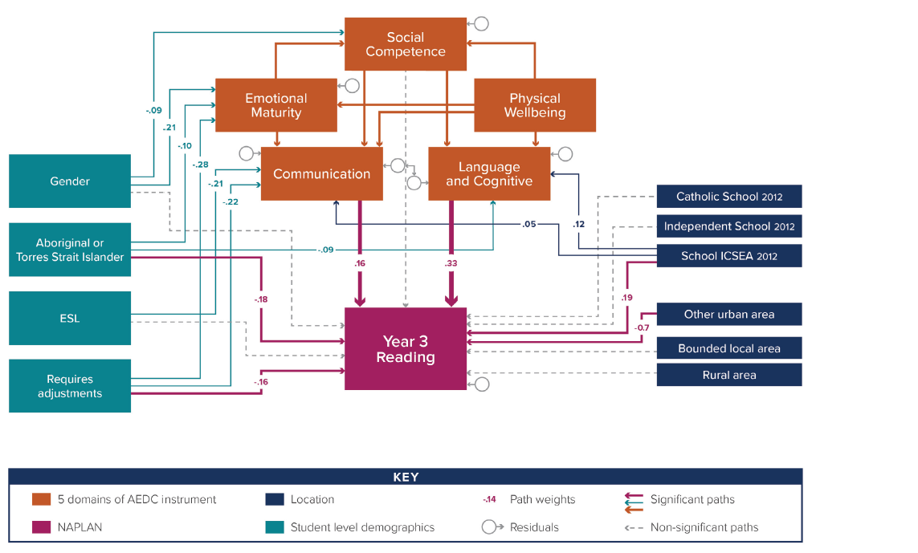
Stage One: Cognitive and language skills have a clear, direct, and positive impact on later achievement.

Slide 18
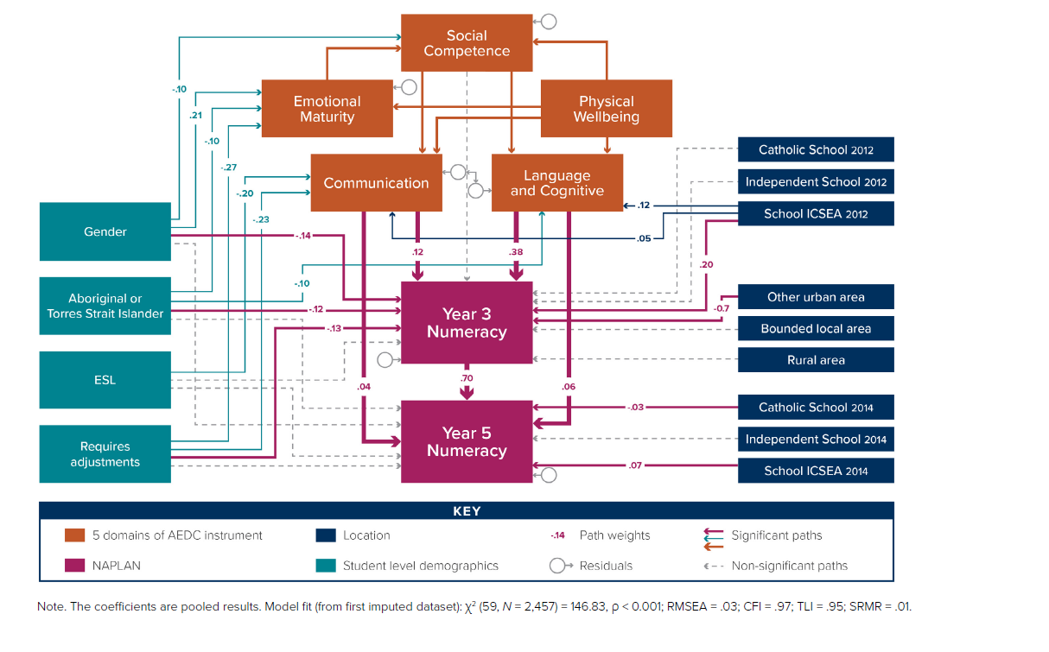
Models predicting Year 5 NAPLAN outcomes

Slide 19
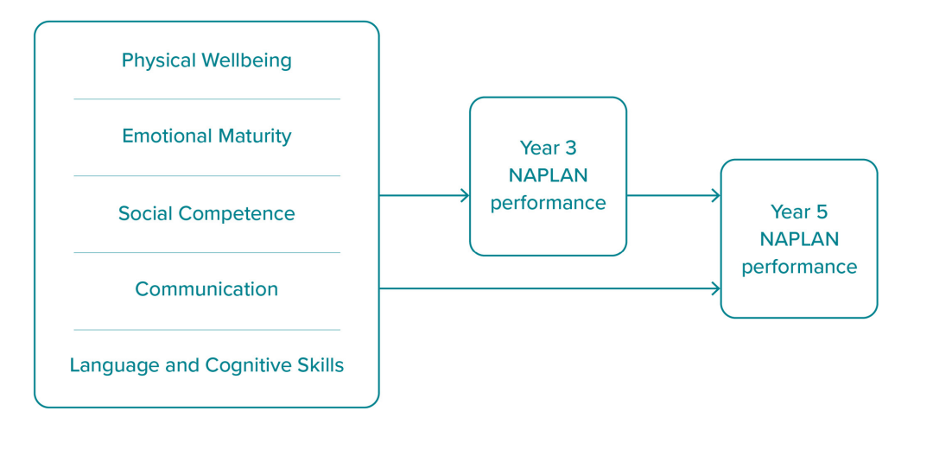
All 5 domains by the AEDC are related to Year 3 and Year 5 NAPLAN performance

Slide 20

In Summary
This shows that early skills are important both for setting a child up for the next step in their learning, and for providing a foundation that supports the development of much later pieces of new learning.
Communication Skills and General Knowledge and Language and Cognitive Skills have an effect directly on Year 5 outcomes, which is additional to the effect that runs through Year 3 to Year 5 achievement.
Communication Skills and General Knowledge and Language and Cognitive Skills at the start of full-time school predict academic achievement in Year 3, which in turn predicts achievement in Year 5

Slide 21
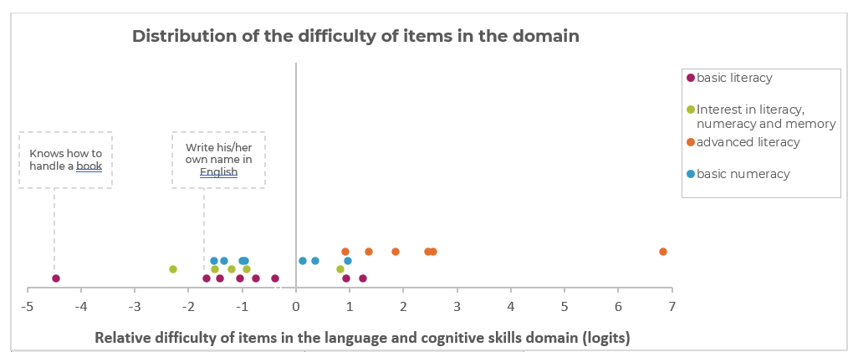
Stage 2: Moving along trajectories of skill development involves leaps between key skills.
Recognise numbers 1-10
Remember things easily
Read simple sentences
Read Complex words
Easier items More challenging items

Slide 22

NAPLAN performance in Year 3 is correlated with 8 early language and cognitive skills.
Recognise numbers 1-10
Read complex words
Count to 20
Remember things easily
Attach sounds to letters
Identify some letters of the alphabet
Write his/her own name in English
Aware of writing directions in English

Slide 23
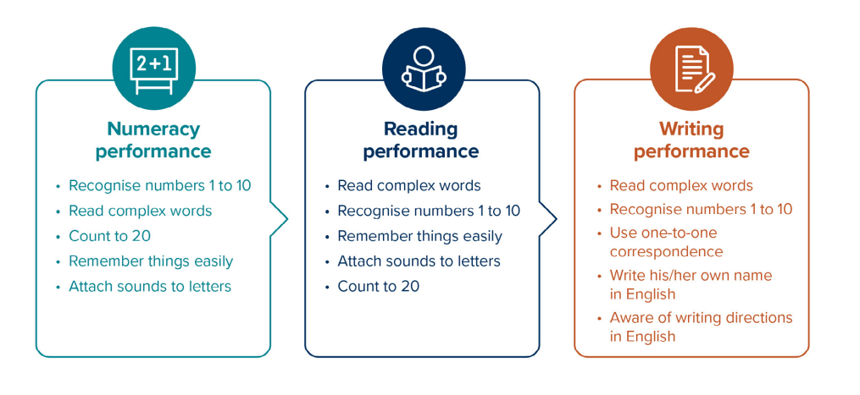
Strongest indicators of future Numeracy, Reading and Writing performance

Slide 24
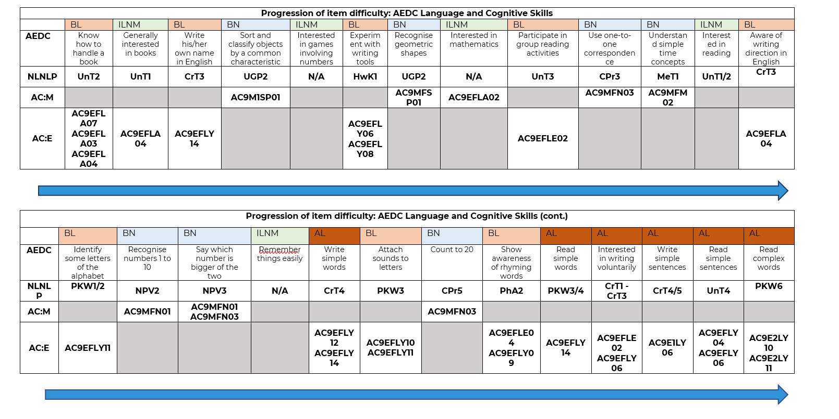
Aligning AEDC with the Australian Curriculum and the NLNLP

Slide 25
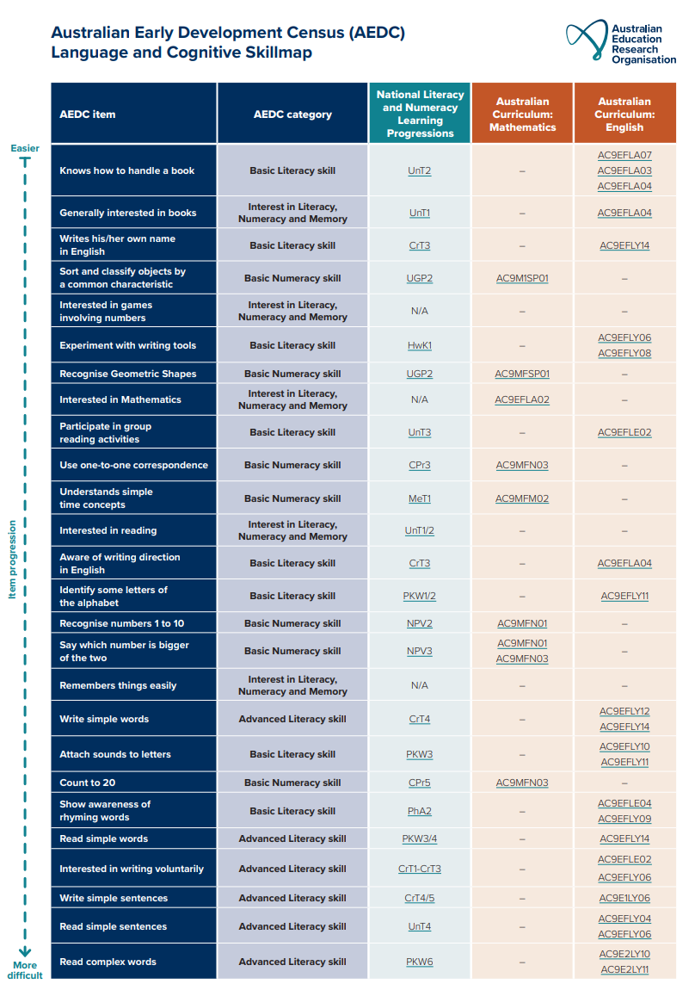
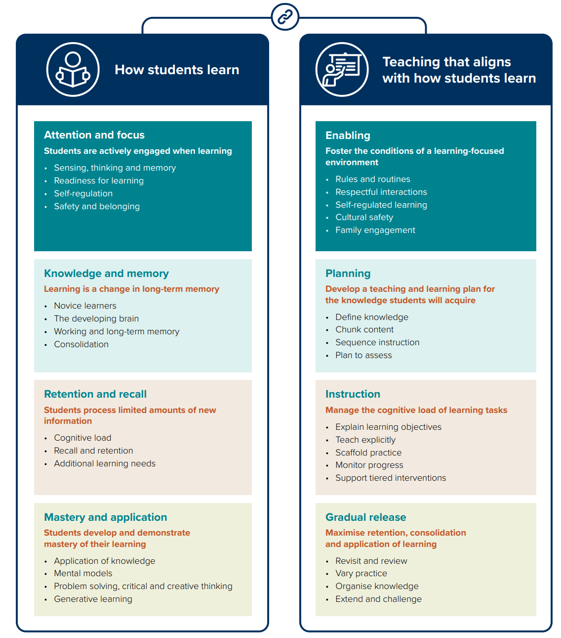
AEDC table data

Slide 26
In summary (1)
All 5 domains assessed by the AEDC are related to Years 3 and 5 NAPLAN performance.
The Language and Cognitive Skills domain of the AEDC has the strongest positive association with children’s academic performance in Year 3, with additional and sustained impact into Year 5.
A set of 8 skills from the Language and Cognitive Skills domain was shown to have a strong correlation with NAPLAN performance in Year 3 across Numeracy, Reading and Writing
The early skills that predict later high performance are not all advanced skills.
The progression of early literacy, numeracy and cognitive skills, as derived from the analysis of AEDC Language and Cognitive Skills domain items, aligns with the Australian Curriculum and the National Literacy and Numeracy Learning Progressions (NLNLP).
The skill indicators in the AEDC Language and Cognitive Skills domain do not distinguish between developmental levels as well as the indicators belonging to the other domains.

Slide 27
Opportunities

Slide 28
For consideration
Given the significance of Language and Cognitive and Communication skills to influence a child’s schooling achievement, there is potential for a greater focus on targeting these skills in the early years of schooling.
Developing children’s skills in Social Competence, Emotional Maturity and Physical Wellbeing is also important. These skills indirectly contribute to children developing and mastering language and cognition and communication skills, that directly impact later literacy and numeracy achievement.

Slide 29
Formative assessment should be used for:
Early assessment of children entering school should be further supported with targeted ongoing formative assessment
Combined with other evidence-based practices such as explicit instruction and mastery learning
Identification of prior learning and progress, and to monitor any gaps in learning that need to be addressed.

Slide 30



In Summary (2)
Linked AEDC and NAPLAN data provide a powerful data asset
AEDC indicators follow the progression of observable skill development outlined in the Australian Curriculum and the NLNLP
Skills that children develop in their first year of schooling are associated with NAPLAN Reading and Writing scores in Year 3, with sustained and additional impact into Year 5.

Slide 31







Other AERO findings from the AEDC
  How does ECEC quality relate to child development?
    First empirical evidence linking the National Quality Standard with child development
            NQS ratings predicted children’s odds of being developmental vulnerable
            Exceeding NQS the most effective threshold for reducing developmental vulnerability.
            Quality Areas 1, 3 and 5 had the strongest relationship with child development
  How can ECEC promote equity for priority cohorts?
  LBOTE (emerging multilingual) children:
Earlier ECEC participation is linked to better outcomes.
Family Day Care (aged 3) followed by preschool (aged 4) had the strongest links to positive development.
FDC
School
Standalone preschool

Slide 32
Evidence and resources educators can trust

