Slide 1


How to use this resource
Sample content and presenter notes have been included to support your parent session about transition
to Kindergarten. All content is optional and should be edited to fit your context.
The acknowledgement of country slide should be adjusted to reflect the local community.
The agenda slide is a sample of how a session with parents could be organised.
This can be adjusted to reflect your event.
Images can be replaced with pictures that reflect your school and context.
Instruction boxes should be deleted once images are replaced.
Instructions in italics should be replaced with information about your school.
Consider how information on the slides can be presented in a way that suits your
community. For example, the timeline on slide 9 could be presented as images or
as a short ‘day in the life of Kindergarten’ video.
Presenter notes have been included as a guide but can be removed or edited to suit
the presenter. Click 'Notes' in the bottom right bar to view the notes.
Some resources have been linked on the slide for easy access to show parents.
Always recheck links before presenting in case they need to be updated.
Try to keep the number of slides to 20 - 25 overall. This is approximately equivalent to a 1-hour presentation.

Slide 2



Transition to Kindergarten at blank public school
Right click the placeholder image and select the ‘change picture’ button. Don’t forget to delete these speech bubbles before finalising the presentation.
Date of session
Select 'insert' from the toolbar at the top and then select 'picture'. Select the location of the emblem. If the emblem is saved on your device, you will select 'this device'.
Insert school emblem
Insert image that reflects your school

Slide 3
Session agenda
Welcome, acknowledgement and agenda | Principal
Transition to Kindergarten presentation (this slide deck) | Kindergarten AP/teachers
Uniform fashion show featuring current Kindergarten students | Kindergarten teachers
Meet and greet morning tea with Kindergarten team | All Kindergarten staff
Optional: School tours with 5/6 student leaders | Relevant staff

Slide 4
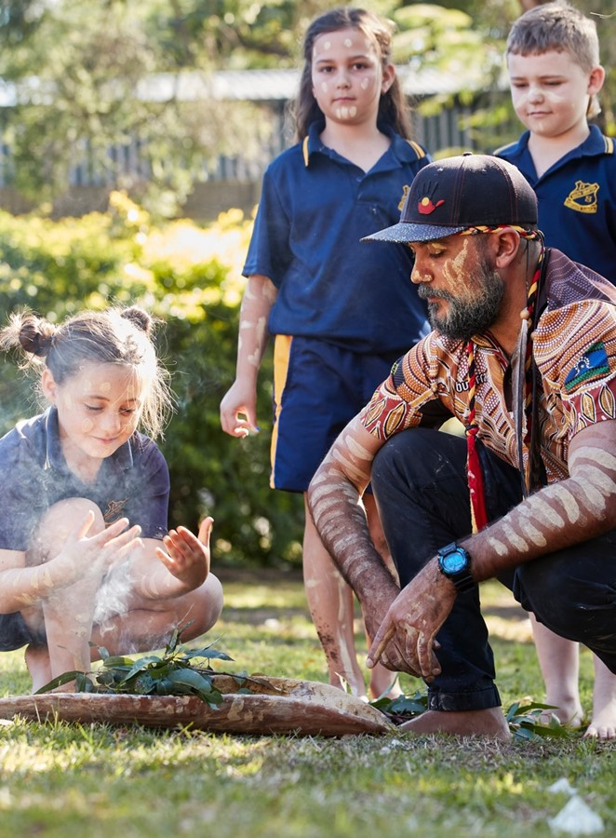
Acknowledgement of Country
NSW Department of Education
We recognise the Ongoing Custodians of the lands and waterways where we work and live. We pay respect to Elders past and present as ongoing teachers of knowledge, songlines and stories.
We strive to ensure every Aboriginal and Torres Strait Islander learner in NSW achieves their potential through education.
You may choose to develop a whole class acknowledgement or use an existing acknowledgement. Learn more about acknowledging Country on the department’s webpage.
Notes:
Presenter notes/script:
I would like to acknowledge the Aboriginal people who have, for thousands of years, been the custodians of the lands where you are listening to this presentation from and acknowledge their strong continuing connections to lands and waterways across NSW.
I pay respect to Aboriginal Elders past, present and emerging and extend that respect to all Aboriginal and Torres Strait Islander people who are joining this presentation. I acknowledge we are on _______land today.

Slide 5
Get to know our school and Kindergarten

Slide 6

Overview of our school
Replace the image in the circle with one of your own by right clicking the image and selecting the ‘change picture’ button.
Don’t forget to delete these speech bubbles and all of its contents before finalising the presentation.
Include dot points about the school, for example:
Number of classes
Number of staff
Extra curricular opportunities
P&C
Strengths of the school
School values
Notes:
Presenter notes/script:
Add information about your school here

Slide 7

The Kindergarten team
Replace the image in the circle with one of your own by right clicking the image and selecting the ‘change picture’ button.
Don’t forget to delete these speech bubbles and all of its contents before finalising the presentation.
Include names and titles of staff involved with kindergarten, for example:
Principal
Assistant principal
Kindergarten teachers
School Learning Support Officers, Aboriginal Education Officers
School Administration Manager, School Administration Officer
English as an Additional Language/Dialect teacher, Learning And Support Teacher
Release From Face-to-Face teaching teachers
Librarian
Other
Notes:
Presenter notes/script:​
Add information about the kindergarten team here

Slide 8
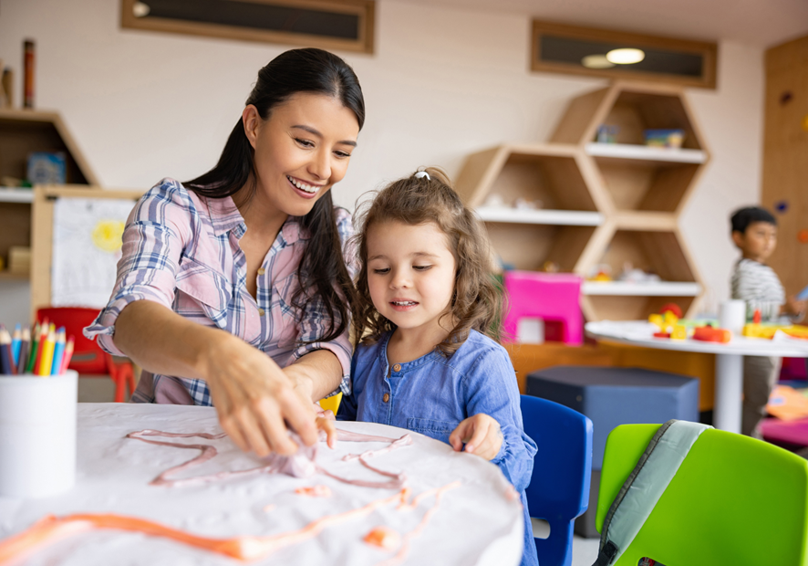
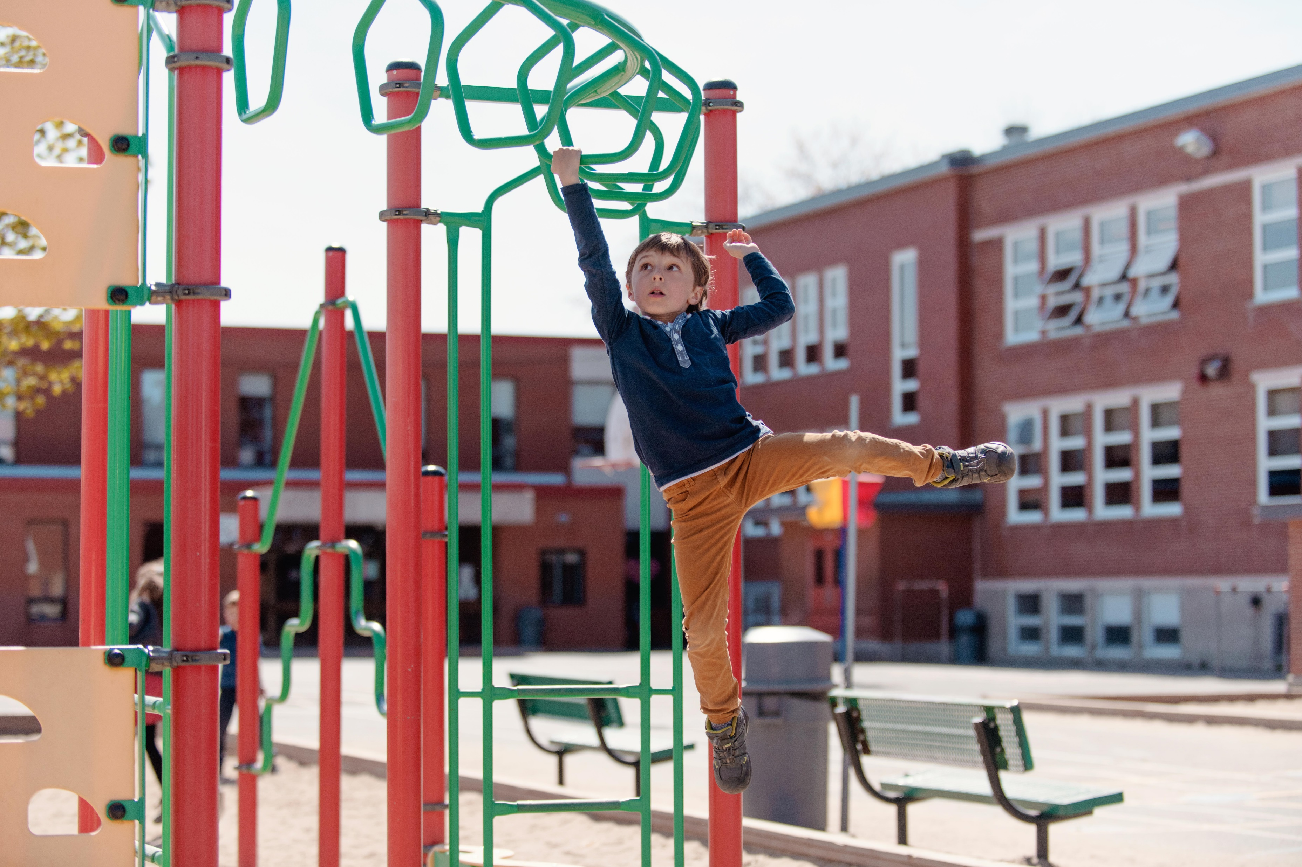
The Kindergarten space
You may also like to add other places in the school the parents may want to know about such as the toilets and canteen.
Don’t forget to delete these speech bubbles and all of its contents before finalising the presentation.
Notes:
Presenter notes/script:
Add information about the kindergarten rooms and spaces here

Slide 9
The Kindergarten routine
Any edits or changes to information can be made in the text boxes.
Don’t forget to delete these speech bubbles and all of its contents before finalising the presentation.
School starts:
line up at the classroom door
Recess:
snack and outdoor play
Lunch and outdoor play
Home time
9am
9-11am
11-11:30am
11:30-1pm
1-1:40pm
1:40-3pm
3pm
Literacy/
numeracy
learning time
Literacy/
numeracy learning time
Other Key learning area time
Notes:
Presenter notes/script:
Outline a typical daily routine for kindergarten here

Slide 10


The kindergarten curriculum and continuity of learning
All syllabuses taught in Early Stage 1
English K–10 Syllabus (Digital Curriculum)
Mathematics K–10 Syllabus (Digital Curriculum)
Science and Technology K–6 (2017)
History K–10 Syllabus (2012)
Geography K–10 Syllabus (2015)
Creative Arts K–6 Syllabus (2006)
PDHPE K–10 Syllabus (2018)
Aboriginal Languages K–10 Syllabus (2003)
K–10 Languages syllabuses
Home
Prior to school curriculum
Notes:
Presenter notes/script:​
Your children bring to school a range of knowledge, understanding and skills developed in home and prior-to-school settings like child care. The movement into Early Stage 1 should be seen as a continuum of learning​
The Early Years Learning Framework for Australia is the curriculum used in prior to school settings and it describes a range of opportunities for children to learn and develop a foundation for future success in learning. This is what we build on in kindergarten.​
Key learning areas (KLAs) describe broad areas of learning. In NSW, syllabuses are developed within the following KLAs.​
English K–10 Syllabus (Digital Curriculum)​
Mathematics K–10 Syllabus (Digital Curriculum)​
Science and Technology K–6 (2017)​
History K–10 Syllabus (2012)​
Geography K–10 Syllabus (2015)​
Creative Arts K–6 Syllabus (2006)​
PDHPE K–10 Syllabus (2018)​
Aboriginal Languages K–10 Syllabus (2003)​
K–10 Languages syllabuses​​
Students are provided with the learning opportunities they need to succeed and progress through each phase of learning. ​
Building strong foundations starts with English and Mathematics K–2 syllabuses. These syllabuses provide the essential skills necessary for future learning at this important time for your child’s development. ​
NOTE: All Syllabuses are hyperlinked if you would like to have one open to show parents. You can refer parents to parent guides here https://educationstandards.nsw.edu.au/wps/portal/go/parents/parents-guide-to-the-nsw-primary-syllabuses​

Slide 11

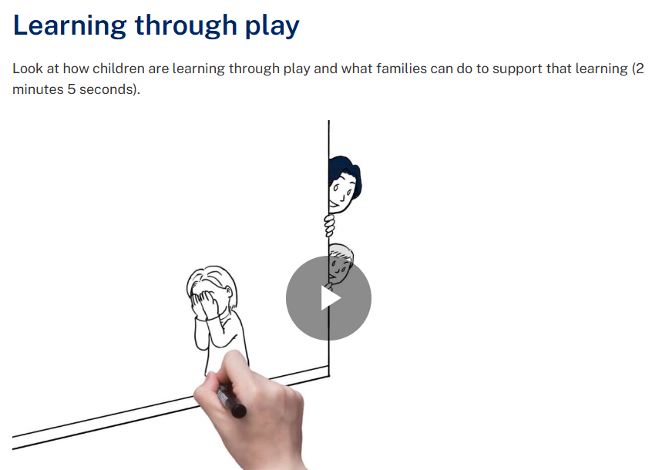



The importance of play in the Kindergarten classroom
It helps develop literacy and numeracy skills.
It helps develop language and communication skills.
It encourages curiosity, problem solving, persistence, commitment, cooperation and resilience.
It helps children become engaged and successful learners.
Notes:
Presenter notes/script:​
Play is important to the child’s development of self awareness and developing their knowledge of how they can interact in their world.​
It is endorsed by the United Nations Charter on the Rights of the Child. “ a child has the right to play and be actively involved in their world” and it is also a familiar way of learning from their preschool or home.​
It can be used to teach many skills and the curriculum. Play is an appropriate way to teach kindergarten aged children. We will use different types of play to teach parts of the curriculum.​
​
Play:​
helps develop literacy and numeracy skills.​
helps children become engaged and successful learners.​
encourages curiosity, problem solving, persistence, commitment, cooperation and ​
resilience.​
helps develop language and communication skills. ​
NOTE: To play the animation about play, have the webpage open in a separate window and scroll to the animation titled ‘learning through play’ https://education.nsw.gov.au/teaching-and-learning/curriculum/early-learning/resources-for-families/animation-clips-for-families. The image is also hyperlinked for you.​

Slide 12
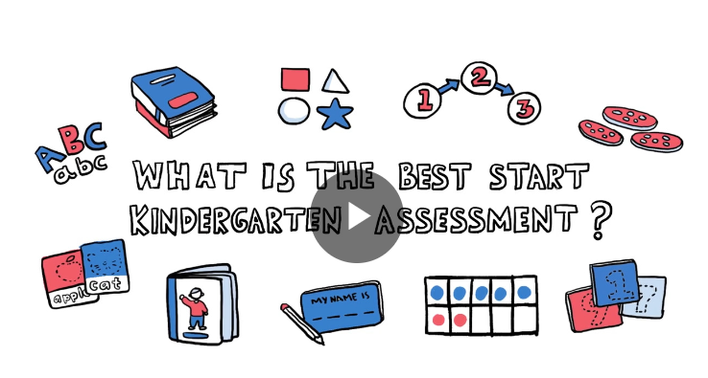

Best Start Kindergarten Assessment
Notes:
Presenter notes/script:​
As you may know your child will participate in the Best Start Kindergarten Assessment during the first 5 weeks of school. This will be done as part of the school day.​
The Best Start Kindergarten Assessment is a state-wide assessment that helps teachers identify the English literacy and numeracy skills of each student at the beginning of Kindergarten. ​
The Best Start Kindergarten Assessment includes a literacy and a numeracy component and provides teachers with information on a student’s individual strengths and needs. The assessment supports teachers to develop teaching and learning programs that build on what students know.​
The teacher will be focusing on what your child ‘can do’ to inform decisions about the teaching and learning activities for your child. Your child does not need to prepare or study for the assessment. As children learn at different rates there is no need to be concerned if your child cannot answer all questions.​
Shortly after the assessment, teachers will provide you with information about the skills, knowledge and understandings your child demonstrated during the assessment.​
If English is not your home language or your child requires adjustments, contact your school for more information on how your child can be supported. ​
NOTE: You can also view video on: What is the Best Start Kindergarten webpage: https://education.nsw.gov.au/teaching-and-learning/curriculum/literacy-and-numeracy/assessment-resources/best-start-kindergarten or use the direct link https://players.brightcove.net/6146050564001/default_default/index.html?videoId=6315137312112​

Slide 13
Why is transition important?
Notes:
Presenter notes/script:
Transition is an opportunity to build relationships with children, families and community as well as an opportunity to orient children to the school. Transition to school is a critical part of quality education and the way we do this makes a big difference as to how strong your child’s start to school will be.

Slide 14


Setting our children up for success
Notes:
Presenter notes/script:
Children have a greater chance of successful lifelong learning and coming to school every day and experiencing less issues when children and families participate in transition activities just like the ones you are doing today.
When children and families visit the school and learn about it and when families share information about their child this sets your child up for success.
We want to make sure you and your child feel sense of belonging to school and that your child feels confident to participate in kindergarten activities and experience a love of school and learning. Transition to school is the best time to build these feelings.
We all need to work together to ensure the children feel they belong to their new school and that they love coming to school each day.

Slide 15


What is important when your children are starting Kindergarten?
Notes:
Presenter notes/script:
A smooth transition for all children is developed by:
schools developing connections with each child and their family
teachers building a respectful and happy relationship with every child
collaborating between preschool and primary school teachers
providing an inclusive environment
Using age appropriate strategies such as play based activities

Slide 16
What can you do to support your child's transition to school?
Attend transition programs and events
Share information about your child with our team
Ask for additional transition visits if you think your child needs them
If you have any questions or
concerns speak to the school
If your child attended an early childhood service, consider connecting their preschool teacher with their new teacher
Read the department’s ‘getting reading for primary school’ guide
Right click on the bubble 'SmartArt graphic'. An editing box will appear on the left of the bubbles. Any edits or changes to information can be made in the editing box. SmartArt menus will also appear in the top tool bar where further changes can be made.
Notes:
Presenter notes/script:
Your family can support a successful transition by:
Attending transition programs and events like today
Sharing information about your child with our team
Asking for additional transition visits if you think your child needs them
Reading the department’s ‘getting reading for primary school’ guide
Speaking to the school if you have any questions or concerns
Organising for your child’s preschool teacher to connect with the kindergarten teacher, if needed. This might include discussing your child's Transition to School Digital Statement
NOTE: The Getting ready for primary school guide is hyperlinked on the slide if you would like to open it to show families. https://education.nsw.gov.au/schooling/parents-and-carers/going-to-school/getting-ready-for-school/starting-primary-school

Slide 17
Tips to prepare for Kindergarten

Slide 18

What to do before your child’s first day
Talk to your child about their new school (including toileting and handwashing)
Focus on positive things about going to school
Remind them about the things that will be the same in kindergarten
as in childcare and home
Practice wearing their uniform and school bag
Practice opening snacks and lunch box
Draw pictures together aboutKkindergarten
Organise play dates with other children that will be going to our school
Talk about what will happen during drop off and pick up times at school
Read books about starting school like ‘Daisy’s first day’
Celebrate your child making such a big transition
If your child is particularly nervous speak with us about bringing something familiar with them such as a family photo or small comfort toy
Notes:
Presenter notes/script:​
To prepare for your child’s first day there are some things you may like to practice:​
Talk to your child about their new school​
Focus on positive things about going to school​
Remind them about the things that will be the same in kindergarten as in childcare and home​
Practice wearing their uniform and school bag​
Practice opening snacks and lunch box​
Draw pictures together about kindergarten​
Organise play dates with other children that will be going to our school​
Talk about what will happen during drop off and pick up times at school​
Read books about starting school like ‘Daisy’s first day’​
Celebrate your child making such a big transition​
If your child is particularly nervous speak with us about bringing something familiar with them such as a family photo or small comfort toy​
NOTE: Daisy’s first day is hyperlinked on the slide if you would like to open it to show families. https://education.nsw.gov.au/schooling/parents-and-carers/going-to-school/getting-ready-for-school/starting-primary-school/the-big-day/daisy-s-first-day​

Slide 19

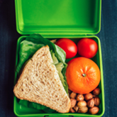

The first day of Kindergarten
Replace the image in the circle with one of your own by right clicking the image and selecting the ‘change picture’ button.
Don’t forget to delete these speech bubbles and all of its contents before finalising the presentation.
Bring your child to the Kindergarten classroom at their start time. Feel free to stay in the room for a little while to help your child settle in.
Make sure you pack their recess snack, water, lunch and hat.
Children can be picked up at 3pm. Wait in
the Kindergarten playground for the
teacher to bring them outside.
Notes:
Presenter notes/script:
Bring your child to the Kindergarten classroom at their start time. Feel free to stay in the room for a little while to help your child settle in. if you are not sure of your start time let us know and we can tell you.
After the first day school will begin at 9am every day.
Make sure you pack their recess snack, water, lunch and hat.
Children can be picked up at 3pm. Wait in the kindergarten playground for the teacher to bring them outside.
NOTE: Adjust the details in the notes to suit your context

Slide 20

Finding support
Make an appointment to speak with the principal or someone from the Kindergarten team
Share any reports or information about medical information, how your child learns or any support they may require
Make sure we know if your child has NDIS funding
Access the department’s inclusive learning support information page for parents and carers
Contact our school:
Phone: ########
Email: ########@det.nsw.edu.au
Notes:
Presenter notes/script:
If you think your child might need some additional support in kindergarten organise to speak with someone from our kindergarten team. We also have a school psychologist who can provide support with any learning needs.
NOTE: Add your school contact details in the blue box on the slide. The learning support page is hyperlinked if you would like to open it to show parents. https://education.nsw.gov.au/schooling/parents-and-carers/inclusive-learning-support

Slide 21

Questions
Notes:
Presenter notes/script:: Let us know if you have any questions.

Slide 22
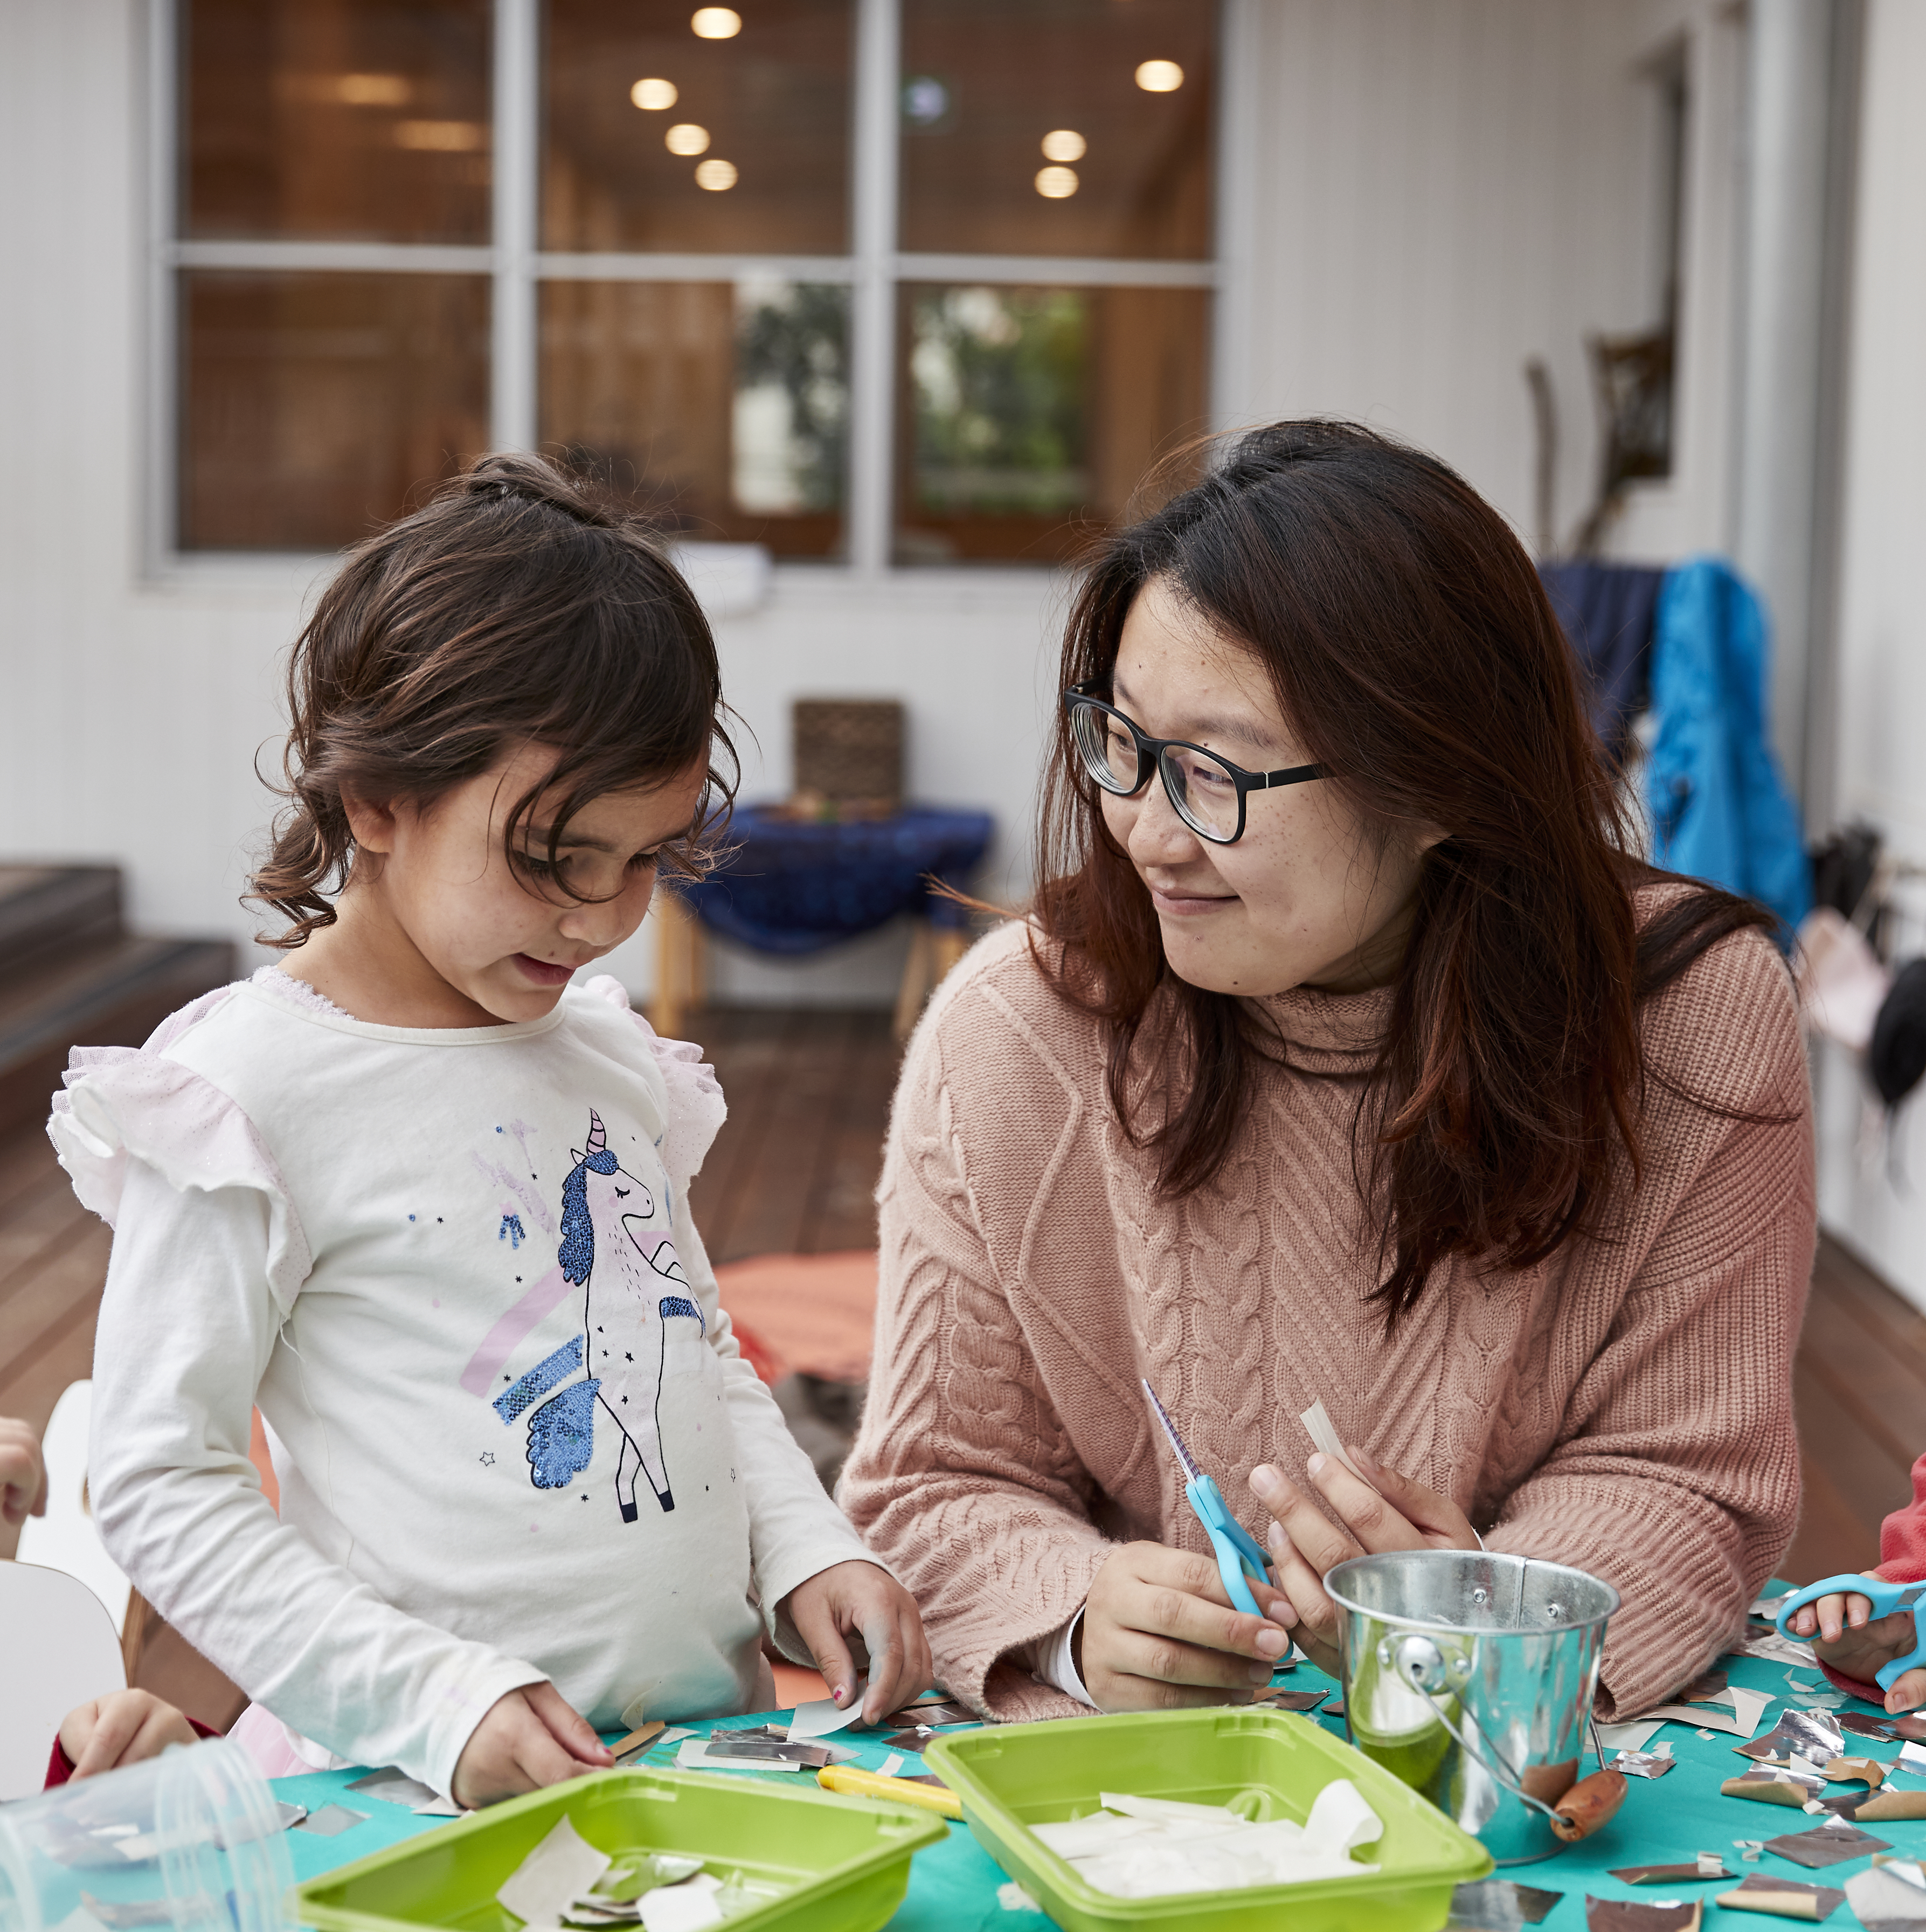
Additional resources you may like to share with parents
These slides are not designed to be presented to parents as is. You may wish to choose some of the resources to add to previous slides or create a handout for families.

Slide 23
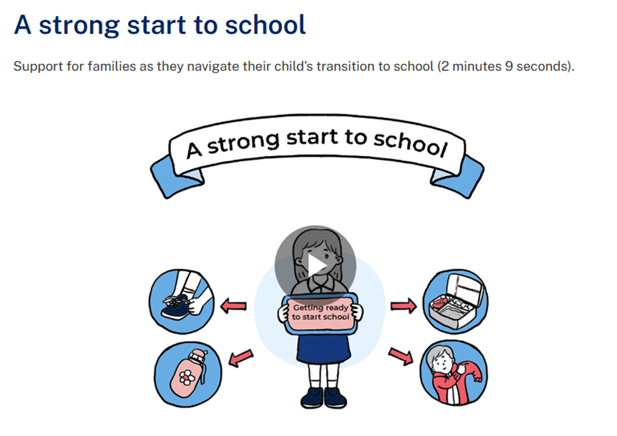
Resources for families from the department webpages
Resources for families about the Early Years Learning Framework and learning through play:
https://education.nsw.gov.au/teaching-and-learning/
curriculum/early-learning/resources-for-families
Animations for families including an animation on transition to Kindergarten:
https://education.nsw.gov.au/teaching-and-learning/
curriculum/early-learning/resources-for-families/animation-clips-for-families
Literacy and numeracy parents and carers page:
https://education.nsw.gov.au/teaching-and-learning/
curriculum/literacy-and-numeracy/resources-for-parents-and-carers

Slide 24








Books about starting school
The Pigeon HAS to Go to School!
Spot Goes to School
Wombat Goes to School
Starting School
First Day
The Kissing Hand
Starting School
Ozzie Goes to School

Slide 25
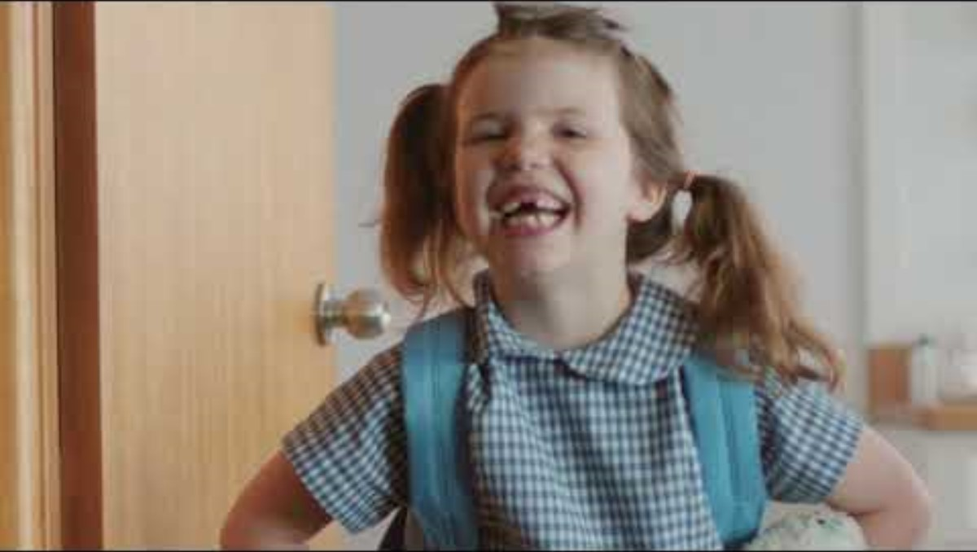

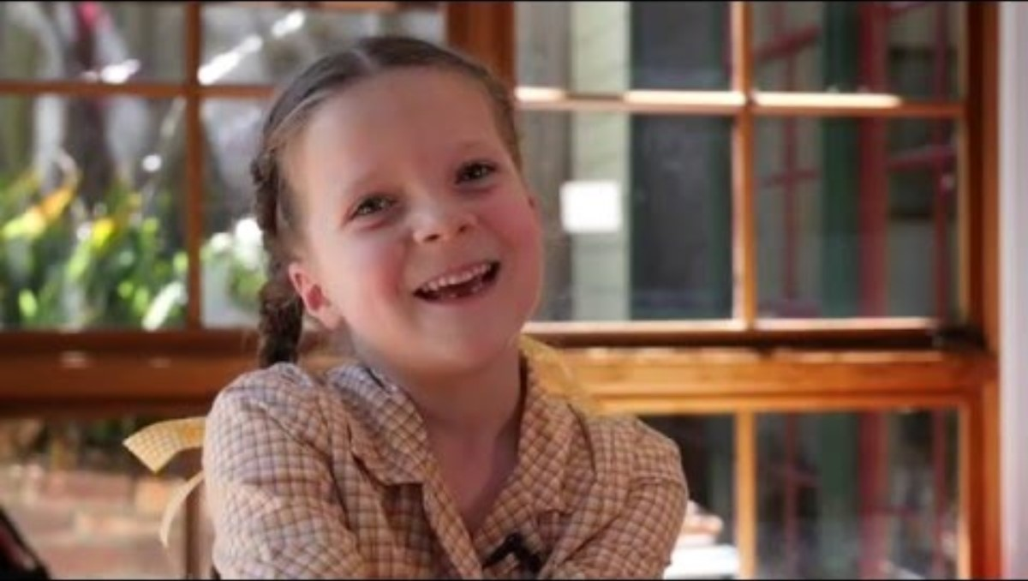
Videos about starting school from the department
https://www.youtube.com/watch?v=FxMBiWiHsgw
https://www.youtube.
com/watch?v=iGw8j3Odqm8
https://www.youtube.com/watch?v=jSwR01Lcyv0

Slide 26
Relevant translated documents
Further translated documents can be found at https://education.nsw.gov.au/schooling/translated-documents
Best Start Kindergarten Assessment:
Best Start Kindergarten Assessment - Letter
Best Start Kindergarten Assessment - Parent brochure
Disability:
Getting ready for school – Disability
Early Learning:
Learning Outcome Cards
Enrolment:
Application to enrol in a NSW Government school
Invitations:
Invitation to a school function
Literacy and numeracy :
Helping your child with literacy and numeracy at home
Road safety information:
Drive and park safely near schools
Safe bus travel
School Counsellor:
School Counselling Service - Information for parents and carers
Telephone interpreter service:
How to contact the telephone interpreter service

