Slide 1
Instructions for use
This resource is not a teaching and learning program. It should be used the ‘Influence and innovation’ unit of work and accompanying resources found on the Planning, programming and assessing music 7–10 (2024) webpage.​
Classroom teachers are encouraged to add and adapt slides as required to meet the needs of their students.
Save a copy of the file to make changes to the slide deck. Go to File > Download a Copy (this downloads a copy to the computer to edit in the PowerPoint app).
To convert the PowerPoint to Google Slides:
  Upload the file into Google Drive and open it.
  Go to File > Save as Google Slides.
  (Note – conversion may cause formatting changes in the slides.)

Slide 2

Influence and innovation
Music – Stage 5
PowerPoint
Cool girl (2021) by Cuongaz, is licensed under Creative Commons 4.0
(accessed 9 November 2025)

Slide 3
Lessons
1
The beauty of taiko
6
Gagaku – the traditional court music of Japan
2
From tradition to tomorrow
7
The future voice – Hatsune Miku and J-pop
3
Suzume unlocked – the sound of anime
8
In the loop – using a loop-based Digital Audio Workstation (DAW)
4
From 8 bit to epic – music in Japanese gaming
9
Track work – composing in a Digital Audio Workstation (DAW)
5
Boss battles and beats – music in Japanese gaming
10
Final mix – listening and reflection
Notes:
Teacher notes:
Click lesson numbers to go to specific lessons
Interactive features can be viewed in slide show

Slide 4
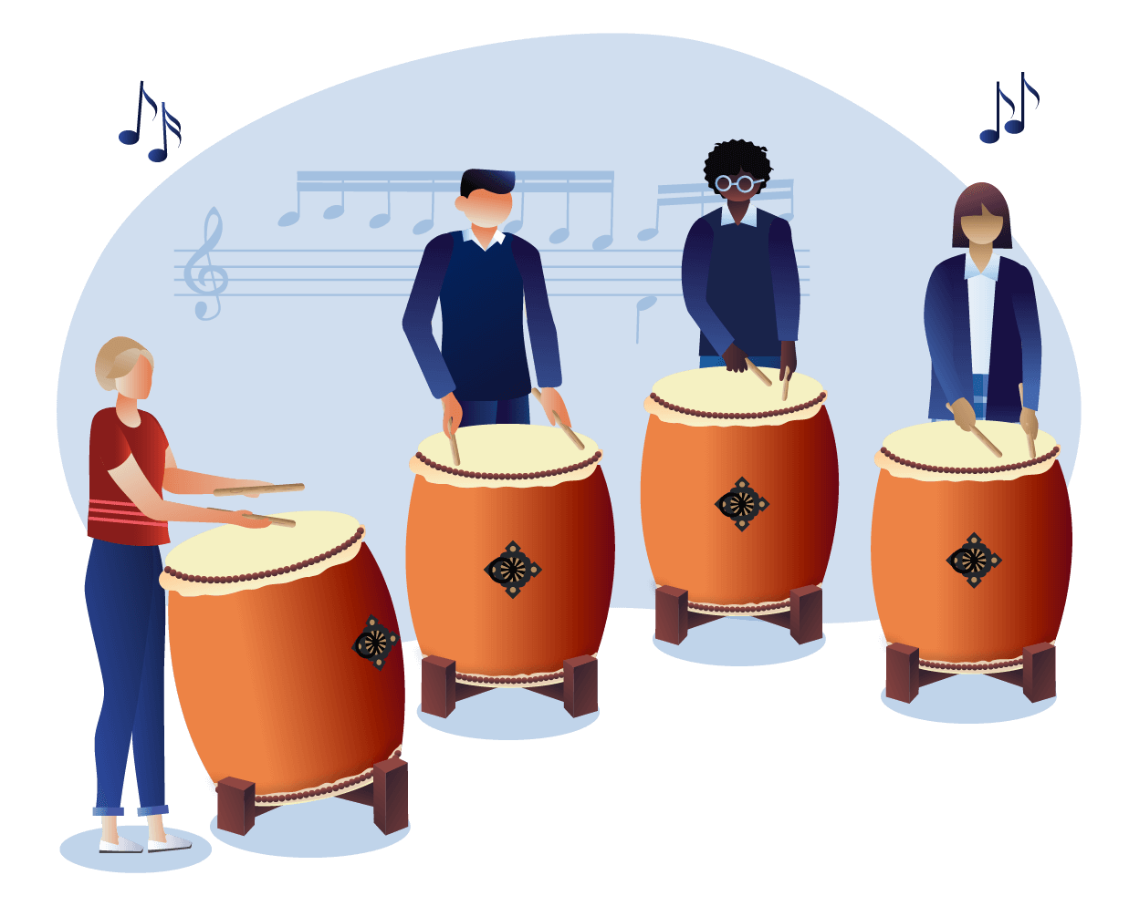
Learning sequence 1
The beauty of taiko

Slide 5
Learning intentions and success criteria (1)
We are learning to
explore the cultural significance of taiko drumming and its historical context within Japanese traditions
analyse rhythmic patterns and elements in taiko performances, identifying key features such as ostinati, syncopation, and call and response
develop skills in performing taiko rhythms, focusing on vocalisations and physical movements that enhance the musical experience.
We can
articulate at least two key cultural aspects of taiko drumming and express personal reflections on its significance
respond thoughtfully to compositional analysis questions, providing specific examples from the score to support explanations of how duration and texture create musical interest
successfully perform assigned ostinati as a group, demonstrating an understanding of layering and rhythmic interplay.
Notes:
Notes for teachers:
Learning intentions and success criteria are best co-constructed with students. Adapt the learning intention as required and add matching success criteria.
For more information See ⁠AITSL or the NSW Department of Education explicit teaching strategies, ⁠Sharing learning intentions and ⁠Sharing success criteria
LISC is not necessarily presented at the beginning of the lesson. Teacher needs to consider most effectual time to introduce
LISC should be revisited during the lesson to support students' evaluation of their learning

Slide 6
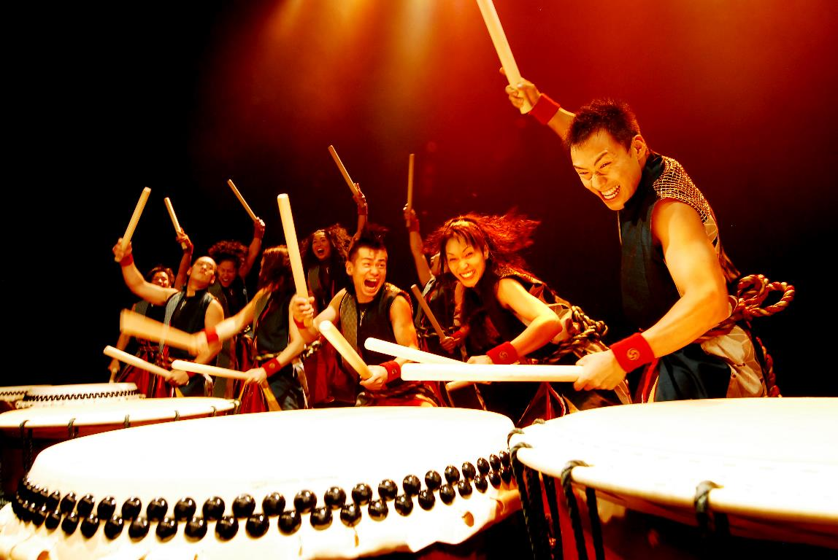
Activity 1.1 – an introduction to taiko (1)
What do you notice and what do you wonder?
Access this image and write down 2–3 things you notice (for example – key details, main ideas, themes) and 2–3 things you wonder.
Yamato - The Drummers of Japan (2010) by Barne227, is licensed under Creative Commons 4.0 (accessed August 2025)

Slide 7
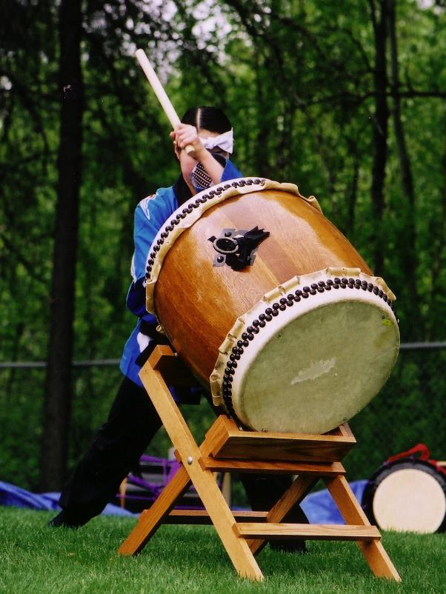
Activity 1.1 – an introduction to taiko (2)
What is the cultural significance of taiko?
Taiko (太鼓), meaning 'drum' in Japanese, holds deep cultural, historical, and spiritual significance in Japan. It's more than just a musical instrument – it's a powerful symbol of identity, community, ritual, and resilience.
Taiko has long been used in religious ceremonies to communicate with the gods, drive away evil spirits, and purify sacred spaces. In Shinto, the sound of taiko is believed to summon the presence of the gods (kami).
It is not just about sound – it's about form, movement, and intention. The physical stance, choreographed movements, and group dynamics reflect values of discipline, respect, and mindfulness. Drumming becomes a spiritual practice, connecting the drummer to breath, body, and community.
Kumi–daiko (ensemble drumming) which was invented in the 1950s by Daihachi Oguchi, is now a global art form known for its athleticism, synchronicity, and theatrical power.
Taiko Drum (2004) by Elijah van der Giessen, is licensed under Creative Commons 2.0 (accessed August 2025)

Slide 8
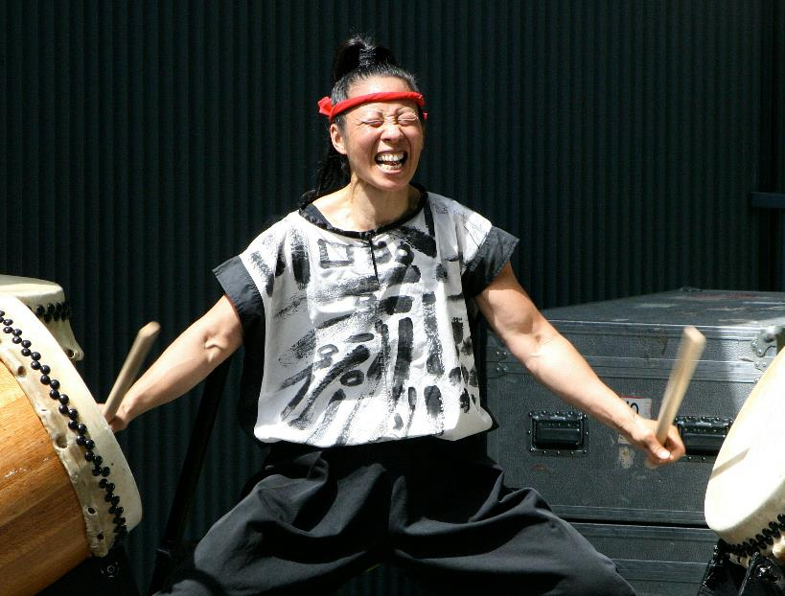
Activity 1.2 – ‘Hana Hachijo’ – The Beauty of 8 (1)
Listening
Rhythmic dictation
Access this segment from the Beauty of 8 and complete the rhythmic dictation:
The Beauty of 8 – Taikoz – Melbourne 2017 (1:41:43)
(1:23:15 – 1:24:20)
notate the ostinato performed in the opening.
notate the first rhythmic change played by Chieko after Ian begins playing the ostinato.
Portrait of a Man Playing Drums (2021) by Harry H Brewster, is licensed under Pexels (accessed August 2025)

Slide 9
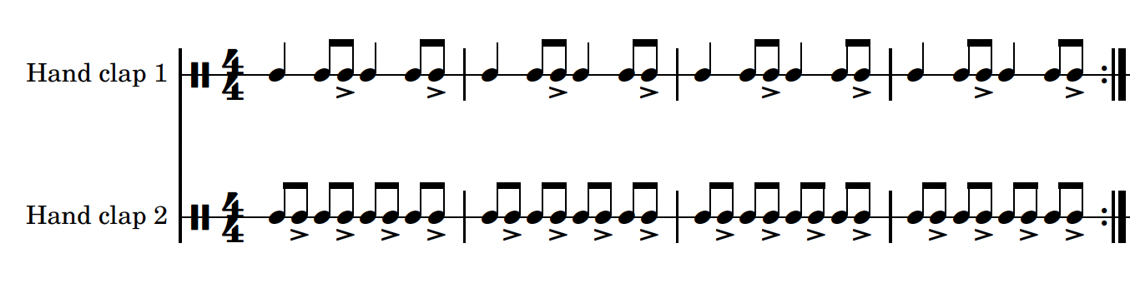
Activity 1.2 – ’Hana Hachijo’ – The Beauty of 8 (2)
Performing
Clap the opening sequence.

Slide 10
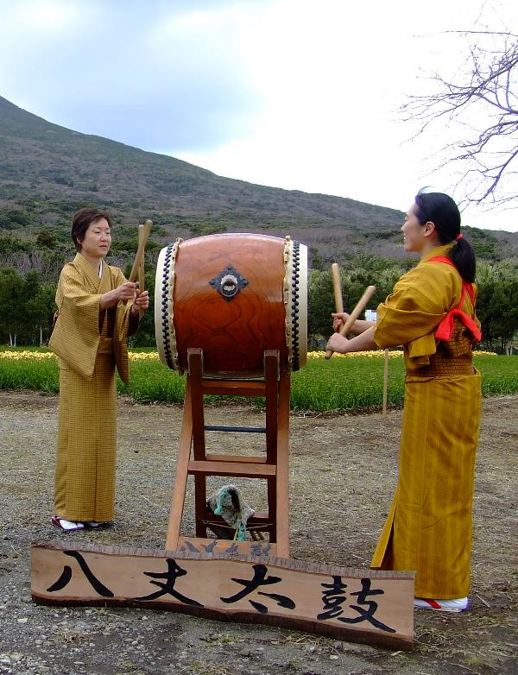
Activity 1.2 – ‘Hana Hachijo’ – The Beauty of 8 (1)
Listening – The Beauty of 8 – Taikoz – Melbourne 2017 (1:41:43)
Access the next segment from the Beauty of 8 and complete the reflection questions:
The Beauty of 8 – Taikoz – Melbourne 2017 (1:41:43)
(1:24:20 – 1:25:30)
Reflection questions
What do you notice about Cheiko’s choices of rhythmic elements?
What physical movements accompany her playing?
Why are these physical movements important to the performance?
Is Chieko’s part improvised or planned? Explain your thoughts.
What effect does Chieko’s rhythmic choices have on the pulse?
Hachijo Taiko (2007) by Goemr, is licensed under Creative Commons 3.0 (accessed 3rd August 2025)

Slide 11
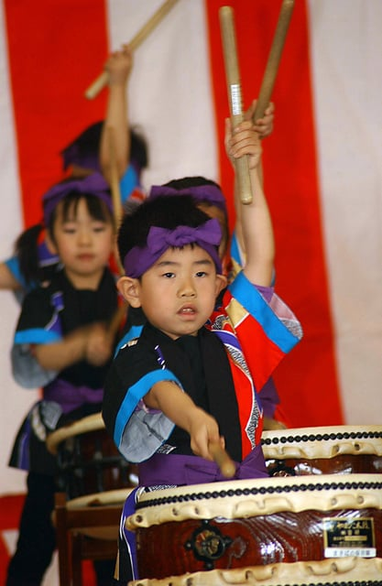
Activity 1.2 – ‘Hana Hachijo’ – The Beauty of 8 (2)
Listening – The Beauty of 8 – Taikoz – Melbourne 2017 (1:41:43)
Access the next segment from the Beauty of 8 and complete the reflection questions:
The Beauty of 8 – Taikoz – Melbourne 2017 (1:41:43)
(1:25:30 – 1:28:20)
Reflection questions
How does Ian know when to start his solo section?
How would you describe Ian’s playing style and rhythmic choices?
Why did they start tapping on the side of the drums?
How would you describe the timbre of the tapping?
What happened towards the end and why was it so engaging as an audience member?
Makibano kid drummers (2004) by Jessica De Pierri, is licensed under Wikimedia commons (accessed August 2025)

Slide 12
Activity 1.4 – safety in the music classroom (1)
Show respect for your classmates, your teacher and the music classroom equipment.
Return instruments and equipment (including leads, adaptors, pedals) to the right place.
Take care when using instruments to avoid accidents and damage. Report any damage immediately to your teacher.
Consider safe volume levels when rehearsing and think about others around you.
Always do a warm-up and/or technical work before rehearsing a performance piece.
Position your music and/or ensemble members to ensure correct posture both in rehearsal and performance.

Slide 13
Activity number 1.4 – safety in the music classroom (2)
Cover any trip hazards, including cords.
Explore different ways to play. For example, adjust volume or pitch controls or select different modes or effects instead of playing forcefully.
Be considerate of class members with sound sensitivity.
Practice safety when packing away. For example, turn off the instrument before unplugging and switch off power points before pulling out plugs.

Slide 14

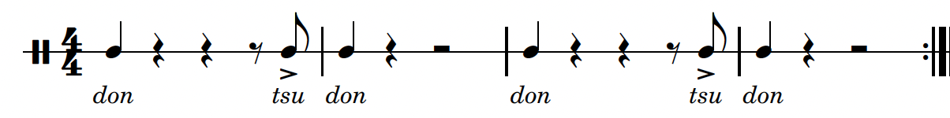
Activity 1.3 – the sound of taiko (1)
Performing
Before you begin, it is helpful to understand the phonics or syllables that are used in taiko. Access the ‘Kagemusha tutorial video’ for instructions on how to play the following ostinatos.
Taiko uses an oral 'nomenclature’ to teach and preserve songs. Each hit has a particular sound (phonic or syllable) to represent it. Memorising these sounds and learning to 'sing' the song is the first step in learning to play the patterns. The three basic sounds are:
don – hard hit on drumhead
tsu – soft hit on drumhead; multiple hits written as tsuku.
ka – sharp rap on the rim; wood sound.
Play ostinato 1 – all quavers are swung.

Slide 15
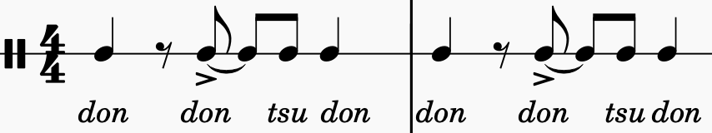
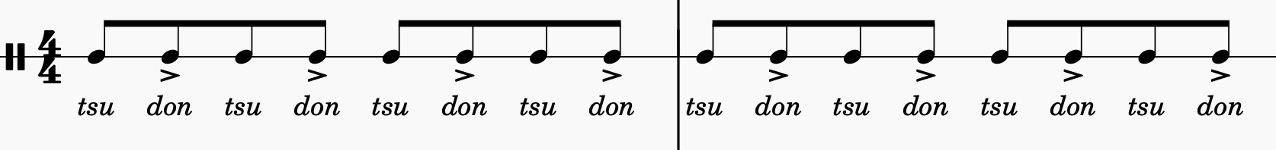
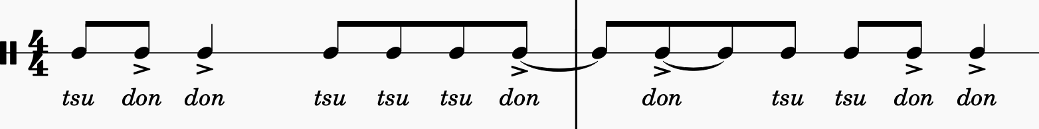
Activity 1.3 – the sound of taiko (2)
Performing
Play ostinato 2
Play ostinato 3
Play ostinato 4

Slide 16
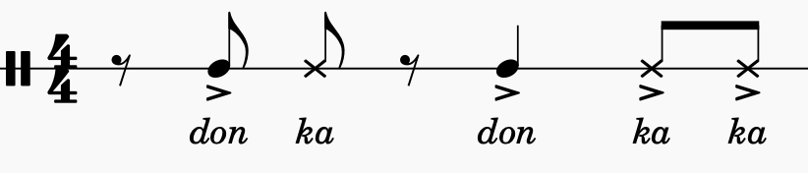
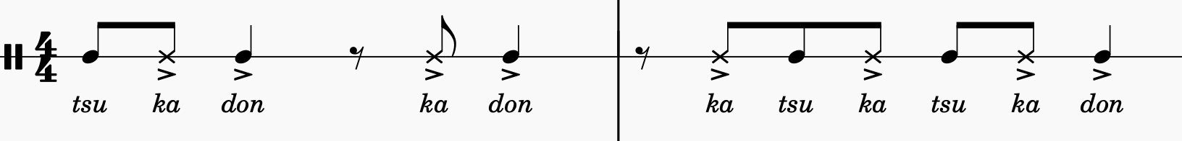
Activity 1.3 – the sound of taiko (3)
Performing
ka – sharp rap on the rim; wood sound.
Let's see how it is used in the piece we are about to play.

Slide 17
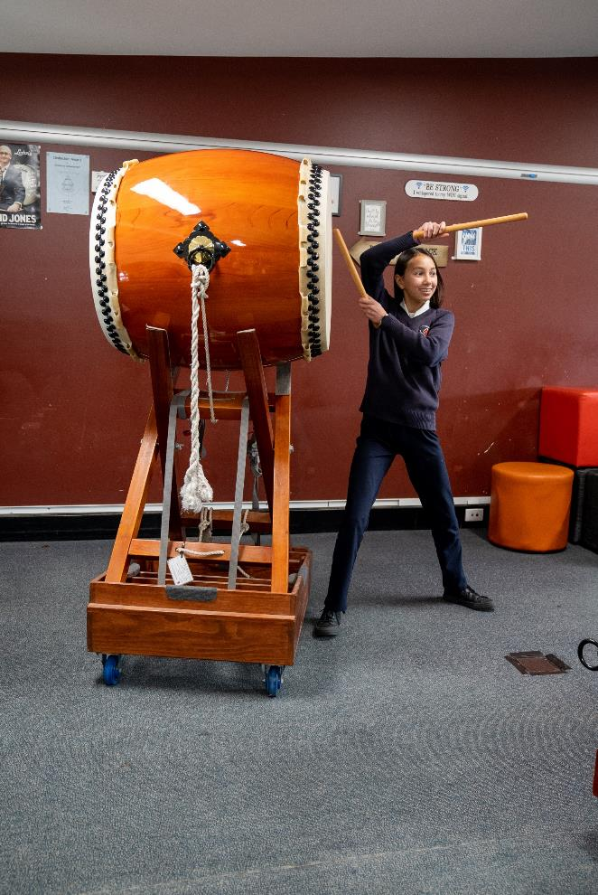
Activity 1.3 – the sound of taiko (4)
Listening
Reflection questions
Which ostinato do you think might be the bass line?
Which ostinato do you think might contain rhythmic interest and why?
Explain what similarities do you see between the ostinati?

Slide 18

Activity 1.4 – ‘Kagemusha’ (1)
Performing
Now it's time to put these ideas into practice. It's time to play ‘Kagemusha’.

Slide 19


Activity 1.4 – ‘Kagemusha’ (2)
Performing
Access the ‘Kagemusha performance video’ and the ‘Kagemusha tutorial video’ to learn to play ‘Kagemusha’.

Slide 20
Activity 1.5 – compositional analysis (1)
‘Kagemusha’
Music symbol or term | Check
ostinato 1, 2, 3, 4
the first use of ka
a cue bar
syncopation using accents, rests and ties
a hemiola
bass role
pulse
rhythmic feature
fragmenting
call and response
unison rhythms
cross rhythms or rhythmic complexity
Access the score for ‘Kagemusha’. Using a highlighter and pen, identify, highlight and label on the score, one example of each of the following:

Slide 21
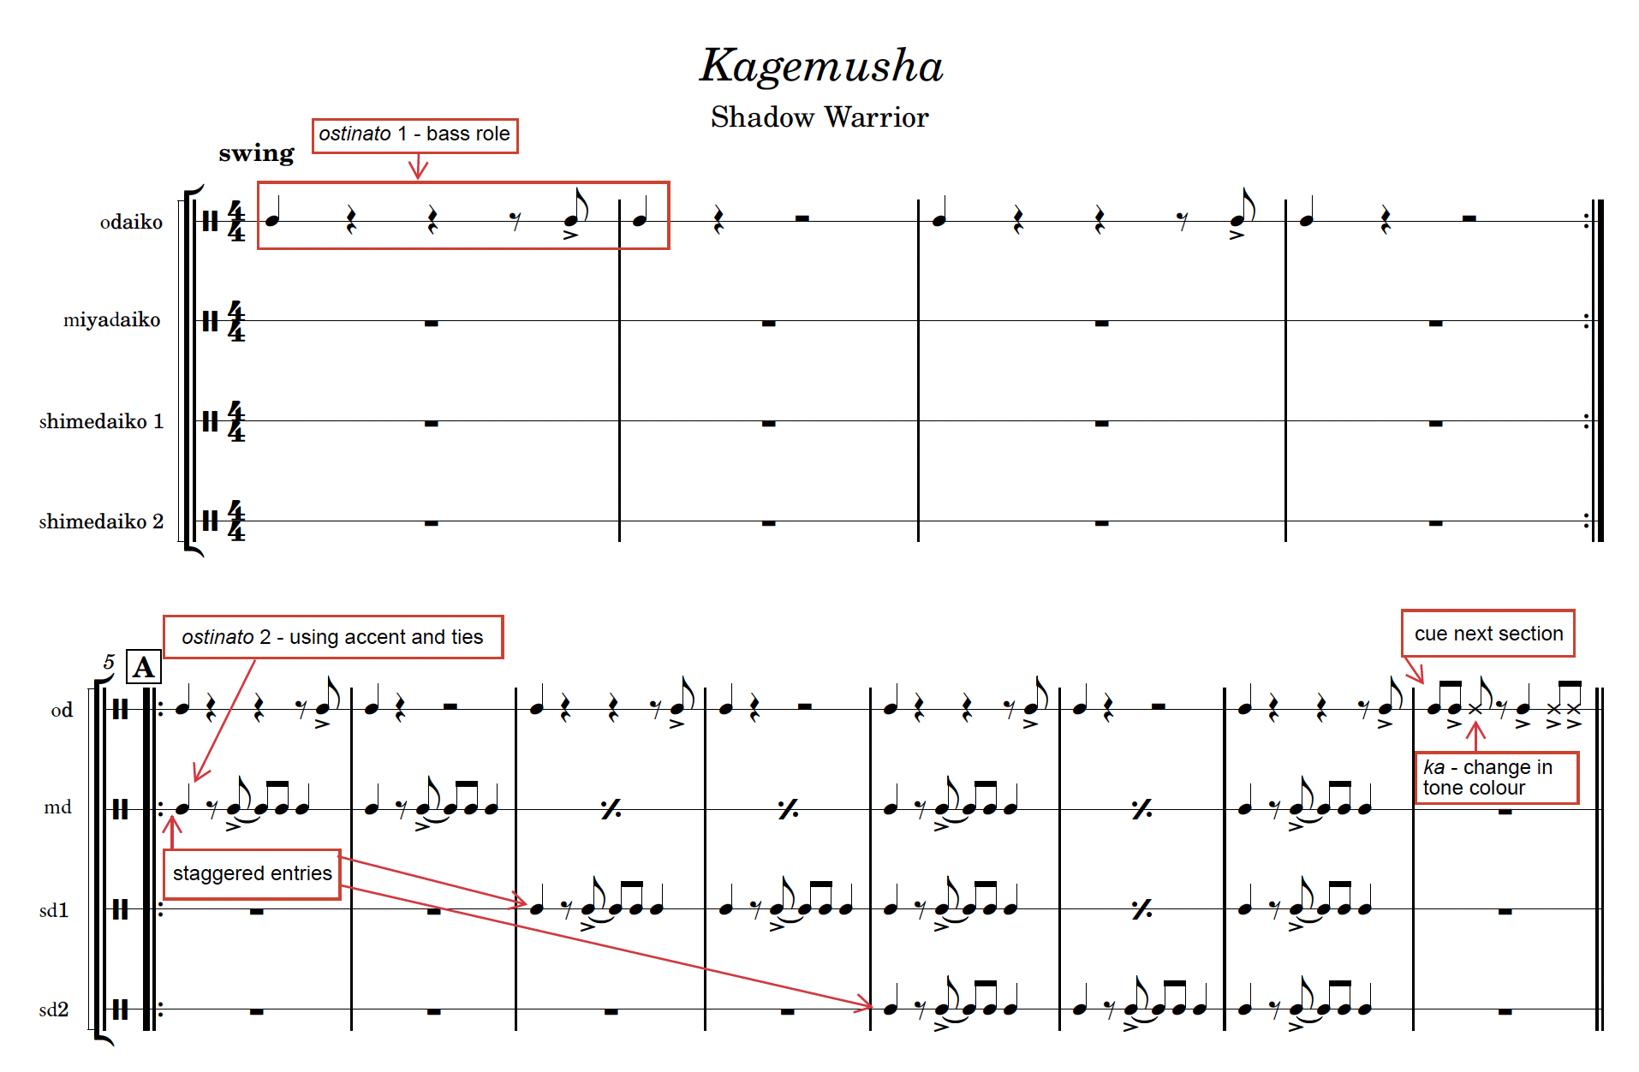
Activity 1.5 – compositional analysis (2)
‘Kagemusha’

Slide 22
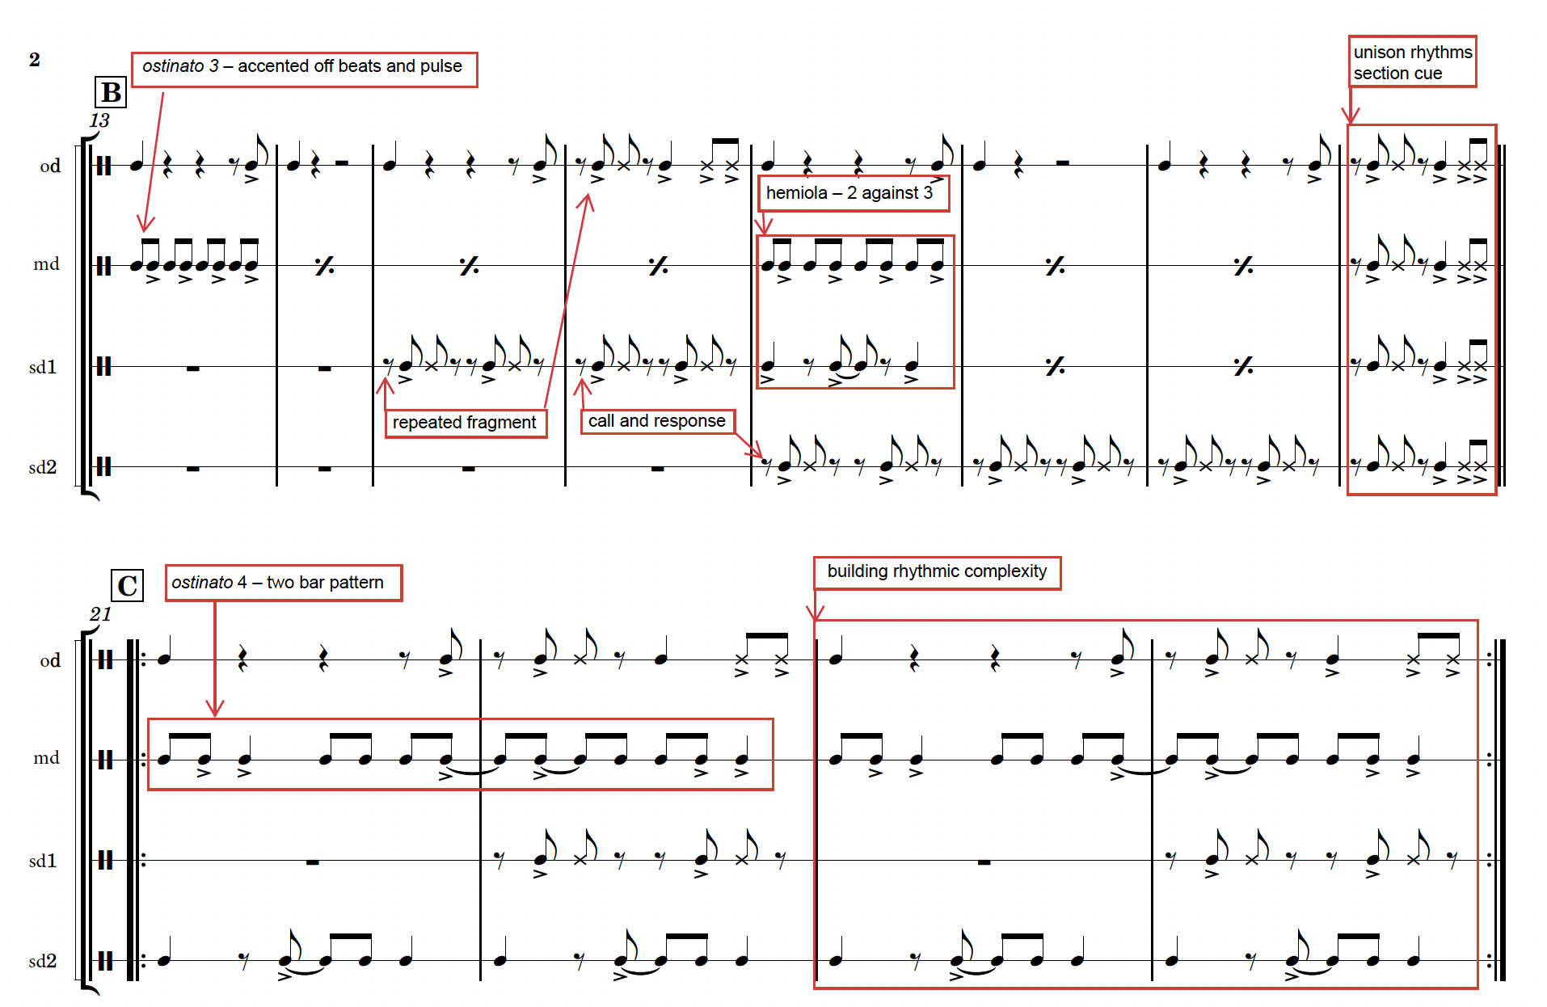
Activity 1.5 – compositional analysis (3)
‘Kagemusha’

Slide 23
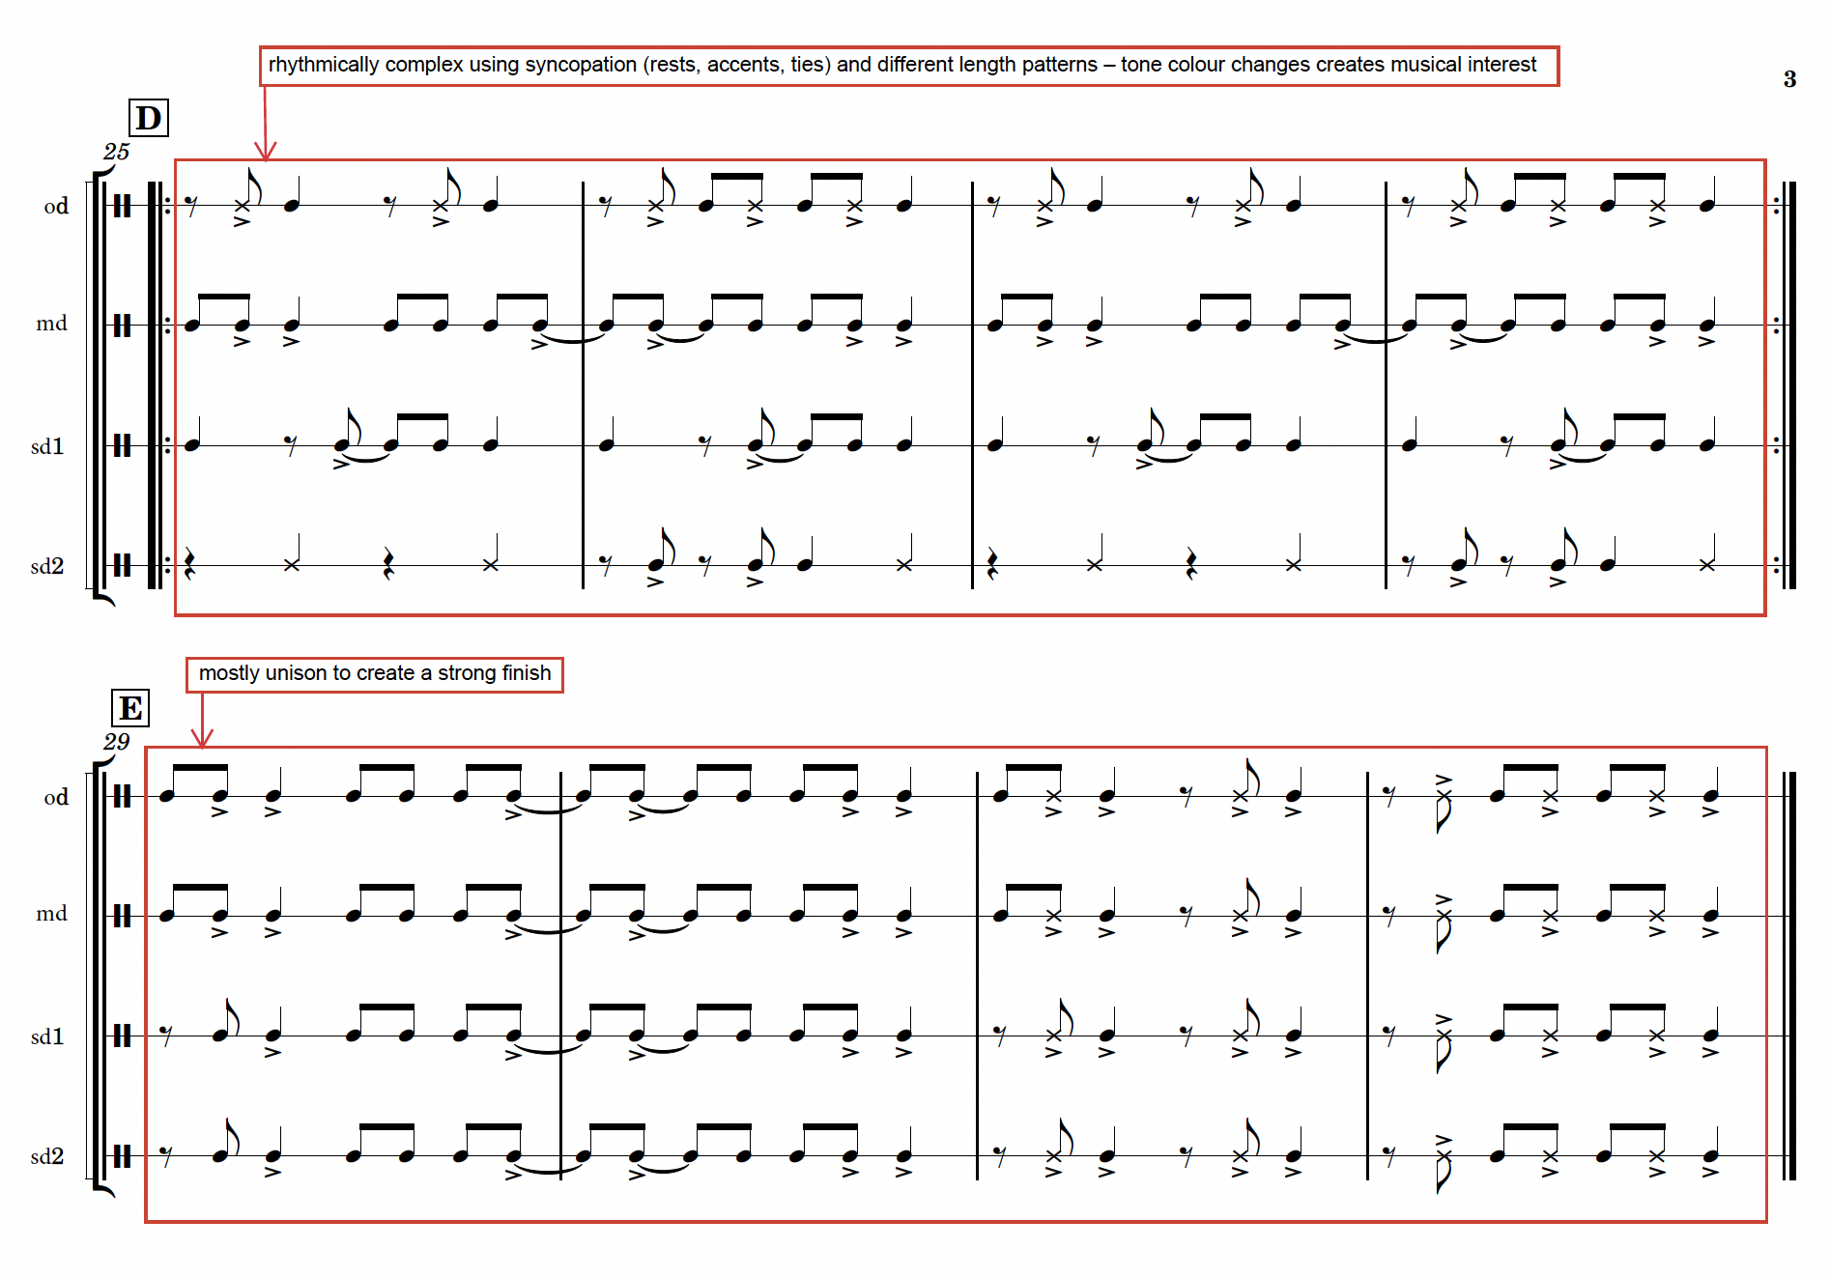
Activity 1.5 – compositional analysis (4)
‘Kagemusha’

Slide 24
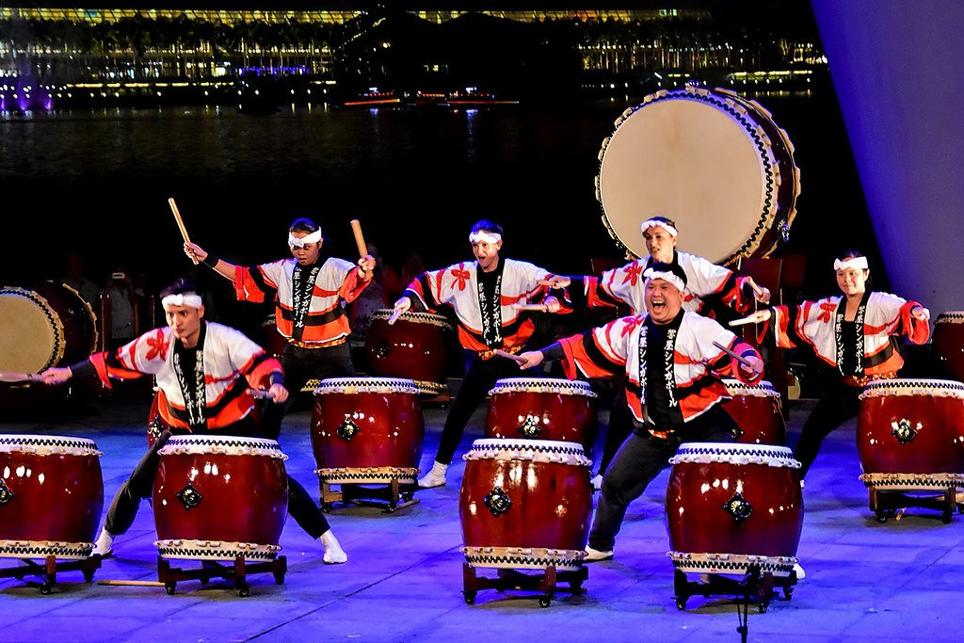
Activity 1.5 – compositional analysis (5)
‘Kagemusha’
Using the information gathered from the score, respond to this question.
How has the composer used duration and texture to create musical interest?
Taiko Concert (2016) by Choo Yut Shing. Used under Creative Commons BY-NC-ND 3.0 (accessed August 2025)

Slide 25
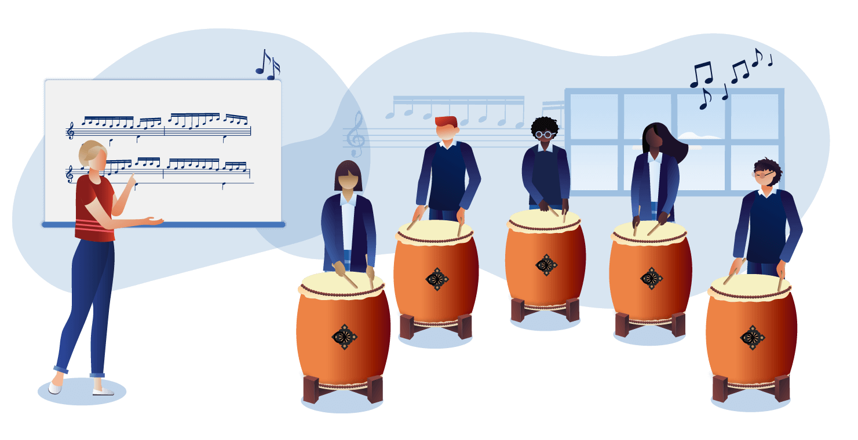
Learning sequence 2
From tradition to tomorrow

Slide 26
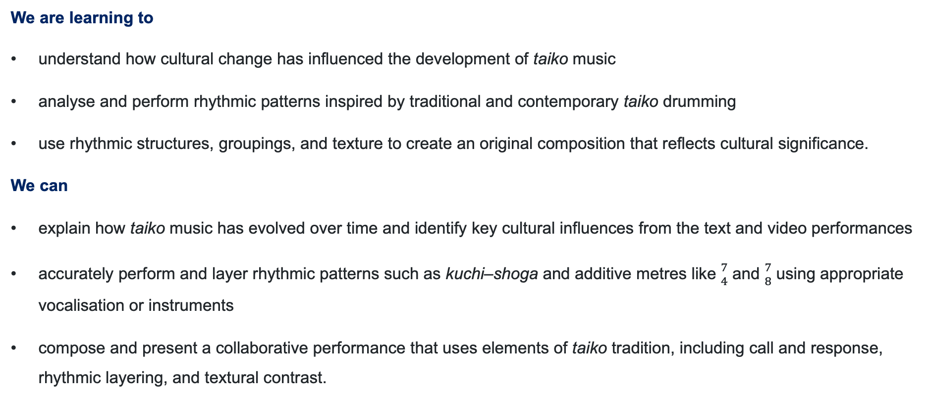
Learning intentions and success criteria (2)
We are learning to
understand how cultural change has influenced the development of taiko music
analyse and perform rhythmic patterns inspired by traditional and contemporary taiko drumming
use rhythmic structures, groupings, and texture to create an original composition that reflects cultural significance.
We can
explain how taiko music has evolved over time and identify key cultural influences from the text and video performances
accurately perform and layer rhythmic patterns such as kuchi–shoga and additive metres like ${7 \atop 4}$ and ${7 \atop 8}$ using appropriate vocalisation or instruments
compose and present a collaborative performance that uses elements of taiko tradition, including call and response, rhythmic layering, and textural contrast.
Notes:
Notes for teachers:
Learning intentions and success criteria are best co-constructed with students. Adapt the learning intention as required and add matching success criteria.
For more information See ⁠AITSL or the NSW Department of Education explicit teaching strategies, ⁠Sharing learning intentions and ⁠Sharing success criteria
LISC is not necessarily presented at the beginning of the lesson. Teacher needs to consider most effectual time to introduce
LISC should be revisited during the lesson to support students' evaluation of their learning

Slide 27

Activity 2.1 – the influence of cultural change
Access the ‘Activity 2.1 – the influence of cultural change worksheet – ‘Taiko through time’. Divide into small groups and obtain a copy of one section of the text. Read through the information and write your observations on butchers’ paper using marker pens.
Complete the following jigsaw activity:
Assign different sections of the text to small groups. Each group becomes an ‘expert’ on their section
Create one question based one the text your group has been given
Share what you have learned from the text and ask the question you have created to the class.
Discuss the responses to each question.
Jigsaw puzzle pieces clipart (2008) by Karen Arnold, is licensed under Creative Commons 1.0 Universal (accessed October 2025)

Slide 28

Activity 2.2 – 'Become' that other side (1)
Context
'The Beauty of 8' explores the theme of transformation and the interconnectedness of life.
'Become' was originally part of a larger work that was loosely composed for taiko, electric guitars, drum set, and electronic sounds. It was inspired by the thought of 'becoming the other side of you'. By challenging yourself, undertaking a difficult task, or putting yourself in extreme situations you can access or ‘become’ that other side.
The piece combines rhythmic complexity and dynamic movement, reflecting the journey of growth and change.
Women exploring a Japanese village in Yukata (2012) by Raw Pixel, is licensed under Creative Commons 1.0 Universal (accessed October 2025.)

Slide 29
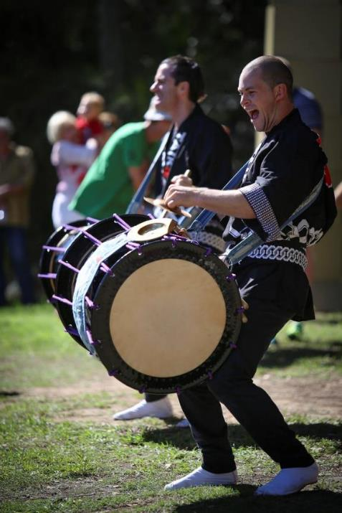
Activity 2.2 – ‘Become’ that other side (2)
Listening
Access the performance segment of the video and complete the reflection questions.
The Beauty of 8 – Taikoz – Melbourne 2017 (1:41:43) – (46:25 – 47.40)
Reflection questions
What do you notice about the different drums used in this performance?
How is sound being produced on the taiko drums?
What and/or who is making the fluttering sound?
Why is Chieko using bells and what do they signify for the performers?
Why is this segment without a pulse?
Taikoz (2014) by Halans, is licensed under Creative Commons 2.0 (accessed August 2025)

Slide 30
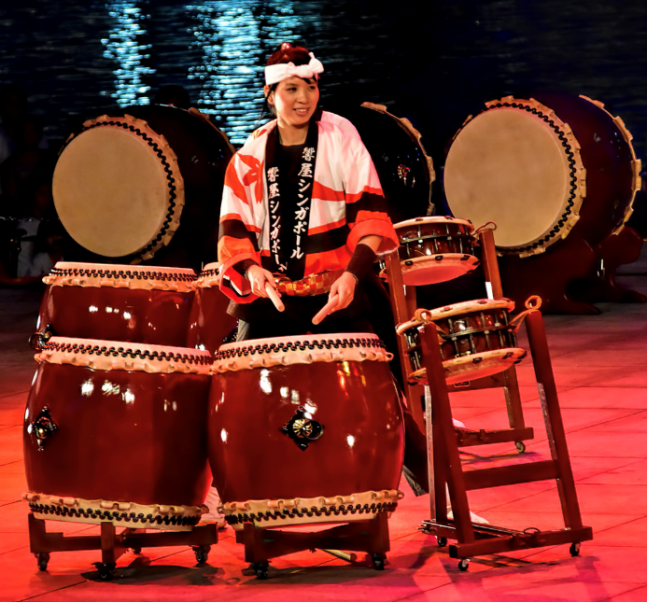
Activity 2.2 – ’Become’ that other side (3)
Listening
Access the next performance segment of the video and complete the reflection questions.
The Beauty of 8 – Taikoz – Melbourne 2017 (1:41:43) - (47:40 – 48:28)
Reflection questions
How is sound being produced on the taiko drums?
How many different drum sounds do you hear?
Is there still fluttering or has that changed?
What is the role of the bells in this section of the performance?
How does the performer on the odeko-daiko create dynamic contrast?
Taiko Concert (2013) by Choo Yut Shing. Used under Creative Commons BY-NC-ND 2.0 (accessed August 2025)

Slide 31
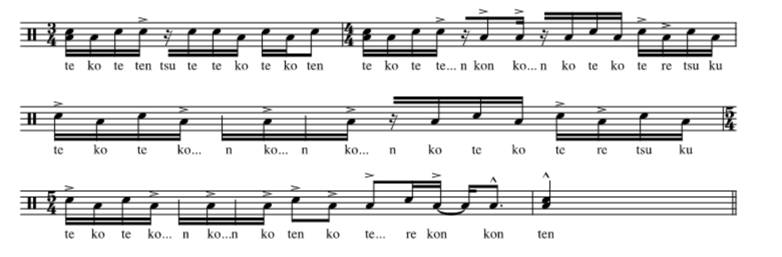
Activity 2.3 – rhythmic transformation (1)
Performing
The kuchi–shoga from 'Become'.
Digital Arts Unit (2025) The Beauty of 8 – ‘Become' – Digital Arts Unit [website], accessed 2 June 2025

Slide 32
Activity 2.3 – rhythmic transformation (2)
Composition
Composition option 1
Recreate your version of 'Become’ using the following structure.
Section A – divide into small groups. Make sure each group has a variety of different pitched drums. Each group creates a soundscape like the opening of the performance from the video. Put these together as part of the opening sequence of your version of 'Become’.
Section B – perform the opening kuchi–shoga from ‘Become’. Play this twice as a group. Over the next two repeats, two people improvise a solo in a call and response structure. This can go longer if you wish.
Section C – repeat the kuchi–shoga twice to end the performance.

Slide 33
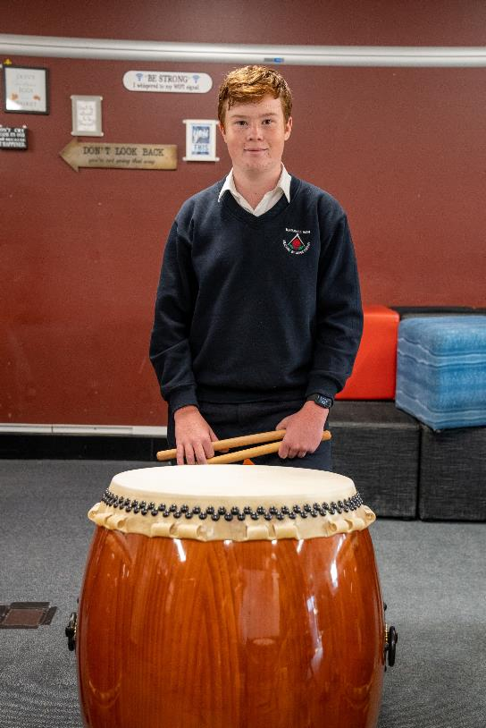
Activity 2.3 – rhythmic transformation (3)
Composition
Composition option 2
Create your own piece using your own structure.
Considering the things learned about the significance of the music in taiko drumming, use the 3 source pieces to create a new work. Give this work a title that reflects the significance of your creation.
The 3 source pieces are:
a soundscape using drums of your choice
the kuchi–shoga
call and response improvisation

Slide 34
Activity 2.4 – the significance of 7 (1)
‘Pearl’ composed by Ian Cleworth
‘Pearl’ by Ian Cleworth was originally composed in 2004 to celebrate Synergy Percussion's 30th anniversary, using a sextet of odaiko. The visual image of six grand drums lined up in a row evokes the horizon, which is a foundation concept of The Beauty Of 8. Playing the large odaiko is both musically and physically challenging, and the sense of struggle and transformation through performing the work is a perfect metaphor for the second part of The Beauty Of 8.
Access Attachment 1: ‘Pearl’ composer notes to read the composer’s perspective on composing the work. Discuss your thoughts and observations with the class.
Reflection question
Explain the significance of the title ‘Pearl’ and how it connects to Ian’s cultural background and the odaiko.

Slide 35
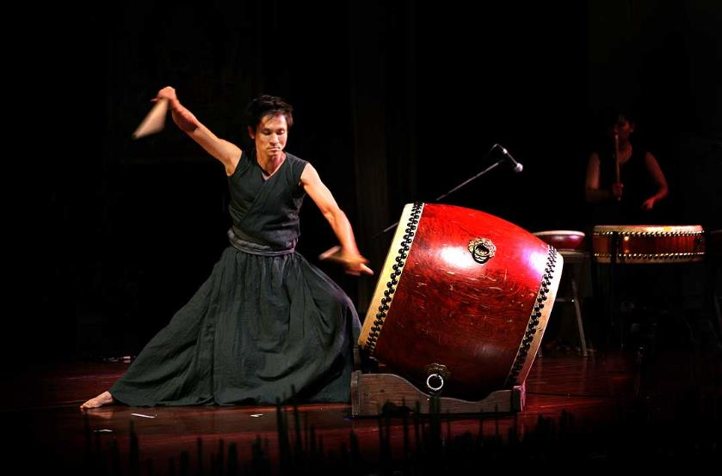
Activity 2.4 – the significance of 7 (2)
Discussion
Access the score for ‘Pearl’ and the performance by Taikoz to complete the activities below.
‘Pearl’ from ‘The Beauty of 8’ (54.06 – 57.36)
Reflection question
Explain the significance of the title ‘Pearl’ and how it connects to Ian's cultural background and the odaiko.
Taikwanese Taiko Drummer (2007) by Steve Evans, is licensed under Creative Commons 2.0 (accessed August 2025)

Slide 36
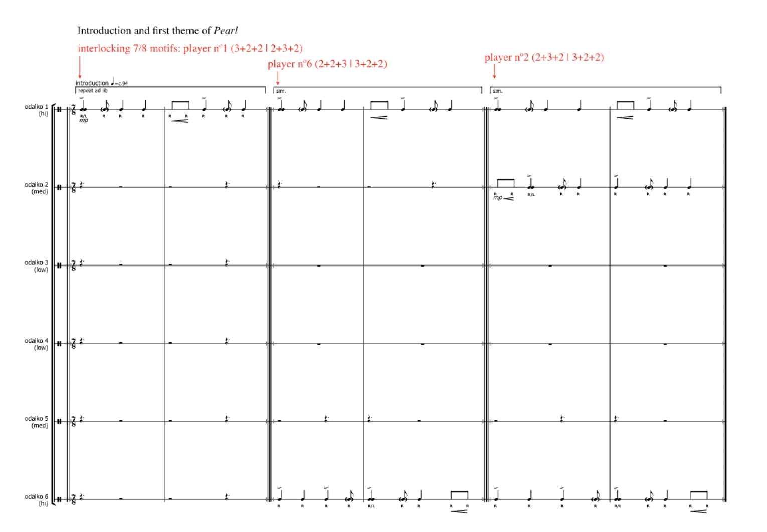
Activity 2.4 – the significance of 7 (3)
Score reading
Digital Arts Unit (2025) The Beauty of 8 – 'Pearl' – Digital Arts Unit [website], accessed 2 June 2025

Slide 37
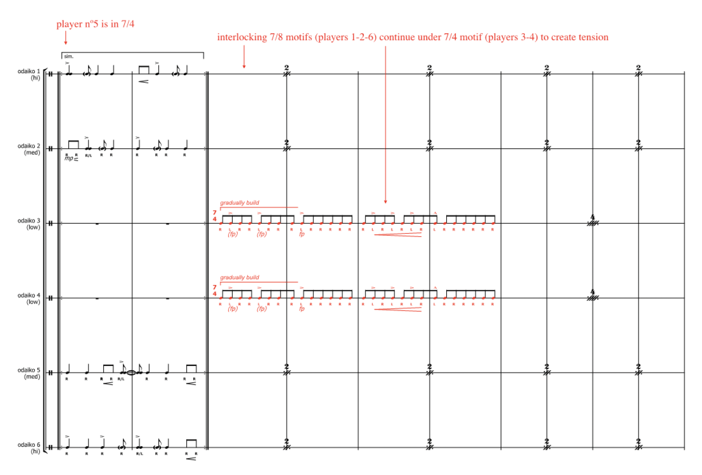
Activity 2.4 – the significance of 7 (4)
Score reading
Digital Arts Unit (2025) The Beauty of 8 – 'Pearl' – Digital Arts Unit [website], accessed 2 June 2025

Slide 38
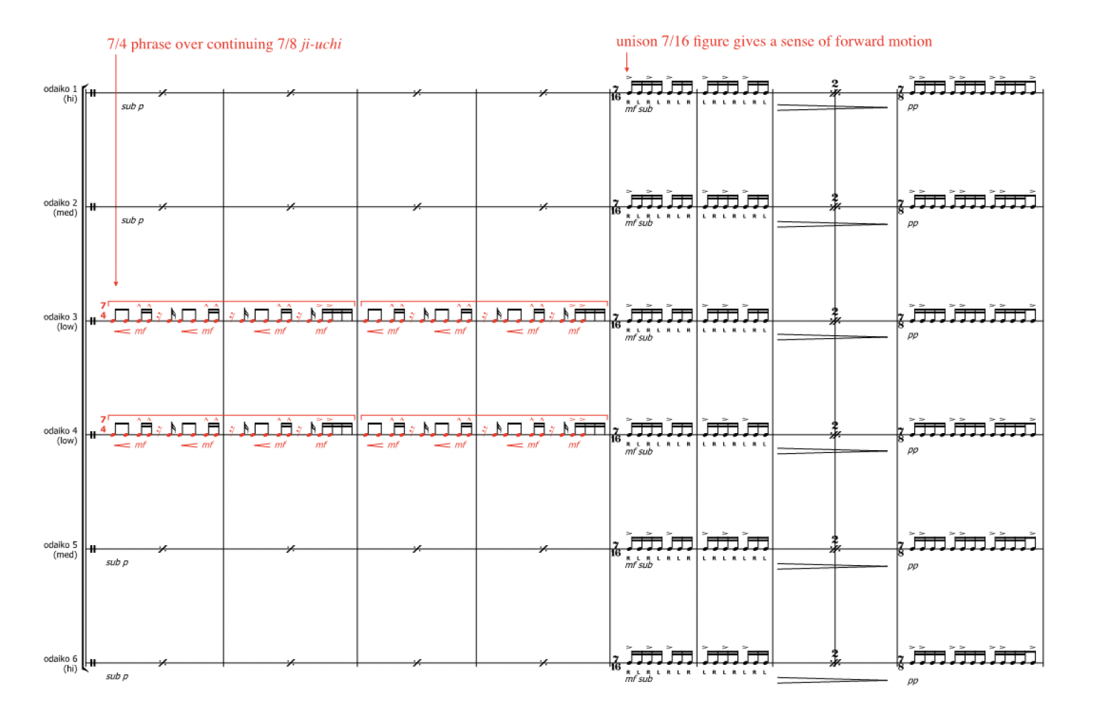
Activity 2.4 – the significance of 7 (5)
Score reading
Digital Arts Unit (2025) The Beauty of 8 – 'Pearl' – Digital Arts Unit [website], accessed 2 June 2025

Slide 39
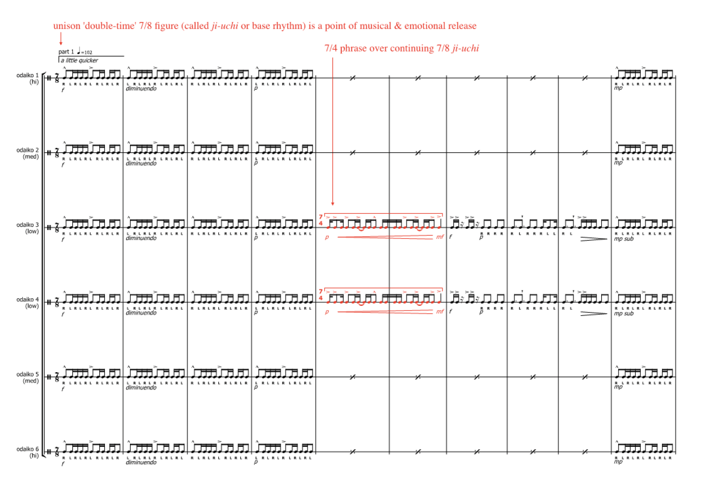
Activity 2.4 – the significance of 7 (6)
Score reading
Digital Arts Unit (2025) The Beauty of 8 – 'Pearl' – Digital Arts Unit [website], accessed 2 June 2025

Slide 40
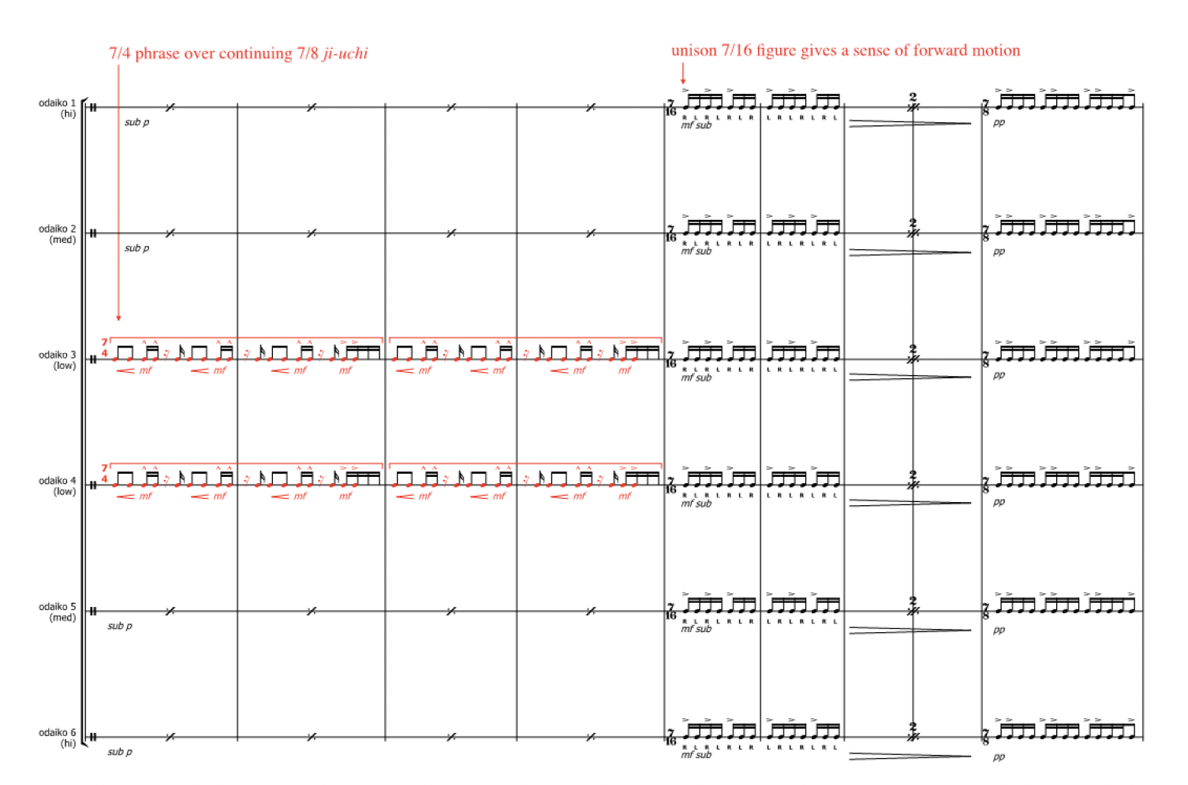
Activity 2.4 – the significance of 7 (7)
Score reading
Digital Arts Unit (2025) The Beauty of 8 – 'Pearl' – Digital Arts Unit [website], accessed 2 June 2025

Slide 41
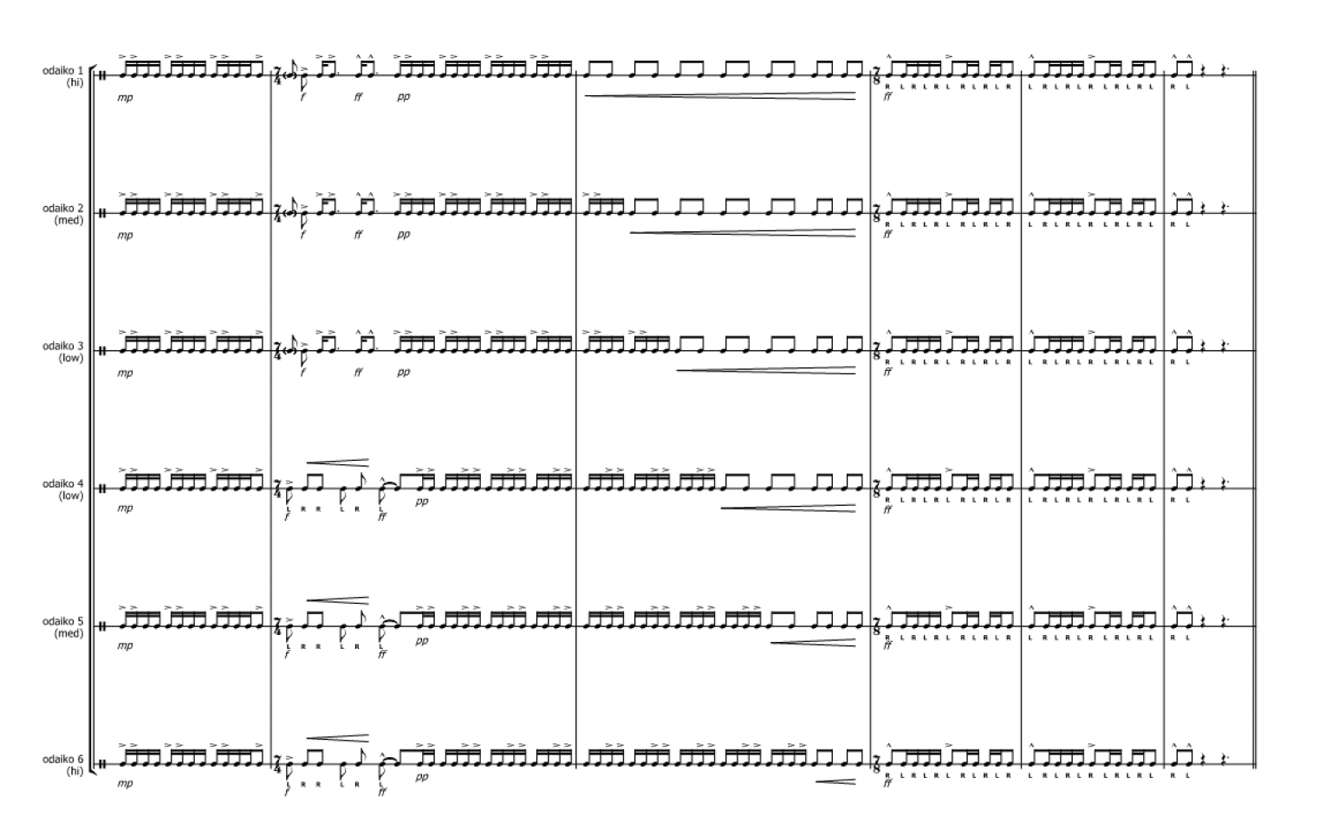
Activity 2.4 – the significance of 7 (8)
Score reading
Digital Arts Unit (2025) The Beauty of 8 – 'Pearl' – Digital Arts Unit [website], accessed 2 June 2025

Slide 42
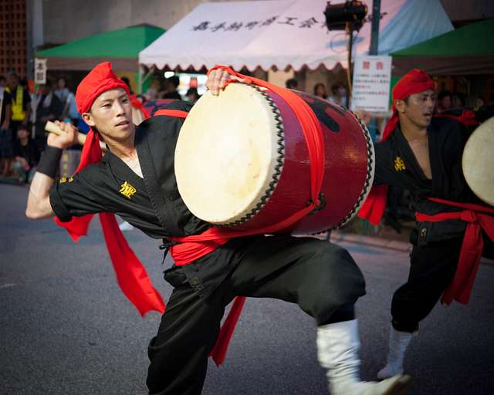
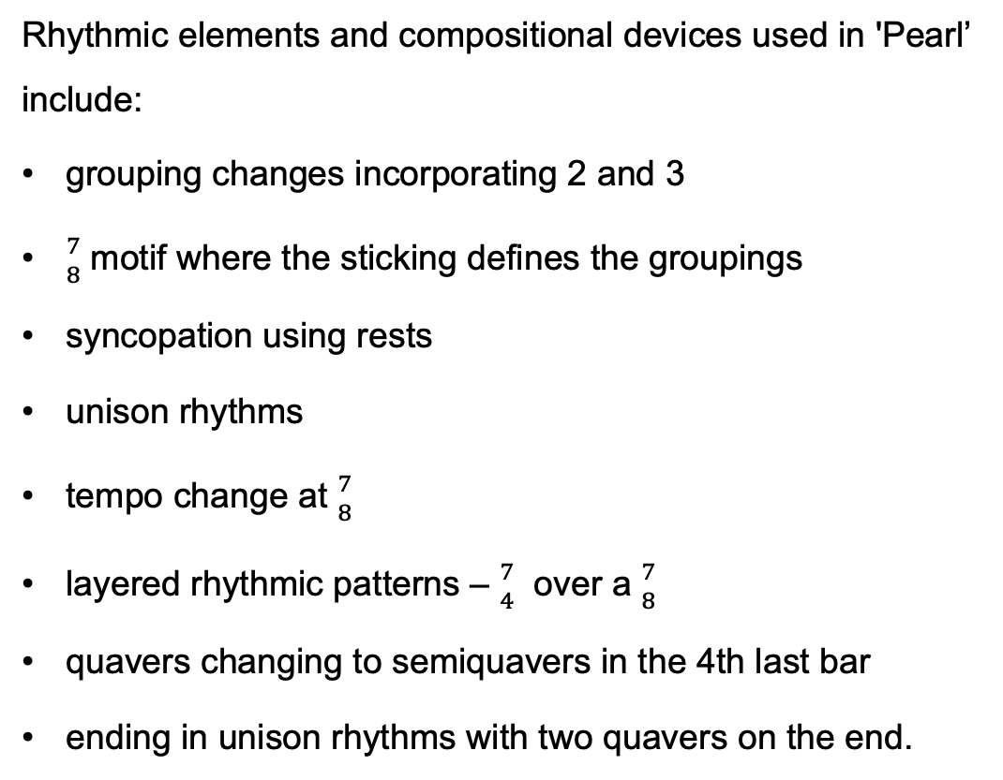
Activity 2.4 – the significance of 7 (9)
Score reading
Rhythmic elements and compositional devices used in 'Pearl’ include:
grouping changes incorporating 2 and 3
${7 \atop 8}$ motif where the sticking defines the groupings
syncopation using rests
unison rhythms
tempo change at ${7 \atop 8}$
layered rhythmic patterns – ${7 \atop 4}$ over a ${7 \atop 8}$
quavers changing to semiquavers in the 4th last bar
ending in unison rhythms with two quavers on the end.
A Taiko drummer performs during a Kadena Town Eisa (2015) by Master Sgt. Jason W. Edwards, is licensed under Creative Commons 2.0 (accessed August 2025)

Slide 43
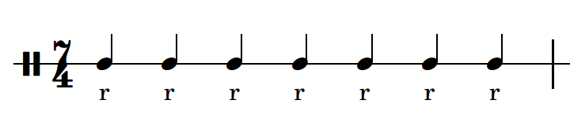
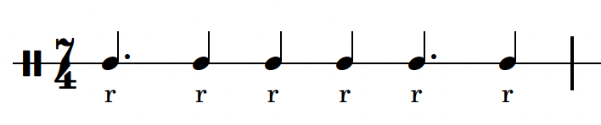
Activity 2.5 – practising ‘Pearl’ (1)
Performing
'Pearl' is based in ${7 \atop 4}$ . There are 7 different cells used in 'Pearl’. Perform each of these cells.
Cell 1 – 7 notes played with the right hand. Note the grouping of quavers for this pattern 2 + 2 + 2 + 2 + 2 + 2 + 2.
Cell 2 – 6 notes played with the right hand. Note the grouping of quavers for this pattern is 3 + 2 + 2 + 2 +3 + 2.

Slide 44
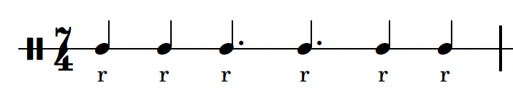
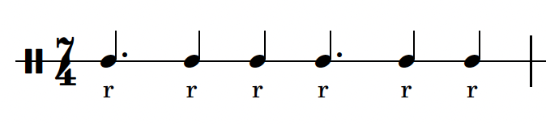
Activity 2.5 – practising ‘Pearl’ (2)
Performing
Cell 3 – 6 notes played with the right hand. Note the grouping of quavers for this pattern 2 + 2 + 3 + 3 + 2 + 2.
This is known as a palindrome rhythm – the same rhythm forwards or backwards.
Cell 4 – 6 notes played with the right hand. Note the grouping of quavers for this pattern is 3 + 2 + 2 + 3 + 2 + 2.

Slide 45
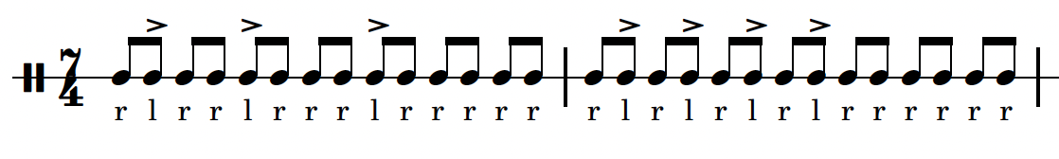
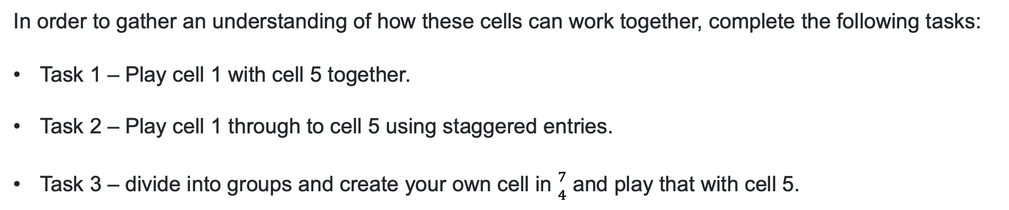
Activity 2.5 – practising ‘Pearl’ (3)
Performing
Cell 5 – all quavers. Note this is the 'Pearl' motif and uses accents on the left hand.
In order to gather an understanding of how these cells can work together, complete the following tasks:
Task 1 – Play cell 1 with cell 5 together.
Task 2 – Play cell 1 through to cell 5 using staggered entries.
Task 3 – divide into groups and create your own cell in ${7 \atop 4}$ and play that with cell 5.

Slide 46
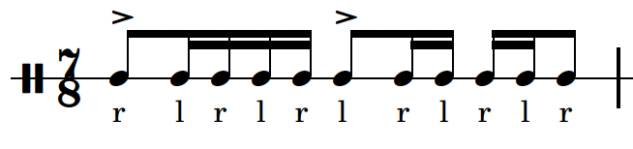
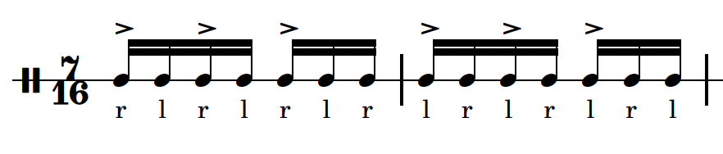
Activity 2.5 – practising ‘Pearl’ (4)
Performing
'Pearl' uses cells in different times signatures based on 7 – ${7 \atop 8}$ and ${7 \atop 16}$ . These cells can be played at the same time. It just means that the shorter cells will need to be played more than once when performed with a ${7 \atop 4}$ cell.
Cell 6 – this is based in quavers and is best practiced with cell 5. It will need to be played twice to finish at the same time as the ${7 \atop 4}$ quaver pattern. Note the accents are on quavers 1 and 4.
Cell 7 – this cell is based on semiquavers and is easier to play if you subdivide it into 2 + 2 + 3 semiquavers. This would be played twice to fit over a single ${7 \atop 4}$ bar.

Slide 47

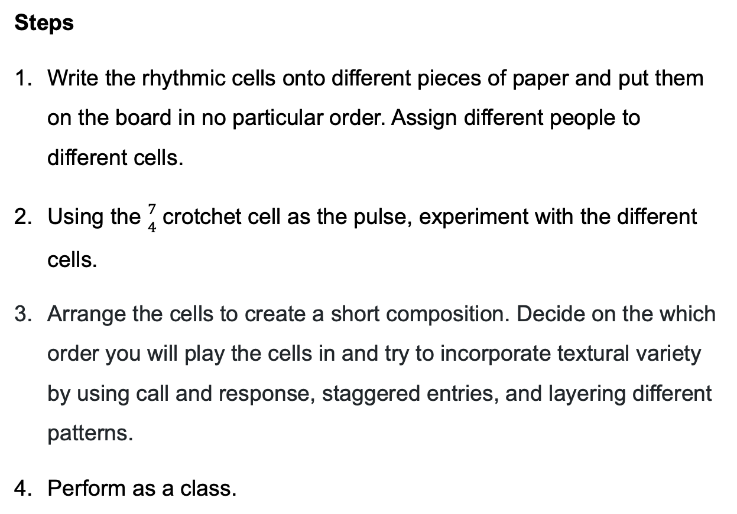
Activity 2.5 – practising ‘Pearl’ (5)
Composing
Steps
Write the rhythmic cells onto different pieces of paper and put them on the board in no particular order. Assign different people to different cells.
Using the ${7 \atop 4}$ crotchet cell as the pulse, experiment with the different cells.
Arrange the cells to create a short composition. Decide on the which order you will play the cells in and try to incorporate textural variety by using call and response, staggered entries, and layering different patterns.
Perform as a class.

Slide 48
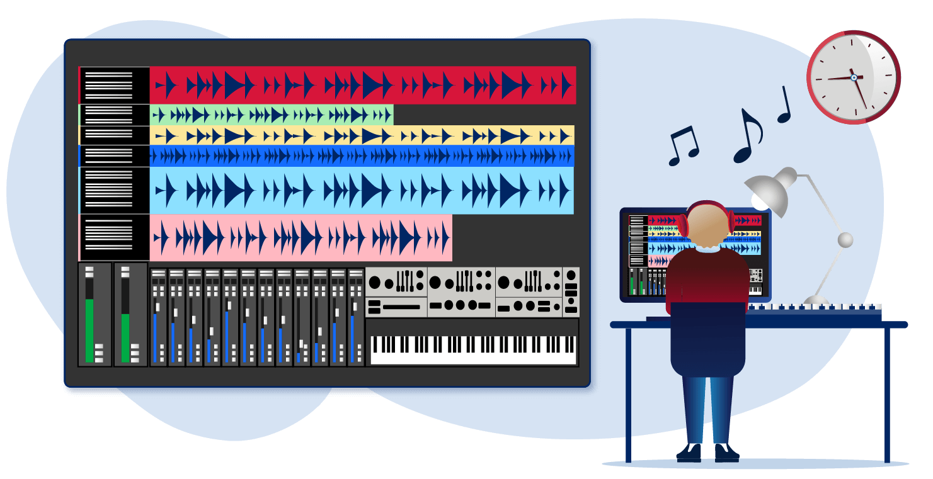
Learning sequence 3
Suzume unlocked – the sound of anime

Slide 49
Learning intentions and success criteria (3)
We are learning to
understand the cultural and musical context of Japanese anime, with a focus on Suzume and its soundtrack
analyse and compare melodic, rhythmic, and structural elements of music from different versions of the Suzume theme
apply compositional techniques to create a short original piece inspired by a visual or emotional theme.
We can
describe key features of anime and explain the cultural meaning of the title Suzume
analyse and perform the main theme from Suzume, including its melodic shape, rhythm, mode, and structure
compose and present a short piece of music that reflects the mood of an abandoned space using musical elements explored in class.
Notes:
Notes for teachers:
Learning intentions and success criteria are best co-constructed with students. Adapt the learning intention as required and add matching success criteria.
For more information See ⁠AITSL or the NSW Department of Education explicit teaching strategies, ⁠Sharing learning intentions and ⁠Sharing success criteria
LISC is not necessarily presented at the beginning of the lesson. Teacher needs to consider most effectual time to introduce
LISC should be revisited during the lesson to support students' evaluation of their learning

Slide 50
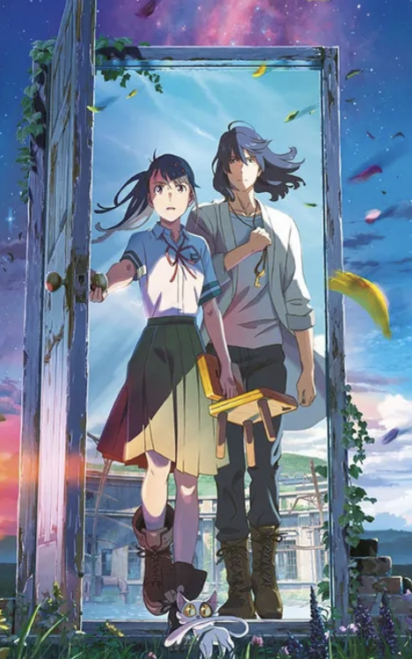
Activity 3.1 – discovering Suzume (1)
What does 'anime' mean?
In Japanese, the word ‘anime’ (アニメ) is simply a shortened form of the word ‘animēshon’ (アニメーション), which means animation in English. So, in Japan, ‘anime’ refers to all animation, regardless of origin. However, internationally, the term is typically used to refer specifically to Japanese animation.
What does 'Suzume’ mean?
In Japanese, ‘Suzume’ (すずめ/雀) means ‘sparrow’. It's a common name, and in Japanese culture, the sparrow is associated with grace, agility, resilience, and freedom.
Suzume/Suzume no Tojimari (2024) by marieauntaunet on DeviantArt. Used under Creative Commons BY-NC-ND 3.0 licence accessed November 2025.

Slide 51

Activity 3.1 – discovering Suzume (2)
Access Suzume | Official Trailer 1 | Netflix (0.00 - 0.13) and complete the following activities:
identify what action is taking place during the trailer.
create a list of events found in the trailer
drawing on the information you have gathered from experiencing the trailer, and your understanding of the meaning behind 'Suzume' and 'anime', what do you think the film is about?
in groups, create a short synopsis of the story.
Suzume (6 April 2024) ‘Suzume | Official Trailer 1 | Netflix.’, Suzume, YouTube, accessed 30 June 2025.

Slide 52
Activity 3.1 – discovering Suzume (3)
Listening
Access Suzume | Official Trailer 1 | Netflix (0.00 - 0.13) and complete the following activities using the worksheet provided.
Listen to the first 8 bars of music on the trailer. This is Suzume's theme.
Sing the theme and choose the correct rhythm. The melody uses these notes – D E F G A Bb C D.
What scale is this? To help you identify the scale, work out the tone and semitone pattern. Draw the treble clef and use an accidental in the scale.
Notate theme A from Suzume. Draw the treble clef and use the key signature for D minor.

Slide 53
Activity 3.2 – Suzume – the main theme (1)
Listening
Access the Suzume | Official Trailer 1 | Netflix. (0:00 – 1:00) trailer with the sound up to complete the following activities.
Identify the musical elements used in each section and give details. For example, ‘the melody is sung by young female voice’.
Time code 0.00 – 0.13 – what instruments do you hear? Identify pitch, duration, and texture elements.
Time code 0.14 - 0.26 – what has been added or changed in this section?
Time code 0.26 – 0.40 – what has been added or changed in this section?
Suzume (6 April 2024) ‘Suzume | Official Trailer 1 | Netflix.’, Suzume, YouTube, accessed 30 June 2025.

Slide 54

Activity 3.2 – Suzume – the main theme (2)
Listening
Access the RADWIMPS ~ Suzume no tojimari theme song (tiktok live) すずめ - feat. Toaka (0.00 - 0.24) on YouTube and complete the reflection question.
Reflection question
How is this version by RADWIMPS different from the trailer?
RADWIMPS featuring Toaka (30 September 2022) ‘RADWIMPS ~ Suzume no tojimari theme song (tiktok live) すずめ - feat. Toaka’, RADWIMPS featuring Toaka, YouTube, accessed 30 June 2025.

Slide 55
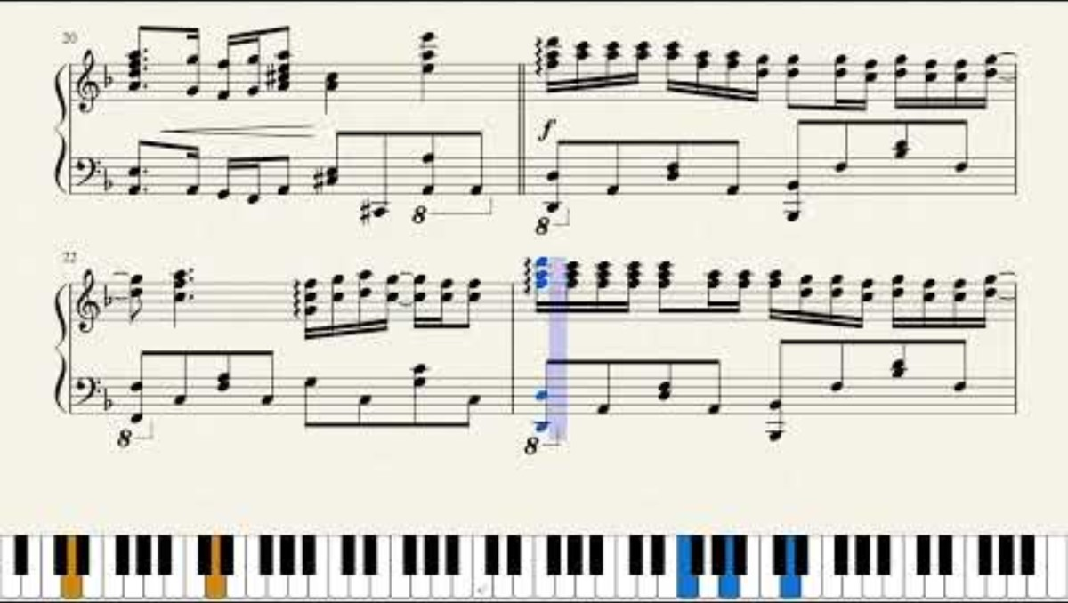
Activity 3.3 – comparison (1)
Listening
Access the Suzume - Full Main Theme [Piano Sheet Music] (0:00 – 3:40) and complete the reflection questions on the next slide.
Torby Brand (5 February 2024) ‘Suzume - Full Main Theme [Piano Sheet Music]’, Torby Brand, YouTube, accessed 4 July 2025.

Slide 56

Activity 3.3 – comparison (2)
Listening
Reflection questions​
in bars 5 – 8, what are the harmonic choices made by the composer? ​
how is the theme different from bars 1–4? ​
identify a better way to write the rolled seconds used in bars 5–8. ​
describe the pitch and duration elements used in the 4 transition bars – bars 9–12. ​
how is the theme treated in bars 13–16?​
how do bars 17–20 use repetition? ​
theme B (bars 21–26) is 6 bars long. Identify the chord progression used. How is the melodic structure different from theme A?​
Suzume 1 (2024) by Artanis Danvers on DeviantArt. Used under Creative Commons BY-NC-ND 3.0 licence.

Slide 57

Activity 3.4 – inside the composing process
Listening
Access Interview with the composers (RADWIMPS) on the soundtrack for Suzume (3.55 – 6.54), (7.47 – 11.15) and (29.47 – 31:16) and complete the questions:
Reflection questions
What were their initial thoughts about sketching out the sound of ‘Suzume’?
Why and how did they use the traditional sounds of Japanese music?
How did they capture the feeling of an abandoned place in Japan?
What was the creative process between RADWIMPS and Kazuma Jinnouchi like?
What did they learn during the recording process in London?
What do they hope viewers of the film ‘Suzume’ take away from the experience?
Suzume/Suzume no Tojimari (2024) by marieauntaunet on DeviantArt. Used under Creative Commons BY-NC-ND 3.0 licence (accessed November 2025).

Slide 58

Activity 3.5 – abandoned places (1)
Composition
The interview asked the composers how they captured the feeling of abandoned places in Japan using performing media that is not easily identified. Complete the follow steps to create your own ‘abandoned places’ composition.
Divide into groups and choose a place that is familiar to you.
Using a mood board, brainstorm what that place would look like if it were to become abandoned.
Create a list of musical examples focusing on the elements that would assist in developing the intention. (See the example on the next slide).
Green plant inside room illustration (2019) by PickPik, is licensed under Creative Commons 2.0 (accessed August 2025)

Slide 59
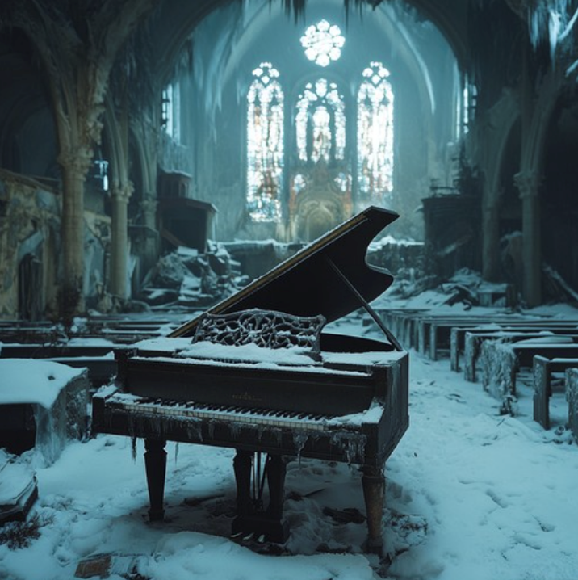
Activity 3.5 – abandoned places (2)
Composition
For example, one scenario could be an abandoned church with broken windows and shards of light streaming through dust in the air.
Pitch / melody – use a modal scale (dorian or aeolian) to create a haunting, ancient quality. Create a chant like motif which is stepwise with a narrow range as it relates to the church location. Occasional high register motifs represent the ‘shards of light’.
Using the material developed during the brainstorming process, create 30 seconds of music that captures your chosen abandoned place. Share your composition with the class.
Abandoned Snowy Piano (2024) by Stockcake, is licensed under Creative Commons 2.0 accessed August 2025

Slide 60
Learning sequence 4
From 8 bit to epic
Music in Japanese gaming

Slide 61
Learning intentions and success criteria (4)
We are learning to
understand and identify motifs in a range of musical contexts, including classical, film, and video game music
analyse how composers manipulate motifs through pitch, duration, dynamics, and expression to convey mood and character
apply compositional techniques to create original motifs and adapt them into loops across different meters and contexts.
We can
accurately identify a motif in different musical excerpts and describe changes to it using correct musical terminology
compare how motifs are developed in different genres (classical versus video game) and explain why the treatment suits its purpose
compose an original motif, develop it using compositional devices, and adapt it into a loop in multiple time signatures while keeping it musically coherent.
Notes:
Notes for teachers:
Learning intentions and success criteria are best co-constructed with students. Adapt the learning intention as required and add matching success criteria.
For more information See ⁠AITSL or the NSW Department of Education explicit teaching strategies, ⁠Sharing learning intentions and ⁠Sharing success criteria
LISC is not necessarily presented at the beginning of the lesson. Teacher needs to consider most effectual time to introduce
LISC should be revisited during the lesson to support students' evaluation of their learning

Slide 62




Activity 4.1 – What is a motif? (1)
Listening
Access the YouTube links below and identify the use of pitch, duration, dynamics and expression.
Excerpt 1 – John Williams – Star Wars Imperial March (with score) – (0:00 – 0:09)
Excerpt 2 – “James Bond Theme” | Score Reduction and Analysis – (0:00 – 0:12).
Excerpt 3 – Quick Guide: Beethoven's Fifth Symphony – (0:00 – 0:12).
A motif is like a musical catchphrase – a short, recurring musical idea

Slide 63
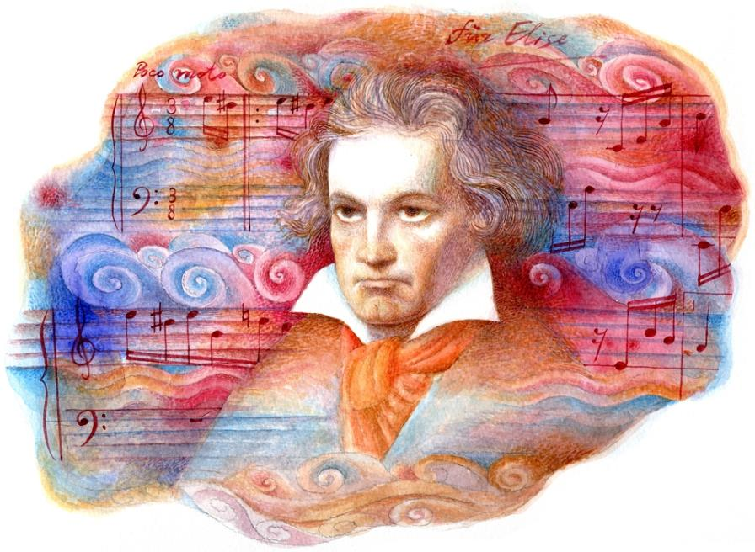
Activity 4.1 – What is a motif? (2)
Listening – Beethoven ‘Symphony No. 5’
Access ‘Beethoven Symphony No.5’ (0:16 – 0:59) and the ‘Beethoven Symphony No. 5 score and answer the following questions:
Reflection questions
How many times do you hear the motif?
Does it change?
How does it change?
What emotion/mood does it create?
What musical elements has he used to make this happen?
Ludwig van Beethoven, Classical Composer (2014) by Wannapik, is licensed under Creative Commons 2.0 (accessed August 2025)

Slide 64

Activity 4.1 – What is a motif? (3)
Listening – ‘Piranha Plant Cove’
Access ‘Piranha Plant Cove hi – Mario Kart 8 Deluxe OST’ and answer the questions below:
describe the motif that you hear focusing on pitch and duration.
how did the motif evolve?
compare the use of the motif to Beethoven. Did Kento Nagata use the same type of compositional devices to develop the motif or motifs?
why does this motif and its treatment suit a video game?
Mario Kart (2011) by Christian Flores, is licensed under Creative Commons 2.0 accessed August 2025
Motif map activity
Access a package of listening score cards. Listen to the recording again and arrange the score cards into the correct order.

Slide 65
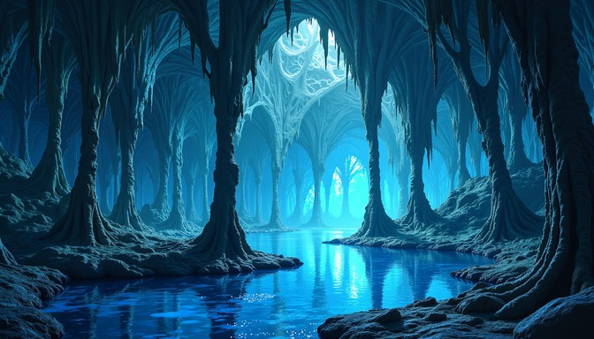
Activity 4.1 – What is a motif? (4)
Composition
Creative motif challenge
Compose a 4–8 bar motif for one of the following:
a villain entering
a secret cave level
a victory or power-up
To help you complete this activity, consider the scenario by discussing the scene (villain, secret cave, victory/power-up), link emotions to musical features like pitch/melody (high = tension, low = menace) and consider structured options, for example, ‘villain entering → slow, minor, dissonant intervals’.
Luminous cave cathedral (2024) by Stockcake, is licensed under Creative Commons 2.0 accessed August 2025

Slide 66
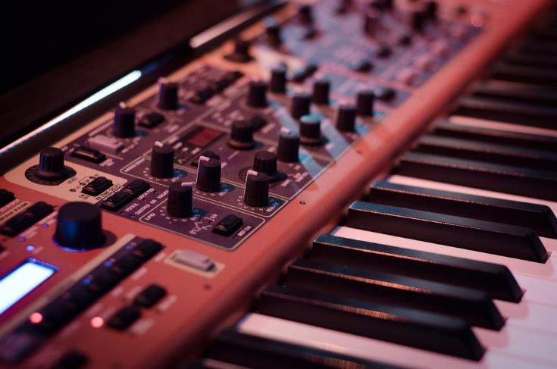
Activity 4.2 – loop-based composition (1)
What is the difference between a motif and a loop in gaming?
A motif is a short musical idea—a melodic, rhythmic, or harmonic fragment that is recognizable and repeatable. The function is to give identity to a character, place, or emotion (like a musical signature).
In gaming, motifs often represent a character or a recurring idea.
A loop is a repeating segment of music that is designed to play continuously without noticeable interruption. The function is to keep the background music consistent during gameplay.
In gaming, most loops can be heard in background tracks or menus (for example, Super Mario level themes).
Synthesizer instrument music (2017) by Pixabay, is licensed under Creative Commons 1.0 accessed August 2025

Slide 67

Activity 4.2 – loop-based composition (2)
Listening – ‘Super Mario Brothers’ and ‘Tetris’
Compare the loops from Super Mario Bros. Theme (Overworld) (0:00 – 1:28)
and Tetris Theme (0:00 – 1:23) and answer the following questions:
what is the structure of the example? (use A, B, C)
how is the loop constructed? (For example, bass line, chords, percussion)
what mood does each loop support?
Fun fact
The main melody in the game Tetris was originally a Russian folksong called ‘Korobeiniki’.
While the song was not originally composed for Tetris, it gained widespread recognition through
its use in the 1989 Game Boy version, where it was arranged by Hirokazu Tanaka.

Slide 68

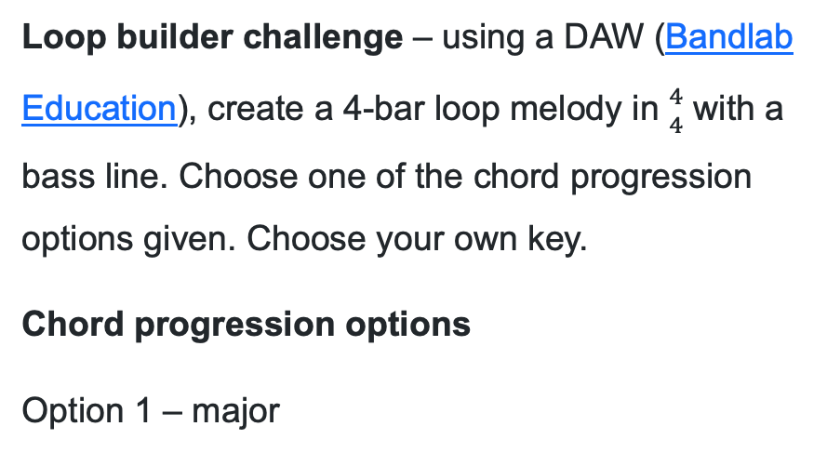
Activity 4.2 – loop-based composition (3)
Composition
Loop builder challenge – using a DAW (Bandlab Education), create a 4-bar loop melody in ${4 \atop 4}$ with a bass line. Choose one of the chord progression options given. Choose your own key.
Chord progression options
Option 1 – major
Option 2 – minor
Close up photo of turned on launchpad (2019) by PickPik, is licensed under Creative Commons 2.0 accessed August 2025

Slide 69


Activity 4.3 – metre madness (1)
Listening
Access the YouTube link Odd Time Signatures in Video Game Music (1:01 – 3:08) and answer the questions:
Reflection questions
Kingdom Hearts – ‘Hollow Bastion Music’ is driven by the ${5 \atop 4}$ clave pattern – notate it.
Identify the groupings of quavers used in this pattern.
Which role plays the clave rhythm – the bass part, the inner plucked string part or the melody?
Which role accents the clave rhythm – the bass part, the inner plucked string part of the melody?
Cat and rat playing video games together (2024) by easy-peasy.ai, is licensed under Creative Commons 4.0 accessed November 2025

Slide 70



Activity 4.3 – metre madness (2)
Composition and performance
Using the material created in the loop builder challenge, copy/adapt it to fit into these different time signatures.
${5 \atop 4}$
${3 \atop 4}$
${6 \atop 8}$
Loop battle mini game – perform your original 4 bar loop in ${4 \atop 4}$ . Select one person to be the ‘composition conductor’ who calls a new time signature every 8 bars while you perform. Adapt your playing to match the new time signature. Stay in time or risk elimination.

Slide 71

Learning sequence 5
Boss battles and beats
Music in Japanese gaming

Slide 72
Learning intentions and success criteria (5)
We are learning to
analyse how musical elements evoke emotions, images, and narrative possibilities
apply Nobuo Uematsu’s creative methods, including modular composition, influences, and the role of vocal and orchestral textures
identify features in other works and draw comparisons with Nobuo Uematsu’s compositions.
We can
accurately describe how specific musical elements (orchestration, choir, dynamics, tempo) create mood, drama, and tension
explain the emotions, imagery, or storylines the music suggests to me and connect them to musical techniques
explain how Uematsu composed ‘One-Winged Angel’, including his use of short musical phrases, influences, and his intention for the piece’s atmosphere.
Notes:
Notes for teachers:
Learning intentions and success criteria are best co-constructed with students. Adapt the learning intention as required and add matching success criteria.
For more information See ⁠AITSL or the NSW Department of Education explicit teaching strategies, ⁠Sharing learning intentions and ⁠Sharing success criteria
LISC is not necessarily presented at the beginning of the lesson. Teacher needs to consider most effectual time to introduce
LISC should be revisited during the lesson to support students' evaluation of their learning

Slide 73

Activity 5.1 – Nobuo Uematsu
Listening
Around the room are questions about ‘One–Winged Angel’. Access ‘One-Winged Angel (Final Fantasy VII)’ (0:00 – 4:25) and as you listen to the music, move around the room and respond to the questions.
Once finished, discuss the responses as a class.

Slide 74
Activity 5.2 – composing ‘One–Winged Angel’
Listening
Access ‘How Nobuo Uematsu Composed FF7's "One-Winged Angel"’ (0:00 – 4:18) and answer the following questions:
what inspired Nobuo Uematsu's compositional process for ‘One-Winged Angel’?
how long did Uematsu spend composing short musical phrases for the piece?
describe his daily routine during the composition process.
why did Uematsu choose to compose the piece using modular phrases rather than writing a continuous melody?
how did Uematsu describe the role of vocal elements (the Latin chorus) within the orchestral texture?
what compositional influences did he cite—such as specific classical or rock works—and how did they shape the piece’s mood?
how did Uematsu’s portrayal of Sephiroth inform the musical development of the theme?
according to Uematsu, what emotional tone or atmosphere was he trying to evoke with this piece?

Slide 75

Activity 5.3 – Who inspired Uematsu?
Listening analysis
‘I wanted the orchestral chaos of Stravinsky with the raw power of Hendrix.’ – Uematsu
Your teacher will provide you with a bag of written musical observations. Access ‘One​-​Winged Angel (Final Fantasy VII)’ (0:00 – 4:25). Sort the aural jigsaw into the correct order according to the recording of ’One-Winged Angel’.
Your teacher will provide you with a bag of written musical observations and a score. Access Stravinsky - The Rite of Spring (Official Score Video w/ Live Chat Commentary) (3:14 – 4:00). Listen to the recording whilst reading the score and attach the descriptions to the score.
Wondercon 2023 Cosplay–Final Fantasy VII–Sephiroth (2023) by Howie Muzika, is licensed under Creative Commons 2.0 accessed August 2025

Slide 76

Activity 5.4 – harmonic revision (1)
Analysis
Let's review tones and semitones.
A semitone is one step on a keyboard and a tone is two steps on a keyboard.

Slide 77
Activity 5.4 – harmonic revision (2)
Chord building
What are scale degrees?
Scale degrees are numbers used to label each note within a scale. The tonic note is always labelled 1.
In the space provided, write out the letters of the C major scale. Underneath each letter, number them from 1 to 8. They are your scale degrees.
C D E F​​​​ G A​ B C
1 2 3 4 5 6 7 8

Slide 78

Activity 5.4 – harmonic revision (3)
Chord building
How to build chords on a major scale
Once you have the scale, you build chords by putting either 2 line notes or two space notes on top of the bass note.

Slide 79

Activity 5.4 – harmonic revision (4)
Chord building
What is the quality of a chord?
When you build these chords and play them, the quality of the chord will always be the same if the scale is a major scale.
Chords 1, 4, and 5 will always be major.
Chords 2, 3 and 6 will always be minor.
Chord 7 will always be a diminished chord.

Slide 80
Activity 5.4 – harmonic revision (5)
Chord building
Identifying a scale from a key signature and working out chords from a scale
Identify the key signature – how many sharps or flats does it have?
Write the 8 notes from tonic to tonic.
Add the key signature.
Add the roman numerals which will identify the quality of each chord. Label them.

Slide 81

Activity 5.4 – harmonic revision (6)
Chord building
Example
Identify the key signature – this is a sharp key signature. Use the rule: identify the last sharp, raise it by a semitone. The last sharp is G#, raise a semitone and it becomes ‘A’. The key signature is A major.
Write the 8 notes from tonic to tonic – A B C D E F G A
Add the key signature – the key signature has three sharps – F#, C# and G#.
A B C# D E F# G# A
Add the roman numerals which will identify the quality of each chord. Label them.
[I, IV, V – major ii, iii, vi – minor vii – diminished]
A Bm C#m D E F#m G#dim A

Slide 82
Activity 5.4 – harmonic revision (7)
Modes and how they sound
There are 7 modes, and these are more commonly known as the ‘white note form of scales.’ Each of these modes have different qualities of sound depending on their combination of tones and semitones. These qualities of sound can be easily explained by dividing these scales in half.
The modes are
Ionian – C – C (C D E F G A B C)
Dorian – D – D (D E F G A B C D)
Phrygian – E – E (E F G A B C D E)
Lydian – F – F (F G A B C D E F)
Mixolydian – G – G (G A B C D E F G)
Aeolian – A – A (A B C D E F G A)
Locrian – B – B (B C D E F G A B)

Slide 83


Activity 5.4 – harmonic revision (8)
Modes and how they sound
Example
The ‘Ionian’ mode is all the white notes from C to C. We know this is C major (C D E F G A B C) and when divided in half, it has two ‘tetrachords’ - a sequence of four notes that span a perfect fourth:
These two ‘tetrachords’ when played individually have a ‘major’ sound because of the combination of tones and semitones. However, when you apply this strategy to the modes, you find that the sound is very different.

Slide 84


Activity 5.4 – harmonic revision (9)
Modes and how they sound
For example
The ‘Dorian’ mode, when divided into half, produces a minor sound for both halves.
Some modes have ambiguous combinations that do not fit into the major or minor mould.

Slide 85


Activity 5.4 – harmonic revision (10)
Modes and how they sound
For example
The ‘Phrygian’ mode is considered an ambiguous mode, which is one of the reasons why it used in a lot of film music. This mode, when divided into two halves, does not fit into either of the major or minor tone and semitone sequence.
Apply this strategy to the remaining modes.
What do you notice?
Why and how is this information useful?

Slide 86

Activity 5.4 – harmonic revision (11)
Identifying chords in modes
Using the ‘Phrygian’ mode, name these chords.

Slide 87

Activity 5.4 – harmonic revision (12)
Identifying chords in modes
Here are the answers. You will notice that the quality of the chords do not follow the same pattern as major chords, and that the pattern is different for each mode.

Slide 88


Activity 5.5 – harmonic exploration in ‘One-Winged Angel’ (1)
Listening
‘One–Winged Angel’ uses shifting keys (E Locrian, D minor, E minor), intense dissonances (for example, a chord made up of E–G–A–Bb), and the juxtaposition of time signatures
${4 \atop 4}$ and ${7 \atop 8}$ to create harmonic and rhythmic variety.
Listen to the three excerpts from ‘One–Winged Angel’ and answer the questions:
how does the harmony make you feel?
does the rhythm feel predictable or chaotic? Why?
can you explain the influence from Stravinsky?
why is E–G–A–Bb considered dissonant?
Final Fantasy VII: Rebirth - Sephiroth (Official) by Alascokevin1 on DeviantArt. Used under Creative Commons BY-NC-ND 3.0 licence. Accessed 4th November 2025

Slide 89
Activity 5.5 – harmonic exploration in ‘One-Winged Angel’ (2)
Composition
‘One–Winged Angel’ uses the following scales/modes:
E Locrian (dark, unstable: E–F–G–A–B♭–C–D)
D minor (sombre and dramatic)
E minor (slightly more grounded, traditional minor)
Composition activity
Using an E minor key signature, explore chord progression options.
Work in pairs to create an unusual chord progression using chords from E minor, D minor and E Locrian (E–F–G–A–B♭–C–D)
Try modifying the chord to create dissonance. For example, swap a chord for one with a b5 or b9, or consider suspensions)

Slide 90

Learning sequence 6
Gagaku
The traditional court music of Japan

Slide 91
Learning intentions and success criteria (6)
We are learning to
understand the historical and cultural context and practices of gagaku music
use listening skills to analyse gagaku music
stylistically manipulate and combine the elements of music to create musical ideas.
We can
use shōga to learn rhythm and melody when singing
name and identify the instruments and musical features found in gagaku music
create and perform a short composition using gagaku musical features.
Notes:
Notes for teachers:
Learning intentions and success criteria are best co-constructed with students. Adapt the learning intention as required and add matching success criteria.
For more information See ⁠AITSL or the NSW Department of Education explicit teaching strategies, ⁠Sharing learning intentions and ⁠Sharing success criteria
LISC is not necessarily presented at the beginning of the lesson. Teacher needs to consider most effectual time to introduce
LISC should be revisited during the lesson to support students' evaluation of their learning

Slide 92

Activity 6.1 – exploring gagaku
Context
Gagaku is Japan’s oldest form of music and was traditionally performed in the Imperial Court of Japan from the 7th century to the 12th century. It is still performed today by gagaku ensembles.
The roots of gagaku come from the influence of dance and instrumental music from Korea and China. It features a unique ensemble of wind, string and percussion instruments who perform ceremonial music which is sometimes accompanied by dance.
There are three types of gagaku music which includes:
kangen (instrumental)
bugaku (dance with instrumental accompaniment)
kayō (singing poetry with instrumental accompaniment).
Gagaku concert (2010) by Antanana, is licensed under Creative Commons Attribution-Share Alike 3.0 accessed November 2025

Slide 93



Activity 6.2 – performing ‘Etenraku’ (1)
Context
The piece you just listened to was called ‘Etenraku’ meaning, ‘music of divinity’, and is the most well-known work of the gagaku repertoire. It consists of 3, 8 bar melodic phrases in a slow ${4 \atop 4}$ and is commonly performed using the hyōjō mode based on E. Sing the hyōjō mode as a class.
In gagaku, modes are associated with the four seasons to set the mood and favour performances during certain seasons, reflecting a deep cultural connection between music, time and the natural world. This concept is called ‘toki no koe’ (sound of the time). The hyōjō mode is linked to the season of autumn.
Red leaves in autumn (2023) by Dagmara Dombrovska on pexels.com, is licensed under Creative Commons Zero (COO) license accessed November 2025

Slide 94

Activity 6.2 – performing ‘Etenraku’ (2)
Japanese music teaching traditions
Gagaku musicians learn how to play the music using traditional Japanese teaching methods. These include:
the use of ‘shōga’ (sung syllables to learn the musical material)
a master and apprentice model (the master teaches a student through observation, repetition and guidance)
oral learning traditions
notation (although rarely used, each instrument has its own specific notation).
Combing his hair – print by Suzuki Harunobu (2017) by Metropolitan Museum of Art is licensed under Creative Commons CCO 1.0 license accessed November 2025

Slide 95
Activity 6.2 – performing ‘Etenraku’ (3)
What is shōga?
In gagaku, shōga are the sung syllables used by musicians to learn and internalise the melody or musical material of a piece. These sung phrases are memorised and are an essential part of the learning process before playing the piece on their instrument. This process helps performers to:
establish the melodic structure – by singing, a performer gains deep understanding of its form and phrasing
preserve tradition – the vocal syllables help transmit the music accurately from master to apprentice, maintaining the oral tradition
internalise ornamentation – for the hichiriki for example, the syllables represent the delicate melodic variations that are difficult to document.

Slide 96

Activity 6.2 – performing ‘Etenraku’ (4)
Shōga syllables for ‘Etenraku’
The syllables of the shōga express the melody systematically. Consonants indicate phrasing and performance techniques, and vowels indicate pitch in relative terms.
consonants – ‘t’ is almost always used at the beginning of phrases, ‘r’ is for melodic movement up or down within a phrase, and ‘f’ signifies a performance technique in which an accent is added to a repeated tone by hitting the nearest open fingerhole of the instrument.
vowels – ‘u’ indicates the lowest pitch, ‘I’ indicates the highest pitch. The other vowels generally fit into this range from low to high pitch in the following order: u, o, a, e, i.
Each instrument used in gagaku has its own specific shōga syllables. The shōga for the hichiriki melody used in ‘Etenraku’ is below. Sing the melody as a class using the shōga syllables, then play it on an instrument of your choice. Focus on rhythm, tone and breathing.

Slide 97
Activity 6.4 – influence and innovation gagaku style
Composition
Working in small groups, create a short, gagaku inspired composition of approximately 30 seconds to one minute, which includes some of the following musical features of gagaku:
very slow tempo
staggered instrument entries
heterophonic texture
use of modes
long, drawn out phrases
use of space and silence
Perform your composition to the class.
Reflection questions
What worked well?
What was challenging about the task and how did you resolve this?
What did you notice about the texture?

Slide 98

Learning sequence 7
The future voice
Hatsune Miku and J-pop

Slide 99
Learning intentions and success criteria (7)
We are learning to
understand how technology shapes the sound and identity of J-pop and Vocaloid music
analyse harmonic progressions and textural features in J-pop repertoire
explore authorship and identity in technology-driven music.
perform J-pop progressions, hooks and textures using live instruments and voice.
We can
describe the role of Vocaloid technology in performance and production
identify and perform common chord progressions used in J-pop.
compare different versions of the same piece, explaining how musical features are manipulated
perform short melodic hooks and layered textures inspired by J-pop and Vocaloid styles.
Notes:
Notes for teachers:
Learning intentions and success criteria are best co-constructed with students. Adapt the learning intention as required and add matching success criteria.
For more information See ⁠AITSL or the NSW Department of Education explicit teaching strategies, ⁠Sharing learning intentions and ⁠Sharing success criteria
LISC is not necessarily presented at the beginning of the lesson. Teacher needs to consider most effectual time to introduce
LISC should be revisited during the lesson to support students' evaluation of their learning

Slide 100


Activity 7.1 – What is a Vocaloid? Who is Hatsune Miku? (1)
Access Explaining Vocaloid in under 3 minutes (0:00-2:19) and consider the following questions:
Who is the ‘artist’ in Vocaloid music — the programmer, the character, or the audience?
How does technology change our idea of performance and authorship?
Hatsune Miku vector 2 by PuppetCapulet on DeviantArt. Used under Creative Commons BY-NC-ND 3.0 licence.
Crunchyroll (15 May 2012) What is Vocaloid? (2:19) [video],
Crunchyroll, YouTube, accessed 26 September 2025

Slide 101

Activity 7.1 – What is a Vocaloid? Who is Hatsune Miku? (2)
Access Hatsune Miku World is Mine / ryo (supercell) (0:00-2:56) and discuss the following questions:
What instruments or sounds can you identify?
How does the synthetic vocal sound compare to a human singer?
How is the audience responding in live concert footage?
Fun fact!
The name of the character comes from merging these Japanese words:
初, hatsu = first
音, ne = sound
ミク, miku = future
‘The first sound of the future’
Hatsune Miku vector 2 by PuppetCapulet on DeviantArt. Used under Creative Commons BY-NC-ND 3.0 licence.
Crypton Future Media (22 May 2011) World is Mine live performance (4:19) [video], Crypton Future Media, YouTube, accessed 3 September 2025

Slide 102


Activity 7.1 – What is a Vocaloid? Who is Hatsune Miku? (3)
Vocaloid rhythm starter
Start a class pulse.
  everyone clap or tap a steady 4-beat pulse
Add a chant – use call and response.
  one group chants 'Hatsune Miku' on the beat
  another group chants it off the beat
Build layers – texture development.
  add body percussion such as pats, clicks or stamps using the vocal rhythms
  add another short phrase, such as ‘Vocaloid' or 'future voice'
Create your mini performance.
  each group keeps their part going while others layer on top
  change the volume, swap roles, or drop parts in and out.

Slide 103
Activity 7.1 – What is a Vocaloid? Who is Hatsune Miku? (4)
Reflection questions
How does this sound like the loops and layers used in Vocaloid music?
What do you notice about the rhythms used in Vocaloid music?
How is repetition used to build energy and drive?
How do different layers (voice, percussion, synth) fit together to create texture?
How does digital precision (perfect timing, quantised beats) affect the feel of the music?
In our class performance, which parts remind you of the layers you hear in Vocaloid tracks?
Hatsune Miku vector 2 by PuppetCapulet on DeviantArt. Used under Creative Commons BY-NC-ND 3.0 licence.

Slide 104

Activity 7.1 – What is a Vocaloid? Who is Hatsune Miku? (5)
Listening – ‘Anamanaguchi’
Access Anamanaguchi - Miku ft. Hatsune Miku (Lyric Video) (0:14-3:58) and complete the following activities :
graphically notate the main melodic motif.
identify two different performing media that use this motif.
Hatsune Miku vector 2 by PuppetCapulet on DeviantArt. Used under Creative Commons BY-NC-ND 3.0 licence.
Hatsune Miku (24 May 2016) Anamanaguchi – Miku ft. Hatsune Miku (Lyric Video) (3:58) [video], Hatsune Miku, YouTube, accessed 3 September 2025

Slide 105
Activity 7.1 – What is a Vocaloid? Who is Hatsune Miku? (6)
Extension activity
Create a class mind map or KWLH table (an example is provided on the next slide) to show what we’ve learned about Hatsune Miku and Vocaloid music.
This could include observations regarding:
musical features (melody, rhythm, texture, technology)
cultural features (identity, audience, performance)
emotions or ideas the music communicates
key vocabulary such as Vocaloid, synthesis and identity.
Hatsune Miku vector 2 by PuppetCapulet on DeviantArt. Used under Creative Commons BY-NC-ND 3.0 licence.

Slide 106
Activity 7.1 – What is a Vocaloid? Who is Hatsune Miku? (7)
Wh | What do I want to know? | What have I learned? | How can I learn more?
K
What do I know?
W
What do I want to know?
L
What have I learned?
H
How can I learn more?

Slide 107


Activity 7.2 – from folk to future (1)
Listening – ‘Ievan Polkka’
Access excerpts from two different versions of ‘Ievan Polkka’ – a Finnish folk melody with lyrics written by Eino Kettunen in 1928. Complete the activities on the next slide.
Hatsune Miku – ‘Ievan Polkka’ (0:00-1:22)
Korpiklaani – ‘Ievan Polkka’ (0:00-1:01)
Hatsune Miku (27 April 2024) Ievan Polkka (Remastered 2024) (2:57) [video], Hatsune Miku, YouTube, accessed 15 October 2025
Korpiklaani (20 March 2019) Ievan Polkka (3:08) [video],YouTube accessed 15 October 2025

Slide 108
Activity 7.2 – from folk to future (2)
Listening – ‘Ievan Polkka’
Step 1 – divide into two groups
group A focuses on the Hatsune Miku version.
group B focuses on the Korpiklaani version.
Step 2 – listen to both excerpts twice
on large paper or small whiteboards, write what you notice about performing media, pitch and texture.
every group member should contribute one observation or add further detail to an existing observation.
Step 3 – build on each other’s work
swap your notes and shift your listening focus to the other version.
listen to both versions twice again.
add extra comments or differences you notice between the two versions.
Reflection questions
How does technology and style change the way we experience this traditional Finnish song?
What other elements of music could you discuss in detail with these two excerpts?

Slide 109
Activity 7.2 – from folk to future (3)
Extension listening – ‘Ievan Polkka’ score analysis
Access the sheet music for ‘Ievan Polkka’ on Musescore (or similar). Make sure there is a concert pitch instrument in whatever version you choose. Here are a few options: ‘Ievan Polkka’ version 1 (score) or ‘Ievan Polkka’ version 2 (score).
Identify the key signature of this piece of music.
What is the tonality of this piece of music? Major? Minor? Modal?
What is the first note used in the bass line? How would you describe this bass line? Is it similar to other styles of music you are familiar with?
Thinking about what you already know about scales and modes, identify the scale or mode the main melody of ‘Ievan Polkka’ uses.
Write out 2 octaves of this scale or mode on a blank stave using crotchets and accidentals in both treble and bass clef. Pay close attention to stem direction and ledger lines as required.
Label each note and identify the interval between each.
Write out the harmonic progression for two different 8-bar sections of ‘Ievan Polkka.’

Slide 110
Activity 7.3 – a ‘Polkka’ performance (1)
Performing
Access the sheet music for Ievan Polkka on Musescore. Options include: ‘Ievan Polkka’ version 1 (score) or ‘Ievan Polkka’ version 2 (score).
Learn the main melodic hook, syncopated/off-beat chords and bass line together as a group.
Break into small ensembles and work on arranging a performance of this song, focusing on balance and blend between your ensemble members. Keep a steady pulse and experiment with different dynamics.
In small groups, add your own rhythmic or improvised elements:
  try layering short rhythmic ostinato.
  add a countermelody or simple harmony.
  experiment with some melodic improvisation and trading solos between instruments.
  Perform your arrangement for the class.

Slide 111

Activity 7.3 – a ‘Polkka’ performance (2)
Performing
After your performance, reflect as a group on how the musical elements worked together:
How did the bass line and melody interact?
What role did each performer have in maintaining groove and texture?
What musical decisions made your version feel more ‘future’ than ‘folk’, or did it feel more ‘folk’ than ‘future’?
Were there any limitations that impacted this, for example, the instrumentation you have available may lend itself to more of a folk or future sound?
How did your live performance compare to the Vocaloid recording?
Optional extension activity
Record your performance and evaluate it using the elements of music.
Suggest one way you could refine or further develop the texture or rhythmic energy.

Slide 112

Activity 7.4 – reimagining the ‘Ievan Polkka’ (1)
Composition
Access the bass line, chord progression or melodic hook from 'Ievan Polkka' as your starting point.
Create a short remix, reinterpretation, or reimagined section that connects the folk origins of the piece with future digital or experimental sounds. The composition should:
be 30-60 seconds in length, with a clear sense of pulse, textural layering and contrast
contain original melodic or harmonic material that remains recognisable but altered through tempo, instrumentation or effects
consider common successful approaches such as slowing the tempo, using ambient synths, adding a trap or hip-hop beat under the folk tune, or creating a bright electronic remix using loops and samples.

Slide 113

Activity 7.4 – reimagining the ‘Ievan Polkka’ (2)
Composition
Use a DAW (Bandlab Education) or similar to complete the following steps:
Choose 4–8 bars of material from the original.
Experiment by changing the tempo, texture, or performing media.
Experiment with layering new rhythmic or electronic elements.
Use loops or samples to create contrast and variation between sections.
Give your composition an appropriate title. For example, 'Polkka Rewired', 'Neo-Folk Mix' or 'Future Spinner’.

Slide 114
Activity 7.4 – reimagining the ‘Ievan Polkka’ (3)
Composition reflection
Share your remix or reinterpretation with the class.
Reflection questions
Which elements of 'Ievan Polkka' did you keep, and which did you transform?
How do your choices in texture, pitch or duration show influence from both folk and electronic styles?
What performing media or technologies helped you achieve your sound?
How does your version reflect influence and innovation?
Extension
Write a short artist statement (2–3 sentences) explaining the intention behind your remix and how it connects to the idea of from ‘folk to future’. Export or perform your remix live with MIDI controller or backing track.

Slide 115

Learning sequence 8
In the loop
Using a loop-based Digital Audio Workstation (DAW)

Slide 116
Learning intentions and success criteria (8)
We are learning to
understand how digital tools can be used to create, layer and refine music in a loop-based Digital Audio Workstation (DAW)
apply knowledge of the elements of music to compose and structure original ideas
use technology to record, edit and balance multiple layers of sound
reflect on and document our compositional process through a digital process journal.
We can
create, arrange and refine musical layers in BandLab for Education (or our preferred DAW)
manipulate the elements of music, including texture, dynamics, duration and timbre, to shape a coherent musical idea
apply saving, exporting and file management routines to preserve work
describe and evaluate how technology supports musical expression and creative decision-making
document our process using screenshots, annotations and reflection statements.
Notes:
Notes for teachers:
Learning intentions and success criteria are best co-constructed with students. Adapt the learning intention as required and add matching success criteria.
For more information See ⁠AITSL or the NSW Department of Education explicit teaching strategies, ⁠Sharing learning intentions and ⁠Sharing success criteria
LISC is not necessarily presented at the beginning of the lesson. Teacher needs to consider most effectual time to introduce
LISC should be revisited during the lesson to support students' evaluation of their learning

Slide 117

Activity 8.1 – getting started in a loop-based DAW (1)
What is a DAW?
A Digital Audio Workstation (DAW) is software used to record, arrange and produce music.
A DAW allows you to combine different sounds, instruments and effects to create and edit complete tracks.
Music production focus (2024) by Stockcake, is licensed under Creative Commons 2.0. Accessed 30 October 2025.
What is a loop?
A loop is a short section of sound that repeats continuously.
Loops can be rhythmic, melodic or harmonic — and when layered together, they form the building blocks of a song.
The word comes from the process of cutting a piece of analog recording tape and sticking it back together in a loop shape, allowing it to playback over and over again without needing to rewind or restart it.

Slide 118

Activity 8.1 – getting started in a loop-based DAW (2)
What can I do in BandLab for Education?
BandLab for Education is a DAW that runs in your web browser. You can use it to:
build music with loops and samples
make your own parts using MIDI and virtual instruments
record live voice or instruments
mix, refine and export your work as a finished track.
There are lots of other DAWs that offer the ability to work with pre-recorded loops: Ableton Live, FL Studio and GarageBand are just a few. Other DAWs that are more focused on audio recording than looping include ProTools, Cubase, Logic Pro and Audacity.
A person using a laptop (2022) by Surface, is licensed under Unsplash Licence. Accessed 30 October 2025
edu.bandlab.com

Slide 119

Activity 8.1 – getting started in a loop-based DAW (3)
Composition – experimentation
Access BandLab For Beginners - Basic BandLab Tutorial (19:33).
Complete the following activities:
start a new project
change the tempo and key
explore loops and tracks
learn how to name and save your work
learn how to take a screenshot of your project.
BandLab For Beginners - Basic BandLab Tutorial (19:33) [video], Inclusive Music (2018), YouTube, accessed 29 October 2025

Slide 120

Activity 8.1 – getting started in a loop-based DAW (4)
The composition portfolio
Purpose
The composition portfolio shows how the composition has developed from first idea to final mix.
It provides evidence of influence and innovation and helps to prepare for the assessment submission. Complete the following steps that detail what information should be included in the composition portfolio.
1. Select evidence
Include clear screenshots that show:
project overview with tracks and layers visible
piano roll or MIDI editor for melodic/rhythmic ideas
mixer view (volume, panning, effects, automation)
examples of stylistic features or techniques you adapted
save one screenshot for each key stage — first idea, development, refinement, and final mix.
Music production focus (2024) by Stockcake, is licensed under Creative Commons 2.0. Accessed 30 October 2025.

Slide 121

Activity 8.1 – getting started in a loop-based DAW (5)
The composition portfolio
2. Write reflection statements
For each screenshot, write 2–3 short sentences explaining:
what you changed
why you made the change
how it improved your composition.
Use these starters to help:
I changed… because…
This improved my piece by…
I decided to… after feedback from…
One influence I used here was…

Slide 122

Activity 8.1 – getting started in a loop-based DAW (6)
The composition portfolio
3. Show stylistic influence
In your written responses:
connect your creative decisions to the styles studied: taiko, gagaku, J-pop, and/or video game music.
mention how you used elements of music (such as duration, texture, timbre, or dynamics and expression) to reflect your chosen influence.
4. Check your submission
Before exporting and submitting:
confirm your mix and automation are complete.
make sure all project files are saved and named clearly.
export your final mix as an MP3 or WAV file.
review your journal for completeness and clarity.
Music production launchpad (2017) by Luca Bravo, is licensed under Creative Commons CCO 1.0.accessed 9 November 2025.

Slide 123

Activity 8.1 – getting started in a loop-based DAW (7)
The composition portfolio
Success criteria
Your composition portfolio:
includes labelled screenshots showing each stage of development
explains decisions clearly using musical language
demonstrates stylistic influence and creative refinement
shows evidence of feedback and reflection
A person playing a keyboard synthesizer (2021) by cottonbro studio on pexels.com, is licensed under Creative Commons CCO license. accessed 9 November 2025.

Slide 124

Activity 8.2 – building layers and loops (1)
Composition – working with loops
Access BandLab Basic – Browsing and using loops (0:00-14:14). Start a new project and complete the following:
experiment with combining different loops to create texture and contrast
adjust volume levels to keep parts balanced
use panning to spread sounds across the stereo field
rename tracks so your project stays clear and organised.
BandLab Basic – Browsing and using loops (14:14) [video], David Gaskell, (2020), YouTube, accessed 29 October 2025

Slide 125

Activity 8.2 – building layers and loops (2)
Composition – working with MIDI and virtual instruments
Access BandLab Basic - Recording MIDI Instruments Part 1 (10:42).
In your project from earlier in the lesson:
create a new MIDI or synth track using the piano roll editor
input short rhythmic or melodic ideas.
experiment with quantising, velocity and sound choices
use mute and solo to refine balance and hear how layers interact
take a screenshot of your project for inclusion in your composition portfolio.
BandLab Basic – Recording MIDI Instruments Part 1 (10:42) [video], David Gaskell, (2020), YouTube, accessed 29 October 2025

Slide 126

Activity 8.2 – building layers and loops (3)
Class discussion
Reflecting on this activity, which elements of music did you manipulate using the DAW?
How did you achieve this?
This work has been generated using artificial intelligence. Any copyright subsisting in this work is owned by © State of New South Wales (Department of Education) 2025

Slide 127

Activity 8.3 – stylistic influence and creativity
Composition – creating expression in a DAW
Access BandLab Basic – Volume Pan and Automation (9:07).
Manipulate the following features in your project from the last lesson to reflect one or more of the genres studied in this unit. For example, taiko, gagaku, J-pop, or video game music. Complete the following steps:
adapt stylistic features using loops, MIDI instruments and effects
adjust tempo, instrumentation and rhythmic emphasis to reflect your chosen influence
experiment with dynamics and expression
take a screenshot showing how your stylistic decisions appear in your project and add this to your composition portfolio.
BandLab Basic – Volume Pan and Automation (9:07) [video], David Gaskell, (2020), YouTube, accessed 29 October 2025.

Slide 128

Activity 8.4 – structuring and refining
Composition – structuring your ideas in the DAW
Access Transform Your Music Dreams Into Reality With BandLab (13:40 – 20:13) for supporting material on how to enact the steps below.
Organise your loops and ideas into clear sections (intro, A, B, outro) to shape your composition. Complete the following steps:
arrange, loop and trim tracks to build a structured timeline
refine balance using volume, panning and effects
listen carefully for clarity and flow
save and export a short draft mix
take a screenshot of your timeline to show your structure for your composition portfolio.
Transform Your Music Dreams Into Reality With BandLab (6:13) [video], Inclusive Music, (2021) YouTube, accessed 29 October 2025 (used October 2025)

Slide 129
Learning sequence 9
Track work
Composing in a Digital Audio Workstation (DAW)
Assessment Task

Slide 130
Learning intentions and success criteria (9)
We are learning to
compose and produce an original work that shows stylistic understanding and expression
combine and manipulate the elements of music to develop a cohesive composition
apply compositional devices and digital techniques to communicate ideas
reflect on feedback to refine and complete the final work
present a final composition that communicates individuality and innovation.
I can
• create and refine musical ideas that reflect my chosen influence
• shape my composition by effectively manipulating pitch, duration, timbre and structure
• use musical and production techniques that enhance my creative intention
• explain and show how feedback informed improvements across each check-in
• produce a polished final work that demonstrates personal creativity and stylistic awareness.
Notes:
Notes for teachers:
Learning intentions and success criteria are best co-constructed with students. Adapt the learning intention as required and add matching success criteria.
For more information See ⁠AITSL or the NSW Department of Education explicit teaching strategies, ⁠Sharing learning intentions and ⁠Sharing success criteria
LISC is not necessarily presented at the beginning of the lesson. Teacher needs to consider most effectual time to introduce
LISC should be revisited during the lesson to support students' evaluation of their learning

Slide 131

Activity 9.1 – project setup and first experiments (1)
Composition – assessment task
Today’s tasks
create a new project in BandLab (or another DAW)
set up tracks, name your tracks and remember to regularly save your work
experiment with initial sound, loop or motif ideas
identify the stylistic influence(s) that will inform the work (ensure this is recorded in your composition portfolio)
take risks and creatively explore without concern for final structure or polish at this stage
complete the ‘Assessment check-in checklist’ for today.
Abstract Beat Making and Music Production Environment (2024) by Easy-Peasy.AI, Is licensed under CC BY 4.0. Accessed 4th November 2025.

Slide 132

Activity 9.1 – project setup and first experiments (2)
Composition – assessment task
Check-in 1 – project setup and first experiments
open a new project in BandLab (or another DAW) and add at least one loop, one MIDI track, and one drum or percussion track
save your project correctly and confirm it can be reopened next lesson.
Evidence
teacher observes the project setup and provides feedback on initial sound choices.
Abstract Beat Making and Music Production Environment (2024) by Easy-Peasy.AI, Is licensed under CC BY 4.0. Accessed 4 November 2025.

Slide 133

Activity 9.2 – developing layers (1)
Composition – assessment task
Today’s tasks
create at least three musical layers (for example, melody, harmony and rhythm) that work together
continue developing MIDI/synth layers using the piano roll editor to expand your melodic or harmonic ideas
capture a screenshot of the project and add a short reflection in your composition portfolio describing how the layers interact
share a short section of the project with your teacher or a peer for feedback.

Slide 134
Activity 9.2 – developing layers (2)
Composition – assessment task
Check-in 2 – developing layers
create at least three layers (for example, melody, harmony, and rhythm) that work effectively together
take a screenshot of the project and add a short explanatory note in your composition portfolio.
Evidence: play a short section of the project to your teacher or a peer for feedback.

Slide 135

Activity 9.3 – stylistic influence (1)
Composition – assessment task
Today’s tasks
identify and apply at least one stylistic influence from the unit (for example, taiko, gagaku, J-pop or video game music)
incorporate musical elements such as duration, texture, timbre, pitch or structure that reflect this influence
record or notate the section where the influence is most evident and describe it briefly in your composition portfolio.

Slide 136
Activity 9.3 – stylistic influence (2)
Composition – assessment task
Check-in 3 – stylistic influence
show how you have used at least one stylistic influence (taiko, gagaku, J-pop, or video game)
explain your chosen influence briefly to your teacher or record it in your composition portfolio
Evidence
your teacher or peer provides feedback on how clearly the stylistic influence is shown.

Slide 137

Activity 9.4 – structuring and refining (1)
Composition – assessment task
Today’s tasks
organise musical ideas into sections (for example, intro, A, B, ending)
use feedback to refine balance, texture or expression within the composition
update your composition portfolio to document structural decisions and refinements made after feedback.

Slide 138
Activity 9.4 – structuring and refining (2)
Composition – assessment task
Check-in 4 – structuring and refining
organise your composition into sections (for example, intro, A, B, and ending)
use feedback to refine the balance, texture, and expression in your work.
Evidence
your teacher or a peer listens to your draft and provides feedback on the structure and flow.

Slide 139

Activity 9.5 – composition portfolio progress (1)
Composition – assessment task
Today’s tasks
ensure your composition portfolio includes regular screenshots of your project
write short reflections explaining your creative decisions and responses to feedback
show clear evidence of ongoing development and refinement across lessons
continue work on developing your musical ideas.

Slide 140
Activity 9.5 – composition portfolio progress (2)
Composition – assessment task
Check-in 5 – composition portfolio progress
maintain your process journal by including regular screenshots and short reflections describing your creative decisions.
Evidence
your teacher reviews your process journal to confirm it is up to date.

Slide 141

Activity 9.6 – finalising work (1)
Composition – assessment task
Today’s tasks
finalise and export your project as an audio file (for example, MP3 or WAV)
check that both the audio file and composition portfolio are complete and ready for submission
present your final work confidently, outlining key stylistic influences and compositional decisions.
Music, home studio, music recording (2020) by francos on pxhere.com is licensed under Creative commons CC0, accessed 9 November 2025.

Slide 142
Activity 9.6 – finalising work (2)
Composition – assessment task
Check-in 6 – finalising work
export your final project as an audio file in MP3 or WAV format
make sure both your audio file and composition portfolio are saved and ready for submission.
Evidence
your teacher confirms that your files open and function correctly.
Music, home studio, music recording (2020) by francos on pxhere.com is licensed under Creative commons CC0, accessed 9 November 2025.

Slide 143

Learning sequence 10
Final mix
Listening and reflection

Slide 144
Learning intentions and success criteria (10)
We are learning to
listen critically and respond to the compositions of peers
evaluate how the elements of music are manipulated to express stylistic influence and innovation
communicate ideas about music using appropriate terminology
reflect on our own compositional decisions and identify areas for future growth.
We can
• listen respectfully and provide constructive feedback to others
• describe how the elements of music are used to communicate influence and innovation
• discuss similarities and differences between compositions and stylistic approaches
• reflect on our own learning and contributions throughout the unit.
Notes:
Notes for teachers:
Learning intentions and success criteria are best co-constructed with students. Adapt the learning intention as required and add matching success criteria.
For more information See ⁠AITSL or the NSW Department of Education explicit teaching strategies, ⁠Sharing learning intentions and ⁠Sharing success criteria
LISC is not necessarily presented at the beginning of the lesson. Teacher needs to consider most effectual time to introduce
LISC should be revisited during the lesson to support students' evaluation of their learning

Slide 145

Activity 10.1 – peer listening and feedback
Listening
As a class, listen to each students’ composition.
As you listen:
identify the stylistic influences and key musical features in each piece
consider how the elements of music are used to communicate ideas and expression.
Focus on how influence and innovation are demonstrated through the manipulation of the elements of music.

Slide 146

Activity 10.2 – reflection and class discussion
Influence and innovation
In 4 groups, brainstorm, discuss and record your ideas on butchers’ paper (or similar) in response to the following questions. Each group is allocated one question.
How have performing, composing and listening activities in this unit helped you grow as a musician?
What have you learned about influence, innovation and creativity in music?
How might the musical styles of taiko, gagaku, J-pop, video game music inspire and shape the way you create music in the future?
How has using a DAW supported your creative expression?
Present your findings to the class.

Slide 147
References (1)
This presentation contains NSW Curriculum and syllabus content. The NSW Curriculum is developed by the NSW Education Standards Authority. This content is prepared by NESA for and on behalf of the Crown in the right of the State of New South Wales. The material is protected by Crown copyright.
Please refer to the NESA Copyright Disclaimer for more information https://educationstandards.nsw.edu.au/wps/portal/nesa/mini-footer/copyright.
NESA holds the only official and up-to-date versions of the NSW Curriculum and syllabus documents. Please visit the NSW Education Standards Authority (NESA) website https://educationstandards.nsw.edu.au/wps/portal/nesa/home and the NSW Curriculum website https://curriculum.nsw.edu.au.
Music 7-10 © Syllabus NSW Education Standards Authority (NESA) for and on behalf of the Crown in right of the State of New South Wales, 2024.
Images
Abandoned Snowy Piano (2024) by Stockcake, is licensed under Creative Commons 2.0 accessed 25 August 2025
Abstract Beat Making and Music Production Environment (2024) by Easy-Peasy.AI, is licensed under CC BY 4.0 accessed 4 November 2025.
A person playing a keyboard synthesizer (2021) by cottonbro studio on pexels.com, is licensed under Creative commons CCO accessed 9 November 2025
A person using a laptop (2022) by Surface, is licensed under Unsplash licence accessed 30 October 2025
A Taiko drummer performs during a Kadena Town Eisa (2015) by Master Sgt. Jason W. Edwards, is licensed under Creative Commons 2.0 accessed 25 August 2025
Cat and rat playing video games together (2024) by easy-peasy.ai, is licensed under Creative commons 4.0 accessed 9 November 2025

Slide 148
References (2)
Close up photo of turned on launchpad (2019) by PickPik, is licensed under Creative commons 2.0 accessed 25 August 2025
Cool girl (2021) by Cuongaz, is licensed under Creative commons 4.0 accessed 9 November 2025
Combing his hair – print by Suzuki Harunobu (2017) by Metropolitan Museum of Art is licensed under Creative commons CCO 1.0 license accessed November 4 2025
Final Fantasy VII: Rebirth - Sephiroth (Official) by Alascokevin1 on DeviantArt licensed under Creative commons BY-NC-ND 3.0 licence. Accessed 4 November 2025
Gagaku concert (2010) by Antanana, is licensed under Creative Commons Attribution-Share Alike 3.0 accessed 4 November 2025
Green plant inside room illustration (2019) by PickPik, is licensed under Creative Commons 2.0 accessed 25 August 2025
Hachijo Taiko (2007) by Goemr, is licensed under Creative Commons 3.0 accessed 3 August 2025
Jigsaw puzzle pieces clipart (2008) by Karen Arnold, is licensed under CC0 1.0 Universal accessed 28 October 2025
Ludwig van Beethoven, Classical Composer (2014) by Wannapik, is licensed under Creative Commons 2.0 accessed 25 August 2025
Luminous cave cathedral (2024) by Stockcake, is licensed under Creative Commons 2.0 accessed August 2025
Makibano kid drummers (2004) by Jessica De Pierri, is licensed under Creative Commons 3.0 accessed 3 August 2025
Mario Kart (2011) by Christian Flores, is licensed under Creative Commons 2.0 accessed 3 August 2025
Music, home studio, music recording (2020) by francos on pxhere.com is licensed under Creative commons CC0, accessed 9 November 2025
Music production focus (2024) by Stockcake, is licensed under Creative Commons 2.0 accessed 30 October 2025

Slide 149
References (3)
Music production launchpad (2017) by Luca Bravo, is licensed under Creative Commons CCO 1.0.accessed 9 November 2025.
Music silhouette (2020) by Mohamad Hassan, is licensed under Creative Commons 2.0 accessed 3 August 2025
Portrait of a Man Playing Drums (2021) by Harry H Brewster, is licensed under Pexels accessed 3 August 2025
Red leaves in autumn (2023) by Dagmara Dombrovska on pexels.com, is licensed under Creative Commons Zero (COO) license accessed 9 November 2025
Suzume 1 (2024) by Artanis Danvers on DeviantArt licensed under Creative Commons BY-NC-ND 3.0 accessed 3 August 2025
Suzume/Suzume no Tojimari (2024) by marieauntaunet on DeviantArt licensed under Creative Commons BY-NC-ND 3.0 accessed 3 August 2025
Synthesizer instrument music (2017) by Pixabay, is licensed under Creative Commons 1.0 accessed 25 August 2025
Taikoz (2014) by Halans, is licensed under Creative Commons 2.0 accessed 25 August 2025
Taiko Drum (2004) by Elijah van der Giessen, is licensed under Creative Commons 2.0 accessed 25 2025
Taiko Concert (2016) by Choo Yut Shing is licensed under Creative Commons BY-NC-ND 3.0 accessed 25 2025
Taiko Concert (2013) by Choo Yut Shing is licensed under Creative Commons BY-NC-ND 2.0 accessed 25 2025
Taikwanese Taiko Drummer (2007) by Steve Evans, is licensed under Creative Commons 2.0 accessed 25 August 2025
Wondercon 2023 Cosplay–Final Fantasy VII–Sephiroth (2023) by Howie Muzika, is licensed under Creative Commons 2.0 accessed 25 August 2025
Women exploring a Japanese village in Yukata (2012) by Raw Pixel, is licensed under Creative Commons 1.0 Universal accessed 29 October 2025
Yamato - The Drummers of Japan (2010) by Barne227, is licensed under Creative Commons 4.0 accessed 25 August 2025

Slide 150
References (4)
Videos
David Gaskell (12 May 2020) BandLab Basic – Browsing and using loops [video], David Gaskell, YouTube, accessed 29 October 2025
David Gaskell (15 April 2020) BandLab Basic – Recording MIDI Instruments Part 1 [video], David Gaskell, YouTube, accessed 29 October 2025
David Gaskell (28 April 2020) BandLab Basic – Volume Pan and Automation [video] David Gaskell, YouTube, accessed 29 October 2025
Crunchyroll (15 May 2012) What is Vocaloid? [video], Crunchyroll, YouTube, accessed 26 September 2025
Crypton Future Media (22 May 2011) World is Mine live performance [video], Crypton Future Media, YouTube, accessed 3 September 2025
Hatsune Miku (24 May 2016) Anamanaguchi – Miku ft. Hatsune Miku (Lyric Video) [video], Hatsune Miku, YouTube, accessed 3 September 2025
Hatsune Miku (27 April 2024) Ievan Polkka (Remastered 2024) [video], Hatsune Miku, YouTube, accessed 15 October 2025
Inclusive Music (26 September 2021) Transform Your Music Dreams Into Reality With BandLab [video], Inclusive Music, (2021) YouTube, accessed 29 October 2025
Inclusive Music (27 February 2018) BandLab For Beginners - Basic BandLab Tutorial [video], Inclusive Music, YouTube, accessed 29 October 2025Korpiklaani (20 March 2019) Ievan Polkka [video], Korpiklaani, YouTube accessed 15 October 2025
RADWIMPS featuring Toaka (30 September 2022) ‘RADWIMPS ~ Suzume no tojimari theme song (tiktok live) すずめ - feat. Toaka’ [video] RADWIMPS featuring Toaka, YouTube, accessed 30 June 2025.
Suzume (6 April 2024) ‘Suzume | Official Trailer 1 | Netflix’ [video], Suzume, YouTube, accessed 30 June 2025
Torby Brand (5 February 2024) ‘Suzume - Full Main Theme [Piano Sheet Music]’, Torby Brand, YouTube, accessed 4 July 2025

Slide 151
Copyright
© State of New South Wales (Department of Education), 2025
The copyright material published in this resource is subject to the Copyright Act 1968 (Cth) and is owned by the NSW Department of Education or, where indicated, by a party other than the NSW Department of Education (third-party material).
Copyright material available in this resource and owned by the NSW Department of Education is licensed under a Creative Commons Attribution 4.0 International (CC BY 4.0) license.
This license allows you to share and adapt the material for any purpose, even commercially.
Attribution should be given to © State of New South Wales (Department of Education), 2025.
Material in this resource not available under a Creative Commons license:
the NSW Department of Education logo, other logos and trademark-protected material
Material owned by a third party that has been reproduced with permission. You will need to obtain permission from the third party to reuse its material.
Links to third-party material and websites
Please note that the provided (reading/viewing material/list/links/texts) are a suggestion only and implies no endorsement, by the New South Wales Department of Education, of any author, publisher, or book title. School principals and teachers are best placed to assess the suitability of resources that would complement the curriculum and reflect the needs and interests of their students.
If you use the links provided in this document to access a third-party’s website, you acknowledge that the terms of use, including licence terms set out on the third-party’s website apply to the use which may be made of the materials on that third-party website or where permitted by the Copyright Act 1968 (Cth). The department accepts no responsibility for content on third-party websites.

