Slide 1
Instructions for use
This resource is not a teaching and learning program. It should be used in conjunction with the ‘Groove expedition’ unit of work and accompanying resources found on the Planning, programming and assessing music 7–10 (2024) webpage.
Classroom teachers are encouraged to add and adapt slides as required to meet the needs of their students.
Save a copy of the file to make changes to the slide deck. Go to File > Download a Copy (this downloads a copy to the computer to edit in the PowerPoint app).
To convert the PowerPoint to Google Slides:
  Upload the file into Google Drive and open it.
  Go to File > Save as Google Slides.
  (Note – conversion may cause formatting changes in the slides.)

Slide 2

Groove expedition
Stage 5
‘Colourful jazz concert (2014) by Jens Thekkeveettil is licensed under Wikimedia commons

Slide 3
Lessons
1
What is jazz?
6
Funk
2
Bossa nova
7
Funk performance and improvisation
3
Swing
8
Improvise, rehearse and refine
4
Improvise, rehearse and refine
9
Assessment preparation
5
Swing musical features
10
Assessment
Notes:
Teacher notes:
Click lesson numbers to go to specific lessons
Interactive features can be viewed in slide show

Slide 4
Learning sequence 1 – what is jazz?

Slide 5
Learning intentions and success criteria (1)
We are learning to:
know and define the musical features of jazz
understand the context of the solo used in jazz
apply the stylistic characteristics of bossa nova through performing
We can:
listen, analyse and evaluate music to determine common musical features of jazz
explain the importance of improvisation as an individualised expressive art form
perform bossa nova rhythmic patterns with accuracy and technical control
Notes:
Notes for teachers:
Learning intentions and success are best co-constructed with students. Adapt the learning intention as required and add matching success criteria.
For more information See ⁠AITSL or the NSW Department of Education explicit teaching strategies, ⁠Sharing learning intentions and ⁠Sharing success criteria
LISC is not necessarily presented at the beginning of the lesson. Teacher needs to consider most effectual time to introduce
LISC should be revisited during the lesson to support students' evaluation of their learning

Slide 6
Activity 1.1 – exploring jazz: fact vs feel (1)
Listening
Facts
What musical features can you hear? For example, instruments, rhythms.
What performing media can you hear and how would you describe the timbre?
Can you describe the tempo, beat and/or rhythms?
Feels
How does this music make you feel?
What feelings are the musicians expressing? For example, joy, intent, flair, charisma, creativity.
What is the mood of the music? For example, energetic, interactive, calming, funky.

Slide 7
Activity 1.1 – exploring jazz: fact vs feel (2)
Listening

Slide 8
Activity 1.2
Musical characteristics of jazz
Texture
Structure
Pitch
Jazz
Duration
Performing media and timbre
Dynamics and expression

Slide 9
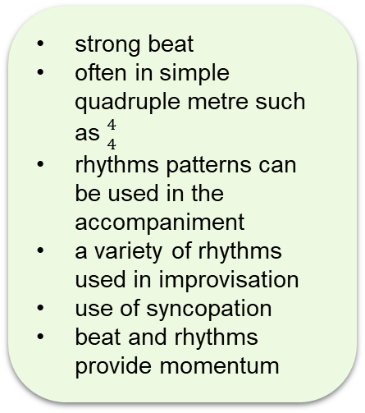
Activity 1.2
Musical characteristics of jazz
each instrument is independent and sometimes improvises
melodies and solos have interactive accompaniment
many instruments provide a thick texture
melodies often overlap
melodies and solos have a wide pitch range
interesting scales are used. For example, the blues scale and chromaticism
the chords used are rich and complex
repeated riffs and/or chord progressions
composed melodies are followed by sections of improvisation
Texture
Structure
Pitch
Jazz
strong beat
often in simple quadruple metre such as ${4 \atop 4}$
rhythms patterns can be used in the accompaniment
a variety of rhythms used in improvisation
use of syncopation
beat and rhythms provide momentum
Common instruments include:
drum kit
double bass
piano
electric guitar
trumpet
trombone
saxophones
vocals
Duration
Performing media and timbre
Dynamics and expression
ensembles are balanced
a wide variety of dynamics are used
varied articulations (accents, staccato, legato)
extended techniques
elements of virtuosity

Slide 10
Activity 1.3 – introducing improvisation and the solo
The solo
As a class, access a range of pieces that include improvisation and discuss the following questions relating to how improvised solos are a key component of jazz and funk. You may like to document your ideas in your book. Questions include:
Would these solos be difficult to perform? Why?
How have the elements of music been manipulated throughout the solo? For example, rhythms, scales, expression.
Comment on the variety of dynamics and articulations used by the soloist.
What expressive techniques make this improvisation unique?
Ideas of aspects of music to help you answer the questions:
virtuosity
rhythmic invention and variety
melodic invention and variety – range, contour, scales, arpeggios
wide or narrow dynamic range – loud, soft, crescendo
articulation – accents, dips, slides, smooth (legato), short (staccato)
interaction with the accompanists.

Slide 11
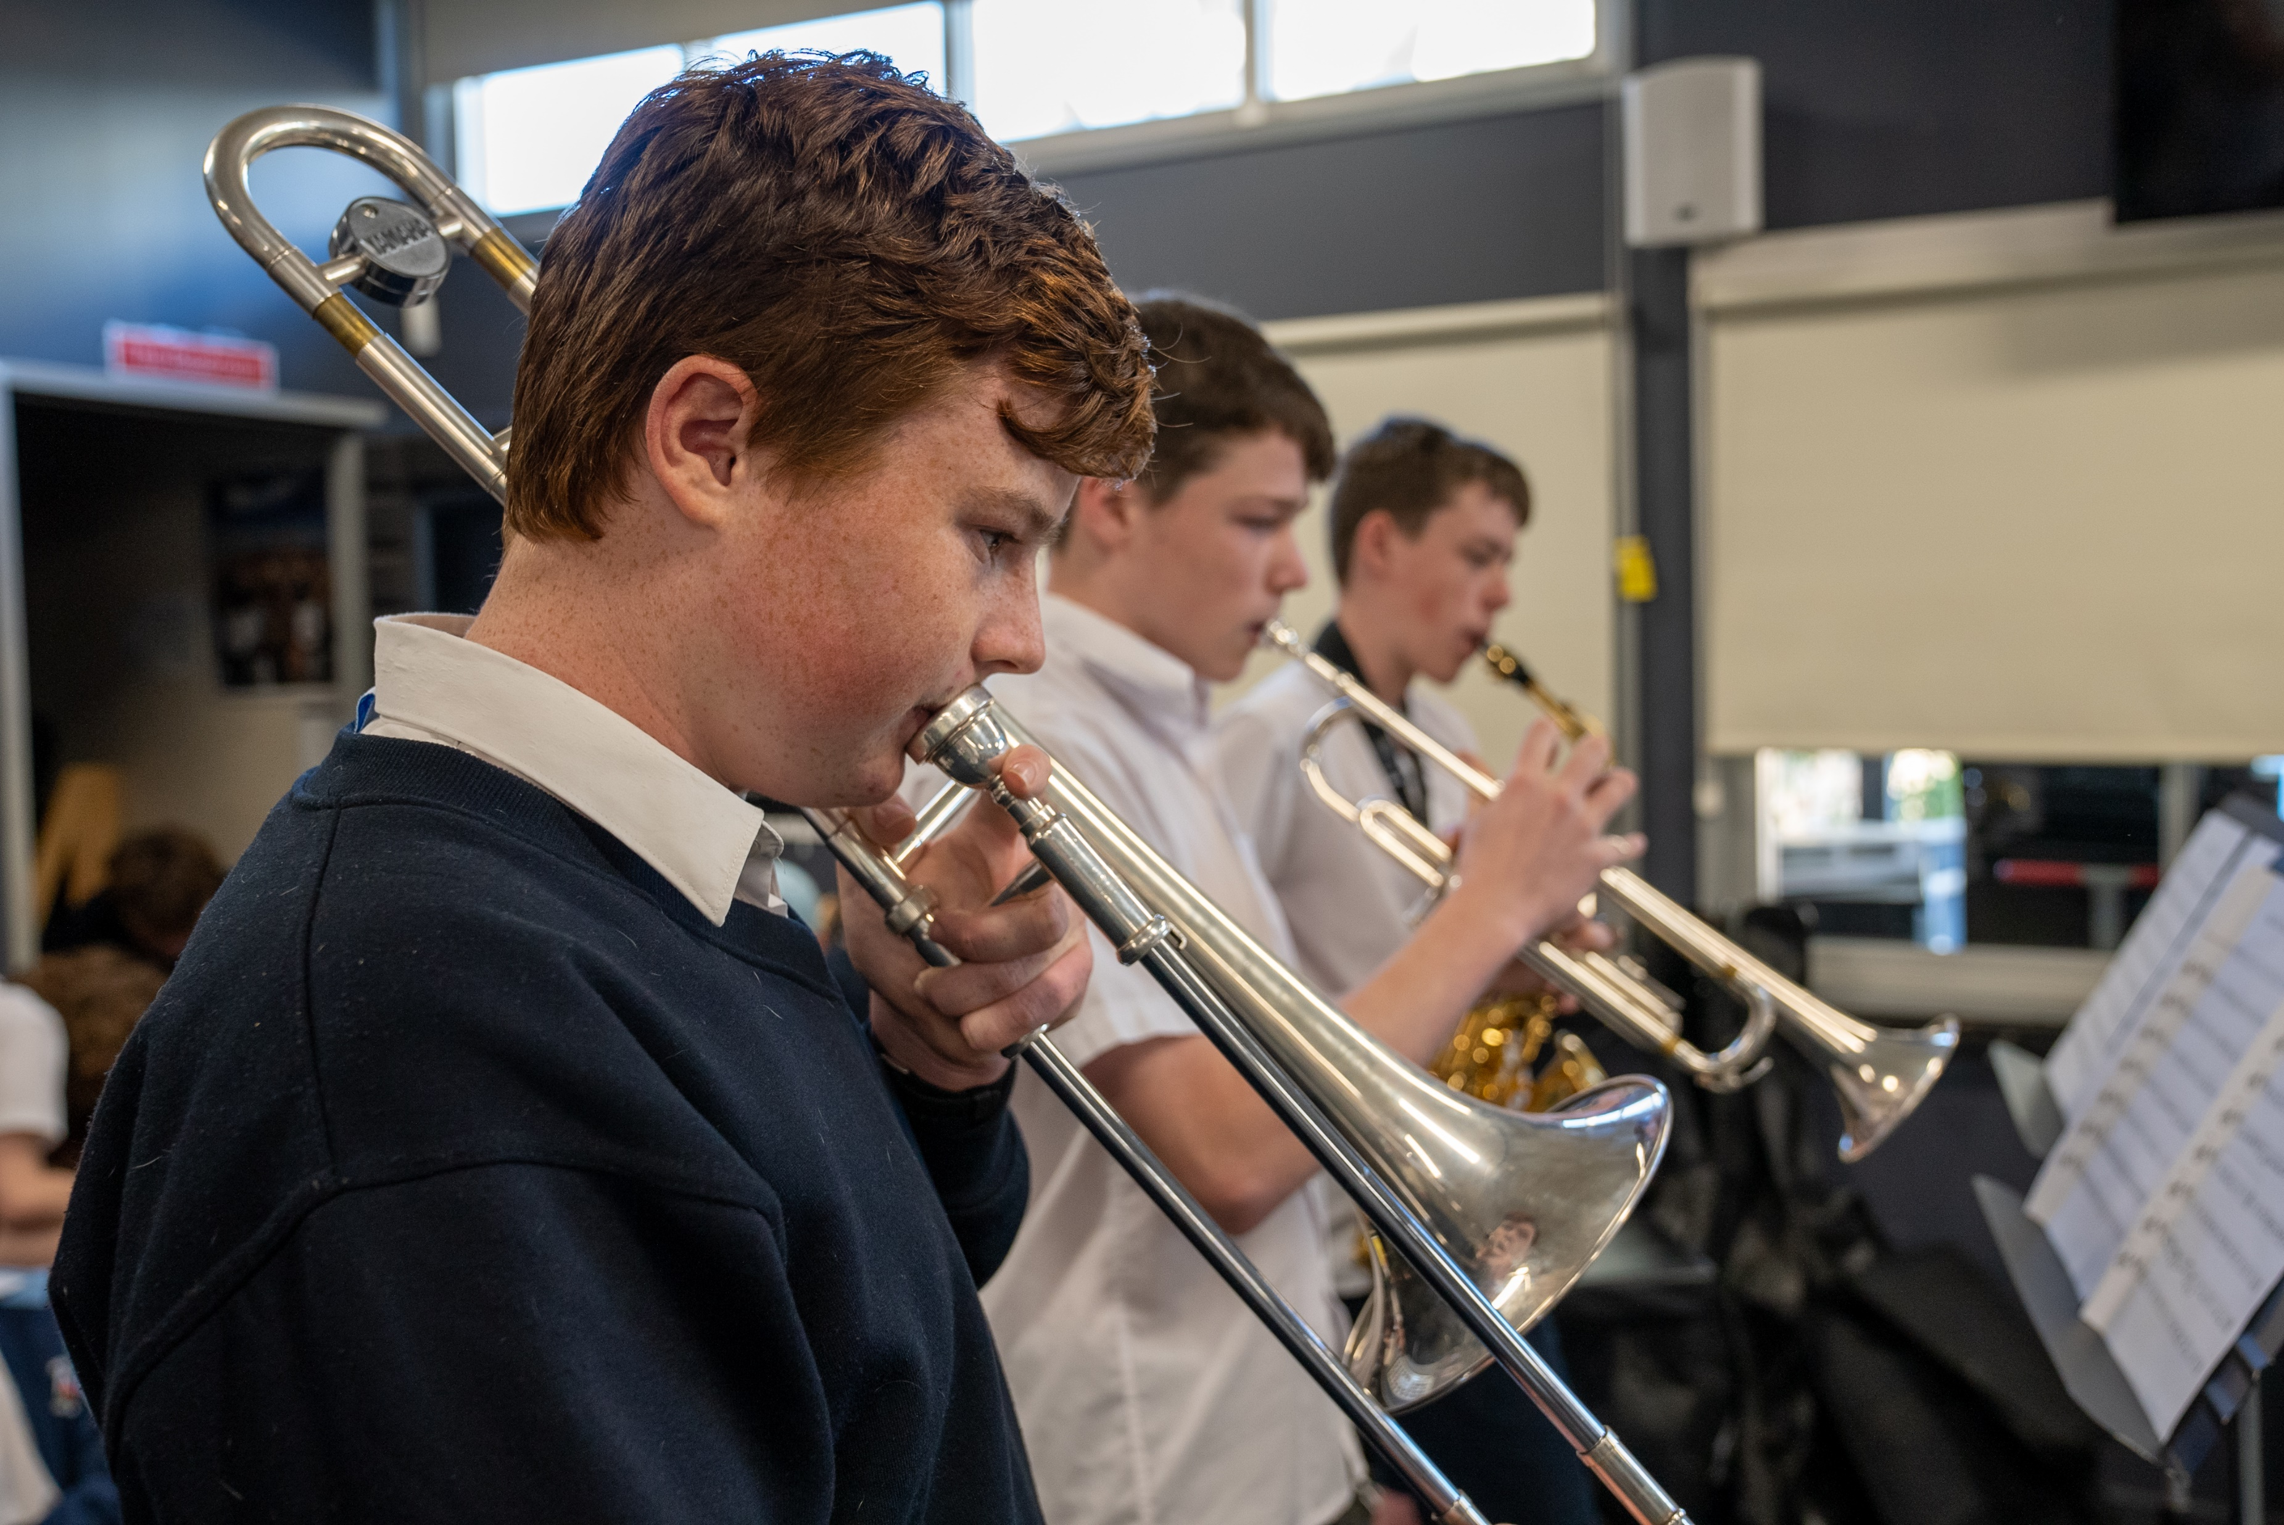
Activity 1.4 – my improvisation journey reflection
Discussion
As a class, discuss the importance of improvisation as an individualised expressive art form. Respond to each point with examples in discussion.
Every jazz solo is unique.
Every solo is underpinned by the technical and expressive practice of each artist.
Musical decisions are made both consciously and subconsciously (choice and automation).

Slide 12
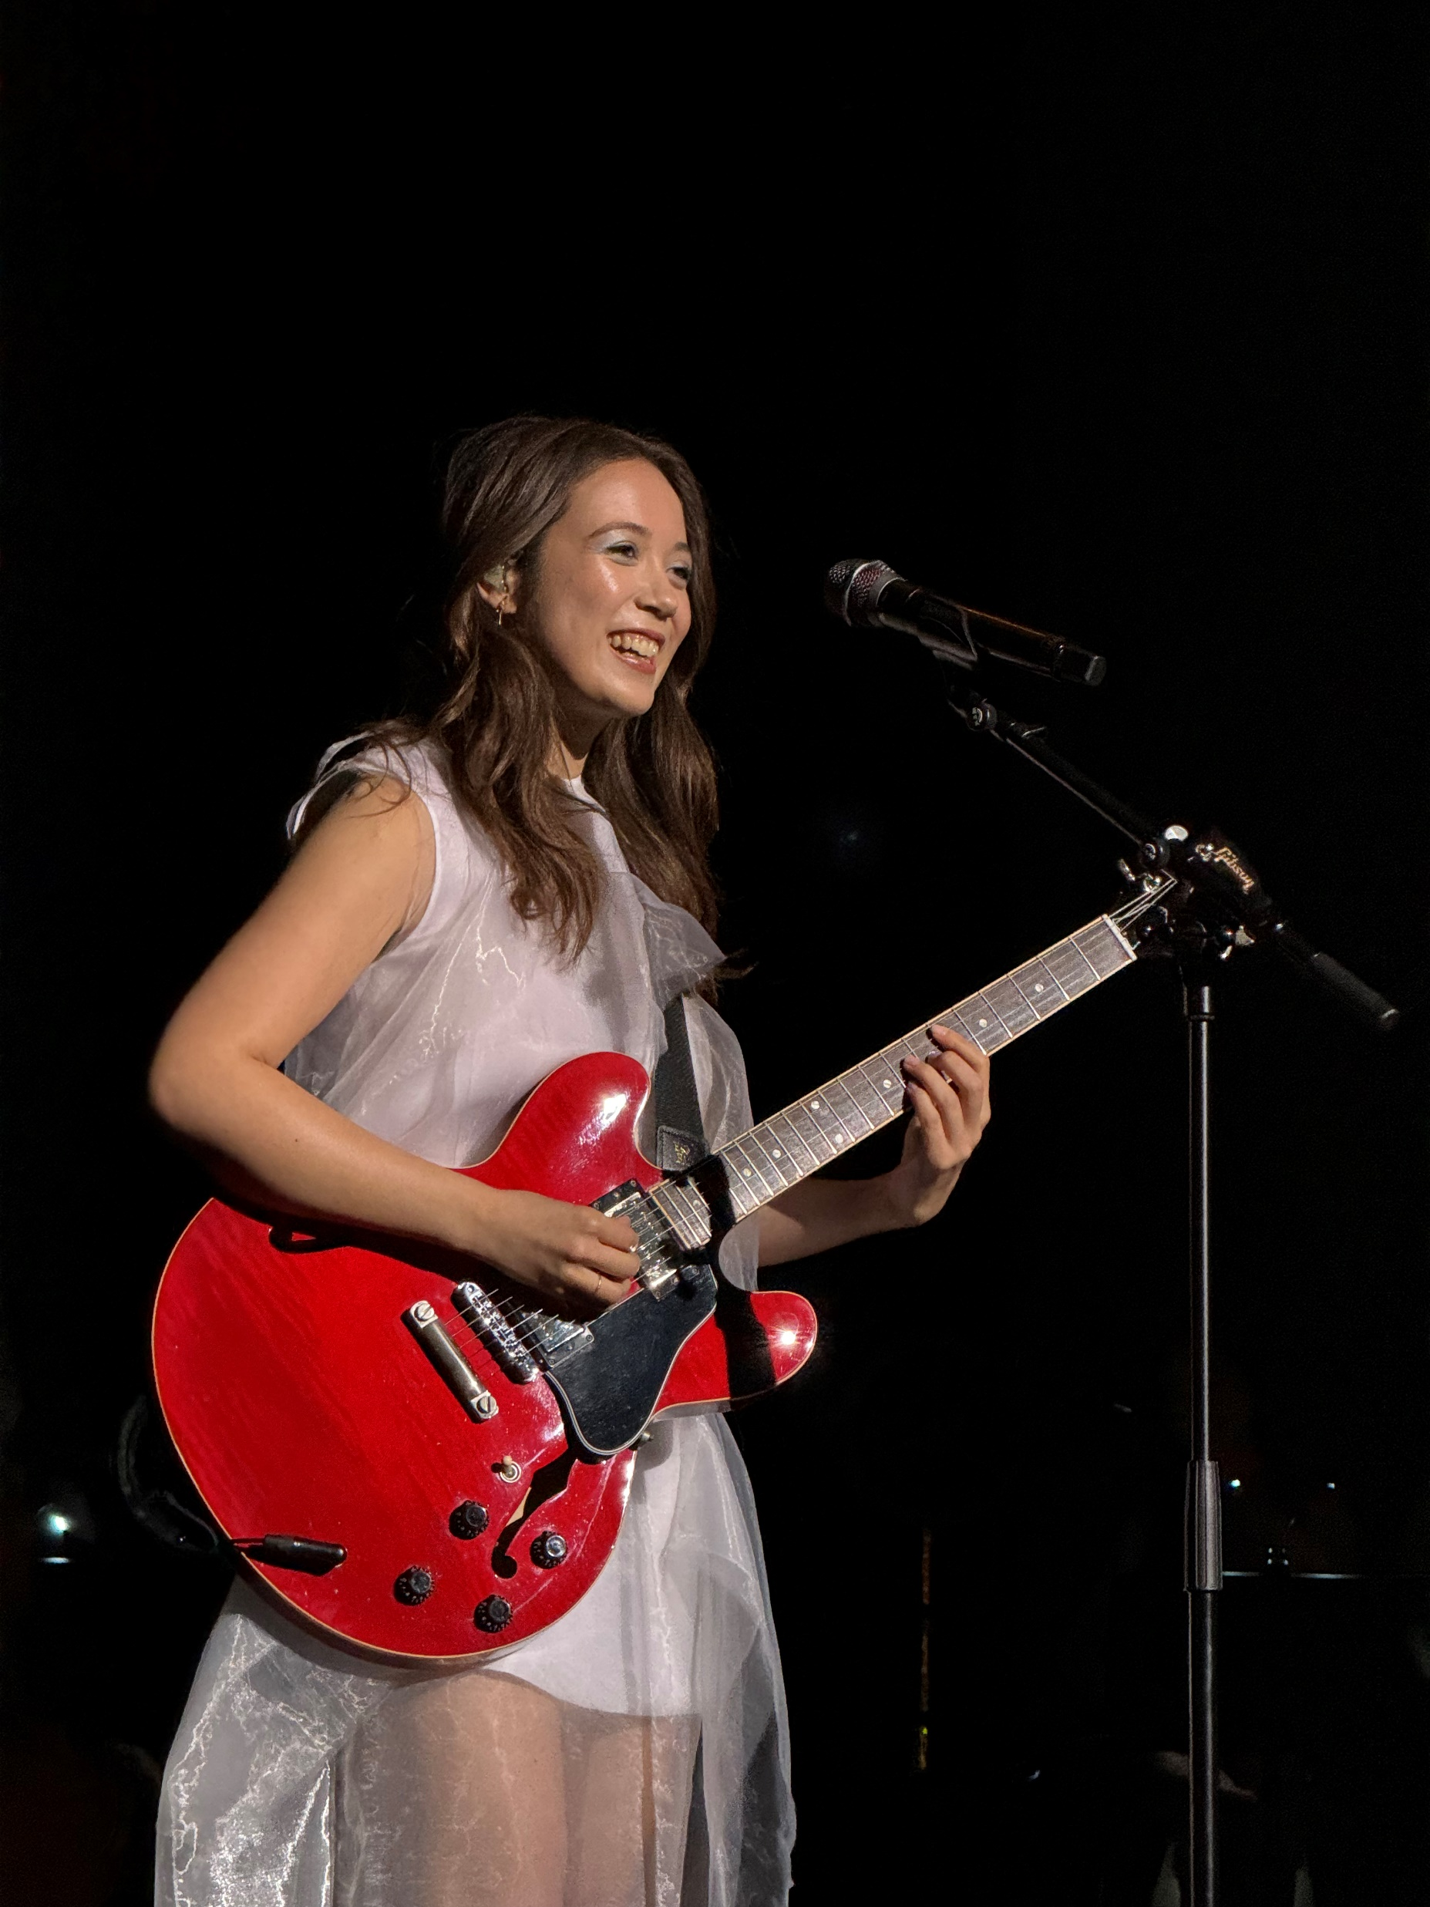
Activity 1.5 – ‘From the Start’ (1)
‘From the Start’ by Laufey
Access Laufey – From The Start (Official Music Video) (2:49) and answer the following questions:
Identify the musical features that you find interesting in the excerpt.
What performing media are used in this piece?
What is the time signature and tempo of this piece?
Outline the structure (including bar numbers) of the song.
How would you describe the vocal solo in the middle of the song? What is the vocalist doing?
Laufey performing at Royal Albert Hall in London, United Kingdom
(2024) by Tomzorz is licensed under Wikimedia commons

Slide 13













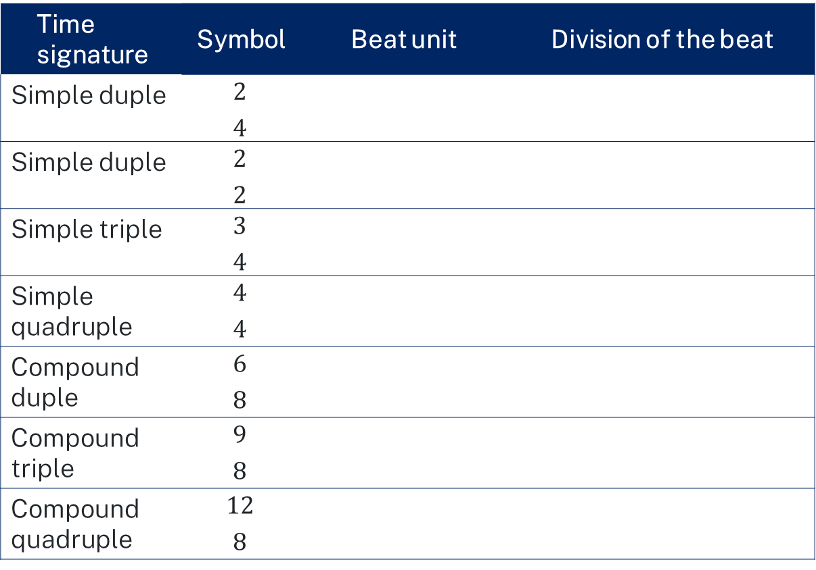
Activity 1.5 – ‘From the Start’ (2)
Musical terms unpacked – simple and compound time signatures
In simple time signatures, each beat within a bar can be divided into 2 equal parts.
Time signature | Symbol | Beat unit | Division of the beat
Simple duple | $${2 \atop 4}$$
Simple duple | $${2 \atop 2}$$
Simple triple | $${3 \atop 4}$$
Simple quadruple | $${4 \atop 4}$$
Compound duple | $${6 \atop 8}$$
Compound triple | $${9 \atop 8}$$
Compound quadruple | $${12 \atop 8}$$
In compound time signatures, each beat within a bar is divided into 3 equal parts.

Slide 14

1.5 – ‘From the Start’ (3)
Musical terms unpacked – describing tempo in jazz
In jazz, tempo is often described using casual English terms rather than the Italian terms we often see in Western art music such as Allegro and Moderato. Words such as fast, slow, moderate or medium may be used to describe the tempo in jazz. In addition to the tempo of the music, the style of the groove is usually also indicated such as ‘swing’, ‘bossa’, ‘Latin’, ‘bebop’, ‘jazz waltz’ or ‘ballad’. Examples of how to describe tempo in jazz music could be:
Medium latin
Fast swing
Slow ballad

Slide 15
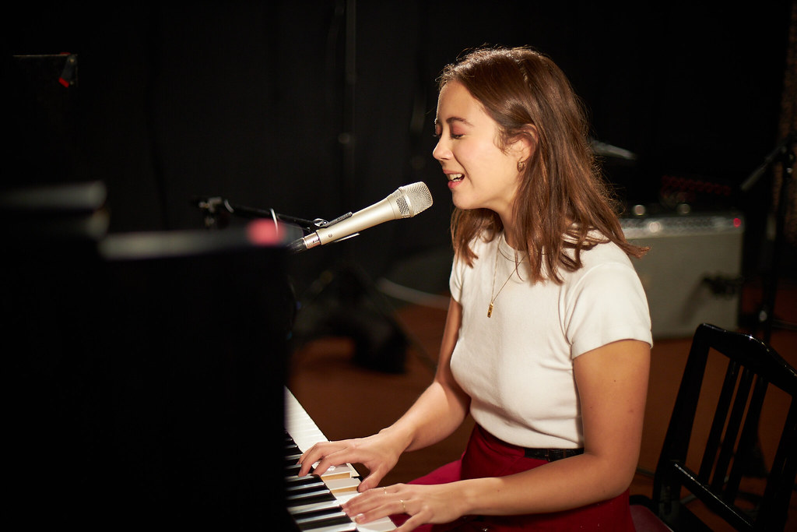
1.5 – ‘From the Start’ (4)
Musical terms unpacked – what is scatting?
Scatting is a form of vocal improvisation in which the vocalist uses nonsense syllables instead of words. In jazz, you may hear syllables such as doo ba, dee, bup, dat, doo wup, vah, zee and shoo be.
Scat singers also sometimes imitate the sound of other instruments in their scatting such as trumpets or drums by changing the timbre of their voice.
Laufey Live at WFUV (2022) by Gus Phillippas is licensed under Creative commons by NC-SA 2.0

Slide 16
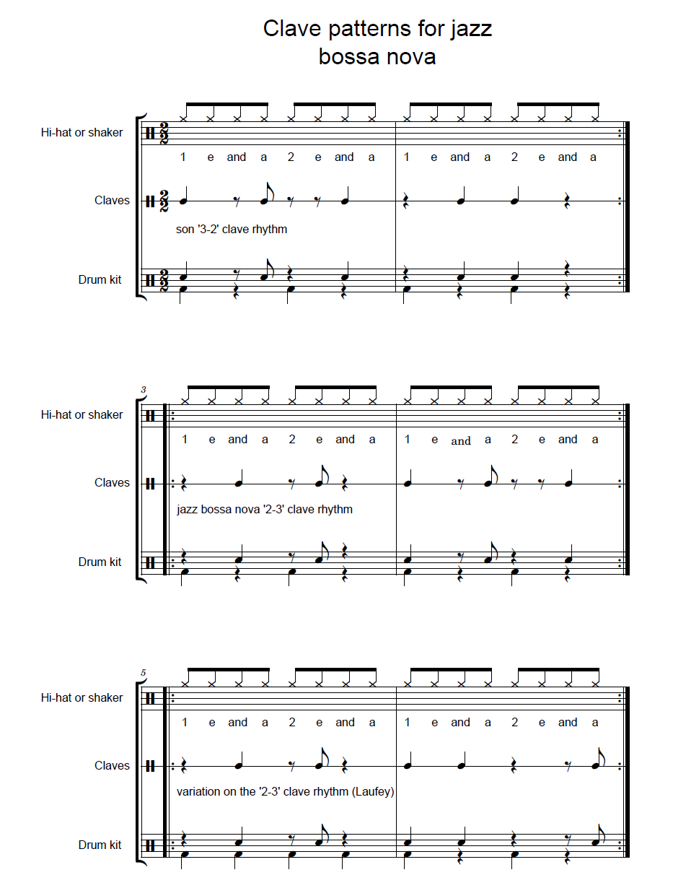
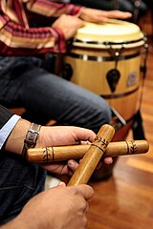
Activity 1.6 – bossa nova groove (1)
Clave patterns
‘From the Start’ by Laufey uses a bossa nova groove. The most important part of this groove is a clave pattern. Clave is a rhythmic pattern used in many styles of music. Claves are a pair of sticks often used to play an ostinato pattern.
Clave patterns have their roots in music from the African diaspora, primarily in Cuban and Brazilian music. These patterns are found in many styles of music including samba, rhumba, son, bossa nova, reggaeton, mambo and many more.
You will learn at least 3 variations of the clave pattern in this activity.
Percussion (2025) by
Cultiralis is licensed under
Creative commons by SA 2.0

Slide 17
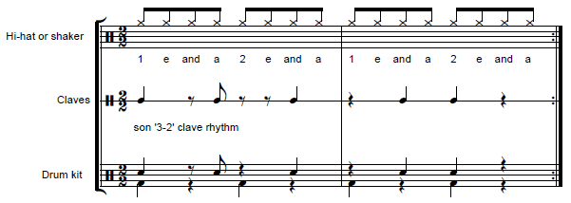
Activity 1.6 – bossa nova groove (2)
Clave pattern 1 – son ‘3-2’ clave rhythm
Perform each clave pattern by tapping the quavers with your right hand and the clave pattern with your left hand. R = right hand. T = together.
T R R T R R T R R R T R T R R R
*Note: a ‘son clave’ is a foundational rhythmic pattern used in Afro-Cuban music based on either a ‘3-2’ or ‘2-3’ pattern.

Slide 18
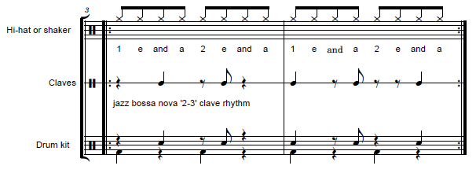
Activity 1.6 – bossa nova groove (3)
Clave pattern 2 – jazz bossa nova ‘2-3’ clave rhythm
R R T R R T R R T R R T R R T R

Slide 19
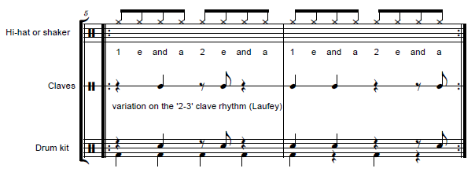
Activity 1.6 – bossa nova groove (4)
Clave pattern 3 – variation on the jazz bossa nova ‘2-3’ clave rhythm
Play this clave pattern along with Is this what heaven sounds like? From the Start – Laufey (2:57) (0:00 – 2:57)
R R T R R T R R T R T R R R R T

Slide 20
Learning sequence 2 – bossa nova

Slide 21
Learning intentions and success criteria (2)
We are learning to:
know what extended chords are, how they are built and what their function is in jazz music
understand the musical features of the bossa nova style
improvise and scat over a jazz chord progression in a bossa nova style
We can:
aurally identify and explain how extended chords are built
apply stylistic understanding of the bossa nova when performing and listening
perform using improvisation and scatting in a bossa nova style
Notes:
Notes for teachers:
Learning intentions and success are best co-constructed with students. Adapt the learning intention as required and add matching success criteria.
For more information See ⁠AITSL or the NSW Department of Education explicit teaching strategies, ⁠Sharing learning intentions and ⁠Sharing success criteria
LISC is not necessarily presented at the beginning of the lesson. Teacher needs to consider most effectual time to introduce
LISC should be revisited during the lesson to support students' evaluation of their learning

Slide 22
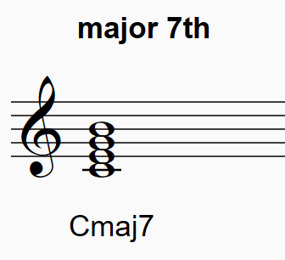
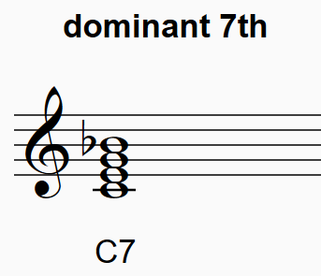
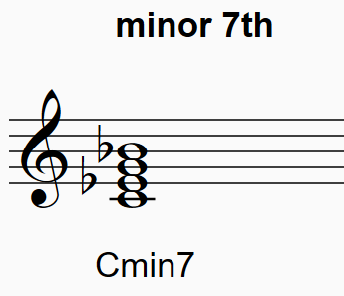
Activity 2.1 – extended chords – 7th chords (1)
Jazz extensions
7th chords and jazz extensions are essential to learn for the jazz style. Jazz approaches to this harmonic language were developed in the early 20th Century as music from Western Europe, African diaspora and communities in the United States collided. 7th chords and extensions are also used frequently in blues, RnB, soul and pop music.
7th chords are created by adding the 7th interval from the tonic to a triad. The three most common chord varieties are:
Listen and read the notation of some basic triads and 7th chords.

Slide 23
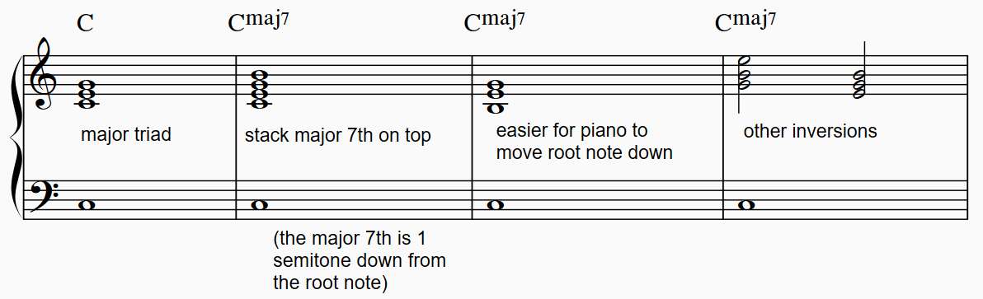
Activity 2.1 – extended chords – 7th chords (2)
Creating major 7th chords – example C^{maj7}
Using a keyboard, play the following chord progressions using the steps provided.
Steps:
1. Play a C major triad with an accompanying root note.
2. Play a C major chord and then add a B above to create a C^{maj}7 chord.
3. Invert the chord and remove the extra tonic in the right hand.
4. Repeat this exercise for G^{maj}7.

Slide 24
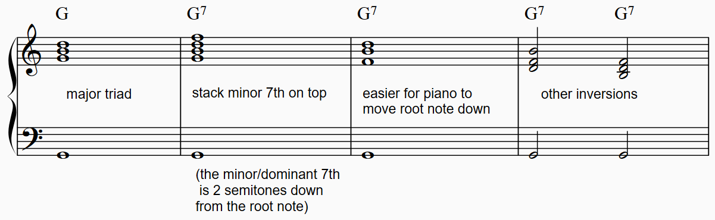
Activity 2.1 – extended chords – 7th chords (3)
Creating dominant 7th chords – example G7
To build a dominant 7th chord, play a G major triad and add the minor 7th on top (G7). Experiment with inverting the chord.

Slide 25
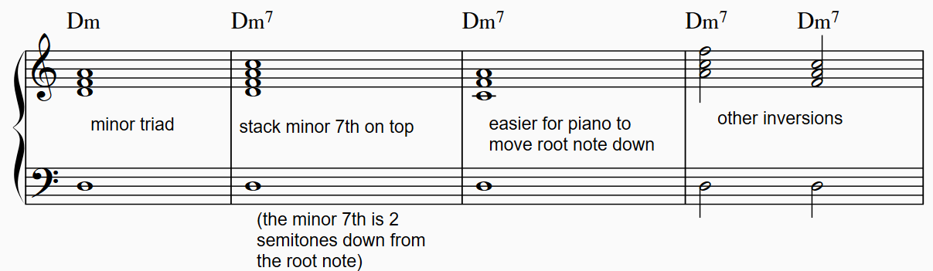
Activity 2.1 – extended chords – 7th chords (4)
Creating minor 7th chords – example Dm7
Repeat this again for D minor triad expanding and inverting to Dm7 (minor 3rd, minor 7th).

Slide 26
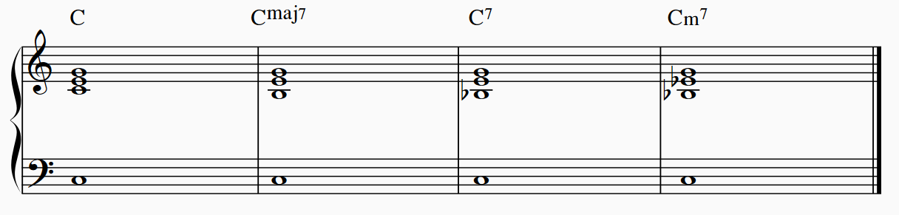
Activity 2.1 – extended chords – 7th chords (5)
Chord inversions
The 7th chord voicing in the right hand can be inverted to create alternate voicings. An inversion is created by building a chord from any of the notes that are not the root note. For clarity of learning these new chord tonalities, keep the left hand note on the root note of the chord. Play and listen to how the chord is altered just by changing the position of the 7th. We can hear the difference between each chord type by keeping the root note the same.

Slide 27
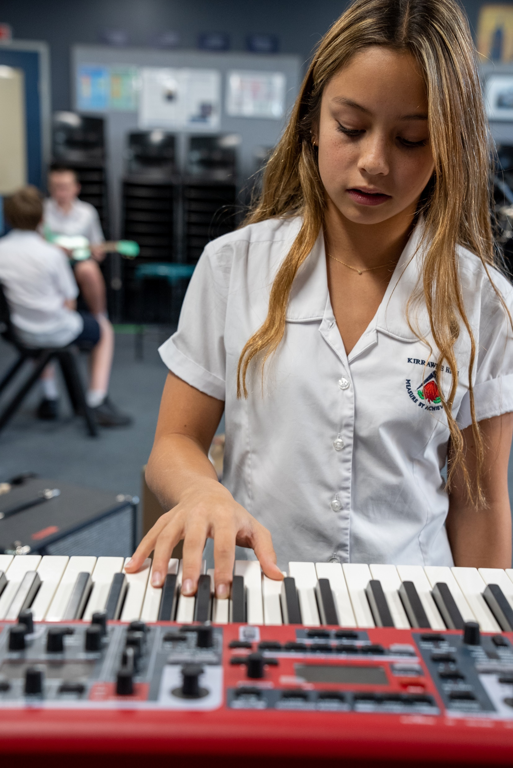
Activity 2.1 – extended chords – 7th chords (6)
Aural skills
1. Aurally identify the chords played by your teacher as either C^{maj}7, G7 or Dm7. There will be 5 examples.
2. Aurally identify the chords played by your teacher as either C^{maj}7, C7 or Cm7. There will be 5 examples.

Slide 28
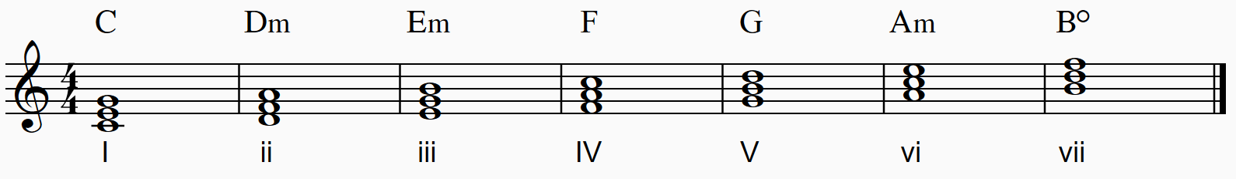
Activity 2.2 – diatonic chords – building, identifying and labelling (1)
Diatonic chords
By harmonising the major scale, we can create chords that can be used functionally, that is, in chord progressions. The simplest way to give chords a relationship, is to build them from the one scale. These are called diatonic chords. Listen carefully to the following diatonic chords built on the scale of C major:
We use upper case Roman numerals for major chords and lower case for minor chords. Chord I is called the tonic chord. This chord will sound like the 'home’ chord, particularly when played directly after chord V.

Slide 29
Activity 2.2 – diatonic chords – building, identifying and labelling (2)
Diatonic chords in C worksheet
Using a keyboard, Play a C major scale using the right hand in treble clef.
Play the C major scale in triads to create each diatonic chord. As you play each chord, recite the number of each chord out loud. For example, C major ‘chord one’, D minor ‘chord 2 ’.

Slide 30
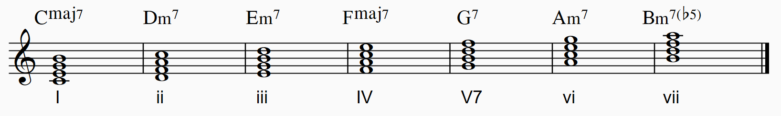
Activity 2.2 – diatonic chords – building, identifying and labelling (3)
Diatonic chords in C worksheet
3. We will now add a 7th note to each chord, producing a mix of major7 and minor7 chords , plus 1 dominant chord (chord V) and a half-diminished chord (chord vii). Play each chord on the keyboard and listen to the scale now harmonised as 7th chords.

Slide 31
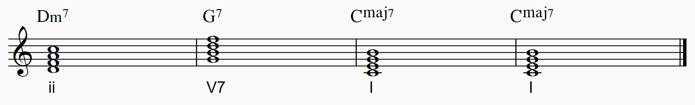
Activity 2.2 – diatonic chords – building, identifying and labelling (4)
Diatonic chords in C worksheet
4. A common jazz chord progression used is the ii, V, I. Listen to this chord progression as it is played on a loop by your teacher on the keyboard.
5. Play these chords on the keyboard. Start by playing the triads, then the 7th chords, then the ii – V – I progression.

Slide 32
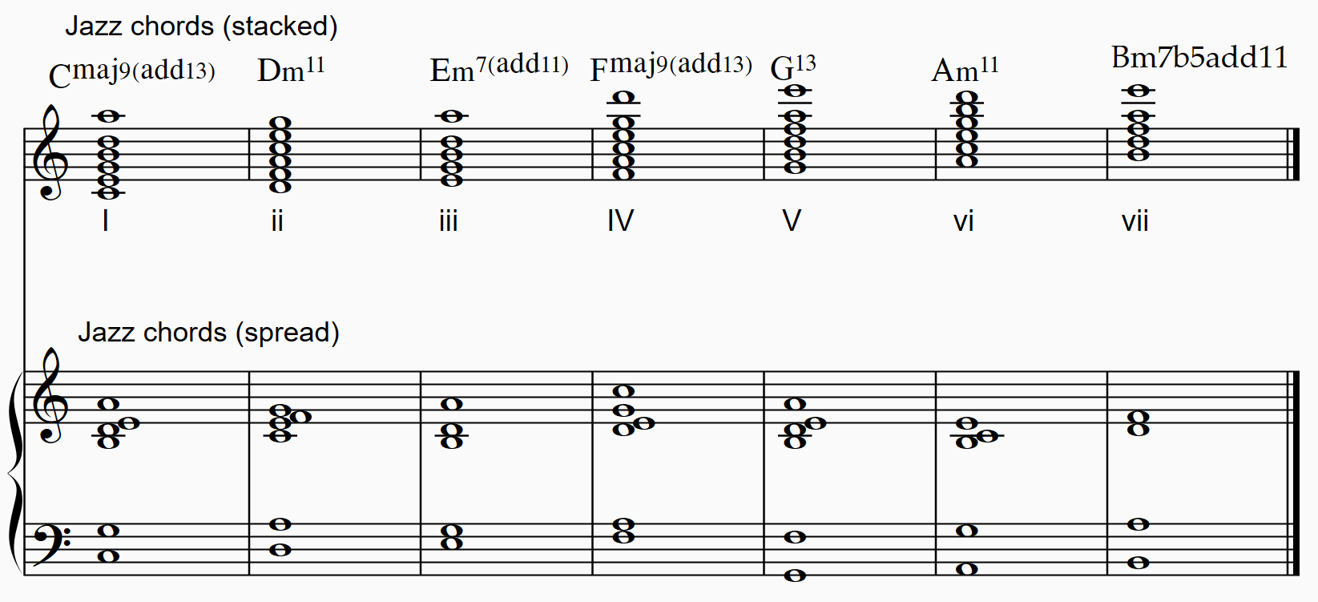
Activity 2.2 – diatonic chords – building, identifying and labelling (5)
Steps:
Perform the jazz piano voicings of these chords in root position. Compare the sound to the 7th chords.
Play the same chords using different inversions as notated above.
Experiment with other voicings as outlined in Activity 2.1.
Extension jazz chords
Examine the notation for diatonic chords that extend even further than the 7th. These chords may include intervals of 9^{ths}, 11^{ths} and/or 13^{ths.}

Slide 33
Activity 2.3 – ii – V – I
The ii – V – I chord progression
One of the most common chord progressions in jazz is the ii – V – I.
In the key of C major, this chord progression, with 7th chord extensions, is:
||: Dm7 | G7 | Cmaj7 | Cmaj7 :||
These chords are arranged into voicings. Voicings help the performer balance the various notes in the jazz chords. Jazz musicians also substitute more colourful notes from the extensions of these chords into the voicing.
Learn this chord progression and ways to perform it in the bossa nova style using the step-by-step instructions for your instrument. You may like to play along with the bossa nova backing track.

Slide 34
Activity 2.4 – scatting and improvising a melody (1)
Musical terms unpacked – what is scatting?
Scatting is a form of vocal improvisation in which the vocalist uses nonsense syllables instead of words. In jazz, you may hear syllables such as doo ba, dee, bup, dat, doo wup, vah, zee and shoo be.
Scat singers also sometimes imitate the sound of other instruments in their scatting such as trumpets or drums by changing the timbre of their voice.
Laufey Live at WFUV (2022) by Gus Phillippas is licensed under Creative commons by NC-SA 2.0

Slide 35
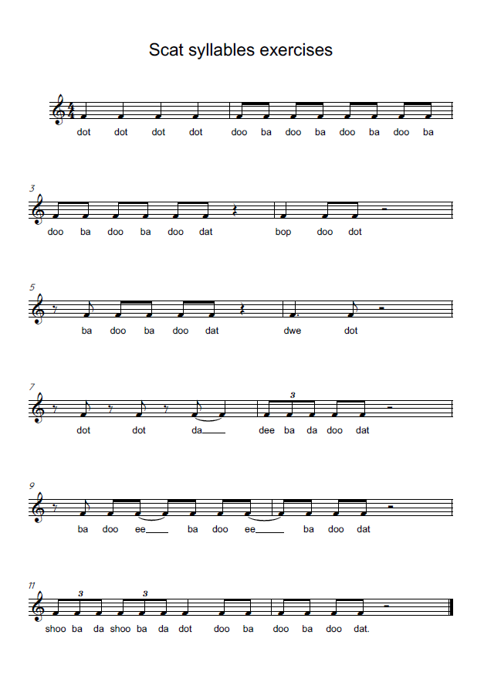
Activity 2.4 – scatting and improvising a melody (2)
Scat syllables exercises
Perform the scat syllables as a class using call and response.

Slide 36
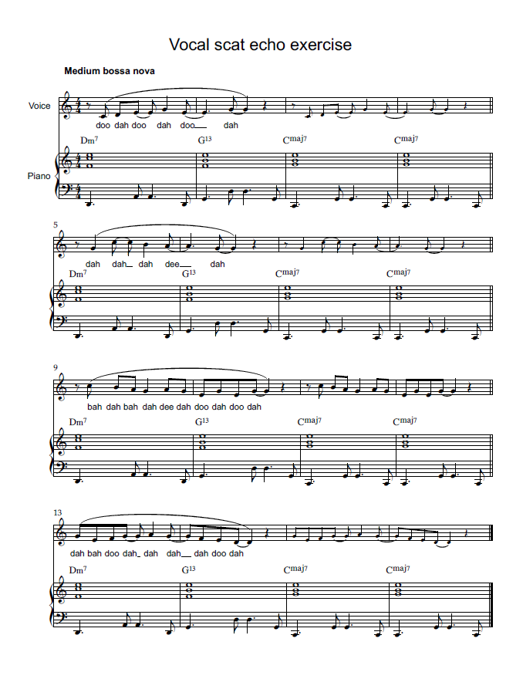
Activity 2.4 – scatting and improvising a melody (3)
Rhythm and articulation exercise
Perform the scat syllables in a bossa nova style as a class using call and response.
Each student takes turns to compose or improvise their own 2-bar phrase, which can be echoed by the class or a partner.
Individually, students take turns to improvise a 2-bar call and response phrase over the chord progression, with each student in the class taking turns to ‘call’ and ‘respond’.
Increase the texture by adding the ii – V – I ensemble parts from activity 2.3 and the percussion parts from activity 1.6.

Slide 37
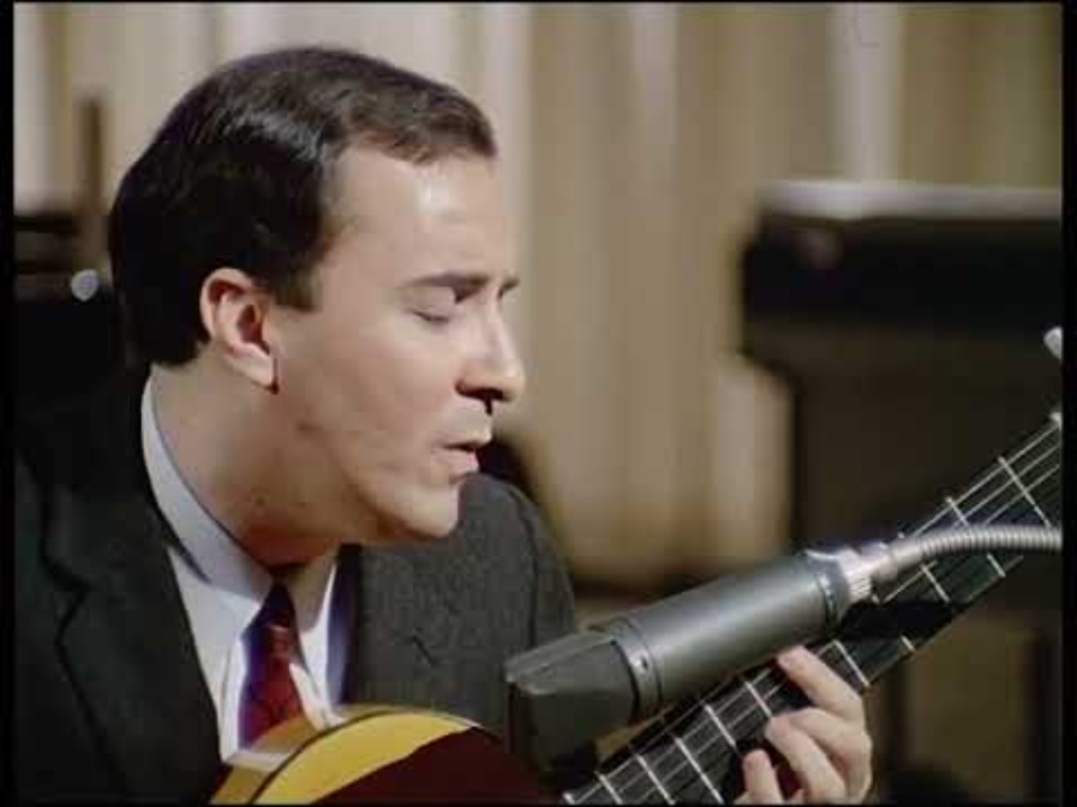
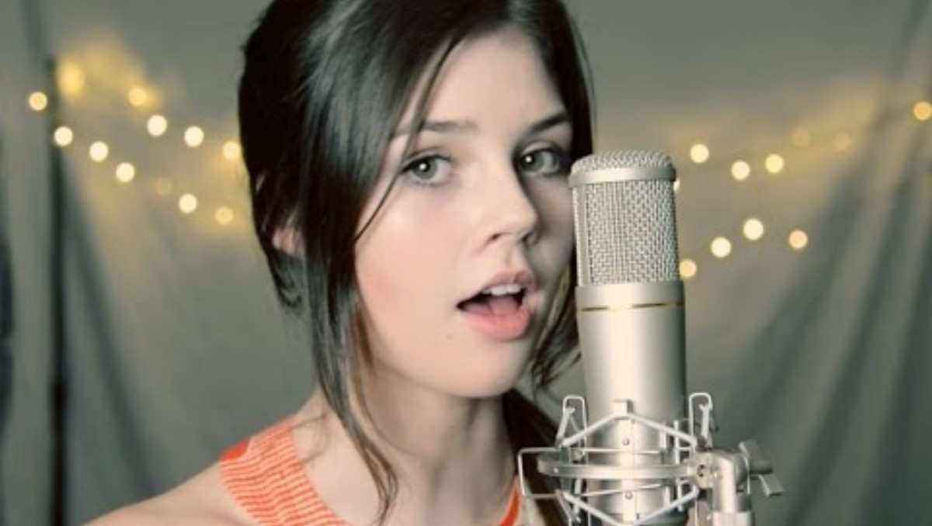
Activity 2.6 – ‘The Girl From Ipanema’ (1)
Musical context
This well-known jazz standard bossa nova song was first released in the 1962 by Brazilian composer Antonio Carlos Jobim. The most famous version features singers Joao and Astrid Gilberto, and jazz saxophonist Stan Getz. This listening activity will look at two different versions of this song.
Joao Gilberto (2024) - Garota de Ipanema (Alemanha, 1967) (3:24)
Elise Trouw (2016) The Girl from Ipanema - Stan Getz & Astrud Gilberto
(cover by Elise) (2:02)

Slide 38
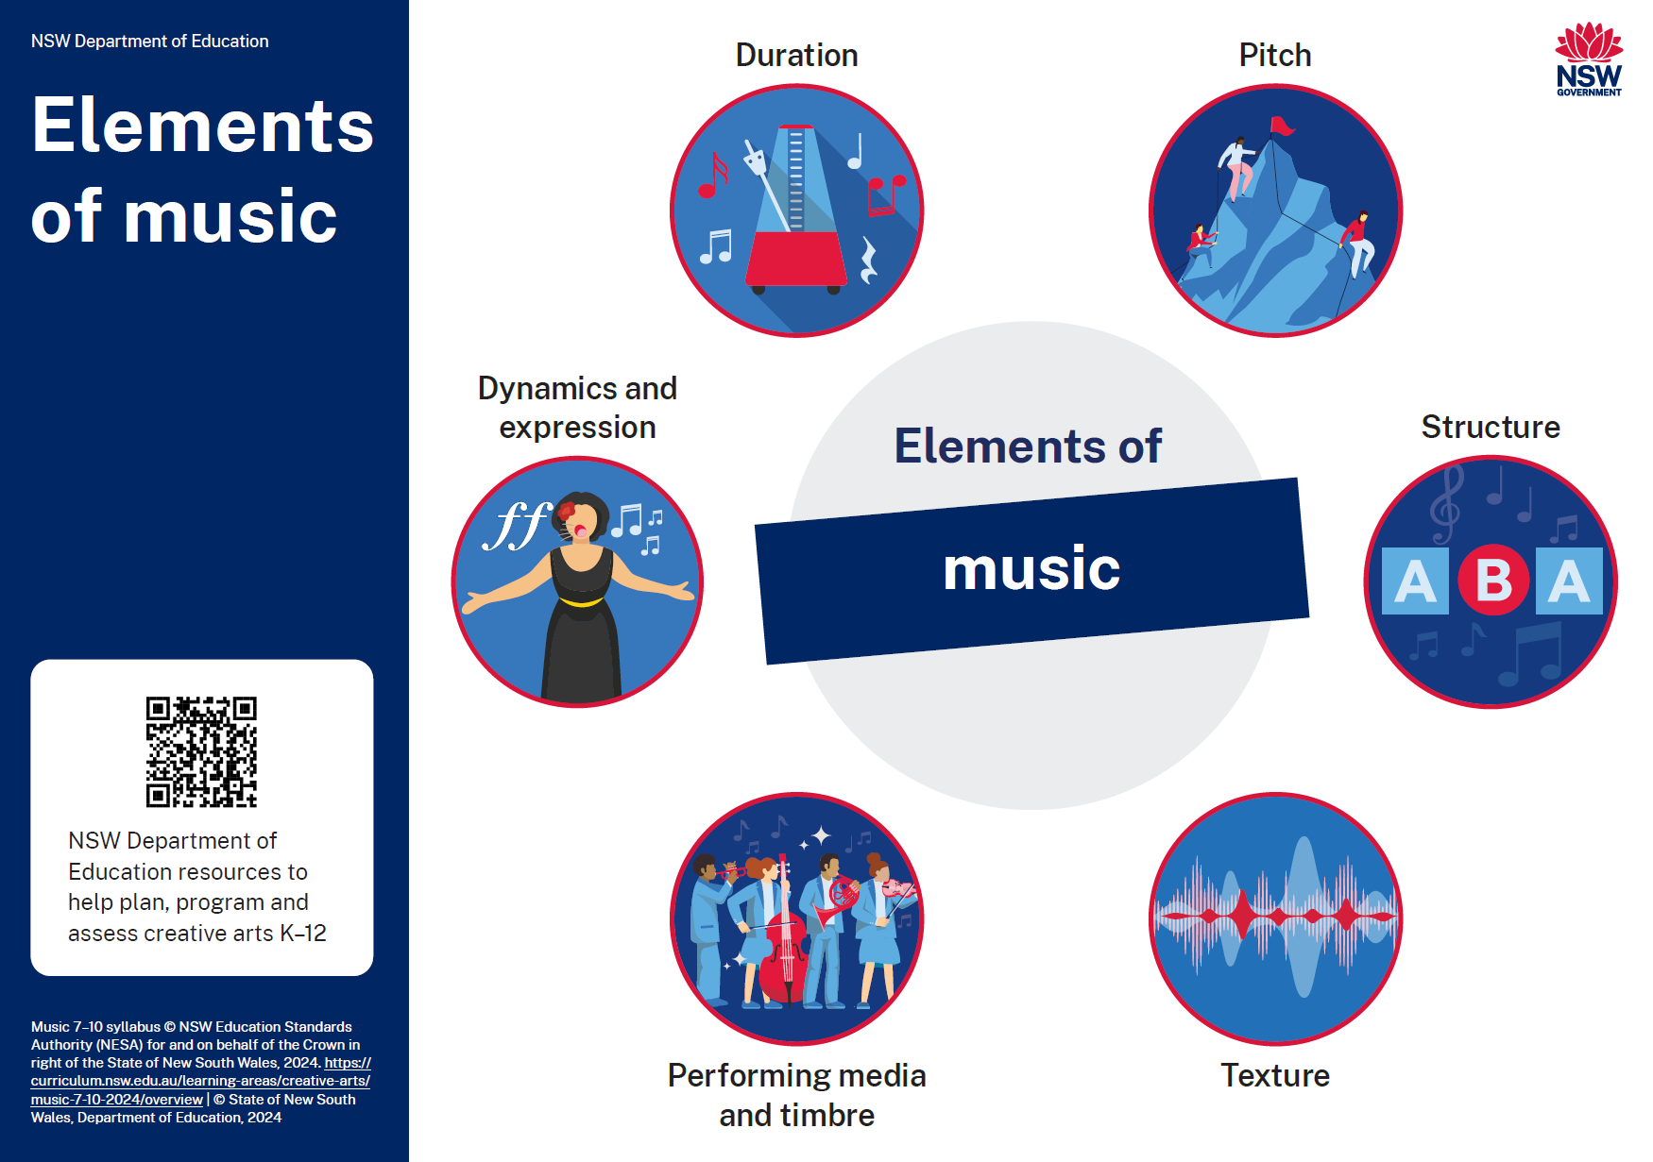
Activity 2.6 – ‘The Girl From Ipanema’ (2)
Comparative listening
Listen to the excerpts at least 2 times each to answer the following questions:
What are the common bossa nova musical features that are heard in each excerpt?
What are the differences between the 2 versions in relation to the elements of music?

Slide 39
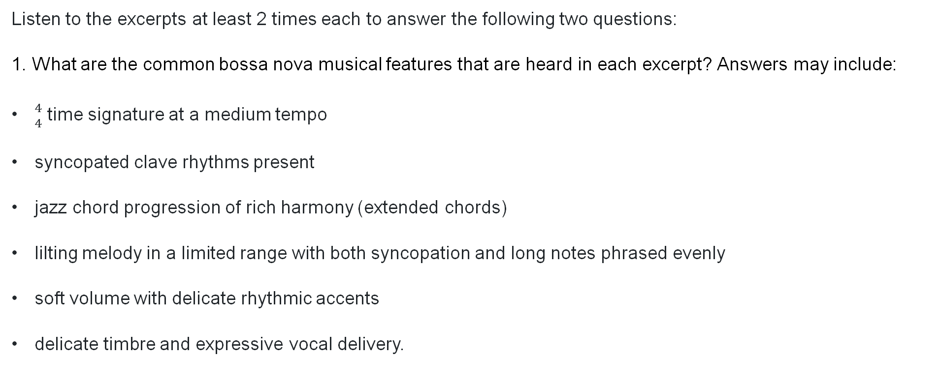
Activity 2.6 – ‘The Girl From Ipanema’ (3)
Answers (1)
Listen to the excerpts at least 2 times each to answer the following two questions:
1. What are the common bossa nova musical features that are heard in each excerpt? Answers may include:
${4 \atop 4}$ time signature at a medium tempo
syncopated clave rhythms present
jazz chord progression of rich harmony (extended chords)
lilting melody in a limited range with both syncopation and long notes phrased evenly
soft volume with delicate rhythmic accents
delicate timbre and expressive vocal delivery.

Slide 40
Activity 2.6 – ‘The Girl From Ipanema’ (4)
Answers (2)
2. What are the differences between the versions in relation to the elements of music?
Elements of music | Joao Gilberto version | Elise version
Performing media and timbre | Sung in a baritone voice with Portuguese lyrics – warm timbre Acoustic guitar – light timbre Hi-hat – dry timbre Tenor saxophone – muffled timbre | Sung in an alto voice with English lyrics. Backing vocal layers create chords in the accompaniment Mellow timbres Various percussion layers including shaker, finger clicks – scratchy and dry timbres Electric bass – warm timbre
Duration | The hi-hat plays simple quavers with syncopated accents to provide a bossa nova rhythm The tempo is faster Syncopation in vocals, guitar and saxophone | Layers of shaker and finger clicking provide the bossa nova rhythm The tempo is slower Syncopation in all parts

Slide 41
Activity 2.6 – ‘The Girl From Ipanema’ (5)
Answers (3)
2. What are the differences between the versions in relation to the elements of music?
Elements of music | Joao Gilberto version | Elise version
Pitch | The tonality is major The bossa nova rhythm is present in the guitar accompaniment and the chords provide the harmonic accompaniment Melody is sung by the vocals | The tonality is major but in a lower key that the first version. The electric bass provides the harmonic foundation while also contributing to the rhythmic movement Melody is sung by the vocals
Texture | The thin texture highlights the gentle vocals Homophonic texture | There are more instrumental layers creating a thick texture and louder volume Homophonic texture
Dynamics and expression | Soft dynamics | Soft to moderate dynamics. The addition of layers make the dynamic become louder
Structure | The 32-bar song is performed in the same manner, with a sax solo occurring afterward (1:35 - 2:33); then a reprise of the final stanza and an improvised coda | The 32-bar song includes an improvised intro and coda. The percussion and bass stop for the final stanza before the coda, to create contrast

Slide 42
Learning sequence 3 – swing

Slide 43
Learning intentions and success criteria (3)
We are learning to:
know the names and roles of the performing media in a big band/ jazz orchestra
understand how melodies can be interpreted and developed in many different ways
interpret musical scores in a jazz swing style
We can:
name and identify the performing media and their roles using appropriate jazz terminology
experiment with the elements of music to create new interpretations of melodies
apply understanding of jazz musical characteristics in performance
Notes:
Notes for teachers:
Learning intentions and success are best co-constructed with students. Adapt the learning intention as required and add matching success criteria.
For more information See ⁠AITSL or the NSW Department of Education explicit teaching strategies, ⁠Sharing learning intentions and ⁠Sharing success criteria
LISC is not necessarily presented at the beginning of the lesson. Teacher needs to consider most effectual time to introduce
LISC should be revisited during the lesson to support students' evaluation of their learning

Slide 44
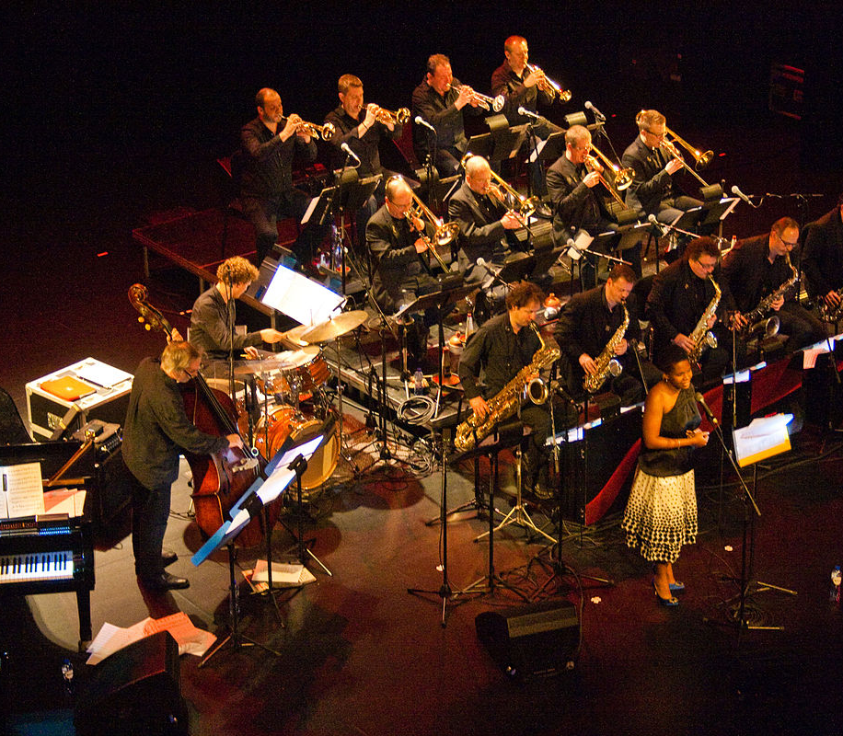
Activity 3.1 – jazz orchestra or big band (1)
Musical context
Jazz orchestras, or more commonly known as big bands, are a musical ensemble associated with jazz that evolved in the 1920’s to 1940’s. Their function was originally to perform in large dance halls for people to dance to, and consisted of sections of trumpets, trombones, saxophones and rhythm section. The swing era, from the 1930’s – 1940’s, saw big bands as the dominant force in American popular music, featuring bandleaders such as Benny Goodman, Duke Ellington and Glenn Miller.
In contrast to the typical jazz emphasis on improvisation, big bands rely on compositions and arrangements with some improvisation.
New York, City of Jazz by the Brussels Jazz orchestra (2014) by
VH Mechelen is licensed under Creative commons SA 4.0

Slide 45
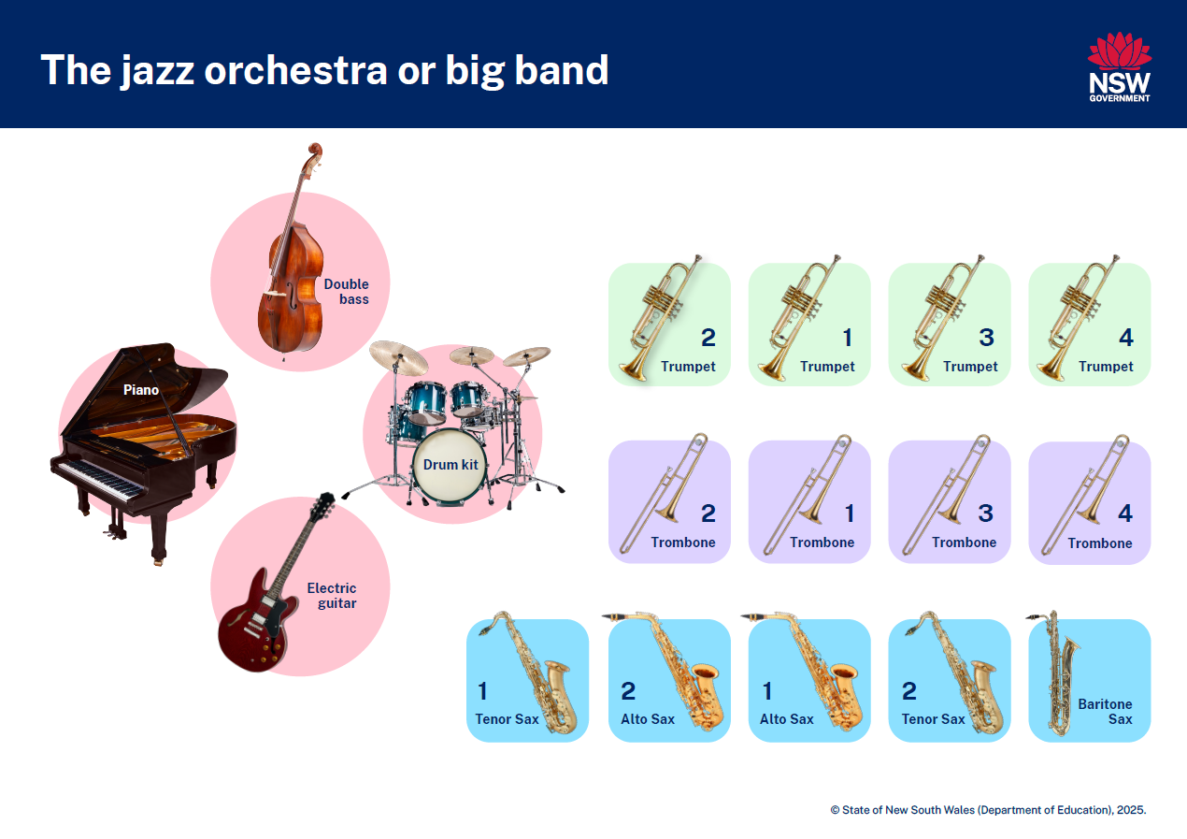
Activity 3.1 – jazz orchestra or big band (2)

Slide 46
Activity 3.1 – jazz orchestra or big band (3)
‘Take the A Train’ by Ellington
Access Take the A Train – The Jazz Ambassadors (2:46) (from 0:00 – 2:46) by Duke Ellington and answer the following questions:
1. Did you identify the band line up correctly? Draw the big band layout and label each instrument.
2. What is the time signature and tempo of this piece of music?
3. Which 2 instruments play in the intro? Describe what they are playing using the elements of music.
4. Identify the role of each instrument section from the top of the first head by completing the table below. Identify any new terminology and add it to your jazz glossary.
5. Which instrument provides a solo in the piece? How does the mute affect the timbre of the instrument? Refer to the timbre terminology worksheet or next slide.
6. Describe how the melody is played differently at the end of the piece after the trumpet solo. Which elements of music have been manipulated and how?
Instrument | Role
Saxophones
Trombones
Trumpets
Rhythm section

Slide 47
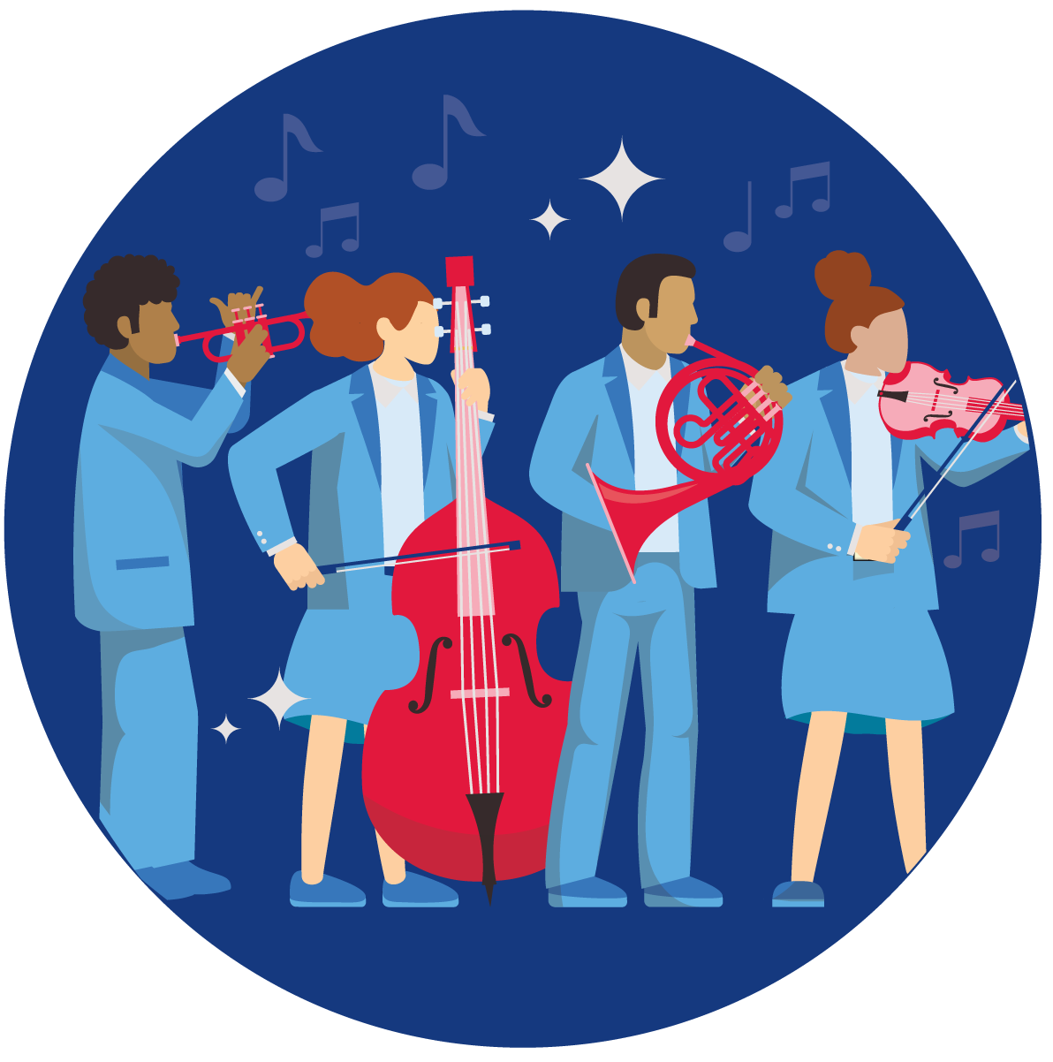
Activity 3.1 – jazz orchestra or big band (4)
What is timbre?
Timbre refers to the distinctive quality of a sound that enables the sound sources to be identified. Through listening, we can use adjectives to describe the timbre of a sound source.

Slide 48
Activity 3.1 – jazz orchestra or big band (5)
What is timbre?

Slide 49
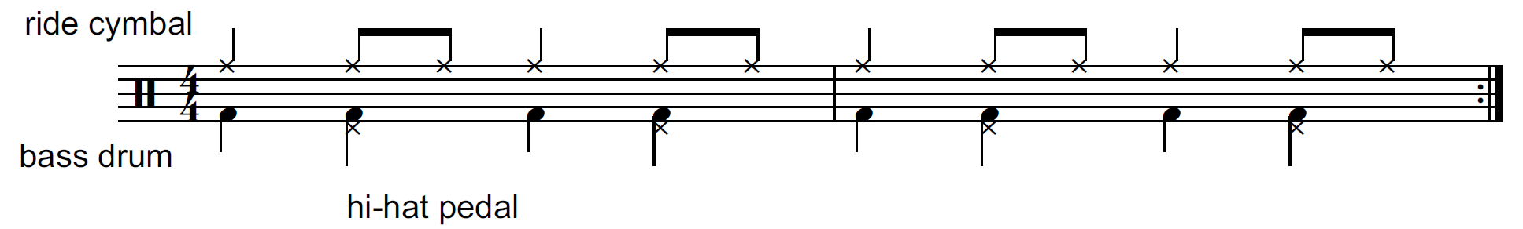
Activity 3.2 – elements of swing (1)
Swing pattern
In ‘Take the A Train’ we can hear a double bass playing crotchets and the drummer playing in a swing pattern with improvised fills.
In a swing pattern, a constant crotchet pulse provides forward momentum. The bass drum is ‘feathered’ in this style which means it is played very softly (pianissimo), or possibly not at all. The pulse is also played by the ride cymbal (or hi-hat) and includes ‘skip notes’ played as quavers, in a swing rhythm. These quavers are performed in pairs – long then short – similar to a triplet grouping ‘1 (and) a’. Hi hat accents on beats 2 and 4 provide more drive and momentum. For example:
Swing

Slide 50
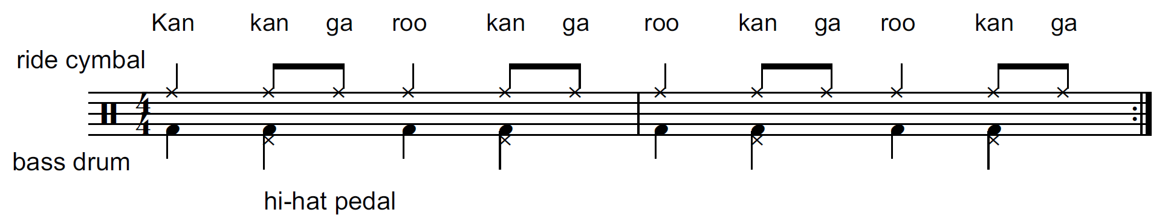
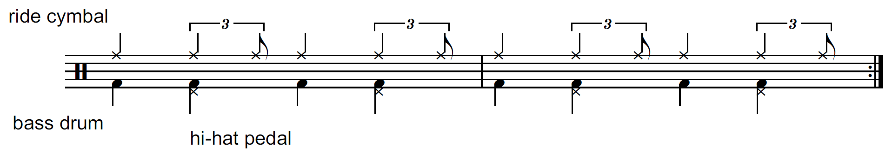
Activity 3.2 – elements of swing (2)
Swing pattern
Saying the word ‘kangaroo’ from beat 2 onwards can help remember the swing rhythm.
which is similar to:
At faster tempos, these uneven quaver pairs become closer to straight quavers.

Slide 51
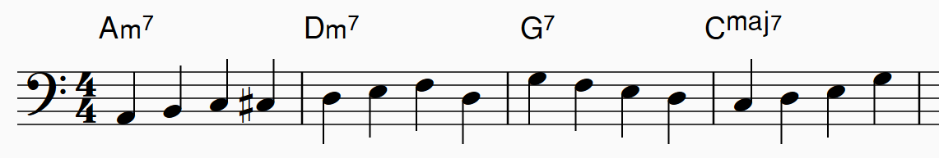
Activity 3.2 – elements of swing (3)
Walking bass line
Walking bass lines are common in swing jazz. Every crotchet is played, with the pitches of each note outlining the root notes of the chord progression with scale or chord tone movement in between.
For example:
Listen to this walking bassline played by your teacher and answer the following questions:
How would you describe the pitch contour?
What is the register of a walking bass line?
Describe the rhythm.

Slide 52
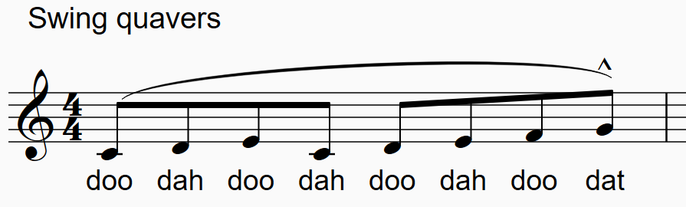
Activity 3.2 – elements of swing (4)
Melody articulations
Tonguing on a wind or brass instrument is when the beginning of a note is articulated with the tongue whilst blowing air through the instrument. Performers often use the syllable ‘da’ or ‘to’ to achieve this. It creates a clear and defined beginning to each note.
In swing style melodies, groups of quavers are mostly played legato. Wind players still tongue each note, which may be referred to as ‘legato tonguing’ or ‘soft tonguing’, brass players may refer to this as ‘doodle tonguing’. The final quaver of a phrase is often syncopated and short.
Most swing quavers are also ‘back-accented’, meaning that the off-beat (short length) quaver has a slight accent to it. Sing this example with soft tonguing:

Slide 53
Activity 3.3 – melodic interpretation (1)
Composing and performing
Melodies can be based on scales, much like ‘Fly Me to the Moon’. In this activity, you will interpret a scale to create a melody. Access the ‘Melodic interpretation exercise ’ score for this activity. Complete the melodic interpretation activity using the steps provided:
Play through the concert C major and A harmonic minor scales.
Play through the two variations of these scales provided on the score. Note that the melodic contour has been altered in these variations.
Access the ‘Melodic interpretation example’ score to observe how various compositional and expressive devices can be used to interpret the melody. Create your own rhythm using the 2 variations provided to reinterpret the melody. Interpret these melodies with swing rhythms and articulations.
Vocalists should use scat syllables such as ‘doo, dah, bah, dwee’. When creating your own interpretation, you may like to consider experimenting with a range of devices.

Slide 54
Activity 3.3 – melodic interpretation (2)
Example
Syncopation
anticipate – play the note on the quaver before
delay – play the note on the quaver after
triplets or other cross rhythms.
Passing or auxiliary notes
Use non-chord notes or neighbouring notes to add to the melody as additional notes and rhythms
Melodic interpretation
Ornamentation
acciaccatura – chromatic, diatonic or intervallic; above or below the note
appoggiatura – can be before or after the beat; chromatic, diatonic or intervallic; above or below the note
turns or mordents
glissandos – fall (descending after the note), scoop (ascending before the note), plop (descending before the note), doit (ascending after the note)
Articulation
staccato, tenuto, marcato (short accent in jazz), slurs

Slide 55
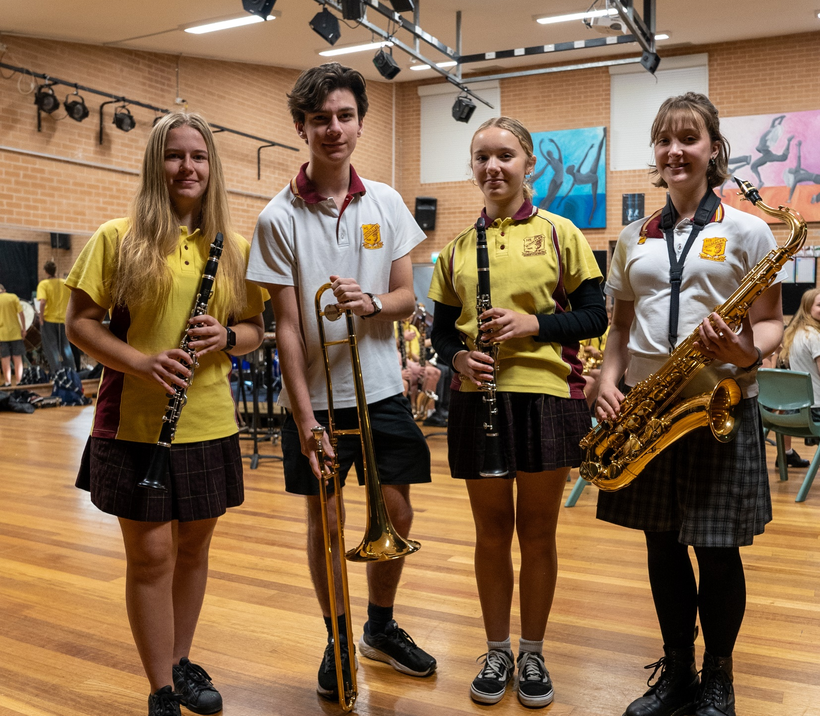
Activity 3.3 – melodic interpretation (3)
Composing and performing continued
4. Use the Activity 3.3 melodic interpretation backing track (0:23) or the Fly Me To The Moon (2008 Remastered) (2:27) by Frank Sinatra recording from the listening task to perform your own melodic interpretation.
5. Transcribe or notate your melodic variation using traditional notation or graphic notation.

Slide 56
Activity 3.5 – safety in the music classroom (1)
Show respect for your classmates, your teacher and the music classroom equipment.
Return instruments and equipment (including leads, adaptors, pedals) to the right place.
Take care when using instruments to avoid accidents and damage. Report any damage immediately to your teacher.
Consider safe volume levels when rehearsing and think about others around you.
Always do a warm-up and/or technical work before rehearsing a performance piece.
Position your music and/or ensemble members to ensure correct posture both in rehearsal and performance.

Slide 57
Activity 3.5 – safety in the music classroom (2)
Cover any trip hazards, including cords.
Explore different ways to play. For example, adjust volume or pitch controls or select different modes or effects instead of playing forcefully.
Be considerate of class members with sound sensitivity.
Practice safety when packing away. For example, turn off the instrument before unplugging and switch off power points before pulling out plugs.

Slide 58

Activity 3.5 – safety in the classroom (3)
Keyboard
When playing the keyboard, it is important that you use the correct technique to play the instrument with ease and avoid strain on your body. Remember to:​
maintain correct posture – sit on a chair or stool with your feet flat on the floor and your body centred in the middle of the keyboard​
maintain correct hand positioning – position your hands softly above the keys like they are resting on a ball​, and ensure your wrists aren’t resting on the desk or keyboard. Press the keys down with the fingertips using medium pressure.
warm-up – practice scale patterns focusing on consistent rhythm. You can try playing these warm-ups with a metronome to improve rhythmic accuracy.
if using amplification, ensure all volume levels are set appropriately for the room and can support a balanced sound with other ensemble members.

Slide 59

Activity 3.5 – safety in the classroom (4)
Guitar
When playing the guitar, it is important that you use the correct technique to play the instrument with ease and avoid strain on your body. Remember to:​
maintain correct posture – sit or stand up with relaxed shoulders. Keep the guitar close to your body and avoid slouching. Position the guitar across your navel. Use a guitar strap if standing.
maintain correct hand positioning – the fret hand should have the thumb placed behind the neck pointing upwards. The palm should not touch the neck. The fingers press the strings down to the fretboard directly behind frets with the fingertips, keeping the strings straight. The fingers should be curved without buckling at the joints. The strumming or picking hand should have a relaxed wrist, and play with controlled, confident movements.
warm-up – begin with finger exercises (scales or similar) or simple repeated strumming patterns, focusing on consistent rhythm and tone. You can try playing these warm-ups with a metronome to improve rhythmic accuracy.
if using amplification, ensure all volume levels are set appropriately for the room and can support a balanced sound with other ensemble members.

Slide 60

Activity 3.5 – safety in the classroom (5)
Bass guitar
When playing the bass guitar, it is important that you use the correct technique to play the instrument with ease and avoid strain on your body. Remember to:​
maintain good posture – sit or stand up with relaxed shoulders. You will need to use a bass guitar strap if standing. Position the bass across your navel.
maintain correct hand positioning – the fret hand should have the thumb placed behind the neck pointing upwards. The palm should not touch the neck. The fingers press the strings down to the fret board directly behind frets with the fingertips, keeping the strings straight. The fingers should be curved without buckling at the joints. The plucking hand should pluck the strings using alternating index and middle fingers, using rest stroke.
warm-up – practice scale patterns or repeated notes focusing on consistent rhythm and tone. You can try playing these warm-ups with a metronome to improve rhythmic accuracy.
if using amplification, ensure all volume levels are set appropriately for the room and can support a balanced sound with other ensemble members.

Slide 61

Activity 3.5 – safety in the classroom (6)
Drumkit
When playing the drumkit, it is important that you use the correct technique to play the instrument with ease and avoid strain on your body. Remember to:​
maintain correct posture – sit at the correct height and distance from the kit. Your thighs should be parallel to the ground or slightly angled down. Sit far enough back to comfortably reach all drums, pedals and cymbals without overextending. Keep your back straight, shoulders relaxed and avoid slouching.
maintain correct technique – hold the sticks loosely but securely. For repeated strikes, use the rebound from the drumskin to produce the subsequent strokes, controlled by the fingers. Maintain relaxed arms, wrists and fingers for consistent technical control. Consider the dynamic and tone when playing so that ensemble balance is achieved.
warm-up – practice rudiments (for example – singles, doubles, paradiddles) on the snare drum focusing on rhythmic evenness. You can try playing these warm-ups with a metronome to improve rhythmic accuracy.

Slide 62

Activity 3.5 – safety in the classroom (7)
Vocals
When singing, it is important that you use the correct technique to sing with ease and avoid strain on your body. Remember to:​
maintain correct posture – stand with your feet shoulder-width apart, knees slightly bent, shoulders relaxed and the chest open. Breathe deeply from the stomach, keeping your shoulders quiet.
maintain correct technique – avoid throat tension by keeping the throat open and relaxed. Breathe deeply and project your voice without overextending it. Articulate clearly for good diction. Stay hydrated​ and take vocal breaks during practice.
warm-up – start with light humming, lip trills and sirens before moving to scales and vocal exercises.

Slide 63


Activity 3.5 – safety in the classroom (8)
Woodwind and brass
When playing a woodwind or brass instrument, it is important that you use the correct technique to play the instrument with ease and avoid strain on your body. Remember to:​
maintain good posture and breath control – sit or stand up with relaxed shoulders with your feet flat on the floor. Breathe deeply from the stomach, keeping your shoulders quiet.
maintain correct hand positioning – keep your fingers curved and relaxed over the keys. Avoid unnecessary tension and use light pressure to press the keys, maintaining agile fingers to facilitate speed and precision.
warm-up – practice long tones to centre your tone. Practice scale patterns focusing on clear tonguing, tone, and consistent rhythm. You can try playing these warm-ups with a metronome to improve rhythmic accuracy. Consider your volume when playing with others to achieve a balanced sound.

Slide 64
Learning sequence 4 – improvise, rehearse and refine

Slide 65
Learning intentions and success criteria (4)
We are learning to:
know the notes of the pentatonic scale
understand how to generate and develop new musical material using the elements of music in improvisation activities
apply, rehearse and refine improvisation skills within the context of performing a piece of music
We can:
name the notes of the pentatonic scale and play the scale on an instrument/voice
apply the pentatonic scale to improvising new musical material over a moving chord progression
identify and explain areas of a performance or improvisation that require further refinement using appropriate musical terminology and how this can be achieved
Notes:
Notes for teachers:
Learning intentions and success are best co-constructed with students. Adapt the learning intention as required and add matching success criteria.
For more information See ⁠AITSL or the NSW Department of Education explicit teaching strategies, ⁠Sharing learning intentions and ⁠Sharing success criteria
LISC is not necessarily presented at the beginning of the lesson. Teacher needs to consider most effectual time to introduce
LISC should be revisited during the lesson to support students' evaluation of their learning

Slide 66
Activity 4.1 – ensemble work (1)
‘Until My Life’s A Song’ by Andrew Robertson and Daryl Aberhart
Continue to rehearse and refine the swing tune ‘Until My Life’s A Song’. As you refine the piece you may like to consider the following:
ensure the ensemble is in tune
break down the piece into smaller sections and focus on one section at a time
chunk and drill by repeating difficult passages multiple times in succession
use the drummer to keep a steady hi-hat pulse to reinforce the conducting
vocalise rhythms and melodies as a class to assist with learning rhythmic and melodic patterns
ensure that the rhythm section is rhythmically solid and reliable before adding the melody and backing figures. Start with the drums and bass, making sure that they are rhythmically locked into each other before adding the piano and guitar. Extra practice for the rhythm section may be required.

Slide 67
Activity 4.1 – ensemble work (2)
‘Until My Life’s A Song’ by Andrew Robertson and Daryl Aberhart
pay close attention to the rhythm and articulation to ensure the jazz style is being realised
focus on accuracy while listening to the ensemble around you. Can you hear if you are locking into and blending with the other parts?
refine transitions between sections
explore contrast in your improvisation using the elements of music by experimenting with different approaches and interpretations
ensure the composed and improvised sections have appropriate dynamic phrasing and climax points including articulations and dynamics
to develop confidence in soloing, experiment with 2 soloists improvising at the same time
ensure backing figures played during solos are balanced appropriately against the soloist
ensure the groove and energy of the piece is communicated – have fun as an ensemble!

Slide 68
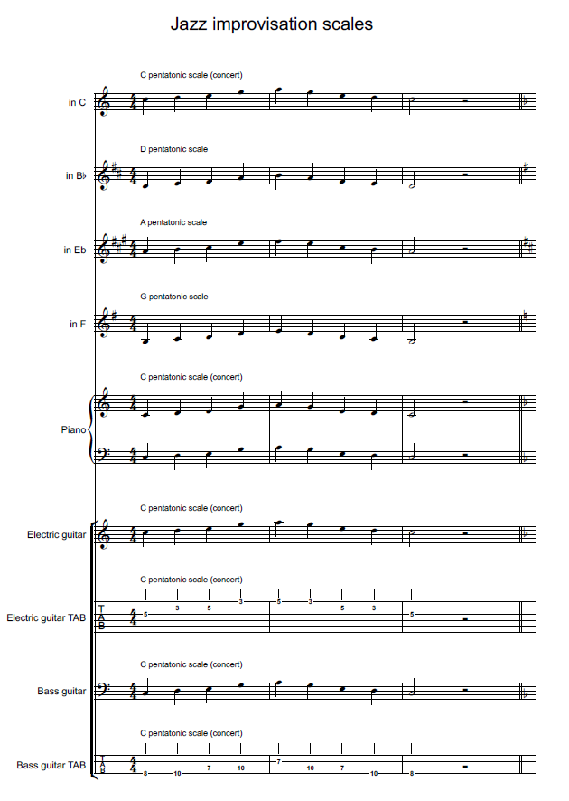
Activity 4.2 – learning to improvise – beginner
The pentatonic scale
Access the Jazz – improvisation – beginner video (5:31) and complete the sequence of activities in the video as a class.

Slide 69
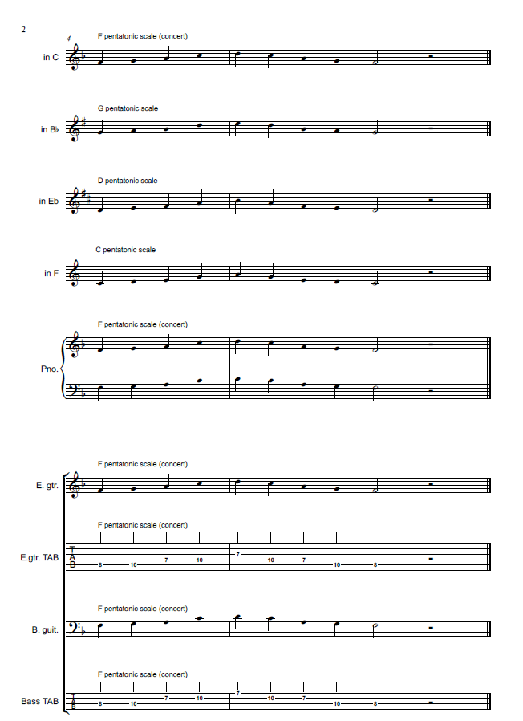
Activity 4.3 – learning to improvise – intermediate
The pentatonic scale
Access the Jazz – improvisation – intermediate (2:47) video and complete the sequence of activities in the video as a class.

Slide 70
Activity 4.4 – developing your solo (1)
Improvisation
As you continue to develop your improvisation solo, you may like to consider the following:
use rhythms, melodies and backing figures from the composed piece as starting points for developing ideas by altering them or repeating fragments of musical material to use in your solo
consider the shape and direction of your solo – where would you like your solo to come to a climax or increase or decrease in intensity? How will you achieve this? Consider rhythmic complexity, pitch direction, range and registers utilised, dynamics and expression
ensure that you interact and communicate with the rhythm section during the solo so that the phrasing and direction of your solo is supported by the ensemble
experiment with timbre and expressive techniques to personalise your solo.

Slide 71
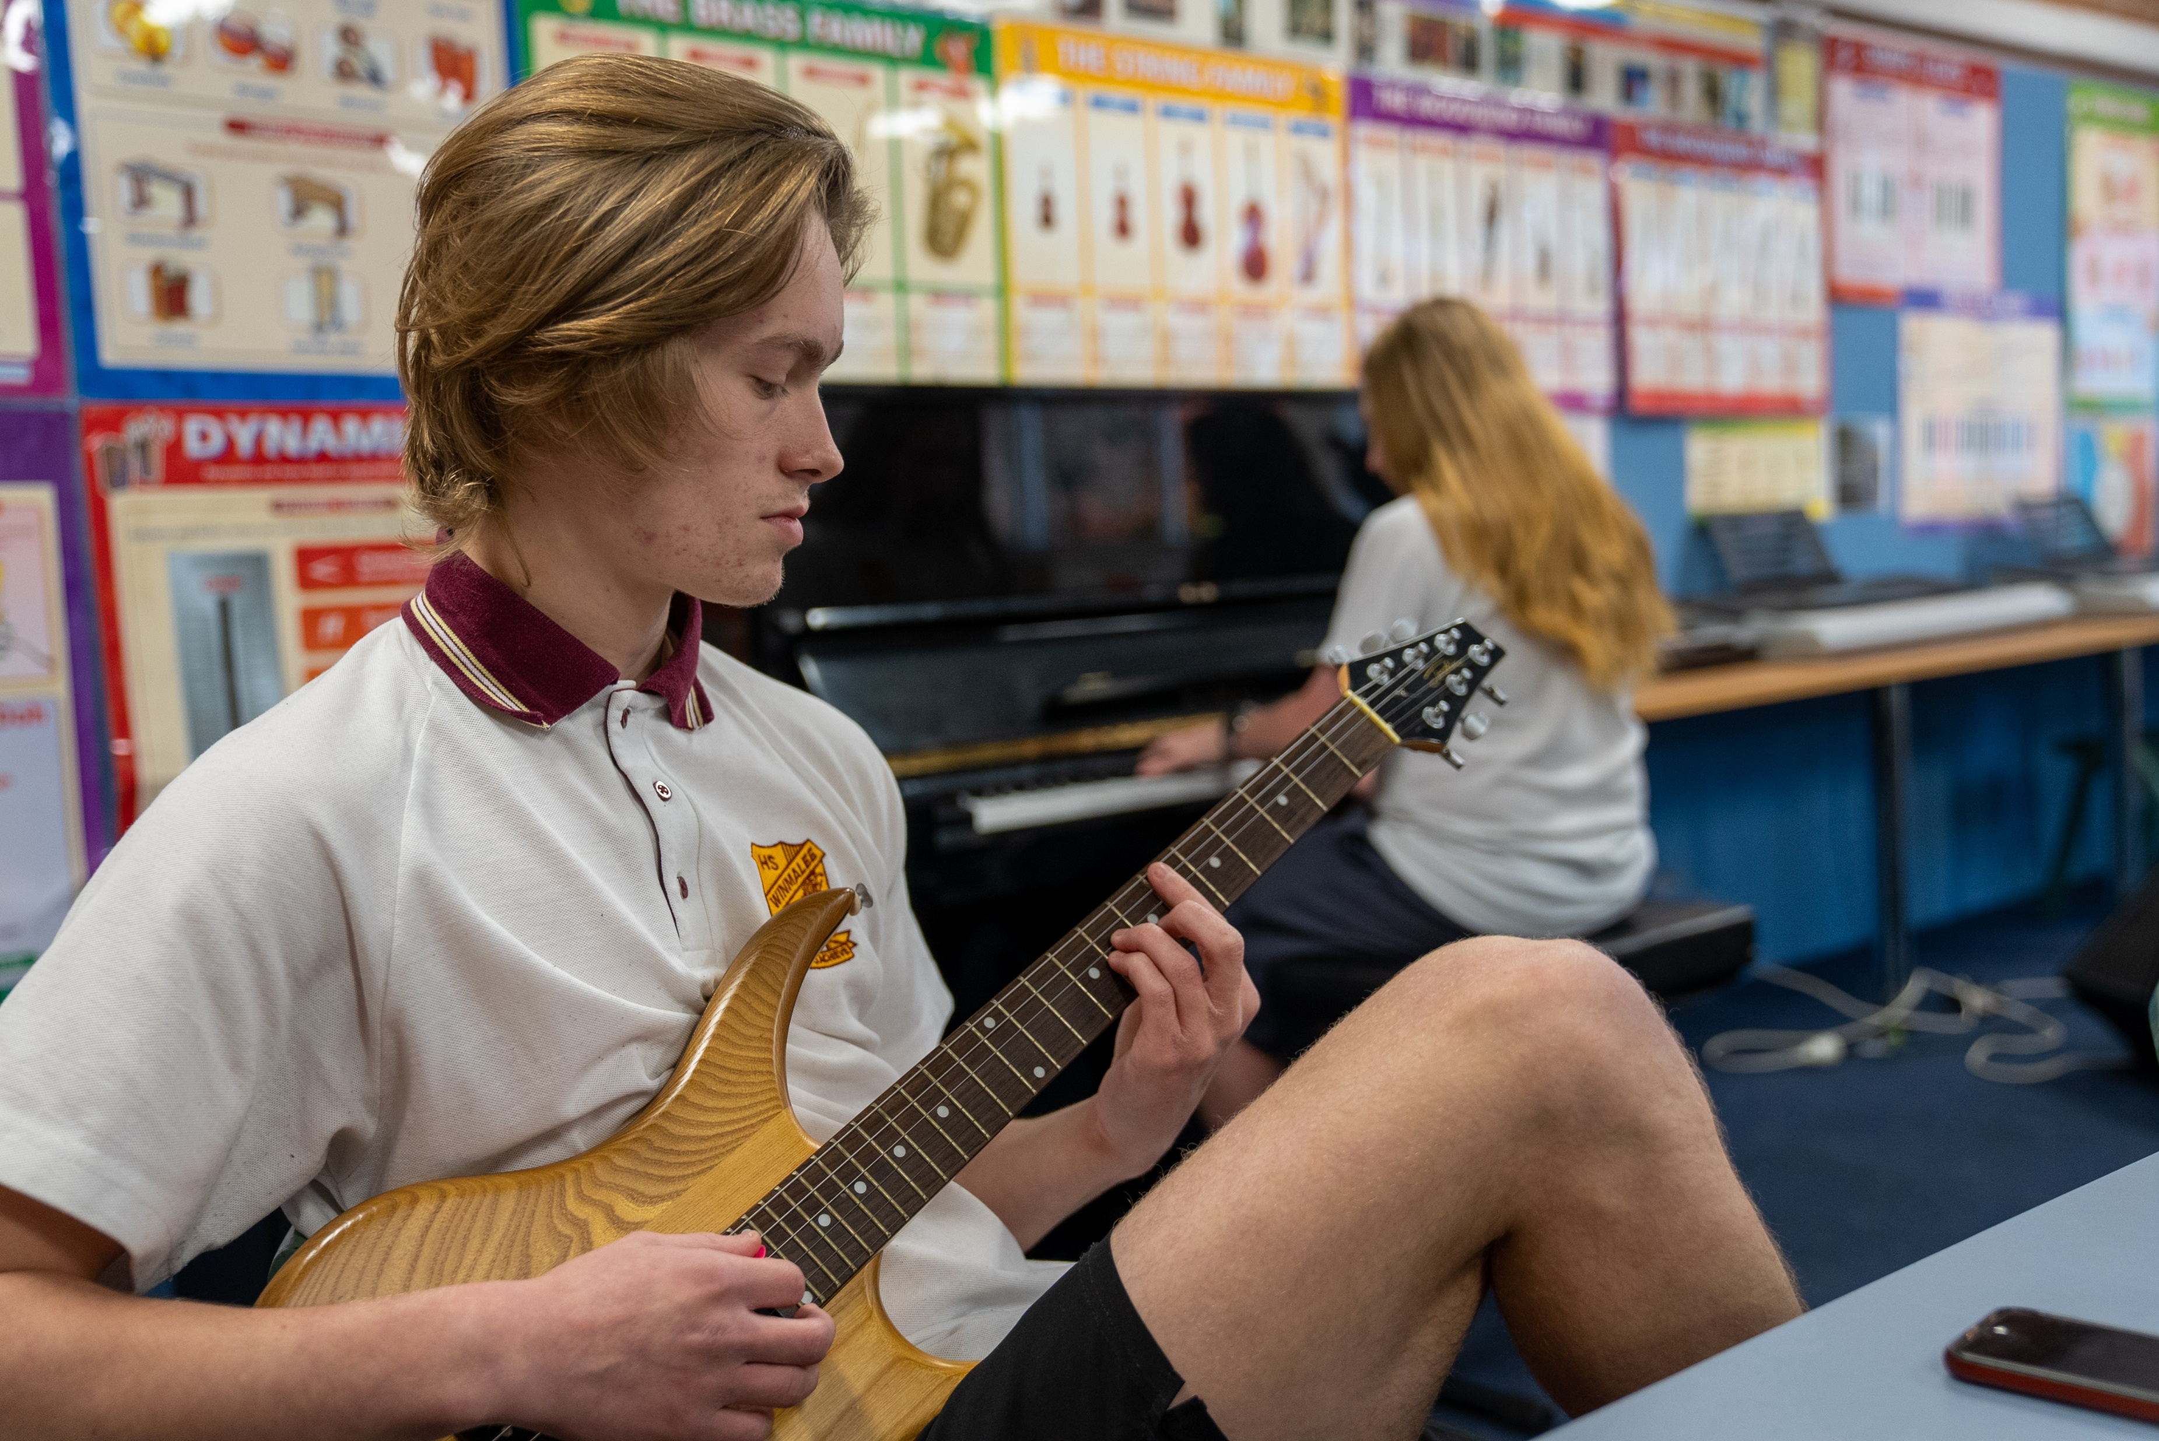
Activity 4.4 – developing your solo (2)
Improvisation
Explore ‘trading 4’s’ by soloing in a call and response manner with another soloist. Each player takes turns improvising for 4 bars, being responsive to the musical material presented by the other player.
Listen to improvisations by your favourite artists – what do you like about their improvisations? How have they demonstrated contrast in their solo? What sort of expressive techniques have they used? Transcribe any favourite rhythms or licks that you might like to incorporate into your own solo.
Record yourself in case you improvise a phrase you’d like to repeat.

Slide 72
Learning sequence 5 – swing musical features

Slide 73
Learning intentions and success criteria (5)
We are learning to:
know how to rehearse and refine performance and improvisation skills
understand and identify the music terminology to describe musical signs, terms and symbols on a score
apply understanding of the elements of music to a jazz context
We can:
identify areas within a performance that require further refinement and apply rehearsal strategies to improve the performance or improvisation
identify and define signs, terms and symbols on a musical score
use the elements of music to describe jazz musical features in listening and score reading activities.
Notes:
Notes for teachers:
Learning intentions and success are best co-constructed with students. Adapt the learning intention as required and add matching success criteria.
For more information See ⁠AITSL or the NSW Department of Education explicit teaching strategies, ⁠Sharing learning intentions and ⁠Sharing success criteria
LISC is not necessarily presented at the beginning of the lesson. Teacher needs to consider most effectual time to introduce
LISC should be revisited during the lesson to support students' evaluation of their learning

Slide 74

Activity 5.2 – score scavenger hunt (1)
Music symbol or term
clefs including treble clef, bass clef and percussion clef
time signature including its definition
key signature
chord symbols
extended chords
repeat sign
syncopation
melody
backing figures
unison
comping
swing beat
articulations such as accent, staccato
all dynamics – identify their name and definition
‘Until My Life’s A Song’ by Andrew Robertson
and Daryl Aberhart
Access the ‘Jazz full performance’ video (5:34) and pages 1–3 of the score for ‘Until My Life’s A Song’ by Andrew Robertson and Daryl Aberhart and follow along with the score while listening. Using a highlighter and pen, identify, highlight and label on the score, one example of each of the following:

Slide 75
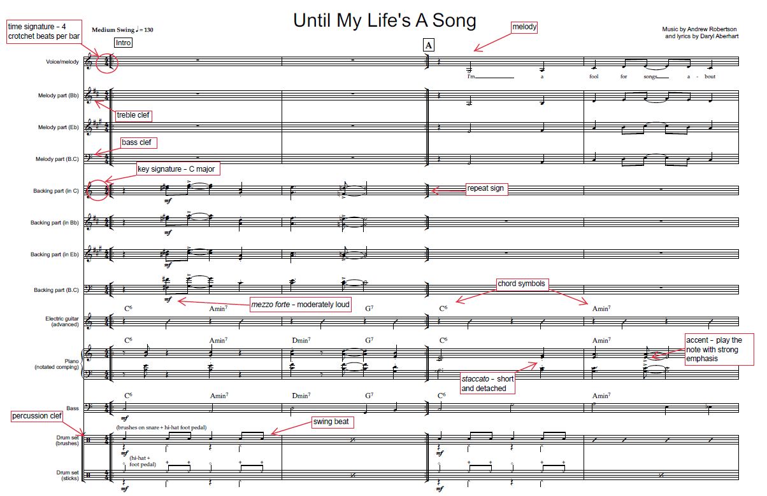
Activity 5.2 – score scavenger hunt (2)
Answers

Slide 76
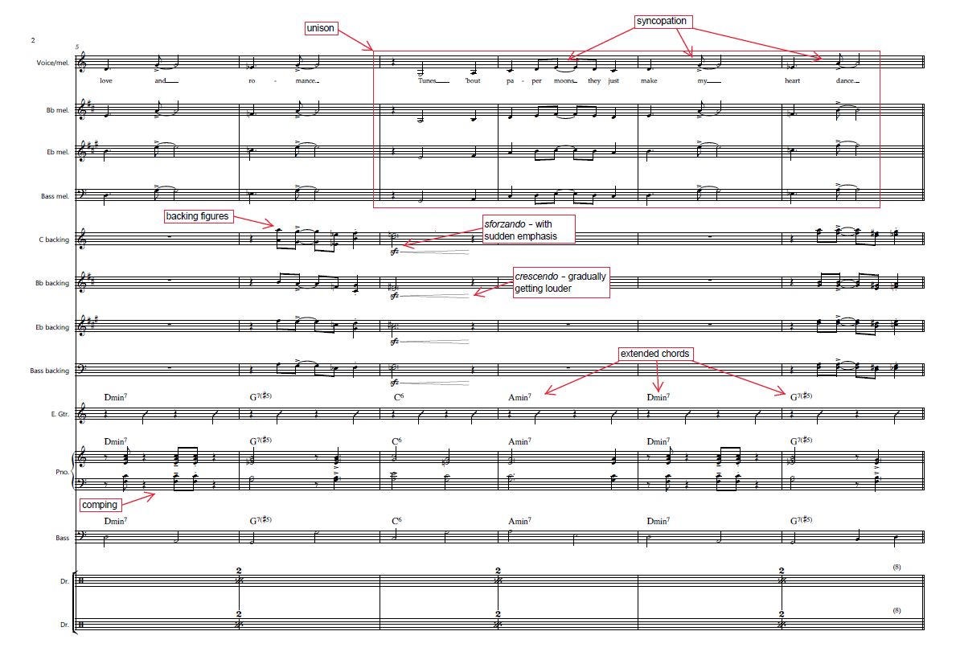
Activity 5.2 – score scavenger hunt (3)
Answers

Slide 77
Learning sequence 6 – funk

Slide 78
Learning intentions and success criteria (6)
We are learning to:
know and define which musical features are representative of funk through the elements of music
understand how funk musical features can be applied in performance and composition activities
interpret musical scores in a funk style
We can:
listen, analyse and evaluate music to determine common musical features of funk
perform, improvise and compose music using funk musical features
read scores and apply stylistic understanding of funk in performance
Notes:
Notes for teachers:
Learning intentions and success are best co-constructed with students. Adapt the learning intention as required and add matching success criteria.
For more information See ⁠AITSL or the NSW Department of Education explicit teaching strategies, ⁠Sharing learning intentions and ⁠Sharing success criteria
LISC is not necessarily presented at the beginning of the lesson. Teacher needs to consider most effectual time to introduce
LISC should be revisited during the lesson to support students' evaluation of their learning

Slide 79
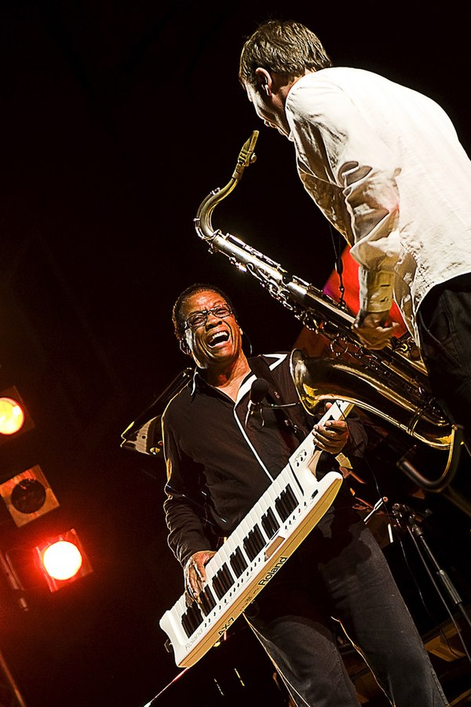
Activity 6.1 – what is funk? (1)
Musical context
Funk music originated in the 1960’s, blending elements of jazz, soul, gospel and rhythm and blues. Funk became popular during a period of social activism and further developed as a genre during the 1970s.
Funk musicians primarily use electronic instrumentation such as electric guitars and basses, synthesizers and organs; horns and additional percussion instruments may also be present. The bass guitar functions as a melodic instrument played in a percussive style. Funk music relies on a steady drumbeat which serves as the foundation for layers of different rhythmic patterns generated by the horn and rhythm sections.
Herbie Hancock live in concert playing the keytar (2008) by
Marco Fedele is licensed under Creative commons 2.0

Slide 80
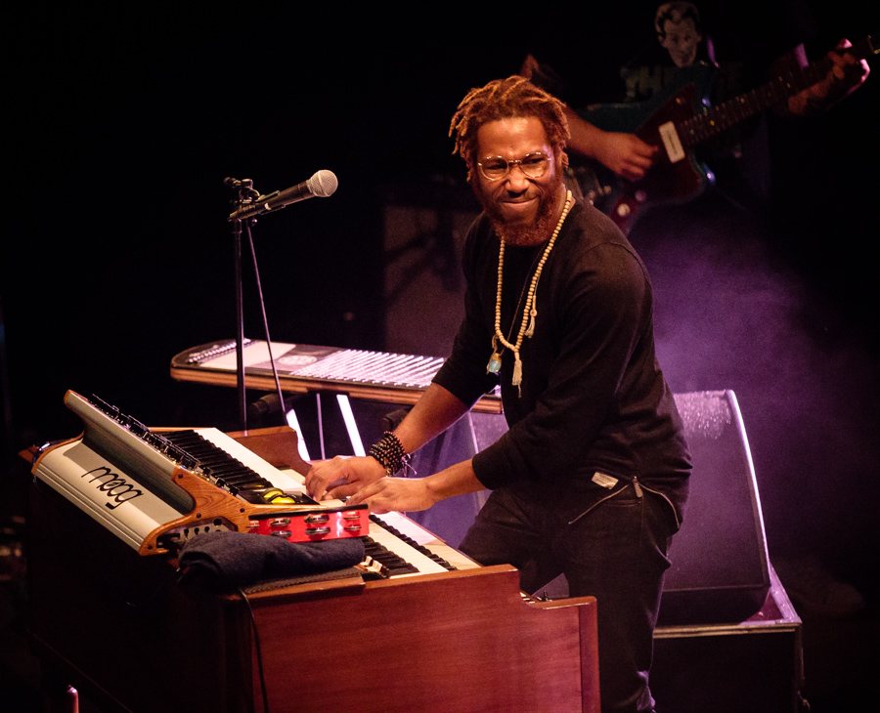
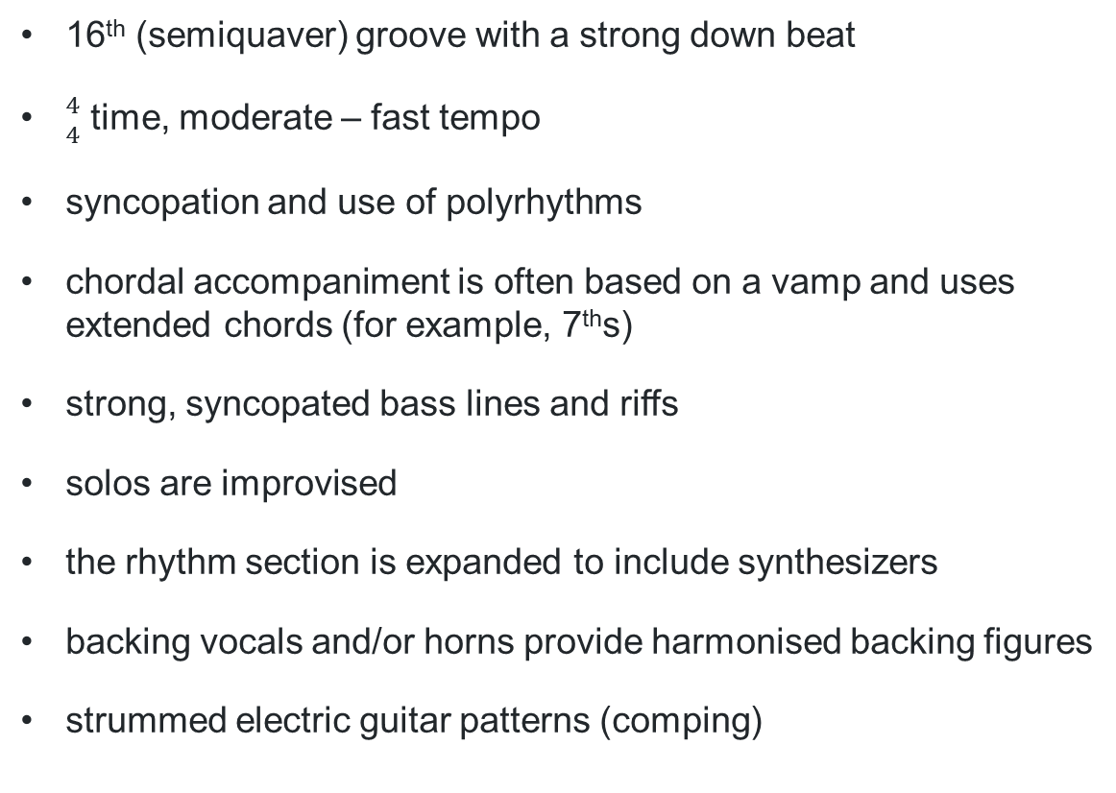
Activity 6.1 – what is funk? (2)
Musical characteristics
16th (semiquaver) groove with a strong down beat
${4 \atop 4}$ time, moderate – fast tempo
syncopation and use of polyrhythms
chordal accompaniment is often based on a vamp and uses extended chords (for example, 7ths)
strong, syncopated bass lines and riffs
solos are improvised
the rhythm section is expanded to include synthesizers
backing vocals and/or horns provide harmonised backing figures
strummed electric guitar patterns (comping)
Cory Henry and the Funk Apostles (2017) by Tore Saetre / Wikimedia
is licensed under Creative commons SA 4.0

Slide 81
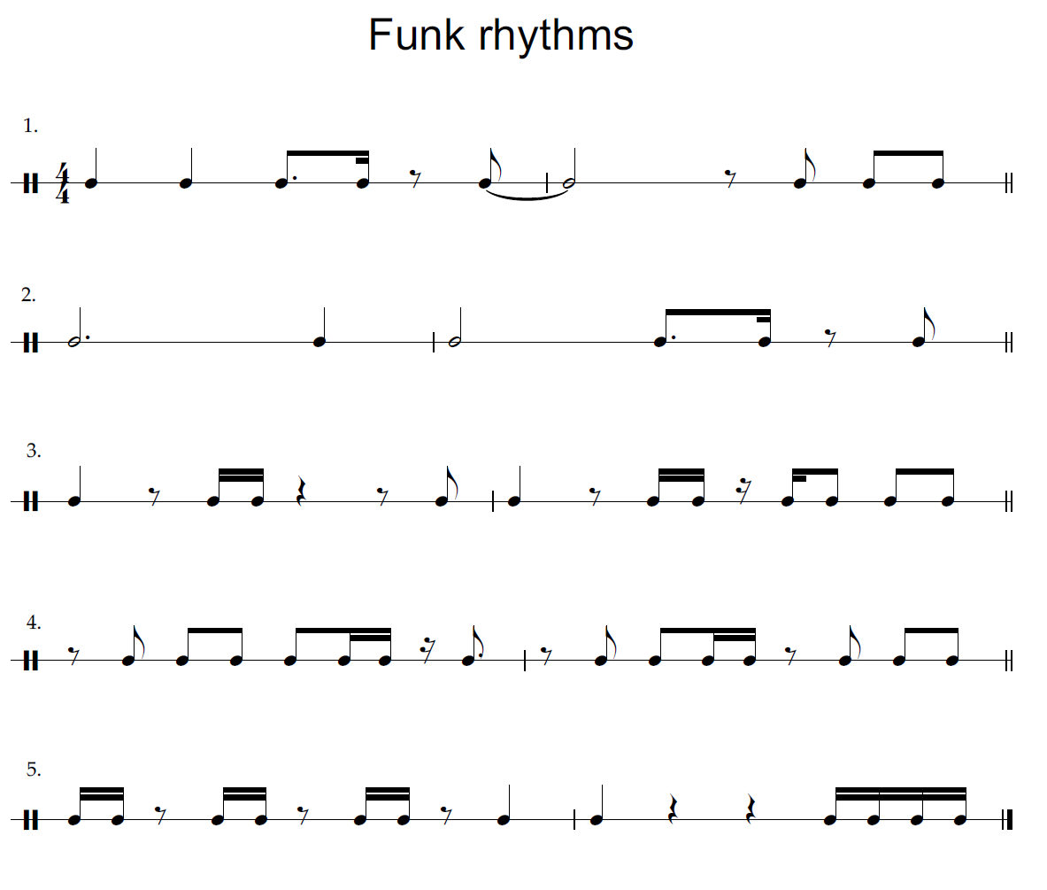
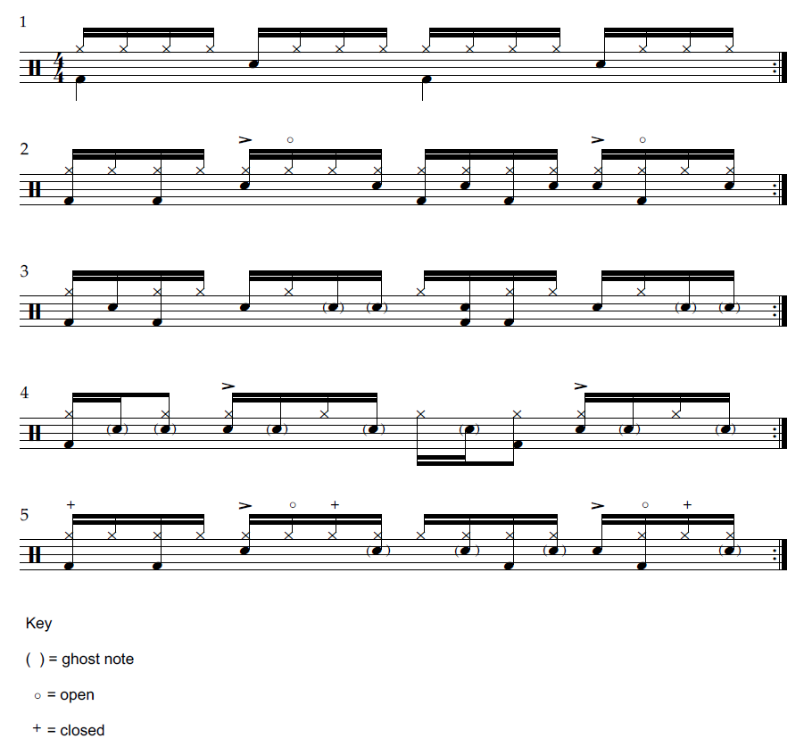
Activity 6.2 – funk stations (1)
16th note (semiquaver ) grooves

Slide 82
Activity 6.2 – funk stations (2)
Musical terms unpacked – syncopation
Syncopation involves playing rhythms and/or accents on weak beats or subdivisions. In funk music, this is typically seen through the use of rests placed on the beat or accents placed on notes off the beat. An example of a syncopated rhythmic pattern can be seen below:

Slide 83

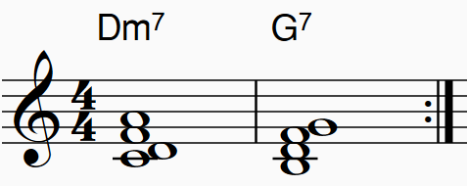
Activity 6.2 – funk stations (3)
Musical terms unpacked – vamp
In funk music, a vamp is a repeated musical sequence, often a short chord progression which provides a rhythmic and harmonic foundation for a song. A vamp usually contains 1-2 extended chords played across 2 bars, repeated. Comping may be used to apply rhythmic patterns to the vamp.
For example:

Slide 84
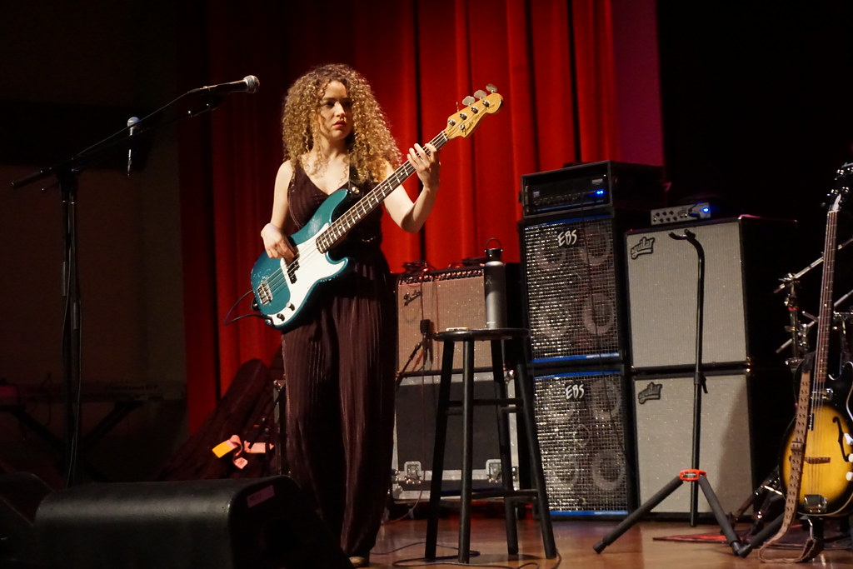
Activity 6.2 – funk stations (4)
Strong, syncopated bass line
The strong, syncopated bass line is one of the most important and prominent features of the funk style. The role of the bass is harmonic and rhythmic, and is used to emphasise repeated patterns, establish the groove and can include extended techniques such as popping or slapping.
Tal Wilkenfeld at NAMM Bass Bash 2020 (2020) by Steve Lawson is licensed
under Creative commons SA 2.0

Slide 85
6.3 – ‘Chameleon’ by Herbie Hancock (1)
Listening
Access Herbie Hancock - Chameleon (Live at Montreux Jazz Festival 2010) (6:07) (from 0:00 – 6:07) and answer the following questions:
1. What instrument plays the main riff at the beginning of the song?
2. What makes the bassline in ‘Chameleon’ so memorable or distinctive? How does it contribute to the overall feel of the song?
3. Describe what the other instruments in the rhythm section are playing in the opening of ‘Chameleon’. (0:00 – 0:50).
4. Outline the structure of the song.
5. What are some characteristics of jazz improvisation you can hear in the keytar solo?

Slide 86
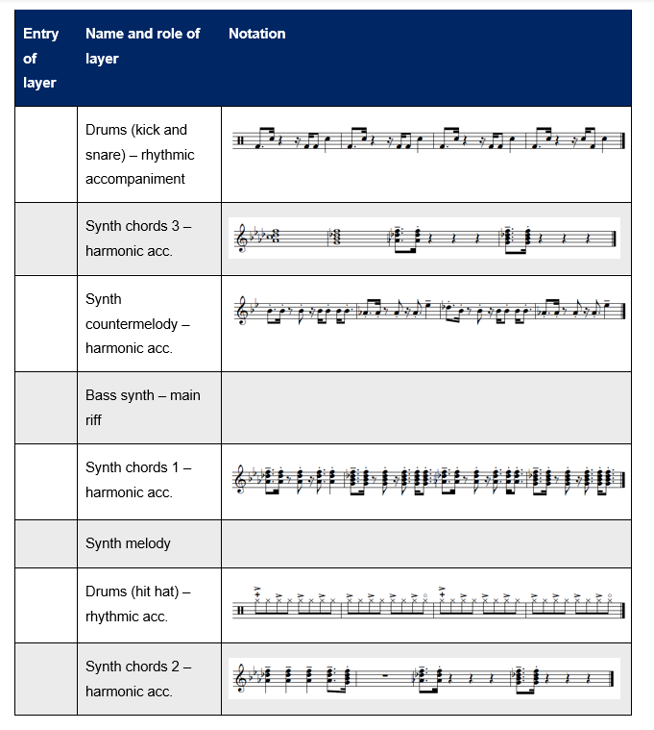
6.3 – ‘Chameleon’ by Herbie Hancock (2)
Listening
Access Herbie Hancock - Chameleon (Live Loop Cover) | Minilab 3 (2:30).
Identify the order in which in the 8 layers of sound enter by numbering them in the table provided. Notate the pattern for the bass synth and synth melody using graphic notation or traditional notation.

Slide 87
Learning sequence 7 – funk performance and improvisation

Slide 88
Learning intentions and success criteria (7)
We are learning to:
know the notes of the D dorian scale
understand how to generate and develop new musical material using the elements of music in improvisation activities
apply, rehearse and refine improvisation skills within the context of performing a piece of music
We can:
name the notes of the D dorian scale and play the scale on an instrument/voice
apply the dorian scale to improvising new musical material over a moving chord progression
identify and explain areas of a performance or improvisation that require further refinement using appropriate musical terminology and how this can be achieved
Notes:
Notes for teachers:
Learning intentions and success are best co-constructed with students. Adapt the learning intention as required and add matching success criteria.
For more information See ⁠AITSL or the NSW Department of Education explicit teaching strategies, ⁠Sharing learning intentions and ⁠Sharing success criteria
LISC is not necessarily presented at the beginning of the lesson. Teacher needs to consider most effectual time to introduce
LISC should be revisited during the lesson to support students' evaluation of their learning

Slide 89

Activity 7.2 – funk improvisation – beginner and intermediate
The dorian scale
Access the Funk – improvisation – beginner video (4:14) and Funk – improvisation – intermediate video (3:59) and complete the sequence of activities in the video as a class.

Slide 90
Learning sequence 8 – improvise, rehearse and refine

Slide 91
Learning intentions and success criteria (8)
We are learning to:
know how to rehearse and refine performance and improvisation skills
understand and identify the music terminology to describe musical signs, terms and symbols on a score
apply understanding of the elements of music to a funk context
We can:
identify and explain areas of a performance or improvisation that require further refinement using appropriate musical terminology and how this can be achieved
identify and define signs, terms and symbols on a musical score
use the elements of music to describe funk musical features in listening and score reading activities.
Notes:
Notes for teachers:
Learning intentions and success are best co-constructed with students. Adapt the learning intention as required and add matching success criteria.
For more information See ⁠AITSL or the NSW Department of Education explicit teaching strategies, ⁠Sharing learning intentions and ⁠Sharing success criteria
LISC is not necessarily presented at the beginning of the lesson. Teacher needs to consider most effectual time to introduce
LISC should be revisited during the lesson to support students' evaluation of their learning

Slide 92
Activity 8.1 – ensemble work (1)
‘Look What The Cat Dragged In’ by Andrew Robertson
Continue to rehearse and refine the swing tune ‘Look What The Cat Dragged In’. As you refine the piece you may like to consider the following:
ensure the ensemble is in tune
break down the piece into smaller sections and focus on one section at a time
chunk and drill by repeating difficult passages multiple times in succession
use the drummer to keep a steady hi-hat pulse to reinforce the conducting
vocalise rhythms and melodies as a class to assist with learning rhythmic and melodic patterns
ensure that the rhythm section is rhythmically solid and reliable before adding the melody and backing figures. Start with the drums and bass, making sure that they are rhythmically locked into each other before adding the piano and guitar. Extra practice for the rhythm section may be required.

Slide 93
Activity 8.1 – ensemble work (2)
‘Look What The Cat Dragged In’ by Andrew Robertson
pay close attention to the rhythm and articulation to ensure the funk style is being realised
focus on accuracy while listening to the ensemble around you. Can you hear if you are locking into and blending with the other parts?
refine transitions between sections
explore contrast in your improvisation using the elements of music by experimenting with different approaches and interpretations
ensure the composed and improvised sections have appropriate dynamic phrasing and climax points including articulations and dynamics
to develop confidence in soloing, experiment with 2 soloists improvising at the same time
ensure backing figures played during solos are balanced appropriately against the soloist
ensure the groove and energy of the piece is communicated – have fun as an ensemble!

Slide 94
Activity 8.2 – score scavenger hunt (1)
Music symbol or term
clefs including treble clef, bass clef and percussion clef
time signature including its definition
key signature
chord symbols
extended chords
repeat sign
syncopation
melody
unison
comping
16th note semiquaver groove
funky bass line
articulations and expressive techniques – identify their name and definition
all dynamics – identify their name and definition
‘Look What The Cat Dragged In’ by Andrew Robertson
Access the Funk full performance video (4:20) and pages 1–3 of the score for ‘Look What The Cat Dragged In’ by Andrew Robertson and follow along with the score while listening. Using a highlighter and pen, identify, highlight and label on the score, one example of each of the following:

Slide 95

Activity 8.2 – score scavenger hunt (2)
Answers

Slide 96

Activity 8.2 – score scavenger hunt (3)
Answers

Slide 97
Learning sequence 9 – assessment preparation

Slide 98
Learning intentions and success criteria (9)
We are learning to:
apply, rehearse and refine performance and improvisation skills within the context of performing a piece of music
understand how to listen and analyse a piece to determine the musical success of a performance or improvisation
apply musical understanding to provide constructive feedback to peers
We can:
identify and explain areas of a performance or improvisation that require further refinement using appropriate musical terminology and how this can be achieved
identify jazz musical features or characteristics and the quality of their execution in performances and improvisations
provide positive and constructive feedback for group and individual performances and improvisations
Notes:
Notes for teachers:
Learning intentions and success are best co-constructed with students. Adapt the learning intention as required and add matching success criteria.
For more information See ⁠AITSL or the NSW Department of Education explicit teaching strategies, ⁠Sharing learning intentions and ⁠Sharing success criteria
LISC is not necessarily presented at the beginning of the lesson. Teacher needs to consider most effectual time to introduce
LISC should be revisited during the lesson to support students' evaluation of their learning

Slide 99

Activity 9.1 – performance assessment preparation
Performing and improvising
As a class or in small groups, continue to prepare, rehearse and refine one jazz or funk song that you have studied in this unit, or select another piece after consultation with your teacher. Either part or all of the song must be arranged for your group with an opportunity given for every group member to improvise. Consider the capabilities of performing media and the needs and perspectives of performers when arranging your piece. Consider how interpretation is affected by changes in instrumentation aesthetic qualities. Experiment with performance spaces, set-ups and production elements to demonstrate understanding of how staging affects the communication of musical ideas.

Slide 100
Activity 9.2 – peer feedback (1)
Whole group feedback
+
?
Plus
Minus
Interesting

Slide 101


Activity 9.2 – peer feedback (2)
Individual feedback – 2 stars and a wish
Something that is going well
Something that is going well
Something to improve on

Slide 102
Learning sequence 10 – assessment

Slide 103
Learning intentions and success criteria (10)
We are learning to:
apply stylistic understanding and musical expression to an ensemble performance
understand how stylistic features and musical expression can be integrated in composition and performance simultaneously
understand what makes a performance or improvisation successful in practice
We can:
perform repertoire with stylistic awareness and musical expression integrating musical features specific to the style
improvise with stylistic understanding and musical expression
analyse and reflect on the performance and composition process with understanding of context
Notes:
Notes for teachers:
Learning intentions and success are best co-constructed with students. Adapt the learning intention as required and add matching success criteria.
For more information See ⁠AITSL or the NSW Department of Education explicit teaching strategies, ⁠Sharing learning intentions and ⁠Sharing success criteria
LISC is not necessarily presented at the beginning of the lesson. Teacher needs to consider most effectual time to introduce
LISC should be revisited during the lesson to support students' evaluation of their learning

Slide 104
References
This presentation contains NSW Curriculum and syllabus content. The NSW Curriculum is developed by the NSW Education Standards Authority. This content is prepared by NESA for and on behalf of the Crown in the right of the State of New South Wales. The material is protected by Crown copyright.
Please refer to the NESA Copyright Disclaimer for more information https://educationstandards.nsw.edu.au/wps/portal/nesa/mini-footer/copyright.
NESA holds the only official and up-to-date versions of the NSW Curriculum and syllabus documents. Please visit the NSW Education Standards Authority (NESA) website https://educationstandards.nsw.edu.au/wps/portal/nesa/home and the NSW Curriculum website https://curriculum.nsw.edu.au.
Music 7–10 Syllabus © NSW Education Standards Authority (NESA) for and on behalf of the Crown in right of the State of New South Wales, 2024.
Cultiralis (2025) Percussion [image] accessed 9 June 2025
Darwin Gomez (2015), Ella Macens bio [image] accessed 10 March 2025
David Hartley (19 January 2021) Musical Cadences: Explained! (4:06) [video], David Hartley, YouTube, accessed 6 January 2025
Elise Trouw (2 September 2016) The Girl from Ipanema - Stan Getz & Astrud Gilberto (cover by Elise) (2:02) [video], Elise Trouw, YouTube, accessed 13 May 2025
Frank Sinatra (12 December 2018) Fly Me To The Moon (2008 Remastered) (2:27) [video], Universal Music Group, YouTube, accessed 13 May 2025
George Collier (23 June 2023) is this what heaven sounds like? (2:57) [video], George Collier, YouTube, accessed 13 May 2025
Gus Phillippas (2022) Laufey Live at WFUV [image] accessed 9 June 2025

Slide 105
References (2)
Jens Thekkeveettil (2014) Colourful jazz concert [image] accessed 9 June 2025
Laufey (2 January 2025) Laufey - From The Start (Live From Dick Clark’s New Year’s Rockin’ Eve 2024) (2:57) [video], Laufey, YouTube, accessed 13 May 2025
Laufey (22 August 2013) Laufey – From The Start (Official Music Video) [video], Laufey, YouTube, accessed 9 June 2025
Marco Fedele (2008) Herbie Hancock live in concert playing the keytar [image] accessed 9 June 2025
Montreux Jazz Festival (13 July 2013) Herbie Hancock – Chameleon (Live at Montreux Jazz Festival 2010) (6:07) [video], Montreux Jazz Festival, YouTube, accessed 1 June 2025
MunomaMusic (23 March 2024) Herbie Hancock – Chameleon (Live Loop Cover) | Minilab 3 (2:30) [video], MunomaMusic, YouTube, accessed 1 June 2025
Steve Lawson (2020) Tal Wilkenfeld at NAMM Bass Bash 2020 [image] accessed 9 June 2025
The United States Army Field Band (12 August 2021) Take the A Train - The Jazz Ambassadors (2:46) [video], The United States Army Field Band, YouTube, accessed 13 May 2025
Tomzorz (2024) Laufey performing at Royal Albert Hall in London, United Kingdom [image] accessed 9 June 2025
Tore Saetre (2017) Cory Henry and the Funk Apostles [image] accessed 9 June 2025
VH Mechelen (2014) New York, City of Jazz by the Brussels Jazz orchestra [image] accessed 9 June 2025

Slide 106
Copyright
© State of New South Wales (Department of Education), 2024
The copyright material published in this resource is subject to the Copyright Act 1968 (Cth) and is owned by the NSW Department of Education or, where indicated, by a party other than the NSW Department of Education (third-party material).
Copyright material available in this resource and owned by the NSW Department of Education is licensed under a Creative Commons Attribution 4.0 International (CC BY 4.0) licence.
This licence allows you to share and adapt the material for any purpose, even commercially.
Attribution should be given to © State of New South Wales (Department of Education), 2024.
Material in this resource not available under a Creative Commons licence:
the NSW Department of Education logo, other logos and trademark-protected material
Material owned by a third party that has been reproduced with permission. You will need to obtain permission from the third party to reuse its material.
Links to third-party material and websites
Please note that the provided (reading/viewing material/list/links/texts) are a suggestion only and implies no endorsement, by the New South Wales Department of Education, of any author, publisher, or book title. School principals and teachers are best placed to assess the suitability of resources that would complement the curriculum and reflect the needs and interests of their students.
If you use the links provided in this document to access a third party’s website, you acknowledge that the terms of use, including licence terms set out on the third-party’s website apply to the use which may be made of the materials on that third-party website or where permitted by the Copyright Act 1968 (Cth). The department accepts no responsibility for content on third-party websites.

