Slide 1
Instructions for use
This resource is not a teaching and learning program. It should be used in conjunction with From me to we – exploring collaboration through devising (Insert unit name and link).
Classroom teachers are encouraged to add and adapt slides as required to meet the needs of their students.
Save a copy of the file to make changes to the slide deck. Go to File > Download a Copy (this downloads a copy to the computer to edit in the PowerPoint app).
To convert the PowerPoint to Google Slides:
  Upload the file into Google Drive and open it.
  Go to File > Save as Google Slides.
  (Note – conversion may cause formatting changes in the slides.)

Slide 2
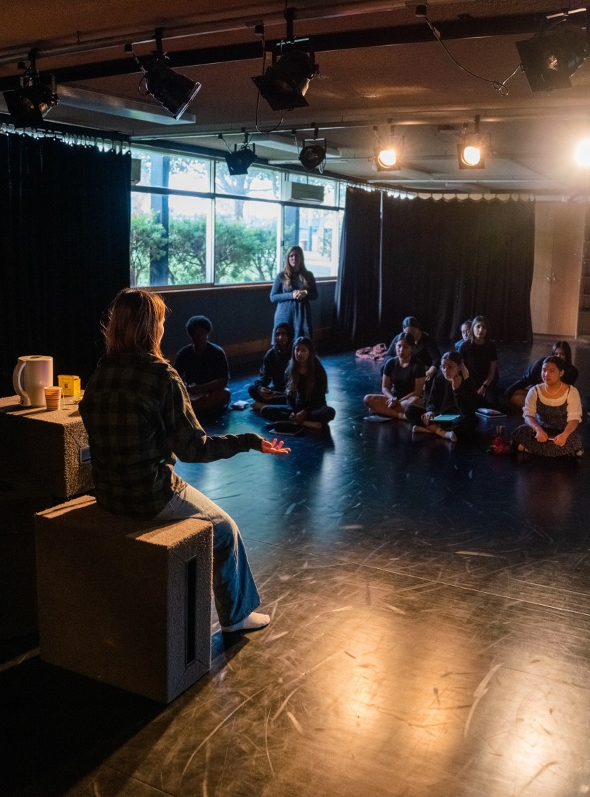
From me to we – exploring collaboration through devising
Stage 5 drama

Slide 3
Learning sequences
  1
  4
Improvising
Greek chorus – voice
  2
  5
Greek chorus
Greek chorus – sound and technologies
  3
  6
Greek chorus – movement
Devising

Slide 4
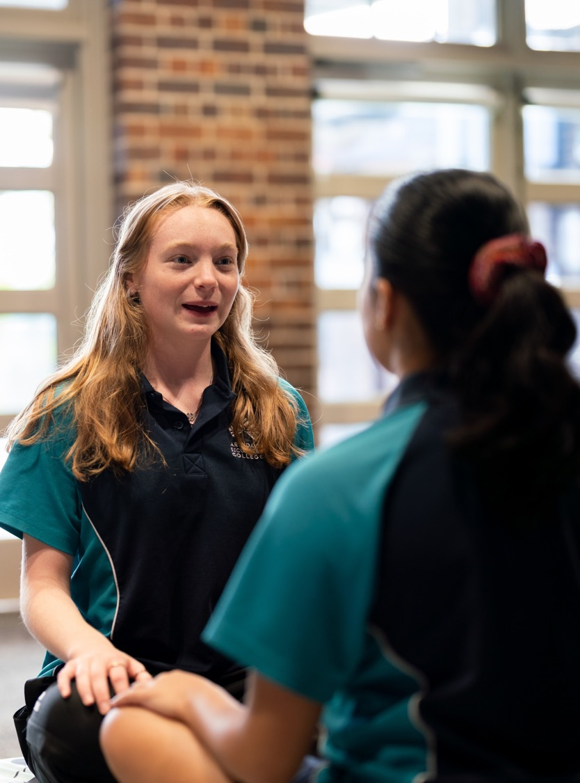

Learning sequence 1 – improvising

Slide 5
Learning intentions and success criteria (1)
1
We are learning to
create and refine meaning through improvisation, using collaborative and safe processes.
We can
interact safely, respectfully and inclusively while collaborating
create and embody characters and situations through improvisation
reflect on collaborative and safe processes.
Notes:
Notes for teachers:
Learning intentions and success criteria are best co-constructed with students. Adapt the learning intention as required and add matching success criteria.
For more information See ⁠AITSL or the NSW Department of Education explicit teaching strategies, ⁠Sharing learning intentions and ⁠Sharing success criteria
LISC is not necessarily presented at the beginning of the lesson. Teacher needs to consider most effectual time to introduce
LISC should be revisited during the lesson to support students' evaluation of their learning

Slide 6
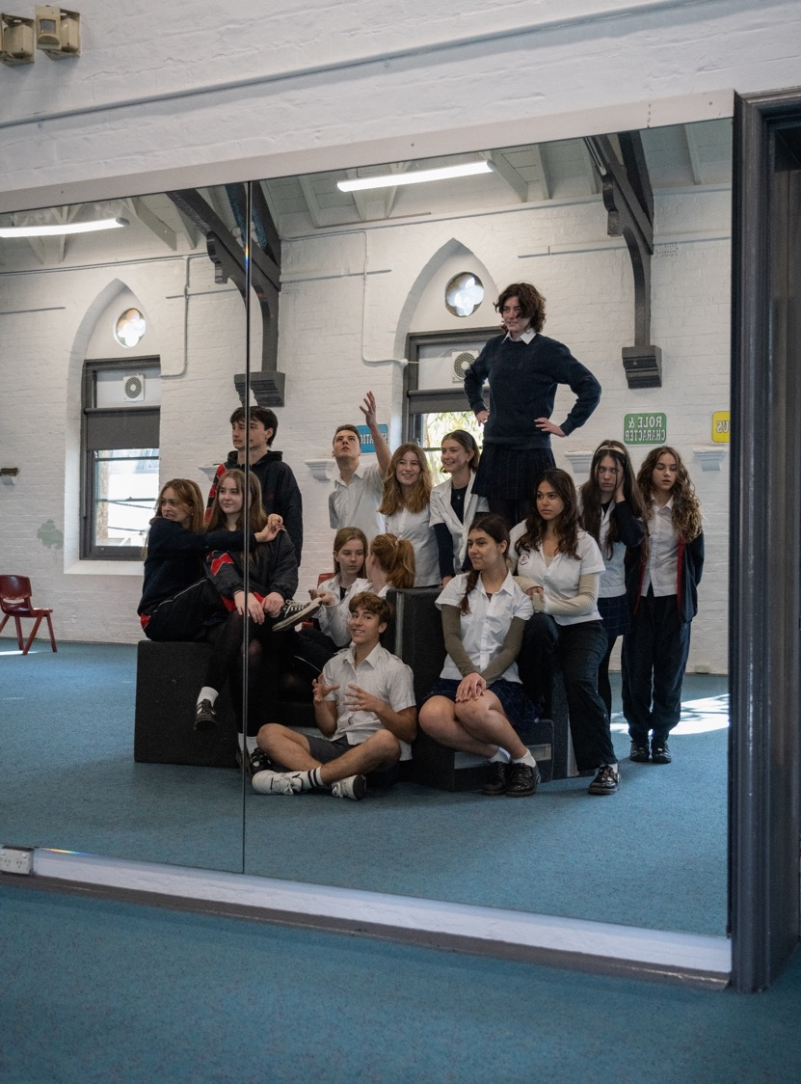
Learning sequence 2 – Greek chorus

Slide 7
Learning intentions and success criteria (2)
2
We are learning to
collaboratively apply and adapt Greek chorus conventions to communicate intention and meaning. Conventions?
We can
collaboratively explore and refine dramatic elements
use language to appropriately communicate a perspective
reflect on collaborative processes and how dramatic meaning was created.
Notes:
Notes for teachers:
Learning intentions and success criteria are best co-constructed with students. Adapt the learning intention as required and add matching success criteria.
For more information See ⁠AITSL or the NSW Department of Education explicit teaching strategies, ⁠Sharing learning intentions and ⁠Sharing success criteria
LISC is not necessarily presented at the beginning of the lesson. Teacher needs to consider most effectual time to introduce
LISC should be revisited during the lesson to support students' evaluation of their learning

Slide 8
How does the Greek chorus work?
2.2a
Movement and choreography
The chorus uses synchronised movements to create visual storytelling. Their physical presence reinforces mood and meaning.
Choral speaking
and song
Through poetic verse, chants, and song, choruses deliver commentary and emotional responses, sometimes addressing the audience directly.
Mask and
costume
Performers often wear masks to help project their voices and to symbolise their collective identity rather than individual personalities.

Slide 9
Nursery rhyme examples
2.2b
Twinkle Twinkle
Twinkle Twinkle, little star,
How I wonder what you are.
Up above the world so high,
Like a diamond in the sky.
Twinkle Twinkle little star,
How I wonder what you are!
Row, row, row your boat
Row, row, row your boat,
Gently down the stream,
Merrily, merrily, merrily, merrily,
Life is but a dream.
The incy wincy spider
The incy wincy spider climbed up the waterspout.
Down came the rain and washed the spider out.
Out came the sun and dried up all the rain,
And the incy wincy spider climbed up the spout again.
BBC (2025) Nursery Rhymes and Songs – A to Z, School Radio, accessed 15 April 2025.

Slide 10
Function of the Greek chorus
2.2c
Provides context
The chorus helps the audience understand the background of the story, offering details about past events, setting, and themes.
Expresses public opinion
The chorus often represents the voice of the community, reflecting societal norms, fears, and emotions in response to the unfolding drama.
Bridges scenes
The chorus can fill gaps in the narrative by linking events, giving the audience time to absorb key moments, and transitioning between dramatic episodes.
Engages in the action
Rather than being passive observers, the chorus can actively influence the story. In some plays, they confront main characters, intervene in conflicts, or even act as central figures themselves.
Guides the audience’s emotions
Through movement, music, and spoken word, the chorus amplifies tension, tragedy, or catharsis, helping the audience connect with the story on a deeper level.

Slide 11
Scenario
2.2d
In your group, work as co-directors to create a vision of how you would use your function of the Greek chorus with the scenario.
Provides context
A warrior is kicked out of their city for a crime they did not commit. They beg to be let back in, but the ruler refuses.
Expresses public opinion
Guides the audience’s emotions
Engages in the action
Bridges scenes

Slide 12
Using the Greek chorus in drama today
2.2e
The Greek chorus technique remains relevant in contemporary theatre. It can be used to:
present a collective perspective in storytelling
add rhythm and theatricality through movement and unified voice
enhance dramatic tension by reinforcing themes and emotions
experiment with physical theatre, vocal work, and ensemble performance
Incorporating a chorus in modern drama can deepen audience engagement with the narrative, creating a dynamic and immersive theatrical experience.

Slide 13
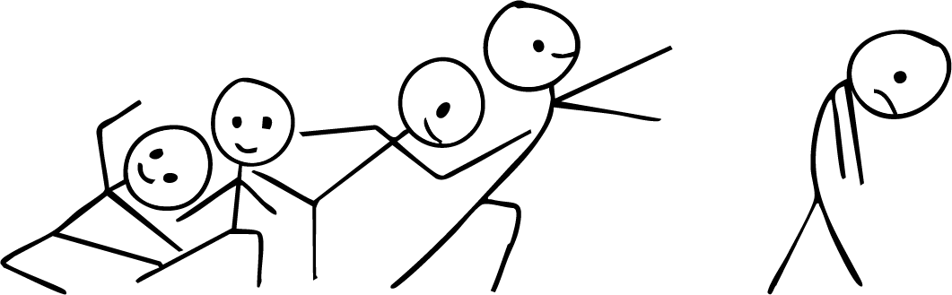
What matters most – social acceptance tableau
2.3
This tableau illustrates how social acceptance requires openness. Even if others are reaching out with acceptance, if you’re turned away, closed off, or in a negative mindset, you won't see or experience that acceptance, even if it is what you want most.
What matters most – social acceptance
Reaching towards isolated person
Shoulders hunched
Head bowed
Different levels getting taller each time
Sorrowful expression with eyes cast downward
All connected
Weighted posture
Body turned away from the group
Lunging forward
Smiling faces

Slide 14
Vocabulary
2.5
Purpose words
Challenge Clarify Construct Create Develop Differentiate Educate Evoke Exemplify Highlight Illuminate Infer Introduce Persuade Provide insight Provoke Specify
Elements of drama
Role Character Focus Tension Situation Space Time Structure Language Moment Atmosphere Belief Symbol
Elements of performance
Voice and movement Dynamics Clarity Energy Expression
Elements of production
Set Lighting Costume Props Sound Technologies

Slide 15

Reflection scaffold example
2.5
I | Identify your Greek chorus perspective. | We created a Greek chorus about how phones make people disconnected.
D | Describe what you did. | We used robotic voices and stood facing away from each other.
E | Explain why you choose this. | We did this to highlight how disconnected we are from reality. It also challenged the audience to think about how we are physically and emotionally distant from each other.
A | Analyse how you created meaning. | We created an atmosphere of unity by speaking in unison and moving robotically. While this was a chorus, the monotonous tone showed we weren’t doing it as individuals as we were disconnected from ourselves and each other.
Use stick figures and draw the key moment from your Greek chorus.
If you could add a song to your Greek chorus, what would it be and why? | Robot Rock by Daft Punk. This is an instrumental song that uses lots of robotic sounds. It is mechanical and could symbolise that we have lost our individualism as we are part of a machine, disconnected from others and ourselves.

Slide 16
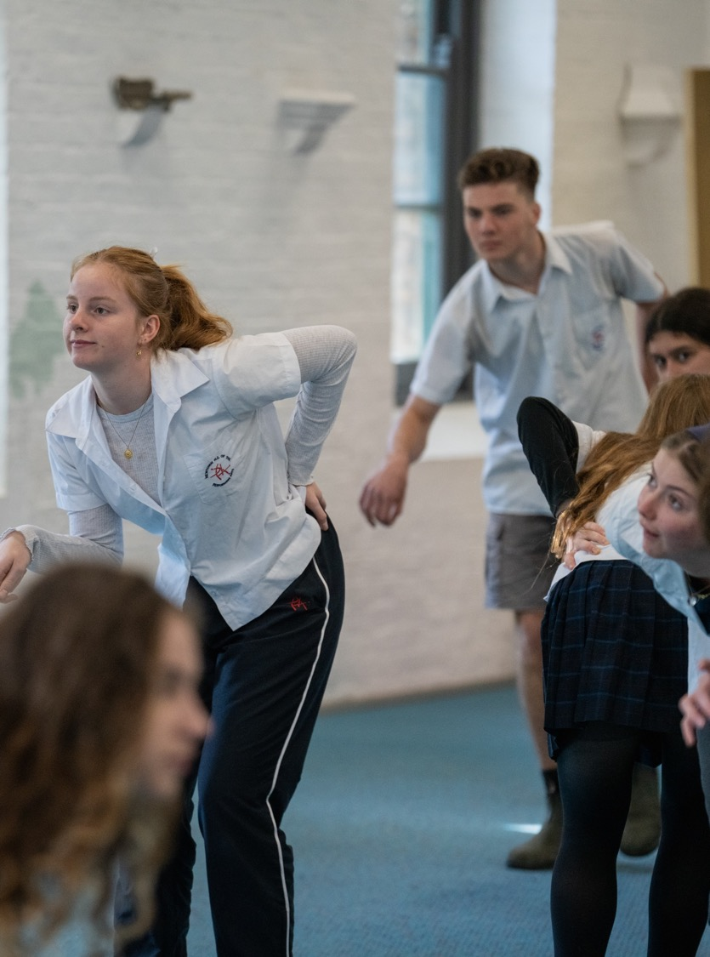

Learning sequence 3 – Greek chorus – movement

Slide 17
Learning intentions and success criteria (3)
3
We are learning to
collaboratively experiment with and manipulate movement to influence an audience’s response.
We can
collaboratively generate and develop Greek chorus moments that influence the audience
take creative risks in applying and managing movement skills
analyse the effectiveness of collaborative and devising processes.
Notes:
Notes for teachers:
Learning intentions and success criteria are best co-constructed with students. Adapt the learning intention as required and add matching success criteria.
For more information See ⁠AITSL or the NSW Department of Education explicit teaching strategies, ⁠Sharing learning intentions and ⁠Sharing success criteria
LISC is not necessarily presented at the beginning of the lesson. Teacher needs to consider most effectual time to introduce
LISC should be revisited during the lesson to support students' evaluation of their learning

Slide 18
Moving in abstract
3.2
What is the stimulus?
What can it look,
sound and feel like? List 20 words.
What are the obvious ideas (cliches)?
What is it like?
Create a simile.
What else do we know about it?
What types of movement does it evoke?
What emotions does it bring up?

Slide 19
Descriptive words
3.3
Tense | Commanding | Resonant | Deliberate | Minimalist
Ethereal | Vulnerable | Piercing | Erratic | Opulent
Menacing | Animated | Monotonous | Graceful | Claustrophobic
Spirited | Brooding | Booming | Rigid | Gloomy
Sombre | Charismatic | Breathy | Jagged | Dynamic

Slide 20






Collaborative images
3.5
These works were generated using artificial intelligence. Any copyright subsisting in this work is owned by © State of New South Wales (Department of Education), 2025.

Slide 21
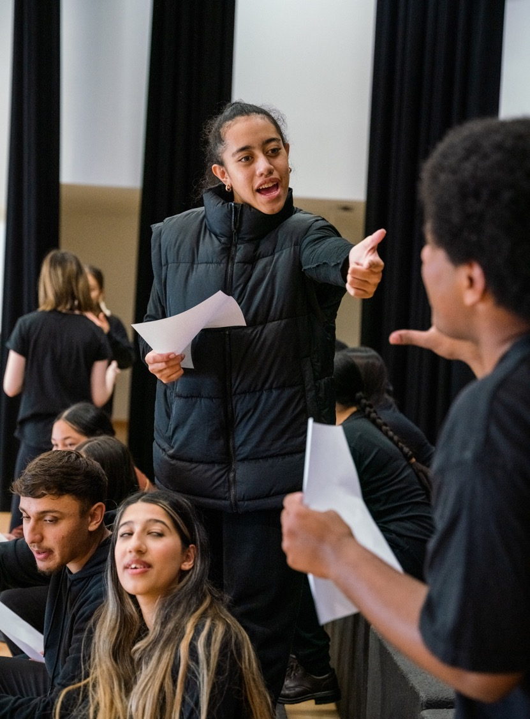

Learning sequence 4 – Greek chorus – voice

Slide 22
Learning intentions and success criteria (4)
4
We are learning to
experiment with and manipulate voice in a collaborative Greek chorus to shape and influence audience response.
We can
explore and refine how to use voice safely
use language and voice to communicate meaning
analyse how our vocal choices shape meaning.
Notes:
Notes for teachers:
Learning intentions and success criteria are best co-constructed with students. Adapt the learning intention as required and add matching success criteria.
For more information See ⁠AITSL or the NSW Department of Education explicit teaching strategies, ⁠Sharing learning intentions and ⁠Sharing success criteria
LISC is not necessarily presented at the beginning of the lesson. Teacher needs to consider most effectual time to introduce
LISC should be revisited during the lesson to support students' evaluation of their learning

Slide 23

PROMETHEUS by Damien Ryan – adapted extract
4.4a
Each time you read the adapted extract in unison, concentrate on different parts of the script and how that impacts voice:
1
2
3
4
5
Exaggerate consonants.
Exaggerate vowel sounds.
Use staccato and sharply finish each word with a repeated pause.
Use legato, smoothly going from one word to another with no silence between them.
Change pitch for each word: low, middle, high, middle, low.

Slide 24
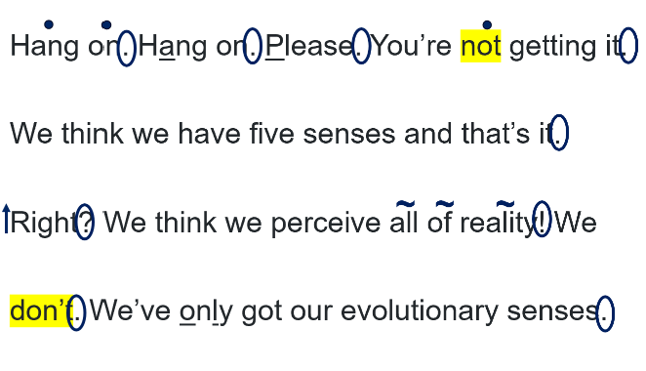
PROMETHEUS by Damien Ryan – annotation example
4.4b
KEY
z
Exaggerated consonants or vowels
Staccato
●
Legato
∼
Pitch Changes
↑↓
Volume increase
Punctuation
PROMETHEUS © Damien Ryan, 2024, damien.ryan@sportforjove.com.au

Slide 25
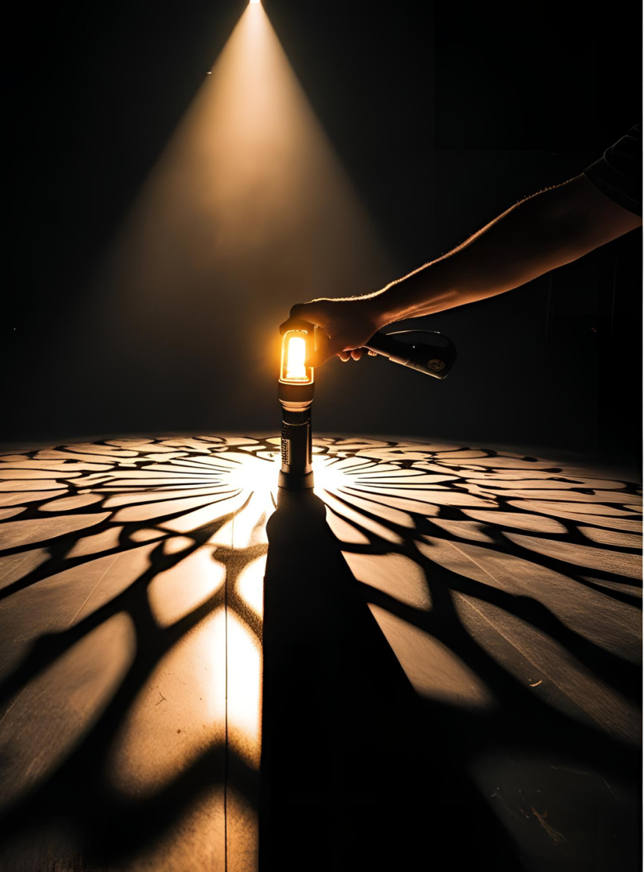


Learning sequence 5 – Greek chorus – sound and technologies
This work was generated using artificial intelligence. Any copyright subsisting in this work is owned by © State of New South Wales (Department of Education), 2025.

Slide 26
Learning intentions and success criteria (5)
5
We are learning to
collaboratively experiment with and apply sound and/or technologies to communicate intention and meaning.
We can
collaboratively generate and explore ways to use sound and/or technologies
safely take creative risks when playing with possibilities with sound and/or technologies
reflect on the effectiveness of creative choices, and collaborative and safe processes.
Notes:
Notes for teachers:
Learning intentions and success criteria are best co-constructed with students. Adapt the learning intention as required and add matching success criteria.
For more information See ⁠AITSL or the NSW Department of Education explicit teaching strategies, ⁠Sharing learning intentions and ⁠Sharing success criteria
LISC is not necessarily presented at the beginning of the lesson. Teacher needs to consider most effectual time to introduce
LISC should be revisited during the lesson to support students' evaluation of their learning

Slide 27
Directorial vision example
5.3
Scene
2 characters texting as a social media post goes viral
Sound
Notification sounds slowly increase in speed.
Different types of notification sounds occur.
Volume of the cacophony increases.
All sounds stop when the characters turn off their phones.
Technologies
Projection of text messages between the 2 actors discussing the photo. Text messages look like they do on a phone.
For each notification sound, the social media post is projected and scrolls up like it does on a phone.
Each time the social media post appears it has more likes or comments.
Scrolling of the social media post and comments intensifies across the entire back wall until it becomes uncomfortable and overwhelming for the characters and audience.
Projection goes to black when the characters turn off their phones.
Actors
Actors say their text messages out loud, directly to the audience.
They move further downstage as the notifications and projections get more overwhelming.
They turn their phones off by stamping foot and leaving the stage.

Slide 28
Word bank for reflection
5.5
Synergy | Cooperation | Adaptability | Open-minded | Empowerment
Empathy | Inclusivity | Accountability | Flexibility | Diversity
Consensus | Compromise | Conflict resolution | Trust | Shared voice
Engagement | Respect | Encouragement | Contribution | Harmony
Active listening | Communication | Support | Equity | Negotiation

Slide 29
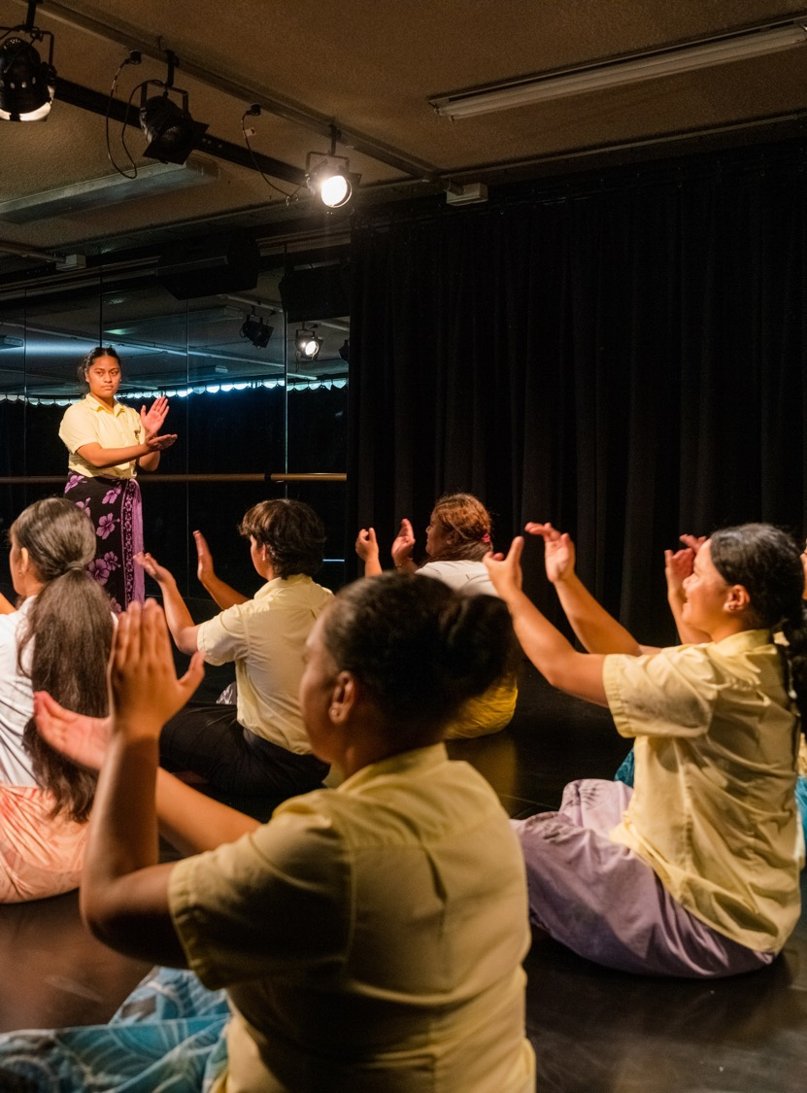
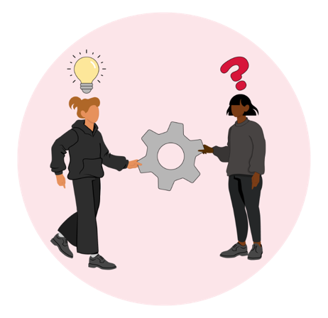
Learning sequence 6 – devising

Slide 30
Learning intentions and success criteria (6)
6
We are learning to
collaboratively use the devising process and Greek chorus techniques to communicate intention and meaning.
We can
collaboratively explore, manipulate and refine the use of dramatic elements
apply and embody appropriate characters and situations when performing
collaboratively document the devising process and reflect on creative choices.
Notes:
Notes for teachers:
Learning intentions and success criteria are best co-constructed with students. Adapt the learning intention as required and add matching success criteria.
For more information See ⁠AITSL or the NSW Department of Education explicit teaching strategies, ⁠Sharing learning intentions and ⁠Sharing success criteria
LISC is not necessarily presented at the beginning of the lesson. Teacher needs to consider most effectual time to introduce
LISC should be revisited during the lesson to support students' evaluation of their learning

Slide 31
Assessment Task – part A
6.2a
Part A – group-devised performance
This group task is an opportunity for you to work collaboratively as you workshop and stage a short group-devised performance. The stimulus for the performance is ‘What matters most’. You can use theatrical moments that you have workshopped in class as part of your performance, including scenes you have created using movement, voice, technologies and/or sound. Your performance should:
be based on the stimulus
be 2 to 4 minutes long
use Greek chorus techniques
demonstrate manipulation of dramatic elements, including narrative structures
showcase collaborative devising processes.

Slide 32
Assessment Task – part B
6.2b
Part B – theatrical moment annotation
This documentation is an opportunity for you to reflect individually on your collaborative processes and creative choices. As you collaboratively workshop your performance, document one or more images from your devising process. Documentation of images may include scripts, descriptions, photographs, sketches, diagrams, video and/or sound bites. Your chosen image/s should represent a theatrical moment that highlights how the creative choices you made shaped intention and meaning. Annotate your image/s by:
identifying and describing the dramatic element/s and the way you used Greek chorus
analysing how you used dramatic elements and devising processes to shape the intention and meaning of your performance
reflecting on your experiences of using collaborative processes to workshop this theatrical moment.

Slide 33
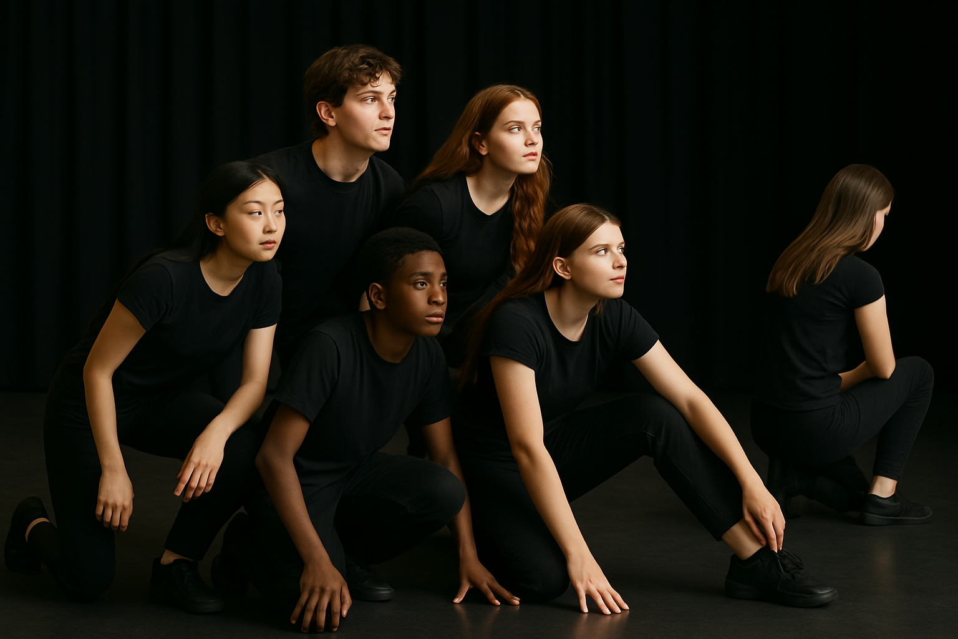
Part B example (1)
6.2c
Annotate your image/s by identifying and describing the dramatic element/s and the way you used Greek chorus.
Mood: sombre mood with an intensity in the chorus's focus.
Space: isolated person has back towards the chorus and is not connected to what the chorus are doing or where they are focusing.
Focus: chorus have a piercing gaze, and all look in the same direction.
Tension: brooding tension in the relationship due to the separation.
Situation: chorus responds in unison with the same energy and emotion.
Space: distance between the chorus and individual is jarring.
Movement: chorus actively leans forward with intent.
This work was generated using artificial intelligence. Any copyright subsisting in this work is owned by © State of New South Wales (Department of Education), 2025.

Slide 34
Part B example (2)
6.2d
Annotate your image/s by analysing how you used dramatic elements and devising processes to shape the intention and meaning of your performance.
The intent and meaning of our performance was to highlight that social acceptance is extremely important to teenagers, and that being open to it can lead to finding people who genuinely want to embrace you for who you really are. To make this clear we used the structuring phase of devising to focus on ensuring each scene had a key moment that showed this.
This tableau highlights how being part of the group can give you strength to look out into the world and embrace it, as you have the support of those around you.
This shows the individual’s exclusion and highlights the impact of not feeling socially accepted by the group.
Tension
Mood
Focus
Space
We used unison to show how the chorus represent society and how the positive voices of many are unheard if we don’t turn around and listen.
This workshop moment expresses the active nature of the chorus who are searching for others to embrace and accept.
Situation
Movement
This work was generated using artificial intelligence. Any copyright subsisting in this work is owned by © State of New South Wales (Department of Education), 2025.

Slide 35
Part B example (3)
6.2e
Annotate your image/s by reflecting on your experiences of using collaborative processes to workshop this theatrical moment.
To create this theatrical moment, we used collaborative processes that helped everyone feel involved. When we were workshopping, we made sure that everyone’s ideas were shared and listened to, which helped us build and improve the scene together. This meant we all felt like we owned the work and had a part in shaping it. One of the collaboration protocols we used was saying “umbrella” if someone got distracted during rehearsals. This worked well because it reminded us to refocus in a fun and respectful way, without causing tension in the group. This moment also shows the trust we built, especially because we were working closely in a small space and exploring deeper themes.
This work was generated using artificial intelligence. Any copyright subsisting in this work is owned by © State of New South Wales (Department of Education), 2025.

Slide 36
Steps to success (1)
6.2f
What I need to do | Ways I can do this
Collaboratively devise a 2 to 4 minute performance. | Use collaboration protocols. Be inclusive, respectful and supportive when making, accepting and extending offers. Seek and implement peer and teacher feedback throughout the devising process. Manipulate dramatic elements to create clear dramatic meaning.
Use group-devising processes to generate, structure, rehearse and refine a performance. | Use draft ideas previously generated and workshopped in the unit. Consider how to manipulate narrative structures. Regularly rehearse ideas and play with possibilities. Continually refine ideas through using feedback. Record ideas through images, sounds and/or writing. Reflect on choices, ideas and changes we make as we develop our work.

Slide 37
Steps to success (2)
6.2g
What I need to do | Ways I can do this
Use Greek chorus techniques. | Generate ideas about how to use a Greek chorus in different ways. Collaboratively rehearse voice and movement skills in dramatic moments. Use recordings and feedback to assist with unison. Develop a clear intent for what the function of the Greek chorus is in our work.
Collaboratively document the devising process. | Record ideas through images, sounds, videos and/or writing. Capture or record rehearsals and annotate creative choices. Reflect on and analyse my use of dramatic elements, including narrative structures. Reflect on and analyse my use of dramatic processes. Use terminology from word banks and dramatic elements. Regularly add to our collaborative document.

Slide 38
SMART goal
6.2h
S
M
A
R
T
Specific
Measurable
Achievable
Realistic
Timely
Example
By the end of the assessment, I will demonstrate effective collaboration by contributing ideas, actively listening and rehearsing with my group at least twice a week.

Slide 39
Generating chorus script – example table
6.3
Name | Idea
What is the perspective you are focusing on?
What are 3 examples of your perspective?
What is the message you want to get across to the audience?
What alliteration, similar or metaphor could you use?
Write 5–10 sentences that could be used for a Greek chorus.

Slide 40
Cinderella story points – linear
6.4a
1
Cinderella’s hard life
Cinderella lives with her mean stepmother and stepsisters, who treat her badly.
3
The ball
Cinderella dances with the prince but runs away at midnight, leaving a glass slipper behind.
5
The perfect fit
Cinderella tries on the slipper, and it fits her perfectly.
2
The magic gift
A fairy godmother gives Cinderella a beautiful dress and glass slippers to go to the ball.
4
The search
The prince looks for the young woman who fits the lost slipper.
6
Happily, ever after
Cinderella marries the prince and is happy forever.

Slide 41
Cinderella story points – non-linear
6.4b
1
The perfect fit
Cinderella tries on the slipper, and it fits her perfectly.
3
Cinderella’s hard life
Cinderella lives with her mean stepmother and stepsisters, who treat her badly.
5
The search
The prince looks for the young woman who fits the lost slipper.
2
Happily, ever after
Cinderella marries the prince and is happy forever.
4
The ball
Cinderella dances with the prince but runs away at midnight, leaving a glass slipper behind.
6
The magic gift
A fairy godmother gives Cinderella a beautiful dress and glass slippers to go to the ball.

Slide 42
Cinderella story points – cyclical
6.4c
The story must end where it began or suggest that the cycle could continue. This structure hints that the
story could repeat for someone else, reinforcing the idea that kindness and transformation are ongoing themes.
The cycle continues Another young woman, mistreated and overlooked, gazes at the palace, dreaming of a better life—just as Cinderella once did.
A young woman’s hard life
A young woman is mistreated by her family, forced to do chores and live in hardship.
A new beginning
The young woman, now a princess, welcomes those in need and helps the less fortunate.
A magical chance
A fairy godmother helps the young woman attend the royal ball, where she meets the prince.
The search and discovery
The prince finds the young woman and they marry, bringing them both happiness.
The escape
At midnight, the young woman flees, leaving behind a glass slipper.
glass slipper behind.

Slide 43
Cinderella story points – episodic
6.4d
The events are out of order, making them feel more like a standalone moment rather than a cause-and-effect chain. There is a mixture of action and introspective episodes that could be rearranged and still make sense.
A test of fate
The prince searches the kingdom for the young woman who fits the glass slipper, unaware of the struggles she has faced.
Life in the ashes
Long before the ball, Cinderella lives as a servant in her own home, dreaming of a different life.
The dance and the escape
Cinderella arrives at the ball, captures the prince’s attention, but must flee at midnight, leaving behind a glass slipper.
A mysterious invitation
The announcement of the royal ball spreads across the kingdom, but Cinderella’s stepfamily laughs at the idea of her attending.
A magical transformation
A fairy godmother grants Cinderella the chance to go to the ball, giving her a gown, glass slippers, and a carriage.
Dreams of something more
Sitting alone by the fire, Cinderella reflects on her past and wonders if she will always be trapped in this life.

Slide 44
Narrative techniques
6.4e
Foreshadowing
A hint or clue about something that will happen later in the story.
Flashback
A scene that takes the reader back to an earlier time to provide background or context.
Symbolism
When an object, person, or event represents a deeper meaning beyond its literal sense.
Unreliable narrator
A storyteller whose version of events may be biased, misleading, or incorrect.
Parallel storyline
A second story running alongside the main plot, often connected in theme or character.
Alternative ending
A different conclusion to the original story that changes the outcome or message.

Slide 45
Peer feedback
6.6
Identify
Describes
Explain
Analyse
Name what they did well.
What did they specifically do?
Why did this impact you as an audience member?
How could they improve their use of dramatic elements?

Slide 46
References
This presentation contains NSW Curriculum and syllabus content. The NSW Curriculum is developed by the NSW Education Standards Authority. This content is prepared by NESA for and on behalf of the Crown in the right of the State of New South Wales. The material is protected by Crown copyright.
Please refer to the NESA Copyright Disclaimer for more information https://educationstandards.nsw.edu.au/wps/portal/nesa/mini-footer/copyright.
NESA holds the only official and up-to-date versions of the NSW Curriculum and syllabus documents. Please visit the NSW Education Standards Authority (NESA) website https://educationstandards.nsw.edu.au/wps/portal/nesa/home and the NSW Curriculum website https://curriculum.nsw.edu.au.
BBC (2025) Nursery Rhymes and Songs - A to Z, School Radio, accessed 15 April 2025.
Drama 7–10 Syllabus© NSW Education Standards Authority (NESA) for and on behalf of the Crown in right of the State of New South Wales, 2023.
Images on slide 19, 32, 33 and 34 were generated using artificial intelligence. Any copyright subsisting in this work is owned by © State of New South Wales (Department of Education), 2025.
PROMETHEUS © Damien Ryan, 2024, damien.ryan@sportforjove.com.au

Slide 47
Copyright
© State of New South Wales (Department of Education), 2025
The copyright material published in this resource is subject to the Copyright Act 1968 (Cth) and is owned by the NSW Department of Education or, where indicated, by a party other than the NSW Department of Education (third-party material).
Copyright material available in this resource and owned by the NSW Department of Education is licensed under a Creative Commons Attribution 4.0 International (CC BY 4.0) license.
This license allows you to share and adapt the material for any purpose, even commercially.
Attribution should be given to © State of New South Wales (Department of Education), 2025.
Material in this resource not available under a Creative Commons license:
the NSW Department of Education logo, other logos and trademark-protected material
Material owned by a third party that has been reproduced with permission. You will need to obtain permission from the third party to reuse its material.
Links to third-party material and websites
Please note that the provided (reading/viewing material/list/links/texts) are a suggestion only and implies no endorsement, by the New South Wales Department of Education, of any author, publisher, or book title. School principals and teachers are best placed to assess the suitability of resources that would complement the curriculum and reflect the needs and interests of their students.
If you use the links provided in this document to access a third-party’s website, you acknowledge that the terms of use, including licence terms set out on the third-party’s website apply to the use which may be made of the materials on that third-party website or where permitted by the Copyright Act 1968 (Cth). The department accepts no responsibility for content on third-party websites.

