Slide 1
Instructions for use
This resource is not a teaching and learning program. It should be used in conjunction with From me to we – exploring collaboration through devising (Insert unit name and link).
Classroom teachers are encouraged to add and adapt slides as required to meet the needs of their students.
Save a copy of the file to make changes to the slide deck. Go to File > Download a Copy (this downloads a copy to the computer to edit in the PowerPoint app).
To convert the PowerPoint to Google Slides:
  Upload the file into Google Drive and open it.
  Go to File > Save as Google Slides.
  (Note – conversion may cause formatting changes in the slides.)

Slide 2
Learning sequences
1
Innovation
6
Community connections and planning
2
The Last Great Hunt
7
Generating
3
Clockfire Theatre
8
Structuring and rehearsing
4
Shock Therapy Arts
9
Refining and performance
5
Our innovative theatre company

Slide 3

Learning sequence 1 – innovation

Slide 4
Learning intentions and success criteria (1)
1
We are learning to
analyse how choices in the elements of drama shape audience impact
collaborate effectively to create moments of theatre which are innovative.
I/We can
engage in practices and processes which are considered theatrically innovative
analyse how creative choices shape intention and meaning.
Notes:
Notes for teachers:
Learning intentions and success criteria are best co-constructed with students. Adapt the learning intention as required and add matching success criteria.
For more information See ⁠AITSL or the NSW Department of Education explicit teaching strategies, ⁠Sharing learning intentions and ⁠Sharing success criteria
LISC is not necessarily presented at the beginning of the lesson. Teacher needs to consider most effectual time to introduce
LISC should be revisited during the lesson to support students' evaluation of their learning

Slide 5
What is innovation?
1.2
Innovation is finding new and better ways to do things, using fresh ideas or tools to improve how we function, process, connect, learn or perform.
Experimenting and trying new approaches
Being curious and flexible
Solving problems creatively
Being innovative means…
Asking ‘why’ and ‘what if’
Questioning the usual
Forward thinking

Slide 6
Innovative theatre examples (1)
1.3a
Image place holder for
Kopernikus, Against the Grain
Theatre company, 2017
Image place holder for The Curious Incident of the Dog in the Night-time, Frantic Assembly, 2012
Against the Grain Theatre is a Canadian experimental opera company dedicated to creating boundary-breaking, genre-defying vocal works and films staged in surprising locations emphasizing innovative storytelling and memorable artistic experiences.
Frantic Assembly use physical theatre and non-naturalistic techniques including projections to create different worlds.

Slide 7
Innovative theatre examples (2)
1.3b
Image place holder for
Life of Pi sights and sounds ,
The Life of Pi, 2023
Image place holder for
Romeo and Juliet, Shakespeare’s Globe, 2025
Life of Pi uses puppets to create different elements of the journey, for example the tiger and other animals
The 2025 version of Romeo and Juliet at The Globe is recontextualised to be set in the American frontier.

Slide 8
Innovative theatre examples (3)
1.3c
Image place holder for
The Greatest Open Air (and floating) Show on Earth, Messy Nessy, 2021
Image place holder for
Chongqing 1949, Klook, 2025.
Each year at The Bregenz Festival in Austria, they create the world’s largest floating stage for grand operas.
The Chongqing 1949 Grand Theatre is located in China and is the worlds largest 360° rotating stage and audience seats.

Slide 9

Learning sequence 2 – The Last Great Hunt

Slide 10
Learning intentions and success criteria (2)
2
We are learning to
explore and interpret dramatic works, practices or practitioners to guide experimentation
apply the elements of production to stage dramatic works
analyse how dramatic practitioners experiment with and stage dramatic forms.
I/We can
interact safely, respectfully and inclusively with others
apply dramatic conventions, forms and styles influenced by dramatic practitioners
analyse how the elements of production can strengthen theatrical moments.
Notes:
Notes for teachers:
Learning intentions and success criteria are best co-constructed with students. Adapt the learning intention as required and add matching success criteria.
For more information See ⁠AITSL or the NSW Department of Education explicit teaching strategies, ⁠Sharing learning intentions and ⁠Sharing success criteria
LISC is not necessarily presented at the beginning of the lesson. Teacher needs to consider most effectual time to introduce
LISC should be revisited during the lesson to support students' evaluation of their learning

Slide 11
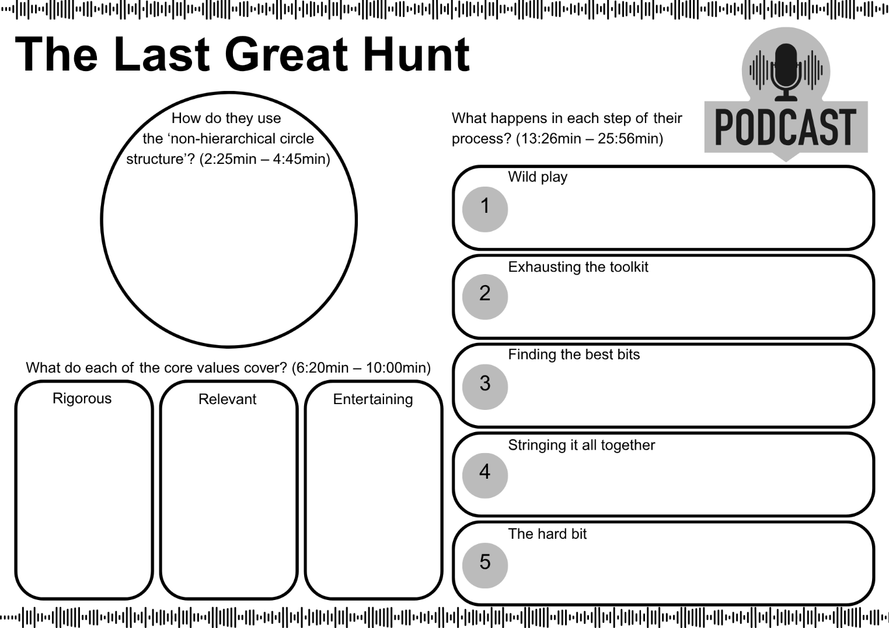
The Last Great Hunt – podcast activity
2.2a

Slide 12
The Last Great Hunt – devising process
2.2b
Free/Wild play
Exhausting the toolkit
Finding the best bits
Stringing it all together
The hard bit
Improvise and play with possibilities.
Through long form improvisation, figure out every single interesting way the toolkit can be used in the space.
Film improvisations and collaboratively use intuition to decide what is working.
Create a visual storyboard allowing scenes, ideas, narratives and characters to emerge and solidify, then clarify the central dramatic question.
Hold onto a sense of play, while applying rigour and openness when refining. Embrace failure and be willing to pivot through rehearsals.

Slide 13
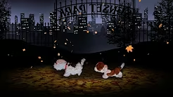
The Last Great Hunt and technologies
2.3a
New Owner : The Great Last Hunt (2019)
Name the different technologies being used.
Describe the use of puppetry.
How is mood and atmosphere created?
How are the elements of production used in innovative ways?
New Owner by The Last Great Hunt – trailer – YouTube (1:21)
Notes:
Note for teachers:
This is a sample of some resources for the screen musical In the Heights (2021) that could be used to support the teaching and learning of activity 1.6 in the Stage 5 Dance (Year 9) – sample unit ‘That’s a wrap!’.
The teacher may wish to explore an alternate screen musical(s). Some suggestions have been included in this slide deck.

Slide 14
‘Wild play’ voice recording reflection
2.3b
Reflect on your improvising processes through wild play.
Questions
What did you learn about the ‘wild play’ step?
Why do you think this step is important to the devising process?
What made you excited when playing with technologies?
How could you continue to extend on one of your ideas?
1
In your group, voice record the following questions and answers.
2
You have 3 minutes to prepare and 3 minutes to record.
3
Share back to the class.
4
Save recording in your online collaborative document.
5

Slide 15
Unpacking the question (1)
2.5a
Refer to specific dramatic elements, processes or contexts
Only asking to refer to The Last Great Hunt
How does The Last Great Hunt use experimentation to create innovative theatre?
Name what type of experimentation they use
Refer to their devising process
Identify what makes them innovative and how they do it

Slide 16
Examples to answer the question (1)
2.5b
Work collaboratively in their devising process. Examples from still images from Night Night with live feed cameras and Falling through the clouds use of puppetry.
Refer to specific dramatic elements, processes or contexts
Only asking to refer to The Last Great Hunt
How does The Last Great Hunt use experimentation to create innovative theatre?
Name what type of experimentation they use
Refer to their devising process
Identify what makes them innovative and how they do it
Use ‘wild play’ to play with possibilities. Use ‘exhausting the toolkit’ to consider different ways to do something.
Large part of their process is focused on improvising which enables new ways of thinking.
Blend different theatrical styles and forms to create new ways to tell stories. Incorporate multimedia and subvert audience expectations.

Slide 17
Word bank
2.5c
Pick at least one word from each column to include in your response.
Purpose words | Elements of drama | Elements of performance | Elements of production
Challenge Clarify Construct Create Develop Differentiate Educate Evoke Exemplify Highlight Illuminate Infer Introduce Persuade Provide insight Provoke Specify | Role Character Focus Tension Situation Space Time Structure Language Moment Atmosphere Belief Symbol | Dynamics, Clarity, Energy and Expression In Voice and movement | Set Lighting Costume Props Sound Technologies

Slide 18
Reflection example
2.5d
The Last Great Hunt effectively uses experimentation as a driving force in their devising process, enabling them to create theatre that is both innovative and highly engaging. They challenge the conventions of traditional theatre by working collaboratively at every stage of development, ensuring that all voices, skills, and creative ideas contribute equally to the final work. This non-hierarchical approach fosters a culture where experimentation thrives, as there is no single ‘correct’ way forward. The first stage of their process, ‘Wild Play’, encourages uninhibited exploration, where any idea, no matter how unusual, is tested and played with. This is followed by ‘Exhausting the Toolkit’, which pushes the ensemble to reimagine and rework ideas in multiple forms, continually asking, “What else can we try?” This process not only broadens the creative possibilities but also pushes the boundaries of how stories can be told. For example, in ‘Night Night’ and ‘Falling Through the Clouds’, their experimentation with live-feed cameras, abstract visual imagery, and symbolic puppetry results in dynamic, multi-layered moments on stage. These creative risks, born from sustained experimentation, demonstrate how The Last Great Hunt’s evolving process leads to them achieving their goal of creating theatre that is rigorous, relevant and entertaining.

Slide 19

Learning sequence 3 – Clockfire Theatre

Slide 20
Learning intentions and success criteria (3)
3
We are learning to
collaboratively generate and develop creative and critical ideas
embody characters, situations and ideas
exchange perspectives with others to reflect on collaborative experiences.
I/We can
interpret the work of dramatic practitioners to guide experimentation
apply performance skills and take creative risks to strengthen dramatic intention
make creative interpretations of drama in discussion with others.
Notes:
Notes for teachers:
Learning intentions and success criteria are best co-constructed with students. Adapt the learning intention as required and add matching success criteria.
For more information See ⁠AITSL or the NSW Department of Education explicit teaching strategies, ⁠Sharing learning intentions and ⁠Sharing success criteria
LISC is not necessarily presented at the beginning of the lesson. Teacher needs to consider most effectual time to introduce
LISC should be revisited during the lesson to support students' evaluation of their learning

Slide 21
7 levels of tension
3.1
Tragic
Total breakdown, unsustainable.
7
Crisis
On the edge, panic, extreme reaction
6
Reactive
Everything has urgency, quick responses.
5
Interested
Slight lean forward, active listening.
4
Neutral
Alert, ready, no emotion.
3
Laid-back
Loose, barely moving, unfocused.
2
Exhausted
No tension, body limp, like you’re made of jelly.
1
Actors Toolkit (nd) A guide to Jacques Lecoq for actors from movement to magic, accessed 24 June 2025.

Slide 22
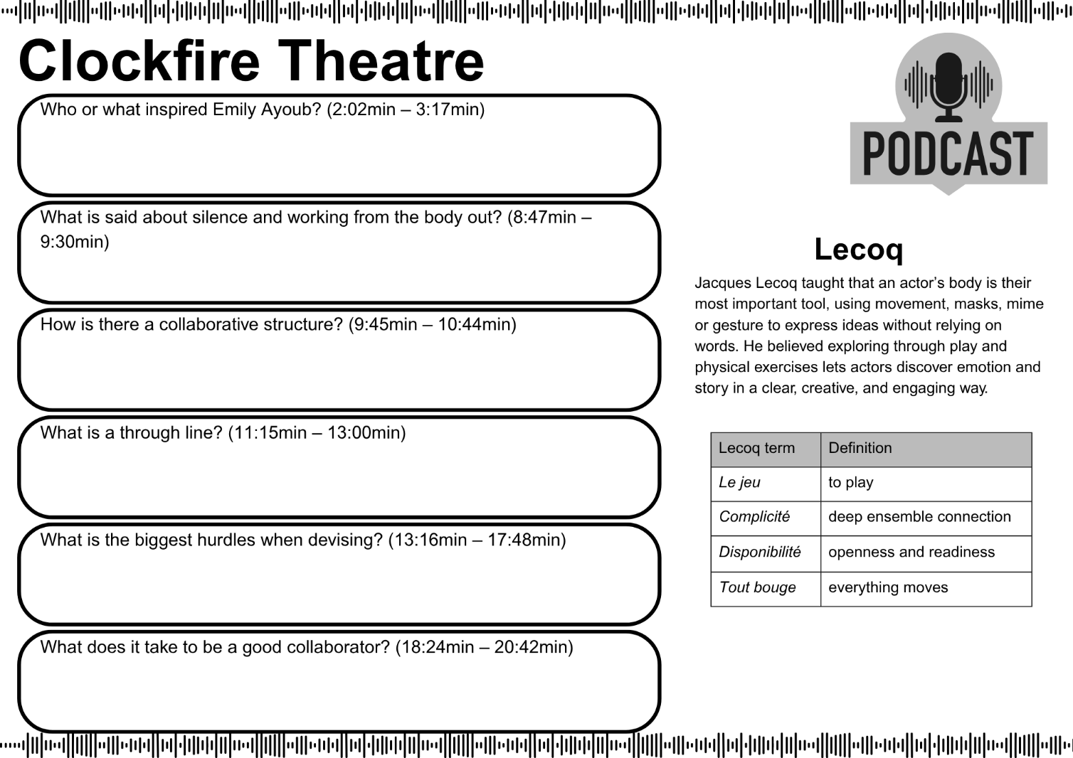
Clockfire Theatre – podcast activity
3.2a

Slide 23


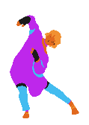

Jacques Lecoq
3.2b
Who he was
His teaching focus
Born in Paris 1921, passed 1999
Founded the École internationale de théâtre Jacques Lecoq in Paris, 1956 (still running)
In 1977 he launched the Laboratory for the Study of Movement (LEM) at his school with architect Krikor Belekian
Emphasised physical theatre – using the moving body, gesture and masks rather than text‑based drama
Created movement exercises like animal work, neutral mask and the “seven levels of tension” to develop character and express emotion
Terminology
Why it matters in our drama class
Le Jeu – 'the play', the actor's ability to connect with audience and performers and to be aware of the theatrical dimension of a moment
Disponibilité – an actor's personal readiness, openness, and receptiveness
Complicité – a shared, deep connection and understanding that binds performers and, by extension, the audience
Teaches you to use your body as a storytelling tool
Encourages creativity through play, masks, and space
Helps build ensemble awareness, rhythm and expressive movement

Slide 24
Clockfire Theatre – devising process
3.2c
Exploring
Co-devising
Defining
the space
Stitching structure
Repeating
Engage closely with the stimulus and research related material.
Create a working space of innovation by bringing together actors, musicians, designers and writers to experiment with.
Define the performance space for performers and audience and explore theatrical styles.
Use imaginative transitions that serve as logic builders.
Use repetition as a rehearsal process to place character and form in the body. Rewrite, rebuild, reject and refine, ready for the audience.

Slide 25





Role descriptions
3.4a
Musician
Responsible for:
adding an ensemble made soundscape
including a soundtrack
Writer
Responsible for:
writing a short poetic verse
adapting poetic verse to a script for ensemble and/or individual lines
Prop Designer
Responsible for:
sourcing a symbolic prop
directing how the symbolic prop can be used within the scene
Lighting designer
Responsible for:
sourcing a lighting source/s
directing how lighting can be used within the scene
Choreographer
Responsible for:
leading the choreography of the movement sequences
teaching movement to group

Slide 26

IDEA reflection (1)
3.4b
I
– identify one standout moment.
D
– describe the movement used in this moment.
E
– explain why this moment stood out.
A
– analyse how this moment added to the effectiveness of their intent.

Slide 27
Podcast reflection suggested questions
3.6
Now that you’ve experimented with Clockfire Theatre’s devising process, what do you think is most unique about it?
What are your thoughts on how playing with different performance spaces can encourage innovation?
How could you use Lecoq’s levels of tension to help devise?
After exploring Clockfire Theatre’s devising process, what’s your biggest takeaway about innovative theatre?

Slide 28

Learning sequence 4 – Shock Therapy Arts

Slide 29
Learning intentions and success criteria (4)
4
We are learning to
explore and document ways to use performance skills to develop dramatic action
adapt and apply the elements of performance
analyse how choices in the elements of drama shape audience impact.
I/We can
collaboratively generate creative ideas in group-devising processes
take creative risks to strengthen dramatic intention
make, accept and extend creative interpretations of drama in discussion with others.
Notes:
Notes for teachers:
Learning intentions and success criteria are best co-constructed with students. Adapt the learning intention as required and add matching success criteria.
For more information See ⁠AITSL or the NSW Department of Education explicit teaching strategies, ⁠Sharing learning intentions and ⁠Sharing success criteria
LISC is not necessarily presented at the beginning of the lesson. Teacher needs to consider most effectual time to introduce
LISC should be revisited during the lesson to support students' evaluation of their learning

Slide 30
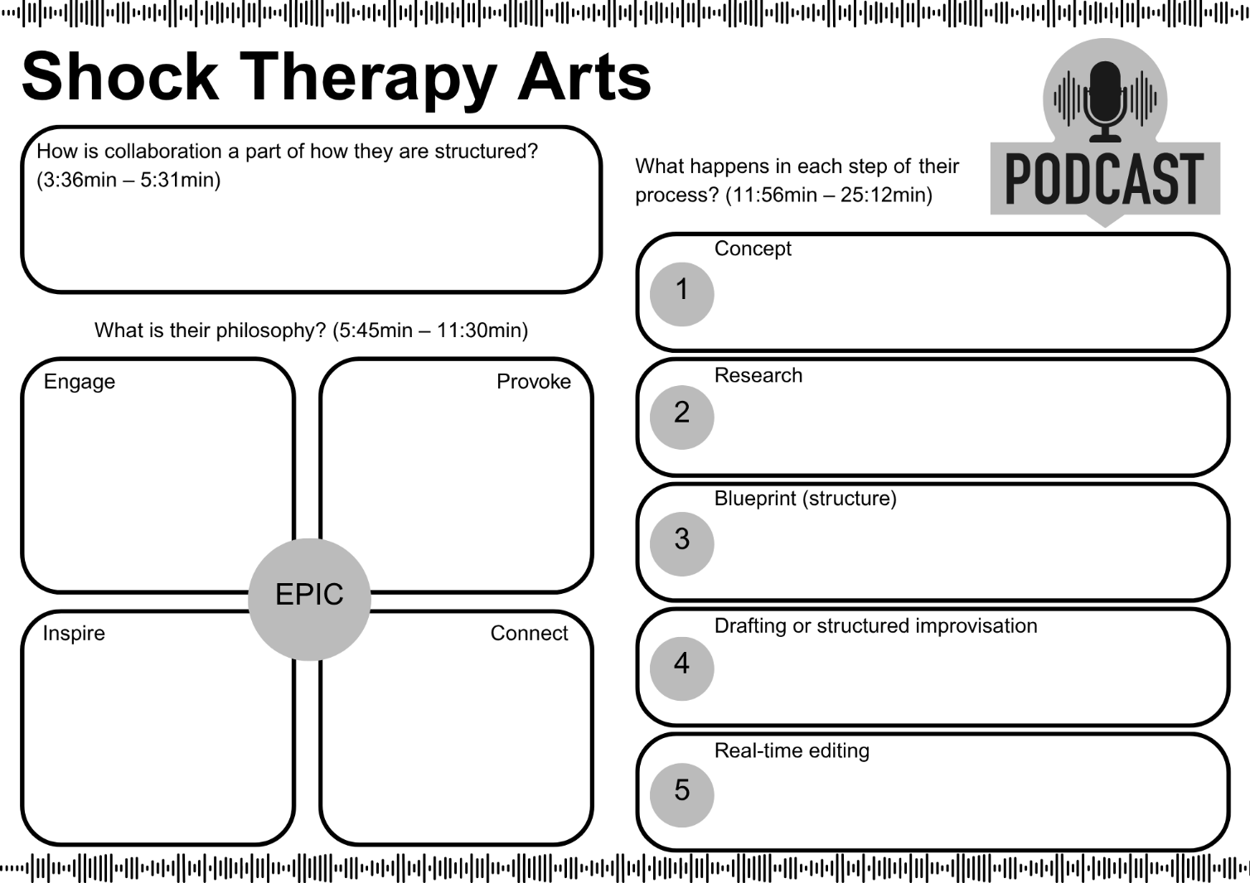
Shock Therapy Arts – podcast activity
4.2a

Slide 31
Shock Therapy Arts – devising process
3.2c
Concept
Research
Blueprint
Drafting OR structured improv
Real-time editing
Start with an idea, theme or concept and explore possibilities.
Deep dive into research, including any references to the concept, and brain-dump everything into a document.
Consider style and structure by creating a storyboard of the narrative in visual or written form.
Draft a bullet point version of the script and beginning refining OR use structured improv to create scenes.
Don’t be attached to the script and continually edit through rehearsals.

Slide 32
Bertolt Brecht
4.4a
Who he was
His teaching focus
Born in Augsburg, Germany, in 1898; died in East Berlin in 1956
A German playwright, poet and theatre director known for his revolutionary ideas in theatre
Founded the Berliner Ensemble theatre company in East Berlin 1949.
Developed Epic Theatre, aiming to make audiences think critically rather than become emotionally absorbed.
Introduced techniques like the Verfremdungseffekt (alienation effect) to prevent emotional attachment and encourage analytical viewing.
Emphasized the use of narration, direct address, and visible stage elements to remind audiences they were watching a play.
Key achievements
Why it matters in our drama class
Wrote influential plays such as The Threepenny Opera (1928), Mother Courage and Her Children (1939), and The Caucasian Chalk Circle (1944).
His works often addressed social and political issues, reflecting his Marxist beliefs.
Left a lasting impact on modern theatre with his innovative approaches to storytelling and stagecraft.
Encourages us to use theatre as a tool for social commentary and change.
Teaches techniques that break the "fourth wall," engaging audiences in new ways.
Inspires critical thinking about the content and purpose of theatrical performances.
Unwin S (2014) The Complete Brecht Toolkit, Nick Herns Books, London.

Slide 33

Quote
4.4b
“Art is not a mirror held up to reality but a hammer with which to shape it.”
Brecht, B. (n.d.). Attributed quote: "Art is not a mirror held up to reality but a hammer with which to shape it."

Slide 34


Alienation effect
4.5a
Brecht didn’t want audiences to get emotionally swept up or lost in the story. Instead, he wanted them to take a step back and think critically about the ideas behind the action — like a mirror to society.
The alienation effect is about making the familiar seem strange so the audience questions what they’d normally accept without thinking.

Slide 35
Alienation effect examples (1)
4.5b
Direct Address
Breaks the fourth wall. Reminds the audience this is a performance and invites critical thought.
Narration
Adds distance by explaining events rather than emotionally engaging with them. Makes the audience think about what will or has happened.
Placards
Displays slogans, facts, or questions. Interrupts the story and guides the audience to think critically.
Gestus
A symbolic, stylised gesture that reveals a character’s social status or attitude — showing the person and their place in society.
Songs/Chants
Break realism and create distance. Lyrics often comment on the action, helping the audience reflect instead of feel.
Third-Person Commentary
The actor talks about themselves as a character. Creates space between actor and role — makes behaviour feel like a choice.
Scene Titles/Visible Stagecraft
Labels scenes or exposes lights, props, or costume changes. Removes theatrical illusion.
Flashbacks
Jumps back in time unexpectedly, disrupting natural storytelling and drawing attention to cause and consequence.
Asides
Character shares private thoughts directly with the audience — creates commentary rather than intimacy.
Tableau
Stops the action to present a visual moment. The stillness gives space for analysis and symbolism.
Chorus
A group speaks or acts together. Creates a collective voice that comments on action rather than emotionally engaging in it.
Transformational Prop
A single object is used to represent many things. Highlights theatricality and symbol over realism.
35

Slide 36
Alienation effect examples (2)
4.5b
Symbolic gesture
Movements that represent larger ideas. Prioritises message over character motivation.
Sing-Song Voice
A deliberately artificial voice disrupts natural speech and reminds us of performance.
Vocal Sound Effects
Created by actors rather than technical systems. Makes the theatrical device visible and strange.
Use of Symbols
Objects or gestures represent deeper meanings. Encourages analysis over identification.
Symbolic Costume
Costumes that represent ideas (e.g., a crown made of money). Makes social roles or themes visible.
Non-Linear Structure
The story is not told in order. Prevents emotional buildup and focuses on causes and outcomes.
Reading Stage Directions Aloud
Draws attention to the script and structure. Shows the actor isn’t fully "inside" the character.
Music to Change Time or Mood
Music cues scene changes or tonal shifts rather than supporting emotional immersion.
Advertising Slogans
Inserts commercial or ideological language into scenes to critique power, capitalism, or propaganda.
Slow Motion / Fast Motion Summary
Heightens moments or compresses time in stylised ways. Makes the audience observe rather than empathise.
Actor Playing Multiple Roles
Prevents full immersion in a single character and shows that roles are constructed, not natural.
Puppetry
Distances audience from emotional realism. Highlights manipulation, control, and metaphor.
36

Slide 37
Brechtian fairytale
4.5d
TASK – Take a well-known fairytale and alienate it using Brechtian techniques. Use these techniques to disrupt the story’s natural flow and force the audience to think instead of just feel.
GOAL – make the audience see something about society in a new way.
1
Choose a fairytale
2
Choose a social or political issue
Incorporate at least 5 Brechtian techniques
3

Slide 38
IDEA reflection (2)
4.5e
I
– identify one standout moment.
D
– describe the movement used in this moment.
E
– explain why this moment stood out.
A
– analyse how this moment added to the effectiveness of their intent.

Slide 39
What we have learnt so far
4.6a
Lighting
Puppets
Shadows
Levels of tension
Jacques Lecoq
Physical improvisation
Roles within a group
Performance spaces
Transformational props
Bertolt Brecht
Alienation effect

Slide 40
Unpacking the question (2)
4.6b
Pick The Last Great Hunt, Clockfire Theatre or Shock Therapy Arts.
Make a judgement on which one helped most.
Pick the theatre company that impacted you the most and answer the following:
How did experimenting with their devising process help you create innovative theatre?
Give specific examples.
Identify what devising process the company uses.
Refer to what you did in an activity.
Specify what innovative theatre is and how you can create it.

Slide 41
Scaffold example
Pick the theatre company that impacted you the most and answer the following:
How did experimenting with their devising process help you create innovative theatre?
4.6c
Scaffold example
Answer the question | Clockfire Theatre greatly impacted my understanding of innovative theatre and how through using a collaborative devising process ideas can be explored in different ways.
Expand information about the theatre company, their devising process and how it results in innovative theatre | Clockfire Theatre has been inspired by the work of Jacques Lecoq and his focus of le jue or playing with possibilities. This is seen in their devising process where they begin with ‘exploring’ and then ‘co-devising’ which brings innovation into the foundations of what they are creating. Through engaging closely with the stimulus and creating a collaborative workspace bringing together different expertise, this process encourages experimentation and contentment with seeing what can be done without working to a set end point. It became clearer through embodying parts of this process that this is creates a space for innovation.
Identify one activity that helped your understanding | In class, we used their devising process of ‘exploring’ to create a movement piece based off Van Gogh’s The Starry Night.
Describe the activity | We improvised different ways to move inspired by the painting and blended these improvisations into a standalone movement performance.
Explain why in helped better your understanding | This activity challenged us to use abstract shapes and transitions to symbolise the atmosphere of the painting. It highlighted the importance of experimenting using all types of methods as our final performance became full of interesting moments that were only created by chance in improvisation.
Analyse how you used the dramatic elements in the activity | When improvising, I was tempted to just use large rounded gestures to mimic the swirling sky in the painting. However, upon bringing these ideas to the group, I saw how we could layer these with smaller, more deliberate swaying and a giant spiral walk around the room that were both offered as ideas in the group. Collaboratively exploring the stimulus further, we added in a contrasting moment where we halted our swirls and transformed into members of the village looking up at the sky. This moment of stillness and a creep of arms pointing to the sky highlighted the awe we felt from the painting.
Conclude and readdress the question | It was through this exercise that I became aware of how powerful Clockfire Theatres devising process is in creating innovative theatre, as it opens opportunities to look at stimulus and ideas in different ways without the constraints of a clear end point.
I
D
E
A

Slide 42
Scaffold to paragraph example
4.6d
Clockfire Theatre greatly impacted my understanding of innovative theatre and how through using a collaborative devising process ideas can be explored in different ways. Clockfire Theatre has been inspired by the work of Jacques Lecoq and his focus of le jeu or playing with possibilities. This is seen in their devising process where they begin with ‘exploring’ and then ‘co-devising’ which brings innovation into the foundations of what they are creating. Through engaging closely with the stimulus and creating a collaborative workspace bringing together different expertise, this process encourages experimentation and contentment with seeing what can be done without working to a set end point. It became clearer through embodying parts of this process that this is creates a space for innovation. In class, we used their devising process of ‘exploring’ to create a movement piece based off Van Gogh’s The Starry Night. We improvised different ways to move inspired by the painting and blended these improvisations into a standalone movement performance. This activity challenged us to use abstract shapes and transitions to symbolise the atmosphere of the painting. It highlighted the importance of experimenting using all types of methods as our final performance became full of interesting moments that were only created by chance in improvisation. When improvising, I was tempted to just use large rounded gestures to mimic the swirling sky in the painting. However, upon bringing these ideas to the group, I saw how we could layer these with smaller, more deliberate swaying and a giant spiral walk around the room that were both offered as ideas in the group. Collaboratively exploring the stimulus further, we added in a contrasting moment where we halted our swirls and transformed into members of the village looking up at the sky. This moment of stillness and a creep of arms pointing to the sky highlighted the awe we felt from the painting. It was through this exercise that I became aware of how powerful Clockfire Theatres devising process is in creating innovative theatre, as it opens opportunities to look at stimulus and ideas in different ways without the constraints of a clear end point.

Slide 43
Paragraph scaffold
Pick the theatre company that impacted you the most and answer the following:
How did experimenting with their devising process help you create innovative theatre?
4.6e
Scaffold example
Answer the question
Expand information about the theatre company, their devising process and how it results in innovative theatre
Identify one activity that helped your understanding
Describe the activity
Explain why in helped better your understanding
Analyse how you used the dramatic elements in the activity
Conclude and readdress the question
I
D
E
A

Slide 44

Learning sequence 5 – our innovative theatre company

Slide 45
Learning intentions and success criteria (5)
5
We are learning to
collaboratively generate creative ideas in the development of an innovative theatre company
apply dramatic conventions and styles influenced by dramatic works, practices, or practitioners
seek, exchange, and question perspectives with others to reflect on our collaborative experiences.
I/We can
create and refine meaning by experimenting with various dramatic processes
apply processes that ensure a safe, respectful, and inclusive performance environment
analyse intentions as maker, performer and audience.
Notes:
Notes for teachers:
Learning intentions and success criteria are best co-constructed with students. Adapt the learning intention as required and add matching success criteria.
For more information See ⁠AITSL or the NSW Department of Education explicit teaching strategies, ⁠Sharing learning intentions and ⁠Sharing success criteria
LISC is not necessarily presented at the beginning of the lesson. Teacher needs to consider most effectual time to introduce
LISC should be revisited during the lesson to support students' evaluation of their learning

Slide 46
Assessment Task – part A (1)
5.1a
This group task is an opportunity for you to collaboratively create an innovative theatre company. You will share your innovative theatre company with an audience through a theatre launch that is 10 minutes. This theatre launch will include a podcast introducing your theatre company and a workshop demonstrating its philosophy.
Your theatre launch should include:
an acknowledgement of country
a presentation of your podcast
a short activity that allows your audience to be immersed in your process
an exit slip.

Slide 47
Assessment Task – part A (2)
5.1b
Your podcast should be submitted as an MP3 file and include:
every member of your group
a clear philosophy for the theatre company
your processes
an intro and outro

Slide 48
Steps to success part A (1)
5.1c
What I need to do | Ways I can do this
Launch our new innovative theatre company | Establish the theatre company’s name, vision, artistic style, and mission. Decide on the types of stories you’ll tell and your unique performance approach. Introduce your company through a mix of audio, live performance, and storytelling that showcases your brand. Include interactive elements or activities that let your audience experience your company’s energy and values firsthand.
Respectfully Acknowledge Country | Understand and respect why Acknowledgement of Country is important. Find out which Country your performance is taking place on. Explore local cultural practices, stories, or symbols that can meaningfully influence your theatre context – always with permission or proper acknowledgment. Write or devise an Acknowledgement that feels genuine to you.

Slide 49
Steps to success part A (2)
5.1d
What I need to do | Ways I can do this
Run an immersive workshop which introduces on of our ‘5 steps’ | Create an immersive setting that reflects the company’s unique brand and artistic voice. Develop interactive moments that highlight the company’s values and performance style in this ‘step’. Plan how participants will move and interact within the space to feel part of the company’s world. Test the workshop, gather feedback, make adjustments, and practice!
Present a podcast. | Highlight your theatre company’s goals, core values, style, and what makes it unique. Decide who you want to reach with your podcast and what will interest them. Outline key features such as the company’s process. Plan the style of your podcast so that it is engaging, informative and accessible.

Slide 50

Questions to consider
5.3a
What do we want our audience to experience?
Who is our audience?
How are we being innovative?
What style/s of the theatre will we explore?
What is the structure of our theatre company?
What do we want to achieve with our audience?
Where and how will we interact with our audience?
How would we like to work creatively together?

Slide 51

Sentence stems
5.3b
Our theatre company aims to create for…
Our theatre company aims to make the audience…
We want our audience to feel…
The structure of our company is… because…
We are inspired by the style of…
By the end of the performance, we want the audience to…
We aim to be innovative by…

Slide 52
Preparing the launch
5.4a
Allocate one person to each deliverable and add to your collaborative online document.
Logo
E-invite
Process cards
Intro/Outro music
Exit slip
  Create a logo for your new theatre company.
  Consider
    Name
    Font
    Colour
    Image
    Size
  Ensure the style and formatting of your logo reflects the philosophy of your theatre company.
  Write an email invitation to be sent to audience members for the launch.
  Consider
    Intended audience
    Vocabulary
  Your email should include
    Introduction to who your theatre company is and what the launch about
    Information about the dates, time and location of the launch
    A way to RSVP
    Correct email etiquette
  Create a devising process card that features your theatre companies 5 step process. Be inspired by the process cards from the theatre companies you have studied.
  Include
    Name of each step
    Brief outline of what each step means
    Visual elements, for example, colour, arrows, images, icons.
  Source licensed free orchestral music to be used in the intro and outro of the podcast.
  Consider
    Length
    Tempo
    Style
  Ensure your choice of music reflects your theatre company
  Develop an exit survey to be given to audience members at the end of your theatre company launch.
  Consider
    The type of survey
    Practicalities of how audience members complete the survey including the time it takes to complete, and equipment needed
  Include
    3-5 questions
    Question/s that clarify their understanding of what you did
    Question/s that allow them to share ideas for future devising

Slide 53

Podcast structures
5.6a
Solo
A series of monologues about your company
Co-hosting
A news feature about your company
Roundtable
A series of experts discussing your company
Narrative
The story of your company
Interview
A discussion with the creators of your company
Documentary
An investigation into your company

Slide 54

Sample questions
5.6b
How is your company structured?
What is your philosophy?
How do you begin devising a show or theatrical experience?
What process do you follow when devising?

Slide 55

Audio checklist
5.6c
Respect your classmates and don’t make a sound!
Close doors and windows. Turn off noisy heating and cooling.
Check bell times and when announcements happen.
Turn off everything which could make a sound including phones, watches and laptops.
If possible, use a microphone.
Make others aware that you are recording.

Slide 56
Organising the launch
5.6c
As a class, you need to:
organise the order of theatre company launches
prepare logistics of how exit slips will be given and collected
assign who will usher audience members and turn lights on/off
prepare the launch venue, including ensuring it facilitates playing of podcasts
plan who will operate audio equipment to support each theatre companies launch
collaboratively manage any logistical requirements involving the use of staging and/or props.

Slide 57

Reflection questions
5.10
  How is the exit survey data going to inform your devising?
  How well did you use collaborative processes in your launch?
  What are you most proud of from your launch?
  Where to next?

Slide 58

Learning sequence 6 – community connections and planning

Slide 59
Learning intentions and success criteria (6)
6
We are learning to
explore and interpret and respect individual and collective identities, values, and perspectives
develop processes used to generate, evaluate and refine dramatic works.
I/We can
interpret and apply cultural, social and personal contexts, protocols and intentions in consultation with community
explain and utilise the processes that support physical, emotional, and cultural safety, respect, and inclusion in drama.
Notes:
Notes for teachers:
Learning intentions and success criteria are best co-constructed with students. Adapt the learning intention as required and add matching success criteria.
For more information See ⁠AITSL or the NSW Department of Education explicit teaching strategies, ⁠Sharing learning intentions and ⁠Sharing success criteria
LISC is not necessarily presented at the beginning of the lesson. Teacher needs to consider most effectual time to introduce
LISC should be revisited during the lesson to support students' evaluation of their learning

Slide 60
Assessment task part B
6.2a
Group-devised performance
This group task is an opportunity for your theatre company to collaboratively create and stage an innovative group-devised performance. Your performance should:
use the processes of your theatre company when devising
include innovative theatre techniques
invite an audience to feel and/or think differently about existing assumptions
show a manipulation of dramatic elements
be 4 to 6 minutes in length.

Slide 61
Steps to success part B (1)
6.2b
What I need to do | Ways I can do this
Use the processes of your theatre company when devising | Incorporate your theatre companies' style, philosophies and purpose in all the work that you do. Experiment with the chosen processes in your planning. Consider how each process and practice contributes to your devising journey. Communicate openly with your peers by actively listening to their ideas and sharing your own while respecting everyone's contributions. Ensure that everyone feels valued and can contribute to the success of the theatre company.
Include innovative theatre techniques | Revisit your learning and identify innovative theatre techniques that resonated with you and your group. Investigate new innovative theatre techniques that can enhance your performance. Experiment with the chosen innovative techniques in your rehearsals. Discuss how each technique can create theatricality and enhance an audience's experience.

Slide 62
Steps to success part B (2)
6.2c
What I need to do | Ways I can do this
Invite an audience to feel and/or think differently about existing assumptions | Identify common assumptions or stereotypes related to your chosen theme or topic. Consider social, cultural, or personal beliefs that you want to challenge. Conduct research and consultation to understand the nuances of the assumptions you are challenging. Gather different perspectives, facts, and narratives to inform your piece and provide depth. Experiment with dramatic styles to emphasise the assumptions and the new perspectives you wish to promote. Consider how dramatic styles can provoke thought and evoke emotions.
Show a manipulation of dramatic elements | Familiarise yourself with the dramatic elements. Discuss how each element contributes to theatricality. Discuss and decide which dramatic elements you want to manipulate in your piece and how you might manipulate them. As you rehearse, focus on how each element can be manipulated for greater effect. Experiment with different approaches to see what resonates most with your vision.

Slide 63
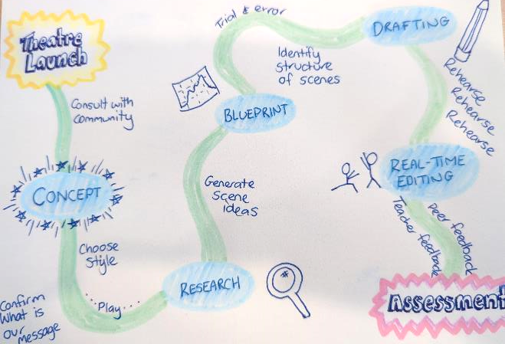
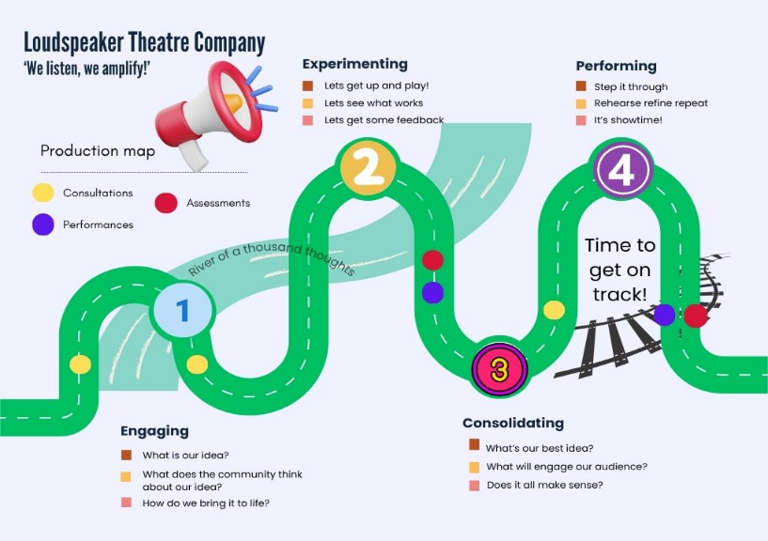
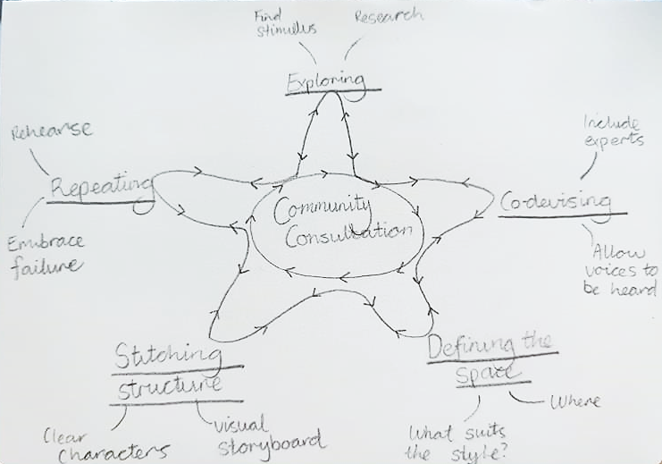
Learning map example
6.3

Slide 64

Research planning questions
6.5a
What are three things I know about the community I am engaging with?
What are three things I would like to learn about this community?
Where am I going to find information about this community?
How am I going to check that this information is reliable?

Slide 65

Research options
6.5b
Pick at least 5 different research options.
Factual articles
Podcasts
Poems
Feature articles
Sketches
Song lyrics
Opinion pieces
Photos
Music
Studies
Artworks
Cartoons
Testimonials
Memes
Advertisements
Websites
Quotes
Posters

Slide 66

Sharing back
6.5c
What is an important piece of information to share?
What is something enlightening, surprising or interesting I discovered?
How is this community represented through artistic and creative mediums?
What is a probing question I still have about my community?

Slide 67

Learning sequence 7 – generating

Slide 68
Learning intentions and success criteria (7)
7
We are learning to
generate, ideas, images, and stories to explore the perspectives of communities
spontaneously create and develop ideas, images and stories through improvisation
document how an ensemble collaboratively creates image, action, and meaning.
I/We can
collaboratively use improvising processes to make, accept and extend offers
engage in practices informed by the dynamic and evolving Cultural Knowledges of Aboriginal and/or Torres Strait Islander works and practices
reflect on how the perspectives of others have supported collaborative experiences.
Notes:
Notes for teachers:
Learning intentions and success criteria are best co-constructed with students. Adapt the learning intention as required and add matching success criteria.
For more information See ⁠AITSL or the NSW Department of Education explicit teaching strategies, ⁠Sharing learning intentions and ⁠Sharing success criteria
LISC is not necessarily presented at the beginning of the lesson. Teacher needs to consider most effectual time to introduce
LISC should be revisited during the lesson to support students' evaluation of their learning

Slide 69

Exploring Cultural Knowledges of Aboriginal and/or Torres Strait Islander works, practices and practitioners
7.4a
Songlines
Songlines are the stories, songs, dances and Histories which Aboriginal Peoples have passed on through generations to explain creation, spirituality and the interconnection between people, the world around them and their way of knowing, doing, being and valuing.
Songlines trace the pathways of Ancestral Spirits as they created the animals, land and Lore (the customs and stories learnt from the Dreaming). They act as verbal maps to remember information for journeys, ceremony and customs.
Artwork by Kayleb Waters, Gomeroi artist and Cultural mentor, 2025
Artwork represents songlines and shows paths and rivers with Dhinawan (emu) tracks, showing that we have walked these paths since the beginning, connected to each other without boundaries, fences or castles, living and sharing as one. It is the Indigenous Cultural and Intellectual Property (ICIP) of the artist. While created by a Gomeroi artist, symbols and meanings may differ on the Country you are on. Please seek permission from the artist before using their work in any other context
Drama 7–10 Syllabus© NSW Education Standards Authority (NESA) for and on behalf of the Crown in right of the State of New South Wales, 2023.

Slide 70
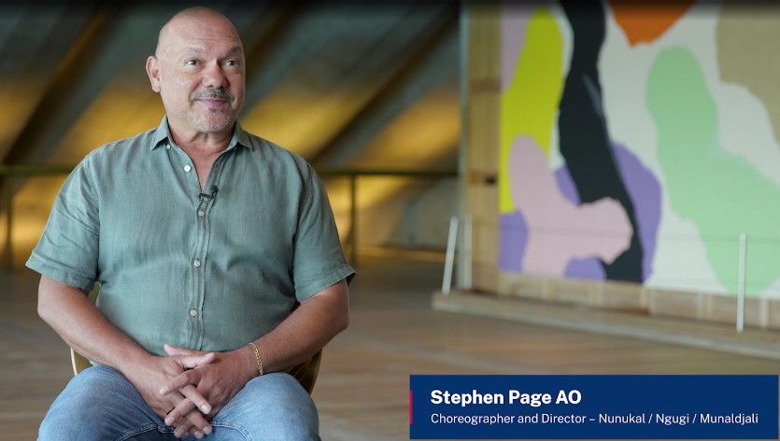
Story sharing reflection questions
7.4b
1. How does Stephen Page describe the ways his work, Baleen Moondjan, explores personal and Cultural connections to Place, Country and Languages?
2. In Baleen Moondjan, Stephen Page uses an artistic metaphor to communicate a story about his mother. Why did he choose this metaphor and what does it tell the audience about Aboriginal Knowledges?
3. Think about Stephen Page’s ‘shopping trolley’. What does he mean by this and why is this not the right approach? What could the right approach be?
4. Stephen Page talks about forming a ‘creative clan’ with the different dancers, actors, composers, designers and writers he works with, to tell stories. How does Stephen Page use collaboration to tell stories?
Artistic kinship systems (13:19)

Slide 71

Story sharing reflection
7.4c
What is the intention behind the dramatic action and what are we trying to say?
How has this process made you feel and/or think differently about existing assumptions?
What individual or collective identities, values and perspectives are presented in the ideas, images and stories created so far?
What emotional or cultural safety protocols need to be considered as you continue to devise this piece?

Slide 72
Dramatic forms
7.5a
Dramatic forms are recognisable types of drama developed, performed or staged for specific mediums including:
Theatre forms
Audio forms
Video forms
Production and design forms
  Such as indoor theatres, outdoor theatres and applied theatre forms
  Such as radio plays, podcasts, soundscapes and sound designs
  Such as live and/or animated film, television and digital platforms
  Such as scripts, cue sheets, designs, models, props and costumes.
Drama 7–10 Syllabus© NSW Education Standards Authority (NESA) for and on behalf of the Crown in right of the State of New South Wales, 2023.

Slide 73
Dramatic styles
7.5b
Dramatic styles are groups of related creative works, practices and/or practitioners that share distinctive conventions and/or intentions.
Acting styles
Improvisational styles
Theatrical styles
  Specific methods of creating role, character, ensemble and/or the actor–audience relationship. Acting styles can develop the actor­–audience relationship in distinctive ways.
  Improvisation is a making and performing strategy and technique used within a range of dramatic styles or as the fundamental principle of a style.
  Theatrical styles include a wide range of styles with specific conventions of storytelling, staging, acting and the actor–audience relationship.
Drama 7–10 Syllabus© NSW Education Standards Authority (NESA) for and on behalf of the Crown in right of the State of New South Wales, 2023.

Slide 74
Examples of theatrical styles
7.5c
Absurdism
A post‑war dramatic style portraying life as inherently meaningless, with dysfunctional dialogue, cyclical plots and existential humour
Clowning, comedy or satire
Drama aiming to entertain through humour; satire also ridicules human folly or social issues to provoke thought.
Commedia dell’arte
16th‑century Italian improvised theatre using masked stock characters and physical comedy in simple scenarios
Documentary drama
Uses real interviews, reports or texts to stage true stories, often unaltered
Epic theatre
Developed by Brecht, encourages critical detachment through narration, breaking the fourth wall and highlighting social issues.
Greek theatre
Ancient storytelling performed in open amphitheatres featuring chorus, mythic plots and formal structure. Often tragedies or comedies.
Immersive theatre
Audience is placed within the performance world, free to move through and interact with actors and environment.
Melodrama
Emotion‑heavy stories with clear heroes and villains, dramatic plot twists and moral simplicity.
Multidisciplinary theatre
Blends drama with other artistic forms such as music, dance, visual arts or digital media, to create hybrid performance.
Physical theatre
Storytelling through body movement rather than dialogue; often expressive, gestural and visually dynamic.
Puppetry
Uses dolls or figures manipulated by puppeteers to tell stories. Can be simple or highly theatrical.
Realism
Attempts to represent life truthfully on stage, with believable dialogue, characters and everyday settings.

Slide 75
Theatrical style research
7.5d
Individually choose a theatrical style
Research the theatrical style
  What historical or cultural events inspired the theatrical styles development?
  What are the dramatic conventions?
  What is the actor-audience relationship?
  How are dramatic elements used?
Add findings to the graffiti wall
Share your learning about the theatrical style with the class
Capture the information on the graffiti wall in your online collaborative document.
Examples of theatrical styles
Absurdism
Clowning, comedy or satire
Commedia dell’arte
Documentary drama
Epic theatre
Greek theatre
Immersive theatre
Melodrama
Multidisciplinary theatre
Physical theatre
Puppetry
Realism

Slide 76

Generating ideas – style
7.6a
Choose 5 conventions appropriate to your chosen theatrical style
Create a short scene, incorporating the 5 conventions
Reflect on how each of the conventions enhanced your scene

Slide 77

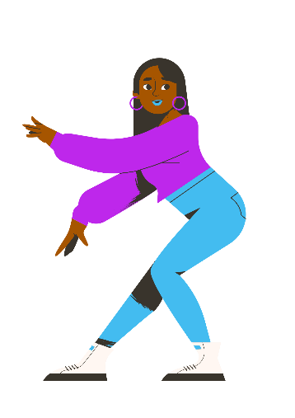
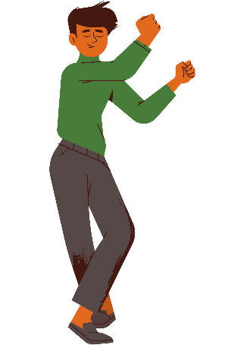
Generating ideas – tableau to life
7.6b
Form a tableau which represents one of your current ideas in your nucleus scene
Choose someone to begin speaking as the tableau comes to life
Add a soundscape of a literal or conceptual environment
Add movement and dynamics to the soundscape
Reflect on how the use of tableau and/or sound could assist communicating an idea, setting or emotion in your nucleus scene

Slide 78
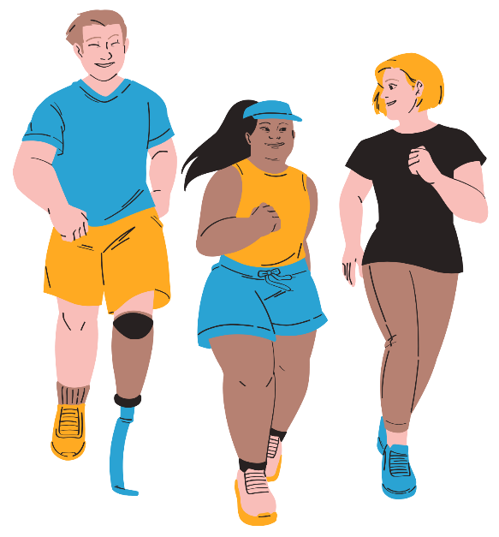
Generating ideas – slow-motion race
7.6c
Form a line at the back of the classroom
Begin a slow-motion running race
Consider your muscle control, tension and focus
Celebrate when each person passes the finish line
Reflect on how slow motion could heighten focus and tension in a specific moment of your nucleus scene

Slide 79

Generating ideas – emotions
7.6d
Devise a new short scene based on a strong emotion
Incorporate your chosen theatrical style
Manipulate dynamics including sensory elements
Reflect on how provoking a response from your audience may be a useful engagement tool in your nucleus scene

Slide 80
IDEA reflection (3)
7.7
I
– identify one standout moment.
D
– describe the movement used in this moment.
E
– explain why this moment stood out.
A
– analyse how this moment added to the effectiveness of their intent.

Slide 81

Learning sequence 8 – structuring and rehearsing

Slide 82
Learning intentions and success criteria (8)
8
We are learning to
select and apply dramatic elements to develop and refine works
apply performance skills and take creative risks to strengthen dramatic intention.
I/We can
document processes used to evaluate and refine dramatic works
collaborate dynamically within an ensemble to jointly develop dramatic action.
Notes:
Notes for teachers:
Learning intentions and success criteria are best co-constructed with students. Adapt the learning intention as required and add matching success criteria.
For more information See ⁠AITSL or the NSW Department of Education explicit teaching strategies, ⁠Sharing learning intentions and ⁠Sharing success criteria
LISC is not necessarily presented at the beginning of the lesson. Teacher needs to consider most effectual time to introduce
LISC should be revisited during the lesson to support students' evaluation of their learning

Slide 83
The Last Great Hunt – wild play
8.1
  How can you effectively use the process of ‘play’ when devising?
  How can you use The Last Great Hunt’s approach to ‘failure’ in your devising process?

Slide 84

Ideas for golden rules
8.2
Speak positively to each other
Notify each other if absent
Experiment with all ideas
Avoid getting too attached and be willing to pivot
Ask everyone to share their ideas

Slide 85

Shock Therapy Arts – Blueprint
8.3a
  How do Shock Therapy Arts allow the opportunity for innovation and new ideas throughout their devising process?
  How can you apply Shock Therapy Arts process of creating a Blueprint to your own devising process?

Slide 86
Developing the nucleus
8.3b
What is happening?
What conventions are we using, adapting or inventing?
What do we want to know?
Who are we?
How are we challenging, subverting or disrupting audience assumptions?
Where are we?
Nucleus scene
What do we know?
What is driving us?
What is at risk?
Whose story are we telling?

Slide 87

Playing with possibilities – narration
8.4a
Create a tableau from your nucleus scene
Choose one person to add narration. This should:
  aim to connect with the audience about aspects of the story being shown.
  consider if it is subtitles, dialogue or direct address.
Reflect on the use of narration and consider if it suits the scene and style.

Slide 88

Playing with possibilities – time
8.4b
Create a starting moment from your nucleus scene.
Improvise new scenes from this moment as different timeframes are called out.
Reflect on how the manipulation of time could enhance your ideas
Pick one improvisation that worked well and experiment with the scene.

Slide 89

Playing with possibilities – intensity
8.4c
Pick one person to become a character in your scene.
In character, deliver a line of dialogue that has strong intensity or intention.
Other group members are directors and provide feedback on how to enhance clarity, expression, energy and/or dynamics.
Reflect on how the changes enhanced the intensity or clarified the intention.
Swap roles and repeat.

Slide 90
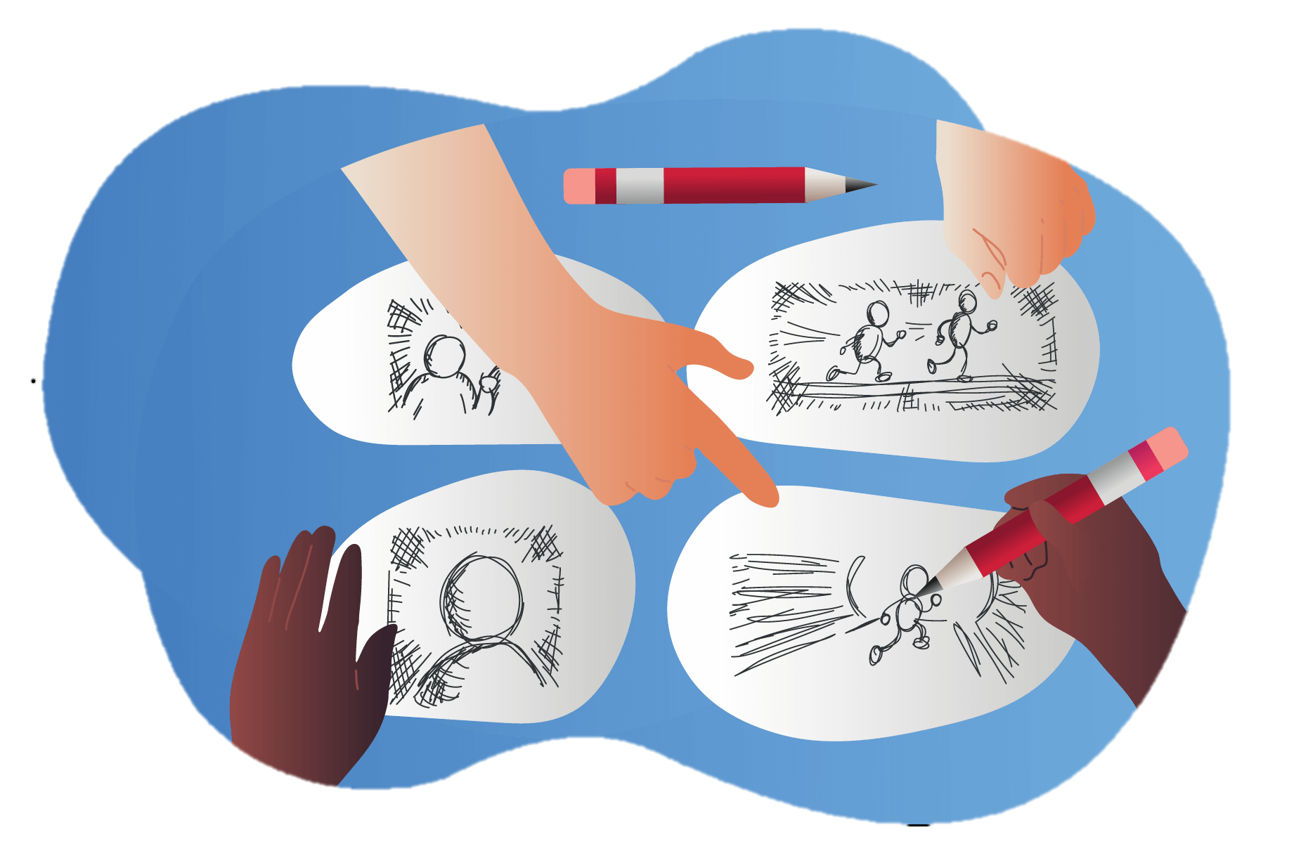
Playing with possibilities – image and movement
8.4d
Pick an image from your research.
Individually improvise a movement sequence that is inspired by the image.
Be inspired by what the group is doing and add, copy or repeat movements.
As a group use the improvisations as the basis of a group movement scene. Consider narrative structure, levels of tension and types of movement.
Reflect on how these movements could be used to enhance your scene/s.

Slide 91

Playing with possibilities – asides
8.4e
Choose a one of your scenes
Add asides and narrate what the characters are doing or offer commentary. Freeze the action each time you add an aside.
Share with the class.
As an audience member write down how the commentary impacted the way you responded to the characters or situation.
Reflect on how this technique amplified the way characters were viewed and whether this supports your chosen style.

Slide 92
Clockfire Theatre – solving problems
8.6
8.6
  What strategies do Clockfire Theatre use when solving problems?
  How could you implement these when devising?
  What additional strategies could you use in your working group?

Slide 93

Reflecting on new steps
8.7
What do we want to keep, change and chuck?
What are our next steps?
How could we use more inspiration from our research and community consultation?

Slide 94

Learning sequence 9 – refining and performance

Slide 95
Learning intentions and success criteria (9)
9
We are learning to
rehearse and refine ways of applying the elements of performance
collaboratively stage group-devised performance with shared and sustained intention
evaluate how choices in the elements of drama develop whilst refining and performing group devised work.
We can
rehearse and refine and the dramatic elements to craft dramatic meaning.
stage ideas, images and stories to express identities, values and perspectives
document processes for developing, investigating and refining new ideas
Notes:
Notes for teachers:
Learning intentions and success criteria are best co-constructed with students. Adapt the learning intention as required and add matching success criteria.
For more information See ⁠AITSL or the NSW Department of Education explicit teaching strategies, ⁠Sharing learning intentions and ⁠Sharing success criteria
LISC is not necessarily presented at the beginning of the lesson. Teacher needs to consider most effectual time to introduce
LISC should be revisited during the lesson to support students' evaluation of their learning

Slide 96

Peer feedback (1)
9.4a
Identify and describe one moment that was effective
  2 sentences
Identify and describe one moment that could be refined
  2 sentences

Slide 97

Peer feedback (2)
9.4b
Explain why this moment needs to be refined.
3 sentences
Include purpose words
Purpose words
Challenge Clarify Construct Create Develop Differentiate Educate Evoke Exemplify Highlight Illuminate Infer Introduce Persuade Provide insight Provoke Specify

Slide 98

Peer feedback (3)
9.4c
Analyse 2 options that could be used to enhance this moment.
4 sentences
Include reference to dramatic elements
Be specific
Elements of drama | Elements of performance | Elements of production
Role Character Focus Tension Situation Space Time Structure Language Moment Atmosphere Belief Symbol | Dynamics, Clarity, Energy and Expression In Voice and movement | Set Lighting Costume Props Sound Technologies

Slide 99

Letter to future drama students
9.9
Write a letter to a future Year 10 drama student about devising. Include:
what you most proud of?
what worked well?
what would you have done differently?
What is the most important advice would you give on devising a piece of theatre?

Slide 100
References (1)
This presentation contains NSW Curriculum and syllabus content. The NSW Curriculum is developed by the NSW Education Standards Authority. This content is prepared by NESA for and on behalf of the Crown in the right of the State of New South Wales. The material is protected by Crown copyright.
Please refer to the NESA Copyright Disclaimer for more information https://educationstandards.nsw.edu.au/wps/portal/nesa/mini-footer/copyright.
NESA holds the only official and up-to-date versions of the NSW Curriculum and syllabus documents. Please visit the NSW Education Standards Authority (NESA) website https://educationstandards.nsw.edu.au/wps/portal/nesa/home and the NSW Curriculum website https://curriculum.nsw.edu.au.
Actors Toolkit (nd) A guide to Jacques Lecoq for actors from movement to magic, accessed 24 June 2025.
Against the Grain Theatre company (2017) Kopernikus, accessed 5 September 2025.
Brecht, B. (n.d.). Attributed quote: "Art is not a mirror held up to reality but a hammer with which to shape it."
Clockfire Theatre (2020) Night Parade of 100 Goblins, accessed 24 June 2025.
Complicité (2007) A Disappearing Number, accessed 23 June 2025.
Drama 7–10 Syllabus© NSW Education Standards Authority (NESA) for and on behalf of the Crown in right of the State of New South Wales, 2023.
Frantic Assembly (2012) The Curious Incident of the Dog in the Night-time, accessed 23 June 2025.
Klook (2025) Chongqing 1949, accessed 23 June 2025.
Life of Pi (2023) Life of Pi sights and sounds, accessed 23 June 2025.
Messy Nessy (2021) The Greatest Open Air (and floating) Show on Earth, accessed 23 June 2025.
YouTube (2025) Night Night : The Great Last Hunt, accessed 27 October 2025

Slide 101
References (2)
Shakespeare’s Globe (2025) Romeo and Juliet, accessed 23 June 2025.
The Last Great Hunt (2024) LÉ NØR [the rain]. Accessed 6 June 2025.
The Last Great Hunt (2024) Bruce. Accessed 6 June 2025.
The Last Great Hunt (2024) It's Dark Outside. Accessed 6 June 2025.
The Last Great Hunt (2024) Falling Through Clouds. Accessed 6 June 2025.
The Last Great Hunt (2024) Night Night. Accessed 6 June 2025.
The Last Great Hunt (2024) Falling Through Clouds. Accessed 6 June 2025.
Unwin S (2014) The Complete Brecht Toolkit, Nick Herns Books, London.
Van Gogh, V (1889) The Starry Night, MoMA website, accessed 16 June 2025.

Slide 102
Copyright
© State of New South Wales (Department of Education), 2025
The copyright material published in this resource is subject to the Copyright Act 1968 (Cth) and is owned by the NSW Department of Education or, where indicated, by a party other than the NSW Department of Education (third-party material).
Copyright material available in this resource and owned by the NSW Department of Education is licensed under a Creative Commons Attribution 4.0 International (CC BY 4.0) license.
This license allows you to share and adapt the material for any purpose, even commercially.
Attribution should be given to © State of New South Wales (Department of Education), 2025.
Material in this resource not available under a Creative Commons license:
the NSW Department of Education logo, other logos and trademark-protected material
Material owned by a third party that has been reproduced with permission. You will need to obtain permission from the third party to reuse its material.
Links to third-party material and websites
Please note that the provided (reading/viewing material/list/links/texts) are a suggestion only and implies no endorsement, by the New South Wales Department of Education, of any author, publisher, or book title. School principals and teachers are best placed to assess the suitability of resources that would complement the curriculum and reflect the needs and interests of their students.
If you use the links provided in this document to access a third-party’s website, you acknowledge that the terms of use, including licence terms set out on the third-party’s website apply to the use which may be made of the materials on that third-party website or where permitted by the Copyright Act 1968 (Cth). The department accepts no responsibility for content on third-party websites.

