Slide 1
Instructions for use
This resource is not a teaching and learning program. It should be used in conjunction with the Stage 5 (Year 9) – ‘That’s a wrap!’ sample unit and assessment available on the Planning, programming and assessing dance 7–10 (2023) webpage. It is intended to support a primarily practical approach to teaching performance.
Classroom teachers are encouraged to add and adapt slides as required to meet the needs of their students.
Save a copy of the file to make changes to the slide deck. Go to File > Download a Copy (this downloads a copy to the computer to edit in the PowerPoint app).
To convert the PowerPoint to Google Slides:
  Upload the file into Google Drive and open it.
  Go to File > Save as Google Slides.
  (Note – conversion may cause formatting changes in the slides.)

Slide 2
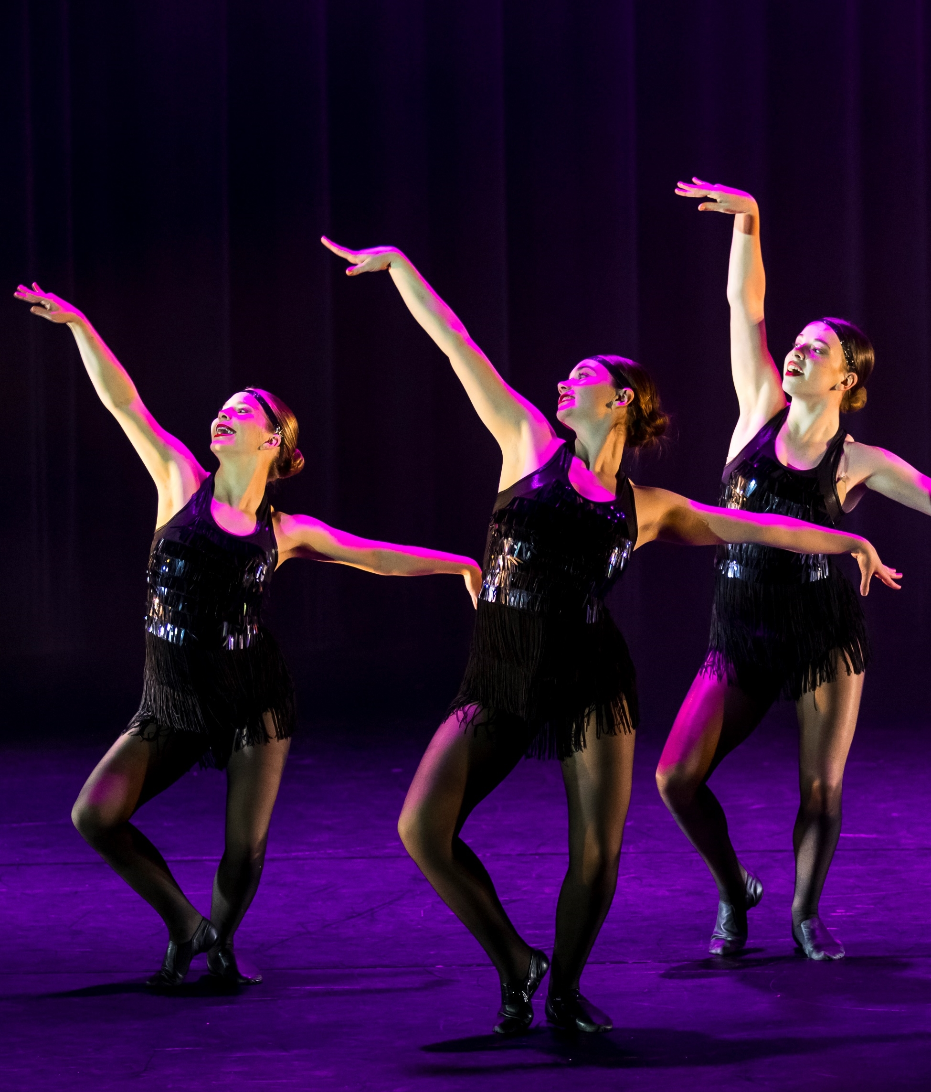
That’s a wrap!
Dance – Stage 5
Performance
Photo by Anna Warr (2024), Central Coast musical theatre ensemble

Slide 3
Contents
1
Learning sequence 1 – context and the conventions of musical theatre
2
Learning sequence 2 – exploring a specific screen musical
3
Appendix 1 – revision slides
Notes:
Teacher notes:
Click lesson numbers to go to specific lessons
Interactive features can be viewed in slide show

Slide 4
Learning sequence 1 – context and conventions of musical theatre

Slide 5
Learning intentions and success criteria
We are learning to
know about the origins of musical theatre
understand the conventions and characteristics of musical theatre
use dance technique lessons to explore the conventions and characteristics of musical theatre.
We can
identify the origins and significant eras of musical theatre
describe and explore the conventions and characteristics of musical theatre including movement for storytelling
demonstrate understanding of the conventions and characteristics of musical theatre including the relationship between character/role, music and movement for storytelling.
Notes:
Notes for teachers:
Learning intentions and success criteria are best co-constructed with students. Adapt the learning intention as required and add matching success criteria.
For more information See ⁠AITSL or the NSW Department of Education explicit teaching strategies, ⁠Sharing learning intentions and ⁠Sharing success criteria
LISC is not necessarily presented at the beginning of the lesson. Teacher needs to consider most effectual time to introduce
LISC should be revisited during the lesson to support students' evaluation of their learning

Slide 6

1.1a – what is musical theatre?
Video sample
Musical Theatre: From Athens to Broadway (1:55)
Notes:
Note for teachers:
The video sample used in this activity references the musical film Dear Evan Hansen (2015) and briefly mentions that the subject matter explores teenage depression and suicide. It is advised teacher’s watch this prior to students’ and use professional judgement if this is appropriate for the students in their context.

Slide 7
1.1b – 3-2-1 things I learned today about musical theatre
List 3 things you learned today about musical theatre:
3
1.
2.
3.
List 2 questions you have about musical theatre:
2
1.
2.
Give 1 reason why it’s important to learn about musical theatre:
1
1.
Notes:
Note for teachers: students are to access the video on 1.1a before completing this slide. You may like to show the video multiple times if it is appropriate for the class context.

Slide 8
1.1b – sample 3-2-1 things I learned today about musical theatre
List 3 things you learned today about musical theatre:
3
1. Musical theatre is music, dance and dialogue to tell emotionally engaging stories.
2. Musical theatre can be traced back to Ancient Greece.
3. Show boat (1927) was the first musical blockbuster in America.
List 2 questions you have about musical theatre:
2
1. Who is Richard Rogers and Oscar Hammenstein?
2. When did musical theatre first appear on a screen?
Give 1 reason why it’s important to learn about musical theatre:
1
1. It addresses social issues like homophobia or racial prejudice and gets audiences to think and talk about them.
Notes:
Note for teachers: this is a sample student response from accessing the video on 1.1a. Some additional answers can be found in the sample Stage 5 Dance unit – That’s a wrap.

Slide 9
1.2a – musical theatre timeline
Pre-1920s
1920s-1930s
1940s–1960s
1970s
1980s–1990s
2000–present
Opera
The jazz age
The golden age
Experimental or Post-Golden age
Mega musical
Contemporary
Adapted from:
Musical Theatre Time Periods - A Full Breakdown | Theatre Trip
The Evolution of Musical Theater: A Journey Through Time – Toxigon
Musical theatre’s history and timeline
A Brief History of Musical Theater - Wenger | J.R. Clancy

Slide 10
1.2b – eras of musical theatre (1)
Era | Popular trends | Sample musicals
Pre 1920s | Opera and operettas (light-hearted, comedic operas) Vaudeville | Pirates of Penzance HMS Pinafore The Mikado
The jazz age | Operettas continued to be popular Heavy influence of jazz Glamourous show girls Book and screen musicals started to emerge | Show Boat Anything Goes Me and My Girl
The golden age | Peak popularity for stage and screen musicals Showtunes played on the radio Large dance numbers Romantic comedies | Oklahoma! South Pacific Singin’ in the rain The Sound of Music
Adapted from:
Musical Theatre Time Periods - A Full Breakdown | Theatre Trip
The Evolution of Musical Theater: A Journey Through Time
Musical theatre’s history and timeline
A Brief History of Musical Theater - Wenger | J.R. Clancy

Slide 11
1.2c – eras of musical theatre (2)
Era | Popular trends | Sample musicals
Experimental/ Post-Golden age | Rock musicals Culturally diverse musicals Shift towards more thought-provoking plots | Hair Jesus Christ Superstar A chorus line Sweeney Todd
Mega musical | Lavish productions with grand sets and global reach Diversity of genres, culture and plots | Cats Phantom of the opera Miss Saigon The Lion King
Contemporary | Diverse styles, genre and themes Focus on representation, innovation and inclusion Musicals based on movies and musical albums | Six Hadestown Moulin Rogue Wicked
Adapted from:
Musical Theatre Time Periods - A Full Breakdown | Theatre Trip
The Evolution of Musical Theater: A Journey Through Time – Toxigon
Musical theatre’s history and timeline
A Brief History of Musical Theater - Wenger | J.R. Clancy

Slide 12
1.2d – eras of musical theatre (3)
Research scaffold
Name of musical:
Era:
Stage and/or screen musical:
The year it premiered:
[insert a short video sample which includes movement]
Narrative/themes:

Slide 13
1.2e – eras of musical theatre (4)
Research scaffold
Description of music:
Description of movement:
One example from video:
Explanation of how the music and movement help to communicate the narrative:
Notes:
Note for teachers:
Description of the music could include: mood, atmosphere, instruments, tempo (fast/slow/accelerating/decelerating), accents, duration (long/short sounds)
Description of the movement could include: body skills (turns, balances, elevations, falls, locomotor sequences, axial movement), kicks/leg extensions, the manipulation of the elements of dance (space, time and dynamics), aspects of performance quality (focus, projection, commitment and confidence, kinaesthetic awareness)

Slide 14

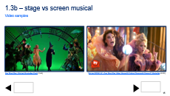
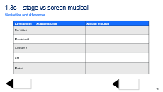
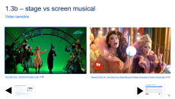
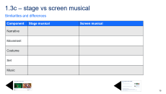
1.3a – stage vs screen musical
Instructions
Access the 2 video samples on slide 1.3b.
For each video sample, complete the table on slide 1.3c.
After viewing both samples, discuss:
What is possible in a screen musical that is not possible in a stage musical?
How is the relationship with the audience influenced in the stage vs the screen samples?
Which do you prefer and why?
Notes:
Note for teachers:
To navigate to the slides 1.3b and 1.3c, press ctrl + click on the black arrows. A visual reference of the slide is also included.

Slide 15
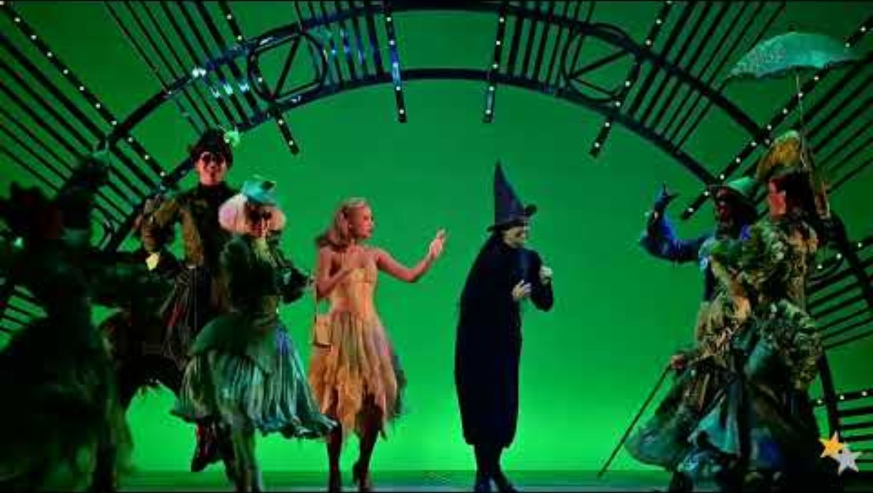
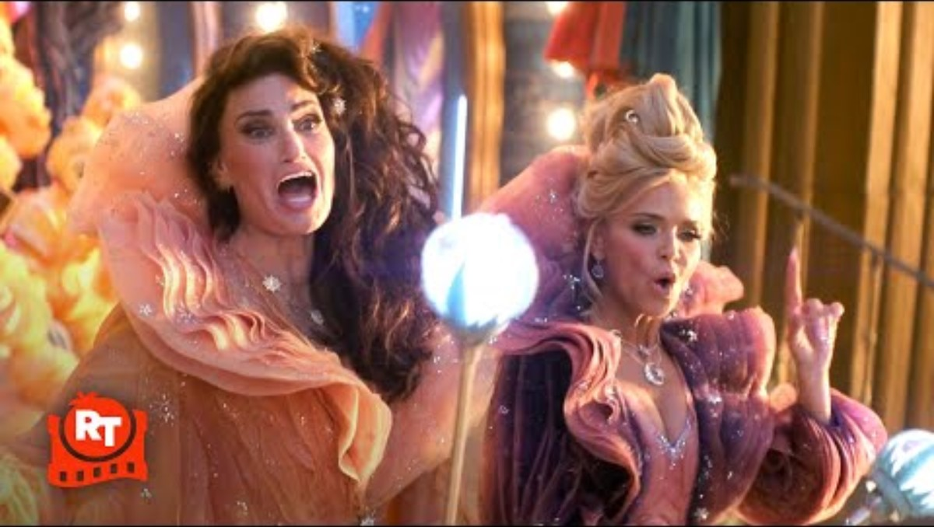




1.3b – stage vs screen musical
Video samples
One Short Day - Wicked (Australian Cast) (3:46)
Wicked (2024) 4K - One Short Day (Idina Menzel & Kristen Chenoweth Cameo) | Movieclips (6:03)
Notes:
Note for teachers:
To navigate to the slides 1.3a and 1.3c, press ctrl + click on the black arrows. A visual reference of the slide is also included

Slide 16




1.3c – stage vs screen musical
Similarities and differences
Component | Stage musical | Screen musical
Narrative
Movement
Costume
Set
Music
Notes:
Note for teachers:
To navigate to the slides 1.3a and 1.3b, press ctrl + click on the black arrows. A visual reference of the slide is also included

Slide 17

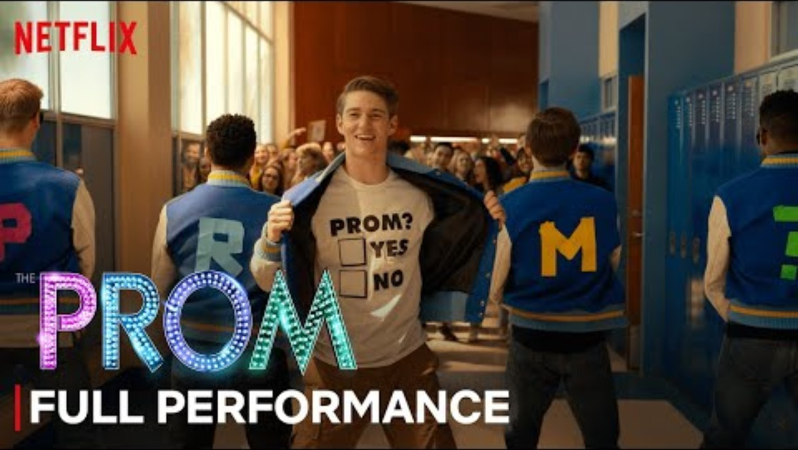

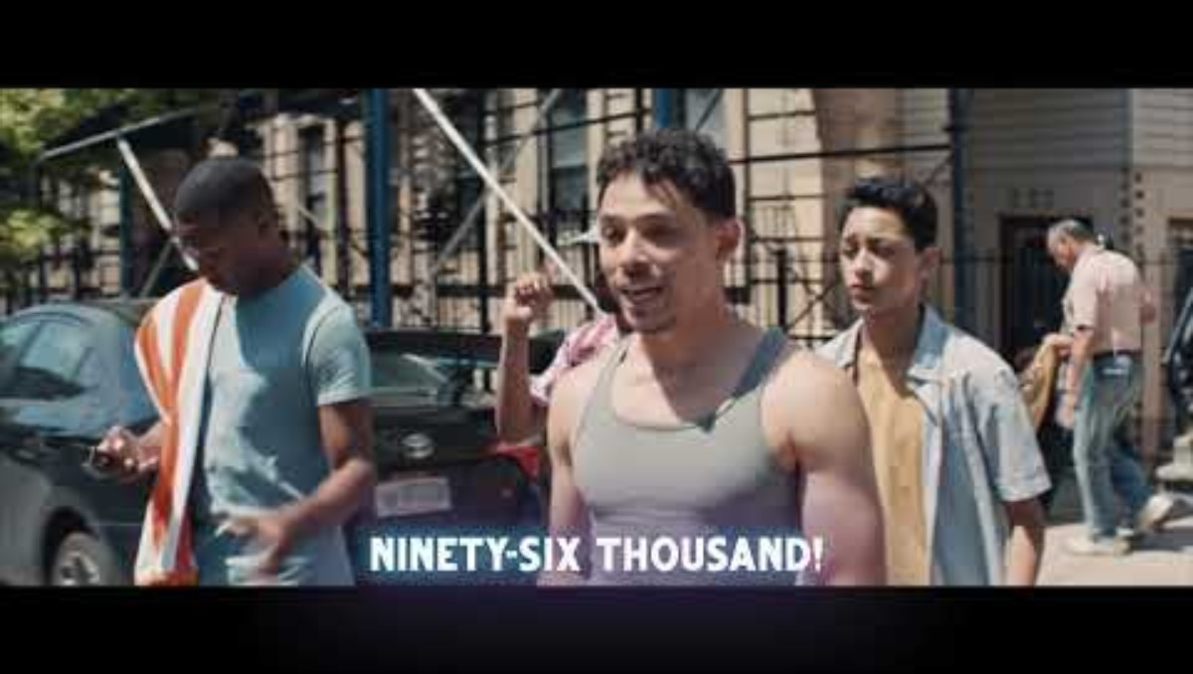
1.4a – conventions of musical theatre
Video samples
Watch one or more of the video samples and describe:
the movement
the relationship between the movement and the music
the use of theatrical elements such as props, costumes, lighting and sets
how the above points give you clues about the narrative/story?
The Greatest Showman Cast - This Is Me (Official Lyric Video) (3:49)
You Happened - Full Promposal Performance feat. Jo Ellen Pellman + Ariana Debose | The Prom (2:18)
Revolting Children | Roald Dahl’s Matilda the Musical | Netflix Philippines (2:51)
In The Heights - 96,000 Sing Along (6:14)

Slide 18
1.4b – conventions of musical theatre
Conventions of musical theatre

Slide 19
1.4c – sample conventions of musical theatre
Movement for storytelling
Common themes of diversity and acceptance
Movement and music/lyrics have strong a relationship
Could include comedy and humour
Conventions of musical theatre
Range of characters/roles which influence movement
Theatrical elements which support storytelling
Exaggerated and emphasised movement
Eclectic range
of dance style(s) influenced by the music and/or story
Notes:
Note for teachers:
This is a sample completed conventions of musical theatre mind map that could be used in the classroom to prompt further discussion.

Slide 20
1.5a – performance protocols in the context of musical theatre
Being on time and prepared
Spatial awareness
Performance protocols for musical theatre
Responsibility to remember dances
Respectful and kind interactions
Keep the dance space clear

Slide 21
1.5b – sample performance protocols in the context of musical theatre
Change of clothes, water bottle and shoes (If needed)
Be aware of others in the dance space
Arrive on time
Move safely, especially when using props
Being on time and prepared
Spatial awareness
Listen and actively participate in class
Listen to and value feedback
Performance protocols for musical theatre
Responsibility to remember dances
Respectful and kind interactions
Revise sequences and dances in own time
Give feedback using kind and positive language
Keep the dance space clear
Keep classroom items tidy and to the side
Put bags away or to the side
Notes:
Note for teachers:
This is a sample completed performance protocols in the context of musical theatre spider map that could be used in the classroom to prompt further discussion.

Slide 22
1.6a – technique class exploring a musical template
Introduction to a musical template
[Musical title]
[Character list]
[Musical narrative
key moments]
Characters
Narrative
[Insert video sample link]
Notes:
Note for teachers:
This template is for teachers to use to introduce the musical(s) that are explored as part of activity 1.4. The narrative/key moments of the musical could be presented using text and/or a video sample.

Slide 23
1.6b – technique class exploring a musical
Class structure with soundtrack planning to explore the narrative/story template
Warm-up
Centre exercise(s)
Introduction to musical
Song:
Song:
Locomotor exercise(s)
Dance sequence
Cool-down / reflection
Song:
Song:
Song:

Slide 24

1.6c – sample technique class exploring Wicked (2024)
Resources
Director – Jon M. Chu
Choreographer – Christopher Scott
Wicked (2024) soundtrack
Narrative, themes and characters
Wicked - Official Trailer (3:32)
Notes:
Note for teachers:
This is a sample of some resources for the screen musical Wicked (2024) that could be used to support the teaching and learning of activity 1.6.
The teacher may wish to explore an alternate screen musical(s). Some suggestions have been included in this slide deck.

Slide 25
1.6d – sample technique class exploring Wicked (2024)
Introduction to Wicked (2024)
Wicked (2024)
Wicked is the story of the witches of Oz.
The film begins with the death of the Wicked Witch of the West, Elphaba. Glinda the Good reflects on their shared history, recounting how they met at Shiz University.
Elphaba, born with green skin, faces prejudice and isolation, while Glinda, initially popular and privileged, undergoes her own transformation.
Their friendship evolves amid political intrigue and personal challenges, leading to their eventual roles as the iconic witches.
Characters
Narrative
Elphaba Thropp
Galinda Upland
Fiyero Tugelaar
Boq Wooman
Nessarose Thropp
Madame Morrible
The Wonderful Wizard of Oz
Doctor Dillamond
Wicked - Official Trailer (3:32)
Adapted from: Wicked (2024) Ending, Explained: Why Didn't Glinda Go With Elphaba?
Notes:
Note for teachers:
This is a sample completed introduction for Wicked (2024) as part of activity 1.6.

Slide 26
1.6e – sample technique class exploring Wicked (2024)
Class structure with soundtrack planning to explore the narrative/story of Wicked (2024)
Warm-up
Centre exercise(s)
Introduction to Wicked (2024)
The wizard and I
Popular
Locomotor exercise(s)
Dance sequence
Cool-down / reflection
Dancing through life
What is this feeling?
Defying gravity
Notes:
Note for teachers:
This is a sample completed introduction for Wicked (2024) as part of activity 1.5 in the sample Stage 5 Dance unit – That’s a wrap!.

Slide 27

1.6f – additional sample musical resources
The Greatest Showman (2017)
Director – Michael Gracey
Choreographer – Ashley Wallen
The Greatest Showman (2017) soundtrack
Narrative, themes and characters
The Greatest Showman | Official HD Trailer #1 | 2017 (2:45)
Notes:
Note for teachers:
This is a sample of some resources for the screen musical The Greatest Showman (2017) that could be used to support the teaching and learning of activity 1.6 in the Stage 5 Dance (Year 9) – sample unit ‘That’s a wrap!’.
The teacher may wish to explore an alternate screen musical(s). Some suggestions have been included in this slide deck.

Slide 28
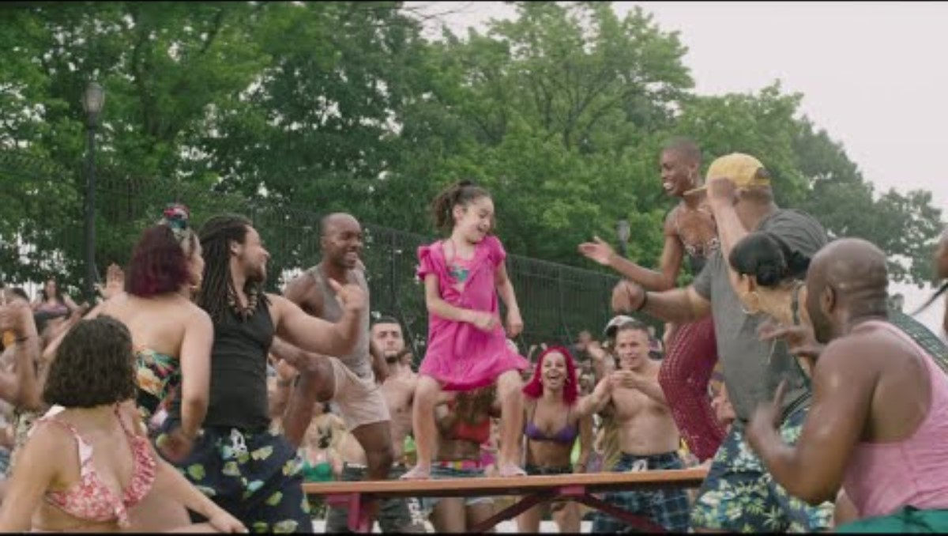
1.6g – additional sample musicals resources
In the Heights (2021)
Director – Jon M. Chu
Choreographer – Christopher Scott
In the Heights (2021) soundtrack
Narrative, themes and characters
In The Heights - from the Official Motion Picture Soundtrack (Official Audio) – YouTube (2:21)
Notes:
Note for teachers:
This is a sample of some resources for the screen musical In the Heights (2021) that could be used to support the teaching and learning of activity 1.6 in the Stage 5 Dance (Year 9) – sample unit ‘That’s a wrap!’.
The teacher may wish to explore an alternate screen musical(s). Some suggestions have been included in this slide deck.

Slide 29
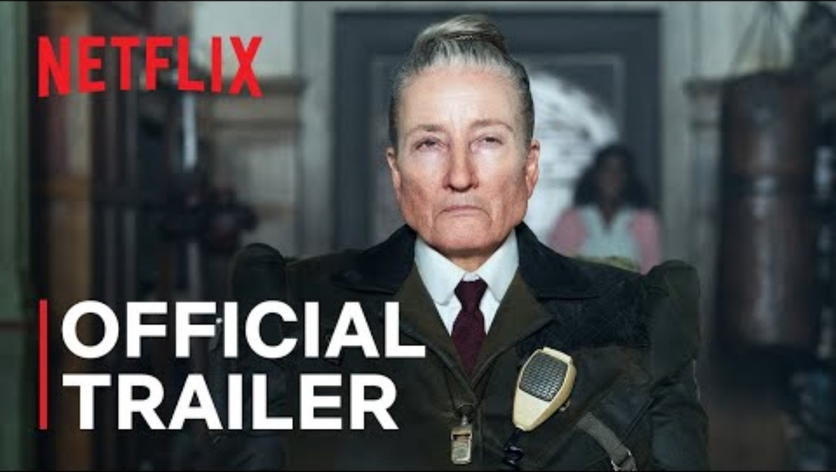
1.6h – additional sample musicals resources
Matilda (2022)
Director – Matthew Warchus
Choreographer – Ellen Kane
Matilda (2022) Soundtrack
Narrative, themes and characters
Roald Dahl’s Matilda the Musical | Official Trailer | Netflix (2:22)
Notes:
Note for teachers:
This is a sample of some resources for the screen musical Matilda (2022) that could be used to support the teaching and learning of activity 1.6 in the Stage 5 Dance (Year 9) – sample unit ‘That’s a wrap!’.
The teacher may wish to explore an alternate screen musical(s). Some suggestions have been included in this slide deck.

Slide 30

1.6i – additional sample musicals resources
The Prom (2020)
Director – Ryan Murphy
Choreographer – Casey Nicholaw
The Prom (2020) soundtrack
Narrative, themes and characters
The Prom | Official Teaser Trailer | Netflix (2:19)
Notes:
Note for teachers:
This is a sample of some resources for the screen musical The Prom (2020) that could be used to support the teaching and learning of activity 1.6 in the Stage 5 Dance (Year 9) – sample unit ‘That’s a wrap!’.
The teacher may wish to explore an alternate screen musical(s). Some suggestions have been included in this slide deck.

Slide 31
Learning sequence 2 – exploring a specific screen musical

Slide 32
Learning intentions and success criteria (2)
We are learning to
know the themes and ideas of a specific song from a musical and select a character/role to explore
understand how we use our bodies to interpret themes and ideas for our character/role when dancing to a specific song from a musical
develop skills in personalising an interpretation of a character/role from a musical.
We can
identify the relationship between the selected character/role and the themes and ideas in the song from a musical
describe and explore ways to personalise an interpretation of a character/role through a dance sequence using a specific song from a musical
demonstrate a personalised interpretation of a character/role from a musical through dance technique, safe dance practice, the elements of dance and performance quality.
Notes:
Notes for teachers:
Learning intentions and success criteria are best co-constructed with students. Adapt the learning intention as required and add matching success criteria.
For more information See ⁠AITSL or the NSW Department of Education explicit teaching strategies, ⁠Sharing learning intentions and ⁠Sharing success criteria
LISC is not necessarily presented at the beginning of the lesson. Teacher needs to consider most effectual time to introduce
LISC should be revisited during the lesson to support students' evaluation of their learning

Slide 33
2.1a – sample assessment task notification
Wicked (2024)
Task
Additional information
You will perform the teacher-choreographed musical theatre dance One short day from Wicked (2024) that you have learnt in class. Your performance will be a personalised interpretation of the teacher-choreographed dance to support your selected role/character in the dance. This may be presented as a solo, duo or small group to support the communication of your ideas.
You may include any relevant props and/or costumes to support your interpretation of your character/role.
This may be presented on a stage with stage lighting or in the dance classroom.
Musical
Song
Wicked (2024)
One short day
Notes:
Notes for teachers:
This is a sample only and can be adapted.

Slide 34
2.1b – sample assessment rubric
Outcomes | A | B | C | D | E
DA5-PER-01 demonstrates safe dance practice and dance technique in preparing the body to express and communicate an intent | I can consistently apply safe dance practice, dance technique and body awareness with control when performing the musical theatre dance. I can communicate an intent in the musical theatre dance by consistently applying appropriate alignment, strength, flexibility, endurance and coordination. | I can apply safe dance practice and dance technique in the execution of the musical theatre dance with appropriate body awareness and control. I can communicate an intent in the musical theatre dance by applying appropriate alignment, strength, flexibility, endurance and coordination. | I can use some aspects of safe dance practice and dance technique in the execution of the musical theatre dance with adequate body awareness. I can communicate an intent in the musical theatre dance by using adequate alignment, strength, flexibility, endurance and coordination. | I can use limited aspects of safe dance practice and dance technique in the musical theatre dance. I can, at times show an intent in the musical theatre dance by using some alignment, strength, flexibility or coordination. | I can attempt to use aspects of safe dance practice and/or dance technique in parts of the musical theatre dance.
DA5-PER-02 manipulates the elements of dance to demonstrate performance quality and interpretation in context | I can effectively manipulate the elements of dance to consistently demonstrate performance quality and a clear interpretation of my character/role in the musical theatre dance. | I can manipulate the elements of dance to appropriately apply performance quality and interpretation of my character/role in the musical theatre dance. | I can use the elements of dance to show performance quality and interpretation of my character/role in the musical theatre dance. | I can, at times use some of the elements of dance to demonstrate some aspects of performance quality and interpretation in the musical theatre dance. | I can attempt to use some movements in the musical theatre dance.
Notes:
Notes for teachers:
This is a sample only and can be adapted.

Slide 35
2.2a – individual character profile
Character name:
Age:
Character’s role in the song:
Possible costume ideas:
Possible props:
The relevance of costumes and/or props to the character:

Slide 36
2.2b – individual character profile
Character traits:
Use of space, time and dynamics to support interpretation:
Use of performance quality to support interpretation:
Mannerisms:

Slide 37
2.5a – formative check-in opportunity 1
Opportunity 1 – you will perform the opening sequence of the musical theatre dance for another group. Using the scaffold provided by your teacher, you will select a short phrase in the sequence and explain how you have personalised the interpretation to demonstrate your character/role. In your discussion you should explain how at least one aspect of dance technique and/or safe dance assists you to achieve your interpretation.

Slide 38
2.5b – formative check-in opportunity 1 scaffold
[image and/or description of skill from the dance sequence]
[Aspect of dance technique and/or safe dance practice]
My character/role is…
My interpretation is…
The skill from the dance sequence is…
The aspect of dance technique and/or safe dance practice is…
This helps me to achieve my interpretation by...
Notes:
Note for teachers:
Some skills could include turns, falls, balance, elevation, locomotor, body articulation and transfer of weight. Some students may reference combinations of skills or a single skill relative to their own experience, knowledge and acquisition of skills.
Aspects of dance technique and/or safe dance practice could include body awareness, control, strength, flexibility, coordination, endurance warm-up, cool-down, alignment, kinaesthetic awareness in relation to personal anatomical structure.

Slide 39
2.8a – formative check-in opportunity 2
Opportunity 2 – you will review video footage of yourself performing the musical theatre dance and reflect on at least two aspects of your performance quality and interpretation using the What Went Well (WWW) and Even Better If (EBI) scaffold. Some suggestions could include how your application of focus, projection, confidence, commitment or the manipulation of the elements of dance assists you to achieve your interpretation. Discuss your scaffold with another student and apply strategies to work on the identified EBI, giving each other constructive feedback and advice.

Slide 40
2.8b – formative check-in opportunity 2 scaffold
At least 2 aspects of performance quality
Strategies to improve ‘Even better if…’
What went well…
Even better if…
Notes:
Note for teachers:
Aspects of performance quality could include focus, projection, musicality, quality of line, kinaesthetic awareness, commitment and confidence.

Slide 41
Appendix 1 – revision slides
Notes:
The following slides are to be used as per the needs of the school and student context to revise Stage 5 Dance Performance content.

Slide 42
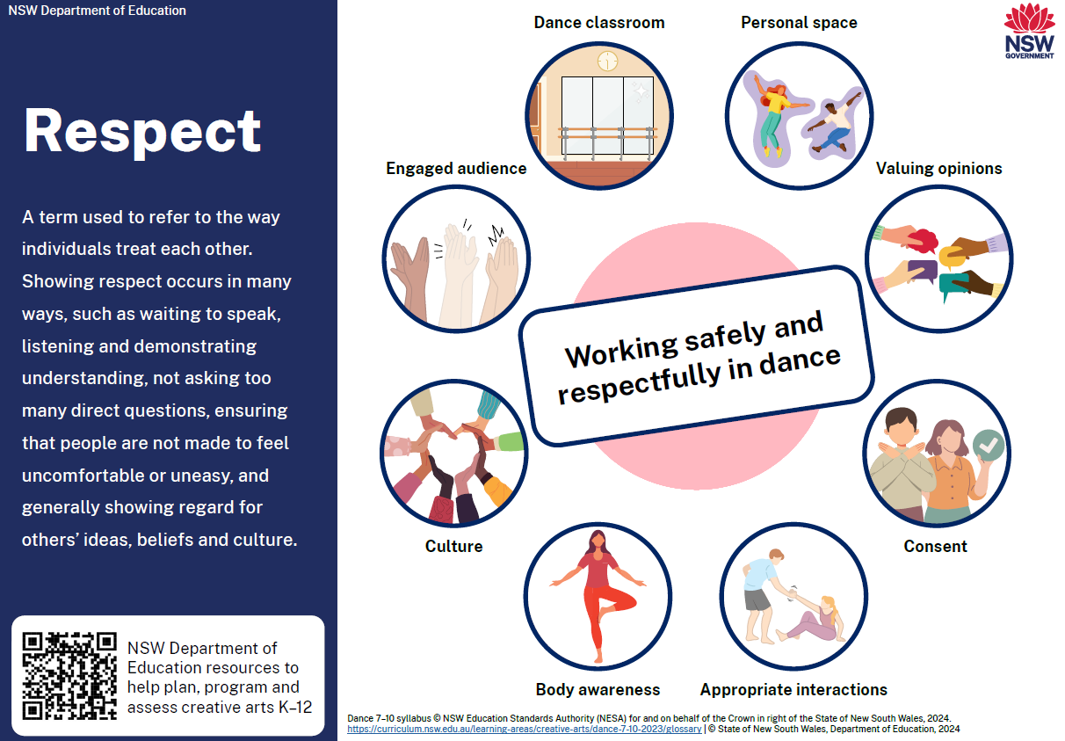
Working safely and respectfully in dance

Slide 43
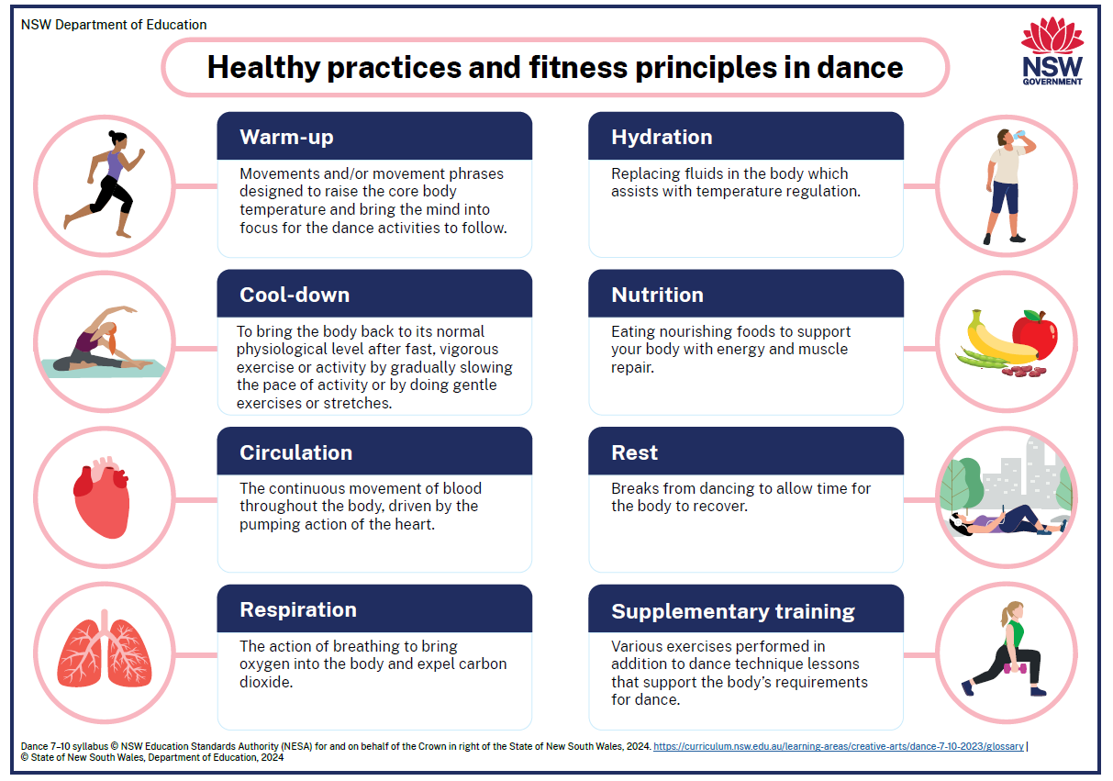
Healthy practices and fitness principles in dance

Slide 44
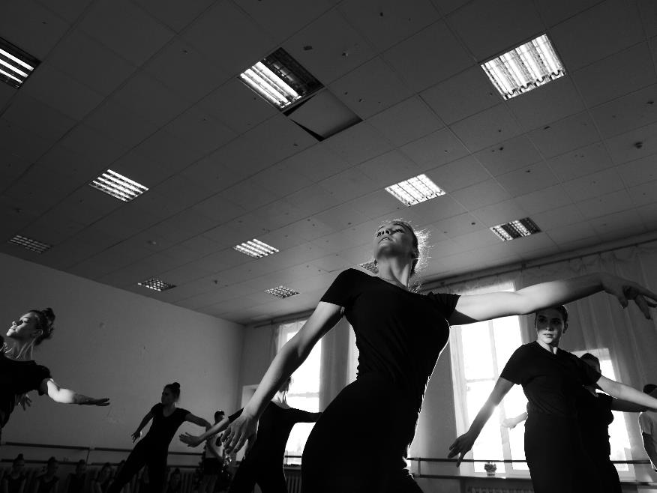
What is a warm-up?
NESA defines a warm-up as ‘movements and/or movement phrases designed to raise the core body temperature and bring the mind into focus for the dance activities to follow.’
(NESA 2023)
‘Ballerinas dancing under lamps during class in hall’ by Mary Nikitina is licensed under the Pexels License.

Slide 45

Steps to a warm-up
Raise pulse or heart rate
Move the joints
Stretch
Strength
Now the temperature of the muscles has increased, begin lengthening the muscles
Raise pulse or heart rate
Increase the intensity and the pace of the movement
Begin strengthening the muscles
Perform relevant stretching techniques to prepare specific muscles for movements you will perform
Perform relevant strengthening exercises to prepare specific muscles for movements you will perform
Gently increase the pulse/ heart rate
Move all joints in the body
For example, if you are performing kicks, a dynamic stretch of the legs will prepare the muscles for the quick action
For example, walking around the dance space, progress to a jog, then a run
For example, extension, flexion and rotation of the shoulders, hips, knees, elbows, spine and ankles
For example, if you are performing jumps, plié exercises will help strengthen to quadriceps

Slide 46
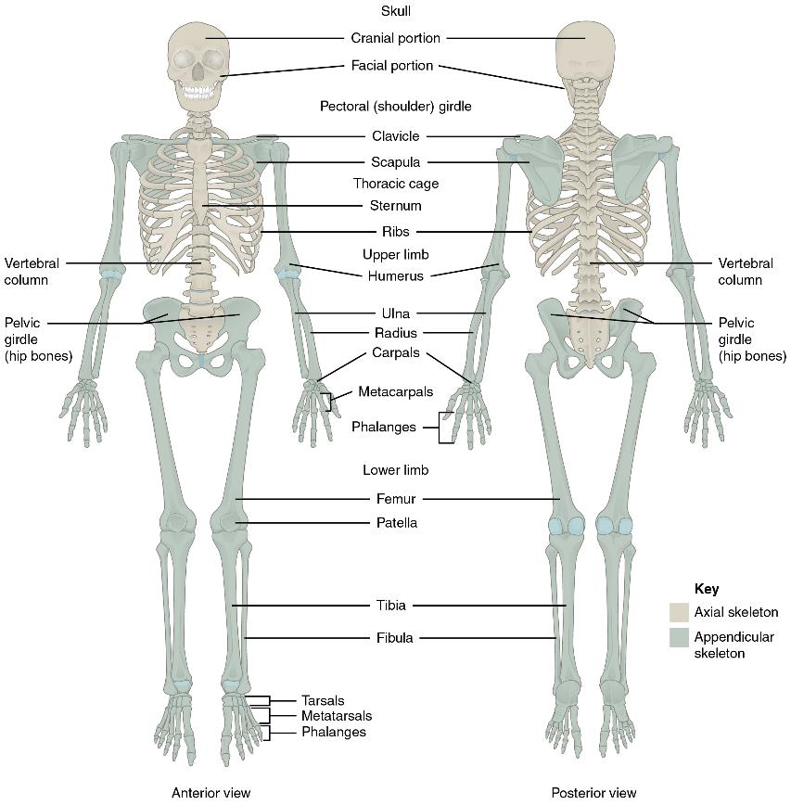
The skeleton
Our bones
The skeletal system is made up of bones and cartilage. It performs the following important functions:
supports the body and gives it shape
facilitates movement
protects internal organs
produces blood cells
stores and releases minerals and fats.
Where 2 bones meet is called a joint.
'Axial and Appendicular Skeleton' by OpenStax College, Anatomy and Physiology is licensed under CC BY 4.0.

Slide 47
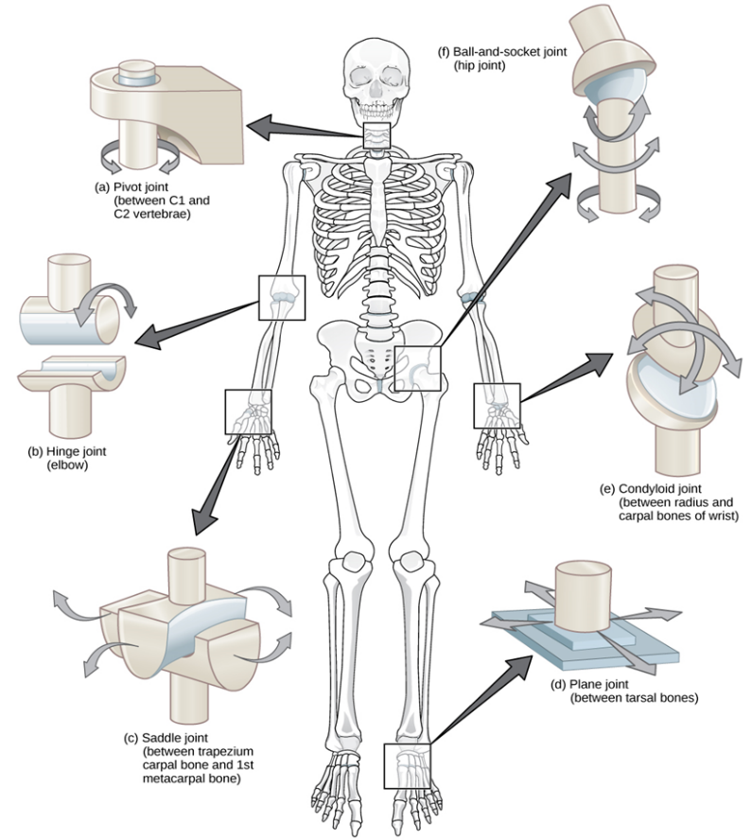
Joints
There are many types of moving joints in the body. Some of the most important to consider in dance are:
ball-and-socket joint (for example the hip and shoulder joints)
hinge joint (for example the elbow and knee joints)
pivot joint (for example between cervical vertebrae in the neck).
‘Types of synovial joints' by Wikimedia Commons is licensed under CC BY 3.0.

Slide 48

Alignment
NESA defines alignment as ‘an aspect of safe dance practice. The relationship of the skeleton to the line of gravity and the base of support, which makes movement more efficient and reduces the chance of injury.’
(NESA 2023)
Unpacking this definition:
The base of support is the body part(s) that are in contact with the ground (for example, 2 feet, one foot, one hand).
The line of gravity is an imaginary vertical line from the centre of gravity to the ground or surface the object or person is on. It is the direction that gravity is acting upon the person or object.

Slide 49
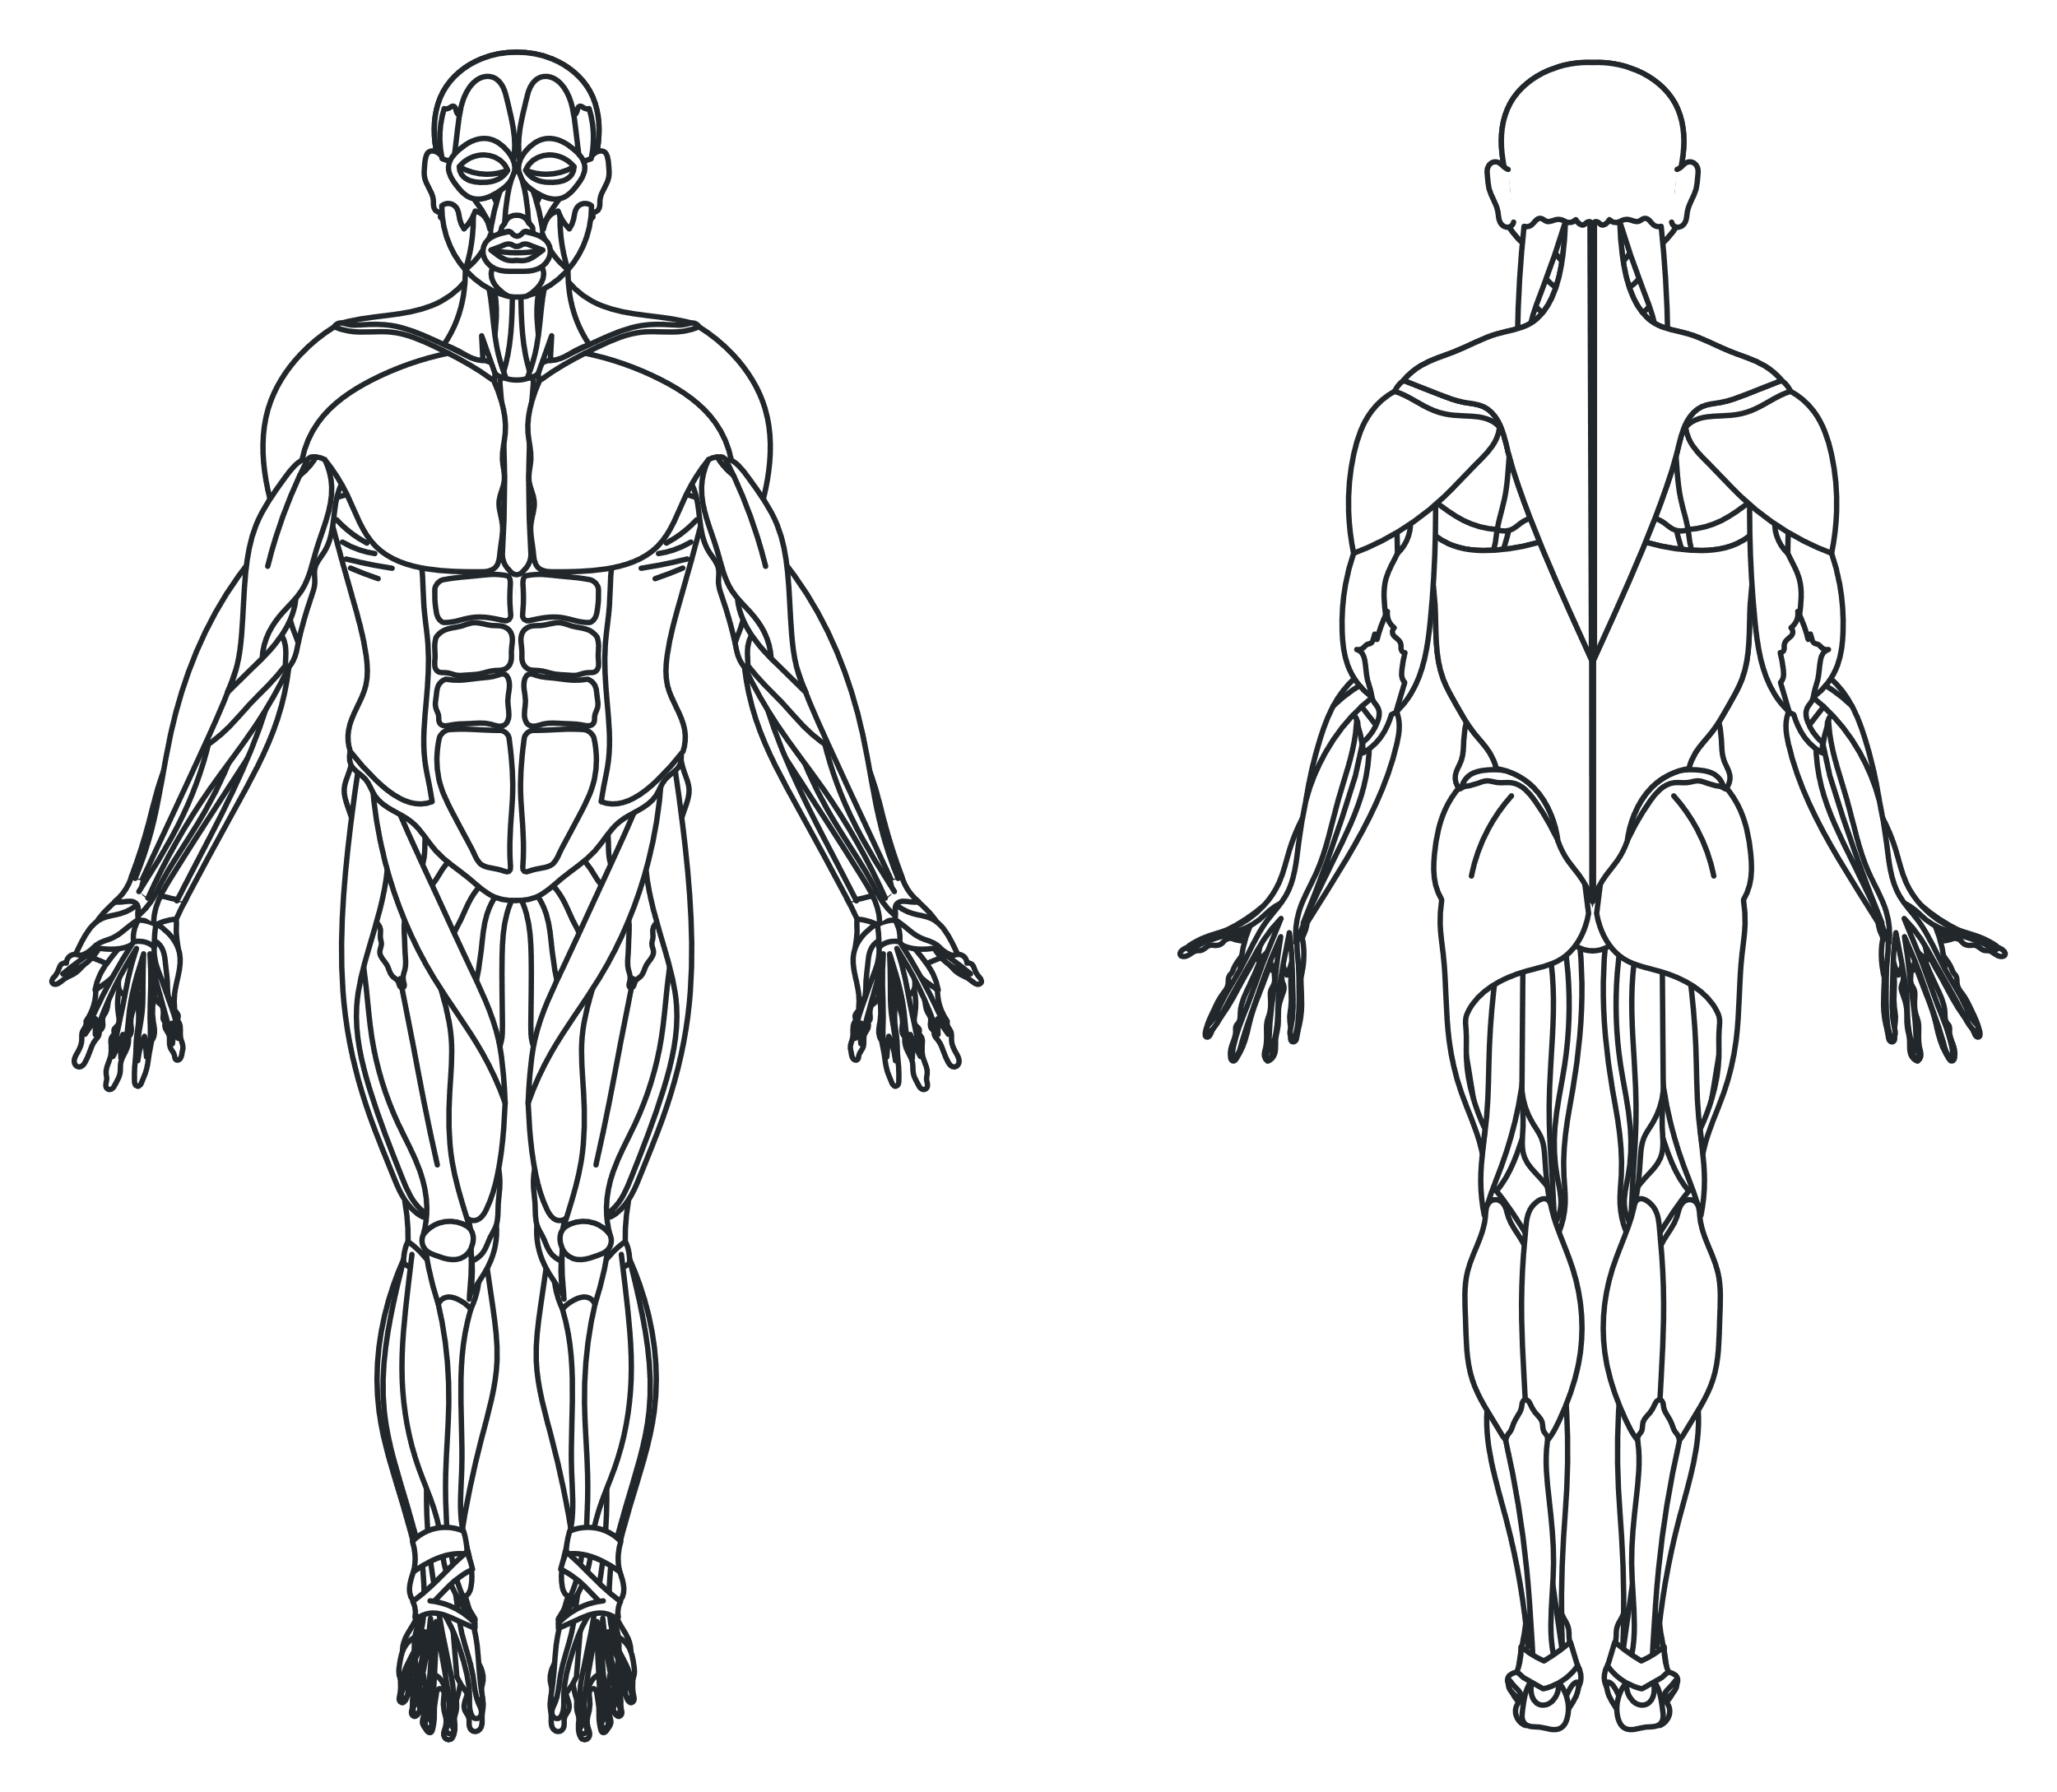
Muscles of the body
Trapezius
Things to know about the muscles and how they work:
Muscles work in pairs.
Muscles work by contracting and relaxing to cause movement.
Muscles are attached by tendons to bone at each end.
Deltoids
Rhomboids
Pectorals
Biceps
Triceps
Rectus abdominis
External obliques
Latissimus dorsi
Sartorius
Gluteus maximus
Quadriceps
Hamstrings
Gastrocnemius
Tibialis anterior
Soleus
Image adapted from 'Muscles front and back' by Wikimedia Commons is licensed under CC BY-SA 4.0.

Slide 50
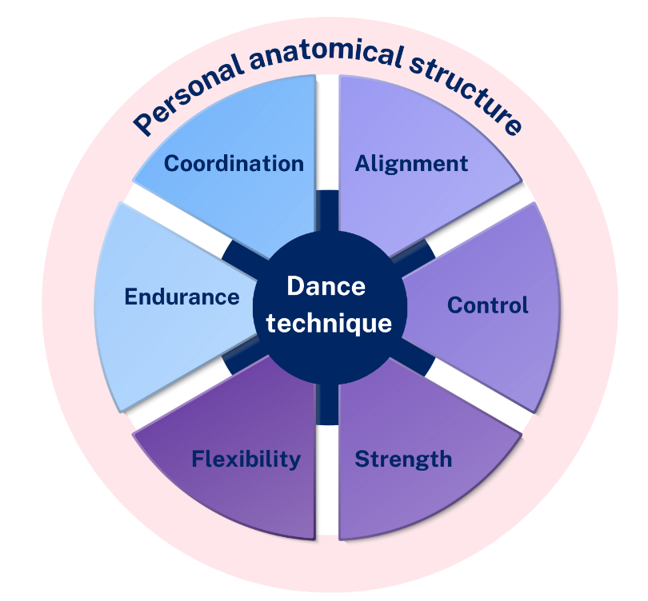
What does dance technique look like?
Dance technique is relative to personal anatomical structure showing the relationship between:
Alignment
Control
Strength
Flexibility
Endurance
Coordination

Slide 51
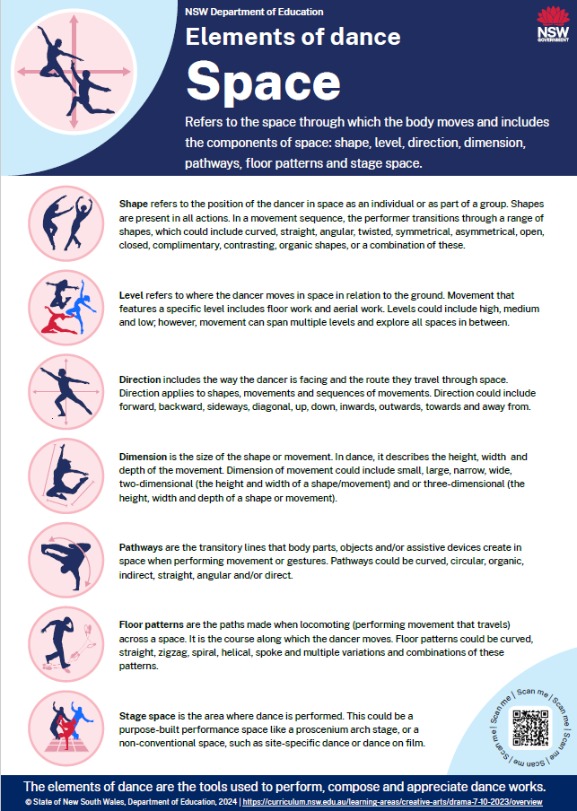
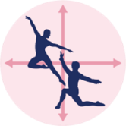
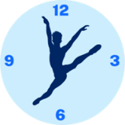

The elements of dance (1)
NESA defines the elements of dance as ‘the tools used to perform, compose and appreciate dance works in artistic, cultural, social and personal contexts.’
(NESA 2023)
Space
Where you are moving
Time
When you are moving
Dynamics
How you are moving
Notes:
Teachers can download the Elements of dance posters from the Planning, programming and assessing in the creative arts website.

Slide 52
The elements of dance (2)
Space | Time | Dynamics
Read Elements of dance – definitions and examples (DOCX 3.62 KB).
Drag and drop words from the bank below into the correct categories.
Swap your table with another student and compare your responses.
Rhythm
Level
Stillness
Direction
Pathway
Accent
Metre
Stage space
Duration
Dimension
Tempo
Shape
Weight and/or force
Release of energy
Movement qualities
Floor pattern
Notes:
This slide can be printed and completed as a worksheet.

Slide 53
What is performance quality?
In other words, using performance quality helps the dancer to:
look like they know what they are doing
have ownership of the movement
create clear shapes and lines with their body
communicate the choreographer’s intent.
NESA defines performance quality as ‘the dancer’s skill in applying projection, focus, musicality, quality of line, kinaesthetic awareness, commitment and confidence in order to communicate the desired intent.’
(NESA 2023)

Slide 54
Kinaesthetic awareness
NESA defines kinaesthetic awareness as ‘sensing or perceiving the body’s muscles, joints and tendons while in motion or while still.’
(NESA 2023)
Kinaesthetic awareness allows the dancer to use their understanding of dance technique and alignment to place their body in shapes and movements that communicate the intent.
By becoming aware of your body parts, you can control the movement you are executing.

Slide 55
Musicality
Musicality could include:
how dancers hear, interpret, and dance to music
how dancers create an emotional connection to the music with their movement
the relationship with music, movement and the element of time
the relationship with time which then influences the dynamics of the movement.
‘Jazz dance is known for its emphasis on rhythm and musicality… This musicality is an essential aspect of jazz dance and requires a keen sense of timing and precision.’
(Art & Dance Studio 2023)

Slide 56
Commitment and confidence
Activity discussion
Commitment is about being dedicated to something.
Discuss:
What does it look like when a dancer is not committed or lacking confidence?
How does this affect the different aspects of performance quality?
How does this affect the dance technique?
How does it affect the communication of meaning?
Confidence refers to the ability to feel assured of your strengths, abilities and value.

Slide 57
Projection and focus
Projection can be described as a confident presentation of one’s body and energy to communicate movement and meaning to an audience.
Possible examples of projection:
external – open shapes and energy outwards of the body
internal – closed-in shapes with energy in towards the body.
Focus can be described as the purposeful gaze and direction of the eye line of the dancer to communicate meaning.
Possible examples of focus:
towards or away from the direction the dancer is travelling
following gesturing limbs such as the hands
upwards to the sky, downwards to the earth.

Slide 58
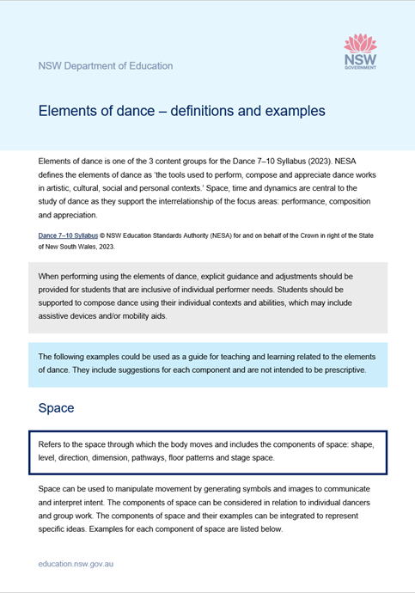
The elements of dance – definitions and examples
The Elements of dance – definitions and examples resource can be used to support this unit and provide guidance for language to describe the elements of dance.

Slide 59
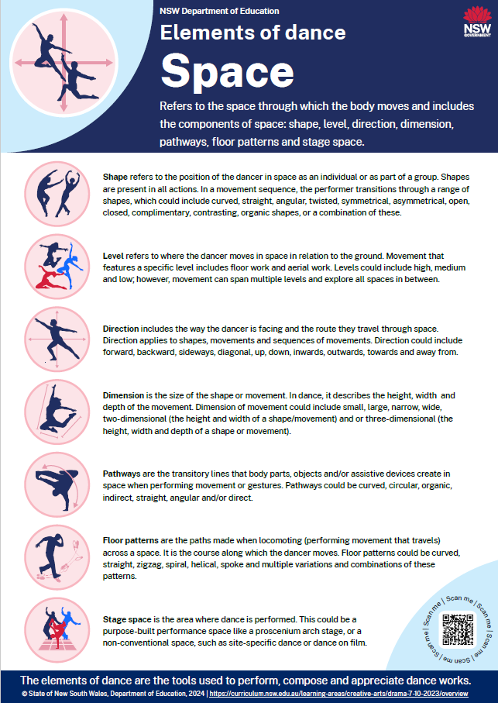
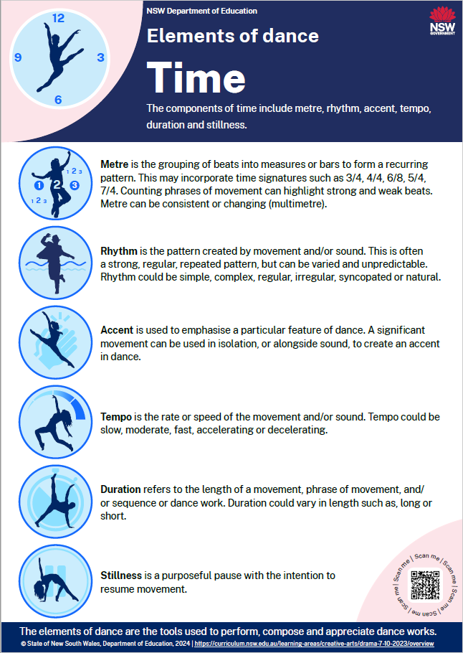
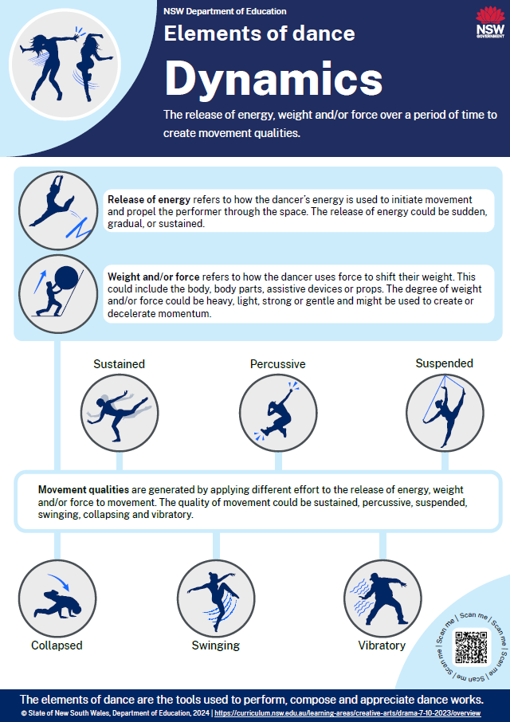
The elements of dance – posters

Slide 60
References
This presentation contains NSW Curriculum and syllabus content. The NSW Curriculum is developed by the NSW Education Standards Authority. This content is prepared by NESA for and on behalf of the Crown in the right of the State of New South Wales. The material is protected by Crown copyright.
Please refer to the NESA Copyright Disclaimer for more information https://educationstandards.nsw.edu.au/wps/portal/nesa/mini-footer/copyright.
NESA holds the only official and up-to-date versions of the NSW Curriculum and syllabus documents. Please visit the NSW Education Standards Authority (NESA) website https://educationstandards.nsw.edu.au/wps/portal/nesa/home and the NSW Curriculum website https://curriculum.nsw.edu.au.
Dance 7–10 Syllabus © NSW Education Standards Authority (NESA) for and on behalf of the Crown in right of the State of New South Wales, 2023.
Anatomy and Physiology (2012) Axial and Appendicular Skeleton [image] accessed 18 July 2024.
Atlantic Records, (23 April 2021), In The Heights - from the Official Motion Picture Soundtrack (Official Audio) – YouTube, [video], Atlantic Records, YouTube, accessed 02/06/2025.
Atlantic Records (12 January 2018), The Greatest Showman Cast - This Is Me (Official Lyric Video) [video], Atlantic Records, YouTube, accessed 02/06/2025.
Atlantic Records, (27 October 2017), The Greatest Showman Soundtrack - YouTube [video], Atlantic Records, YouTube, accessed 02/06/2025.
Hazique Zairill, (07 July 2022), Musical theatre’s history and timeline [website], The Sun, accessed 02/06/2025.
Mary Nikitina (2021) Ballerinas dancing under lamps during class in hall [image] accessed 18 July 2024.
Netflix Philippines, (5 January 2023), Revolting Children | Roald Dahl’s Matilda the Musical | Netflix Philippines [video], Netflix Philippines, YouTube, accessed 02/06/2025.
Netflix, (14 October 2022), Roald Dahl’s Matilda the Musical | Official Trailer | Netflix , [video], Netflix, YouTube, accessed 02/06/2025.

Slide 61
References (2)
Netflix, (23 October 2020), The Prom | Official Teaser Trailer | Netflix - YouTube , [video], Netflix, YouTube, accessed 11/06/2025.
Netflix, (12 December 2020), You Happened - Full Promposal Performance feat. Jo Ellen Pellman + Ariana Debose | The Prom - YouTube, [video], Netflix, YouTube, accessed 11/06/2025.
Movieclips, (2 March 2025), Wicked (2024) 4K - One Short Day (Idina Menzel & Kristen Chenoweth Cameo) | Movieclips [video], Movieclips, YouTube, accessed 02/06/2025.
Original Soundtrack (3 December 2020), The Prom (Soundtrack) [video], Original Soundtrack, YouTube, Accessed 11/06/2025.
Republic Records, (22 November 2024), Wicked The Soundtrack – YouTube [video], Republic Records, YouTube, accessed 02/06/2025.
Roadshow Films, (26 July 2021), In The Heights - 96,000 Sing Along [video], Roadshow Films, YouTube, accessed 02/06/2025.
Rylee Vogel, (date unknown) A Brief History of Musical Theater - Wenger | J.R. Clancy [website], Wenger Corporation, accessed 02/06/2025.
Stacy Karyn, (21 September 2022), Musical Theatre Time Periods - A Full Breakdown | Theatre Trip [website], Theatre Trip , accessed 02/06/2025.
SonySoundtracksVEVO, (2 December 2022), Roald Dahl's Matilda The Musical (Soundtrack from the Netflix Film) – YouTube [video], Atlantic Records, YouTube, accessed 02/06/2025.
Toxigon (30 September 2024), The Evolution of Musical Theater: A Journey Through Time [website] , Toxigon infinite, accessed 02/06/2025.
Theatre matters, (2 September 2023), One Short Day - Wicked (Australian Cast) [video], Theatre Matters, YouTube, accessed 02/06/2025.

Slide 62
References (3)
Universal Pictures, (16 May 2024), Wicked - Official Trailer [video], Universal Pictures, YouTube, accessed 02/06/2025.
Untold History (10 March 2021), Musical Theatre: From Athens to Broadway [video], Untold History, YouTube, accessed 02/06/2025.
Warr, A (2024) On Broadway [image] Central Coast musical theatre ensemble, The Arts Unit, State Dance Festival, accessed 10/06/2025.
What’s After The Movie, (date unknown), The Greatest Showman (2017) - Movie Summary, Ending Explained & Themes, [website], What's After the Movie 2025, accessed 02/06/2025.
What’s After The Movie, (date unknown), In the Heights (2021) - Movie Summary, Ending Explained & Themes, [website], What's After the Movie 2025, accessed 02/06/2025.
What’s After The Movie, (date unknown), Roald Dahl's Matilda The Musical (2022) - Movie Summary, Ending Explained & Themes, [website], What's After the Movie 2025, accessed 02/06/2025.
What’s After The Movie, (date unknown), The Prom (2020) - Movie Summary, Ending Explained & Themes | What's After the Movie 2025, [website], What's After the Movie 2025, accessed 11/06/2025.
What’s After The Movie, (date unknown), Wicked (2024) - Movie Summary, Ending Explained & Themes, [website], What's After the Movie 2025, accessed 02/06/2025.
Wikimedia Commons (2007) Types of synovial joints [image] accessed 18 July 2024.
Wikimedia Commons (2020) Muscles front and back [image] accessed 18 July 2024.
20th Century Studios UK, (28 June 2017), The Greatest Showman | Official HD Trailer #1 | 2017 [video], 20th Century Studios UK, YouTube, accessed 02/06/2025

Slide 63
Copyright
© State of New South Wales (Department of Education), 2025
The copyright material published in this resource is subject to the Copyright Act 1968 (Cth) and is owned by the NSW Department of Education or, where indicated, by a party other than the NSW Department of Education (third-party material).
Copyright material available in this resource and owned by the NSW Department of Education is licensed under a Creative Commons Attribution 4.0 International (CC BY 4.0) license.
This license allows you to share and adapt the material for any purpose, even commercially.
Attribution should be given to © State of New South Wales (Department of Education), 2025.
Material in this resource not available under a Creative Commons license:
the NSW Department of Education logo, other logos and trademark-protected material
Material owned by a third party that has been reproduced with permission. You will need to obtain permission from the third party to reuse its material.
Links to third-party material and websites
Please note that the provided (reading/viewing material/list/links/texts) are a suggestion only and implies no endorsement, by the New South Wales Department of Education, of any author, publisher, or book title. School principals and teachers are best placed to assess the suitability of resources that would complement the curriculum and reflect the needs and interests of their students.
If you use the links provided in this document to access a third-party’s website, you acknowledge that the terms of use, including licence terms set out on the third-party’s website apply to the use which may be made of the materials on that third-party website or where permitted by the Copyright Act 1968 (Cth). The department accepts no responsibility for content on third-party websites.

