Slide 1
Instructions for use
This resource is not a teaching and learning program. It should be used in conjunction with the visual arts Stage 4 sample unit 'EAT! Exploring Artistic Tastes' and the EAT! Exploring Artistic Tastes assessment task, available on the Planning, programming and assessing visual arts 7–10 webpage. Classroom teachers are encouraged to add and adapt slides as required to meet the needs of their students.
Save a copy of the file to make changes to the slide deck. Go to File > Download a Copy (this downloads a copy to the computer to edit in the PowerPoint app).
To convert the PowerPoint to Google Slides:
  Upload the file into Google Drive and open it.
  Go to File > Save as Google Slides.
  (Note – conversion may cause formatting changes in the slides.)

Slide 2
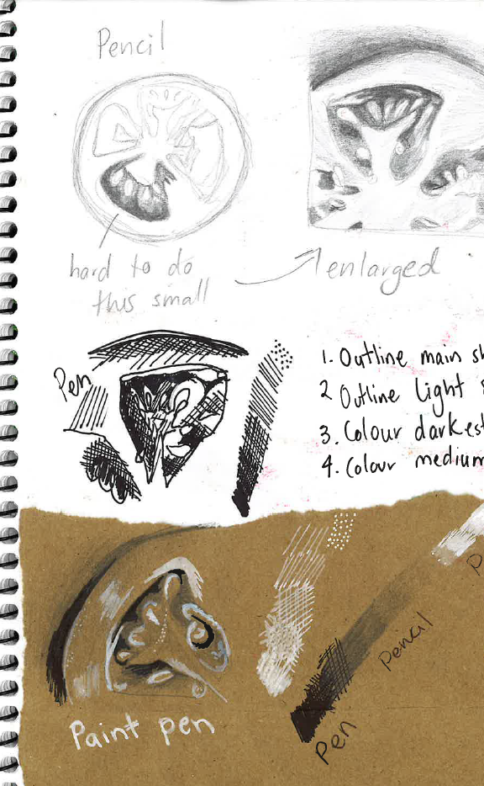
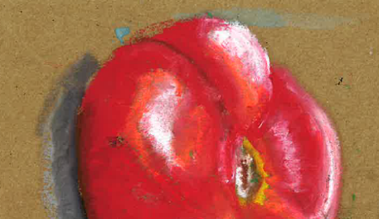
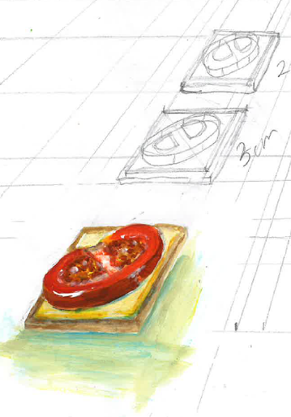
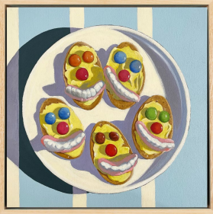
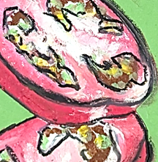
EAT!
Exploring Artistic Tastes
Visual arts – Stage 4

Slide 3
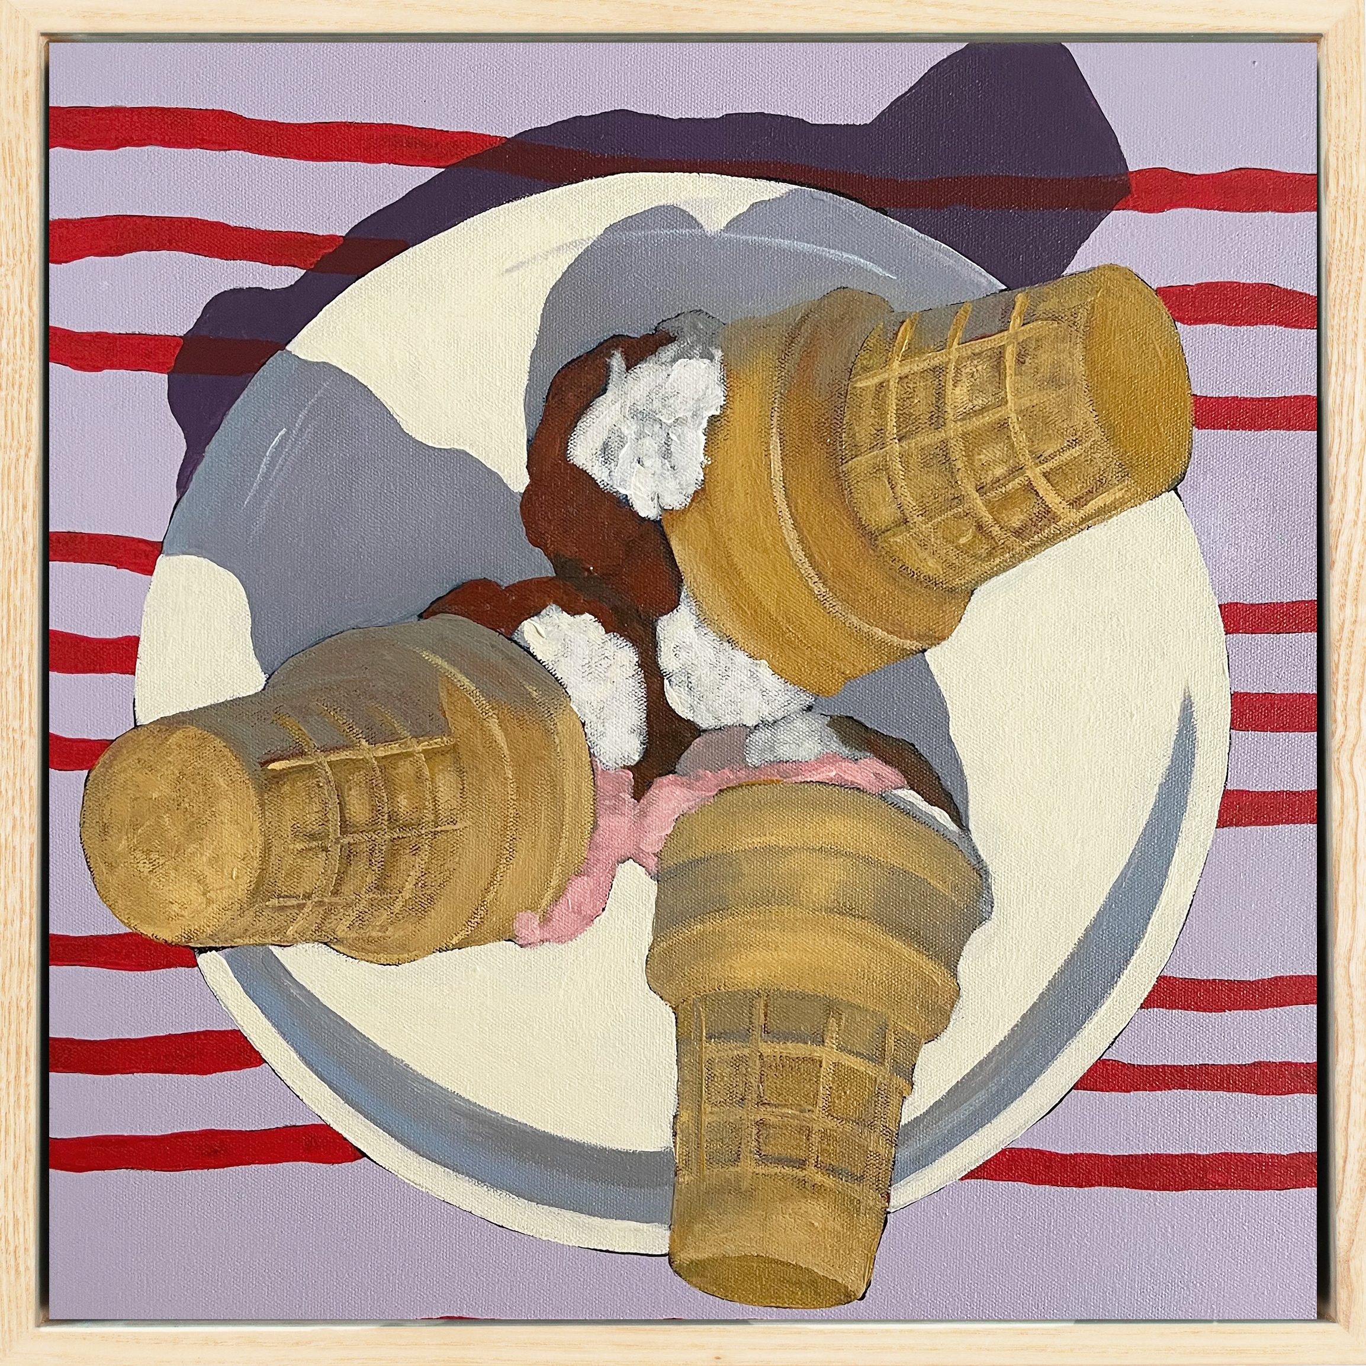
Learning sequences
1
Communicate as an artist
2
Jo White case study
3
Wayne Thiebaud case study
4
Ron Magnes case study
5
Adopt the role of the artist
'Neapolitan, 2022 distribution permissions for Secondary Curriculum, Curriculum and Reform Directorate of NSW Department of Education, granted by © Jo White, 2025.
Notes:
Teacher notes:
Click lesson numbers to go to specific lessons
Interactive features can be viewed in slide show

Slide 4
Learning sequence 1:
Communicate as an artist

Slide 5
LS 1: Learning intentions and success criteria
We are learning to:
explore the world, including our personal experiences within it, as a source of ideas for artmaking
explore how the elements of art can communicate ideas in drawings
investigate how artworks can reflect social values and share cultural experiences.
I can:
consider and document personal experiences related to food
describe components of an artwork and consider how they communicate ideas about the artist’s values and beliefs
use subject-specific language and drawing techniques to represent ideas about food.
Notes:
Notes for teachers:
Learning intentions and success criteria are carefully designed using syllabus outcomes and content
For more information See ⁠AITSL or the NSW Department of Education explicit teaching strategies, ⁠Sharing learning intentions and ⁠Sharing success criteria
LISC should be revisited during the lesson to support students' evaluation of their learning

Slide 6
Message sent
…
1.1(a)
When you share your ideas with someone, what clues help them recognise that the message is coming from you?
Consider the way you speak, write, or express yourself in different situations.
What makes your communication unique to you?
How do artists communicate
their ideas?
Notes:
Question: When you share your ideas with someone, what clues help them recognise that the message is coming from you? Consider the way you speak, write, or express yourself in different situations. What makes your communication unique to you?
Possible answers: your face, sound of your voice, your name, profile picture, sign off on an email, your phone number.
Click to reveal – how do artists communicate their ideas?
Possible answers: subject matter, choice of material.

Slide 7
Message received
1.1(b)
How do you know who is talking to you if:
you’re on a call?
you’re online?
you’re in person
What choices can artists make to tell their story?
Notes:
Question: When someone is communicating with you, how do you recognise who they are? What signals or clues make their communication distinct?
Possible answers: think about their voice, writing style, body language, or other unique characteristics that help you identify them.
Click to reveal – What choices can artists make to tell their story?
Possible answers: subject matter, choice of material.

Slide 8
Who’s this?
Artists communicate ideas
with the audience using a visual language
1.1(c)
How do you know who is talking to you
when you are in person?
when you are online?
when you are on a voice-only call?
Visual language is the codes, symbols and techniques that communicate ideas and meaning. It can also help the audience identify who the artist is through the subject matter, materials and techniques they use.
Notes:
Question: When you want to communicate your ideas to someone else, how do they know its you?
Possible answers: your face, sound of your voice, your name, profile picture, sign off on an email, your phone number.
Click to reveal – Artists communicate ideas with the audience using a visual language.
Click to reveal – Visual language is the codes, symbols and techniques that communicate ideas and meaning. It can also help the audience identify who the artist is through the subject matter, materials and techniques they use.
You could share examples of artworks students might be familiar with such as Starry night by Vincent van Gogh and Mona Lisa by Da Vinci.

Slide 9
Adopt the role of the artist
1.1(d)
This course aims to develop your knowledge, understanding and skills in visual arts to be able to:
communicate like an artist
interpret ideas and
meaning in artworks.
In this unit you will start exploring ways other artists communicate ideas and meaning to help you develop your own visual language to share your ideas.

Slide 10
Find my match
1.1(e)
3 different artists made these artworks, can you find the pairs that were made by the same artist?
A
B
C
D
E
F
Women Collecting Wild Bush Fruits by Marie Ryder, 2024
Sushi on blue by Ron Magnes, 2019
Tokyo sausage roll by Jo White, 2024
Women Gathering Edible Mistletoe, Wild Figs and Honey Ants by Marie Ryder, 2025
Agro – aggressive, mad by Jo White, 2024
French fries on blue by Ron Magnes, 2019
Notes:
Teacher slide instructions: copy and paste the 6 images on the slide for students
Tell students that visual language is the artists unique voice, each one has their own characteristics that makes them identifiable.
What characteristics in the artworks helped you work out which artworks were made by the same person? Consider codes, symbols and techniques, subject matter, materials and techniques.
Answers:
A and D
B and F
C and E
Image references
A- Marie Ryder (2024) Women collecting bush fruits [image] accessed 28/3/2025.
B - Ron Magnes (2019) Sushi on blue [image] accessed 28/3/2025.
C - Michael Reid Murrurundi (2022) Jo White Tuckshop catalogue [pdf] accessed 28/3/2025.
D - Marie Ryder (2024) Women Gathering Edible Mistletoe, Wild Figs and Honey Ants by Marie Ryder, 2025 [image] accessed 29/1/2026.
E- Michael Reid Murrurundi (2022) Jo White Tuckshop catalogue [pdf] accessed 28/3/2025.
F - Ron Magnes (2019) French fries on blue [image] accessed 28/3/2025.

Slide 11
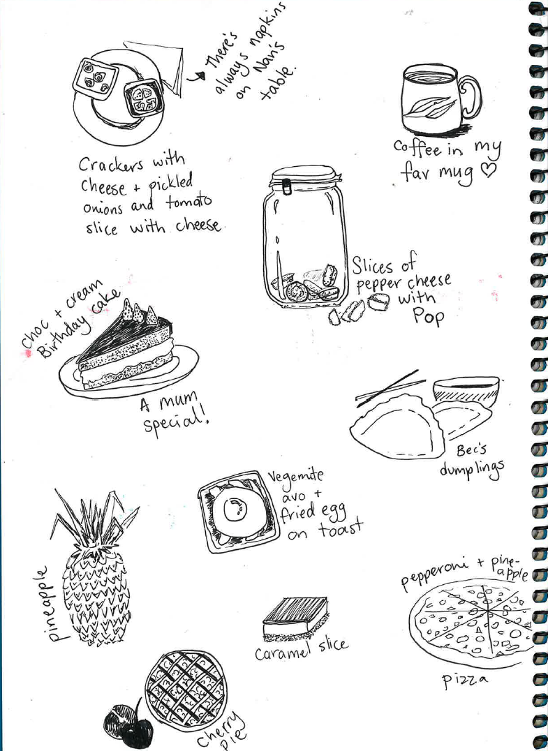
Don’t tell me, show me!
1.1(f)
Don’t think too hard, quick sketch foods that you:
enjoy as a treat
can make/cook for yourself
love, that someone you know is really good at making
almost always have when visiting a relative
would share at an event with your friends or family
What traditions do you associate with food?
Notes:
Question: what kinds of events bring your family together to share food?
Possible answers: birthday, new years eve, religious or cultural days.
Question: are there traditions that go with the food?
Possible answers: singing happy birthday and blowing out candles, slow cookers lining the bench full of curries for Eid, gifting others sweet treats, assembling gingerbread houses and decorating them with lollies.

Slide 12
Introducing Culture
1.2
Culture is the customs, habits, beliefs/spirituality, social organisation and ways of life that characterise different groups and communities.
Cultural characteristics give a group or individual a sense of who they are and help them make sense of the world in which they live.
Culture is a shared system but inherently diverse – there can be individual and group differences within cultures.
Everyone has culture – it is a lens through which we see the world.
Can you think of an example of how food can represent culture?

Slide 13
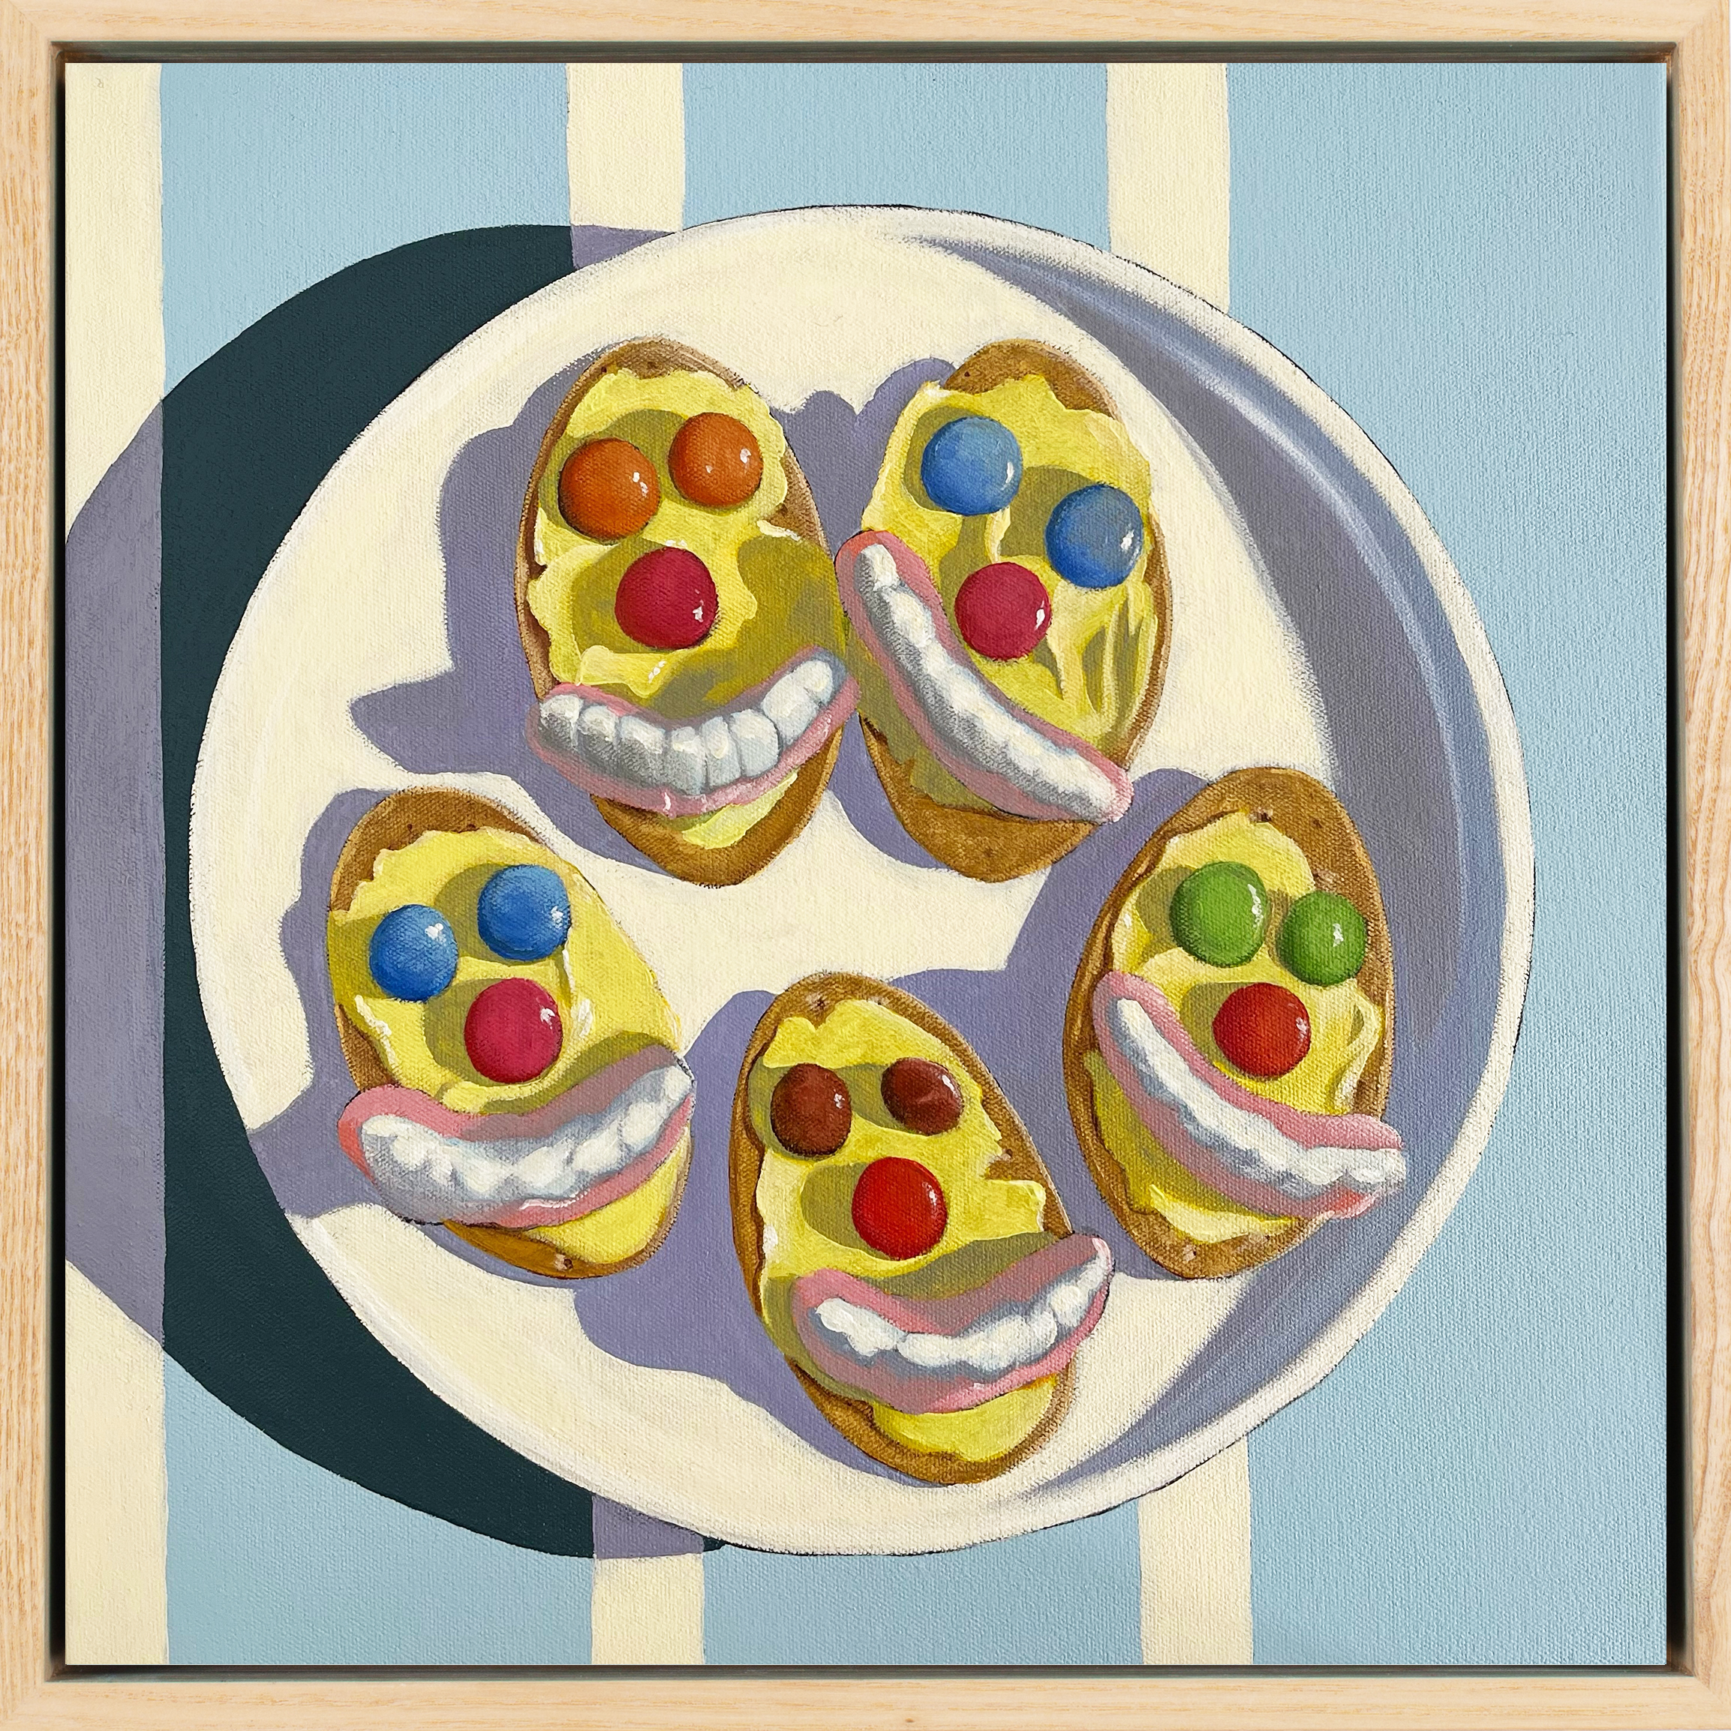
The art of looking closely
1.3 What is communicated about Jo White’s culture?
Sketch this artwork in your visual arts diary
Describe the key features you can see
Explain what idea the key feature represents
Explain what the features tells you about the artists culture (values/customs/ways of life)
Iced Bickies, 2022, Acrylic on canvas, 30 x 30 cm
Iced Bickies, 2022, distribution permissions for Secondary Curriculum, Curriculum Directorate of NSW Department of Education, granted by © Jo White, 2025.
Notes:
Possible answers:
I can see 5 iced funny face biscuits; this could represent a plate of food that is intended to be shared and highlights socialising with food is important in Jo White’s culture.
I can see silly faces made with lollies, this could represent a sense of humour, the people who eat this food possibly don’t take themselves too seriously.
I can see bright light and contrasting shadows, this could represent an outdoor sunny environment. It reminds me of a party at a park.

Slide 14
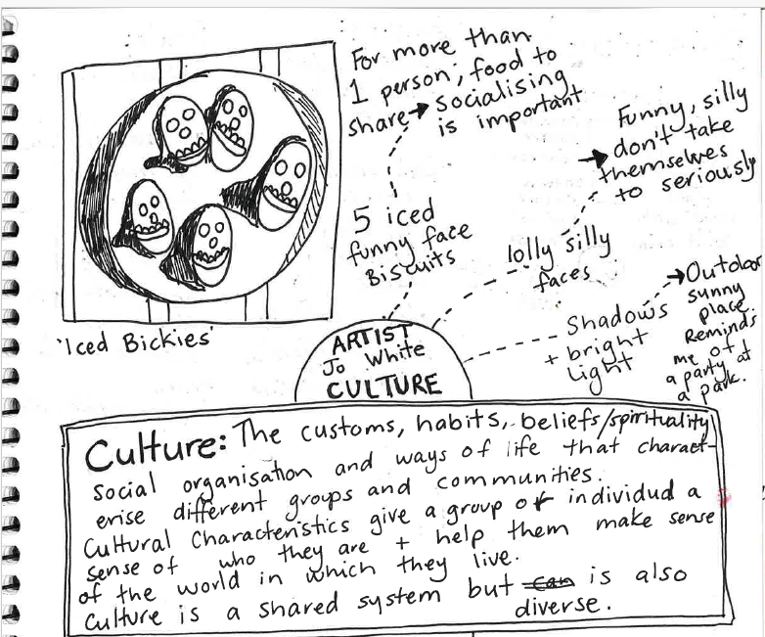
Sample diary page - Iced bickies
1.3(a)
Inference table
Key features | This represents… | What it says about the artist’s culture
5 iced biscuits | a plate of food that is intended to be shared | socialising important
Silly faces made with lollies | a sense of humour child-like fun party food | people who eat this food don’t take themselves too seriously
bright light and contrasting shadows | an outdoor sunny environment | She socialises outdoors, a connection to nature

Slide 15
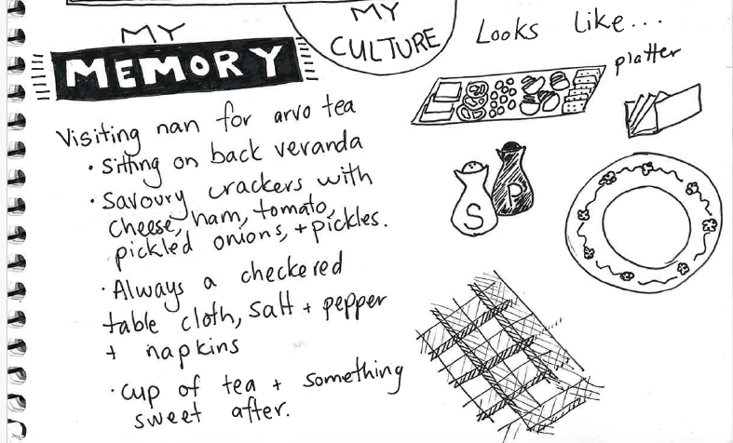

Remember when…
1.4(a)
Recall a time when you were visiting a relative or friend and you were given something to eat or drink.
Record it in your Visual arts diary
Notes:
Ask students to visualise how the food or drink is presented. Is it on a plate, in a bowl or cup? What else might be on the table/in the area you share the food/drink – utensils, cushions, rug, tablecloth, napkins, seasonings?

Slide 16
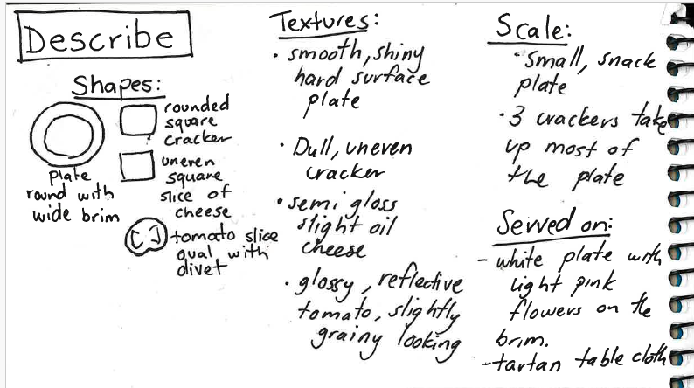
Remember when…
1.4(b)
Make a list of each item from the memory.
Sketch each item and label them with words to describe their shape and texture
16

Slide 17
Pair – share – compare
1.4(c)
1
2
3
Pair up with a peer and describe the food from your memory without sharing your sketch.
Take turns sketching what you imagine is being described.
Compare your representations.
Why are they different?

Slide 18
Vocabulary
1.4(d)
Shapes | Texture | Scale

Slide 19
Reflect on your learning
1.5
Let’s reflect on the success criteria ‘Use subject specific language to describe and draw shapes, textures and scale to represent ideas about food’ using the check lists below.
I have used visual language to represent:
shapes
textures
scale.
I have used words from the vocabulary list to describe the:
shapes
textures
scale.
Notes:
As a class, discuss the impact that specific language choices have on our understanding and interpretation of a memory or idea.

Slide 20
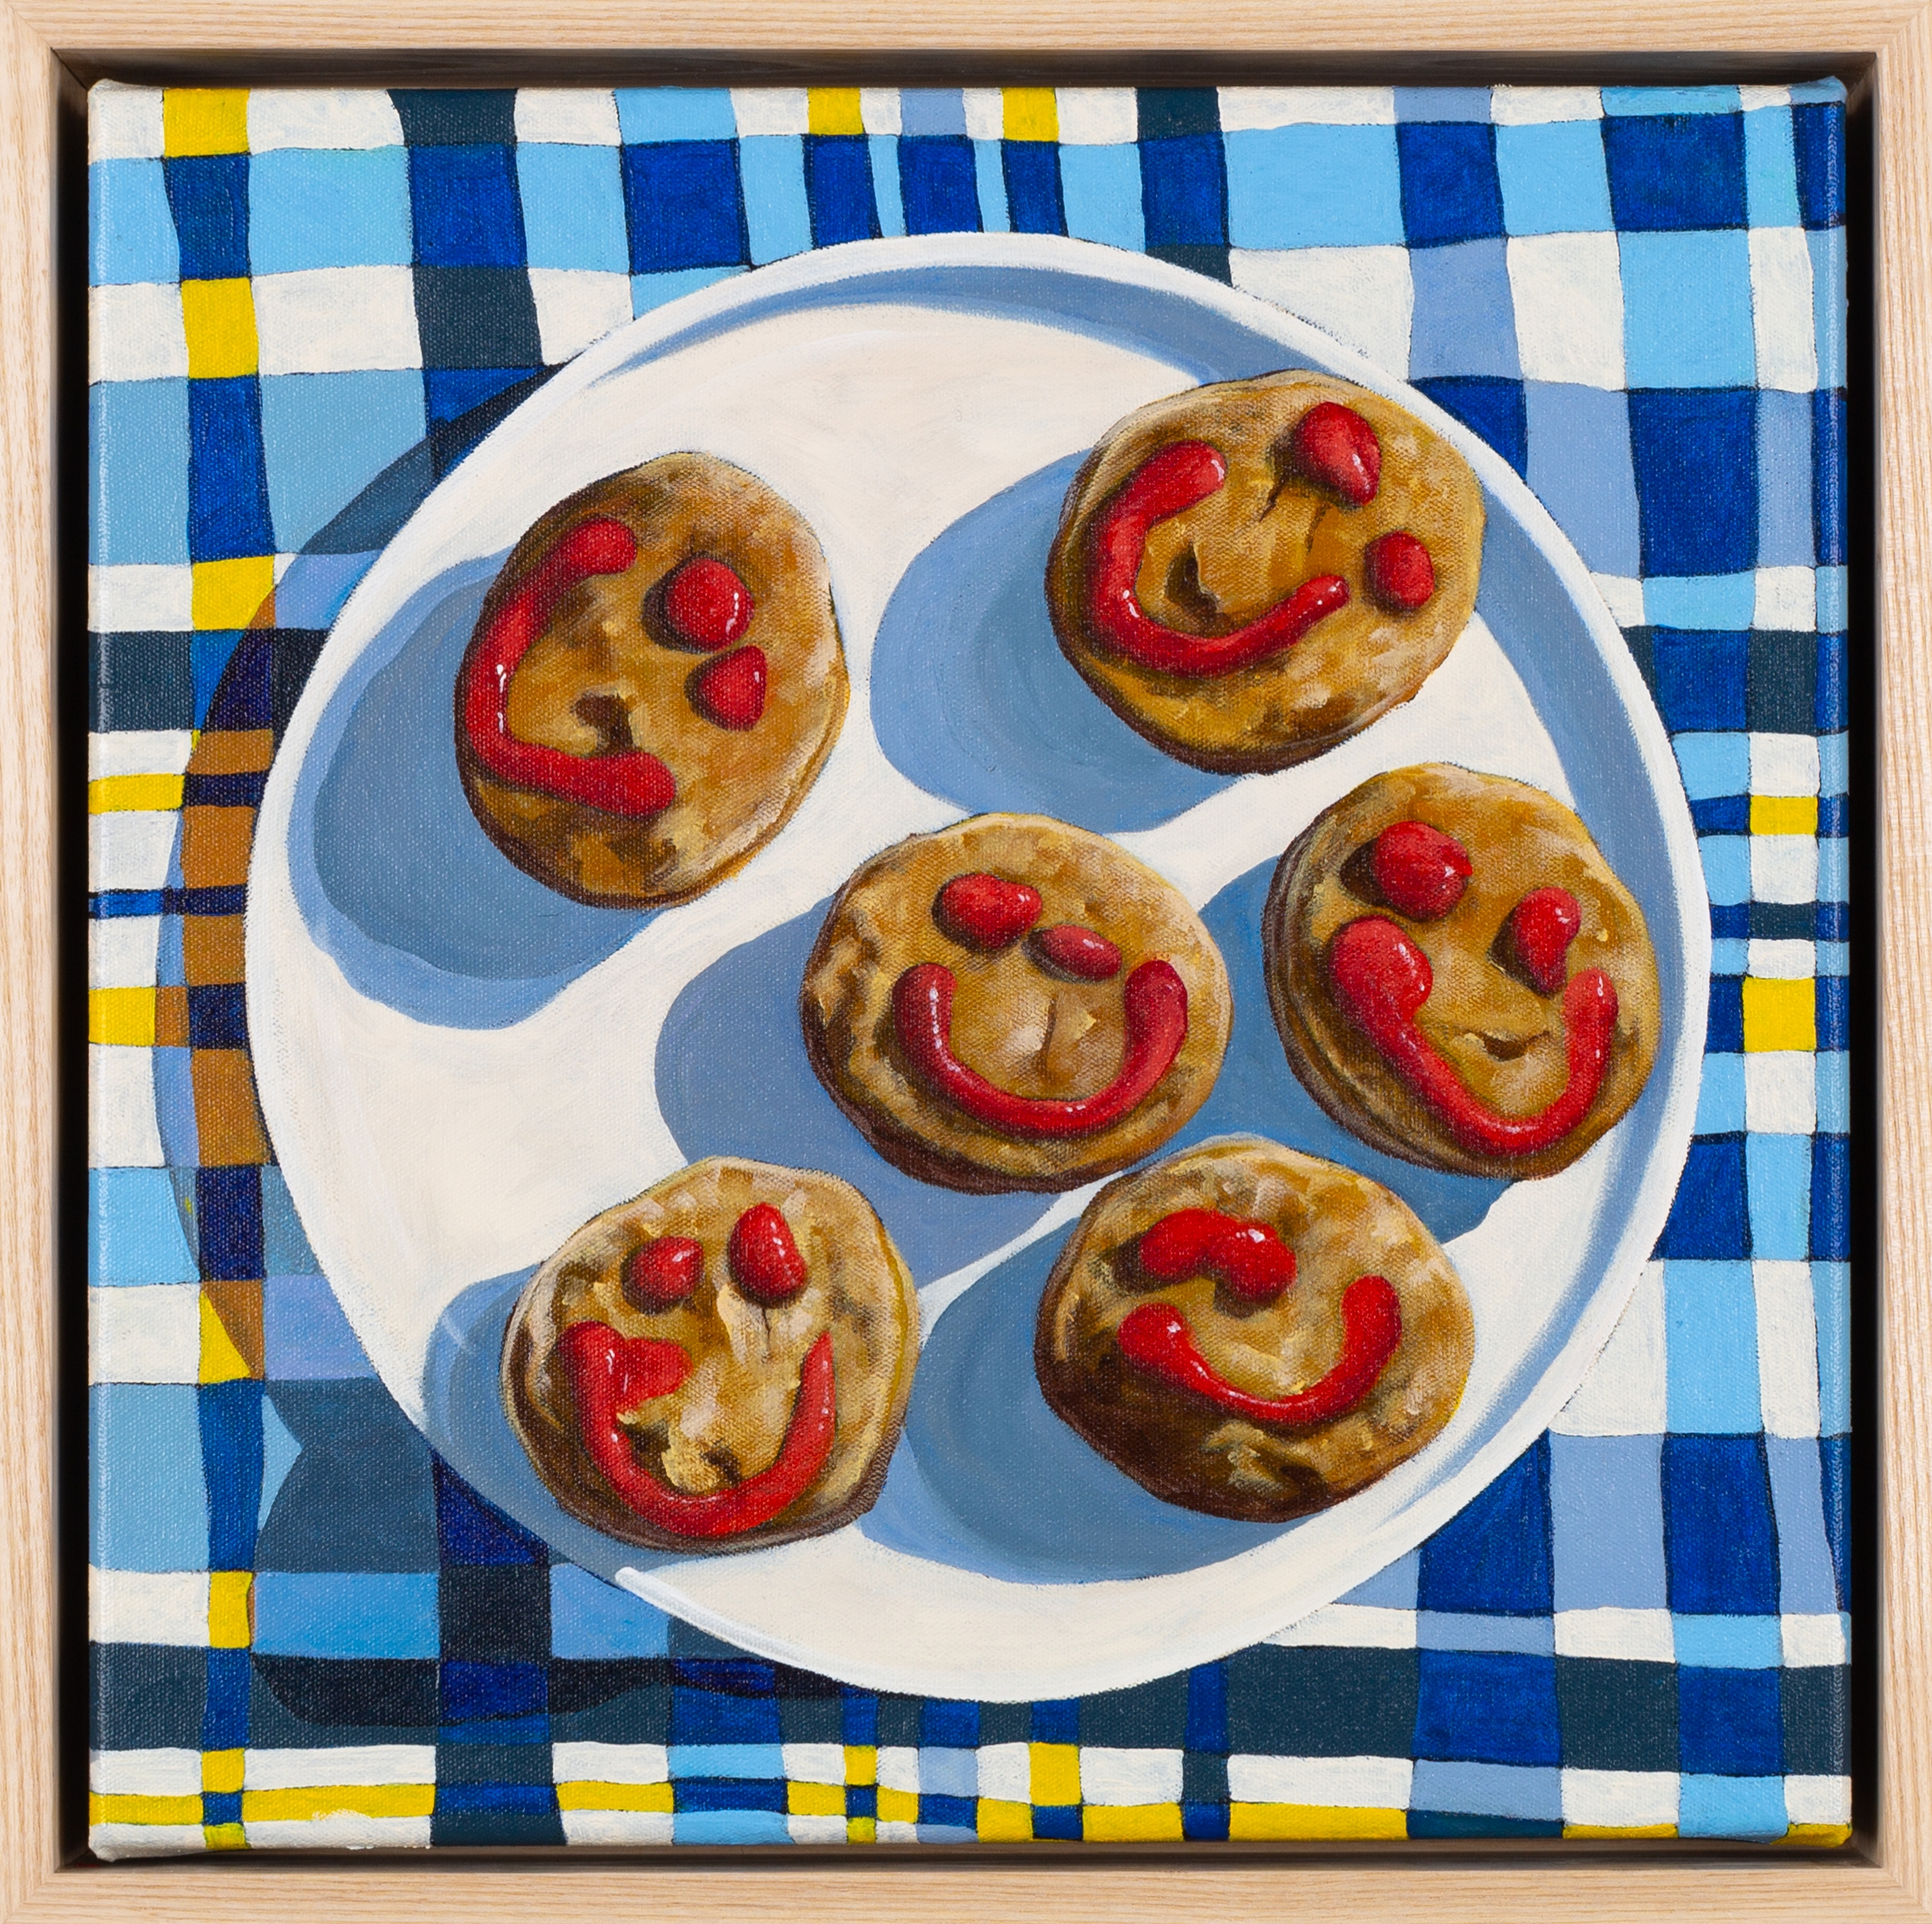
Learning sequence 2:
Jo White case study
Party Pies, 2022 distribution permissions for Secondary Curriculum, Curriculum Directorate of NSW Department of Education, granted by © Jo White, 2025.

Slide 21
LS 2: Learning intentions and success criteria
We are learning to:
identify symbols and interpret their meaning in artworks
identify and describe the artworld concepts in Jo White’s practice
identify and apply Jo White’s art making conventions in our own representations
experiment with and make choices about drawing materials and techniques.
I can:
explore and explain aspects of the artworld concepts in Jo White’s practice
explain how culture is represented in a Jo White artwork
adopt Jo White’s art making conventions to compose an artwork
apply, evaluate and refine drawing techniques.
Notes:
Notes for teachers:
Learning intentions and success criteria are carefully designed using syllabus outcomes and content
For more information See ⁠AITSL or the NSW Department of Education explicit teaching strategies, ⁠Sharing learning intentions and ⁠Sharing success criteria
LISC should be revisited during the lesson to support students' evaluation of their learning

Slide 22
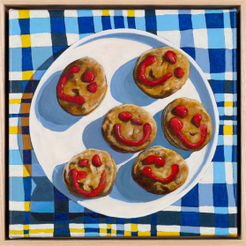
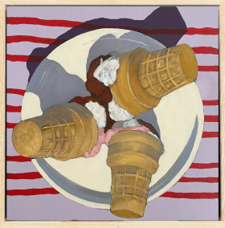
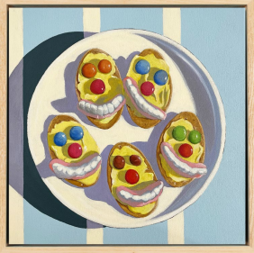
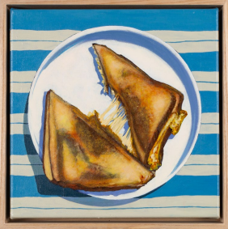
Spot the similarities
2.1
Image distribution permissions for Secondary Curriculum, Curriculum Directorate of NSW Department of Education, granted by © Jo White, 2025.
Notes:
Possible answers: round, plain white plates, repeated line patterned tablecloth, square canvas, multiple items on each plate, the same food with different shapes from one another, smiley faces (lollies and sauce), birds eye view, food items are not evenly spaced or centred, bright white light with high contrast shadows.
NESA definition of conventions: established rule, method or practice in the artworld that guides the making, presentation and interpretation of artworks.
Access the Jo White Tuckshop catalogue (link in references slide) and ask students to cross check if the conventions list they have created is largely accurate when considering a broader range of works from the same exhibition and artist. Refine the list of conventions.

Slide 23
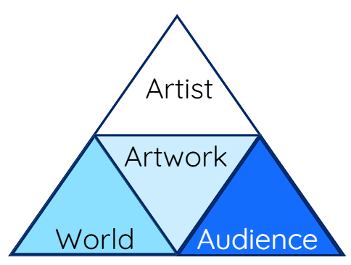
Artworld concepts
2.1(a)
The artworld concepts are:
artist
artwork
audience
world
Each concept has its own role in the artworld
There are relationships between each of the concepts.
Notes:
Possible answers:
Artist–world relationship:
The artist has experiences in the world that inform/inspire their art making practice.
The artist influences what happens in the world by sharing their ideas through artworks
Artist–artwork relationship:
The artist communicates their ideas through their artwork
Artworks are the product of an artist’s self expression
Artist–audience relationship:
The artist communicates their ideas to the audience (through the artwork)
Artwork–audience relationship:
The audience interpret the ideas and meaning of the artwork
Artworks can inform, challenge, remind audiences about ideas and experiences
Audience–world relationship:
Audience learn about the artist world at the time and place the artwork was created
The audience’s experience in the world shapes how they interpret the artwork

Slide 24
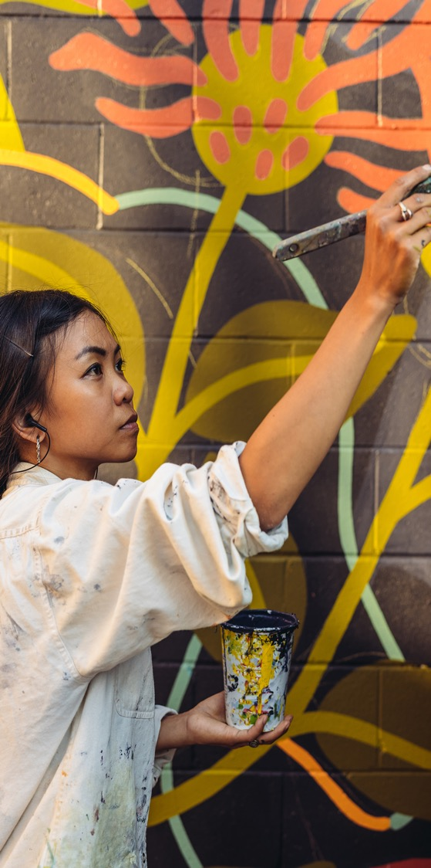
Artist
2.1(b) Artworld concepts
Artists create an intention, make choices and take actions to make artworks that communicate their ideas about the world to an audience.
Artist–artwork relationship
Artists communicate their ideas through visual/ multisensory language in the form of artworks.
Artist–world relationship
The world is a source of ideas for the artist.
The artist can influence ideas and actions in the world.
Artist–audience relationship
Artists communicate ideas to the audience through their artworks.

Slide 25
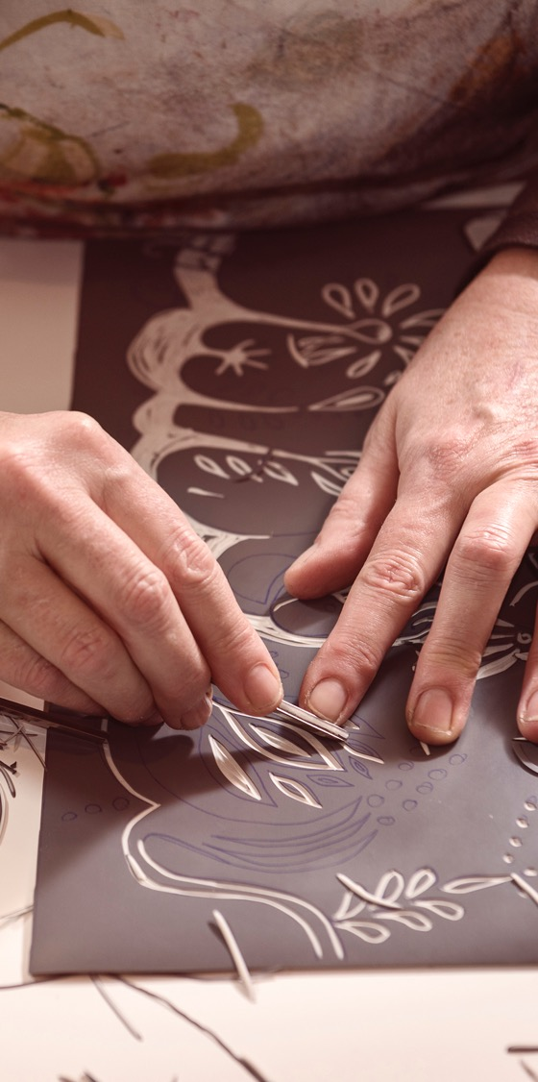
Artwork
2.1(c) Artworld concepts
Artworks can be 2D, 3D and or 4D artworks, artefacts, events and idea. They are intentionally conceived by artists to communicate ideas and/or create an experience for the audience.
Artwork–artist relationship
Artists communicate their ideas through visual/ multisensory language in the form of artworks
Artwork–world relationship
Artworks represent the ideas, conditions and events experienced in the world at particular times and places.
Artwork–audience relationship
Audiences interpret, interact with, discuss and ascribe meaning to artworks.

Slide 26
World
2.1(d) Artworld concepts
The world is a source of interests, ideas, conditions and events represented by artists in artworks. It can include a personal world, physical world, a spiritual world, technological world in different times, places and contexts.
Artist–world relationship
The world is a source of ideas for the artist.
The artist can influence ideas and actions in the world.
World–artwork relationship
Artworks represent the ideas, conditions and events experienced in the world at particular times and places
World–audience relationship
Audiences change over time and construct different meanings based on their beliefs and values.

Slide 27
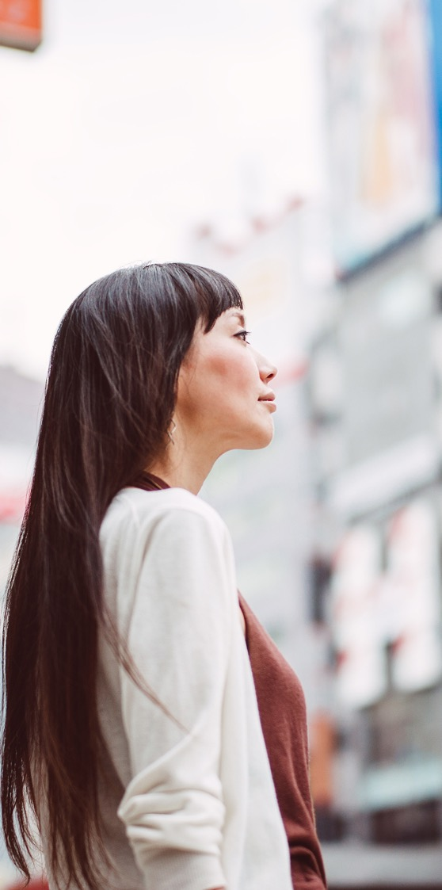
Audience
2.1(e) Artworld concepts
Audiences interpret the ideas, meaning and significance being communicated by the artist through artworks.
Audience–artist relationship
Artists communicate ideas to the audience through their artworks.
Audience–world relationship
Audiences change over time and construct different meanings based on their beliefs and values.
Audience–artwork relationship
Audiences interpret, interact with, discuss and ascribe meaning to artworks.

Slide 28
Artworld concepts through the cultural viewpoint
2.1(f)
 | Artist | Artwork | World | Audience
In the cultural viewpoint, | Artists are influenced by and contribute to the shared social understandings of a community. | Artworks reflect and represent social ideologies and values shaped by community beliefs and conditions. | The world influences artists to reflect on social, economic and political conditions. | Audiences interpret and value artworks informed by their social and community perspective.
Notes:
Possible examples:
An artist is influenced by a social event or issue in their community such as Harmony Day lunch at the local park and makes an artwork expressing their point of view about the event. The audience learn about the artist’s perspective and how much they value the cultural diversity of their local community and way their local community come together to share their food and time with one another. Audience members might be reminded of times they have shared food and time with others or be inspired to want to connect with more people in their local community.
Artists might be influenced by an environmental issue that impacts their local area such as rubbish in their creeks and waterways. They could make an artwork about the impact the rubbish is having on the local wildlife. This could inform the audience about the pollution and impact, and they might change the way they dispose of their rubbish to reduce the impact on the environment.

Slide 29
Jo White’s practice – Artworld concepts
2.1(g)
Artist
Artworks
Artist Jo White Contemporary Australian painter | Uses old photographs as a starting point for her paintings Creates acrylic paintings on canvas Subject matter includes references to everyday Australian objects, places, phrases and activities
Currently lives and works in Armidale, NSW Grew up in Coonamble, NSW on sheep and broad acre farms | Nostalgic and relatable subject matter for many Australian audience members who are reminded of their personal experiences and memories when viewing her work. Informs audience about rural and regional Australian culture
Subject-specific language
World
Audience
Notes:
Subject specific language could include: artist, artwork, audience, world, painting, influence, impact, Australian culture, subject matter, personal experience, nostalgic, humour, light-hearted

Slide 30
Artworld concepts response
2.1(h) Explain the relationships between Jo White, her artworks, her world and/or the audience
Acronym | Paragraph element | Description
P | Point | A topic sentence that states the key point you are making in this paragraph. Name the artist/artworks you will refer to Identify the artworld concepts you will explore and how they influence one another
E | Explain | Describe specific features of Jo white’s practice related to each artworld concept Explain the relationship between the artworld concepts Hint: remember relationships are 2-way transactions, think about what each concept ‘gives’ and ‘receives’ from the other concepts
E | Evidence | Use the evidence provided on the previous slide, and specific references to artworks to explain your interpretation of the relationships between artworld concepts
L | Link | Summarise how the evidence you have used proves the point you raised in the topic sentence.

Slide 31
Artworld concepts response 2
2.1(i) Explain the relationships between Jo White, her artworks, her world and/or the audience
Acronym | Example
P
E
E
L

Slide 32
Sample artworld concepts response
2.1(j) Explain the relationships between Jo White, her artworks, her world and/or the audience
Acronym | Example
P | Jo White’s connection to her world is shaped by her rural upbringing and involvement with regional Australian culture. Growing up in Coonamble, NSW, on large sheep farms, she learned to appreciate the simple moments and things that make country life unique. Her paintings reflect and celebrate aspects of rural Australian identity.
E | An example of this connection to her world is evident in her painting Cupcakes, which shows a nostalgic reference to the tradition of home baking. The painting captures the fun associated with baking and decorating cupcakes, which many Australians can relate to, especially those from country towns. Homemade treats remind us of community gatherings, school events, and family celebrations.
E | This artwork highlights White’s skill in turning everyday subjects into meaningful art. She reminds her audience of lively party decorations, with soft pink, buttery icing contrasting with turquoise stripes on a well-used cotton tablecloth. The painting reflects her personal memories and the experiences of many Australians, especially those who spent time flipping through the Women's Weekly Birthday Cake book when preparing for birthdays.
L | By using old photographs in her art, White connects to the past, and as a result, her audience is reminded of their own memories and nostalgic thoughts of Australian culture. Cupcakes is more than just a picture of baked goods; it celebrates the warmth, hospitality, and comforts of country life. Through this artwork, White emphasises the cultural importance of these simple moments for herself and her audience.
Notes:
Here is a more sophisticated response for high potential and gifted students:
Point: Jo White’s connection to her world is deeply influenced by her rural upbringing and engagement with regional Australian culture. Growing up in Coonamble, NSW, on large sheep farms, she developed an appreciation for the everyday moments and objects that define country life. Her paintings reflect and preserve aspects of rural Australian identity.
Example: An example of this connection to her world is evident in her painting Cupcakes, which presents a nostalgic reference to the shared tradition of home baking. The painting captures the simple yet meaningful act of baking cupcakes, which resonates with many Australians, especially those from country towns, where homemade treats often symbolise community gatherings, school events, and family celebrations.
Evidence: This artwork highlights White's ability to transform everyday subjects into compelling compositions. White reminds her audience of vibrant party decorations as soft, pink, buttery icing contrasts with turquoise streams that stripe a well-loved and worn cotton tablecloth. She recalls her personal experiences and reflects on the lives of many Australians, particularly those who have spent countless hours leafing the pages of the Women's Weekly Birthday Cake book in the weeks leading up to their birthday.
Link: By referencing old photographs, White strengthens her connection to the past, reinforcing nostalgia and cultural heritage themes. Jo White preserves and celebrates rural Australian identity in Cupcakes, transforming it into more than just a depiction of baked goods. Through this artwork, she symbolises the warmth, hospitality, and enduring comforts of country life, highlighting the cultural significance of these everyday moments for herself and her audience.

Slide 33
It’s time to apply Jo White art making conventions
2.2
Jo White POV:
Your POV:
Set an intentions.
Make choices.
Take action.
Reflect and refine.
Iced Bickies, 2022, distribution permissions for Secondary Curriculum, Curriculum Directorate of NSW Department of Education, granted by © Jo White, 2025.

Slide 34
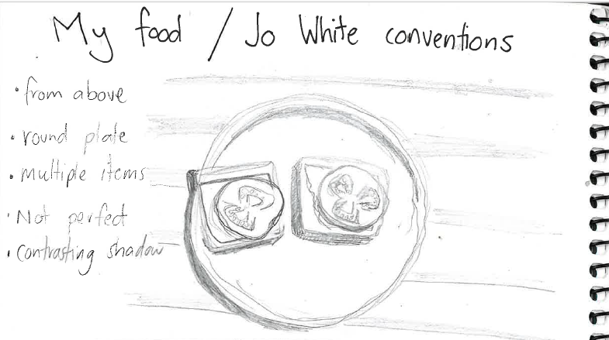
My food memory using Jo White conventions
2.2(a) Example

Slide 35


Art making reflections
It’s time.
Refine
your
design.
2.2(b)
What do you like?
What do you dislike?
What isn’t working?

Slide 36
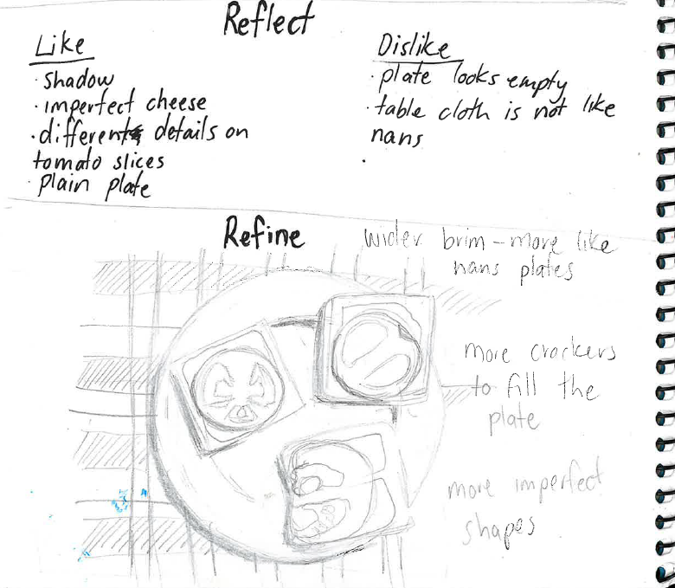
Sample reflection and refinement
2.2(b)

Slide 37
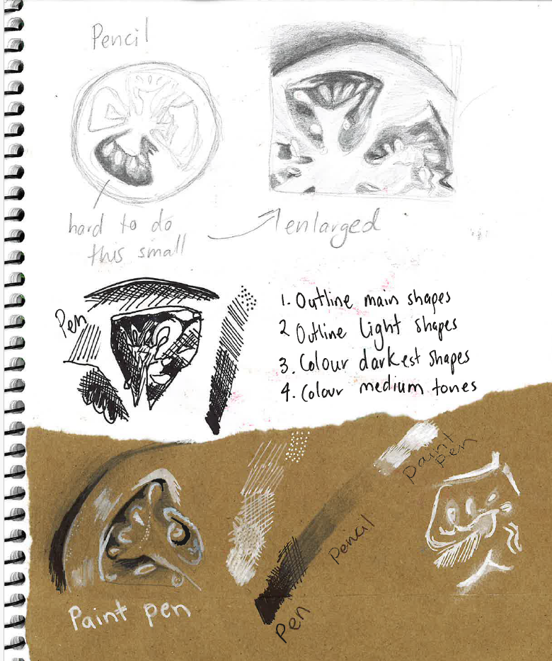
Exploring techniques example – shape and tone
2.3

Slide 38
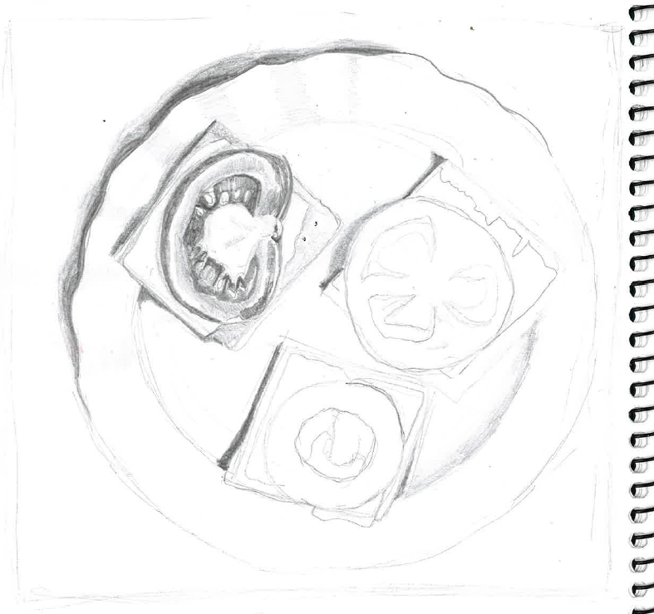
Jo White inspired drawing sample
2.4

Slide 39

Let’s check our progress
2.4(b)
I can:
explore and explain aspects of the artworld concepts in Jo White’s practice
explain how culture is represented in a Jo White artwork
adopt Jo White’s art making conventions to compose an artwork
apply, evaluate and refine drawing techniques.
Notes:
Notes for teachers:
Learning intentions and success criteria are carefully designed using syllabus outcomes and content
For more information See ⁠AITSL or the NSW Department of Education explicit teaching strategies, ⁠Sharing learning intentions and ⁠Sharing success criteria
LISC should be revisited during the lesson to support students' evaluation of their learning

Slide 40
Learning sequence 3:
Wayne Thiebaud – case study

Slide 41
LS 3: Learning intentions and success criteria
We are learning to:
identify symbols and interpret their meaning in visual art works
describe and explain the artworld concepts in Wayne Thiebaud’s practice
explore Wayne Thiebaud’s art making conventions and adapt them in our own representations
experiment make choices about materials and techniques to communicate an idea to the audience
I can:
explain roles and explore the relationships between the artworld concepts in an artists’ practice
explain how Wayne Thiebaud represents culture in his context
adapt Thiebaud conventions to compose an artwork that is relatable for my audience
apply, evaluate and refine art making choices that consider how the audience experience the work
Notes:
Notes for teachers:
Learning intentions and success criteria are carefully designed using syllabus outcomes and content
For more information See ⁠AITSL or the NSW Department of Education explicit teaching strategies, ⁠Sharing learning intentions and ⁠Sharing success criteria
LISC should be revisited during the lesson to support students' evaluation of their learning

Slide 42
Spot the similarities – Thiebaud conventions
3.1(a)
Image place holder for
Food counter by Wayne Thiebaud, 2007
Image place holder for Cakes by Wayne Thiebaud, 1963
Wayne Thiebaud (2007) Food counter [image] accessed 28/3/2025.
Wayne Thiebaud (1963) Cakes [image] accessed 28/3/205.
Notes:
Possible answers: subject matter is desserts, repetition of shapes, expressive pain strokes, dark shadows, presented like a shop display, pastel colours, presented from a front view, uses one-point perspective
NESA definition of conventions: established rule, method or practice in the artworld that guides the making, presentation and interpretation of artworks.
Image reference
Wayne Thiebaud (2007) Food counter [image] accessed 28/3/2025.
Wayne Thiebaud (1963) Cakes [image] accessed 28/3/205.

Slide 43
Spot the similarities – Thiebaud conventions 2
3.1(b)
Image place holder for
Pie counter by Wayne Thiebaud, 1963
Image place holder for Three cones by Wayne Thiebaud, 1964
Wayne Thiebaud (1963) Pie counter [image] accessed 28/3/2025.
Wayne Thiebaud (1963) Three cones [image] accessed 28/3/2025.
Notes:
Possible answers: subject matter is desserts, repetition of shapes, expressive pain strokes, dark shadows, presented like a shop display, pastel colours, presented from a front view, uses one-point perspective.
NESA definition of conventions: established rule, method or practice in the artworld that guides the making, presentation and interpretation of artworks.
Access the Tuckshop catalogue and ask students to cross check if the conventions list they have created is largely accurate when considering a broader range of works from the same exhibition and artist. Refine the list of conventions.
Image reference
Wayne Thiebaud (1963) Pie counter [image] accessed 28/3/2025.
Wayne Thiebaud (1964) Three cones [image] accessed 28/3/2025.

Slide 44
Analysing Wayne Thiebaud’s artwork
3.1(c)
Image place holder for
Food counter by Wayne Thiebaud, 2007
Inference table
Key features | This represents… | What it says about the artist’s culture
Wayne Thiebaud (2007) Food counter [image] accessed 28/3/2025.
Notes:
Image reference: Wayne Thiebaud (2007) Food counter [image] accessed 28/3/2025.

Slide 45
Pop Art – the world at the time
3.2(a)
Divide a page in your diary into
4 parts and label each one with the artworld concepts.
Summarise key points from the video into the most appropriate section.
Pop art: an introduction
(0:00 – 3:40 minutes)
Artwork | Artist
World | Audience
Wayne Thiebaud, draftsman
(4:02 minutes)
Sauers virtual art room (2021) Pop art: an introduction [video] accessed 28/3/2025.
The Morgan Library and Museum (2019) Wayne Thiebaud, draftsman [video] accessed 28/3/2025.

Slide 46
Artworld concepts 2
3.2(b)
The artworld concepts are:
artist
artwork
audience
world
Each concept has its own role in the artworld
There are relationships between each of the concepts.
Notes:
Possible answers:
Artist–world relationship:
The artist has experiences in the world that inform/inspire their art making practice.
The artist influences what happens in the world by sharing their ideas through artworks
Artist–artwork relationship:
The artist communicates their ideas through their artwork
Artworks are the product of an artist’s self expression
Artist–audience relationship:
The artist communicates their ideas to the audience (through the artwork)
Artwork–audience relationship:
The audience interpret the ideas and meaning of the artwork
Artworks can inform, challenge, remind audiences about ideas and experiences
Audience–world relationship:
Audience learn about the artist world at the time and place the artwork was created
The audience’s experience in the world shapes how they interpret the artwork

Slide 47
Artworld concepts response 2
3.2(c) Explain the relationships between the artist, his artworks, his world and/or the audience
Paragraph element | Description | Where can I get this information from?
P Point | A topic sentence that states the key point you are making in this paragraph. Name the artist/artworks you will refer to Identify the artworld concepts you will explore and how they influence one another | Inference table column 3 Artworld concepts table
E Explain | Describe specific features of the artist’s practice related to each artworld concept Explain the relationship between the artworld concepts | Artworld concepts table
E Evidence | Use the evidence provided on the previous slide and specific key features in the artwork/s to explain your interpretation of the relationships between artworld concepts | Inference table columns 1 and 2 Artworld concepts table
L Link | Summarise how the evidence you have used proves the point you raised in the topic sentence. | Inference table column 3 Artworld concepts table
Notes:
Subject specific language could include: artist, artwork, audience, world, painting, influence, impact, American culture, subject matter, personal experience, nostalgic, light-hearted, consumer culture,
Hint for students: remember relationships are 2-way transactions, think about what each concept ‘gives’ and ‘receives’ from the other concept

Slide 48
Peer review
3.2(d)
1
2
3
Highlight or underline subject-specific language they have used.
Annotate where they have completed each part of the scaffold. For example, the point, explanation, evidence and link
Provide feedback on:
something good about their answer
a way they could make their response stronger
Notes:
As a class come up with a list of suggestions students can give one another to strengthen their responses such as using subject specific language, making sure all part of the scaffold have been addressed, giving a more specific example or focusing on explaining the relationship between concepts.

Slide 49
Spot the difference – intentions, choices and actions
3.3(a)
Image place holder for Three cones by Wanye Thiebaud, 1964
Image place holder for
Pie counter by Wayne Thiebaud, 1963
Image place holder for Cakes by Wayne Thiebaud, 1963
Notes:
White presents individual or small group serving in a personal setting like at home or on a family picnic, Thiebaud’s food is presented through a community perspective where it is prepared and presented in an aesthetically appealing way to entice the public to purchase the food.
Image reference:
Wayne Thiebaud (1963) Three cones [image] accessed 28/3/2025.
Wayne Thiebaud (1963) Pie counter [image] accessed 28/3/2025.
Wayne Thiebaud (1963) Cakes [image] accessed 28/3/205.
Image distribution permissions for Secondary Curriculum, Curriculum and Reform Directorate of NSW Department of Education, granted by © Jo White, 2025.

Slide 50
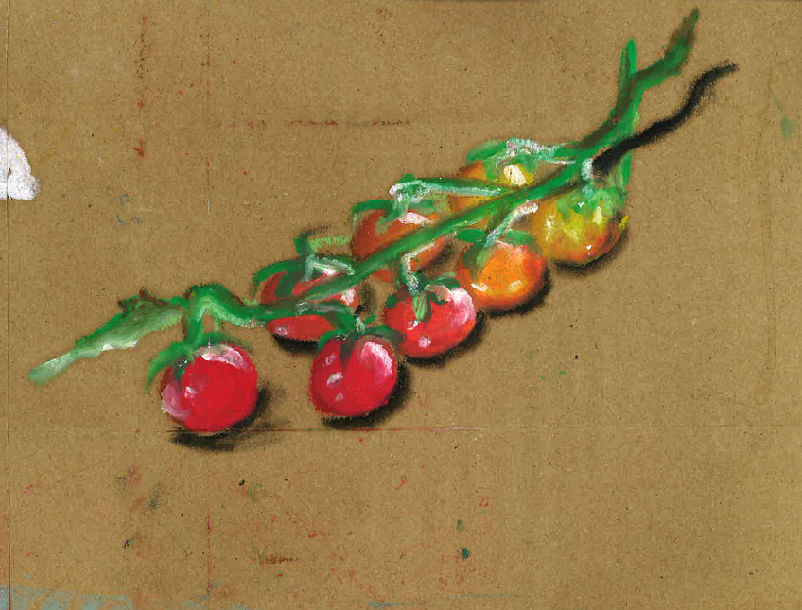
My food memory using Thiebaud’s conventions
3.3(b)
How can your food memory be presented to resonate with a broader audience?
Consider how it could be represented in:
a shop window?
on a menu?
a supermarket? (just one ingredient)
Oil pastel drawing on brown paper shopping bag. Reference image was in a supermarket catalogue.

Slide 51
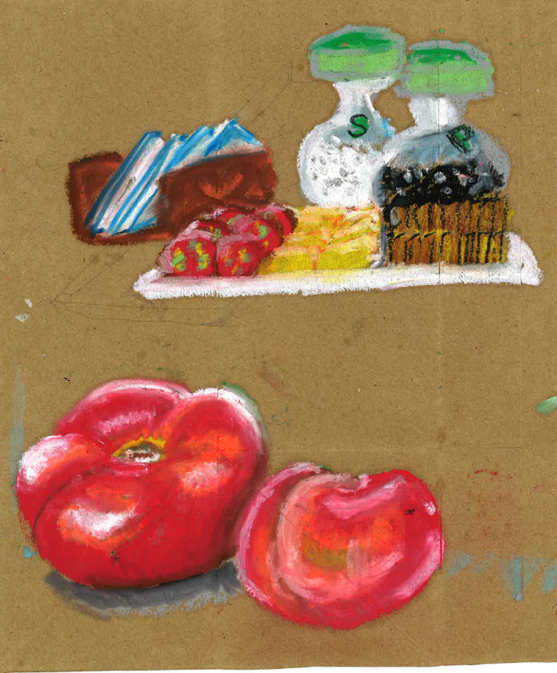
Wayne Thiebaud inspired ideas
3.3(c)
Oil pastel drawings on brown paper shopping bag. Tomato reference image was in a supermarket catalogue.

Slide 52
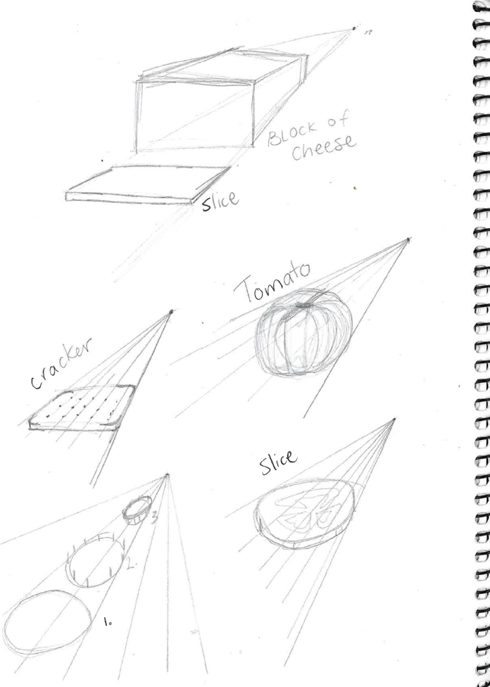
Exploring techniques example – perspective
3.4(a)
Practising one-point perspective drawing technique for each item in my food memory.

Slide 53
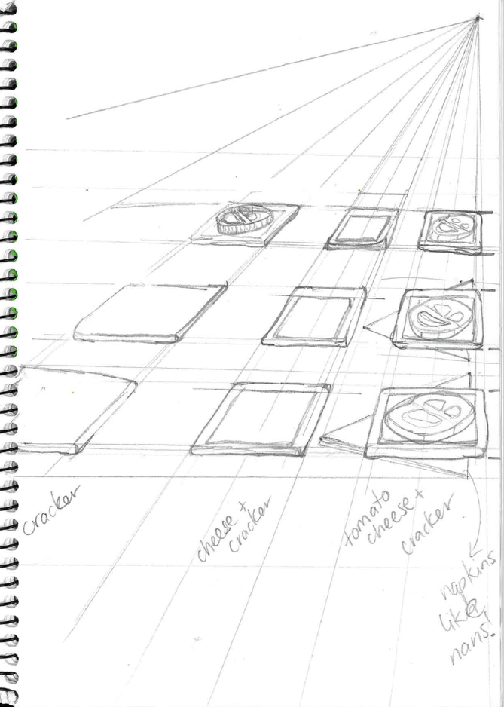
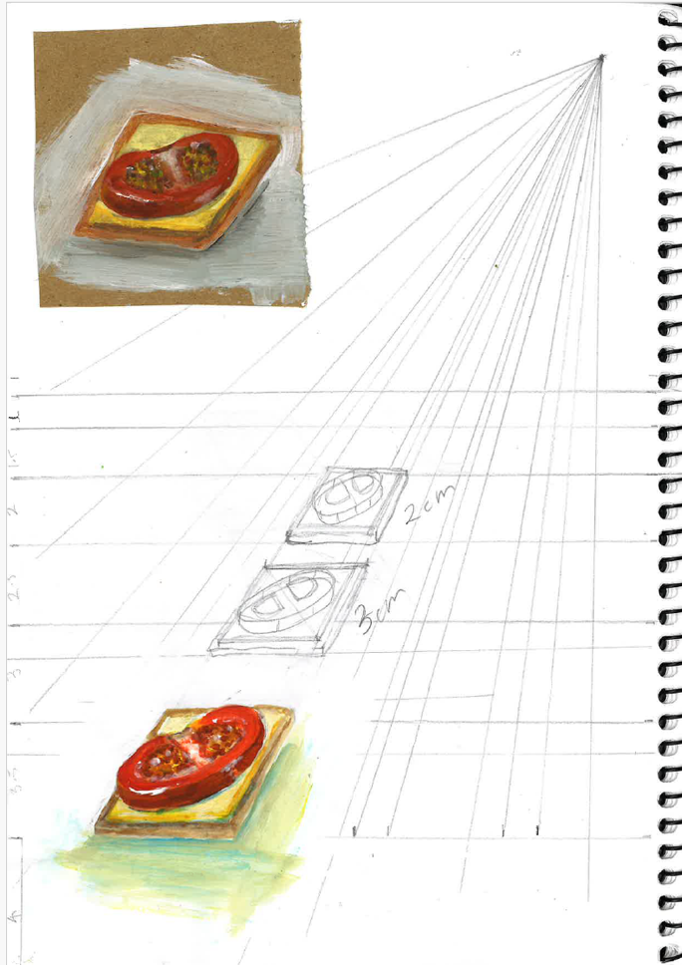
Wayne Thiebaud inspired perspective drawing samples
3.4(c)
I simplified the composition down to 3 crackers and practised my painting techniques on white and brown paper. I prefer the vibrancy of the colour on the white paper.
I had fun seeing rows of crackers presented like Thiebaud’s cakes, but I realised I wouldn’t have time to paint it all properly.

Slide 54
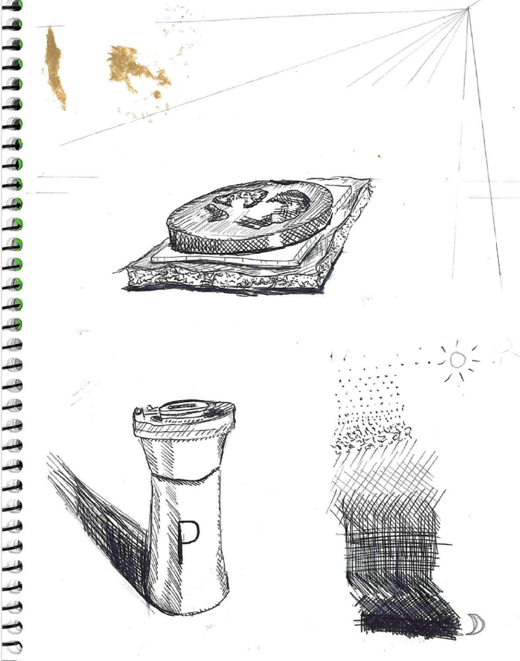
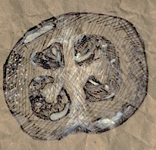
Wayne Thiebaud inspired drawing sample
3.4(d)
Image place holder for Coconut cake by Wayne Thiebaud, 1964
Wayne Thiebaud (1964) Coconut cake [image] accessed 28/3/2025.
Notes:
Image reference
Wayne Thiebaud (1964) Coconut cake [image] accessed 28/3/2025.

Slide 55
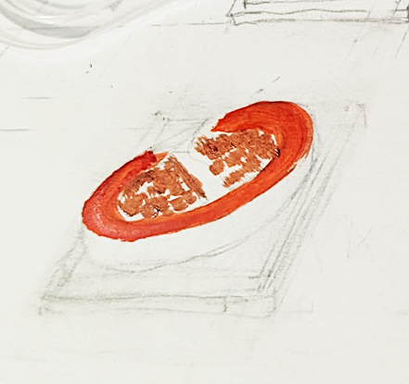
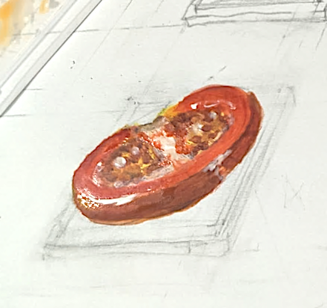
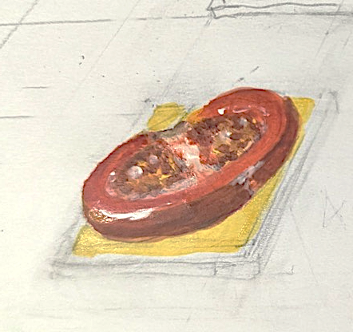
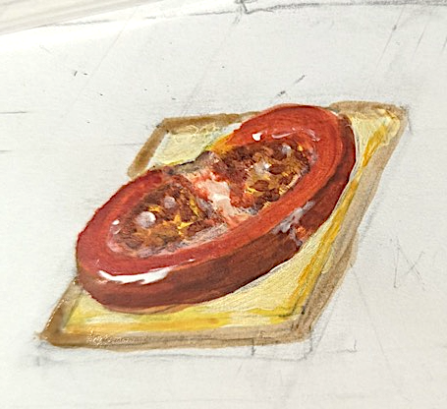
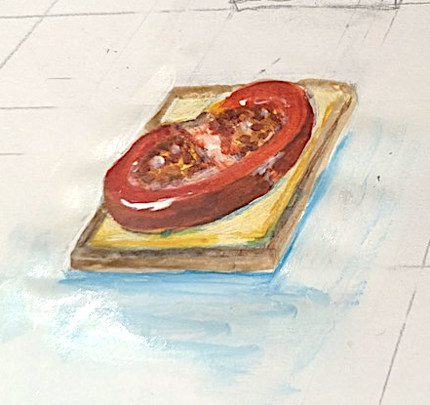
Wayne Thiebaud inspired painting samples
3.5(a) Process photos

Slide 56
Peer feedback
3.5(b)
What does the artwork
remind you of?
Which Wayne Thiebaud conventions can you see
in this artwork?
What is the strongest aspect of the artwork and why?
How could the artwork
be improved?

Slide 57
Learning sequence 4:
Ron Magnes case study
Image placeholder for Nachos on blue by Ron Magnes, 2019

Slide 58
LS 4: Learning intentions and success criteria
We are learning to:
identify symbols and interpret their meaning in artworks
describe and explain the artworld concepts in Ron Magnes’ practice
explain Ron Magnes’ art making conventions and adapt them in our own representations
experiment with and make choices about materials and techniques to communicate an idea to the audience.
I can:
explain roles and relationships between the artworld concepts in Ron Magnes’ practice
explain how Ron Magnes represents culture in his context
adapt Ron Magnes’ conventions to compose an artwork
apply, evaluate and refine art making choices that consider artistic intent.
Notes:
Notes for teachers:
Learning intentions and success criteria are carefully designed using syllabus outcomes and content
For more information See ⁠AITSL or the NSW Department of Education explicit teaching strategies, ⁠Sharing learning intentions and ⁠Sharing success criteria
LISC should be revisited during the lesson to support students' evaluation of their learning

Slide 59
Spot the similarities – Magnes conventions
4.1(a) Art critical and historical assessment – step 1
Image place holder for Pizza on blue by Ron Magnes, 2019
Image place holder for French fries on blue by Ron Magnes, 2019
Image place holder for Nachos on blue by Ron Magnes, 2019
Ron Magnes (2019) Pizza on blue [image] accessed 28/3/2025.
Ron Magnes (2019) French fries on blue [image] accessed 28/3/2025.
Ron Magnes (2019) Nachos on blue [image] accessed 28/3/2025.
Notes:
Possible answers: subject matter is western fast foods, repetition of shapes, vibrant colours, falling food/sense of motion, flat background/no contextual information given, pop art inspired style, presented from a front view, uses one-point perspective, single serve, whole ingredients or condiments included.
Image reference
Ron Magnes (2019) Pizza on blue [image] accessed 28/3/2025.
Ron Magnes (2019) French fries on blue [image] accessed 28/3/2025.
Ron Magnes (2019) Nachos on blue [image] accessed 28/3/2025.

Slide 60
Analysing Ron Magnes’ artwork
4.1(b) Art critical and historical assessment – step 2
Image place holder for Pizza on blue by Ron Magnes, 2019
Inference table
Key features | This represents… | What it says about the artist’s culture

Slide 61
Ron Magnes’ practice – Artworld concepts table
4.1(c) Art critical and historical assessment – step 3
Ron Magnes Contemporary American artist | Creates digital drawings of everyday objects, places and food.
Inspired by pop art created in America in the 1960’s. | Aimed at the average American and people familiar with Western culture Creates a fun and whimsical perspective on the foods he represents
Artist
Artworks
World
Audience

Slide 62
Artworld concepts response 3
4.1(d) Explain the relationships between the artist, his artworks, his world and/or the audience
Paragraph element | Description | Where can I get this information from?
P Point | A topic sentence that states the key point you are making in this paragraph. Name the artist/artworks you will refer to Identify the artworld concepts you will explore and how they influence one another | Inference table column 3 Artworld concepts table
E Explain | Describe specific features of the artist’s practice related to each artworld concept Explain the relationship between the artworld concepts | Artworld concepts table
E Evidence | Use the evidence provided on the previous slide and specific key features in the artwork/s to explain your interpretation of the relationships between artworld concepts | Inference table columns 1 and 2 Artworld concepts table
L Link | Summarise how the evidence you have used proves the point you raised in the topic sentence. | Inference table column 3 Artworld concepts table
Notes:
Teacher to edit question as needed.

Slide 63
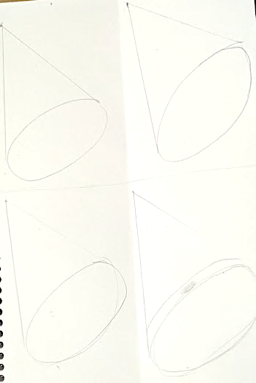
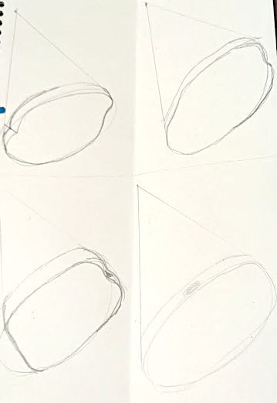
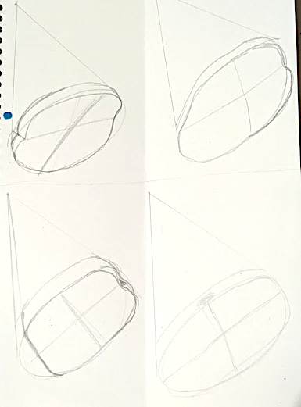
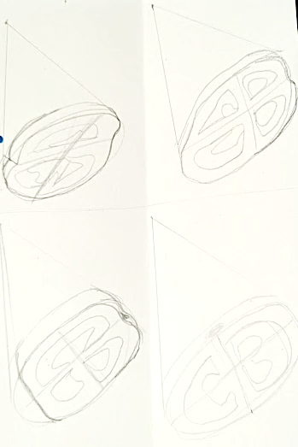
Exploring techniques example – perspective and adapting shapes
4.2(a) examples of drawings
Using one-point perspective, draw a basic 3D shape, 4 times on a page.
Slightly modify the shape to be more realistic to the subject matter you are representing.
Use top-to-bottom and left-to-right axis lines to help guide your perspective.
Add details to each shape.
Notes:
-

Slide 64
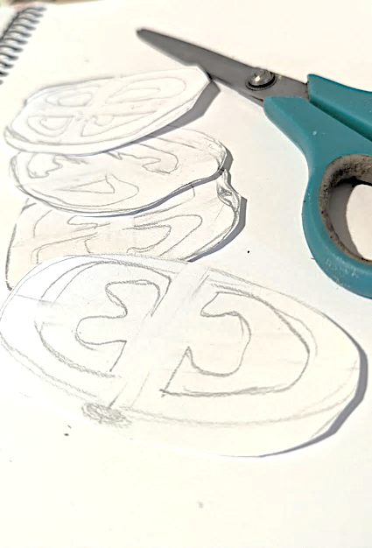
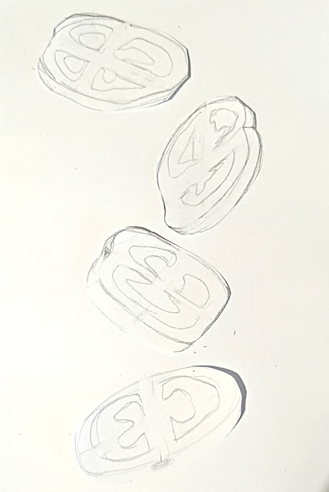
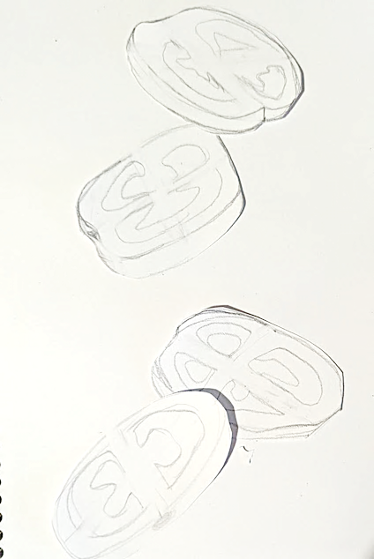
Exploring techniques example – falling composition
4.2(b) examples of compositions
Cut out your drawings
Experiment with different composition.
Document your ideas in your visual arts diary

Slide 65
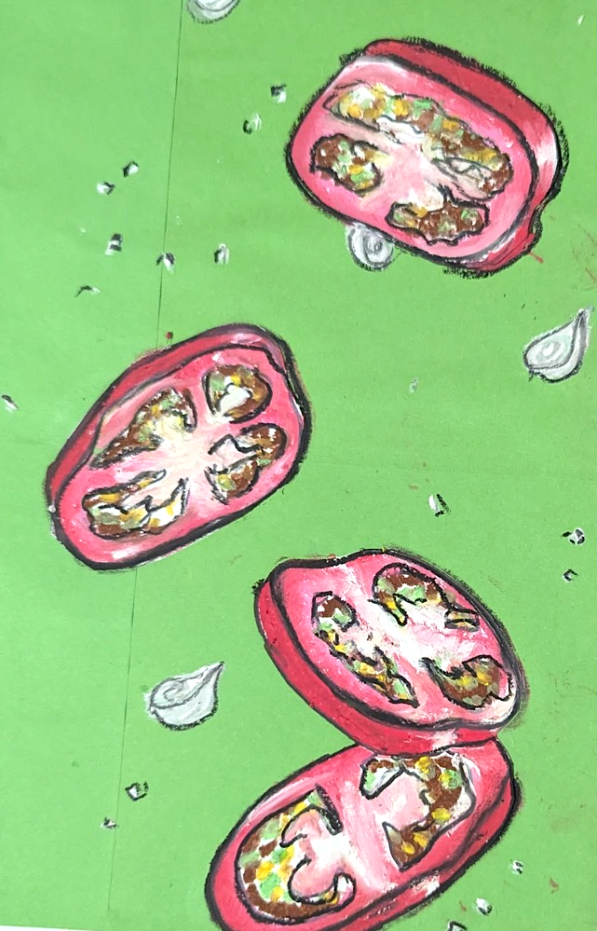
Sample Ron Magnes inspired artwork
4.2(c)

Slide 66
Self reflection
4.2(d)
What is the strongest aspect
of the artwork and why?
How could the artwork be improved?

Slide 67
Learning sequence 5:
Adopt the role of the artist

Slide 68
LS 5: Learning intentions and success criteria
We are learning to:
adopt the role of an artist
develop and refine our own visual language
communicate our own ideas to an audience
I can:
set intentions, make choices and take actions to communicate ideas through an artwork
create visual codes and symbols to communicate my ideas
experiment with, evaluate and modify my use of materials and techniques to create a refined artwork
Notes:
Notes for teachers:
Learning intentions and success criteria are carefully designed using syllabus outcomes and content
For more information See ⁠AITSL or the NSW Department of Education explicit teaching strategies, ⁠Sharing learning intentions and ⁠Sharing success criteria
LISC should be revisited during the lesson to support students' evaluation of their learning

Slide 69
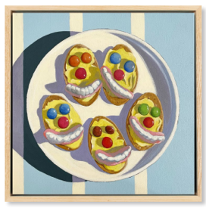
Art making – planning phase
5.1(a)
What art forms and materials have we explored in this unit?
Jo White conventions
Wayne Thiebaud conventions
Ron Magnes conventions
Image place holder for Cakes by Wayne Thiebaud, 1963
Image place holder for Pizza on blue by Ron Magnes, 2019
Iced Bickies, 2022, distribution permissions for Secondary Curriculum, Curriculum and Reform Directorate of NSW Department of Education, granted by © Jo White, 2025.
Wayne Thiebaud (1963) Cakes [image] accessed 28/3/2025.
Ron Magnes (2019) Pizza on blue [image] accessed 28/3/2025.
Notes:
Answers:
Art forms – drawing and painting
Materials – pencil, pen and paint
Image reference:
Wayne Thiebaud (1963) Cakes [image] accessed 28/3/2025.
Ron Magnes (2019) Pizza on blue [image] accessed 28/3/2025.
Iced Bickies, 2022, distribution permissions for Secondary Curriculum, Curriculum and Reform Directorate of NSW Department of Education, granted by © Jo White, 2025

Slide 70
Art making – intentions and choices
5.1(b)
Intentions:
What ideas do you want to communicate about your food memory in your artwork?
Choices
What form will you work in?
drawing
painting
hybrid
What symbols will you use to represent your food memory and/or culture?
Symbols can include:
objects
patterns
colours
application of materials
Which conventions will you borrow and/or adapt from the artists we have studied?
What material/s will you use?
pencil
pen
paint
digital

Slide 71
Artwork reflection
5.3
Imagine your artwork here.
Inference table
Key features | This represents… | What it says about the artist’s culture

Slide 72
Appendix – Jo White artworks

Slide 73
Appendix 1
Iced Bickies, 2022, distribution permissions for Secondary Curriculum, Curriculum Directorate of NSW Department of Education, granted by © Jo White, 2025.

Slide 74
Appendix 3
Neapolitan, 2022 distribution permissions for Secondary Curriculum, Curriculum and Reform Directorate of NSW Department of Education, granted by © Jo White, 2025.

Slide 75

Appendix 2
Party Pies, 2022 distribution permissions for Secondary Curriculum, Curriculum Directorate of NSW Department of Education, granted by © Jo White, 2025.

Slide 76
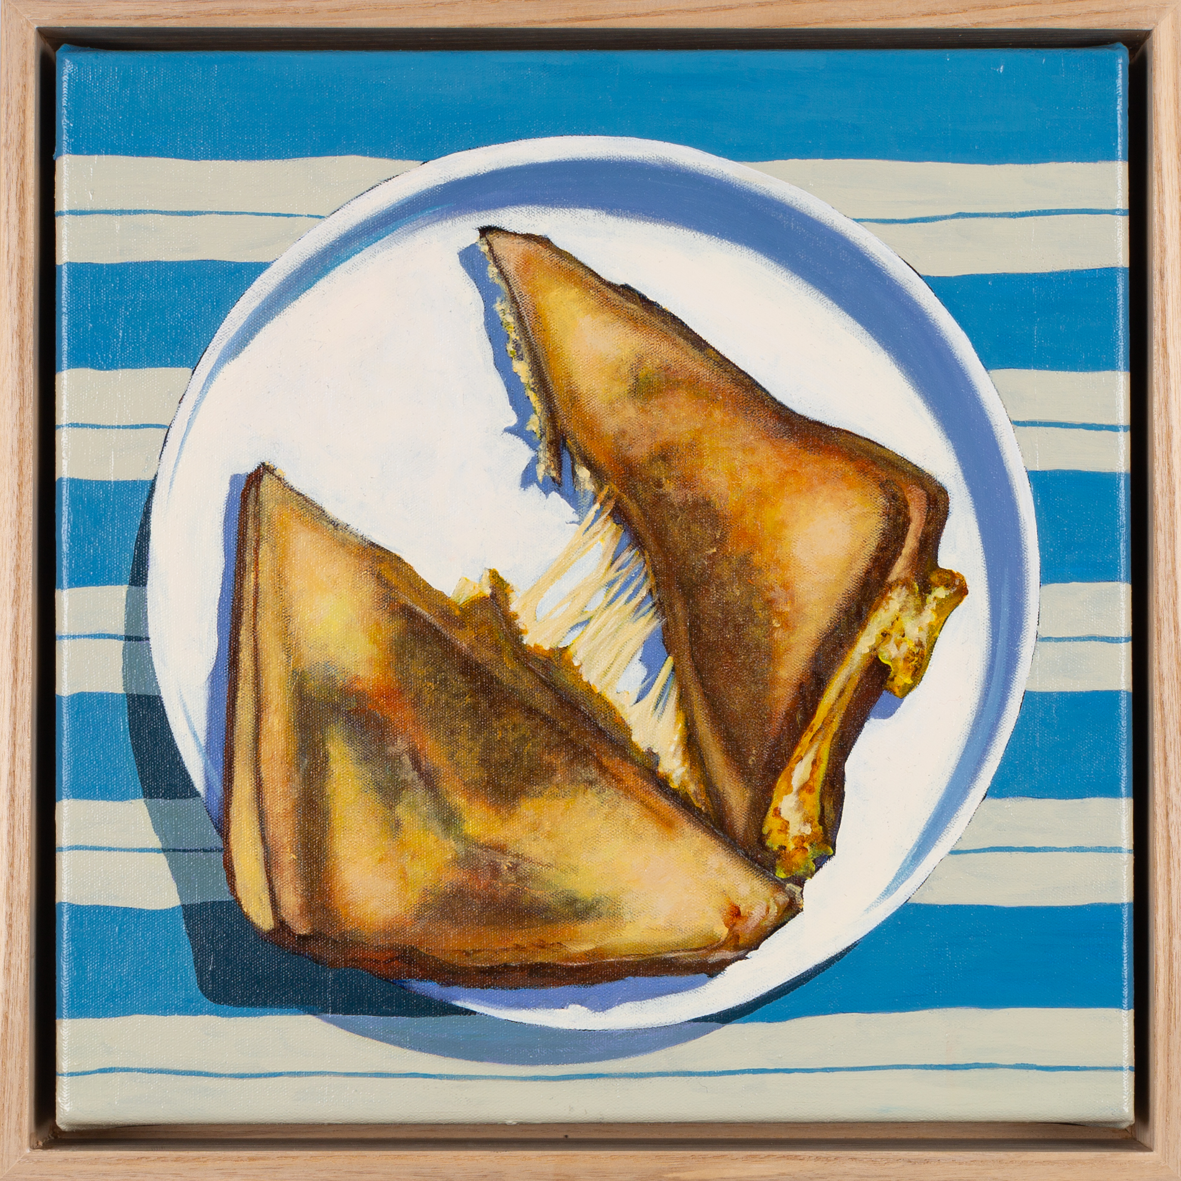
Appendix 4
Toastie, 2022 distribution permissions for Secondary Curriculum, Curriculum Directorate of NSW Department of Education, granted by © Jo White, 2025.

Slide 77
References
This presentation contains NSW Curriculum and syllabus content. The NSW Curriculum is developed by the NSW Education Standards Authority. This content is prepared by NESA for and on behalf of the Crown in the right of the State of New South Wales. The material is protected by Crown copyright.
Please refer to the NESA Copyright Disclaimer for more information https://educationstandards.nsw.edu.au/wps/portal/nesa/mini-footer/copyright.
NESA holds the only official and up-to-date versions of the NSW Curriculum and syllabus documents. Please visit the NSW Education Standards Authority (NESA) website https://educationstandards.nsw.edu.au/wps/portal/nesa/home and the NSW Curriculum website https://curriculum.nsw.edu.au.
Visual arts 7–10 Syllabus © NSW Education Standards Authority (NESA) for and on behalf of the Crown in right of the State of New South Wales, 2024.
Marie Ryder (2024) Women collecting bush fruits [image] accessed 28/3/2025.
Marie Ryder (2024) Women Gathering Edible Mistletoe, Wild Figs and Honey Ants [image] accessed 29/1/2026.
Ron Magnes (2019) Sushi on blue [image] accessed 28/3/2025.
Ron Magnes (2019) French fries on blue [image] accessed 28/3/2025.
Ron Magnes (2019) Pizza on blue [image] accessed 28/3/2025.
Ron Magnes (2019) Nachos on blue [image] accessed 28/3/2025.
Sauers virtual art room (2021) Pop art: an introduction [video] accessed 28/3/2025.
The Morgan Library and Museum (2019) Wayne Thiebaud, draftsman [video] accessed 28/3/2025.

Slide 78
References continued
This presentation contains NSW Curriculum and syllabus content. The NSW Curriculum is developed by the NSW Education Standards Authority. This content is prepared by NESA for and on behalf of the Crown in the right of the State of New South Wales. The material is protected by Crown copyright.
Please refer to the NESA Copyright Disclaimer for more information https://educationstandards.nsw.edu.au/wps/portal/nesa/mini-footer/copyright.
NESA holds the only official and up-to-date versions of the NSW Curriculum and syllabus documents. Please visit the NSW Education Standards Authority (NESA) website https://educationstandards.nsw.edu.au/wps/portal/nesa/home and the NSW Curriculum website https://curriculum.nsw.edu.au.
Wayne Thiebaud (1963) Cakes [image] accessed 28/3/2025.
Wayne Thiebaud (1964) Coconut cake [image] accessed 28/3/2025.
Wayne Thiebaud (1964) Three cones [image] accessed 28/3/2025.
Wayne Thiebaud (1963) Pie counter [image] accessed 28/3/2025.
Wayne Thiebaud (2007) Food counter [image] accessed 28/3/2025.
Michael Reid Murrurundi (2022) Jo White Tuckshop catalogue [pdf] accessed 28/3/2025.

Slide 79
Copyright
© State of New South Wales (Department of Education), 2025
The copyright material published in this resource is subject to the Copyright Act 1968 (Cth) and is owned by the NSW Department of Education or, where indicated, by a party other than the NSW Department of Education (third-party material).
Copyright material available in this resource and owned by the NSW Department of Education is licensed under a Creative Commons Attribution 4.0 International (CC BY 4.0) license.
This license allows you to share and adapt the material for any purpose, even commercially.
Attribution should be given to © State of New South Wales (Department of Education), 2025.
Material in this resource not available under a Creative Commons license:
the NSW Department of Education logo, other logos and trademark-protected material
Material owned by a third party that has been reproduced with permission. You will need to obtain permission from the third party to reuse its material.
Links to third-party material and websites
Please note that the provided (reading/viewing material/list/links/texts) are a suggestion only and implies no endorsement, by the New South Wales Department of Education, of any author, publisher, or book title. School principals and teachers are best placed to assess the suitability of resources that would complement the curriculum and reflect the needs and interests of their students.
If you use the links provided in this document to access a third-party’s website, you acknowledge that the terms of use, including licence terms set out on the third-party’s website apply to the use which may be made of the materials on that third-party website or where permitted by the Copyright Act 1968 (Cth). The department accepts no responsibility for content on third-party websites.

