Slide 1
Instructions for use
This resource is not a teaching and learning program. It should be used in conjunction with the visual arts Stage 4 sample unit ‘Creatures of consequence’ and the Creatures of consequence assessment task, available on the Planning, programming and assessing visual arts 7–10 webpage. Classroom teachers are encouraged to add and adapt slides as required to meet the needs of their students.
Save a copy of the file to make changes to the slide deck. Go to File > Download a Copy (this downloads a copy to the computer to edit in the PowerPoint app).
To convert the PowerPoint to Google Slides:
  Upload the file into Google Drive and open it.
  Go to File > Save as Google Slides.
  (Note – conversion may cause formatting changes in the slides.)

Slide 2
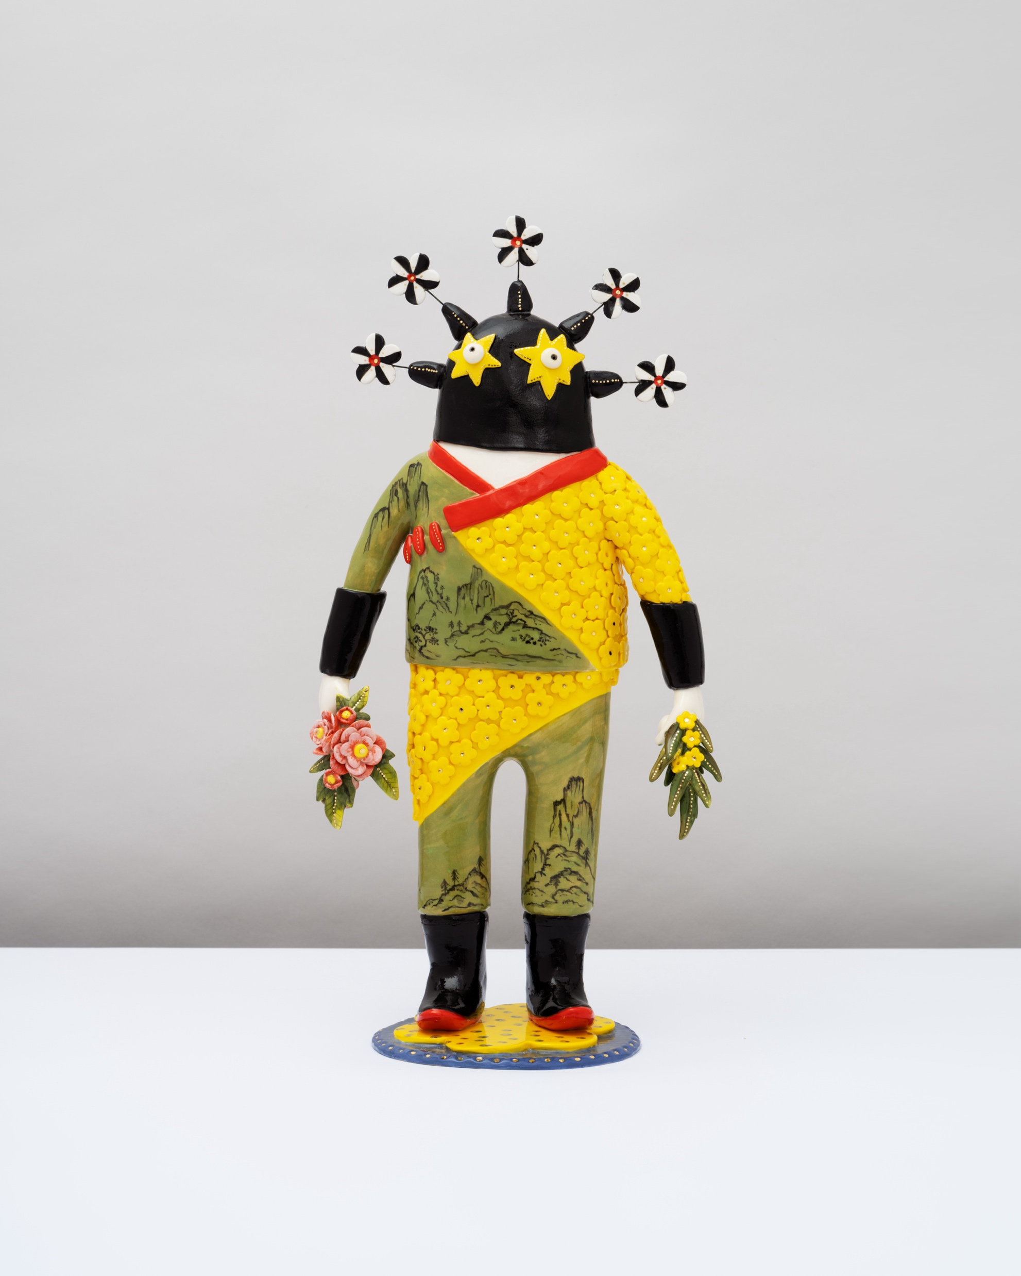
Creatures of consequence
Visual arts – Stage 4
Gold And Green Warrior, 2022, distribution permissions for Secondary Curriculum, Curriculum and Reform Directorate of NSW Department of Education, granted by © Vipoo Srivilasa, 2025

Slide 3
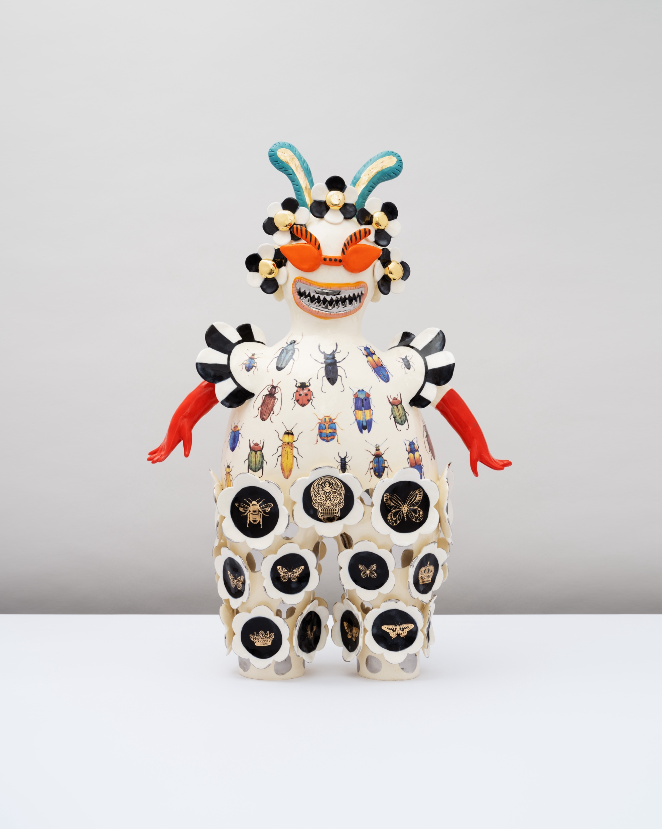
Learning sequences
1
Jenny Orchard
2
The Hermannsburg Potters
3
Vipoo Srivilasa
4
Creatures of Consequence
5
Think like a critic
‘Climate Change Bug Ball’, 2022 distribution permissions for Secondary Curriculum, Curriculum and Reform Directorate of NSW Department of Education, granted by © Vipoo Srivilasa, 2025.
Notes:
Teacher notes:
Click lesson numbers to go to specific lessons
Interactive features can be viewed in slide show

Slide 4
Learning sequence 1 – Jenny Orchard

Slide 5
Learning intentions and success criteria
We are learning to:
experiment with subjective and interpretive language to develop imaginative concepts for artmaking
I can:
respond to and interpret stimulus
explore and connect symbolic and imaginative words to generate ideas for artmaking
draw imaginative representations of the connections I’ve made between ideas.
Notes:
Notes for teachers:
Learning intentions and success criteria are best co-constructed with students. Adapt the learning intention as required and add matching success criteria.
For more information See ⁠AITSL or the NSW Department of Education explicit teaching strategies, ⁠Sharing learning intentions and ⁠Sharing success criteria
LISC is not necessarily presented at the beginning of the lesson. Teacher needs to consider most effectual time to introduce
LISC should be revisited during the lesson to support students' evaluation of their learning

Slide 6
Creatures of consequence
1.1(a)
Creature: Any living being
Consequence: The result or effect that follows an action, decision, or event

Slide 7
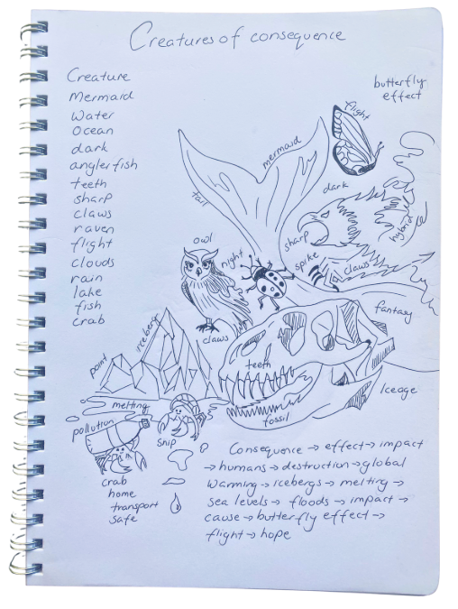
Word association
1.1(b) Word association
Subjectivity is about how you personally see, feel, and respond to the world. In Visual Arts, this means your own experiences, memories, and feelings help shape the way you create and understand artworks. You might make connections or associations between a word, colour, or image that shapes your interpretation.
Our personal experiences influence our interpretation of words and art. This game highlights how we all differ in our interpretations and that this difference supports our ability to think creatively and tell our own unique stories through language and art making.
We live in an image-saturated world, and we are constantly bombarded with images, leaving us very little time to decode them, process their meaning, respond emotionally, and form opinions.
Accessing the right words to help us understand art and articulate our thoughts is more important than ever.
Let’s look at how words choices help us build creative ideas.
Notes:
This slide is animated
Click to reveal additional information.

Slide 8
Learning intentions and success criteria (2)
We are learning to:
explore the subjective viewpoint to infer how an artist’s imagination shapes their practice and the meaning of their artworks.
I can:
describe an artist’s practice
respond to artworks and artists statements to infer how artists use imagination in their artmaking practice
experiment with images and words to create a collaged creature that communicates a concept.
Notes:
Notes for teachers:
Learning intentions and success criteria are best co-constructed with students. Adapt the learning intention as required and add matching success criteria.
For more information See ⁠AITSL or the NSW Department of Education explicit teaching strategies, ⁠Sharing learning intentions and ⁠Sharing success criteria
LISC is not necessarily presented at the beginning of the lesson. Teacher needs to consider most effectual time to introduce
LISC should be revisited during the lesson to support students' evaluation of their learning

Slide 9
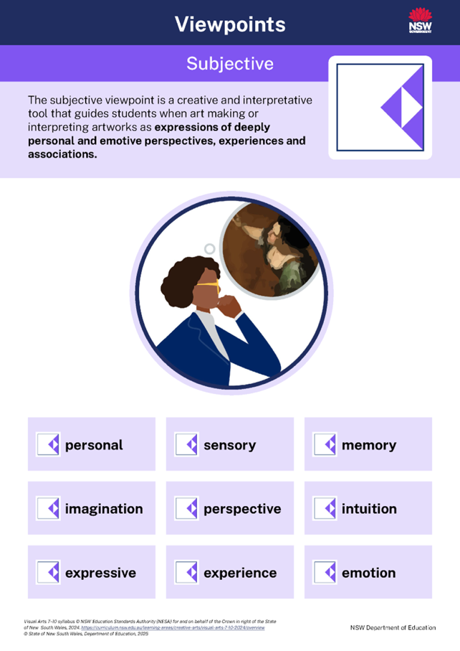
In the studio with Jenny Orchard (1)
1.2(a) Art making practice and the subjective viewpoint
Art making practice is about what artworld practitioners know and do.
Jenny Orchard is an Australian ceramicist whose practice is shaped by imagination and personal experiences.
We will use the subjective viewpoint to look at how her intentions, actions and choices are informed by intuition, emotion and memories.
Notes:
Use these Frayer Model style notes to define the terms perspective and intuition in the context of the subjective viewpoint
1. Intuition
Definition
A personal feeling or idea you get about something without needing proof, much like a ‘gut feeling.’
Characteristics
Based on emotion or gut feeling
Often immediate and personal
May differ from person to person
Important in subjective interpretations of art
Examples
Feeling that an artwork is sad without knowing why
You feel uncomfortable looking at an artwork, but you can't explain why, it just has something about it that unsettles you.
Believing a symbol means hope because of personal associations
Non-examples
Measuring the dimensions of an artwork
Listing the colours used
Using only historical facts to interpret meaning
2. Perspective
Definition
Perspective is the way someone sees or understands something, based on their own experiences, background, culture, and beliefs. In art, it means people can look at the same artwork and think or feel different things about it.
Characteristics
Different people can see the same artwork in very different ways
What you think about an artwork can be shaped by your culture, personality, and life experiences
There’s no one ‘right’ answer – many ideas and interpretations can be true
Examples
People see and understand art differently.
Your thoughts about an artwork are shaped by who you are
There’s not just one ‘correct’ meaning, many ideas can be right.
Non-examples
Finding out what the artist says their work is about without adding your own ideas
Believing that there’s only one right meaning for the artwork
Forgetting that the audience’s thoughts and feelings are important too

Slide 10


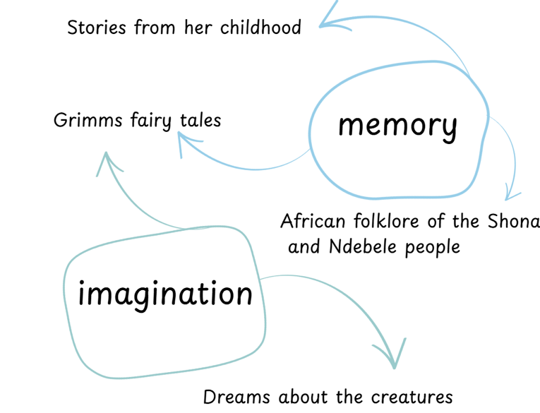
In the studio with Jenny Orchard (2)
1.2(b) Conceptual practice and the subjective viewpoint
Listen carefully
Jenny Orchard – Bush Of Ghosts – Artist Interview (3:56 minutes)
Identify some of Jenny Orchard's influences.
Describe the role of nature and imagination in Orchard's art making.
What does Orchard intend to communicate through her artworks?
Notes:
This slide is animated
Click to reveal follow-up questions.
1. Identify some of Jenny Orchard's influences.
2. Describe the role of nature and imagination in Orchard's artmaking.
3. What does Orchard aim to communicate through her art works?
Video reference
Despard Gallery (2019) Jenny Orchard- Bush Of Ghosts - Artist Interview [video] accessed 16/3/2022.

Slide 11

In the studio with Jenny Orchard (3)
1.2(c) Material practice and the subjective viewpoint
Adverbs
Jenny Orchard:
Cuts with a cutting wire to slice the block of raw clay
Squeezes and models the clay
Applies slip with a bristle brush
Scratches the surface of the clay to create texture
Presses and pushes the clay
Imprints and stamps the surface with a banksia to create texture
Incises and draws into the clay with a needle tool
Mixes new glazes
Jenny Orchard:
Carefully cuts with a cutting wire to slice the block of raw clay
Firmly squeezes and models the clay
Evenly applies slip with a bristle brush
Lightly scratches the surface of the clay to create texture
Gently presses and pushes the clay
Delicately imprints and stamps the surface with a banksia to create texture
Precisely incises and draws into the clay with a needle tool
Meticulously mixes new glazes
JENNY ORCHARD - Bush Of Ghosts - Artist Interview (3:56) minutes
Watch what the artist is doing with her hands, materials and tools.
Describe the artist’s actions using verbs (doing words).
Notes:
This slide is animated
Jenny Orchard:
Cuts with a cutting wire to slice the block of raw clay
Squeezes and models the clay
Applies slip with a bristle brush
Scratches the surface of the clay to create texture
Presses and pushes the clay
Imprints and stamps the surface with a banksia to create texture
Incises and draws into the clay with a needle tool
Mixes new glazes firing them differently
Connects to her natural world
These sample responses represent only a few of the multitude of responses that students may provide. They have been included as a guide and are not intended to limit the potential scope of students' responses.
Click to reveal possible answers.
Jenny Orchard:
Carefully cuts with a cutting wire to slice the block of raw clay
Firmly squeezes and models the clay
Evenly applies slip with a bristle brush
Lightly scratches the surface of the clay to create texture
Gently presses and pushes the clay
Delicately imprints and stamps the surface with a banksia to create texture
Precisely incises and draws into the clay with a needle tool
Meticulously mixes new glazes
Question: Why is it important to provide specific detail when describing an artist’s practice?
Sample answer: Detailed descriptions are helpful when giving step-by-step instructions because they make it easier to understand and follow an artist’s technique. They allow us to try out the same methods ourselves and encourage us to think about why the artist made certain choices. They also help us communicate our ideas more clearly and support deeper discussions about art.
Question: What’s the relationship between her intentions and the actions that she takes in the studio?
Sample answer: Jenny Orchard’s actions are guided by her intentions. Her work is a physical expression of her ideas that are bought to life with clay and glazes. Orchard uses natural materials to mark the clay, and her studio is set amongst nature. She forms the creature's bodies with shapes that remind us of plants.
Video reference
Despard Gallery (2019) JENNY ORCHARD - Bush Of Ghosts - Artist Interview [video] accessed 16/3/2022.

Slide 12

In the studio with Jenny Orchard (4)
1.3(a) The 2-word strategy – conceptual practice
Thinking on paper
I chose the word thriving because Orchard's creations seem to take on a life of their own. They beam with energy and resemble exotic flora and fauna that you might stumble across in a tropical rainforest. There is a sense that they may continue to grow, evolve, perhaps even morph into other creatures.
I know that life is the main idea communicated in Orchard's artworks, which leads me to believe that Orchard's mysterious creatures are thriving beings that exist alongside us and flourish out of sight.
I chose this word …………….because.......
I think .............. because.......
This suggests......... so I can infer that……
I know that ........... which leads me to believe ...........
I can see ........... so, I'm guessing............
There is a sense that …………..
Notes:
This slide is animated
Click to reveal a sample response
I chose the word thriving because Orchard's creations seem to take on a life of their own. They beam with energy and resemble exotic flora and fauna that you might stumble across in a tropical rainforest. There is a sense that they may continue to grow, evolve, perhaps even morph into other creatures.
I know that life is the main idea communicated in Orchard's artworks, which leads me to believe that Orchard's mysterious creatures are thriving beings that exist alongside us and flourish out of sight.

Slide 13
In the studio with Jenny Orchard (5)
1.3(b) The 2-word strategy – material practice
Thinking on paper
Jenny Orchard connects to the natural world through her work by choosing to use a banksia to imprint patterns into the clay. The act of imprinting suggests a deliberate choice to capture native flora, so I can infer that Orchard wanted to connect with the environment. Banksias have a rough, patterned surface, which leads me to believe the artist wanted to create an organic texture and make it look like the sculpture is part of the landscape. There is a sense that the imprinted clay holds a memory of nature, like a fossil that has hardened over time.
The artist has chosen to…... which suggests...
By using/ choosing ………….the artist might be trying to...
It seems the artist deliberately........... because...
This choice of material/technique could mean that……....
There is a sense that………..
Notes:
This slide is animated
Click to reveal a sample response
Jenny Orchard connects to the natural world through her work by choosing to use a banksia to imprint patterns into the clay. The act of imprinting suggests a deliberate choice to capture native flora, so I can infer that Orchard wanted to connect with the environment. Banksias have a rough, patterned surface, which leads me to believe the artist wanted to create an organic texture and make it look like the sculpture is part of the landscape. There is a sense that the imprinted clay holds a memory of nature, like a fossil that has hardened over time.
Question - Why did the writer include the word ‘chooses’?
Sample answer - To show that Jenny Orchard made a deliberate and conscious around how she might achieve a certain mark in the clay.
Question - What does the writer mean by ‘there is a sense’ ?
Sample answer - It helps the writer show that they are making an interpretation and are expressing a point of view about an idea or feeling. It helps the reader imagine that the clay is more than just a material and that it can also represent more that a solid form or texture.

Slide 14

Conducting curation
1.4(a) Mayhem in the museum
Discuss the role that experimentation plays in her practice.
What are the results of this approach?
What considerations were made for the presentation of these artworks in Shepparton Art Museum?
Write down 2 words that describe the structure of these sculptures.
Write down 2 words that capture your subjective response to these sculptures.
Write down 2 words that reflect Jenny Orchard’s practice as described in this video.
A curator is a professional who selects, organises, and arranges artworks to help tell a clear and powerful story. Curators carefully consider which artworks to include, where to display them, how to light them, and even what text or information to accompany them. By considering how each artwork connects and works together, the curator ensures the entire exhibition feels unified and leaves a lasting impression on the audience.
Shepparton Art Museum, Nick Baylart on Jenny Orchard - Big Ceramic Energy (2:08 minutes)
Notes:
This slide is animated
Click to reveal questions
1. What role does experimentation play in her practice?
Sample response: Experimentation is important in Jenny Orchard’s art. She tries new ways to mix materials, shapes, and ideas. She played around with different clay shapes, textures, and other materials to make fun and unusual sculptures. These strange, imaginary creatures look like a mix of animals, people, and machines. She doesn’t always plan exactly how each piece will turn out, sometimes she lets mistakes or surprises help guide what she makes.
2. What are the results of this approach?
Sample response: The sculptures Jenny Orchard makes are creative and unique. They make us think differently about art. Each sculpture looks like it has its own personality or story to tell. Because Orchard likes to experiment, her artworks make people curious and get them thinking about big ideas like the environment, technology, and how different cultures mix together.
3. What considerations were made for the presentation of these artworks?
Sample response: The sculptures were arranged to stand on their own, while also being viewed as part of a larger community of creatures. The installation used a bight cobalt blue backgrounds to cause a jarring clash and highlight the vibrant colours and detailed textures of her sculptures. Lighting was used to create dramatic shadows and draw attention to the fine details and layered surfaces. The black and white checkered floorboards added to the chaos.
4. Write down 2 words that describe the structure of these sculptures.
Sample response:
Mix and match
Plastic
Old rubbish
Industrial materials
Bright glazes
Textured
Industrial
5. Write down 2 words that capture your subjective response to these sculptures.
Sample response:
Humorous
Kooky
Monstrous
Adaptation
Clashing
Chaos
6. Write down 2 words that reflect her practice as described in this video.
Sample response:
Evolution
Experimentation
Eclectic
Mixing mediums
Video reference
Shepparton Art Museum (2024) Nick Baylart on Jenny Orchard - Big Ceramic Energy [video] accessed 27/5/2025.

Slide 15
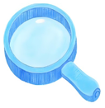
An awkward collision (1)
1.4(b) Catching an idea
In creating her own fictions and contemporary folklores Orchard playfully draws from our everyday. Of her intuitive process she states, “it’s like catching an idea – seeing a form in the garden or having an experience of a creature and catching that moment where it is inspiring, and you are not quite sure why. I’ll do a few drawings, make notes, do some more drawing, and I start making, I do it all by hand. I feel like I am talking to this evolving creature, and when I can look it in the eye, and we can laugh together – there is that communication. I want to pull together all those vibrations, different energies into a piece that has a life of its own.”
Jenny Orchard, quoted in Artist Profile – Jenny Orchard a new weird, wonderful by Lucy Stranger, Bandicoot Publishing PTY Ltd 2025
Jenny Orchard, Lost in the City at Night, 2016
Jenny Orchard, Change is possible, Hope is power, 2020
Jenny Orchard, Planetmind, 2020
Notes:
Questions to guide a class discussion:
Jenny Orchard describes part of her creative process as 'like catching an idea.' What do you think she means by this? Why might she choose these words to explain how her concepts take shape?
Orchard mentions doing a few drawings and making notes before beginning to make. What does this tell us about how she moves from an idea to making an artwork?
Orchard draws from ‘everyday’ experiences to create ‘contemporary folklores’. How might fictional characters or creatures help explore real-world ideas?
Visit the Despard Gallery via the link on the slide, select one collage and ask students:
What visual qualities can we see?
Where do you think she sources her images from?
How has she edited or extended the collage?
What is the effect of the hand drawn and handwritten elements?
References
Stranger, L. (2025). Artist Profile Jenny Orchard: A new weird, wonderful. Bandicoot Publishing Pty Ltd.
Orchard, J (2016) JENNY ORCHARD Lost in the City at Night 2016 Watercolour and collage on paper 76 x 56 cm Signed front $1950 - Despard Gallery, accessed 24 July 2025.
Orchard, J (2020) 25 JENNY ORCHARD Change Is Possible, Hope Is Power 2020 Paint and collage on paper 70 x 50 cm - Despard Gallery, accessed 24 July 2025.
Orchard, J (2020) 22 JENNY ORCHARD Planetmind (More Than Human Poster Series) 2020 Paint and collage on paper 59.5 x 42 cm - Despard Gallery, accessed 24 July 2025.

Slide 16
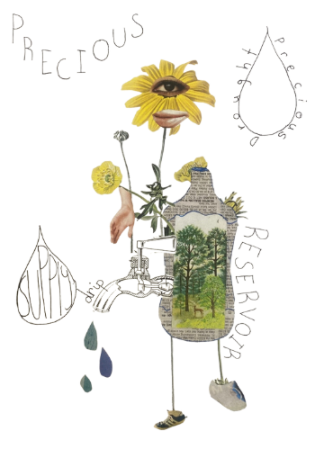
An awkward collision (2)
1.5(a) Generating ideas through experimentation with collage
Drawing inspiration from Jenny Orchard’s hybrid creations, design your own collaged creature by blending unusual images and words in creative ways.
As you work, allow a theme or idea to emerge naturally through your creative choices.
Notes:
This word association chain can be used to illustrate how the words water; rain and lake were used as inspiration for the creature in this collage.
Mermaid
Water
Ocean
Dark
Anglerfish
Teeth
Sharp
Claws
Raven
Flight
Clouds
Rain
Lake
Fish
Scale

Slide 17
An awkward collision (3)
1.5(b) Generating ideas through experimentation with collage
1. Start with words
Revisit your word association activity.
Highlight 2–3 words that stand out to you or spark your imagination.
Ask yourself: Which words seem interesting, emotional, or playful?
2. Gather imagery
Use your selected words as inspiration to collect images from magazines, books, or online sources.
Focus on unusual or contrasting elements, shapes, patterns, textures, animals, objects, or human features.
3. Illustrate and extend
Use text as a visual element to create movement, unity, pattern, and interest.
Your choice of words should emphasise your concept and compliment your collaged creature.

Slide 18
I see, I think, I wonder (1)
1.5(c) Awkward collision peer reflection
I see
Describe how the structural features and the elements evoke an emotional response for you
I think
Make subjective interpretations
I wonder
Speculate, inquire and be curious

Slide 19
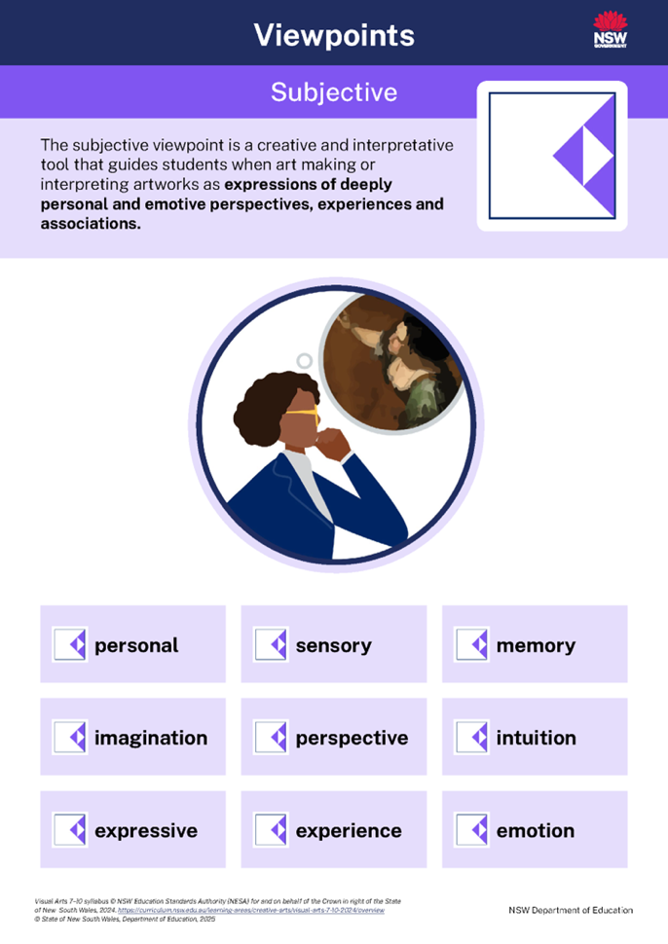
I see, I think, I wonder (2)
1.5(d) Awkward collision peer reflection
Focus on the subjective viewpoint in your peer reflection by asking thoughtful questions guided by these key words.

Slide 20
I see, I think, I wonder (3)
1.5(e) Awkward collision peer reflection
I see
Describe the structural features and which elements evoke an emotional response for you
I see expressive choices in colour and line that might reflect feelings of…..
I see how your use of space and layering creates a sensory or dream-like experience...
I see shapes and images that could connect to memory or imagination...
I think
Make subjective interpretations
I think you might have started with the words…….. because………
I think your work invites the viewer to imagine...
I think the collage communicates the theme of ……
I wonder
Speculate, inquire and be curious
I wonder what experience might have inspired this collage...
I wonder how the work would feel if you changed the colour to shift the emotion...
I wonder whether the composition was guided more by intuition or a specific plan...
Notes:
This slide is animated

Slide 21
Learning sequence 2 –
The Hermannsburg Potters

Slide 22
Learning intentions and success criteria (3)
We are learning to:
use the structural viewpoint to examine how the Hermannsburg Potters convey meaning and depict narratives on their clay vessels
communicate ideas through symbols
make a pinch pot.
I can:
use subject-specific language to describe the visual language of the Hermannsburg potters
develop representational symbols to communicate a narrative
use clay to make a pinch pot.
Notes:
Notes for teachers:
Learning intentions and success criteria are best co-constructed with students. Adapt the learning intention as required and add matching success criteria.
For more information See ⁠AITSL or the NSW Department of Education explicit teaching strategies, ⁠Sharing learning intentions and ⁠Sharing success criteria
LISC is not necessarily presented at the beginning of the lesson. Teacher needs to consider most effectual time to introduce
LISC should be revisited during the lesson to support students' evaluation of their learning

Slide 23
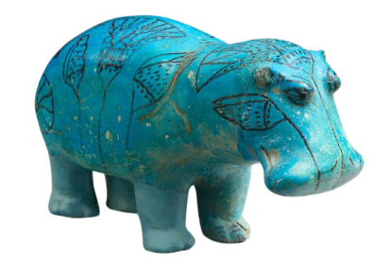
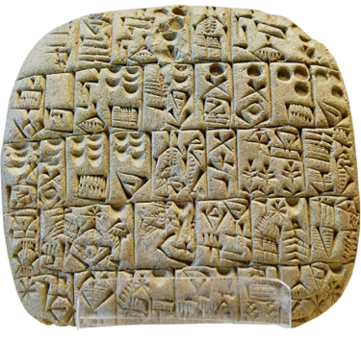
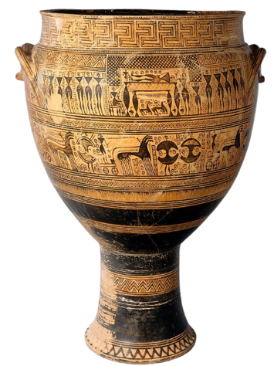
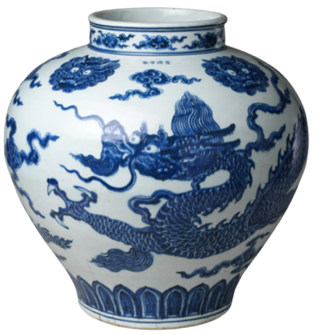
Clay – a material to tell stories
2.1
In ancient Mesopotamia clay tablets were used for
early writing systems to record laws, myths, trade,
and religious practices.
Ancient Egyptian clay figurines and pottery depicted gods,
daily life, and the afterlife, often included in tombs to tell
stories of the deceased's journey.
Circa 750–735 BCE, ancient Greece ceramic
vessels told visual stories of mythology, war,
daily life, and cultural values.
Chinese porcelain from the Ming dynasty in the early 15th century was adorned with symbolic motifs and narratives tied to nature, folklore, or poetry.
Notes:
Discussion points may include:
Bill of Sale – AO 3766 (Ancient Mesopotamia)
Function as a record.
It served as a physical record of a sale or transaction.
Gives audiences today a window into everyday life in ancient Mesopotamia
Hippopotamus ("William"), ca. 1961–1878 B.C. (Middle Kingdom Egypt)
Represents the Nile hippopotamus, a powerful creature associated with regeneration and the natural world.
Found in a tomb, ‘William’ likely had religious or protective purposes, communicating beliefs about the afterlife.
The decorative lotus flowers and aquatic motifs on its surface reference the Nile, reinforcing its symbolic link to nature and rebirth.
Terracotta Krater by the Hirschfeld Workshop, ca. 750–735 BCE (Ancient Greece)
Storytelling through imagery.
Decorated with geometric patterns and funerary scenes, it communicated cultural values about death and remembrance.
Used as a grave marker, it reinforced shared cultural practices and beliefs about the afterlife.
The abstract, simplified figures convey narrative in a symbolic way, relying on pattern and repetition.
Jar with Dragon, China, early 15th century (Ming Dynasty)
The dragon, often associated with imperial authority, strength, and good fortune, communicates political and spiritual power.
The jar reflects the height of Ming ceramic production, communicating national identity and pride through form and decoration.
Question: What might a contemporary version of these forms of communication look like in our world today?
Sample answers:
Digital receipts or contracts
Emojis, memes
Good luck charms
Books, video games
Question: Are these things tangible, can they be held in our hands?
Sample answers: Some are still physical, like printed receipts, packaging, or photo albums. Others are digital world and intangible.
Question: If so, what materials are they made of?
Sample answers: Paper, plastic, glass, various technology
Image references
Marie-Lan Nguyen (2005) Sales contract Shuruppak Louvre AO3766 [image] Wikimedia Commons, accessed 10 June 2025.
Riccardelli, C. (2017) Egyptian faience: Technology and production [image] The Metropolitan Museum of Art, accessed 10 June 2025.
Department of Greek and Roman Art (2004) Geometric art in ancient Greece [image] The Metropolitan Museum of Art, accessed 10 June 2025.
The Metropolitan Museum of Art (n.d.) Jar with dragon [image], accessed 30 June 2025.

Slide 24

The Hermannsburg Potters (1)
2.2(a) Sculpting narratives
The Hermannsburg Potters are Aranda (Arrernte) artists.
Who?
When?
Where?
What?
Why?
How?
QAGOMA The full-bodied vessels of the Hermannsburg Potters document their culture, Bruce McLean 2018
Notes:
Read QAGOMA The full-bodied vessels of the Hermannsburg Potters document their culture, Bruce McLean 2018 aloud with the students.
Questions and answers
Who?
Hermannsburg Potters (all women), Western Arrernte people
When?
1990s, establishment of the Hermannsburg Pottery
What?
Hand-built pottery with painted surfaces
Figurative lids and landscape decoration
Artistic self-expression and cultural storytelling
Where?
Ntaria (Hermannsburg Mission), Northern Territory, Australia
Why?
To create livelihoods
To document and express culture and daily life
To continue a visual storytelling tradition
To engage with tourism and global audiences
How?
Hand-coiled pottery techniques
Painted decoration inspired by Hermannsburg School
Community-driven arts practice
References
McLean, B. (2018, May 16). The full-bodied vessels of the Hermannsburg Potters document their culture. Queensland Art Gallery | Gallery of Modern Art. https://www.qagoma.qld.gov.au/stories/full-bodied-vessels-of-the-Hermannsburg-Potters-document-their-culture
Hermannsburg Potters. (n.d.). Hermannsburg Potters: Aranda Artists of Central Australia. Accessed June 26, 2025, from https://www.hermannsburgpotters.com.au/
Gattermayr, S. (2021, May). Building New Legacies With The Hermannsburg Potters. The Design Files. Accessed May 23, 2025, from https://thedesignfiles.net/2021/05/art-hermannsburg-potters

Slide 25

The Hermannsburg Potters (2)
2.2(b) Sculpting narratives
Who? The Hermannsburg Potters,
When? who began their work in …………..,
Where? at…………..
What? make/produce/create …………..
Why? that/to …………..
How? using …………..
The Hermannsburg Potters, who began their work in the 1990s in Ntaria, create hand-built pots with painted landscapes and sculpted lids that tell stories about their culture and daily life, using coiling techniques and the Hermannsburg School style of painting.
Hermannsburg Potters: Aranda Artists of Central Australia
Building New Legacies With The Hermannsburg Potters, Sasha Gattermayr, The Design Files, 2021
Notes:
This slide is animated
Visit Hermannsburg Potters: Aranda Artists of Central Australia to show students an animated pot in the round on the homepage.
Visit Building New Legacies With The Hermannsburg Potters, Sasha Gattermayr, The Design Files, 2021 to show students photographs of the Hermannsburg Potters engaging in artmaking practice
Questions and answers
Who?
Hermannsburg Potters (all women), Western Arrernte people
When?
1990s, establishment of the Hermannsburg Pottery
What?
Hand-built pottery with painted surfaces
Figurative lids and landscape decoration
Artistic self-expression and cultural storytelling
Where?
Ntaria (Hermannsburg Mission), Northern Territory, Australia
Why?
To create livelihoods
To document and express culture and daily life
To continue a visual storytelling tradition
To engage with tourism and global audiences
How?
Hand-coiled pottery techniques
Painted decoration inspired by Hermannsburg School
Community-driven arts practice
References
McLean, B. (2018, May 16). The full-bodied vessels of the Hermannsburg Potters document their culture. Queensland Art Gallery | Gallery of Modern Art. https://www.qagoma.qld.gov.au/stories/full-bodied-vessels-of-the-Hermannsburg-Potters-document-their-culture
Hermannsburg Potters. (n.d.). Hermannsburg Potters: Aranda Artists of Central Australia. Accessed June 26, 2025, from https://www.hermannsburgpotters.com.au/
Gattermayr, S. (2021, May). Building New Legacies With The Hermannsburg Potters. The Design Files. Accessed May 23, 2025, from https://thedesignfiles.net/2021/05/art-hermannsburg-potters

Slide 26
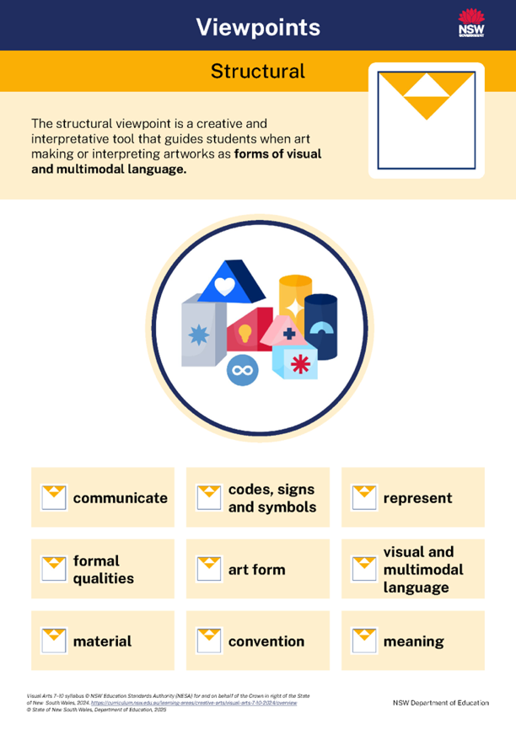
Looking through the structural viewpoint (1)
2.2(c) The visual language of the Hermannsburg Potters
Image placeholder for
Potters’ Portrait Pot
by The Hermannsburg Potters, 2009
The Hermannsburg Potters (2009) Potters’ Portrait Pot
[image] accessed 20 May 2025.
Notes:
Reference
The Hermannsburg Potters (2009) Potters’ Portrait Pot [image] accessed 20/5/2025.

Slide 27


Looking through the structural viewpoint (2)
2.2(d) The visual language of the Hermannsburg Potters
Image placeholder for
Potters’ Portrait Pot
by The Hermannsburg Potters, 2009
Symbols communicate meaning between artists and audiences. The symbols used by the Hermannsburg Potters are representational or figurative which means they appear as they would look in the visible world.
Although these symbols are stylised and simplified, we can clearly see what they represent.
They have been objectively presented by the artists.
Representational – shows something real and identifiable
Figurative – shows human or animal forms in particular
The Hermannsburg Potters (2009) Potters’ Portrait Pot
[image] accessed 20 May 2025.
View National Portrait Gallery | Potters’ Portrait Pot
Read Of human clay by Michael Desmond
Notes:
Play the video ’National Portrait Gallery Trumble Tour Potter’s Portrait Pot (Part 10)’. There is a link to the video on the slide.
Question: How does the Potter’s Portrait Pot differ to more familiar forms of portraiture?
Sample answer: This is not an image of a face; it is three dimensional and includes paintings of the land and animals as symbols of the people that it represents. More than one person is represented and there are 3 female figure on the lid.
Question: What does this collective self portrait say way that the Hermannsburg Potter see themselves?
Sample answer: They see themselves as connected to Country and feel part of a boarded sense of community and tradition.
Ask student to:
Closely observe the Potter’s Portrait Pot by the Hermannsburg Potters.
Make observational drawings of symbols that you see.
Label your drawings and write descriptions of the symbols alongside your drawings.
Descriptions may include:
Hand-painted symbols on a sculptural pot
A narrative that honours a tradition of telling a story
Personal and communal experiences
Landscape and Country
Everyday life and community
Cultural practices
Totemic animals
Plants
Scenes of daily life
Flora and fauna
The pot is like a three-dimensional storybook
Read ‘Of human clay’ by curator Michael Desmond, using the link on the slide.
Reference
The Hermannsburg Potters (2009) Potters’ Portrait Pot [image] accessed 20/5/2025.
Desmond, M. (2009) Of human clay National Portrait Gallery, accessed 12 March 2025.
The National Portrait Gallery (2016) National Portrait Gallery | Potters’ Portrait Pot [video], accessed 22 February 2025

Slide 28
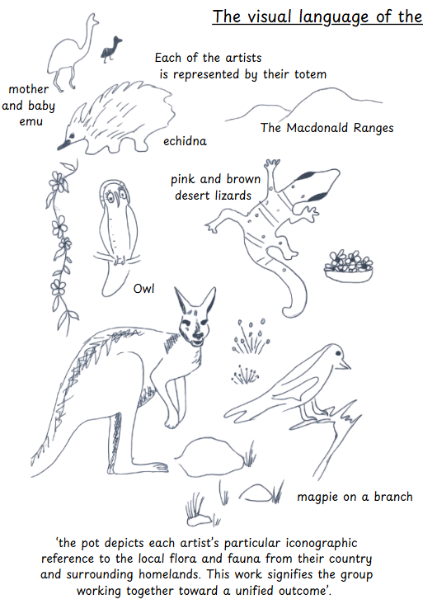
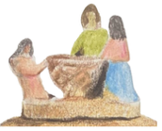


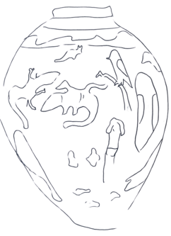
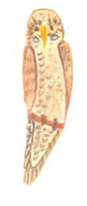

Looking through the structural viewpoint (3)
2.2(e) The visual language of the Hermannsburg Potters
The visual language of the Hermannsburg Potters
The Hermannsburg Potters bring their stories to life through a visual language of figurative forms, often stylised with simplified flat planes of colour, framed with a black outline.
Their work often features sculptural lids shaped into humans and animal figures that embody cultural identity and narrative. Painted surfaces depict representational imagery of landscapes, community life, and events, creating vivid visual storytelling. These elements work together to honour tradition, place, and lived experience through bold and meaningful symbolism.
Notes:
This slide is animated
Click to reveal the passage ‘The visual language of the Hermannsburg potters’ read it aloud and model how the terms representational, figurative, stylised and simplified can be used to talk about artworks.
Image reference
Prepared by Curriculum Advisor

Slide 29
The visual language of the Hermannsburg Potters (1)
2.2(f) Tiered vocabulary
Figurative
representational
stylised, simplified
sculptural, iconographic
Tier 3
New terms or academic language that is specifically associated with the visual arts.
Narrative, symbolism
embody, identity
Tier 2
High-utility academic language that we use to form our body of knowledge. These words are used across subject areas.
Animals, clay, landscapes, colours
Tier 1
Everyday language.
Notes:
Tier 3 – new subject specific words that we learn about in different subjects.
Tier 2 – words that we hear and may need to consider using in our writing and discussions when using our new tier 3 words. These words are used across subjects. Where else do we hear the word narrative?
Tier 1 – our common everyday words that we often use when speaking

Slide 30


The visual language of the Hermannsburg Potters (2)
2.2(g) Noun groups
Expand one of your descriptions to include noun groups that offers specific details about the symbol.
A brown owl
A _______owl is confidently perched on a ________ branch.
Its _________feathers are painted with ________, ________ strokes that follow the
curve of its ________ wings. The owl's ________, ______ gaze suggests wisdom and quiet strength.
Notes:
Some examples include;
A brown owl
A single owl
A wide-eyed owl
An observant owl
A poised owl
A protective owl

Slide 31
The visual language of the Hermannsburg Potters (3)
2.2(h) Noun groups
Adjective – describing words
Noun – person, place or thing
A brown owl
A brown owl is confidently perched on a leafless branch.
Its layered feathers are painted with short, rhythmic, repetitive strokes that follow the curve of its stiff outer wings. The owl's direct, peering gaze suggests wisdom and quiet strength.

Slide 32
Ray Mudjandi (1)
2.3(a) Black Speed
Read Ray Mudjandi – Tarnanthi 2023 Education Resource
How does Ray Mudjandi use his environment and lived experiences to develop his superhero character?
In what ways does this story reflect traditional storytelling practices in clay?
How does the origin story of Black Speed contribute to the power and meaning of the artwork?
Why is storytelling through art an important way to share cultural knowledge and identity?
Image placeholder for
Black Speed by
Ray Mudjandi, 2024
Ray Mudjandi (2024) Black Speed [image]
accessed 20 May 2025.
Notes:
References
Ray Mudjandi (2024) Black Speed [image] accessed 20/5/2025
Art Gallery of South Australia (2023) Ray Mudjandi – Tarnanthi 2023 Education Resource, accessed 26 June 2025.

Slide 33
Ray Mudjandi (2)
2.3(b)Tiered vocabulary
Sculptural relief,
graphic style,
cartooning,
cultural iconography,
Pop Art aesthetic, hand-built vessel
Tier 3
New terms or academic language that is specifically associated with the visual arts.
Identity, heroism, resilience, aspiration, dynamic, animated, exaggerated, imagery
Tier 2
High-utility academic language that we use to form our body of knowledge. These words are used across subject areas.
Lightening bolt, action, superhero, youth, culture, fun, strength, movement
Tier 1
Everyday language.

Slide 34
Ray Mudjandi (3)
Tier 1 and 3 language
‘Black Speed’ is a hand-built vessel decorated with cultural iconography in a graphic style. Sculptural relief shows a superhero in motion with a lightning bolt.
2.3(c)Tiered vocabulary sample sentences
Sculptural relief,
graphic style,
cartooning,
cultural iconography,
Pop Art aesthetic, hand-built vessel
Tier 1, 2 and 3 language
In ‘’Black Speed, Ray Mudjandi blends superhero imagery with a graphic style to explore themes of identity, resilience, and aspiration, celebrating youth and culture through a dynamic, animated figure built up in a sculptural relief.
Identity, heroism, resilience, aspiration, dynamic, animated, exaggerated, imagery
Lightening bolt, action, superhero, youth, culture, fun, strength, movement
Tier 1 language only
‘Black Speed’ shows lots of movement and action, with a big lightning bolt that makes it feel strong and exciting.
Notes:
The second sample sentence that includes Tier 2 language is stronger because it uses Tier 2 words that help the writer to deepen their interpretation and makes the sentence more analytically rich.

Slide 35
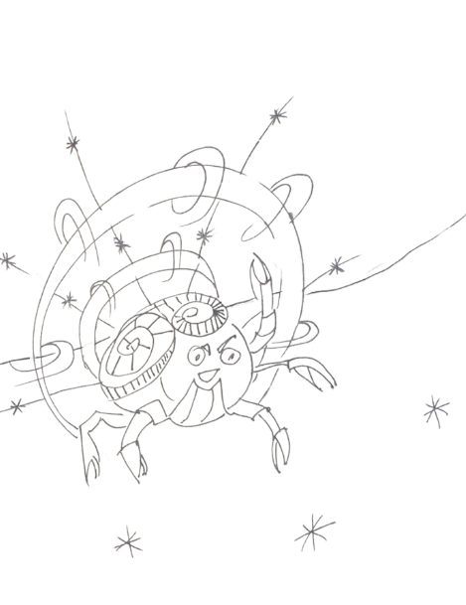
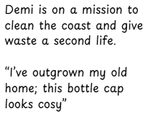
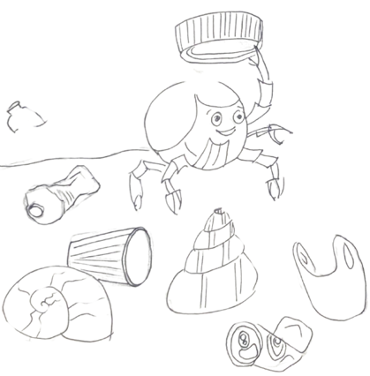
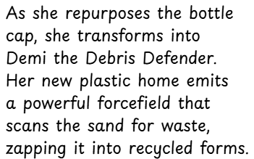
Telling stories
2.3(d) Symbols and superheroes
Design your own superhero who represents a cause or issue that is meaningful to you.
Like the frames in a comic strip, develop a visual narrative about this superhero.
Your symbols will represent key aspects of your superhero’s story and should be arranged
against the land, sea or sky in the style of the Hermannsburg Potters.
You will practice working with clay by making a pinch pot and illustrating this visual narrative on its surface.

Slide 36
The lifecycle of clay
2.4(a)
1. Slip
Clay suspended in water, can be used for joining, decorating and moulding clay forms.
2. Plastic
Wet workable clay strong enough to hold its own shape and bend without breaking.
3. Leather hard
Drying clay that has some flexibility but will crack when bent. It is cold to touch and a good stage for carving.
4. Bone dry
Dry clay that has no flexibility, is fragile and appears much lighter than when it was plastic. Bone dry clay is ready to fire.
5. Bisqueware
Clay that has been fired once in a kiln and has permanently hardened but is still porous. Any water or organic matter is driven out of the clay.
6. Glazeware
Glazeware has been fired a second time at a higher temperature, this time with a coat of glaze applied to its surface. During this firing, a process called vitrification takes place. This means the clay particles begin to melt slightly and fuse together, making the ceramic hard, dense, and no longer porous. The glaze also melts and forms a smooth, glass-like coating, which protects the finished piece.
Notes:
This slide is animated
Play video 3 ‘The lifecycle of clay’ Ceramics – Materials in Practice (5:05).
Link: https://education.nsw.gov.au/teaching-and-learning/curriculum/creative-arts/creative-arts-curriculum-resources-k-12/7-10-curriculum-resources/visual-arts-7-10-mip-ceramics#Introduction0

Slide 37
The stages of clay
2.4(b)Tiered vocabulary –Tracking our conscious knowledge of text
Bisqueware, slip, vitrification, glazeware, kiln, bone dry, leather hard, kiln
Tier 3
New terms or academic language that is specifically associated with the visual arts.
Organic matter, fragile, plastic, fused, porous
Tier 2
High-utility academic language that we use to form our body of knowledge. These words are used across subject areas.
Ceramic, clay, decorated, carved, dry, wet
Tier 1
Everyday language.

Slide 38

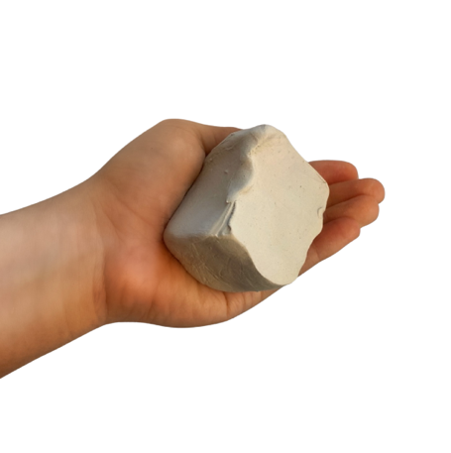
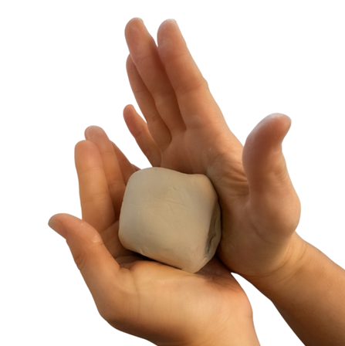
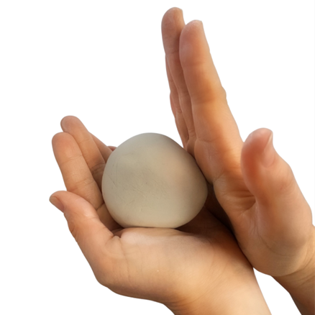
Making a pinch pot (1)
2.5(a)
1
2
3
Take a piece of clay that fits comfortably in your palm.
Firmly tap any corners or flat edges of the clay into a sphere using the palm of your other hand.
Continue to rotate the clay on your palm while tapping it into an even ball.

Slide 39
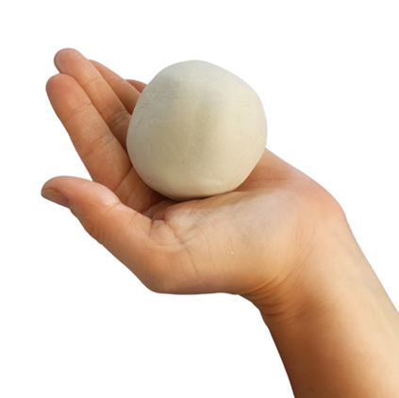
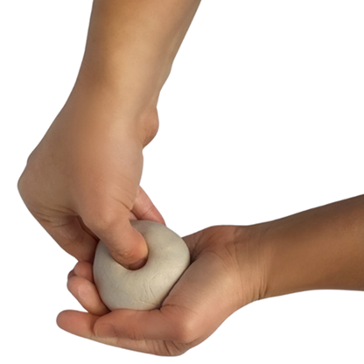
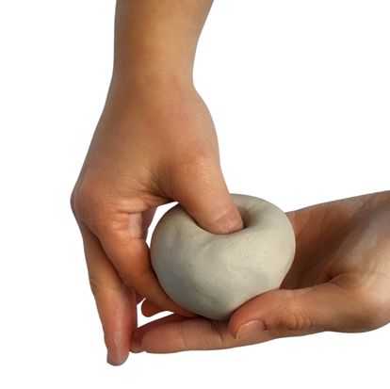
Making a pinch pot (2)
2.5(b)
4
5
6
Use your thumb and index finger to measure the depth of the indent. The base of the pot and the walls should be approximately the same width.
Hold the evenly formed ball of clay in your flat palm.
Gently press your thumb directly into the centre of the ball aiming downwards until you reach two thirds of the way down.

Slide 40
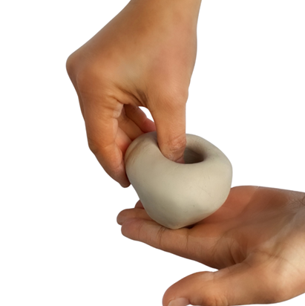
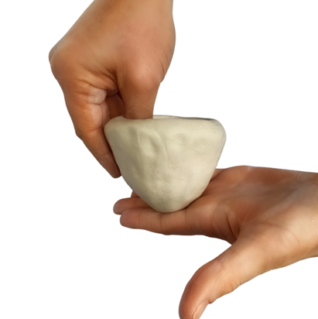
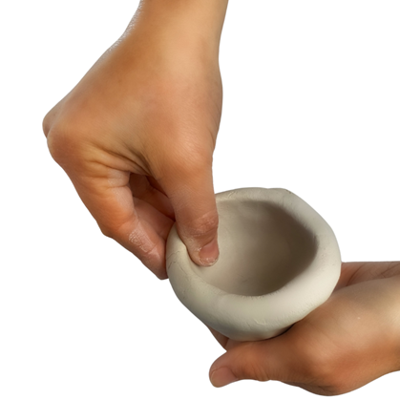
Making a pinch pot (3)
2.5(c)
7
8
9
Starting from the lowest point of the pot, gently pinch and rotate the clay. Work slowly to maintain control.
Keep your hand vertical and continue to turn and gently pinch the walls of the pot upwards not outwards.
Maintain even pressure as you make your way around the pot and towards the top.

Slide 41
Joining pinch pots (1)
2.5(d)
Watch video 5, 'Building technique – pinch pots’ (2:20-8:20 minutes)
Use a toothbrush to create a textured surface along the rims of both pinch pots.
Apply vinegar to the rims, line the pinch pots up so that that the rims touch and gently apply pressure from the top and bottom of the newly formed sphere.
Blend the clay across the join with your thumb by dragging your thumb up and down across the join to secure both pots to one another.
Add a soft, plastic coil along the seam to strengthen fill any gaps.
Smooth the surface of the sphere with a rubber kidney tool or your thumb. At this point your form will be airlocked.
Tap the sphere into your desired shape with a paddle or the palms of your hands. At this stage you can elongate the form and tapper the base.
Notes:
Next lesson- The form will have firmed up a bit more but will not have reached leather hard stage yet. If it has, spray it with a fine mist of water and rewrap it to allow the water to seep into the clay.
Continue to smooth and refine the surface of the pot.

Slide 42
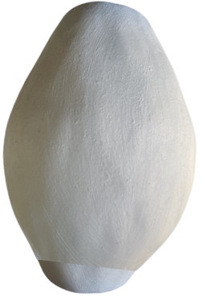
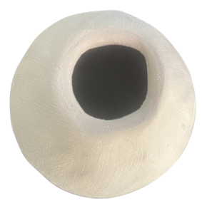
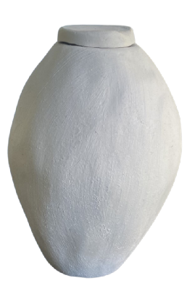
Joining pinch pots (2)
2.5(e)
Once you have roughly achieved the form that you would like, use a potter’s knife to cut a small opening in the top of the form.
Wrap this excess clay as it will form your lid.
Place the form on a table and gently tap it up and down to create a flat base.
Gently shape the pot using your hands to achieve your desired shape.
Smooth the surface with your hand and avoid adding water where possible.
Wrap your pot with plastic, label it with your name and class and place it in a container to prevent it from drying out.
Notes:
Next lesson- The form will have firmed up a bit more but will not have reached leather hard stage yet. If it has spray it with a fine mist of water and rewrap it to allow the water to seep into the clay.
Continue to smooth and refine the surface of the pot.

Slide 43
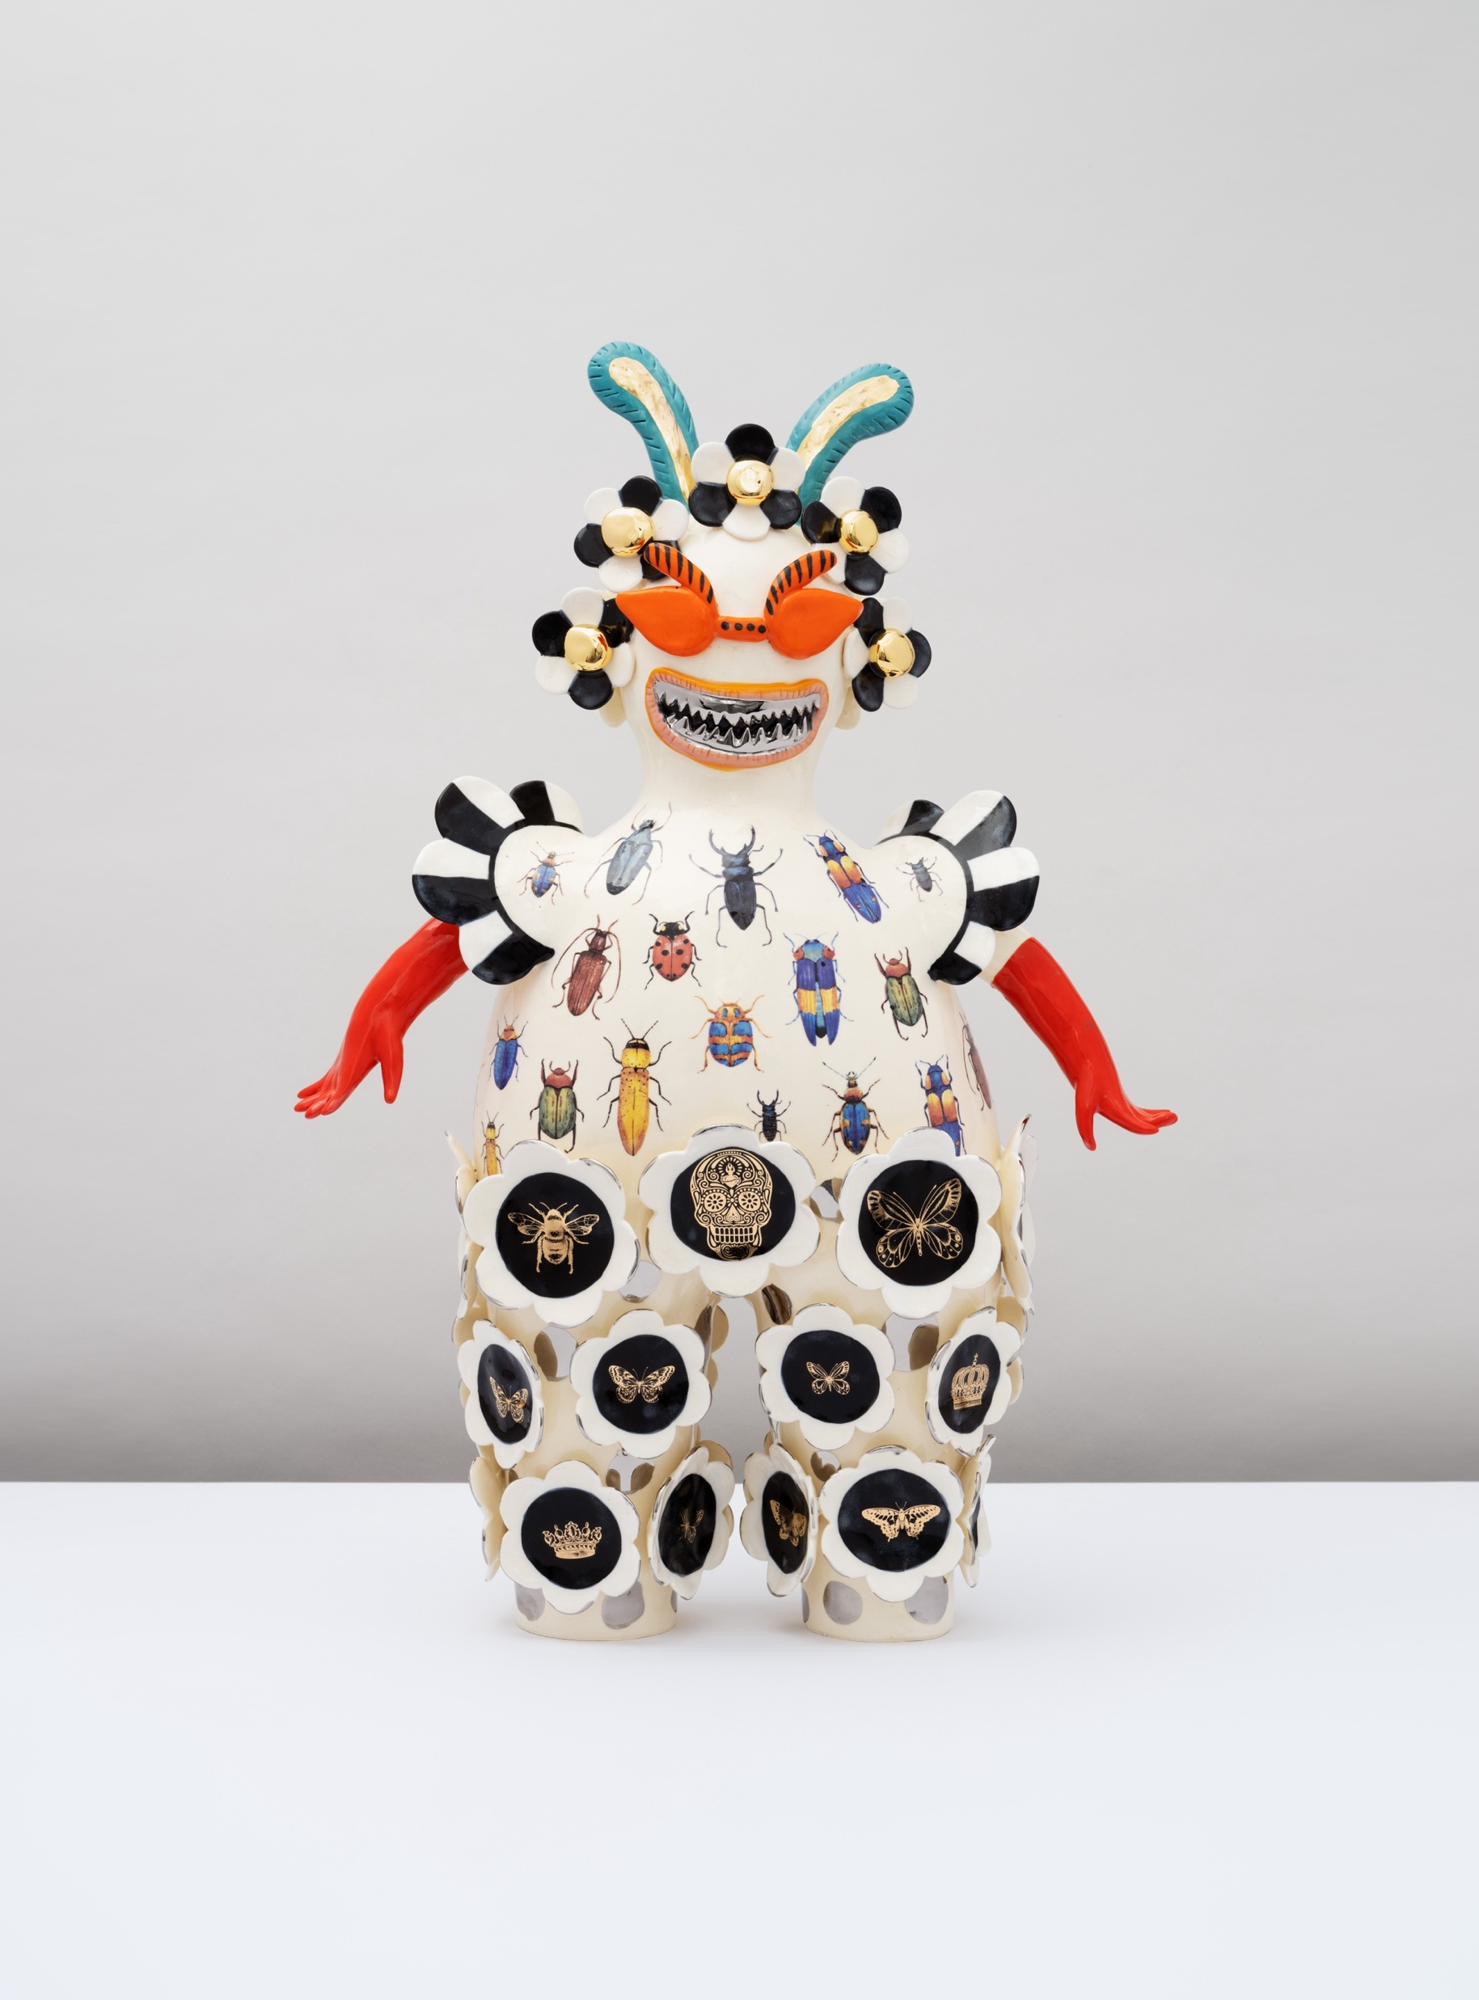
Learning sequence 3 –
Vipoo Srivilasa
‘Climate Change Bug Ball’, 2022 distribution permissions for Secondary Curriculum, Curriculum and Reform Directorate of NSW Department of Education, granted by © Vipoo Srivilasa, 2025

Slide 44
Learning intentions and success criteria (4)
We are learning to:
investigate Vipoo Srivilasa’s artmaking practice using the Artworld concepts of artist, artwork, world and audience
I can:
use the artworld concepts to investigate Vipoo Srivilasa’s practice
identify and describe the visual language of Vipoo Srivilasa’s artworks
use the subjective viewpoint to interpret and explain meaning in Vipoo Srivilasa’s artworks
Notes:
Notes for teachers:
Learning intentions and success criteria are best co-constructed with students. Adapt the learning intention as required and add matching success criteria.
For more information See ⁠AITSL or the NSW Department of Education explicit teaching strategies, ⁠Sharing learning intentions and ⁠Sharing success criteria
LISC is not necessarily presented at the beginning of the lesson. Teacher needs to consider most effectual time to introduce
LISC should be revisited during the lesson to support students' evaluation of their learning

Slide 45
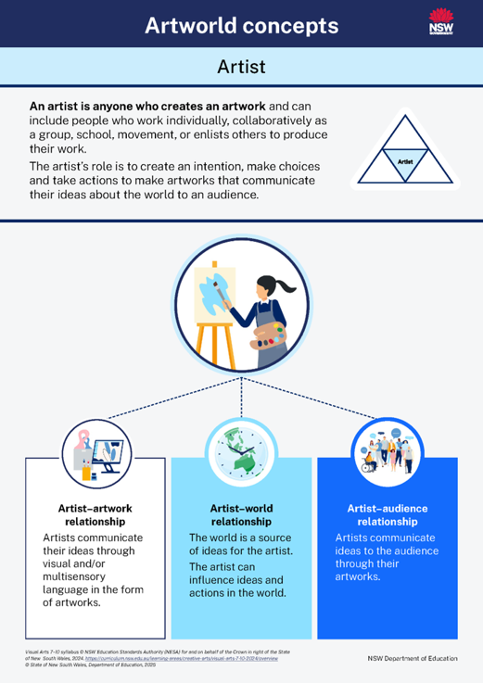
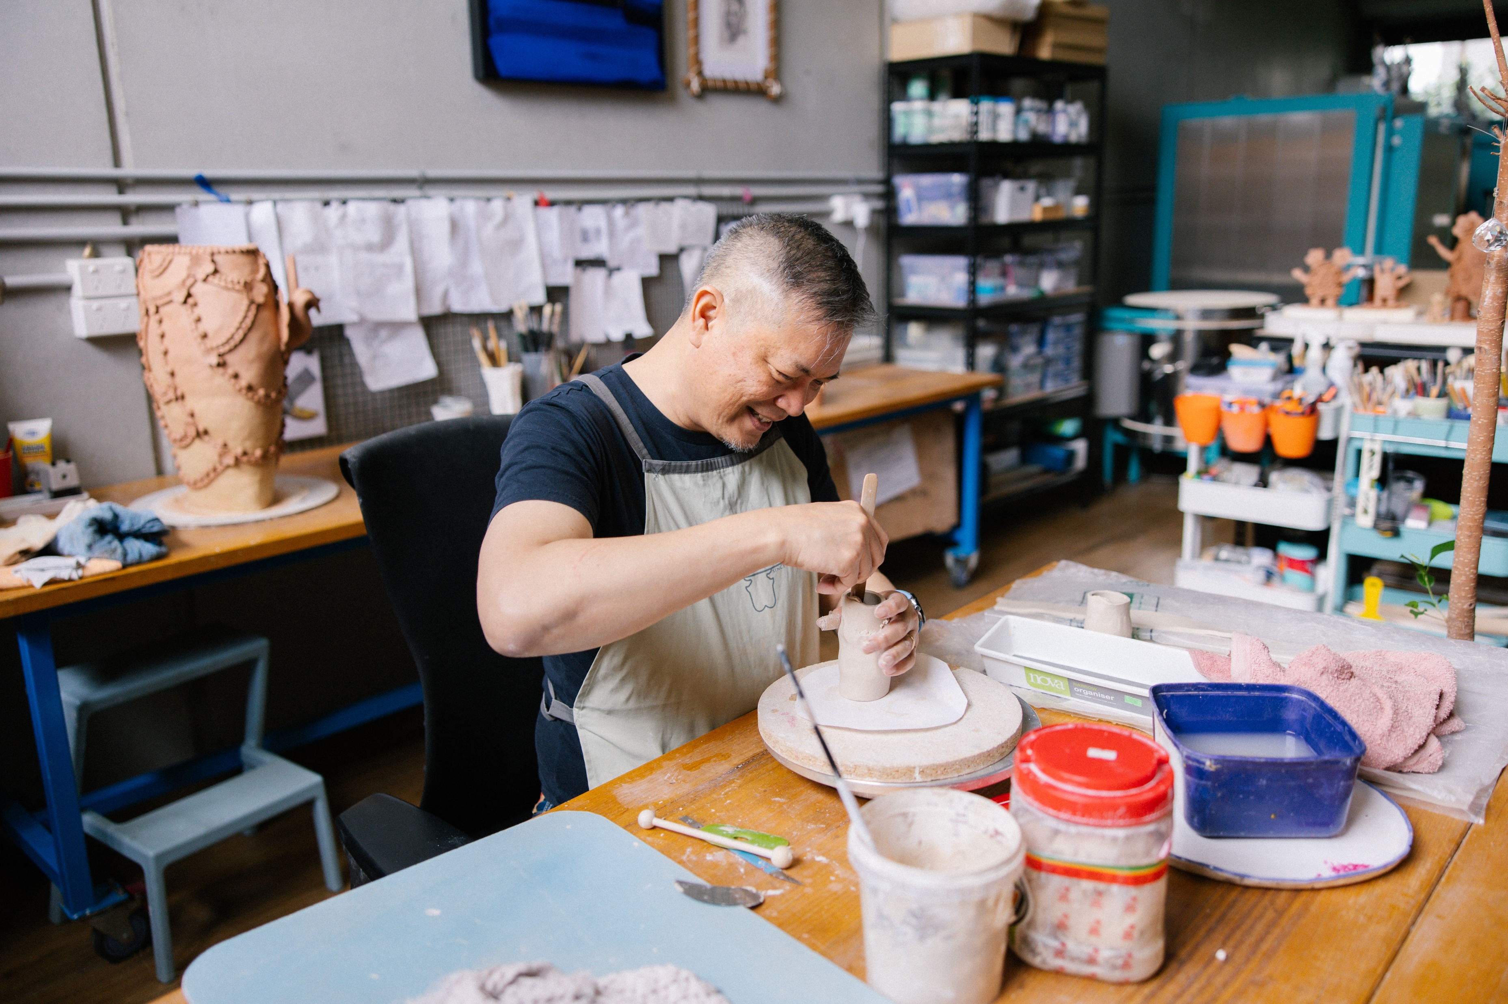
Vipoo Srivilasa (1)
3.1(a) Artist
Vipoo Srivilasa, born in Bangkok in 1969, is a Thai-Australian ceramicist whose practice is grounded in joy, gratitude, and a deep curiosity about the world around him. A humanist at heart, he often includes autobiographical or universal themes such as love, grief, joy, spirituality, or responsibility.
Srivilasa is known for his distinctive intricate and layered decorations that are influenced by the ornate Buddhist temples he encountered growing up in Thailand. He describe this aesthetic as “more is more”.
Vipoo Srivilasa asks what is it to live in this work right now, the uncertainty of Covid 19, isolation, obsession and digital networks, relationships with pets and each other and how to turn these subjects into artworks.
Image courtesy of Vipoo Srivilasa. Photograph by Jessica Tremp, distribution permissions for Secondary Curriculum, Curriculum and Reform Directorate of NSW Department of Education, granted by © Vipoo Srivilasa, 2025.
View Olsen Gallery, Vipoo Srivilasa 'Always better together’
Notes:
This slide is animated
Examples of Tier 2 words on this slide include:
gratitude
curiosity
humanist
autobiographical
Universal themes
spirituality
responsibility
distinctive
intricate
aesthetic
uncertainty
isolation
obsession
Video reference
The Olsen Gallery (2022) Vipoo Srivilasa ‘Always better together’[video] accessed 16/2/2025.
Image courtesy of Vipoo Srivilasa. Photograph by Jessica Tremp, distribution permissions for Secondary Curriculum, Curriculum and Reform Directorate of NSW Department of Education, granted by © Vipoo Srivilasa, 2025

Slide 46
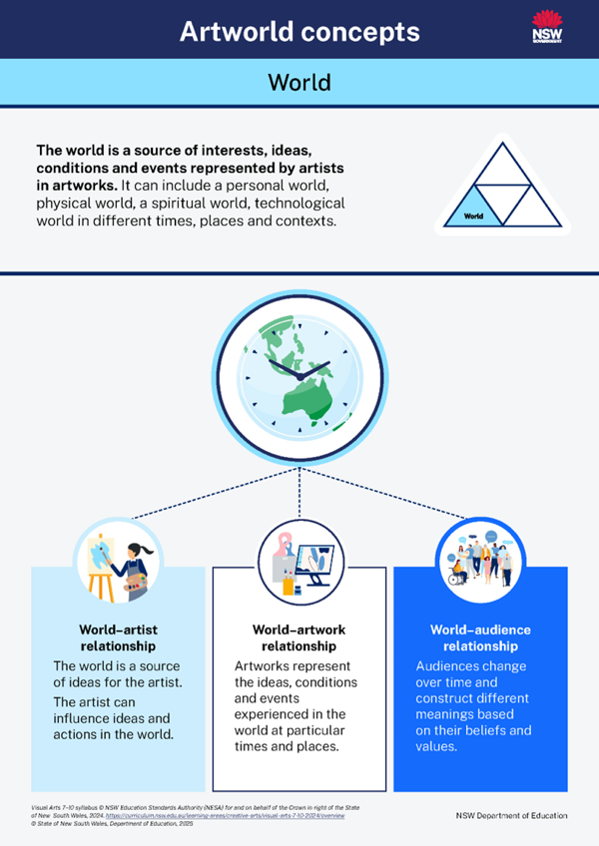
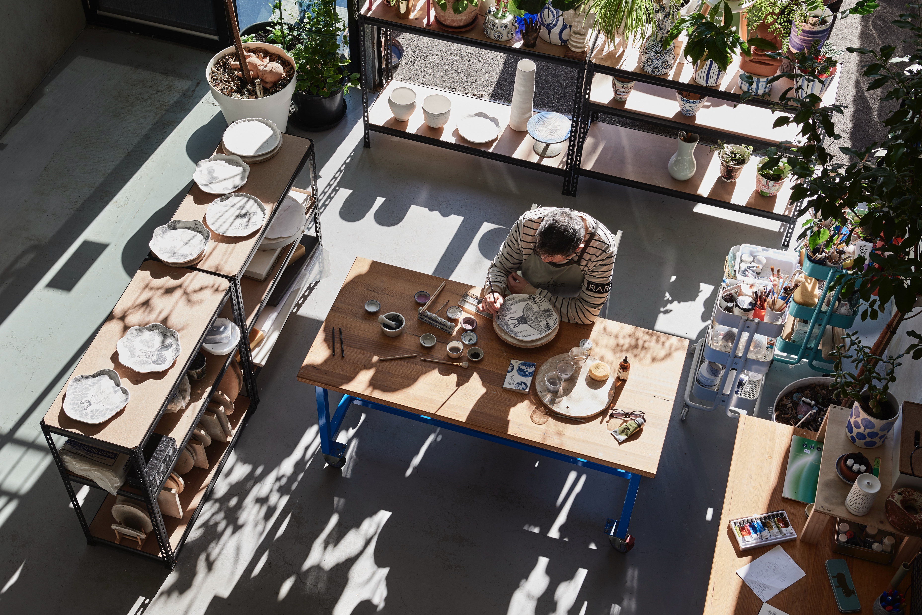
Vipoo Srivilasa (2)
3.1(b) World
His art practice is a response to the complexities of living between cultures and reflects his observations of global challenges and personal experiences.
He often draws on ritual practices, memory, and sensory experience, showing how the personal issues such as migration, identity, belonging and contemporary life impact on broader social and political issues such as multiculturalism, globalisation, inclusion and tradition.
He creates spaces where viewers are encouraged to reflect on their own emotions, behaviours, and responsibilities in a rapidly changing world.
Through ceramics, he builds a bridge between the self and the world; between imagination and lived reality.
Image courtesy of Vipoo Srivilasa. Photograph by Eve Wilson, distribution permissions for Secondary Curriculum, Curriculum and Reform Directorate of NSW Department of Education, granted by © Vipoo Srivilasa, 2025.
Notes:
This slide is animated

Slide 47
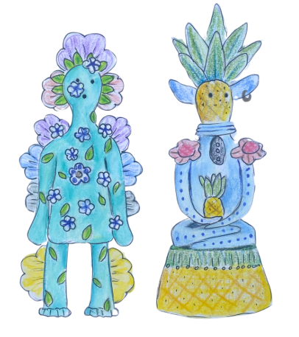
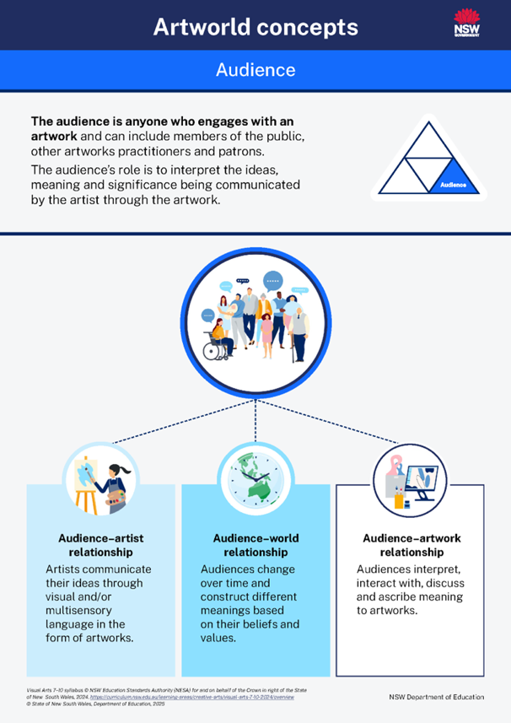
Vipoo Srivilasa (3)
3.1(c) Audience – Collaboration on Wellness Deity
What have art critics said about Vipoo Srivilasa’s artworks?
“Central to Vipoo Srivilasa’s creative practice is art’s ability to elicit the sense of joy, whilst also acting as a conduit for serious issues...”
Nikita Holcombe (2022) Vipoo Srivilasa [Artist Profile], accessed 5 June 2025
“Srivilasa’s Wellness Deity harnessed the power of art to forge connections during a time of isolation.”
Celina Lei (2021) Exhibition Review: Vipoo Srivilasa: Wellness Deity, Linden New Art [ARTS hub], accessed 10 June 2025
Vipoo Srivilasa uses humour and charm to spark audiences’ curiosity; they often find that on closer inspection, his work reveals layered and thought-provoking ideas. What begins as an amusing encounter gradually unfolds into deeper reflections on spirituality, mental health, nationalism, climate change, and cultural values. His symbolic sculptures act as gentle prompts, encouraging viewers to consider their own place in the world.
Collaboration is an important part of his art practice, and he regularly takes part in community-driven projects such as ‘Wellness Deity’, which he undertook during the COVID lockdowns.
By inviting audiences into the storytelling process, he fosters dialogue, connection, and a sense of belonging, using art as a bridge across cultural divides.
“When you work with your hands, it does something to loosen the mind. It helps people to open up.”
Watch Vipoo Srivilasa collaborate
Vipoo Srivilasa on making stunning
porcelain deities | Art Works
Notes:
This slide is animated
Tier 2 words in these quotes include:
Central
Creative
Practice
Ability
Elicit
Sense
Conduit
Issues
Harnessed
Power
Forge
Connections
Isolation
Video reference
Art Works (2022) Vipoo Srivilasa on making stunning porcelain deities [video] accessed 16/2/2025

Slide 48
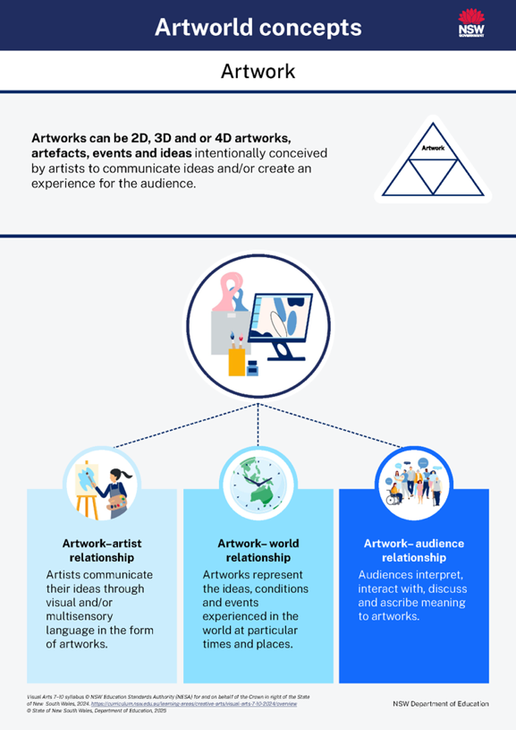

Vipoo Srivilasa (4)
3.1(d) Artwork – Happy Australian – Climate Change Bug Ball
Vipoo Srivilasa often uses porcelain clay and fires it in a kiln to 1200 degrees Celsius to achieve a stark whiteness. His highly decorative, fantastical ceramic figures are vehicles for storytelling and their cuteness belies a deeper political and social commentary.
Srivilasa’s Happy Australian is a collaborative series of ten ceramic portraits inspired by submissions of people designing their most ‘Australian Eleganza Extravaganza outfit’ to wear on the happiest occasion of their life.
Explore Vipoo Srivilasa Happy Australians, 2023
Read about Vipoo Srivilasa’s inspiration for Climate Change Bug Ball at N Smith Gallery.
‘Climate Change Bug Ball’, 2022 distribution permissions for Secondary Curriculum, Curriculum and Reform Directorate of NSW Department of Education, granted by © Vipoo Srivilasa, 2025.
Notes:
This slide is animated
References
Srivilasa, V. (2022). Climate Change Bug Ball [Ceramic sculpture]. N.Smith Gallery. Retrieved June 30, 2025, from https://www.nsmithgallery.com/artworks/6643-vipoo-srivilasa-climate-change-bug-ball-2022/
Srivilasa, V. (2023). Happy Australian. Vipoo Srivilasa. Accessed June 30, 2025, from https://www.vipoo.com/projects/happy-australian
Srivilasa, V. (2022). Climate Change Bug Ball [article]. N.Smith Gallery. Accessed June 30, 2025, from https://www.nsmithgallery.com/artworks/6643-vipoo-srivilasa-climate-change-bug-ball-2022/

Slide 49
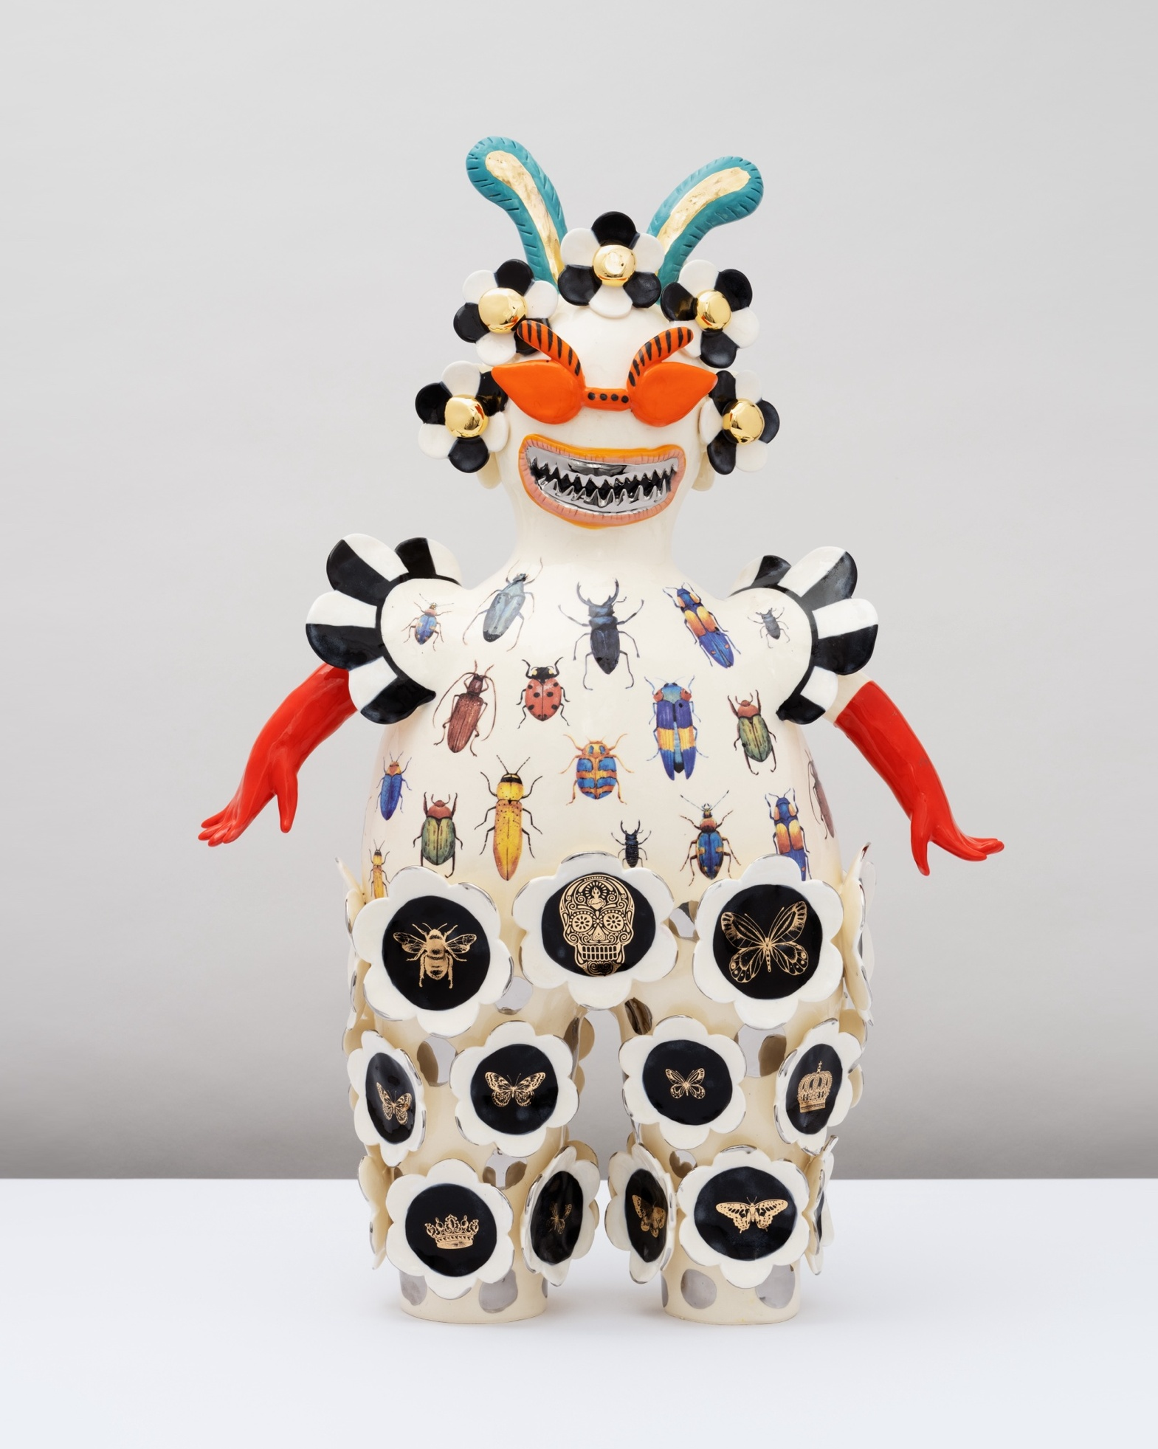
The visual language of Vipoo Srivilasa (1)
3.1(e) Artwork – Happy Australian – Climate Change Bug Ball
Vipoo Srivilasa’s symbols often go beyond their literal or representational appearance. They function as carriers of layered abstract meaning. His sculptures are allegorical and communicate complex narratives.
Allegory – A story that expresses a big idea using characters or symbols instead of words.
Allegorical symbols represent ideas beyond their actual form.
For example, a ceramic koala could represent identity, belonging, habitat destruction or human responsibility. The koala stands form more that its observable features.
Srivilasa’s approach to symbolism is associative, which means the meanings don’t come from just one place. He connects ideas from different sources to build rich, complex meanings. His symbols are not fixed, they are open to different interpretations.
‘Climate Change Bug Ball’, 2022 distribution permissions for Secondary Curriculum, Curriculum and Reform Directorate of NSW Department of Education, granted by © Vipoo Srivilasa, 2025.

Slide 50
The visual language of Vipoo Srivilasa (2)
3.1(f) Artwork – Happy Australian – Climate Change Bug Ball
Closely observe ‘Climate Change Bug Ball’.
Make observational drawings of symbols that you see.
Label your drawings and write descriptions of the symbols alongside your drawings. Remember to expand your descriptions to include noun groups.
Symbol examples:
Flower motifs
Coloured bugs
Skulls
Gold outlines on black
Orange glasses
Red gloves
Black and white stripes
Frills
Blocks of flat colour
Circular forms
Embellishments
‘Climate Change Bug Ball’, 2022 distribution permissions for Secondary Curriculum, Curriculum and Reform Directorate of NSW Department of Education, granted by © Vipoo Srivilasa, 2025.
Notes:
This slide is animated
Click to reveal a list of symbol examples.

Slide 51
The visual language of Vipoo Srivilasa (3)
3.1(g) Artwork – Happy Australian – Climate Change Bug Ball
Vipoo Srivilasa’s symbolic visual language draws from mythology, folklore, pop culture, and personal memory. His approach to symbolism is associative and layered, transforming fantastical creatures, native fauna, and decorative motifs into conceptual sculptural forms.
His intricately embellished figurines are playful and exaggerated, embodying complex narratives about themes such as spirituality, tradition, identity, and consumer desire.
Through rich symbolism, Srivilasa creates allegorical narratives that tell stories, inviting viewers to look closely and interpret meaning. His use of repetition, decorative detail, and clustered figures draws the audience into the storytelling process.
Rather than offering a single fixed meaning, Srivilasa’s sculptures are open to multiple interpretations, they encourage viewers to engage with the work as co-readers of their visual language.
Notes:
Read ‘The visual language of Vipoo Srivilasa’ aloud and model how the terms ‘abstract’, ‘allegory’, ‘associative’, ‘decorative and ‘embellishments’ can be used to talk about artworks.

Slide 52
I see, I think, I wonder (4)
3.2(a) Thinking routine
I see
Describe how the structural features and the elements evoke an emotional response for you
I think
Make subjective interpretations
I wonder
Speculate, inquire and be curious
Notes:
Prompts for ‘I think’:
This symbol communicates ideas or feelings about...
The artwork is a personal response to...
I think this relates to the artist’s experience with...
Perhaps…
Prompts for ‘I wonder’:
This makes me wonder if......
It’s possible that….
I wonder why…
I wonder how…

Slide 53
I see
3.2(b) Describe the structural features
A bug human hybrid creature
A collection of colourful bugs at the top
Faded bugs towards the bottom
Tight, elbow length red gloves
Solid blocks of black, red and orange
Medallions, ornaments or buttons
Repeated, floral shapes and scalloped details
Jagged, pointy silver teeth
Intricate gold lustre outlines of a skull and winged insects
‘Climate Change Bug Ball’, 2022 distribution permissions for Secondary Curriculum, Curriculum and Reform Directorate of NSW Department of Education, granted by © Vipoo Srivilasa, 2025.
Notes:
This slide is animated

Slide 54
I think
3.2(c) Make subjective interpretations
I think the creature has a bold, vivacious personality.
I think bugs represent the natural world.
I think this creature is an environmentalist who doesn’t use pesticides in the garden.
The use of orange, red, and black evokes road signs or safety warnings, suggesting that Srivilasa may be cautioning the audience about an urgent issue.
I think the artwork is about society’s apathy and excessive lifestyle in the face of climate change.
I think Srivilasa is drawing a connection between the bugs and nature by including scalloped, petal forms that are reminiscent of flowers.
‘Climate Change Bug Ball’, 2022 distribution permissions for Secondary Curriculum, Curriculum and Reform Directorate of NSW Department of Education, granted by © Vipoo Srivilasa, 2025.
Notes:
This slide is animated
I think prompt for ‘I think’:
This symbol communicates ideas or feelings about...
The artwork is a personal response to...
I think this relates to the artist’s experience with...
Perhaps…

Slide 55
I wonder
3.2(d) Speculate, inquire, express curiosity
I wonder if the and intricate gold outlines on the black medallions represent the insects that are disappearing. I’m reminded of pinned insects that we now only see in museums.
Perhaps each different bug symbolises a specific environmental concern or climate issue.
Does Srivilasa use humour and cuteness to engage audiences in difficult conversations?
Does Srivilasa wants us to reflect on our role in environmental destruction and ‘wear’ the consequences of our actions?
I wonder if Srivilasa is offering hope for the dwindling bug population through the strength and imaginative design of this creature, especially with his use of brilliant colours towards the top, which may symbolise renewal or resilience.
‘Climate Change Bug Ball’, 2022 distribution permissions for Secondary Curriculum, Curriculum and Reform Directorate of NSW Department of Education, granted by © Vipoo Srivilasa, 2025.
Notes:
This slide is animated
I think prompt for ‘I wonder’:
This makes me wonder if...
It’s possible that…
I wonder why…
I wonder how…

Slide 56
I see, I think, I wonder (1)
3.2(e) Connecting ideas
I wonder
I think
I wonder if Srivilasa wants us to reflect on our role in environmental destruction and ‘wear’ the consequences of our actions.
I see
These colours remind me of road signs or safety warnings. Maybe Srivilasa is cautioning the audience about an urgent issue.
Solid blocks of black, red and orange.

Slide 57
I see, I think, I wonder (2)
3.2(f) Connecting ideas
Solid blocks of black, red, and orange evoke road signs and safety warnings. This deliberate use of a bold, confrontational colour palette creates a sense of alarm and potential danger. Perhaps Srivilasa is warning the audience about the urgency of a climate issue, as suggested by the title ‘Climate Change Bug Ball’. I wonder if Srivilasa is encouraging us to reflect on our role in environmental destruction, inviting us to metaphorically ‘wear’ the consequences of our actions. This is suggested by the way the figure is dressed in materials that resemble rubbish and natural decay. The use of bright, alarming colours suggests he is urging the audience to develop a deeper awareness of our impact on the environment.
Notes:
The sample paragraph below is interchangeable with the sample paragraph on the slide and communicates similar ideas.
Solid blocks of black, red, and orange remind me of road signs or safety warnings. These bold colours make me feel uneasy and give me the sense that we should follow directions, rules or advice. Maybe Srivilasa is warning us about climate change; I think this because the artwork is titled ‘Climate Change Bug Ball’. Although it is a funny combination of words, I feel that a serious message is communicated. I wonder if the artist wants us to think about how we are damaging the environment and how we might have to face the consequences of our actions. By using bright, warm colours, Srivilasa captures our attention and makes us more aware of how our choices affect the planet.

Slide 58
I see, I think, I wonder (3)
3.2(g) Connecting ideas
Acronym | Paragraph element | Description
P | Point | Vipoo Srivilasa uses colour and symbolism to provoke reflection on environmental issues.
E | Explain | Solid blocks of black, red, and orange evoke road signs and safety warnings. This deliberate use of a bold, confrontational colour palette creates a sense of alarm and potential danger. The title ‘Climate Change Bug Ball’ further suggests an urgent environmental message.
E | Evidence | Srivilasa may be warning the audience about the consequences of climate change and encouraging personal reflection. The figure's clothing is composed of eclectic elements that resemble discarded materials and natural decay, suggesting a connection to ecological concerns. Delicate gold outlines of skulls and insects against shiny black medallions or buttons invite us to metaphorically ‘wear’ the bleak consequences of environmental collapse. Srivilasa’s eclectic use of symbolism reinforces the severity of dwindling bug populations, he shows us the mayhem that it will cause for our environment.
L | Link | Through this visual language, the artist urges viewers to confront their role in environmental destruction and develop a deeper awareness of their actions.
Notes:
Question:
How are these two opening sentences different?
Solid blocks of black, red, and orange evoke road signs and safety warnings.
Vipoo Srivilasa uses colour and symbolism to provoke reflection on environmental issues.
Sample answer- The second sentence provides more context by including the artist’s name. The ideas are grouped together so colour and symbolism become the main topic and details of those colours can be expanded upon later in the paragraph. That way you don’t run out of things to say early on. An effect is included in the second sentence, and this opens the paragraph up and allows for greater explanation.
The example below is interchangeable with the example on the slide and is less lexically dense.
Point: Vipoo Srivilasa uses bright colours and symbols in his artwork to make people think about how we treat the environment.
Evidence: In one of his artworks, he uses intense colours like black, red and orange, which are often used in warning signs. The title, Climate Change Bug Ball, also hints that something serious is going on.
Explanation: These colours make the artwork feel urgent and dangerous as if it’s trying to warn us. The figure in the artwork wears clothes that appear to be made from old rubbish or natural materials. There are small pictures of skulls and bugs on shiny buttons, which remind us of the sad things that can happen if we don’t look after the Earth.
Link: By using colour and symbols in this way, Srivilasa helps us think more deeply about climate change and how our actions can damage our environment.

Slide 59
Explain like a critic (1)
3.2(h) Connecting ideas
Explanations of artworks help us understand intentions and meaning. When we explain we use cause and effect language to talk about what the artist did and what it makes us think or feel. We show how colours, shapes, or symbols work together and explain why or how the artist might have made certain choices or how those choices create meaning.
Because
Since
Due to
As a result of
In response to
Which
As
shows
This invites
This evokes
This communicates
This creates
This reinforces
This symbolises
This suggests
Inviting, invites
Evoking, evokes
Communicating, communicates
Creating, creates
Reinforcing, reinforces
Symbolising, symbolises
Suggesting, suggests
‘Climate Change Bug Ball’, 2022 distribution permissions for Secondary Curriculum, Curriculum and Reform Directorate of NSW Department of Education, granted by © Vipoo Srivilasa, 2025.
Notes:
This slide is animated
Click to reveal cause and effect language

Slide 60
Explain like a critic (2)
3.2(i) Connecting ideas
Srivilasa may be warning the audience about the consequences of climate change and encouraging personal reflection. The figure's clothing is composed of eclectic elements that resemble discarded materials and natural decay, suggesting a connection to ecological concerns. Delicate gold outlines of skulls and insects against shiny black medallions or buttons invite us to metaphorically ‘wear’ the bleak consequences of environmental collapse. Srivilasa’s eclectic use of symbolism reinforces the severity of dwindling bug populations, he shows us the mayhem that it will cause for our environment.
‘Climate Change Bug Ball’, 2022 distribution permissions for Secondary Curriculum, Curriculum and Reform Directorate of NSW Department of Education, granted by © Vipoo Srivilasa, 2025.
Notes:
Question:
Identify where cause and effect language has been used in the paragraph?
Answers may include:
Suggesting, invite, reinforces, shows
Question:
Why would learning about cause-and-effect language support your artmaking?
Answers may include:
We need to built a concept about a consequence, so we need to think about this language as we develop our ideas. A consequence is the effect of a something, a result that happens because of a particular cause. Our sculptures need to show the effects of environmental impacts.

Slide 61
I see, I think, I wonder (4)
Adjective – describing word
Noun – person, place or thing
Cause and effect language – to explain and make connections
3.2(j) Connecting ideas
P
E
E
L
Vipoo Srivilasa uses colour and symbolism to provoke reflection on environmental issues.
Solid blocks of black, red, and orange evoke road signs and safety warnings. This deliberate use of a bold, confrontational colour palette creates a sense of alarm and potential danger. The title ‘Climate Change Bug Ball’ further suggests an urgent environmental message.
Solid blocks of black, red, and orange evoke road signs and safety warnings. This deliberate use of a bold, confrontational colour palette creates a sense of alarm and potential danger. The title ‘Climate Change Bug Ball’ further suggests an urgent environmental message.
Srivilasa may be warning the audience about the consequences of climate change and encouraging personal reflection. The figure's clothing is composed of eclectic elements that resemble discarded materials and natural decay, suggesting a connection to ecological concerns. Delicate gold outlines of skulls and insects against shiny black medallions or buttons invite us to metaphorically ‘wear’ the bleak consequences of environmental collapse. Srivilasa’s eclectic use of symbolism reinforces the severity of dwindling bug populations, he shows us the mayhem that it will cause for our environment.
Srivilasa may be warning the audience about the consequences of climate change and encouraging personal reflection. The figure's clothing is composed of eclectic elements that resemble discarded materials and natural decay, suggesting a connection to ecological concerns. Delicate gold outlines of skulls and insects against shiny black medallions or buttons invite us to metaphorically ‘wear’ the bleak consequences of environmental collapse. Srivilasa’s eclectic use of symbolism reinforces the severity of dwindling bug populations, he shows us the mayhem that it will cause for our environment.
Through this visual language, the artist urges viewers to confront their role in environmental destruction and develop a deeper awareness of their actions.
Notes:
This slide is animated
Focus on the word and sentence level.
Ask student to identify any adjectives and nouns in noun groups
Ask students to identity any cause-and-effect language.
Click to reveal some of the answers
Revise the important of thoughtful word selection as students explain what the see, think and wonder.
The example below is interchangeable with the example on the slide and is less lexically dense.
Point: Vipoo Srivilasa uses bright colours and symbols in his artwork to make people think about how we treat the environment.
Evidence: In one of his artworks, he uses intense colours like black, red and orange, which are often used in warning signs. The title, Climate Change Bug Ball, also hints that something serious is going on.
Explanation: These colours make the artwork feel urgent and dangerous as if it’s trying to warn us. The figure in the artwork wears clothes that appear to be made from old rubbish or natural materials. There are small pictures of skulls and bugs on shiny buttons, which remind us of the terrible things that can happen if we don’t look after the Earth.
Link: By using colour and symbols in this way, Srivilasa helps us think more deeply about climate change and how our actions can damage our environment.
Examples of adjectives in this example include:
Bright, intense black, red, orange, serious, urgent, dangerous, old, natural, small, shiny, sad
Some example of nouns in this example include:
Vipoo Srivilasa, colours, symbols, artwork, environnent, materials, skulls
Some example of cause-and-effect language in this example include:
to make people think
which are often used in warning signs
also hints that
make the artwork feel
which remind us of
helps us think more deeply about

Slide 62
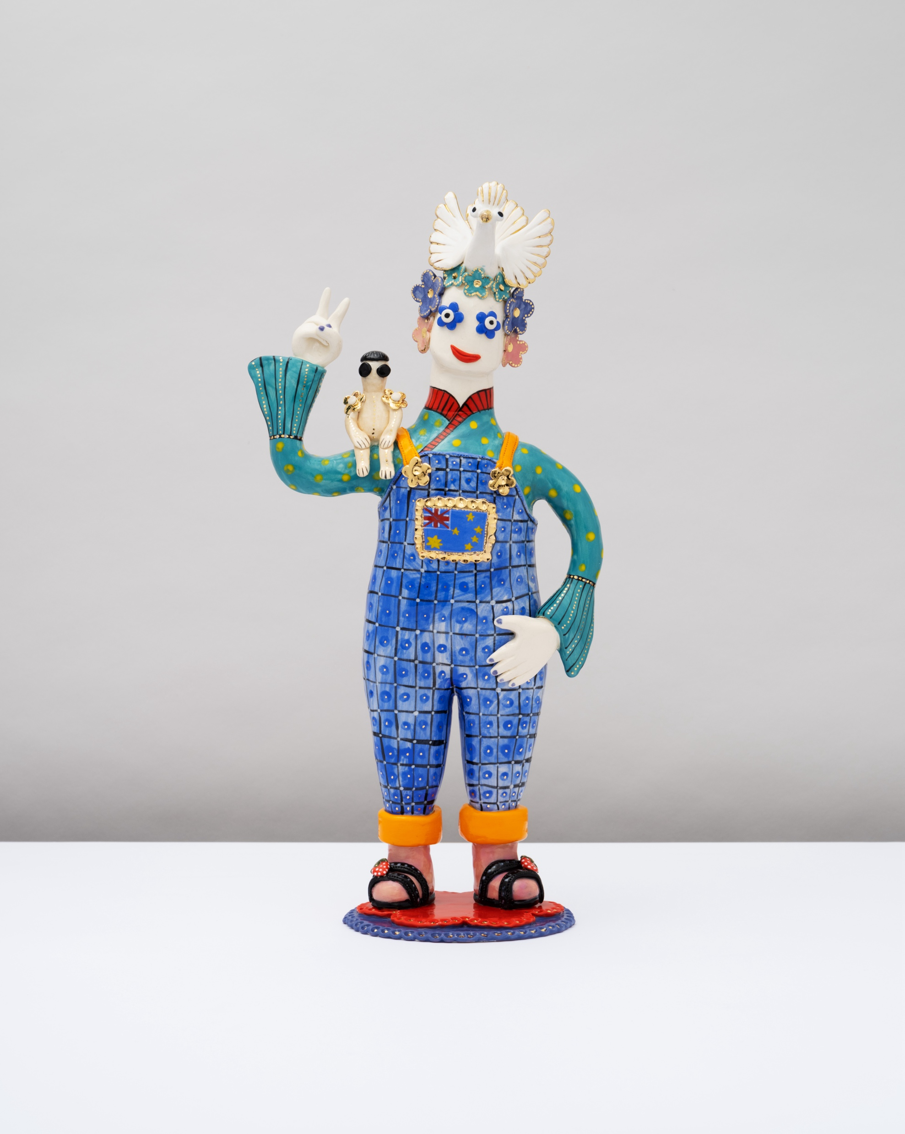
Learning sequence 4 –
Creatures of consequence
'Free as a Bird’, 2022 distribution permissions for Secondary Curriculum, Curriculum
and Reform Directorate of NSW Department of Education, granted by © Vipoo Srivilasa, 2025

Slide 63
Learning intentions and success criteria (5)
We are learning to:
use the viewpoints to develop a narrative to represent meaning in a ceramic sculpture that communicates ideas about human impact on the environment.
I can:
develop a concept that responds to a specific environmental issue
select and combine hand-building techniques to create a ceramic sculpture
design representational and associative symbols to communicate meaning to an audience
document my planning and concept development with annotated sketches in my visual arts diary
Notes:
Notes for teachers:
Learning intentions and success criteria are best co-constructed with students. Adapt the learning intention as required and add matching success criteria.
For more information See ⁠AITSL or the NSW Department of Education explicit teaching strategies, ⁠Sharing learning intentions and ⁠Sharing success criteria
LISC is not necessarily presented at the beginning of the lesson. Teacher needs to consider most effectual time to introduce
LISC should be revisited during the lesson to support students' evaluation of their learning

Slide 64
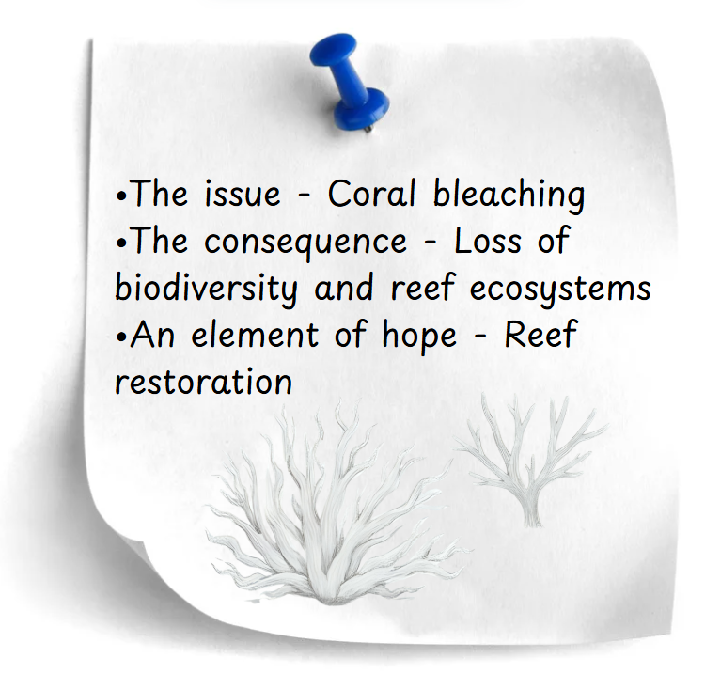
Concept seeds
4.1(a) Collaboratively developing a concept
  Select an environmental issue from the past, present, or even
  an imagined future scenario.
  Record the following points on your concept seed card:
  The issue
  The consequence
  An element of hope
  Quick sketches
“Connections are made that trigger ideas and discussions that lead to another path”
Srivilasa, V. (2024). Vipoo Srivilasa: Positive Art Work (28 pp.)

Slide 65
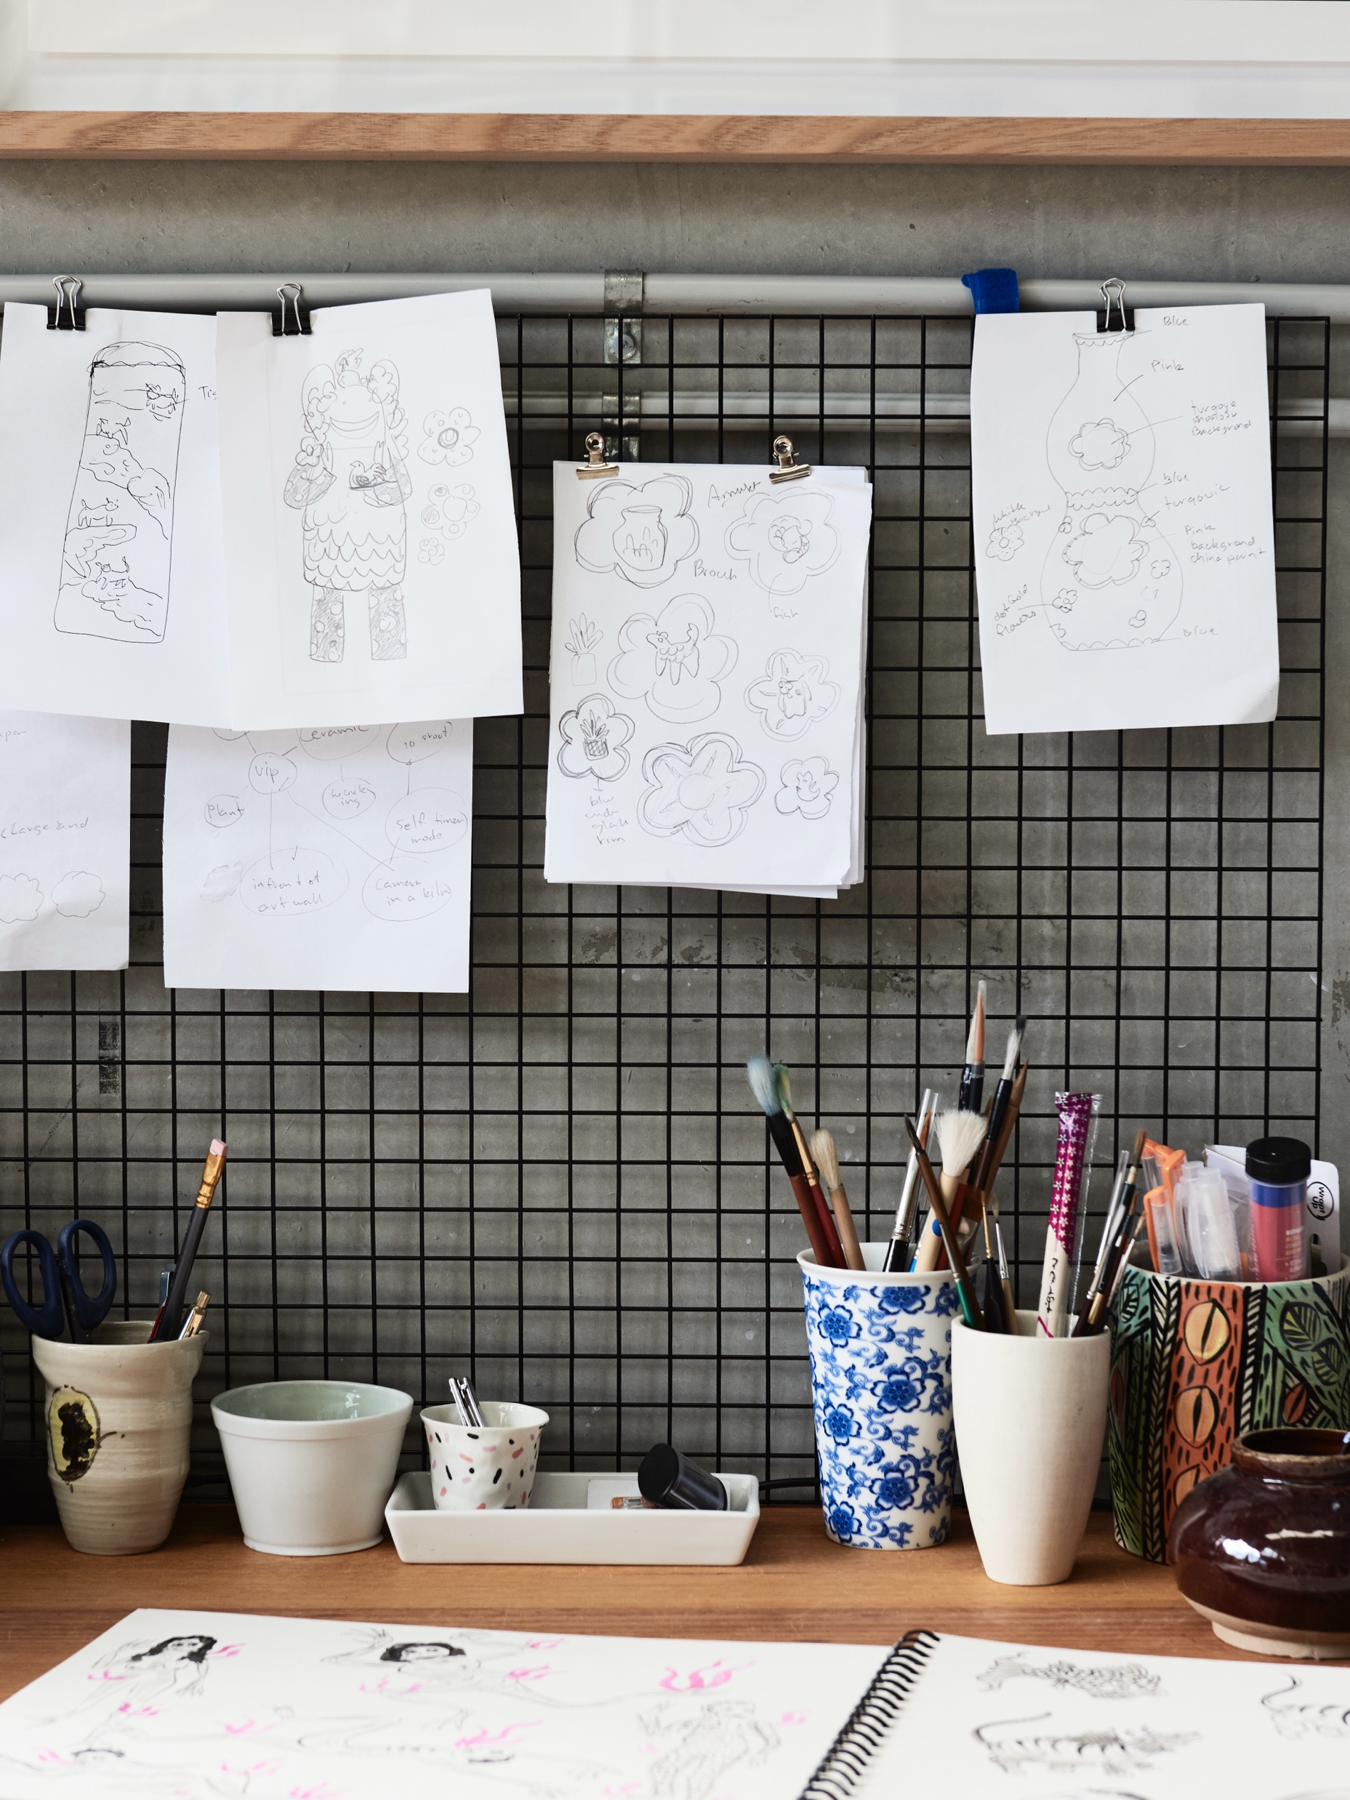
Sprouting ideas (1)
4.1(b) Concept development
Explore your chosen issue in your visual arts diary
Describe the issue and its effects on the environment.
Write associated words and visual representations of these words.
Consider the physical consequences that this issue has on our Earth and the emotional impact it has on humans.
Think about what ideas or themes it connects to, for example: loss, destruction, resilience and change.
Image courtesy of Vipoo Srivilasa. Photograph by Eve Wilson, distribution permissions for Secondary Curriculum, Curriculum and Reform Directorate of NSW Department of Education, granted by © Vipoo Srivilasa, 2025

Slide 66
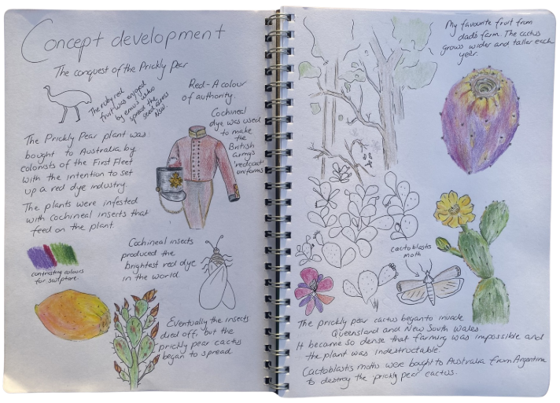
Sprouting ideas (2)
4.1(c) Concept development
Outline a narrative that will drive your concept and the design of your creature of consequence.
As your narrative comes together document:
Shapes
Textures
Motifs
Embellishments
Colours
Srivilasa’s sculptures are open to multiple interpretations. How can use these elements to develop associated symbols to communicate your narrative?
Notes:
The example on this slide is a comprehensive example of concept exploration in a visual arts diary. It is important to communicate to students that this part of the process is about the development of ideas for a sculpture.
Explain the following intentions, actions and choices to students when displaying this slide:
In this example the narrative is based on Australian history and the destructive impact of the introduced species of the Prickly Pear cactus.
The shape of the prickly pear plant was repeated on the page to show how it engulfed Australian farmland. It could develop into a pattern.
The waxy texture of the cactus was drawn with green pencil.
The cactus flower was simplified to create a flower motif.
A simple outline of the cochineal insect and cactoblast moth could inspire the sculpture's form, act as motifs or symbols for production and control.
Colour studies of different types of prickly pear fruits will inform colour choices.
The colour red is explored as a symbol of authority in a drawing of the British army’s ‘redcoat’ uniform as the red dye from cochineal bugs was used to dye these coats.

Slide 67
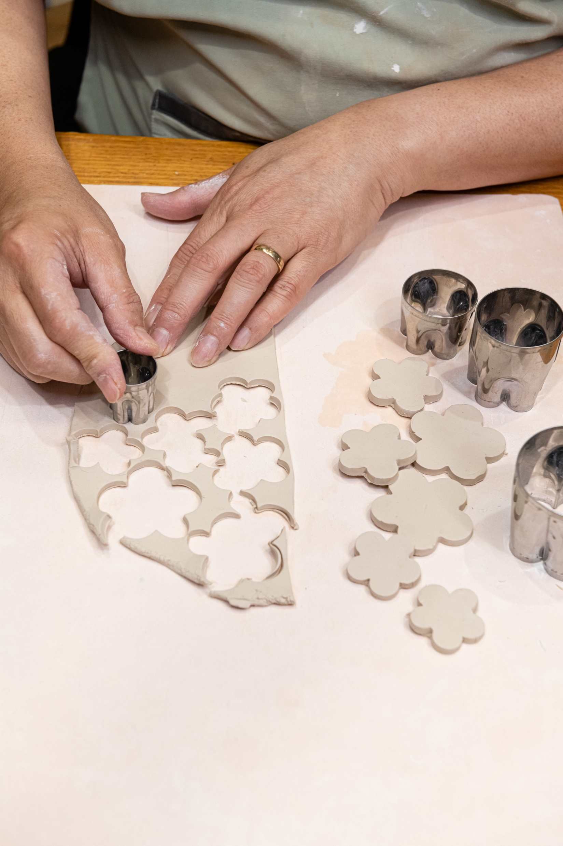
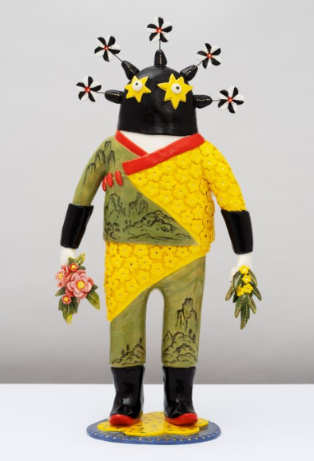
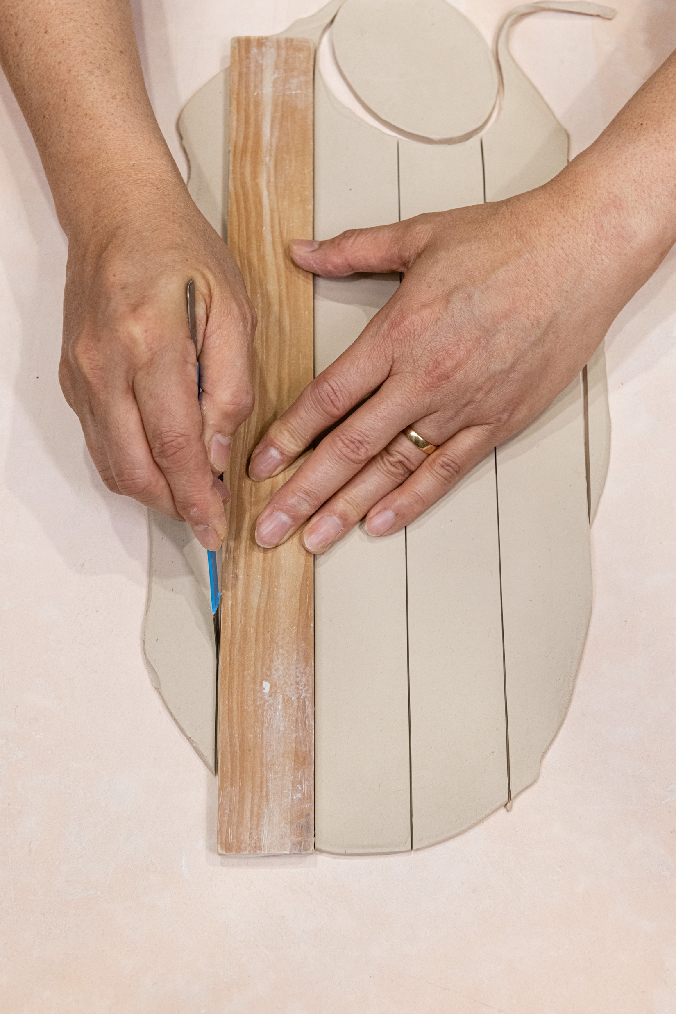
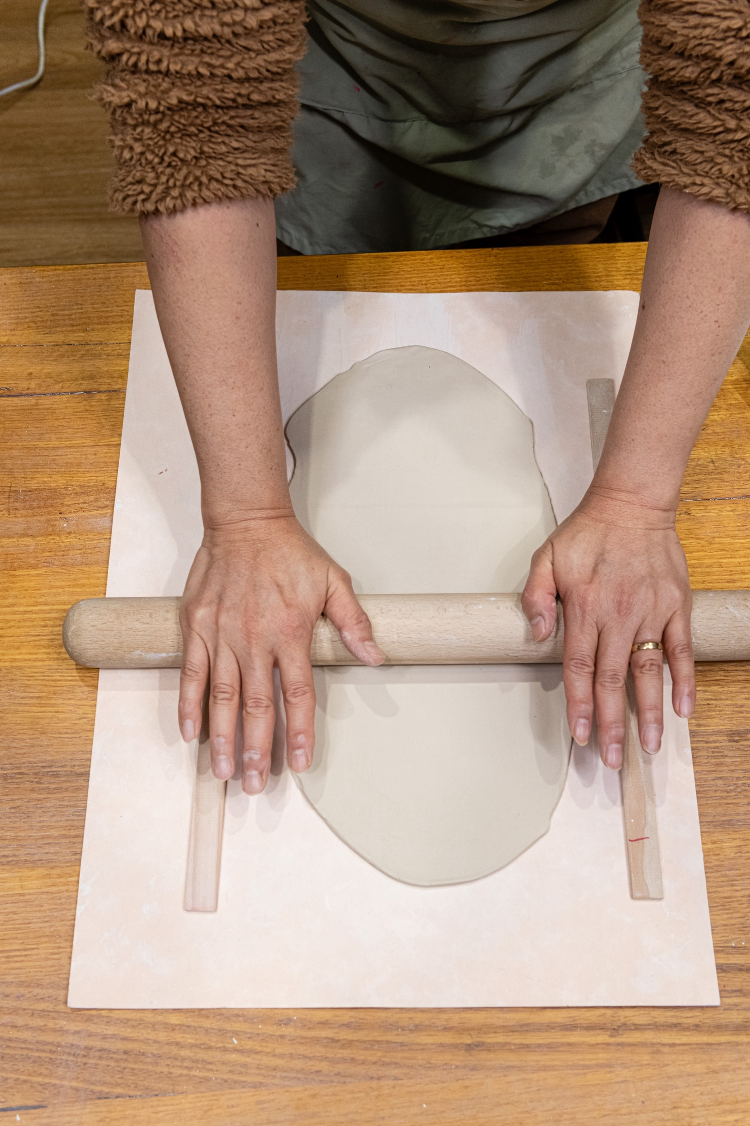
Form and structure (1)
4.2(a) The Warrior’s structure uncovered – Structural components
Fine layered slabs flowers
Short, tapered coil crown
Small pinched cylinder strap head
Relief slab star eyes
A draped, stamped slab jacket
Tapered, curved coil arms
Cylinder strap torso
Fine, layered slabs and coils
Thick coil legs
A slab disc base
Gold And Green Warrior, 2022, distribution permissions for Secondary Curriculum, Curriculum and Reform Directorate of NSW Department of Education, granted by © Vipoo Srivilasa, 2025.
Notes:
This slide is animated
Display and animate this slide while student are drawing their own designs to inspire use of different hand-building techniques.
Artwork citation - Gold And Green Warrior 2022 Inspired by Bo Hu’s submission Ceramic, glaze and gold lustre H 43 / W 22 / D 14 cm

Slide 68
Form and structure (2)
A black protective crown.
Windmill-like pinwheels show
movement and transformation
4.2(b) The Warrior’s structure uncovered – Subjective interpretations
Proud, upright posture
Stars as eyes to show childlike
innocence, a dreamy outlook
and imagination
Red symbolic of strength, and courage
Gold and green mirrors the country’s
national sporting colours.
Patriotism and pride
Ornate armour
Eastern ink landscape paintings
of tranquil places
Flowers in the warrior's hands
show gentleness and peace
Yellow wattle flowers are a
national emblem
Harmony in a multicultural existence
Cultural hybridity
Black boots are associated with power
Gold And Green Warrior, 2022, distribution permissions for Secondary Curriculum, Curriculum and Reform Directorate of NSW Department of Education, granted by © Vipoo Srivilasa, 2025.
Notes:
This slide is animated

Slide 69

Planning structural components (1)
I used a representational image of a moth a placed it across the creature's chest to symbolise that the young cactus is doomed, highlighting the intentional consequences of introducing the moth to control the cactus population.
4.2(c)
These swirls look effective in the drawing, but they could be too thin and fragile when made from clay.
I developed a range of associative symbols to remind audiences of rebels who can’t be tamed. Piercings, spikes and exaggerated facial features support the narrative that the Prickly Pear Cactus is a wild and obnoxious species.
The flower buds on the crown would need to be attached directly to the head. The stems are too fine and narrow.
I simplified the form of the cactus to represent a youthful seedling. The round simplified shapes embody innocence and as a result audiences may feel empathy for the creature.
The legs are too thin to support the weight of the body, they would need to be thicker.
Notes:
This slide is animated

Slide 70


Planning structural components (2)
4.2(d)
One solid sphere pierced with the end of a loop tool handle to create a hollow void
Two slabs cut using a paper stencil as a guide to trace around
One narrow, elongated pinch pot

Slide 71


Tools of the trade
carving/sculpting tool
4.2(e)
loop and ribbon tools
metal scraping rib
brush
cutting wire
sponge
rubber kidney tool
Potter’s rib
modelling/trimming tools
Image courtesy of Vipoo Srivilasa. Photograph by Jessica Tremp, distribution permissions for Secondary Curriculum, Curriculum and Reform Directorate of NSW Department of Education, granted by © Vipoo Srivilasa, 2025

Slide 72






Joining and securing attachments
4.2(f)
1
2
3
4
5
Map out where the attachment will sit.
Score both pieces of clay.
Apply white vinegar and thick slip to both scored sections of clay.
Gently press. Support heavy attachments until they are securely joined.
Place a soft, thin coil along the join seam.
Use a modelling tool to incorporate the coil and remove excess clay.

Slide 73


Preparing for the bisque firing
4.2(g)
Kiln ticket
Name: class: date:
I have prepared my sculpture for
bisque firing
glaze firing
I have checked the thickness of my sculpture and hollowed out clay thicker than 1.5cm.
I scored and applied slip/vinegar to join all attachments.
I have pierced a hole if necessary.
I have followed underglaze/glaze instructions.
I have cleaned the base of my sculpture with a damp sponge and it free of glaze.
I have carved my initials into the base.
Image courtesy of Vipoo Srivilasa. Photograph by Jessica Tremp, distribution permissions for Secondary Curriculum, Curriculum and Reform Directorate of NSW Department of Education, granted by © Vipoo Srivilasa, 2025

Slide 74

Learning sequence 5 –
Think like a critic

Slide 75
Learning intentions and success criteria (6)
We are learning to:
utilise both structural and subjective viewpoints to craft a critical review of an artwork, adopting the perspective of an art critic.
I can:
use evaluative language to express my subjective response to an artwork
explain how structural features communicate meaning using cause-and-effect language
organise my ideas clearly to show my understanding of both the structural and subjective viewpoints.
Notes:
Notes for teachers:
Learning intentions and success criteria are best co-constructed with students. Adapt the learning intention as required and add matching success criteria.
For more information See ⁠AITSL or the NSW Department of Education explicit teaching strategies, ⁠Sharing learning intentions and ⁠Sharing success criteria
LISC is not necessarily presented at the beginning of the lesson. Teacher needs to consider most effectual time to introduce
LISC should be revisited during the lesson to support students' evaluation of their learning

Slide 76


Think like an art critic (1)
5.1(a) Using evaluative language
Evaluative language
‘Not only do the ceramic forms exude a sense of joy, but the feeling of happiness is integral to their creation.’
‘His fantastical friends are not only roaming throughout the gallery space and hailed as deities but also adorn the walls.’
‘Srivilasa’s work is “all about positive thinking and happiness,’ so that people effortlessly ‘connect to [his] work first and then later get the serious message”.’
Nikita Holcombe (2022) Vipoo Srivilasa Artist Profile, accessed 5 June 2025
‘Not only do the ceramic forms exude a sense of joy, but the feeling of happiness is integral to their creation.’
‘His fantastical friends are not only roaming throughout the gallery space and hailed as deities but also adorn the walls.’
‘Srivilasa’s work is “all about positive thinking and happiness,’ so that people effortlessly ‘connect to [his] work first and then later get the serious message”.’
Nikita Holcombe (2022) Vipoo Srivilasa Artist Profile, accessed 5 June 2025
Art critics do more than simply describe what they see. They use evaluative language to express judgements, opinions, and interpretations about artworks, helping readers appreciate, and think more deeply about artworks.
Evaluative adjectives can express shades of meaning, feeling and opinion. This language can be positive, negative, or neutral, and always aims to communicate the critic’s informed point of view.
'Free as a Bird’, 2022 distribution permissions for Secondary Curriculum, Curriculum and Reform Directorate of NSW Department of Education, granted by© Vipoo Srivilasa, 2025
Notes:
This slide is animated
Click to reveal three quotes
Questions:
1. Which words or phrases in this sentence tell us how the critic feels about the artwork?
Sample answer: The words sense of joy and feeling of happiness communicate positive emotions.
2. Is the critic describing what the artwork is or how the artwork makes them feel? How can you tell?
Sample answer: The artists is describing how the artwork makes them feel and this is clear because words that describe emotions have been used. These words to stir emotion and influence audiences.
Click to reveal evaluative language highlighted in green.

Slide 77
Think like an art critic (2)
5.1(b) Using evaluative language
Evaluative language
Evaluate ‘Climate Change Bug Ball’ like an art critic
Descriptive – The sculpture has bugs.
Interpretive – The bugs symbolise the natural world.
Evaluative – The repetition of bug motifs powerfully reinforces the fragility of ecosystems.
‘Climate Change Bug Ball’, 2022 distribution permissions for Secondary Curriculum, Curriculum and Reform Directorate of NSW Department of Education, granted by © Vipoo Srivilasa, 2025.

Slide 78
Think like an art critic (3)
5.1(c) Using evaluative language
Evaluative language allows art critics to express informed opinions about the quality, impact, and significance of an artwork. Art critics describe evidence in artworks to justify their interpretations while also acknowledging or challenging the artist’s choices. By using evaluative and descriptive language, art critics shape how audiences understand, value, and respond to artworks.
Positive: powerful, striking, refined, joyful, emotive, innovative, balanced, poetic, imaginative, dramatic, thought-provoking, successful
Negative: bulky, inconsistent, unbalanced, flat, clumsily joined, unevenly glazed, poorly constructed, awkward
'Free as a Bird’, 2022 distribution permissions for Secondary Curriculum, Curriculum and Reform Directorate of NSW Department of Education, granted by© Vipoo Srivilasa, 2025
Notes:
This slide is animated

Slide 79
Think like an art critic (4)
5.1(d) Using evaluative language
Evaluative language to describe structural viewpoints
skilfully crafted
technically impressive
masterfully glazed
expertly balanced
visually striking
bold
subtle and refined
harmonious
richly textured
vibrant
alluring
Evaluative language to describe subjective viewpoints
evocative
powerfully
thought-provoking
dreamlike
whimsical
confronting
mysterious
nostalgic
joyful
uplifting
deeply personal
emotionally charged
culturally relevant
'Free as a Bird’, 2022 distribution permissions for Secondary Curriculum, Curriculum and Reform Directorate of NSW Department of Education, granted by© Vipoo Srivilasa, 2025
Notes:
This slide is animated

Slide 80

Think like an art critic (5)
5.1(e) Using evaluative language
Everyone is a critic !
Write a bank of evaluative words and phrases based on your response to ‘Gold and Green Warrior’, 2022.
Think like a critic and use evaluative language to communicate your thoughts on this artwork.
Share your sentence with a partner and identify the evaluative language in your partner’s response.
Tell your partner what you understood about the artwork after considering their evaluation of the artwork.
Did your partner’s evaluation of the artwork affect your interpretation
‘Gold And Green Warrior’, 2022, distribution permissions for Secondary Curriculum, Curriculum and Reform Directorate of NSW Department of Education, granted by © Vipoo Srivilasa, 2025.

Slide 81
Think like an art critic (6)
5.2(a) TAG peer review
1. Tell
Share your evaluative response with your partner using both positive and critical language. Focus on the strengths and areas for growth in your partner’s surface treatment design.
2. Ask
Pose questions that help the artist think more deeply about their choices, concept, and intentions.
3. Give
Offer constructive suggestions to support your partner’s surface treatment plans.
Notes:
Use the prompts below to model the Tell, Ask, Give review for students
Tell:
Once strength of your colour choices is ... because it enhances…
This detail strikes me because...
It may be difficult to understand the concept clearly because these colours ...
Your colour choices seem to reflect the concept, but your plans to apply this pattern on top of the underglaze is a bit unclear
Ask:
What made you choose this specific colour palette?
Will the texture be as visible once it’s covered with underglaze and gloss?
Have you thought about how light and shadow will interact with this surface treatment?
What emotion do you want the audience to feel when they see it?
What symbolism are you hoping viewers will understand through these colours?
Give:
You could think about using harmonious/ complementary colours to enhance …..
Try softening or intensifying this colour to align with your intention of…..
This choice of colour symbolism is effective because ……..
Consider repeating/simplifying this surface pattern to reinforce the theme

Slide 82
Write like an art critic (1)
5.3(a) Breaking down the question
Provide reasons and show
cause and effect using
cause and effect language.
How is this material treated
and used to build sculptures.
Use technical language and verbs.
Describe the symbols using noun groups and explain what they mean with cause-and-effect language.
Explain how Vipoo Srivilasa uses clay to convey symbolic messages in imaginative ways
Reveal what you know about this artist's intentions and practice.
Imagination and wonder.
Make interpretations with evaluative language.
Make judgments shaped by your own memories,
experiences, associations and senses.

Slide 83
Write like an art critic (2)
5.3(b) Explain how Vipoo Srivilasa uses clay to convey symbolic messages in imaginative ways
I see
I think
Overalls worn on top of a traditional Thai shirt
Dove on head
Looks like a clown
Peace symbol gesture
Sandals with pink socks
Australian flag
Smile
cultural hybridity
peace and fun
comically jovial
shows he is relaxed and friendly
creative energy, spontaneous
a sense of pride and belonging
approachable
'Free as a Bird’, 2022 distribution permissions for Secondary Curriculum, Curriculum and Reform Directorate of NSW Department of Education, granted by© Vipoo Srivilasa, 2025
Notes:
This slide is animated
Click to reveal an example of an ‘I see’ list.
Click to reveal some ‘I think’ examples.

Slide 84
Critical review – explaining like an art critic (1)
5.3(c) Explain how Vipoo Srivilasa uses clay to convey symbolic messages in imaginative ways
Explanations of artworks help us understand intentions and meaning. When we explain we use cause and effect language to talk about what the artist did and what it makes us think or feel. We show how colours, shapes, or symbols work together and explain why or how the artist might have made certain choices or how those choices create meaning.
Because
Since
Due to
As a result of
In response to
In order to
As
This invites
This evokes
This communicates
This creates
This reinforces
This symbolises
This suggests
Inviting, invites
Evoking, evokes
Communicating, communicates
Creating, creates
Reinforcing, reinforces
Symbolising, symbolises
Suggesting, suggests
'Free as a Bird’, 2022 distribution permissions for Secondary Curriculum, Curriculum and Reform Directorate of NSW Department of Education, granted by© Vipoo Srivilasa, 2025
Notes:
This slide is animated
Question:
Why is it important for an art critic to explain before they judge?
Sample answer: It helps other to understand the artwork first. An explanation is based on evidence and reasons so without an explanation audiences might not believe or agree with the critic. It also helps build credibility and shows audiences that the critic has an informed opinion.
Question:
Who can offer some examples of cause-and-effect language?
Click to reveal cause and effect language word banks
Demonstrate how to write explanatory sentences using some examples of the cause-and-effect language listed on the slide in real time so students can see and hear your though processes.
Click to reveal example of common cause and effect conjunctions and phrases
Click to reveal effect verbs which are used when art critics begin to analyse and interpret artworks.
Click to reveal effect and interpretive verbs in different tenses and model their different uses.

Slide 85
Critical review – explaining like an art critic (2)
5.3(d) Explain how Vipoo Srivilasa uses clay to convey symbolic messages in imaginative ways
A white dove, a symbol of peace, sits atop the creature’s head, its wings edged with gold, are spread wide, as if ready to take flight. This symbol further reinforces themes of freedom, peace and love. Srivilasa creates a world of fantasy which leads audiences to consider alternative realities shaped by peace and joy. I wonder if this creature represents humanity, and the dove is a reminder of the peace we are still trying to achieve.
'Free as a Bird’, 2022 distribution permissions for Secondary Curriculum, Curriculum and Reform Directorate of NSW Department of Education, granted by© Vipoo Srivilasa, 2025
Notes:
The response below is interchangeable with the example on the slide and includes less complex language. Teachers are encouraged to adapt all sample response to suit the needs of students in the classroom.
‘A white dove, which means peace, sits on the creature’s head. Its wings have gold edges and are open wide suggesting that it has magical qualities and is about to fly away. This communicates ideas of freedom, peace, and love. Srivilasa creates a fantasy world that causes audiences to imagine life in a perfect happy place.‘
The following sentence starters are designed to support students and are grouped into I see, I think, I wonder prompts to align with the scaffold on slide 5.3(f)
I see
(adjective) (adjective) (noun) represents……..
A noticeable clay technique here is the use of…..
The detail ………. reinforces the idea that…..
By using ……….., the artist encourages the audiences to…..
Symbolically, …………. might represent…..
I think
I believe the use of ……… symbolises……
From this, we can infer that the artist is exploring……
One effect of using this technique is that it creates a sense of……
It seems the artist wants the viewer to feel……
There’s a clear sense that the artist intended to……
I wonder
Audeinces are led to wonder…..
It raises the question of……
Could it be that Vipoo Srivilasa………?
One might be led to wonder how this reflects broader themes of………
We are encouraged to consider………..
Vipoo Srivilasa inspires……………

Slide 86
Critical review – sample introduction
5.3(e) Explain how Vipoo Srivilasa uses clay to convey symbolic messages in imaginative ways
Vipoo Srivilasa’s ‘Free as a Bird’ is a joyful ceramic sculpture that reflects cultural hybridity, imagination, peace. It is part of the ‘Happy Australian’ series and was inspired by an original drawing by Ching Liang in 2022. Through the fusion of traditional Thai garments with Western overalls, the work explores identity with humour and pride. The sculpture’s intricate playful details create a dreamlike world that invites viewers to participate in storytelling. Srivilasa’s communicates light-hearted messages of positivity though his use of stark white porcelain with vibrant cheerful glazes that expresses a childlike innocence that all audiences can personally relate to.
'Free as a Bird’, 2022 distribution permissions for Secondary Curriculum, Curriculum and Reform Directorate of NSW Department of Education, granted by© Vipoo Srivilasa, 2025
Notes:
This sample paragraph is interchangeable with the sample paragraph on the slide and communicates similar ideas.
‘Free as a Bird’ looks like a friendly clown from a dream. With red curly hair and bright blue flowers for eyes it stands tall and smiles at us with kindness. On its right shoulder sits a small, white figure. This little character might be an imaginary friend or a guardian angel. Its face doesn’t show any feelings, but the way it sits makes it seem gentle, calm, and safe. Because it’s so mysterious, we start to imagine our own ideas about who or what it is. Vipoo Srivilasa, reminds us of how it feels to be a kid, when we made up stories, played pretend, and believed anything could happen. On the creature’s head is a white dove, a bird that means peace. Its wings are lined with shiny gold and look like they could fly at any moment. Srivilasa attaches small, detailed symbols to add to his story of kindness, fun, and hope. His artwork shows us a magical world where peace, happiness, and play matter and where we’re free to dream and believe in magic.

Slide 87
Critical review – sample paragraph (1)
5.3(f) Explain how Vipoo Srivilasa uses clay to convey symbolic messages in imaginative ways
PEEL | Notice | See | Think/wonder | Evaluate
Point The main idea | imagination and innocence
Example Describe what you see |  | white, smile, little creature, dove
Explain Think and wonder. Cause and effect |  |  | peace, play, looks like a toy or figurine faceless mysterious creature, leads us to guess and imagine
Link Evaluate and offer judgement |  |  |  | the wonder of childhood, hopeful visions, magical clay figures
Notes:
The following sentence starters are designed to support students and are grouped into I see, I think, I wonder prompts to align with the scaffold.
I see
(adjective) (adjective) (noun) represents……..
A noticeable clay technique here is the use of…..
The detail ………. reinforces the idea that…..
By using ……….., the artist encourages the audiences to…..
Symbolically, …………. might represent…..
I think
I believe the use of ……… symbolises……
From this, we can infer that the artist is exploring……
One effect of using this technique is that it creates a sense of……
It seems the artist wants the viewer to feel……
There’s a clear sense that the artist intended to……
I wonder
Audeinces are led to wonder…..
It raises the question of……
Could it be that Vipoo Srivilasa………?
One might be led to wonder how this reflects broader themes of………
We are encouraged to consider………..
Vipoo Srivilasa inspires……………

Slide 88
Critical review – scaffold
5.3(g) Explain how Vipoo Srivilasa uses clay to convey symbolic messages in imaginative ways
PEEL | Notice | See | Think/wonder | Evaluate
Point The main idea
Example Describe what you see
Explain Think and wonder. Cause and effect
Link Evaluate and offer judgement

Slide 89
Critical review – sample paragraph (2)
5.3(h) Explain how Vipoo Srivilasa uses clay to convey symbolic messages in imaginative ways
Notice > See > Think/wonder > Evaluate
Point
Example
Explain
Evaluate
Example
Explain
Evaluate/
Link
‘Free as a bird’ has a surreal, almost floating presence. Perched on its right shoulder is a small, white figure that could be interpreted as an imaginary friend or guardian angel. With its blank face and large black eyes, the figure conveys no clear emotion, yet its gentle posture evokes a sense of comfort and protection. Our imaginations run wild as we search for its meaning and fill in the gaps to complete the story ourselves. This makes the artwork personal for audiences as they rely on memories and experiences to complete the narrative. Srivilasa taps into the wonder of childhood, transporting us back to a time of guessing, dreaming, and make-believe. He models and attaches small detailed symbols to accompany his creatures. A white dove, a symbols of peace, sits atop the creature’s head, its wings edged with gold, are spread wide, as if ready to take flight. This symbol further reinforces themes of freedom, peace and love. Srivilasa creates a world of fantasy where audiences can consider alternative realities shaped by peace and joy. He presents hopeful vision of the world through playfully decorated figures, inviting reflection on what could be.
Notes:
Question: Can you explain this colour coding system?
Sample answer: The colours show us what type of thinking we could be doing to structure our paragraph.
Question: What are some of the benefits of colour coding our own drafts?
Sample answer: We can see if we have structured our ideas using PEEL and if we are exploring the structural and subjective viewpoints thoroughly with Notice > See > Think/ wonder > Evaluate. It also shows us how balanced our response is.
This sample paragraph below is interchangeable with the sample on the slide and includes less complex language. Teachers are encouraged to adjust written samples to suit the needs of the students in their classrooms.
‘Free as a Bird’ looks like a friendly clown from a dream. With red curly hair and bright blue flowers for eyes it stands tall and smiles at us with kindness. On its right shoulder sits a small, white figure. This little character might be an imaginary friend or a guardian angel. Its face doesn’t show any feelings, but the way it sits makes it seem gentle, calm, and safe. Because it’s so mysterious, we start to imagine our own ideas about who or what it is. Vipoo Srivilasa, reminds us of how it feels to be a child, when we made up stories, played pretend, and believed anything could happen. On the creature’s head is a white dove, an icon of peace. Its wings are lined with shiny gold, and it looks like it could fly off at any moment. Srivilasa attaches small, detailed symbols and motifs to add to his story of kindness, fun, and hope. His artwork shows us a magical world where peace, happiness, and play matter and where we’re free to dream and believe in magic. By making audiences imagine he opens us up to a world of possibilities where we could make our dreams for the world come true.

Slide 90
Appendix–
Vipoo Srivilasa’s artworks

Slide 91

Climate Change Bug Ball, 2022 distribution permissions for Secondary Curriculum, Curriculum and Reform Directorate of NSW Department of Education, granted by © Vipoo Srivilasa, 2025

Slide 92

Gold and Green Warrior, 2022, distribution permissions for Secondary Curriculum, Curriculum and Reform Directorate of NSW Department of Education, granted by © Vipoo Srivilasa, 2025.

Slide 93

Free as a Bird, 2022 distribution permissions for
Secondary Curriculum, Curriculum and Reform Directorate of NSW Department of Education, granted by © Vipoo Srivilasa, 2025

Slide 94
References (1)
This presentation contains NSW Curriculum and syllabus content. The NSW Curriculum is developed by the NSW Education Standards Authority. This content is prepared by NESA for and on behalf of the Crown in the right of the State of New South Wales. The material is protected by Crown copyright.
Please refer to the NESA Copyright Disclaimer for more information https://educationstandards.nsw.edu.au/wps/portal/nesa/mini-footer/copyright.
NESA holds the only official and up-to-date versions of the NSW Curriculum and syllabus documents. Please visit the NSW Education Standards Authority (NESA) website https://educationstandards.nsw.edu.au/wps/portal/nesa/home and the NSW Curriculum website https://curriculum.nsw.edu.au.
Visual Arts 7–10 Syllabus © NSW Education Standards Authority (NESA) for and on behalf of the Crown in right of the State of New South Wales, 2024.
Art Gallery of South Australia (2023) Ray Mudjandi – Tarnanthi 2023 Education Resource, accessed 26 June 2025.
Art Works (2022) Vipoo Srivilasa on making stunning porcelain deities [video], accessed 16 February 2025.
Desmond, M. (2009) Of human clay National Portrait Gallery, accessed 12 March 2025.
Despard Gallery (2019) Jenny Orchard - Bush Of Ghosts - Artist Interview [video], accessed 16 March 2022.
Gattermayr, S. (2021) Building New Legacies With The Hermannsburg Potters The Design Files, accessed 23 May 2025.
Hermannsburg Potters (n.d.) Hermannsburg Potters: Aranda Artists of Central Australia, accessed June 26 2025.
Lei C (21 July 2021) ‘Exhibition Review: Vipoo Srivilasa: Wellness Deity, Linden New Art’, ARTShub News, accessed 10 June 2025.
McLean, B. (2018) The full-bodied vessels of the Hermannsburg Potters document their culture Queensland Art Gallery, accessed 23 March 2025.
National Portrait Gallery (2009) Potter’s Portrait Pot, National Portrait Gallery website, accessed 20 May 2025.

Slide 95
References (2)
National Portrait Gallery (28 April 2016) 'National Portrait Gallery | Potters’ Portrait Pot' [video], accessed 22 February 2025.
Nguyen M (2005) Sales contract Shuruppak Louvre AO3766 [image] Wikimedia Commons, accessed 10 June 2025.
OLSEN Gallery (2022) Vipoo Srivilasa ‘Always better together’[video], accessed 16 February 2025.
Orchard J (2020) 25 JENNY ORCHARD Change Is Possible, Hope Is Power 2020 Paint and collage on paper 70 x 50 cm, Despard Gallery website, accessed 24 July 2025.
——(2020) 22 JENNY ORCHARD Planetmind (More Than Human Poster Series) 2020 Paint and collage on paper 59.5 x 42 cm, Despard Gallery website, accessed 24 July 2025.
——(2016) JENNY ORCHARD Lost in the City at Night 2016 Watercolour and collage on paper 76 x 56 cm Signed front $1950, Despard Gallery website, accessed 24 July 2025.
Riccardelli C (2017) Egyptian faience: Technology and production [image] The Metropolitan Museum of Art, accessed 10 June 2025.
Shepparton Art Museum (2024) Nick Baylart on Jenny Orchard - Big Ceramic Energy [video], accessed 27 May 2025.
Srivilasa, V. (2023) Happy Australian. Vipoo Srivilasa, accessed 30 June 2025.
Srivilasa V (2024) Positive Art Work, Paper Boat Press Editions & The Australian Design Centre, Ashgrove, Queensland.
Stranger L (2025) Artist Profile Jenny Orchard: A new weird, wonderful. Bandicoot Publishing Pty Ltd
The Metropolitan Museum of Art (2004) Geometric art in ancient Greece [image] The Metropolitan Museum of Art, accessed 10 June 2025.
The Metropolitan Museum of Art (n.d.) Jar with dragon, The Met website, accessed 30 June 2025.

Slide 96
Copyright
© State of New South Wales (Department of Education), 2025
The copyright material published in this resource is subject to the Copyright Act 1968 (Cth) and is owned by the NSW Department of Education or, where indicated, by a party other than the NSW Department of Education (third-party material).
Copyright material available in this resource and owned by the NSW Department of Education is licensed under a Creative Commons Attribution 4.0 International (CC BY 4.0) license.
This license allows you to share and adapt the material for any purpose, even commercially.
Attribution should be given to © State of New South Wales (Department of Education), 2025.
Material in this resource not available under a Creative Commons license:
the NSW Department of Education logo, other logos and trademark-protected material
Material owned by a third party that has been reproduced with permission. You will need to obtain permission from the third party to reuse its material.
Links to third-party material and websites
Please note that the provided (reading/viewing material/list/links/texts) are a suggestion only and implies no endorsement, by the New South Wales Department of Education, of any author, publisher, or book title. School principals and teachers are best placed to assess the suitability of resources that would complement the curriculum and reflect the needs and interests of their students.
If you use the links provided in this document to access a third-party’s website, you acknowledge that the terms of use, including licence terms set out on the third-party’s website apply to the use which may be made of the materials on that third-party website or where permitted by the Copyright Act 1968 (Cth). The department accepts no responsibility for content on third-party websites.

