Slide 1
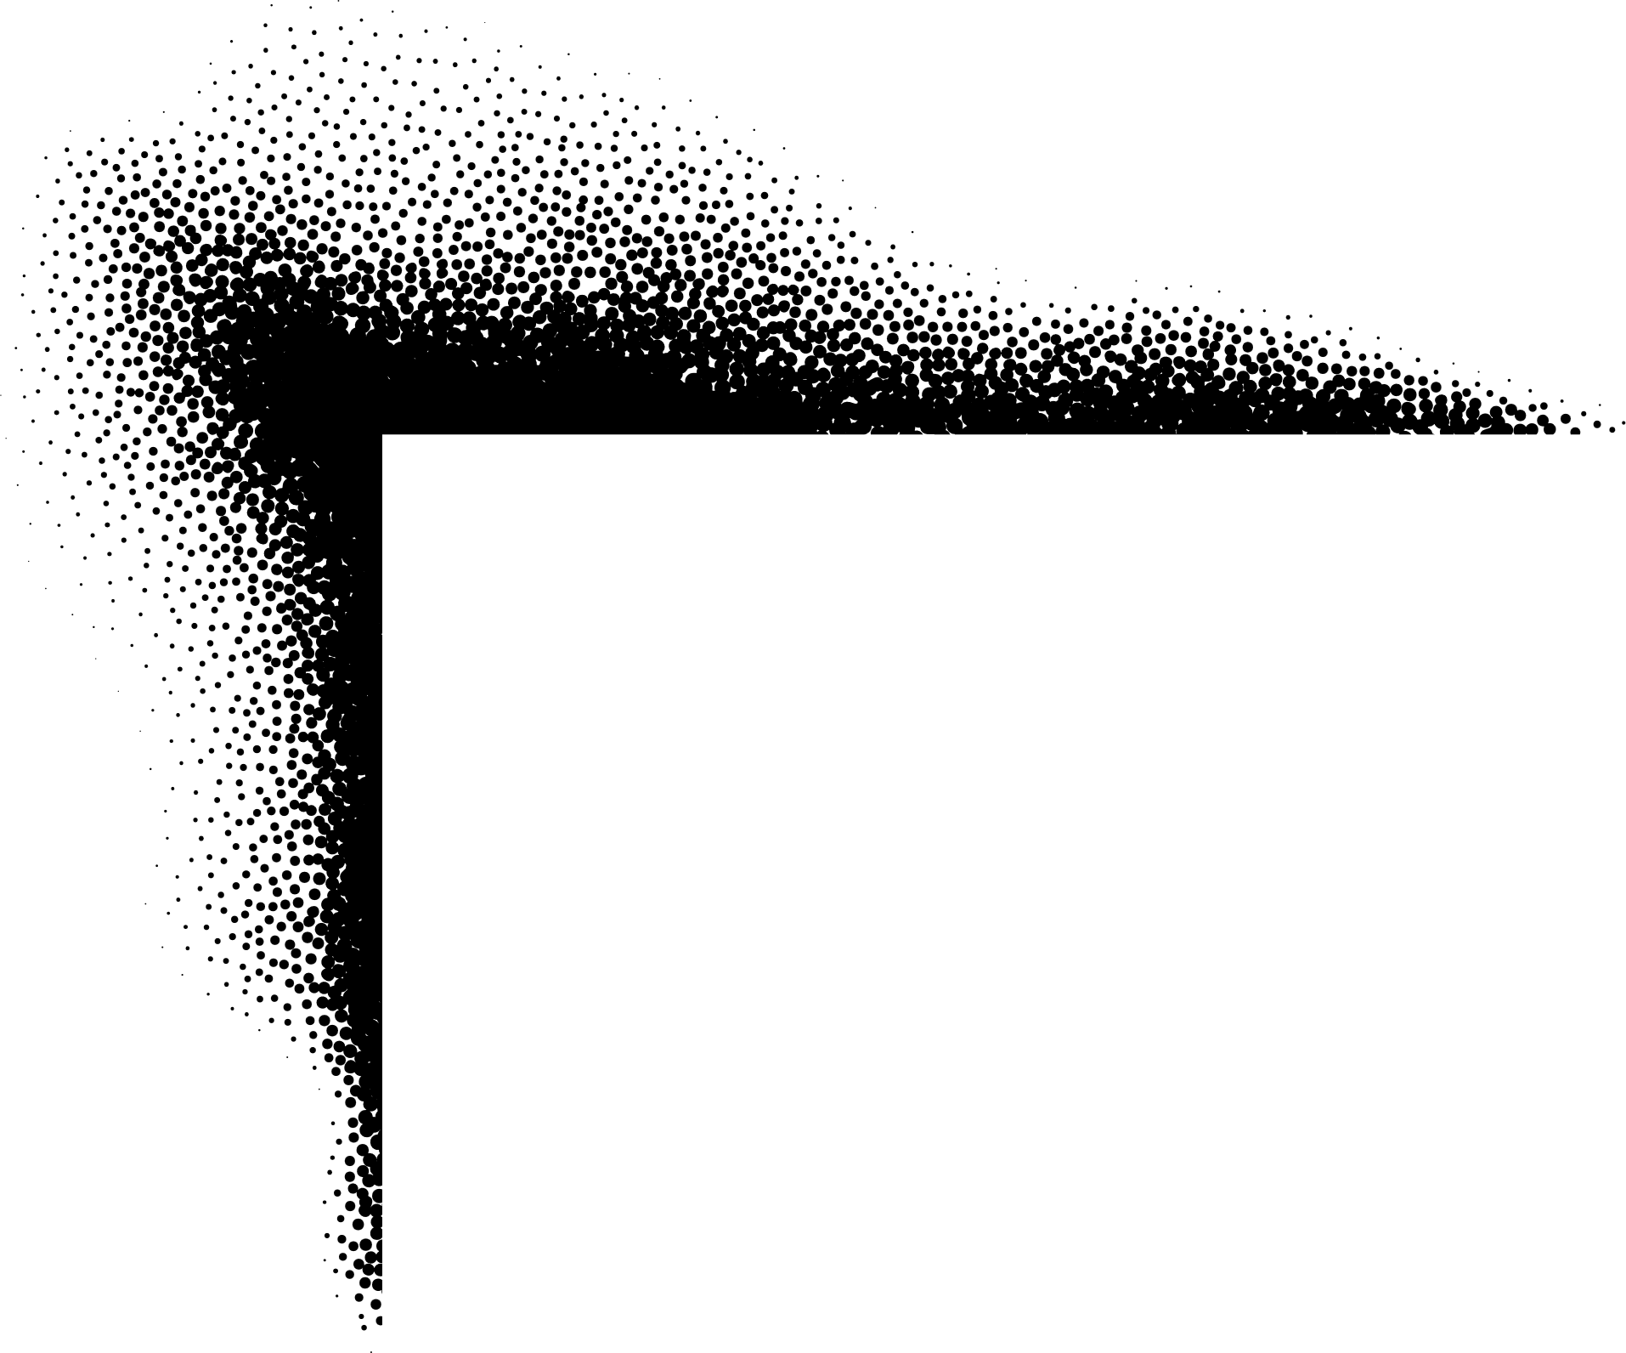




Reko Rennie
Street art
Research
Insert image here
Insert image here
Insert image here
Insert image here
Websites
  https://rekorennie.com/work/
  https://www.nevadaart.org/art/exhibitions/always-was-always-will-be/
  https://www.cityofsydney.nsw.gov.au/murals-and-street-art/always-was-always-will-be

Slide 2










Information about Reko Rennie’s art practice
Artist
Reko Rennie is a Kamilaroi/Gamilaraay man, born in Melbourne, Australia. He is an interdisciplinary artist who explores his Aboriginal identity through contemporary forms and materials. He values his Aboriginal heritage deeply and believes that art is a powerful way to share and celebrate Aboriginal culture. His artworks reflect the evolution and expression of Aboriginal culture and identity in our current time and place.
Artwork
Audience
His artworks combine the iconography of his Kamilaroi heritage with stylistic elements of graffiti. Merging traditional diamond-shaped designs, hand-drawn symbols and repetitive patterning to challenge accepted ideas about Aboriginal identity. His artworks include large-scale murals, paintings, and installations in galleries and public spaces across Australia. Rennie works with spray paint, acrylics, and neon lights to create visually striking artworks with a vibrant, non-traditional colour palette.
Reko Rennie creates art to provoke discussions surrounding Aboriginal culture and identity in contemporary urban environments. His work aims to raise awareness about Aboriginal culture and challenge stereotypes. This impact is important because it helps build respect, understanding, and reconciliation between different communities in Australia.
World
Through his art, Reko Rennie presents stories and identities of Aboriginal people and culture. His work highlights themes like connection to land, heritage, and resilience. By installing his artworks in public spaces, Rennie helps Aboriginal voices be seen and heard, influencing how communities appreciate and celebrate Aboriginal and Torres Strait Islander culture in everyday life.

Slide 3
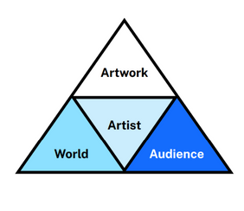
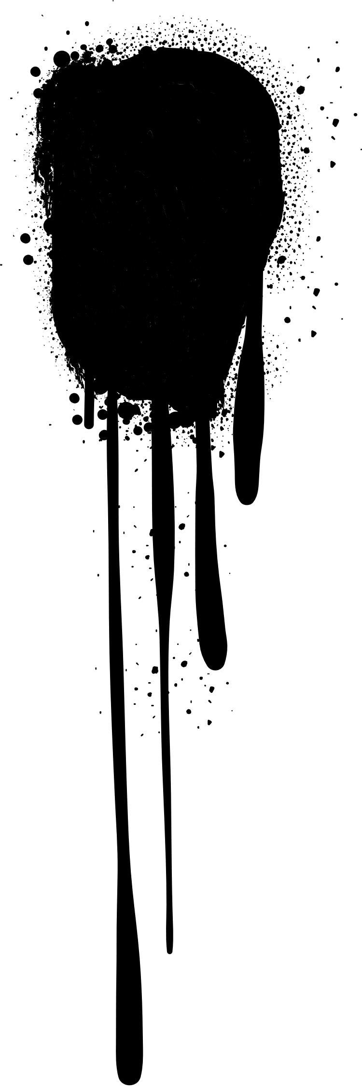



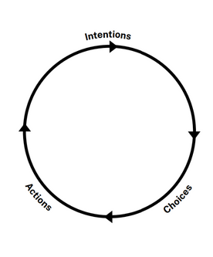

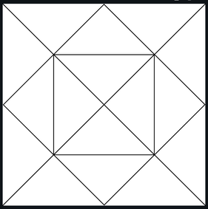

Response scaffold
Explore the artworld concepts
  What communities does the artist represent?
  What aspects of the world are important to the artist?
  List the title (if it has one), date created, form, materials, location, size, subject matter of the artwork
  What impact does this artwork have on the audience?
Notes
Think from a point of view – Contemporary viewpoint
  How does the artwork reimagine or challenge ideas about what art is or can be?
  How does the artwork challenge stereotypes about the community it represents?
Notes
Zoom out to understand practice
  What were the artists intentions, choices and actions in creating this artwork?
  What impact does this artwork have on the audience?
  Why is the artwork and its impact important?
Structural
Contemporary
Subjective
Artwork
World
Artist
Audience
Cultural
Notes

Slide 4


Mulga
Street art
Research
Insert image here
Insert image here
Insert image here
Insert image here
Website
  https://mulgatheartist.com.au/blogs/murals

Slide 5






Information about Mulga’s art practice
Artist
Mulga, whose real name is Joel Moore, is a Sydney-based artist known for his vibrant and playful artworks. His works often feature intricate line work and bright colours, reflecting his love for Australian nature and animals. Mulga values creativity, joy, and the ability to bring smiles to people's faces through his art.
Artwork
Audience
His artworks depict whimsical characters, such as bearded men and animals wearing sunglasses, as well as tropical scenes. His murals grace the walls of schools and coastal locations across Australia, often in public spaces and urban environments. He transforms ordinary walls into joyful spectacles using spray paint, acrylics and paint pens to bring his imaginative creations to life.
Mulga aims to inspire and uplift his audience by creating art that is fun, and accessible. His cartoon-like characters and humorous scenes spark joy and curiosity, encouraging audiences to connect with art in a playful way. By transforming ordinary walls and objects into vibrant artworks, Mulga makes art part of everyday life and helps build a sense of community.
World
Mulga playfully interprets Australian larrikin culture, infusing humour and mischief into his murals. By celebrating local wildlife and Australian culture, he brings art into everyday life and affirms street art as a legitimate and influential practice. His work inspires audiences to recognise the social and communal power of art.

Slide 6
Response scaffold
Explore the artworld concepts
  What communities does the artist represent?
  What aspects of the world are important to the artist?
  List the title (if it has one), date created, form, materials, location, size, subject matter of the artwork
  What impact does this artwork have on the audience?
Notes
Think from a point of view – Contemporary viewpoint
  How does the artwork reimagine or challenge ideas about what art is or can be?
  How does the artwork challenge stereotypes about the community it represents?
Notes
Zoom out to understand practice
  What were the artists intentions, choices and actions in creating this artwork?
  What impact does this artwork have on the audience?
  Why is the artwork and its impact important?
Structural
Contemporary
Subjective
Artwork
World
Artist
Audience
Cultural
Notes

Slide 7


Beastman
Street art
Research
Insert image here
Insert image here
Insert image here
Insert image here
Website
  https://beastman.com.au/murals

Slide 8






Information about Beastman’s art practice
Artist
Beastman is a Sydney-based multidisciplinary artist whose work often combines street art, illustration, and a vibrant use of colour. His energetic paintings, digital illustrations and public murals explore a unique visual language, depicting future environments of abstracted geometric landscapes, potential new life forms and the impact of humans on nature. He is a dedicated environmentalist who often uses his work to raise awareness about environmental issues.
Artwork
Audience
Beastman’s work is instantly recognisable for its bold black outlines, vibrant blocks of colour and simplified organic shapes. Inspired by nature, tribal art and sacred geometry, his visual language blurs the boundary between design and fine art. His murals, paintings, and digital works pulse with repeating patterns, geometric forms, and abstract symbols that evoke plants, seeds, life cycles, and imagined new life forms. Using spray paint, acrylics and digital design tools, Beastman creates artworks that are visually striking and highly distinctive.
Beastman's murals brighten public areas and create a sense of energy and optimism. His audience is diverse, ranging from people who encounter his murals in public spaces to followers on digital platforms to those who view his work in exhibitions. His colourful style is visually engaging and accessible, inviting viewers to reflect on contemporary life, and the ways art can exist beyond traditional galleries.
World
Beastman’s art is influenced by the world around him, particularly popular culture, street culture, and the growing acceptance of urban art within galleries and public spaces. His practice reflects a world where digital technologies, social media, and urban environments are central to artistic communication. He is part of a global movement of artists who bring street-based practices into broader artworld conversations.

Slide 9
Response scaffold
Explore the artworld concepts
  What communities does the artist represent?
  What aspects of the world are important to the artist?
  List the title (if it has one), date created, form, materials, location, size, subject matter of the artwork
  What impact does this artwork have on the audience?
Notes
Think from a point of view – Contemporary viewpoint
  How does the artwork reimagine or challenge ideas about what art is or can be?
  How does the artwork challenge stereotypes about the community it represents?
Notes
Zoom out to understand practice
  What were the artists intentions, choices and actions in creating this artwork?
  What impact does this artwork have on the audience?
  Why is the artwork and its impact important?
Structural
Contemporary
Subjective
Artwork
World
Artist
Audience
Cultural
Notes

Slide 10


Krimsone
Street art
Research
Insert image here
Insert image here
Insert image here
Insert image here
Website
  https://www.krimsone.com/

Slide 11
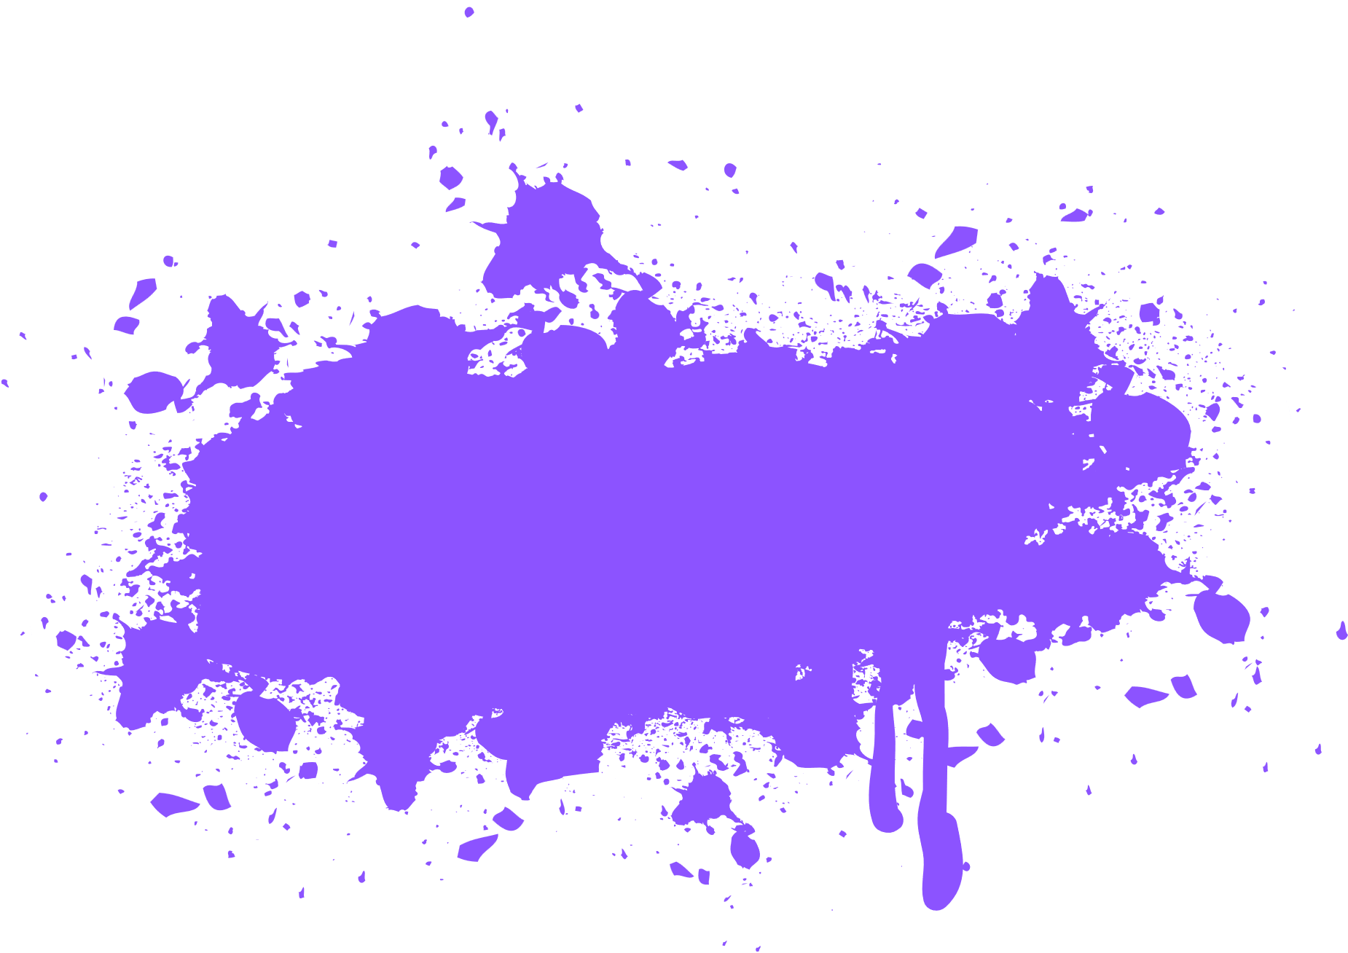





Information about Krimsone’s art practice
Artist
Janne Birkner, known as Krimsone, is an Australian muralist and street artist who grew up in the Blue Mountains and trained in fine art at the National Art School in Darlinghurst. She is recognised for blending realism with surrealism. Krimsone rarely uses reference images; she likes to explore ideas from her imagination and translate them into physical marks and colours.
Artwork
Audience
Vivid colour palettes, meticulous detail, and surreal juxtapositions characterise Krimsone’s murals. Her traditional fine art training is evident in detailed brushwork and compositional choices. She merges this with spray paint techniques typical of street art, bridging two worlds with a high level of technical control. Building dreamlike narratives, her works often feature animals in strange, floating or otherworldly environments, creating a surreal story rather than just a single image.
Audiences encounter Krimsone’s work in everyday life, often unexpectedly, when walking through city laneways or industrial sites. Audiences stop to interpret the symbolic qualities of the work, making personal connections with themes of imagination, which can be calming or unsettling. Encountering her surreal imagery often feels like an invitation to step into another world. When viewing her works up close, audiences feel a sense of immersion as they feel dwarfed in comparison to the large-scale artwork.
World
Krimsone brings a unique female perspective to muralism, contributing a female voice to the male-dominated street art scene in Australia. Her training in fine art connects her practice to traditional artworld conventions such as drawing, painting, showing how street art intersects with contemporary art discourses. Krimsone has contributed to festivals and collaborations in Australia and abroad, aligning her with a street art world that values creativity, accessibility, and community.

Slide 12
Response scaffold
Explore the artworld concepts
  What communities does the artist represent?
  What aspects of the world are important to the artist?
  List the title (if it has one), date created, form, materials, location, size, subject matter of the artwork
  What impact does this artwork have on the audience?
Notes
Think from a point of view – Contemporary viewpoint
  How does the artwork reimagine or challenge ideas about what art is or can be?
  How does the artwork challenge stereotypes about the community it represents?
Notes
Zoom out to understand practice
  What were the artists intentions, choices and actions in creating this artwork?
  What impact does this artwork have on the audience?
  Why is the artwork and its impact important?
Structural
Contemporary
Subjective
Artwork
World
Artist
Audience
Cultural
Notes

