Slide 1
Instructions for use
This resource is not a teaching and learning program. It should be used in conjunction with (Insert unit name and link).
Classroom teachers are encouraged to add and adapt slides as required to meet the needs of their students.
Save a copy of the file to make changes to the slide deck. Go to File > Download a Copy (this downloads a copy to the computer to edit in the PowerPoint app).
To convert the PowerPoint to Google Slides:
  Upload the file into Google Drive and open it.
  Go to File > Save as Google Slides.
  (Note – conversion may cause formatting changes in the slides.)

Slide 2
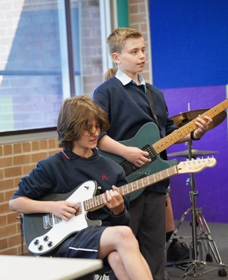
Garage to Grammys
Stage 4 music

Slide 3
Lessons
1
The Blues
4
The drums
2
The guitar
5
The keyboard
3
Performance assessment
6
Ensemble composition and performance
Notes:
Teacher notes:
Click lesson numbers to go to specific lessons
Interactive features can be viewed in slide show
Notes for vendors [to be removed after slide deck creation]:
Create hyperlinks to dividers that match lesson numbers by
Right click on the number>edit link>select slide in deck to connect to

Slide 4
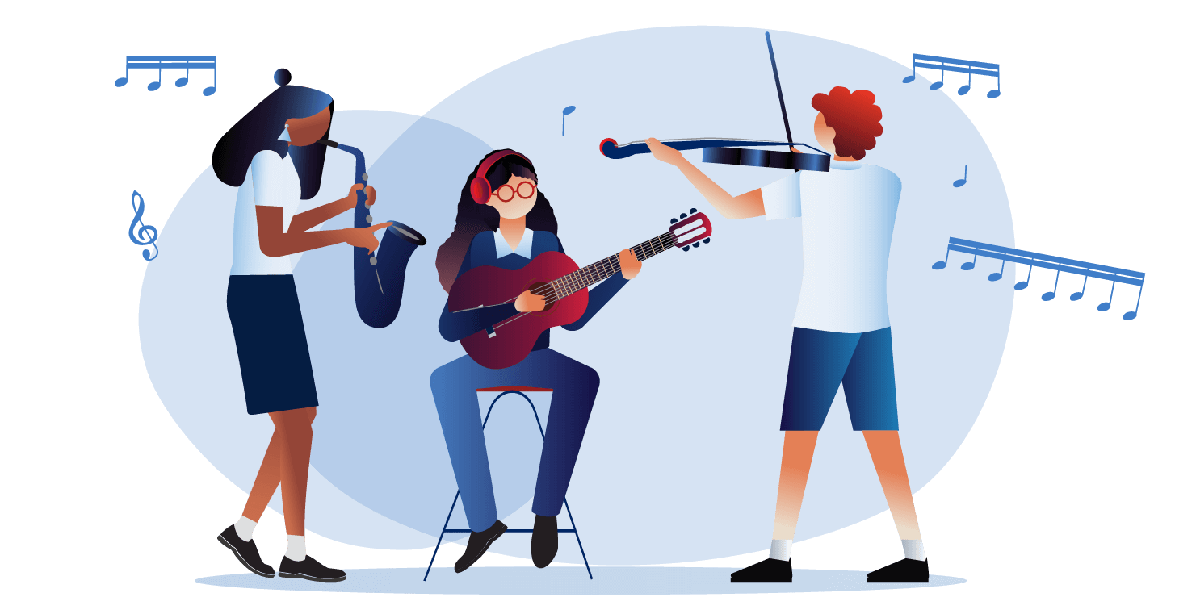
Learning sequence 1 – the blues

Slide 5
Learning intentions and success criteria (1)
We are learning to
understand the history and musical features of the blues genre
identify the 12-bar blues musical structure
apply understanding of the 12-bar blues structure to the C major scale to identify and play the chord progression in C major on the keyboard
We can
identify and explain the musical features of subgenres of blues styles through listening
identify a 12-bar blues chord progression through listening
notate the chords of the 12-bar blues progression in C major and play the 12-bar blues progression in C major on the keyboard
Notes:
Notes for teachers:
Learning intentions and success criteria are best co-constructed with students. Adapt the learning intention as required and add matching success criteria.
For more information See ⁠AITSL or the NSW Department of Education explicit teaching strategies, ⁠Sharing learning intentions and ⁠Sharing success criteria
LISC is not necessarily presented at the beginning of the lesson. Teacher needs to consider most effectual time to introduce
LISC should be revisited during the lesson to support students' evaluation of their learning

Slide 6
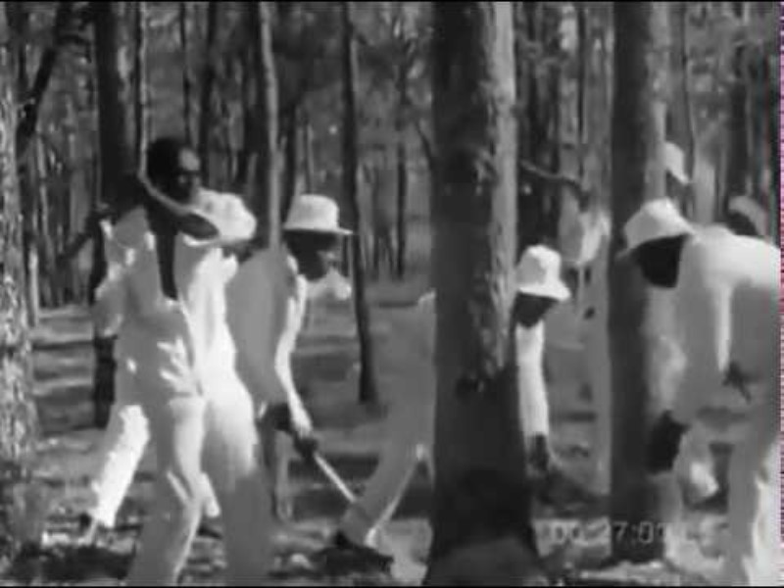
Activity 1.1 – the Blues (1)
Origins of the blues
The blues emerged in the early 1900s in the southern United States, evolving from the vocal traditions of African American slaves.
They were not allowed to talk while they worked, so they used to sing to communicate. This was often through work songs and spirituals. A key feature of the songs was the call and response style of singing adopted from the African music traditions. Here, one person would sing a phrase, and others would respond or repeat it through song.
Swing this Music (8 February 2017) Call & Response. Work song - Prision song (1966) (0:57) [video], Swing this Music, YouTube, accessed 14 May 2025

Slide 7
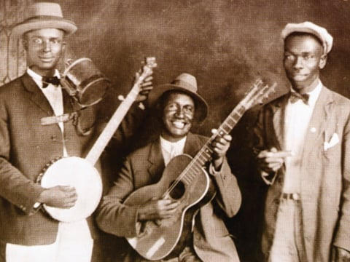
Activity 1.1 – the Blues (2)
Origins of the blues
Although slavery ended in 1865, newly freed African Americans continued to face hardship, which became the foundation of the Blues. They took their music and stories with them as they moved on to other parts of the United States of America.
Jug Band Cannon's Jug Stompers (from left to right : Gus Cannon, banjo and jug, Ashley Thompson, guitar and Noah Lewis, harmonica) (1928) by Wikimedia Commons is licensed under CC BY 3.0

Slide 8
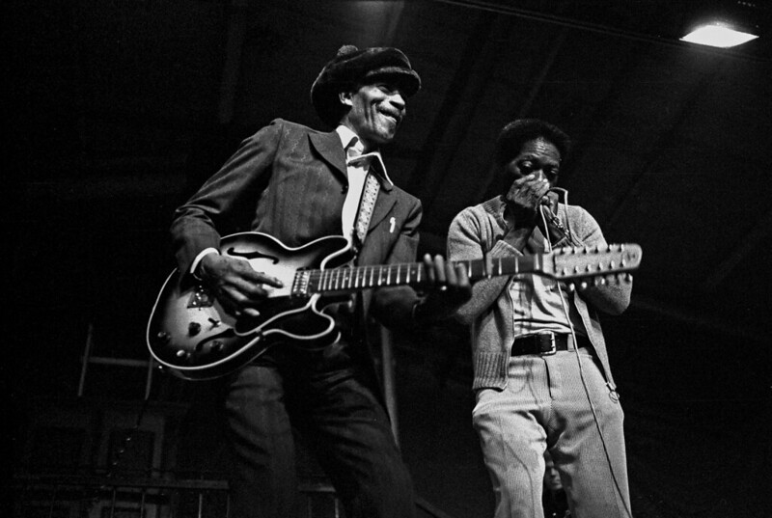
Activity 1.1 – the Blues (3)
General features
The lyrics were often sorrowful and had themes of struggle, loss, sadness, and social issues.
The 12-bar blues is a chord progression that forms the basis of many blues songs.
Included use of ‘blue notes’, with some notes having a minor (sadder sound) interval (distance between notes) instead of major (happier sound) one.
Blues lyrics typically follow an AAB structure.
"American Blues Legends" Live in Hamburg, 1972 by Flickr licensed under CC BY-NC-SA 2.0

Slide 9
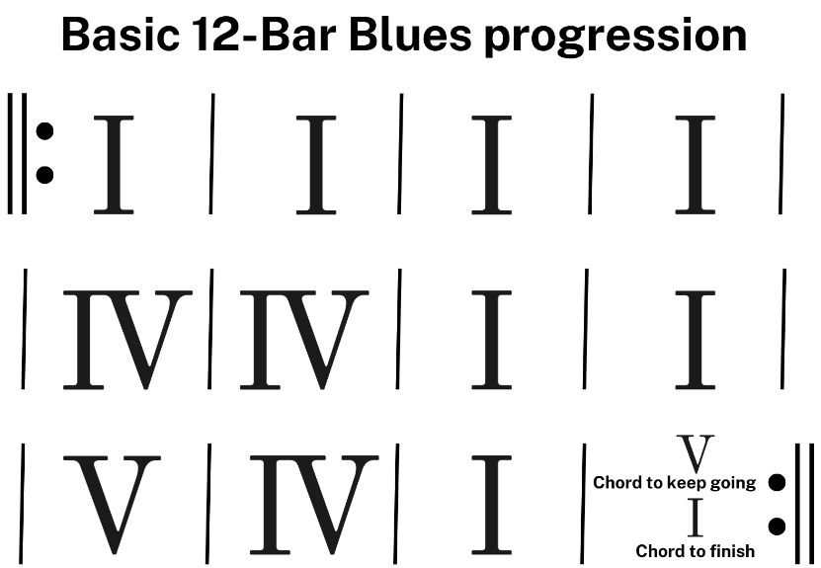
Activity 1.1 – the Blues (4)
12-bar blues chord progression
The 12-bar blues is a chord progression that forms the basis of many blues songs.
It follows a simple structure, and the name comes from the fact that the progression is 12 bars long, typically divided into 3 lines of 4 bars each. It follows a specific pattern using the I, IV, and V chords of a key. These are our primary chords (based on 1st, 4th and 5th notes of a scale) and are the building block for many songs.

Slide 10

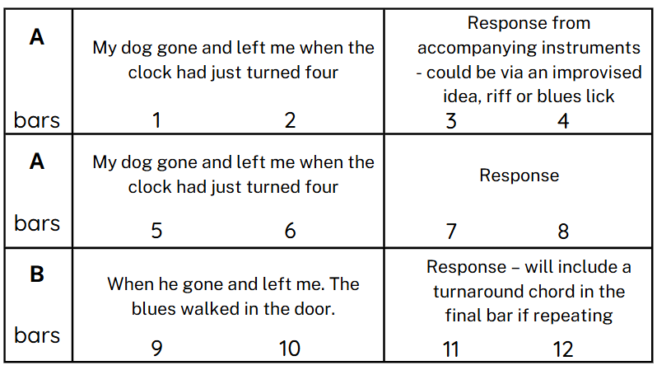
Activity 1.1 – the Blues (5)
General features
Example of an AAB structure:
line A statement
line A – statement repeated (sometimes with a slight variation)
line B – response and will often rhyme or use a play on words.
Each line of lyrics is typically based on 2 bars and the following 2 bars are complimented by accompanying instruments.

Slide 11
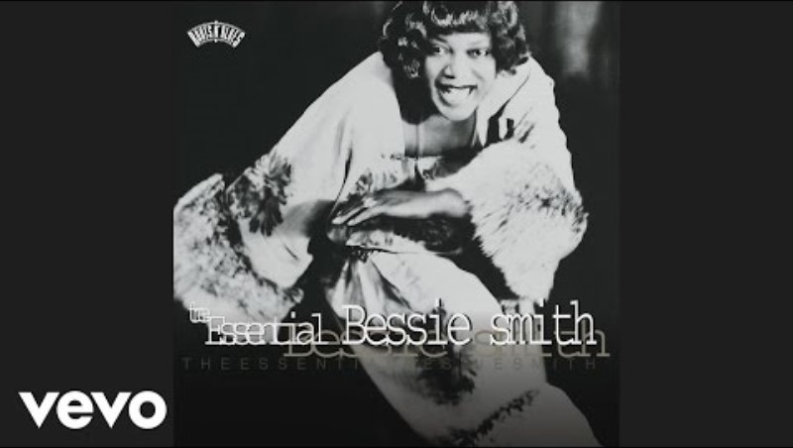
Activity 1.1 – the Blues (6)
AAB structure examples
Jazz music emerged shortly after the Blues, drawing on its rich musical traditions. One notable influence is the AAB structure, which became a common feature in many early jazz songs.
BessieSmithVEVO (1 May 2015) Bessie Smith - St. Louis Blues (Audio) (3:10) [video], BessieSmithVEVO, YouTube, accessed 14 May 2025

Slide 12
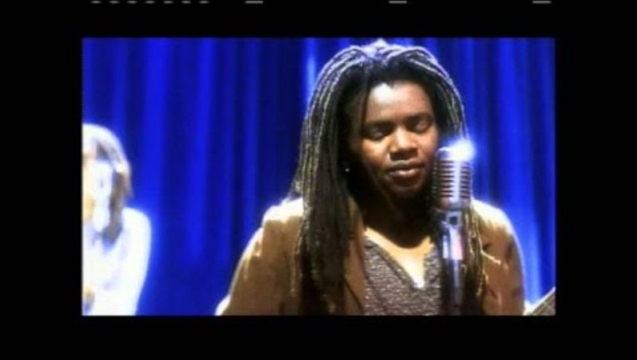
Activity 1.1 – the Blues (7)
AAB structure examples
In Tracy Chapman's song ‘Give Me One Reason’, the AAB form is used. This structure helps to highlight the lyrics. AAB format is still important in popular music today.
Tracy Chapman (14 November 2015) Tracy Chapman - Give Me One Reason (Official Music Video) (4:07) [video], Tracy Chapman, YouTube, accessed 14 May 2025

Slide 13


Activity 1.1 – the Blues (8)
Music terms
Improvisation is making up music as you perform, instead of following written notes. Musicians use creativity to change melodies and rhythms, like a musical conversation. It is common in blues, jazz, and rock music.
Jazz at Lincoln Center’s JAZZ ACADEMY (23 February 2015) Jazz Fundamentals: What Is Improvisation?[video], Jazz at Lincoln Center’s JAZZ ACADEMY, YouTube, accessed 21 August 2025

Slide 14
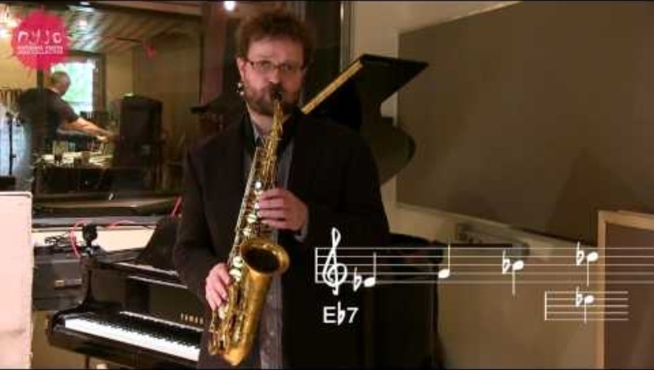


Activity 1.1 – the Blues (9)
Music terms
Blues notes are specific notes in a blues scale that have been flattened (lowered). This is often the 3rd, 5th, and 7th notes of the scale. When played, they create an expressive and 'bluesy' sound, and are a key feature of blues, jazz, and related styles.
The 12-bar blues chord progression is a short, catchy, and repeated musical pattern that helps shape the structure of the song. It can include melody and chord ideas.
National Youth Jazz Collective (24 October 2014) NYJC Glossary of Terms - Blue Notes[video], National Youth Jazz Collective, YouTube, accessed 21 August 2025
World Heart Beat (17 June 2022)Introduction to the blues - an easy and accessible explanation of the classic 12-bar blues format[video], World Heart Beat, YouTube, accessed 21 August 2025

Slide 15

Activity 1.1 – the Blues (10)
Music terms
A riff is a short, catchy, and repeated musical pattern that helps shape the structure of the song. It can include melody and chord ideas.
A lick is a short melodic phrase used to embellish solos or improvisation. Unlike riffs, licks are not repeated throughout a song but are flexible patterns typically used by musicians in their playing.
Conor Rocks (10 March 2024) Guitar Riff vs Lick: EASY Beginners Guide [video], Conor Rocks, YouTube, accessed 21 August 2025

Slide 16
Activity 1.2– early blues style (1)
Early blues styles
Early Blues music evolved into many various forms (subgenres) over time. Some of the most prominent styles include:
East Coast Blues (Piedmont Blues) - lyrics were based on storytelling, everyday life and included humour. Accompanied by intricate guitar finger picking and often paired with a harmonica. The style was influenced by Ragtime (an early form of jazz that was mainly played on the piano).
Delta Blues – emotional and raw sounding vocals with lyrics that focused on hardship and folklore. Songs were accompanied by guitar incorporating fingerpicking and use of a slide.
Chicago Blues – lyrics focused on city life, social struggles and love. Accompaniment often includes electric guitar, harmonica, piano, bass and drums.

Slide 17
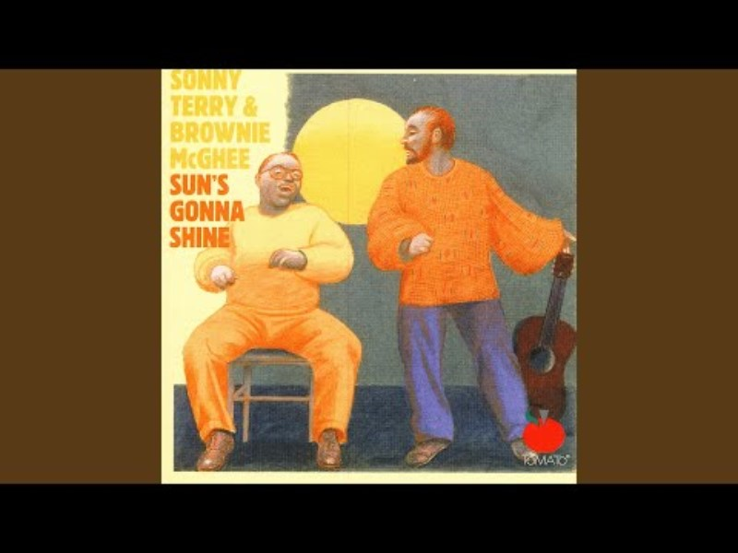

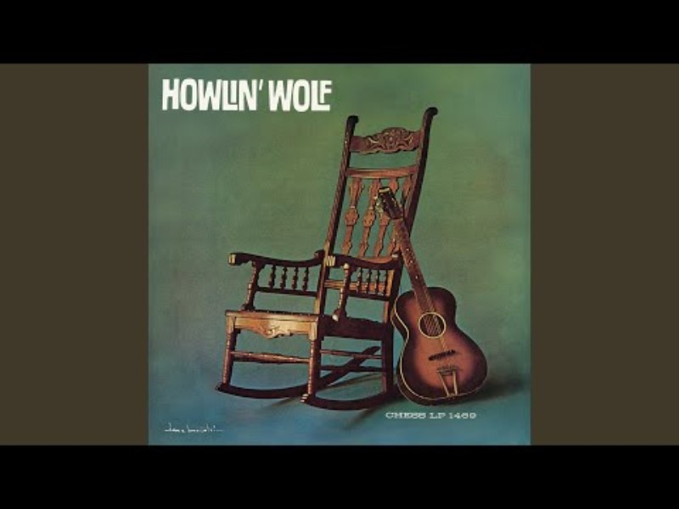
Activity 1.2 – early blues style – listening (1)
Early blues style – listening worksheet samples
Walk On (3:18)
Sweet Home Chicago (2:59)
Spoonful (2:50)
Reference numbers for the Elements of music (see following slide for example)
1 – pitch (relative highness and lowness of sounds)
2 – duration (the lengths of sounds and silences is music)
3 – structure (the design or form of music. Construction of sections or parts)
4 – performing media and timbre (the instrument/s/voices used, and the quality of their sound created)

Slide 18
Activity 1.2 – early blues style – listening (2)
Early blues style – listening worksheet response sample
Question | Response
Describe how the vocalist sounds | male vocals singing melody line (1), which is quite repetitive. There is some harsher quality in the voice (4), when jumping to higher notes (1) in the choruses (3)
Reference numbers for the Elements of music (see following slide for example)
1 – pitch (relative highness and lowness of sounds)
2 – duration (the lengths of sounds and silences is music)
3 – structure (the design or form of music. Construction of sections or parts)
4 – performing media and timbre (the instrument/s/voices used, and the quality of their sound created)

Slide 19

Activity 1.3 – 12-bar blues chord progression (1)
Introduction
Here is a standard format for a 12-bar blues chord progression. In music, we sometimes see chords referred to in Roman numerals. This is so we can apply the pattern to any key we may want to play in. You can see this pattern uses chords I, IV and V.
Here are the Roman numerals for 1 to 10
1 (I), 2 (II), 3 (III), 4 (IV), 5 (V), 6 (VI), 7 (VII), 8 (VIII), 9 (IX) and 10 (X)
We use uppercase for major and lowercase for minor. For example, chord 3 major (III) and chord 3 minor (iii).
The first 4 bars of music use chord I, although we might see a chord IV in the second bar, as an alternative to repeating chord I. We will also find a chord V in the final bar instead of chord I, if we are repeating the chord progression. This is called a ‘turnaround’.

Slide 20
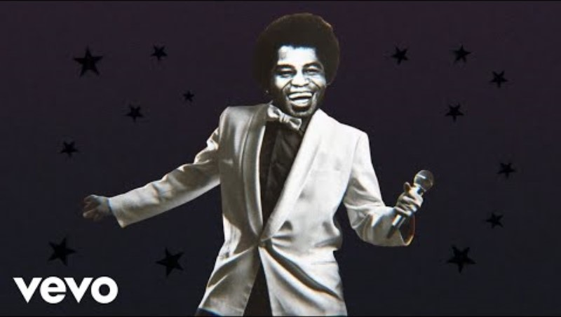
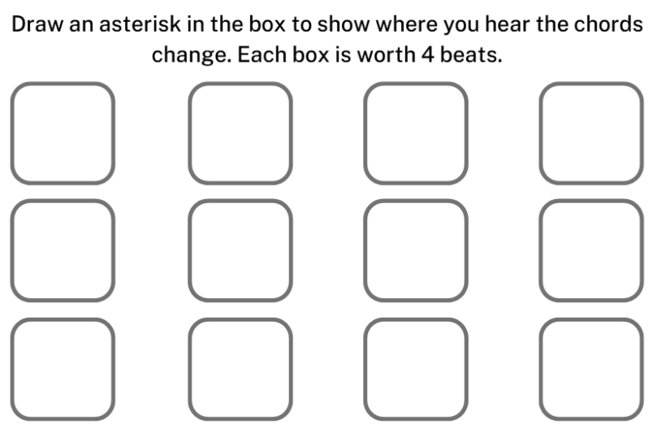
Activity 1.3 – 12-bar blues chord progression (2)
Listening
Use the worksheet provided and place an asterisk in the bar to show when you hear the chord changes within the 12-bar blues progression.
James Brown (9 November 2014) I Feel Good (I Got You) (0:00 - 2:44) [video], James Brown, YouTube, accessed 14 May 2025

Slide 21
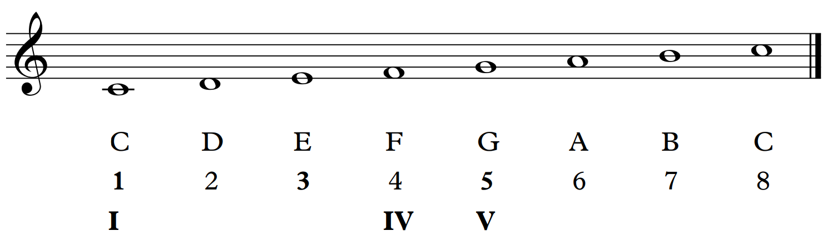
Activity 1.4 – 12-bar blues progression in C major (1)
12-bar blues progression in C major
Write out the 12-bar blues chord progression out in the key of C major. To help you, find the note on the scale that responds to the roman numerals.

Slide 22
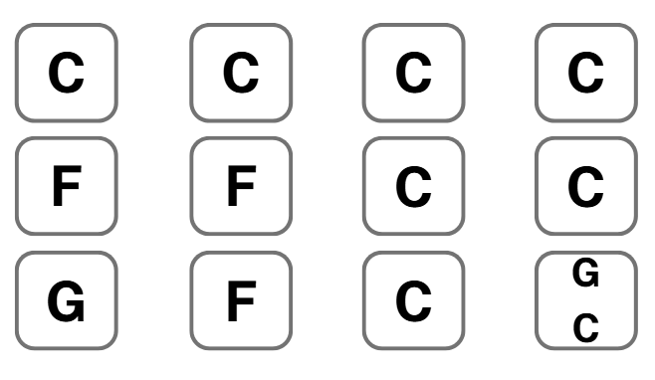
Activity 1.4 – 12-bar blues progression in C major (2)
12-bar blues progression in C major
Check your work.

Slide 23
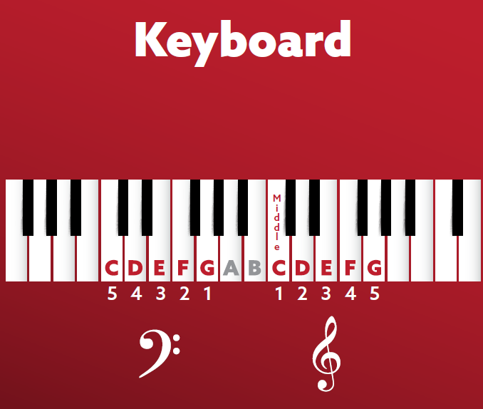
Activity 1.4 – 12-bar blues progression in C major (3)
Revision on keyboard
The keyboard is made up of black and white keys. The white keys use the letter names of A, B, C, D, E, F, G. The black keys are the sharps or flats that relate to each note on either side of the white notes.
Sharp (#) notes are the black notes to the right of a white note. Flat (b) notes are the black notes to the left of a white note.

Slide 24
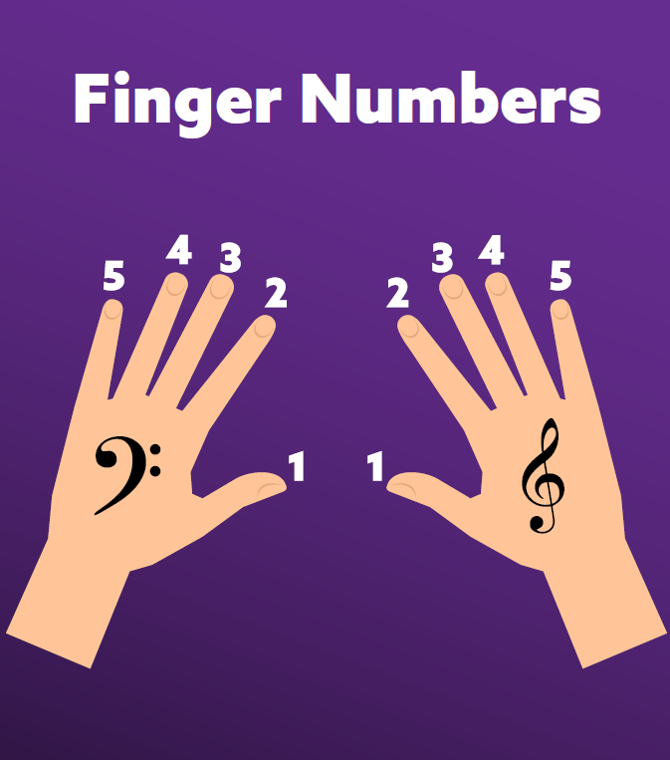
Activity 1.4 – 12-bar blues progression in C major (4)
Keyboard fingering
The music you play on the keyboard uses both the treble and bass clefs. Usually the left hand (LH) plays the bass notes, and the right hand (RH) plays the treble notes. The finger numbers we use to play the keyboard are 5, 4, 3, 2, 1 for the left hand and 1, 2, 3, 4, 5 for the right hand.

Slide 25
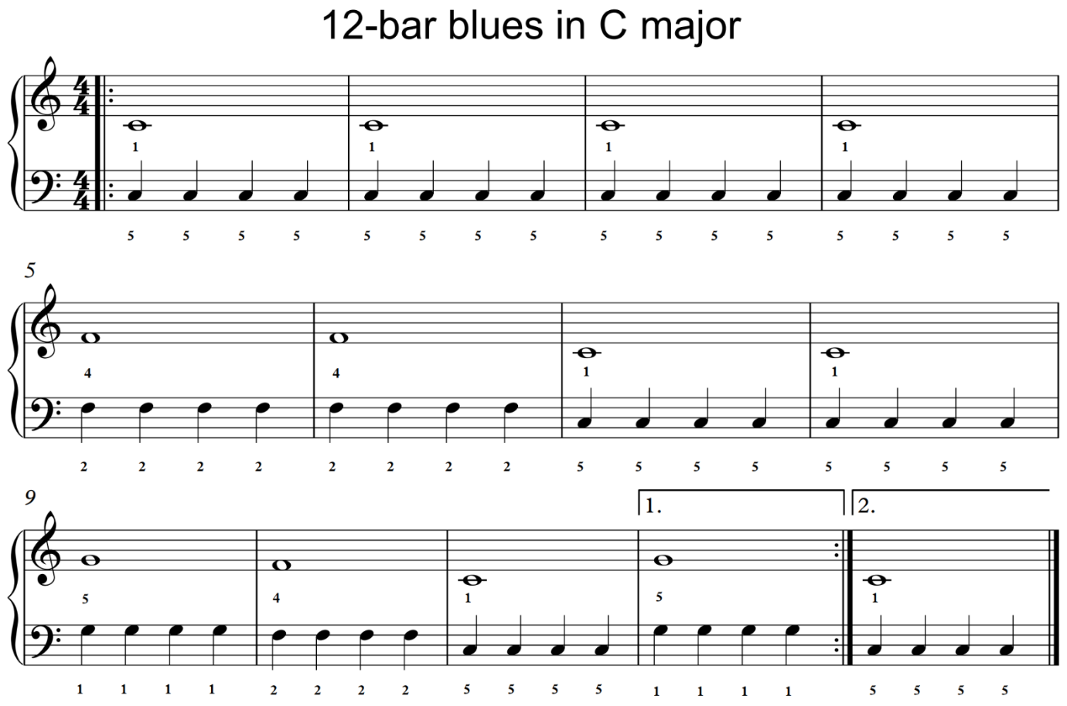
Activity 1.4 – 12-bar blues progression in C major (5)
Performing
Play through the root notes of each chord on the keyboard for a 12-bar blues progression in C major.

Slide 26

Learning sequence 2 – the guitar

Slide 27
Learning intentions and success criteria (2)
We are learning to
apply correct technique and safe practice when playing the guitar
build understanding of the 12-bar blues chord progression
read and play using various forms of guitar notation – tablature and chord diagrams
develop individual performance skills.
We can
play melodic and chordal patterns on the guitar demonstrating correct technique and secure delivery
interpret guitar tablature and chord diagram notation systems
demonstrate skills and understanding through playing as an individual and within an ensemble.
Notes:
Notes for teachers:
Learning intentions and success criteria are best co-constructed with students. Adapt the learning intention as required and add matching success criteria.
For more information See ⁠AITSL or the NSW Department of Education explicit teaching strategies, ⁠Sharing learning intentions and ⁠Sharing success criteria
LISC is not necessarily presented at the beginning of the lesson. Teacher needs to consider most effectual time to introduce
LISC should be revisited during the lesson to support students' evaluation of their learning

Slide 28
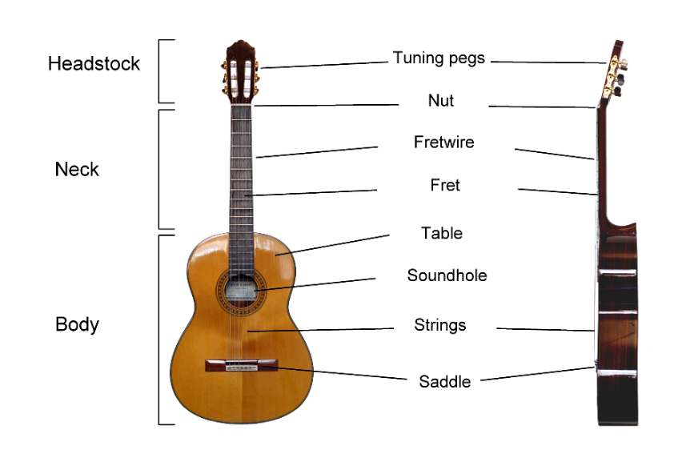
Activity 2.1 – facts and features of the guitar (1)
General facts
The guitar is a stringed instrument typically played with fingers or a pick.
It usually has six strings, but this can vary.
Guitars are used in many music genres, including blues, rock, jazz, country, and classical.
Acoustic guitar
Commonly made from wood, with steel strings
It has a hollow body which naturally amplifies the sound
Mainly used in in folk, country, pop and rock music
Classical guitar
Acoustic guitar that uses nylon strings instead of steel
Played with fingers (fingerpicking) instead of using a pick
Classical Guitar labelled english by Wikimedia Commons is licensed under CC BY 3.0

Slide 29
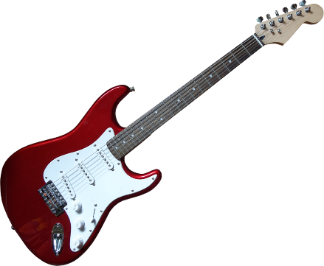
Activity 2.1 – facts and features of the guitar (2)
General facts
Electric guitar
Typically has a solid body and requires an amplifier to be heard
Has pickups that convert string vibrations into electrical signals
Used in wide genres of music, including blues, jazz, rock and popular music styles
Lead guitar
Plays melodies, solos, and riffs
Uses techniques like bending, tapping, and pedals to enhance sound
Rhythm guitar
Focuses on chords and strumming patterns to support the melody
Supports the beat and harmony in a band
Electric guitar image - from Pixabay, published prior to July 2017 under the Creative Commons CC0 1.0

Slide 30

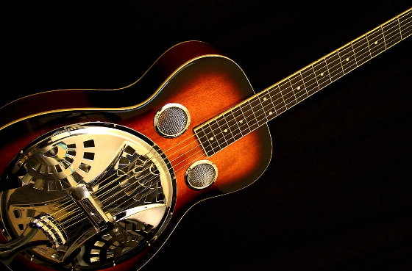
Activity 2.1 – facts and features of the guitar (3)
General facts
Other guitars used in blues, jazz and popular music
Bass guitar
4 (sometimes 5 or 6), thicker than regular guitar strings
Solid body, similar to an electric guitar but larger
Provides harmony and rhythm foundation in a piece
Features in rock, metal, funk, pop and jazz
Played with fingers or a pick
Dobro (resonator) guitar
Has a metal resonator instead of a wooden sound hole.
Often played with a slide in blues and bluegrass music.
Creates a distinct twangy, metallic sound.
Person Playing an Electric Guitar, May 11, 2021 – – by Antoni Shkraba production is licensed under the Pexels License
Gold Tone Paul Beard signature resonator guitar, 6 December 2010 – Wikimedia commons in licensed under CC BY 2.0

Slide 31

Activity 2.1 – facts and features of the guitar (4)
Technique
Playing position steps
Sit up straight and avoid slouching over the guitar
Position the guitar so the back rests against your body, and the body remains stable on your thigh
Angle the neck slightly upward, not straight or pointing towards the floor
Strumming/picking hand
Keep your wrist loose and relaxed
Strum over the soundhole (acoustic) or pickups (electric)
If using a pick, hold it securely between your thumb and index finger
Fretting hand
Relax your wrist to avoid any strain
Keep your thumb behind the neck and your fingers curved to press the strings

Slide 32
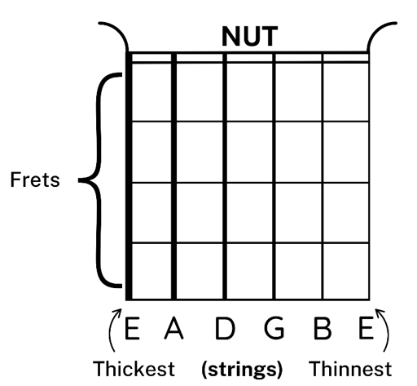
Activity 2.2 –12-bar blues in A major and reading tablature (1)
Reading tablature
What is guitar tablature?
Tablature, or TAB, is a simple way to read music for a fretted string instrument, such as the guitar. Instead of regular sheet music, it shows you where to put your fingers on the strings.
Each line on the TAB represents a string on the guitar. The bottom line is your thickest string (low E) and the top line is your thinnest string (high E).

Slide 33
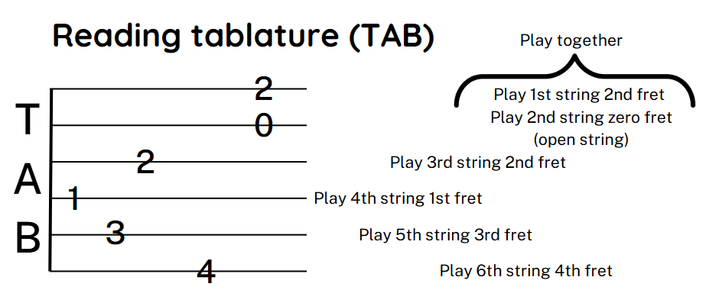
Activity 2.2 – 12-bar blues in A major and reading tablature (2)
Reading tablature
0 means an open string (play without pressing any frets).
Other numbers tell you which fret to press.
If numbers are stacked, play them together (like a chord).
Sometimes there may be additional symbols explaining a particular technique to use.
Tip – When reading TAB, it is like reading a map to show where you put your fingers and what string to play. A good way to help you find the strings when using TAB is, think T for ‘toes’ (thinnest string) and B for ‘brain’ (thickest string).

Slide 34
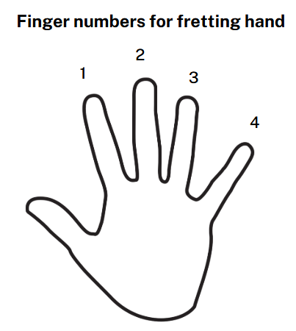
Activity 2.2 – 12-bar blues in A major and reading tablature (3)
Reading tablature
For our hand that plays on the frets we use the finger numbers shown.

Slide 35
Activity 2.2 – 12-bar blues in A major and reading tablature (4)
Blues in A major – overview of levels
Introduction level – you will start with playing an open single string on the root note of each of the chords in the 12-bar blues chord progression.
Level 1 – you will see the pattern you played in the introduction has an additional note above. This will require you playing both strings.
Level 2 – you will see the pattern you played in level 1, but the rhythm is now in quavers This will require you to play more notes per bar.
Level 3 – you will see the rhythm you played in level 2, with the addition of the alternating 7th blues note on beats 2 and 4 of each bar. This will require you to change from your 2nd to 4th finger each on each beat of the bar.

Slide 36
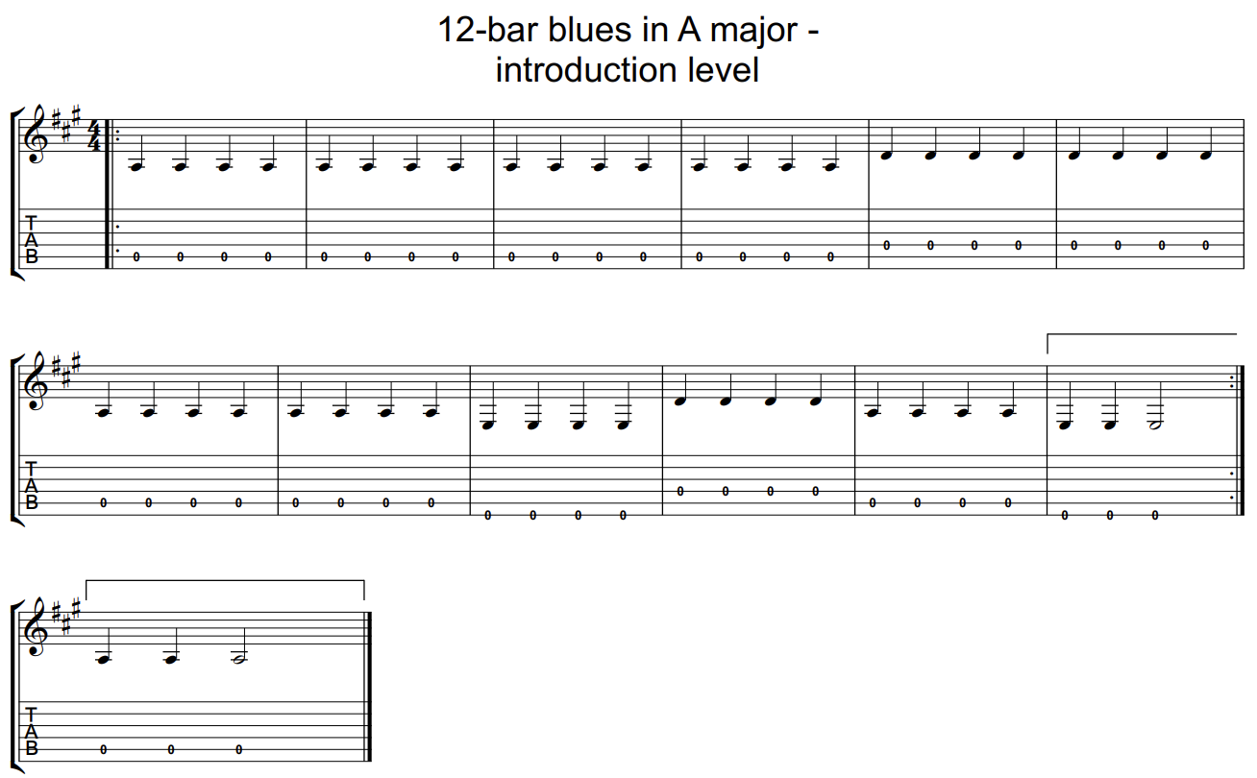
12-bar blues in A major – introduction level

Slide 37
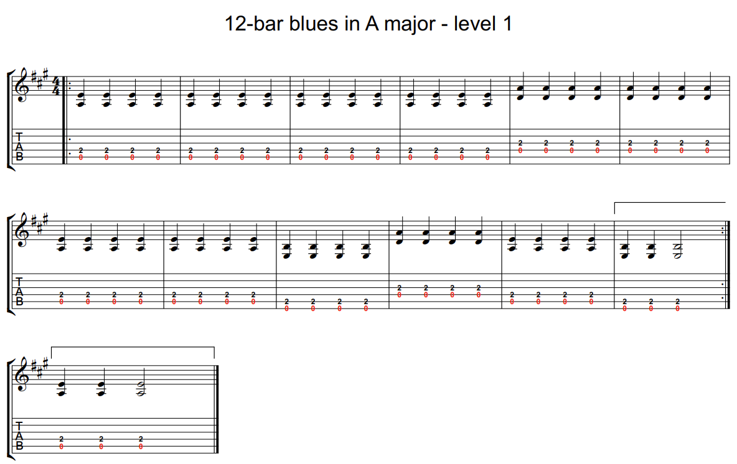
12-bar blues in A major – level 1

Slide 38
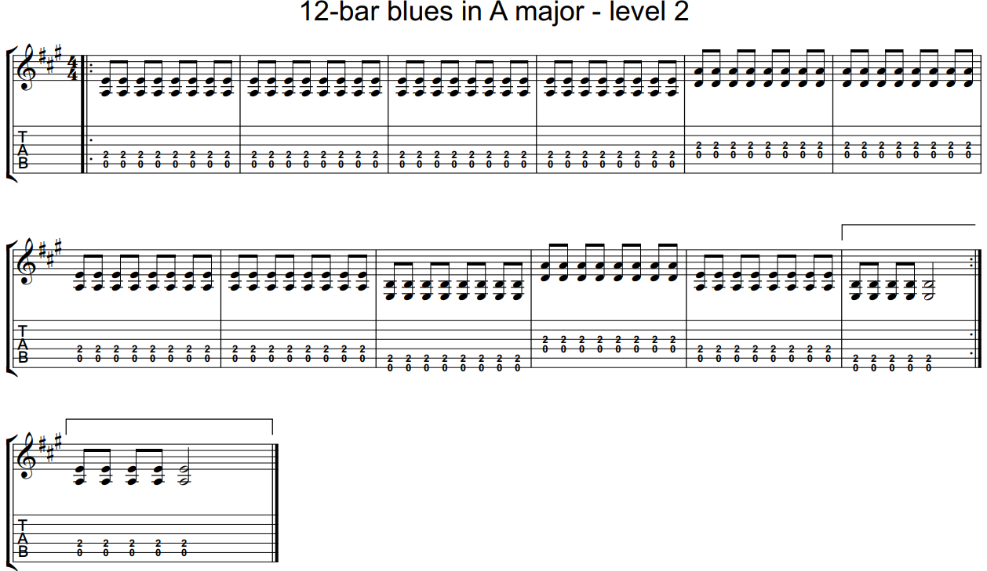
12-bar blues in A major – level 2

Slide 39
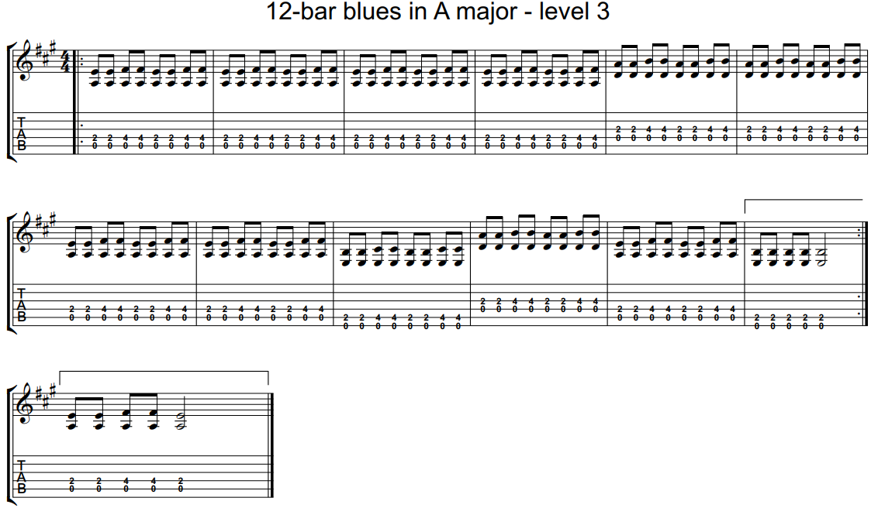
12-bar blues in A major – level 3

Slide 40

Activity 2.3 – swing vs straight rhythms (1)
Duration music terms
Swing rhythm – is based on triplets, which means we divide each beat into 3 equal parts instead of 2. But instead of playing all 3 parts, the first 2 notes are held together, giving the distinct, long-short feel. Commonly heard in jazz music styles.
Shuffle rhythm – is based on a triplet idea, where the first and third notes are played. This creates a distinctive long-short rhythm pattern that gives the music a bouncy, driving, and infectious groove. Commonly heard in popular music styles.

Slide 41
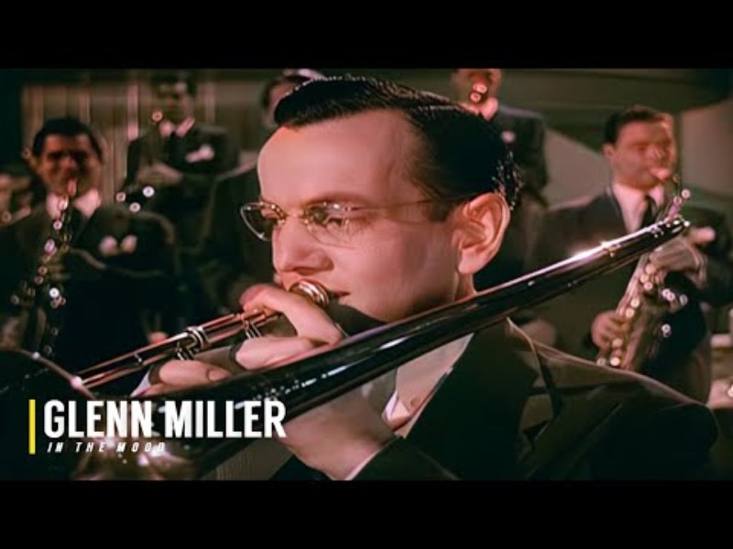
Activity 2.3 – swing vs straight rhythms (2)
Swing rhythms
Swing music is a style of jazz which developed in the 1930s. It is characterised by its lively and infectious rhythm, primarily performed by Big Bands – large ensembles featuring sections for trumpets, saxophones, and trombones, supported by a rhythm section of drums, double bass, guitar, and piano.
The swing rhythm is commonly used in jazz music where the musicians play a long-short pattern. This creates a relaxed but energetic feel to the music.
Watch ‘In the Mood’ performed by Glenn Miller and his big band. While the piece has an overall bouncy feel, listen particularly to the strong swing pattern being played on the drums.
Classic Hits Studio (6 March 2022) Glenn Miller - In The Mood | Colorized (1941) 4K (3:21) [video], Classic Hits Studio, YouTube, accessed 14 May 2025

Slide 42
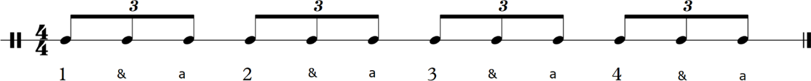
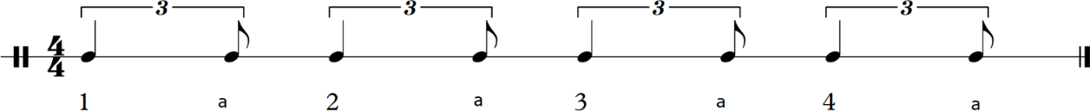
Activity 2.3 – swing vs straight rhythms (3)
Swing vs straight rhythms
Clap through each of the rhythms.
Triplets
Swing rhythm (based on triplets)
Straight rhythm (based on quavers)
Now try half the class clapping a swing rhythm, while the others clap a straight rhythm together.

Slide 43

Activity 2.3 – swing vs straight rhythms (4)
Shuffle rhythms
A shuffle rhythm is commonly heard in blues, rock ‘n’ roll, and boogie-woogie music. It is based on a triplet idea, where the first and third notes are played. This creates a distinctive long-short rhythm pattern that gives the music a bouncy, driving, and infectious groove.
Like the swing feel in jazz, the term ‘shuffle’ is used when the same rhythmic idea is used in other popular styles of music.
Guitar Center (21 August 2021) How to Play the Blues Shuffle | Beginner Guitar Tips [video], Guitar Center, YouTube, accessed 25 August 2025

Slide 44
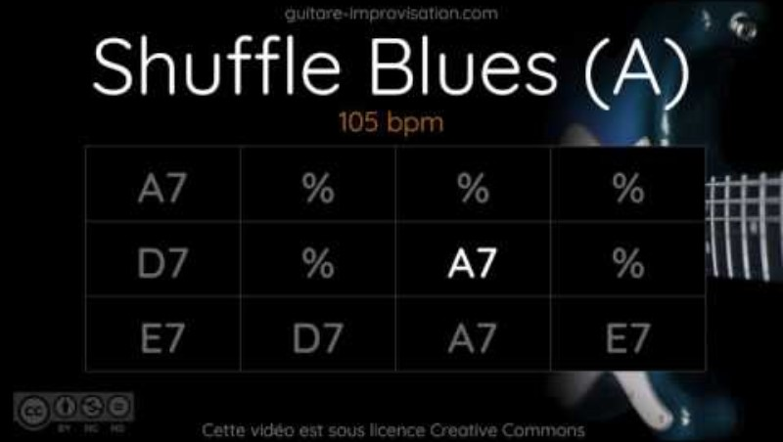
Activity 2.3 – swing vs straight rhythms (5)
Blues in A backing track
Play along with the backing track using a shuffle rhythm and choose the appropriate level of the 12-bar blues in A major that you are comfortable playing.
Guitar Improvisation (28 June 2017) Blues Shuffle in A (5:42) [video], Guitar Improvisation, YouTube, accessed 14 May 2025

Slide 45
Activity 2.4 – chords on the guitar (1)
What is a chord?
A chord is when 2 or more notes are played together and are built using different notes
(intervals – space between notes). Chords create harmony in music and make it sound full.
There are different types of chords, such as major chords, which sound happy (bright), and minor chords, which sound sad (darker).
We are going to explore a variety of chords and terms during this unit:
Major chord – made up using these notes from the scale – 1(root note), 3 and 5
Minor chord – uses these scale notes – 1(root note), b3 (flattened 3rd) and 5
Triad – basic chord structure, made up using 3 notes played simultaneously
7th chords – adding the 7th note (above the root note) to a triad enhances the chord providing extra colour and emotion, often creating a ‘bluesy’ sound.

Slide 46
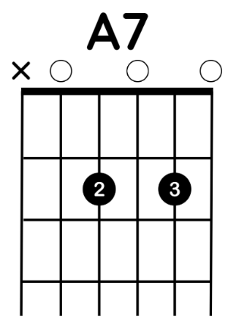

Activity 2.4 – chords on the guitar (2)
Guitar chord diagrams
A chord diagram visually shows where to place your fingers on the fretboard.
Black dots indicate which fret and string to press and may include finger numbers.
(O) Circles above the nut mean play the string open.
(X) Crosses above the nut means do not play that string.
The vertical lines represent guitar strings from low E (6th string, thickest) to high E (1st string, thinnest).
Each string is tuned to a specific note, and tuning typically starts from the 6th string through to the 1st.

Slide 47
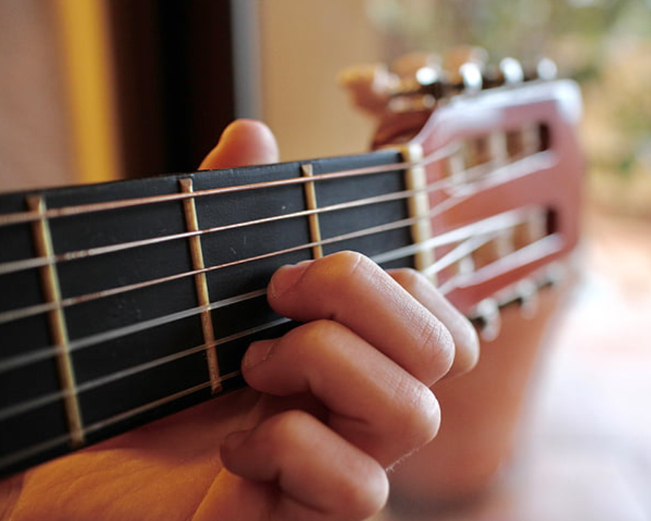
Activity 2.4 – chords on the guitar (3)
Guitar chord diagrams – reminder
The string numbers and names from lowest to highest –
6th (E), 5th (A), 4th (D), 3rd (G), 2nd (B) and 1st (E)
Remember, for our hand that plays on the frets we use the finger numbers shown.
Hand on guitar by pxhere licensed under CC0 Public Domain

Slide 48
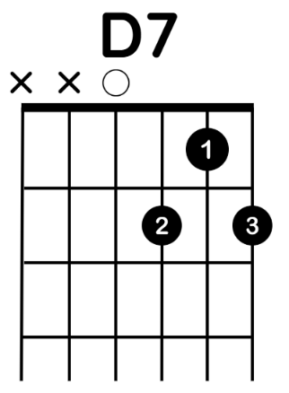
Activity 2.4 – chords on the guitar (4)
Learning guitar chords
Here are the first 2 chords we will learn.

Slide 49
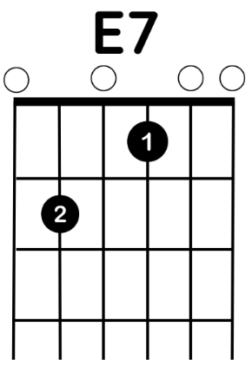
Activity 2.4 – chords on the guitar (5)
Learning guitar chords
Here is our next chord.
It takes time to learn to change hand position for each chord shape. To help you improve, you can start strumming the chords only on beat one and then use the additional beats in that bar to change your hand ready for the new chord shape. As you improve, try more strums and fewer beats to change on, until you can strum the full 4 beats for each bar.

Slide 50
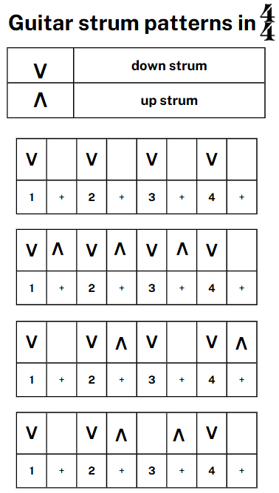
Activity 2.4 – chords on the guitar (6)
Strum patterns
A strum pattern is the rhythm of your strumming hand when playing the guitar. It incorporates up and down strokes, providing different rhythm patterns. This makes your playing more interesting and supports you play a variety of songs.
Explore these patterns using the previous chord progression you learnt.

Slide 51



Activity 2.5 – learning Feelin’ Blues-E (1)
Listening
The next piece we are going to learn on guitar is called, Feelin’ Blues-E. This is a 12-bar blues piece that uses a number of riff ideas throughout.
Before we learn it, we are going to listen to some jazz and popular music examples where riffs are a prominent musical feature.
Herbie Hancock (11 March 2017) Watermelon Man (Remastered 2007) (7:09) [video], Herbie Hancock, YouTube, accessed 14 May 2025
RHINO (23 January 2018) Booker T. & The MG's - Green Onions (Official Audio) (2:53) [video], RHINO, YouTube, accessed 14 May 2025
Metallica (8 June 2022) Enter Sandman (Remastered) (5:31) [video], Metallica, YouTube, accessed 14 May 2025

Slide 52
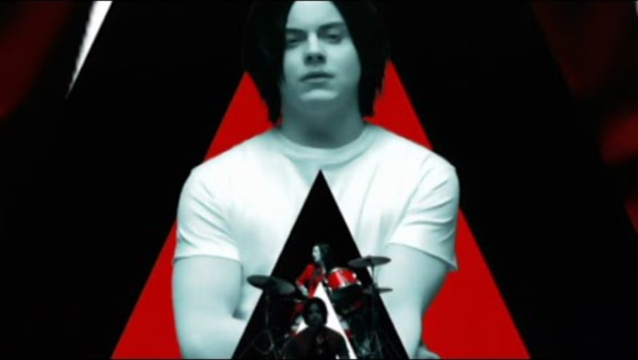

Activity 2.5 – learning Feelin’ Blues-E (2)
Listening
Here are 2 other pieces you may be familiar with that use riffs.
The White Stripes (22 October 2008) The White Stripes - Seven Nation Army (Official Music Video) (3:58) [video], The White Stripes, YouTube, accessed 14 May 2025
Deep Purple (2 March 2024) Smoke On the Water (Official Music Video) [video], Deep Purple, YouTube, accessed 14 May 2025

Slide 53
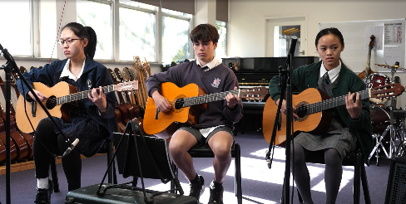
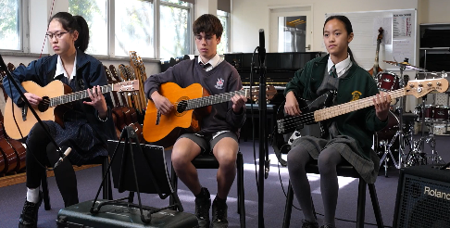
Activity 2.5 – learning Feelin’ Blues-E (3)
Ensemble performance
Click on red arrow on the play button to watch the complete performances of Feelin’ Blues-E.
Use these to help you learn to play your part.
Full ensemble – parts 1,2,3 on guitars
Full ensemble – parts 1,2,3 on guitars and bass guitar
Notes:
Teacher note – the play buttons work best when in presenter mode.

Slide 54
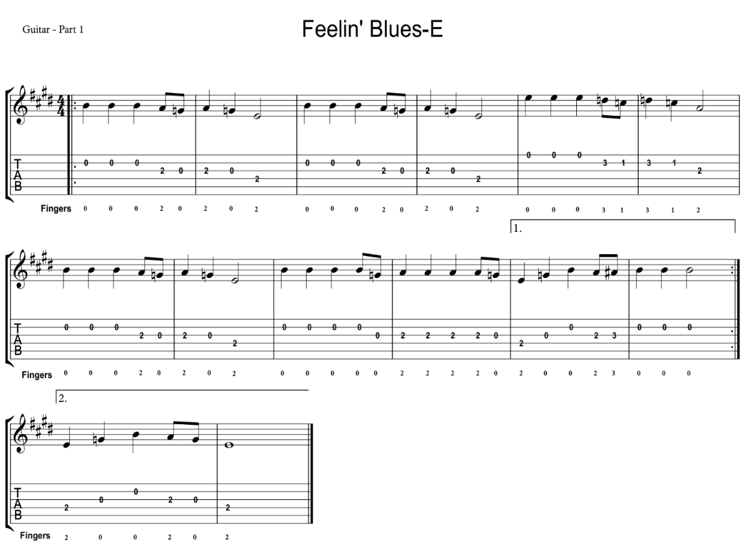
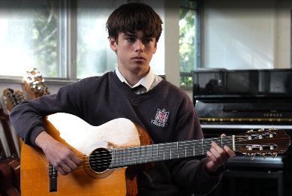
Activity 2.5 – learning Feelin’ Blues-E (4)
Performing – Guitar part 1
Notes:
Teacher note – the play buttons work best when in presenter mode.

Slide 55
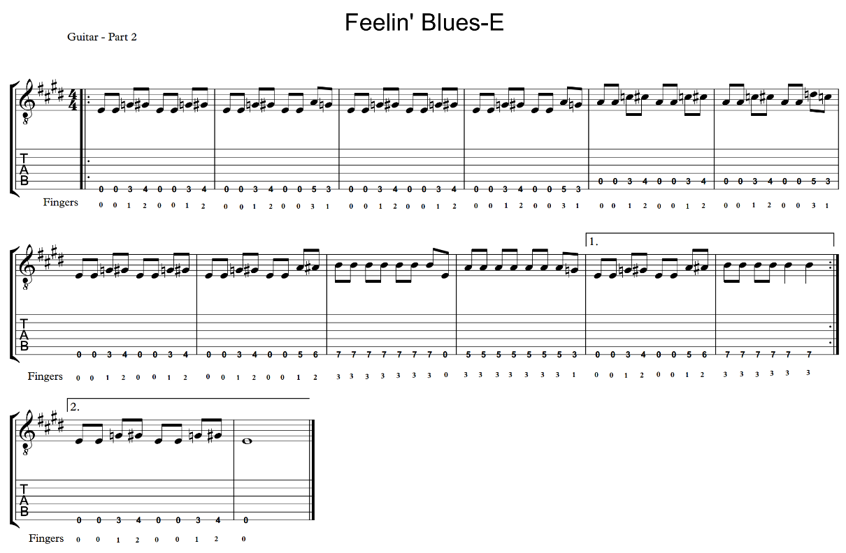
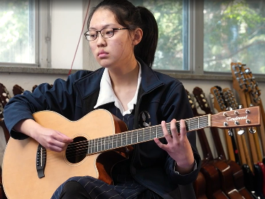
Activity 2.5 – learning Feelin’ Blues-E (5)
Performing – Guitar part 2
Notes:
Teacher note – the play buttons work best when in presenter mode.

Slide 56
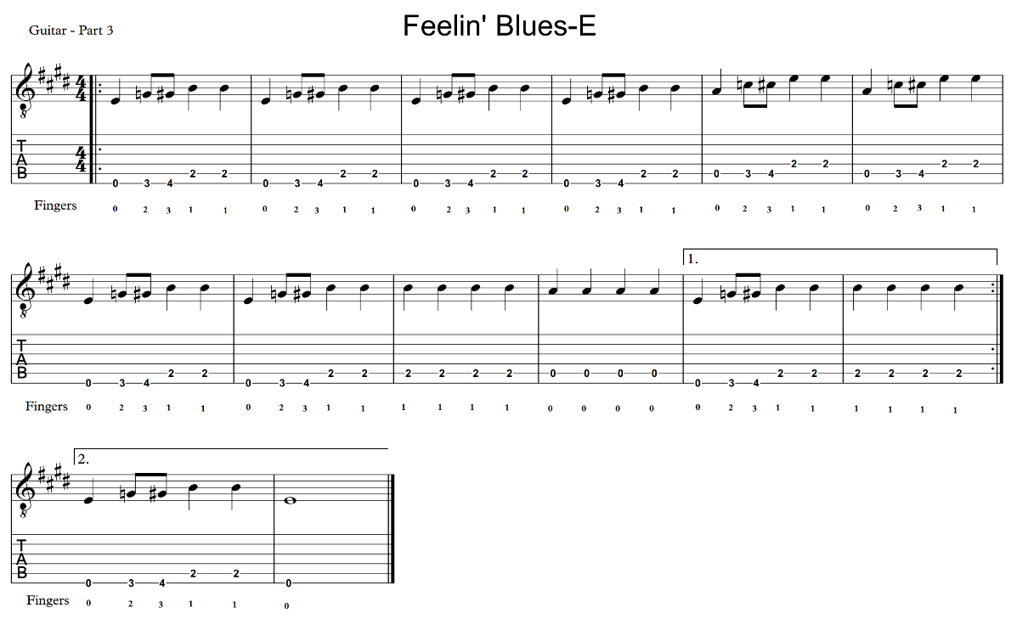
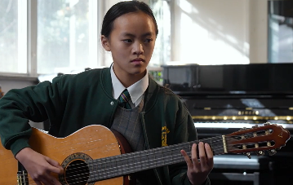
Activity 2.5 – learning Feelin’ Blues-E (6)
Performing – Guitar part 3
Notes:
Teacher note – the play buttons work best when in presenter mode.

Slide 57
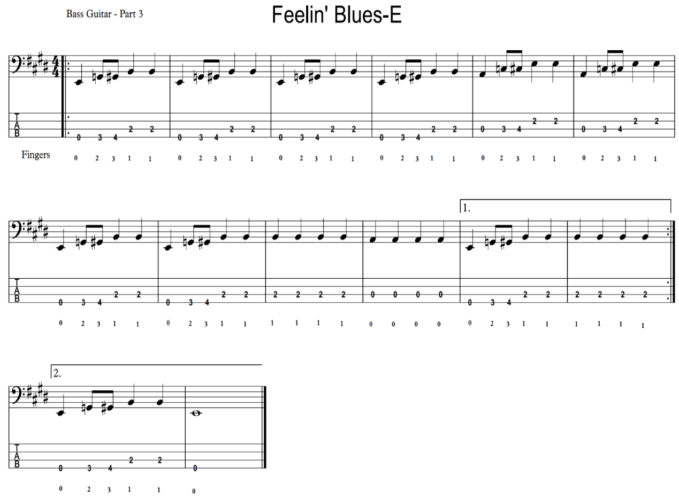
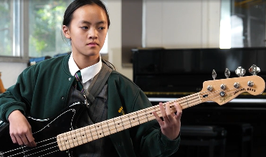
Activity 2.5 – learning Feelin’ Blues-E (7)
Performing – Bass guitar
Notes:
Teacher note – the play buttons work best when in presenter mode.

Slide 58

Learning sequence 3 – performance assessment

Slide 59
Learning intentions and success criteria – learning sequence (3)
We are learning to
rehearse and refine a piece of music using listening and performing skills
develop individual performance skills to play in an ensemble.
We can
play the music demonstrating a controlled and accurate performance
apply safe practice and correct playing technique on the guitar
respond to feedback during the rehearsal process to refine performing and listening skills
demonstrate ability to maintain individual role and secure ensemble balance and cohesion.
Notes:
Notes for teachers:
Learning intentions and success criteria are best co-constructed with students. Adapt the learning intention as required and add matching success criteria.
For more information see ⁠AITSL or the NSW Department of Education explicit teaching strategies, ⁠Sharing learning intentions and ⁠Sharing success criteria.
LISC is not necessarily presented at the beginning of the lesson. Teacher needs to consider most effectual time to introduce.
LISC should be revisited during the lesson to support students' evaluation of their learning.

Slide 60

Activity 3.1 – performance assessment (1)
Performing
What do I have to do for the assessment task?
Present an ensemble performance of Feelin’ Blues-E.
Ensure the ensemble includes at least 3 members, with each person either playing the melody (part 1), accompaniment (part 2), or bass role (part 3).
All members must perform on individual instruments, such as acoustic or electric guitars.
Maintaining balance and clarity in each part during the performance is essential.
Actively participate in rehearsals and feedback sessions during class in the lead up to the task.

Slide 61
Activity 3.1 – performance assessment (2)
Performing
How do I prepare?
Practise consistently – dedicate time to learn and practice your specific part on the instrument.
Focus on technique – work on using correct technique while playing, including posture and safe playing practices.
Rehearse with the ensemble – schedule regular rehearsals with your group to ensure everyone is synchronised and comfortable with their parts.
Seek feedback – be open to receiving and acting on feedback from peers and teachers to refine your performance.
Reflect on progress – after each rehearsal, discuss what worked well and what needs improvement with your ensemble.

Slide 62
Activity 3.1 – performance assessment (3)
Performing
How am I being assessed?
You will be assessed based on 4 main criteria:
Technical proficiency – your ability to demonstrate correct technique and control throughout the performance.
Rhythmic accuracy – your ability to maintain accurate rhythm and an even tempo.
Sound clarity – your ability to produce a clear and consistent sound, considering dynamics, articulation, and tone.
Ensemble balance – your ability to maintain a balanced and controlled role within the ensemble.

Slide 63
Activity 3.1 – performance assessment (4)
Performing
What do I need to do to make sure I am ready?
Secure your part – make sure you can play your part confidently before rehearsing with others.
Tune instruments – ensure all instruments are accurately tuned and balanced, especially if using amplified equipment.
Establish a starting point – practice a clear way to start the piece together, such as a one-bar count-in.
Communicate effectively – arrange yourselves in a U or V shape during rehearsals to improve communication and visibility within the ensemble.
Maintain tempo – work on keeping a consistent tempo with your ensemble.
Balance your sound – focus on clear articulation and tone to ensure your part is identifiable within the ensemble

Slide 64

Learning sequence 4 – the drum kit

Slide 65
Learning intentions and success criteria (4)
We are learning to
apply correct technique and safe practice when playing the drum kit
build independence between hands and feet to play various components of the drum kit
read, play and compose using drum kit rhythm diagram
develop individual performance skills.
We can
play demonstrating correct technique and independence between hands and feet
transfer skills from body percussion and demonstrate on the drum kit
interpret and create drum kit rhythm diagram to learn various rock beat patterns
maintain a consistent rock beat and incorporate drums fills to create rhythmic variety.
Notes:
Notes for teachers:
Learning intentions and success criteria are best co-constructed with students. Adapt the learning intention as required and add matching success criteria.
For more information See ⁠AITSL or the NSW Department of Education explicit teaching strategies, ⁠Sharing learning intentions and ⁠Sharing success criteria
LISC is not necessarily presented at the beginning of the lesson. Teacher needs to consider most effectual time to introduce
LISC should be revisited during the lesson to support students' evaluation of their learning

Slide 66
Activity 4.1 – overview of the drum kit (1)
Overview
A drum kit is a collection of drums, cymbals, and sometimes additional percussion instruments, designed to be played by one person. The drummer uses drumsticks or brushes in their hands and operates the hi-hat and bass drum pedals with their feet.
The standard drum kit consists of a:
Snare drum – a double head drum, with snare wires attached underneath that is mounted on a stand
Bass drum – large central drum positioned on the floor, played with a beater attached to a single or double-foot pedal.
Tom-toms – these can include rack-mounted toms and floor toms of various sizes creating differing pitch and timbre.
Cymbals – typically includes a ride cymbal and crash cymbal for different effects.
Hi-hat cymbals – a pair of cymbals played using a foot-operated pedal to open or close the hi-hat.

Slide 67
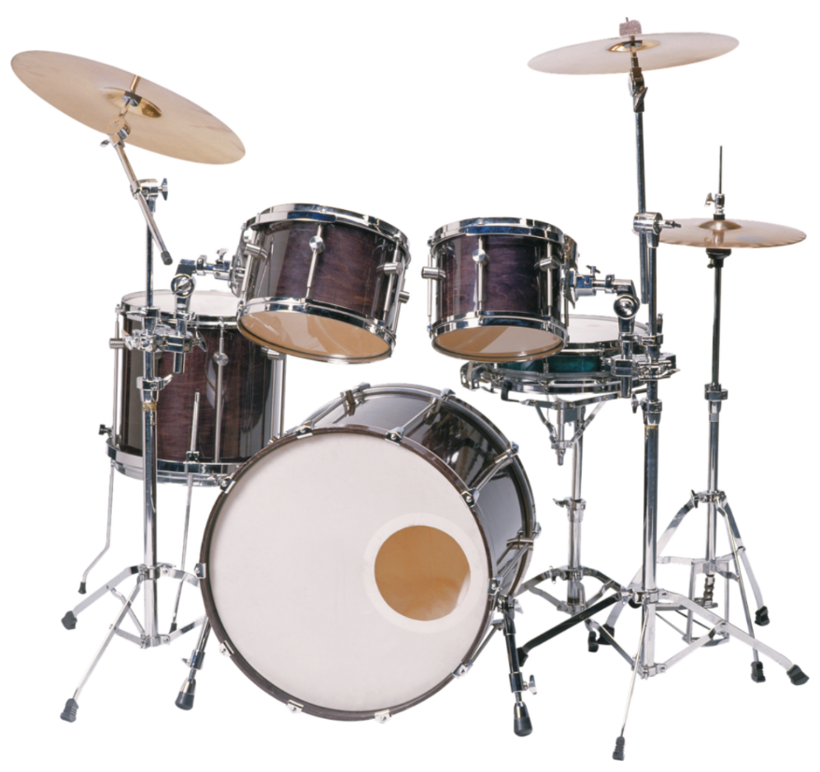
Activity 4.1 – overview of the drum kit (2)
Overview
Role in music
The drum kit is an essential part of the rhythm section and is used across various music genres, including rock, pop, blues, and jazz.
Public domain stock image. Drums tools percussion, music – from Pixabay and was published prior to July 2017 is licensed under CC0 1.0

Slide 68

Activity 4.1 – overview of the drum kit (4)
Drum notation
Drum kit notation is read from left to right, much like standard sheet music. Though instead of notes, it indicates the various components of the drum kit. Each being allocated to a particular line or space on the staff for each specific drum or cymbal. The drums are typically represented by standard note heads and the cymbals as ‘x’ s.
This system can take some time to learn, so instead we will use a rhythm pattern diagram to help you learn to play a variety of basic rock beats.

Slide 69



Activity 4.1 – overview of the drum kit (3)
Performing
This exercise will help you get used to alternating your hands to play rhythm patterns on the drums
Patsch the following rhythm on your thighs while tapping your foot to keep the beat.

Slide 70

Activity 4.2 – learning a basic rock pattern (1)
Drum kit – playing position
Playing the drum kit requires coordination and controlled movement between your hands and feet. To build this independence and support your ability to play different rhythms, we will explore how music for the drum kit can be represented in a diagram to guide you in developing this technique.
The image demonstrates a standard sitting position at the drum kit. The players dominant hand crossed over and playing the hi-hat. This technique is often referred to as ‘open-handed drumming’.
A Person Playing the Drums, 1 August 2021 – by Yan Krukau is licensed under the Pexels License

Slide 71


Activity 4.2 – learning a basic rock pattern (2)
Drum kit – rhythm pattern diagrams

Slide 72

Activity 4.2 – learning a basic rock pattern (3)
Drum kit – rhythm pattern diagrams

Slide 73

Activity 4.3 – drum fills (1)
Adding a drum fill
A drum fill is a short, often louder or more complicated rhythm played to break up the beat and lead into a new section of the music (like a verse or chorus).
It helps to transition between parts and adds rhythmic variety and interest to the music.
Drumeo (20 October 2018) 7 Rock Drum Fills for Beginners (9:57) [video], Drumeo, YouTube, accessed 14 May 2025

Slide 74
Activity 4.3 – drum fills (2)
Adding a drum fill
When playing the fills, use these steps to help you:
follow the drum diagram carefully
play semiquavers evenly and keep your beat steady
use the correct hand or drum based on the symbols shown
practise using patsching and body percussion first to secure the patterns, then try it on the drum kit (if available)
Repeat slowly, building confidence and accuracy.

Slide 75

Activity 4.3 – drum fills (3)
Drum kit – rhythm pattern diagrams

Slide 76

Activity 4.4 – composing a drum pattern (1)
Composition

Slide 77
Activity 4.4 – composing a drum pattern (2)
Composition reflection
Complete this activity to reflect on your 4-bar composition on the drum kit.
In today’s lesson I composed a 4-bar rhythm I wrote for the drums.
Composition
The musical decisions I made were to include rhythms patterns, dynamics, and a fill. I did this by:
(include specific reference to where it happens in your piece, for example, the drum and beat you chose to play on)
My drum fill included using (select from below) components of the drum kit.
(bass drum, snare drum, hi-hat, hi-tom, mid-tom)

Slide 78
Activity 4.4 – composing a drum pattern (3)
Performance reflection
Complete this activity to reflect on your 4-bar performance on the drum kit.
In today’s lesson I performed a 4-bar rhythm I wrote for the drums.
Performance
During my performance, I think I did well at:
(consider – keeping a steady pulse, coordinating hands and feet, playing the fill securely)
I think I could improve on:
(consider – keeping time, securing rhythm patterns)
I feel today’s performance was (select one) – fun, challenging, rewarding.
Reflection on learning:
The skills I gained from learning the drums pattern exercises, helped me with this activity by:
(consider – provided ideas, helped to learn to read the notation, helped to secure playing technique)

Slide 79

Learning sequence 5 – the keyboard

Slide 80
Learning intentions and success criteria (5)
We are learning to
build knowledge of chords and how to play them
develop skills in reading music notation
play chords and add a melody
develop individual performance skills.
We can
play demonstrating correct technique and fingering
play chords accurately and successfully move between
perform with both hands
create melodic ideas using pentatonic scale over a given chord progression.
Notes:
Notes for teachers:
Learning intentions and success criteria are best co-constructed with students. Adapt the learning intention as required and add matching success criteria.
For more information See ⁠AITSL or the NSW Department of Education explicit teaching strategies, ⁠Sharing learning intentions and ⁠Sharing success criteria
LISC is not necessarily presented at the beginning of the lesson. Teacher needs to consider most effectual time to introduce
LISC should be revisited during the lesson to support students' evaluation of their learning

Slide 81


Activity 5.1 – revision on the keyboard (1)

Slide 82


Activity 5.1 – revision on the keyboard (2)

Slide 83
Activity 5.2 – playing chords using correct technique and fingers (1)
Improving technique
Some things to remember when playing the keyboard to improve your technique.
Keep your fingers curved like you are holding a small ball.
Relax your wrist avoiding tension and position your fingertips lightly on the keys.
Avoid using only one or two fingers and practice using all fingers evenly.
The finger numbers we use to play the keyboard are 5, 4, 3, 2, 1 for the left hand and 1, 2, 3, 4, 5 for the right hand.

Slide 84


Activity 5.2 – playing chords using correct technique and fingers (2)
Finger exercises and chords
Practise playing through the following exercises to build independence in your fingers and learn notes in the chord.
C chord
G chord

Slide 85



Activity 5.2 – playing chords using correct technique and fingers (3)
C and G chord
F chord
C, F and G chord

Slide 86

Activity 5.2 – playing chords using correct technique and fingers (4)
Your teacher will provide you with a copy of the keyboard chord guide to help you with learning new chords and completing upcoming activities.

Slide 87


Activity 5.2 – playing chords using correct technique and fingers (5)
4-chord progression - this is a common sequence of 4 chords that form the harmonic foundation of many songs. These progressions are used widely in pop, rock, blues, jazz, and many other genres of music.
Below is a popular progression that we will explore.
Phiddy1990 (3 November 2012) Axis of Awesome (Clean) (5:46) [video], Phiddy1990, YouTube, accessed 14 May 2025

Slide 88

Activity 5.2 – playing chords using correct technique and fingers (6)
Axis of Awesome – play along
Axis of Awesome is in the key of D major.
Try playing along with the bass notes as you listen.

Slide 89





Activity 5.2 – playing chords using correct technique and fingers (7)
We are going to learn this in the key of G major

Slide 90



Activity 5.3 – the pentatonic scale (1)
The pentatonic scale
This is a musical scale made up of 5 notes per octave. It is one of the most common scales in music and is used in many styles, including rock, blues, jazz, folk, and classical music.
We are going to look at the G major pentatonic scale. This is based on G major, but the 4th and 7th notes are not included.
G major scale consists of the following notes.
In G major pentatonic, we find these notes.

Slide 91

Activity 5.3 – the pentatonic scale (2)
Playing the G major pentatonic scale
Play up and down the scale to hear how it sounds, getting use to the notes and correct fingering.

Slide 92

Activity 5.4 – composing using the pentatonic scale (1)
Composing
Individual
Use the G pentatonic scale to create a 2-bar melody on the keyboard.
Small groups
Use the melody you have created for a call and response activity.
After playing the melody, everyone in the group will echo it back by singing using ‘la’, ‘ah’, or any open vowel sound.
Take turns around the group to sing back a different response, by experimenting with various rhythms, such as long notes, short notes, or syncopated rhythms. Use the same notes from the melody.
Explore adding additional notes from the G major pentatonic scale to add further variety to your response.

Slide 93

Activity 5.4 – composing using the pentatonic scale (2)
Composing
Working in pairs, one partner use the guitar or lower half of the keyboard to play the I-V-vi-IV 4 chord progression as accompaniment in G major.
One partner will create a 4-bar melody using the G major pentatonic scale while the other partner plays the chord progression.
After the first partner has composed their melody, switch roles. The second partner will now create a melody on the keyboard over the same chord progression.
Explore using varied dynamics and expression to add further musical contrast in your melody.
After both partners have created their melodies, take a moment to discuss what worked well and what could be improved in the compositions.
Refine your melody and take turns to play your compositions back to the class.

Slide 94




Activity 5.4 – composing using the pentatonic scale (3)
Here are the chords for guitar and keyboard.

Slide 95

Learning sequence 6 – ensemble composition and performance

Slide 96
Learning intentions and success criteria (6)
We are learning to
build knowledge of chords and how to play them
develop arrangement or own composition as part of an ensemble
reflection on composition and performance process
develop individual and ensemble performance skills.
We can
play demonstrating accuracy, control and role within the ensemble
compose and perform an original work or arrangement
reflect on the composition process and use of the elements of music
reflect on performance and use of elements of music.
Notes:
Notes for teachers:
Learning intentions and success criteria are best co-constructed with students. Adapt the learning intention as required and add matching success criteria.
For more information See ⁠AITSL or the NSW Department of Education explicit teaching strategies, ⁠Sharing learning intentions and ⁠Sharing success criteria
LISC is not necessarily presented at the beginning of the lesson. Teacher needs to consider most effectual time to introduce
LISC should be revisited during the lesson to support students' evaluation of their learning

Slide 97


Activity 6.1 – comparing versions (1)
Listening activity
Listening to music is a great way to get some ideas when composing. Whether you are creating an original work or arranging an existing piece, hearing different versions of music can spark inspiration and help you understand how music ideas can be put together.
Guns N’ Roses (25 December 2009) Guns N' Roses - Sweet Child O' Mine (Official Music Video) (5:02) [video], Guns N’ Roses, YouTube, accessed 14 May 2025
PostmodernJukebox (13 February 2014) "Sweet Child O' Mine" - New Orleans Style Guns N' Roses Cover ft. Miche Braden (4:20) [video], PostmodernJukebox, YouTube, accessed 14 May 2025

Slide 98


Activity 6.1 – comparing versions (2)
Listening activity
Bon Jovi (17 June 2009) Bon Jovi - Livin' On A Prayer (4:08) [video], Bon Jovi, YouTube, accessed 14 May 2025
PostmodernJukebox (30 July 2014) Livin' on a Prayer - Vintage Jazz Bon Jovi Cover ft. Miche Braden (3:56) [video], PostmodernJukebox, YouTube, accessed 14 May 2025

Slide 99


Activity 6.1 – comparing versions (3)
Listening activity
The Beatles (17 June 2018) Can't Buy Me Love (Remastered 2015) (2:11) [video], The Beatles, YouTube, accessed 14 May 2025
THE JAZZ WORLD (6 April 2022) Michael Bublé ‎– Can't Buy Me Love (3:20) [video], THE JAZZ WORLD, YouTube, accessed 14 May 2025

Slide 100


Activity 6.1 – comparing versions (4)
Listening activity
aa (13 October 2011) David Guetta - Titanium (Audio) (4:05) featuring Sia [video], aa, YouTube, accessed 14 May 2025
PostmodernJukebox (5 November 2014) Titanium - Vintage 1940s Jazz Crooner - Style Sia / David Guetta Cover ft. Von Smith (4:06) [video], PostmodernJukebox, YouTube, accessed 14 May 2025

Slide 101


Activity 6.1 – comparing versions (5)
Listening activity
Island Records UK (23 February 2008) Sam Sparro - Black and Gold (3:39) [video], Island Records UK, YouTube, accessed 14 May 2025
Brenna Whitaker (30 October 2015) Brenna Whitaker - Black And Gold (4:02) [video], Brenna Whitaker, YouTube, accessed 14 May 2025

Slide 102

Activity 6.2 – ensemble composition and performance
Composing and performing
Using the skills and knowledge you have learnt throughout this unit, you are going to form an ensemble and explore either composing and performing an original piece or arrangement of an existing piece.
You will be provided class time to develop and rehearse your piece before performing it to the class.
You will be required to log the development of your composition, including decisions you have made about the use of the elements of music and a reflection at the end of the task.

Slide 103
Activity 6.3 – composing an original piece (1)
Composing an original piece
To help you in composing your own original piece, use the following as a guide to help you explore and refine your ideas. You will be provided with a copy of the ‘composition toolbox worksheets’ to help you develop your composition and document your ideas.
Steps:
choose a key and scale
pick a key to work in. (G major works well for all instruments and you could continue using this and the G major pentatonic scale from previous activities).
create a chord progression
as a group, decide on 3–4 chords (e.g., I–V–vi–IV 4-chord progression you have learnt).
guitar, bass, and keyboard will base their parts on these chords.

Slide 104

Activity 6.3 – composing an original piece (2)
Composing an original piece
You may use The Jam Grid online tool to help you develop your chord progression. At this point, leave the diminished chord option unchecked.
Steps:
choose a key – pick a key from the menu to see its chords.
select an instrument – choose guitar, bass, ukulele (optional), or keyboard to see and hear the chords.
randomise progressions – press the button to mix up the chords and try new progressions.
flip the chord cards – click a card to flip it and see the chord diagram for your instrument. Transfer this information to your worksheet
hear the chords – click a card to listen to what the chord sounds like.
Musical Futures International Jam Grid - Musical Futures International, Musical Futures International, accessed 14 May 2025

Slide 105

Activity 6.3 – composing an original piece (3)
Composing an original piece
Once you have established a chord progression to use, transfer the chord information for each relevant instrument onto your ‘composition toolbox’. You will use this for reference and help when transferring this onto your instruments.

Slide 106

Activity 6.3 – composing an original piece (4)
Composing an original piece
Your next steps will be:
Write a simple melody
Use the pentatonic scale to create a short 4-bar, catchy melody. Begin and end on the 1st note of the scale. Move mainly by step with a few leaps and minimal jumps.
Develop instrument parts
Keyboard and guitar – play chords or simple riffs based on the progression.
Bass – play root notes (chord note name) or simple patterns that match the chords.
Drums – explore patterns you have previously learnt and consider ideas that you will use for drum fills to help join sections of your piece and add rhythmic variety.

Slide 107
Activity 6.3 – composing an original piece (5)
Composing an original piece
Your next steps will be:
Determine the song structure
Plan the sections of the song (For example: Intro – Verse – Chorus – Verse – Chorus – Ending)
Decide which instruments are playing in each part and what they are doing
Add Lyrics
Work together to write simple lyrics that fit the melody and rhythm you have created.
Rehearse, review and refine
Play through your ideas individually and together, adjusting to best fit with the ensemble
Listen to each other to stay together and balance the sound
Discuss how your composition is developing – What is working? What needs more work?

Slide 108

Activity 6.4 – composing an arrangement (1)
Composing an arrangement of a piece
If you are choosing to work on creating your own arrangement of an existing piece of music, it is important to choose a piece that is achievable.
Steps in choosing a piece:
pick a piece that has simple, clear and catchy melody
choose a song that uses only a few chords, as this will make it easier to adapt and play
find a copy of the music (chords, lyrics and/or sheet music) to help learn it
find a piece that works well with the instruments and voices in your ensemble.

Slide 109
Activity 6.4 – composing an arrangement (2)
Composing an arrangement of a piece
Listening and planning your next steps:
listen to the piece multiple times to familiarise yourself with how it goes and it musical features – including the structure (such as, intro, verse, chorus, ending), key and chords (what progression it uses), melody and riffs, and the instruments used.
Consider:
what aspects of the piece you want to keep in your version (important help others recognise the piece).
what you might want to remove (sections are too long or repeated).
what you could adjust (different order, change of feel, shorten or simplify sections).

Slide 110
Activity 6.4 – composing an arrangement (3)
Composing an arrangement of a piece
Use these steps to help you develop your arrangement:
have copies of the music for members in your group to help them learn their parts – include chord diagrams, lyrics, or simplified notation (note names, tablature).
Decide on the roles of the instruments – guitar/keyboard (chords, riffs), bass (root notes, riff or a groove), drums (steady beat, fills, rhythmic variety), vocals (melody, harmony).
use rehearsal time to focus on refining individual parts and modify any musical material that may be too difficult to secure.

Slide 111
Activity 6.4 – composing an arrangement (5)
Composing an arrangement of a piece
What to keep?
the main melody, as this will help people to recognise the song
the chord progression and recognisable riffs
lyrics (unless creating an instrumental version).
What to change?
duration – use a slower tempo for a ballad style or add a swing/shuffle rhythmic feel. This could be supported by changing the style of the piece.
instruments – create an acoustic version of a piece, swap instruments to add new performing media and textures.
structure – cut verses, extend choruses, repeat sections for effect.
use dynamics and expression to create contrast throughout the song.

Slide 112
Activity 6.5 – safety in the music classroom (1)
Show respect for your classmates, your teacher and the music classroom equipment.
Return instruments and equipment (including leads, adaptors, pedals) to the right place.
Take care when using instruments to avoid accidents and damage. Report any damage immediately to your teacher.
Consider safe volume levels when rehearsing and think about others around you.
Always do a warm-up and/or technical work before rehearsing a performance piece.
Position your music and/or ensemble members to ensure correct posture both in rehearsal and performance.

Slide 113
Activity 6.5 – safety in the music classroom (2)
Cover any trip hazards, including cords.
Explore different ways to play. For example, adjust volume or pitch controls or select different modes or effects instead of playing forcefully.
Be considerate of class members with sound sensitivity.
Practice safety when packing away. For example, turn off the instrument before unplugging and switch off power points before pulling out plugs.

Slide 114

Activity 6.6 – ensemble performance (1)
Rehearsing and performing
Individual practise:
learn your own parts – riffs, chord progressions, drum patterns, bass lines, lyrics, melodies.
use sheet music, tabs, chord charts, lyric sheets or learn by ear if best.
along learning the melody, singers should practise the lyrics and phrasing separately.
practise slowly at first, then build up speed.
focus on playing accurately and using correct technique.
Ensemble practise
play through the piece slowly together.
stop and fix any sections where rhythm issues or insecure notes occur.
focus on secure timing and smooth transitions between sections.

Slide 115
Activity 6.6 – ensemble performance (2)
Rehearsing and performing
Rehearsal steps:
review and refine your composition or arrangement while learning how to play it
decide on cues to help show changes between sections and keep your performance secure
plan how you will start and finish the piece, with consideration given to visual signals or count ins
refine dynamics, add contrast where appropriate and ensure that all parts are balanced and can be heard
play through the piece from start to finish and don’t stop, even if someone makes a mistake
after each run through, discuss what went well and what needs work
practice the areas that are not secure separately, either as individuals or as an ensemble
add them back in and continue playing through the whole piece
seek feedback from your teacher and peers on how to refine your work

Slide 116

Activity 6.6 – ensemble performance (3)
Final performance
Your final step will be performing your composition or arrangement for the class.
Things to remember to include:
ensure that all instruments have been carefully tuned
make sure any amplified instruments (including vocals) are balanced, and all parts can be heard
make sure you can see and interact with each member of your ensemble
stay relaxed and trust your preparation

Slide 117

Activity 6.7 – ensemble composition and performance
Reflection questions
Complete the reflection questions using the Microsoft form. These will allow you to reflect on the experiences you have had during the composition and performance activities.
Customer Satisfaction Survey January 26th 2019, - CC

Slide 118

Activity 6.8 – Elements of music (1)
Structure
Terms to remember
12-bar blues chord progression – chord progression using chords I, IV and V, that is 12 bars long, typically divided into 3 lines of 4 bars each
AAB form – is a musical structure with two repeated lines (A, A) followed by a contrasting line (B). This form is often used in blues music, where each section is typically a line of lyrics in a 12-bar blues progression

Slide 119
Activity 6.8 – Elements of music (2)
Duration
Terms to remember
Syncopation – where emphasis is shifted to accent weak beats or offbeats, creating a sense of surprise or rhythmic tension. It’s commonly used in jazz, funk, and pop to add energy and create a groove
Swing – is a rhythm where notes that are normally played evenly are instead played with a long-short pattern, giving the music a bouncy feel. It is an important feature in jazz music

Slide 120

Activity 6.8 – Elements of music (3)
Pitch
Terms to remember
Chord progression – is a sequence of chords played in a specific order that forms the harmonic basis of a piece of music
Chord – is a group of three or more notes played together to create harmony. Chords are the building blocks of harmony in music and can convey different moods depending on their type, for example major (happy) and minor (sad)
Call and Response – one person would sing/play a phrase, and other musicians would respond or repeat it

Slide 121
Activity 6.8 – Elements of music (4)
Pitch
Terms to remember
Improvisation – to make the music up as you perform, instead of following written notes. It's common in blues, jazz, and rock music
Lick – is a short melodic phrase used in a flexible way for musicians to embellish solos and improvisation
Pentatonic scale – 5 note scale, widely used in many musical traditions around the world due to its simple and pleasant sound
Riff – a short, catchy, and repeated musical pattern based on melodic and chord ideas

Slide 122
References (1)
This presentation contains NSW Curriculum and syllabus content. The NSW Curriculum is developed by the NSW Education Standards Authority. This content is prepared by NESA for and on behalf of the Crown in the right of the State of New South Wales. The material is protected by Crown copyright.
Please refer to the NESA Copyright Disclaimer for more information https://educationstandards.nsw.edu.au/wps/portal/nesa/mini-footer/copyright.
NESA holds the only official and up-to-date versions of the NSW Curriculum and syllabus documents. Please visit the NSW Education Standards Authority (NESA) website https://educationstandards.nsw.edu.au/wps/portal/nesa/home and the NSW Curriculum website https://curriculum.nsw.edu.au.
Music 7–10 Syllabus © NSW Education Standards Authority (NESA) for and on behalf of the Crown in right of the State of New South Wales, 2024.
"American Blues Legends" Live in Hamburg, 1972 by Flickr licensed under CC BY-NC-SA 2.0, accessed 14 May 2025
A Person Playing the Drums, 1 August 2021 – by Yan Krukau is licensed under the Pexels License, accessed 14 May 2025
aa (13 October 2011) David Guetta - Titanium (Audio) featuring Sia [video], aa, YouTube, accessed 14 May 2025
BessieSmithVEVO (1 May 2015) Bessie Smith - St. Louis Blues (Audio) [video], BessieSmithVEVO, YouTube, accessed 14 May 2025
Bon Jovi (17 June 2009) Bon Jovi - Livin' On A Prayer [video], Bon Jovi, YouTube, accessed 14 May 2025
Brenna Whitaker (30 October 2015) Brenna Whitaker - Black And Gold [video], Brenna Whitaker, YouTube, accessed 14 May 2025
Chuck Berry (29 April 2020) Johnny Be Goode [video], Chuck Berry, YouTube, accessed 14 May 2025

Slide 123
References (2)
Classic Hits Studio (6 March 2022) Glenn Miller - In The Mood | Colorized (1941) 4K [video], Classic Hits Studio, YouTube, accessed 14 May 2025
Classic Mood Experience (17 April 2021) Robert Johnson - Sweet Home Chicago [1937] [video], Classic Mood Experience, YouTube, accessed 14 May 2025
Classical Guitar labelled english by Wikimedia Commons is licensed under CC BY 3.0, accessed 14 May 2025
Conor Rocks (10 March 2024) Guitar Riff vs Lick: EASY Beginners Guide [video], Conor Rocks, YouTube, accessed 21 August 2025
Customer Satisfaction Survey January 26th 2019, - CC, accessed 14 May 2025
Deep Purple (2 March 2024) Smoke On the Water (Official Music Video) [video], Deep Purple, YouTube, accessed 14 May 2025
Drumeo (20 October 2018) 7 Rock Drum Fills for Beginners [video], Drumeo, YouTube, accessed 14 May 2025
Electric guitar image - from Pixabay, published prior to July 2017 under the Creative Commons CC0 1.0, accessed 14 May 2025
Elvis Presley (5 June 2013) Elvis Presley - Hound Dog (Official Audio) [video], Elvis Presley, YouTube, accessed 14 May 2025
Gold Tone Paul Beard signature resonator guitar, 6 December 2010 – Wikimedia commons in licensed under CC BY 2.0, accessed 14 May 2025

Slide 124
References (3)
Guitar Center (21 August 2021) How to Play the Blues Shuffle | Beginner Guitar Tips [video], Guitar Center, YouTube, accessed 25 August 2025
Guitar Improvisation (28 June 2017) Blues Shuffle in A [video], Guitar Improvisation, YouTube, accessed 14 May 2025
Guns N’ Roses (25 December 2009) Guns N' Roses - Sweet Child O' Mine (Official Music Video) [video], Guns N’ Roses, YouTube, accessed 14 May 2025
Hand on guitar by pxhere licensed under CC0 Public Domain, accessed 14 May 2025
Herbie Hancock (11 March 2017) Watermelon Man (Remastered 2007) [video], Herbie Hancock, YouTube, accessed 14 May 2025
Howlin’ Wolf – Topic (8 August 2018) Spoonful [video], Howlin’ Wolf, YouTube, accessed 14 May 2025
Island Records UK (23 February 2008) Sam Sparro - Black and Gold [video], Island Records UK, YouTube, accessed 14 May 2025
James Brown (9 November 2014) I Feel Good (I Got You) [video], James Brown, YouTube, accessed 14 May 2025
Jazz at Lincoln Center’s JAZZ ACADEMY (23 February 2015) Jazz Fundamentals: What Is Improvisation? [video], Jazz at Lincoln Center’s JAZZ ACADEMY, YouTube, accessed 21 August 2025
Jug Band Cannon's Jug Stompers (from left to right : Gus Cannon, banjo and jug, Ashley Thompson, guitar and Noah Lewis, harmonica) (1928) by Wikimedia Commons is licensed under CC BY 3.0, accessed 14 May 2025

Slide 125
References (4)
Metallica (8 June 2022) Enter Sandman (Remastered) [video], Metallica, YouTube, accessed 14 May 2025
Musical Futures International (n.d.) Jam Grid - Musical Futures International [website], accessed 14 May 2025
National Youth Jazz Collective (24 October 2014) NYJC Glossary of Terms - Blue Notes [video], National Youth Jazz Collective, YouTube, accessed 21 August 2025
Person Playing an Electric Guitar, May 11, 2021 – – by Antoni Shkraba production is licensed under the Pexels License, accessed 14 May 2025
Phiddy1990 (3 November 2012) Axis of Awesome (Clean) [video], Phiddy1990, YouTube, accessed 14 May 2025
PostmodernJukebox (13 February 2014) "Sweet Child O' Mine" - New Orleans Style Guns N' Roses Cover ft. Miche Braden [video], PostmodernJukebox, YouTube, accessed 14 May 2025
PostmodernJukebox (30 July 2014) Livin' on a Prayer - Vintage Jazz Bon Jovi Cover ft. Miche Braden [video], PostmodernJukebox, YouTube, accessed 14 May 2025
PostmodernJukebox (5 November 2014) Titanium - Vintage 1940s Jazz Crooner - Style Sia / David Guetta Cover ft. Von Smith [video], PostmodernJukebox, YouTube, accessed 14 May 2025
Public domain stock image. Drums tools percussion, music – from Pixabay and was published prior to July 2017 is licensed under CC0 1.0, accessed 14 May 2025

Slide 126
References (5)
RHINO (23 January 2018) Booker T. & The MG's - Green Onions (Official Audio) [video], RHINO, YouTube, accessed 14 May 2025
Sonny Terry & Brownie McGhee – Topic (3 January 2015) Walk On [video], Sonny Terry & Brownie McGhee, YouTube, accessed 14 May 2025
Swing this Music (8 February 2017) Call & Response. Work song - Prision song (1966) [video], Swing this Music, YouTube, accessed 14 May 2025
The Beatles (17 June 2018) Can't Buy Me Love (Remastered 2015) [video], The Beatles, YouTube, accessed 14 May 2025
THE JAZZ WORLD (6 April 2022) Michael Bublé ‎– Can't Buy Me Love [video], THE JAZZ WORLD, YouTube, accessed 14 May 2025
The Surfaris – Topic (4 March 2020) Wipe Out [video], The Surfaris, YouTube, accessed 14 May 2025
The White Stripes (22 October 2008) The White Stripes - Seven Nation Army (Official Music Video) [video], The White Stripes, YouTube, accessed 14 May 2025
Tracy Chapman (14 November 2015) Tracy Chapman - Give Me One Reason (Official Music Video) [video], Tracy Chapman, YouTube, accessed 14 May 2025
World Heart Beat (17 June 2022) Introduction to the blues - an easy and accessible explanation of the classic 12-bar blues format [video], World Heart Beat, YouTube, accessed 21 August 2025

Slide 127
Copyright
© State of New South Wales (Department of Education), 2025
The copyright material published in this resource is subject to the Copyright Act 1968 (Cth) and is owned by the NSW Department of Education or, where indicated, by a party other than the NSW Department of Education (third-party material).
Copyright material available in this resource and owned by the NSW Department of Education is licensed under a Creative Commons Attribution 4.0 International (CC BY 4.0) license.
This license allows you to share and adapt the material for any purpose, even commercially.
Attribution should be given to © State of New South Wales (Department of Education), 2025.
Material in this resource not available under a Creative Commons license:
the NSW Department of Education logo, other logos and trademark-protected material
Material owned by a third party that has been reproduced with permission. You will need to obtain permission from the third party to reuse its material.
Links to third-party material and websites
Please note that the provided (reading/viewing material/list/links/texts) are a suggestion only and implies no endorsement, by the New South Wales Department of Education, of any author, publisher, or book title. School principals and teachers are best placed to assess the suitability of resources that would complement the curriculum and reflect the needs and interests of their students.
If you use the links provided in this document to access a third-party’s website, you acknowledge that the terms of use, including licence terms set out on the third-party’s website apply to the use which may be made of the materials on that third-party website or where permitted by the Copyright Act 1968 (Cth). The department accepts no responsibility for content on third-party websites.

