Slide 1
Instructions for use
This resource is not a teaching and learning program. It should be used in with the ‘Bigger than the song’ unit of work and accompanying resources found on the Planning, programming and assessing music 7–10 (2024) webpage. Classroom teachers are encouraged to add and adapt slides as required to meet the needs of their students.
Save a copy of the file to make changes to the slide deck. Go to File > Download a Copy (this downloads a copy to the computer to edit in the PowerPoint app).
To convert the PowerPoint to Google Slides:
  Upload the file into Google Drive and open it.
  Go to File > Save as Google Slides.
  (Note – conversion may cause formatting changes in the slides.)

Slide 2
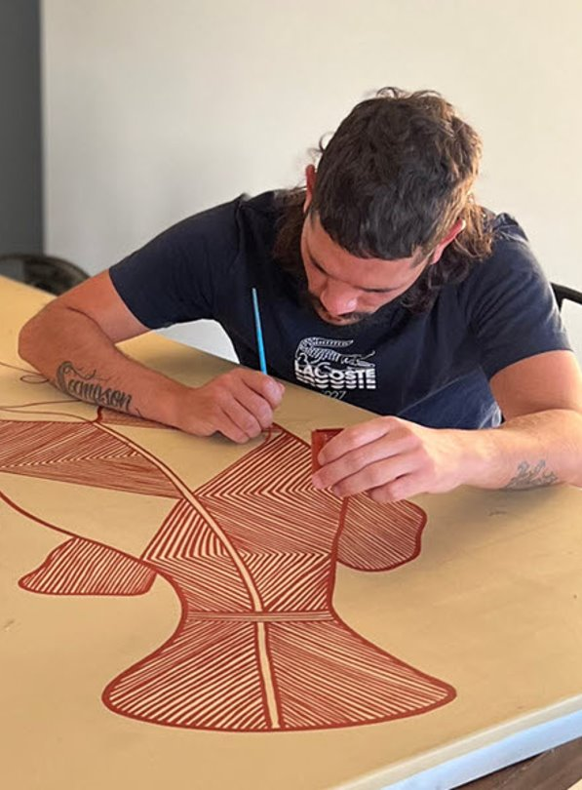
Acknowledgement​ of artwork and symbols​
This resource contains artworks and symbols © Kayleb Waters, Gomeroi artist and Cultural mentor, 2025, used with permission.​
Some artwork, symbols and/or icons in this resource represent the Indigenous Cultural and Intellectual Property (ICIP) of the artist, Kayleb Waters, and/or the Gomeroi Community.​
While created by a Gomeroi artist, symbols and meanings may be used and interpreted differently by Aboriginal people.​
Please seek permission from the artist before using their artwork outside of the Department or for commercial purposes.​
Image © Kayleb Waters, 2025. Used with permission.​

Slide 3

Artwork – Truth Telling​
This artwork shares the story of the power of connection and understanding, our stories are the oldest stories in the world. The traditional symbols and patterns used in the artwork have been used by Gomeroi people to highlight connections for thousands of years. These connections, which are woven tighter with unity, respect, acceptance and truth-telling, are still vital today and should be seen through the relationship between the NSW Department of Education and Community today. ​
This story and artwork offer a powerful reminder of the importance of truth-telling in building strong relationships, preserving cultural values and fostering reconciliation and partnership.​
Stories are shared and relationships are built and maintained at the Gumbul – the corroboree ground. For thousands of years, people have come together from all different communities to move and dance as one. Today these relationships have expanded, and the relationship between The Department of Education and the Community is of extreme value. This relationship must be nurtured and we continue to create spaces where people from all diverse backgrounds to teach and learn as one.​
Artwork – Truth Telling © Kayleb Waters, 2024. Used with permission.​

Slide 4

Bigger than the song
Music – Stage 4
Artwork – Truth Telling © Kayleb Waters, 2024. Used with permission.​
Notes:
The Truth Telling artwork is by Gomeroi artist Kayleb Waters. This artwork shares the story of the power of connection and understanding, Aboriginal stories are the older stories in the world. The traditional symbols and patterns used in the artwork have ben used by Gomeroi People to highlight connections for thousands of years. These connections which are woven together with unity, respect, acceptance and truth-telling are still vital today and should be seen through the relationship between the NSW Department of Education and Community today. This story and artwork offer a powerful reminder of the importance of truth-telling in building strong relationships, preserving cultural values and fostering reconciliation and partnership. Stories are shared and relationships are built and maintained at the Gumbul - the corroboree ground. For thousands of years, people have come together from all different communities to move and dance as one. Today these relationships have expanded and the relationship between The Department of Education and the Community is of extreme value. This relationship must be nurtured, and we continue to create spaces where people from all diverse backgrounds to teach and learn as one.

Slide 5
Cultural Advice – Aboriginal and Torres Strait Islander Peoples are advised that this resource contains images, names and/or voices of people who have passed away.

Slide 6
Pre-learning

Slide 7








Aboriginal Symbols (1)
Aboriginal Ways of Knowing, Being and Doing
Aboriginal Knowledge Holders
Story Sharing / Knowledge Sharing
Community
This symbol of continuous circles represents our stories, as well as our deeper connection to understanding, Country, and the values that guide how we live our lives.
This symbol shows a person sitting with story, respect and responsibility.
This symbol shows people sitting down in a circle sharing knowledge or sharing stories.
This symbol is expressed through people sitting together in one place, showing unity, responsibility, love, and respect.
Partnerships
Partnerships
Pathways
Songlines
This symbol shows schools on one side and Community on the other, with the line between them representing coming together on the same path and the relationship built.
This symbol shows schools on one side and Community on the other, with the line between them representing coming together on the same path and the relationship built.
This symbol is expressed through people travelling, representing the pathways we take and the boundaries we overcome.
This symbol is represented by paths and rivers with Dhinawan (emu) tracks, showing that we have walked these paths since the beginning, connected to each other without boundaries, fences or castles, living and sharing as one.
Symbols © Kayleb Waters, 2025. Used with permission.

Slide 8





Aboriginal Symbols (2)
Systems and Protocols
Systems and Protocols
Aboriginal Cultures
Dynamic and Evolving
This symbol shows each mob as circles with their own customs yet sharing the same values and celebrating together on the path rather than being divided.
This symbol shows Emu prints, representing how our mob learns kinship, responsibilities, and obligations from that animal.
This symbol is represented by a hand stencil painted in caves, showing our enduring connection to Country and story.
This symbol shows that knowledges are not static but continue to develop, expressed through our stories and paths as we adapt to current times while still living by the same values our old people held thousands of years ago.
Cultural Practices
The symbol reflects the use of tools and the ​continuation of our practices, highlighting the ​importance of carrying them forward rather ​than simply preserving them.
Symbols © Kayleb Waters, 2025. Used with permission.
Notes:
Note: Presenter to ensure that participants have opportunity to read/access the content of this slide.

Slide 9
Lessons
1
I Belong – As I Walk On My Country (Barkindji)
6
‘Names Mean Nothing’ – Tempe High School
2
Emma Donovan (Gumbaynggirr)
7
On Country excursion and lyric development
3
Ngarra Badhu and Yanma Ngurrawa (Dharug)
8
Developing compositions
4
Yanada (Darug)
9
Finishing and sharing projects
5
Storytelling in hip-hop
10
Podcasting
Notes:
Teacher notes:
Click lesson titles to go to specific lessons
Interactive features can be viewed in slide show
Notes for vendors [to be removed after slide deck creation]:
Create hyperlinks to dividers that match lesson numbers by
Right click on the number>edit link>select slide in deck to connect to

Slide 10

Learning sequence 1 – ‘I Belong – As I Walk On My Country’ (Barkindji)
Symbol – Aboriginal Ways of Knowing, Being and Doing © Kayleb Waters, 2025. Used with permission.

Slide 11
Learning intentions and success criteria (1)
We are learning to
understand and reflect on the cultural meaning of Country in Aboriginal music
develop performance skills through singing and ukulele accompaniment
express a personal connection to Place by writing and performing an original verse.
We can
explain how the song reflects Aboriginal perspectives of Country and identify the use of Paakintyi Language
sing and play the song 'I Belong' with accurate timing and expression
write and perform a verse that shows my own sense of belonging to a place.
Notes:
Notes for teachers:
Learning intentions and success criteria are best co-constructed with students. Adapt the learning intention as required and add matching success criteria.
For more information See ⁠AITSL or the NSW Department of Education explicit teaching strategies, ⁠Sharing learning intentions and ⁠Sharing success criteria
LISC is not necessarily presented at the beginning of the lesson. Teacher needs to consider most effectual time to introduce
LISC should be revisited during the lesson to support students' evaluation of their learning

Slide 12
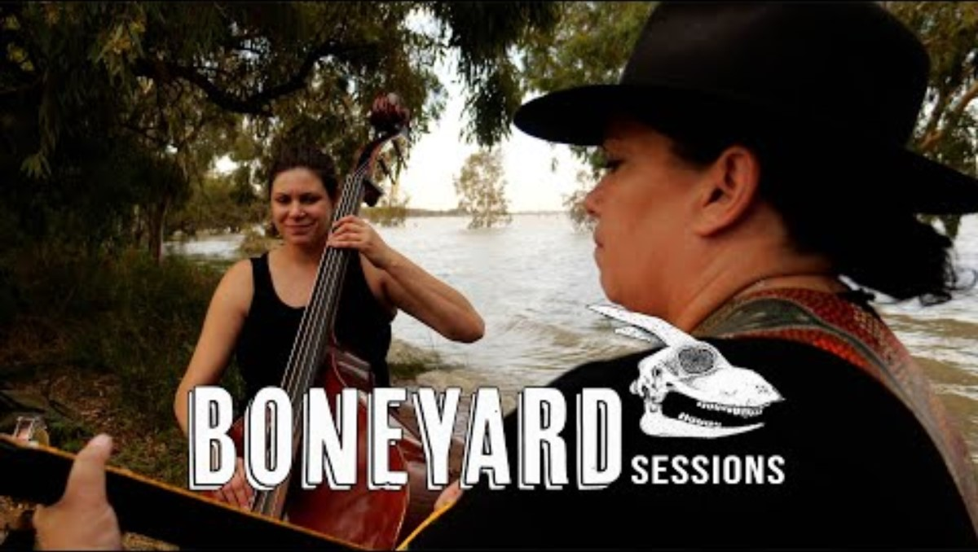
Activity 1.1a – listen to ‘I Belong – As I Walk On My Country’ (1)
(Barkindji)
As you listen, close your eyes and imagine the place that is being sung about.
Boneyard sessions (20 October 2022) Nancy Bates and Allara | " I Belong: As I Walk On My Country" | Boneyard Sessions (5:41) [video], Boneyard sessions, YouTube, accessed 11 June 2025.

Slide 13
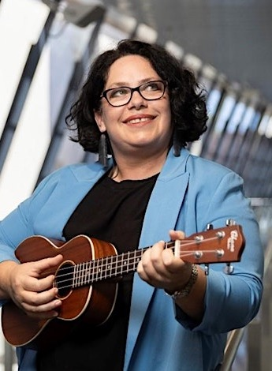
Activity 1.1a – listen to ‘I Belong: As I Walk On My Country’ (2)
Barkindji
Nancy Bates is a composer, writer, educator, and proudly Barkindji. With cultural ties to communities running the length of the Baarka, she is a river woman connecting music, education, and sharing the message of resistance against the effects of colonialisation.*
Listening activity
Creative Cast – Bigger than the song – Nancy Bates (08:34 – 13:34 )
Consider what Nancy says about how her song ‘I Belong’, communicates her Cultural understanding of Place, and Country.​
*Information adapted respectfully from Nancy Bates’ website and promotional material. Nancy Bates (2024) photo from Nancy Bates Music 2024.

Slide 14
Activity 1.1a – listen to ‘I Belong – As I Walk On My Country’ (3)
Listening / performing
Verse 1
G
As I walk on my Country
C
Feel the spirit of the trees
Em
Hear our stories
C
Upon the wind
G
Feel the power of this place
C
Speak our Language, speak our names
Em
We’ve come together
C
As we have always
Chorus
G C
I belong, I belong
Em D C
Let the love of Country make you strong
G C
I am free, I am free
Em D C
Part of everything that lives and breathes
Boneyard sessions (20 October 2022) Nancy Bates and Allara | " I Belong: As I Walk On My Country" | Boneyard Sessions (5:41) [video], Boneyard sessions, YouTube, accessed 11 June 2025.
Listen from (0:52–2:13)
‘I Belong’ by Nancy Bates has been licensed by the NSW Department of Education. All rights reserved for the use of NSW Department of Education teachers and students only.

Slide 15
Activity 1.1a – listen to ‘I Belong – As I Walk On My Country’ (4)
Reflection
Sit together in a circle and consider the lyrics and their meaning, and also the lyrics in Paakintyi.
Discuss
How ‘I Belong: As I Walk On My Country’ communicates a Cultural understanding of Place or Country
The use of Paakintyi Language in the song, and the meaning that comes from the inclusion of Language in this song
How listening to Nancy and this song makes you feel about Country.
Symbol – Aboriginal Cultures © Kayleb Waters, 2025. Used with permission.

Slide 16
Activity 1.1b – ‘Acknowledgement of Country’ (1)
Deliver an Acknowledgement of Country that means something
As a class listen to the segment of the Creative Cast – Bigger than the song – Nancy Bates (13:41 – 14:59), podcast where Nancy explains what Acknowledgement of Country means to her.
Listen again to ‘I Belong: As I Walk On My Country’ by Nancy Bates and Allara, reading the lyrics as the video is played.
Boneyard sessions (20 October, 2022) Nancy Bates and Allara | " I Belong: As I Walk On My Country" | Boneyard Sessions (5:41) [video], Boneyard sessions, YouTube, accessed 11 June 2025,
Reflection
How does Nancy’s song Acknowledge Country?

Slide 17
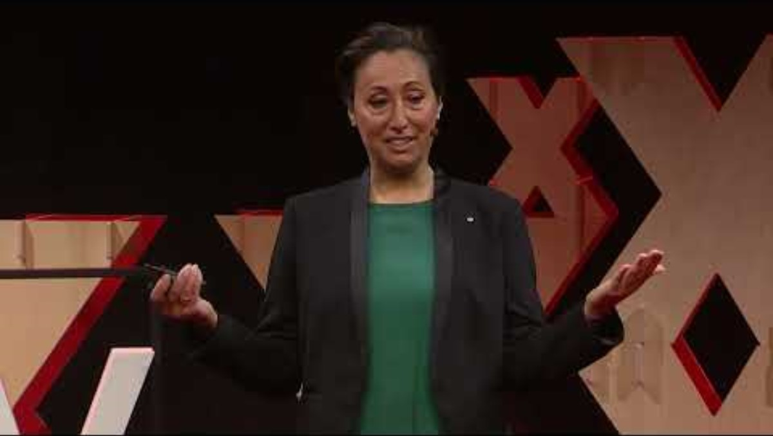
Activity 1.1b – ‘Acknowledgement of Country’ (2)
Reflection
What is the difference between a Welcome to Country and an Acknowledgement of Country?
TED talks (26 January 2022) Deliver an Acknowledgement of Country that really means something | Shelley Reys | TEDxSydney (8:59) [video], TED talks, YouTube, accessed 11 June 2025.

Slide 18
Activity 1.1b – ‘Acknowledgement of Country’ (3)
Access the student booklet and Map of Indigenous Australia to research the Country you are on or come from.
Write your own personal Acknowledgement of Country and practice speaking it to a classmate.
Symbols – Aboriginal Ways of Knowing, Being and Doing © Kayleb Waters, 2025. Used with permission.

Slide 19

Activity 1.2 – perform ‘I Belong – As I Walk On My Country’ (Barkindji) (1)
As a class, listen to the segment of the Creative Cast – Bigger than the song – Nancy Bates (19:21 – 30:16) , podcast where Nancy discusses the Cultural protocols she followed to write this song and the permission and protocols she would like you to consider when listening to, performing and composing music inspired by her song. Complete the table in the student booklet to reflect on the following question:
Reflection question
What are some protocols and ethical choices we can make about performing this song?
Symbol – Systems and Protocols © Kayleb Waters, 2025. Used with permission.

Slide 20
Activity 1.2 – perform ‘I Belong – As I Walk On My Country’ (Barkindji) (2)
Discussion – What ethical choices do you need to make when performing this song?
You may like to consider:
Language: Do we have permission to sing this Language? Is it ok to sing this Language on this Country? How do I make sure I am pronouncing these words correctly? What do these words in Paakintyi mean?
instruments
style
performing for an audience.
Make some choices as a class and note these in the final column of the table in your student booklet.

Slide 21
Activity 1.2 – perform ‘I Belong – As I Walk On My Country’ (Barkindji) (3) | Discussing ethical choices
How do we make sure we are pronouncing the words correctly?
What do these words in Paakityi mean?
Would it be appropriate to record our performance?
What risks and protocols related to information, identity and intellectual property when sharing compositions or other material on public or private forums should be considered?
Language
Recording the performance
Do we have permission to sing this Language?
Ethical choices
Is it okay to sing this Language on this Country?
Style
Performing for an audience
Instruments
What ICIP should be acknowledged?
What styles would be appropriate for a classroom arrangement?
What would we need to consider if performing for an audience?
What instruments can we use?

Slide 22

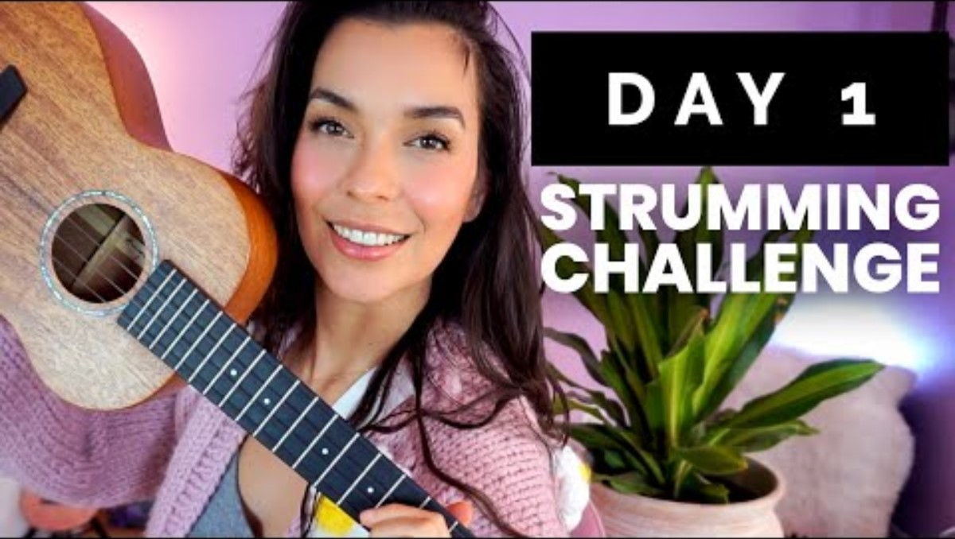
Activity 1.2 – perform ‘I Belong – As I Walk On My Country’ (Barkindji) (4)
Introduction to the ukulele
Bernadette Teaches Music (16 April 2017) How To Hold The Ukulele - Ukulele School (4:20) [video], Bernadette Teaches Music , YouTube, accessed 11 June 2025.
Bernadette Teaches Music (18 August 2021) HOW TO Strum A Ukulele for Beginners - Ukulele Strumming Challenge | DAY 1 of 5 (6:50) [video], Bernadette Teaches Music, YouTube, accessed 11 June 2025.

Slide 23
Activity 1.2 – perform ‘I Belong – As I Walk On My Country’ (Barkindji) (5)
Verse chords
|G |C |Em |C |
Chorus chords
|G |C |Em D |C |
Verse 1
As I walk on my country
Feel the spirit of the trees
Hear our stories
Upon the wind
Feel the power of this place
Speak our language, speak our names
We’ve come together
As we have always
Chorus
I belong, I belong
Let the love of country make you strong
I am free, I am free
Part of everything that lives and breathes
‘I Belong’ by Nancy Bates has been licensed by the NSW Department of Education. All rights reserved for the use of NSW Department of Education teachers and students only.

Slide 24
Activity 1.2 – perform ‘I Belong – As I Walk On My Country’ (Barkindji) (6)
Verse chords
|G |C |Em |C |
Chorus chords
|G |C |Em D |C |
Chorus
I belong, I belong
Let the love of country make you strong
I am free, I am free
Part of everything that lives and breathes
Verse 2
When our bodies return to the land
Back to dust, to soil and to sand
I’ll be ready, I’ll understand
Ancestors there in the sky
Will lead us all through the long dark night
To their love and to the light
Bridge chords
|G |C |
Bridge
Kirra-yi-ri, kirra-yi-ri thik-aapa x 3
‘I Belong’ by Nancy Bates has been licensed by the NSW Department of Education. All rights reserved for the use of NSW Department of Education teachers and students only.

Slide 25
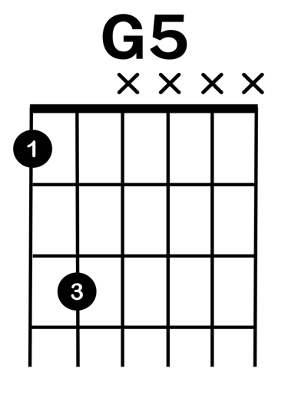
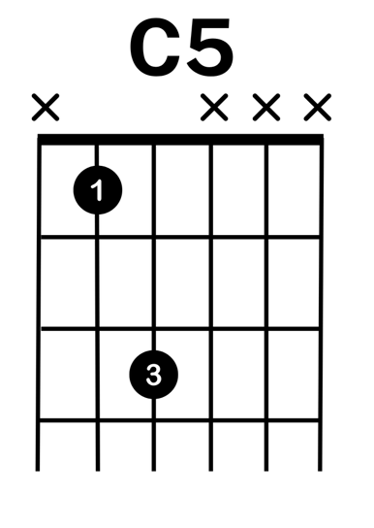
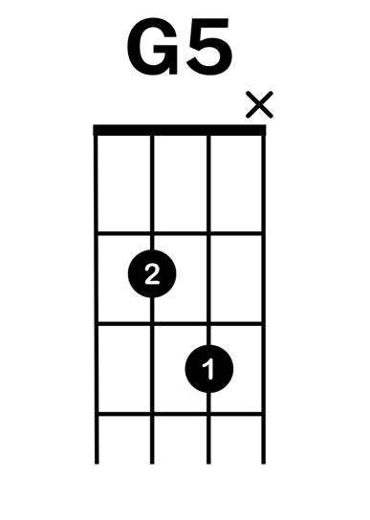
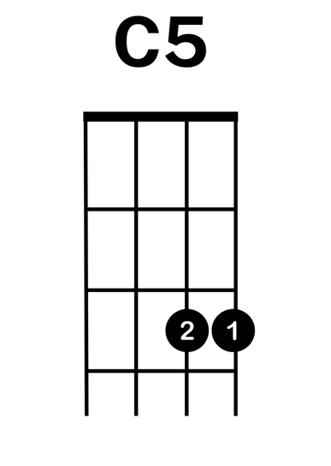
Activity 1.2 – perform ‘I Belong – As I Walk On My Country’ (Barkindji) (7)
Alternate power chords – lead sheet
Guitar
Ukulele
‘I Belong’ by Nancy Bates has been licensed by the NSW Department of Education. All rights reserved for the use of NSW Department of Education teachers and students only.

Slide 26
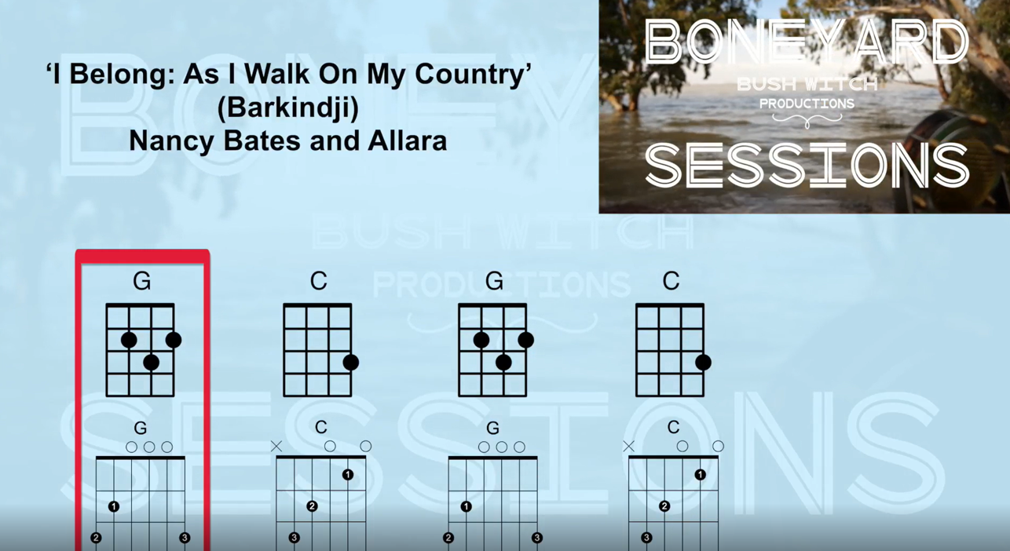
Activity 1.2 – perform ‘I Belong – As I Walk On My Country’ (Barkindji) (8)
Play along video
‘I Belong’ by Nancy Bates has been licensed by the NSW Department of Education. All rights reserved for the use of NSW Department of Education teachers and students only.

Slide 27
Activity 1.3 – writing the third verse (1)
Listening
Listen (from 0:00-0:43) to Nancy Bates and Allara | “I Belong: As I Walk On My Country” | Boneyard Sessions (5:41)
Close your eyes and imagine a place you walk often.
Focus on different senses: 'sight, sound, smell, touch or taste'.
Write down a single sensory detail that stood out and explain why it matters to you.
In pairs, share that detail and its significance.
Boneyard sessions (20 October 2022) Nancy Bates and Allara | " I Belong: As I Walk On My Country" | Boneyard Sessions (5:41) [video], Boneyard sessions, YouTube, accessed 11 June 2025.

Slide 28
Activity 1.3 – writing the third verse (2)
Listening
As a class, listen to the segment of the Creative Cast – Bigger than the song – Nancy Bates (30:16 – 32:36) where Nancy gives you an instruction for writing a third verse for her song.
Consider what this means for you and the place that you thought about and/or live on.

Slide 29
Activity 1.3 – writing the third verse (3)
Composition
Verse 1
As I walk on my country
Feel the spirit of the trees
Hear our stories
Upon the wind
Feel the power of this place
Speak our language, speak our names
We’ve come together
As we have always
​Structure​
8 lines​
mix of action sense and reflection​
ends with togetherness
Write 8 lines following the model
As I … (your action/place)
[Sense] the … (sight sound smell touch or taste)
Hear/see … (connect to memory or story)
Feel/Sense … (state power or heartbeat)
Speak … (your language or story)
Speak … (your name or truth)
We … (gather together)
As we … (have always done)
‘I Belong’ by Nancy Bates has been licensed by the NSW Department of Education. All rights reserved for the use of NSW Department of Education teachers and students only.

Slide 30

Learning sequence 2 – Emma Donovan (Gumbaynggirr)
Symbol – Dynamic and Evolving © Kayleb Waters, 2025. Used with permission.

Slide 31
Learning intentions and success criteria (2)
We are learning to
• understand how Aboriginal and Torres Strait Islander artists use music to communicate connection to Country, memory, and community
• collaborate respectfully to an arrangement, and safe songwriting spaces
• engage with the music of Aboriginal and Torres Strait Islander Peoples to recreate an instrumental track through aural learning.
We can
• describe how Emma Donovan’s music reflects Aboriginal People's experiences of Country, protest, and collaboration.
• work together to create a respectful performance that shows understanding of safe cultural practice
• listen and learn to perform with confident timing, and rhythmic accuracy.
Notes:
Notes for teachers:
Learning intentions and success criteria are best co-constructed with students. Adapt the learning intention as required and add matching success criteria.
For more information See ⁠AITSL or the NSW Department of Education explicit teaching strategies, ⁠Sharing learning intentions and ⁠Sharing success criteria
LISC is not necessarily presented at the beginning of the lesson. Teacher needs to consider most effectual time to introduce
LISC should be revisited during the lesson to support students' evaluation of their learning

Slide 32
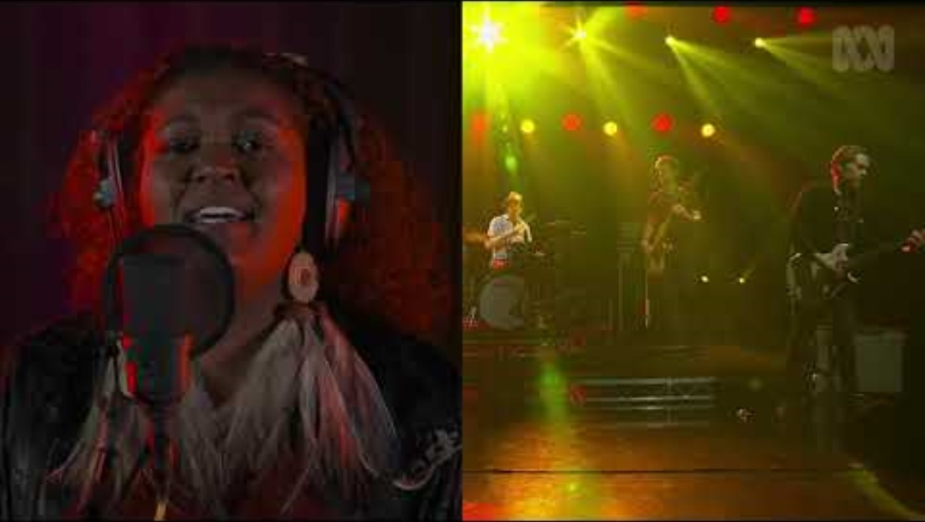
Activity 2.1 – ‘Mob March’ (1)
Listening
CAMILLIAN FILMS (14 February 2021) Emma Donovan & The Putbacks, 'Mob March’ (5:44) [video], CAMILLIAN FILMS, YouTube, accessed 11 June 2025.

Slide 33
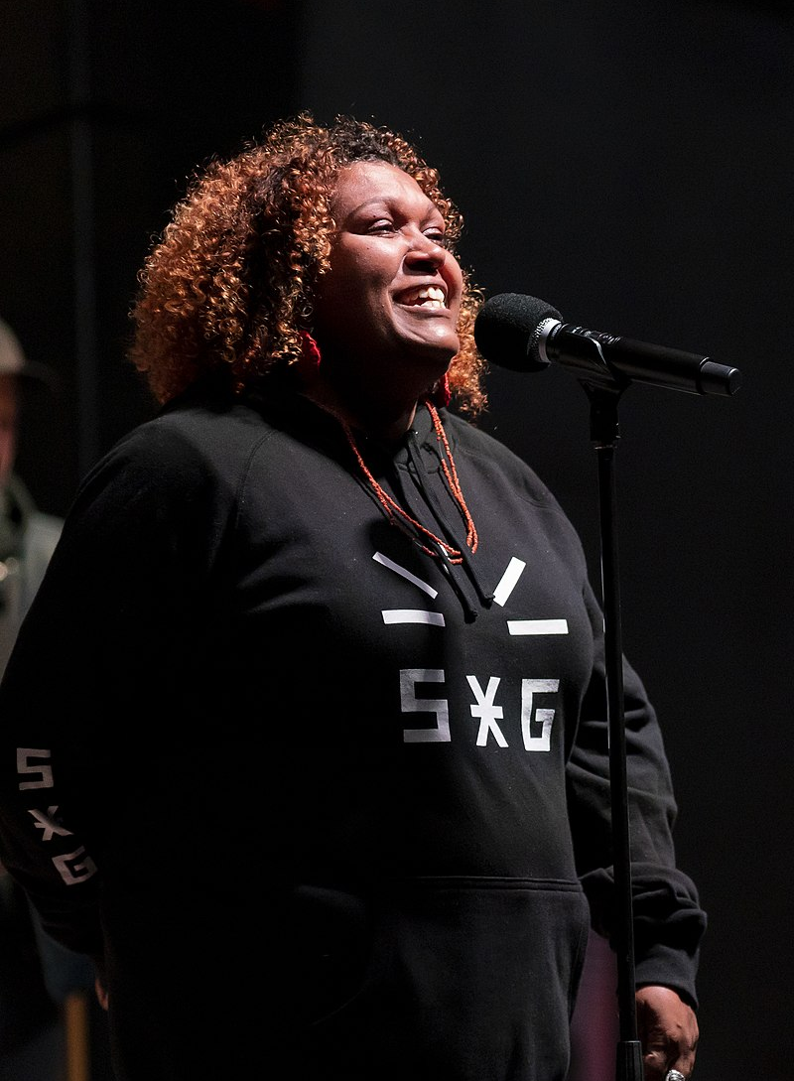
Emma Donovan
Gumbaynggir
Emma Donovan is a proud Gumbaynggir woman from the Nambucca Valley on the north coast of New South Wales. She is a singer and songwriter from a family of renowned musicians.
Listen to a segment of Creative Cast – Bigger than the song – Emma Donovan (09:05 – 11:47), to learn more about Emma's song 'Mob March'.
Discussion
What is the purpose of the song ‘Mob March’?
What does it represent?
*Information adapted respectfully from Emma Donovan’s website and Melbourne Symphony Melboure Symphony Orchestra - Behind the music, Emma Donovan Behind the Music.
Emma Donovan 2022 by Matt Hrkac is licensed under CC BY 2.0

Slide 34
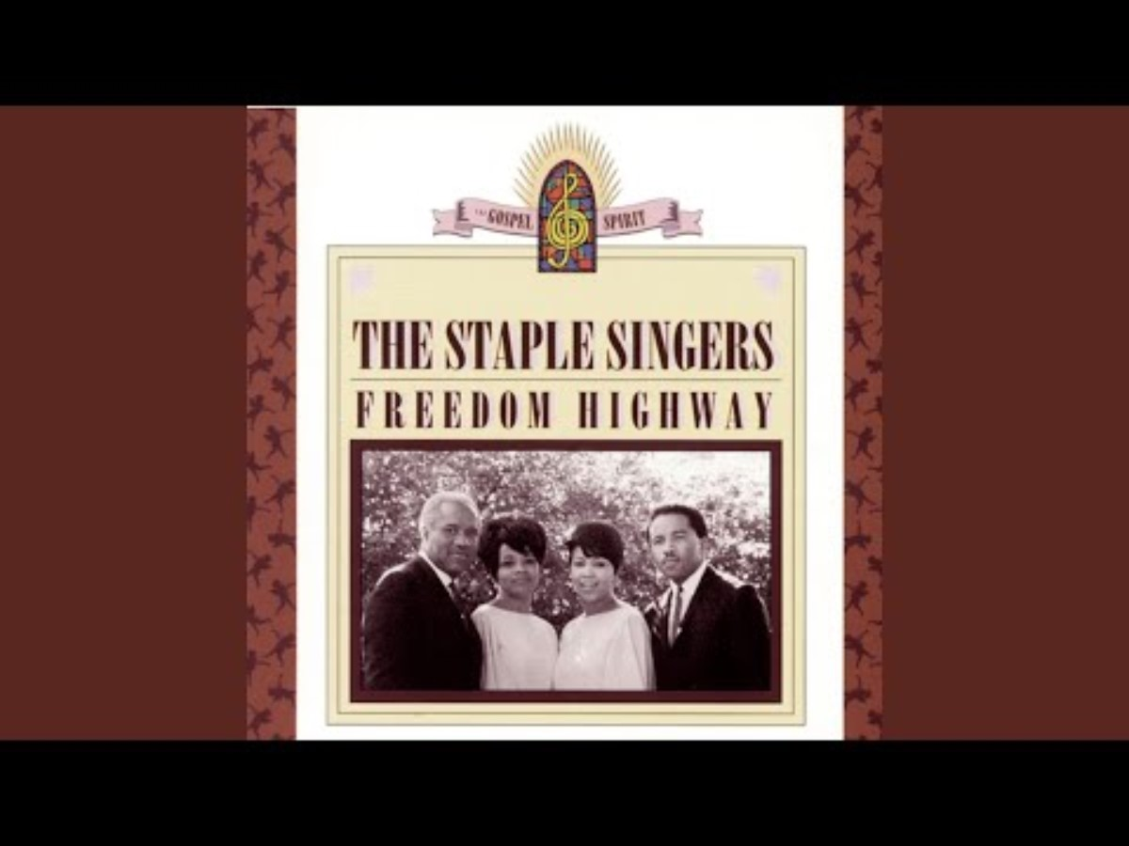
Activity 2.1 – ‘Mob March’ (2)
Listening – Freedom Highway
Listen to 'Freedom Highway' by The Staple Singers.
Discuss what this song is about.
Discuss how Freedom Highway might have influenced Emma in providing inspiration for ‘Mob March’.
The Staple Singers (17 March 2015) Freedom Highway (2:55) [video], The Staple Singers, YouTube, accessed 22 December 2025.

Slide 35
Activity 2.1 – ‘Mob March’ (3)
Listening – outro
Listen from 4:13-5:44
Access the article Always Was, Always Will Be, Aboriginal Land - The Australian Museum.
Consider what you have learnt about the phrase ‘Always Was, Always Will Be, Aboriginal Land.’ What does this say about Country and Community?
Listen to the outro of 'Mob March'.
Discuss – how does the use of the protest chants and the phrase ‘Always Was, Always Will Be’ communicate Aboriginal People’s connection to Country?
CAMILLIAN FILMS (14 February 2021) Emma Donovan & The Putbacks, 'Mob March’ (5:44) [video], CAMILLIAN FILMS, YouTube, accessed 11 June 2025

Slide 36
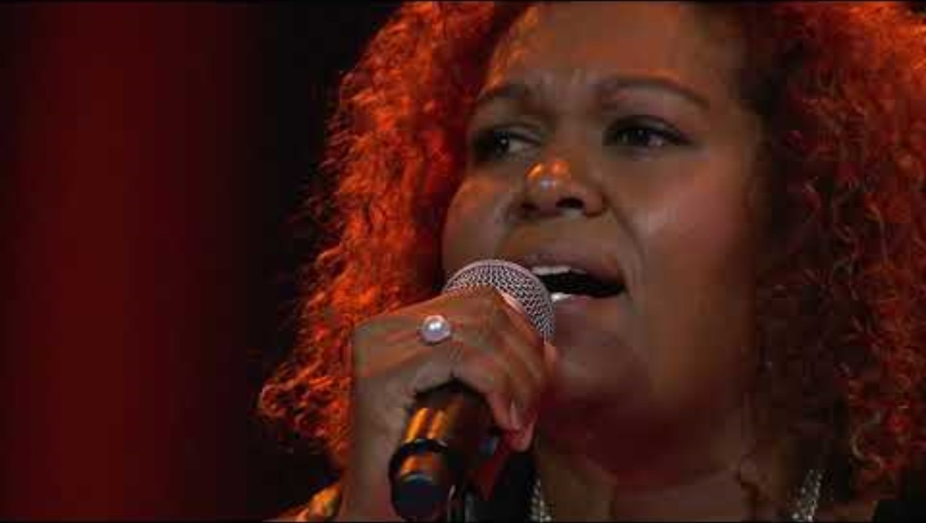
Activity 2.2 – Warrell Creek (1)
TedxSydney
TEDx Talks (18 December 2020) Warrell Creek Song | Emma Donovan | TEDxSydney (4”05) [video], TEDx Talks, YouTube, accessed 11 June 2025.

Slide 37
Activity 2.2 – Warrell Creek (2)
Warrell Creek Song is an old traditional Gumbaynggirr song based on a sighting of a strange vessel off the mid-north coast of New South Wales, with new arrangements by Emma Donovan & The Putbacks. The lyrics were originally sung by Emma's great-great Granny Ballengarry, Harry Buchanan and other Gumbaynggirr mob.
Lyrics and literal translation
Widing || Wirraal-wirraada ngaya.
pained Warrell-creek at I
Widing || Wirraal-Wirraada ngaya.
pained Warrell-creek-at I
Widing || gulun-gulunda.
pained rain-rain-in
Nyuurrgu||-wa bawgi-langmi
smoke-in bathe-d
ngaanya || jumbulbangga;
me big-smoke-in
biganybada* || nyurram-nyurramba ngaya.
lake-at southerly-buster-in I
Emma’s translation – Hurting at Warrell Creek was I; hurting at Warrell Creek was I. In the smoke I was bathed; in the massive smoke, on the lagoon, in the sea-storm.
'Warrell Creek ' by Emma Donovan has been licensed by the NSW Department of Education. All rights reserved for the use of NSW Department of Education teachers and students only.

Slide 38
Activity 2.2 – Warrell Creek (3)
‘Hurting at Warrell Creek was I… in the massive smoke.’
Quietly think about this lyric – ‘Hurting at Warrell Creek was I… in the massive smoke.’ What do you think ‘massive smoke’ represents?
In a circle, take turns sharing one idea. You might begin with: ‘I think the smoke means…’, ‘It reminds me of…’, or ‘It made me feel…’. As others speak, listen respectfully. Notice what stories, emotions, or symbols are shared.
As a class, talk about what this line tells us about Country, memory, and how music can carry culture and pain.
Make some notes about this reflection in your student reflection book.
TEDx Talks (18 December 2020) Warrell Creek Song | Emma Donovan | TEDxSydney (4”05) [video], TEDx Talks, YouTube, accessed 11 June 2025

Slide 39
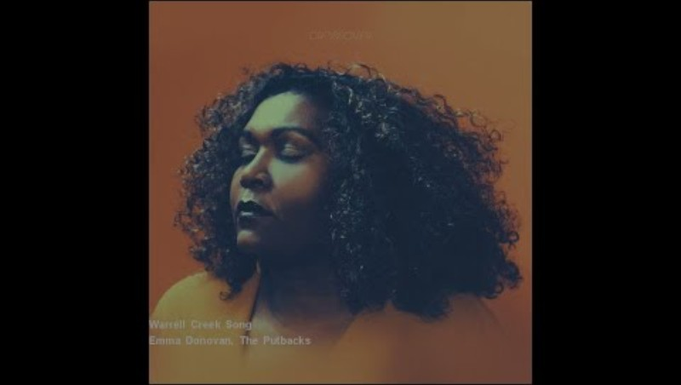
Activity 2.2 – ‘Warrell Creek’ (4)
Listening – comparison
Creative Cast – Bigger than the song – Emma Donovan (11:47 – 16:46)
TEDx Talks (18 December 2020) Warrell Creek Song | Emma Donovan | TEDxSydney (4”05) [video], TEDx Talks, YouTube, accessed 11 June 2025
Listen to Emma’s soul version of the song 'Warrell Creek’.
Discuss and make notes in your student reflection booklet:
How is the soul version of ‘Warrell Creek’ both similar and different to the TEDxSydney performance?
What protocols and ethical choices did Emma make in creating the version of the song with the Putbacks?
Hopestreet Recordings (17 August 2021) Emma Donovan, The Putbacks - Warrell Creek Song (5:38) [video], Hopestreet Recordings, YouTube, accessed 11 June 2025.

Slide 40
Activity 2.3 – class instrumental arrangement (1)
Fill out the first column of the table in your student reflection booklet as you listen to:
Creative Cast – Bigger than the song – Emma Donovan (16:46 – 26:14).
Answer the following questions in the second column of your student reflection booklet:
What has Emma said about the protocols she followed and would like you to follow?
Make a list of the ethical choices you think you should make when engaging with her songs.
Symbol – Systems and Protocols © Kayleb Waters, 2025. Used with permission.

Slide 41
Activity 2.3 – class instrumental arrangement (2)
Discussing ethical choices
How do we make sure we are pronouncing the words correctly?
What do these words in Gumbaynggir mean?
Would it be appropriate to record our arrangement?
What risks and protocols related to information, identity and intellectual property when sharing compositions or other material on public or private forums should be considered?
Language
Recording the performance
Do we have permission to sing this Language?
Ethical choices
Is it okay to sing this Language on this Country?
Style
Performing for an audience
Instruments
What ICIP should be acknowledged?
What styles would be appropriate for a classroom arrangement?
What would we need to consider if performing for an audience?
What instruments can we use?

Slide 42
Activity 2.3 – class instrumental arrangement (3)
Listening
‘Warrell Creek’
‘Mob March’
Hopestreet Recordings (17 August 2021) Emma Donovan, The Putbacks - Warrell Creek Song (5:38) [video], Hopestreet Recordings, YouTube, accessed 11 June 2025.
CAMILLIAN FILMS (14 February 2021) Emma Donovan & The Putbacks, 'Mob March’ (5:44) [video], CAMILLIAN FILMS, YouTube, accessed 11 June 2025.
Considering your learning and the ethical choices you have made as a class, work together to decide on which song you would like to recreate the instrumental track.

Slide 43
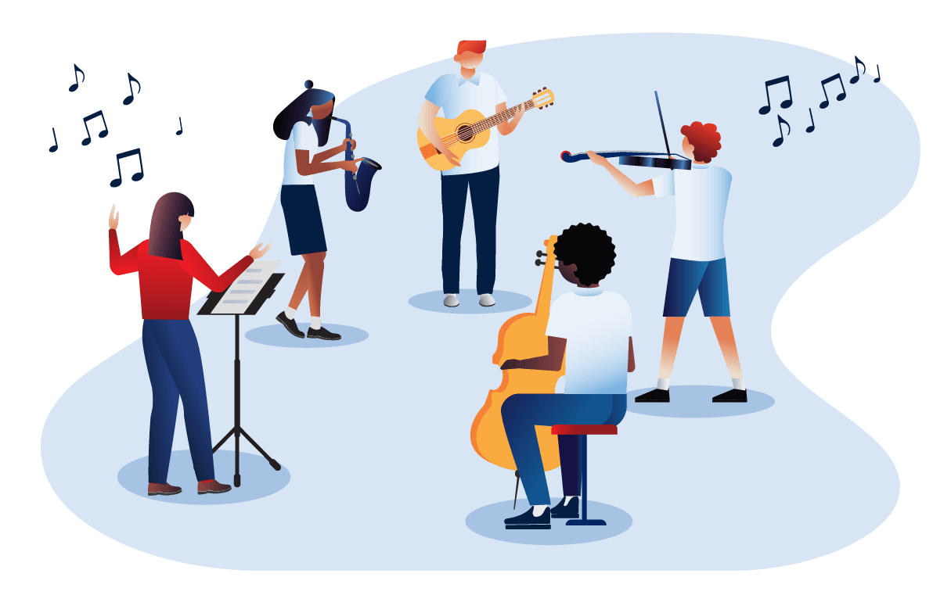
Activity 2.3 – class instrumental arrangement (4)
Arrangement instructions
Listen to the selected song, noting the bass line, chord changes and percussive parts. Through listening and guidance from your teacher, begin to learn your individual parts.
Rehearse individual sections of the work: decide on an introduction (for example, a spoken Acknowledgement of Country), entry point for each layer, dynamic shaping and a clear ending.
Combine the sections into a class instrumental arrangement.
Run the full arrangement several times, refining balance, timing and dynamics.
Rehearse until you achieve ensemble cohesion.

Slide 44
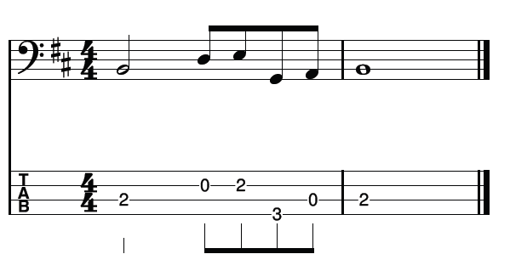

Activity 2.3 – class instrumental arrangement (5)
Learning to play ‘Warrell Creek’ – bass line and percussion
Bass line
Percussion
'Warrell Creek ' by Emma Donovan has been licensed by the NSW Department of Education. All rights reserved for the use of NSW Department of Education teachers and students only.

Slide 45
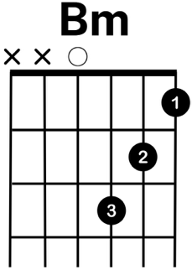
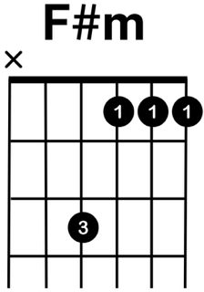
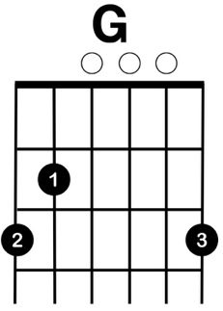
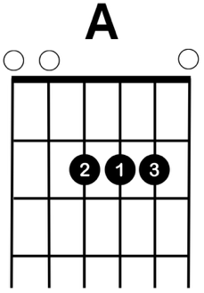
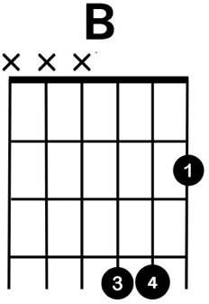
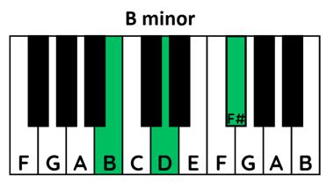
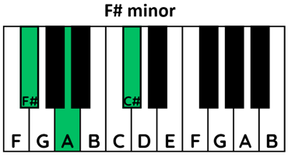
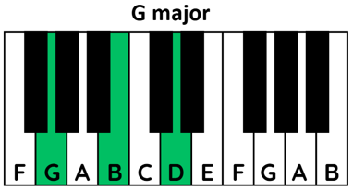
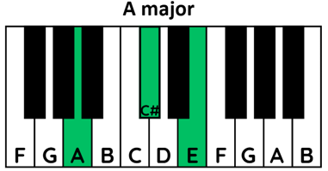
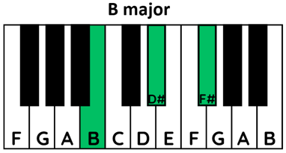
Activity 2.3 – class instrumental arrangement (6)
Learning to play ‘Warrell Creek’ – chords
'Warrell Creek ' by Emma Donovan has been licensed by the NSW Department of Education. All rights reserved for the use of NSW Department of Education teachers and students only.

Slide 46
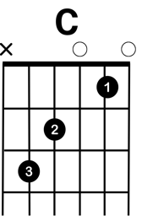
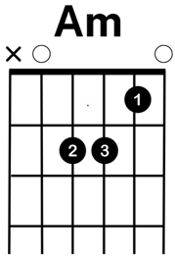
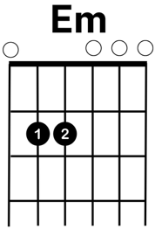
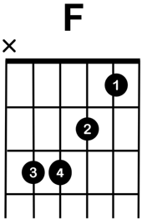
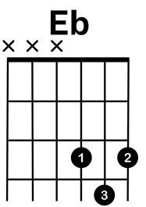
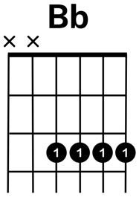
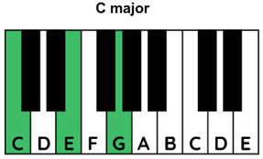
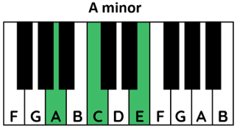
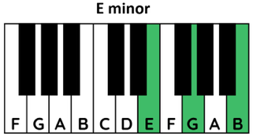
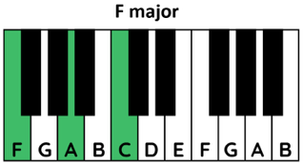
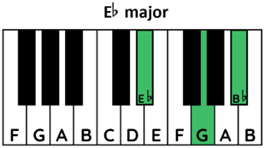
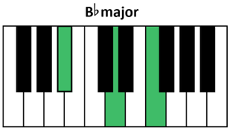
Activity 2.3 – class instrumental arrangement (7)
Learning to perform ‘Mob March’
The score and parts for ‘Mob March’ can be accessed in the score booklet. Below are the guitar and piano chord diagrams.
'Warrell Creek ' by Emma Donovan has been licensed by the NSW Department of Education. All rights reserved for the use of NSW Department of Education teachers and students only.

Slide 47
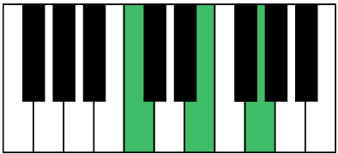
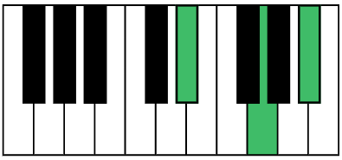
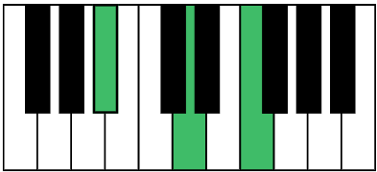
Activity 2.3 – class instrumental arrangement (8)
Performance – outro keyboard (2)
Chord progression –
C | E♭ | B♭
C
E♭
B♭
Rehearse the full outro slowly, focusing on a steady pulse.
Repeat at performance tempo with strong volume and uniform phrasing.
'Mob March' by Emma Donovan has been licensed by the NSW Department of Education. All rights reserved for the use of NSW Department of Education teachers and students only.

Slide 48
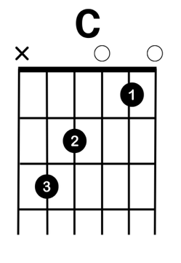
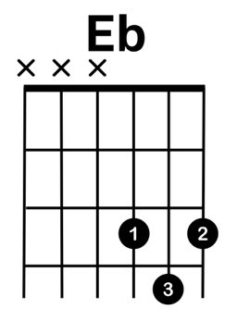
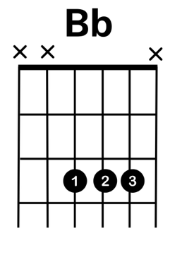
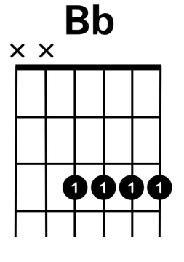
Activity 2.3 – class instrumental arrangement (9)
Performance – outro guitar (3)
Chord progression –
C | E♭ | B♭
or
Rehearse the full outro slowly, focusing on a steady pulse.
Repeat at performance tempo with strong volume and uniform phrasing.
'Mob March' by Emma Donovan has been licensed by the NSW Department of Education. All rights reserved for the use of NSW Department of Education teachers and students only.

Slide 49
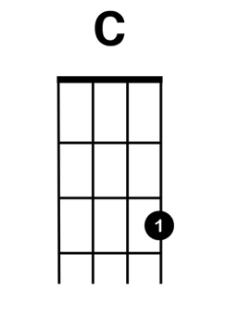
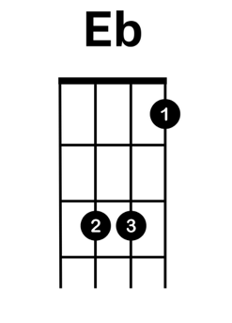
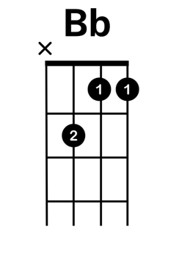
Activity 2.3 – class instrumental arrangement (10)
Performance – outro ukulele (4)
Chord progression –
C | E♭ | B♭
Rehearse the full outro slowly, focusing on a steady pulse.
Repeat at performance tempo with strong volume and uniform phrasing.
'Mob March' by Emma Donovan has been licensed by the NSW Department of Education. All rights reserved for the use of NSW Department of Education teachers and students only.

Slide 50

Learning sequence 3 – ‘Ngarra Badhu’ and ‘Yanma Ngurrawa’ (Dharug)
Symbol – Cultural Practices © Kayleb Waters, 2025. Used with permission.

Slide 51
Learning intentions and success criteria (3)
We are learning to
sing songs in Dharug Language with accurate pronunciation, musical expression and Cultural respect
understand how ‘Ngarra Badhu’ and ‘Yanma Ngurrawa’ express connection to Country and support Language revitalisation
work together to create and perform a classroom arrangement that honours meaning and feeling of the original songs.
We can
sing the melodies of ‘Ngarra Badhu’ and ‘Yanma Ngurrawa’ with correct phrasing, pitch and respectful pronunciation
explain how the songs reflect Cultural identity, Language and connection to Country
perform in a group arrangement that balances voice, rhythm and harmony to communicate the songs’ emotional and cultural messages.
Notes:
Notes for teachers:
Learning intentions and success criteria are best co-constructed with students. Adapt the learning intention as required and add matching success criteria.
For more information See ⁠AITSL or the NSW Department of Education explicit teaching strategies, ⁠Sharing learning intentions and ⁠Sharing success criteria
LISC is not necessarily presented at the beginning of the lesson. Teacher needs to consider most effectual time to introduce
LISC should be revisited during the lesson to support students' evaluation of their learning

Slide 52
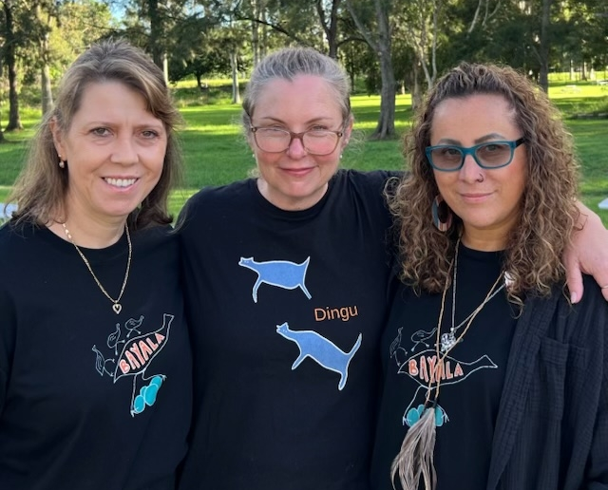
Bayala
Dharug
Bayala Aboriginal Corporation is made up of Dharug people, including Jasmine Seymour, Corina Norman and Debbie Smith, all of whom are actively involved in Dharug Language research, curriculum development, community teaching, and the broader revitalisation movement. Their work is grounded in cultural responsibility, community authority, and the collective care required to ensure Dharug continues to grow for future generations.
Information and image provided and adapted respectfully from Bayala website, Corina Norman and Jasmine Seymour

Slide 53

Activity 3.1 – ‘Ngarra Badhu’ (1)
Language revitalisation
Access Creative Cast – Bigger than the song – Bayala Aboriginal Corporation (13:39 – 16:31).
Reflection
Why it is important to learn these songs in class?
Symbol – Pathways © Kayleb Waters, 2025. Used with permission.

Slide 54

Activity 3.1 – ‘Ngarra Badhu’ (2)
Learning the pronunciation
Jasmine Seymour (9 April 2023), Dharug Sounds (3:02) [video], Jasmine Seymour, YouTube, accessed 10 November 2025.

Slide 55

Activity 3.1 – ‘Ngarra Badhu’ (3)
Listen to ‘Ngarra Badhu’ by Jasmine Seymour
Bayala Dharug Dhalang (28 July 2025) Mix – Ngarra Badhu – Listen to Water (2:37) [video], Bayala Dharug Dhalang YouTube, accessed 10 November 2025.

Slide 56
Activity 3.1 – ‘Ngarra Badhu’ (4)
Perform ‘Ngarra Badhu’ by Jasmine Seymour (1)
Lyrics
Ngarra Ngarra Badhu Badhu
Ngarra Ngarra Badhu Badhu
Ngarra Ngarra Badhu Badhu
Ngarra Ngarra Badhu Badhu
Ngalawa Ngarra Ngarra Badhuyin Ngurruwa
Ngalawa Ngarra Ngarra Badhuyin Ngurruwa
Ngarra Ngarra Badhu Badhu
Repeat 4 times and fade
Gently sing along on an open vowel to begin learning the vocal melody and warm up the voice.
Access Creative Cast – Bigger than the song – Bayala Aboriginal Corporation (27:48 – 29:29).
Bayala Dharug Dhalang (28 July 2025) Mix – Ngarra Badhu – Listen to Water (2:37) [video], Bayala Dharug Dhalang YouTube, accessed 10 November 2025
'Ngarra Badhu' from the Bayala Songbook has been licensed by the NSW Department of Education. All rights reserved for the use of NSW Department of Education teachers and students only.

Slide 57
Activity 3.1 – ‘Ngarra Badhu’ (5)
Perform ‘Ngarra Badhu’ by Jasmine Seymour (2)
Lyrics
Ngarra Ngarra Badhu Badhu
Ngarra Ngarra Badhu Badhu
Ngarra Ngarra Badhu Badhu
Ngarra Ngarra Badhu Badhu
Ngalawa Ngarra Ngarra Badhuyin Ngurruwa
Ngalawa Ngarra Ngarra Badhuyin Ngurruwa
Ngarra Ngarra Badhu Badhu
Repeat 4 times and fade
Using the lyrics and translations provided in the video, read through the words focusing on pronunciation.
Sing through the piece along with the recording.
Bayala Dharug Dhalang (28 July 2025) Mix – Ngarra Badhu – Listen to Water (2:37) [video], Bayala Dharug Dhalang YouTube, accessed 10 November 2025

Slide 58

Activity 3.2 – ‘Yanma Ngurrawa’ (1)
Listen and sing
Listen to Yanma Ngurrawa - Walk on Country (01:34).
Practise humming or singing along on open vowels.
Learn the melody through call and response, focusing on phrasing, expression and vocal unity.
Learn the Dharug lyrics of the song. As a class, discuss the meaning of Dharug words ‘Yanma’ (walk) and ‘Ngurrawa’ (Country).
Sing through the full song together with the video.
Bayala Dharug Dhalang (29 July 2025) Yanma Ngurrawa - Walk on Country (01:34) [video], Bayala Dharug Dhalang YouTube, accessed 10 November 2025.

Slide 59
Activity 3.2 – ‘Yanma Ngurrawa’ (2)
Think–pair–share – listen – discuss
Think – How does singing ‘Yanma Ngurrawa’ help you understand connection to Country?
Pair – Discuss your thoughts with a partner.
Share – From your discussion, offer one insight of your own and one your partner shared.
Access Creative Cast – Bigger than the song – Bayala Aboriginal Corporation (22:36 – 24:48).
Discussion
What are the guidelines outlined by The Bayala Aboriginal Corporation?
How would you approach a classroom arrangement of this piece?
Translations of Darug words
Yanma – walk
Ngurrawa – Country

Slide 60
Activity 3.2 – ‘Yanma Ngurrawa’ (3)
Classroom arrangement (1)
In 3 groups, select a musical role based on available instruments and abilities:
  Group A sings the melody with clarity and feeling
  Group B creates a simple bass line on keyboard, bass guitar or tuned percussion to reinforce tonality
  Group C adds a gentle rhythmic layer
Rehearse individual parts, listening for cohesion and considering how each role supports the song’s feeling
Combine all parts to rehearse the full arrangement deciding collaboratively how to start, the order of entries, any dynamic build-up and the ending.
Perform the arrangement together, focusing on unity, balance and emotional expression. Record or share if possible.
Symbol – Dynamic and Evolving © Kayleb Waters, 2025. Used with permission.

Slide 61


Activity 3.2 – ‘Yanma Ngurrawa’ (4)
Classroom arrangement (2)
'Yanma Ngurrawa' from the Bayala Songbook has been licensed by the NSW Department of Education. All rights reserved for the use of NSW Department of Education teachers and students only.

Slide 62
Activity 3.2 – ‘Yanma Ngurrawa’ (5)
Classroom arrangement (3)
Reflection/discussion
What did you learn about Dharug Culture or Language through the song?
How did your arrangement express walking softly on Country?
How did you collaborate to achieve your final arrangement?
Symbol – Dynamic and Evolving © Kayleb Waters, 2025. Used with permission.

Slide 63

Learning sequence 4 – ‘Yanada’ (Dharug)
Symbol – Story Sharing / Knowledge Sharing © Kayleb Waters, 2025. Used with permission.

Slide 64
Learning intentions and success criteria (4)
We are learning to
understand the importance of Indigenous Cultural and Intellectual Property (ICIP) when working with Aboriginal and Torres Strait Islander music and stories
explore how respectful collaboration is shown through ‘Yanada’ by the Preatures and Jacinta Tobin
use digital tools to reflect on and share ideas through podcasting.
We can
explain how ICIP protects Aboriginal and Torres Strait Islander stories, Languages and music, and why permission matters
describe how ‘Yanada’ was created through respectful collaboration with the Dharug community
record and edit a clear, respectful podcast using DAW software to reflect ICIP and musical collaboration.
Notes:
Notes for teachers:
Learning intentions and success criteria are best co-constructed with students. Adapt the learning intention as required and add matching success criteria.
For more information See ⁠AITSL or the NSW Department of Education explicit teaching strategies, ⁠Sharing learning intentions and ⁠Sharing success criteria
LISC is not necessarily presented at the beginning of the lesson. Teacher needs to consider most effectual time to introduce
LISC should be revisited during the lesson to support students' evaluation of their learning

Slide 65

The Preatures
The Preatures are an Australian indie rock band from Sydney made up of Isabella Manfredi (lead vocals), Jack Moffitt (guitar and vocals), Thomas Champion (bass) and Luke Davison (drums). None of the band members identify as Aboriginal or Torres Strait Islander, however, they worked closely with the Dharug community to gain approval to tell an Aboriginal story and sing in the Dharug Language in their song ‘Yanada’.
*Information adapted respectfully from The Preachers' website and Triple J - How The Preatures came to collaborate with Indigenous communities for new single 'Yanada'..
The Preatures playing live by Bruce Baker is licensed under CC BY 2.0

Slide 66

Jacinta Tobin
Darug
Dr Aunty Jacinta Tobin is a Dharug Elder and Song Woman. She uses her music to educate others about Dharug Culture, songs and Language. She played an important part in the creation of the song ‘Yanada’, by providing advice and permission to The Preatures.
Information adapted respectfully from Writing NSW and The 3rd City
Jacinta Tobin bio photo from Writing NSW N.D.

Slide 67

Activity 4.1 – ‘Yanada’ and Indigenous Cultural Intellectual Property (ICIP) (1)
SBS The Feed (26 September 2017) The Preatures: Making Yanada, a story of Indigenous collaboration - The Feed (8:18) [video], SBS The Feed, YouTube, accessed 11 June 2025.

Slide 68

Activity 4.1 – ‘Yanada’ and Indigenous Cultural Intellectual Property (ICIP) (2)
Listening
The Preatures (4 August 2017) The Preatures – Yanada (4:48) [video], The Preatures, YouTube, accessed 7 November 2025.

Slide 69

Activity 4.1 – ‘Yanada’ and Indigenous Cultural Intellectual Property (ICIP) (3)
Reflecting quietly, write down key words or quotes that answer each of the following questions:
Reflection questions:
How did The Preatures consult Jacinta Tobin and the Dharug community?
What actions did Isabella Manfredi take when she realised she was telling an Aboriginal story?
Why is it important to seek permission and follow cultural protocols with Aboriginal stories, Language or music?
Share in a small group. Begin with, ‘I noticed they consulted by…’, ‘Isabella showed respect when…’, or ‘permission matters because…’. Listen deeply while others speak.
Symbol – Partnerships © Kayleb Waters, 2025. Used with permission.

Slide 70
Activity 4.1 – ‘Yanada’ and Indigenous Cultural Intellectual Property (ICIP) (4)
Dr Aunty Jacinta Tobin discusses ICIP and how Cultural Knowledge is shared in Aboriginal Culture.
Creative Cast – Bigger than the song – Jacinta Tobin (10:17 – 13:54)
Discussion – What does this teach us about ICIP and respectful Aboriginal/non-Indigenous partnerships?
Reflection – Write a reflection about what ICIP means and what protocols or ethical choices you feel you should follow when performing or composing music including Indigenous Cultural Intellectual Property.
Symbol – Partnerships © Kayleb Waters, 2025. Used with permission.

Slide 71
Activity 4.2 – Indigenous Cultural Intellectual Property (ICIP) podcast (1)
Think back to how The Preatures worked with Jacinta Tobin on Yanada, and what ICIP means.
Work in pairs using the following prompts to write the script for your podcast.
a. ‘Hello – we are [names], and today’s podcast is about ‘Yanada’s’ collaboration.’
b. ‘The Preatures worked with Jacinta Tobin by [brief summary]’
c. ‘ICIP means [one sentence definition]’
d. ‘Artists can collaborate respectfully by [one suggestion]’
Use the script template in the student booklet, to create a script for a podcast.
Practise reading your script aloud with clear pacing and expression.

Slide 72

Activity 4.2 – Indigenous Cultural Intellectual Property (ICIP) podcast (2)
View the 'How to Podcast’ tutorial video.
Use a Digital Audio Workstation (DAW) such as BandLab to record and edit your own short podcast reflecting on ICIP and respectful collaboration.
Submit your podcast to your teacher for feedback/marking.

Slide 73
Learning sequence 5 – Storytelling in hip-hop
Symbol – Story Sharing / Knowledge Sharing © Kayleb Waters, 2025. Used with permission.

Slide 74
Cultural advice – Aboriginal and Torres Strait Islander Peoples are advised that this lesson sequence contains images, names and/or voices of people who have passed away.

Slide 75
Learning intentions and success criteria (5)
We are learning to
understand how hip-hop artists like BARKAA and DOBBY use music to tell personal and Cultural stories
explore sound, rhythm, and language as tools for expressing identity and connection to Country
create and perform original musical ideas using spoken word, rap, and rhythmic accompaniment.
We can
describe how BARKAA and DOBBY communicate themes like strength, identity, and land through lyrics and sound
recreate rhythmic and melodic patterns from ‘water’ and compose a short rap or sound piece inspired by Cultural themes
collaborate to write and perform a class rap that tells a clear story and uses rhythm, rhyme, and expressive language.
Notes:
Notes for teachers:
Learning intentions and success criteria are best co-constructed with students. Adapt the learning intention as required and add matching success criteria.
For more information See ⁠AITSL or the NSW Department of Education explicit teaching strategies, ⁠Sharing learning intentions and ⁠Sharing success criteria
LISC is not necessarily presented at the beginning of the lesson. Teacher needs to consider most effectual time to introduce
LISC should be revisited during the lesson to support students' evaluation of their learning

Slide 76

Activity 5.1 – hip-hop history (1)
Listening
Access Rap and Hip Hop: Crash Course Black American History #47 (14:54) (from 0:00-5:00) and answer the questions below.
      Questions
      Where and when did hip-hop begin?​
      What are the four elements of
      hip-hop?​
      Why is hip-hop more than just music?
CrashCourse (21 September 2022) Rap and Hip Hop: Crash Course Black American History #47 (14:54) [video], CrashCourse, YouTube, accessed 11 June 2025.

Slide 77

Activity 5.1 – hip-hop history (2)
Listening
Watch Who is South West Syndicate? (SWS TV – Episode 1) (02:44) to learn about one of Australia’s first hip-hip bands.
South West Syndicate (26 July 2019) Who is South West Syndicate ? (SWS TV - Episode 01) (2:44) [video], South West Syndicate , accessed 23 December 2025.

Slide 78

Activity 5.1 – hip-hop history (3)
Jigsaw activity
Access the article From the Meanjin Archive: the New Corroboree by Tony Mitchell (2005)
Break into groups of 3-4 students
Divide the article among the groups and each group to read and summarise their distributed section
Report your summary back to the class

Slide 79
Activity 5.1 – hip-hop history (4)
Hip-hop Global music culture in Australia
Discussion
Why does hip-hop connect with Aboriginal and/or Torres Strait Islander Communities?
Why is it important for Australian hip-hop artists to perform with their own accents and for Aboriginal hip-hop artists to incorporate their own Aboriginal Language?
How does hip-hop reflect a Global music culture that supports Indigenous artists around the world to tell their story?

Slide 80

Archie Roach
Gunditjmara and Bundjalung
We pay our respects to Uncle Archie Roach (1956–2022), a proud Gunditjmara and Bundjalung man, musician, and storyteller. As a member of the Stolen Generations, he used his powerful songs, especially ‘Took the Children Away’, to share his story and raise awareness about the strength, resilience, and enduring impact of the Stolen Generations. In 2015 he was made a Member of the Order of Australia for his service to the arts and social justice.
This information has been respectfully adapted from the obituary of Archie Roach published by the Australian National University, shared respectfully to honour Uncle Archie’s legacy.
Roach in 2016 by Australian Human Rights Commission is licensed under CC BY 2.0

Slide 81

Briggs
Yorta Yorta
Adam Briggs is a proud Yorta Yorta man. He started out as a solo rapper, recording music at home. In 2016, he co-founded the hip-hop duo A.B. Original, whose album Reclaim Australia won several awards, including ARIA Awards for Best Independent Release and Best Urban Album. Through his music, he shares stories about Aboriginal culture, identity, and social issues. He set up a foundation dedicated to developing the skills and increasing the visibility of Aboriginal and Torres Strait Islander Peoples in the creative industries.
Information adapted respectfully from Bad Apples Music.
Briggs by Bruce is licensed under CC BY 2.0

Slide 82


Activity 5.1 – hip-hop history (7)
Comparative listening – Compare the following songs by Archie Roach and Briggs
‘Took The Children Away’ – Archie Roach
        Questions for each song
        Who is the song about?
        What is the message?
        What emotions does it show?
        How do the musical features support how the story is told?
Warner Music Australia (3 November 2020) Archie Roach - Took The Children Away (Official Music Video) 5:22) [video], Warner Music Australia, YouTube, accessed 11 June 2025.
‘The Children Came Back’ – Briggs
Briggs (3 July 2015) Briggs - The Children Came Back ft. Gurrumul & Dewayne Everettsmith (Official Video) (3:50) [video], Briggs, YouTube, accessed 11 June 2025.

Slide 83
Activity 5.1 – hip-hop history (8)
Conveying a message
Discussion
How do these pieces of music, which are from different times and styles, reflect the identity of Aboriginal and Torres Strait Islander Peoples?
Symbol – Story Sharing / Knowledge Sharing © Kayleb Waters, 2025. Used with permission.

Slide 84

BARKAA
Malyangapa and Barkindji
BARKAA is the stage name of Chloe Quayle, a proud Malyangapa and Barkindji woman. The word BARKAA is taken from the Barkindji word of the Darling River. She is a rapper whose work reflects her experiences and identity as an Aboriginal woman from Gadigal Land. Her music addresses themes related to her culture, politics, personal history and power in womanhood.
Information adapted respectfully from BARKAA’s website.
BARKAA photo from BARKAA 2024

Slide 85

Uncle Leroy Johnson
Barkindji / Malyunapa
Uncle Leroy Johnson is a Barkindji / Malyunapa man who is a storyteller, singer/songwriter and guitarist. As director of the Barkindji Native Title Prescribed Body Corporate which manages native title rights and interests for Barkindji people in NSW and the first Aboriginal park manager of Mutawintji National Park, his music draws inspiration from the land. Themes include environmental issues and connection to Country.
Information adapted respectfully from ABC News and West Darling Arts.
Leroy Johnson photo from Bad Apples Music 2023

Slide 86


Activity 5.1 – hip-hop history (11)
Comparative listening
‘Ngamaka’ – BARKAA ft. Leroy Johnson
‘Nhaampa Buka’ – Leroy Johnson
BARKAA (29 May 2025) Barkaa - Ngamaka (feat. Leroy Johnson) ft. Leroy Johnson (3:38) [video], BARKAA, YouTube, accessed 11 June 2025.
Sydney Youth Orchestras (12 October 2023) Barkaa - Nhaampa Buka - Leroy Johnson and The SYO Big West Orchestra. (4:23) [video], Sydney Youth Orchestras, YouTube, accessed 11 June 2025.

Slide 87
Activity 5.1 – hip-hop history (12)
Connections
Access Ngamaka – Bad Apples Music to learn about the story behind these 2 songs and the collaboration between BARKAA and Uncle Leroy Johnson.
Access the ‘Activity 5.1 – hip-hop history worksheet’ in the student booklet and complete the comparison activity between the two pieces.
In small groups, discuss the connections between ‘Nhaampa Buka’ and ‘Ngamaka’, and how Barkaa honours the original piece whilst adding her own story to it. Use the following prompts to guide your discussion:
How are the moods of the 2 songs different?
How does combining these songs create a conversation or dialogue in Ngamaka?
How do the lyrics, instruments, and style of each song help communicate their meaning?
What happens when you reflect on both songs together – what bigger story or message comes through?

Slide 88

DOBBY
Murrawarri and Filipino
Rhyan Clapham, also known as DOBBY, is a proud Filipino and Murrawarri musician. Rhyan’s grandmother was born and grew up in Brewarrina, on Ngemba Country in north-west New South Wales. His great-grandfather was born by the birthing tree on the Culgoa River in Weilmoringle and Murrawarri Country.
Rhyan’s love for music started when he was about 7 years old, when his mum encouraged him to learn piano. As he grew up, he became really interested in hip-hop music. He is both a jazz drummer and a rapper, and calls himself a ‘drapper’ because he mixes both talents.
DOBBY image from DOBBYau.com (2025) [website], accessed 26 November 2025.

Slide 89

Activity 5.2 – playing ‘Water’ (1)
Connections
DOBBY – it's bigger than the song (8:19)
Discussion
What does DOBBY say about:
the links between the 4 elements of hip-hop culture and the 4 elements of Aboriginal Culture?
telling your own stories through music?

Slide 90

Activity 5.2 – playing ‘Water’ (2)
Meaning
Access from 4:05 – 8:34
Discussion
What is the meaning behind this album?
What story is DOBBY telling in the album?
ABC Music (11 July 2024) DOBBY - The Making of 'Warrangu; River Story' (9:43) (4:05-8:34) [video], ABC Australia, YouTube, accessed 23 December 2025.

Slide 91

Activity 5.2 – playing ‘Water’ (3)
Listening
Listen to Water (2:13) by DOBBY focusing on its layers of sound.
Think – What sounds do you notice in the song? Consider voices, instruments, environmental sounds or percussion.
Pair – discuss why those sounds might be included and how they contribute to the song’s message.
Share – offer one example of a sound you heard and explain its purpose in communicating the song’s meaning.
DOBBYau (13 June 2024) Water (2:13) [video], DOBBYau, YouTube, accessed 11 June 2025.

Slide 92
Activity 5.2 – playing ‘Water’ (4)
Performing and listening
Listen to the song again and complete the following performing task:
Identify and tap a steady beat on your lap or stomp your feet to feel the pulse.
Listen from 0:14 to 0:27 and isolate the bassline, the low repeated groove.
Hum the bass line together using a simple ‘mm’ or ‘doom’ sound to internalise its pitch and rhythm.
Explore the keyboard individually or in pairs, matching the bass notes by ear. Begin with the first note and gradually build the entire pattern.
Practise playing the bass line on keyboards, first slowly and then at full speed, ensuring a steady pulse
(the notation has been provided on the following slide if needed).
Play along with ‘Water’ as a class, each student playing the bass line on keyboards and tapping or
stomping the beat to lock in the groove.
DOBBYau (13 June 2024) Water (2:13) [video], DOBBYau, YouTube, accessed 11 June 2025

Slide 93

Activity 5.2 – playing ‘Water’ (5)
Performing
Bassline – easy
Bassline – simplified
Bassline – as heard
Words and music by Rhyan Clapham © Copyright Sony Music Publishing (Australia) P/L
Print Rights administered in Australia and New Zealand by Hal Leonard Australia Pty Ltd ABN 13 085 333 713
www.halleonard.com.au Used By Permission. All Rights Reserved. Unauthorised Reproduction is Illegal.

Slide 94

Activity 5.3 – random rap with DOBBY (1)
DOBBY workshop at Tempe High School
Access the clip of DOBBY and Tempe High School students writing a rap to see the process in action. Bigger than the Song – Tempe High School (11:30 – 13:11, 13:30 – 19:00).

Slide 95

Activity 5.3 – random rap with DOBBY (2)
DOBBY workshop
As a class, develop lyrics, rhymes, story, and message to create different verse, chorus, bridge sections to rap over the provided beat. Complete your own random rap as a class by following these steps:
As a class, decide on a beat from the following copyright free rap beat playlist No Copyright RAP BEATS !.
As you listen to the beat, suggest words that come to mind. Your teacher will write these on the board.
Generate rhyming words for the word list, including perfect rhymes and near rhymes.
DOBBY image from DOBBYau.com (2025) [website], accessed 27 November 2025.

Slide 96

Activity 5.3 – random rap with DOBBY (3)
DOBBY workshop
Use the alphabet to spark more word ideas or find rhymes (for example, think of words starting with each letter that might fit the theme)
Explore multisyllabic rhymes by combining syllables (for example, ‘onomatopoeia’ rhymes with ‘water at the pier’).
Connect the rhyming ideas into a cohesive story or theme as the rap takes shape.
Introduce rhythmic symbols (. , /) to indicate breaths, rests, kick and snare patterns, and anacrusis placement within lines.
Discuss similes and metaphors to deepen imagery and help generate more vivid ideas for each verse.
DOBBY image from DOBBYau.com (2025) [website], accessed 27 November 2025.

Slide 97

Learning sequence 6 – ‘Names Mean Nothing’ – Tempe High School
Symbol – Community © Kayleb Waters, 2025. Used with permission.

Slide 98
Learning intentions and success criteria (6)
We are learning to
understand how personal and Cultural experiences can be turned into music through collaborative songwriting
explore how music and identity are connected by analysing the creative process behind ‘Names Mean Nothing’
use digital tools to recreate and layer music, following ethical and creative protocols.
We can
describe how the ‘Names Mean Nothing’ project reflects real student experiences and shared creative ideas
reflect on how lyrics and musical choices communicate identity, place, or social messages
recreate parts of the ‘Names Mean Nothing’ beat in BandLab, layering sounds and making creative decisions in line with the tutorial.
Notes:
Notes for teachers:
Learning intentions and success criteria are best co-constructed with students. Adapt the learning intention as required and add matching success criteria.
For more information See ⁠AITSL or the NSW Department of Education explicit teaching strategies, ⁠Sharing learning intentions and ⁠Sharing success criteria
LISC is not necessarily presented at the beginning of the lesson. Teacher needs to consider most effectual time to introduce
LISC should be revisited during the lesson to support students' evaluation of their learning

Slide 99

Activity 6.1 – ‘Names Mean Nothing’ (1)
'Names Mean Nothing' – Tempe High School
Listen to the audio track of ‘Names Mean Nothing’ by students at Tempe High School.

Slide 100


Activity 6.1 – ‘Names Mean Nothing’ (2)
Bigger than the song – On Country excursion and composition project
As a class, access the Bigger than the Song – On Country excursion and composition project with Tempe High School video that follows the collaborative development of a song inspired by a student excursion.
Listen to the following excerpts:
On Country excursion: (00:00–6:44, 8:08–9:00)
Songwriting workshop: (19:20–22:07, 23:42–24:52)
Performance: (25:35–26:34)
BBQ and sharing (26:53–30:16, 32:07–32:30)

Slide 101
Activity 6.1 – ‘Names Mean Nothing’ (3)
Discussion questions
What was the purpose of the excursion?
How did students use what they saw, heard or felt to generate lyrics?
What role did DOBBY play in supporting the creative process?
What themes or ideas emerged from the group writing process?
How did students choose certain words or phrases?
How did cultural, social or personal perspectives influence the lyrics?
How were music and message combined?
Reflection – respond in written or verbal form to one of the following prompts:
What lyric or idea stood out to you, and why?
How would you describe the mood or tone of the piece created in the workshop?
What would you include in a song based on one of your own school or cultural experiences?
Symbols – Aboriginal Ways of Knowing, Being and Doing © Kayleb Waters, 2025. Used with permission.

Slide 102

Activity 6.2 – Names Mean Nothing – beat recreation
Tutorial video
Download the ‘Names Mean Nothing sample files’ and import them into BandLab to begin working on the recreation.
You may wish to recreate the track from scratch or work on individual sections.
Use headphones to ensure you can hear all parts of the project.

Slide 103
Learning sequence 7 – On Country excursion and lyric development
Symbol – Community © Kayleb Waters, 2025. Used with permission.

Slide 104
Learning intentions and success criteria (7)
We are learning to
engage respectfully with Aboriginal Knowledge Holders through an On Country experience to deepen our understanding of Place and Story
develop original lyrics that reflect Cultural knowledge, personal insights, and themes shared during the excursion
collaborate to shape and perform verses that honour the voices, values, and experiences encountered On Country.
We can
describe and reflect on the Cultural knowledge shared during the excursion, showing understanding of Country and identity
create lyrics in small groups that are respectful, meaningful, and connected to stories heard from Knowledge Holders
share our verses with the class using rhythm, voice, or music, ensuring our performance communicates the message with care and intent.
Notes:
Notes for teachers:
Learning intentions and success criteria are best co-constructed with students. Adapt the learning intention as required and add matching success criteria.
For more information See ⁠AITSL or the NSW Department of Education explicit teaching strategies, ⁠Sharing learning intentions and ⁠Sharing success criteria
LISC is not necessarily presented at the beginning of the lesson. Teacher needs to consider most effectual time to introduce
LISC should be revisited during the lesson to support students' evaluation of their learning

Slide 105
Activity 7.2 – writing lyrics as a class
Composition
Look at key ideas, theme and quotes shared by local Knowledge Holders
Compare these ideas and notice strong links from group discussion
Think back to specific moments, quotes or powerful phrases from the excursion
Share these with the class and add them to the visual for everyone to see
Sort ideas that are similar into groups. These could become verses or lines in the song
Tap a steady beat and speak some of the lines in rhythm. Echo the lines back to test their flow
If you have a better way to say something, share it with the class
Together check that every lyric is accurate and respectful. It must honour the Knowledge Holders' voices and stories
As a class choose the best lines, finalise order and rhythm, and shape a strong 4-line verse
Practise saying it aloud
The final verse will be displayed to guide your songwriting and rehearsals

Slide 106
Activity 7.3 – developing lyrics in small groups
Composition
In this activity you will work in small groups to create your own 4-line verse using the following steps:
Divide into groups of 2 to 3 and move to a workspace in the classroom or nearby area.
Revisit your butcher’s paper or mini whiteboard showing ideas and quotes you wrote during the excursion. As a group, choose whether you want to draw inspiration from this, the class’ shared story or from a different theme or moment that stood out to you.
Work together to write a 4-line verse that reflects your chosen ideas. Think carefully about word choice, rhythm, and phrasing. Make sure your lyrics respect and honour the voices of the Knowledge Holders.
Once your group has finalised your verse, return to the full class and get ready to share.
Present your verse in a way that feels right for your group—this could be reading it aloud, speaking it in rhythm, or even rapping or singing if you feel confident.
Each group will have a chance to share. After each performance, show encouragement and offer positive feedback to celebrate everyone’s contributions.
Symbol – Story Sharing / Knowledge Sharing © Kayleb Waters, 2025. Used with permission.

Slide 107
Learning sequence 8 – developing compositions
Symbol – Partnership © Kayleb Waters, 2025. Used with permission.

Slide 108
Learning intentions and success criteria (8)
We are learning to
choose a story, message, or mood to guide the creation of an original composition
use BandLab to build a music project using loops, samples, and digital audio tools
make musical decisions that reflect the emotion, style, and structure of our chosen theme.
We can
devise a one-sentence project theme and mood selection with style and tempo identified
create a BandLab project file showing use of loops, recorded sounds, or musical layers aligned to story or emotion
explain how musical choices support the intended theme or message.
Notes:
Notes for teachers:
Learning intentions and success criteria are best co-constructed with students. Adapt the learning intention as required and add matching success criteria.
For more information See ⁠AITSL or the NSW Department of Education explicit teaching strategies, ⁠Sharing learning intentions and ⁠Sharing success criteria
LISC is not necessarily presented at the beginning of the lesson. Teacher needs to consider most effectual time to introduce
LISC should be revisited during the lesson to support students' evaluation of their learning

Slide 109
Activity 8.1 – composition and podcast assessment task (1)
Part A Original composition
Create an original song inspired by the music of the Aboriginal and/or Torres Strait Islander artists you have studied and the connection with local Community Knowledge Holders. Your composition must feature a clear vocal line and at least one additional musical layer such as a bass line or accompaniment. Consider the elements of music to creatively express the story of the song and apply protocols with respect for Aboriginal and Torres Strait Islander musicians, Communities and Cultural Knowledges, as well as Indigenous Cultural and Intellectual Property (ICIP).
Your composition must include:
song lyrics connected to your experience with local Community Knowledge Holders
a minimum of 2 musical layers that fulfil melodic and harmonic and/or rhythmic roles
a completed composition planning and reflection worksheet
a score (traditional or graphic), of a short section of your composition showing each layer
a recording of the final composition.

Slide 110
Activity 8.1 – composition and podcast assessment task (2)
Part B Podcast
Create a 3–5-minute podcast that outlines a comparison of an Australian work studied in class and your composition. Your podcast should:
introduce the name and composer of the studied work and name all contributors of your composition and their roles
explain how the composer of your chosen studied work communicated Cultural understanding of Place, Country or Language
explain how the local Community Knowledge Holders inspired your composition in relation to your understanding of Place, Country or Language
identify and compare the key musical features in your composition and the chosen studied work. Discuss through the elements of music
acknowledge any Cultural Knowledge shared by Community members and explain how you followed ICIP (Indigenous Cultural and Intellectual Property) protocols.

Slide 111
Activity 8.1 – composition and podcast assessment task (3)
Assessment
You will be assessed as a group. You will be assessed on how well you demonstrate:
composition skills by creating an original piece inspired by the respectful use of shared Cultural Knowledge
listening skills through a podcast by describing musical influences and decisions using the elements of music.
listening skills to describe music in relation to stylistic, cultural, historical or social contexts.
Symbols – Aboriginal Ways of Knowing, Being and Doing © Kayleb Waters, 2025. Used with permission.

Slide 112

Activity 8.2 – building a track (1)
Discussion
What kinds of stories have we heard in the songs we have studied in this unit?
What kinds of songs have we heard during this unit?
Can a beat or sound express emotion even before we add lyrics?
What resonated most with you?
In pairs:
Choose a story or moment to focus on in your composition
Write a one-sentence description of your song’s theme or story
Select 2 or 3 mood words that capture the feeling you want your song to have
Decide on a musical style such as hip-hop, folk, ambient, or pop and agree on an approximate tempo (slow medium or fast)
Open your DAW (such as BandLab) and create a new project
Begin experimenting with the sounds to create your song.

Slide 113

Activity 8.2 – building a track (2)
How to make your first beat
BandLab (24 June 2022) How to make your first beat using BandLab's free web Studio (BandLab Tutorial) (10:42) [video], BandLab, YouTube, accessed 11 November 2025.

Slide 114

Activity 8.2 – building a track (3)
Composing using BandLab
BandLab (2 July 2022) Composing your own music using BandLab’s free web Studio (BandLab Tutoriial) (10:11) [video], BandLab, YouTube, accessed 11 November 2025.

Slide 115

Activity 8.2 – building a track (4)
Using loops

Slide 116

Activity 8.2 – building a track (5)
Inputting smart chords

Slide 117
Learning sequence 9 – finishing and sharing projects
Symbol – Community © Kayleb Waters, 2025. Used with permission.

Slide 118
Learning intentions and success criteria (9)
We are learning to
record original sounds, samples, and instrumental layers to build our music projects in BandLab
capture and edit vocal tracks that match the mood and message of our compositions
share our finished music respectfully with Community members, acknowledging the stories and cultural learning that inspired our work.
We can
use BandLab to record and layer environmental sounds, instruments, or body percussion, and organise them effectively in our project timeline
record, trim, and align vocals to fit our song, adjusting volume and experimenting with tone or effects to match the emotion of the track
present our finished piece at a class or community event, introduce our creative process, and acknowledge the influence of Knowledge Holders and cultural learning in our work.
Notes:
Notes for teachers:
Learning intentions and success criteria are best co-constructed with students. Adapt the learning intention as required and add matching success criteria.
For more information See ⁠AITSL or the NSW Department of Education explicit teaching strategies, ⁠Sharing learning intentions and ⁠Sharing success criteria
LISC is not necessarily presented at the beginning of the lesson. Teacher needs to consider most effectual time to introduce
LISC should be revisited during the lesson to support students' evaluation of their learning

Slide 119

Activity 9.1 – using samples and effects (1)
Using samples

Slide 120
Activity 9.1 – using samples and effects (2)
Adding a sample
During this lesson, you will learn how to use samples and effects in your composition.
Steps
Open your DAW, such as BandLab and use the Sampler tool to record your own sound.
Watch the ‘Using samples tutorial video’ in the slide deck to learn how to capture a sample. This could be a sound from your excursion, a vocal sample, or anything you want to say or play. The video will also show how to edit, rename, and trim your sample.
Work in your pairs or small groups to create at least one original sound to add to your song. Once recorded, label it clearly and arrange it in a section where it supports your track. For example, the intro, section A or a transition section.
Think about how your sound incorporates texture, character, or meaning to your music. Your teacher will be available to help with recording setups, troubleshoot any issues, and offer creative ideas for how to use your sample effectively.

Slide 121

Activity 9.1 – using samples and effects (3)
Adding a sample
Remember the mood, story, and emotion you are trying to create. As you work, your teacher will be checking in to help with recording setups, fix any input issues, and give ideas for creative ways to use your samples.
As you develop your track, ask yourself:
Where does this sound fit best and why?
How does it help tell the story I want my music to express?

Slide 122
Activity 9.2 – recording vocals
Adding vocals
Add a voice/mic track to your project.
Label it clearly. For example, Verse Vox or Chorus 1. If you need extra support, you can rewatch the vocal track setup in the earlier podcast tutorial.
Check your mic input by speaking and watching the meter. Adjust the levels so your voice is clear but not too loud.
Press ‘record’ and perform a vocal idea. Press ‘record’ or ‘space bar’ to stop. Play it back to check that it has recorded correctly.
Trim the clip to remove background noise or mistakes and drag it into place so it lines up with your other tracks.
Use the ‘gain control’ to balance the volume of the mix.
Recording tips
Consider recording a few takes and choosing your best one.
Think about your vocal tone and delivery. Make sure your performance supports the mood and story of your music.

Slide 123
Learning sequence 10 – podcasting
Symbol – Story Sharing / Knowledge Sharing © Kayleb Waters, 2025. Used with permission.

Slide 124
Learning intentions and success criteria (10)
We are learning to
plan and script a podcast that clearly explains our composition process, acknowledges Cultural knowledge, and demonstrates respect for ICIP
use tone, pacing, and vocal delivery to create an engaging and reflective podcast
finalise, export, and share our podcast using digital tools and contribute to a positive listening and feedback session.
We can
complete a podcast script that includes an introduction, ICIP acknowledgement, creative breakdown, contributor roles, and a personal reflection
record our podcast with a confident and expressive delivery using appropriate tone and pacing
export and upload our final podcast and provide thoughtful peer feedback during the listening session.
Notes:
Notes for teachers:
Learning intentions and success criteria are best co-constructed with students. Adapt the learning intention as required and add matching success criteria.
For more information See ⁠AITSL or the NSW Department of Education explicit teaching strategies, ⁠Sharing learning intentions and ⁠Sharing success criteria
LISC is not necessarily presented at the beginning of the lesson. Teacher needs to consider most effectual time to introduce
LISC should be revisited during the lesson to support students' evaluation of their learning

Slide 125
Activity 10.1 – podcast planning (1)
Storyboard scaffold
Work individually or in pairs to draft your podcast planning scaffold.
Acknowledgement of Country
Begin with an Acknowledgement of Country for the Lands you are on. Describe how the Knowledge Holders’ stories helped shape your song and express your gratitude.
Introduction
Introduce yourselves and explain what your podcast episode is about. Include the title and artist of the studied work and list all contributors of your composition and their roles.
Symbol – Story Sharing / Knowledge Sharing © Kayleb Waters, 2025. Used with permission.
Cultural understanding
Explain how the composer of your chosen studied work communicated Cultural understanding of Place, Country or Language.

Slide 126
Activity 10.1 – podcast planning (2)
Storyboard scaffold
ICIP protocols
Acknowledge any Cultural Knowledge shared by Community members and explain how you followed Cultural Protocols respectfully during the songwriting process
Creative
breakdown
provide a clear step-by-step explanation of how the song was created. Explain how the local Community Knowledge Holders inspired your composition in relation to your understanding of Place, Country or Language
Comparison
Identify and compare the key musical features in your composition and the chosen studied work. Discuss the elements of music through context and how they support the storytelling, messages or ideas.
Symbol – Story Sharing / Knowledge Sharing © Kayleb Waters, 2025. Used with permission.
Conclusion
credit each person and their contribution to the project. Reflect on what you learned and thank the audience for listening

Slide 127

Activity 10.1 – podcast planning (3)
Peer feedback
Once your podcast planning scaffold is complete, swap with another pair or classmate. Your peer can use your worksheet to provide their feedback on your work so far. Give each other feedback on:
clarity
engagement
Cultural respect

Slide 128
Activity 10.2 – recording the podcast
Vocal expression
Choose 2 or 3 lines from your storyboard scaffold that resonate most. This could be a lyric you wrote, a reflection on the excursion, or a point about ICIP or collaboration.
Practise those lines in 3 different ways:
  read them exactly as written without any expression to hear the flat version
  imagine you are telling the same lines to a close friend over lunch and make the delivery relaxed, expressive and authentic
  deliver them as a podcast host from your favourite platform with confidence, warmth and clear pacing
Record each version on your device in BandLab, then listen back and
compare how tone, expression and pacing change the listener’s experience.
Symbol – Story Sharing / Knowledge Sharing © Kayleb Waters, 2025. Used with permission.

Slide 129
References (1)
This presentation contains NSW Curriculum and syllabus content. The NSW Curriculum is developed by the NSW Education Standards Authority. This content is prepared by NESA for and on behalf of the Crown in the right of the State of New South Wales. The material is protected by Crown copyright.
Please refer to the NESA Copyright Disclaimer for more information https://educationstandards.nsw.edu.au/wps/portal/nesa/mini-footer/copyright.
NESA holds the only official and up-to-date versions of the NSW Curriculum and syllabus documents. Please visit the NSW Education Standards Authority (NESA) website https://educationstandards.nsw.edu.au/wps/portal/nesa/home and the NSW Curriculum website https://curriculum.nsw.edu.au.
Music 7–10 Syllabus © NSW Education Standards Authority (NESA) for and on behalf of the Crown in right of the State of New South Wales, 2024.
Videos
ABC Music (11 July 2024) DOBBY - The Making of 'Warrangu; River Story' (9:43) (4:05-8:34) [video], ABC Australia, YouTube, accessed 23 December 2025.
BandLab (2 July 2022) Composing your own music using BandLab’s free web Studio (BandLab Tutoriial) (10:11) [video], BandLab, YouTube, accessed 11 November 2025.
BandLab (24 June 2022) How to make your first beat using BandLab's free web Studio (BandLab Tutorial) (10:42) [video], BandLab, YouTube, accessed 11 November 2025.
BARKAA (29 May 2025) Barkaa - Ngamaka (feat. Leroy Johnson) ft. Leroy Johnson (3:38) [video], BARKAA, YouTube, accessed 11 June 2025.
Bayala Dharug Dhalang (28 July 2025) Mix – Ngarra Badhu – Listen to Water (2:37) [video], Bayala Dharug Dhalang YouTube, accessed 10 November 2025.

Slide 130
References (2)
Bayala Dharug Dhalang (29 July 2025) Yanma Ngurrawa - Walk on Country (01:34) [video], Bayala Dharug Dhalang YouTube, accessed 10 November 2025.
Bernadette Teaches Music (16 April 2017) How To Hold The Ukulele - Ukulele School (4:20) [video], Bernadette Teaches Music , YouTube, accessed 11 June 2025.
Bernadette Teaches Music (18 August 2021) HOW TO Strum A Ukulele for Beginners - Ukulele Strumming Challenge | DAY 1 of 5 (6:50) [video], Bernadette Teaches Music, YouTube, accessed 11 June 2025.
Boneyard sessions (20 October 2022) Nancy Bates and Allara | " I Belong: As I Walk On My Country" | Boneyard Sessions (5:41) [video], Boneyard sessions, YouTube, accessed 11 June 2025.
Briggs (3 July 2015) Briggs - The Children Came Back ft. Gurrumul & Dewayne Everettsmith (Official Video) (3:50) [video], Briggs, YouTube, accessed 11 June 2025.
CAMILLIAN FILMS (14 February 2021) Emma Donovan & The Putbacks, 'Mob March’ (5:44) [video], CAMILLIAN FILMS, YouTube, accessed 11 June 2025.
CrashCourse (21 September 2022) Rap and Hip Hop: Crash Course Black American History #47 (14:54) [video], CrashCourse, YouTube, accessed 11 June 2025.
DOBBYau (13 June 2024) Water (2:13) [video], DOBBYau, YouTube, accessed 11 June 2025.
Hopestreet Recordings (17 August 2021) Emma Donovan, The Putbacks - Warrell Creek Song (5:38) [video], Hopestreet Recordings, YouTube, accessed 11 June 2025.
Jasmine Seymour (9 April 2023), Dharug Sounds (3:02) [video], Jasmine Seymour, YouTube, accessed 10 November 2025.
NITV (26 January 2015) ALWAYS WAS, ALWAYS WILL BE ABORIGINAL LAND : RALLIES ACROSS AUSTRALIA ON SURVIVAL DAY 2015 (11:012) [video], NITV, YouTube, accessed 11 June 2025.
SBS The Feed (26 September 2017) The Preatures: Making Yanada, a story of Indigenous collaboration - The Feed (8:18) [video], SBS The Feed, YouTube, accessed 11 June 2025.

Slide 131
References (3)
South West Syndicate (26 July 2019) Who is South West Syndicate ? (SWS TV - Episode 01) (2:44) [video], South West Syndicate , accessed 23 December 2025.
Sydney Youth Orchestras (12 October 2023) Barkaa - Nhaampa Buka - Leroy Johnson and The SYO Big West Orchestra. (4:23) [video], Sydney Youth Orchestras, YouTube, accessed 11 June 2025.
TED talks (26 January 2022) Deliver an Acknowledgement of Country that really means something | Shelley Reys | TEDxSydney (8:59) [video], TED talks, YouTube, accessed 11 June 2025.
TEDx Talks (18 December 2020) Warrell Creek Song | Emma Donovan | TEDxSydney (4”05) [video], TEDx Talks, YouTube, accessed 11 June 2025.
The Preatures (4 August 2017) The Preatures – Yanada (4:48) [video], The Preatures, YouTube, accessed 7 November 2025.
The Staple Singers (17 March 2015) Freedom Highway (2:55) [video], The Staple Singers, YouTube, accessed 22 December 2025.
The Sydney Morning Herald and the Age (13 July 2023) How the US brought hip-hop to Australia (26:31) [video], The Sydney Morning Herald and the Age, accessed 11 June 2025.
Warner Music Australia (3 November 2020) Archie Roach - Took The Children Away (Official Music Video) 5:22) [video], Warner Music Australia, YouTube, accessed 11 June 2025.
Websites
ABC (2025) How The Preatures came to collaborate with Indigenous communities for new single ‘Yanada’ [website], accessed 13 November 2025.
ABC News (2025) Malyanapa and Barkindji man Leory Johnson performs song in native language on the Opera House stage [website], accessed 13 November 2025 .
Art Gallery NSW (N.D.) BARKAA [website], accessed 13 November 2025.

Slide 132
References (4)
Australian National University (2013) GOOMEDA DIJIN: Jacinta Tobin [website], accessed 13 November 2025.
Bad Apples Music (2023) BARKAA [website], accessed 13 November 2025.
Bad Apples Music (2023) Briggs [website], accessed 13 November 2025.
Bad Apples Music (2023) Ngamaka: BARKAA Feat. Leroy Johnson: Single [website], accessed 13 November 2025.
BARKAA (2024) About: BARKAA [website], accessed 13 November 2025.
Bayala (2021) About Bayala Aboriginal Corporation [website], accessed 13 November 2025.
Creative Representation (2025) Adam Briggs [website], accessed 13 November 2025.
Melbourne Symphony Orchestra (2025) Emma Donovan, Melbourne Symphony Orchestra [website], accessed 13 November 2025.
Nancy Bates (2024) Nancy Bates Music [website], accessed 13 November 2025.
NITV (2020) ‘For our people’: Emma Donovan on writing a NAIDOC anthem with The Putbacks [website], accessed 11 June 2025.
The Staple Singers (2024) Meaning of Freedom Highway by The Staple Singers, Songtell [Website], accessed 23 December 2025.
Robin Denselow, Roach, Archibald William (Archie) (1956–2022), Obituaries Australia, National Centre of Biography, Australian National University, accessed 13 November 2025.
Tony Mitchell (2017), From the Meanjin Archive: The New Corroboree by Tony Mitchell (2005), Meanjin [website], accessed 23 December 2025
West Darling Arts (2020) Leroy Johnson and Waterbag Band [website, accessed 13 November 2025.
Writing NSW (N.D.) Jacinta Tobin [website], accessed 13 November 2025.

Slide 133
Copyright
© State of New South Wales (Department of Education), 2025
The copyright material published in this resource is subject to the Copyright Act 1968 (Cth) and is owned by the NSW Department of Education or, where indicated, by a party other than the NSW Department of Education (third-party material).
Copyright material available in this resource and owned by the NSW Department of Education is licensed under a Creative Commons Attribution 4.0 International (CC BY 4.0) license.
This license allows you to share and adapt the material for any purpose, even commercially.
Attribution should be given to © State of New South Wales (Department of Education), 2025.
Material in this resource not available under a Creative Commons license:
the NSW Department of Education logo, other logos and trademark-protected material
Material owned by a third party that has been reproduced with permission. You will need to obtain permission from the third party to reuse its material.
Links to third-party material and websites
Please note that the provided (reading/viewing material/list/links/texts) are a suggestion only and implies no endorsement, by the New South Wales Department of Education, of any author, publisher, or book title. School principals and teachers are best placed to assess the suitability of resources that would complement the curriculum and reflect the needs and interests of their students.
If you use the links provided in this document to access a third-party’s website, you acknowledge that the terms of use, including licence terms set out on the third-party’s website apply to the use which may be made of the materials on that third-party website or where permitted by the Copyright Act 1968 (Cth). The department accepts no responsibility for content on third-party websites.

