Slide 1
Instructions for use
This resource is not a teaching and learning program. It should be used in conjunction with Music Stage 4 (Year 7) ‘Beats and tunes’ unit on the Planning, programming and assessing music 7–10 (2024) webpage.
Classroom teachers are encouraged to add and adapt slides as required to meet the needs of their students.
Save a copy of the file to make changes to the slide deck. Go to File > Download a Copy (this downloads a copy to the computer to edit in the PowerPoint app).
To convert the PowerPoint to Google Slides:
  Upload the file into Google Drive and open it.
  Go to File > Save as Google Slides.
  (Note – conversion may cause formatting changes in the slides.)

Slide 2
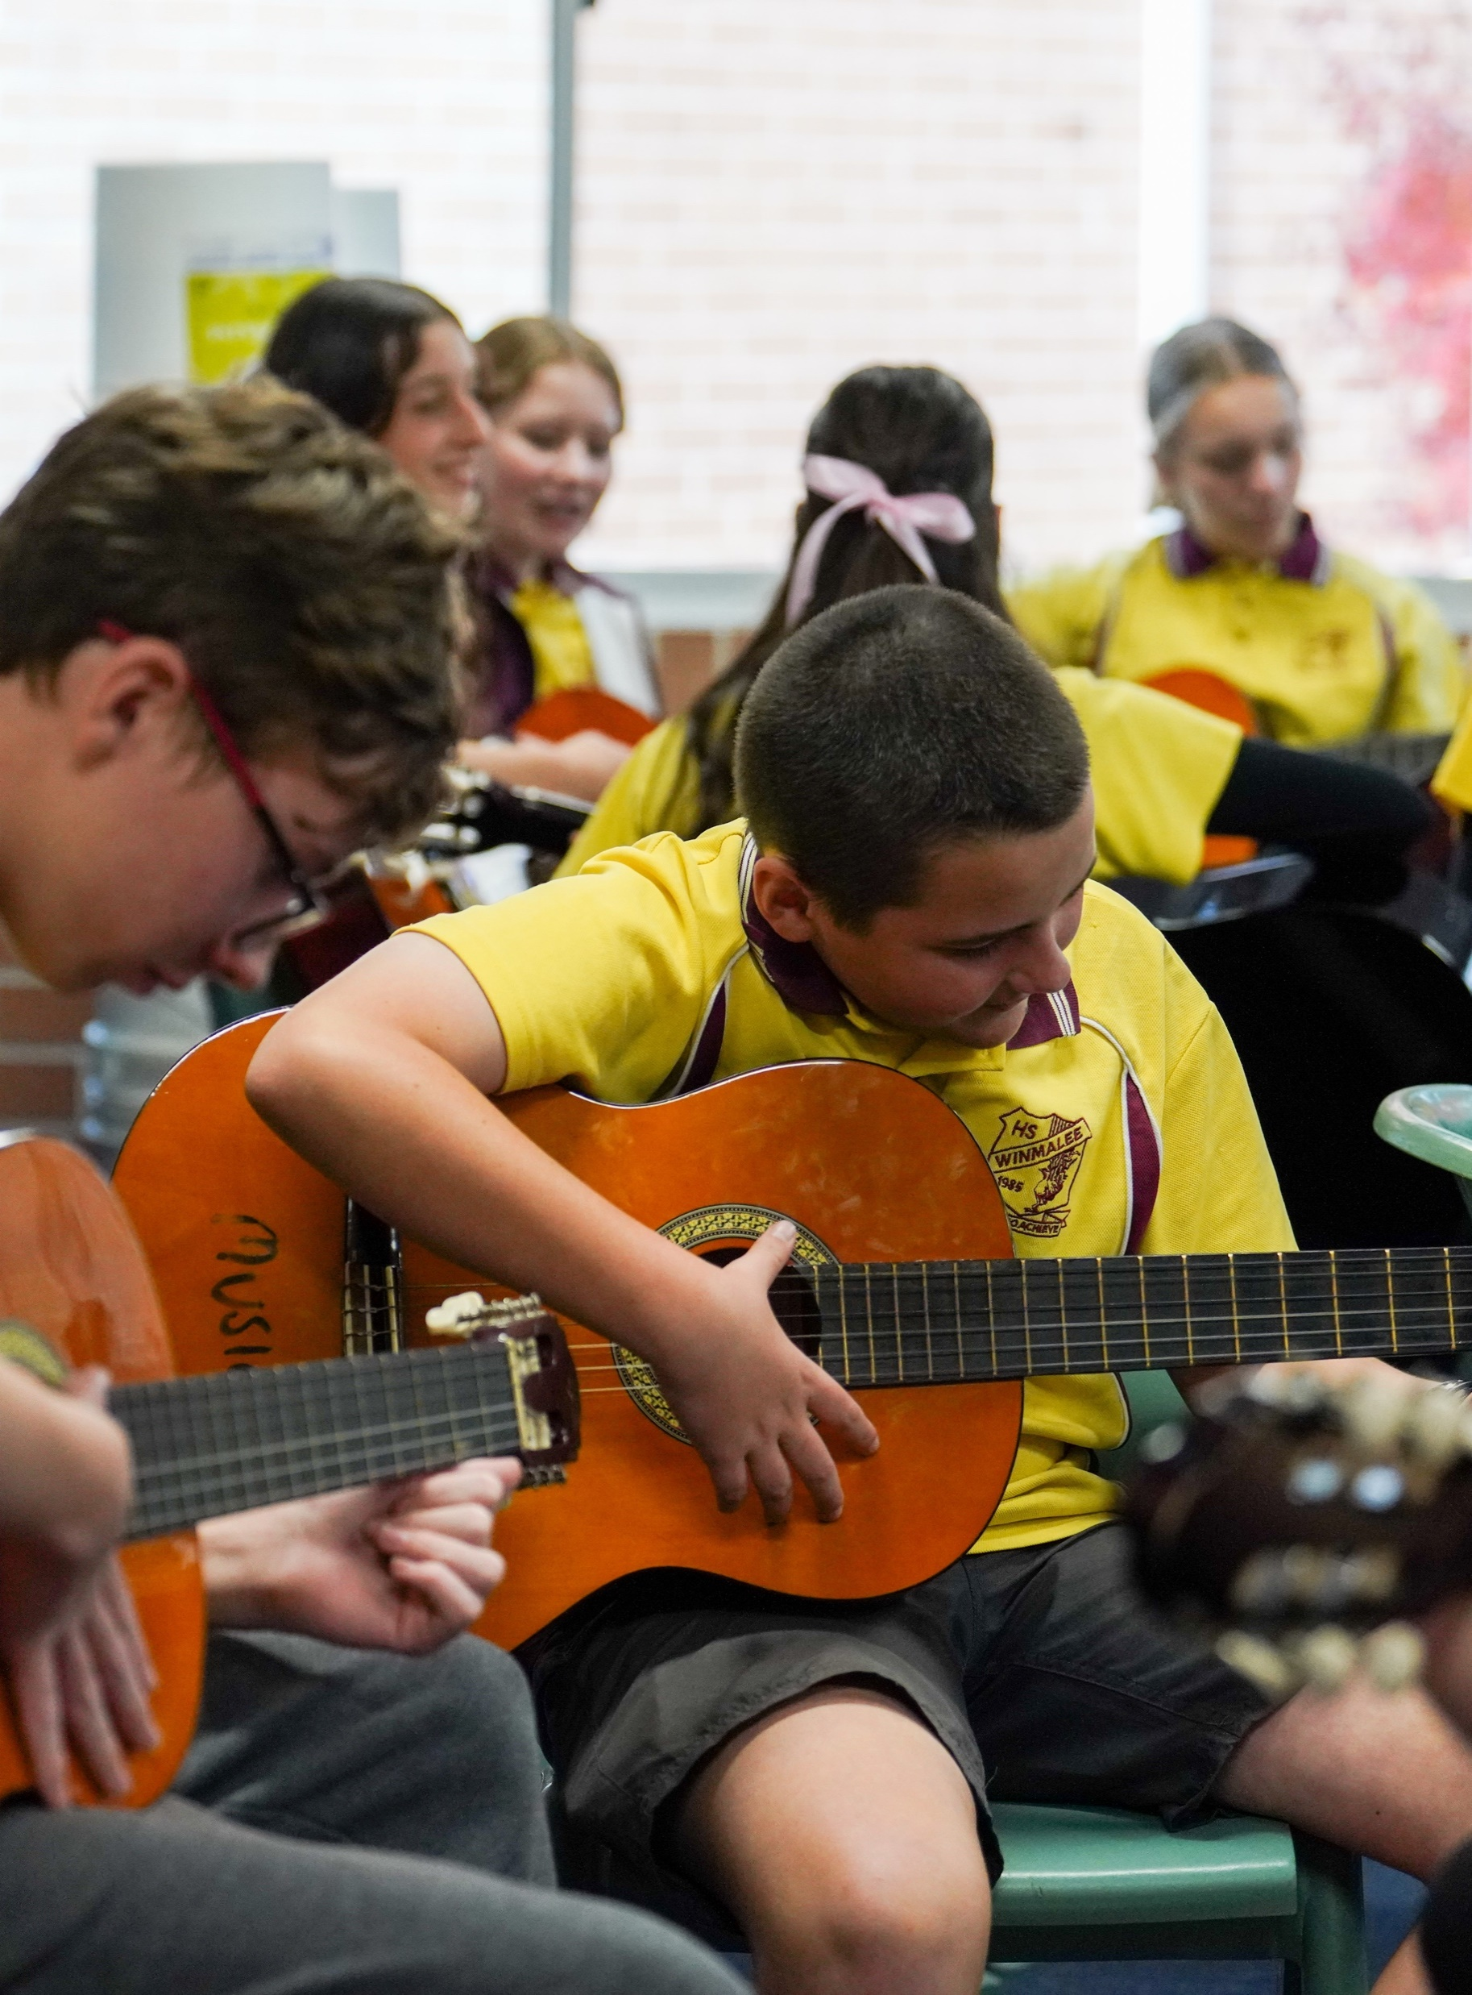
Music Stage 4
Tunes

Slide 3
Learning intentions and success criteria – LS 4
We are learning to:
read notes on the treble clef
identify tuned percussion instruments
identify Gamelan orchestra percussion instruments
use leger lines and the stem rule
how to play and perform on a mallet percussion instrument.
We can:
name the letter names of the notes on the 5 lines and 4 spaces of the treble clef
identify visually and recall aurally, tuned percussion instruments
name the instruments of the Gamelan orchestra, what they are made from and how their sound is produced
notate and name music notes above and below the 5 lines of the staff using the stem rule
use correct mallet technique when learning repertoire on mallet percussion instruments.

Slide 4

Musical terms – Pitch (1)
Pitch refers to the relative highness and lowness of sounds.
Key terms include – melody, harmony, higher and lower, definite and indefinite, contour, steps, leaps and repeated notes, tonality, chord progressions, scales, pitch devices, methods of notation.

Slide 5
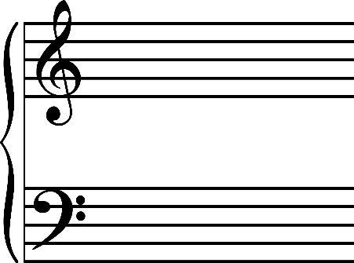
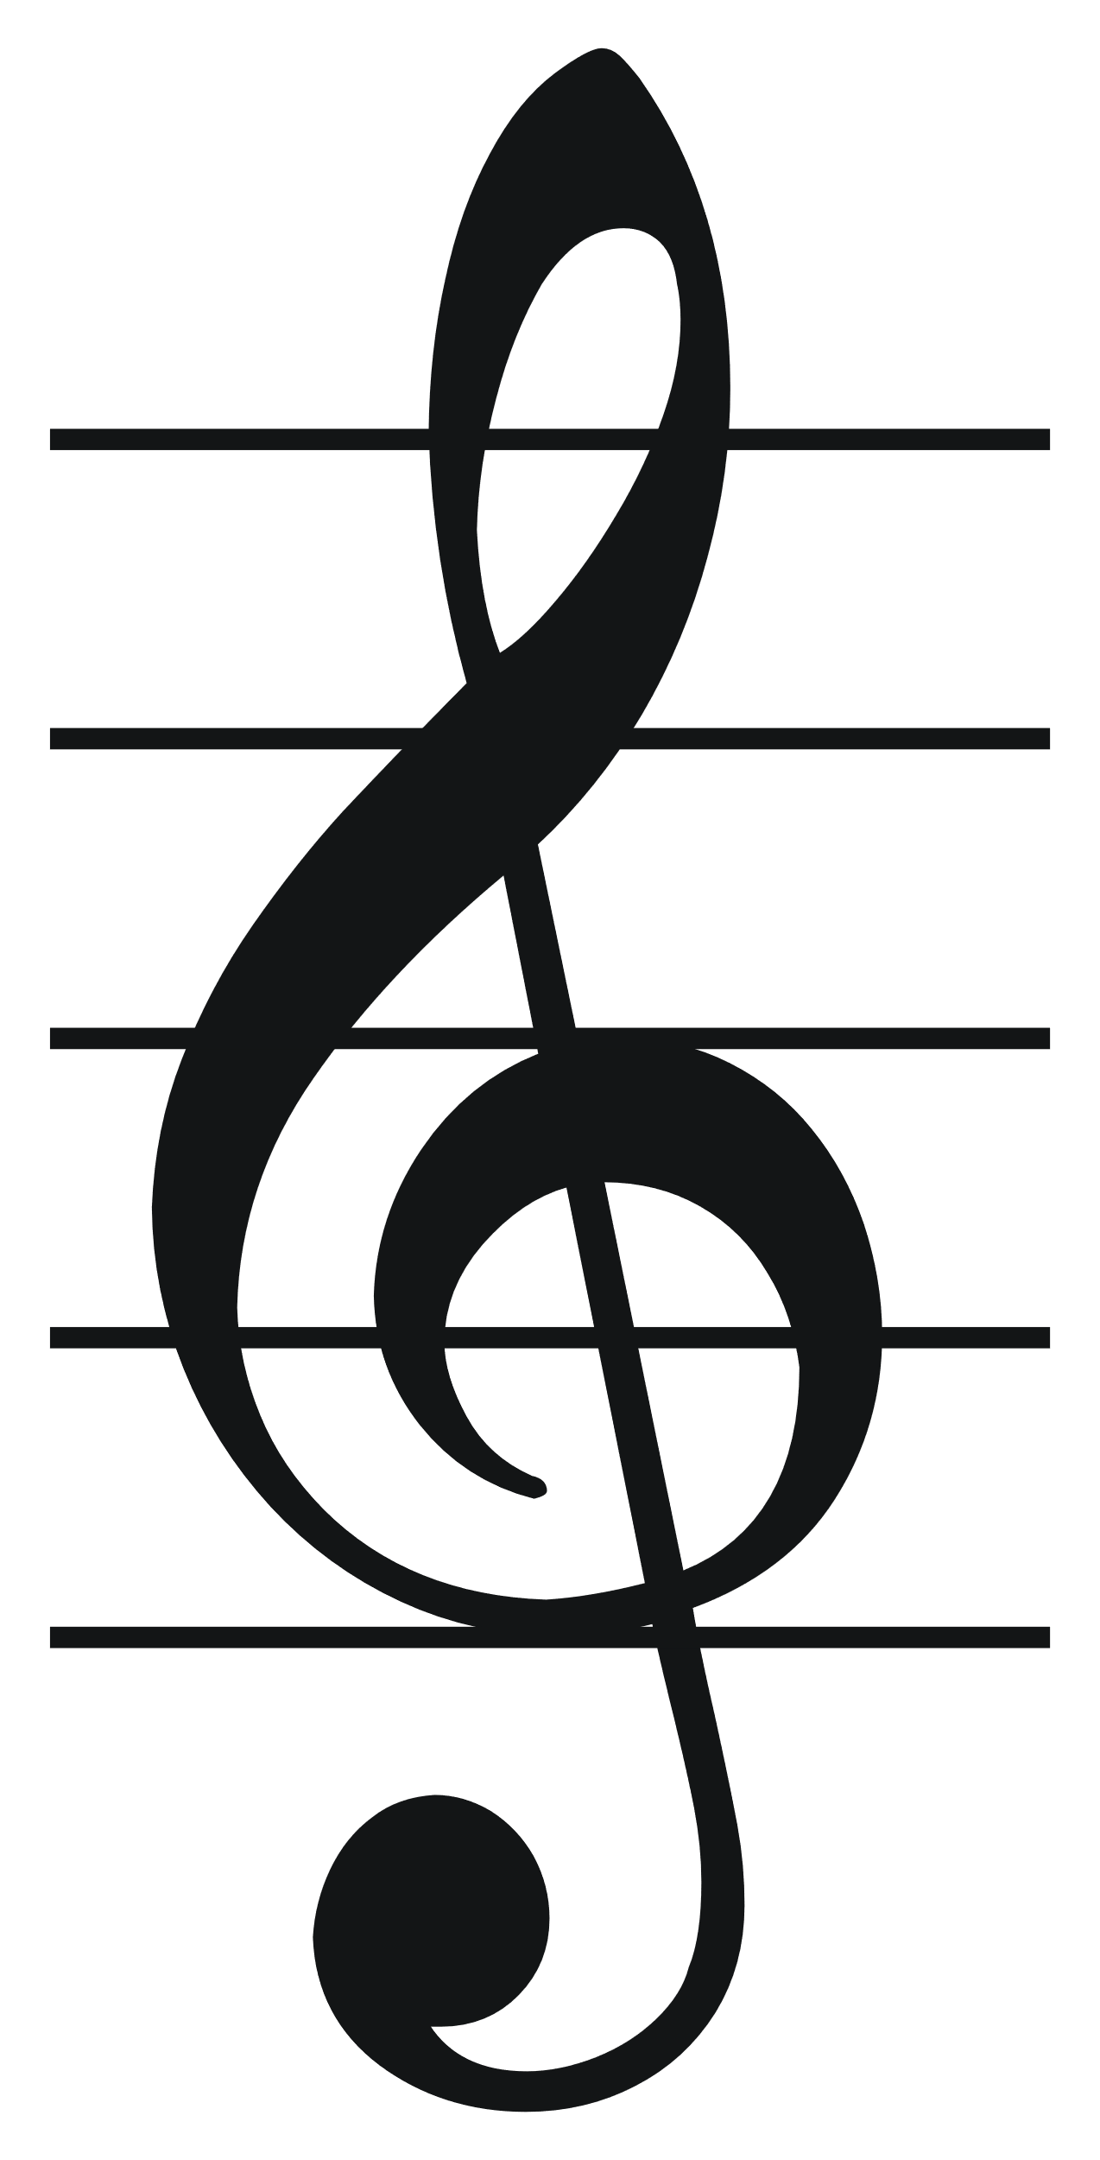
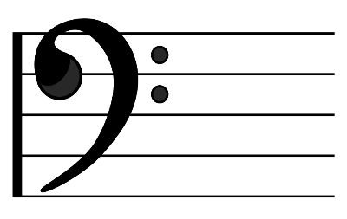
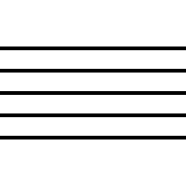
Musical terms (1)
Grand staff –treble and bass clef.
Treble clef – a symbol that shows the higher notes on the staff. Typically, above middle C.
Bass clef – a symbol that shows
the lower notes on the staff. Typically, below middle C.
Staff – five lines
of manuscript.

Slide 6
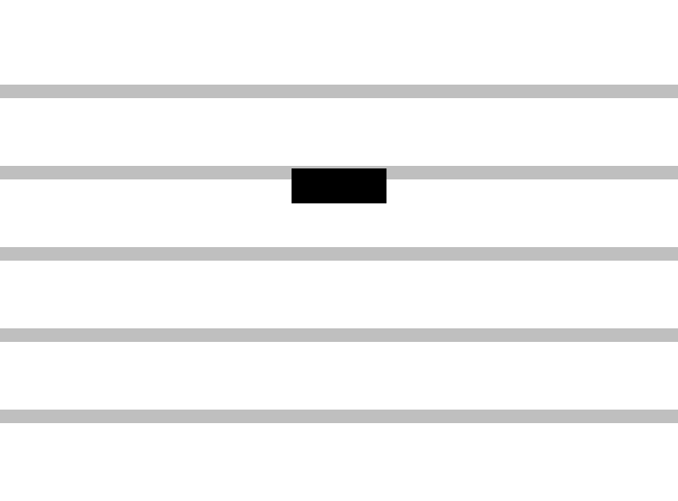


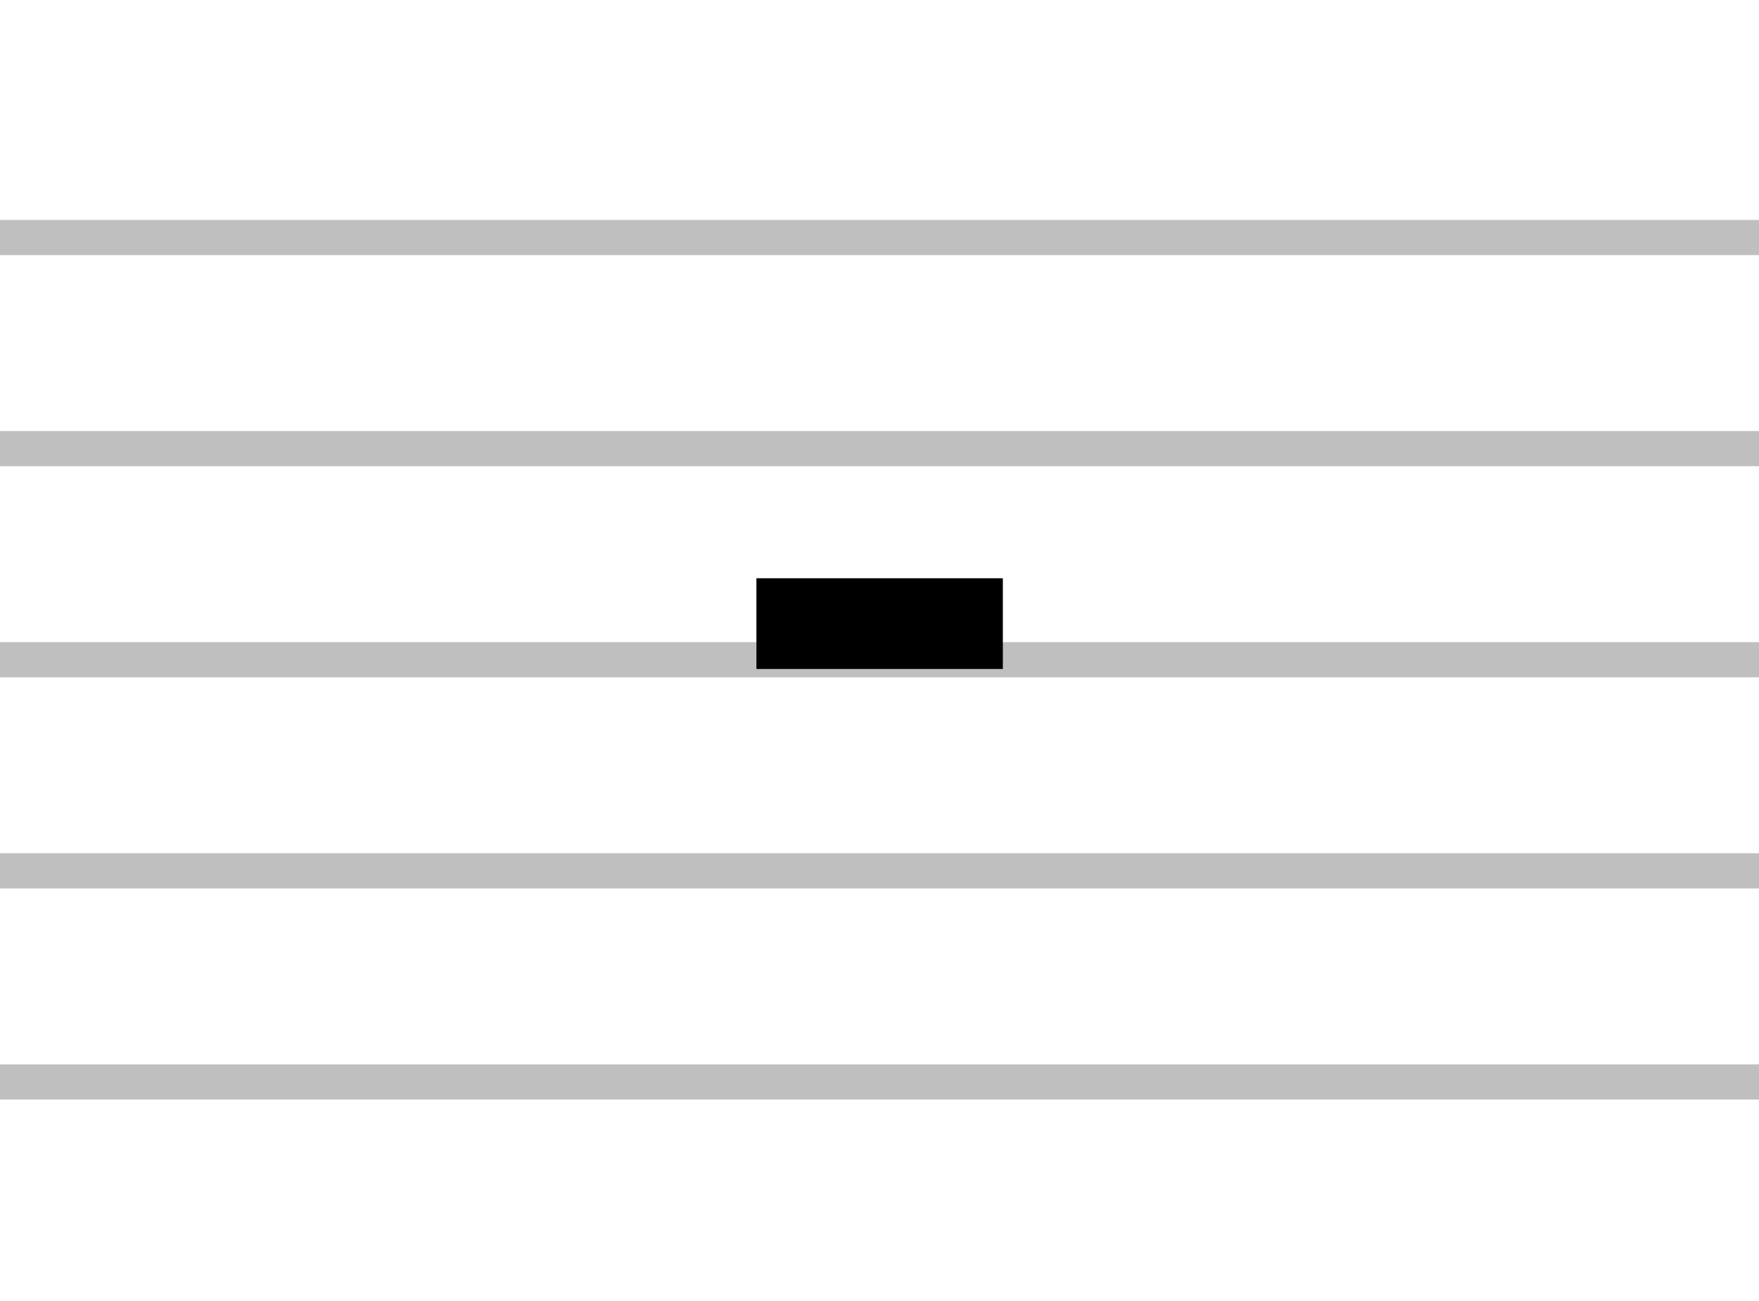











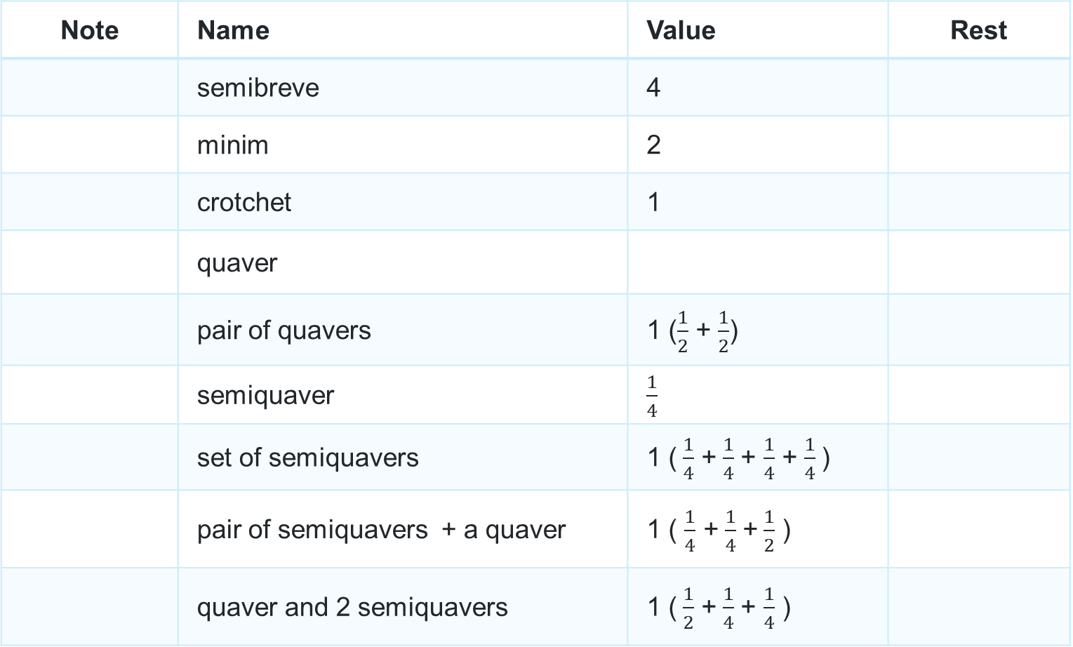
More note names and values
Note | Name | Value | Rest
 | semibreve | 4
 | minim | 2
 | crotchet | 1
 | quaver
 | pair of quavers | 1 ($\frac{1}{2}$ + $\frac{1}{2}$)
 | semiquaver | $\frac{1}{4}$
 | set of semiquavers | 1 ($\frac{1}{4}$ +$\frac{1}{4}$ + $\frac{1}{4}$ + $\frac{1}{4}$)
 | pair of semiquavers + a quaver | 1 ( $\frac{1}{4}$ +$\frac{1}{4}$ +$\frac{1}{2}$ )
 | quaver and 2 semiquavers | 1 ($\frac{1}{2}$ +$\frac{1}{4}$ + $\frac{1}{4}$ )

Slide 7
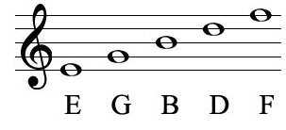
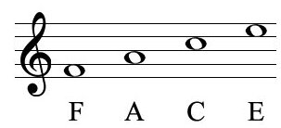
Treble clef (1)
Notes and rhymes
Lines
Every Good Boy Does Fine
Spaces
F A C E

Slide 8
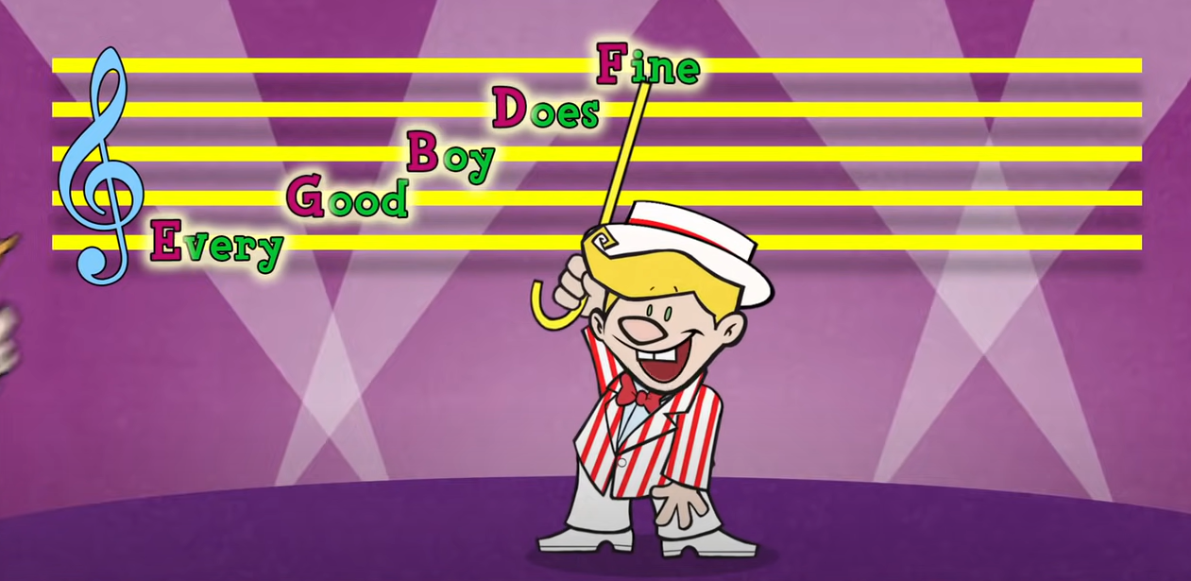
Treble clef (2)
Notes and rhymes
“Lines & Spaces” Episode #9 Preview – Quaver’s Marvellous World of Music (0:38)

Slide 9
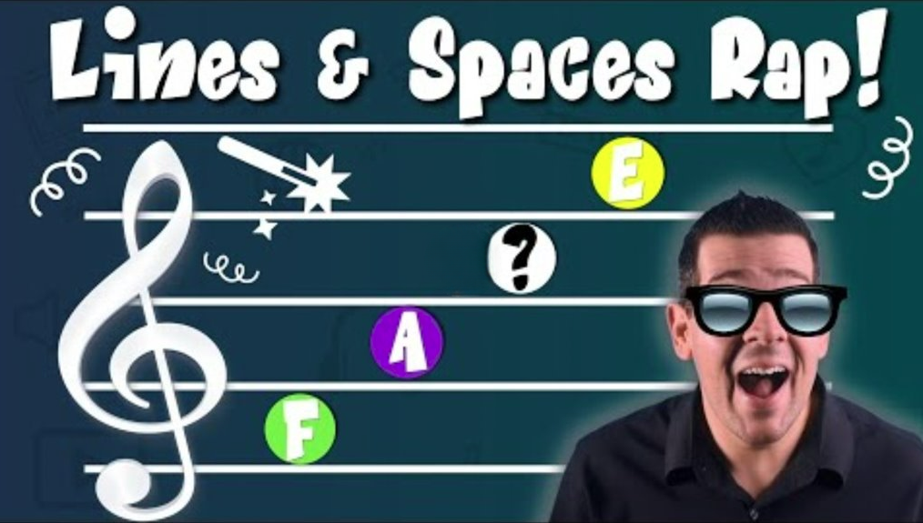
Reading treble staff revision
Reading the Music Staff: Lines & Spaces Game! (6:26)​

Slide 10
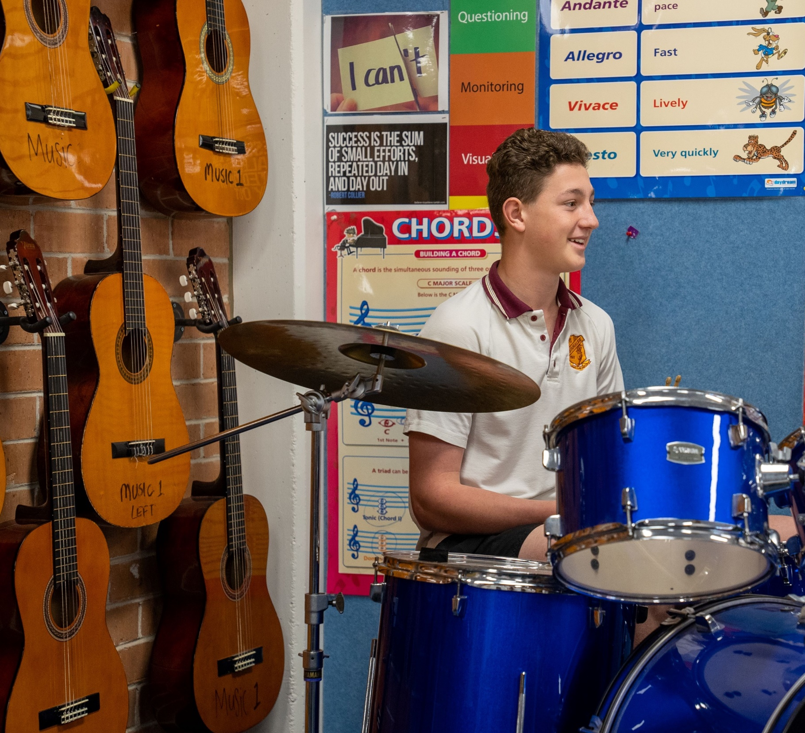




Rhythmic dictations
2-bar rhythm
4
4
4
4
10

Slide 11
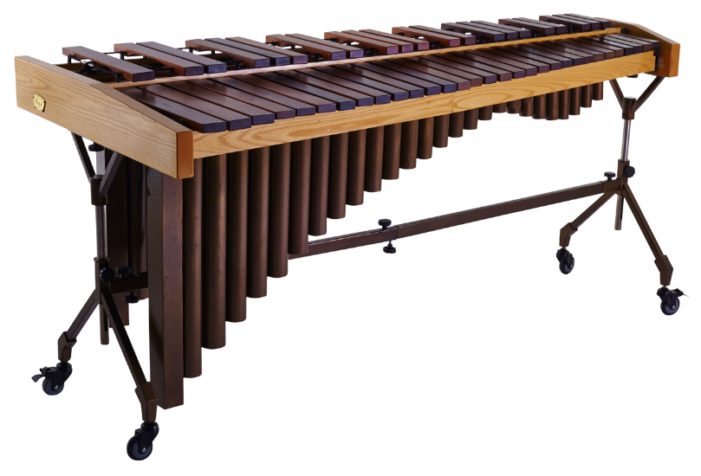
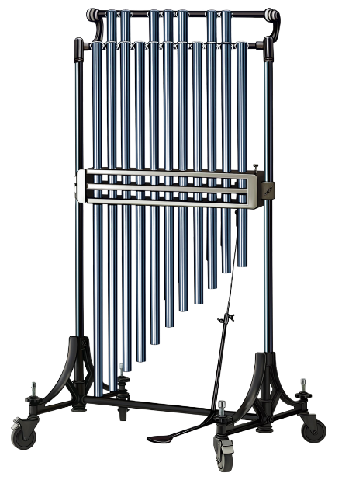
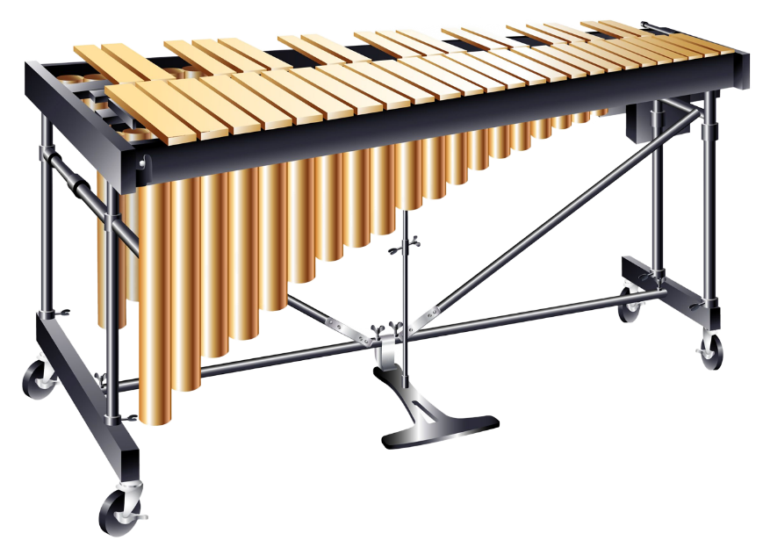
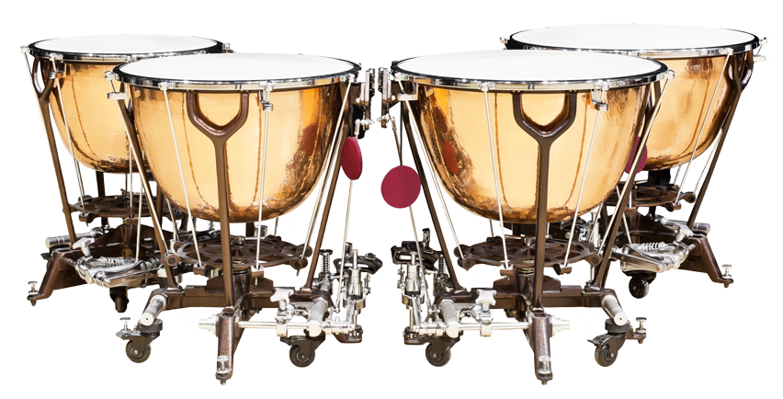
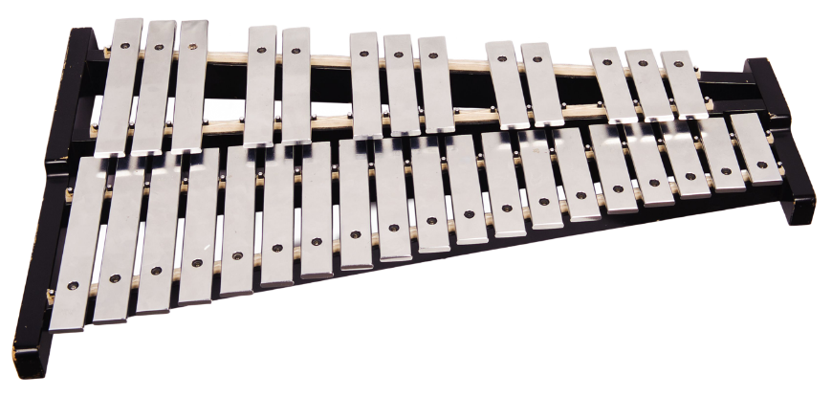
Tuned percussion instruments
Marimba
Tubular bells
Vibraphone
Glockenspiel
Timpani

Slide 12
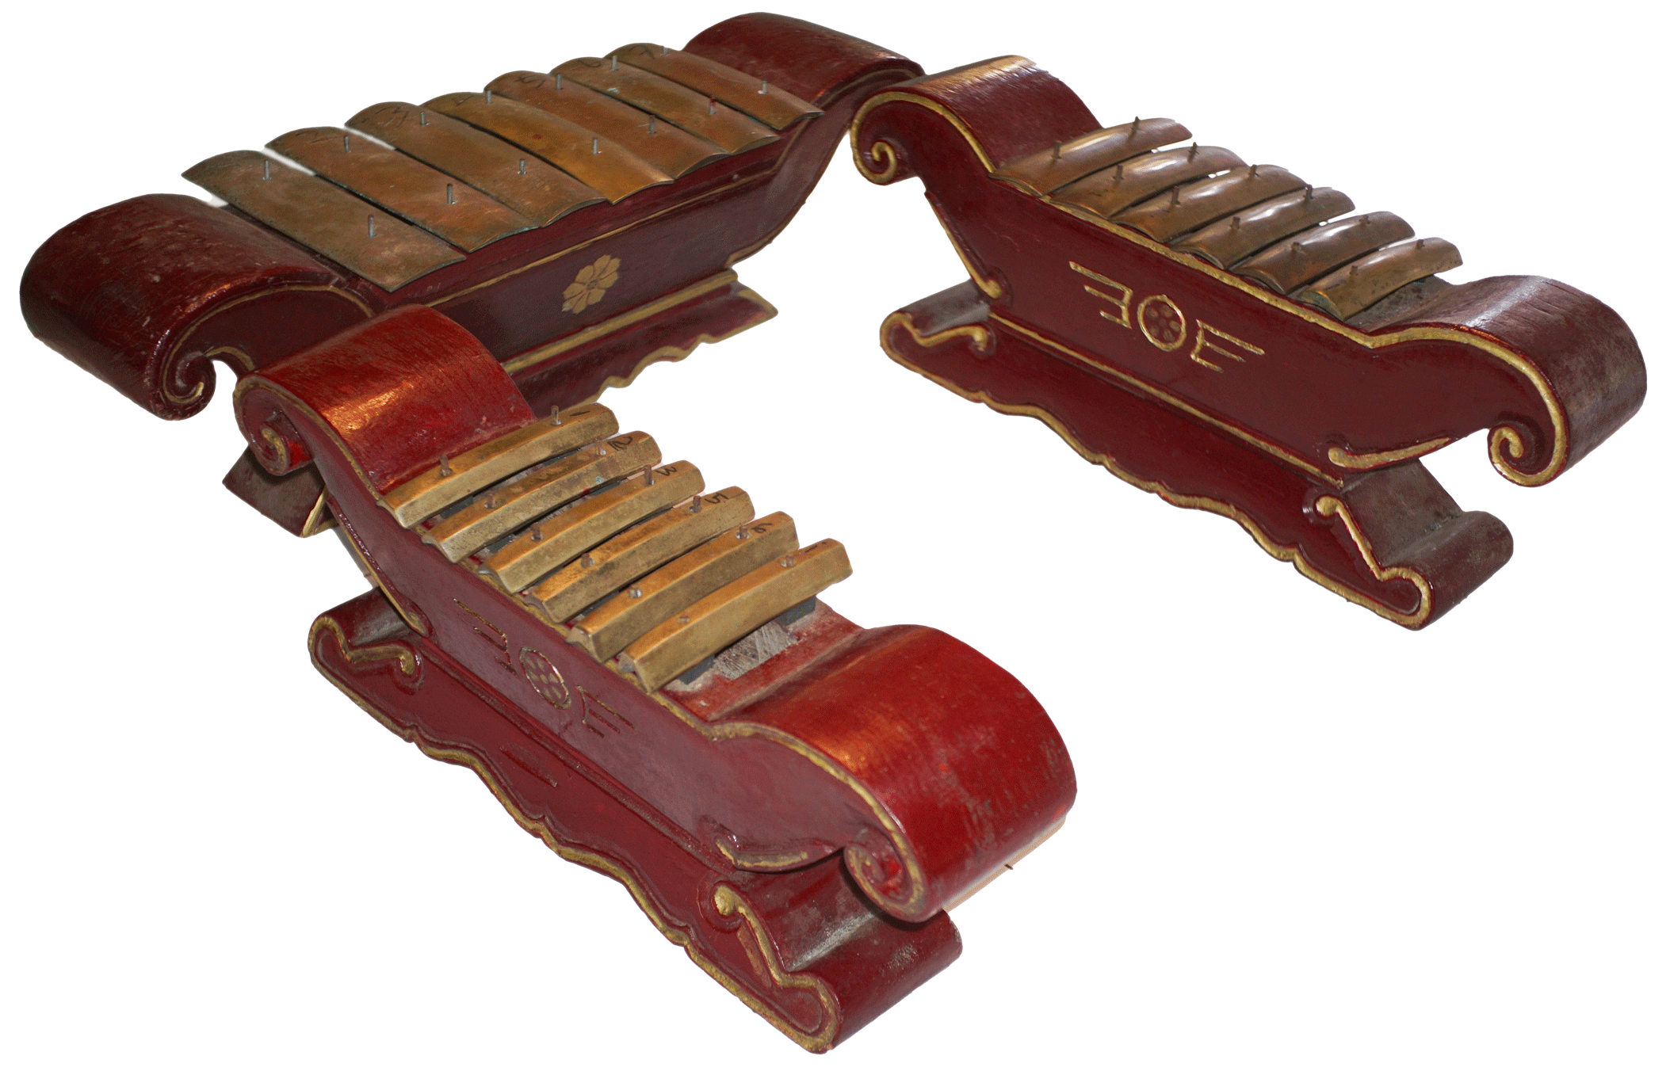
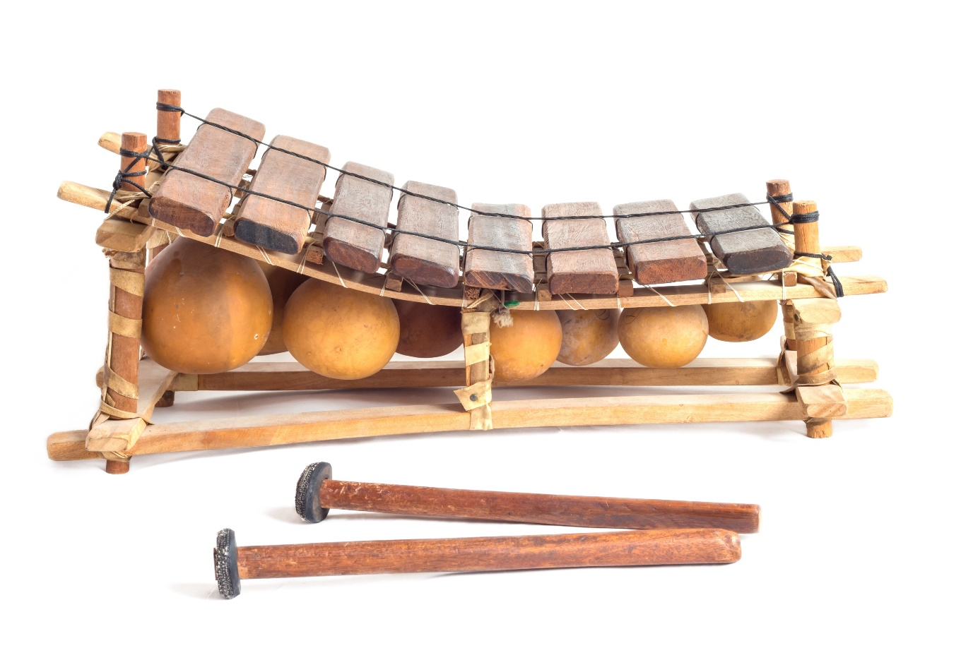
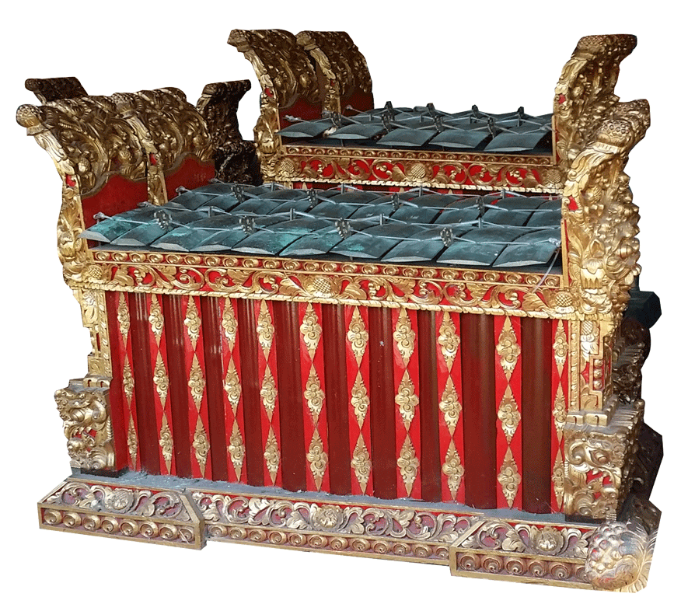
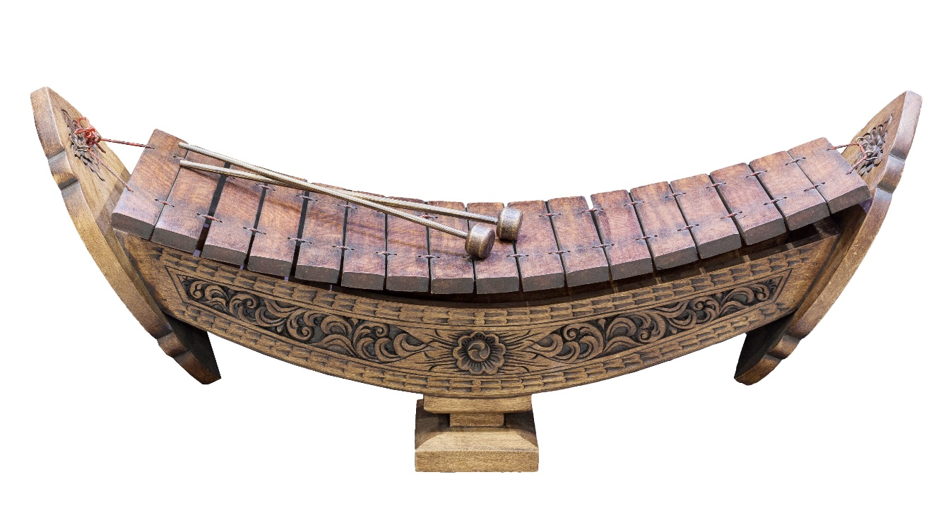
Global music tuned percussion instruments
Gangsa – Indonesian gamelan
Balafon – West Africa
Saron – Indonesian gamelan
Ranat ek – Thailand

Slide 13
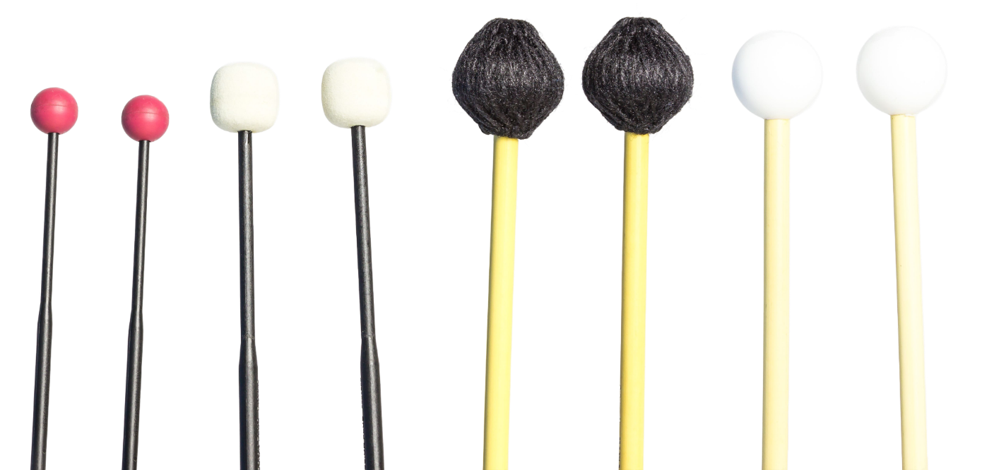
Mallet technique
Hold the mallets loosely in each hand. Two hands, 2 mallets
Make sure your elbows are not close to your body when playing
Always alternate the hand you use when playing the same pitch and sequential notes
Hit the note in the centre of the key
Remove the mallet from the key at the end of a note so the sound rings out
To stop a sound ringing, tap the note with your finger

Slide 14
Caring for the instruments
Always carry the instruments with 2 hands, and when carrying a bass instrument use 2 people.
Mallet percussion instruments are not to be played with anything other than mallets.
Strike the instrument from a short distance. You do not need to hit the instrument hard to produce a sound.

Slide 15
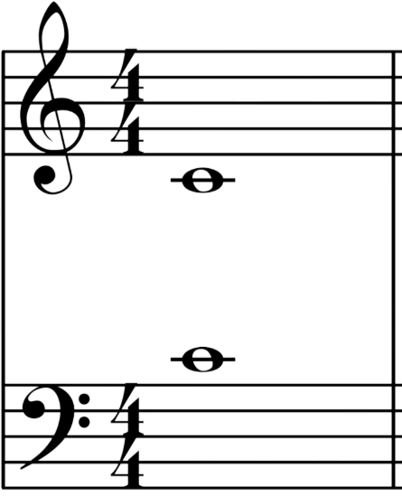
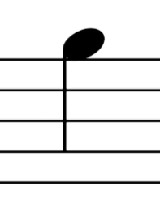
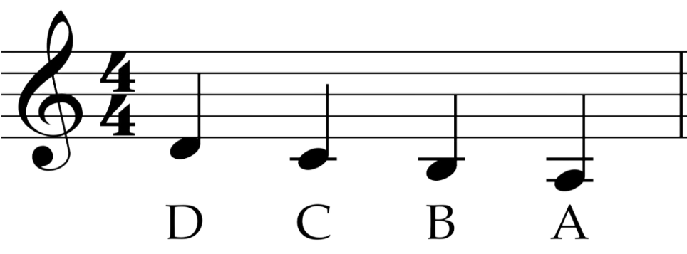
Musical terms and rules (2)
  Notes above and
  below the staff
Notes can be written above and below the staff. When above, go forward in the musical alphabet, when below, go backward in the musical alphabet.
For example, the top line in treble clef is F, one
note higher is G.
Leger lines
Leger lines are the small lines to indicate the lines and spaces above and below the staff. They continue the pattern of lines and spaces.
  Middle C
Middle C is the first leger line note below the treble clef and the first leger line note above the bass clef. It is in the middle of the piano keyboard.

Slide 16
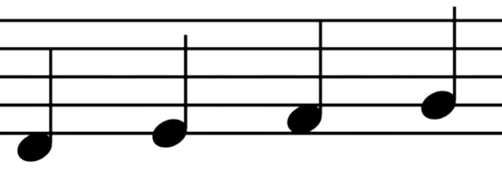
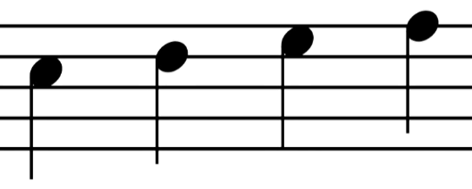
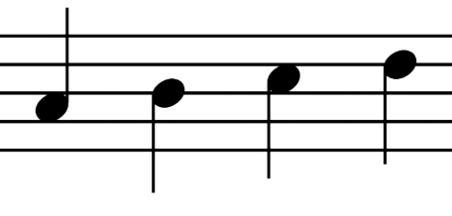
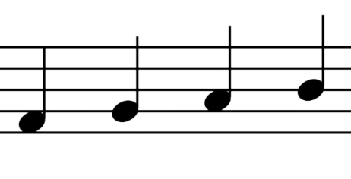
Stem rule
Stem rule
For notes below the middle line, the stems go up on the right (like a d).
For notes below the middle line, the stems go down on the left (like a p)
Notes on the middle line can go either direction, usually considering what the rest of the bar is doing.
Activity
Write the following notes in the treble clef as crotchets:
Stems up on the right.
E, F, A
Stems down on the left.
E, C, B
Using the stem rule, write all 5 notes on the lines.

Slide 17
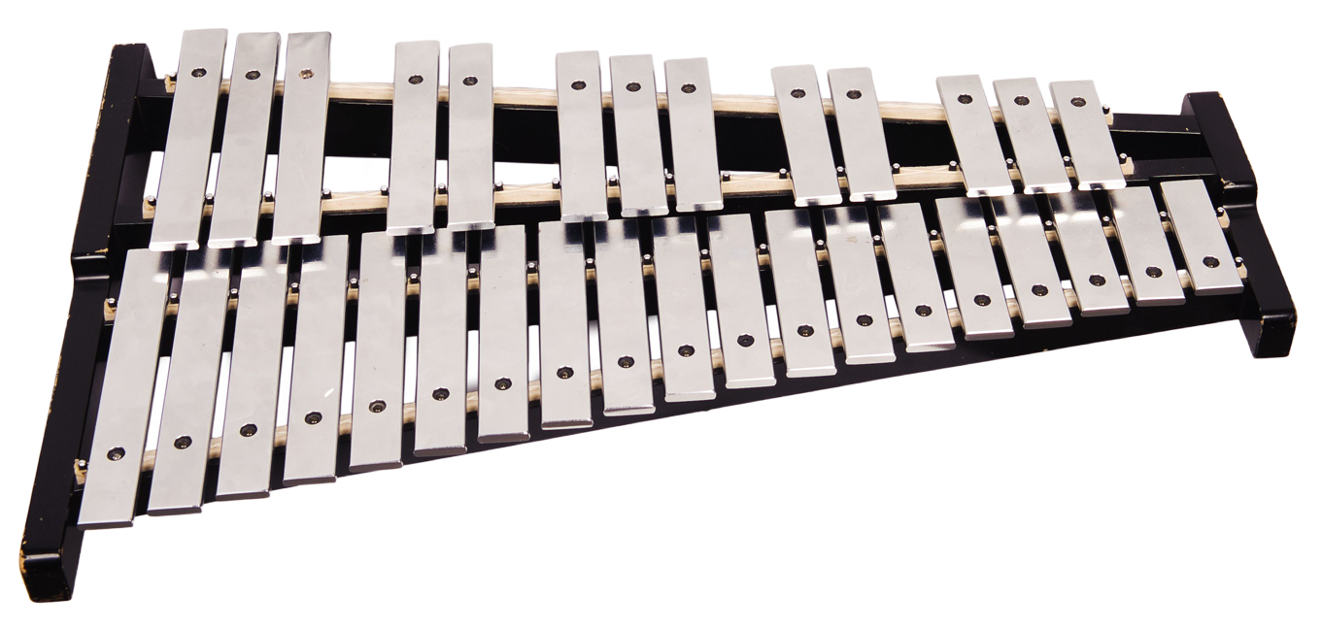
Glockenspiel
Tuned percussion you might find in the classroom
A high-pitched tuned percussion instrument with small metal keys.

Slide 18
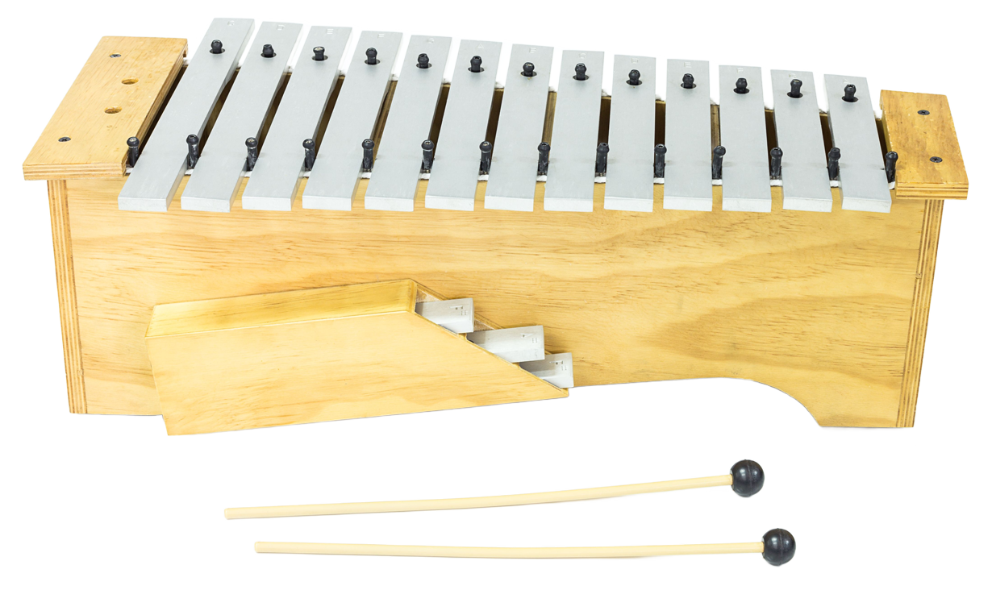
Metallophone
Tuned percussion you might find in the classroom
A tuned percussion instrument with larger and thicker metal keys.
A variety of pitches can be achieved depending on whether the instrument is a bass, tenor, alto or soprano metallophone.

Slide 19
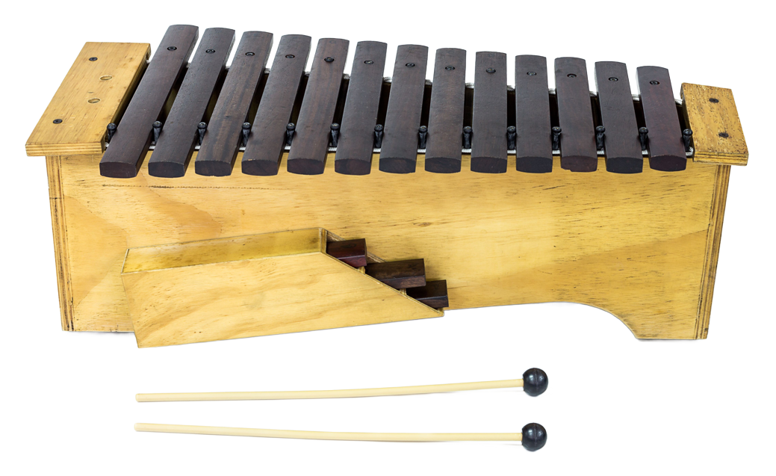
Xylophone
Tuned percussion you might find in the classroom
A tuned percussion instrument with wooden keys.
A variety of pitches can be achieved depending on whether the instrument is a bass, tenor, alto or soprano xylophone.

Slide 20
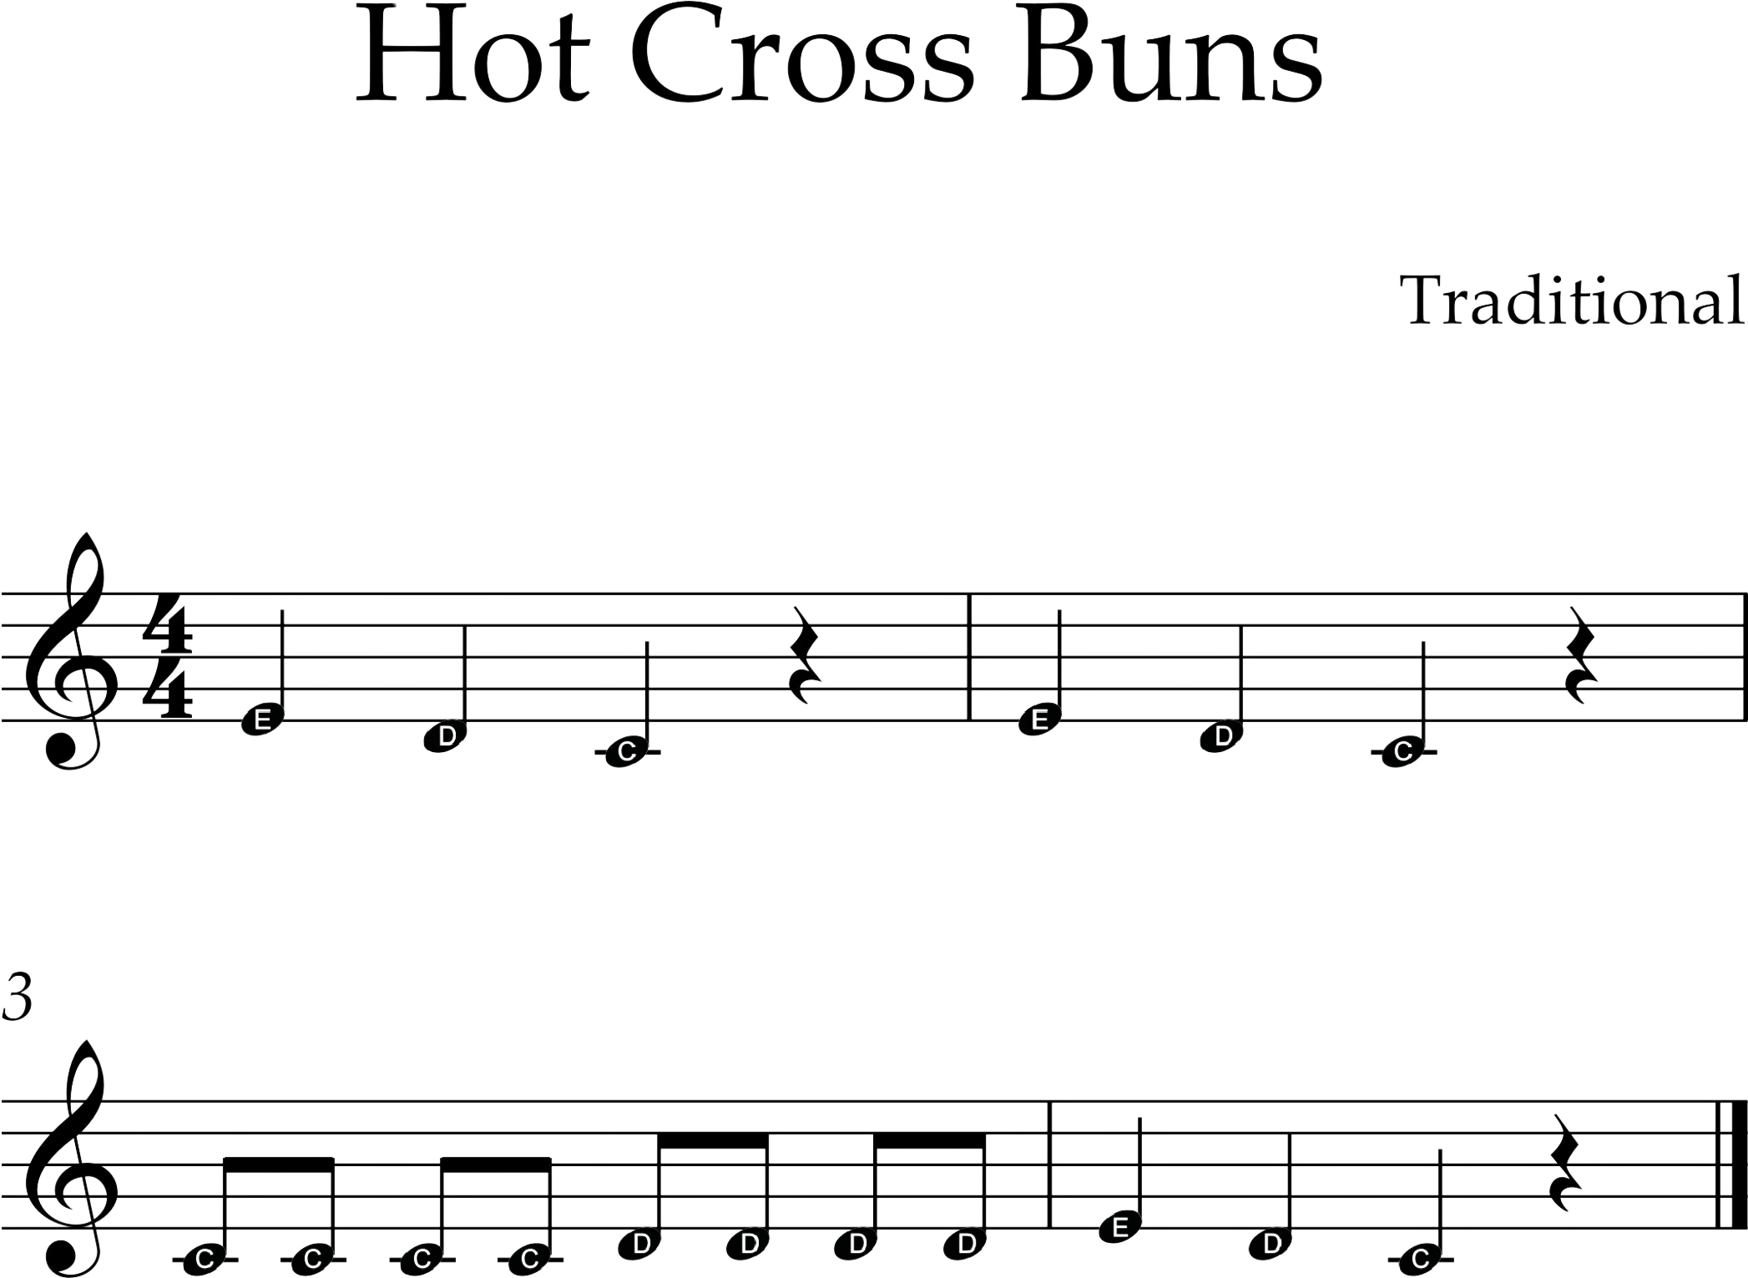
Hot Cross Buns
Traditional

Slide 21
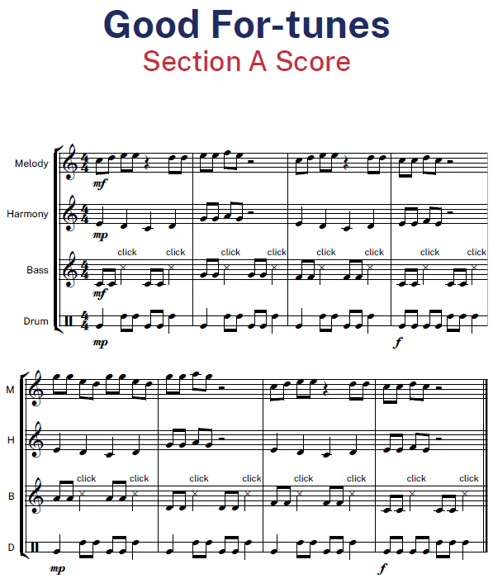
Section A Score

Slide 22
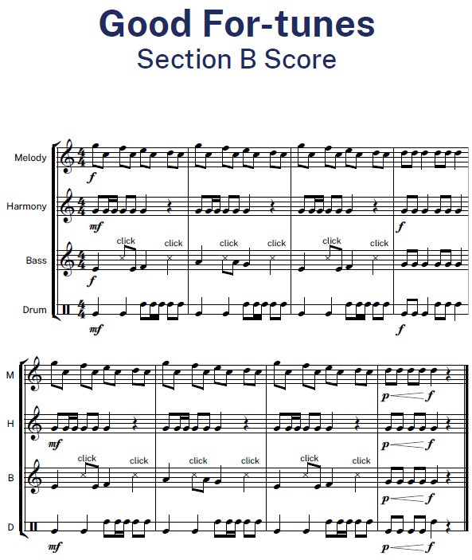
Section B Score

Slide 23
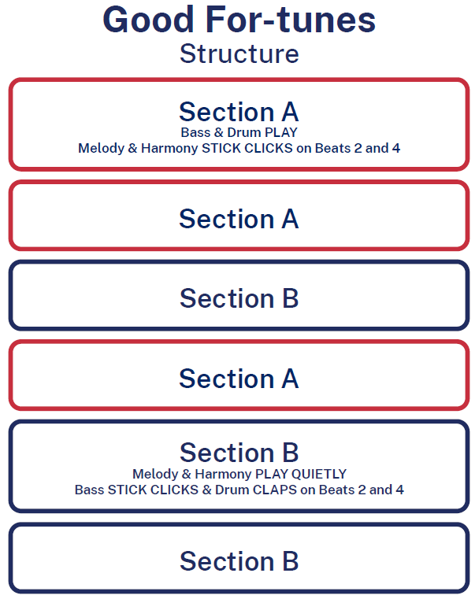
Structure

Slide 24
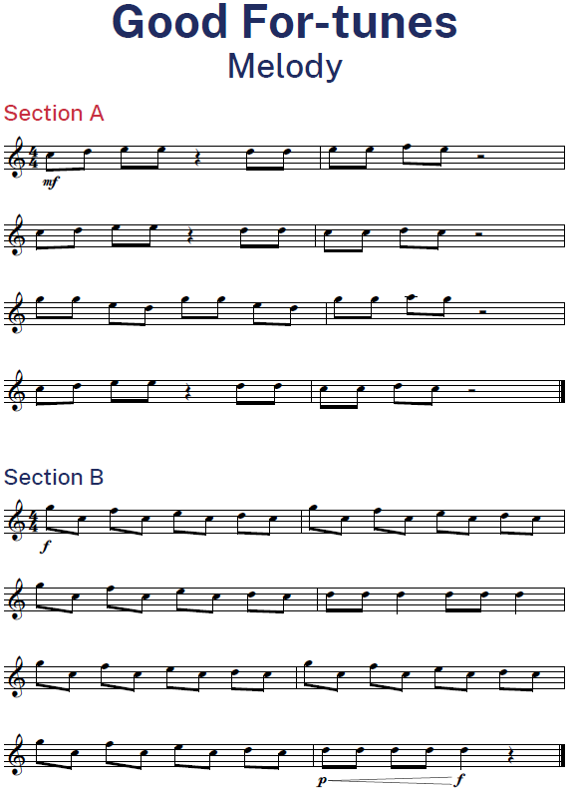
Melody

Slide 25
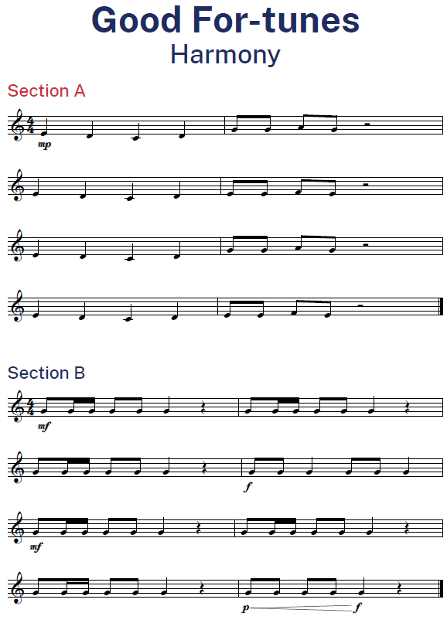
Harmony

Slide 26
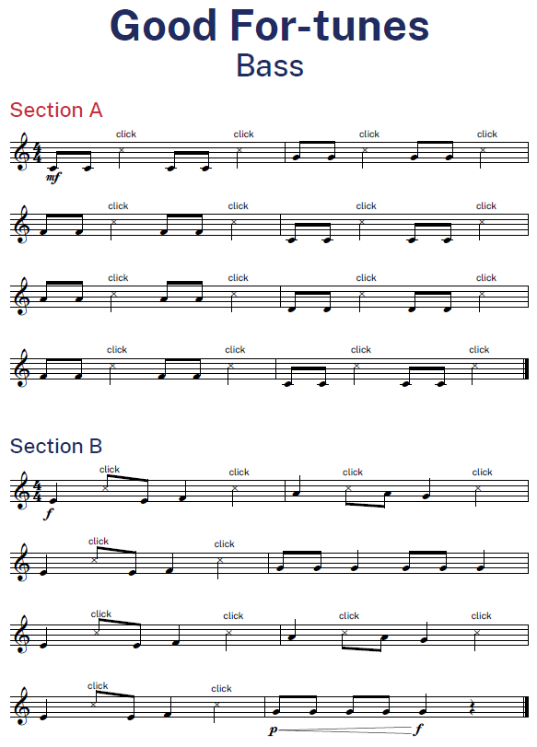
Bass

Slide 27
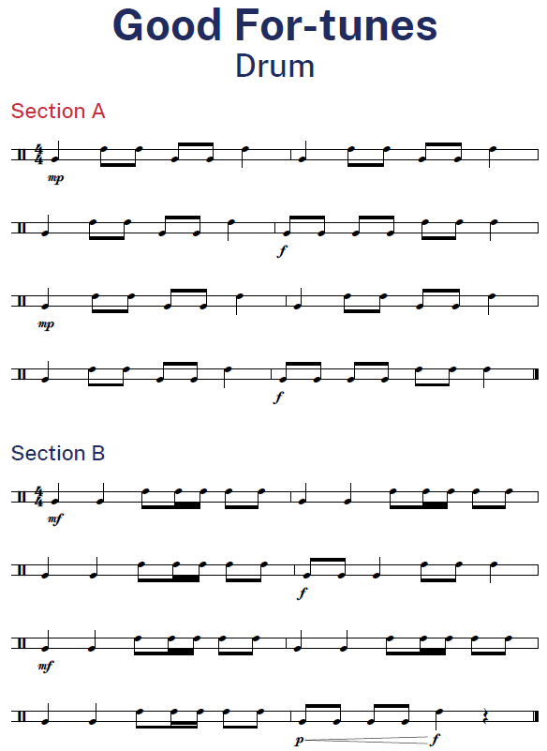
Drum

Slide 28
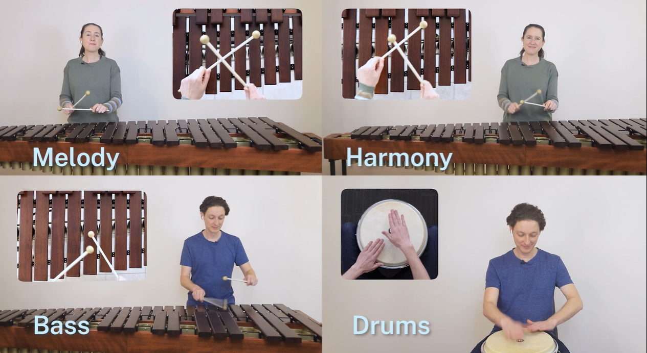
Performance recording
Good For-tunes

Slide 29
Musical terms – Pitch (2)
Refers to the relative highness and lowness of sounds.
Key terms include – melody, harmony, higher and lower, definite and indefinite, contour, steps, leaps and repeated notes, tonality, chord progressions, scales, pitch devices, methods of notation.

Slide 30
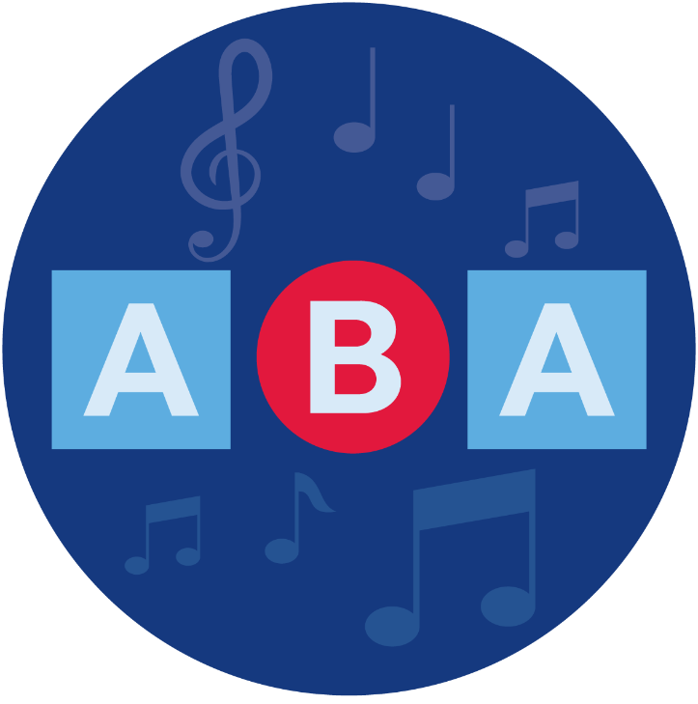
Musical terms – Structure
Structure refers to the design or form in music. It refers to how a composition is constructed in sections or parts.
Key terms include:
Macrostructures – verse/chorus form, binary, cyclic, strophic, multi–movement.
Microstructures – riff, phrase, motif, ostinato, sequence, head, colotomy.

Slide 31

Musical terms – Dynamics and expression
Dynamics – the volume of sound.
Expression – the musical detail that articulates a style or interpretation of a style.
Key terms include:
Dynamics and gradations – pianissimo, piano, mezzo piano, mezzo forte, forte, fortissimo, crescendo, diminuendo, niente, sforzando
Articulations – legato, accent, tenuto, marcato, portato
Expressive techniques – pizzicato, slap, palm muting, flutter–tonguing
Electronic manipulation techniques – distortion, delay, looping, compression, sustain
Expressive directions – rubato, dolce, smoothly, vocal ad lib, groove ad lib

Slide 32
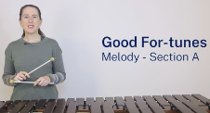
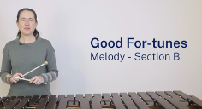
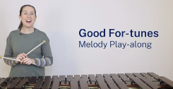
Learning the melody part
Good For-tunes
Section A
Section B
Play-along

Slide 33
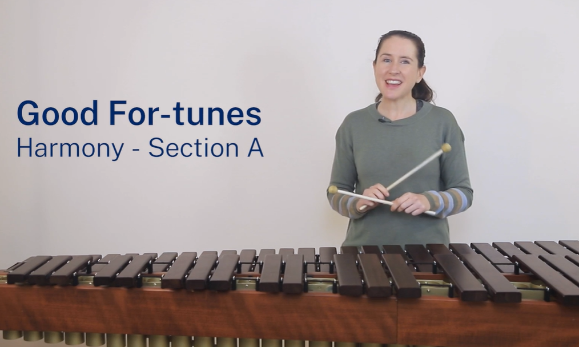
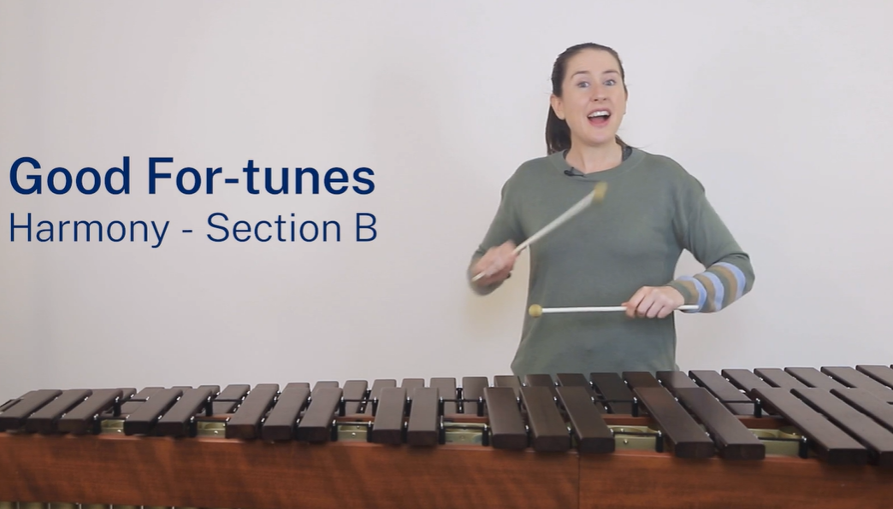
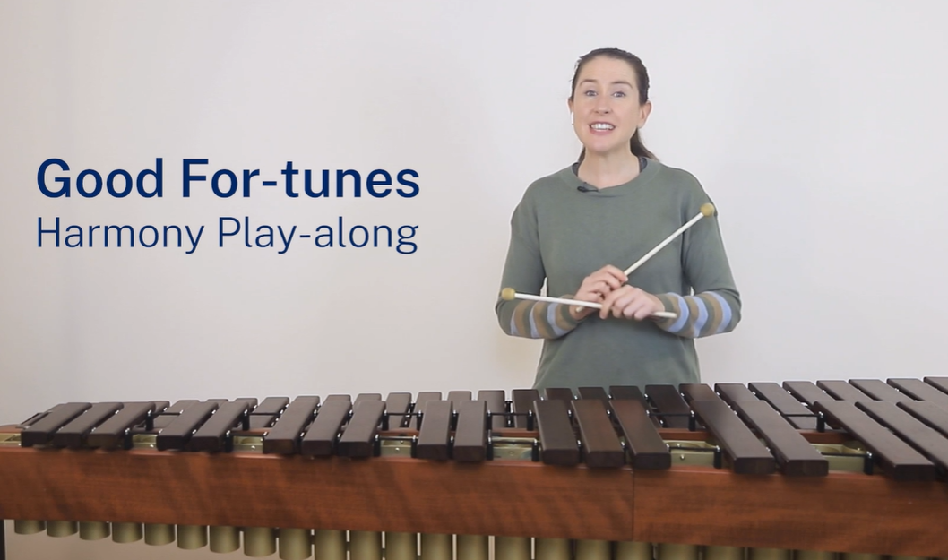
Learning the harmony part
Good For-tunes
Section A
Section B
Play-along

Slide 34
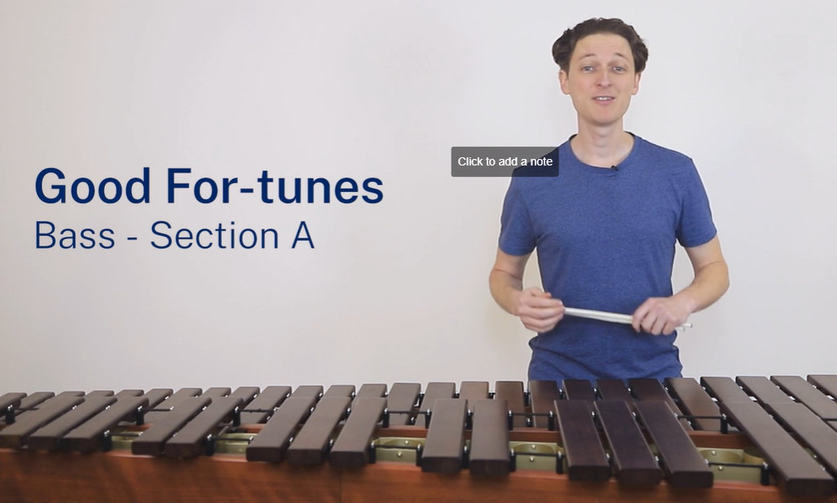


Learning the bass part
Good For-tunes
Section A
Section B
Play-along

Slide 35



Learning the drum part
Good For-tunes
Section A
Section B
Play-along

Slide 36
Learning intentions and success criteria – LS 5
We are learning to:
compose for a pitched instrument
listen, identify and notate a melody
make musical performance decisions and rehearse and perform in groups
peer and self-reflect.
We can:
write a notated melody for mallet percussion considering pitch, contour, metre and rhythm
notate the pitch and rhythm of melodic dictations
decide, plan and incorporate expressive and structural musical elements into performance to present group performances considering structure and musical expression
reflect on the musical decisions and success of composition writing and group performances.

Slide 37






Musical term – Contour
Contour – the shape of the melody.
Is the melody ascending or descending?
Is it moving by a step, skip or leap?
Is the melody using repeated notes?

Slide 38

Composition activity
On manuscript paper, and using a lead pencil, compose a piece for mallet percussion using the following guidelines:
Start with a treble clef and time signature
Length – 4 bars
Use the notes – C, D and E only
Begin and end on C to give the piece a 'home'
Use mainly crotchets, pairs of quavers and crotchet rests
Include 2 to 3 other rhythms like semiquavers and quaver or semiquaver options
Use mostly steps, with some skips and one or 2 leaps.
Finish with a double barline.

Slide 39
Composition reflection scaffold
Date
In today's lesson I wrote a _____ (number of bars) bar melody.
The time signature was ______ , and I used the pitch notes of ____ (name the letter names of notes).
The note values that I used were _____ (examples below)
The contour of my melody consisted mainly of (select one)
I used a step in bar ____ , a skip in bar ____ and a leap in bar ____ .
My composition started on the pitch note of _____ (letter name) , it was a _____ (name the value)
and it ended on a _____(letter) as a ______ (value).
I finished the composition with a (select one)
I am most proud of ___.
My peer feedback said that ____.
Crotchet – pair of quavers – set of semiquavers – crotchet rest
steps skips leaps
barline double barline

Slide 40



Melodic dictation (1)
The dictation will be played 6 times for you to notate the 2-bar example.
Notes used will be F, G and A.
Only crotchets will be used.
Listen out for steps, skips and repeated notes.
This dictation will begin and end on F.
40

Slide 41

Melodic dictation (2)
This final dictation will include pairs of quavers. Still only using the notes, F, G and A.
‘Man writing piano music onto a manuscript’ by Tymking is licensed under CC0.
41

Slide 42
Performance reflection scaffold
Date
Today my group performed the piece Good For-tunes.
I am proud of myself because …
I am most pleased with my group because …
Our performance was musical because …
If we were to do the performance again, I would …

Slide 43
Learning intentions and success criteria – LS 6
We are learning to:
notate melodies using notation software
compose a melody using a pentatonic scale
read and understand score indications and music terminology
perform from a score considering the composer's directions.
We can:
transcribe a handwritten score into a notation software program
compose and notate an 8-bar melody using the pentatonic scale using notation software
read the score indications of first and second time bar, tempo and dynamic markings
perform Vivaldi's Allegro changing the dynamics on repeats and at an Allegro tempo as indicated by the composer on the score.

Slide 44

Pentatonic scale
A 5-note scale
Pentatonic scales are evident in many cultural music traditions including Africa, India, China and Japan
Pentatonic scales have been used by famous composers such as Beethoven and Chopin and in Jazz music
The pentatonic scale you will use in class will include the notes C, D, E, G, A
‘Ruanxian player in Chinese Orchestra’ by ‘Yishin Junior College Photos’ is licensed under CC BY 2.0.
44

Slide 45



Musical terms (3)
Anacrusis
An anacrusis is where one or more ‘weak beat’ notes occur before the strong beat (First beat) in bar 1. It ‘robs’ the equivalent beat(s) from the last bar in the piece.
1st and 2nd time bar
A piece of music may require a different ending each time it is played. Example – on the first playing, use the 1st time bar, on the second playing, skip the 1st time bar and go straight to the 2nd time bar.
Speed
The Italian term or the musical term for the speed of the music is tempo. Sometimes on music the tempo marking is written in Italian. For example, allegro. The English translation is fast and lively.

Slide 46



Musical terms and rules
Dynamics
Tremolo
A rapid repetition of a single note or an alternation between 2 notes in fast succession. The number of horizontal lines indicates the speed of the tremolo.
Symbol | Italian | English
p | piano | soft
mp | mezzo piano | moderately soft
f | forte | loud
mf | mezzo forte | moderately loud
 | crescendo | gradually get louder

Slide 47

Spring from Violin Concerto – Four Seasons

Slide 48

Spring from Violin Concerto – Four Seasons – Melody

Slide 49

Spring from Violin Concerto – Four Seasons – Harmony

Slide 50

Spring from Violin Concerto – Four Seasons – Bass

Slide 51
References
This presentation contains NSW Curriculum and syllabus content. The NSW Curriculum is developed by the NSW Education Standards Authority. This content is prepared by NESA for and on behalf of the Crown in the right of the State of New South Wales. The material is protected by Crown copyright.
Please refer to the NESA Copyright Disclaimer for more information https://educationstandards.nsw.edu.au/wps/portal/nesa/mini-footer/copyright.
NESA holds the only official and up-to-date versions of the NSW Curriculum and syllabus documents. Please visit the NSW Education Standards Authority (NESA) website https://educationstandards.nsw.edu.au/wps/portal/nesa/home and the NSW Curriculum website https://curriculum.nsw.edu.au.
Music 7–10 © Syllabus NSW Education Standards Authority (NESA) for and on behalf of the Crown in right of the State of New South Wales, 2024.
BarronimoMusic (10 April 2012) 'Every Good Boy Deserves Football' [video], BarronimoMusic, YouTube, accessed 9 August 2024.
Mr. Henry's Music World (2 August 2022) 'Reading the Music Staff: Lines & Spaces Game!' [video], Mr. Henry’s Music World, YouTube, accessed 9 August 2024.
QuaverEd (18 October 2012) '"Lines & Spaces" Episode #9 Preview - Quaver's Marvelous World of Music' [video], QuaverEd, YouTube, accessed 2 September 2024.
'Good For-tunes' was commissioned by the NSW Department of Education. All rights reserved for the use of NSW Department of Education teachers and students only. Individuals and organisations outside the department must seek the composer’s permission to use the score and teaching videos in this resource. Please contact kaboom@kaboompercussion.com.

Slide 52
Copyright
© State of New South Wales (Department of Education), 2024
The copyright material published in this resource is subject to the Copyright Act 1968 (Cth) and is owned by the NSW Department of Education or, where indicated, by a party other than the NSW Department of Education (third-party material).
Copyright material available in this resource and owned by the NSW Department of Education is licensed under a Creative Commons Attribution 4.0 International (CC BY 4.0) license.
This license allows you to share and adapt the material for any purpose, even commercially.
Attribution should be given to © State of New South Wales (Department of Education), 2024.
Material in this resource not available under a Creative Commons license:
the NSW Department of Education logo, other logos and trademark-protected material
Material owned by a third party that has been reproduced with permission. You will need to obtain permission from the third party to reuse its material.
Links to third-party material and websites
Please note that the provided (reading/viewing material/list/links/texts) are a suggestion only and implies no endorsement, by the New South Wales Department of Education, of any author, publisher, or book title. School principals and teachers are best placed to assess the suitability of resources that would complement the curriculum and reflect the needs and interests of their students.
If you use the links provided in this document to access a third party’s website, you acknowledge that the terms of use, including licence terms set out on the third-party’s website apply to the use which may be made of the materials on that third-party website or where permitted by the Copyright Act 1968 (Cth). The department accepts no responsibility for content on third-party websites.

