Slide 1
Instructions for use
This resource is not a teaching and learning program. It should be used in conjunction with Music Stage 4 (Year 7) 'Beats and tunes' unit on the Planning, programming and assessing music 7–10 (2024) webpage.
Classroom teachers are encouraged to add and adapt slides as required to meet the needs of their students.
Save a copy of the file to make changes to the slide deck. Go to File > Download a Copy (this downloads a copy to the computer to edit in the PowerPoint app).
To convert the PowerPoint to Google Slides:
  Upload the file into Google Drive and open it.
  Go to File > Save as Google Slides.
  (Note: conversion may cause formatting changes in the slides.)

Slide 2
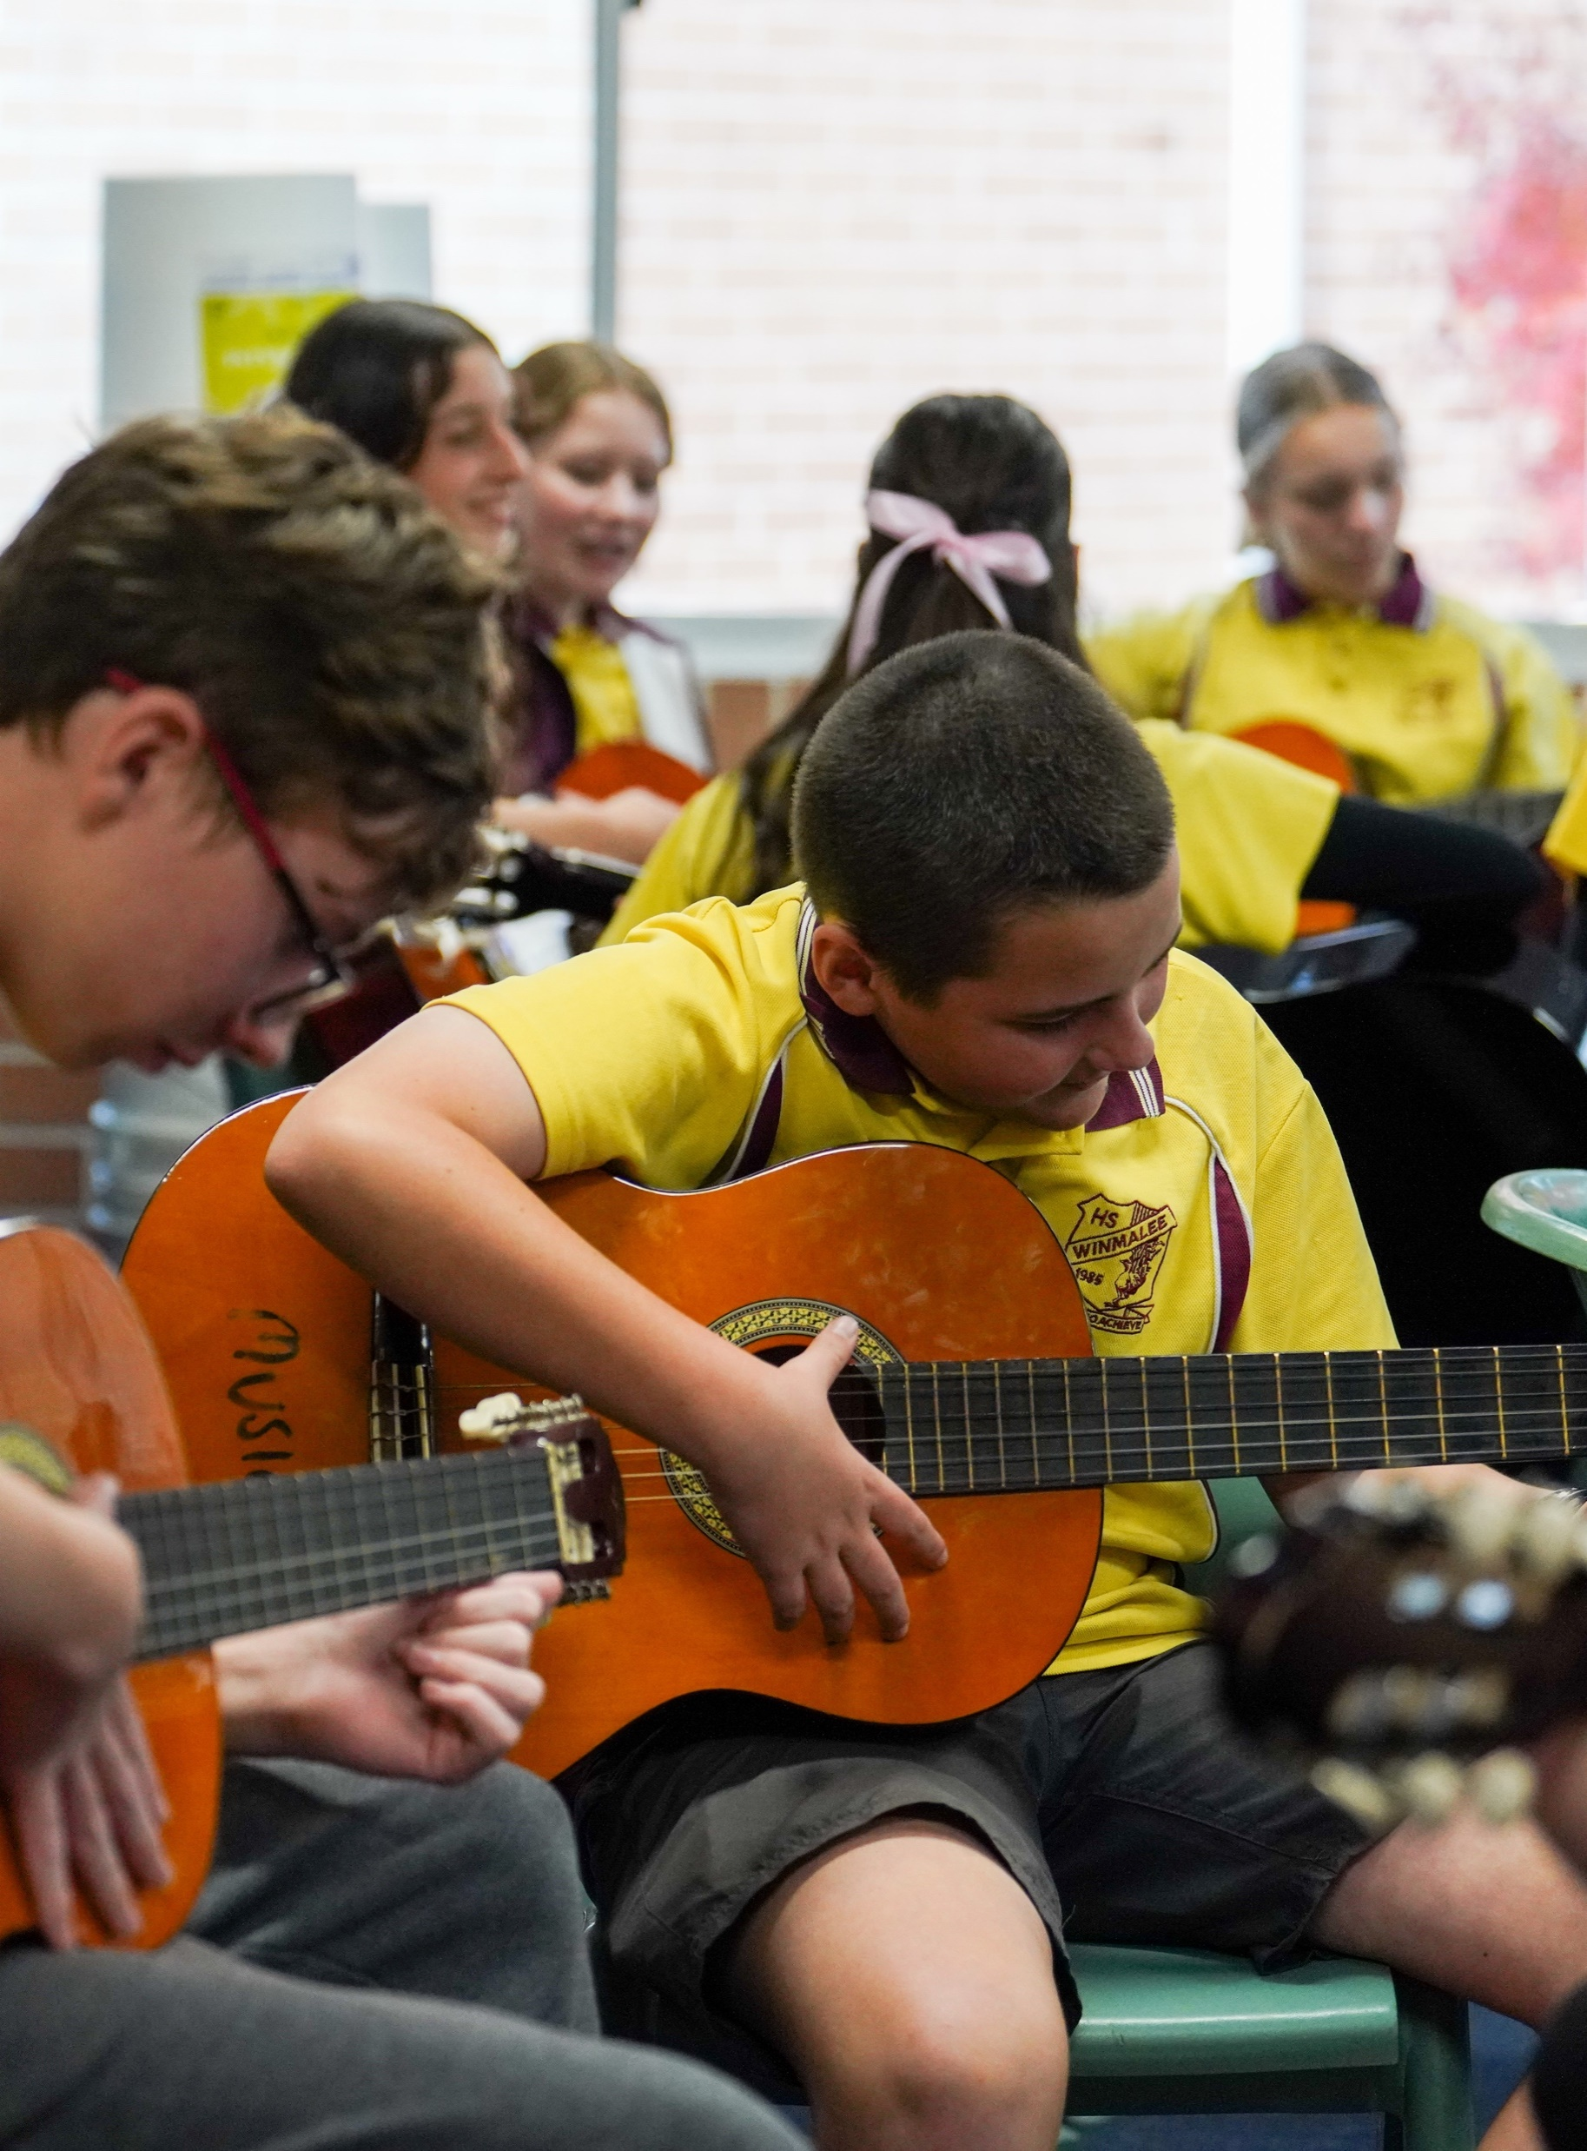
Music Stage 4
Beats

Slide 3
Learning intentions and success criteria – LS 1
We are learning to:
create a safe and respectful classroom
sing as a whole class and in canon
define and perform beats and rhythms and know the difference.
We can:
work safely and respectfully with others
sing a warm-up song together as a class and divide into groups to sing in canon
perform a constant beat and changing rhythm vocally and with body percussion.
Notes:
Notes for teachers:
Learning intentions and success are best co-constructed with students. Adapt the learning intention as required and add matching success criteria.
For more information see ⁠AITSL or the NSW Department of Education explicit teaching strategies, ⁠Sharing learning intentions and ⁠Sharing success criteria.
LISC is not necessarily presented at the beginning of the lesson. Teacher needs to consider most effectual time to introduce.
LISC should be revisited during the lesson to support students' evaluation of their learning.

Slide 4
Safety in the music classroom (1)
Show respect for your classmates, your teacher and the music classroom equipment.
Return instruments and equipment (including leads, adaptors, pedals) to the right place.
Take care when using instruments to avoid accidents and damage. Report any damage immediately to your teacher.
Consider safe volume levels when rehearsing and think about others around you.
Always do a warm-up and/or technical work before rehearsing a performance piece.
Position your music and/or ensemble members to ensure correct posture both in rehearsal and performance.

Slide 5
Safety in the music classroom (2)
Cover any trip hazards, including cords.
Explore different ways to play. For example, adjust volume or pitch controls or select different
modes or effects instead of playing forcefully.
Be considerate of class members with sound sensitivity.
Practice safety when packing away. For example, turn off the instrument before unplugging and switch off power points before pulling out plugs.

Slide 6
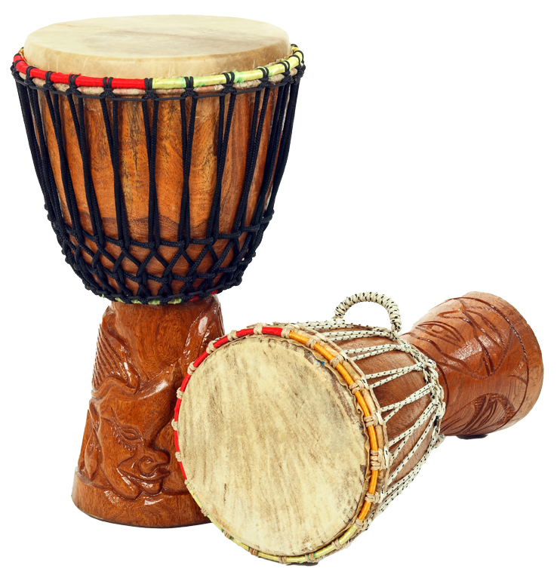
Djembe
The djembe is an untuned percussion instrument.
It is a membranophone, meaning with skin or membrane
It is an instrument from West Africa.
The body is made from wood and the drumhead from animal skin.
A master djembe player is called a djembefola.
The djembe was traditionally used for communicating long distances between tribes due to its loud, resonating sound.
Djembe translates to 'everyone gather together in peace’.
The 3 basic sounds produced on the djembe are bass, tone and slap.

Slide 7
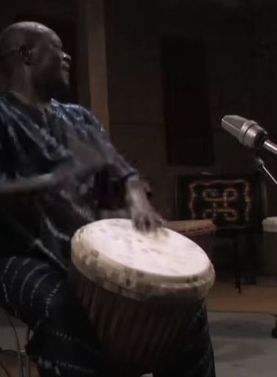

Djembe – listening
M'Bemba Bangoura
Listen for the different rhythms and sounds that can be played on the djembe.
Djembe Solo by Master Drummer: M'Bemba Bangoura (1:09)

Slide 8
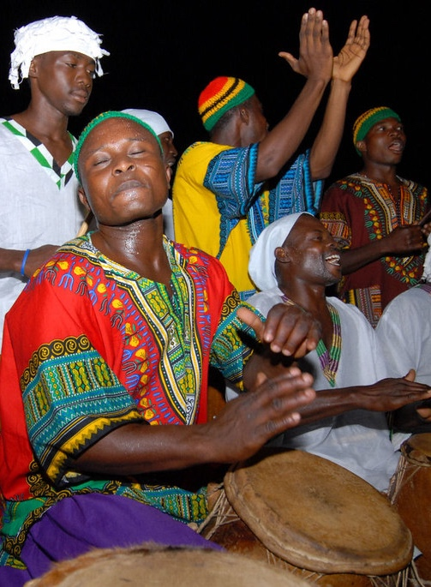
Call and response
Call and response is like a conversation.
In Sub-Saharan African cultures, it was used in public gatherings (civic affairs, religious rituals, vocal and instrumental expression).
In music, call and response is a composition device where one musician performs a phrase or musical idea (call) and a single or group of musicians respond (response). The response can be the same idea, a variation of the idea or something new.
‘Lift the Spirit!’ by Emilio Labrador is licenced under CC BY 2.0.

Slide 9
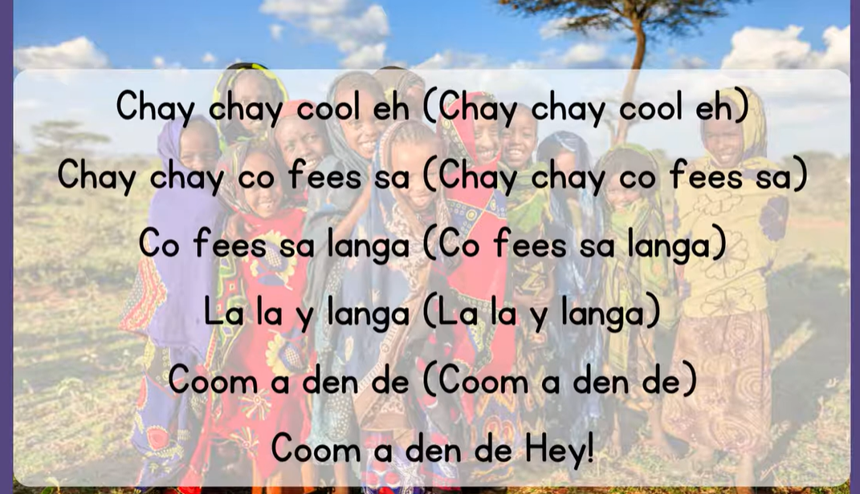
Call and response – listening (1)
Echo
Music: Chay Chay Cool Eh, Vocal Music Education, African Song, Children Singing Call and Response (1:05)

Slide 10
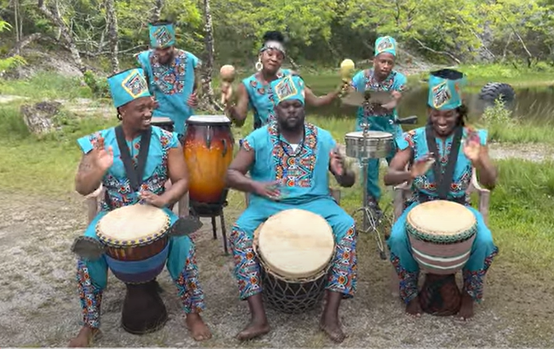
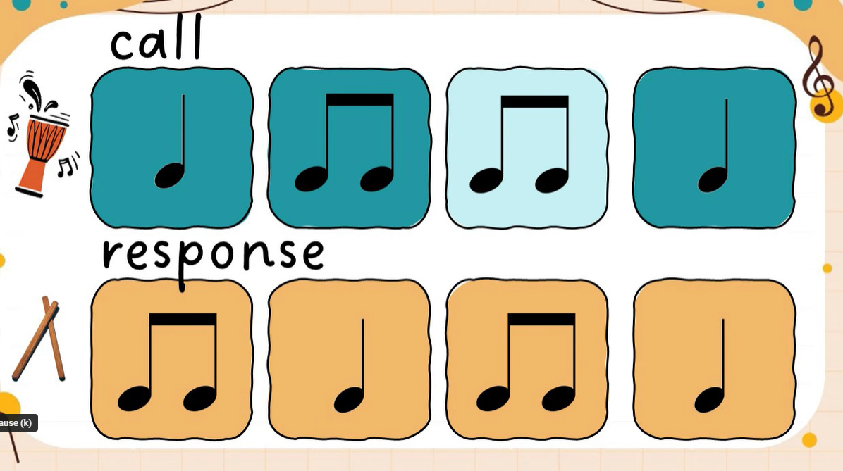
Call and response – listening (2)
Question and answer
Look at these examples of the ‘question and answer’ style of call and response
African Drumming in Trinidad and Tobago....Happy Emancipation! (4:01)
Call and Response: Percussion Play Along with Quacktavious Beakman (3:05)

Slide 11
Learning intentions and success criteria – LS 2
We are learning to:
read music notation
recall and notate musical patterns
define music terminology for the element of duration.
We can:
identify the symbol, name and value for the notes and rests: crotchet, quavers and semiquavers
use listening skills to memorise and notate short rhythmic patterns
compose a short rhythmic composition using music notation.
Notes:
Notes for teachers:
Learning intentions and success are best co-constructed with students. Adapt the learning intention as required and add matching success criteria.
For more information see ⁠AITSL or the NSW Department of Education explicit teaching strategies, ⁠Sharing learning intentions and ⁠Sharing success criteria.
LISC is not necessarily presented at the beginning of the lesson. Teacher needs to consider most effectual time to introduce.
LISC should be revisited during the lesson to support students' evaluation of their learning.

Slide 12
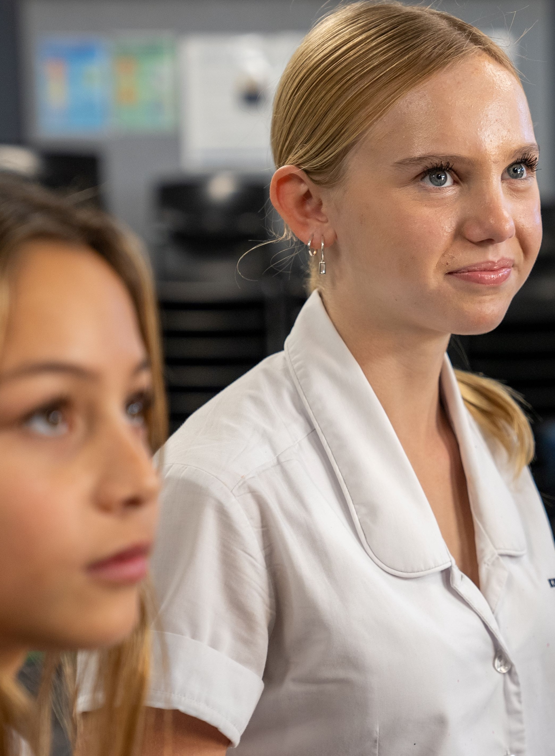






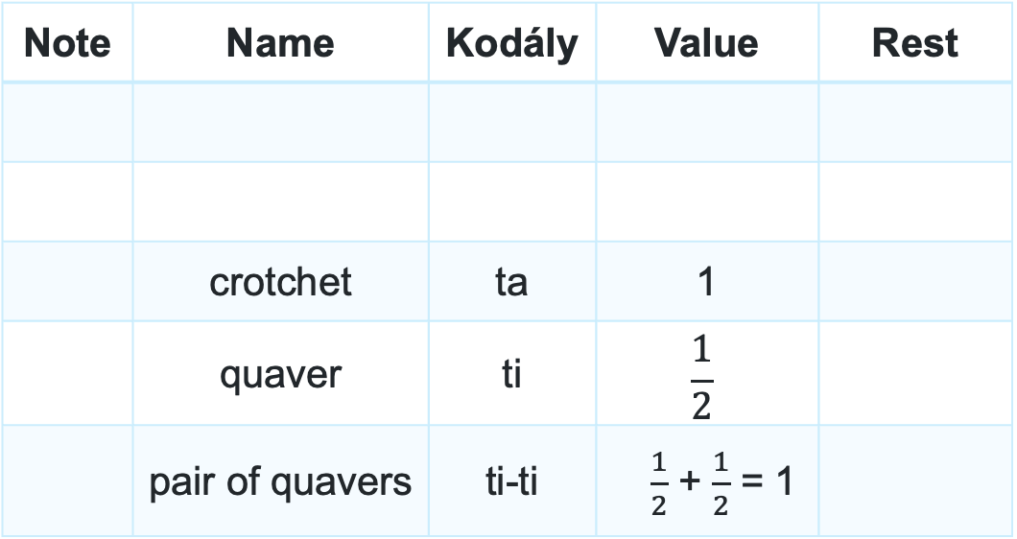
Note names and values
Leave first 2 lines blank
Note | Name | Kodály | Value | Rest
 | crotchet | ta | 1
 | quaver | ti | $$\frac{1}{2}$$
 | pair of quavers | ti-ti | $\frac{1}{2}$ + $\frac{1}{2}$ = 1

Slide 13
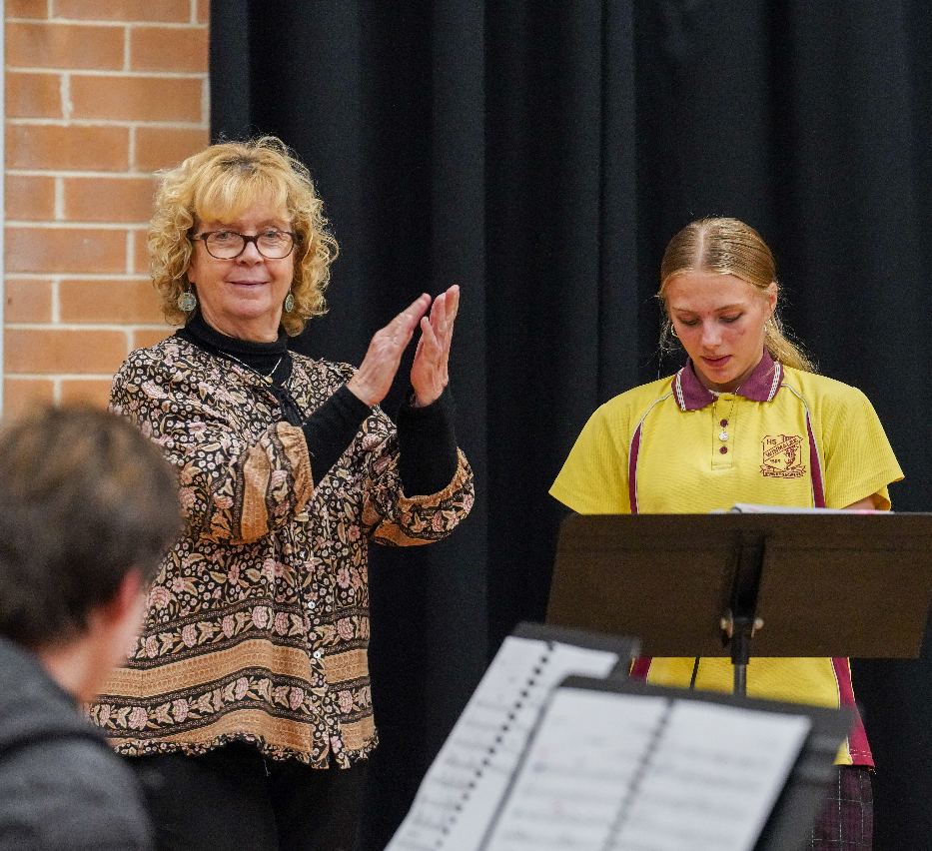



Beat circles (1)
Rhythm dictation

Slide 14

Musical terms – Duration
Duration refers to the lengths of sounds and silences in music.
Some key terms include:
beat
tempo
notes and rest values
rhythm and rhythmic devices.

Slide 15
Element of music and definitions
Musical terms
Beat
Rhythm
Canon
a regular,
constant pulse
the arrangement or pattern of long and short sounds and silences
where 2 or more parts sing/play the same melody but start at different times

Slide 16

Beat circles (2)
Hot Cross Buns
Hot cross buns,
hot cross buns.
One a penny, 2 a penny,
hot cross buns.

Slide 17
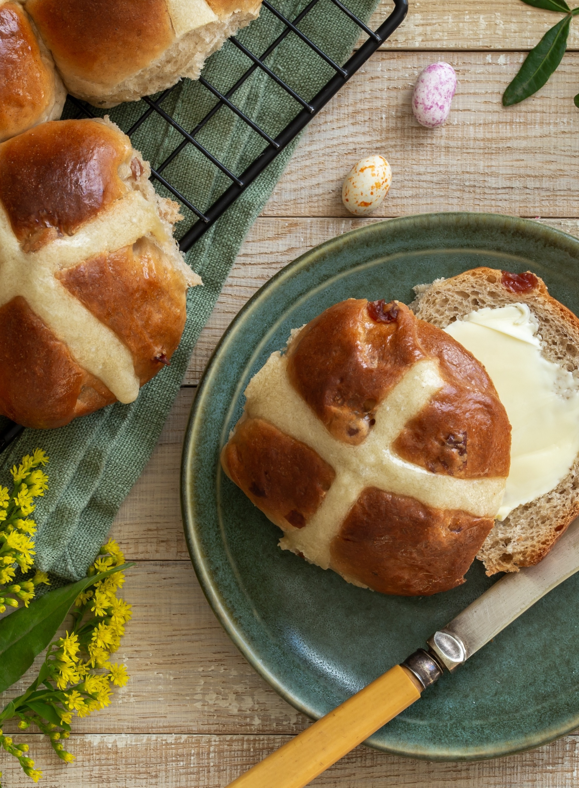


Hot Cross Buns
Answer
Hot cross buns,
hot cross buns.
One–a pen-ny, two–a pen-ny,
hot cross buns.

Slide 18
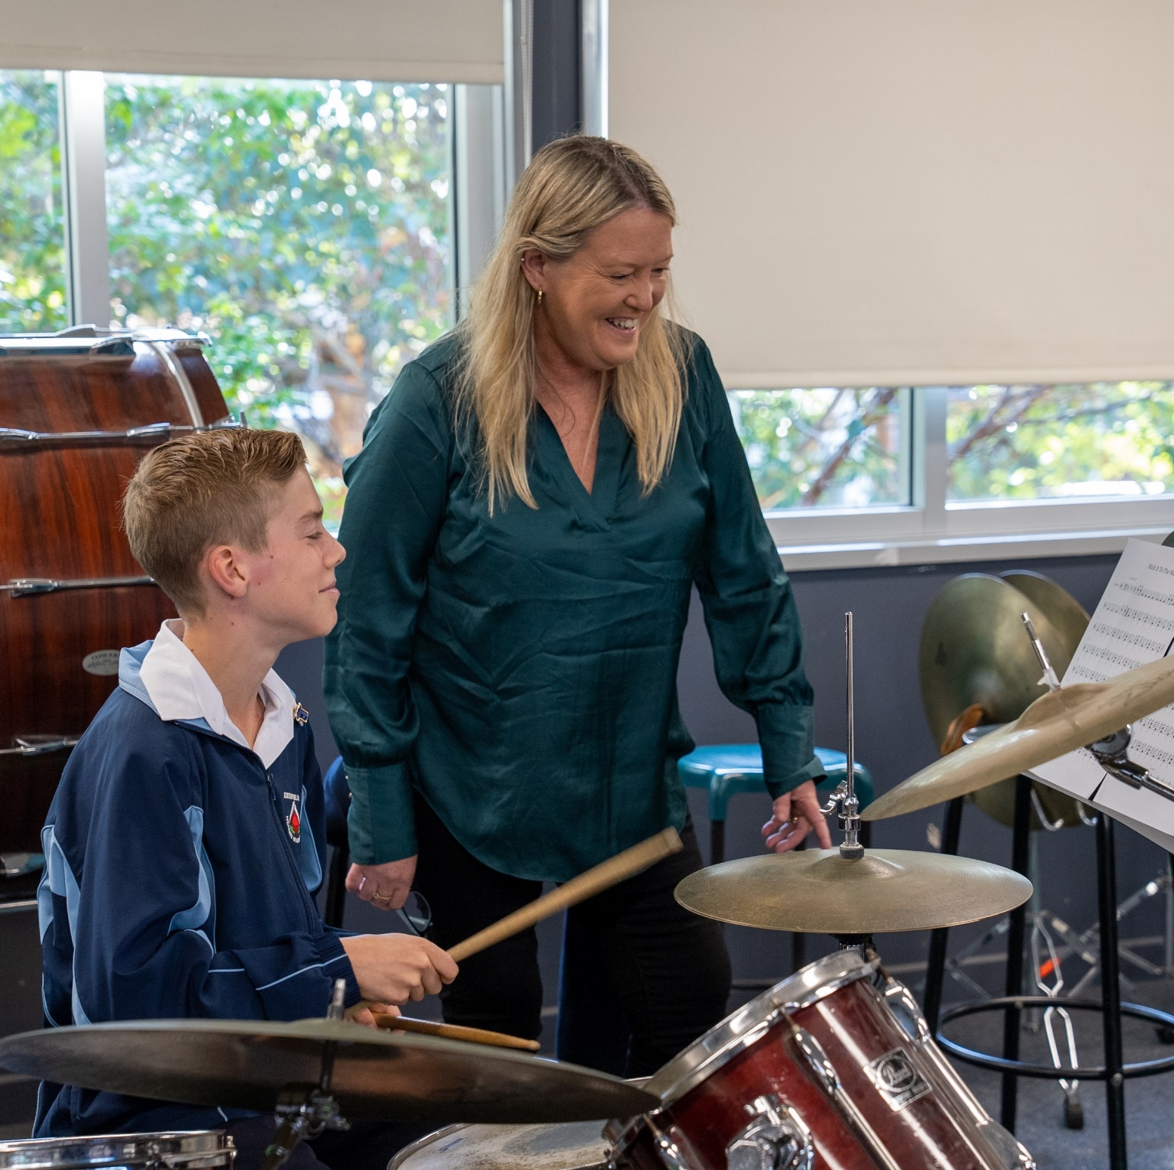








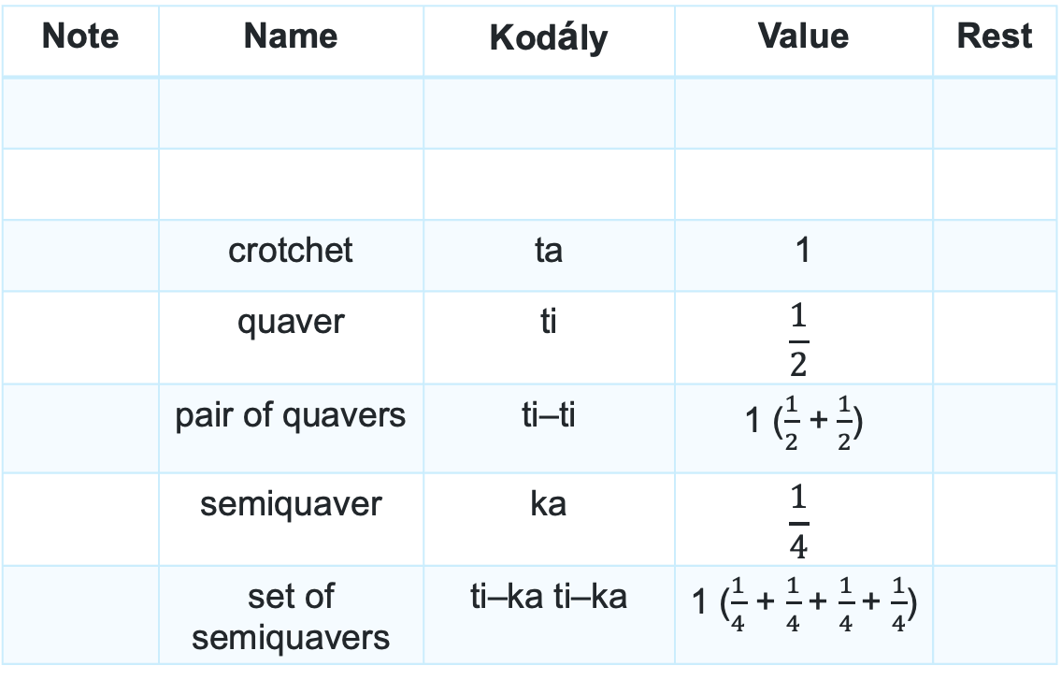
More note names and values (1)
Note | Name | Kodály | Value | Rest
 | crotchet | ta | 1
 | quaver | ti | $$\frac{1}{2}$$
 | pair of quavers | ti–ti | 1 ($\frac{1}{2}$ +$\frac{1}{2}$)
 | semiquaver | ka | $$\frac{1}{4}$$
 | set of semiquavers | ti–ka ti–ka | 1 ($\frac{1}{4}$ + $\frac{1}{4}$+ $\frac{1}{4}$+ $\frac{1}{4}$)
18

Slide 19
Rhythms – Echo clapping
1.
2.
3.

Slide 20
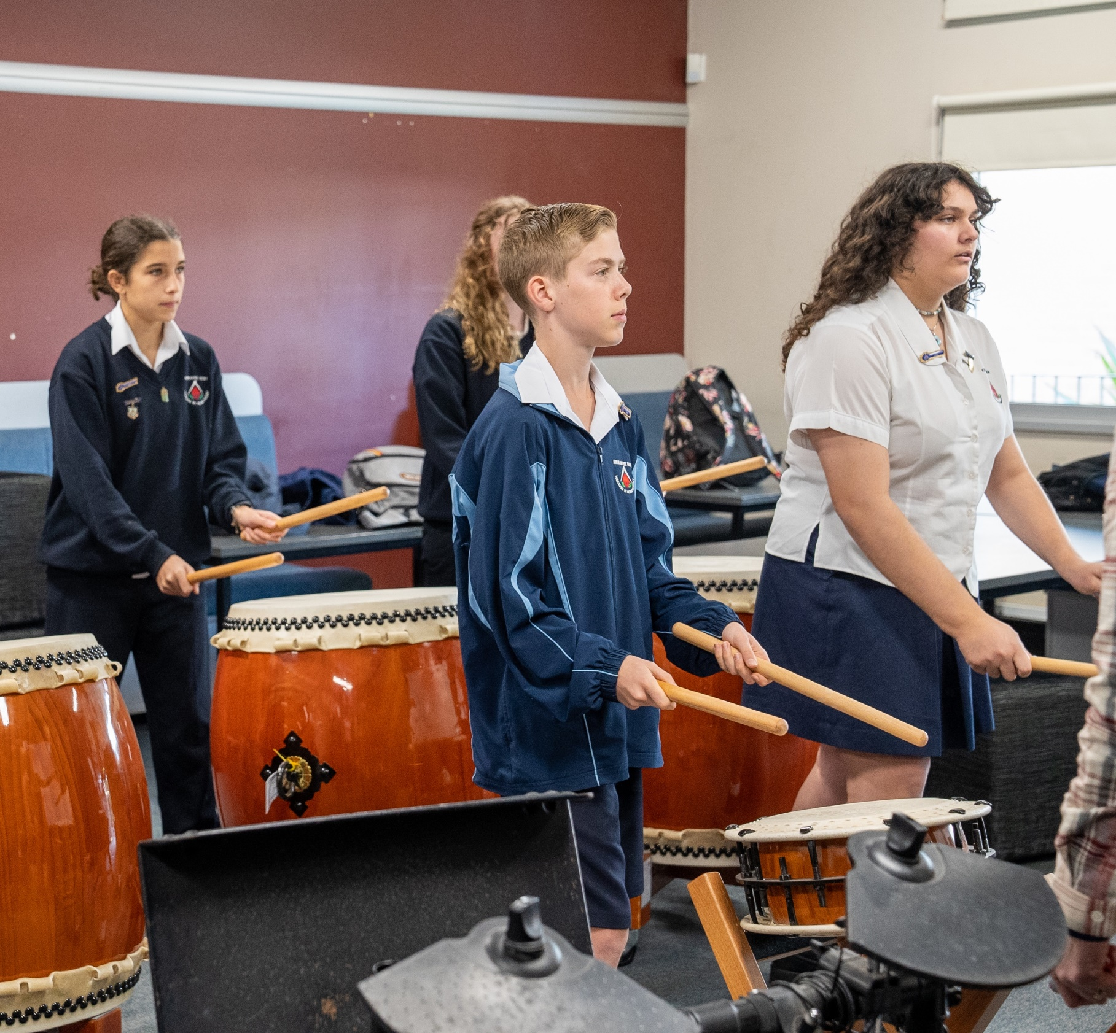

Beat circles (3)
Rhythm dictation
20

Slide 21

Time signature and barlines
Musical terms
Time signature – is an indication at the beginning of a piece of music to tell you HOW many beats and WHAT type of beats there are in the bar. The top number tells you HOW many, the bottom number tells you WHAT type.
For example, – tells us there are 3 crotchet beats to a bar.
Metre – the grouping of beats in regular patterns, strong and weak beats. For example, duple metre (strong, weak), triple metre (strong, weak, weak), quadruple metre (strong, weak, medium, weak).
Barline – the small line that divides the music into smaller sections.
Double barline – 2 lines drawn to indicate the end of the piece.

Slide 22




Moving beat circles to bars (1)
Example
4
4
22

Slide 23

Moving beat circles to bars (2)
4
4
Your turn
23

Slide 24
Learning intentions and success criteria – LS 3
We are learning to:
perform from musical scores
perform with musical expression
identify untuned percussion instruments by sight and/or listening
experiment with and notate musical ideas for untuned percussion instruments.
We can:
read and interpret musical symbols and structure
interpret dynamic and tempo markings on musical scores
use listening and/or visual skills to recognise and name untuned percussion instruments
organise music ideas into a 2-bar composition for untuned percussion instruments.
Notes:
Notes for teachers:
Learning intentions and success are best co-constructed with students. Adapt the learning intention as required and add matching success criteria.
For more information see ⁠AITSL or the NSW Department of Education explicit teaching strategies, ⁠Sharing learning intentions and ⁠Sharing success criteria.
LISC is not necessarily presented at the beginning of the lesson. Teacher needs to consider most effectual time to introduce.
LISC should be revisited during the lesson to support students' evaluation of their learning.

Slide 25
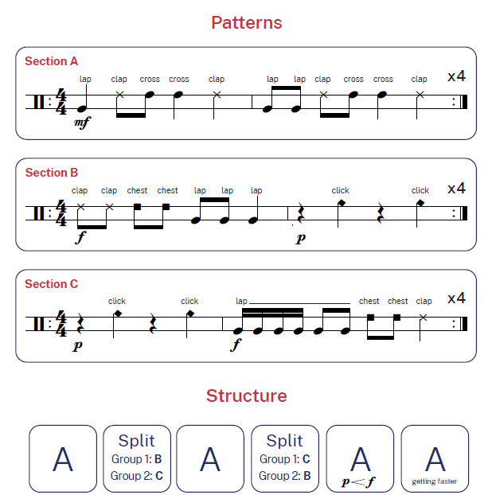
Score
Beats and Pieces

Slide 26
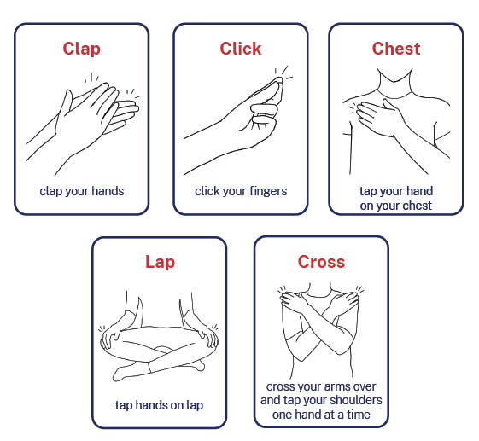
Legend
Beats and Pieces

Slide 27
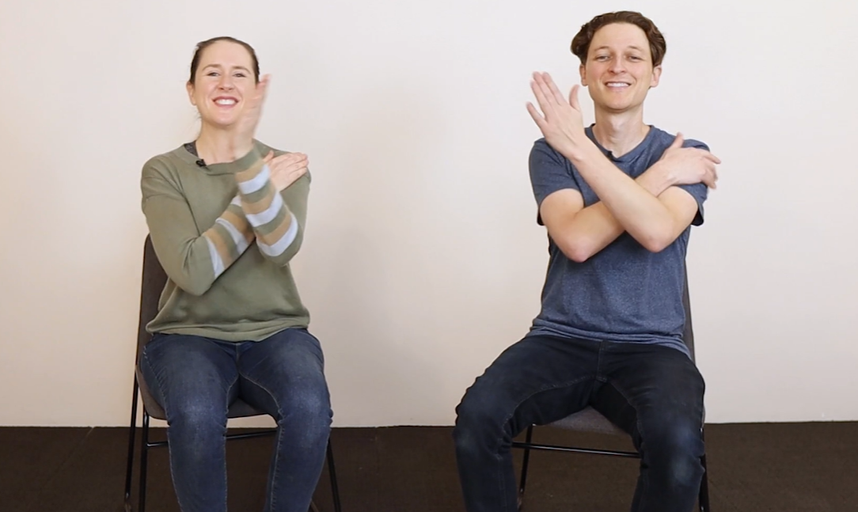
Performance recording
Beats and Pieces

Slide 28
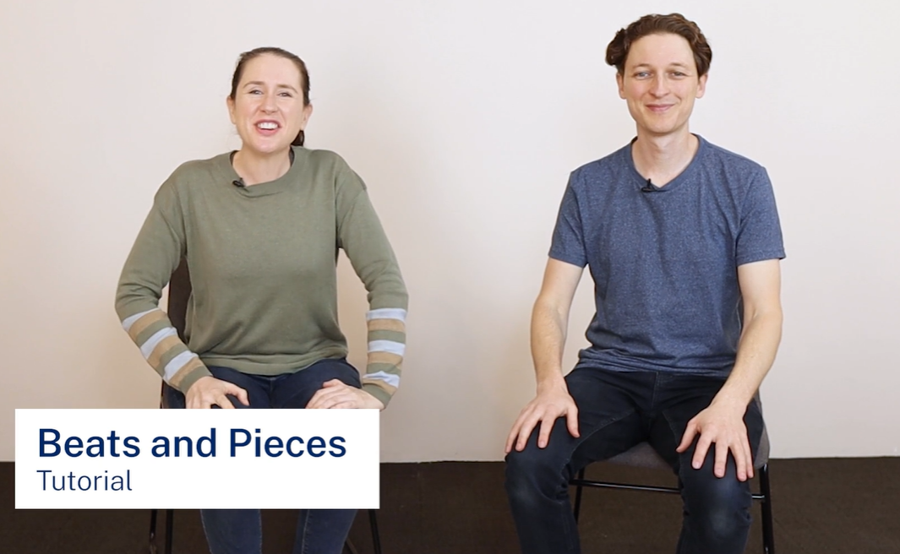
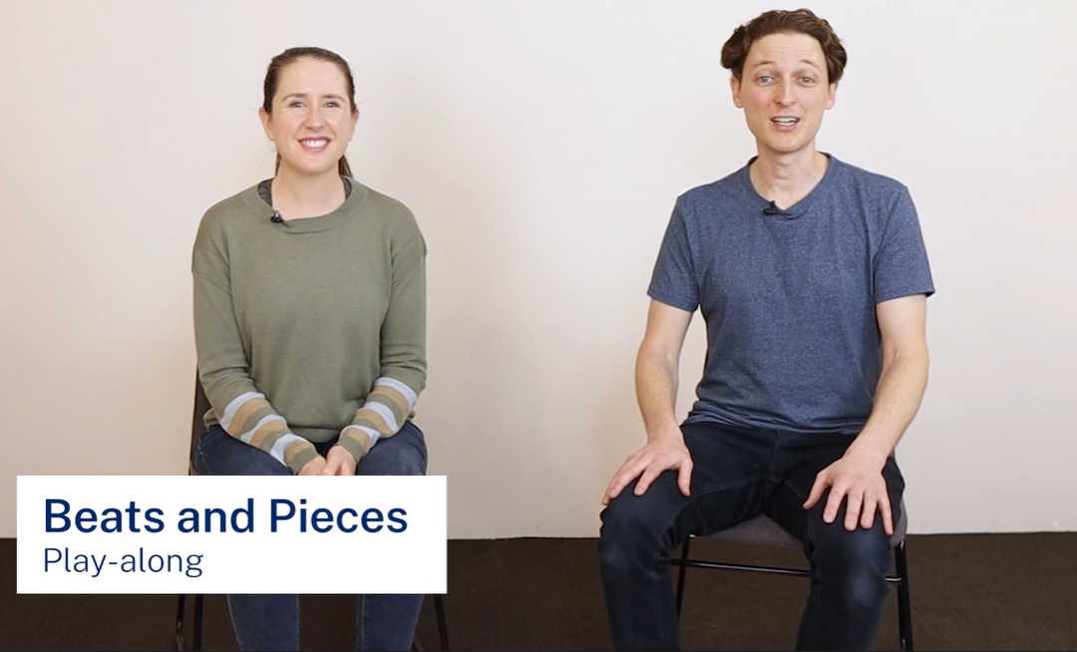
Tutorial and play-along
Beats and Pieces
Tutorial
Play-along

Slide 29



Repeat signs
Musical terms
Repeat signs – tell us to go back and play again. There are 3 types of repeats signs:
Beginning (open) repeat sign – where you go back to and start playing again. If there is no beginning repeat sign, go back to the start of the piece.
Ending (close) repeat sign – where you finish playing the repeat.
Repeat bar before sign – where you play the same notes as was in the previous.

Slide 30
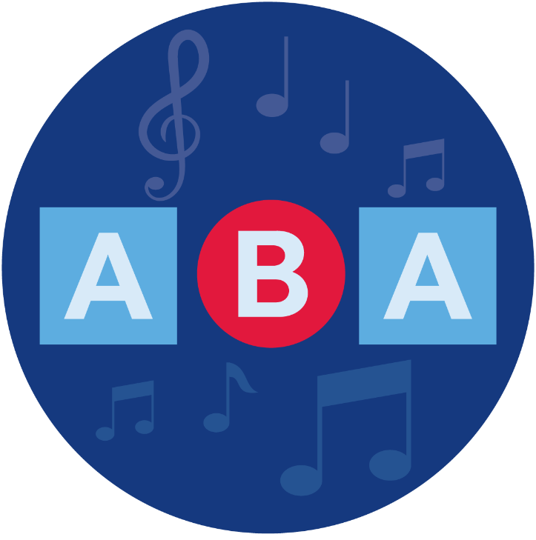
Musical terms – Structure
Structure refers to the design or form in music. It refers to how a composition is constructed in sections or parts.
Key terms include:
Macrostructures – verse/chorus form, binary, cyclic, strophic, multi–movement.
Microstructures – riff, phrase, motif, ostinato, sequence, head, colotomy
30

Slide 31
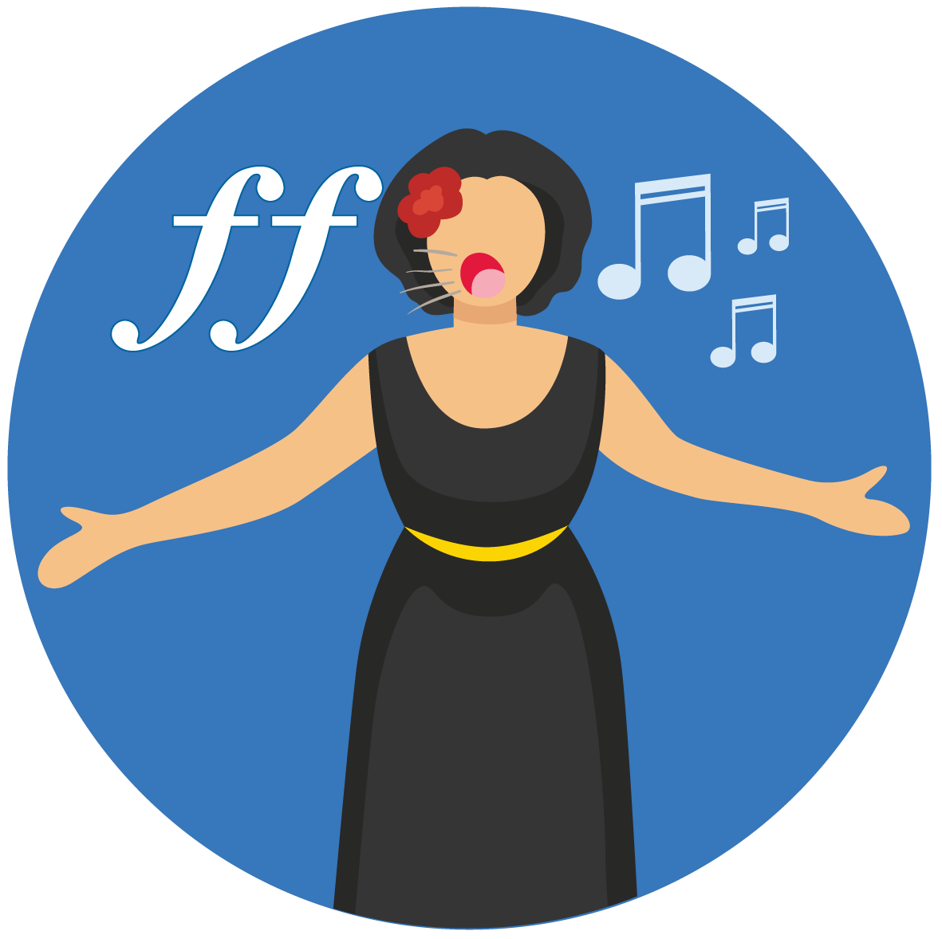
Musical terms
Dynamics and expression
Dynamics – the volume of sound
Expression – the musical detail that articulates a style or interpretation of a style.
Key terms include:
Dynamics and gradations – pianissimo, piano, mezzo piano, mezzo forte, forte, fortissimo, crescendo, diminuendo, niente, sforzando
Articulations – legato, accent, tenuto, marcato, portato
Expressive techniques – pizzicato, slap, palm muting, flutter–tonguing
Electronic manipulation techniques – distortion, delay, looping, compression, sustain
Expressive directions – rubato, dolce, smoothly, vocal ad lib,
groove ad lib

Slide 32


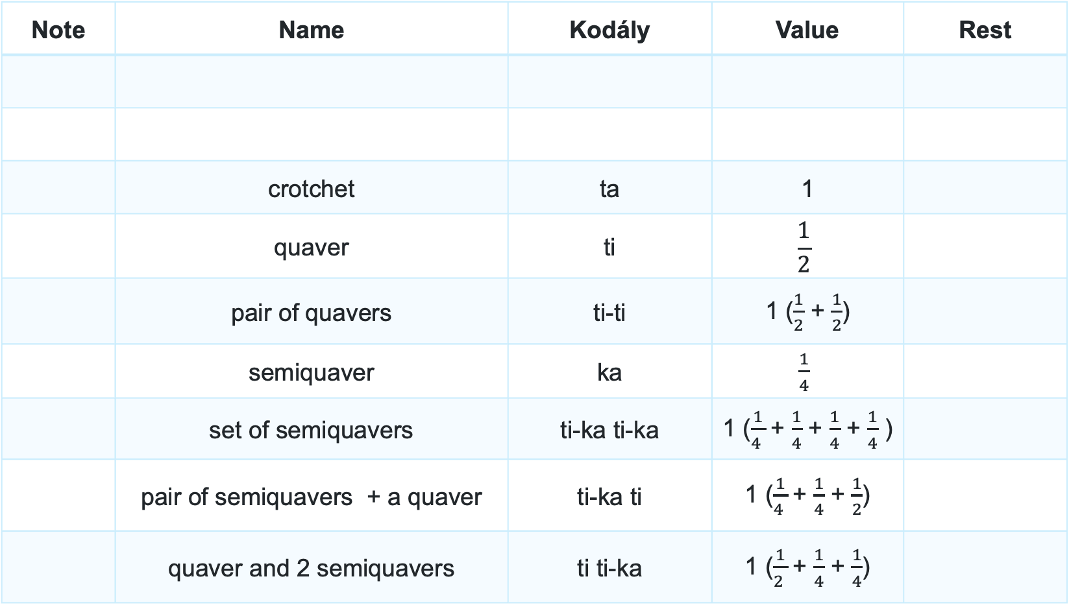
More note names and values (2)
Note | Name | Kodály | Value | Rest
 | crotchet | ta | 1
 | quaver | ti | $$\frac{1}{2}$$
 | pair of quavers | ti-ti | 1 ($\frac{1}{2}$ + $\frac{1}{2}$)
 | semiquaver | ka | $\frac{1}{4}$
 | set of semiquavers | ti-ka ti-ka | 1 ($\frac{1}{4 }$+ $\frac{1}{4}$ + $\frac{1}{4}$ + $\frac{1}{4}$ )
 | pair of semiquavers + a quaver | ti-ka ti | 1 ($\frac{1}{4 }$+ $\frac{1}{4}$ + $\frac{1}{2}$)
 | quaver and 2 semiquavers | ti ti-ka | 1 ($\frac{1}{2 }$+ $\frac{1}{4}$ + $\frac{1}{4}$)

Slide 33
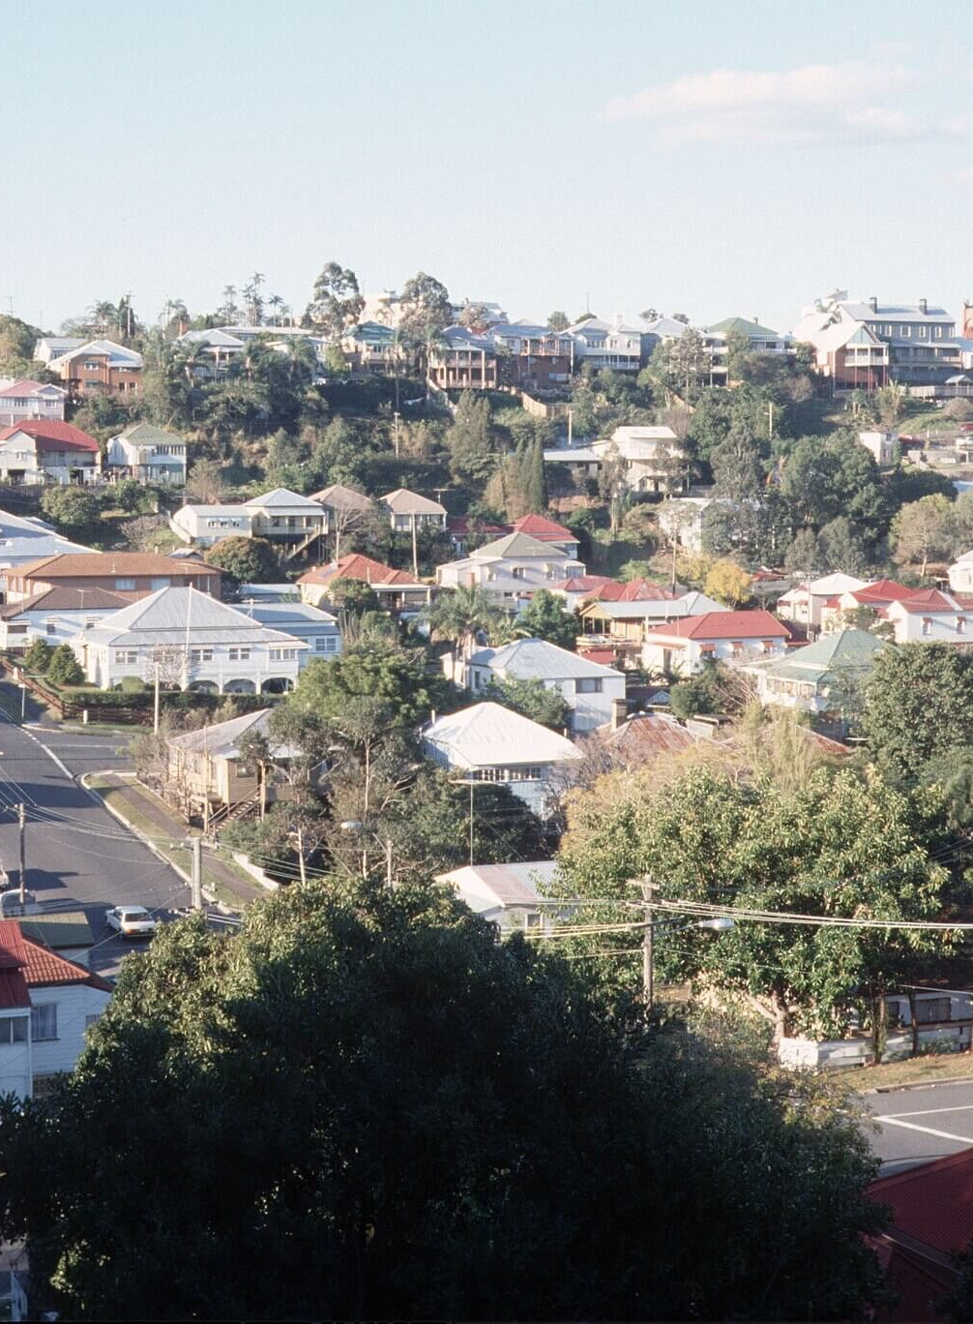
Suburban rhythms
Note | Suburb name | Value
 | Bourke | 1
 | Syd-ney | 1
 | Me-re-we-ther | 1
 | Arm-i-dale | 1
 | Coffs Har-bour | 1
 | rest | 1
‘Suburban housing, Paddington/Red Hill Brisbane around late 1980s’ by Iraphne Childs licensed under CC BY 4.0.

Slide 34
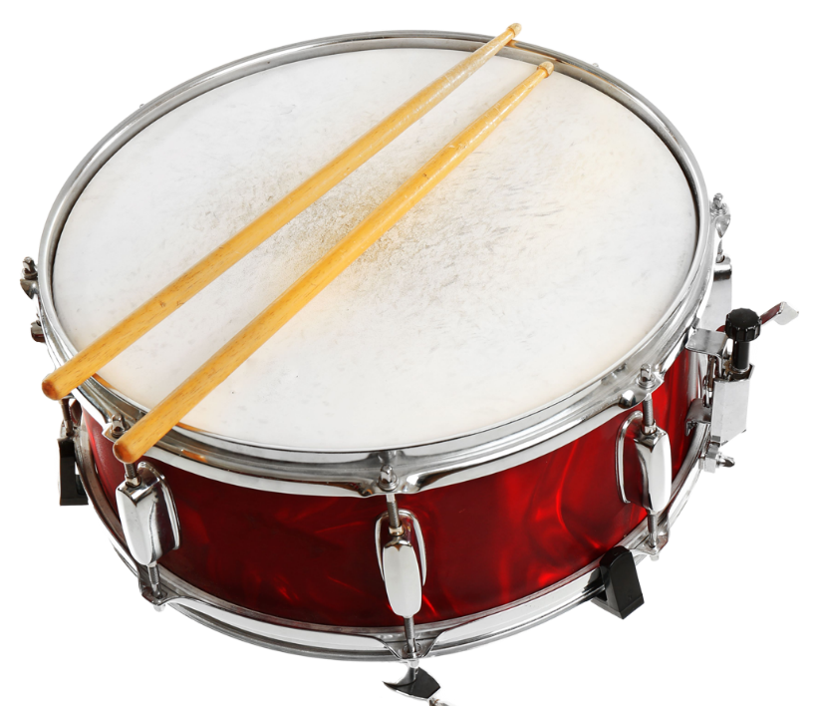
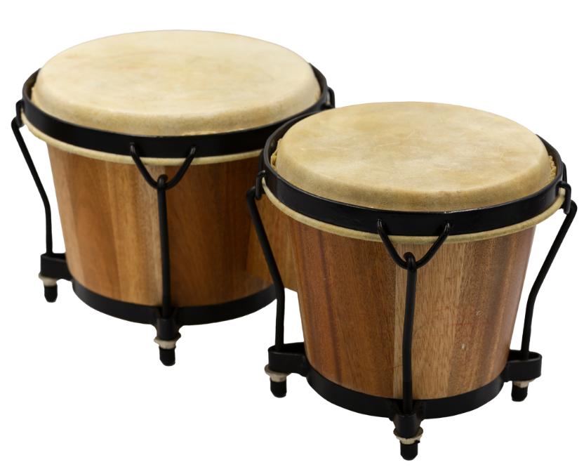
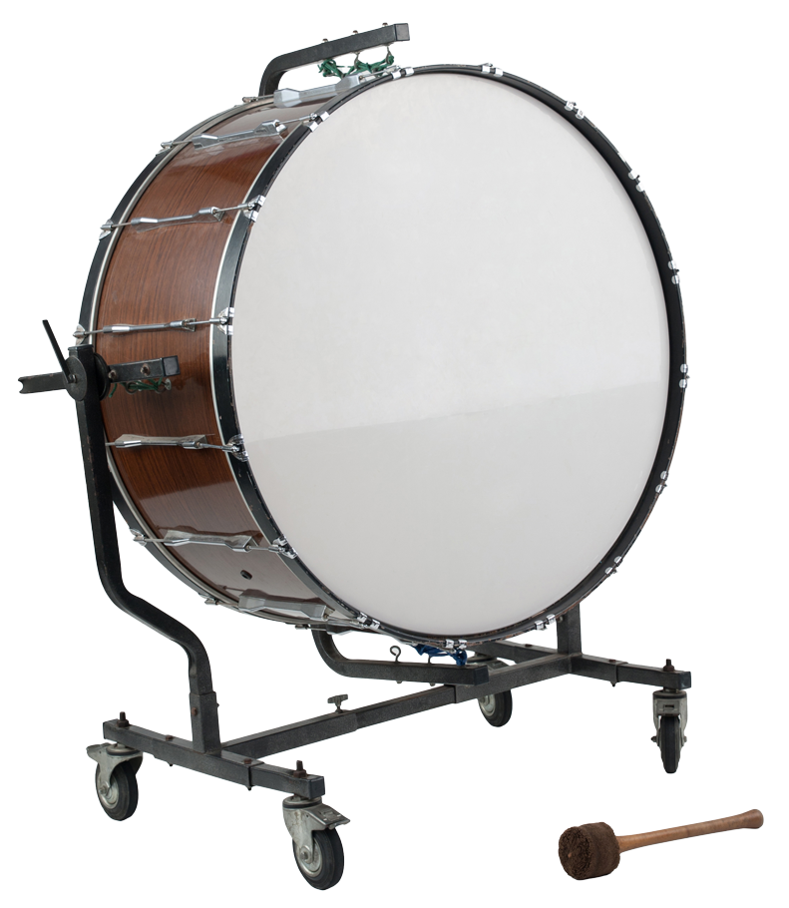
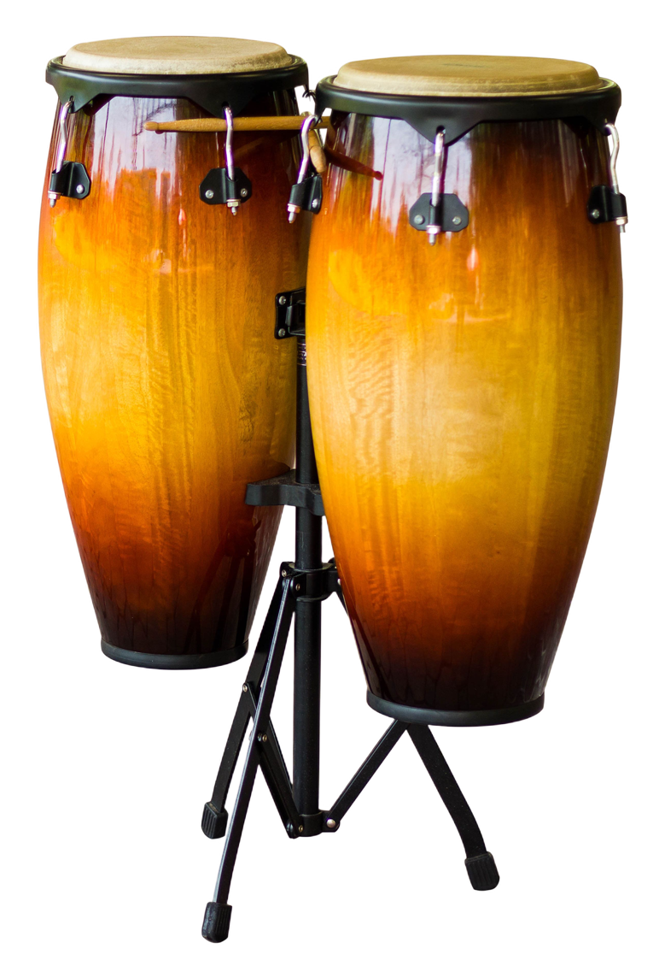
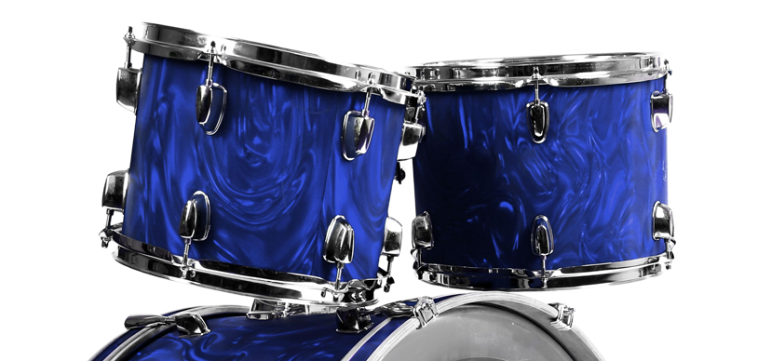
Types of drums (Hit)
Untuned percussion instruments
Snare drum
Bass drum
Bongos
Congas
Tom toms

Slide 35
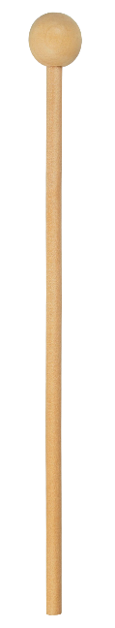
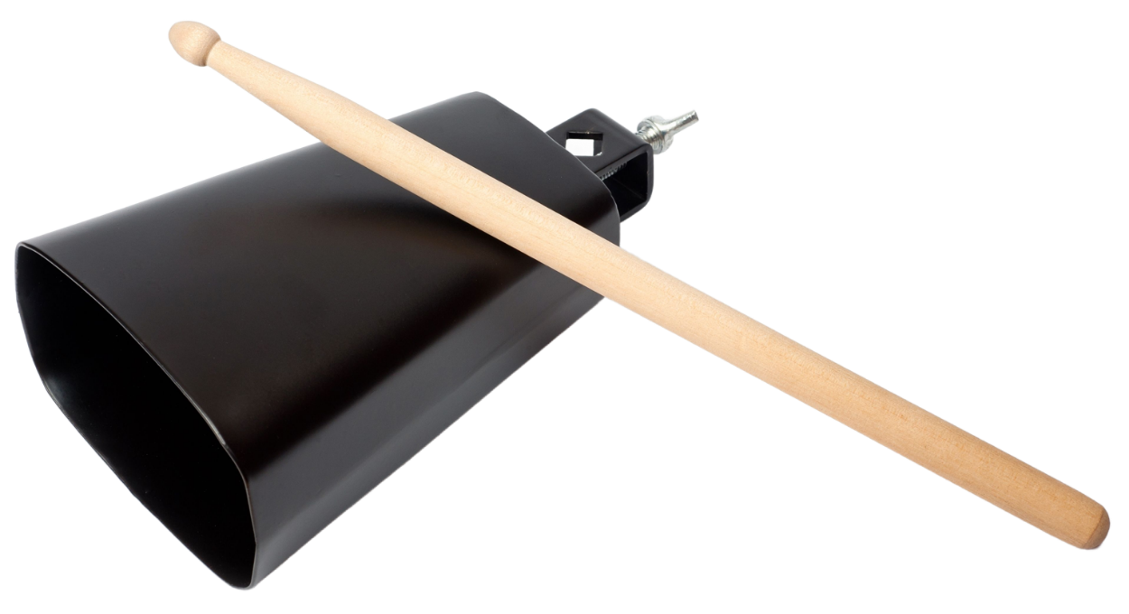
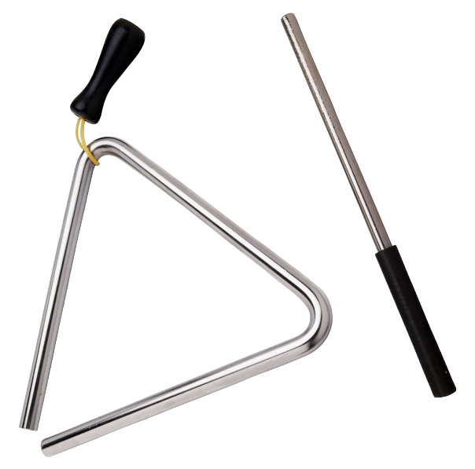
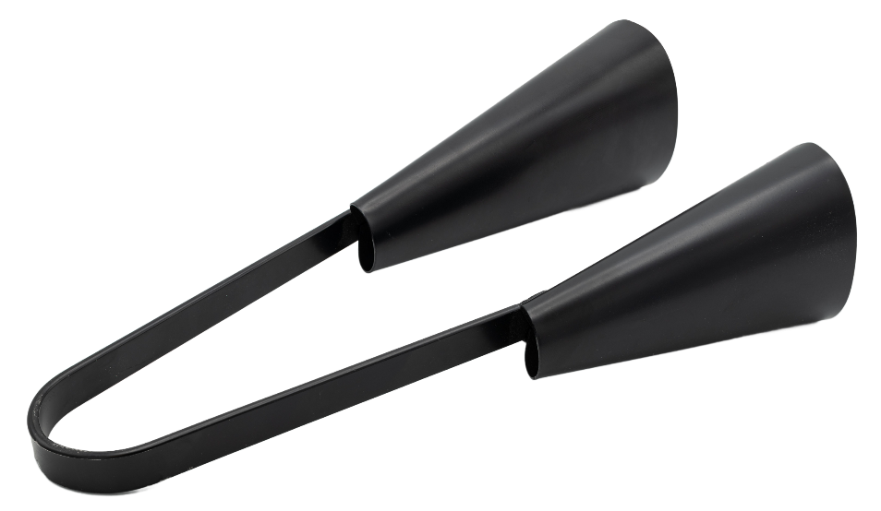
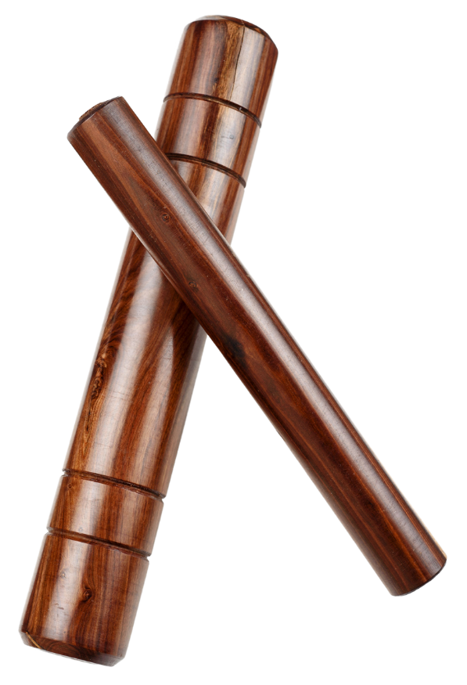
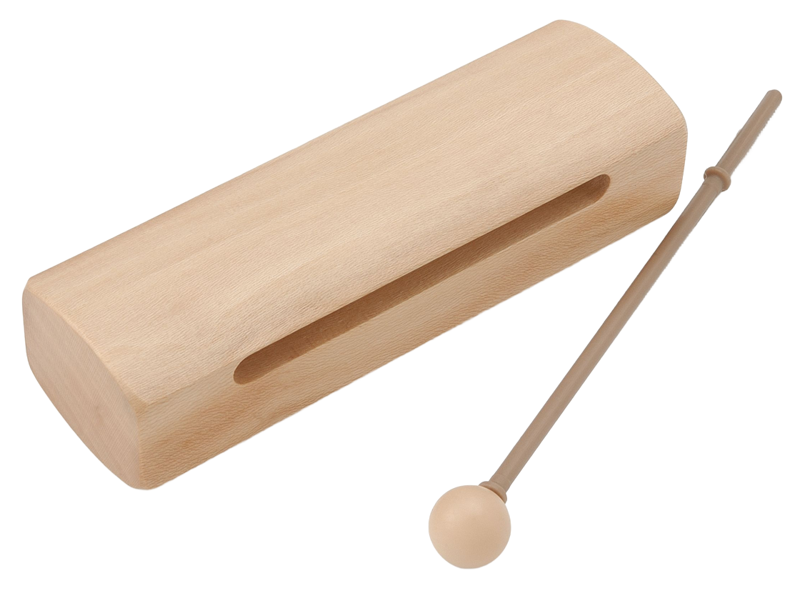
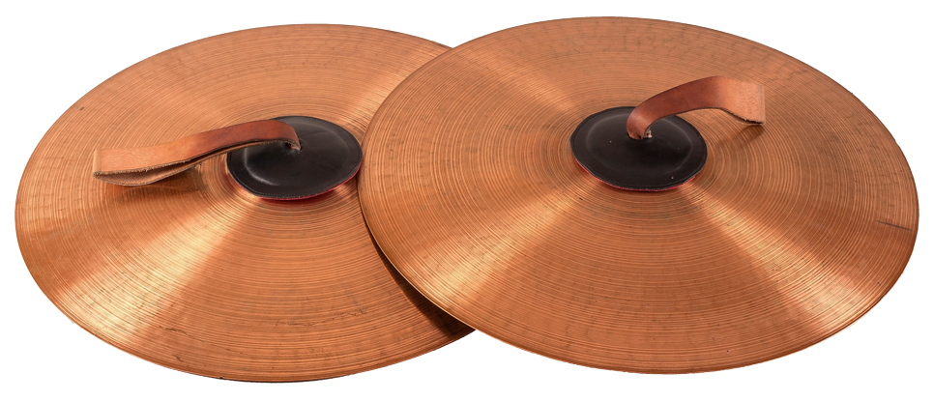
Hit
Untuned percussion instruments
Agogo bells
Cowbell
Triangle
Woodblocks
Claves
Cymbals

Slide 36
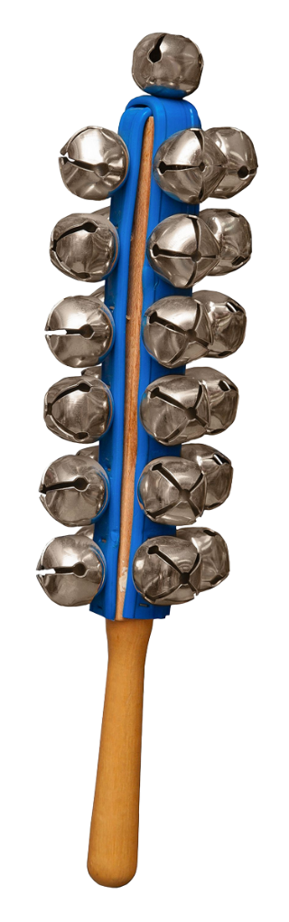
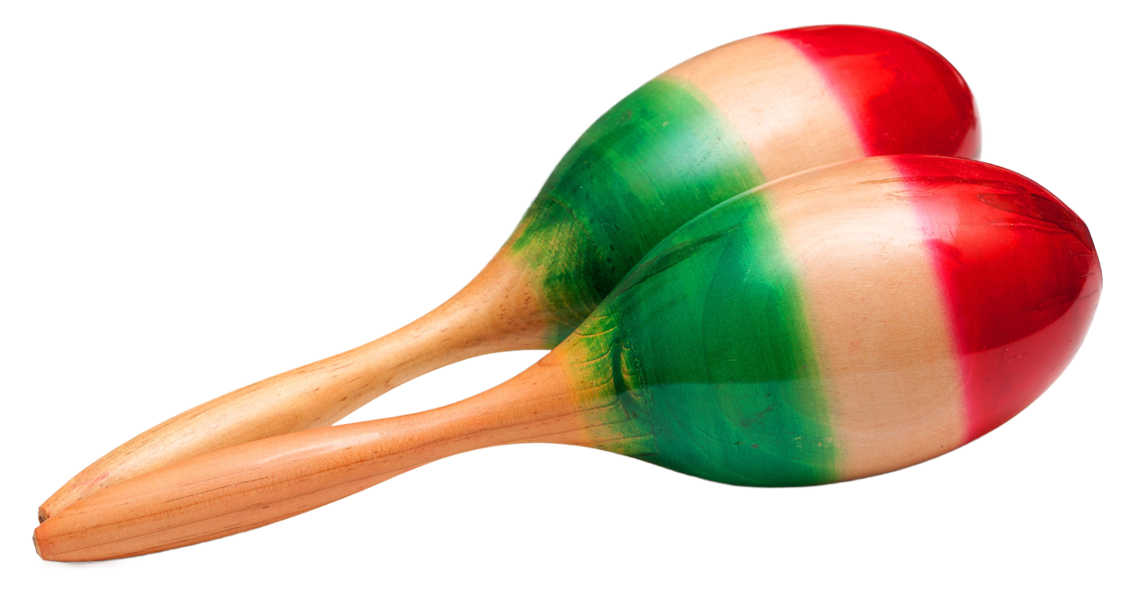
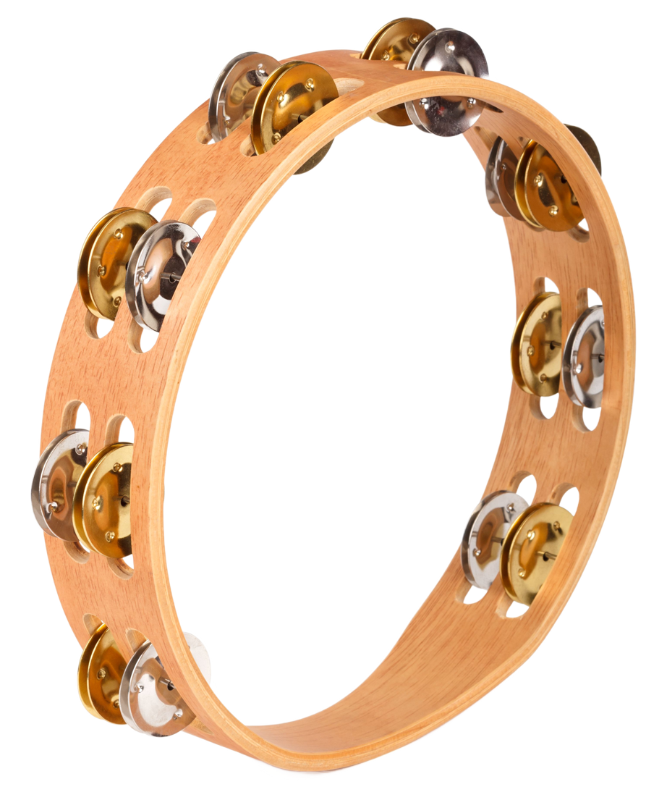
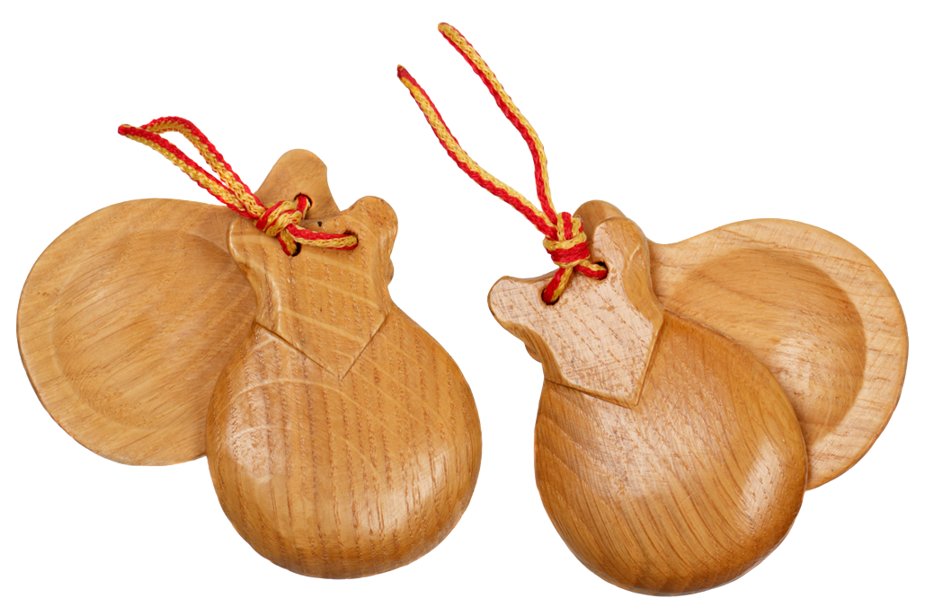
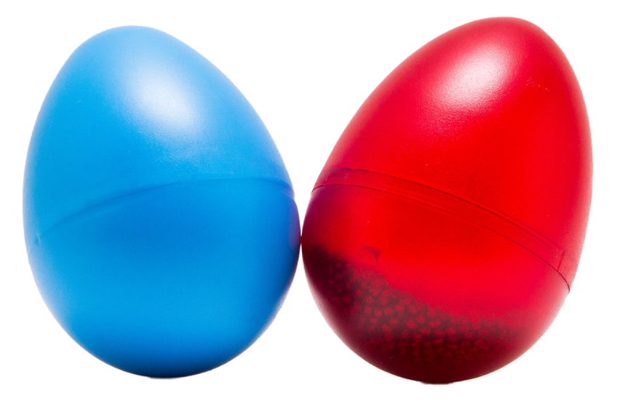
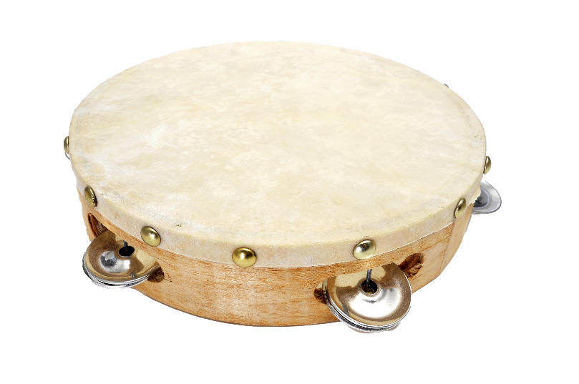
Shake
Untuned percussion instruments
Tambourine
Maracas
Sleigh bells
Castanets
Shakers

Slide 37
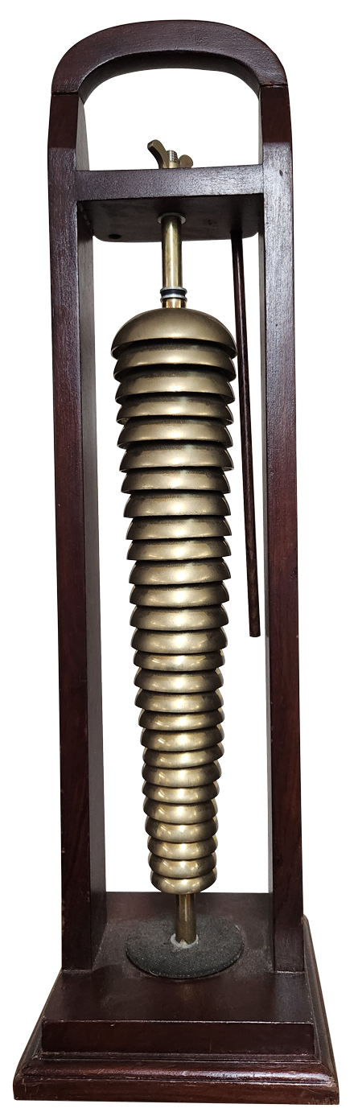
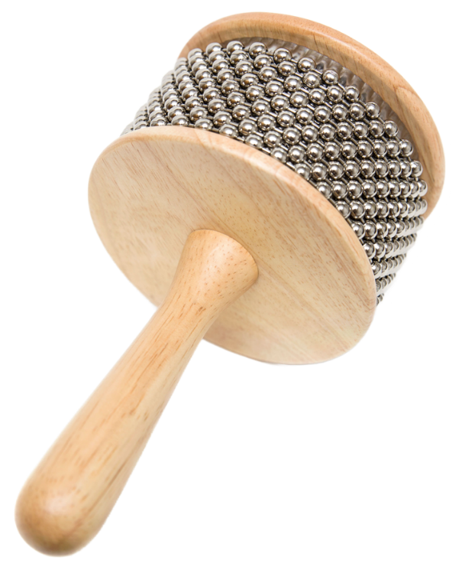
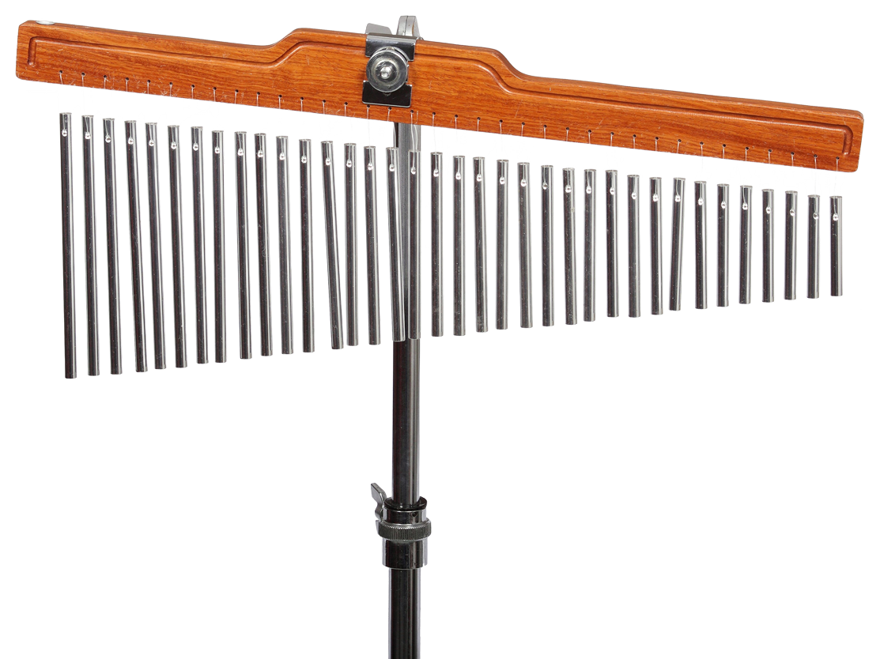
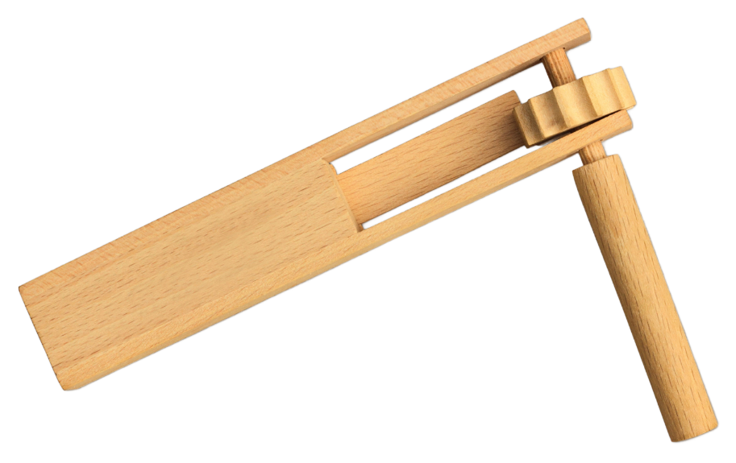
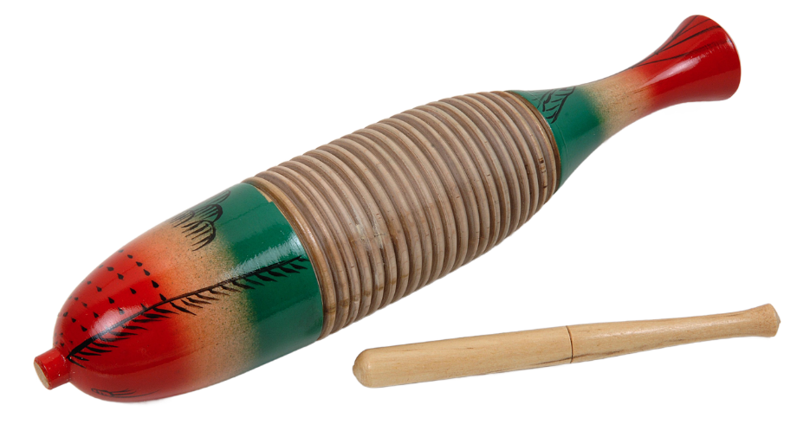
Scrape
Untuned percussion instruments
Chimes or mark tree
Bell tree
Cabasa
Guiro
Ratchet

Slide 38
Composition reflection scaffold
Date
In today's lesson I wrote a _____ (number of bars) bar rhythm.
The rhythm was in ______ , (identify the time signature) meaning there were ____ crotchet beats in a bar.
The note values that I used were (select from the list)
The suburban rhythm names for these note values were (select from the list)
I used a barline after ____ beats and a double barline at the ____ of the piece.
I am most proud of ___.
Crotchet – pair of quavers – set of semiquavers – crotchet rest
Bourke – Sydney – Merewether – rest

Slide 39
Performance preparation reflection scaffold
Date
In today's lesson I was working in a group to prepare our group performance. The members of my group are _______________.
(Name 1) and (Name 2) are performing Part 1 and (Name 3) and (Name 4), Part 2.
The musical decisions our group made were to include dynamics and expression. We did this by __________ (include specific reference to where it happens in the piece and who plays it).
I enjoyed preparing for our performance of 'Beats and Pieces' because...
Before we perform to the class, I would like to improve... (outline what you would like to improve. Examples – keeping in time, dynamics, the speed) and I will do this by...
I feel that today's rehearsal was (select one)
Example: we did this by everyone starting moderately loud (mf) in section A and then we split into 2 parts, where section B started loud (forte) and section C started soft (piano). When we came back to section A, only (name 1 and name 2) performed and they performed it at a soft (piano) dynamic.
successful, fun, challenging.

Slide 40
Performance etiquette
As a performer and an audience member
Performer
Move to the performance space and face the audience
Ensure that you have eye contact with the other members of your group
Wait until the audience is settled and quiet
Remain focused throughout the performance, even if you lose your place
If you lose your place, don’t giggle or pull faces, focus on joining back in with the rest of the group
Appreciate the applause from the audience. Take a bow
Audience member
Respect the performer(s) by not talking or moving during their performance
Applause only – show the performer(s) your appreciation by applauding. No whistling or calling out.
If you arrive to class late or need to leave, do not enter or exit during a performance, wait until the performance is over
Outside a school setting, remember to have your mobile phone switched off and put it in your bag/pocket

Slide 41
Performance reflection scaffold
Date
Today my group performed ’Beats and Pieces’.
I am proud of myself because …
I am most pleased with my group because …
Our performance was musical because …
If we were to do the performance again, what would I change?

Slide 42

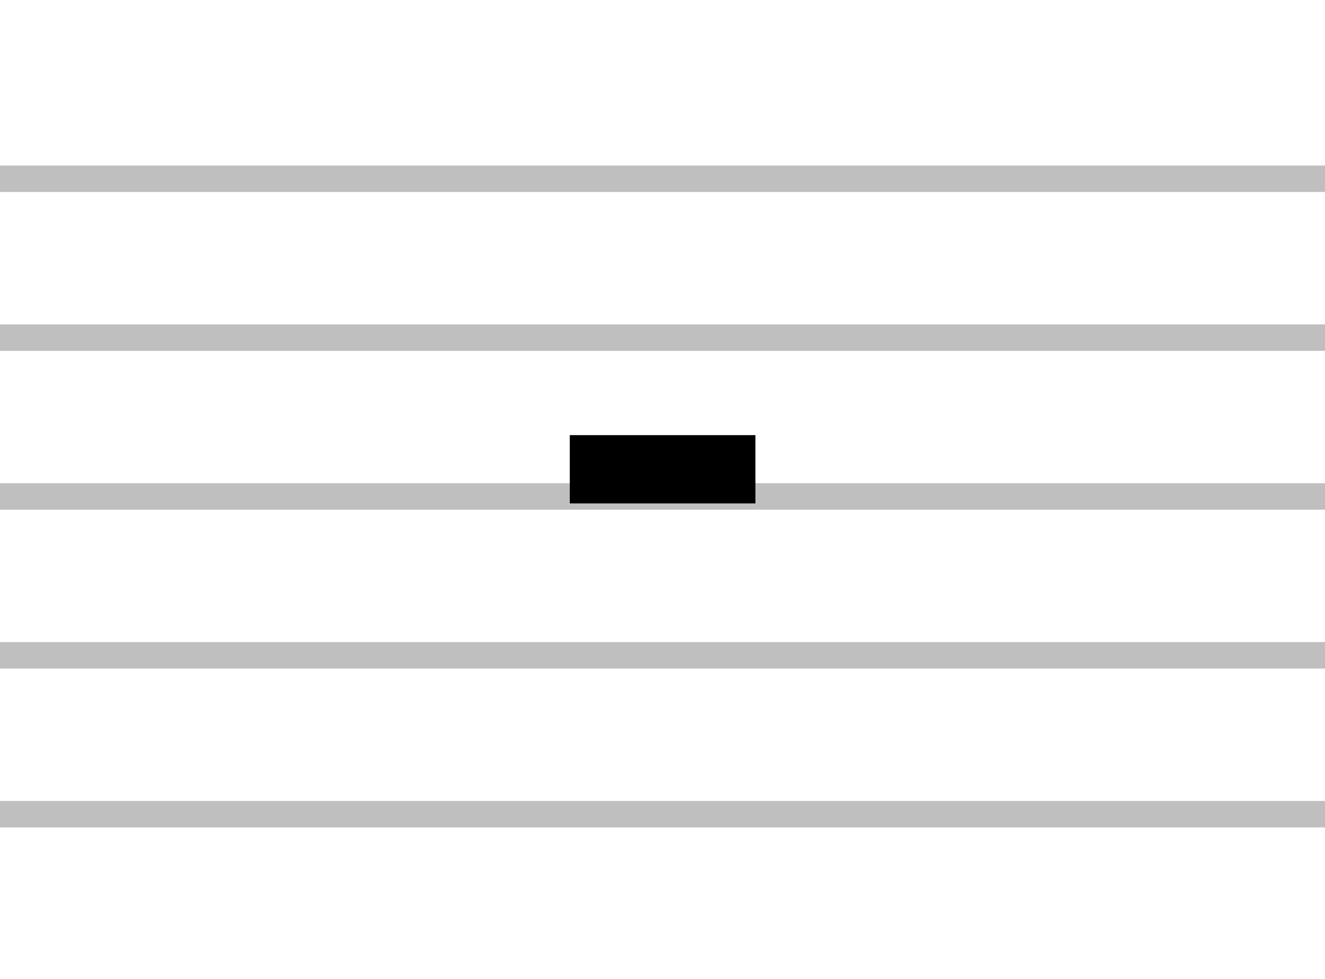
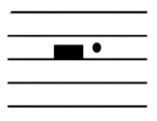




Dotted notes
Note | Name | Kodály | Value | Rest
 | dotted minim | toom | 3 (2 + 1) | or
 | dotted crotchet | tum | 1 ½ (1+1/2) | or
 | dotted quaver/semiquaver | tim-ka | (1/2 + 1/4 +1/4)
A minim is worth 2 beats. The dot is worth half of 2 beats = 1
A dot after a note adds value
That means a dotted minim is worth 3 beats.
A dot is worth half the value of the note

Slide 43
References
This presentation contains NSW Curriculum and syllabus content. The NSW Curriculum is developed by the NSW Education Standards Authority. This content is prepared by NESA for and on behalf of the Crown in the right of the State of New South Wales. The material is protected by Crown copyright.
Please refer to the NESA Copyright Disclaimer for more information https://educationstandards.nsw.edu.au/wps/portal/nesa/mini-footer/copyright.
NESA holds the only official and up-to-date versions of the NSW Curriculum and syllabus documents. Please visit the NSW Education Standards Authority (NESA) website https://educationstandards.nsw.edu.au/wps/portal/nesa/home and the NSW Curriculum website https://curriculum.nsw.edu.au.
Music 7–10 © Syllabus NSW Education Standards Authority (NESA) for and on behalf of the Crown in right of the State of New South Wales, 2024.
K5 Hidden Peak Education (25 July 2022) ‘Music: Chay Chay Cool Eh, Vocal Music Education, African Song, Children Singing Call and Response' [video], K5 Hidden Peak Education, YouTube, accessed 5 August 2024.
Music with Mrs E (30 April 2024) 'Call and Response: Percussion Play Along with Quacktavious Beakman' [video], Music with Mrs E, YouTube, accessed 21 August 2024.
Neptune J (1 August 2021) 'African Drumming in Trinidad and Tobago....Happy Emancipation!' [video], Jahvin Neptune, YouTube, accessed 29 August 2024.
Philharmonia (2024) 'Sound samples’, Resources, Philharmonia website, accessed 21 August 2024.
wuladrum (13 May 2011) 'Djembe Solo by Master Drummer: M'Bemba Bangoura' [video], wuladrum, YouTube, accessed 2 August 2024.
'Beats and Pieces' was commissioned by the NSW Department of Education. All rights reserved for the use of NSW Department of Education teachers and students only. Individuals and organisations outside the department must seek the composer’s permission to use the score and teaching videos in this resource. Please contact kaboom@kaboompercussion.com

Slide 44
Copyright
© State of New South Wales (Department of Education), 2024
The copyright material published in this resource is subject to the Copyright Act 1968 (Cth) and is owned by the NSW Department of Education or, where indicated, by a party other than the NSW Department of Education (third-party material).
Copyright material available in this resource and owned by the NSW Department of Education is licensed under a Creative Commons Attribution 4.0 International (CC BY 4.0) license.
This license allows you to share and adapt the material for any purpose, even commercially.
Attribution should be given to © State of New South Wales (Department of Education), 2024.
Material in this resource not available under a Creative Commons license:
the NSW Department of Education logo, other logos and trademark-protected material
Material owned by a third party that has been reproduced with permission. You will need to obtain permission from the third party to reuse its material.
Links to third-party material and websites
Please note that the provided (reading/viewing material/list/links/texts) are a suggestion only and implies no endorsement, by the New South Wales Department of Education, of any author, publisher, or book title. School principals and teachers are best placed to assess the suitability of resources that would complement the curriculum and reflect the needs and interests of their students.
If you use the links provided in this document to access a third party’s website, you acknowledge that the terms of use, including licence terms set out on the third-party’s website apply to the use which may be made of the materials on that third-party website or where permitted by the Copyright Act 1968 (Cth). The department accepts no responsibility for content on third-party websites.

