Slide 1

Creative arts
May 2025
Notes:
1. Purpose: Creative arts title slide
Timing: 15 sec
Presenter notes:
Welcome to our Creative arts session: unpacking the elements and artworld concepts in the Creative Arts K-6 Syllabus.
[NEXT SLIDE]
​

Slide 2
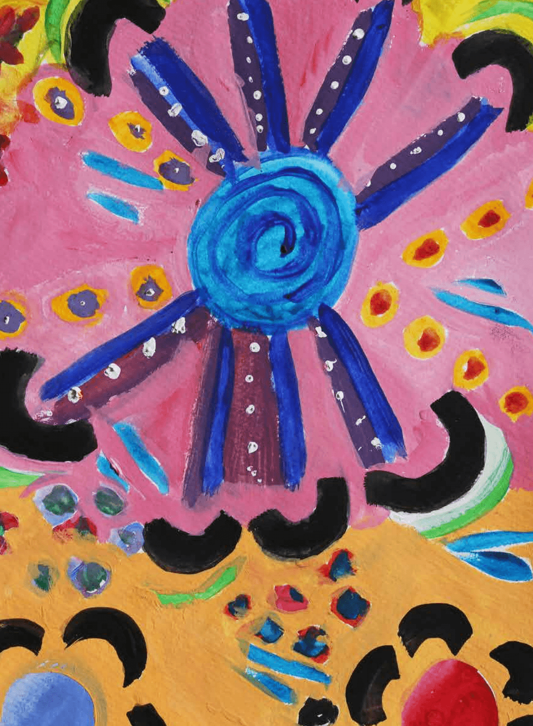
Acknowledgement of Country
We recognise the Ongoing Custodians of the lands and waterways where we work and live. We pay respect to Elders past and present as ongoing teachers of knowledge, songlines and stories. We strive to ensure every Aboriginal and Torres Strait Islander learner in NSW achieves their potential through education.
‘Kariong – Our meeting place’ created by Stella Haynes from Cammeray Public School on Eora Country as part of the 2022 Calendar for cultural diversity.
Notes:
2. Purpose: Acknowledgement of Country
Time: 30 sec
Presenter notes:
I would like to pay my respect and acknowledge the Ongoing Custodians of the lands on which we meet. I pay respect to Elders past and present and extend that respect to other Aboriginal and Torres Strait people with us here today.

Slide 3
Australian Professional Standards for Teachers
Standard descriptors
6.2 – Engage in professional learning and improve practice
6.2.2 – Participate in learning to update knowledge and practice, targeted to professional needs and school and/or system priorities.
6.3 – Engage with colleagues and improve practice
6.3.2 – Contribute to collegial discussions and apply constructive feedback from colleagues to improve professional knowledge and practice
Notes:
3. Purpose: To outline the teaching standards addressed in this professional learning.
Time: 15 sec
Presenter notes:
Here are the Australian Professional Standards for Teachers that today’s presentation will address. Please take a moment to read through them.
Pause 10 seconds
[NEXT SLIDE]

Slide 4


Learning intentions and success criteria
Learning intention
Success criteria
I will be successful if I can
We are learning to deepen our understanding of Creative arts K–6 syllabus content.
describe how elements in the Creative Arts K–6 Syllabus contribute to building knowledge and skills.
Notes:
4. Purpose: To outline the learning intention and success criteria for the workshop
Time: 30 sec
Presenter notes:
We are learning to deepen our understanding of Creative arts K-6 syllabus content.
By the end of this workshop, we will be successful if we can:
explore how the elements and artworld concepts in the Creative Arts K-6 Syllabus contribute to building knowledge, understanding, and skills.
[NEXT SLIDE]

Slide 5

During this workshop we will:​
explore how the elements and artworld concepts contribute to building knowledge, understanding and skills in creative arts K–6
examine the elements of dance, drama, music and visual arts as outlined in the Creative Arts
K–6 Syllabus (2024)
explore the elements and artworld concepts in practice.
Notes:
5. Purpose: To outline the learning outcomes for this workshop.
Time: 30 sec
Presenter notes:
During this workshop we will:​
[CLICK] explore how the elements and artworld concepts contribute to building knowledge, understanding and skills in creative arts K-6
[CLICK] examine the elements of dance, drama, music and visual arts as outlined in the Creative Arts K-6 Syllabus (2024), and
[CLICK] explore the elements and artworld concepts in practice.
[NEXT SLIDE]

Slide 6
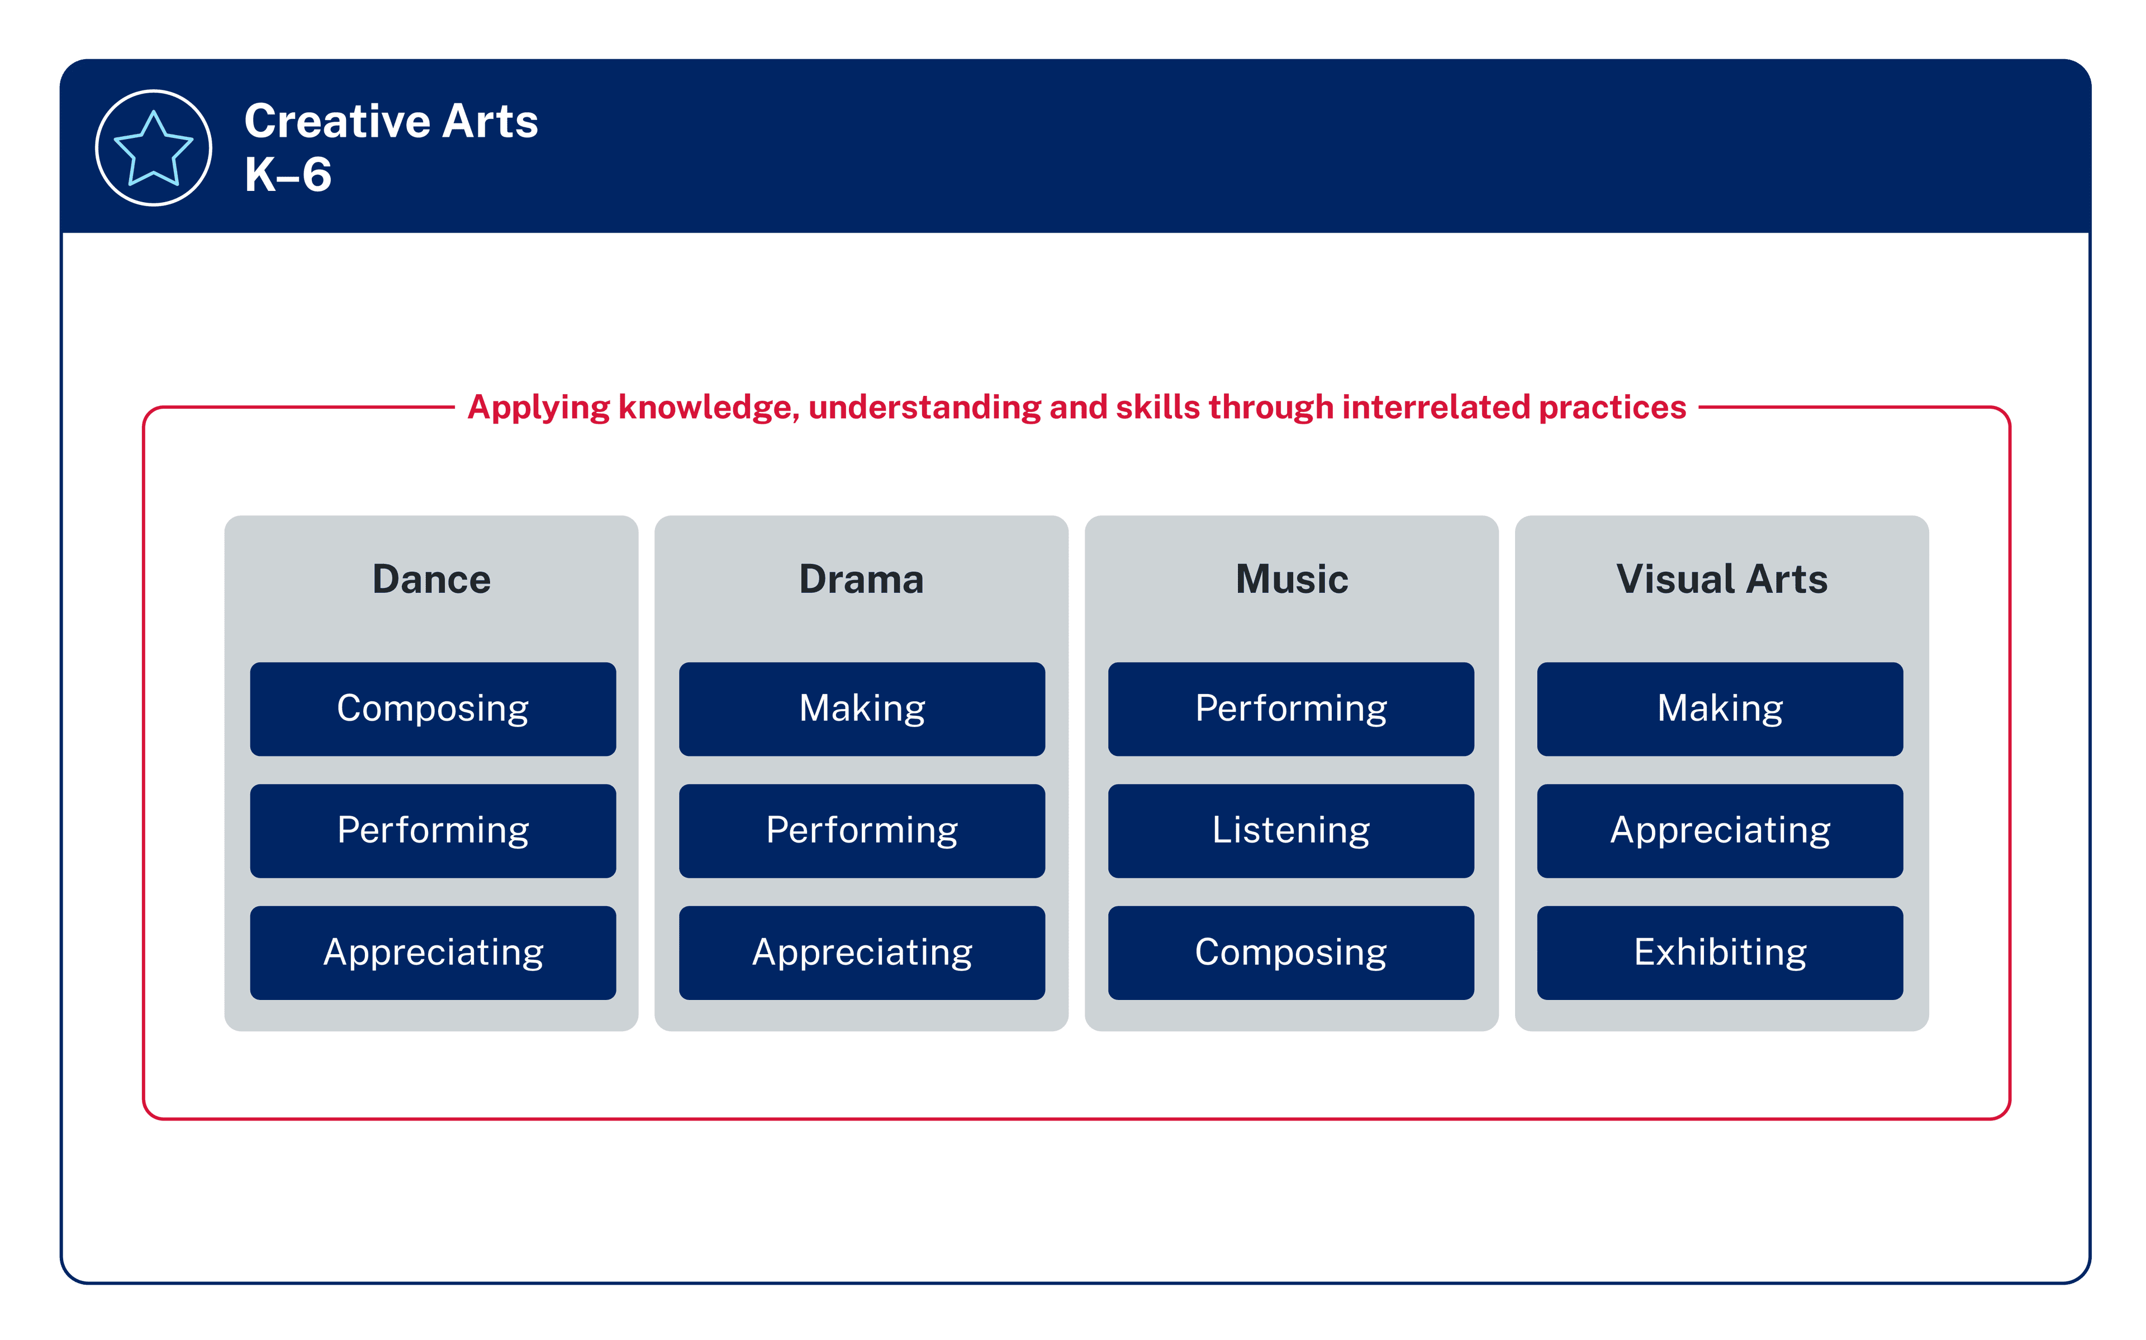
Syllabus organisation
Focus areas
Content groups that highlight the essential arts practices
Notes:
6. Purpose: To provide an overview of the syllabus organisation, revisiting key messaging from the Term 1 workshop.
Time: 2 min
Presenter notes:
We will start by looking at the organisation of the Creative arts syllabus.
The focus areas of creative arts are:
[CLICK] Dance, Drama, Music, and Visual Arts. Whilst each focus area has a distinct body of knowledge, connections exist across the focus areas.
[CLICK] The red line surrounding the syllabus organisation diagram emphasises the importance of students applying knowledge, understanding, and skills through the interrelated practices of each focus area.
[CLICK] The content groups, shown in the dark blue boxes, highlight the interrelated arts practices for each focus areas. [Presenter to model an example]. These are not meant to be taught in a linear, sequential way. They clarify what is essential for students to know, understand, and do in creative arts.
Learning experiences should support students to make connections between content groups within each focus area. This will assist students to apply their learning in meaningful and creative ways.
[CLICK] Within each focus area, essential content makes clear what students are expected to know, understand and do. The content addresses the outcomes in the focus area. No single content point alone will enable a student to demonstrate an outcome.
There is a balance of syllabus content across dance, drama, music and visual arts. This means that that all focus areas should be given approximately equal teaching time to support students in achieving syllabus outcomes. It is up to individual schools to determine how to achieve this balance among the four focus areas in a way that suits their unique context.
[NEXT SLIDE]

Slide 7
The elements
Dance
space, time, dynamics
Drama
role, character, tension, situation, space, time,
structure, language, atmosphere, symbol
Dance
Drama
Focus Areas
Music
Visual arts
Music
duration, pitch, texture, performing media, timbre, dynamics, expression,
structure
Visual arts
Elements of art
line, shape, form, space and perspective, colour, tone, texture
Visual arts
Elements of design
rhythm and movement, balance, unity, contrast, emphasis, proportion, signs and symbols, repetition and pattern
Notes:
7. Purpose: To identify the elements of dance, drama, music and visual arts.
Time: 3 mins
Presenter notes:
The elements of each focus area are fundamental to learning in creative arts.
By understanding how to recognise and manipulate the elements of each focus area, students develop the skills and vocabulary to create, interpret and respond to artistic works.
The teaching advice in the syllabus includes definitions, focus questions, and vocabulary examples to support student learning and deepen understanding.
The introduction and progression of the elements across the stages of learning builds the foundational understandings which are further developed in 7-10 syllabus.
[CLICK] In dance, students explore how the components of space, time and dynamics help to structure movement, express ideas, and respond to the dances of others.
[CLICK] In drama, students develop understanding of how the dramatic elements are used to build stories, shape meaning, and interpret dramatic action.
[CLICK] In music, students learn about and use the elements of duration, pitch, texture, performing media, timbre (pron. tam-ba), dynamics, expression and structure to compose, perform, and respond to music in meaningful ways.
[CLICK] In visual arts, students learn how artists can use the elements of art and design to communicate ideas and intent.
[CLICK] Knowledge, understanding and skills in the elements progresses from Early Stage 1 to Stage 3. Syllabus content builds on prior learning about the elements, and in some focus areas, new elements are introduced.
The syllabus teaching advice provides further support in the introduction and progression of the elements.
[NEXT SLIDE]

Slide 8
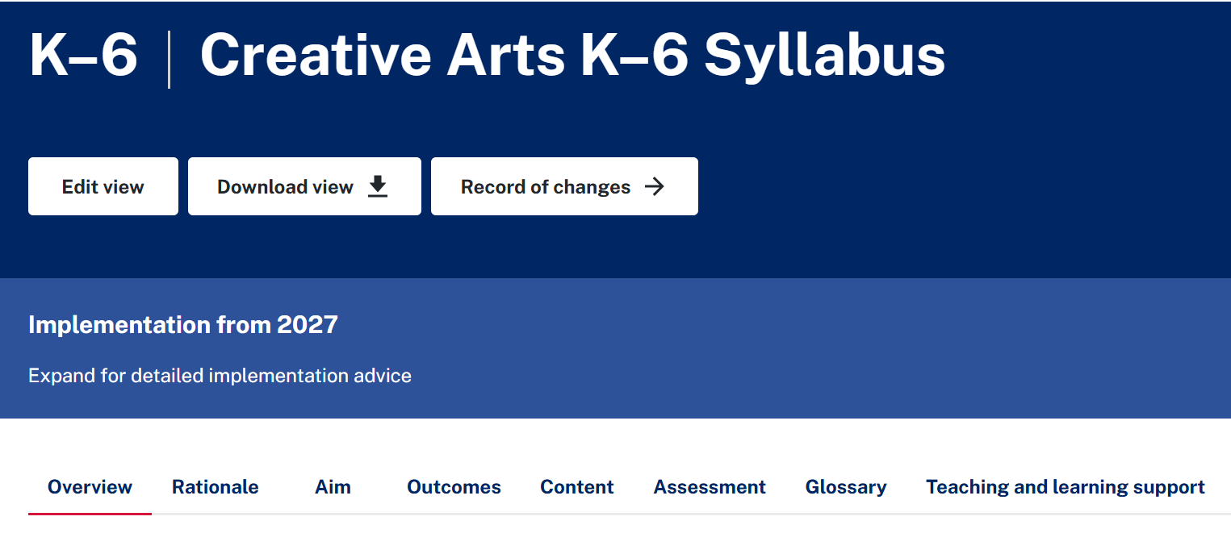
How does the syllabus address the elements? (1)
Notes:
8. Purpose: To provide a live walkthrough of the digital platform so participants can identify and locate evidence of the elements within syllabus content, teaching advice and examples.
Time: 3 mins
Presenter notes:
We will now conduct a walkthrough of the Creative Arts K-6 Syllabus, highlighting the inclusion of the elements within syllabus content, teaching advice and examples.
Invite participants to open to open the syllabus using the link in their workbook and follow along.
[CLICK] Let's start by selecting the ‘content’ tab.
[NEXT SLIDE]

Slide 9
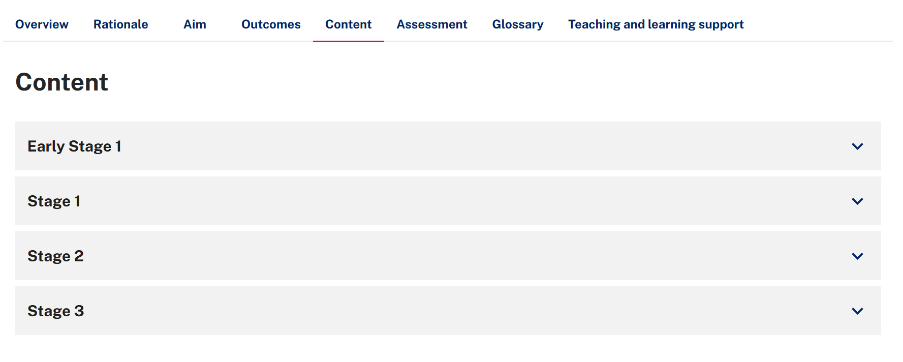
How does the syllabus address the elements? (2)
Notes:
9. Purpose: To provide a walkthrough of the digital platform so participants can identify and locate evidence of the elements within syllabus content, teaching advice and examples.
Time: 1 min
Presenter notes:
Syllabus content represents the essential learning within each focus area. [CLICK] In this example, we will use Stage 1 syllabus content within the focus area of dance as our example.
Important to note: The content addresses the outcomes in the focus area. No single content point alone will enable a student to demonstrate an outcome. NESA refers to the essential content and outcomes as 'firm friends'.
[NEXT SLIDE]

Slide 10
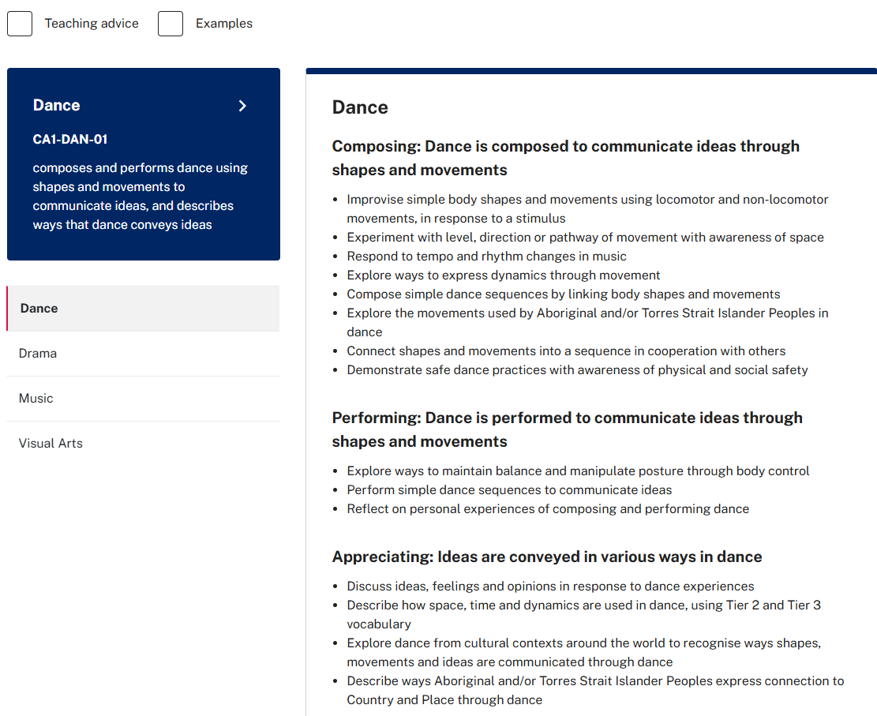

How does the syllabus address the elements? (3)
Notes:
10. Purpose: To provide a walkthrough of the digital platform so participants can identify and locate evidence of the elements within syllabus content, teaching advice and examples.
Time: 1 min
Presenter notes:
The content point ‘experiment with level, direction, or pathway of movement with awareness of space’ highlights some of the components of space that Stage 1 students can experiment with when composing dances.
[NEXT SLIDE]

Slide 11
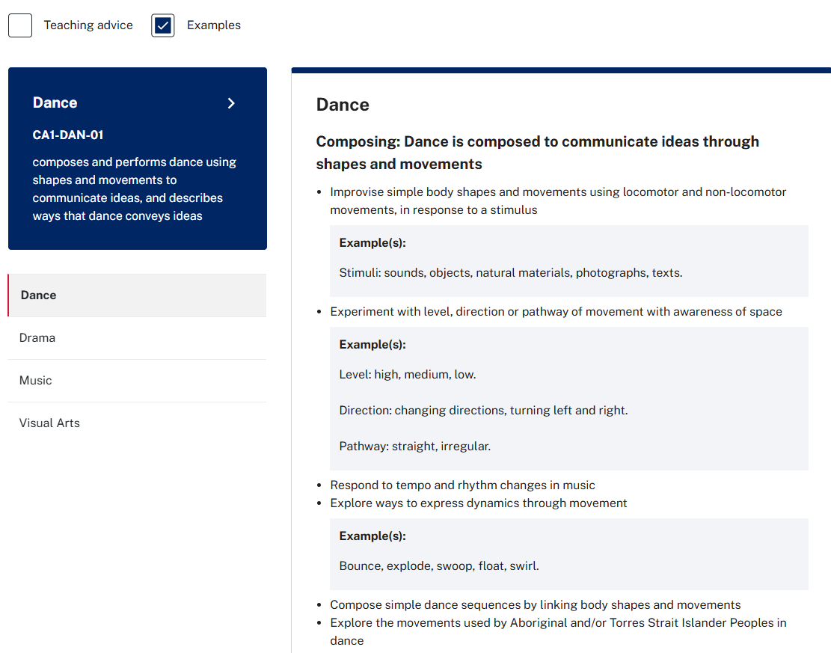
How does the syllabus support teaching the elements? (1)
Notes:
11. Purpose: To provide a walkthrough of the digital platform so participants can identify and locate evidence of the elements within syllabus content, teaching advice and examples.
Time: 1 min
Presenter notes:
The examples in the syllabus provide additional information and guidance to support teaching and learning.
[CLICK] Access the examples by selecting the button at the top of the content. The examples for this content point show relevant vocabulary and ideas to support students in experimenting with level, direction and pathway of movement.
[NEXT SLIDE]

Slide 12
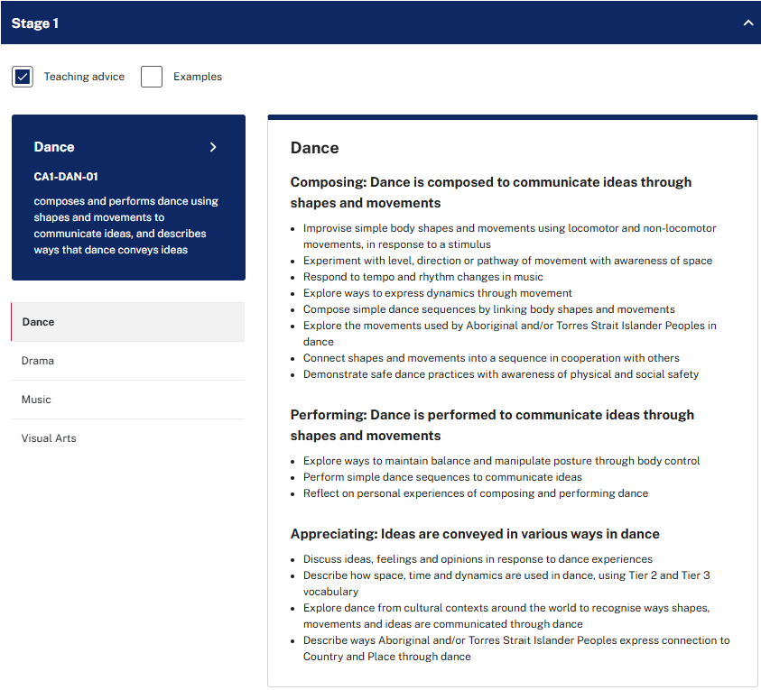
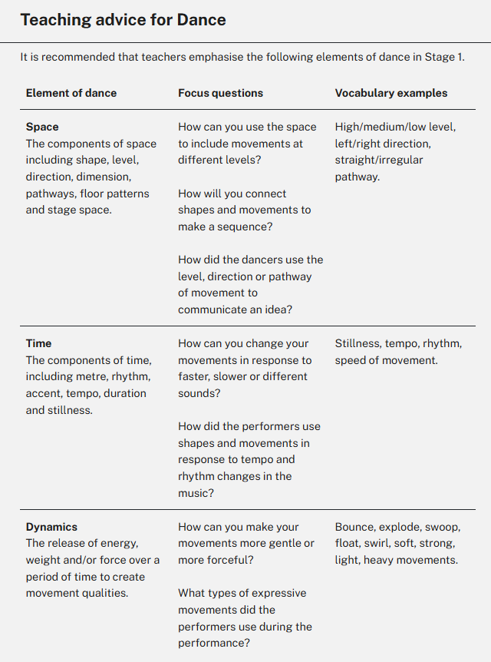
How does the syllabus support teaching the elements? (2)
Notes:
12. Purpose: To provide a walkthrough of the digital platform so participants can identify and locate evidence of the elements within syllabus content, teaching advice and examples.
Time: 1 min
Presenter notes:
The teaching advice provides additional information and advice to support teaching the content in each focus area. The teaching advice outlines the elements of dance, drama and music for each stage of learning. It also includes key focus questions and examples of tier 2 and 3 vocabulary.
For our Stage 1 dance example, explicitly teaching the language and vocabulary of the elements of dance – space, time and dynamics – helps students understand and describe dance as they learn to compose, perform and appreciate it.
[NEXT SLIDE]

Slide 13

Activity – scavenger hunt
Your turn
  This activity will support you to examine the elements in greater detail.
  Open the digital Creative Arts K–6 Syllabus (2024)
  Use the questions on the next slide to explore
  the content, examples, and teaching advice
  Record your responses in your workbook
Notes:
13. Purpose: To introduce activity 1: scavenger hunt.
Time: 2 mins
Presenter notes:
We are now going to explore the syllabus by engaging in a scavenger hunt. This activity is an opportunity for you to examine the elements in greater detail by exploring the syllabus content, examples and teaching advice. If you haven’t already, take a moment to access the digital syllabus. I recommend bookmarking this page to return to later.
[NEXT SLIDE]

Slide 14
Activity – scavenger hunt
Drama
  Use the teaching advice to identify the dramatic elements
  as they are introduced in each stage.
Dance
  What vocabulary examples are suggested for the element
  of dynamics in Stage 1?
Music
  In Stage 2 music, which element is defined as 'the relative highness or lowness of sounds’?
Visual
arts
  In Stage 3 visual arts, what content point explicitly references the elements of art and design? What examples are provided?
Notes:
14. Purpose: Time to navigate the syllabus to locate information on the elements of dance, drama and music and visual arts
Time: 12 mins
We will use the questions on this slide to explore the inclusion of the elements in the syllabus. You will find a copy of these questions on page 33 of your workbook.
This activity should take approximately 10 minutes. You can use your workbook to record your responses.
We will now begin our scavenger hunt.
Thank you for engaging in this activity. Let’s examine the answers together.
[NEXT SLIDE]

Slide 15
Identify the dramatic elements
Drama
  Use the teaching advice to identify the dramatic elements as they are introduced
  in each stage.
ANSWERS
ES1 – role, character, situation
S1 – role, character, situation, language, space, time
S2 – role, character, situation, language, space, time, structure, tension
S3 – role, character, situation, language, space, time, structure, tension, atmosphere, symbol
Notes:
15. Purpose: Time to walk through the answers for each of the questions in the scavenger hunt.
Time: 4 minutes (total)
ANSWERS:
I will now walk you through answers for each of the questions.
Question 1: Drama
[CLICK]
In ES1, the dramatic elements are– role, character, situation
In S1 the dramatic elements include– role, character, situation, language, space, time
In S2 they are– role, character, situation, language, space, time, structure, tension
And in S3– role, character, situation, language, space, time, structure, tension, atmosphere, symbol
As outlined in the syllabus, new elements are introduced progressively from ES1 to S3, while the complexity of existing elements is developed further. This progression is clearly outlined in the teaching advice.
You may have noticed that the progression of elements develops differently across each focus area, particularly in terms of when new elements are introduced and how their complexity builds on prior learning.
It is important to highlight that the syllabus content is designed to be coherent, and carefully sequenced. This intentional structure helps build students' vocabulary and enriches their background knowledge, equipping them to tackle increasingly complex concepts and language as they advance in their learning journey.
[NEXT SLIDE]

Slide 16
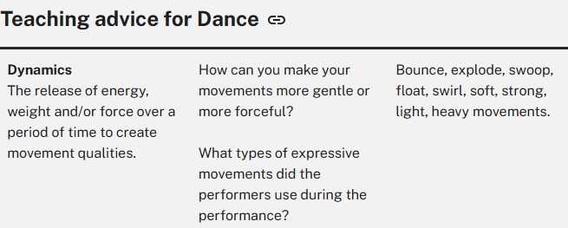
Teaching advice for dance
Dance
  What vocabulary examples are suggested for the element of dynamics in Stage 1?
Notes:
16. Purpose: Time to walk through the answers for each of the questions in the scavenger hunt.
Time: 4 minutes (total)
ANSWERS:
Question 2: Dance
The vocabulary examples suggested for dynamics in stage 1 dance are:
[CLICK] Bounce, explode, swoop, float, swirl, soft, strong, light, heavy movements.
[NEXT SLIDE]

Slide 17
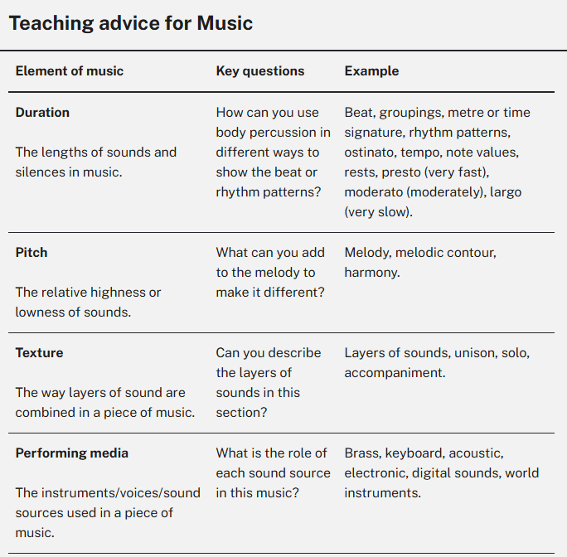
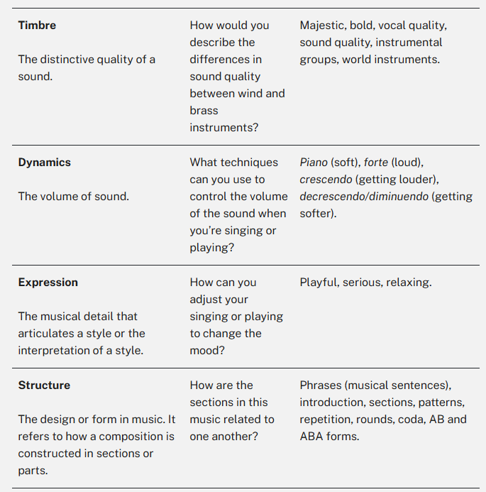
Teaching advice for music
Music
  In Stage 2 music, which element is defined as 'the relative highness or lowness of sounds’?
Notes:
17. Purpose: Time to walk through the answers for each of the questions in the scavenger hunt.
Time: 4 minutes (total)
ANSWERS:
Question 3: Music
ANSWERS:
Question 3: Music
In Stage 2 Music, (click) pitch is the element defined as 'the relative highness or lowness of sounds’.
[NEXT SLIDE]

Slide 18
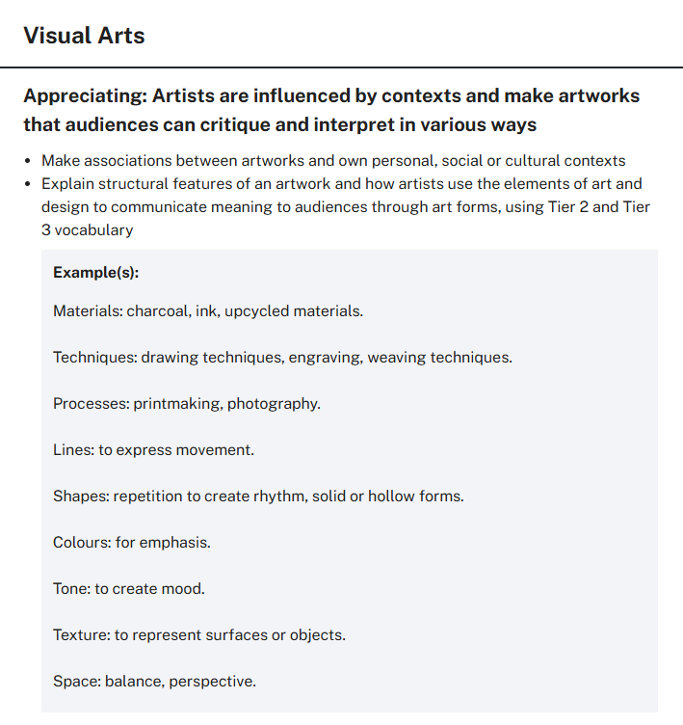
Teaching advice for visual arts
Visual
Arts
  In Stage 3 visual arts, what content point explicitly references the elements of art and design? What examples are provided?
Notes:
18. Purpose: Time to walk through the answers for each of the questions in the scavenger hunt.
Time: 4 minutes (total)
ANSWERS:
Question 4: VA
In Stage 3 visual arts, the content point that explicitly references the elements of art and design asks students to:
[CLICK] Explain structural features of an artwork and how artists use the elements of art and design to communicate meaning to audiences through art forms, using Tier 2 and Tier 3 vocabulary
[CLICK] Examples of the elements of art and design include:
Lines: to express movement.
Shapes: repetition to create rhythm, solid or hollow forms.
Colours: for emphasis.
Tone: to create mood.
Texture: to represent surfaces or objects.
Space: balance, perspective.
[NEXT SLIDE]

Slide 19
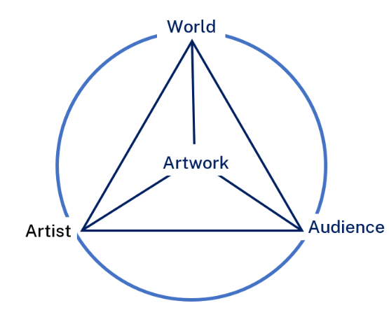
What are the artworld concepts?
Artist – Artists make artworks, either individually or in groups. Students are artists when they create artworks.
Artwork – Artworks are made by artist. They reflect the artist's ideas, choices and intentions.
World – Artists, artworks and the audience are influenced by the world, time and environment around them.
Audience – An audience is anyone who views an artwork in physical or digital from. Audiences can interpret artworks in various ways.
Figure 1: Artworld concepts diagram (NESA, 2024)
Notes:
19. Purpose: To support participants to understand and become familiar with the artworld concepts in visual arts.
Time: 4 mins
Presenter notes:
We will now explore the artworld concepts as they relate to learning in visual arts.
The artworld concepts are a conceptual framework that highlight the relationships between artists, artworks, the world and audiences. Understanding the artworld concepts assists students to represent subject matter or ideas with intent, for diverse audiences.
Let's take a closer look at the artworld concepts.
[CLICK] Artists: Students explore the role of artists as creators who express their ideas, feelings, and cultural narratives through their work. Understanding this helps students appreciate the intention behind an artwork.
[CLICK] Artworks: Students consider how artworks communicate the artist's ideas, choices and intentions. They reflect on the use of forms, materials and techniques to consider the meanings they convey.
[CLICK] World: Artists, artworks and the audience are influenced by the world, time and environment in which they exist. An artist's experience of the world influences their artmaking practice. An audience's experience of the world influences the way they value and interpret artworks.
[CLICK] Audiences: An audience is anyone who views an artwork. Students consider how individual experiences and perspectives can influence how audiences engage with and interpret artworks .
[CLICK] Through the artworld concepts, students develop an understanding of the ways subject matter and ideas about the world are represented in artworks and how artists communicate ideas to audiences. Making, appreciating and exhibiting art through the lens of the artworld concepts adds depth and rigour to student learning in visual arts. Students are encouraged to consider the context in which art is made and viewed and see themselves as artists. It is important for students to be aware of the way in which their own context influences the way they make, view and interpret art.
[NEXT SLIDE]

Slide 20
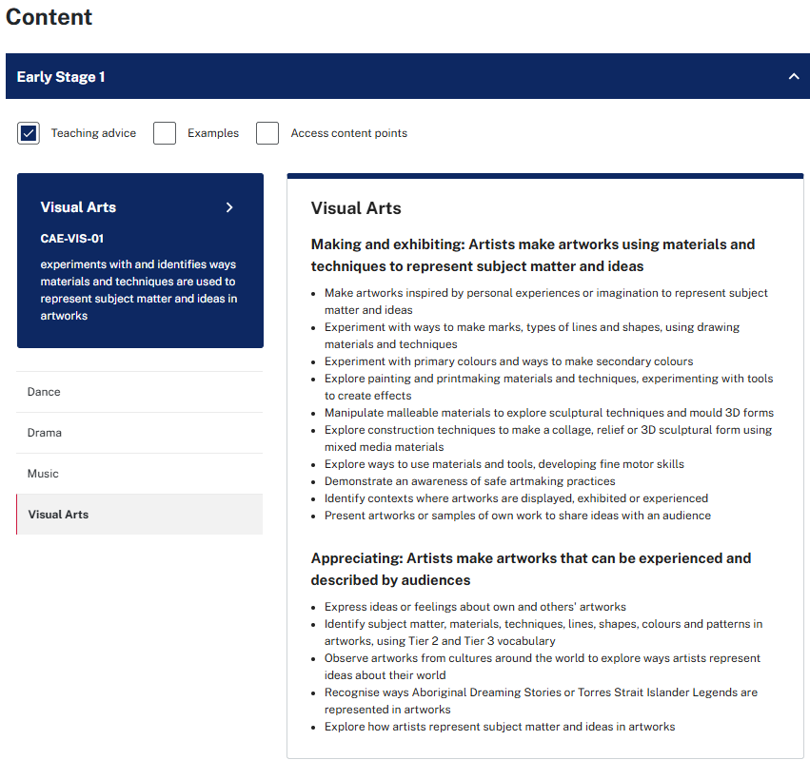
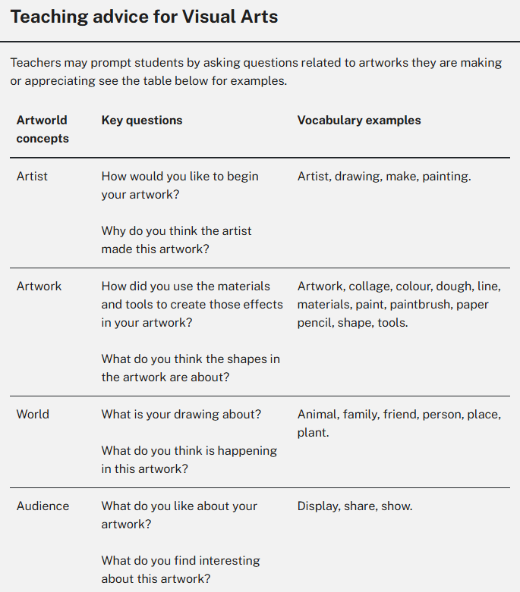
Where do we find the artworld concepts in the syllabus?
Notes:
20. Purpose: To identify where participants can locate teaching advice for artworld concepts.
Time: 1 min
Presenter notes:
We will now explore the syllabus to identify where we can find further information to support teacher understanding about the artworld concepts.
[CLICK] The teaching advice includes valuable information about artworld concepts to support teaching and learning.
[CLICK] It also includes key questions and vocabulary examples.
In the next part of the session, we will model how the elements and artworld concepts can be used to support teaching and learning in visual arts.
[NEXT SLIDE]

Slide 21
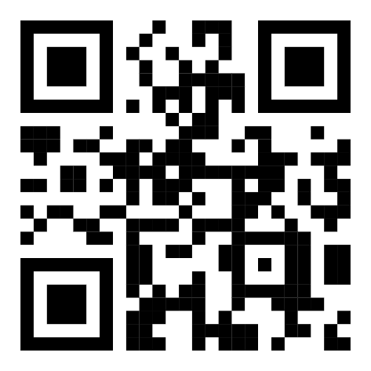
Ballarat, My Country, 2020 (1)
Marlene Gilson
Example Stage 3 content points
Explain structural features of an artwork and how artists use the elements of art and design to communicate meaning to audiences through art forms, using Tier 2 and Tier 3 vocabulary
Describe how meaning is conveyed through signs and symbols in artworks
Investigate an artist's practice and explain the roles and connections between artist, artwork, the world and audiences.
https://www.artgallery.nsw.gov.au/collection/works/77.2020/
Notes:
21. Purpose: To explore how the elements and artworld concepts can be used in practice when appreciating artworks.
Time: 4 mins
Presenter notes:
We will now examine how the elements and artworld concepts can be used in practice. Let's start with the syllabus content. This makes clear what students are expected to know, understand and do.
[CLICK] We have selected some Stage 3 content points from the Appreciating content group to inform the focus of our art appreciation.
In the classroom, we would model and scaffold an analysis of an example artwork by discussing the relevant contexts of the artwork, artist, audience and world.
[CLICK] For this example, we are using Ballarat, My Country by Marlene Gilson, which is on display at the Art Gallery of NSW. We can't display the image in this slide deck, due to copyright restrictions, however if you scan the QR code, it will take you to the Art Gallery of NSW Website, where you can view the artwork. Take a moment to observe the artwork. What do you notice?
[Provide time for participants to share their observations.]
By sharing background information about artworks, artists and the world they are representing, teachers can support students can gain a deeper understanding of why artists have made particular choices and how meaning can be shared through artworks. For example:
Marlene Gilson is a Wathaurung artist known for her storytelling style of painting. Her work challenges the dominant versions of Australia’s history by re-inserting Aboriginal voices and perspectives that have often been left out.
In this painting, Marlene shares stories passed down through her family—focusing on life on Country during the gold rush.
Marlene's paintings are rich in detail and symbolism. In this work, she includes real people, places, and events—like John Ah Loo’s restaurant, the Cobb and Co coaches, Chinese market gardens, Aboriginal families, and even small touches like a woman harvesting murnong daisies. These details carry cultural and historical significance, highlighting stories often left out of history.
There are also strong connections to HSIE, particularly the gold rush and its impact on colonial life in Australia.
This is a great example of how creative arts can connect with broader curriculum learning while deepening students’ understanding of history, culture, and artistic practice.
[NEXT SLIDE]

Slide 22

Ballarat, My Country, 2020 (2)
Marlene Gilson
I see …
What do you see when looking at the artwork? How has the artist used colour, line and symbol? (artwork)
I think …
What is the subject of this painting and what makes you think that? What meaning is the artist trying to convey? Why? (artist, artwork)
I feel …
How does the artwork make you feel? How did hearing about the artist and artwork change how you view the painting? (audience)
I wonder …
How are the artist’s personal ideas or experiences represented in the artwork? How might my personal context influence the way I view the art? (artist, world, audience)
Notes:
22. Purpose: To explore how the artworld concepts can be used in practice when analysing an artwork.
Time: 3 mins
Presenter notes:
Visible thinking routines like See, Think, Feel, Wonder, combined with effective questioning, encourage students to analyse artworks and interpret meaning through the lens of the elements and artworld concepts. In a classroom context, you could use background knowledge of the artwork, artist, world and audience and 'Think-alouds' to scaffold analysis of the artwork.
Take a moment to read the example questions. In the brackets, you will see each of the artworld concepts that are related to the questions.
[Pause - 30 seconds to allow the group to read the questions]
When discussing artworks with students, the artist's intention must be represented. It is important that we consider and understand the lens we bring to viewing and interpreting art. Similarly, it is important that we encourage students to consider their context and how this may influence the way they view and interpret art. This analysis of a chosen artwork is part of the creative process. Making art then springboards from this, ensuring that the focus is on creating art - not replication or imitation.
This approach supports students to engage critically with artworks, connect personally with what they see, and deepen their understanding of how the elements and artworld concepts work together.
These example questions are included in your workbook for reference, as well as an alternative approach with another example artwork.
[NEXT SLIDE]

Slide 23

Activity
Your turn
  This activity will support you to examine the elements and artworld concepts in greater detail.
  Select an artwork.
  Access the syllabus. Select content from the Appreciating and Making content groups.
  Develop guiding questions to scaffold student appreciation of an artwork through the lens of the elements and artworld concepts.
  Plan learning experiences for 'Making' content based on the chosen artwork.
Elements and artworld concepts
Notes:
23. Purpose: To provide time for participants to engage with the Creative Arts Syllabus (2024) and deepen understanding of the elements and artworld concepts.
Time: 23 mins
Presenter notes:
This activity provides you with an opportunity to deepen and apply your understanding of the elements and artworld concepts. You will develop an activity that incorporates effective questioning and/or visible thinking routines to enhance visual arts learning in your classroom.
This activity can be completed individually or collaboratively in teams.
1. Select an artwork. You can refer to the examples provided in the workbook or select an artwork that you are familiar with or plan to use in an upcoming lesson.
2. Identify content points. Select a stage and use the syllabus to identify the appreciating and making content points that will drive your learning experiences.
3. Develop guiding questions: Consider questions that will scaffold the analysis of the artwork through the lens of the elements and artworld concepts. Feel free to refer to the modelled examples in the workbook.
4. Plan learning experiences: If time allows, consider how you could design learning experiences based on the chosen artwork to support the teaching of a 'Making' content point. For example:
What themes are communicated through the artwork? For instance, Marlene Gilson explores themes of life on Country during the gold rush, highlighting stories of cultural and historical significance that are often overlooked.
How could you experiment with the artist's processes and practices, including forms, techniques, and materials? For example, Gilson's paintings are rich in detail, symbolism, and storytelling. In her work, she incorporates real people, places, and events, using acrylic paint on linen.
5. Please note: As reflected in the artworld concepts, we want students to see themselves as artists. When planning learning that focuses on artmaking, it is important to avoid imitation or replication, but rather use understanding of the elements and artworld concepts to support students in communication and self-expression through their own creative practice.
Please complete the activity on your screen. You may only complete one or two parts, that’s ok, but it will serve as a solid starting point for further planning. I will leave a copy of the instructions on the screen, but just a reminder, there are also instructions and links in your workbook. Please allow approximately 20 minutes to engage in this activity.
[NEXT SLIDE]

Slide 24
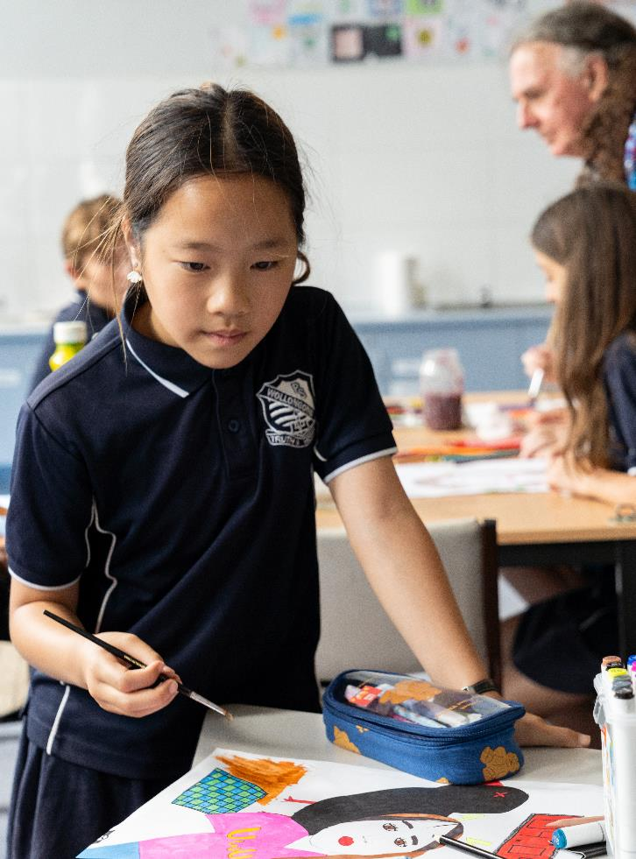
Reflect
Connect – How did the information presented today connect to what you already know?
Extend – How did it extend your thinking? What new learning emerged for you?
Challenge – What challenges or puzzles emerged for you?
Notes:
24. Purpose: to support participants to make connections between new ideas and prior knowledge.
Time: 2 mins
Presenter Notes:
Connect, extend, challenge is a great routine to make connections between new ideas and prior knowledge. Take a moment to reflect on what we have learned about the elements and artworld concepts in the Creative Arts K-6 Syllabus. Feel free to discuss with those around you or record your thoughts in your workbook.
[NEXT SLIDE]

Slide 25
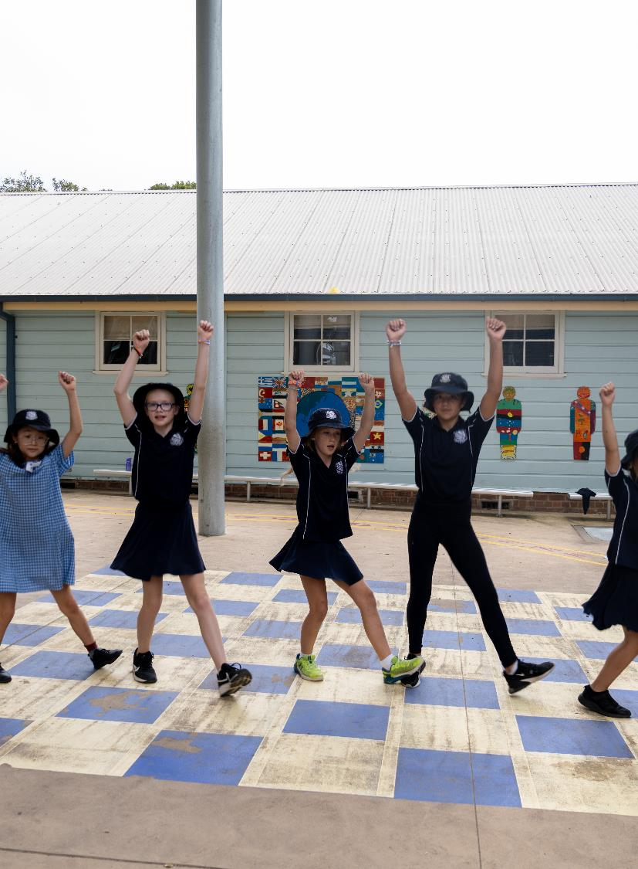
Key takeaways (4)
Consider:
How will you use the elements and artworld concepts to support the development of artistic and aesthetic knowledge, understanding and skills?
How will you share your understanding of the elements and artworld concepts with colleagues?
Notes:
25. Purpose: To reflect on the key takeaways of the creative arts presentation.
Time: 1 min
Presenter notes:
We hope that we have supported you to explore how the elements and artworld concepts in the Creative arts K–6 syllabus contribute to building knowledge, understanding and skills. The reflection questions on screen could help guide your next steps.
[NEXT SLIDE]

Slide 26
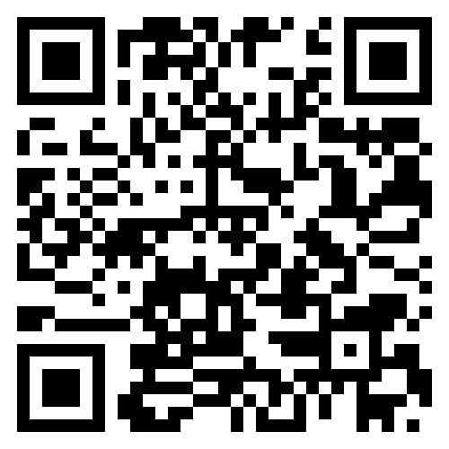
Contact us
Primary Curriculum Statewide Staffroom
primarycurriculum@det.nsw.edu.au
Notes:
26. Purpose: Contact details for the Primary Curriculum team
Time: 30 sec
Presenter notes:
If you have any questions or would like to reach out to the Primary Curriculum team, please contact us via this email address, or through the Statewide Staffroom.
This QR code takes you to the enrolment page to join the statewide staffroom.
[NEXT SLIDE]

Slide 27
Copyright
© State of New South Wales (Department of Education), 2025
The copyright material published in this resource is subject to the Copyright Act 1968 (Cth) and is owned by the NSW Department of Education or, where indicated, by a party other than the NSW Department of Education (third-party material).
Copyright material available in this resource and owned by the NSW Department of Education is licensed under a Creative Commons Attribution 4.0 International (CC BY 4.0) license.
This licence allows you to share and adapt the material for any purpose, even commercially.
Attribution should be given to © State of New South Wales (Department of Education), 2025.
Material in this resource not available under a Creative Commons licence:
the NSW Department of Education logo, other logos and trademark-protected material
Material owned by a third party that has been reproduced with permission. You will need to obtain permission from the third party to reuse its material.
Links to third-party material and websites
Please note that the provided (reading/viewing material/list/links/texts) are a suggestion only and implies no endorsement, by the New South Wales Department of Education, of any author, publisher, or book title. School principals and teachers are best placed to assess the suitability of resources that would complement the curriculum and reflect the needs and interests of their students.
If you use the links provided in this document to access a third party’s website, you acknowledge that the terms of use, including licence terms set out on the third-party’s website apply to the use which may be made of the materials on that third-party website or where permitted by the Copyright Act 1968 (Cth). The department accepts no responsibility for content on third-party websites.

