Slide 1

CHPS sample units: from planning to practice
Stage 1
October 2025
Notes:
1. Purpose: Title slide
Time: 1 minute
Presenter notes:
Welcome to Term 4 Professional Learning on CHPS sample units: From planning to practice.
[NEXT SLIDE]

Slide 2

Acknowledgement of Country
We recognise the Ongoing Custodians of the lands and waterways where we work and live. We pay respect to Elders past and present as ongoing teachers of knowledge, songlines and stories. We strive to ensure every Aboriginal and Torres Strait Islander learner in NSW achieves their potential through education.
Artwork © Kayleb Waters,Gomeroi artist and Cultural mentor 2025. This image represents Aboriginal Cultures. “This symbol is represented by a hand stencil painted in caves, showing our enduring connection to Country and story.”​
Notes:
2. Purpose: Acknowledgement of Country
Time: 2 minutes
Presenter notes:
I acknowledge the Traditional Custodians of the many lands we are joining from today across New South Wales. I am presenting today from Awabakal Country, and I pay my respects to Elders past and present and extend that respect to all Aboriginal and Torres Strait Islander colleagues with us today.
As we engage in this professional learning focused on curriculum and teaching practice, we are reminded that the NSW syllabuses strengthen the inclusion of Aboriginal histories, cultures and perspectives. This is not only an educational requirement—it is a responsibility. It invites us to teach in ways that honour truth, embed cultural integrity, and recognise the diversity of Aboriginal Nations across NSW.
Today is also a reminder that deepening our understanding of Aboriginal content is not a single lesson or unit—it is a commitment to practice. It requires ongoing learning, respectful collaboration with local communities, and ensuring that Aboriginal perspectives are embedded meaningfully, not as a token, but as a thread woven throughout learning. May we continue to walk together, listen deeply, and create classrooms where every student sees themselves and their culture respected and valued.
[NEXT SLIDE]

Slide 3
Australian Professional Standards for Teachers
Standard descriptors
6.2 – Engage in professional learning and improve practice
6.2.2 – Participate in learning to update knowledge and practice, targeted to professional needs and school and/or system priorities
6.3 – Engage with colleagues and improve practice
6.3.2 – Contribute to collegial discussions and apply constructive feedback from colleagues to improve professional knowledge and practice
Notes:
3. Purpose: To outline the teaching standards addressed in this professional learning.
Time: 30 seconds
Presenter notes:
On the slide you will see the Australian Professional Standards for Teachers that today’s professional learning will be addressing.
[NEXT SLIDE]

Slide 4





Purpose
Outcomes
By the end of this workshop, participants will:
The purpose of this session is to understand the common lesson structure of CHPS sample units and plan effectively for next steps in 2026.
preview the sample units prior to release
develop a clear understanding of what is required for 2026 readiness at year and stage level
deepen their understanding of unit and lesson structures
identify practical next steps for successful syllabus implementation at their school.
Notes:
4. Purpose: To introduce the purpose and outcomes for the workshop.
Time: 2 minutes
Presenter notes:
On the screen you can see the purpose and outcomes of the session.
Today, the professional learning will explore sample units across the four key learning areas to understand the common lesson structure that supports effective teaching and learning. Then examine how key unit features guide our planning for assessment and differentiation, ensuring all students’ needs are met. Additionally, discuss the organisation of school-ready resources for Term 1, 2026, so that teaching materials are readily accessible. Then highlight the importance of key vocabulary lists to support EAL/D students and enhance whole-class planning. Last, identify next steps for 2026 readiness at both year and stage levels, outlining clear actions for leaders and classroom teachers to ensure a smooth and successful start
For multi-age schools, implementation of the new syllabuses can be deferred until they are mandatory in 2027. Early adoption is possible, though supporting resources may be limited. Primary Curriculum acknowledge the unique challenges of multi-age settings and will provide ongoing communication and support to assist with planning and integration. The extended familiarisation period offers time to adapt units thoughtfully to diverse classroom contexts while preparing for mandatory implementation.
[NEXT SLIDE]

Slide 5

Activity
Feedback
Have you reviewed any of the sample English and mathematics units released?
Are you currently implementing any aspects of the new CHPS syllabuses, or do you plan to do so soon?
Have you ever thought about how the Department develops these sample units?
Notes:
6. Purpose: To engage with participants through questioning and reaction buttons.
Time: 5 minutes
Presenter notes:
To begin our session, I’d like to get a sense of where everyone is at, in relation to the new CHPS syllabuses. I will ask some questions to help understand your current engagement and experiences.
[CLICK] Have you reviewed any of the sample English and mathematics units released?
[CLICK] Are you currently implementing any aspects of the new syllabus, or do you plan to do so soon?
[CLICK] Have you ever thought about how the Department develops these sample units?
[NEXT SLIDE]

Slide 6

Common lesson structures across the four key learning areas
Notes:
6. Purpose: To preview commonalities in CHPS units.
Time: 10 seconds
Presenter notes:
The session will explore common lesson structures across the four key learning areas to show you their consistent look and feel and explain how the key sample unit features support explicit teaching, assessment and differentiation.
[NEXT SLIDE]

Slide 7

3 pillars of resource development
CHPS Sample Units
Evidence based principles
Purposeful design
Practical classroom support
Notes:
7. Purpose: To reinforce the 3 pillars of resource development.
Time: 2 minutes
Presenter notes:
When the Primary Curriculum team talk about the design of CHPS sample units, it is important to understand that everything created is grounded in three key pillars: evidence-based principles, purposeful design, and practical classroom support. These pillars guide the work from initial concept through to final delivery, ensuring high quality, impactful, and genuinely useful resources for teachers and students.
First pillar is evidence-based principles.
This means every resource is informed by current research, best practice, and data on what works in improving student learning. Developers engage with educational research and curriculum policy, so the work aligns with system priorities and supports consistent, high-quality teaching. By embedding evidence from the outset.
Second pillar is purposeful design.
This is about intentionality designing resources with a clear purpose, logical structure, and strong alignment to syllabus outcomes and learning progressions. The focus is on clarity, accessibility, and coherence so that teachers can easily see how each part connects to the bigger picture.
Third pillar is practical classroom support.
Teachers need resources they can confidently pick up and use. The materials are created to be adaptable and supportive of diverse learners. Built in are clear instructions, scaffolds, differentiation suggestions, and assessment checkpoints so teachers can focus on teaching rather than creating resources from scratch.
[NEXT SLIDE]

Slide 8
Why consistency matters
CHPS Sample Units
Creative arts
HSIE
PDHPE
Science and Technology
Notes:
8. Purpose: To explain why consistency matters across the CHPS units
Time: 1 minute
Presenter notes:
Let’s take a moment to set the scene and explain why consistency across these units is so important. The sample units play a central role in supporting schools as we move toward the 2027 mandatory implementation of the new syllabuses. They have been designed to reflect the new syllabuses and provide leaders and teachers with practical, high-quality resources they can confidently use in classrooms.
The CHPS sample units are directly aligned with the Department’s scope and sequences, and NESA’s whole-school plan. This alignment provides clarity, prevents duplication, and helps reduce workload.
The CHPS sample units are designed to engage students, support teachers, and promote consistent, high-quality learning experiences that support explicit teaching, assessment and differentiation.
[NEXT SLIDE]

Slide 9


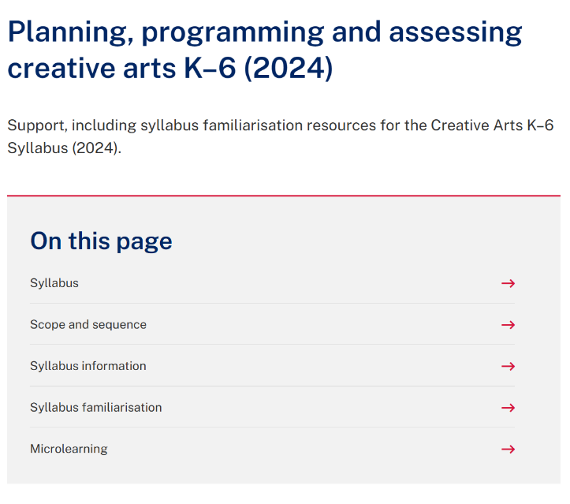
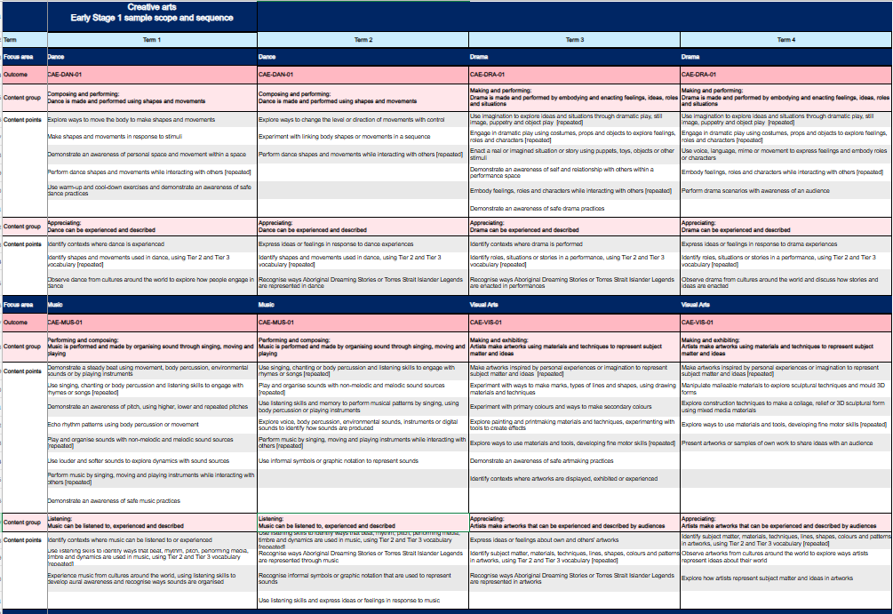
Scope and sequences
CHPS Sample Units
Notes:
9. Purpose: To highlight where to access DoE CHPS scope and sequences
Time: 30 seconds
Presenter notes:
This slide highlights where you can access the Department’s scope and sequences. You can find them by following these breadcrumbs. We have used a creative arts example on screen.
If you would like to explore scope and sequences further, the Term 3 microlearning professional learning has a focus on scope and sequences and you can access the recording and resources on demand.
[NEXT SLIDE]

Slide 10

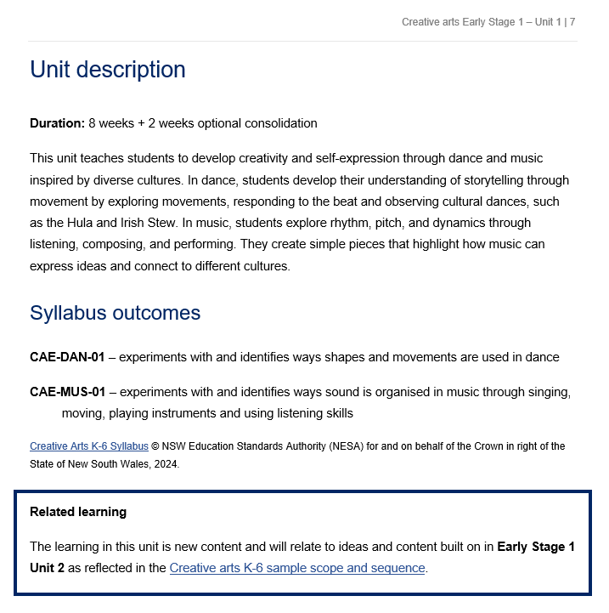
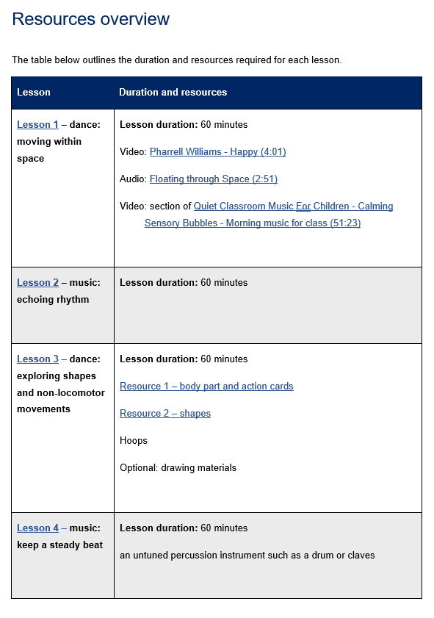
Unit and lesson structure
CHPS Sample Units
Notes:
10. Purpose: To unpack the unit and lesson structure
Time: 2 minutes
Presenter notes:
The CHPS sample units are designed as a flexible framework, just one example of how programming might look. Schools are encouraged to adapt them to suit their own context and student needs.
Each unit uses the same template, giving a consistent look and feel across all key learning areas. On page one, you’ll see the identified syllabus, stage, unit number, and focus areas.
Every unit begins with a clear description that outlines the duration of the lesson, the focus of learning, and how students will build knowledge and skills.
Related learning is highlighted to demonstrate possible connections to relevant prior learning.
Syllabus outcomes are clearly identified, ensuring every lesson is grounded in syllabus content.
Each unit also includes a resources overview, and lessons are structured as two 60-minute sessions per week, aligning with NESA’s suggested time allocation for CHPS key learning areas. This design streamlines planning, keeps expectations clear, and ensures a consistent experience for teachers and students. The resources overview makes preparation simple, everything is listed in one place, from videos and audio tracks to physical materials like hoops, percussion instruments, or action cards. This not only supports smooth planning but also helps schools plan for and manage resourcing across each term.
[NEXT SLIDE]

Slide 11
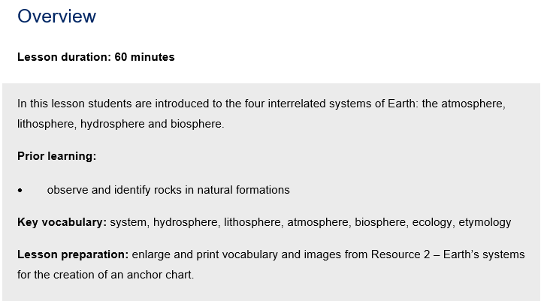
Key features of the lesson structure (1)
Overview
Science and Technology – Stage 2 – Unit 1
Notes:
11. Purpose: To unpacking Beginning the lesson
Time: 30 seconds
Presenter notes:
Each lesson in the CHPS sample units follows the same structure, ensuring consistency across all KLAs. We begin with an overview that provides a short description of the learning and identifies the prior learning the lesson builds on. This prior learning isn’t necessarily specific content points but is aligned to the syllabus content. The overview also lists the key vocabulary to be taught and highlights any preparation required.
Each lesson is 60 minutes in duration
[NEXT SLIDE]

Slide 12
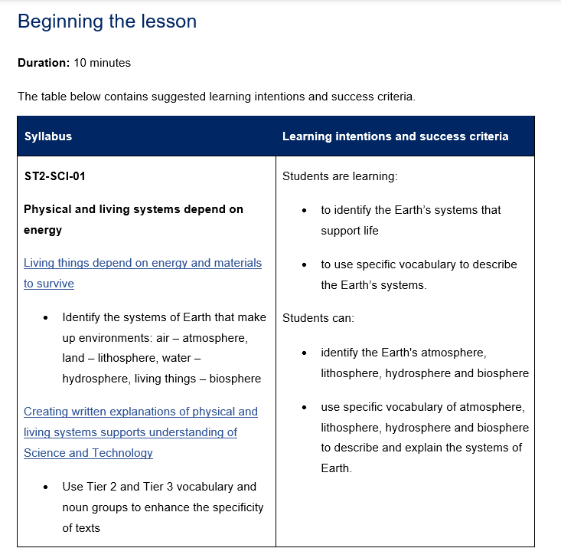
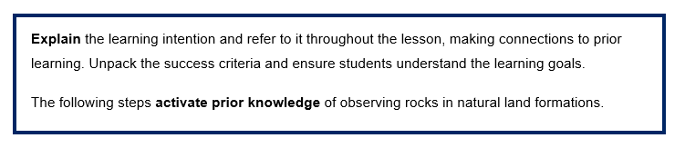
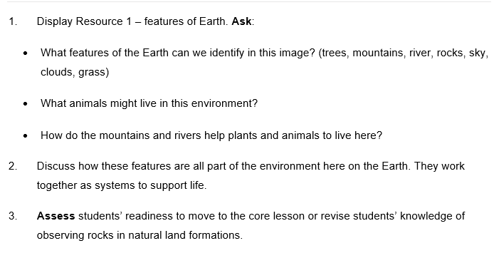
Key features of the lesson structure (2)
Beginning the lesson
Science and Technology – Stage 2 – Unit 1
Notes:
12. Purpose: To unpack Beginning the lesson
Time: 1 minute
Presenter notes:
The beginning of each lesson is usually 10 minutes duration. You will notice explicit teaching strategies embedded in the units. The learning intention and success criteria are so students know exactly what they’re working towards and how they’ll know they’ve achieved it. Making this visible is a key part of explicit teaching, it removes the guesswork and gives learning a clear purpose. This also includes activate prior knowledge. Here the focus is on students retrieving what they already know, not on reteaching content. This approach hooks into their existing schema, to prepare them for the new learning in the core lesson.
Right from the start, explicit teaching is modelled, being clear about the destination and deliberately connecting the lesson to what students bring with them.
[NEXT SLIDE]

Slide 13
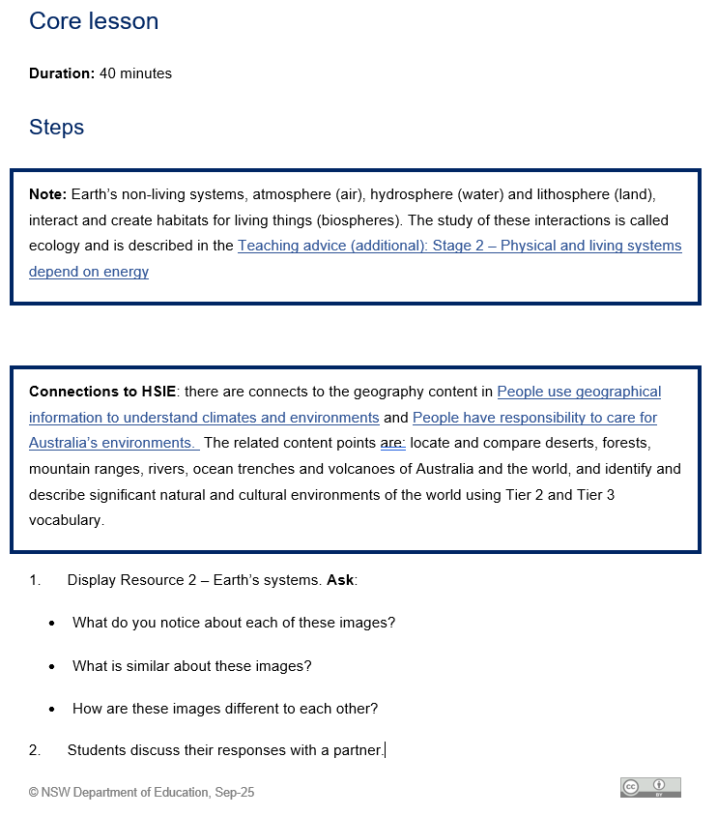
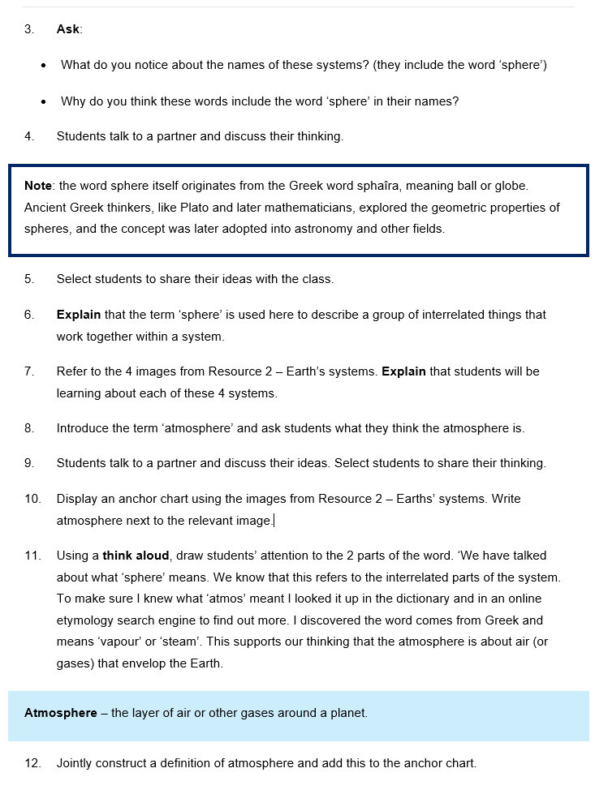
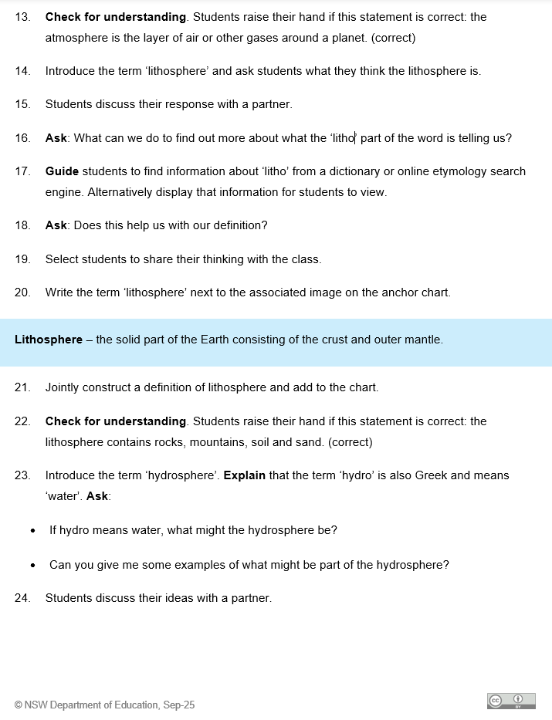
Key features of the lesson structure (3)
Core lesson
Science and Technology – Stage 2 – Unit 1
Notes:
13. Purpose: To unpack the core lesson
Time: 1 minute 30 seconds
Presenter notes:
The core lesson is planned for around 40 minutes. You will notice more explicit teaching strategies embedded here. Teachers begin by explaining and modelling the new knowledge or skill. Then students move into guided practice before working more independently, this is the Gradual Release of Responsibility in action.
The activities are tightly aligned to the learning intention. They are sequenced from simple to complex, scaffolds are gradually removed, and extension opportunities are built in, so every student is challenged at the right level.
Throughout the core lesson, teachers use checks for understanding such as questioning, response systems, or observation to monitor learning progress. These checks for understanding drive timely feedback, helping teachers adjust pace, identify areas that require re-teaching and are connected to the success criteria.
While explicit teaching strategies are central, they are balanced with a variety of other high-quality practices of collaborative learning, use of real-world contexts, inclusion of diverse backgrounds and abilities, and multimodal resources.
[NEXT SLIDE]

Slide 14
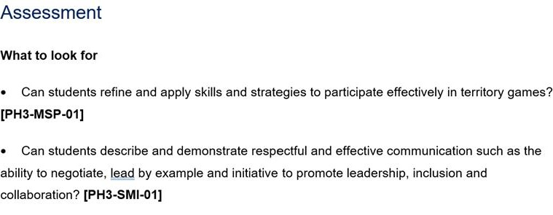
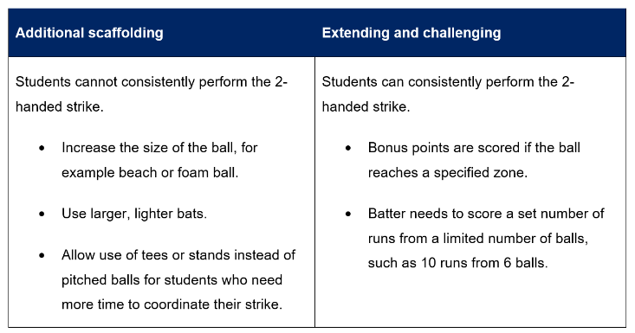
Key features of the lesson structure (4)
Differentiation and Assessment
PDHPE Stage 3 – Unit 1
Notes:
14. Purpose: To unpack differentiation and assessment
Time: 2 minutes
Presenter notes:
Each lesson includes a differentiation table to help teachers plan for the full range of learners in their classrooms. It provides practical examples of additional scaffolds for students who need more support, as well as extension strategies for those ready to be challenged. All adjustments are anchored to the same learning intention and success criteria. This means students may take different pathways, but everyone is working towards the same goal. The table helps teachers anticipate needs in advance, promotes inclusive practice, and ensures high expectations are maintained for every student.
Assessment is also embedded in every lesson, always tied directly to the learning intention, success criteria, and syllabus outcomes. The ‘What to look for’ section gives teachers clear guidance on the observable evidence that shows whether students are meeting the learning intention. For example, in this lesson teachers are looking at whether students can describe strategies to enhance road safety decision making, and whether they can explain actions and messaging for staying safe.
By aligning assessment with the success criteria, we take the guesswork out of checking progress. Teachers know exactly what evidence to gather, and students understand what success looks like. Importantly, this doesn’t add extra workload, assessment is built into the flow of the lesson and doubles as a check for understanding to guide next steps.
[NEXT SLIDE]

Slide 15
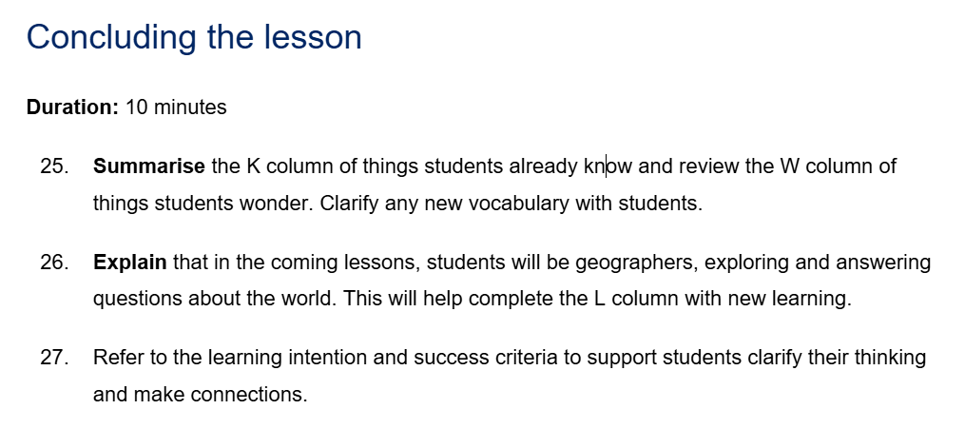
Key features of the lesson structure (5)
Concluding the lesson
HSIE Stage 1 – Unit 1
Notes:
15. Purpose: To unpack the key features of the lesson structure within the CHPS units: Concluding the lesson
Time: 1 minute
Presenter notes:
The conclusion of each lesson is approximately 10 minutes and provides an intentional wrap up of the learning. This phase is about revisiting the learning intention and success criteria, so students are reminded of the purpose of the lesson and what they’ve achieved. It allows them to reflect on how the activities connected to the learning, and to make sense of the knowledge and skills they’ve developed. There is no new content introduced here and no formal check for understanding — it’s simply about clarifying, reinforcing, and closing the loop so students leave the lesson with a clear picture of their progress.
[NEXT SLIDE]

Slide 16
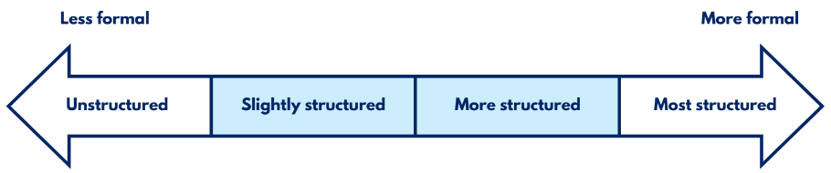
Optional assessments
Opportunities for real-time feedback
Optional assessment: Creative arts Early Stage 1 – Unit 1 – Lesson 5
Observe students during the movement stations activity to assess students’ ability to:
travel from one station to another using locomotor movements
create dance steps
This task provides evidence of student learning aligned to the success criteria. It assesses students’ ability to explore and make shapes and movements with their bodies.
Optional assessments help identify gaps in student learning and misconceptions.
They guide teaching decisions by providing a way to check student understanding at the lesson level and plan the next steps in teaching.
Notes:
16. Purpose: To unpack optional assessments
Time: 2 minutes
Presenter notes:
Each lesson contains optional assessments. These are provided as a flexible tool for assessing student understanding of key content from the lesson.
[CLICK] A benefits of these assessments is that they help identify the gaps in student learning and misconceptions that can occur during a lesson. This is valuable in ensuring that all students grasp essential concepts before new learning is introduced.
[CLICK] They guide teaching decisions. By using these assessments, teachers can gain real-time insights into student understanding and use that information to adjust instruction, provide targeted support, or extend learning. The optional assessments serve as a practical way to check comprehension at the lesson level and plan the next steps in teaching.
Optional assessments offer a range of approaches, from informal methods like planned observations and targeted questioning to identify misconceptions, to more formal tasks such as evaluating student work samples using predetermined criteria.
They are designed to be a flexible, optional resource, available for use when and where they are needed and are a tool to support your teaching.
[NEXT SLIDE]

Slide 17
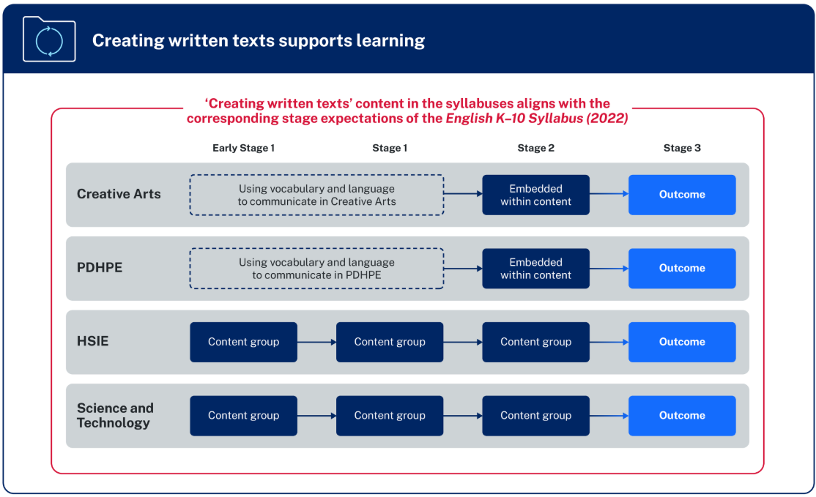
Creating written texts in CHPS K–6
“Creating written texts is a way of organising thoughts, explaining thinking and making connections within and across learning areas. The learning areas provide meaningful content for writing beyond the subject of English.” – NESA
Notes:
17. Purpose: To explore the creating written texts connection across CHPS syllabuses.
Time: 1 min
Presenter notes:
NESA’s diagram provides an overview of the organisation of content for Creating written texts is included in all CHPS syllabuses:
in Early Stage 1 and Stage 1, the focus in PDHPE and Creative arts is on developing students’ subject-specific vocabulary to support communicating. In HSIE and Science and technology there are individual content groups.
in Stage 2, for PDHPE and Creative arts opportunities are embedded within the content for students to create written texts. In HSIE and Science and technology there is an individual content group.
in Stage 3, there is a dedicated creating written texts outcome for all CHPS key learning areas with specific subject content.
NESA highlights that various methods of transcription may be employed, and a student’s preferred communication form(s) should be considered when teaching writing.
[CLICK] NESA states, “Creating written texts is a way of organising thoughts, explaining thinking and making connections within and across learning areas. The learning areas provide meaningful content for writing beyond the subject of English.”
[NEXT SLIDE]

Slide 18

Creating written text
PDHPE Stage 3 Unit 1
Activity:
Create a mind map to determine who or what was an influence on their personal wellbeing and how it impacted them.
Reflect on individual mind map
Use a combination of simple, compound and complex sentences to record reflections.
PH3-CWT-01
creating written texts supports understanding of health, safety and wellbeing
PH3-IHW-01
changes and factors can promote a positive identity
Notes:
18. Purpose: To highlight how CWT is embedded meaningfully in CHPS.
Time: 1 minute
Presenter notes:
Take a moment to review the PDHPE example on the screen.
This example demonstrates how creating written texts is effectively integrated into the PDHPE curriculum to enhance students' understanding of health, safety, and wellbeing. By engaging in the activity of creating a mind map, students reflect on influences affecting their personal wellbeing, promoting self-awareness and positive identity development. The task encourages the use of varied sentence structures, supporting literacy skills alongside personal development. This integrated approach helps students articulate their thoughts clearly while connecting literacy with key health concepts. It exemplifies how writing activities can deepen learning across key learning areas by combining content knowledge with essential communication skills..
[NEXT SLIDE]

Slide 19

Behind the scenes developing the sample units
… with students at the centre of all decisions
Syllabus is the starting point
Deep content knowledge
Enjoyment and engagement
Pedagogy and practices
Collaboration
Stakeholder consultation
Notes:
19. Purpose: To explain how CHPS units are designed with students at the centre of all decision making.
Time: 2 minutes
Presenter notes:
With students at the centre of all decisions, [CLICK] planning started with the NESA syllabus and Teaching Advice, ensuring fidelity to the syllabus rationale, intent and extensive evidence-base to shape decisions.
[CLICK] Teachers with deep content knowledge can explain concepts clearly, chunk learning effectively, differentiate with purpose, and respond confidently to key teaching moments. The sample units build this expertise by highlighting misconceptions, identifying essential vocabulary, practical tools, and expert advice.
[CLICK] Engagement is non-negotiable - the design for students to be in-task, more than just on-task: thinking deeply, doing the work, and feeling positive about learning.
[CLICK] The pedagogy and practices within the sample units are anchored in the Explicit Teaching in NSW Public Schools statement and research-informed practices tailored to each key learning area.
[CLICK] The sample units have been a collaborative build and
[CLICK] Consultation with stakeholders ensured shared understandings and inclusive approaches. These partnerships ensure that the sample units are comprehensive, culturally responsive, and aligned with best practices to support diverse student needs and enhance learning outcomes.
[NEXT SLIDE]

Slide 20

Roadmap of a CHPS unit across 13 weeks
Quality assurance
Design stage
Consult phase
Develop stage
Review stage
Digital stage
KLA Advisors map syllabus expectations from the scope and sequence into a 16-lesson sequence + 4 consolidation lessons.
Coordinators and Leader review and refine the sequence through rigorous feedback.
Quality assurance
Consultation and collaboration occurs stakeholder groups, including Aboriginal Education Advisors, Road Safety, Respectful Relationships and Effective Teaching Practices team.
Quality assurance
Writing pods develop the lessons into a sequenced unit.
Embed explicit teaching strategies, quality resources and assessment into every lesson – supported by SMEs.
Quality assurance
KLA Advisors review and provide extensive feedback for refinement.
Coordinators and Leader review for endorsement and approval.
Consultation loop is closed on the final lessons.
Quality assurance
Final checks:
Reviewed by an Editorial team
Checked by Website team.
Communication plan to feature in the Staff Noticeboard.
Quality assurance
Notes:
20. Purpose: To unpack the roadmap of CHPS unit design and quality-assurance.
Time: 2 minutes
Presenter notes:
This slide outlines the 13-week roadmap for every CHPS unit, with quality assurance built in at every stage.
It starts at the design stage, key learning advisors, subject matter specialists map syllabus expectations from the DoE scope and sequence into a 16-lesson sequence, plus four optional consolidation lessons. Coordinators and leaders then refine the sequence.
Next is the consult phase, where we test the draft with key stakeholder groups, including Aboriginal Education, Multicultural, Respectful Relationships, Road Safety, Effective Teaching Practices, and others, to ensure intent and inclusivity.
In the develop stage, writing pods build the full sequence, embedding explicit teaching, high-quality resources, and assessment in every lesson.
In the review stage key learning advisors provide detailed feedback, followed by coordinator and leader endorsement, and close the consultation loop on the final lessons.
Finally, in the digital stage, editorial and website checks are completed, and communications go out, so the unit appears on the Staff Noticeboard.
Through this pipeline, Primary Curriculum are delivering 114 units—over 2,200 lessons—ready to support the mandatory CHPS implementation in 2027.
[NEXT SLIDE]

Slide 21

Activity
Key similarities and differences
What similarities to the way you plan now can you see in the sample units?
What differences to the way you plan now can you see in the sample units?
Notes:
21. Purpose: To provide time for participants to reflect on the key similarities and differences to how they already program with the new CHPS sample units.
Time: 5 minutes
Presenter notes:
Now you have viewed the features of the sample units for CHPS let’s consider the questions on the slide.
What similarities to the way you plan now can you see in the sample units?
What differences to the way you plan now can you see in the sample units?
[NEXT SLIDE]

Slide 22

Unit Preview
Notes:
22. Purpose: To introduce the walkthrough of Unit 1 and Unit 5 for each stage and each KLA
Time: 30 seconds
Presenter notes:
This session is designed to a look at what will be in the first unit for each year.
Each KLA will be sharing the outcomes and content that these units will cover.
[NEXT SLIDE]

Slide 23
Human Society and its Environment (HSIE) – unit 1
Unit 1
Notes:
23. Purpose: To provide an overview of unit 1
Time: 10 seconds
Presenter notes:
Let's look at Stage 1 Human Society and its Environment Unit 1.
[NEXT SLIDE]

Slide 24

HSIE – unit 1 overview
In Unit 1, students:
explore continents, oceans and Australia on physical maps
locate Australian states, territories and capital cities
distinguish between Aboriginal Country and Torres Strait Islander Places using language maps
collect and organise data in lists, tables or picture graphs.
Notes:
24. Purpose: To provide an overview of the HSIE S1 unit 1.
Time: 30 seconds
Presenter notes:
In Unit 1, students explore continents, oceans and Australia on physical and political maps and consider reasons people are connected to places worldwide. Students distinguish between Aboriginal Country and Torres Strait Islander Places using language maps and describe the diversity of Australian places and communities.
[NEXT SLIDE]

Slide 25
HSIE – unit 1 syllabus outcomes
Focus Area: People are connected to places and groups
HS1-ACH-01
describes interactions between Aboriginal Peoples and Country
HS1-GEO-01
describes ways people connect to and care for places, water environments and each other, using geographical information
Notes:
25. Purpose: To outline the outcomes and content in the unit
Time: 45 seconds
Presenter notes:
Unit 1 covers the focus area 'People are connected to places and groups.'
There are 2 content groups:
Aboriginal Peoples have a responsibility to Country, and
People show their connection to places using geographical information.
[NEXT SLIDE]

Slide 26
HSIE – unit 1 syllabus content
Content Group: Aboriginal Peoples have a responsibility to Country
Identify how Aboriginal Country is represented in a range of contexts
Content group: People show their connection to places using geographical information
Locate the 7 continents and 5 oceans of the world
Locate Australia in relation to hemispheres, oceans, continents and neighbouring countries using physical maps, political maps and globes
Describe the features of Australian urban, rural and remote places and communities by comparing images
Locate Australian states, territories and capital cities using political maps
Describe reasons people are connected to places across the world by collecting and organising data in lists, tables or picture graphs
Distinguish Aboriginal Country from Torres Strait Islander Places using language maps
Notes:
26. Purpose: To outline the outcomes and content in the unit
Time: 45 seconds
Presenter notes:
Unit 1 covers the focus area 'People are connected to places and groups.'
There are 2 content groups:
Aboriginal Peoples have a responsibility to Country, and
People show their connection to places using geographical information.
[NEXT SLIDE]

Slide 27

Aboriginal Cultures and Histories content
All HSIE units, which cover ACH content, are written in consultation with Department of Education Aboriginal Education Advisors.
In adapting and implementing the units, schools are encouraged to:
involve local Aboriginal Communities and/or appropriate Knowledge Holders
use Aboriginal and/or Torres Strait Islander-authored or endorsed publications
read the principles and protocols relating to teaching and learning about Aboriginal and/or Torres Strait Islander histories and Cultures and the involvement of local Aboriginal Communities
Refer to the Australian Institute of Aboriginal and Torres Strait Islander Studies (AIATSIS) Guide to evaluating and selecting education resources when selecting appropriate resources.
Artwork © Kayleb Waters, Gomeroi artist and Cultural mentor 2025.
​
This image represents Community (families, parents, Aunts, Uncles, Elders, schools, teachers, LAECGs, LALCs)
“This symbol is expressed through people sitting together in one place, showing unity, responsibility, love, and respect.”
Notes:
27. Purpose: To explain the requirements for schools in relation to Aboriginal Cultures and Histories content.
Time: 30 seconds
Presenter notes:
All HSIE units, which cover Aboriginal Cultures and Histories content, are written in consultation with Department of Education Aboriginal Education Advisors.
When planning and programming content relating to Aboriginal and/or Torres Strait Islander histories and Cultures, teachers are encouraged to:
involve local Aboriginal Communities and/or appropriate Knowledge Holders in determining suitable resources
use Aboriginal and/or Torres Strait Islander-authored or endorsed publications.
read the principles and protocols relating to teaching and learning about Aboriginal and/or Torres Strait Islander histories and Cultures and the involvement of local Aboriginal Communities.
The Australian Institute of Aboriginal and Torres Strait Islander Studies (AIATSIS) Guide to evaluating and selecting education resources has been developed to assist teachers in selecting appropriate resources for teaching about Aboriginal and Torres Strait Islander histories, Cultures and Languages respectfully and effectively.
[NEXT SLIDE]

Slide 28

HSIE – unit 1 skill development
In this unit, students learn and apply geographical skills by:
using maps and globes to locate the 7 continents, 5 oceans, the hemispheres and Australia in relation to the world
locating Australian states, territories and capital cities on a political map and Aboriginal Country and Torres Strait Islander Places using language maps
exploring and comparing different environments in Australia
describing reasons people are connected to places across the world
organising and representing data in a table.
Notes:
28. Purpose: To outline the skills students learn and apply during the unit.
Time: 40 seconds
Presenter notes:
Throughout this unit, students are provided with opportunities to learn and apply geographical skills whilst building their knowledge, understanding.
In Unit 1, students:
develop mapping skills and learn to locate the 7 continents, 5 oceans, the hemispheres and Australia on a globe and variety of maps
identify Australian states, territories and capital cities on a political map and locate local Aboriginal Country and Torres Strait Islander Places using language maps
explore and compare urban, rural and remote environments. This build on Early Stage 1 content where students learned about inland and coastal environments as well as natural and human features, and
collect and record data in a table.
[NEXT SLIDE]

Slide 29
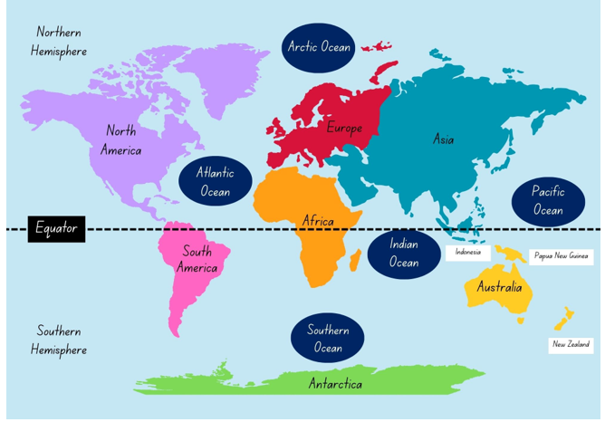
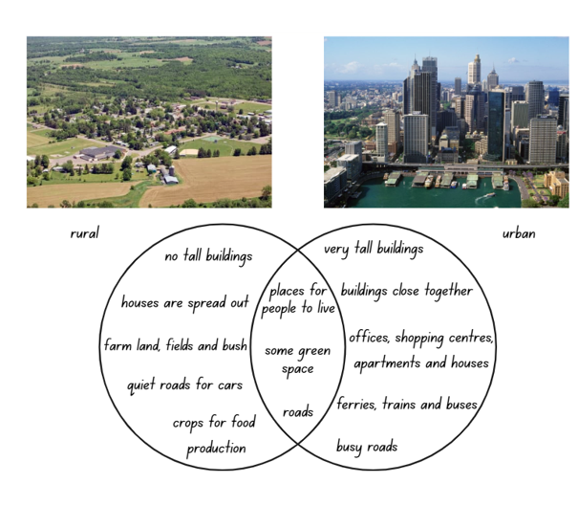
HSIE – unit 1 spotlight (1)
Students as Geographers
Students locate the 7 continents and 5 oceans of the world
Students describe the features of Australian urban, rural and remote places and communities by comparing images
Notes:
29. Purpose: To outline the skills students, learn and apply during the unit.
Time: 1 minute
Presenter notes:
Throughout the unit, students are explicitly taught the skills and tools that geographers use. This includes an introduction to tools such as maps and globes, with their purposes clearly explained and opportunities provided to practise using them like geographers. Skills such as locating, describing, organising and identifying are scaffolded using hands-on learning experiences to allow students time to develop these skills in age-appropriate ways.
In multiple lessons, students locate the 7 continents and 5 oceans of the world and locate Australia identifying where it is in the world and in relation to hemispheres using physical and political maps and globes.
Over a series of lessons, students use political maps to locate Australian states and territories and capital cities.
Describing the features of Australian urban, rural and remote places and communities engages students by comparing images, watching video clips and using Google Earth to explore. The lessons also use Venn Diagrams to organise information.
This unit supports students to be geographers using the tools and skills of geography, to support future learning in HSIE.
[NEXT SLIDE]

Slide 30

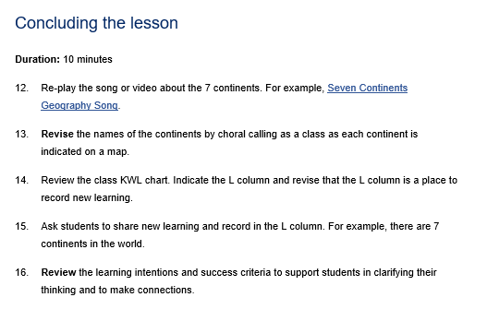


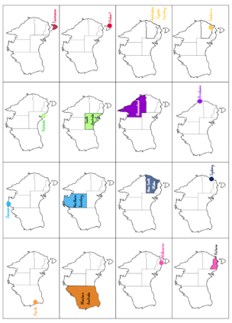
HSIE – unit 1 spotlight (2)
Resources
Notes:
30. Purpose: To outline the skills students, learn and apply during the unit.
Time: 30 seconds
Presenter notes:
Students are now learning content which has not previously been taught in Stage 1. To support this when writing this unit, we have looked to include resources which will support teachers and students and included games that can be played again, songs to revise concepts and anchor charts.
In this unit we introduce and use a class Know, Wonder and Learn chart to engage the students. The chart is used and added to throughout the unit to activate prior learning, during core lesson activities and to summarise learning.
[NEXT SLIDE]

Slide 31



HSIE – unit 1 spotlight (3)
Maps
Students use a variety of maps to locate Australia, the continents and key geographical features to build their understanding Australia and the world around them.
National Geographic, (n.d), Map Maker, Arcgis website, accessed 30 September 2025.
Images sourced from Canva.
Australian Institute of Aboriginal and Torres Strait Islander Studies (1996). Map of Indigenous Australia, AIATSIS website, accessed 30 September 2025.
Notes:
31. Purpose: To highlight activities within the unit
Time: 30 seconds
Presenter notes:
This unit also allows students to learn about Australia’s place in the world using a variety of maps. After using a world map to locate Australia in relation to all the continents students move to explore Australia in more detail, using political maps. Political maps are used to identify its states and territories.
Language maps are used in the unit to learn about Aboriginal Country and Torres Strait Islander Places. Students will also use maps to locate their school in relation to Australia and the rest of the world, enhancing their geographical understanding.
[NEXT SLIDE]

Slide 32

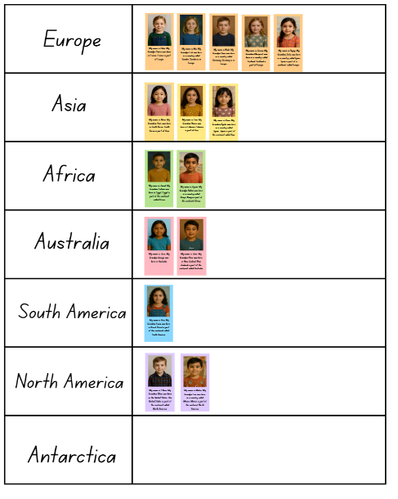
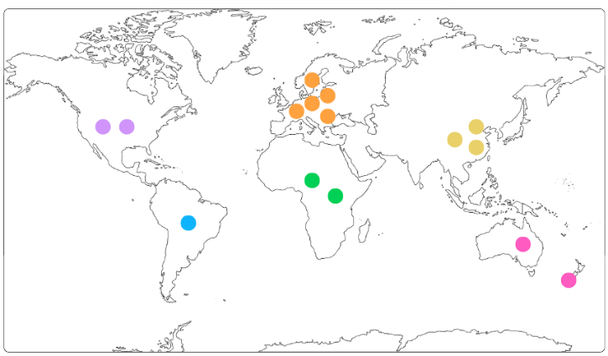
HSIE – unit 1 spotlight (4)
Representing global connections using data
Describe reasons people are connected to places across the world by collecting and organising data in lists, tables or picture graphs
Notes:
32. Purpose: To highlight activities within the unit.
Time: 1 minute
Presenter notes:
Describe reasons people are connected to places across the world by collecting and organising data in lists, tables or picture graphs is a content point this lesson explores.
This lesson sequence invites students to explore and describe the reasons people are connected to places around the world by examining personal, family and cultural ties. Through this activity, students read cards provided about grandparents and organise the data into a table as seen on screen. Additionally, students make meaningful connections to another country, further broadening their understanding of how people relate to different places.
Students are then able to connect the data to previous lessons knowledge of the continents and record information on a world map.
[NEXT SLIDE]

Slide 33
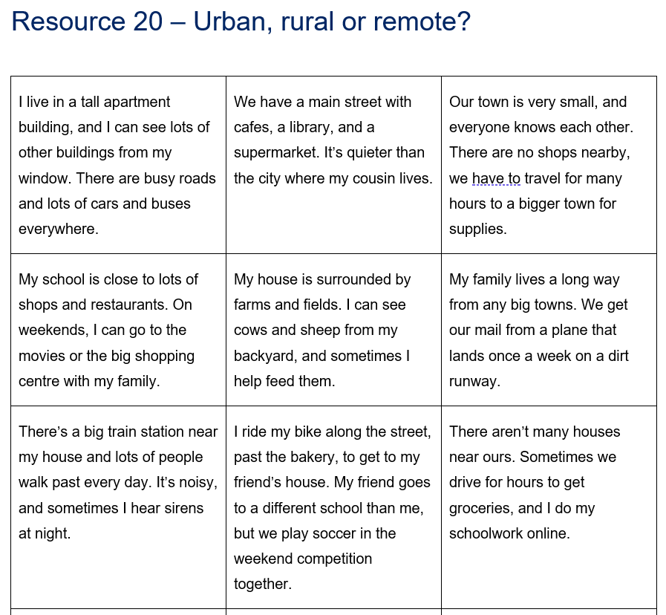
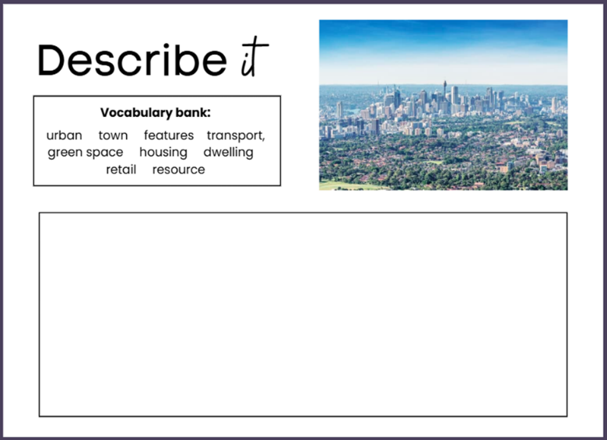
HSIE – unit 1 spotlight (5)
Compare different environments
Students identify the features of remote, urban and rural environments and make comparisons between them.
Notes:
33. Purpose: To highlight activities within the unit.
Time: 20 seconds
Presenter notes:
Building on students’ understanding of global connections and data organisation, they apply this knowledge to a geographical context by mapping information and deepening awareness of place.
This lesson requires students to explore and identify the similarities and differences between urban, rural and remote environments.
Students listen carefully to clues to determine if a place is urban, rural or remote and then select one environment to describe in detail.
[NEXT SLIDE]

Slide 34
Human Society and its Environment (HSIE) – unit 5
Unit 5
Notes:
34. Purpose: To provide an overview of the unit.
Time: 10 seconds
Presenter notes:
The second spotlight unit is Stage 1 Unit 5.
[NEXT SLIDE]

Slide 35

HSIE – unit 5 overview
In Unit 5, students:
explore how communication has changed over time
describe how Aboriginal and Torres Strait Islander Peoples communicated using stories, images, objects or sites
distinguish between Aboriginal Country and Torres Strait Islander Places using language maps
use Tier 2 and Tier 3 vocabulary to draw conclusions.
Notes:
35. Purpose: To provide an overview of the HSIE S1 Unit 5
Time: 40 seconds
Presenter notes:
In Unit 5, students examine how communication has changed over time. Beginning with communication used in the present and then investigating and sequencing changes in written communication, the telephone, postal services and impact of technology.
Students describe how Aboriginal and Torres Strait Islander Peoples communicated using stories, images, objects or sites as evidence.
Students compare changes in communication in Australia and the world and use Tier 2 and Tier 3 vocabulary to draw conclusions about these changes.
[NEXT SLIDE]

Slide 36
HSIE – unit 5 syllabus outcomes
Focus Area: People learn about the past by engaging with stories, images, objects and sites
HS1-ACH-01
describes interactions between Aboriginal Peoples and Country
HS1-HIS-01
describes the ancient past and changes in communication over time, using stories, images, objects and sites as evidence
Notes:
36. Purpose: To outline the outcomes and content in the unit.
Time: 1 minute
Presenter notes:
Unit 5 addresses the focus area 'People learn about the past by engaging with stories, images, objects and sites.
There are 2 content groups covered:
The way people communicate has changed over time, and
Sequencing ideas in written texts supports understanding of the past.
Take a moment to read through the content points on the slide.
[NEXT SLIDE]

Slide 37
HSIE – unit 5 syllabus content (1)
Content Group: The way people communicate has changed over time
Examine ways people communicated with each other in the past
Identify ways people communicate with each other in the present
Describe ways communication has changed over time by comparing stories, images, objects and sites as evidence
Describe ways Aboriginal and Torres Strait Islander Peoples have communicated over time by comparing stories, images, objects or sites as evidence
Sequence significant changes in communications that connected Australia to the world
Draw conclusions about why communications have changed over time using Tier 2 and Tier 3 vocabulary
Notes:
37. Purpose: To outline the outcomes and content in the unit.
Time: 1 minute
Presenter notes:
Unit 5 addresses the focus area 'People learn about the past by engaging with stories, images, objects and sites.
There are 2 content groups covered:
The way people communicate has changed over time, and
Sequencing ideas in written texts supports understanding of the past.
Take a moment to read through the content points on the slide.
[NEXT SLIDE]

Slide 38
HSIE – unit 5 syllabus content (2)
Content group: Sequencing ideas in written texts supports understanding of the past
Use past and present tense to describe change over time
Use time connectives to sequence information and events
Create compound sentences using coordinating conjunctions to compare, describe or give an opinion on the past
Group simple and compound sentences into paragraphs to recount a sequence of events or a story from the past
Notes:
38. Purpose: To outline the outcomes and content in the unit.
Time: 1 minute
Presenter notes:
Unit 5 addresses the focus area 'People learn about the past by engaging with stories, images, objects and sites.
There are 2 content groups covered:
The way people communicate has changed over time, and
Sequencing ideas in written texts supports understanding of the past.
Take a moment to read through the content points on the slide.
[NEXT SLIDE]

Slide 39

HSIE – unit 5 skill development
In this unit, students learn and apply historical skills by:
identifying ways people communicate with each other in the past and present
examining storytelling as an ancient and enduring form of communication
examining evidence to acquire information about the past
describe ways Aboriginal and Torres Strait Islander Peoples have communicated over time
sequence changes in communication over time
comparing past and present writing implements
drawing conclusions about the changes from the past to the present.
Notes:
39. Purpose: To outline the skills students, learn and apply during the unit.
Time: 1 minute 30 seconds
Presenter notes:
Throughout this unit, students are provided with opportunities to learn and apply historical skills whilst building their knowledge and understanding.
In Unit 5, students:
identify ways people communicate with each other in the past and present using images and stories as evidence
examine storytelling as an ancient and enduring form of communication
examine evidence to acquire information about the past
describe ways Aboriginal and Torres Strait Islander Peoples have communicated over time using images, stories and sites as evidence
sequence changes in communication over time, including phones, written and postal communication
compare past and present writing implements
draw conclusions about the changes from the past to the present For example, messengers on horseback, horseback/coaches, international mail service via ship, airmail, and
draw conclusions, using Tier 2 and Tier 3 vocabulary, about why communication methods have changed over time and the impact of these changes. Students construct a written text which describes or explains how communication has changed over time.
[NEXT SLIDE]

Slide 40
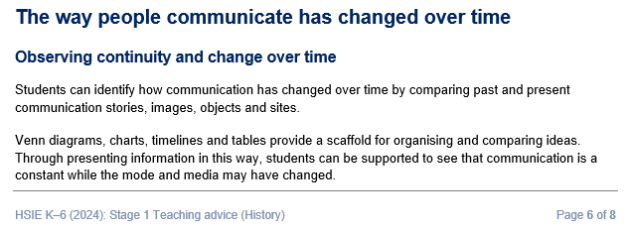


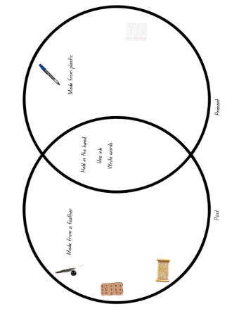
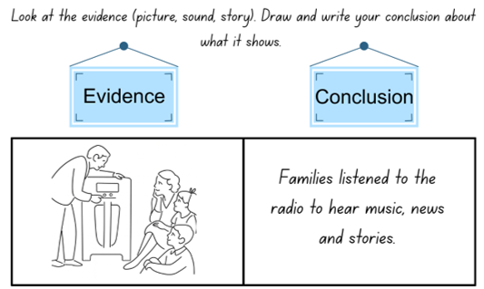
HSIE – unit 5 spotlight (1)
Change over time
NESA Stage 1 Teaching advice (History)
Resource 12 – past and present
Resource 11 – comparison table
Resource 8c –Venn diagram
Resource 13b – evidence conclusion chart
Notes:
40. Purpose: To outline the Teaching advice being incorporated into lessons throughout the unit.
Time: 1 minute
Presenter notes:
The NESA teaching advice calls out that “Venn diagrams, charts, timelines and tables provide a scaffold for organising and comparing ideas. Through presenting information in this way, students can be supported to see that communication is a constant while the mode and media may have changed.”
Throughout the unit students are provided with engaging activities some of which are displayed on the screen. For example, Resource 8c a Venn diagram, Resource 13b a chart and Resource 11 a table to investigate changes in communication over time.
An additional activity is a class timeline that is updated with different forms of communication as they are introduced. Students sequence these items, creating a visual reference to support their learning. This timeline helps activate prior knowledge and builds schema throughout the lessons.
[NEXT SLIDE]

Slide 41



HSIE – unit 5 spotlight (2)
Ancient communication
Examine the ways people communicated with each other in the past.
Describe ways communication has changed over time by comparing stories, images, objects and sites as evidence.
Notes:
41. Purpose: To outline the Teaching advice being incorporated into lessons throughout the unit.
Time: 50 seconds
Presenter notes:
Continuing to look at communication, throughout the unit students will use a variety of artefacts and sources as evidence to explore how communication has changed over time. Through hands-on activities, students explore different types of communication methods and use these artefacts to investigate how communication methods have evolved.
One activity features a communication display designed to help students observe and describe changes over time. It begins with present communication methods and following a guest speaker, who shares changes they've witnessed in their lifetime, moves to looking at the recent and ancient past.
The images on screen are from a lesson where students examine ancient communication forms including the clay tablet, papyrus and quill. They use images, stories, video clips and Venn diagrams to compare evidence to describe changes in written communication over time. These images are sequenced on a class timeline and compared to written communication methods today.
[NEXT SLIDE]

Slide 42
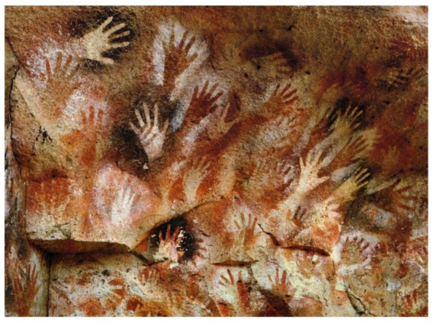
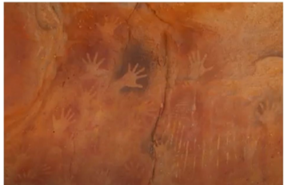
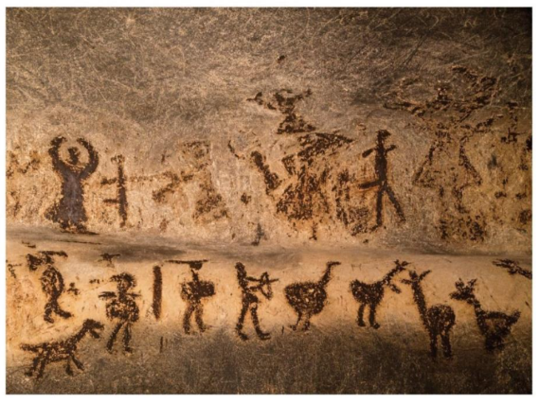
HSIE – unit 5 spotlight (3)
Aboriginal communication
Describe ways Aboriginal and Torres Strait Islander Peoples have communicated over time by comparing stories, images, objects or sites as evidence
Notes:
42. Purpose: To explore enduring communication forms.
Time: 30 seconds
Presenter notes:
In addition to exploring how communication has changed over time globally, the unit also guides students to examine enduring forms of Aboriginal communication as powerful ways of sharing knowledge across generations.
Students examine evidence of storytelling as a continuous form of oral communication and evidence that stories and knowledge were shared through pictures created on Country.
One lesson in the unit explores rock art, focusing on handprints as an early form of communication that often indicated who was present. Students then make a meaningful connection by creating their own handprints to represent the number of people present in the class.
[NEXT SLIDE]

Slide 43

HSIE unit 5 – spotlight (4)
Connecting Australia to the world
Students explore the significant changes in communications that connected Australia to the world.
Video sourced from Canva
Notes:
43. Purpose: To highlight activities within the unit
Time: 1 minute
Presenter notes:
Press play to start the onscreen video this will play in background (there is no sound). Presenter to pause while the video begins and then read below presenter notes.
As a final activity students explore the significant changes in communication technologies that have connected Australia to the world, focusing on examples such as computers, satellites and internet technology. They sequence them and add them to a timeline to understand the progression of communication methods over time. Using a range of evidence, students discuss how communication via the internet has affected people’s lives and draw conclusions about why communication has changed. Throughout the lesson, they apply Tier 2 and Tier 3 vocabulary to articulate their understanding of these technological advancements and their impact on peoples' lives. This allows students to synthesise their understanding of both traditional and present communication methods, recognising the significance of cultural continuity alongside technological advancement and drawing informed conclusions about how and why communication continues to evolve.
[NEXT SLIDE]

Slide 44

HSIE – unit 5 reflection
What excites you about these units?
What changes did you notice which you will need to make some considerations about or do some preparation for?
What is still circling that you need some further clarification on?
Notes:
44. Purpose: To reflect on the units presented and take notes.
Time: 5 minutes
Presenter notes:
We would like to give you some time now to reflect on what you have seen, make some notes and start to think about what this could look like in your school context.
In your participant workbook you will find the reflection section and a heading for each KLA.
You will have 5minutes to add some notes.
After 5 minutes
We will be referring to this activity again after each KLA unit walkthrough.
[NEXT SLIDE]

Slide 45
Science and technology – unit 1
Unit 1
Notes:
45. Purpose: To preview the first 2 Science and technology Stage 1 Units.
Time: 5 seconds
Presenter notes:
Let’s explore Science and technology Unit 1.
[NEXT SLIDE]

Slide 46
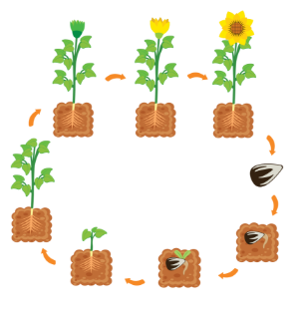
Science and technology – unit 1 overview
This unit explores:
that plants change as they grow
that data about living things can be collected through observation
how to record observations using a digital device
how to create a sequential algorithm that controls a digital device
that Aboriginal Peoples have observed plants and animal life cycles for thousands of years
that scientists can investigate extinct animals.
Notes:
46. Purpose: To provide an overview of the unit
Time: 30 seconds
Presenter notes:
This unit marks the beginning of students’ science and technology learning in Stage 1. They investigate the life cycles of plants and animals, exploring how living things grow and change. Students also learn how both scientists and Aboriginal Peoples have observed, recorded and passed on knowledge about these changes over time. As part of their inquiry, students collect and group data from a local habitat and use digital tools to record their observations. They also create simple sequential algorithms to control digital devices. Finally, students examine how scientists use evidence from the past to investigate plants and animals that are now extinct, building their understanding of how the natural world has changed over time.
[NEXT SLIDE]
Image Credit: Canva Education. 2025. Images via Canva. https://www.canva.com/ accessed 30 Sept 2025.

Slide 47
Science and technology – unit 1 syllabus outcomes
Focus area: Investigations of change provide knowledge and understanding
ST1-SCI-01 measures and describes changes in living things, materials, movement, Earth and the sky
ST1-PQU-01 poses questions based on observations and information to investigate cause and effect
ST1-DAT-01 interprets data to support explanations and arguments
Focus area: Design and digital solutions are created through knowledge and understanding
ST1-DDT-01 creates, evaluates and modifies algorithms to code or control digital devices and systems
Notes:
47. Purpose: To outline the outcomes and content in the unit.
Time: 1 minute
Presenter notes:
The science focus area for the whole of Stage 1 is Investigations of change provide knowledge and understanding.
The Stage 1 Technologies focus area is Design and digital solutions are created through knowledge and understanding.
It is important to keep the wording of each focus area front of mind as we unpack the content of the Stage 1 sample units.
Here are the outcomes for this unit. As the content is multi-faceted, we have bolded the aspects covered in this unit.
As it is still early in the students Stage 1 learning journey, students may only demonstrate achievement of relevant parts of an outcome.
Just a reminder here that in science and technology, there is no requirement for an equal allocation of time between science and technology.
Take a moment to read through the content points covered in this unit.
[NEXT SLIDE]

Slide 48
Science and technology – unit 1 syllabus content (1)
Content Group: Living things change over time
Describe the changes in a plant as it grows using data and scientific models
Recognise that data can be collected through observation, testing and research, and that it can be represented as descriptions, diagrams, graphs, images and tables
Describe how Aboriginal and/or Torres Strait Islander Peoples use Knowledges of the life cycles of livings things
Use nouns, noun groups and verbs to create notes, annotations and labels to document observations
Describe the changes in an animal as it goes through its life cycle using data and scientific models
Examine the evidence for extinct animals
Collects, represents and uses data to identify patterns and relationships
Collect data about the variety of living things in a local habitat, group them and justify the groupings
Notes:
48. Purpose: To outline the outcomes and content in the unit.
Time: 1 minute
Presenter notes:
The science focus area for the whole of Stage 1 is Investigations of change provide knowledge and understanding.
The Stage 1 Technologies focus area is Design and digital solutions are created through knowledge and understanding.
It is important to keep the wording of each focus area front of mind as we unpack the content of the Stage 1 sample units.
Here are the outcomes for this unit. As the content is multi-faceted, we have bolded the aspects covered in this unit.
As it is still early in the students Stage 1 learning journey, students may only demonstrate achievement of relevant parts of an outcome.
Just a reminder here that in science and technology, there is no requirement for an equal allocation of time between science and technology.
Take a moment to read through the content points covered in this unit.
[NEXT SLIDE]

Slide 49
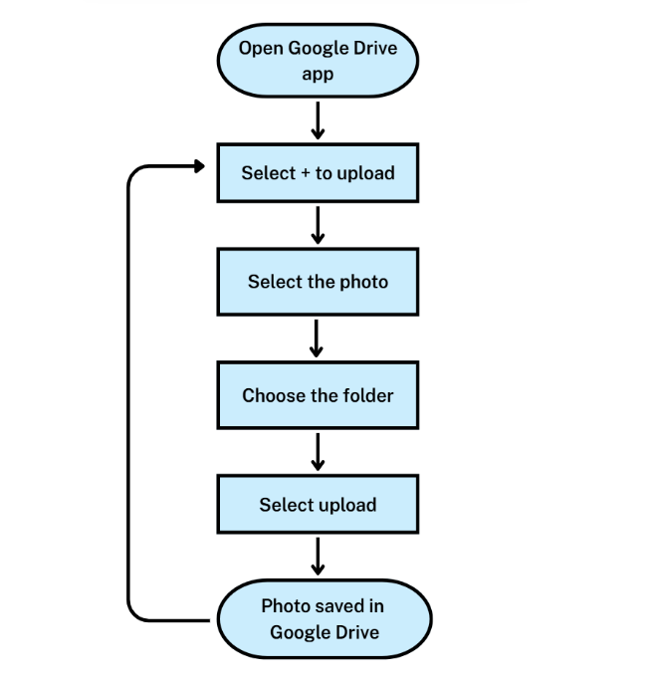
Science and technology – unit 1 syllabus content (2)
Content group: Digital systems use inputs and algorithms to produce an output
Identify digital systems that can be used to collect personal data and how to protect personal information
Use the basic features of common digital tools to capture, save and retrieve data to communicate and collaborate following agreed rules
Create a sequential algorithm that controls a digital device
Notes:
49. Purpose: To outline the outcomes and content in the unit
Time: 30 seconds
Presenter notes:
On screen you can see the content that sits under the focus area: Design and digital solutions are created through knowledge and understanding.
[NEXT SLIDE]

Slide 50
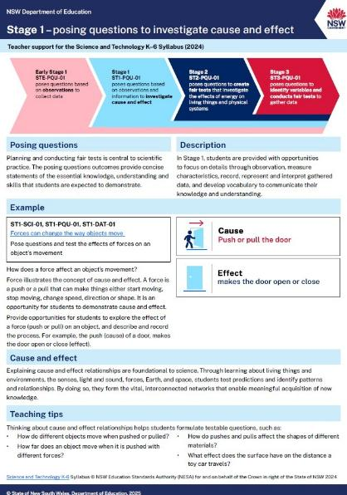
Posing Questions (PQU)
Support document
ST1-PQU-01
poses questions to investigate cause and effect
Notes:
50. Purpose: To explain teacher support for posing questions outcomes
Time: 1 minute 10 seconds
Presenter notes:
New to the 2024 Science and Technology syllabus for each stage are posing questions outcomes.
Right from the beginning of Early Stage 1 students are developing their questioning, observation and data analysis skills in a sequential way. This learning supports the introduction of Working Scientifically outcomes in Stage 4.
To supplement the syllabus teaching advice, the department has created an information document for posing questions. This will be available on the department’s website.
In Stage 1 learning is scaffolded to build students skills in posing questions to investigate cause and effect.
In Stage 1 Unit 1, students are learning to pose questions based on observations. The skill of posing questions to investigate cause and effect will continue to be developed in future Stage 1 units.
[NEXT SLIDE]

Slide 51
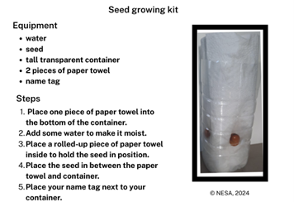
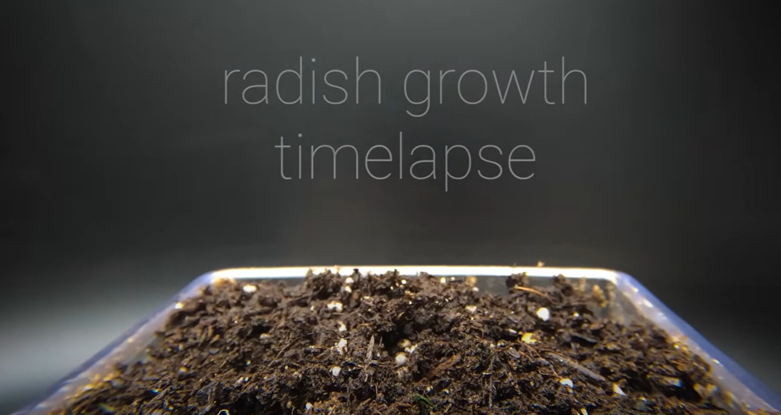
Science and technology – unit 1 spotlight (1)
Plant growing
Notes:
51. Purpose: To highlight activities within the unit
Time: 40 seconds
Presenter notes:
CLICK and video will start. There is no sound, it will play as presenter is reading the notes below.
The first activity we would like to highlight from this unit is plant growing. This activity is introduced in Lesson 1, and the observation activities are included at the beginning of Lessons 4-8.
The plant growing activities in this unit complement those set out in the Teaching advice (additional): Stage 1 – Investigations of changes provide knowledge and understanding (NESA 2024). Students observe their plant growing kits and capture and store an image using a digital device or as a sketch with labels to describe the changes they observe.
The next few slides will focus on activities within the unit.
[NEXT SLIDE]
Video credit: Rapidlapse (28 April 2021) Growing radish from seed to harvest - 31 days’ time lapse [video], Rapidlapse, YouTube, accessed 7 July 2025.

Slide 52
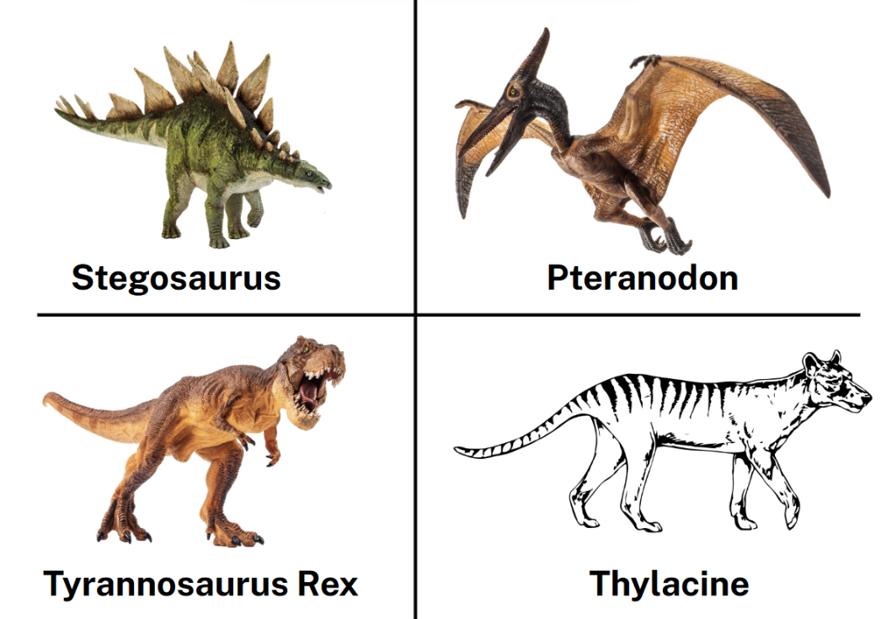
Science and technology – unit 1 spotlight (2)
Which one doesn’t belong – extinct animals
A
B
C
D
Notes:
52. Purpose: To highlight activities within the unit.
Time: 2 minutes
Presenter notes:
This activity is at the beginning of the first extinct animals lessons. Students are asked to decide which animal does not belong to a group made by the other animals. It is explained that there may be more than one answer, or more than one reason. Which one doesn’t belong is a flexible thinking routine. Students may make a case for why any one item is excluded by a characteristic possessed by the other items. Students may focus on observable characteristics or have relevant background knowledge. It is a great tool because the focus is not on the answer, but on the student being able to communicate their reasoning and justification.
[NEXT SLIDE]
Image Credit: Canva Education. 2025. Images via Canva. https://www.canva.com/ accessed 30 Sept 2025.

Slide 53
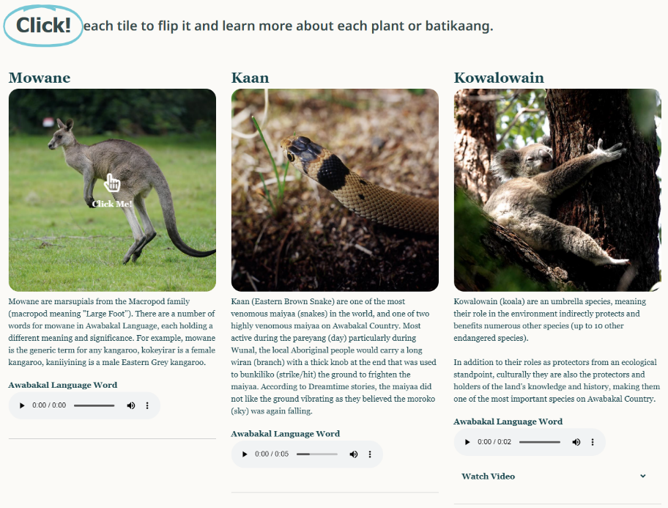
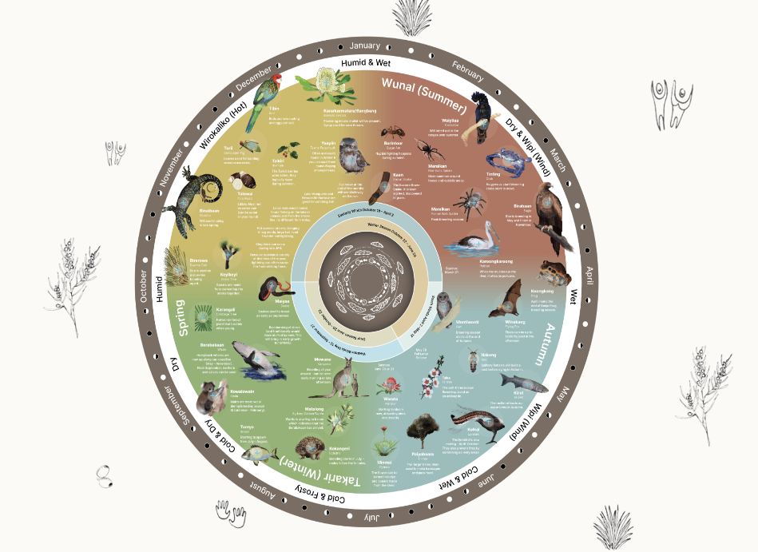
Science and technology – unit 1 spotlight (3)
Aboriginal Peoples use Knowledges of the life cycles of plants and animals
Notes:
55. Purpose: To highlight activities within the unit.
Time: 1 minute
Presenter notes:
In lesson 14 students learn to describe the observable changes in the life cycle of a kangaroo. They learn about how Aboriginal Peoples use Knowledges of the life cycles of various plants and animals.
The lesson revisits that Aboriginal Peoples, Australia's first scientists, have a deep understanding of animal life cycles. This knowledge helps them know when seasonal foods are ready, when animals are breeding, and when to carry out important land and sea management activities.
Students explore the Awabakal interactive seasonal calendar to explore how knowledge of animal and plant lifecycles are used by Aboriginal Peoples. They will notice the connection between animal and plant life cycles, such as when the Watalong (wattle) start to bloom late in the colder months, this signifies that Tureya (bream) will start to bite more. Teachers are encouraged to use seasonal calendars from the Country that their school is located on if available to provide local contextualised content.
[NEXT SLIDE]
Miromaa Aboriginal Language and Technology Centre (2025) ‘Interactive calendar’, The Awabakal Seasonal Calendar website, accessed 30 September 2025.

Slide 54

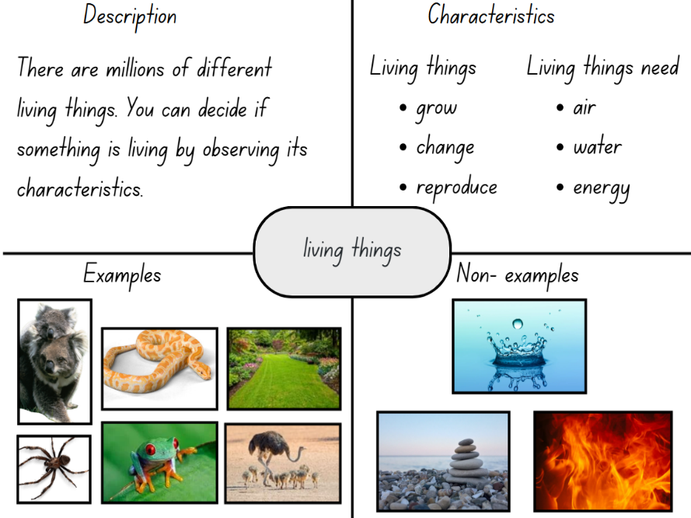
Science and technology – unit 1 misconceptions
Common student misconceptions addressed
Notes:
54. Purpose: To highlight common misconceptions addressed in the unit.
Time: 40 seconds
Presenter notes:
As with many areas of science education, part of the teacher's role is to understand and to address student misconceptions using evidence-based approaches.
Being aware of common misconceptions is the first step in addressing them. The sample units include note boxes to alert teachers to possible student misconceptions.
The lesson content uses evidence-based approaches to surfacing misconceptions and to addressing them.
This sample unit seeks to address student misconceptions, including:
that observations are only things that can be seen
associating life with movement (e.g., clouds or car), energy (e.g., sun, fire, lightning),
that plants only refer to things in pots, excluding trees and grass
that humans, birds, fish, insects, worms and other invertebrates are not animals
[NEXT SLIDE]
Image Credit: Canva Education. 2025. Images via Canva. https://www.canva.com/ accessed 30 Sept 2025.

Slide 55
Science and technology – unit 5
Unit 5
Notes:
55. Purpose: To introduce Stage 1 Unit 5
Time: 5 seconds
Presenter notes:
We will now explore Unit 5.
[NEXT SLIDE]

Slide 56
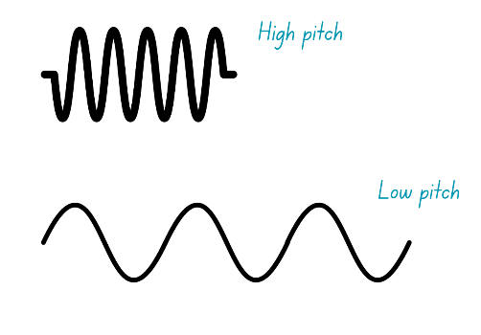

Science and technology – unit 5 overview
This unit explores:
that sound can travel through air, water and some solids and is affected by those materials
that sound is created and carried by vibrations
the use of digital devices to capture sound
making instruments that produce sound by striking, shaking, blowing and plucking
how instruments are designed by Aboriginal and/or Torres Strait Islander Peoples using natural materials.
This Photo by Unknown Author is licensed under CC BY-NC
Notes:
56. Purpose: To provide an overview of the unit
Time: 2 minutes
Presenter notes:
In this unit students explore how sound is produced and transmitted through various materials and recognise the role of vibrations in creating sound. Students will apply selected steps of a design process to create items that demonstrate how material properties affect sound production and transmission. There are strong content connections to creative arts, particularly the focus area of music. The following content points from Stage 1 music highlight these connections:
explore changes in pitch and pitch patterns, indicating changes with gestures
use sound sources to experiment with dynamic effects, including gradual or sudden changes in volume
explore sound sources used in Aboriginal and/or Torres Strait Islander music.
This unit is aligned with Term 5 in our sample scope and sequence. It focuses on the content group: Light and sound interact with materials in different ways. In this unit as per the sample scope and sequence only sound has been scoped. Light is scoped for Term 6.
This activity aligns closest with the first point, that sound can travel through air, water and some solids and is affected by those materials. In the activity the string is the solid that the sound is traveling through.
[NEXT SLIDE]
Image Credit: Canva Education. 2025. Images via Canva. https://www.canva.com/ accessed 30 Sept 2025.

Slide 57
Science and technology – unit 5 syllabus outcomes
Focus area: Investigations of change provide knowledge and understanding
ST1-SCI-01 measures and describes changes in living things, materials, movement, Earth and the sky
ST1-PQU-01 poses questions based on observations and information to investigate cause and effect
ST1-DAT-01 interprets data to support explanations and arguments
​Focus area: Design and digital solutions are created through knowledge and understanding
ST1-DDT-01 uses technologies and materials to design and make products to address user needs or opportunities
Notes:
57. Purpose: To outline the outcomes and content in the unit
Time: 40 seconds
Presenter notes:
The science focus area for the whole of Stage 1 is Investigations of change provide knowledge and understanding.
On the left of the slide are the outcomes for this unit.
The content group is Light and sound interact with materials in different ways.
As the content is multi-faceted, we have bolded the aspects covered in this unit.
[NEXT SLIDE]

Slide 58
Science and technology – unit 5 syllabus content (1)
Content Group: Light and sound interact with materials in different ways
Recognise that light and sound can travel through air, water and some solids and are affected by those materials
Recognise that sound is created and carried by vibrations
Observe how Aboriginal and/or Torres Strait Islander Peoples use a range of materials and cations to create sound for specific purposes
Test how different materials and actions affect the volume and pitch of sound
Notes:
58. Purpose: To outline the outcomes and content in the unit
Time: 40 seconds
Presenter notes:
The science focus area for the whole of Stage 1 is Investigations of change provide knowledge and understanding.
On the left of the slide are the outcomes for this unit.
The content group is Light and sound interact with materials in different ways.
As the content is multi-faceted, we have bolded the aspects covered in this unit.
[NEXT SLIDE]

Slide 59
Science and technology – unit 5 syllabus content (2)
Content group: A design process is used to define user needs and create solutions
Apply one or more steps of a design process to make a product
Describe the ways in which Aboriginal and/or Torres Strait Islander Peoples design using natural materials for specific purposes
Content group: Digital systems use inputs and algorithms to produce an output​
Identify digital systems that can be used to collect personal data and how to protect personal information​
Use the basic features of common digital tools to capture, save and retrieve data to communicate and collaborate following agreed rules​
Notes:
59. Purpose: To outline the outcomes and content in the unit
Time: 50 seconds
Presenter notes:
Shifting our focus now to the Stage 1 Technologies focus area: Design and digital solutions are created through knowledge and understanding.
[NEXT SLIDE]

Slide 60
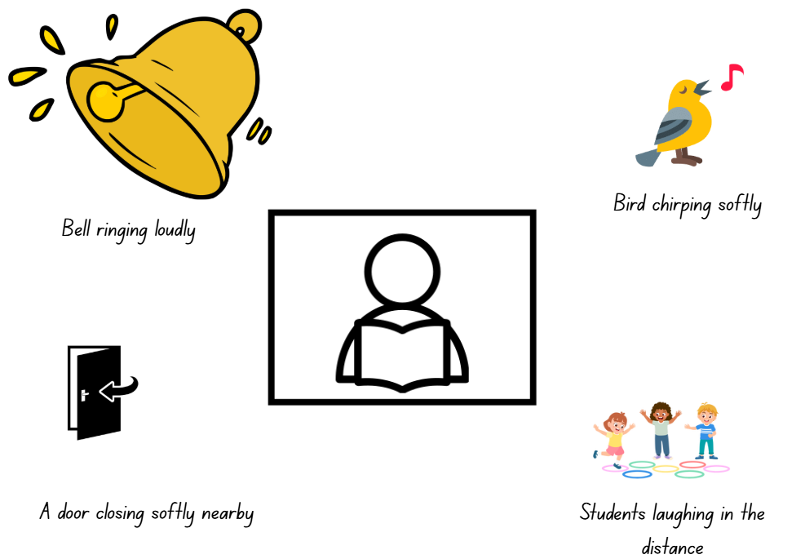
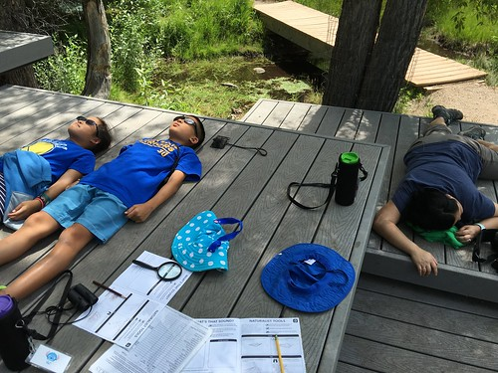
Science and technology – unit 5 spotlight (1)
Sound audit
This Photo by Unknown Author is licenced under CC BY-NC-ND
Notes:
60. Purpose: To highlight activities within the unit.
Time: 50 seconds
Presenter notes:
The first activity we would like to highlight from this unit is the sound audit. This activity is in Lesson 1 and involves students observing a range of sounds in the classroom and school grounds using the senses of hearing and touch, while collecting data that describes the different sounds.
Students will begin the sound audit by drawing themselves in the centre of the page.
As they listen to the sounds around them, they illustrate each sound as an image.
The size of each image represents the volume of the sound—louder sounds are drawn larger, and softer sounds are drawn smaller.
The position of each image on the page reflects the direction the sound came from—sounds heard from the left are drawn on the left side of the page, and sounds from the right are drawn on the right.
[NEXT SLIDE]
Image Credit: Canva Education. 2025. Images via Canva. https://www.canva.com/ accessed 30 Sept 2025.

Slide 61
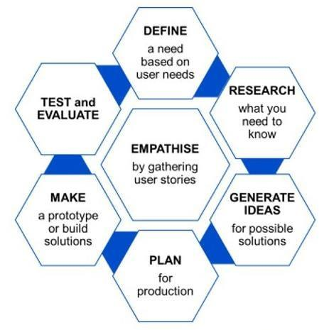

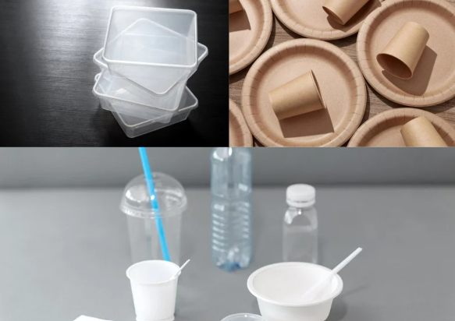
Science and technology – unit 5 spotlight (2)
Designing and making an instrument
image: © NSW Education Standards Authority (NESA)
Notes:
61. Purpose: To highlight activities within the unit
Time: 35 seconds
Presenter notes:
In lessons 10 and 11 students design and make an instrument for a specific purpose.
In lesson 10 students begin to design their instrument by generating ideas from the available materials. They capture their ideas in a digital format to support making the instrument in the following lesson.
In lesson 11 students use their design plans to make the instrument. Students capture the making process at various steps using a digital device.
For example, photographing when all the materials are selected, when placing the shaker material in the container, and when attaching the lid to the container.
Images captured are used to support the optional assessment in the lesson.
[NEXT SLIDE]
Image Credit: Canva Education. 2025. Images via Canva. https://www.canva.com/ accessed 30 Sept 2025.

Slide 62
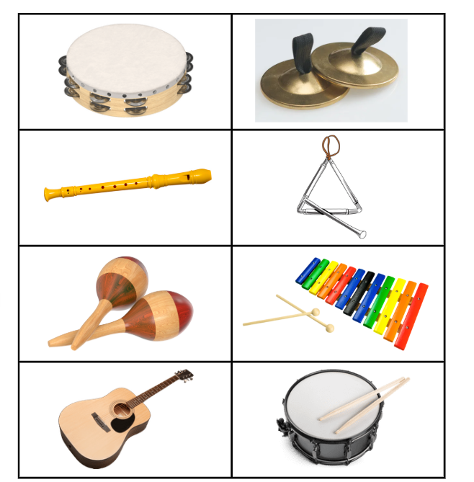
Science and technology – unit 5 spotlight (3)
School band – instrument actions
Striking
Blowing
Shaking
Plucking
Notes:
62. Purpose: To highlight activities within the unit.
Time: 1 minute 30 seconds
Presenter notes:
In this activity students use the sounds of the orchestra to identify and categorise blowing, plucking, striking and shaking instruments. They match instruments to the actions that make the sound.
We are going to give you a minute to categorise the action that produces sound as blowing, plucking, striking or shaking for the 8 instruments on screen. Record your responses on paper.
Pause for 1 minute to give participants time to categorise the instruments.
Provide correct categories:
Striking- drum, cymbals, triangle, xylophone
Blowing- recorder
Shaking- maracas, tambourine
Plucking- guitar
[NEXT SLIDE]
Image Credit: Canva Education. 2025. Images via Canva. https://www.canva.com/ accessed 30 Sept 2025.

Slide 63
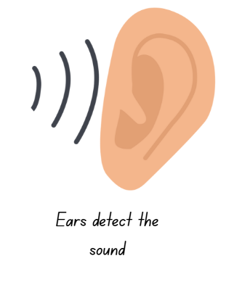



Science and technology – unit 5 misconceptions
Common misconceptions addressed
Notes:
63. Purpose: To highlight common misconceptions addressed in the unit
Time: 1 minute
Presenter notes:
There are also student misconceptions called out in the content scoped for Unit 5, it is important that educators identify and respond to student misconceptions using strategies grounded in evidence and research-informed practice.
One common misconception is that sound cannot travel through solid matter. In the unit there are many hands-on activities which allow students to observe sound travelling through solid matter.
Other common misunderstandings include:
loudness, and pitch are the same thing. In Lesson 8 this misconception is addressed by modelling a think aloud to explain the change in pitch. For example, ‘when the bottle is full of water, it creates a high pitch sound. As the water in the bottle is reduced the sound becomes lower in pitch. When the water bottle is empty it creates the lowest pitch sound. Students participate in hands on activities at sound stations to explore pitch and volume. A check for understanding has been included that involves reading statements about changes in pitch and volume. Students show thumbs up for true statements and thumbs down for false. The teacher provides feedback and addresses any misconceptions as each statement is discussed.
another misconception is that nothing passes between the source of a sound and a person’s ears. In Lesson 2 students explore what happens when a sound travels through air – they discover that it can be affected (blocked or muffled) by different materials.
Addressing common misconceptions is essential for building accurate scientific understanding, ensuring that students develop a strong conceptual foundation and are better equipped to engage with more complex ideas in future stages of learning.
[NEXT SLIDE]
Image Credit: Canva Education. 2025. Images via Canva. https://www.canva.com/ accessed 30 Sept 2025.

Slide 64
Science and technology – unit 5 reflection
What excites you about these units?
What changes did you notice which you will need to make some considerations about or do some preparation for?
What is still circling that you need some further clarification on?
Notes:
64. Purpose: To reflect on the units presented and take notes.
Time: 5 minutes
Presenter notes:
Take a moment now to consider what you’ve observed record any thoughts and begin to imagine how this might be applied within your own school setting.
Return to your participant workbook reflection section.
You will again have 5 minutes to add some notes.
After 5 minutes
Let’s continue.
[NEXT SLIDE]

Slide 65
Creative arts
Unit 1 and 5
Notes:
65. Purpose: Divider slide to introduce Creative arts units
Time: 20 seconds
Presenter notes:
There are a total of 8 Creative arts units in development for Stage 1. Each one provides students with opportunities to engage in syllabus content in meaningful and connected ways. Students are supported to meet the aim of the syllabus by developing curiosity, creativity, imagination, self-expression and collaboration as they develop knowledge, understanding and skills in dance, drama, music and visual arts.
Today, we’re putting a spotlight on two of the Stage 1 units: Unit 1 and Unit 5.
[NEXT SLIDE]

Slide 66
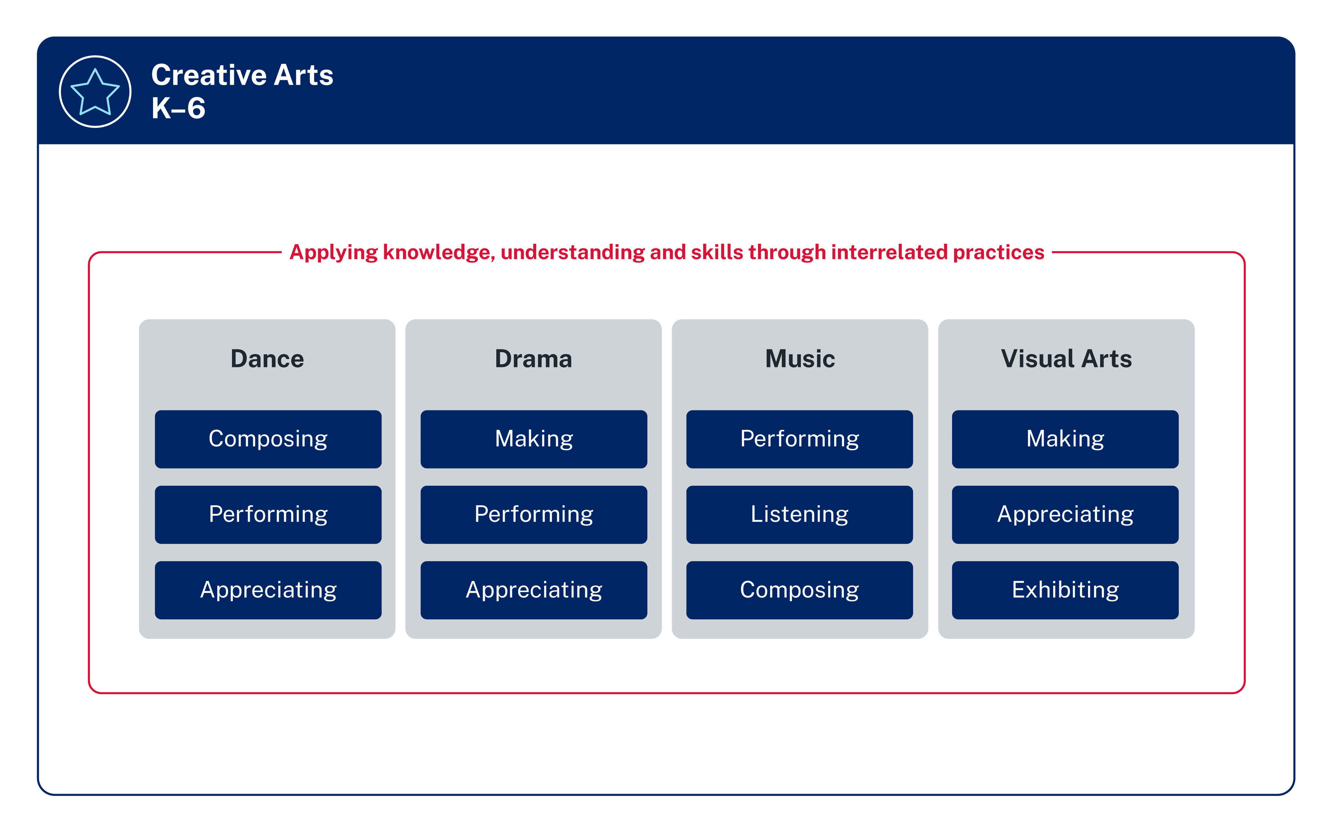
Syllabus content
Summary
2 focus areas each semester
Interrelated practices
Semester 1
Semester 2
Applying knowledge, understanding and skills through interrelated practices
Dance and Music
Drama and Visual arts
Notes:
66. Purpose: To highlight the structure of Creative arts learning across a stage
Time: 1 minute 30 seconds
Presenter notes: ​
Each semester, students learn about 2 focus areas. [CLICK] In Semester 1, the focus is on Dance and Music, while in Semester 2, the focus shifts to Drama and Visual Arts. Focus areas are repeated across 2 terms to support students in making connections and building schema by activating prior learning. This approach provides students with greater opportunities to consolidate learning and supports assessment and reporting practices, allowing for teachers to focus on just 2 focus areas in a semester, rather than all 4
[CLICK] Across these areas, students apply knowledge, understanding, and skills through the interrelated practices of each focus area. The content groups in creative arts are not isolated or linear and should not be taught in a sequential way. What is learnt in one content group connects to the others and supports students to understand, interpret, critique and apply their learning in meaningful ways across all focus areas.
Because we are looking at Units 1 and 5 today, the focus is on Dance and Music.
For Dance, the interrelated practices are composing, performing, and appreciating. This means that students are not just learning dance steps — they are creating, expressing, analysing, interpreting, appreciating, reflecting and applying their learning.
For Music, the interrelated practices are performing, listening, and composing. This ensures students experience music as performers and as creators, while also developing their ability to reflect and respond through listening to a range of music from cultures all around the world, in recorded form and performed by their peers.
This structure allows students to experience the creative arts holistically. It provides multiple entry points for expression, while building students' confidence and deepening their understanding across all four focus areas.
[NEXT SLIDE]

Slide 67
Key Features
Sample Creative arts units
Equal time allocation
Connections across dance and music
Context
Resources
Notes:
67. Purpose: To identify key features of Creative arts Units
Time: 2 minutes
Presenter notes:
Let’s take a closer look at some of the key features of the sample creative arts units.
[CLICK] First, equal time allocation. Each unit contains 10 dance lessons and 10 music lessons, giving students a balanced and consistent experience across both focus areas. Of these, 4 lessons are optional consolidation lessons, allowing for interruptions to regular timetables and supporting teachers to extend or deepen learning where it’s needed. This structure ensures every student has the opportunity to build real confidence and skill in both dance and music.
[CLICK] Second, the units make clear connections across dance and music. Students aren’t learning in silos — they’re seeing how movement and sound work together to communicate meaning. The dance and music components connect, but do not rely on each other. If a school chooses to teach only the music component or only the dance component, the lessons still maintain a consistent flow and meet the syllabus requirements and intent.
[CLICK] Third, the units are designed with context in mind. Every school is different, and these units acknowledge that. Whether they’re delivered by a classroom teacher, timetabled as RFF, or taught by a specialist teacher, the design allows schools to adapt while still staying true to the syllabus.
[CLICK] And finally, resources. Each unit contains direct links to music and dance repertoire including songs and videos that will support the learning—there are samples provided, with opportunities for teachers to adapt and select alternatives if preferred. Lesson templates, visuals and posters are provided. The units are intentionally designed to work in all school contexts: if percussion instruments aren't available, an alternative is usually provided so students can use found instruments, body percussion, digital applications or their voice to achieve the same learning.
[NEXT SLIDE]

Slide 68
Creative arts – unit 1 and 5 syllabus outcomes
Focus Areas: Dance and Music
CA1-DAN-01
composes and performs dance using shapes and movements to communicate ideas, and describes ways that dance conveys ideas
CA1-MUS-01
performs, uses listening skills and composes to communicate ideas through sound, and describes ways musical ideas are conveyed
Notes:
68. Purpose: To outline the outcomes and content in the featured units.
Time: 40 seconds
Presenter notes:
On screen you can see how content is organised through the interrelated practices. Together, these ensure students are performing, composing and appreciating creative works as they develop the vocabulary to be able to recognise, understand, interpret and explain choices made by composers and performers.
[NEXT SLIDE]

Slide 69
Creative arts – unit 1 and 5 syllabus content
Dance
Composing: Dance is composed to communicate ideas through shapes and movements
Performing: Dance is performed to communicate ideas through shapes and movements
Appreciating: Ideas are conveyed in various ways in dance
Music
Performing: Music is performed to communicate musical ideas through sound
Composing: Musical ideas are conveyed through sound
Listening: Music is composed to communicate musical ideas through sound
Notes:
69. Purpose: To outline the outcomes and content in the featured units.
Time: 40 seconds
Presenter notes:
On screen you can see how content is organised through the interrelated practices. Together, these ensure students are performing, composing and appreciating creative works as they develop the vocabulary to be able to recognise, understand, interpret and explain choices made by composers and performers.
[NEXT SLIDE]

Slide 70
Creative arts – unit 1
Unit 1
Notes:
70. Purpose: Divider slide to introduce Creative arts units
Time: 5 seconds
Presenter notes:
The first feature unit is Unit 1.
[NEXT SLIDE]

Slide 71
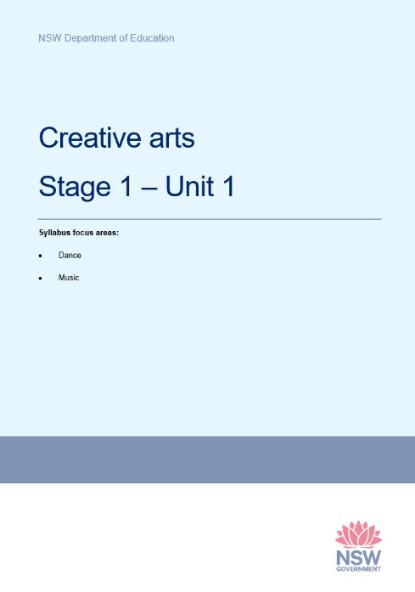
Creative arts – unit 1 overview
Students explore movement and music to inspire creative expression.
Dance focus: traditional African dances, exploring space and time, improvising movement inspired by living things.
  Music focus: soundscapes and performances inspired by African songs and animals, focusing on duration, pitch, timbre and structure.
Notes:
71. Purpose: To provide an overview of the unit.
Time: 40 seconds
Presenter notes:
This unit gives students the chance to use both Dance and Music for creative expression and storytelling.
In Dance, the focus is on traditional African dances. Students explore the elements of space and time, improvising movements inspired by living things and developing confidence in expressing ideas through their bodies.
In Music, the focus is on creating soundscapes and performances inspired by African songs and animals. Students experiment with duration, pitch, timbre and structure, giving them a toolkit to compose and perform their own musical ideas.
Together, these experiences help students connect movement and sound, while also broadening their cultural awareness through rich and authentic contexts.
[NEXT SLIDE]

Slide 72
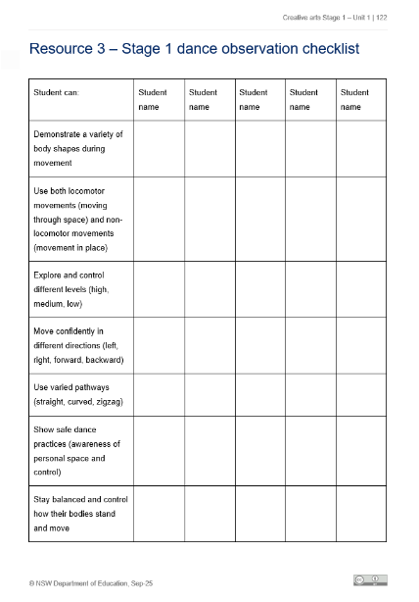

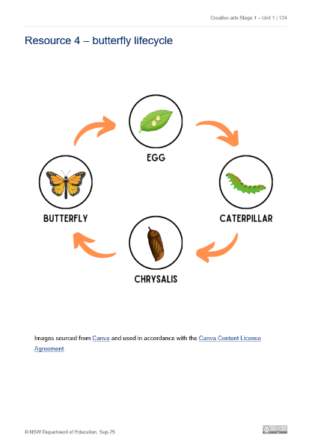

Creative arts – unit 1 spotlight (1)
Dance
Locomotor and non-locomotor movement
Inspired by Still Life at the Penguin Café
Butterfly life cycle
Levels, pathways and shapes to show transformation
South African gumboot dancing
Authentic cultural context and performance
Waka Waka Finale
High-energy group compositions
Birmingham Royal Ballet in ‘Still Life’ at the Penguin Café. © Bill Cooper
Gumboot dancers. http://creativecommons.org/licenses/by-sa/3.0/
Notes:
72. Purpose: To highlight exciting dance activities included in this sample unit of work.
Time: 40 seconds
Presenter notes:
The unit invites students to explore both dance and music through creative, playful and culturally rich experiences.
In dance, students start with locomotor and non-locomotor movements, inspired by a performance from the Birmingham Royal Ballet to Still Life at the Penguin Café. They explore space by making animal-inspired body shapes, then move into pathways, levels and directions, even representing the life cycle of a butterfly through movement.
Later in the unit, students experience South African gumboot dancing, and finish with high-energy composition tasks where they create their own short sequences to music like Shakira’s Waka Waka.
[NEXT SLIDE]

Slide 73




Creative arts – unit 1 spotlight (2)
Music
Exploring beat and tempo
Carnival of the Animals and Obwisana stone-passing game
Exploring timbre and pitch
Voices, instruments or Chrome Music Lab
Abiyoyo storytelling
Linking music, story and culture
Sound story performance
Compose, rehearse and refine animal sound stories
Cover illustration from the children's book "Abiyoyo" (1986), published by Simon and Shuster.
Notes:
73. Purpose: To highlight exciting music activities included in this sample unit of work.
Time: 40 seconds
Presenter notes:
In music, students begin by exploring a steady beat and tempo through Carnival of the Animals by Camille Saint-Saëns, a playful suite that depicts different animals, and Obwisana, a traditional song from Ghana. They improvise rhythms using body percussion, pass stones to feel the beat, and explore pitch and timbre with classroom instruments or digital tools such as Chrome Music Lab. The storytelling focus is highlighted through the South African tale Abiyoyo, where students sing, play and ultimately create their own sound stories.
This unit contains a strong mix of authentic cultural contexts, student creativity through improvisation and composition, and ready-to-use resources — like flashcards, anchor charts and observation checklists. These features make it practical for teachers while keeping the joy and movement at the centre of learning.
[NEXT SLIDE]

Slide 74



Creative arts – unit 1 spotlight (3)
Lesson 4 – music: exploring beat and tempo
Learn Obwisana (traditional Ghanaian song)
Keep a steady beat through clapping and movement
Play the stone-passing circle game to feel the beat
Explore rhythm patterns using body percussion
Notes:
74. Purpose: To highlight exciting music activities included in this sample unit of work.
Time: 1 minute 10 seconds
Presenter notes:
In Lesson 4 – Music, students explore beat, tempo and rhythm through the traditional Ghanaian song Obwisana.
The lesson begins with students clapping and moving to a steady beat. They practise keeping the beat together, first with clapping, then with stomping or marching.
Students are introduced to Obwisana by listening and echo-singing line by line until they can perform the full song.
Students then play a stone passing circle game, where each student passes a stone to the person beside them on the beat. This activity helps students feel the beat and notice how the speed of the beat (tempo) changes the energy. It also helps to reinforce the importance of everyone keeping in time with the beat and working together.
The lesson then moves into exploring rhythm. Students create body percussion patterns and then layer these over the steady beat of the song to develop their understanding that the beat stays the same, but rhythms can change.
The lesson ends with students sharing what they noticed about beat, rhythm, and tempo.
This lesson is a highlight because it is engaging, hands-on, and connected to cultural traditions.
[NEXT SLIDE]

Slide 75
Creative arts – unit 5
Unit 5
Notes:
75. Purpose: Divider slide to introduce Creative arts units.
Time: 5 seconds
Presenter notes:
The next feature unit is Unit 5.
[NEXT SLIDE]

Slide 76

Creative arts – unit 5 overview
Students engage in creative storytelling through dance and music.
Dance focus: Bollywood-inspired dance; composing and performing with shapes and movements
Music focus: Japanese and Norwegian folk tales; exploring elements of music to communicate ideas
Notes:
76. Purpose: To provide an overview of unit 5.
Time: 30 seconds
Presenter notes:
Unit 5 gives students the opportunity to explore creative storytelling through dance and music.
In dance, students investigate Bollywood style dance to explore how dance is composed and performed to communicate ideas through shapes and movements.
In music, students listen to a variety of music, including songs inspired by Japanese and Norwegian folk tales, to explore how composers and musicians use the elements of music to communicate ideas and meaning. They use the elements of music to compose and perform music that tells a story.
Together, these experiences enable students to connect movement and sound as forms of storytelling, while also engaging with diverse cultural traditions.
[NEXT SLIDE]

Slide 77





Creative arts – unit 5 spotlight (1)
Music
Explore songs and stories from around the world
Investigate Japanese and Norwegian music inspired by folk tales
Experiment with pitch, duration, timbre, and structure
Compose soundscapes and story-inspired music
Flannery, A. (2013). In the Hall of the Mountain King
Icinori, R. (2014). Issun Boshi: The One-Inch Boy
Notes:
77. Purpose: To highlight exciting music activities included in this sample unit of work.
Time: 30 seconds
Presenter notes:
Looking at music, students learn that sound can tell a story. They listen to examples such as Issunboshi from Japan and In the Hall of the Mountain King from Norway, exploring how cultural traditions influence musical choices.
They experiment with vocal ostinatos, body percussion, and instrumental sounds to reflect the characters and moods of different stories. They also develop soundscapes to accompany picture books, learning how to select and organise sounds with intent.
Through these activities, students see how music can create images, mood, and narratives, while also building their vocabulary to describe duration, pitch, timbre, and structure.
[NEXT SLIDE]
[NEXT SLIDE]

Slide 78


Creative arts – unit 5 spotlight (2)
Dance
Explore Bollywood style dance and its origins
Learn mudras (hand gestures) and expressions used in storytelling
Experiment with shapes, levels, direction and tempo
Compose and perform simple Bollywood-inspired sequences
Still from Spectacular Schools (The Arts Unit, 2018)
Notes:
78. Purpose: To highlight exciting dance activities included in this sample unit of work.
Time: 20 seconds
Presenter notes:
In dance, students are introduced to Bollywood as a cultural dance style with rich storytelling traditions. They learn about its origins and how hand gestures, called mudras, along with facial expressions, help to communicate ideas.
Students experiment with the elements of dance — space, time, and dynamics, through a range of movement activities. They also build their Tier 2 and Tier 3 vocabulary and use this language to describe how the elements are used in dance.
The unit culminates with students composing and performing a group-devised Bollywood-inspired dance sequence that integrates mudras, movements and expressions to communicate a story to the audience.
[NEXT SLIDE]

Slide 79

Creative arts – unit 5 – mudras
Dance
Notes:
79. Purpose: To end the session with a light Bollywood-inspired storytelling activity.
Time: 2 minutes
Presenter Notes:
To wrap up, let’s finish with a quick Bollywood-inspired moment!
On the slide, you’ll see three hand gestures — or mudras — used in Bollywood storytelling. Each is matched with an emoji:
🌸 Lotus (Alapadma) – beauty or celebration
🦚 Peacock (Mayura) – elegance or nature
🙏 Namaste – respect or greeting
Take a look and pick the one that best matches your current mood or energy. No need to overthink it, just go with your first instinct!
[NEXT SLIDE]

Slide 80
Creative arts – unit 5 reflection
What excites you about these units?
What changes did you notice which you will need to make some considerations about or do some preparation for?
What is still circling that you need some further clarification on?
Notes:
80. Purpose: To reflect on the units presented and take notes.
Time: 5 minutes
Presenter notes:
Once again, we invite you to pause and reflect on what you’ve learned, take some notes and begin considering how these ideas might translate into your own school environment.
Return to your participant workbook reflection section.
You will again have 5 minutes to add some notes.
After 5 minutes
We will continue now.
[NEXT SLIDE]

Slide 81
Personal Development, Health and Physical Education – unit 1
Unit 1
Notes:
81. Purpose: To introduce the first of 2 PDHPE Stage 1 Units that will be published for use next year.
Time: 5 seconds
Presenter notes:
We will now shift our focus to the key learning area of Personal development, health and physical education. The following slides will unpack Unit 1.
[NEXT SLIDE]

Slide 82

PDHPE – unit 1 time allocation (2)
PDH/PE lesson structure: balanced approach with equal focus in line with NESA guidelines
8 PDH lessons and 8 PE lessons designed for weekly implementation (1 each per week)
PE supports the recommended 150 minutes of physical activity per week
Notes:
82. Purpose: To demonstrate the balanced approach of lessons and how the 150 minutes of moderate to vigorous physical activity can be achieved across the school week.
Time: 2 minutes
Presenter notes:
PDH and PE lessons are structured to ensure an equal emphasis on both subject areas, following the recommendation of 8% (approximately 2 hours) provided by NESA.
The units are written based on a 10-week term approach. The design includes 8 PDH lessons and 8 PE lessons, which allows us to implement one PDH lesson and one PE lesson each week, maintaining a balanced and consistent approach throughout the term. The 4 remaining optional consolidation lessons are used to revise keys concepts or skills.
Time allocation is applied in the same way across all sample units.
Importantly, the PE lessons contribute directly to meeting the recommended 150 minutes of physical activity per week, supporting students’ health and wellbeing goals.
This graphic demonstrates how schools can meet the recommended requirements of the department’s Sport and Physical Activity procedures. Note the red circle, this represents NESA (therefore the syllabus), and the blue circle represents the department's Sport and Physical Activity Procedures. Let's now identify what contributes to the 150 minutes of physical activity per week.
PE is part of the mandatory PDHPE key learning area. Physical activity performed in PE lessons contributes towards meeting the 150 minutes. PDH lessons do not contribute to the 150 minutes unless they include physical activity.
School sport is a mandatory part of whole school planning which offers students weekly planned opportunities to participate in physical activities which also contributes to the 150 minutes. Schools are able to design their own programs for weekly school sport. Schools must provide a minimum 60 minutes of sport per week for years 3-6. There is no set amount of time allocated to weekly sport for students in Years K– 2, although some schools choose to run a weekly sport session across classes or stages.
Other structured physical activity may include:
Classroom Energisers - these are fun and moderate to vigorous activities designed to break up long periods of sitting and stimulate learning. For example, a class takes part in a 10-minute energiser activity every day making a total of 50 minutes of physical activity for the week. The frequency and duration of classroom energisers should be represented in class timetables.
This information is available in the FAQs of the PDHPE channel in the Primary curriculum Statewide staffroom.
[NEXT SLIDE]

Slide 83

PDHPE – unit 1 overview
Students:
develop balance, running, and catching skills, applying them in games that promote safety, enjoyment, and fair play
build self-management skills by recognising emotions and understanding the connection between feelings, words, and body language
learn an understanding of road safety in the contexts of pedestrian, passenger and wheels.
Notes:
83. Purpose: To introduce stage 1 unit 1 sample unit with the unit overview.
Time: 1 minute
Presenter notes:
In Unit 1, students are developing the knowledge, skills, and understanding to support both their health and their physical development.
[CLICK] The personal development and health components focus on students learning how to be safe road users, how to respond to emergencies, and how to practise hygiene routines that support wellbeing. They also begin exploring personal identity by noticing the physical and social changes that shape who they are.
[CLICK] In physical education, the focus is on balance, running, and catching skills. Students practise these in structured games and activities where they also apply principles of safety, enjoyment, and fair play.
[CLICK] Another important thread in this unit is self-management. Students build skills to recognise their own emotions and understand how feelings, words, and body language connect. This sets the foundation for respectful relationships and effective communication.
[NEXT SLIDE]

Slide 84
PDHPE – unit 1 syllabus outcomes
PH1-MSP-01 demonstrate fundamental movement skills and fair play in physical activities
PH1-RRS-01 describe and demonstrate actions that support respectful relationships and safety offline and online
PH1-IHW-01 describe factors that contribute to identify health and wellbeing
PH1-SMI-01 describe and demonstrate self-management and interpersonal skills in a range of contexts
Notes:
84. Purpose: To outline the outcomes and content in the unit.
Time: 1 minute 30 seconds
Presenter notes:
The focus areas for Unit 1 are [CLICK]:
Movement skill and physical activity
Respectful relationships and safety
Identity health and wellbeing, and
Self-management and interpersonal skills.
[CLICK] In the focus area Movement skill and physical activity students are working on demonstrating fundamental movement skills and learning about fair play in physical activities. This isn’t just about skill development, it’s also about how students participate safely and inclusively.
[CLICK] In the focus area Respectful relationships and safety, students are encouraged to describe and demonstrate actions that keep themselves and others safe, both offline and online.
[CLICK] In the focus area Identity health and wellbeing the focus is on recognising the factors that shape who we are and how choices, characteristics, and personal care can contribute to health and safety.
[CLICK] In the focus area Self-management and interpersonal skills, students practise managing their emotions, making responsible choices and build the skills needed to interact positively with others.
[NEXT SLIDE]

Slide 85
PDHPE – unit 1 syllabus content (1)
Focus areas and content groups
Movement skill and physical activity:
Participate with others safely and fairly in physical activities
Fundamental movement skills support health and wellbeing
Respectful relationships and safety:
Respectful relationships improve health and wellbeing
Choices and actions contribute to safety
Notes:
85. Purpose: To outline the outcomes and content in the unit.
Time: 1 minute 30 seconds
Presenter notes:
The focus areas for Unit 1 are [CLICK]:
Movement skill and physical activity
Respectful relationships and safety
Identity health and wellbeing, and
Self-management and interpersonal skills.
[CLICK] In the focus area Movement skill and physical activity students are working on demonstrating fundamental movement skills and learning about fair play in physical activities. This isn’t just about skill development, it’s also about how students participate safely and inclusively.
[CLICK] In the focus area Respectful relationships and safety, students are encouraged to describe and demonstrate actions that keep themselves and others safe, both offline and online.
[CLICK] In the focus area Identity health and wellbeing the focus is on recognising the factors that shape who we are and how choices, characteristics, and personal care can contribute to health and safety.
[CLICK] In the focus area Self-management and interpersonal skills, students practise managing their emotions, making responsible choices and build the skills needed to interact positively with others.
[NEXT SLIDE]

Slide 86
PDHPE – unit 1 syllabus content (2)
Identity health and wellbeing:
Factors and characteristics can shape identity
Factors can support and strengthen identity
Self-management and interpersonal skills:
Responsible choices and actions promote self-management
Notes:
86. Purpose: To outline the outcomes and content in the unit.
Time: 1 minute 30 seconds
Presenter notes:
The focus areas for Unit 1 are [CLICK]:
Movement skill and physical activity
Respectful relationships and safety
Identity health and wellbeing, and
Self-management and interpersonal skills.
[CLICK] In the focus area Movement skill and physical activity students are working on demonstrating fundamental movement skills and learning about fair play in physical activities. This isn’t just about skill development, it’s also about how students participate safely and inclusively.
[CLICK] In the focus area Respectful relationships and safety, students are encouraged to describe and demonstrate actions that keep themselves and others safe, both offline and online.
[CLICK] In the focus area Identity health and wellbeing the focus is on recognising the factors that shape who we are and how choices, characteristics, and personal care can contribute to health and safety.
[CLICK] In the focus area Self-management and interpersonal skills, students practise managing their emotions, making responsible choices and build the skills needed to interact positively with others.
[NEXT SLIDE]

Slide 87

PDHPE – unit 1 skill development
In this unit, students learn:
PDH content supports the development of class and school routines and expectations:
road safety
hygiene
self-care
respectful relationships
self-management and interpersonal skills
PE structure and content:
fast starts
spatial awareness, following rules and fundamental movement skills
fundamental movement skills
self-management and interpersonal skills, including goal setting.
Notes:
87. Purpose: To introduce the skill development in stage 1 for PDHPE.
Time: 1 minute
Presenter notes:
PDH content provides the foundation for developing class and school routines that help students engage safely, respectfully, and responsibly. Through explicit teaching and practice, students learn key habits in areas such as road safety, hygiene, self-care, and interpersonal skills. For example, safe lining up, structured times for handwashing, drink breaks, or turn-taking routines embed these skills into daily practice.
PE lessons focus on developing movement competence, confidence, and positive attitudes to being active. Fast starts, such as short tag games or stretches, quickly engage students and establish active participation as a routine. Lessons also build spatial awareness and fundamental movement skills through simple activities like “traffic lights,” skill stations, or small team games. At the same time, students practise goal setting, teamwork, and fair play, with routines like reflection circles or shaking hands before and after games reinforcing respect, cooperation, and resilience.
[NEXT SLIDE]

Slide 88


PDHPE – unit 1 spotlight (1)
PDH lessons
hygiene is taught in Lesson 1 to support students healthy return to school
road safety is taught in term 1 each year
resources reflect real life scenarios
Notes:
88. Purpose: To highlight exciting activities included in this sample unit of work.
Time: 1 minute 30 seconds
Presenter notes:
The sequence of PDH lessons is carefully structured to guide students through essential personal safety and social skills topics across the school year. Each lesson is designed to introduce skills at a developmentally appropriate time, so that students are supported just when they need it most.
In Unit 1, the very first lesson focuses on hygiene—an important foundation for the start of the school year when students are settling back into routines. From there, the lessons gradually build into broader personal and social skills.
Students practise making responsible choices and explore what it means to be a good friend. This includes recognising and managing emotions, and learning calm strategies such as taking a deep breath, talking to a teacher, counting to five, or walking away from a problem. They also engage in role-play, working through “What would you do if…?” scenarios.
The sequence also includes lessons on personal safety in real-world contexts. For example, students learn how to identify hazards when walking to and from school. A walking excursion provides a hands-on opportunity to explore the local environment, where students observe and discuss potential risks such as car parks, driveways, and busy traffic areas.
Passenger safety is another focus. Students revise what safe behaviour looks like as a passenger and then demonstrate it in small groups. They explain and act out safe behaviours in cars and buses, including correct entry and exit, wearing seatbelts, using booster seats, sitting quietly, and following adult instructions in different scenarios.
This deliberate sequencing ensures that students are not only learning new skills, but also applying them in practical, meaningful ways that directly connect to their daily lives.
Image Credit: Canva Education. 2025. Images via Canva. https://www.canva.com
[NEXT SLIDE]

Slide 89




PDHPE – unit 1 spotlight (2)
Lesson 12
Notes:
89. Purpose: To highlight exciting activities included in this sample unit of work.
Time: 1 minute
Presenter notes:
In PE lesson, it is important to think about how we’ll know if students have achieved the learning intentions. The focus here is on run and sprint.
In the core of the lesson the run and sprint skill components are highlighted in a feature box.
Connected to that is;
Differentiation,
Assessment – what to look for and
Optional assessment
These all work together to support you to gather evidence and insight you need to assess students achieved of the outcomes and readiness to move on.
Differentiation ensures all learners are supported. By thinking about assessment alongside scaffolding and challenge, all students are supported to succeed, while also stretching those who are ready for the next step.
Assessment – what to look for are observable points show whether students are achieving the correct technique for running and sprinting.
Optional assessment tasks are a great way to collect additional evidence in line with or beyond the main activity.
By deliberately watching for key running actions, using short optional assessment tasks, and adjusting the level of challenge, you can gather clear evidence of learning while ensuring every student has the chance to progress in their running and sprinting technique.
[NEXT SLIDE]

Slide 90
Personal Development, Health and Physical Education – unit 5
Unit 5
Notes:
90. Purpose: To preview unit 5.
Time: 5 seconds
Presenter notes:
Now we explore Unit 5.
[NEXT SLIDE]

Slide 91

PDHPE – unit 5 overview
Students learn to:
make good choices in friendships, managing emotions, healthy eating, and staying safe
explore respectful relationships and how they change, the benefits of healthy eating (including bush foods)
stay safe as road users
develop and apply balance, running, sprinting and catching skills in games that encourage safety, inclusion and enjoyment
build self-management skills by setting goals, practising self-regulation strategies and responding thoughtfully to different situations.
Notes:
91. Purpose: To introduce stage 1 unit 5 sample unit with the unit overview.
Time: 1 minute
Presenter notes:
[CLICK] In Unit 5, the focus is on supporting students to make positive and healthy choices in their everyday lives.
[CLICK] Through the personal development and health lessons, students learn strategies for building and maintaining friendships, managing their emotions, and staying safe. They explore how respectful relationships can change over time and how to respond thoughtfully to those changes.
Nutrition is also a key focus, with students learning about the benefits of healthy eating, including the role of bush foods in supporting wellbeing. Road safety continues to be reinforced as an essential life skill.
In physical education, students further develop their balance, running, sprinting, and catching skills. These are applied in a range of games that encourage participation, enjoyment, safety, and inclusion.
A strong emphasis is also placed on self-management. Students practise setting goals, using self-regulation strategies, and reflecting on how to respond constructively in different situations.
These skills strengthen their ability to engage positively with both learning and relationships.
[NEXT SLIDE]

Slide 92

PDHPE – unit 5 syllabus outcomes
Focus Areas: Respectful relationships and safety and Identity health and wellbeing
PH1-RRS-01 describe and demonstrate actions that support respectful relationships and safety offline and online
PH1-IHW-01 describe factors that contribute to identify health and wellbeing
Notes:
92. Purpose: To outline the outcomes and content in the unit.
Time: 1 minute
Presenter notes:
Syllabus content introduced in Stage 1 Unit 1 is revisited in Unit 5, which is intentional. Based on NESA’s whole school plan, the DoE scope and sequences, and research on how students build schemas through sequenced learning, the deliberate repetition of key content ensures students consolidate their understanding, make stronger connections and apply their learning in new contexts.
In addition to revisiting earlier learning, Unit 5 introduces new content.
[CLICK] Students learning how relationships change over time as well as how their actions contribute to respectful relationships.
[CLICK] Students begin to describe the benefits of healthy eating and drinking habits, making clear links to how these choices improve their health and wellbeing.”
A significant extension in this unit is the inclusion of bush foods, where students learn about their nutritional benefits and cultural importance, broadening their understanding of healthy eating beyond everyday choices.
This content group, Responsible choices improve health, and wellbeing builds on students’ prior knowledge by encouraging them to think critically about the food and drink decisions they make, and how these decisions contribute to their overall wellbeing.
As we have already mentioned each unit is structured around a 10-week term with 8 PDH lessons and 8 PE lessons, providing a balanced approach of one PDH and one PE lesson per week, plus four optional consolidation lessons.
As it is with Unit 1, Unit 5 PE lessons contribute directly to the 150 minutes of weekly physical activity recommended by the Department’s Sport and Physical Activity Procedures, while PDH lessons focus on respectful relationships, identity, health and wellbeing, safety, and decision-making.
[NEXT SLIDE]

Slide 93
PDHPE – unit 5 syllabus content
Content groups and content points
Respectful relationships improve health and wellbeing:
Describe how relationships can change over time
Demonstrate actions that contribute to respectful relationships
Responsible choices improve health and wellbeing:
Describe the benefits of healthy eating and drinking habits for health and wellbeing
Describe the benefits of bush food to improve health and wellbeing
Notes:
93. Purpose: To outline the outcomes and content in the unit.
Time: 1 minute
Presenter notes:
Syllabus content introduced in Stage 1 Unit 1 is revisited in Unit 5, which is intentional. Based on NESA’s whole school plan, the DoE scope and sequences, and research on how students build schemas through sequenced learning, the deliberate repetition of key content ensures students consolidate their understanding, make stronger connections and apply their learning in new contexts.
In addition to revisiting earlier learning, Unit 5 introduces new content.
[CLICK] Students learning how relationships change over time as well as how their actions contribute to respectful relationships.
[CLICK] Students begin to describe the benefits of healthy eating and drinking habits, making clear links to how these choices improve their health and wellbeing.”
A significant extension in this unit is the inclusion of bush foods, where students learn about their nutritional benefits and cultural importance, broadening their understanding of healthy eating beyond everyday choices.
This content group, Responsible choices improve health, and wellbeing builds on students’ prior knowledge by encouraging them to think critically about the food and drink decisions they make, and how these decisions contribute to their overall wellbeing.
As we have already mentioned each unit is structured around a 10-week term with 8 PDH lessons and 8 PE lessons, providing a balanced approach of one PDH and one PE lesson per week, plus four optional consolidation lessons.
As it is with Unit 1, Unit 5 PE lessons contribute directly to the 150 minutes of weekly physical activity recommended by the Department’s Sport and Physical Activity Procedures, while PDH lessons focus on respectful relationships, identity, health and wellbeing, safety, and decision-making.
[NEXT SLIDE]

Slide 94

PDHPE – unit 5 skill development
In this unit, students learn:
PDH content supports the development of class and school routines and expectations:
road safety
hygiene
self-care
respectful relationships
nutrition
self-management and interpersonal skills
PE structure and content:
fast starts
spatial awareness, following rules and fundamental movement skills
fundamental movement skills
self-management and interpersonal skills, including goal setting.
Notes:
94. Purpose: To introduce the skill development in stage 1 for PDHPE.
Time: 1 minute
Presenter notes:
In Unit 5, students continue to develop key skills in several areas the same as unit 1. The unit continues to develop:
road safety
hygiene
self-care
self-Management and interpersonal skills
PE lessons foster physical competence, confidence, goal setting and positive attitudes toward activity through movement skill development, balance, run and sprint and catch.
[CLICK] You can see highlight that the new content in this unit includes:
Healthy eating and drinking habits are central to students’ health and wellbeing. Making responsible food and beverage choices supports energy, concentration, immunity, and emotional balance. Encouraging balanced meals with fruits, vegetables, wholegrains, proteins, and regular water intake helps build lifelong habits for growth and disease prevention.
Learning about bush foods also connects students to Country, culture, and sustainability. Native fruits, nuts, and seeds provide rich nutritional value while promoting cultural awareness and respect for the environment. Classroom routines can reinforce this by highlighting the benefits of different food groups, modelling regular water breaks, and exploring bush foods through storytelling, cooking, or community visits.
Through these experiences, students develop the knowledge and skills to make mindful choices that support their health while also deepening their understanding of cultural heritage and connection to the environment.
[NEXT SLIDE]

Slide 95



PDHPE – unit 5 spotlight (1)
Lesson 4
PDH
Meaningful connections between Aboriginal and Torres Strait Islander culture, bush foods and healthy eating
Advice on who to contact for contextually relevant information
Martin, C. (2023). The Toast Tree.
Notes:
95. Purpose: To highlight exciting activities included in this sample unit of work.
Time: 1 minute 30 seconds
Presenter notes:
Unit 5 uses the beautiful text The Toast Tree by Corina Martin, illustrated by Fern Martins. The story provides a meaningful context for exploring bush foods and native plants, while also highlighting connections to Country and the importance of respecting Aboriginal and Torres Strait Islander perspectives.
The focus here is on native plants, with bush tucker examples such as fruits, seeds, and other plant-based foods. Where appropriate, the unit also notes that bush foods may include native animals like kangaroo or emu, allowing teachers to adapt depending on local context and knowledge shared by Elders or Knowledge Holders.
Bush foods are deeply tied to Country, Place, and culture, so it’s important to localise the learning. Teachers are encouraged to connect with local Elders, AECGs, Land Councils, or Land Services to gather accurate information about bush foods specific to their area. This ensures what is taught is both respectful and relevant, while also helping students connect more meaningfully with the Country they live and learn on.
Embedding this knowledge gives students an understanding of bush foods while fostering respect for Aboriginal cultural knowledge and a sense of belonging and responsibility to care for Country. The key takeaway for teachers is to use the unit as a starting point for conversations with local communities, making the learning culturally responsive and authentic.
[NEXT SLIDE]

Slide 96

PDHPE – unit 5 spotlight (2)
Lesson 10
PE
games are designed to activate students' prior knowledge or practice new skill components
games in PE lessons are based on department approved resources
include clear instructions and images to effectively demonstrate rules and objectives.
Adapted from: Paying for life, Australian Sports Commission
Notes:
96. Purpose: To highlight exciting activities included in this sample unit of work.
Time: 1 minute
Presenter notes:
PE lessons are built on a variety of department approved resources, ensuring that the activities are evidenced based, age appropriate and aligned with syllabus outcomes.
Games are built into the beginning, core and concluding parts of the sample units where relevant to the learning sequence.
Students engage in a Fast start warm up activity which provides an opportunity to:
-engage in moderate to vigorous physical activity (huff 'n' puff) with minimal rules within 2 minutes
-explore and practise movement skills (fundamental and specialised movement skills and concepts, tactical and creative movement, health and fitness enhancing movement)
-reinforce an inclusive learning environment that supports positive interactions and ongoing collaboration.
Stage 1 Sample Unit – PE Lesson: Static and Dynamic Balance
Again, this PE lesson is built on Department-approved resources and gives students opportunities to apply both static and dynamic balance in fun and engaging ways. The game Stone, Bridge and Tree (adapted from Playing for Life) is designed to develop balance, coordination, and teamwork. The lesson includes directions on how to play the game.
Students are refining and practising balance skill components.
Students demonstrate individual skill components of balance while teacher observes and checks for understanding.
[NEXT SLIDE]

Slide 97
PDHPE – unit 5 reflection
What excites you about these units?
What changes did you notice which you will need to make some considerations about or do some preparation for?
What is still circling that you need some further clarification on?
Notes:
97. Purpose: To reflect on the units presented and take notes.
Time: 5 minutes
Presenter notes:
Now is another opportunity to step back, capture your initial thoughts and think about how this could take shape in the unique context of your school.
Return to your participant workbook reflection section.
You will again have 5 minutes to add some notes.
After 5 minutes
Thank you everyone, we will continue now
[NEXT SLIDE]

Slide 98

Gap analysis
Notes:
98. Purpose: To explain that there have been some content changes across all CHPS syllabuses and conduct a gap analysis to identify how to support teachers' awareness of these gaps.
Time: 30 seconds
Presenter notes:
This session is designed to give you an overview of the content changes across the new CHPS syllabuses.
Also, to introduce the Gap Analysis tool, which supports schools in identifying differences in content, timing, and potential gaps in student knowledge.
By the end, you’ll see how this tool can guide future planning and discussions in your teams
[NEXT SLIDE]

Slide 99

Changes in the CHPS syllabus content (1)
Key updates
the introduction of new content aligned with contemporary needs
shift in timing to ensure learning is developmentally appropriate
the merging and strengthening of existing areas for greater clarity and impact.
Notes:
99. Purpose: To explain why the changes to the CHPS syllabus matters to identifying the gaps in the sequence of learning.
Time: 1 minute
Presenter notes:
The CHPS syllabuses have been updated to better reflect current knowledge, skills, and priorities. The new syllabuses focus on what is essential to know and do for success in education and life.
These changes are designed to create a more streamlined, relevant, and future-focused curriculum. By understanding and engaging with these updates, we can:
Adapt and refine teaching programs to reflect current priorities
plan strategically for resourcing across the school
engage in targeted professional learning to build teacher confidence
provide consistent and equitable support for students, ensuring every learner can thrive
[NEXT SLIDE]

Slide 100

Changes in the CHPS syllabus content (2)
Notes:
100. Purpose: To explain why the changes to the CHPS syllabus matters to identifying the gaps in the sequence of learning.
Time: 1 minute
Presenter notes:
To identify gaps students will have when you implement the new syllabuses you can compare the content with what students were expected to learn with the previous syllabus. Think about your school curriculum, your stage, the scope and sequences and class programs. Then cross check whether students have these understandings through assessments, class discussion and observation of their learning.
To support you to identify new syllabus content, you have access to information in the NSW department of education intranet page through the curriculum tab. On the screen you can see the pathway to find the HSIE what has changed overview.
The links to all the CHPS key learning areas overviews can be found in your participant workbook.
[NEXT SLIDE]
Leaders' information CHPS
Human Society and its Environment K–6 Syllabus (2024) – information for school leaders
Science and Technology K–6 Syllabus (2024) – information for school leaders
Creative Arts K–6 Syllabus (2024) – information for school leaders
PDHPE K–6 Syllabus (2024) – information for school leaders

Slide 101

Overview of key changes across CHPS (1)
HSIE
Aboriginal Cultures and Histories strengthened from ES1–S3
Ancient Cultures and Histories now in Stage 1 and 2
Resourcing/teacher knowledge of maps and geographical information critical
History + Geography now integrated into one HSIE KLA
Notes:
101. Purpose: To provide an overview of key changes across KLA’s.
Time: 1 minute
Presenter notes:
[CLICK] In HSIE:
Aboriginal Cultures and Histories outcomes and content are strengthened from ES1–S3. The updated syllabus places a stronger emphasis on Aboriginal Cultures and Histories across all stages of learning. This requires teachers to embed Aboriginal perspectives consistently and authentically, not just in isolated units. This will require consultation with local Aboriginal communities to ensure respectful, authentic learning.
[CLICK] Students will now begin exploring Ancient Cultures and Histories earlier in their schooling, from Stage 1 and 2. This shift introduces historical inquiry skills at a younger age, allowing students to engage with the diversity of human experiences and compare past and present societies in more meaningful ways.
[CLICK] There is an increased focus on students using maps and other geographical tools to build spatial awareness and interpret information. Teachers will need to strengthen their own knowledge and confidence with geographical skills, and schools may need to invest in updated resources such as atlases, digital mapping tools, and classroom globes.
[CLICK] Previously taught as separate syllabuses, History and Geography are now combined into one HSIE KLA. This integration encourages teachers to plan more connected units that draw on both historical and geographical perspectives, supporting students to see the links between people, place, and time. It also reduces duplication and provides more flexibility in program design.
[NEXT SLIDE]

Slide 102

Overview of key changes across CHPS (2)
Science and technology
Human body content is new across K–6, including knowledge of the ear, eyes, digestive system, muscles, and skeleton
Additional practical investigation, demonstration and hands-on learning
Working Scientifically skills are embedded across all years, not treated as a separate component
Notes:
102. Purpose: To provide an overview of key changes across KLA’s.
Time: 1 minute
Presenter notes:
[CLICK] In Science and technology:
Human body content is a new focus across K–6, with students learning about key systems and structures such as the ear, eyes, digestive system, muscles, and skeleton. This development provides a strong foundation for understanding how the body functions, promoting health awareness and scientific literacy from an early age. Integrating this content across all year levels ensures students build progressively deeper knowledge and can make connections between body systems, health, and everyday experiences.
[CLICK] Electricity syllabus content requires additional practical investigation, demonstration, and hands-on learning. This may require additional resources to provide appropriate materials and equipment. Teacher guidance is essential to ensure students can explore concepts safely, engage with experiments, and develop a deep understanding of electrical circuits and energy transfer.
[CLICK] Working Scientifically skills are now embedded across all year levels rather than treated as a separate component. Students consistently develop skills such as questioning, predicting, planning, conducting investigations, collecting and interpreting data, and evaluating results. Embedding these skills throughout the curriculum ensures they are applied in context, strengthening students’ problem-solving, critical thinking, and scientific reasoning capabilities from K–6.
[NEXT SLIDE]

Slide 103

Overview of key changes across CHPS (3)
Creative arts
Dance and music elements have been updated from the previous syllabus
There is a strengthened focus on historical and cultural arts practices globally, including Aboriginal and/or Torres Strait Islander practices
Greater emphasis on vocabulary development, critical and creative writing (CWT)
Digital technology and digital safety are now explicitly referenced in essential content
Notes:
103. Purpose: To provide an overview of key changes across KLA’s.
Time: 2 minutes
Presenter notes:
[CLICK] In Creative Arts:
Dance and music elements have been updated from the previous syllabus, providing students with more contemporary, engaging, and developmentally appropriate learning experiences. These updates support skill progression, creativity, and expression while ensuring alignment with current educational standards.
[CLICK] There is a strengthened focus on historical and cultural arts practices from around the world, including Aboriginal and Torres Strait Islander traditions. This approach enables students to appreciate the diversity of artistic expression, understand cultural contexts, and develop respect for both local and global creative practices.
[CLICK] Through creating written text there is now greater emphasis on vocabulary development, critical and creative writing. Students are encouraged to articulate ideas effectively, analyse artistic works critically, and engage in imaginative and reflective thinking, which strengthens both literacy and cognitive skills in meaningful arts contexts.
[CLICK] Digital technology and digital safety are explicitly referenced in the essential content, ensuring students understand how to use digital tools responsibly, ethically, and safely within arts learning. This inclusion reflects the growing role of technology in creative practice and prepares students to confidently navigate digital spaces.
[NEXT SLIDE]

Slide 104

Overview of key changes across CHPS (4)
PDHPE
Financial wellbeing is now a focus in Stages 1–3
Media literacy is explicitly embedded from Stage 1–3
PE has a stronger focus on small-sided games (requiring new resources and game structures)
PE K–2 includes explicit teaching of all fundamental movement skills to be achieved by the end of Stage 1, which may require targeted PL and resourcing
Notes:
104. Purpose: To provide an overview of key changes across KLA’s.
Time: 1 minute
Presenter notes:
n PDHPE:
Financial wellbeing is now an explicit focus from Stage 1 to Stage 3. Students are supported to develop foundational skills in managing money, such as understanding needs versus wants, making responsible spending and saving choices, and recognising the value of financial planning. Integrating financial literacy from an early age equips students with practical life skills, helping them to make informed decisions and build long-term economic resilience.
[CLICK] Media literacy is explicitly embedded from Stage 1 to Stage 3, recognising the increasingly complex media environment students navigate. Students learn to critically analyse and interpret information, identify bias or misinformation, and respond thoughtfully to media messages across multiple platforms. Early and consistent teaching of media literacy supports informed citizenship and encourages safe, responsible engagement with digital media.
[CLICK] Physical Education now places a stronger emphasis on small-sided games, which promote higher levels of participation, teamwork, spatial awareness, and decision-making compared with traditional large-group formats. Implementing small-sided games requires new teaching approaches, modified resources, and adaptable game structures to ensure all students are actively engaged and developing their skills. This approach also supports differentiation, allowing students of varying abilities to participate meaningfully.
[CLICK] PE for K–2 now includes the explicit teaching of all fundamental movement skills, with the goal that students achieve proficiency by the end of Stage 1. This ensures that students have a strong foundation in core movement patterns such as running, jumping, catching, throwing, balancing, and dodging. Achieving this goal may require targeted professional learning for teachers, additional resources, and structured practice opportunities to provide consistent and effective skill development for all students.
[NEXT SLIDE]

Slide 105

Introducing the gap analysis tool
Notes:
105. Purpose: To introduce the gap analysis tool.
Time: 2 minutes
Presenter notes:
The Gap Analysis tool is designed to help you systematically identify differences in content and timing between the old and new syllabuses.
It allows you to map where content has moved, been added, or consolidated, and to identify potential gaps in student knowledge.
To use the tool.
First identify the new content. Look at the updated syllabus for your stage. Record what is new or different compared to the previous syllabus in the New Content column.
Second, check prior stage learning. Consider what students should already know from previous stage/s. Note what they have may have missed or had less exposure to in the Prior Stage Content column. (e.g. due to timing changes, merged content, or new additions).
Third, pinpoint possible gaps. In the Gaps column, outline how you will find out if students have this gap. This could include quick check in activities, pre-assessments/ quizzes, class discussions and observations of student work.
Finally plan your actions, in the Action column, write how you will address the gap through your teaching. Examples could include incorporating revision activities, scaffolding with visuals or hands-on tasks, adjusting the sequence of lessons, small group support or targeted interventions.
On completion of a gap analysis tool, it is important to review and refine. Revisit your gap analysis during and after teaching the new content. Update the actions based on student progress to ensure consistent support across the stage.
An example will be modelled next to show how it works
[NEXT SLIDE]

Slide 106

Gap analysis tool – using content points
Notes:
106. Purpose: To model an example to identify gaps in content points.
Time: 30 seconds
Presenter notes:
The image on the screen shows all content covered in Stage 2 Unit 5 for each of the CHPS syllabus. A copy of content for unit 1 and unit 5 has been included in the participant workbook.
Considering PDHPE as the example, highlighted is one area of new content.
Looking at the PDHPE syllabus content, financial literacy within the focus area Identify, Health and Wellbeing. The Stage 2 content group – Decisions and actions promote health and wellbeing has a content point – describe the benefits of responsible saving and spending of money for wellbeing.
This is one area that can now be completed using the gap analysis tool.
[NEXT SLIDE]

Slide 107

Example of the gap analysis tool
Stage 2 Unit 5
Notes:
107. Purpose: To model an example to identify gaps between the old and new syllabus to support the sequence of learning.
Time: 3 minutes
Presenter notes:
Think of this example from the perspective of a classroom teacher in stage 2 planning to implement the PDHPE syllabus.
The new content is from PDHPE syllabus, financial literacy within the focus area Identify, Health and Wellbeing. Stage 2 content group –Decisions and actions promote health and wellbeing. Content point – describe the benefits of responsible saving and spending of money for wellbeing.
In stage 1 it is planned for students to learn the basics, recognising that money can be save or spent on needs and wants.
In stage 2, they build on this be deciding the benefits of responsible saving and spending, making clearer connections to wellbeing.
The stage 2 teacher needs to think about the gaps the students will have because they are in stage 2 and have not experienced the new syllabus until now. The teacher might identify gaps in students' knowledge, that they may not be able to consistently differentiate between needs and wants. They may not yet link money behaviours to wellbeing, for example how saving can reduce stress or support long term goals.
To find these gaps exist the teacher can use pre assessment, observation and check ins. For example, asking students to draw or write what how they would spend or save an imaginary $20 or a similar contextually relevant scenario. The teacher could pose questions, for example ‘If you save money every week, what could that help you do?”
Once the gaps have been identified, the teacher can take deliberate actions, for example building financial vocabulary word wall to help students use and understand key terms. Model goal setting together, create a class savings goal and reflect on how it felt to achieve the goal.
Importantly the teacher should link these activities to wellbeing, making it clear that informed financial decisions help us feel safe, proud and happy. This supports not only money management but embeds it within health and wellbeing helping students see the real-life benefits of their choices.
As you can see, this process helps leaders and teachers identify both content gaps and implications for practice.
[NEXT SLIDE]

Slide 108

Gap analysis – activity
Choose a key learning area relevant to your current work
List the new content in the tool
Check prior stages of learning to identify gaps
Decide on strategies to assess gaps in student learning
Record how you will address identified gaps
Notes:
108. Purpose: To provide time for participants to choose a KLA of their own preference and use the gap analysis tool.
Time: 3 minutes explanation of task + 20 minutes activity time + 1 minute reflection
Presenter notes:
Now there is time to complete you own gap analysis based on a KLA you are using or planning to use at your school.
Please map key content changes we have identified in this professional learning and consider implications for your planning and assessment.
Some examples include:
In HSIE, Ancient Cultures and Histories now in Stage 1 and 2
For PDHPE, PE has a stronger focus on small-sided games (requiring new resources and game structures)
In Science, Human body content is new across K–6, including knowledge of the ear, eyes, digestive system, muscles, and skeleton
Creative Arts, Dance and music elements have been updated from the previous syllabus
These can be found in your participant workbook alongside this activity.
First, choose a key learning area relevant to your work, open the relevant digital syllabus and identify the new content.
Then check prior stage learning, think about what students should already know from the prior stage/s.
Decide on the strategies that you could use to pinpoint the gaps in students learning.
In the action column record how, you will address any identified gaps through your teaching.
You have 20 minutes to begin your gap analysis in your chosen KLA.
I will turn my camera off for this activity, but if you have any questions please place them I the QandA.
Presenter turn off camera and allow participants to engage with activity.
Return after 20 minutes.
Thank you for engaging with the activity.
After this online session, with your teams use the Gap Analysis tool and complete this activity together.
By working with this tool, your team will be able to adapt to the changes with clarity and confidence, ensuring students experience a smooth and consistent transition into the new syllabuses.
[NEXT SLIDE]

Slide 109

Resources
Notes:
109. Purpose: To introduce the resource and vocabulary list for the sample units of work in CHPS
Time: 10 seconds
Presenter notes:
Alongside the CHPS sample units of work are carefully curated resources and vocabulary list to support your teaching and students.
[NEXT SLIDE]

Slide 110

Resource and vocabulary toolkit
Resource lists and key vocabulary have been provided, detailing all required materials and including checkboxes to track availability.
Freely available and digital alternatives are included to ensure all schools can access necessary resources.
Vocabulary lists support EAL/D students and consistent teaching of subject-specific terms, making planning and delivery more efficient.
Notes:
110. Purpose: To identify the resources for each KLA to support unit implementation and purchasing of equipment.
Time: 1 minute
Presenter notes:
To support your preparation for implementing the new CHPS syllabus units a suggested resource list and key vocabulary for sample unit 1 and unit 5 has been sent to you. These resource lists detail all physical materials required for each unit, with checkboxes for teachers to indicate whether items are available at school or need to be ordered.
Recognising that many schools may already have access to these materials, the units also incorporate freely available and digital alternatives to ensure accessibility for all. For example, in HSIE, when a globe is needed for an activity, a link to a digital version is provided, with similar alternatives for maps and other resources included within the units.
Vocabulary lists sit within sample units and have been included in this resource lists. Vocabulary lists provide teachers with a clear reference to key words that students need to learn. They support EAL/D students by offering focused language to improve comprehension and communication. Additionally, vocabulary lists help reinforce consistent teaching and learning of subject-specific terms.
Overall, these resources are designed to make your planning and delivery as straightforward and efficient as possible, allowing you to focus on engaging your students effectively.
[NEXT SLIDE]

Slide 111

Conclusion
Notes:
111. Purpose: To orientate participants to the conclusion.
Time: 5 seconds
Presenter notes:
[NEXT SLIDE]

Slide 112

Reflect
See – How did the information presented today connect to what you already do?
Think – What will you do with the information you previewed today?
Wonder – What would you like to explore further?
Notes:
112. Purpose: To support participants to make connections between new ideas and prior knowledge.
Time: 5 minutes
Presenter Notes:
See, think, wonder is a great routine to make connections between new ideas and prior knowledge. Take a moment to reflect on what we have learned by previewing the sample units today from the CHPS key learning areas.
We will give you 5 minutes to return to your participant workbook and reflect on these questions.
After 5 minutes
This reflection tool can be used collaboratively with your team who attended with you or share back with colleagues at your school.
[NEXT SLIDE]

Slide 113

Key takeaways
CHPS sample units have a common lesson structure across all four key learning areas
Key sample unit features support explicit teaching, assessment and differentiation
Support materials will be available for teaching and learning in term 1 2026 including resource lists
Vocabulary lists will be available to support EAL/D students and strengthen whole class planning
Consider:
How will you identify next steps for 2026 at year and stage levels including actions for leaders and teachers?
Notes:
113. Purpose: To reflect on the key takeaways of the creative arts presentation.
Time: 1 minute
Presenter notes:
To conclude this professional learning, think about these key takeaways.
The common lesson structure across CHPS sample units provides a consistent framework that supports explicit teaching, assessment, and differentiation.
The upcoming support materials, including resource and vocabulary lists, will enhance planning and effectively assist EAL/D students.
Moving forward, it will be important to identify next steps for 2026 at year and stage levels by collaborating with leaders and teachers to implement targeted actions that build on these resources.
[NEXT SLIDE]

Slide 114

Contact us
Primary Curriculum Statewide Staffroom
primarycurriculum@det.nsw.edu.au
Notes:
114. Purpose: Contact details for the Primary Curriculum team
Time: 1 minute
Presenter notes:
If you have any questions or would like to reach out to the Primary Curriculum Team, please contact us via this email address, or through the Statewide Staffroom.
This QR code takes you to the enrolment page to join the primary curriculum statewide staffroom.
[NEXT SLIDE]

Slide 115
References (1)
This presentation contains NSW Curriculum and syllabus content. The NSW Curriculum is developed by the NSW Education Standards Authority. This content is prepared by NESA for and on behalf of the Crown in the right of the State of New South Wales. The material is protected by Crown copyright.
Please refer to the NESA Copyright Disclaimer for more information https://educationstandards.nsw.edu.au/wps/portal/nesa/mini-footer/copyright.
NESA holds the only official and up-to-date versions of the NSW Curriculum and syllabus documents. Please visit the NSW Education Standards Authority (NESA) website https://educationstandards.nsw.edu.au/wps/portal/nesa/home and the NSW Curriculum website https://curriculum.nsw.edu.au.
Creative Arts K–6 Syllabus © NSW Education Standards Authority (NESA) for and on behalf of the Crown in right of the State of New South Wales, 2024.
Human Society and its Environment K–6 Syllabus © NSW Education Standards Authority (NESA) for and on behalf of the Crown in right of the State of New South Wales, 2024.
Personal Development, Health and Physical Education K–6 Syllabus @ NSW Education Standards Authority (NESA) for and on behalf of the Crown in right of the State of New South Wales, 2024.
Science and Technology K–6 Syllabus © NSW Education Standards Authority (NESA) for and on behalf of the Crown in right of the State of New South Wales, 2024.
NSW Education Standards Authority (NESA) (2025) Teaching resources | Syllabus support | NSW Curriculum | NSW Education Standards Authority, NESA website, accessed 7 August 2025.

Slide 116
References (2)
State of New South Wales (Department of Education) (2025) Creative arts K-6 sample scope and sequence [website],accessed on 7 August 2025.
State of New South Wales (Department of Education) (2025) HSIE K-6 sample scope and sequence [website],accessed on 7 August 2025.
State of New South Wales (Department of Education) (2025) PDHPE K-6 sample scope and sequence [website], accessed on 7 August 2025.
State of New South Wales (Department of Education) (2025) Science and technology K-6 sample scope and sequence [website],accessed on 7 August 2025

Slide 117
Copyright
© State of New South Wales (Department of Education), 2025
The copyright material published in this resource is subject to the Copyright Act 1968 (Cth) and is owned by the NSW Department of Education or, where indicated, by a party other than the NSW Department of Education (third-party material).
Copyright material available in this resource and owned by the NSW Department of Education is licensed under a Creative Commons Attribution 4.0 International (CC BY 4.0) license.
This license allows you to share and adapt the material for any purpose, even commercially.
Attribution should be given to © State of New South Wales (Department of Education), 2025.
Material in this resource not available under a Creative Commons license:
the NSW Department of Education logo, other logos and trademark-protected material
Material owned by a third party that has been reproduced with permission. You will need to obtain permission from the third party to reuse its material.
Links to third-party material and websites
Please note that the provided (reading/viewing material/list/links/texts) are a suggestion only and implies no endorsement, by the New South Wales Department of Education, of any author, publisher, or book title. School principals and teachers are best placed to assess the suitability of resources that would complement the curriculum and reflect the needs and interests of their students.
If you use the links provided in this document to access a third-party’s website, you acknowledge that the terms of use, including licence terms set out on the third-party’s website apply to the use which may be made of the materials on that third-party website or where permitted by the Copyright Act 1968 (Cth). The department accepts no responsibility for content on third-party websites.

