Slide 1

Exploring the creative arts, HSIE, PDHPE and science and technology K–6 sample scope and sequences
September 2025
Gwynneville Public School – Kindergarten – Music
Notes:
1. Purpose: to introduce the workshop and presenters.
Time: 15 secs
Presenter notes:
Welcome to our Term 3 professional learning module 3.
Looking forward to working with you today to build knowledge and understanding of the NSW creative arts, HSIE, PDHPE and science and technology K-6 sample scope and sequences.
Throughout the presentation you will hear the term CHPS – this is the acronym for the key learning areas you see on your screen.
[NEXT SLIDE]

Slide 2

Acknowledgement of Country
We recognise the Ongoing Custodians of the lands and waterways where we work and live. We pay respect to Elders past and present as ongoing teachers of knowledge, songlines and stories. We strive to ensure every Aboriginal and Torres Strait Islander learner in NSW achieves their potential through education.
‘Kariong – Our meeting place’ created by Stella Haynes from Cammeray Public School on Eora Country as part of the 2022 Calendar for cultural diversity.
Notes:
2. Purpose: Acknowledgement of Country
Time: 30 sec
Presenter notes:
Insert local acknowledgement of Country.
I would like to start by acknowledging the traditional custodians of the various lands on which our meeting is taking place.
Land that always was, is and will be Aboriginal land. Land that forms part of the oldest, continuous living culture in the world.
I am joining you from … country. I pay respect to Elders, past and present, and extend that respect to any Aboriginal and Torres Strait Islander people joining us today.
[NEXT SLIDE]

Slide 3
Australian Professional Standards for Teachers
Standard descriptors
2.2 – Content selection and organisations
2.2.2 – Organise content into coherent, well-sequenced learning and teaching programs
6.2 – Engage in professional learning and improve practice
6.2.2 – Participate in learning to update knowledge and practice, targeted to professional needs and school and/or system priorities
6.3 – Engage with colleagues and improve practice
6.3.2 – Contribute to collegial discussions and apply constructive feedback from colleagues to improve professional knowledge and practice
Notes:
3. Purpose: to outline the teaching standards addressed in this professional learning.
Time: 15 sec
Presenter notes:
Here are the Australian Professional Standards for Teachers that today’s presentation will address. Please take a moment to read through.
Pause 10 seconds
[NEXT SLIDE]

Slide 4




Purpose
Outcomes
By the end of this workshop, participants will
To understand the structure and intent of the CHPS K–6 sample scope and sequences.
understand the essential content and key features of the CHPS scope and sequences
identify the content connections across the sample scope and sequences
determine the next steps for implementation.
Notes:
4. Purpose: to outline the purpose and outcomes for the workshop.
Time: 30 secs
Presenter notes:
We are learning to understand the structure and intent of the Department’s CHPS sample scope and sequences.
By the end of this workshop, participants will:
understand the essential content and key features of the CHPS scope and sequences
identify the content connections across the sample scope and sequences, and
determine the next steps for implementation.
[NEXT SLIDE]

Slide 5
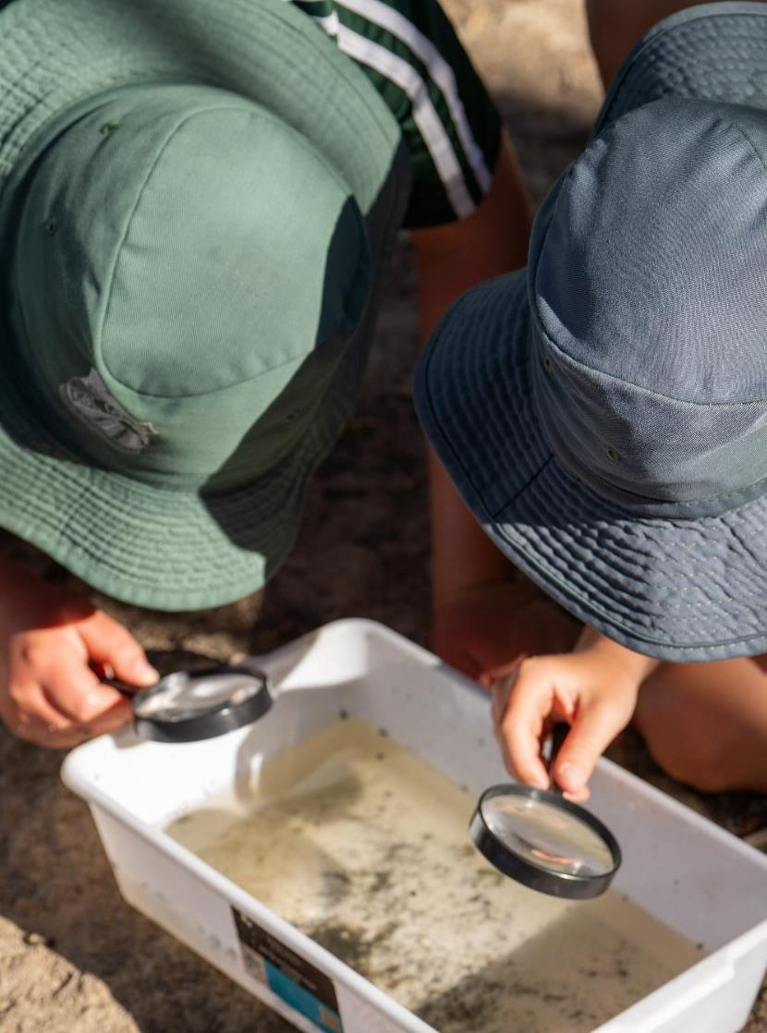
Introduction to CHPS sample scope and sequences
Notes:
6. Purpose: to introduce the CHPS sample scope and sequences.
Time: 20 secs
Presenter notes:
The Primary Curriculum team have worked in partnership with NESA to develop sample scope and sequences. Today we will focus on unpacking each of the sample scope and sequences to strengthen your understanding and support you to determine next steps for implementation in your school context.
[NEXT SLIDE]

Slide 6

CHPS sample scope and sequences
Notes:
7. Purpose: to highlight the location of the CHPS sample scope and sequences.
Time: 1 min
Presenter notes:
Each individual CHPS sample scope and sequence can be located on the four key learning area websites.
Before we begin, we’d like to understand how have you engaged with the CHPS sample scope and sequences. When we count to 3 let us know by using the reactions button:
Thumbs up - yes have opened them, explored them and looking forward to planning with them
Applause- opened them, saved the tabs but haven’t looked at them
Surprised- not opened – will learn where to find these scope and sequences today.
Count to 3 and then review participants reactions.
Thank you for helping us guide our support for you today by sharing your engagement so far.
We will now demonstrate how to access the sample scope and sequences and walk through navigating the documents.
[NEXT SLIDE]

Slide 7

Navigation
Live walkthrough of a sample scope and sequence
https://education.nsw.gov.au/
Notes:
8. Purpose: to model the organisation and structure of the Department CHPS sample scope and sequences, including excel functionality.
Time: 12 mins
Presenter notes: LIVE WALKTHROUGH
Throughout the day we will be exploring the four CHPS sample scope and sequences. Please open your laptops and follow along as we conduct a live walkthrough using the PDHPE scope and sequence as an example.
Use alternate tab to navigate to the Doe Homepage to conduct the live walkthrough
Thank you we will now return to our presentation.
[NEXT SLIDE]
Steps for presenter:
Minimise the PL deck or use alt-tab to access the browser. Ensure you have a browser open on your computer.
Open the NSW Department of Education homepage- https://education.nsw.gov.au/
Navigate to ‘Teaching and Learning’ tab
Select ‘Curriculum’
Scroll down to ‘Key Learning Areas’
Click on the key learning area PDHPE
Scroll to ‘Planning, programming and assessing PDHPE K–12’
On the left select ‘Planning, programming and assessing PDHPE K–6’
Click the arrow to access the sample scope and sequence link
Note: download is an excel document.
Open the downloaded excel file (or have one open ready)
Explain the ‘Introduction’ tab:
Reference NESA sample whole school curriculum plan
Links to the syllabus
Quick links to terms within each stage
Sequencing learning across 8 terms (except ES1- 1 year of learning), allows teachers to identify how knowledge and skills are introduced, revisited and built upon, to support students to make vertical and horizontal connections between ideas and retain learning over time.
The scope and sequence is a flexible planning tool that schools can adapt to their local context, to support school-based curriculum decisions.
Click into Early Stage 1 tab:
4 terms (as it’s one year)
Columns and rows arrangement: Term → Focus Area → Outcome → Content Group → Content Points
Open Stage 1, 2, and 3 tabs:
Each stage has content for 8 terms (over 2 years)
Emphasise that the first column remains fixed, helping orientation as you scroll across
Each term block represents approximately 10 weeks of learning.
In Stage 3, point out the bracketed timeframes that appear across the CHPS sample scope and sequences.
[Each Year]- once per year
[Each Term]- repeated every term
[Each Semester]- once per semester
‘Not planned for this term’- not taught that term
Model “Sort & Filter” → choose “Filter”
Use the dropdown arrows (top row) to unselect all, tick just what you want to view
Press OK to filter, for example:
Focus Areas
Content Groups
Show how to reset to view all again.
Model how to “hide” content and “unhide” content in rows and columns.

Slide 8

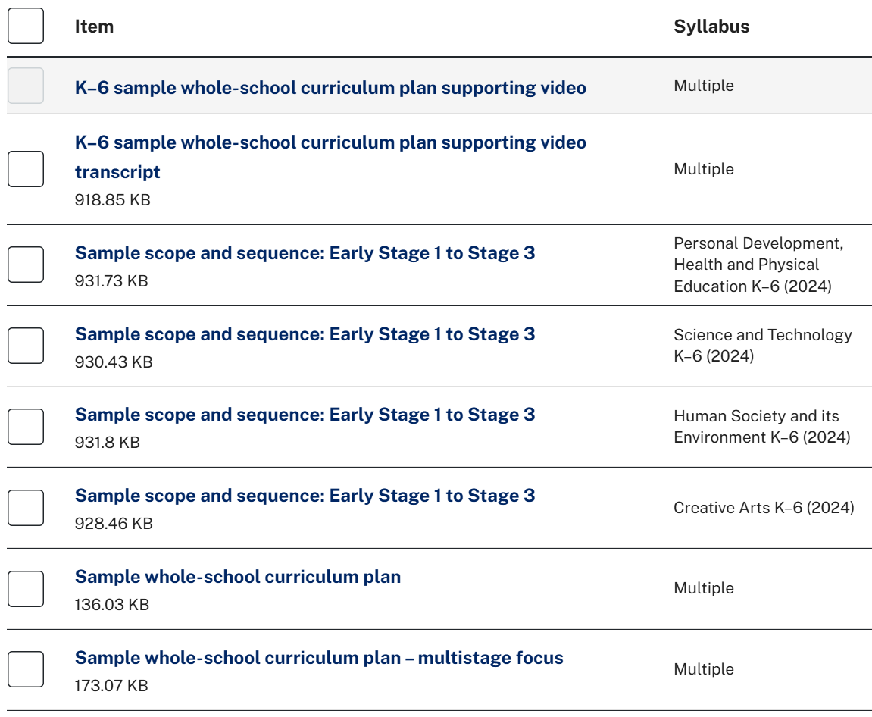

NESA K–6 sample whole-school curriculum plans
Notes:
9. Purpose: to identify the NESA K-6 sample whole school curriculum plan and supporting resources.
Time: 1 min
Presenter notes:
NESA recently released K–6 sample whole school curriculum plans for Creative Arts, HSIE, PDHPE, and Science and Technology.
This release included three key resources:
[CLICK] 1.Video explainer – providing an overview of the curriculum planning approach. You will have received an email from Primary Curriculum with a link to this video and your workbook.
[CLICK] 2. K-6 sample whole school curriculum plan – illustrating how curriculum content can be mapped across terms and stages.
[CLICK] 3. K-6 sample whole-school curriculum plan: multistage – demonstrating how schools can align learning across stages.
These resources are designed to support schools in planning for curriculum implementation and can be accessed in the teaching resources
Tab on the NESA curriculum website. Teaching resources | Syllabus support | NSW Curriculum | NSW Education Standards Authority
[NEXT SLIDE]

Slide 9



Multistage whole school planning
NESA Multistage focus K–6 sample
whole-school curriculum plan
Primary Curriculum team will work with
the NSW Primary Principals’ Association
Support for teaching principals to help schools plan across multi-age settings
Notes:
10. Purpose: to discuss the multistage scope and sequence whole-school planning.
Time: 1 min
Presenter notes:
As we know multistage settings are diverse and vary in complexity. NESA’s Multistage focus K-6 sample whole-school curriculum plan enables concurrent teaching and learning of focus areas across Kindergarten to Year 6 through content group organisation.
The Primary Curriculum team have made a commitment to work with the NSW Primary Principals’ Association on more support for teaching principals to help schools plan across K–6 multi-age settings for new syllabuses.
[NEXT SLIDE]

Slide 10
Alignment
Alignment to NESA sample whole-school curriculum plan:
applies the principles of a knowledge-rich curriculum
prioritises the explicit teaching of essential content
content is selective, coherent, carefully sequenced and specific and clear
builds mental frameworks or schemas for deeper understanding and retention.
“
‘Careful sequencing in a knowledge-rich curriculum enables students to master subject knowledge and related skills that are essential for their success and achievement in the classroom.’
(A knowledge-rich approach to curriculum design, AERO 2024)
Notes:
11. Purpose: to identify the alignment between NESA’s sample whole-school curriculum plan and the CHPS sample scope and sequences.
Time: 1 min
Presenter notes:
The Primary Curriculum team have worked in partnership with NESA to develop the CHPS sample scope and sequences. This reflects the commitment to the NSW Primary Principals' Association for the department and NESA to work together to ensure consistency for schools. The department sample scope and sequences are aligned with the NESA sample whole-school curriculum plan, reflecting the principles of a knowledge-rich curriculum. A knowledge-rich syllabus prioritises the explicit teaching of essential content that is selective, coherent, carefully sequenced, specific and clear.
A well-designed whole school plan helps students build mental frameworks or schemas for deeper understanding and retention. Schema-building refers to how students organise and store information in long-term memory by connecting new knowledge to prior knowledge.
The AERO paper from 2024 ‘A knowledge-rich approach to curriculum design’, informed the development of the scope and sequences. The quote to the right of the slide comes from this paper. I will give you a moment to read the quote.
Pause 15 sec for participants to read quote
[NEXT SLIDE]

Slide 11
Whole-school curriculum approach
This is important as it:
supports students to build mental frameworks or schemas for deeper understanding and retention
reduces content gaps and duplication
optimises teacher collaboration and planning time
reduces cognitive load for students-providing opportunity for them to connect knowledge from other key learning areas.
“
‘This approach takes the lottery out of learning, because it guarantees that all students receive common, high-quality teaching that supports them to build knowledge and skills through their school years.’
(Grattan Institute, 2022)
Notes:
12. Purpose: to identify the importance of a whole school curriculum approach.
Time: 1 min
Presenter notes:
As we look at why connecting key learning areas when creating scope and sequences is so critical, there are several key benefits to keep in mind:
supporting students to build mental frameworks, or schemas, enables them to develop a deeper understanding of concepts. When students make connections across subjects, they retain information more effectively because it's anchored to broader, more meaningful ideas.
secondly, this approach reduces content gaps and duplication. By aligning and connecting curriculum areas, we ensure that students aren't missing essential content — and we're also not repeating the same content unnecessarily across different key learning areas
thirdly, it helps optimise teacher collaboration and planning time. When teams work together to integrate their teaching, planning becomes more efficient and purposeful. Teachers can share teaching strategies, align objectives, and create more cohesive learning experiences.
Finally, it reduces cognitive load for students. When students can connect new learning to what they already know from other areas, they're better able to process and apply that knowledge.
How to implement a whole-school curriculum approach: A guide for principals
[NEXT SLIDE]

Slide 12
Scope sequence design considerations
Selective
Coherent
Carefully sequenced
Specific and clear
Notes:
13. Purpose: to revisit the importance of a knowledge-rich curriculum when creating scope and sequences.
Time: 1 min 30 sec
Presenter notes:
What makes a scope and sequence effective? According to the Australian Education Research Organisation, a knowledge-rich curriculum isn’t just about covering content—it's about how that content is selected, structured, and taught.
A knowledge-rich curriculum is designed in line with the cognitive science evidence for how students learn best. AERO’s review identified the 4 key features of a knowledge-rich curriculum that enable students to progressively build and master essential subject-specific knowledge and skills:
1. Selective – Content is chosen purposefully for each subject, in alignment with a vision of education.
2. Coherent – The curriculum ensures content is interconnected across topics, subjects and stages. A structured, coherent curriculum design can reduce cognitive overload and minimise both gaps and duplication in content. Curriculum design that reflects the links within and across subjects can also support teachers and students to understand how the curriculum builds cumulative learning and knowledge (Niemelä, 2021)
3. Carefully sequenced – The curriculum is designed to develop deep and broad knowledge over time by building on prior content and gradually increasing complexity. The curriculum should establish a strong foundation in the early years (Ashbee, 2021) and build complexity over time through sequencing and pacing content, in line with the evidence for how students learn.
4. Specific and clear - The curriculum explicitly outlines what students are expected to know, understand and be able to do for subjects and topics across all stages.
[NEXT SLIDE]

Slide 13
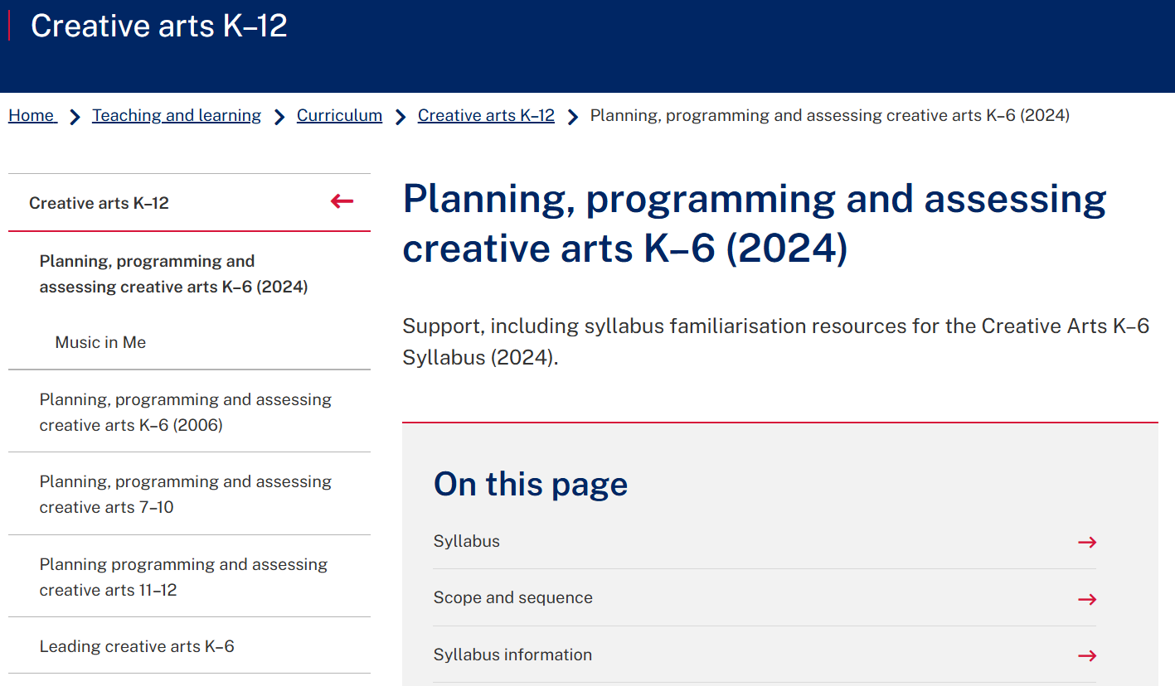
Planning, programming and assessing K–6
Creative arts example
Notes:
14. Purpose: to explore a sample scope and sequence.
Time: 2 min 30 sec (30 secs notes, 2 mins to open S&S)
Presenter notes:
We will now briefly review the steps of where to access the CHPS sample scope and sequences, using all four key learning areas as an example.
1. Open the Navigate to the ‘Teaching and Learning’ tab
2. Select ‘Curriculum’
3. Scroll down to ‘Key Learning Areas’
4. Choose the key learning area you would like to explore
[CLICK] The breadcrumbs at the top of the image on the slide are the steps to locate [CLICK] the sample scope and sequences.
[NEXT SLIDE]

Slide 14
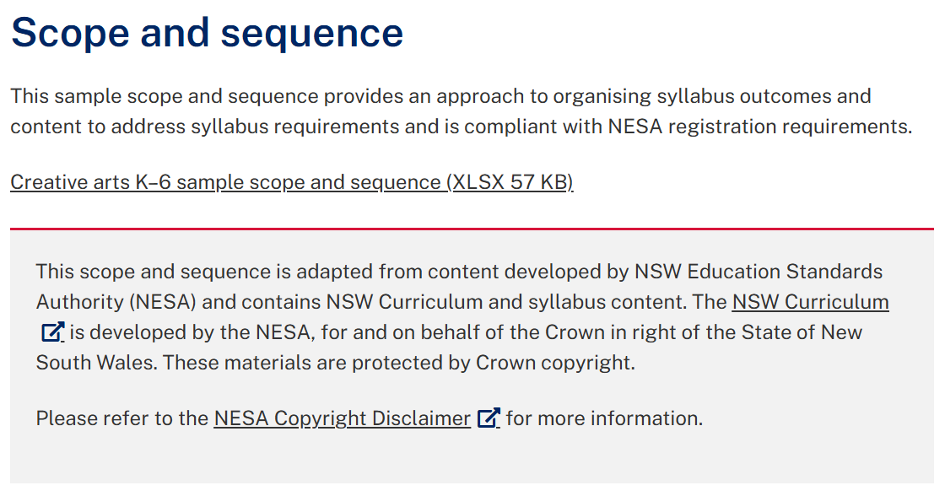
Planning, programming and assessing K–6
Creative arts example
Notes:
15. Purpose: to explore a sample scope and sequence.
Time: 2 min 30 sec (30 secs notes, 2 mins to open S&S)
Presenter notes:
Then click on sample scope and sequence to download the excel document.
Please take time now to access a sample scope and sequence of your choice. Follow along over the next few slides as we explore the organisation and structure of the sample scope and sequences.
PAUSE 2 mins to allow participants to open a scope and sequence of their choice. You may need to go back to first image to show the breadcrumbs.
[NEXT SLIDE]

Slide 15
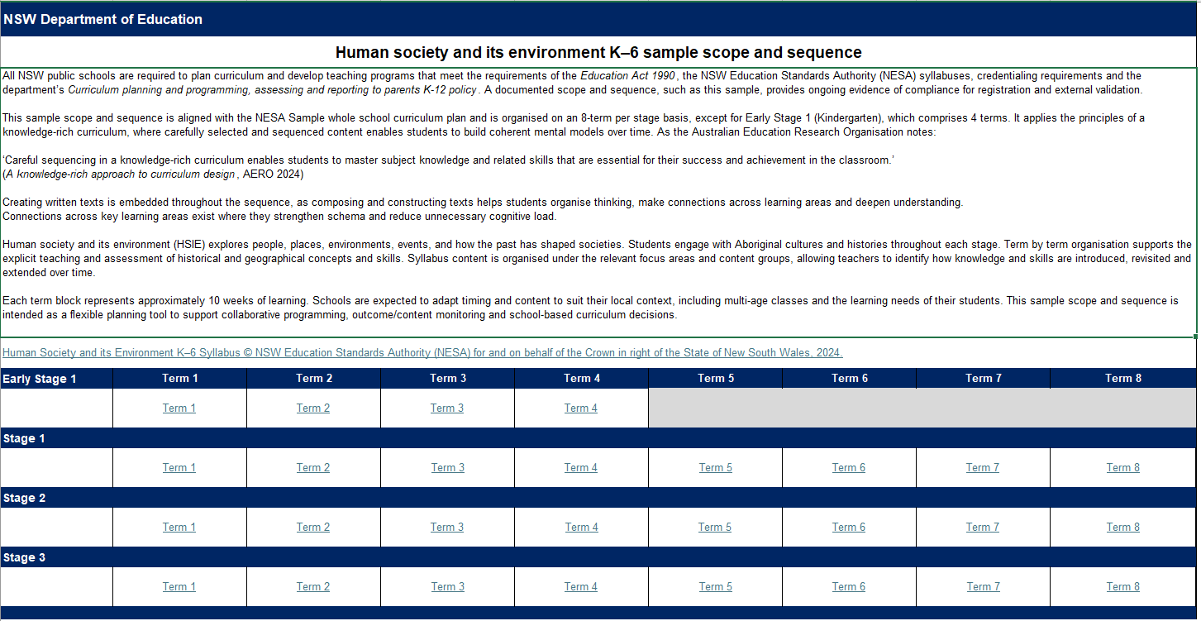
CHPS sample scope and sequence – introduction
HSIE example
Notes:
16. Purpose: to unpack the introduction tab using HSIE sample scope and sequence as an example and allow time for participant exploration.
Time: 3 min
Presenter notes:
All CHPS sample scope and sequences have an introduction tab that has hyperlinks to the relevant syllabus and to each term for every stage, allowing for ease of navigation.
On the slide you will see an example of the HSIE sample scope and sequence and [CLICK] the link to the HSIE K-6 Syllabus.
[CLICK] Here we can see the 8-term approach for stages 1, 2 and 3 to represent the two years of learning. This term-by-term organisation supports the explicit teaching and assessment of concepts and skills.
Please take 2 mins to explore this tab in your chosen sample scope and sequence.
PAUSE for 2 mins for exploration
[NEXT SLIDE]

Slide 16
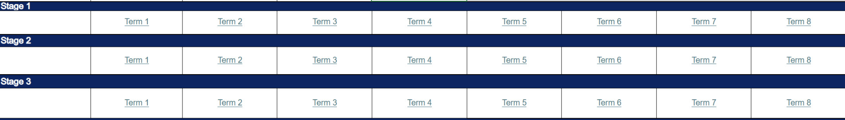
Organisation and structure (1)
8 term approach
Notes:
17. Purpose: to model the organisation and structure of the CHPS sample scope and sequences 8 term approach and allow time for participant exploration.
Time: 10 sec
Presenter notes:
CHPS sample scope and sequences are organised on an 8-term per stage basis, except for Early Stage 1, which comprises of 4 terms.
[NEXT SLIDE]

Slide 17
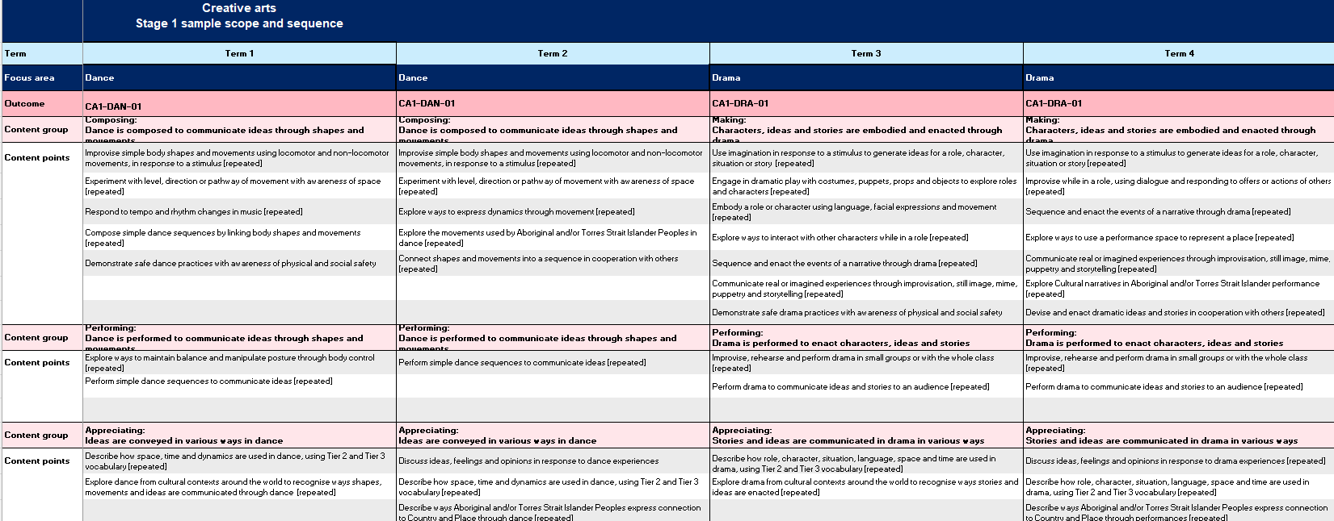
Organisation and structure (2)
8 term approach
Notes:
18. Purpose: to model the organisation and structure of the CHPS sample scope and sequences 8 term approach and allow time for participant exploration.
Time: 10 sec
Presenter notes:
Syllabus content is organised by term under the relevant focus area, outcome, content groups and content points.
[NEXT SLIDE]

Slide 18
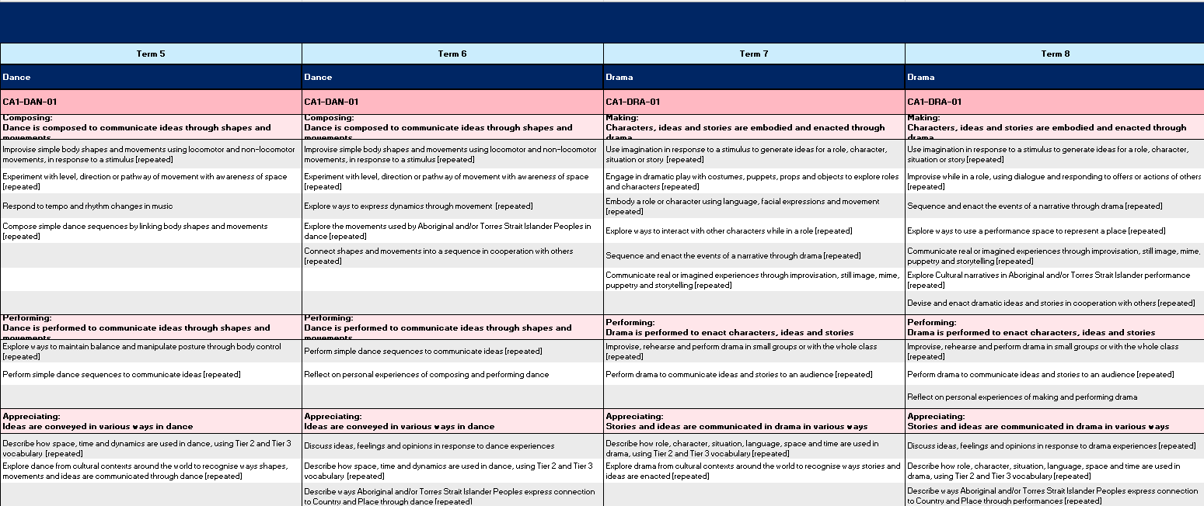
Organisation and structure (3)
8 term approach
Notes:
19. Purpose: to model the organisation and structure of the CHPS sample scope and sequences 8 term approach and allow time for participant exploration.
Time: 2 mins
Presenter notes:
Sequencing learning across 8 terms, allows teachers to identify how knowledge and skills are introduced, revisited and built upon, to support students to make connections between ideas and retain learning over time. Each term block represents approximately 10 weeks of learning. The time allocation established by NESA is 8% for each CHPS key learning area per week.
The scope and sequence is a flexible planning tool that schools can adapt to their local context, to support school-based curriculum decisions.
Please take 2 mins to explore this tab in your chosen sample scope and sequence.
PAUSE for 2 mins for exploration
[NEXT SLIDE]

Slide 19
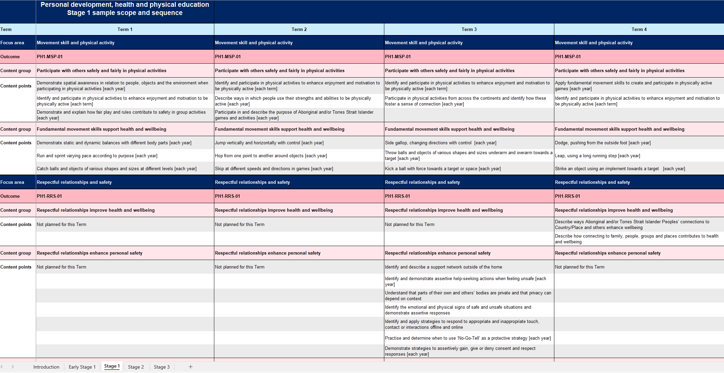
CHPS sample scope and sequence – features
PDHPE – example
Notes:
20. Purpose: to unpack features of the CHPS sample scope and sequences using PDHPE as an example and allow time for participant exploration.
Time: 3 mins
Presenter notes:
Let’s briefly revisit some features of the CHPS sample scope and sequences using PDHPE as an example.
At the top of the document, you will see the key learning area and stage, you can navigate between stages by using the tabs at the bottom of the spreadsheets.
[CLICK] As highlighted in the earlier navigation walkthrough, some content points within a stage have been labelled with bracketed information for further detail including:
[each year]
[each term]
[each semester], and
[not planned for his term].
Please take 2 mins to explore this feature in your chosen sample scope and sequence.
PAUSE for 2 mins for exploration
[NEXT SLIDE]

Slide 20
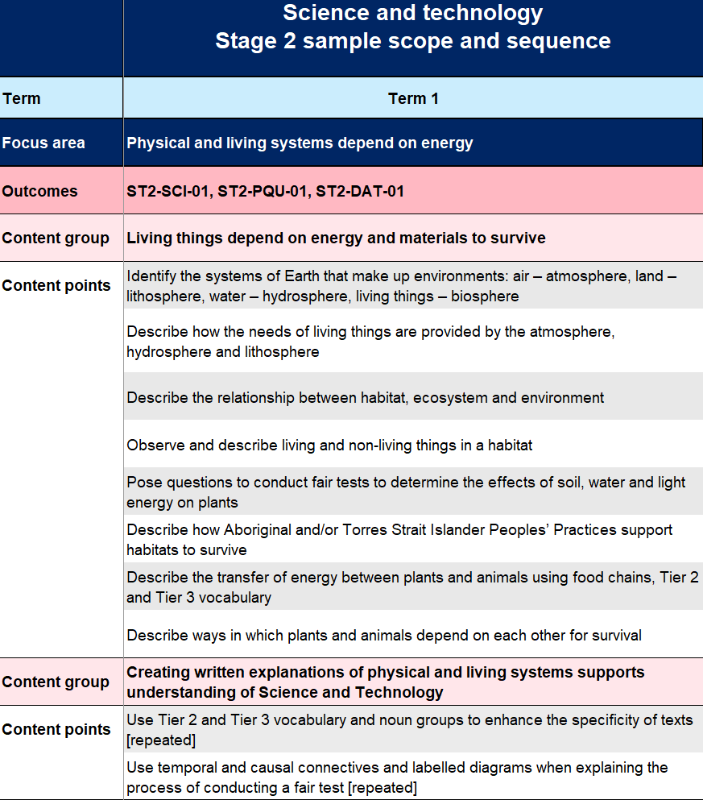


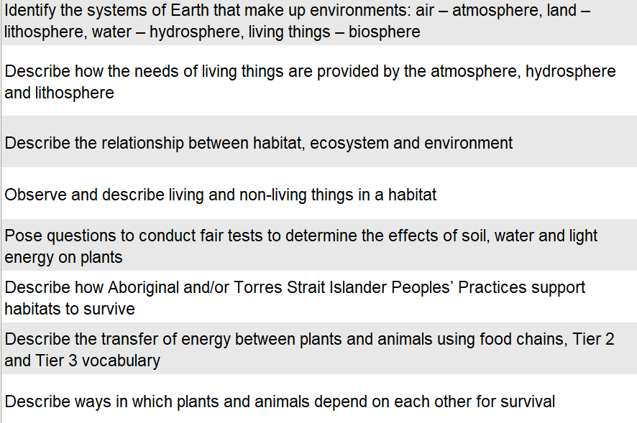
Science and technology sample scope and sequence
Content structure – Stage 2 example
Notes:
21. Purpose: to unpack the content structure of the CHPS sample scope and sequences using Science and technology as an example and allow time for participant exploration.
Time: 5 mins
Presenter notes:
Syllabus content is displayed consistently in all CHPS sample scope and sequences; here is an example from the Science and technology scope and sequence.
The left-hand column contains how the content is structured for all stages: this example shows Term 1 Stage 2. Noting the:
[CLICK] Focus area – for example Physical and living systems depend on energy
[CLICK] Outcomes – there are three Science outcomes in this example; ST2-SCI-01, ST2-PQU-01 and ST2-DAT-01
[CLICK] Content group – the content group example is Living things depend on energy and materials to survive
[CLICK] Content points – Content points for each content group sit below the content group
Please take 4 mins to explore the content in your chosen sample scope and sequence.
PAUSE for 4 mins for exploration
[NEXT SLIDE]

Slide 21

CHPS sample scope and sequences (2)
Notes:
22. Purpose: to unpack the CHPS sample scope and sequences.
Time: 10 sec
Presenter notes:
We will now explore all four of the CHPS sample scope and sequences. Let’s begin with Creative arts.
[NEXT SLIDE]

Slide 22

Creative arts (1)
Dance, Drama, Music and Visual Arts
Notes:
23. Purpose: to introduce the key learning area of Creative arts.
Time: 10 secs
Presenter notes:
The Creative arts syllabus encompasses learning in the focus areas of dance, drama, music and visual arts.
[NEXT SLIDE]

Slide 23
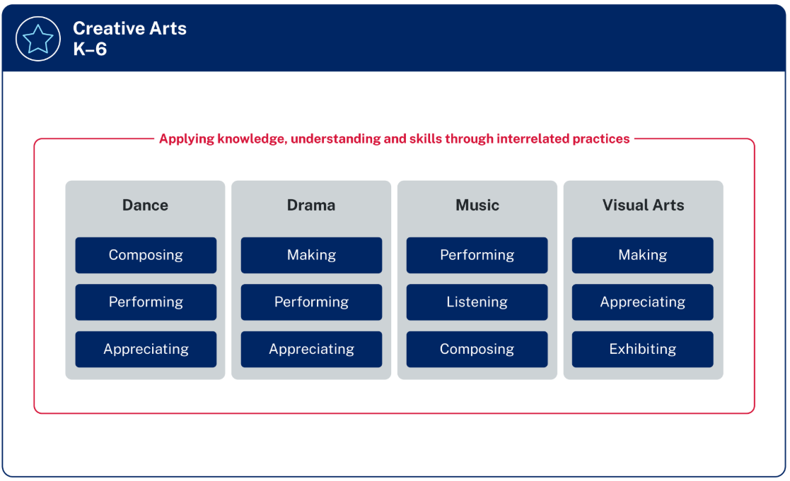
Creative arts (2)
Focus areas
Creative arts sample scope and sequence balances learning time equally between the focus areas
Music and Dance – Terms 1 and 2 and Terms 5 and 6
Drama and Visual Arts – Terms 3 and 4 and Terms 7 and 8
Content is repeated in both years of each stage with slight differences
Figure 1: The organisation of Creative Arts K–6
Notes:
24. Purpose: to unpack the balance of content reflected in the Creative arts sample scope and sequence.
Time: 1 min 30 sec
Presenter notes:
The Creative Arts K–6 syllabus focuses on the essential knowledge and skills needed to develop understanding and practices in Dance, Drama, Music, and Visual Arts. These focus areas each have a distinct body of knowledge, with connections across the focus areas.
There is a balance of syllabus content across each focus area. This means that all focus areas should be given approximately equal teaching time to support students in achieving syllabus outcomes. Schools can determine how to achieve this balance in a way that suits their unique context.
This sample scope and sequence divides learning time equally amongst the focus areas. In the sample scope and sequence, Music and Dance are scoped for Terms 1 and 2 and Terms 5 and 6, while Drama and Visual Arts are scoped for Terms 3 and 4 and Terms 7 and 8.
Content is repeated across the 8 terms, however, there are slight differences between terms 1 to 4 and 5 to 8, for example safe arts practices threads of content are introduced in the first term of each semester within a stage. Another example is, content related to reflecting on personal experiences of creative production is only included in the last term that a focus area is addressed in each stage.
[NEXT SLIDE]

Slide 24
Carefully sequenced content
Progression of learning example – elements of music
Creative arts sample scope and sequence
ES1
Use louder and softer sounds to explore dynamics with sound sources
Term 1
S1
Use sound sources to experiment with dynamic effects, including gradual or sudden changes in volume
Term 2 and 6
S2
Experiment with instrumental techniques and sound sources to create changes in dynamics and expression
Term 2 and 6
S3
Demonstrate an aural understanding of dynamics and expression while performing vocal repertoire
Term 2 and 6
Notes:
25. Purpose: to highlight carefully sequenced content using the elements of music as an example thread of learning within the Creative arts sample scope and sequence.
Timing: 1 min
Presenter notes:
The Creative arts sample scope and sequence supports a whole school planning approach by carefully sequencing content across the stages.
This approach supports students in developing the required knowledge, understanding and skills in the earlier years to successfully access content in later years.
The content points from the music focus area on the slide are an example of how content has been carefully sequenced to show a clear progression of learning. We have highlighted where these content points have been included in the Creative arts sample scope and sequence. This strategic design includes time for repetition, practice and the application of knowledge.
This is just one example and is mirrored throughout the Creative arts sample scope and sequence across all four focus areas.
[NEXT SLIDE]

Slide 25
Connection across content groups (1)
An example of learning through the interrelated practices in Drama
Dance
Drama
Music
Visual Arts
Notes:
26. Purpose: to demonstrate the connections between content groups in the creative arts sample scope and sequence.
Timing: 30 sec
Presenter notes:
The content groups in creative arts highlight the interrelated practices of each focus area. These are not meant to be taught in a linear, sequential way. Learning experiences should support students to make connections between content groups within each focus area. This will assist students to apply their learning in meaningful and creative ways.​ The sample scope and sequences support these connections across content groups.
[NEXT SLIDE]

Slide 26
Connection across content groups (2)
Terms 3 and 7
An example of learning through the interrelated practices in Drama
Making
Embody a role or character using language, facial expressions and movement
Making
Explore ways to interact with other characters while in a role
Performing
Improvise, rehearse and perform drama in small groups or with the whole class
Appreciating
Describe how role, character, situation, language, space and time are used in drama, using Tier 2 and Tier 3 vocabulary
Notes:
27. Purpose: to demonstrate the connections between content groups in the creative arts sample scope and sequence.
Timing: 2 mins
Presenter notes:
Let’s look at an example of connected content from Stage 1 Drama.
The ‘making’ content group contains content related to embodying a role or character and interacting with other characters while in a role.
The ‘performing’ content group involves opportunities for students to develop characters and roles as they improvise, rehearse and perform Drama.
In the ‘appreciating’ content group, students use Tier 2 and 3 vocabulary to describe how role and character are used in drama.
By connecting this learning, students develop knowledge, understanding and skills relating to the dramatic elements as they explore the various ways they can interact with drama as a creator, performer and audience member. This supports students to achieve the aim of the syllabus, by developing curiosity, creativity and imagination as they express themselves and develop an understanding of how creative works convey meaning.
This content is scoped in Terms 3 and 7 of the sample scope and sequence.
[NEXT SLIDE]

Slide 27

Personal Development Health and Physical Education (1)
Equips students with the knowledge, skills and values to lead safe, active and healthy lives
Notes:
28. Purpose: to introduce the key learning area of Personal Development Health and Physical Education.
Time: 15 secs
Presenter notes:
We will now turn our attention to PDHPE.
Learning in PDHPE is the foundation for lifelong engagement in physical activity. Through studying PDHPE, students develop, evaluate and apply a broad range of skills to build and maintain a sense of connection, identity, resilience and respectful relationships.
[NEXT SLIDE]

Slide 28
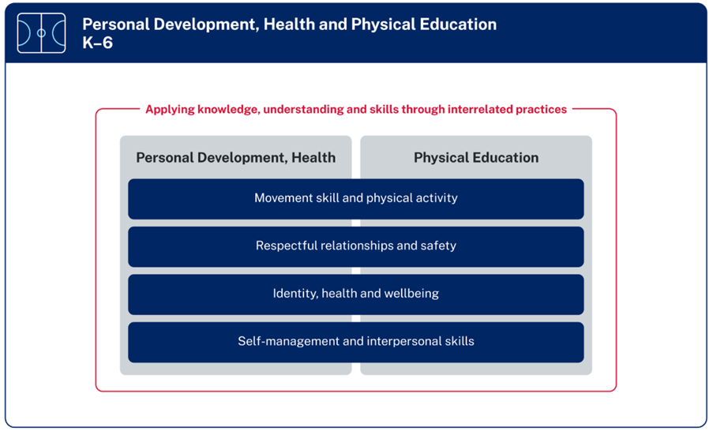
Personal Development, Health and Physical Education (2)
Balance of content
PDHPE sample scope and sequence balances learning time equally between PDH and PE
60 minutes of PE counts towards 150 minutes of physical activity each week
Figure 1 – The organisation of PDHPE K–6 (NESA 2024)
Notes:
29. Purpose: to unpack the balance of content reflected in the PDHPE sample scope and sequence.
Time: 1 min
Presenter notes:
This diagram shows the organisation of PDHPE K-6 Syllabus under 4 focus areas. Each of the focus areas provides essential content for both the Personal Development and Health (PDH) and the Physical Education (PE) elements of the syllabus.
The PDHPE sample scope and sequence, balances learning time equally between PDH and PE.
60 minutes of Physical Education counts towards the department’s sport and physical activity procedures which require 150 minutes of planned moderate to vigorous physical activity across the school week. PDH does not contribute to the 150 minutes unless it contains regular, planned moderate to vigorous physical activity.
[NEXT SLIDE]
Additional information for presenters:
This information is available in the FAQs of the PDHPE channel in the Primary curriculum Statewide staffroom.

Slide 29
PDHPE sample scope and sequence (1)
Terms 3 and 7
Consent content – ES1 and Stage 1
Focus area – Respectful relationships and safety
Respectful relationships contribute to personal safety, for example:
Demonstrate how to assertively gain, give or deny consent
Demonstrate protective strategies including ‘No-Go-Tell’
Personal actions support safety, for example:
Identify ways to contribute to personal safety online and seek help from trusted adults when feeling unsafe
Identify people who can help maintain health and safety in various contexts
ES1
Respectful relationships enhance personal safety, for example:
Practise and determine when to use ‘No-Go-Tell’ as a protective strategy
Demonstrate strategies to assertively gain, give or deny consent and respect responses
Responsible choices promote online safety, for example:
Describe and enact ways to contribute to personal safety online and seek help from trusted adults when feeling unsafe
S1
Notes:
30. Purpose: to unpack the consent content in the PDHPE sample scope and sequence.
Time: 1 min 30 sec
Presenter notes:
Consent is taught from Early Stage 1 through to Stage 3 through the Respectful relationships and safety focus area.
Personal safety education, including child protection, must be taught in every stage of learning. In the PDHPE sample scope and sequence this is in Terms 3 and 7 across every stage each year.
In ES1 the consent content is in the content groups of ‘Respectful relationships contribute to personal safety’ and ‘Personal actions support safety’. Here we can see examples of content points.
In Stage 1 consent content is in the content groups of ‘Respectful relationships enhance personal safety’ and ‘Responsible choices promote online safety’. Here we can see examples of content points.
[NEXT SLIDE]
Additional notes for presenters only:
This information does not need to be shared however, if presenters are questioned about child protection, possible questions and responses include:
-Can schools still use the existing child protection units? Existing child protection units align with the PDHPE K-10 Syllabus (2018). Each unit of work is designed as a sequence of learning which can be used in their entirety, or sections of the unit inserted into existing units to complement learning. It is recommended that learning is of adequate duration to allow students the opportunity to build in-depth knowledge, understanding, and skills.
-Are there new child protection units being developed to align with new syllabus? The Respectful Relationship team are developing updated resources for Child Protection Education and these resources are due for release to use at the commencement of mandatory syllabus implementation at the commencement of 2027. As per current advice, these are optional materials for schools to use.
- If schools implementing before 2027 can we use the existing child protection units? Yes but the school will need to align the outcomes and essential content to the 2024 PDHPE syllabus.

Slide 30
PDHPE sample scope and sequence (2)
Terms 3 and 7
Consent – Stage 2 and Stage 3
Focus area – Respectful relationships and safety
Personal safety strategies strengthen respectful relationships, for example:
Identify people and places to seek help from when in unsafe situations
Practise assertive strategies and responses that promote protective behaviours in unsafe or risky situations offline and online
Actions can enhance online safety, for example:
Identify unsafe situations in online environments and describe how to seek help
Identify how and when to assertively gain, give or deny consent before information is shared online
S2
Personal safety strategies enhance respectful relationships, for example:
Apply strategies to enhance protective and upstander behaviours in unsafe or risky situations offline and online
Describe the right to be safe from abuse and identify protective strategies
Informed decisions and strategies enhance online safety, for example:
Describe and demonstrate ways to report negative, harmful or unsafe situations to trusted adults or in online tools
S3
Notes:
31. Purpose: to unpack the consent content in the PDHPE sample scope and sequence.
Time: 1 min 30 sec
Presenter notes:
In Stage 2 consent is taught in the content groups of ‘Personal safety strategies strengthen respectful relationships’ and ‘Actions can enhance online safety’. Here we can see examples of content points.
In Stage 3 in the content groups of ‘Personal safety strategies enhance respectful relationships’ and ‘Informed decisions and strategies enhance online safety’. Here we can see examples of content points.
The Respectful Relationships team are developing updated resources for Child Protection Education and these resources are due for release for use by schools at the commencement of mandatory syllabus implementation in 2027. As per current advice, these are optional materials for schools to use.
Just as a reminder personal safety education, including child protection in the PDHPE sample scope and sequence is in Terms 3 and 7 across every stage each year.
Please note the teaching of consent in K-6 focuses on permission, boundaries, bodily autonomy, help-seeking, protective strategies and support networks. Sexual consent is addressed in the PDHPE 7-10 Syllabus.
[NEXT SLIDE]

Slide 31
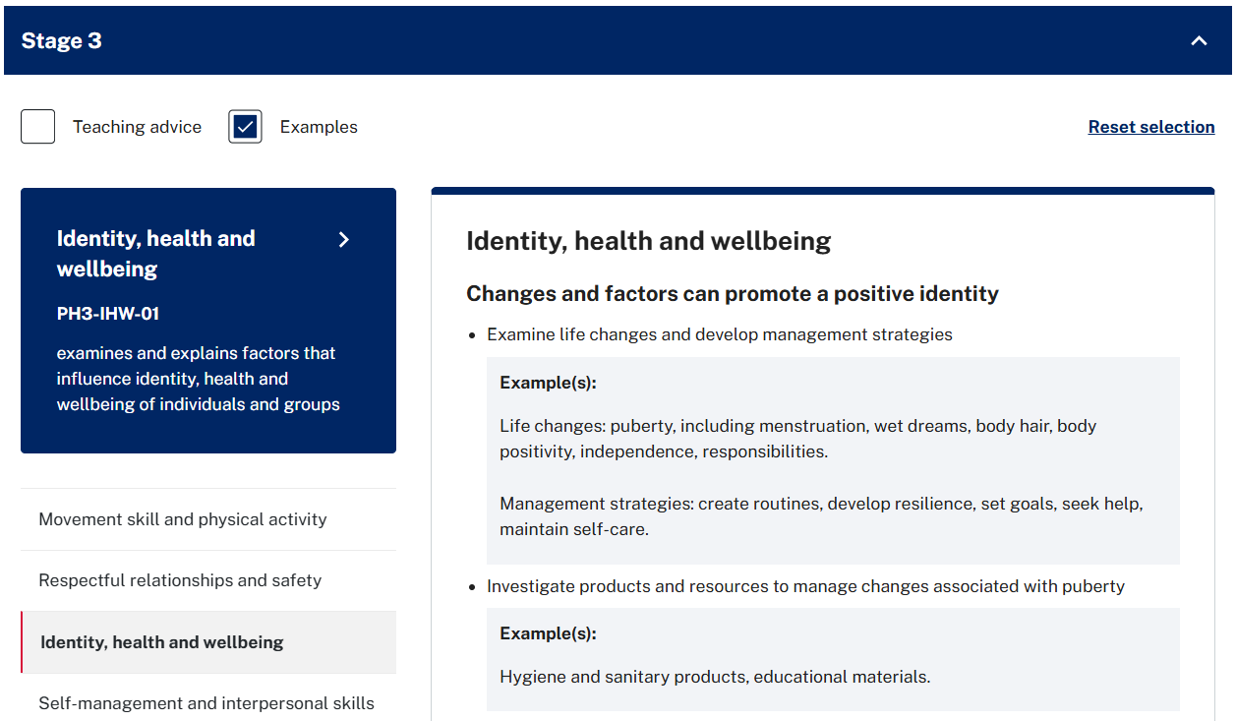
PDHPE sample scope and sequence (3)
Physical Changes content
Notes:
32. Purpose: to unpack the Physical Changes content in the PDHPE sample scope and sequence.
Time: 30 secs
Presenter notes:
In Stage 3 in the focus area [CLICK] ‘Identity health and wellbeing’, under the content group
[CLICK] ‘Changes and factors can promote a positive identity’ the first two content points are connected.
These content points are:
[CLICK] Examine life changes and develop management strategies, and
[CLICK] Investigate products and resources to manage changes associated with puberty.
As you can see on the slide the examples in the syllabus support how this learning can be connected.
[NEXT SLIDE]
Additional information for presenters:
Link to PDHPE communicating with parents and carers- https://education.nsw.gov.au/teaching-and-learning/curriculum/pdhpe/planning-programming-and-assessing-pdhpe-k-12/pdhpe-communicating-with-parents-and-carers

Slide 32

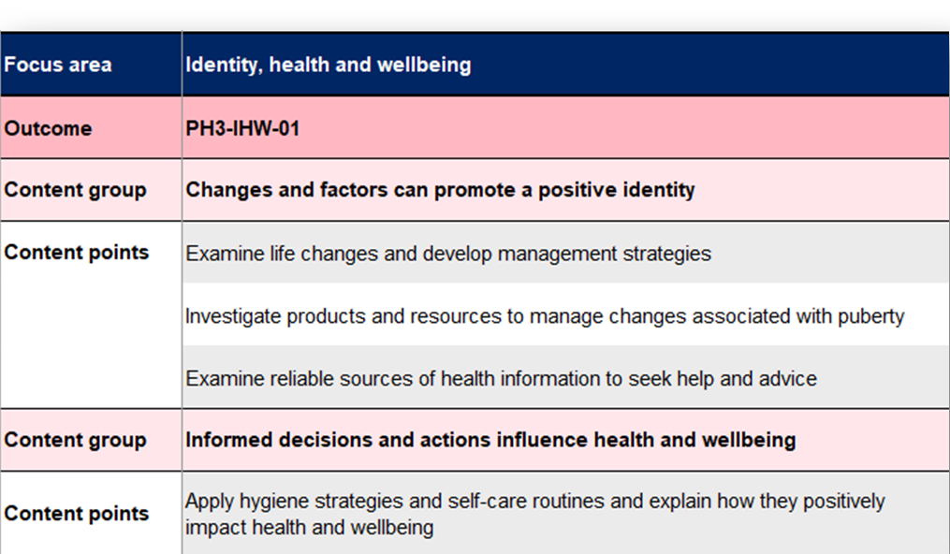
PDHPE sample scope and sequence (4)
Physical Changes content
Notes:
33. Purpose: to unpack the Physical Changes content in the PDHPE sample scope and sequence.
Time: 30 secs
Presenter notes:
The PDHPE sample scope and sequence supports this connection through Term 1 teaching.
The school community needs to be notified prior to this content being taught in schools. Supporting resources and communication templates can be found in many different languages on the PDHPE communicating with parents and carers department webpage.
[NEXT SLIDE]

Slide 33
PDHPE sample scope and sequence (5)
Financial wellbeing
S1
Content group – Responsible choices improve health and wellbeing
Content point – Identify how money can be saved and spent on needs and wants
S2
Content group – Decisions and actions promote health and wellbeing
Content point – Describe the benefits of responsible saving and spending of money for wellbeing
S3
Content group – Informed decisions and actions influence health and wellbeing
Content point – Explain the benefits of saving, goal-setting and decision making to manage finances for wellbeing
Financial wellbeing content is scoped to be taught in one term across a stage of learning
Notes:
34. Purpose: to unpack financial wellbeing content thread in the PDHPE sample scope and sequence.
Time: 1 min
Presenter notes:
Financial wellbeing is new content that sits within the focus area of Identity, health and wellbeing beginning in stage 1 through to stage 3 as indicated by the content thread on the slide.
This content is scoped to be taught in one term across each stage of learning for:
Stage 1- Term 8
Stage 2- Term 5
Stage 3- Term 2
Take a moment to review the content increase in complexity over the stages.
[NEXT SLIDE]

Slide 34


Energiser
From 2027 you only need to implement 1 key learning area of your choice.
The department is providing sample scope and sequences for each CHPS key learning area.
The CHPS sample scope and sequences are mandatory.
True
False
Notes:
35. Purpose: to re-engage participants and provide a movement opportunity.
Time: 5 mins
Presenter notes:
Let’s begin with a quick energiser.
Could everyone please stand up?
I am going to read out 3 statements.
If you answer True, please complete high knees (or your own modified version).
If you answer False, please complete side lunges (or your own modified version).
[CLICK] From 2027 you only need to implement 1 key learning area of your choice True/False
Pause 10 secs
Presenter reads explanation:
False, from 2027 it is mandatory to have all 4 CHPS syllabuses implemented.
[CLICK] The department is providing sample scope and sequences for each CHPS key learning area? True/False
Pause 10 secs
Presenter reads explanation:
True
[CLICK] The CHPS sample scope and sequences are mandatory. True/False
Pause 10 secs
Presenter reads explanation:
False, the CHPS sample scope and sequences are not mandatory. The only mandatory documents are the CHPS syllabuses. Schools are encouraged to contextualise scope and sequences where possible to meet their schools’ individual needs.
Thank you for your engagement.
[NEXT SLIDE]

Slide 35


Human Society and its Environment
Explores people, places, environments, events, and how the past has shaped societies. Students engage with Aboriginal Cultures and Histories throughout each stage.
Notes:
36. Purpose: to introduce the HSIE session.
Time: 10 Sec
Presenter notes:
We will now unpack key features of the HSIE sample scope and sequence.
[NEXT SLIDE]

Slide 36
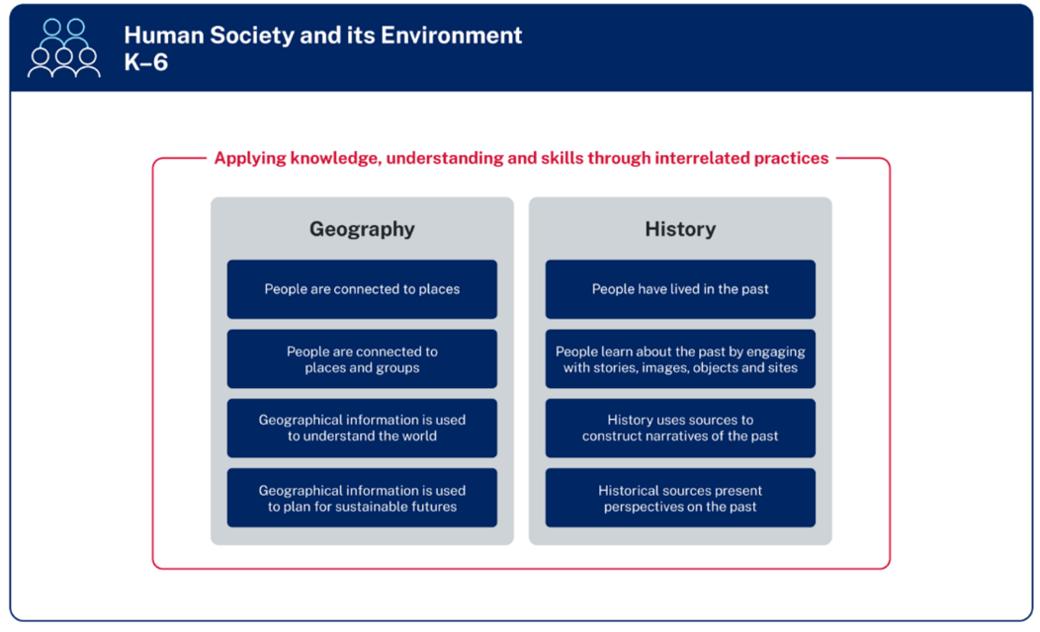
HSIE
Balance of content
HSIE sample scope and sequence incorporates Aboriginal Cultures and Histories, geography and history
Aboriginal Cultures and Histories across geography and history
Figure 1 – The organisation of HSIE K–6 (NESA 2024)
Notes:
37. Purpose: to unpack the balance of content reflected in the HSIE sample scope and sequence.
Time: 1 min
Presenter notes:
Figure 1 on the slide shows the organisation of the HSIE K-6 Syllabus with 4 Geography focus areas and 4 History focus areas. The HSIE sample scope and sequence, balances learning time equally between Geography and History.
Aboriginal and Torres Strait Islander priorities are embedded as students learn about Aboriginal Cultures and Histories, with opportunities to broaden every student’s knowledge about Aboriginal Peoples by building knowledge of the oldest living, continuous Cultures in the world. Students explore the sustainable practices developed and implemented by Aboriginal and Torres Strait Islander Peoples over millennia, the diversity of Aboriginal and Torres Strait Islander Peoples, the interdependence with Country and Place, and understandings of past and present.
[NEXT SLIDE]
Additional information for presenters:
This information is available in the FAQs of the HSIE channel in the Primary curriculum Statewide staffroom.

Slide 37
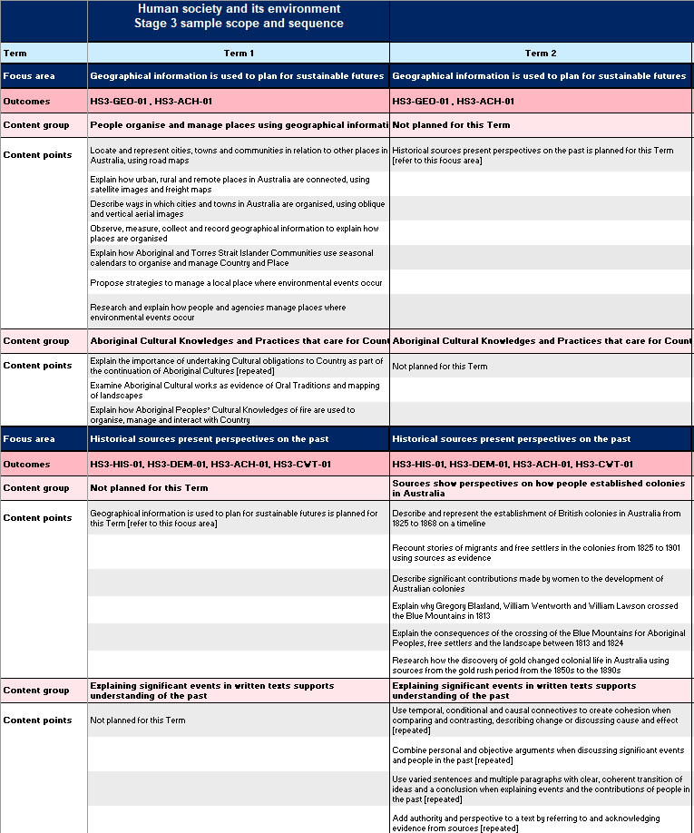
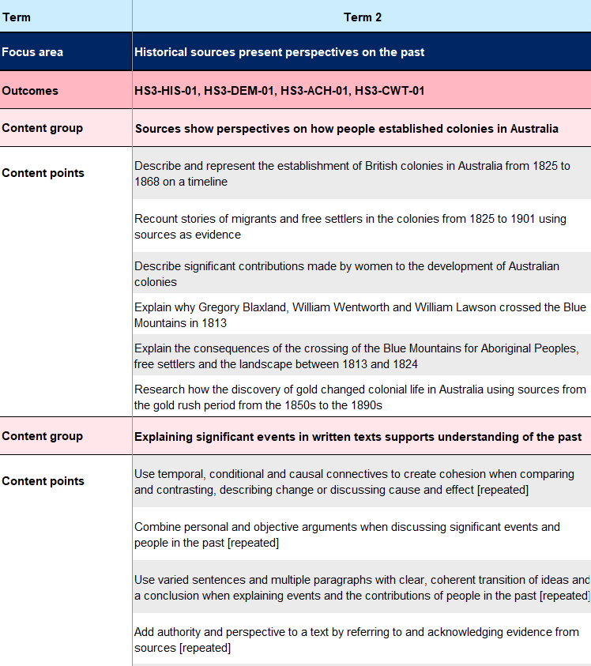
HSIE sample scope and sequence (1)
Notes:
38. Purpose: to unpack the HSIE sample scope and sequence arrangement.
Time: 15 secs
Presenter notes:
The HSIE sample scope and sequence arranges the content over the 8 terms of learning. Throughout the cycle, History content and Geography content are focus areas for a term.
Each of the terms have content grouped, as you can see with the arrangement of content for the term 2 History section.
[NEXT SLIDE]

Slide 38
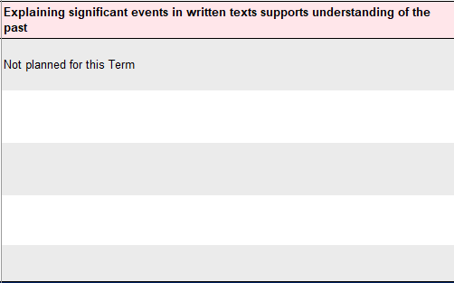
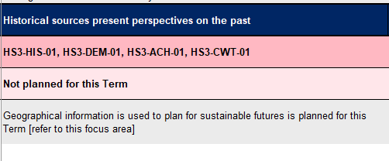
HSIE sample scope and sequence (2)
Notes:
39. Purpose: to unpack the HSIE sample scope and sequence arrangement.
Time: 15 secs
Presenter notes:
For terms where content is not being covered you will notice the following – Not planned for this Term, or an indication of the focus area being taught.
Assessment and reporting will cover the Learning area of HSIE, both History and Geography are a part of this and content needs to be covered within the 2 year cycle for stages 1, 2 and 3 and 1 year for Early Stage 1.
[NEXT SLIDE]

Slide 39
Aboriginal Cultures and Histories content (1)
Early Stage 1
Stage 1
Stage 2
Stage 3
HSE-ACH-01
identifies ways that Aboriginal peoples connect with Country, Culture and Community
HS1-ACH-01
describes interactions between Aboriginal Peoples and Country
HS2-ACH-01
describes Aboriginal Peoples’ obligations to Country, Culture and Community
HS3-ACH-01
describes Aboriginal Knowledges and Practices that care for Country and the importance of Aboriginal Languages revival
Notes:
40. Purpose: to unpack the content in the HSIE sample scope and sequence.
Time: 30 sec
Presenter notes:
Aboriginal Cultures and Histories is aligned within both geographical and historical content across all stages. There is an Aboriginal Cultures and Histories outcome for each stage labelled with the code ACH.
In Early Stage 1, Stage 1 and Stage 2 and Stage 3 there is a content group in both history and geography. Additionally, there are also content points embedded within other content groups.
[NEXT SLIDE]

Slide 40
Aboriginal Cultures and Histories content (2)
Geography
ES1
Aboriginal Peoples are the Traditional Custodians of Country
Term 1, Term 2
S1
Aboriginal Peoples have a responsibility to Country
Term 1, Term 3, Term 8
S2
Aboriginal Peoples use and care for the environment sustainably
Term 3, Term 5
S3
Aboriginal Cultural Knowledges and Practices that care for Country
Term 1, Term 5
Notes:
41. Purpose: to unpack the content in the HSIE sample scope and sequence.
Time: 10 sec
Presenter notes:
On the screen you can see the geographical Aboriginal Cultures and Histories Focus areas for each stage and the terms they are covered in the Scope and Sequence.
[NEXT SLIDE]

Slide 41
Aboriginal Cultures and Histories content (3)
History
ES1
Aboriginal Peoples are connected to Country
Term 1, Term 2,
Term 3
S1
Aboriginal Peoples have rich and diverse Cultures and Histories
Term 3, Term 4
S2
Aboriginal Peoples have the oldest living continuous Cultures in the world
Term 3, Term 4, Term 6, Term 7
S3
Aboriginal Peoples have diverse Languages
Term 6
Notes:
42. Purpose: to unpack the content in the HSIE sample scope and sequence.
Time: 20 secs
Presenter notes:
Here you can see the History Aboriginal Cultures and Histories Focus areas for each stage and the terms they are covered in the Scope and Sequence.
Reviewing the scope and sequences to see where the Aboriginal Cultures and History content is represented as well as embedded, is an important part of unpacking the sequence of learning to ensure knowledge and understandings are built upon, genuinely and authentically.
[NEXT SLIDE]

Slide 42

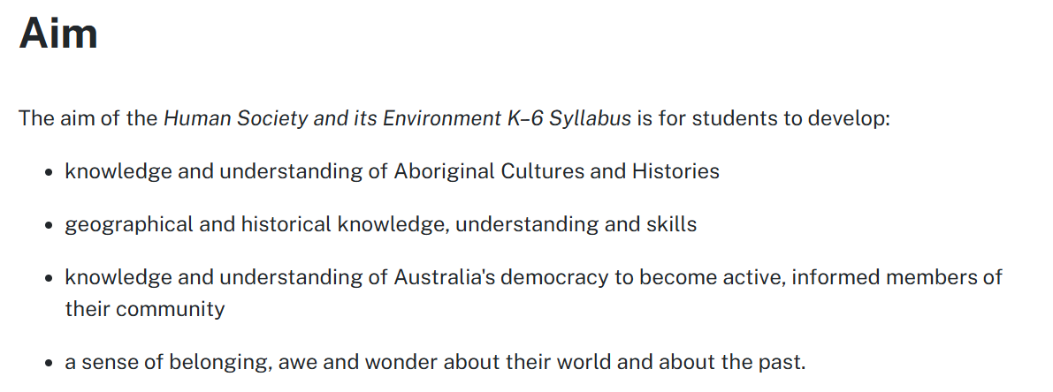
HSIE skills development (1)
Notes:
43. Purpose: to unpack HSIE skills development within the sample scope and sequence.
Time: 45 sec
Presenter notes:
Let’s focus on the embedded content within the HSIE sample scope and sequence.
Developing skills in geography and history enables students to engage with the content in deeper, more meaningful ways and apply their knowledge and understanding in increasingly complex contexts.
As stated in the HSIE syllabus aim, – geographical and historical knowledge, understanding and skills are what we are aiming for our students to develop. The verbs within the content points provide guidance on how to develop geographical and historical skills . These verbs guide our teaching of the content and contribute to the development of the skills.
[NEXT SLIDE]

Slide 43


HSIE skills development (2)
Geography skills
History skills
acquire information
analyse sources
communicate findings
comprehension and chronology
analysis and use of sources
perspectives
research
communication
Notes:
44. Purpose: to unpack HSIE skills development within the sample scope and sequence.
Time: 45 sec
Presenter notes:
In the 7-10 History and Geography syllabi, Historical skills and Geographical inquiry skills are explicitly called out. When we backward map these skills we can see the development we are aiming for with our K-6 students:
In geography, students develop the skills to:
acquire information from sources
process the information sources provide, and
communicate findings.
And in history, students apply skills in:
comprehension and chronology
analysis and use of sources
Perspectives and interpretations
Research, and
Communication.
[NEXT SLIDE]

Slide 44



Geographical and historical content verbs
locate
examine
Geographical and historical content verbs
compare
investigate
explain
represent
distinguish
design
observe
recognise
research
Notes:
45. Purpose: to identify examples of geographical information.
Time: 1 min
Presenter notes:
The development of geographical and historical skills is seen in the introduction of particular verbs over the course of the 28 weeks of learning in HSIE across History and Geography content. Geography and History are prioritised over different terms within the sample scope and sequence. One of the connections across the two are the verbs to teach the content that we use to develop the skills required to acquire knowledge and apply understandings.
These verbs are the words you will see throughout the content points, as the actions we want to see students demonstrating. We develop the skills through the verbs which is how we teach the content.
Here are just some of the skills you may see. Pause while participants read through words
[NEXT SLIDE]

Slide 45
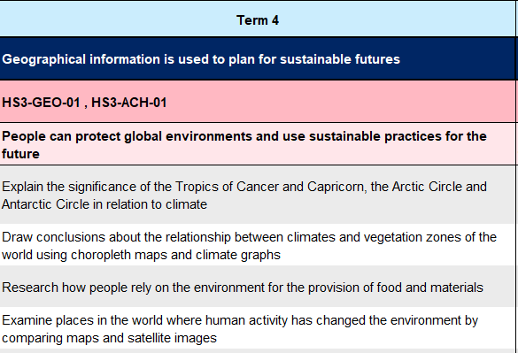
HSIE verb complexity (1)
Stage 3 example
Notes:
46. Purpose: to identify examples of skill development in the stage 3 HSIE sample scope and sequence.
Time: 30 secs
Presenter notes:
Let’s have a closer look at how the verbs are shown in the HSIE sample scope and sequence. As the skills are embedded in the content points as verbs, you will see evidence of these where the content has been grouped each term. Over and within the stages the complexity of verbs will increase.
In this example, the Stage 3 Term 4 Geography focus, is on protecting global environments and using sustainable practices for the future. In the grouping of content for this term [CLICK] we can see students are developing the ability to explain, draw conclusions, research and examine.
[NEXT SLIDE]

Slide 46
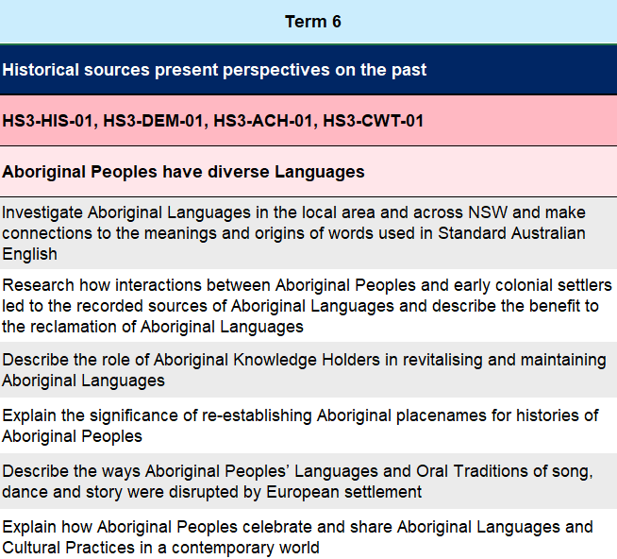
HSIE verb complexity (2)
Stage 3 example
Notes:
47. Purpose: to identify examples of skill development in the stage 3 HSIE sample scope and sequence.
Time: 30 secs
Presenter notes:
In the progression of learning in the scope and sequence we can see in the Term 6 History focus in Stage 3, students are again researching and explaining as well as investigating as an extension of researching.
Understanding the skills that students have developed in previous terms helps us assess their current ability. These skills can then be used effectively in their learning. These skills build in complexity over the stages of learning, so students enter Year 7 able to apply Historical Skills to understand the past and Geographical inquiry skills to conduct geographical investigations.
[NEXT SLIDE]

Slide 47
Historical and Geographical skills (1)
Stage 3 example
Term 2 – Historical sources
present perspectives on the past
Historical skills
Research how the discovery of gold changed colonial life in Australia using sources from the gold rush period from
the 1850s to the 1890s.
Research
Analysis and use of sources
research
identify sources
Notes:
48. Purpose: to identify examples of skill development in stage 3 HSIE.
Time: 30 sec
Presenter notes:
Let's take a closer look at the verbs highlighting the skills through the content.
In our sample scope and sequence, in Stage 3, term 2 history content, we have the content point ‘Research how the discovery of gold changed colonial life in Australia using sources from the gold rush period from the 1850s to the 1890s.’
To achieve this content point, students need to research to gather knowledge about the discovery of gold, with the added complexity of identifying appropriate sources of information from the Gold rush period. The historical skills being developed are Research and Analysis and use of sources.
[NEXT SLIDE]

Slide 48
Historical and Geographical skills (2)
Stage 3 example
Term 4 – Geographical information is used to plan for sustainable futures
Geographical inquiry skills
Draw conclusions about the relationship between climates and vegetation zones of the world using choropleth maps and climate graphs
Acquiring geographical information
Processing geographical information
draw conclusions
use geographical tools
Notes:
49. Purpose: to identify examples of skill development in stage 3 HSIE.
Time: 30 sec
Presenter notes:
In the sample scope and sequence in Stage 3, Geography content for Term 4, we can see the content point ‘Draw conclusions about the relationship between climates and vegetation zones of the world using choropleth maps and climate graphs’.
The knowledge and understanding is about climate and vegetation relationships, learnt through drawing conclusions and using geographical tools. Students will acquire and process geographical information from maps and graphs to then draw conclusions. The Geographical skills are Acquiring geographical information and Processing geographical information.
[NEXT SLIDE]

Slide 49

Science and technology (1)
develops students’ scientific and technological knowledge, skills, practices and dispositions
Notes:
50. Purpose: to introduce the Science and technology session.
Time: 10 secs
Presenter notes:
We will now explore key features in the Science and technology sample scope and sequence.
[NEXT SLIDE]

Slide 50
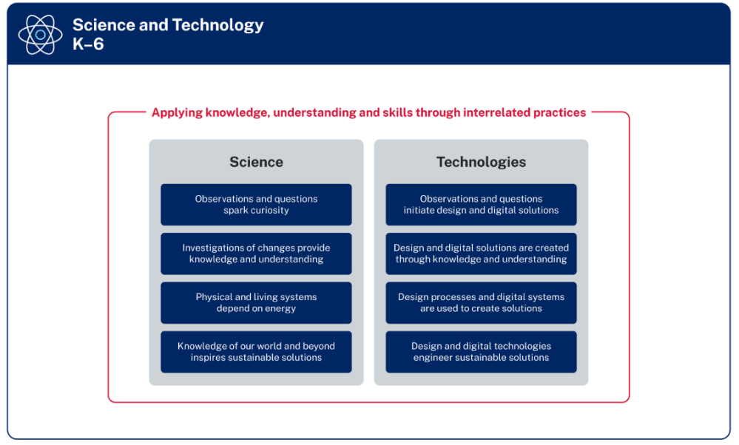
Science and technology (2)
Focus areas in Science and Technologies
The Science and technology sample scope and sequence balances learning time between the Science and Technologies focus areas
Design and digital technologies are content groups in the Technologies focus area
Figure 1 – The organisation of Science and Technology K–6 (NESA 2024)
Notes:
51. Purpose: to unpack the balance of content reflected in the Science and technology sample scope and sequence.
Time: 1 min
Presenter notes:
This figure shows the organisation of the Science and Technologies focus areas. Each of the focus areas include essential content for both the Science and Technologies elements of the syllabus.
The Science and technology sample scope and sequence outlines one way to program learning for the Science and Technologies focus areas.
[NEXT SLIDE]
Additional information for presenters:
This information is available in the FAQs of the Science and technology channel in the Primary curriculum Statewide staffroom.

Slide 51
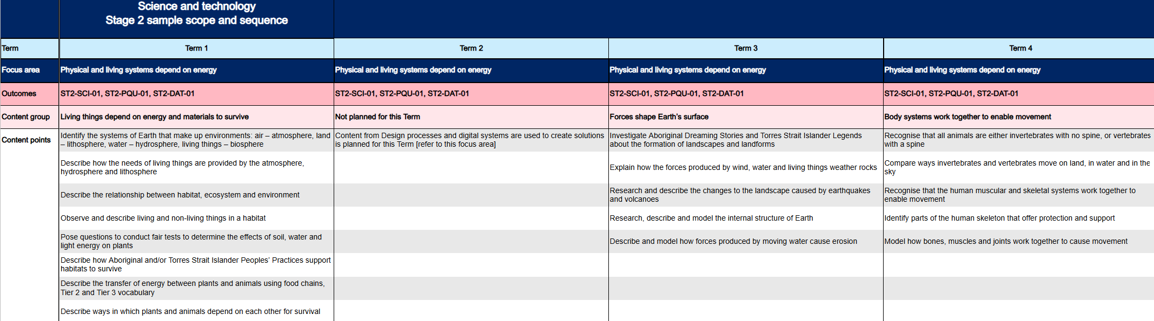
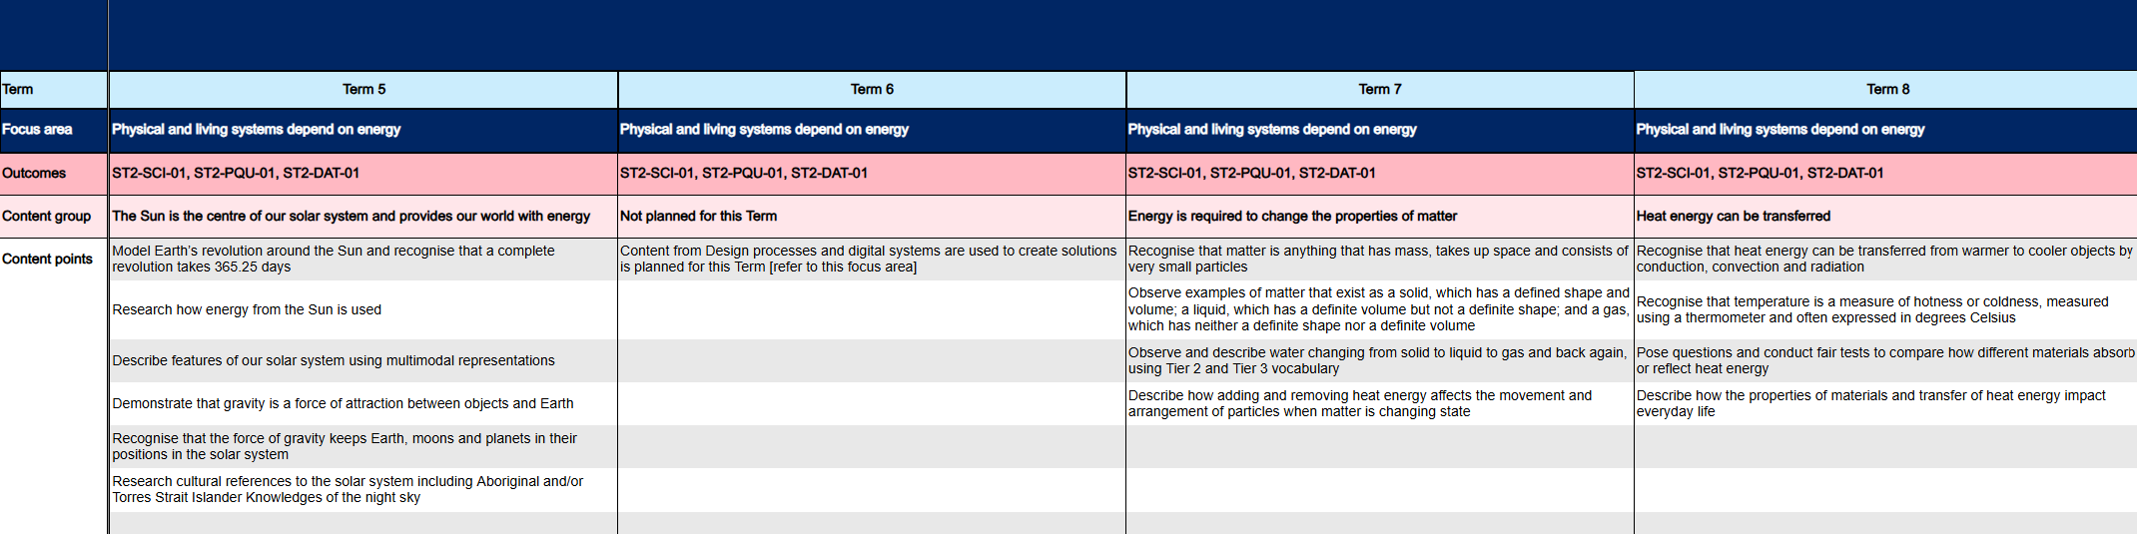
Technologies focus
Stage 2 example
Notes:
52. Purpose: to explain that some terms have a technology only focus.
Time: 1 min
Presenter notes:
In this scope and sequence there are terms where one or the other (science or technology) has been scoped. In the example on the screen, we see in Stage 2 that Terms 2 and 6 do not have science content planned. Instead, these terms have a technologies focus. There is at least one term in each stage that does not have science content planned.
[NEXT SLIDE]

Slide 52
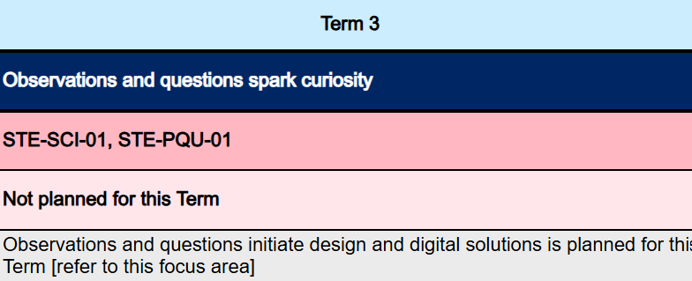
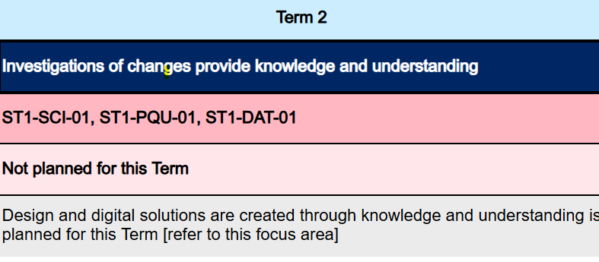
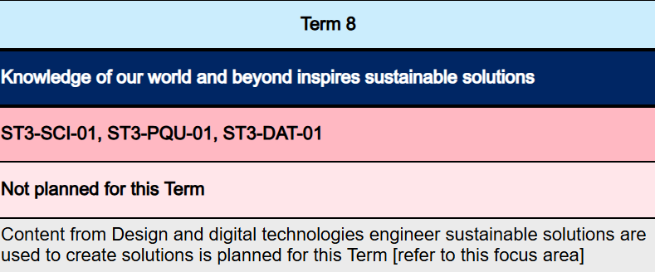
Technology only focus
Stage examples
Early Stage 1 – Term 3
Stage 1 – Term 2
Stage 3 – Term 8
Notes:
53. Purpose: to draw attention to terms across K-6 that have no science content scoped.
Time: 1 min
Presenter notes:
Here you can see that there has been no Science content scoped for Early Stage 1- Term 3, Stage 1- Term 2 and Stage 3- Term 8 . In the sample Science and Technology scope and sequence, each stage has at least one term that does not have science content included.
The samples on screen show how this is represented in ES1 Term 3, S1 Term 2, and S3 Term 8. Please take a moment to read these.
[NEXT SLIDE]

Slide 53
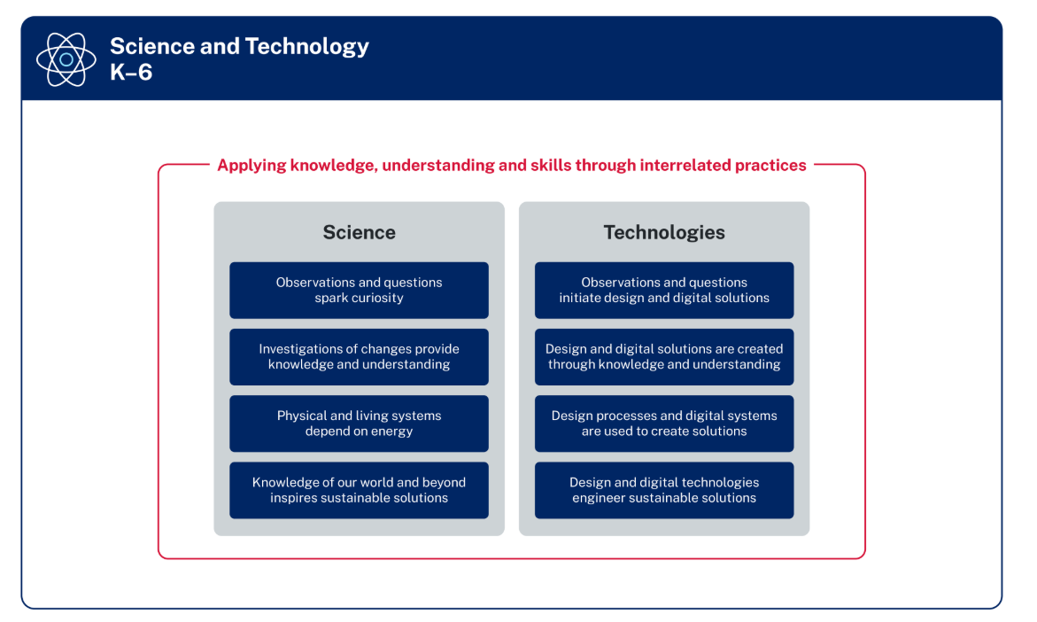
Focus area not covered in a semester (1)
Stage 2 example – Terms 3–4
Notes:
54. Purpose: to provide information about reporting of science and technology in semesters where only science learning is scoped.
Time: 10 sec
Presenter notes:
The syllabus provides flexibility in how schools sequence learning and reporting on outcomes is dependent on the content taught.
[NEXT SLIDE]

Slide 54
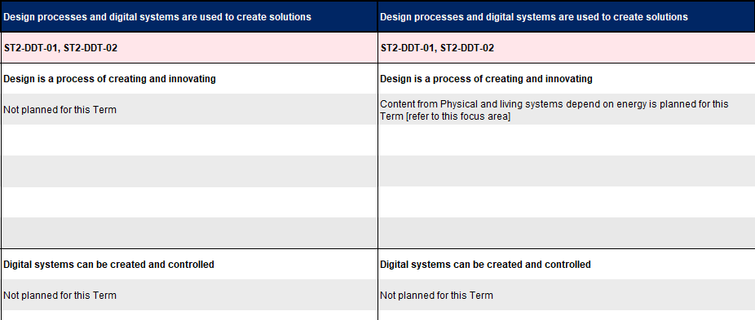
Focus area not covered in a semester (2)
Stage 2 example – Terms 3–4
Notes:
55. Purpose: to provide information about reporting of science and technology in semesters where only science learning is scoped.
Time: 50 secs
Presenter notes:
In this Stage 2 example from the sample scope and sequence, Technologies has not been planned for Terms 3 and 4. Apart from the teaching and learning aspect an important impact of not scoping technologies is that reporting will target the science outcomes.
In this example, if schools choose to incorporate technologies content into term 3 and 4, then reporting may address both technologies and science outcomes.
[NEXT SLIDE]

Slide 55
Scoped content
Science content points are scoped once in all stages.
Creating written text content points are scoped multiple times across each stage (except for in Early Stage 1).
Technologies content points are scoped multiple times across
each stage (except for in Early Stage 1).
Notes:
56. Purpose: to identify content group scoping.
Time: 1 min
Presenter notes:
In the Science focus area, content points are scoped once in all stages. Each content group is taught in a separate term, however there are two occasions where a content group has been split across two terms. In Stage 1 the content group of Light and sound interact with materials in different ways has been split across Term 5 and Term 6, one term will focus on sound and the other on light. In Stage 3 the content group Electrical energy can be transferred and transformed has been split across Term 3 and Term 4.
Creating written text content points are scoped multiple times across each stage. For example, in Stage 2 the content point ‘Use Tier 2 and Tier 3 vocabulary and noun groups to enhance the specificity of texts’ is scoped four times.
In the Technologies focus area, most content points are scoped multiple times. For example, In Stage 1 the content point ‘Apply one or more steps of a design process to make a product’ is included three times.
In Early Stage 1 ALL content points are only scoped once.
[NEXT SLIDE]

Slide 56

Activity 1
Scope and sequence exploration
Go to your chosen sample scope and sequence.
Choose a stage.
Review the 8 – term approach for that stage.
Select a year of learning (Terms 1–4 or 5–8) and identify the content groups scoped for that year.
Record the KLA, stage, year, content groups scoped in that year and list any similarities and differences to current school scope and sequences.
Share as a group through Mentimeter.
Notes:
57. Purpose: to provide time for participants to focus on the way the content is structured in their chosen scope and sequence.
Time: 21 mins (1 min intro and 20 mins activity)
Presenter notes:
Now you are going to have time to focus on the content in one stage in your chosen sample scope and sequence. This will help consolidate your understanding of the way the content has been scoped in this key learning area.
To begin:
select your chosen sample scope and sequence
choose a stage
review the 8-term approach for that stage
select a year of learning (Terms 1-4 or 5-8) and identify the content groups scoped for that year, and
record the KLA, stage, year, content groups scoped in that year and list any similarities and differences to current school scope and sequences.
Share as a KLA group.
There is space in the workbook to record your findings.
You have 20 minutes for this task.
After 20 minutes
We are now going to join with our colleagues who chose the same key learning area to share our findings, you will have 5 minutes for this activity.
Presenters to facilitate participants making KLA groups and 5-minute sharing.
After 5 mins
We will now share our learning with a new colleague.
[NEXT SLIDE]

Slide 57

Morning Tea
10:40–11:00 am
Notes:
60. Purpose: to provide time for participants to have a break.
Time: 20 mins
Presenter notes:
It is now time for morning tea. We will meet back here ready for a 11:00am start.
[NEXT SLIDE]

Slide 58

Connections
Notes:
61. Purpose: to introduce the connections session.
Time: 10 sec
Presenter notes:
In this session we will look at the connections across the key learning areas and sample scope and sequences.
[NEXT SLIDE]

Slide 59
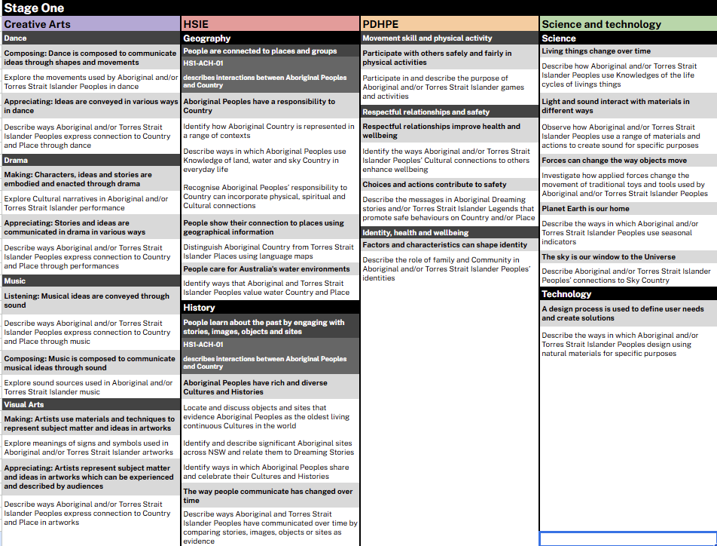
Aboriginal and Torres Strait Islander content (1)
Notes:
63. Purpose: to identify the Aboriginal and Torres Strait Islander cultures content in the CHPS sample scope and sequences.
Time: 1 min
Presenter notes:
Aboriginal and Torres Strait Islander histories and cultures content is included in each CHPS sample scope and sequence across all stages.
The way that the content is embedded differs in each key learning area. In PDHPE, Science and technology and Creative arts the content is embedded as content points within focus area content groups. In HSIE the content is included as content groups as well as in focus area content groups.
On the screen you will see a Stage 1 example of Aboriginal and Torres Strait Islander content that has been mapped across all CHPS key learning areas. This highlights the many connections.
[NEXT SLIDE]

Slide 60
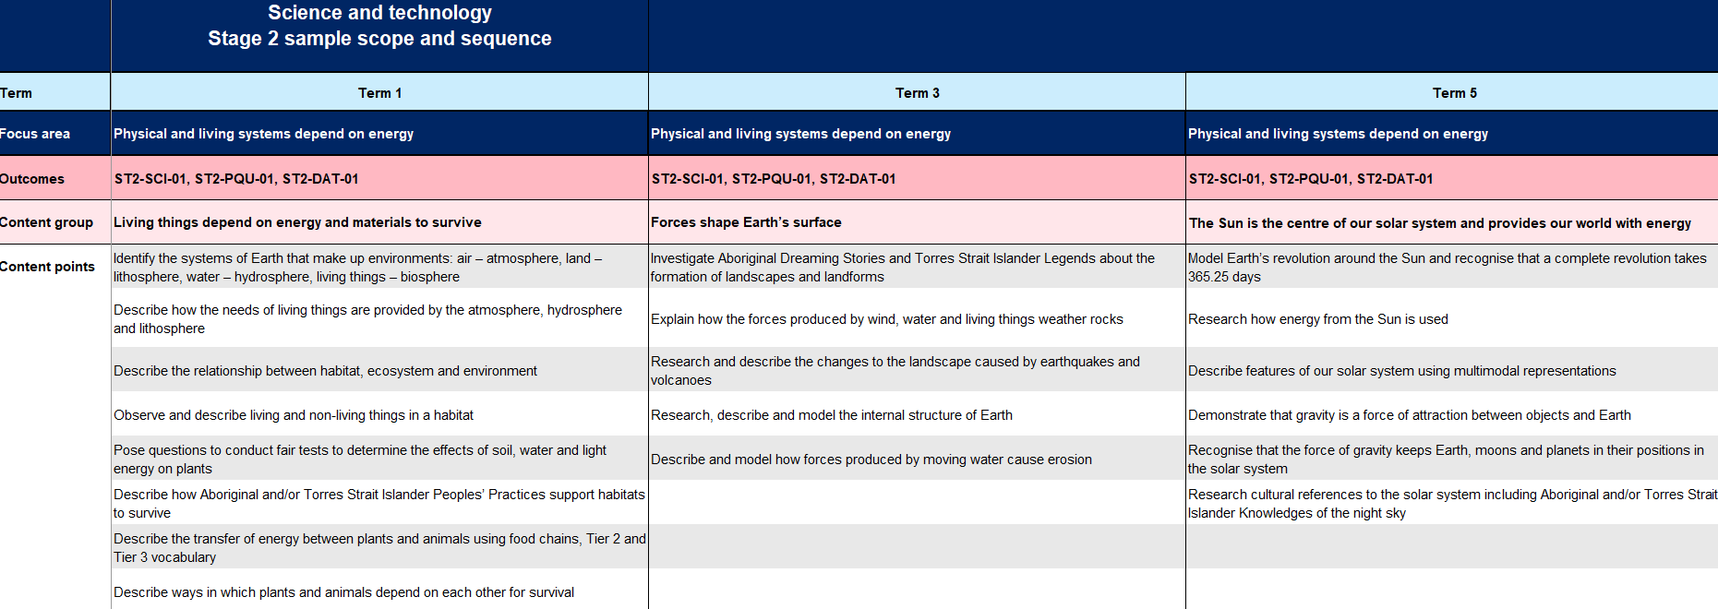
Aboriginal and Torres Strait Islander content (2)
Notes:
64. Purpose: to identify the Aboriginal and Torres Strait Islander Cultures content in the sample science and technology and PDHPE scope and sequence.
Time: 30 sec
Presenter notes:
In the Science and Technology and PDHPE sample scope and sequences the Aboriginal and Torres Strait Islander histories and cultures content has been embedded as content points within content groups.
[CLICK] In this Stage 2 Science and technology sample scope and sequence example you can see the embedded content points in Term 1, Term 3 and Term 5 sequences of learning.
[NEXT SLIDE]

Slide 61
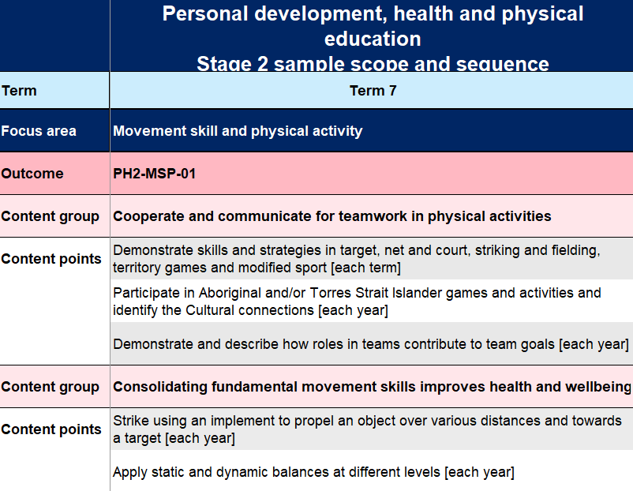
Aboriginal and Torres Strait Islander content (3)
Notes:
65. Purpose: to identify the Aboriginal and Torres Strait Islander Cultures content in the sample science and technology and PDHPE scope and sequence.
Time: 30 secs
Presenter notes:
In this PDHPE sample scope and sequence example highlighted is the embedded content point in the ‘Cooperate and communicate for teamwork in physical activities’ content group.
It is important to consider connections with other key learning areas to enrich student learning within this content area. For example, when addressing the Stage 2 content point, research cultural references to the solar system including Aboriginal and Torres Strait Islander knowledges of the night sky a connection to HSIE could be made.
[NEXT SLIDE]

Slide 62
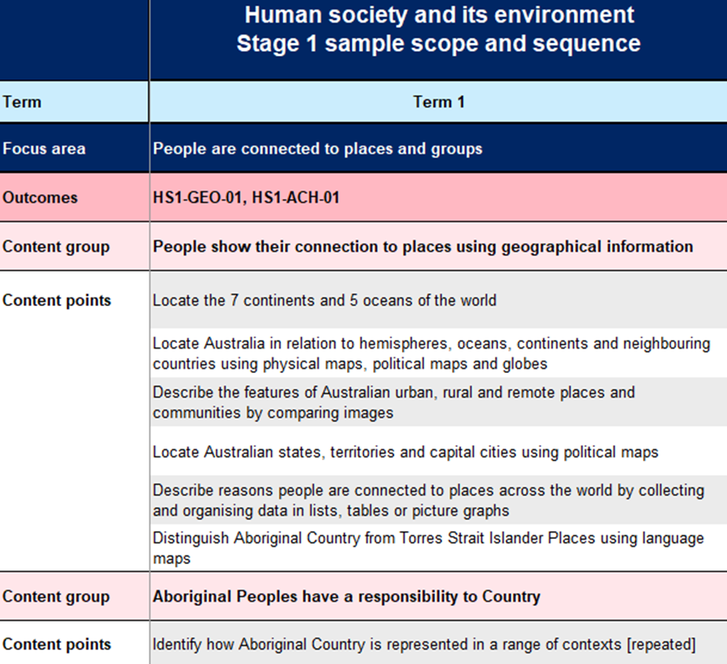
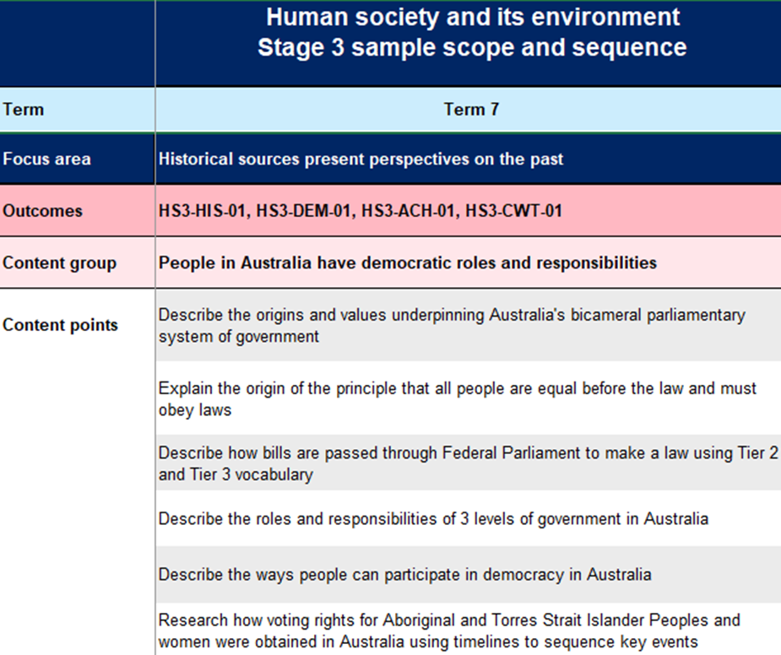
Aboriginal and Torres Strait Islander content (4)
Notes:
66. Purpose: to identify the Aboriginal and Torres Strait Islander cultures content in the HSIE sample scope and sequence.
Time: 1 min
Presenter notes:
In the HSIE syllabus and scope and sequence the Aboriginal and Torres Strait Islander content is organised as content groups in both History and Geography. [CLICK] As you can see in this Stage 1 example the content group for Geography is Aboriginal Peoples have a responsibility to Country with accompanying content point. This has been sequenced with the Geography content point – People show their connection places using geographical information for term 1.
In HSIE Aboriginal and Torres Strait Islander histories and culture content is also embedded within other geography and history content groups. [CLICK] In this Stage 3 example the content group for History is People in Australia have democratic roles and responsibilities. The content point Research how voting rights for Aboriginal and Torres Strait Isander Peoples and women were obtained in Australia using timelines to sequence key events.
[NEXT SLIDE]

Slide 63
Aboriginal and Torres Strait Islander content (5)
Learning is connected across the interrelated practices
 | Listening | Composing
Early Stage 1 | Recognise ways Aboriginal Dreaming Stories or Torres Strait Islander Legends are represented through music
Stage 1 | Describe ways Aboriginal and Torres Strait Islander Peoples express connection to Country and Place through music | Explore sound sources used in Aboriginal and Torres Strait Islander music
Stage 2 | Investigate ways Aboriginal and Torres Strait Islander Peoples engage with music for story sharing, celebrations or Cultural expression | Explore music practices and protocols of Aboriginal and Torres Strait Islander artists to understand how Cultural ideas are expressed
Stage 3 | Describe ways current Aboriginal and Torres Strait Islander music practices maintain Cultural identity and belonging | Explore ways Cultural Knowledges, practices and protocols are used in Aboriginal and Torres Strait Islander music
Notes:
67. Purpose: to demonstrate how Aboriginal and Torres Strait Islander content is connected across content groups in Creative arts.
Time: 1 min
Presenter notes:
We can see clear connections across content groups. The example on screen shows how learning about Aboriginal and Torres Strait Islander music practices supports learning in both listening and composing content groups in the creative arts syllabus.
We also see strong connections across content groups around content related to the elements of music. What students learn in one content group is applied to the others.
There are opportunities to strengthen your planning for CHPS sample scope and sequence implementation by reviewing the horizontal connections in the Aboriginal and Torres Strait Islanders histories and cultures content within specific learning areas as well as across learning areas. Reflecting on how the advice, support and collaboration with local Aboriginal Elders and Knowledge holders can be best planned and utilised will strengthen authentic connections across the whole school.
[NEXT SLIDE]

Slide 64
Activity 2
Aboriginal and Torres Strait Islander content (6)
Select one CHPS and examine the Aboriginal and Torres Strait Islander content thread in a sample scope and sequence.
What connections did you find?
What do you notice about the increase in complexity over the stages?
Repeat the process with another CHPS sample scope and sequence.
Compare the 2 key learning areas scope and sequences Aboriginal and Torres Strait Islander content:
What are the similarities and differences across both key learning areas?
Notes:
68. Purpose: to allow time for participants to explore the Aboriginal and Torres Strait Islander cultures content in the CHPS sample scope and sequences.
Time: 26 mins (1 min intro 20 mins activity and 5 mins sharing)
Presenter notes:
You will now have time to explore a selected CHPS sample scope and sequence and examine the Aboriginal and Torres Strait Islander content thread across the stages. When exploring please ponder these questions:
What connections did you find?
What do you notice about the increase in complexity over the stages?
Once you have explored one of the CHPS sample scope and sequences, examine another CHPS sample scope and sequence.
Take some time then to compare the two CHPS sample scope and sequences that you explored. What were some of the similarities and differences you noticed?
You will have 20 minutes for this activity. There is a space in your workbook to record your thoughts.
After 20 mins
We will now share as a whole group the connections you found and discuss the similarities and differences across both key learning areas.
Presenters to facilitate whole group 5-minute sharing session.
[NEXT SLIDE]
Image Credit: Canva Education. 2025. Images via Canva. https://www.canva.com/ accessed 1 August 2025.

Slide 65
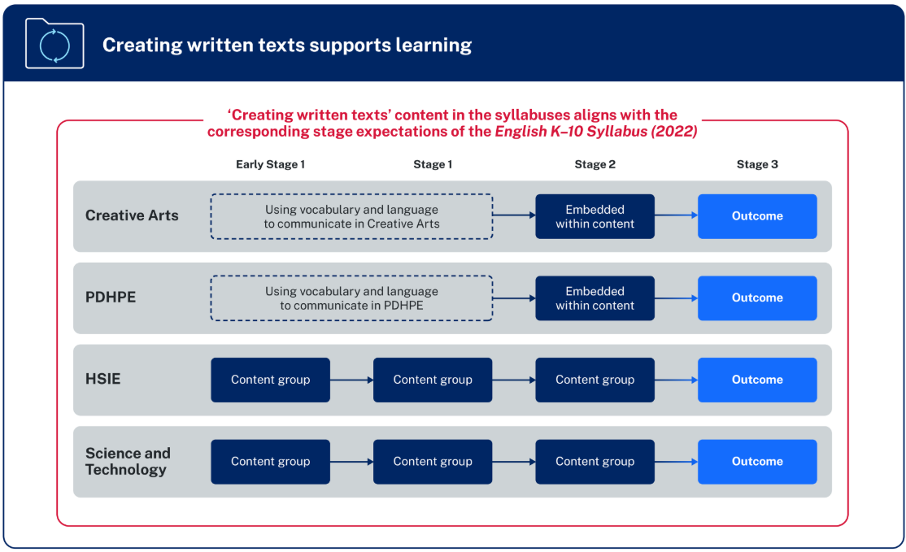
Creating written texts in CHPS K–6
‘Creating written texts is a way of organising thoughts, explaining thinking
and making connections within and across learning areas. The learning areas provide meaningful content for writing beyond the subject of English.’
NESA
Notes:
71. Purpose: to explore the creating written texts connection across CHPS syllabuses.
Time: 1 min
Presenter notes:
NESA’s diagram provides an overview of the organisation of content for Creating written texts is included in all CHPS syllabuses:
in Early Stage 1 and Stage 1, the focus in PDHPE and Creative arts is on developing students’ subject-specific vocabulary to support communicating. In HSIE and Science and technology there are individual content groups.
in Stage 2, for PDHPE and Creative arts opportunities are embedded within the content for students to create written texts. In HSIE and Science and technology there is an individual content group.
in Stage 3, there is a dedicated creating written texts outcome for all CHPS key learning areas with specific subject content.
NESA highlights that various methods of transcription may be employed, and a student’s preferred communication form(s) should be considered when teaching writing.
[CLICK] NESA states, “Creating written texts is a way of organising thoughts, explaining thinking and making connections within and across learning areas. The learning areas provide meaningful content for writing beyond the subject of English.”
[NEXT SLIDE]

Slide 66
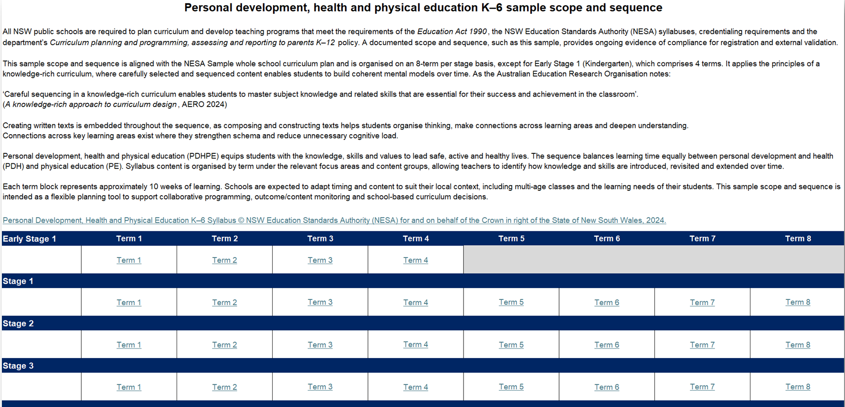
Creating written texts (1)
Example – PDHPE sample scope and sequence ‘Introduction’
Creating written texts is embedded throughout the sequence, as composing and constructing texts helps students organise thinking, make connections across learning areas and deepen understanding.
Connections across key learning areas exist where they strengthen schema and reduce unnecessary cognitive load.
Notes:
72. Purpose: to explore the creating written texts connection across the CHPS sample scope and sequences.
Time: 30 secs
Presenter notes:
In each of the CHPS sample scope and sequences, the ‘Introduction’ tab explains that [CLICK] creating written texts is embedded throughout the sequence, as composing and constructing texts helps students organise thinking, make connections across learning areas and deepen understanding.
Connections across key learning areas exist where they strengthen schema and reduce unnecessary cognitive load.
[NEXT SLIDE]

Slide 67
Creating written texts in Science and technology (1)
ES1
Outcome – STE-SCI-01, STE-PQU-01
Focus area – Observations and questions spark curiosity
Content group – Creating written sentences supports understanding of Science and Technology
Content point examples:
Select adjectives to add precision when describing the properties of materials
Use nouns, adjectives and verbs to label pictures to describe the characteristics or movement of living things
Terms 2 and 4
S1
Outcome – ST1-SCI-01, ST1-PQU-01, ST1-DAT-01
Focus area – Investigations of changes provide knowledge and understanding
Content group – Creating written texts supports understanding of Science and Technology
Content point examples:
Use nouns, noun groups and verbs to create notes, annotations and labels to document observations
Use simple and compound sentences, flow charts and labelled diagrams to describe a process or function
Terms 1, 3, 4, 6–8
Notes:
73. Purpose: to explore Creating written texts content in the Science and technology sample scope and sequence.
Time: 2 mins
Presenter notes:
Let’s now explore some examples of where Creating written texts content is included in the Science and technology sample scope and sequence. For ES1 and S1 these stages have specific content groups focusing on subject specific text features in Science.
Looking at ES1:
There are 2 outcomes including STE-SCI-01 and STE-PQU-01
Focus area-Observations and questions spark curiosity
Content group- Creating written sentences supports understanding of Science and Technology
There are 3 content points for this content group please take a moment to read two on the slide.
This content is scoped for terms 2 and 4 for ES1.
For Stage 1:
There are 3 outcomes including ST1-SCI-01, ST1-PQU-01 and ST1-DAT-01
Focus area- Investigations of changes provide knowledge and understanding
Content group- Creating written texts supports understanding of Science and Technology, and
There are 3 content points for this content group please take a moment to read two on the slide.
This content is scoped for terms 1, 3, 4 and 6 through to 8 for Stage 1.
[NEXT SLIDE]

Slide 68
Creating written texts in Science and technology (2)
S2
Outcome – ST2-SCI-01, ST2-PQU-01, ST2-DAT-01
Focus area – Physical and living systems depend on energy
Content group – Creating written explanations of physical and living systems supports understanding of Science and Technology
Content point examples:
Use Tier 2 and Tier 3 vocabulary and noun groups to enhance the specificity of texts
Use notes, diagrams, flow charts and annotations to support understanding and explain processes
Terms
1–5 ,7–8
S3
Outcome – ST3-CWT-01
Focus area – Creating written texts in Science and Technology
Content group – Creating written explanations of concepts and processes supports understanding of Science and Technology
Content point examples:
Use nominalisations to convey scientific and technological concepts and processes succinctly
Use notetaking, journalling, annotations and labelled images to create a multimodal text that documents the design processes involved in developing a solution
Terms 1–4, 6–8
Notes:
74. Purpose: to explore Creating written texts content in the Science and technology sample scope and sequence.
Time: 2 mins
Presenter notes:
Let’s now explore some more examples of where Creating written texts content is included in the Science and technology sample scope and sequence.
As previously stated in sample scope and sequences content is repeated this is indicated in the bracketed detail at the end of some content points.
Looking at Stage 2:
There are 3 outcomes including T2-SCI-01, ST2-PQU-01 and ST2-DAT-01
Focus area- Physical and living systems depend on energy
Content group- Creating written explanations of physical and living systems supports understanding of Science and Technology
There are 4 content points for this content group please take a moment to read two on the slide.
This content is scoped for all terms except term 6.
For Stage 3:
The outcome is ST3-CWT-01
Focus area- Creating written texts in Science and Technology
Content group- Creating written explanations of concepts and processes supports understanding of Science and Technology, and
There are 5 content points for this content group please take a moment to read two on the slide.
This content is scoped for all terms except term 5.
[NEXT SLIDE]

Slide 69
Creating written texts in Creative arts
S2
Outcome – CA2-MUS-01
Focus area – Music
Content group – Listening – Musical ideas are conveyed in various ways using the elements of music
Content point
Use Tier 2 and Tier 3 vocabulary and a combination of written sentences to give an opinion about, describe or explain music
Terms
1, 2 and 5
S3
Outcome – CA3-CWT-01
Focus areas – Dance, Drama, Music, Visual Arts
Content group – Creating written texts supports understanding in Music
Content points Music example:
Experiment with language, word order and repetition to adapt or create song lyrics
Use Tier 2 and Tier 3 vocabulary to create a written review of music, using the elements of music to reinforce an opinion
Acknowledge artists, titles, origins of music and sources of information to add authority to written texts
Terms 1–8
Notes:
75. Purpose: to explore Creating written texts content in the Creative arts sample scope and sequence.
Time: 3 mins
Presenter notes:
We will now look at an example of the sequence of content in the scope and sequence in the focus area of Music.
Creating written texts content in creative arts reinforces the role of writing as a tool to deepen students’ understanding of subject-specific learning.
Students apply learning gained in English to their learning in creative arts. Music is not the time for the explicit teaching of English. However, there may be a need to revisit English content depending on the time between it being explicitly taught in English and applied in creative arts.
Let’s now look at a Creating written texts and vocabulary content example for Stages 2 and 3.
For both stages the focus area in our example is Music.
For Stage 2:
Outcome: CA2-MUS-01
Content group is Listening: Musical ideas are conveyed in various ways using the elements of music, and
Content point: use Tier 2 and Tier 3 vocabulary and a combination of written sentences to give an opinion about, describe or explain music.
This content point is repeated in Terms 1, 2 and 5 in the sample scope and sequence.
For Stage 3:
Outcome is CA3-CWT-01- creates written texts to communicate ideas and understanding in Dance, Drama, Music and Visual Arts
Content group for this example is Creating written texts supports understanding in Music
Content points for this Music example are on the screen. I’ll give you a moment to read the slide.
Content in the Creating written texts outcome is addressed in all Terms from 1 to 8 through each focus area.
[NEXT SLIDE]

Slide 70

Creating written texts supports learning
Recap of key points
Creating written texts is a learning entitlement for all students.
Each syllabus includes new content that connects writing to the CHPS
key learning area instead of only linking to English as a subject.
Writing and content knowledge are closely related.
Writing about content enhances learning across subjects and stages.
The act of writing is a tool that students use to process information.
Notes:
76. Purpose: to reinforce the importance of Creating written texts in the CHPS sample scope and sequences.
Time: 1 min
Presenter notes:
Before we move on, let's revisit how Creating written texts supports learning in CHPS:
Creating written texts is a learning entitlement for all students
Each syllabus includes new content that connects writing to the CHPS key learning area instead of only linking to English as a subject
Writing and content knowledge are closely related
Writing about content enhances learning across subjects and stages, and
The act of writing is a tool that students use to process information.
[NEXT SLIDE]

Slide 71
Activity 3
CHPS – Creating written texts (2)
Select either the Creative arts or PDHPE sample scope and sequence:
examine the creating written texts content embedded within the Stage 2 and Stage 3 content groups.
Select either HSIE or Science and Technology sample scope and sequence:
examine the creating written texts content groups
explore the increase in complexity across the stages
review the key learning area specific language, skills and knowledge required.
Discuss – What similarities and differences did you notice between the two key learning areas?
Notes:
77. Purpose: to provide time for participants to explore the creating written texts content in the CHPS scope and sequences.
Time: 26 mins (1 min intro 25 mins activity)
Presenter notes:
We would now like you to examine a 'Creating written texts' thread in a sample scope and sequence. Consider how the content develops in complexity.
Then, compare this with another key learning area's scope and sequence, noting similarities and differences in content across both key learning areas.
To begin, select either the Creative arts or PDHPE sample scope and sequence.
Examine the creating written texts content embedded within Stage 2 and the Stage 3 content groups.
You will have 10 minutes for this task.
After 10 minutes
You will now have time to explore a second CHPS sample scope and sequence.
Select either the HSIE or Science and technology sample scope and sequence:
examine the creating written texts content groups
explore the increase in complexity over the stages, and
review the key learning area specific language, skills and knowledge required.
You will have 10 minutes for this activity.
After 10 minutes
Once you have explored both your selected CHPS sample scope and sequences, if you are working with a team today discuss as a group the similarities and differences you noticed. If you are working alone you could note these down and discuss with staff at a later date.
You will have 5 minutes for this task.
After 5 mins
[NEXT SLIDE]

Slide 72
Connections across CHPS (1)
Sample scope and sequence connections
Aboriginal Cultures and Histories
Creative arts
HSIE
PDHPE
Science and technology
Creating written texts
Notes:
79. Purpose: to share examples of connections across the syllabus and CHPS sample scope and sequences.
Time: 1 min
Presenter notes:
We have explored the connections across all the CHPS syllabuses with Aboriginal and Torres Strait Islander priorities and Creating written texts.
There are also horizontal connections within the content across the CHPS key learning areas. The alignment and sequence of content highlights opportunities to build schema in each learning area and make connections to other learning.
[NEXT SLIDE]

Slide 73
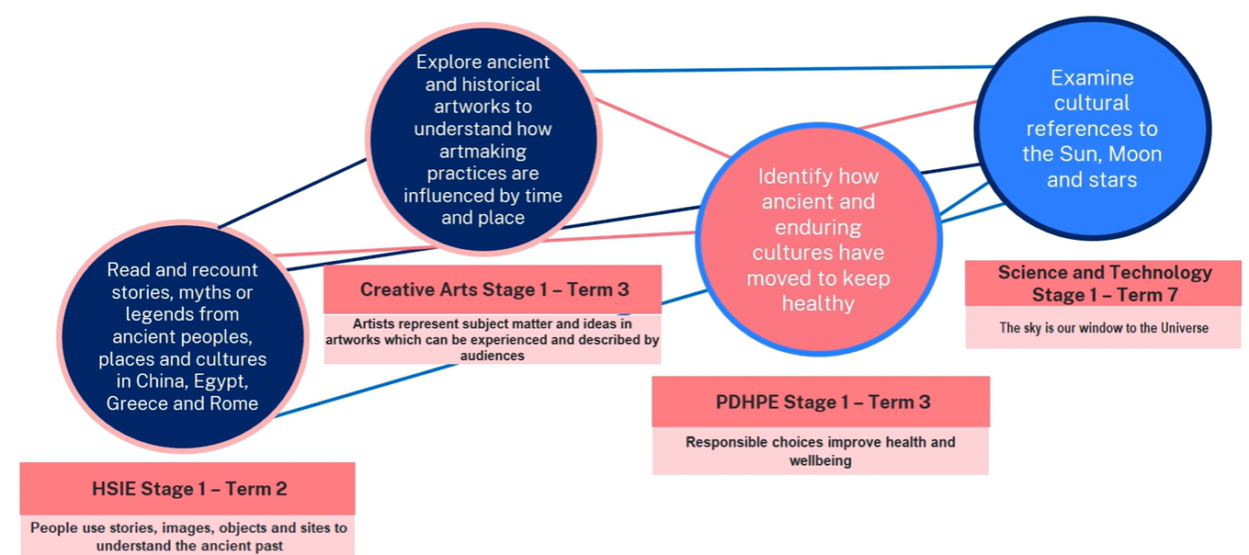
Connections across CHPS (2)
Sample scope and sequence connections
Notes:
80. Purpose: to share examples of connections across the syllabus and CHPS sample scope and sequences.
Time: 1 min
Presenter notes:
An example of a connection is provided by NESA in the K-6 sample whole-school curriculum plan supporting video.
In Term 2 of Stage 1, students learn about the ancient past in HSIE through reading and recounting ancient stories, myths or legends.
Related content also appears in Term 3 of Creative arts enabling students to apply their understanding when learning about ancient and historical artworks and practices.
As well as in PDHPE when learning how ancient and enduring cultures have moved, to keep healthy.
It is then built on by examining how ancient Roman, Greek, Egyptian and Chinese stories, art and music were used in the cultural representation of the Sun, Moon and stars in Science and technology.
This planned sequence is just one example of how knowledge and understanding can be built within and across learning areas.
[NEXT SLIDE]

Slide 74
Connections across CHPS (3)
Sample scope and sequence connections
Creative arts – Music
Science and technology
Stage 1
Performing
Music is performed to communicate musical ideas through sound
Stage 1
Light and sound interact with materials in different ways
Term 1, Term 2, Term 5 and Term 6
Term 5 and Term 6
Notes:
81. Purpose: to share example of connections across the syllabus and CHPS sample scope and sequences.
Time: 1 min
Presenter notes:
Connections between the CHPS sample scope and sequences enable content to support students building of schema.
In this example, the connection between Science and technology with the Terms 5 and 6 content for Light and sound interact with materials in different ways, links to the Creative arts Music content in Performing: Music is performed to communicate musical ideas through sound.
The content is mapped for Term 1 and then again in Term 5. The content in Music enables students to explore changes in pitch and pitch patterns and produce sounds using voice, body percussion, environmental sounds, instruments or digital technologies to develop an awareness of timbre.
This learning is supported with content in Terms 5 and 6 in Science and technology where students are testing how different materials and actions affect the volume and pitch of sound.
[NEXT SLIDE]

Slide 75
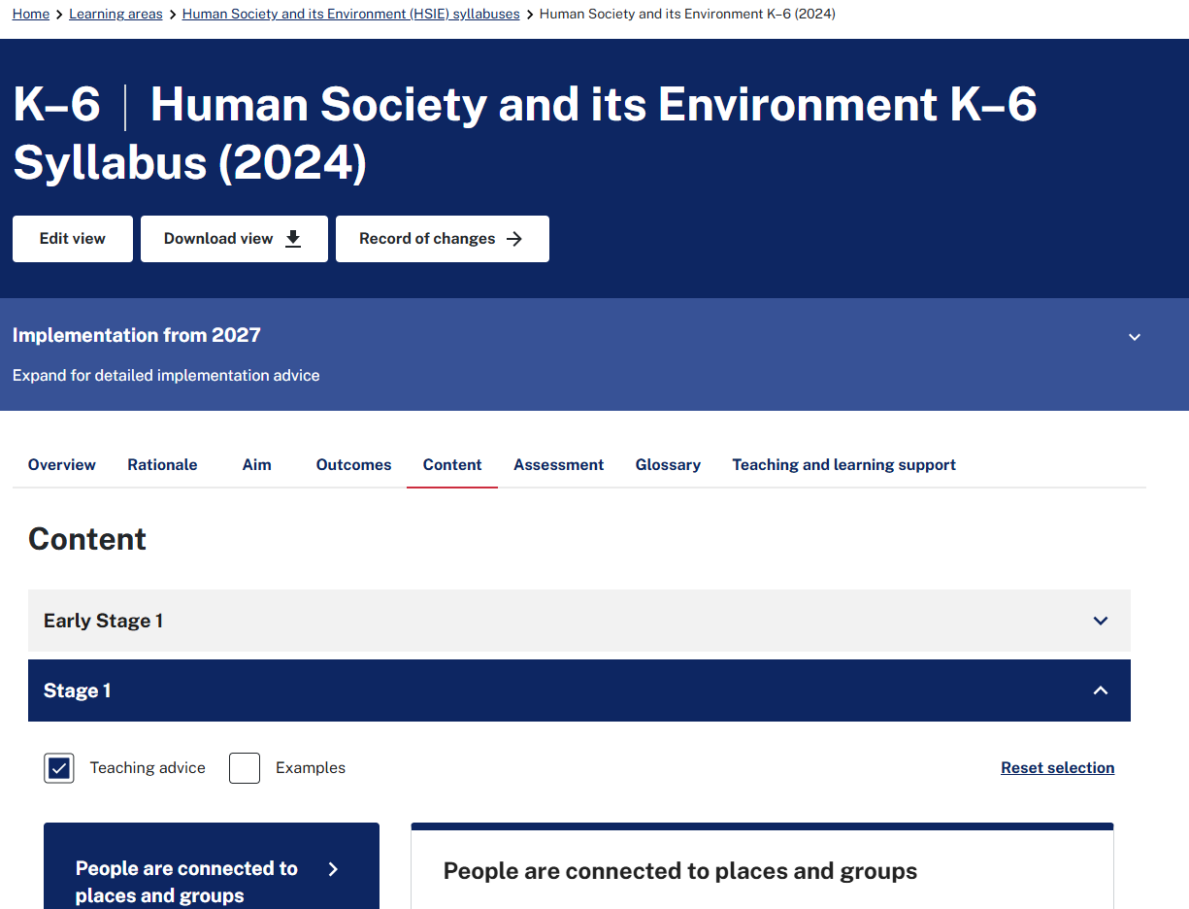
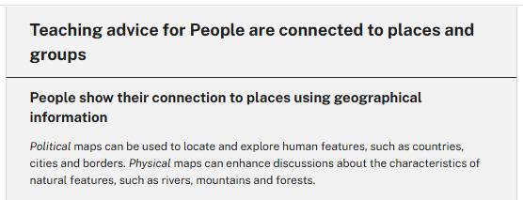
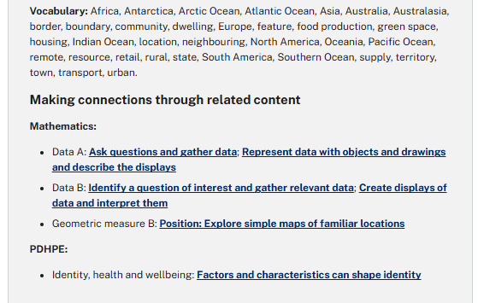
Connections across CHPS (4)
Teaching advice connections
Notes:
82. Purpose: to share an example of connections across the syllabus and CHPS sample scope and sequences from the teaching advice.
Time: 30 secs
Presenter notes:
To support your strategic planning, the syllabus Teaching advice calls out connections for related content across the different learning areas.
We have an example from the HSIE syllabus teaching advice in Stage 1- People are connected to places and groups. Within the teaching advice for ‘People show their connection to places using geographical information’ it connects related content with - PDHPE in Identity, health and wellbeing and Mathematics – Data A, Data B and Geometric measure B.
[NEXT SLIDE]

Slide 76
Connections across CHPS (5)
Teaching advice connections
Geometric measure B: Position: Explore simple maps of familiar locations
Factors and characteristics can shape identity
Data B: Identify a question of interest and gather relevant data
People show their connection to places using geographical information
Mathematics Stage 1 –Year A Term 2 and Year B Term 4
PDHPE Stage 1 – Term 3
Mathematics Stage 1 – Year B Term 2 and Term 4
HSIE Stage 1 – Term 1
Notes:
83. Purpose: to share an example of connections across the syllabus and CHPS sample scope and sequences from the teaching advice.
Time: 1 min 30 secs
Presenter notes:
In the CHPS sample scope and sequences we look at the arrangement of the content groups within the sequence of learning. If we follow where the HSIE content group ‘People show their connections to places using geographical information’, we can see it as Term 1 content.
If we look at the PDHPE sample scope and sequence the related content is ‘Factors and characteristics can shape identity’ in Term 3.
In Mathematics connections can be made with the ‘Data B, identify a question of interest and gather relevant data’, in Terms 2 and 4. For connections in Geometric measure B: Position we see the content group ‘Explore simple maps of familiar locations’ in Term 2 and Term 4.
These connections across learning areas are identified in all the CHPS syllabus teaching advice and additional teaching advice downloads. When you begin focusing on contextualising the scope and sequences for your school, reviewing these cross-learning area connections is important to ensure a sequence of learning that students can build their schema within and across learning areas.
[NEXT SLIDE]

Slide 77
CHPS content connections
Examples across CHPS
HSIE
History – Sources show perspectives on how people established colonies in Australia (S3)
Science and technology
Living things depend on energy and materials to survive (S2)
Creative Arts
Composing – Dance is composed to communicate ideas through shapes and movements (S1)
HSIE
Geography – People show their connection to places using geographical information (S1)
Creative Arts
Visual Arts – Appreciating – Artists are influenced by contexts and make artworks that audiences can critique and interpret in various ways (S3)
HSIE
Geography – People use geographical information to understand climates and environments (S2)
PDHPE
Movement skill – Participate with others safely and fairly in physical activities (S1)
Notes:
84. Purpose: to share some examples of connections in CHPS scope and sequences.
Time: 2 mins
Presenter notes:
Here we have outlined just a few of the many connections between the syllabus and supporting sample scope and sequences.
HSIE and Creative arts connections with History content–’Sources show perspectives on how people established colonies in Australia’ connects to content in Visual Arts: Appreciating: ‘Artists are influenced by contexts and make artworks that audiences can critique and interpret in various ways’.
Science and technology and HSIE- ‘Living things depend on energy and materials to survive’ content connects to ‘Geographical information is used to understand the world’.
PDHPE, Creative arts Dance and HSIE –the focus area of ‘Movement skill and physical activity’ content connects to Dance: Composing: ‘Dance is composed to communicate ideas through shapes and movements’ (S1) as well as HSIE ‘People are connected to places and groups’ and Geography ‘People show their connection to places using geographical information’ (S1).
Further connections can be seen in PDHPE and Science and technology. ‘Movement skill and physical activity and Identity, health and wellbeing’ connects to content in the Science and technology ‘Stage 3 Body systems coordinate for survival’, we also see connections in HSIE and mathematics with mapping content in Geography linking to position content across stages.
There are many connections within the content mapped out in the sample scope and sequences.
These examples will support you with the next activity.
[NEXT SLIDE]

Slide 78

Activity 4
Connections across sample scope and sequences
Explore a connection between CHPS syllabus content.
Examine the CHPS sample scope and sequences and explore the content connections.
Consider:
  How does the learning connect with another CHPS key learning area?
  What connections can you see?
  How do these connections influence your whole school planning?
Notes:
85. Purpose: to explore the connections across CHPS sample scope and sequences.
Time: 16 min (1 min intro, 10 mins activity and 5 mins group discussion)
Presenter notes:
You now have time to explore the connections within and across the CHPS sample scope and sequences. You may also choose to look at the teaching advice for further connections.
Please look for a connection through the key learning areas and stages to identify how the content builds over time.
Consider:
How does the learning connect with another CHPS key learning area?
What connections can you see?
How do these connections influence your school planning?
You may like to complete this activity in school groups, small table groups or individually. There is space in your workbook to record the connections and considerations for whole school planning.
You have 10 minutes for this activity.
After 10 minutes
We will now share the connections found and the whole school planning considerations.
Presenters to facilitate a 5-minute whole group discussion to allow participants to share their connections and whole school planning considerations.
We hope that the opportunity to explore the connections in the sample scope and sequences has allowed you to see the many connections that have been included to support student learning. This knowledge of connections will assist you as we move into the school planning session.
[NEXT SLIDE]

Slide 79

School Planning
Notes:
87. Purpose: to introduce school planning time.
Time: 10 sec
Presenter notes:
This afternoon we will take our learning and thinking from today and begin planning for individual school contexts.
[NEXT SLIDE]

Slide 80
Whole school planning (1)
Adopting a whole-school approach to delivering the curriculum ensures teachers are effectively collaborating so that all students in the school have access to the same learning opportunities.
(AERO – A Knowledge-rich approach to curriculum design)
Notes:
88. Purpose: to relate the contextual considerations for schools to scope and sequences.
Time: 30 secs
Presenter notes:
Please take a moment to read the quote from AERO (Australian Education Research Organisation) on screen.
Pause to allow time for participants to read the quote.
[NEXT SLIDE]
AERO paper- link – https://www.edresearch.edu.au/sites/default/files/2024-02/knowledge-rich-approach-curriculum-design-aa.pdf
Grattan link- https://grattan.edu.au/wp-content/uploads/2023/03/How-to-implement-a-whole-school-curriculum-approach-A-guide-for-principals.pdf

Slide 81
Whole school planning (2)
The primary curriculum is structured cohesively with careful consideration to the sequential building of knowledge and skills. The reformed NSW Curriculum’s CHPS syllabuses represent an opportunity for schools to refresh their planning practices in line with the knowledge and skills explicit approach to curriculum content.
(NESA – K–6 Whole-school curriculum planning video)
Notes:
89. Purpose: to relate the contextual considerations for schools to scope and sequences.
Time: 1 min 30 secs
Presenter notes:
NESA identified in their Whole school curriculum planning video that, “The primary curriculum is structured cohesively with careful consideration to the sequential building of knowledge and skills. The reformed NSW Curriculum’s CHPS syllabuses represent an opportunity for schools to refresh their planning practices in line with the knowledge and skills explicit approach to curriculum content.”
The CHPS sample scope and sequences keep this rich curriculum at the core whilst managing the contextual needs of individual school settings.
As we know- there are 28 terms of learning from the beginning of Kindergarten to the end of Year 6. Ensuring coherent planning and sequencing across those 28 terms will maximise learning for students in your school.
In the 2023 Grattan report, ‘How to implement a whole school curriculum approach’ they unpack beneficial leadership decision making in curriculum design. The reports states, having a clear vision helps school leaders provide an anchor for their decision making, helping prioritise resources and overcome inevitable challenges.
[NEXT SLIDE]
AERO paper- link – https://www.edresearch.edu.au/sites/default/files/2024-02/knowledge-rich-approach-curriculum-design-aa.pdf
Grattan link- https://grattan.edu.au/wp-content/uploads/2023/03/How-to-implement-a-whole-school-curriculum-approach-A-guide-for-principals.pdf

Slide 82
Whole school planning (3)
Sample scope and sequences implementation considerations
Cross stage classes
Resources
Student needs
Cohort size
Community
Teaching staff
Excursions
Notes:
90. Purpose: to unpack considerations for whole school planning to support CHPS scope and sequence implementation.
Time: 1 min
Presenter notes:
Whole school planning is a collaborative process shaped by your students’ contextual needs. When implementing a scope and sequence, you incorporate essential syllabus learning and map it into a plan tailored to your school.
Many factors will vary across schools during implementation, including but not limited to what we have called out here.
We will pause for a moment to allow you to review these considerations.
Pause 30 seconds
[NEXT SLIDE]

Slide 83
Whole school planning (4)
Sample scope and sequences implementation considerations
Student needs
Reflect on unique needs of students
Cultural considerations
Planning at a stage level for new content
Teaching staff
Careful staff placement
Planning professional learning
Cross stage classes
Class structures
Identify opportunities for vertical connections
Notes:
91. Purpose: to unpack considerations for whole school planning to support CHPS scope and sequence implementation.
Time: 2 mins
Presenter notes:
Let’s now unpack each of these considerations.
Student needs:
reflecting on your students’ unique needs while aligning with the syllabus design
local cultural considerations, and
planning for new content in a carefully sequenced way that caters for the needs of the students in higher grades who have not been exposed to the prior learning.
Teaching staff:
the composition of your teaching team influences how the CHPS scope and sequences are implemented, and
planning of professional learning prior and during implementation.
Cross-stage classes:
class structures often vary year to year. Whether cross-stage classes are common or occasional, they affect planning approaches, and
this may include identifying opportunities for the vertical connections that are manageable for your setting.
[NEXT SLIDE]

Slide 84
Whole school planning (5)
Sample scope and sequences implementation considerations
Cohort size
Shape class structures – may include multi-stage classes
Resources and Excursions
Resourcing
Budgeting
Storage
Planning
Community
Authentic connections
Engage with Local Elders and Knowledge Holders
Notes:
92. Purpose: to unpack considerations for whole school planning to support CHPS scope and sequence implementation.
Time: 2 mins
Presenter notes:
Cohort sizes:
shape class structures, which might include multi-stage classes, this impacts CHPS planning and may result in the scope and sequences needing to be carefully mapped out to ensure content is sequential.
Resources and excursions:
to deliver rich syllabus content, and
careful planning of the required resources will support successful implementation, for example budgeting and even storage solutions.
camps often connect to CHPS content and should be considered in your planning, for example, advanced bookings
checking alignment with scope and sequences, and
opportunities in the local area that may support the sequence of learning.
Community:
authentic community connections enhance learning. For example, engaging with Local Elders and Knowledge Holders supports delivery of Aboriginal and Torres Strait Islander histories and cultures content, and
review scope and sequences for where opportunities exist to develop community partnerships to support learning.
[NEXT SLIDE]

Slide 85
Activity 5
Professional borrowing
Task 1 – Brainstorming
Individually record whole school planning considerations for CHPS.
Task 2 – Borrowing time
Professionally borrow ideas by reviewing the word cloud with the group’s ideas.
Task 3 – Building on ideas
Add any borrowed ideas to your own.
Notes:
93. Purpose: to collaborate on considerations for whole school scope and sequence refining/planning
Time: 5 mins (1 min intro 4 mins activity)
Presenter notes:
We will now engage in a whole group sharing of unique school considerations, using our collective groups unique school settings and needs.
This activity is called ‘Professional borrowing’, there are three parts:
Task 1- Brainstorming- in table groups, using post it notes, discuss and record some of the considerations when whole school planning for CHPS using the sample scope and sequences. What are the unique factors for your settings? Group these into themes if applicable.
Task 2- Borrowing time- take a gallery walk around the other table groups to see others' ideas.
Task 3- Building on ideas- return to your table groups and build on your previous ideas by recording any new borrowed ideas. Discuss as a table anything you borrowed.
You will have 20 minutes for this activity; we will prompt you when it is time to move around and ‘borrow’.
After 12 minutes prompt participants to begin the borrowing of ideas on contextualising CHPS sample scope and sequences. After 5 minutes of ‘borrowing’ time prompt participants to return to table groups and add any new ideas (3 mins) to post it notes to use in the school planning session.
Thank you for your active engagement in this activity. We hope it has sparked some ideas for your whole school planning.
[NEXT SLIDE]

Slide 86

Lunch
1:00–1:30 pm
Notes:
95. Purpose: to provide a lunch break for participants.
Time: 30 mins

Slide 87
CHPS whole school planning
Whole school
Stages
Classroom
Student
Notes:
96. Purpose: to provide an overview of whole school planning.
Time: 2 min
Presenter notes:
Welcome back.
When contextualising your whole school plan for implementation of the CHPS sample scope and sequences, it is important to consider the many factors we discussed earlier in the workshop, for example community and excursions.
It is also important to ensure that you have considered all perspectives such as:
Whole school level- what influences your decision making for the whole school? Think about size, stakeholders, staffing, leadership, and budgeting.
Stage level- how will the stages be structured, staffed, approach the 8-term model? Will it be a grade approach or stage approach? Or even cross stage?
Classroom level- How does this plan look in the classroom? What needs to be planned for- resources, accessibility?
Student level- How will your students learn the content? What needs to be factored?
[NEXT SLIDE]

Slide 88
Whole-school planning (6)
School planning matrix
Plan now
What high-priority areas should be planned for medium-long term?
Do Now
What high impact quick-wins should be executed in the short term?
Park for Later
What items should be parked for now and reviewed in the future?
Do Soon
What low hanging fruit should be completed with or after the quick wins
Notes:
97. Purpose: to introduce the whole- school planning matrix.
Time: 1 min
Presenter notes:
We are going to use the whole - school planning matrix to support you in the school planning session, there is a copy of the matrix in your workbook.
Please take a moment to familiarise yourself with the four sections of the matrix.
[NEXT SLIDE]
Reference: https://kickframetoolbox.com/prioritization-matrix/

Slide 89

Activity 6
Whole school planning
What do you need to consider at your school to implement the CHPS sample scope and sequences? Use the school planning matrix to plan your next steps:
How will you support colleagues’ understanding and implementation?
What are the considerations for RFF/specialist teachers?
How will you support staff to plan for new content that has been introduced to avoid gaps forming in student learning?
Notes:
98. Purpose: to provide planning time for implementation of CHPS scope and sequence.
Time: 50 min (2 min intro 45 mins activity 3 min wrap-up)
Presenter notes:
Implementing the CHPS sample scope and sequences requires careful planning, time, collaboration and consideration of impacting factors.
You will now have time to use the planning matrix to plan your next steps for implementing the CHPS sample scope and sequences in your schools.
We have provided prompts to guide your planning on the slide, take a moment to read these considerations.
PAUSE 1 min
In your workbook there is space to record your planning and next steps. You may like to complete this activity in school or small groups.
Participants will have the opportunity to learn from each other by sharing next steps with the group after planning.
You have 45 minutes for this activity.
Presenters to roam the room being available for questions and discussion. Monitor the group and provide time checks throughout the planning time.
After 45 minutes
We hope you found this activity useful, We will now share with the group.
[NEXT SLIDE]

Slide 90

Share next steps
Plan Now
Do Now
Do Soon
Park for Later
Notes:
99. Purpose: to share next steps for school implementation of CHPS sample scope and sequences.
Time: 6 mins (1 min intro, 5 mins activity)
Presenter notes:
We will use the matrix scaffold to support sharing of our next steps for CHPS scope and sequence implementation in your schools.
For this activity you will share one of the following:
Plan Now- What high-priority areas should be planned for medium-long term?
Do Now- What high impact quick-wins should be executed in the short term?
Park for Later- What items should be parked for now and reviewed in the future?
Do Soon- What low hanging fruit should be completed with or after the quick wins?
Presenter to facilitate discussions by calling on individual participants.
After 5 minutes
We hope that this reflection has helped to consolidate your learning from today. This planning process and thinking will continue back in your schools.
[NEXT SLIDE]

Slide 91
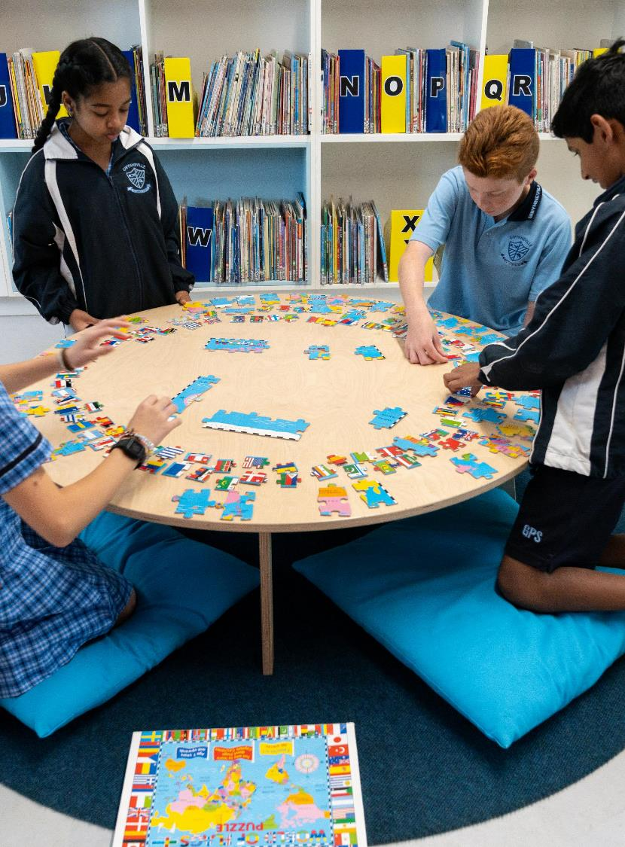
Conclusion
Notes:
104. Purpose: to orientate participants to the conclusion.
Time: 10 sec
Content:
We will come back together to finish up the day of professional learning. Thank you for your active engagement in the school planning session.
[NEXT SLIDE]

Slide 92

Key takeaways
Each key learning area has a unique scope and sequence.
There are connections across and within the scope and sequences.
Plan the implementation of sample scope and sequences for your school context.
Notes:
105. Purpose: to reflect on the key takeaways of today’s professional learning workshop.
Time: 2 mins
Presenter notes:
Thank you all for your active participation and thoughtful contributions throughout this workshop. Your engagement with the CHPS sample scope and sequences has been invaluable. We hope that we have supported you to explore these scope and sequences and plan for implementation in your school contexts.
Our key takeaway messages for today are clear:
[CLICK] Each CHPS key learning area has a unique sample scope and sequence that captures the nuances of that specific key learning area. Each scope and sequence has been carefully sequenced, in a selective way, to be coherent and specific for students learning over the 28 weeks.
[CLICK] There are connections across and within the scope and sequences, through Aboriginal and Torres Strait Islander Content, Creating written texts and within content groups. Content has been selectively included across all the CHPS scope and sequences with vertical and horizontal connections.
[CLICK] Having a clear understanding of how you will implement the sample scope and sequences in your school ensures your students needs are being met. It is important that you review CHPS sample scope and sequences for your school setting and needs.
[NEXT SLIDE]

Slide 93

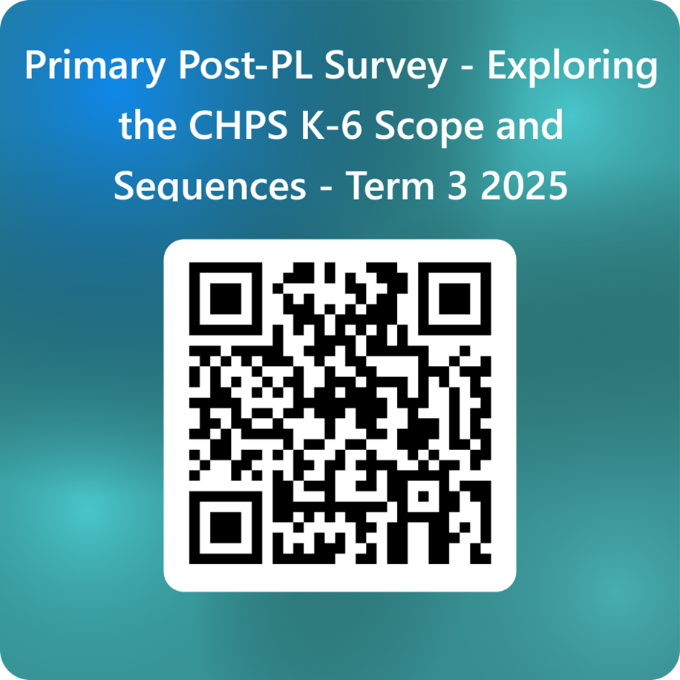

CHPS feedback
Please scan the QR code to provide feedback on each session and ask questions you may still have.
ThePhoto by PhotoAuthor is licensed under CCYYSA.
Notes:
106. Purpose: to capture feedback from participants.
Time: 3 mins
Content:
Thank you for your attendance and active engagement in the professional learning today. We have unpacked the structure and intent of the CHPS sample scope and sequences and worked together to support your next steps in implementation in your schools.
We would now like you to complete a short survey to provide feedback on today’s professional learning. Could you please use your phones to access the survey and share your thoughts with us. ​
[NEXT SLIDE]

Slide 94

Contact us
Primary Curriculum Statewide Staffroom
primarycurriculum@det.nsw.edu.au
Notes:
Time: 30 sec
Presenter notes:
If you have any questions or would like to reach out to the Primary Curriculum team, please contact us via this email address, or through the Statewide Staffroom.
This QR code takes you to the enrolment page to join the statewide staffroom.
[NEXT SLIDE]

Slide 95
Copyright
© State of New South Wales (Department of Education), 2025
The copyright material published in this resource is subject to the Copyright Act 1968 (Cth) and is owned by the NSW Department of Education or, where indicated, by a party other than the NSW Department of Education (third-party material).
Copyright material available in this resource and owned by the NSW Department of Education is licensed under a Creative Commons Attribution 4.0 International (CC BY 4.0) license.
This licence allows you to share and adapt the material for any purpose, even commercially.
Attribution should be given to © State of New South Wales (Department of Education), 2025.
Material in this resource not available under a Creative Commons licence:
the NSW Department of Education logo, other logos and trademark-protected material
Material owned by a third party that has been reproduced with permission. You will need to obtain permission from the third party to reuse its material.
Links to third-party material and websites
Please note that the provided (reading/viewing material/list/links/texts) are a suggestion only and implies no endorsement, by the New South Wales Department of Education, of any author, publisher, or book title. School principals and teachers are best placed to assess the suitability of resources that would complement the curriculum and reflect the needs and interests of their students.
If you use the links provided in this document to access a third party’s website, you acknowledge that the terms of use, including licence terms set out on the third-party’s website apply to the use which may be made of the materials on that third-party website or where permitted by the Copyright Act 1968 (Cth). The department accepts no responsibility for content on third-party websites.

