Slide 1

CHPS sample units: from planning to practice
Early Stage 1
October 2025
Notes:
1. Purpose: Title slide
Time: 1 minute
Presenter notes:
Welcome to Term 4 Professional Learning on CHPS sample units: From planning to practice.
[NEXT SLIDE]

Slide 2

Acknowledgement of Country
We recognise the Ongoing Custodians of the lands and waterways where we work and live. We pay respect to Elders past and present as ongoing teachers of knowledge, songlines and stories. We strive to ensure every Aboriginal and Torres Strait Islander learner in NSW achieves their potential through education.
Artwork © Kayleb Waters, Gomeroi artist and Cultural mentor 2025. This image represents Aboriginal Cultures. “This symbol is represented by a hand stencil painted in caves, showing our enduring connection to Country and story.”​
Notes:
2. Purpose: Acknowledgement of Country
Time: 2 minutes
Presenter notes:
I acknowledge the Traditional Custodians of the many lands we are joining from today across New South Wales. I am presenting today from Awabakal Country, and I pay my respects to Elders past and present and extend that respect to all Aboriginal and Torres Strait Islander colleagues with us today.
As we engage in this professional learning focused on curriculum and teaching practice, we are reminded that the NSW syllabuses strengthen the inclusion of Aboriginal histories, cultures and perspectives. This is not only an educational requirement—it is a responsibility. It invites us to teach in ways that honour truth, embed cultural integrity, and recognise the diversity of Aboriginal Nations across NSW.
Today is also a reminder that deepening our understanding of Aboriginal content is not a single lesson or unit—it is a commitment to practice. It requires ongoing learning, respectful collaboration with local communities, and ensuring that Aboriginal perspectives are embedded meaningfully, not as a token, but as a thread woven throughout learning. May we continue to walk together, listen deeply, and create classrooms where every student sees themselves and their culture respected and valued.
[NEXT SLIDE]

Slide 3
Australian Professional Standards for Teachers
Standard descriptors
6.2 – Engage in professional learning and improve practice
6.2.2 – Participate in learning to update knowledge and practice, targeted to professional needs and school and/or system priorities
6.3 – Engage with colleagues and improve practice
6.3.2 – Contribute to collegial discussions and apply constructive feedback from colleagues to improve professional knowledge and practice
Notes:
3. Purpose: To outline the teaching standards addressed in this professional learning.
Time: 30 seconds
Presenter notes:
On the slide you will see the Australian Professional Standards for Teachers that today’s professional learning will be addressing. I will give you a moment to review.
[NEXT SLIDE]

Slide 4





Purpose
Outcomes
By the end of this workshop, participants will:
The purpose of this session is to understand the common lesson structure of CHPS sample units and plan effectively for next steps in 2026.
preview the sample units prior to release
develop a clear understanding of what is required for 2026 readiness at year and stage level
deepen their understanding of unit and lesson structures
identify practical next steps for successful syllabus implementation at their school.
Notes:
4. Purpose: To introduce the purpose and outcomes for the workshop.
Time: 2 minutes
Presenter notes:
On the screen are the purpose and outcomes of the session.
Today’s professional learning previews sample units across the four key learning areas, with a focus on the common lesson structure designed to support effective teaching and learning. The session will unpack how key unit features guide our planning for assessment and differentiation, ensuring all students’ needs are met. There will also be a focus on classroom readiness for Term 1, 2026. This includes access to resource lists, as well as key vocabulary lists to support EAL/D students and enhance whole-class planning. The session will conclude by identify next steps for 2026 readiness at both year and stage levels, outlining clear actions for leaders and classroom teachers to ensure a smooth and successful start
For multi-age settings, implementation of the new syllabuses can be deferred until they are mandatory in 2027. Early adoption is possible, though supporting resources may be limited. Primary Curriculum acknowledge the unique challenges of multi-age settings and will provide ongoing communication and support to assist with planning and integration. The extended familiarisation period offers time to adapt units thoughtfully to diverse classroom contexts while preparing for mandatory implementation.
[NEXT SLIDE]

Slide 5

Activity
Feedback
Have you reviewed any of the sample English and mathematics units released?
Are you currently implementing any aspects of the new CHPS syllabuses, or do you plan to do so soon?
Have you ever thought about how the Department develops these sample units?
Notes:
5. Purpose: To engage with participants through questioning and reaction buttons.
Time: 5 minutes
Presenter notes:
To begin our session, I’d like to get a sense of where everyone is at, in relation to the new CHPS syllabuses. I will ask some questions to help understand your current engagement and experiences.
[CLICK] Have you reviewed any of the sample English and mathematics units released?
[CLICK] Are you currently implementing any aspects of the new syllabus, or do you plan to do so soon
[CLICK] Have you ever thought about how the Department develops these sample units?
[NEXT SLIDE]

Slide 6

Common lesson structures across the four key learning areas
Notes:
6. Purpose: To preview commonalities in CHPS units.
Time: 10 seconds
Presenter notes:
There are common lesson structures across the CHPS sample units which support a consistent look and feel. Today we will explore how the key sample unit features support explicit teaching, assessment and differentiation.
[NEXT SLIDE]

Slide 7

3 pillars of resource development
CHPS Sample Units
Evidence based principles
Purposeful design
Practical classroom support
Notes:
7. Purpose: To reinforce the 3 pillars of resource development.
Time: 2 minutes
Presenter notes:
When the Primary Curriculum team talk about the design of CHPS sample units, it is important to understand that everything created is grounded in three key pillars: evidence-based principles, purposeful design, and practical classroom support. These pillars guide the work from initial concept through to final delivery, ensuring high quality, impactful, and genuinely useful resources for teachers and students.
Evidence based principals ensures every resource is informed by current research, best practice, and data on what works in improving student learning. Developers engage with educational research and curriculum policy, so the work aligns with system priorities and supports consistent, high-quality teaching.
Purposeful design refers to intentionally designing resources with a clear purpose, logical structure, and strong alignment to syllabus outcomes and learning progressions. The focus is on clarity, accessibility, and coherence so that teachers can easily see how each part connects to the bigger picture.
Practical classroom support ensures teachers have access to materials that are adaptable and supportive of diverse learners. Within each resource are clear instructions, scaffolds, differentiation suggestions, and assessment checkpoints so teachers can focus on teaching rather than creating resources from scratch.
[NEXT SLIDE]

Slide 8
Why consistency matters
CHPS Sample Units
Creative arts
HSIE
PDHPE
Science and Technology
Notes:
8. Purpose: To explain why consistency matters across the CHPS units
Time: 1 minute
Presenter notes:
The sample units play a central role in supporting schools as we move toward the 2027 mandatory implementation of the new syllabuses. They have been designed to reflect the new syllabuses and provide leaders and teachers with practical, high-quality resources they can confidently use in classrooms.
The CHPS sample units are directly aligned with the Department’s scope and sequences, and NESA’s whole-school plan. This alignment provides clarity, prevents duplication, and helps reduce workload.
The CHPS sample units are designed to engage students, support teachers, and promote consistent, high-quality learning experiences that support explicit teaching, assessment and differentiation.
[NEXT SLIDE]

Slide 9


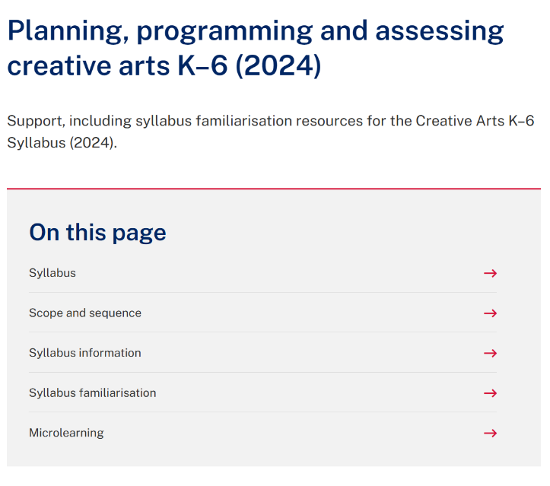
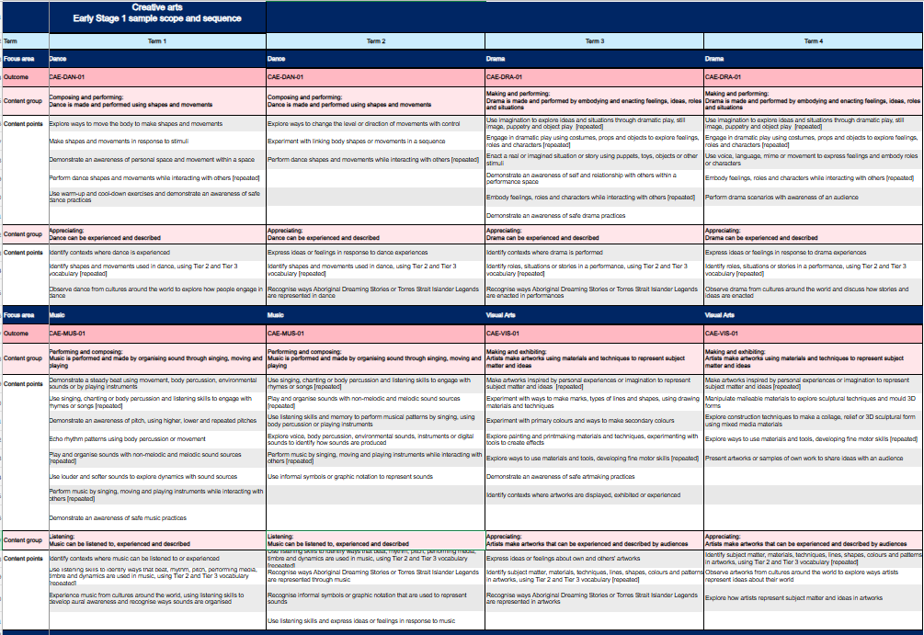
Scope and sequences
CHPS Sample Units
Notes:
9. Purpose: To highlight where to access DoE CHPS scope and sequences
Time: 30 seconds
Presenter notes:
This is where you can access the Department’s sample scope and sequences. You can find them by following these breadcrumbs. We have used a creative arts example on screen.
If you would like to explore scope and sequences further, the Term 3 microlearning professional learning has a focus on scope and sequences and you can access the recording and resources on demand.
[NEXT SLIDE]

Slide 10

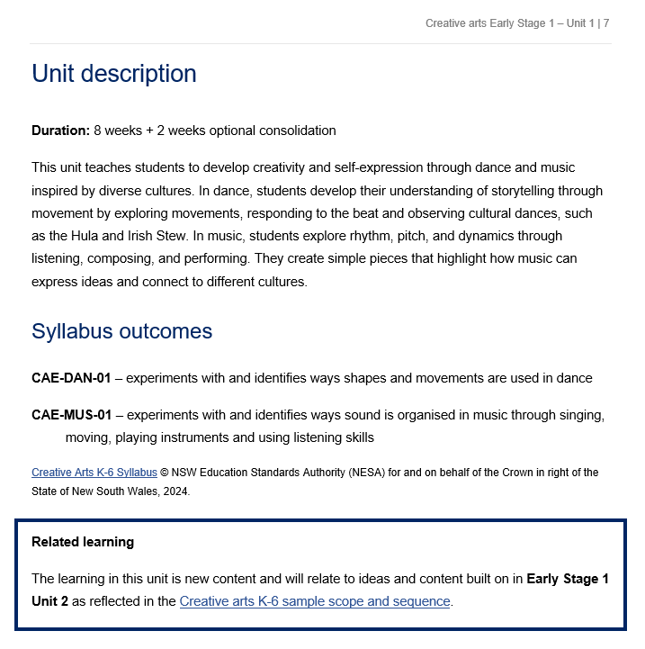
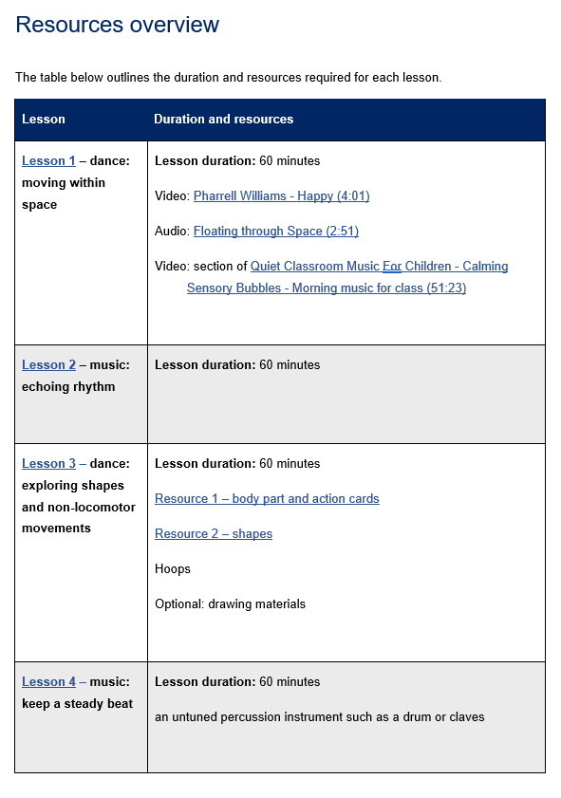
Unit and lesson structure
CHPS Sample Units
Notes:
10. Purpose: To unpack the unit and lesson structure
Time: 2 minutes
Presenter notes:
The CHPS sample units are designed as a flexible framework, this is just one example of how programming might look. Schools are encouraged to adapt them to suit their own context and student needs.
Each unit uses the same template, giving a consistent look and feel across all four key learning areas. On page one, you’ll see the identified syllabus, stage, unit number, and focus areas.
Every unit begins with a clear description that outlines the duration of the lesson, the focus of learning, and how students will build knowledge and skills.
Related learning is highlighted to demonstrate possible connections to relevant prior learning.
Syllabus outcomes are clearly identified, ensuring every lesson is grounded in syllabus content.
Each unit also includes a resources overview, and lessons are structured as two 60-minute sessions per week, aligning with NESA’s suggested time allocation for CHPS key learning areas. This design streamlines planning, keeps expectations clear, and ensures a consistent experience for teachers and students. The resources overview makes preparation simple, everything is listed in one place, from videos and audio tracks to physical materials like hoops, percussion instruments, or action cards. This not only supports smooth planning but also helps schools plan for and manage resourcing across each term.
[NEXT SLIDE]

Slide 11
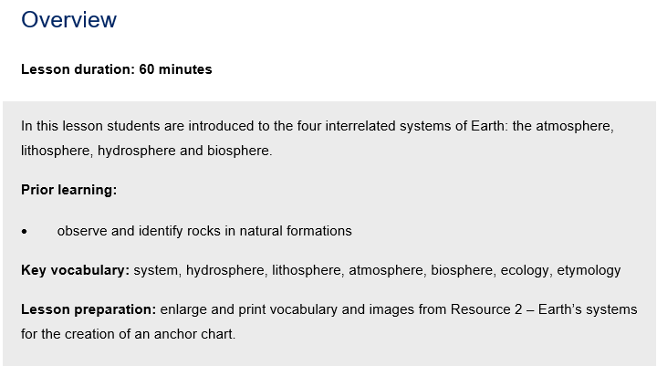
Key features of the lesson structure (1)
Overview
Science and Technology – Stage 2 – Unit 1
Notes:
11. Purpose: To unpacking Beginning the lesson
Time: 30 seconds
Presenter notes:
Each lesson in the CHPS sample units follows the same structure, ensuring consistency across all four KLAs. They begin with an overview that provides a short description of the learning and identifies the prior learning the lesson builds on. This prior learning is aligned to the syllabus content. The overview also lists the key vocabulary to be taught and highlights any preparation required.
Each lesson is 60 minutes in duration.
[NEXT SLIDE]

Slide 12
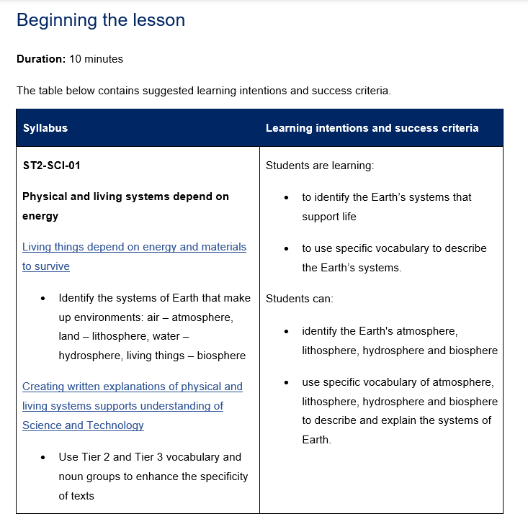
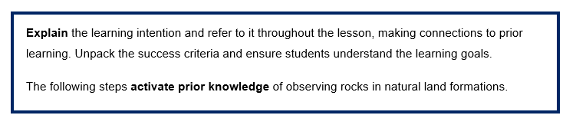
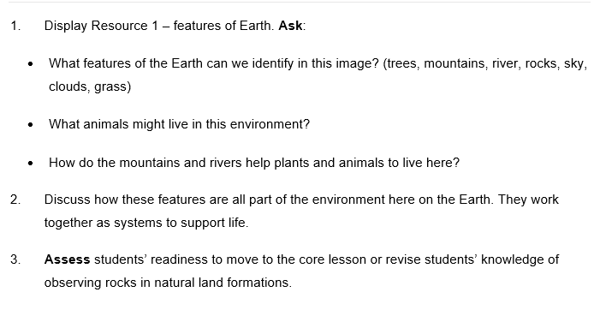
Key features of the lesson structure (2)
Beginning the lesson
Science and Technology – Stage 2 – Unit 1
Notes:
12. Purpose: To unpack Beginning the lesson
Time: 1 minute
Presenter notes:
The beginning of each lesson is usually 10 minutes in duration. You will notice explicit teaching strategies embedded in the units. The learning intention and success criteria support students to know exactly what they’re working towards and how they’ll know they’ve achieved it. Making learning visible is a key part of explicit teaching, it removes the guesswork and gives each lesson clear purpose. The beginning section of the lesson also seeks to activate prior knowledge. Here the focus is on students retrieving what they already know, not on reteaching content. This approach hooks into existing schema, to prepare them for the new learning in the core lesson.
Right from the start, explicit teaching is modelled, being clear about the destination and deliberately connecting the lesson to the knowledge students already have.
[NEXT SLIDE]

Slide 13
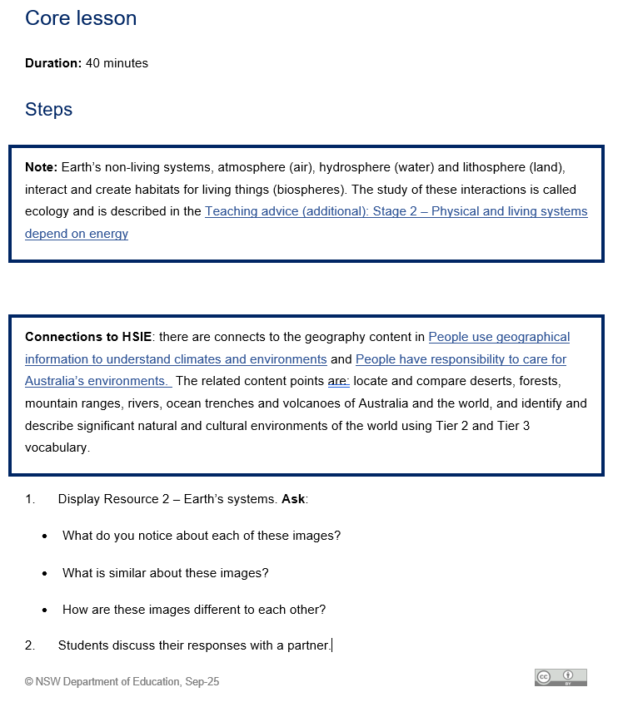
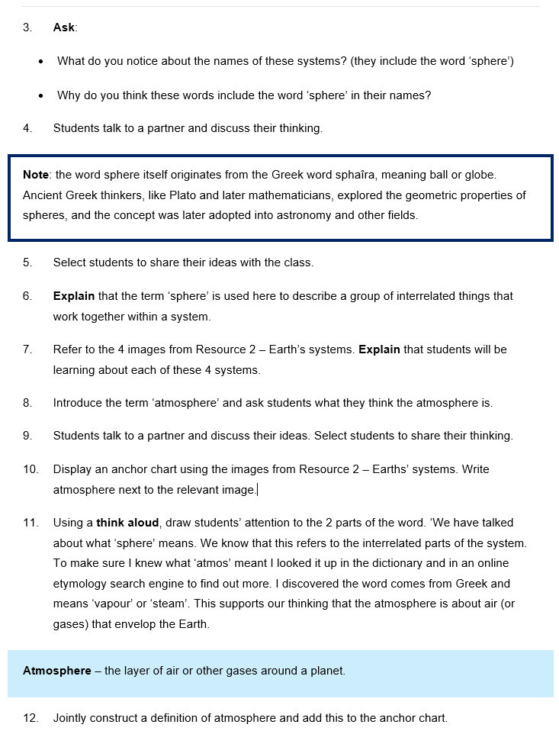
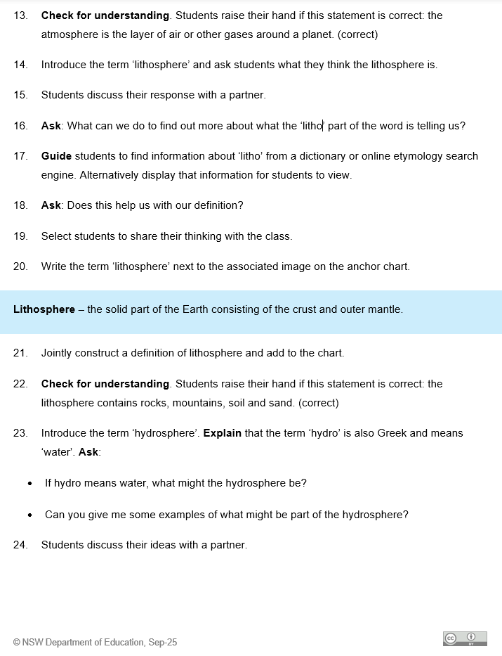
Key features of the lesson structure (3)
Core lesson
Science and Technology – Stage 2 – Unit 1
Notes:
13. Purpose: To unpack the core lesson
Time: 1 minute 30 seconds
Presenter notes:
The core lesson is planned for around 40 minutes. You will notice more explicit teaching strategies embedded here. Teachers begin by explaining and modelling the new knowledge or skill. Then students move into guided practice before working more independently, this is the Gradual Release of Responsibility in action.
The activities are tightly aligned to the learning intention. They are sequenced from simple to complex, scaffolds are gradually removed, and extension opportunities are built in, so every student is challenged at the right level.
Throughout the core lesson, teachers use checks for understanding such as questioning, response systems, or observation to monitor learning progress. These checks for understanding drive timely feedback, helping teachers adjust pace, identify areas that require re-teaching and are connected to the success criteria.
While explicit teaching strategies are central, they are balanced with a variety of other high-quality practices of collaborative learning, use of real-world contexts, inclusion of diverse backgrounds and abilities, and multimodal resources.
[NEXT SLIDE]

Slide 14
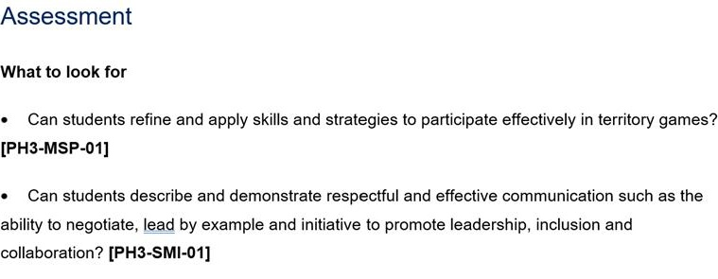
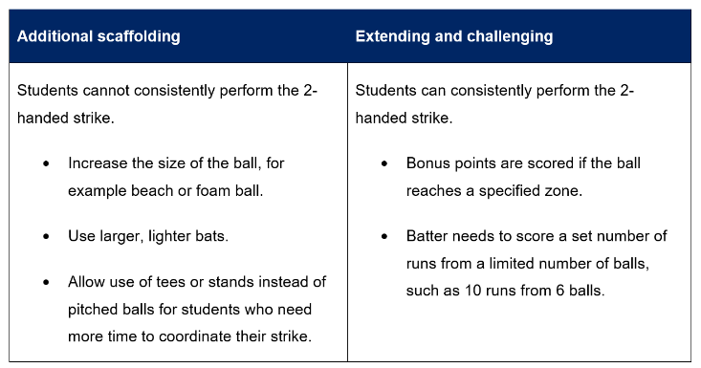
Key features of the lesson structure (4)
Differentiation and Assessment
PDHPE Stage 3 – Unit 1
Notes:
14. Purpose: To unpack differentiation and assessment
Time: 2 minutes
Presenter notes:
Each lesson includes a differentiation table to help teachers plan for the full range of learners in their classrooms. It provides practical examples of additional scaffolds for students who need more support, as well as extension strategies for those ready to be challenged. All adjustments are anchored to the same learning intention and success criteria. This means students may take different pathways, but everyone is working towards the same goal. The table helps teachers anticipate needs in advance, promotes inclusive practice, and ensures high expectations are maintained for every student.
Assessment is also embedded in every lesson, always tied directly to the learning intention, success criteria, and syllabus outcomes. The ‘What to look for’ section gives teachers clear guidance on the observable evidence that shows whether students are meeting the learning intention. For example, in this lesson teachers are looking at whether students can describe strategies to enhance road safety decision making, and whether they can explain actions and messaging for staying safe.
By aligning assessment with the success criteria, we take the guesswork out of checking progress. Teachers know exactly what evidence to gather, and students understand what success looks like. Importantly, assessment is built into the flow of the lesson and doubles as a check for understanding to guide next steps.
[NEXT SLIDE]

Slide 15
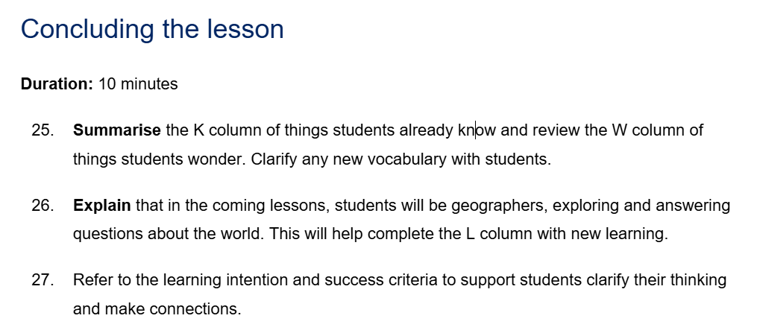
Key features of the lesson structure (5)
Concluding the lesson
HSIE Stage 1 – Unit 1
Notes:
15. Purpose: To unpack the key features of the lesson structure within the CHPS units: Concluding the lesson
Time: 1 minute
Presenter notes:
The conclusion of each lesson is approximately 10 minutes and provides an intentional wrap up of the learning. In this phase teachers revisit the learning intention and success criteria, so students are reminded of the purpose of the lesson and what they’ve achieved. It allows them to reflect on how the activities connected to the learning, and to make sense of the knowledge and skills they’ve developed. There is no new content introduced here and no formal check for understanding — it’s simply about clarifying, reinforcing, and closing the loop so students leave the lesson with a clear picture of their progress.
[NEXT SLIDE]

Slide 16
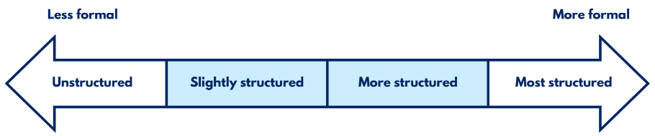
Optional assessments
Opportunities for real-time feedback
Optional assessment: Creative arts Early Stage 1 – Unit 1 – Lesson 5
Observe students during the movement stations activity to assess students’ ability to:
travel from one station to another using locomotor movements
create dance shapes and non-locomotor movements
This task provides evidence of student learning aligned to the success criteria. It assesses students’ ability to make a variety of shapes and movements with their bodies.
Optional assessments help identify gaps in student learning and misconceptions.
They guide teaching decisions by providing a way to check student understanding at the lesson level and plan the next steps in teaching.
Notes:
16. Purpose: To unpack optional assessments
Time: 2 minutes
Presenter notes:
Each lesson contains optional assessments. They are designed to be a flexible, optional resource, available for use when and where they are needed and are a tool to support your teaching.
[CLICK] A benefits of these assessments is that they help identify the gaps in student learning and misconceptions that can occur during a lesson. This is valuable in ensuring that all students grasp essential concepts before new learning is introduced.
[CLICK] They guide teaching decisions. By using these assessments, teachers can gain real-time insights into student understanding and use that information to adjust instruction, provide targeted support, or extend learning. The optional assessments serve as a practical way to check comprehension at the lesson level and plan the next steps in teaching.
Optional assessments offer a range of approaches, from informal methods like planned observations and targeted questioning to identify misconceptions, to more formal tasks such as evaluating student work samples using predetermined criteria.
[NEXT SLIDE]

Slide 17
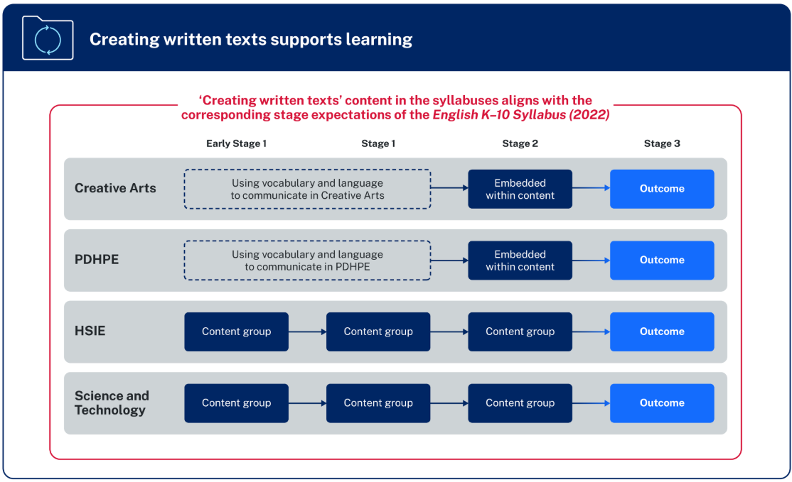
Creating written texts in CHPS K–6
“Creating written texts is a way of organising thoughts, explaining thinking and making connections within and across learning areas. The learning areas provide meaningful content for writing beyond the subject of English.” – NESA
Notes:
17. Purpose: To explore the creating written texts connection across CHPS syllabuses.
Time: 1 minute
Presenter notes:
NESA’s diagram provides an overview of the organisation of content for Creating written texts which is included in all CHPS syllabuses:
in Early Stage 1 and Stage 1, the focus in PDHPE and Creative arts is on developing students’ subject-specific vocabulary to support communicating. In HSIE and Science and technology there are individual content groups.
in Stage 2, for PDHPE and Creative arts opportunities are embedded within the content for students to create written texts. In HSIE and Science and technology there is an individual content group.
in Stage 3, there is a dedicated creating written texts outcome for all CHPS key learning areas with specific subject content.
NESA identifies that various methods of transcription may be employed, and a student’s preferred communication form(s) should be considered when teaching writing.
[CLICK] NESA states, “Creating written texts is a way of organising thoughts, explaining thinking and making connections within and across learning areas. The learning areas provide meaningful content for writing beyond the subject of English.”
[NEXT SLIDE]

Slide 18

Creating written text
PDHPE Stage 3 Unit 1
Activity:
Create a mind map to determine who or what was an influence on their personal wellbeing and how it impacted them.
Reflect on individual mind map
Use a combination of simple, compound and complex sentences to record reflections.
PH3-CWT-01
creating written texts supports understanding of health, safety and wellbeing
PH3-IHW-01
changes and factors can promote a positive identity
Notes:
18. Purpose: To highlight how CWT is embedded meaningfully in CHPS.
Time: 1 minute
Presenter notes:
Take a moment to review the PDHPE example on screen.
This example demonstrates how creating written texts is effectively integrated into the PDHPE curriculum to enhance students' understanding of health, safety, and wellbeing. By engaging in the activity of creating a mind map, students reflect on influences affecting their personal wellbeing, promoting self-awareness and positive identity development. The task encourages the use of varied sentence structures, supporting literacy skills alongside personal development. This integrated approach helps students articulate their thoughts clearly while connecting literacy with key health concepts. It exemplifies how writing activities can deepen learning across key learning areas by combining content knowledge with essential communication skills.
[NEXT SLIDE]

Slide 19

Behind the scenes developing the sample units
… with students at the centre of all decisions
Syllabus is the starting point
Deep content knowledge
Enjoyment and engagement
Pedagogy and practices
Collaboration
Stakeholder consultation
Notes:
19. Purpose: To explain how CHPS units are designed with students at the centre of all decision making.
Time: 2 minutes
Presenter notes:
With students at the centre of all decisions, [CLICK] planning started with the NESA syllabus and Teaching Advice, ensuring fidelity with the syllabus rationale, intent and extensive evidence-base to shape decisions.
[CLICK] Teachers with deep content knowledge can explain concepts clearly, chunk learning effectively, differentiate with purpose, and respond confidently to key teaching moments. The sample units build this expertise by highlighting misconceptions, identifying essential vocabulary, practical tools, and expert advice.
[CLICK] Engagement is non-negotiable - the design is for students to be in-task, more than just on-task: thinking deeply, doing the work, and feeling positive about learning.
[CLICK] The pedagogy and practices within the sample units are anchored in the Explicit Teaching in NSW Public Schools statement and research-informed practices tailored to each key learning area.
[CLICK] The sample units have been a collaborative build supported by
[CLICK] Consultation with stakeholders to develop shared understandings and inclusive approaches. These partnerships ensure that the sample units are comprehensive, culturally responsive, and aligned with best practices to support diverse student needs and enhance learning outcomes.
[NEXT SLIDE]

Slide 20

Roadmap of a CHPS unit across 13 weeks
Quality assurance
Design stage
Consult stage
Develop stage
Review stage
Digital stage
KLA Advisors map syllabus expectations from the scope and sequence into a 16-lesson sequence + 4 consolidation lessons.
Coordinators and Leader review and refine the sequence through rigorous feedback.
Quality assurance
Consultation and collaboration occurs stakeholder groups, including Aboriginal Education Advisors, Road Safety, Respectful Relationships and Effective Teaching Practices team.
Quality assurance
Writing pods develop the lessons into a sequenced unit.
Embed explicit teaching strategies, quality resources and assessment into every lesson – supported by SMEs.
Quality assurance
KLA Advisors review and provide extensive feedback for refinement.
Coordinators and Leader review for endorsement and approval.
Consultation loop is closed on the final lessons.
Quality assurance
Final checks:
Reviewed by an Editorial team
Checked by Website team.
Communication plan to feature in the Staff Noticeboard.
Quality assurance
Notes:
20. Purpose: To unpack the roadmap of CHPS unit design and quality-assurance.
Time: 2 minutes
Presenter notes:
This slide outlines the 13-week roadmap for every CHPS sample unit, with quality assurance built in at every stage.
It begins at the design stage when subject matter specialists map syllabus expectations from the sample scope and sequence.
Next is the consult stage, where the draft is shared with key stakeholder groups, including Aboriginal Education, Respectful Relationships, Effective Teaching Practices, and others, to ensure intent and inclusivity.
In the develop stage, writing pods build the full sequence, embedding explicit teaching, high-quality resources, and assessment in every lesson.
In the review stage, key learning area advisors provide detailed feedback, followed by coordinator and leader endorsement, and close the consultation loop on the final lessons.
Finally, in the digital stage, editorial and website checks are completed and the unit is published.
Through this process, Primary Curriculum will deliver over 2,200 lessons to support mandatory CHPS implementation in 2027.
[NEXT SLIDE]

Slide 21

Activity
Key similarities and differences
What similarities to the way you plan now can you see in the sample units?
What differences to the way you plan now can you see in the sample units?
Notes:
21. Purpose: To provide time for participants to reflect on the key similarities and differences to how they already program with the new CHPS sample units.
Time: 5 minutes
Presenter notes:
Now you have viewed the features of the sample units for CHPS please consider.
What similarities to the way you plan now can you see in the sample units?
What differences to the way you plan now can you see in the sample units?
[NEXT SLIDE]

Slide 22

Unit Preview
Notes:
22. Purpose: To introduce the walkthrough of Unit 1 and Unit 5 for each stage and each KLA
Time: 30 seconds
Presenter notes:
We will now look at the first unit for Early Stage 1 for each of the CHPS key learning areas.
Each key learning area will be sharing an overview of the outcomes and content in these units.
[NEXT SLIDE]

Slide 23
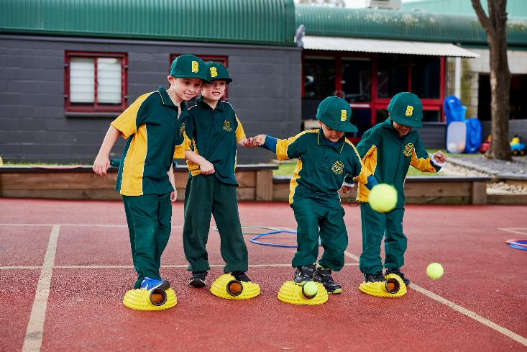
CHPS Units
Early literacy development considerations
In CHPS Early Stage 1 units:
Oral language focus – rich talk experiences
Writing expectations – reduce early writing
Visual supports – use visual aids
Print – keep text simple
Notes:
23. Purpose: To outline early literacy considerations in the development of CHPS sample units.
Time: 1 minute
Presenter notes:
Supporting early literacy development is crucial for setting a strong foundation and has been a key consideration in the development of CHPS sample units for Early Stage 1 students.
Key considerations included:
Oral language focus- prioritising rich oral language experiences through discussions, storytelling and shared conversations
Writing expectations- minimising writing tasks in the first five weeks of term one. Use drawing, dictation, or oral retelling as alternatives to writing
Visual supports- incorporate pictures, real objects and visuals to support comprehension and vocabulary development. Use illustrated books and visual cues to support lessons, and
Print- learning materials presented with minimal text to avoid overwhelming students. Use large, clear fonts and simple sentences when print is necessary.
[NEXT SLIDE]

Slide 24
Human Society and its Environment
Unit 1
Notes:
24. Purpose: To introduce the ES1 HSIE unit 1.
Time: 10 seconds
Presenter notes:
Let’s explore Human Society and its Environment Unit 1.
[NEXT SLIDE]

Slide 25

HSIE – unit 1 overview
Students:
explore the significance of Aboriginal Country and the Traditional Custodians of the land on which their school is located
engage with Dreaming Stories
participate in mapping activities and discussions on cultural practices
develop an understanding of the natural and human features of their environment
learn about the connections Aboriginal and Torres Strait Islander Peoples have with Country and Place.
​Artwork © Kayleb Waters, Gomeroi artist and Cultural mentor 2025.
“This symbol of continuous circles represents our stories, as well as our deeper connection to understanding, Country, and the values that guide how we live our lives.”
Notes:
25. Purpose: To provide an overview of the unit.
Time: 30 seconds
Presenter notes:
In Unit 1, students explore the significance of Aboriginal Country and the Traditional Custodians of the land on which their school is located.
Through engaging with Dreaming Stories, mapping activities and discussions on cultural practices, students develop an understanding of the natural and human features of their environment and the connections Aboriginal and Torres Strait Islander People have with Country and Place.
[NEXT SLIDE]

Slide 26
HSIE – unit 1 syllabus outcomes
Focus area: People are connected to places​
HSE-ACH-01 identifies ways that Aboriginal Peoples connect with Country, Culture and Community​
HSE-GEO-01 identifies and locates places people connect with, using geographical information
Notes:
26. Purpose: To outline the outcomes and content in the unit
Time: 45 seconds
Presenter notes:
Unit 1 covers the focus area 'People are connected to places.
There are 2 outcomes addressed in this unit which are on the screen.
[NEXT SLIDE]

Slide 27
HSIE – unit 1 syllabus content (1)
Content Group: Aboriginal Peoples are the Traditional Custodians of Country
Identify the Traditional Custodians and Aboriginal Country where the school is located using images
Describe natural features of land, water and sky Country by engaging with Aboriginal Dreaming Stories and Languages
Content Group: Aboriginal Peoples are connected to Country
Identify the importance of and differences between a Welcome to Country and an Acknowledgement of Country
Notes:
27. Purpose: To outline the outcomes and content in the unit
Time: 45 seconds
Presenter notes:
There are 3 content groups covered in this unit. Two of these are displayed on the slide:
Aboriginal Peoples are the Traditional Custodians of Country
Aboriginal Peoples are connected to Country
[NEXT SLIDE]

Slide 28
HSIE – unit 1 syllabus content (2)
Content Group: Places can be located and described using geographical information
Locate land, water and Australia using world maps, globes and images
Describe natural and human features of Australian coastal and inland places using Tier 2 and Tier 3 vocabulary
Observe and record natural and human features of familiar places and present in data displays
Recognise that Aboriginal and Torres Strait Islander Peoples connect to the features of Country or Place in a variety of ways
Notes:
28. Purpose: To outline the outcomes and content in the unit
Time: 45 seconds
Presenter notes:
The third content group in the unit is :
Places can be located and described using geographical information
We will now look at the Aboriginal Cultures and Histories content
[NEXT SLIDE]

Slide 29

Aboriginal Cultures and Histories content
All HSIE units, which cover ACH content, are written in consultation with Department of Education Aboriginal Education Advisors.
In adapting and implementing the units, schools are encouraged to:
involve local Aboriginal Communities and/or appropriate Knowledge Holders
use Aboriginal and/or Torres Strait Islander-authored or endorsed publications
read the principles and protocols relating to teaching and learning about Aboriginal and/or Torres Strait Islander histories and Cultures and the involvement of local Aboriginal Communities
Refer to the Australian Institute of Aboriginal and Torres Strait Islander Studies (AIATSIS) Guide to evaluating and selecting education resources when selecting appropriate resources.
Artwork © Kayleb Waters, Gomeroi artist and Cultural mentor 2025.
​
This image represents Community (families, parents, Aunts, Uncles, Elders, schools, teachers, LAECGs, LALCs)
“This symbol is expressed through people sitting together in one place, showing unity, responsibility, love, and respect.”
Notes:
29. Purpose: To explain the requirements for schools in relation to Aboriginal Cultures and Histories content.
Time: 30 seconds
Presenter notes:
All HSIE units, which cover Aboriginal Cultures and Histories content, are written in consultation with Department of Education Aboriginal Education Advisors.
When planning and programming content relating to Aboriginal and/or Torres Strait Islander histories and Cultures, teachers are encouraged to:
involve local Aboriginal Communities and/or appropriate Knowledge Holders in determining suitable resources
use Aboriginal and/or Torres Strait Islander-authored or endorsed publications
read the principles and protocols relating to teaching and learning about Aboriginal and/or Torres Strait Islander histories and Cultures and the involvement of local Aboriginal Communities, and
The Australian Institute of Aboriginal and Torres Strait Islander Studies (AIATSIS) Guide to evaluating and selecting education resources has been developed to assist teachers in selecting appropriate resources for teaching about Aboriginal and Torres Strait Islander histories, Cultures and Languages respectfully and effectively.
[NEXT SLIDE]

Slide 30

HSIE – unit 1 skill development
In this unit, students learn and apply geographical skills by:
locating and describing places using maps, globes and images
describing natural and human features of places using Tier 2 and Tier 3 vocabulary
identifying the Traditional Custodians and Aboriginal Country
identifying ways Aboriginal Peoples connect with Country, Culture and Community.
Notes:
30. Purpose: To outline the skills students learn and apply during the unit.
Time: 1 minute
Presenter notes:
Students are provided with opportunities to learn and apply geographical skills whilst learning about the content.
In Unit 1, students engage in:
locating and describing places using maps, globes and images. The skill of locating is carefully introduced using maps with opportunities to describe features of water, land and Australia.
describing natural and human features of places using Tier 2 and Tier 3 vocabulary. The modelled use of vocabulary to understand natural and human features for coastal and inland places in multiple lessons provides opportunities for repeated use of the Tier 2 and Tier 3 words.
identifying the Traditional Custodians and Aboriginal Country. Through contextualised experiences to their school and local area students have a solid understanding of the land on which they learn.
identifying ways Aboriginal Peoples connect with Country, Culture and Community. Providing learning experiences identifying and describing features of land, water and sky Country is supported through videos, stories and images.
[NEXT SLIDE]

Slide 31

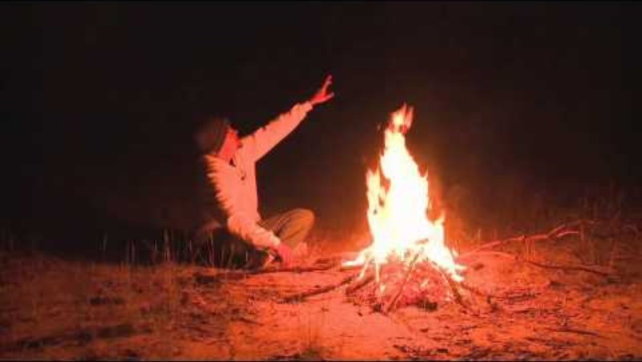
HSIE – unit 1 spotlight (1)
Aboriginal Dreaming Stories
Students engage with Aboriginal Dreaming Stories to learn about land, water and sky Country and connect to knowledge, understanding and skills locating land, water and Australia using maps and images.
Notes:
31. Purpose: To highlight exciting activities included in this sample unit of work.
Time: 2 minutes and 30 seconds (2 minutes video)
Presenter notes:
Embedded throughout this unit is learning that develops students' understandings of Aboriginal Cultures and Histories.
The concepts of land, sky and water Country are explored through engagement with Aboriginal Dreaming Stories. The use of a wide variety of stories and images helps students identify, describe and use Tier 2 and Tier 3 vocabulary.
One of the exciting opportunities for Early Stage 1 students is learning about sky Country and The Emu in the Night Sky Aboriginal Dreaming story.
Exploring the use of the stars to guide and help understand the seasons by Aboriginal and Torres Strait Islander Peoples, is strengthened with the use of a video shared by Ben Flick. In the video the story of the emu in the sky guiding the timing for hunting is shared.
This video is an engaging way for students to hear an Aboriginal Dreaming Story spoken and shared as has been Tradition for thousands of years. Here we will play some of the video for you to enjoy the experience as well.
Play video 2 minutes
[NEXT SLIDE]
The Emu in the Night Sky (Western Local Land Services, 2014)

Slide 32
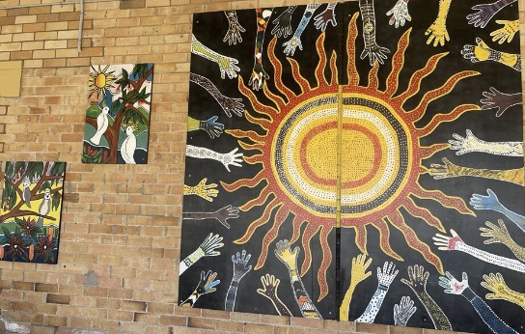
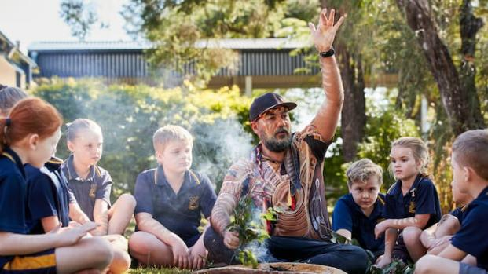

HSIE – unit 1 spotlight (2)
Aboriginal Country
Students learn about the Aboriginal Country their school is located on and explore signs, murals, artwork or gardens within the school ground that Acknowledge Country.
https://education.nsw.gov.au/about-us/strategies-and-reports/our-reconciliation-action-plan/acknowledgement-of-country
Notes:
32. Purpose: To highlight exciting activities included in this sample unit of work.
Time: 30 seconds
Presenter notes:
This unit includes learning experiences that develop students' knowledge and understanding of the Traditional Custodians and Aboriginal Country for their school and local area.
Students will develop an understanding of the importance of a Welcome to Country and an Acknowledgment of Country. Activities strengthen this understanding by exploring the school environment for acknowledgment of Aboriginal Country and development of a class acknowledgement of Country for the Traditional custodians of the land the school is on.
[NEXT SLIDE]

Slide 33


HSIE – unit 1 spotlight (3)
Students as Geographers
Students have opportunities to identify land, water and Australia on maps and globes and in images.
Notes:
33. Purpose: To unpack students as geographers within the unit
Time: 30 seconds
Presenter notes:
An interesting element of this unit is introducing the idea of being a geographer to students. Throughout the unit the tools of geographers such as maps and globes are introduced with their purpose explained and opportunities to practice being geographers with these tools.
The skills geographers use such as identifying, sorting, observing and recording are explicitly introduced and taught. Scaffolded hands-on learning experiences are provided to allow students time to develop these skills in age-appropriate ways.
In multiple lessons, students locate water, land and Australia with the introduction of maps and globes, which is then supported with many images of water and land to support connection to the globe and real world.
[NEXT SLIDE]

Slide 34
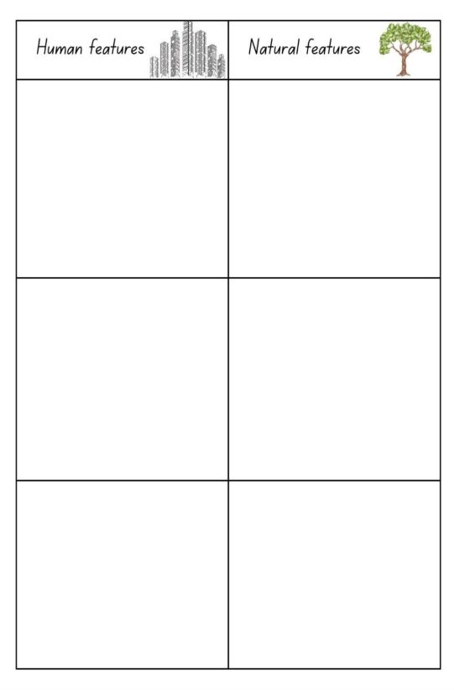




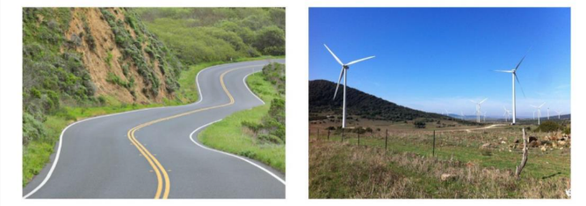
HSIE – unit 1 spotlight (4)
Students as Geographers
Students sort images of human and natural features.
Notes:
34. Purpose: To unpack students as geographers within the unit
Time: 30 seconds
Presenter notes:
Over the series of lessons, exploring natural and human features engages students in sorting images, demonstrated viewing of maps in street view and learning about coastal and inland areas. The use of story books also connects student learning.
This unit supports students to be geographers and introduce the tools and skills of geography, to support future learning in HSIE.
[NEXT SLIDE]

Slide 35

HSIE – unit 1 reflection
What excites you about these units?
What changes did you notice which you will need to make some considerations about or do some preparation for?
What is still circling that you need some further clarification on?
Notes:
35. Purpose: To reflect on the units presented and take notes.
Time: 5 minutes
Presenter notes:
We would like to give you some time now to reflect on what you have seen, make some notes and start to think about what this could look like in your school context.
In your participant workbook you will find the reflection section and a heading for each Key Learning Area.
You will have 5 minutes to add some notes.
We will be referring to this activity again after each Key Learning Area unit walkthrough.
[NEXT SLIDE]

Slide 36
Science and technology – unit 1
Unit 1
Notes:
36. Purpose: To introduce the ES1 Science and Technology unit 1
Time: 10 seconds
Presenter notes:
Unit 1 focuses on one Science content group about living things, with an emphasis on identifying and describing living things through observation.
The unit explores how Aboriginal and Torres Strait Islander Peoples use plants and animals for survival. Students learn how plants provide food, shelter, tools and even medicine.
[NEXT SLIDE]

Slide 37

Science and technology – unit 1 quiz time
Animal tracks
Write down the names of the 6 animals that made these tracks.
Notes:
37. Purpose: To have participants identify animal tracks
Time: 1 minute 30 seconds
Presenter notes:
Here is an activity from the unit to support the content, describing how Aboriginal Peoples apply knowledge of animal characteristics for survival, including using tracks to understand animal behaviour.
You will have one minute to identify the six animals that made the tracks shown on screen. Record your answers on paper.
Answers will be revealed at the end of the science and technology section.
[NEXT SLIDE]
Image Credit: Canva Education. 2025. Images via Canva. https://www.canva.com/ accessed 30 Sept 2025.

Slide 38
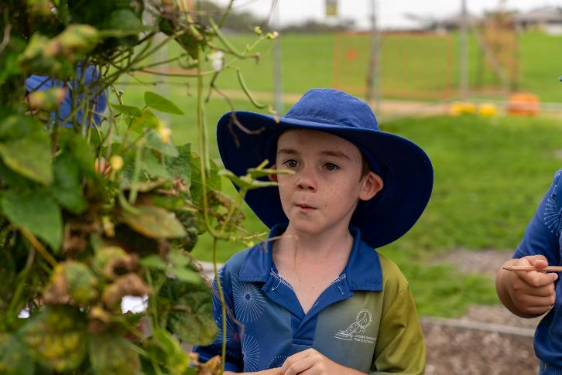
Science and technology – unit 1 overview
This unit explores:
sense organs and how they are used to make observations
tools used to extend observations
the basic needs of living things
local plants and animals
grouping animals based on observable characteristics
Aboriginal and Torres Strait Islander use of plants and animals.
Notes:
38. Purpose: To provide an overview of the unit
Time: 1 minute
Presenter notes:
In the unit students:
[CLICK] identify the five sense organs, their functions and how they are used to make observations
[CLICK] use tools, such as magnifying glasses and cameras, to enhance and extend their sensory observations
[CLICK] investigate how living things survive and compare the characteristics of living and non-living things
[CLICK] explore and document living things in their local environment
[CLICK] describe parts of plants and animals and group animals based on their characteristics, and
[CLICK] learn how Aboriginal and Torres Strait Islander Peoples use plants and animals for food, tools, and survival.
Through observation and description, students pose questions about living and non-living things.
[NEXT SLIDE]

Slide 39
Science and technology – unit 1 syllabus outcomes
Focus area: Observations and questions spark curiosity
STE-SCI-01 identifies and describes characteristics of living things, properties of materials, and movement
STE-PQU-01 poses questions based on observations to collect data
Notes:
39. Purpose: To outline the outcomes and content in the unit.
Time: 1 minute
Presenter notes:
The focus area for Unit 1 is Observations and questions spark curiosity; Technologies is not scoped for this unit.
[CLICK] The science outcome, identifies and describes characteristics of living things, properties of materials, and movement is multifaceted: in this unit, students will learn how to identify and describe the characteristics of living things. Later units provide opportunities to engage with the other parts of the outcome; the properties of materials and movement.
Much of this unit guides students to make observations, pose questions and collect data.
[NEXT SLIDE]

Slide 40
Science and technology – unit 1 syllabus content (1)
Content Group: Living things have characteristics that help them survive in their environment
Identify the sense organs and describe their functions
Identify and use tools to aid and extend sensory observations
Describe how living things get air, water and energy to survive in their environment
Recognise that plants produce their own food, and animals need to find their food
Examine flowers, fruit, leaves, roots and stems of plants and describe their purpose
Examine animal bodies, their body coverings, and how and what they eat
Observe and group animals based on their characteristics and justify the grouping
Describe ways Aboriginal and/or Torres Strait Islander Peoples use Knowledges of the characteristics of plants and animals to survive
Pose questions to compare the characteristics of living things and non-living things
Notes:
40. Purpose: To outline the outcomes and content in the unit.
Time: 1 minute
Presenter notes:
[CLICK] The first content point builds knowledge of sense organs and their function. Initially, students build the vocabulary and skills to observe and then apply this to future content points.
[CLICK] Across Early Stage 1, all content points are addressed only once.
[NEXT SLIDE]

Slide 41
Science and technology – unit 1 syllabus content (2)
Content Group: Living things have characteristics that help them survive in their environment
Identify the sense organs and describe their functions
Identify and use tools to aid and extend sensory observations
Describe how living things get air, water and energy to survive in their environment
Recognise that plants produce their own food, and animals need to find their food
Examine flowers, fruit, leaves, roots and stems of plants and describe their purpose
Examine animal bodies, their body coverings, and how and what they eat
Observe and group animals based on their characteristics and justify the grouping
Describe ways Aboriginal and/or Torres Strait Islander Peoples use Knowledges of the characteristics of plants and animals to survive
Pose questions to compare the characteristics of living things and non-living things
Notes:
41. Purpose: To outline the outcomes and content in the unit.
Time: 1 minute
Presenter notes:
I want to draw your attention to the last content point that starts [CLICK] ‘pose questions’. Please remember that throughout the unit, students will be observing, posing questions and collecting data. The skills within the Posing Questions outcome are developed through the content.
Data is also collected by students as they undertake a senses-scavenger hunt, observe plants and animals and group them. So, the posing questions outcome is more than just the final content point.
[NEXT SLIDE]

Slide 42
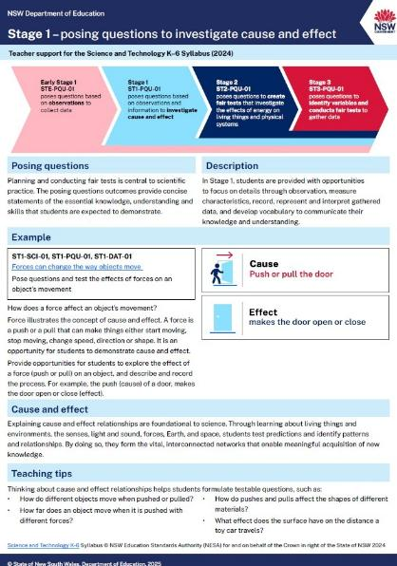
Posing Questions (PQU)
Support document
ST1-PQU-01
poses questions to investigate cause and effect
Notes:
42. Purpose: To explain teacher support for posing questions outcomes.
Time: 1 minute 30 seconds
Presenter notes:
The Posing Questions outcome is new to the Science and Technology syllabus and appears in each stage.
For Early Stage 1 the outcome is: poses questions based on observations to collect data.
When Early Stage 1 students develop their questioning and observation skills, we form a foundation to explore cause and effect in Stage 1. Making observations and Posing questions provides opportunities to collect data, which leads to further questioning. The ability to pose scientific questions builds towards the introduction of Working Scientifically outcomes in Stage 4.
To supplement the syllabus teaching advice, the department has created an information document for posing questions. This will be published on the department’s website.
The advice provides background information, examples and teaching tips relevant for each stage of learning.
For Early Stage 1, students pose questions based on their observations to collect data.
[NEXT SLIDE]

Slide 43
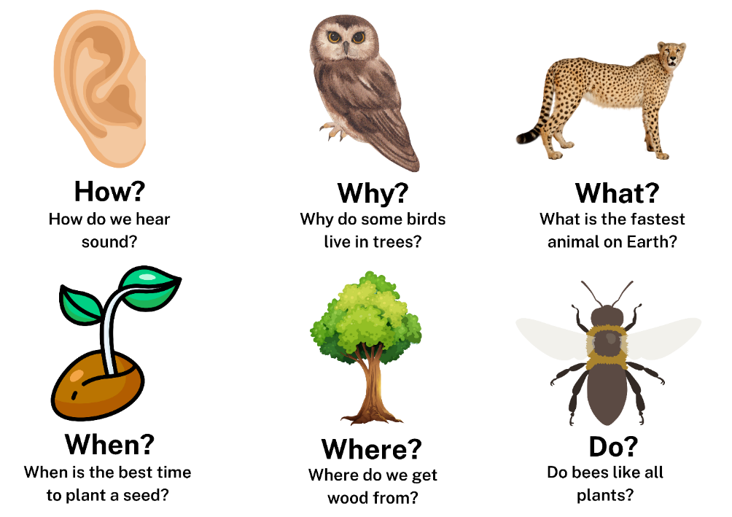
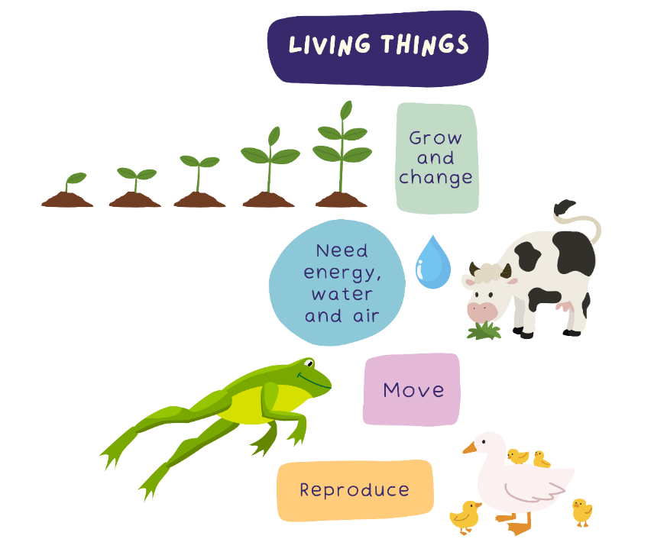
Science and technology – unit 1 spotlight (1)
Learning to pose questions about living and non-living things
Notes:
43. Purpose: To highlight exciting activities included in this sample unit of work.
Time: 30 seconds
Presenter notes:
Throughout the unit, students are scaffolded to develop their ability to pose questions. They are first introduced to the types of questions scientists ask, then taught the characteristics of living things and finally guided to pose questions that compare the characteristics of living and non-living things.
Some examples of this are on the screen.
[NEXT SLIDE]
Image Credit: Canva Education. 2025. Images via Canva. https://www.canva.com/ accessed 30 Sept 2025.

Slide 44


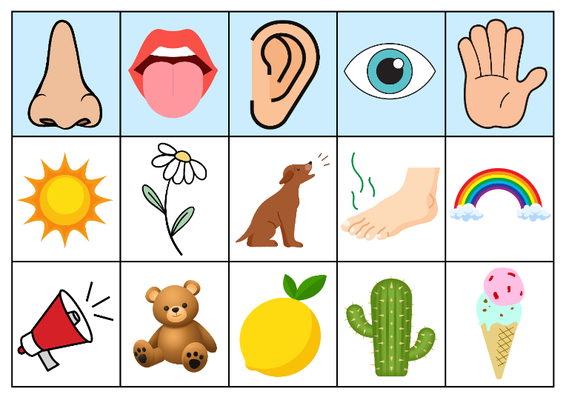
Science and technology – unit 1 misconceptions
Scientific observations are more than only what we see
Scientific observations are made using all five senses.
Students will:
identify the sense organs
describe their functions
use their sense organs to explore and observe.
Notes:
44. Purpose: To identify misconceptions
Time: 30 seconds
Presenter notes:
A common misconception is that observations are only things that can be seen. In fact, observations can be made using all five senses.
In this unit students will learn about all their senses and are provided experiences to observe the world using a range of senses beyond sight. Students will observe with their sense of smell, hearing and touch. We have avoided activities that include taste – generally, it is not advisable to include taste with science investigations.
Using new vocabulary, such as bright, smooth, rough, crunchy and loud, students will add precision to their descriptions of observations.
[NEXT SLIDE]
Image Credit: Canva Education. 2025. Images via Canva. https://www.canva.com/ accessed 30 Sept 2025.

Slide 45
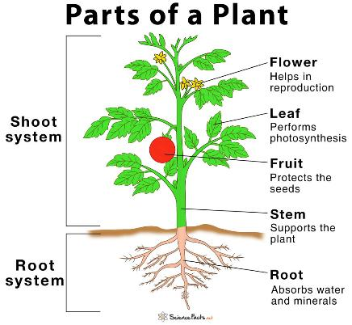
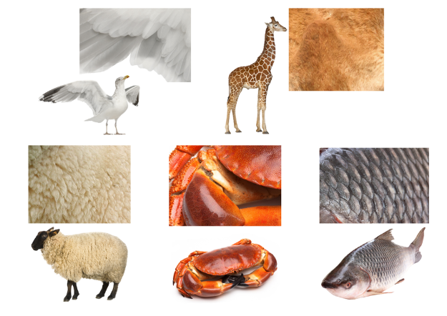
Science and technology – unit 1 spotlight (2)
      Tools that aid and extend sensory observations
      Sensory scavenger hunt
Playground observations
Growing plants
Examining animal body coverings and how and what they eat
Environmental and Zoo Education centres
Notes:
45. Purpose: To highlight exciting activities included in this sample unit of work.
Time: 30 seconds
Presenter notes:
An engaging feature of this unit is the use of tools to enhance students’ senses. Magnifying glasses, binoculars and cameras support detailed observation, while discussions about glasses and hearing aids highlight how technology assists our senses when needed.
Observation skills are reinforced through a scavenger hunt, where students search for objects linked to each sense. For example, they might photograph a flower to represent smell or collect bark to represent touch. Describing their chosen objects helps students connect them to the appropriate sense organ.
Students also grow seeds to observe plant parts and their functions and spend time studying animals—their body coverings, diets and behaviours. They then apply this knowledge by grouping animals according to their characteristics and justifying their groupings.
A strong focus of the unit is connecting students with their environment. Excursions to local environmental or zoo education centres provide valuable opportunities to deepen this connection through hands-on experiences with living things.
[NEXT SLIDE]
Image Credit: Canva Education. 2025. Images via Canva. https://www.canva.com/ accessed 30 Sept 2025.

Slide 46
Science and technology – unit 1 quiz time question
Animal tracks
Write down the names of the 6 animals that made these tracks.
Notes:
46. Purpose: To reveal answers to quiz
Time: 10 seconds
Presenter notes:
Now, how did you go with your animal track guesses?
[NEXT SLIDE]
Image Credit: Canva Education. 2025. Images via Canva. https://www.canva.com/ accessed 30 Sept 2025.

Slide 47
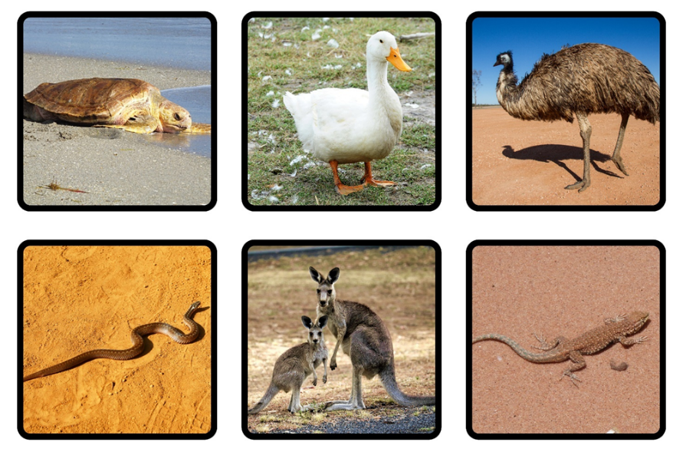
Science and technology – unit 1 quiz time answer
Animal tracks
Write down the names of the 6 animals that made these tracks.
Notes:
47. Purpose: To reveal answers to quiz - (duplicate slide instead of a transition)
Time: 20 seconds
Presenter notes:
Please see the answers revealed on the slide.
[NEXT SLIDE]
Image Credit: Canva Education. 2025. Images via Canva. https://www.canva.com/ accessed 30 Sept 2025.

Slide 48
Science and technology – unit 1 reflection
What excites you about these units?
What changes did you notice which you will need to make some considerations about or do some preparation for?
What is still circling that you need some further clarification on?
Notes:
48. Purpose: To reflect on the units presented and take notes.
Time: 5 minutes
Presenter notes:
We would like to give you some time to reflect on what you have seen and heard, make some notes and start to think about what this unit could look like in your school context.
Please return to your participant workbook reflection section.
You will have 5 minutes to add some notes.
Let’s continue exploring the sample units.
[NEXT SLIDE]

Slide 49
Creative arts
Unit 1
Notes:
49. Purpose: Divider slide to introduce Creative arts units
Time: 20 seconds
Presenter notes:
Each Creative arts sample unit provides students with opportunities to engage in syllabus content in meaningful and connected ways. Students are supported to meet the aim of the syllabus by developing curiosity, creativity, imagination, self-expression and collaboration as they develop knowledge, understanding and skills in dance, drama, music and visual arts.
[NEXT SLIDE]

Slide 50
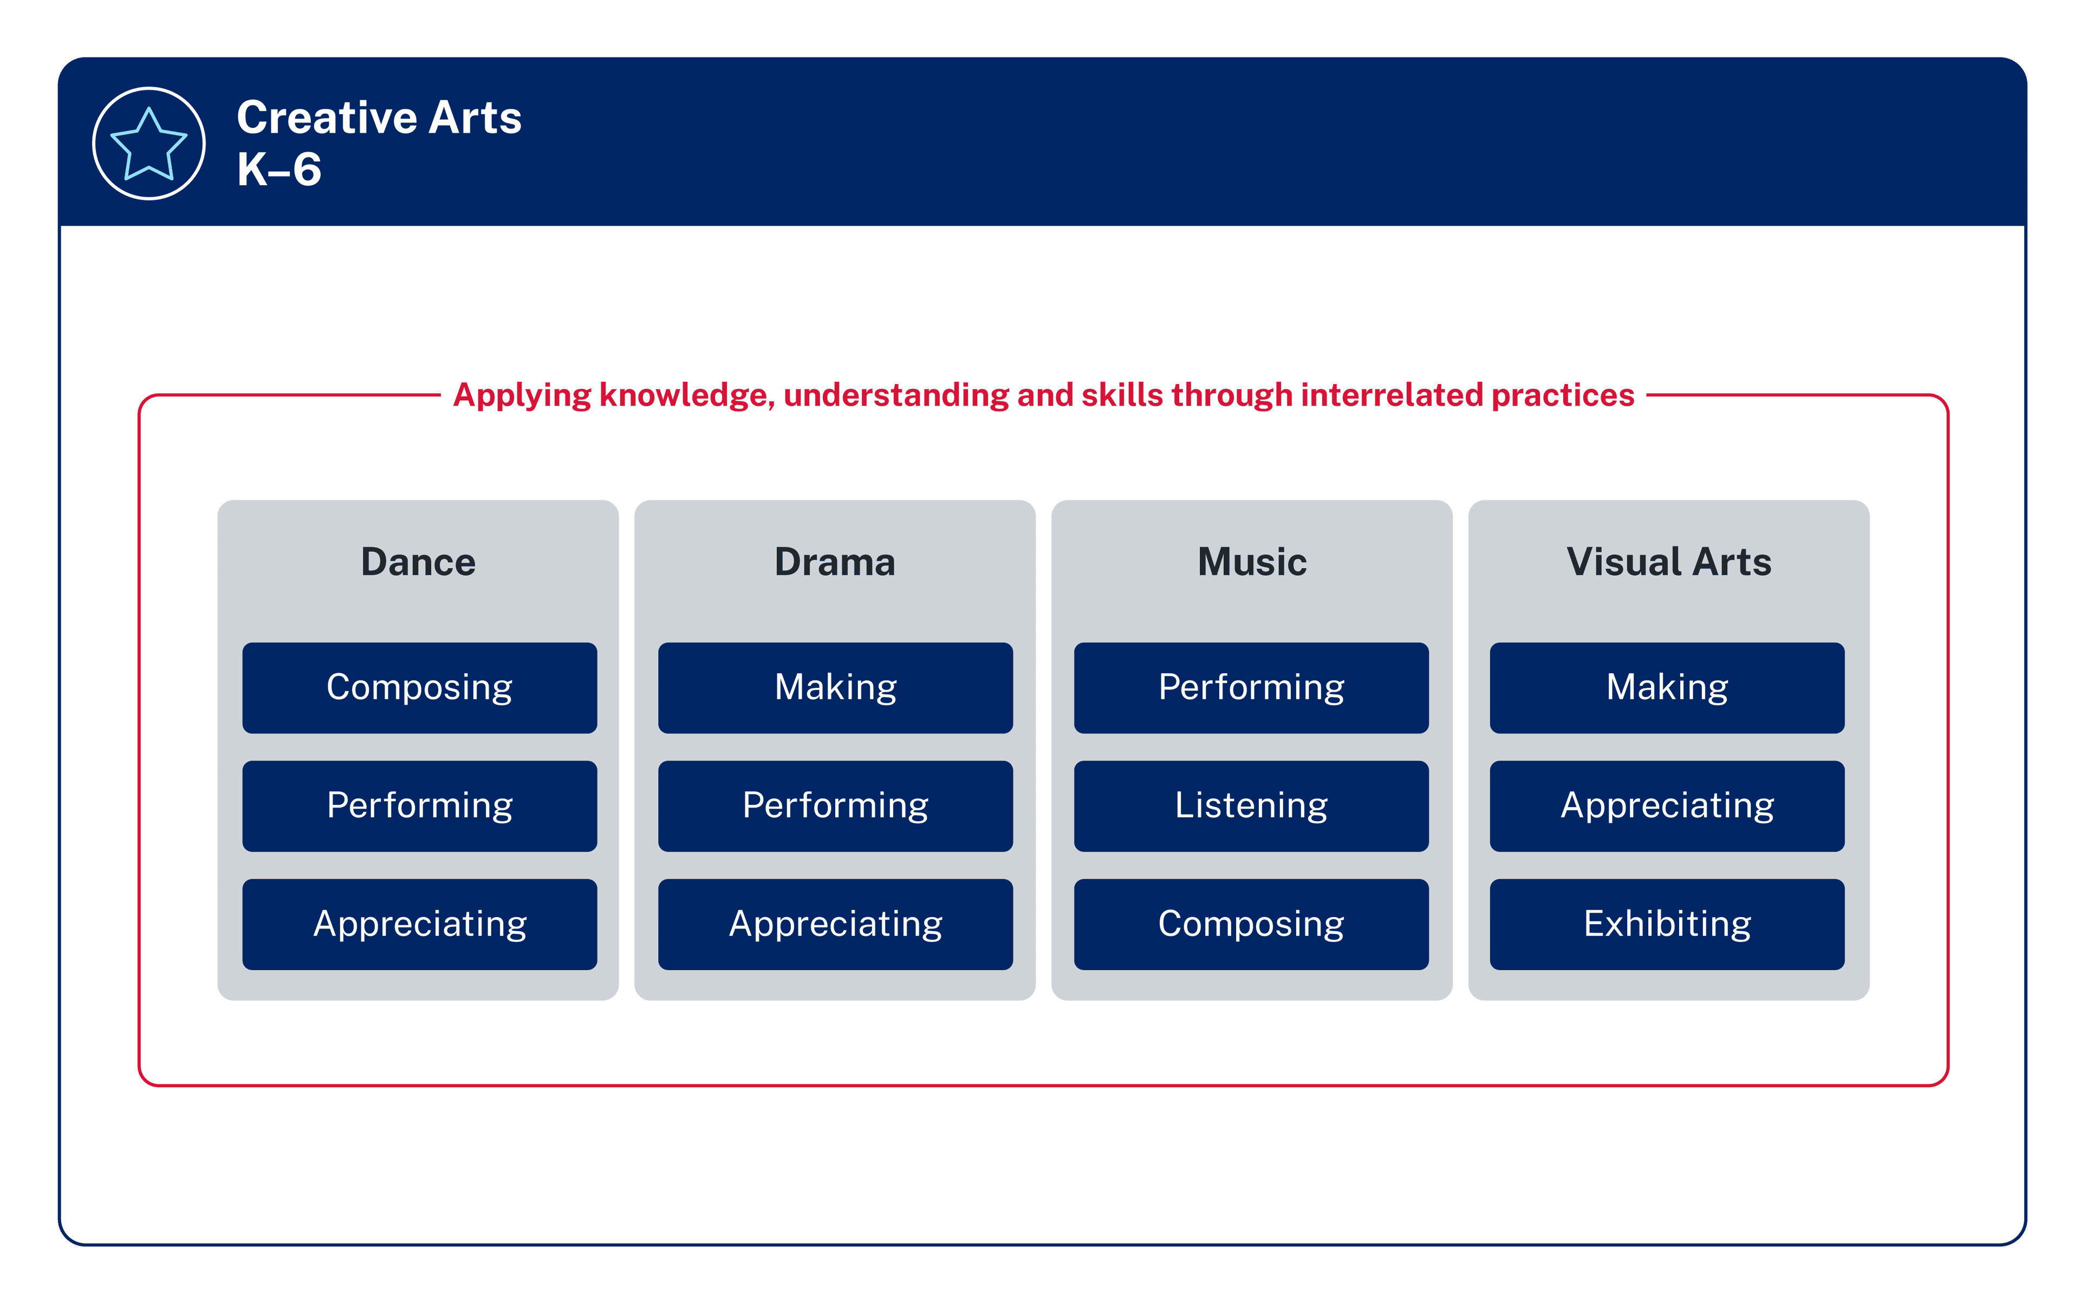
Syllabus content
Summary
2 focus areas each semester
Interrelated practices
Semester 1
Semester 2
Applying knowledge, understanding and skills through interrelated practices
Dance and Music
Drama and Visual arts
Notes:
50. Purpose: To highlight the structure of Creative arts learning across a stage
Time: 1 minute 20 seconds
Presenter notes: ​
Each semester, students will learn about 2 focus areas.
[CLICK] In Semester 1, the sample scope and sequence identifies Dance and Music, while in Semester 2, attention shifts to Drama and Visual Arts. Focus areas are repeated across 2 terms to support students in making connections and building schema by activating prior learning. This approach provides students with greater opportunities to consolidate learning and supports assessment and reporting practices on 2 focus areas each semester.
[CLICK] Across these areas, students apply knowledge, understanding and skills. The content groups in creative arts are not isolated or linear and should not be taught in a sequential way. What is learnt in one content group connects to the others and supports students to understand, interpret, critique and apply their learning in meaningful ways.
In Dance, the interrelated practices are composing, performing and appreciating. Students are not just learning dance steps — they are creating, expressing, analysing, interpreting, appreciating, reflecting and applying their learning.
In Music, the interrelated practices are performing, listening and composing. Students experience music as performers and as creators, while also developing their ability to reflect and respond through listening to a range of music from cultures all around the world.
This structure allows students to experience the creative arts holistically. It provides multiple entry points for expression, while building students' confidence and deepening their understanding across all four focus areas.
[NEXT SLIDE]

Slide 51
Key Features
Sample Creative arts units
Equal time allocation
Connections across dance and music
Context
Resources
Notes:
51. Purpose: To identify key features of Creative arts Units
Time: 2 minutes
Presenter notes:
Let’s take a closer look at some of the key features of the creative arts sample units.
[CLICK] Firstly, equal time allocation. Each unit contains 10 dance lessons and 10 music lessons. Of these, 4 lessons are optional consolidation lessons, allowing for interruptions to regular timetables and supporting teachers to extend learning where needed.
[CLICK] Second, the units make clear connections across focus areas. Students aren’t learning in silos, in Semester 1 they’re seeing how movement and sound work together to communicate meaning. The dance and music components connect, but do not rely on each other. If a school chooses to teach only the music component or only the dance component, the lessons still maintain a consistent flow and meet the syllabus requirements and intent.
[CLICK] Third, the units are designed with context in mind. Whether they’re delivered by a classroom teacher, timetabled as RFF, or taught by a specialist teacher, the design allows schools to adapt while still staying true to the syllabus.
[CLICK] And finally, resources. Each unit contains direct links to songs and videos that will support learning, with opportunities for teachers to adapt and select alternatives if preferred. Lesson templates, visuals and posters are provided. The units are intentionally designed to support all school contexts: if percussion instruments aren't available, an alternative is provided so students can use body percussion, digital applications or their voice to achieve the same learning.
[NEXT SLIDE]

Slide 52
Creative arts – unit 1 syllabus outcomes
Focus areas: Dance and Music
CAE-DAN-01 experiments with and identifies ways shapes and movements are used in dance
CAE-MUS-01 experiments with and identifies ways sound is organised in music through singing, moving, playing instruments and using listening skills
Notes:
52. Purpose: To outline the outcomes in the unit.
Time: 30 seconds
Presenter notes:
The outcomes for Unit 1 are:
experiments with and identifies ways shapes and movements are used in dance
experiments with and identifies ways sound is organised in music through singing, moving, playing instruments and using listening skills.
[NEXT SLIDE]

Slide 53
Creative arts – unit 1 syllabus content
Dance
Composing and performing: Dance is made and performed using shapes and movements
Appreciating: Dance can be experienced and described
Music
Performing and composing: Music is performed and made by organising sound through singing, moving and playing
Listening: Music can be listened to, experienced and described
Notes:
53. Purpose: To outline content in the featured unit.
Time: 30 seconds
Presenter notes:
On screen you can see how content is organised through the interrelated practices.
[NEXT SLIDE]

Slide 54

Creative arts – unit 1 overview
Students develop creativity and experience the joy of movement and sound through dance and music.
Dance focus: Understand how the body can move to express as they explore movement, personal space, shapes and safe dance practices.
Music focus: Explore how sound can be organised and performed to communicate meaning as they explore beat, rhythm, pitch and dynamics through listening, body percussion, singing and playing instruments.
Notes:
54. Purpose: To provide a broad overview of the unit
Time: 30 seconds
Presenter notes:
Unit 1 explores how dance and music help students develop creativity, self-expression and joy through movement and sound. The unit introduces students to the foundational elements of both art forms.
In dance, students begin to understand how the body can move to express ideas as they explore movement, personal space, shapes and safe dance practices. They observe and learn dances from different cultures, including the Hawaiian Hula and Irish folk dancing.
In music, students explore how sound can be organised and performed to communicate meaning as they explore beat, rhythm, pitch and dynamics through listening, body percussion, singing and playing instruments. They compose and perform music to express ideas and connect to different cultures, as they experience folk songs from France, Morocco and Jamaica.
The strength of the unit lies in its integration of practical, hands-on activities with cultural connections. Students are learning skills, while also experiencing how dance and music are used across different places and traditions to share stories and connect communities.
[NEXT SLIDE]

Slide 55


Creative arts - Unit 1 spotlight (1)
Dance
Notes:
55. Purpose: To unpack the ES1 Unit 1 spotlight on dance.
Time: 30 seconds
Presenter notes:
The unit invites students to explore dance through playful, creative and culturally rich experiences.
Students begin by learning safe dance practices, exploring personal space through their ‘dance bubbles’ and freeze games. They create and connect body shapes using both locomotor and non-locomotor movements and learn to move in time with a steady beat. As the unit progresses, students experience cultural dances such as the Hawaiian Hula, where they tell stories through gentle swaying and curved shapes and the Irish Stew Dance, which is energetic and collaborative.
The unit concludes with students composing and performing their own short movement sequences, celebrating dance as a way of sharing ideas and feelings.
[NEXT SLIDE]

Slide 56

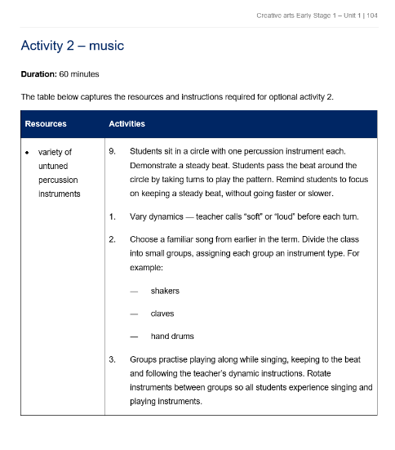

Creative arts - Unit spotlight (2)
Music
Notes:
56. Purpose: To unpack the ES1 Unit 1 spotlight on music
Time: 30 seconds
Presenter notes:
In music, students learn to keep a steady beat and echo rhythm patterns using body percussion, clapping games and movement activities. Students will explore tempo, pitch and dynamics through movement and sound. Cultural connections are emphasised through songs including Frère Jacques from France, A Ram Sam Sam from Morocco and Shake the Papaya Down from Jamaica. Students improvise rhythms, layer sounds and consider how different sounds and patterns are used in music.
One of the exciting features of this unit is its mix of authentic cultural contexts and engaging, hands-on learning experiences. In each lesson, students move, sing, dance and make music with their bodies or instruments, fostering creativity and supporting them to express themselves through movement and sound. Teachers are supported with quality resources such as movement cards, visual prompts and observation checklists.
Designed to be practical and engaging, the unit ensures the joy of music and dance shines through in every classroom.
[NEXT SLIDE]

Slide 57
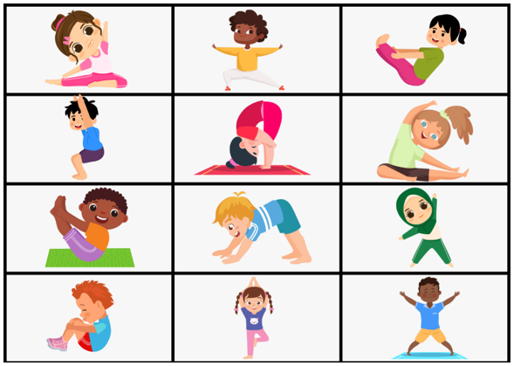

Creative arts – unit 1 lesson spotlight
Lesson 3 – dance: exploring dance shapes and non-locomotor movements
Images sourced from Canva and used in accordance with the Canva Content License Agreement.
Notes:
57. Purpose: To highlight features of a dance lesson
Time: 30 seconds
Presenter notes:
In Lesson 3 (the second dance lesson), the focus is on students exploring how to make and describe body shapes using non-locomotor movements while moving safely in their personal dance space.
Students continue to develop the idea of a ‘dance bubble’ — the space around their bodies that helps them move safely without bumping into others. They practise moving within this bubble through playful activities and songs. Students practise isolating and moving different body parts in a variety of ways, play a game of 'shape party' and do a shape stretch to cool down and relax their bodies.
Students reflect on their movements to consider what shapes they made, how it felt to move different body parts, what was challenging and how they stayed safe while moving.
This lesson continues to lay the foundation for dance in Early Stage 1: moving safely, respecting space and having fun with movement. It builds confidence and sets students up for later experiences where they learn cultural dances and create their own movement sequences.
[NEXT SLIDE]

Slide 58
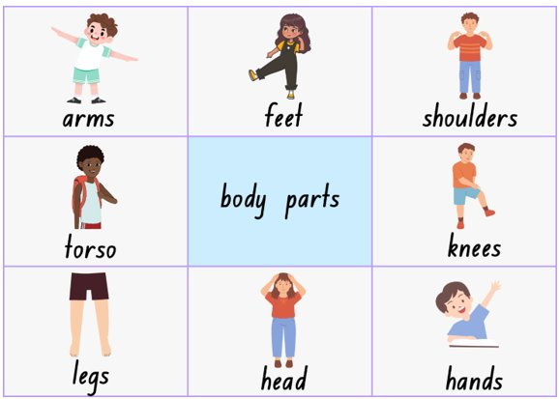
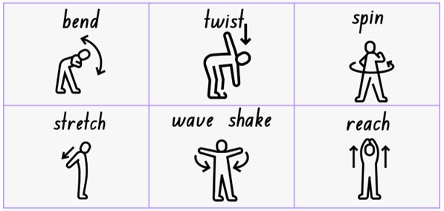
Creative arts – unit 1 – body part and action cards
Notes:
58. Purpose: To experience 1 activity from the ES1 unit
Time: 2 minutes
Presenter notes:
To give you a taste of what students experience in this unit, we’ll try a quick activity.
First, imagine your own ‘dance bubble’ — the safe space around your body where you can move without bumping into others.
I will select one body part and one action from the visual cues on screen. These cards are included as a resource in the unit so they can be displayed digitally, printed and enlarged or cut up for use however you choose. As I call out the body part and action, you need to safely move that body part with the chosen action. Let's give it a go.
Arms – reach
Shoulders – stretch
Hands – wave shake
This is how students develop their understanding of safe dance practices and non-locomotor movements in a fun and engaging way. It helps them explore shapes, develop body awareness and practise moving safely in shared spaces.
[NEXT SLIDE]

Slide 59
Creative arts – unit 1 reflection
What excites you about these units?
What changes did you notice which you will need to make some considerations about or do some preparation for?
What is still circling that you need some further clarification on?
Notes:
59. Purpose: To reflect on the units presented and take notes.
Time: 5 minutes
Presenter notes:
We will now take some time to reflect on what you have seen and heard, make some notes and start to think about what this unit could look like in your school context.
Please return to your participant workbook reflection section.
You will have 5 minutes to add some notes to the creative arts activity page.
After 5 minutes
Let’s explore the final term one sample unit.
[NEXT SLIDE]

Slide 60
Personal Development, Health and Physical Education – unit 1
Unit 1
Notes:
60. Purpose: To introduce the PDHPE Early Stage 1 Unit that will be published for use next year.
Time: 10 seconds
Presenter notes:
We will now shift our focus to the key learning area of Personal development, health and physical education. The following slides will unpack Unit 1.
[NEXT SLIDE]

Slide 61
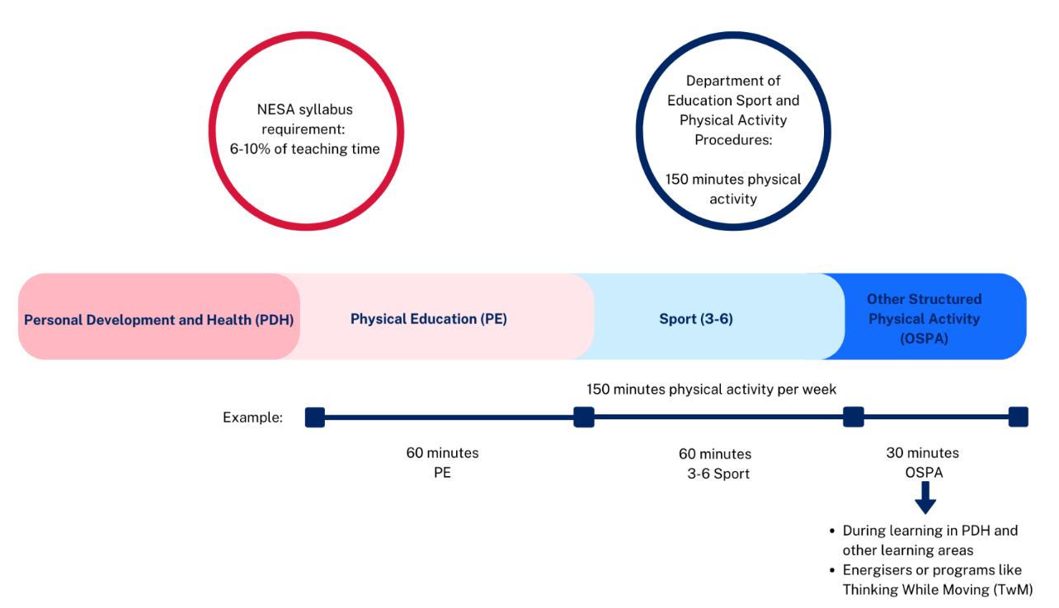
PDHPE – unit 1 time allocation (2)
PDH/PE lesson structure: balanced approach with equal focus in line with NESA guidelines
8 PDH lessons and 8 PE lessons designed for weekly implementation (1 each per week)
PE supports the recommended 150 minutes of physical activity per week
Notes:
61. Purpose: To demonstrate the balanced approach of lessons and how the 150 minutes of moderate to vigorous physical activity can be achieved across the school week.
Time: 2 minutes
Presenter notes:
PDH and PE lessons are structured to ensure an equal emphasis on both subject areas, following the recommendation of 8% (approximately 2 hours) provided by NESA.
The units are written based on a 10-week term approach. The design includes 8 PDH lessons and 8 PE lessons, which allows one PDH lesson and one PE lesson each week, maintaining a balanced and consistent approach throughout the term. The 4 remaining optional consolidation lessons are used to revise key concepts or skills.
Time allocation is applied in the same way across all sample units.
Importantly, the PE lessons contribute directly to meeting the recommended 150 minutes of physical activity per week, supporting students’ health and wellbeing goals.
This graphic demonstrates how schools can meet the recommended requirements of the department’s Sport and Physical Activity procedures. Note the red circle, this represents NESA (therefore the syllabus), and the blue circle represents the department's Sport and Physical Activity Procedures. Let's now identify what contributes to the 150 minutes of physical activity per week.
PE is part of the mandatory PDHPE key learning area. Physical activity performed in PE lessons contributes towards meeting the 150 minutes. PDH lessons do not contribute to the 150 minutes unless they include physical activity.
School sport is a mandatory part of whole school planning which offers students weekly planned opportunities to participate in physical activities which also contributes to the 150 minutes. Schools are able to design their own programs for weekly school sport. Schools must provide a minimum 60 minutes of sport per week for years 3-6. There is no set amount of time allocated to weekly sport for students in Years K– 2, although some schools choose to run a weekly sport session across classes or stages.
Other structured physical activity may include:
Classroom Energisers - these are fun and moderate to vigorous activities designed to break up long periods of sitting and stimulate learning. For example, a class takes part in a 10-minute energiser activity every day making a total of 50 minutes of physical activity for the week. The frequency and duration of classroom energisers should be represented in class timetables.
This information is available in the FAQs of the PDHPE channel in the Primary curriculum Statewide staffroom.
[NEXT SLIDE]

Slide 62

PDHPE – unit 1 overview
In Personal Development and Health (PDH), students:
develop essential safety skills
learn how to improve health through hygiene practices
strengthen self-management and interpersonal skills.
In Physical Education (PE), students:
develop and refine fundamental movement skills such as balancing, running, sprinting, and catching
participate in games that build spatial awareness
engage in activities that encourage fairness
promote safe use of equipment.
Notes:
62. Purpose: To introduce early stage 1 unit 1 sample unit with the unit overview.
Time: 1 minute 30 seconds
Presenter notes:
In Unit 1, students build knowledge, skills, and understanding to support both their personal development and physical education.
The personal development and health component introduces students to personal strengths, respectful relationships and essential safety skills. They also engage with Aboriginal and Torres Strait Islander stories that share lessons about identity, wellbeing and community.
Students practise ways to improve their health through hygiene routines and build self-management and interpersonal skills. They learn how to recognise and manage emotions, make decisions, ask for help and respond respectfully in different situations. These are the foundations for positive relationships and effective communication.
In physical education, students develop fundamental movement skills including balancing, running, sprinting, and catching. They apply these in structured games that build spatial awareness, encourage fairness and promote the safe use of equipment.
As we explore this unit, think about the different ways you could tailor the learning experiences to your class context. The activities are designed to be flexible, so you can adapt them to your students’ strengths and needs, while keeping the outcomes and key intentions at the centre of your teaching.
[NEXT SLIDE]

Slide 63
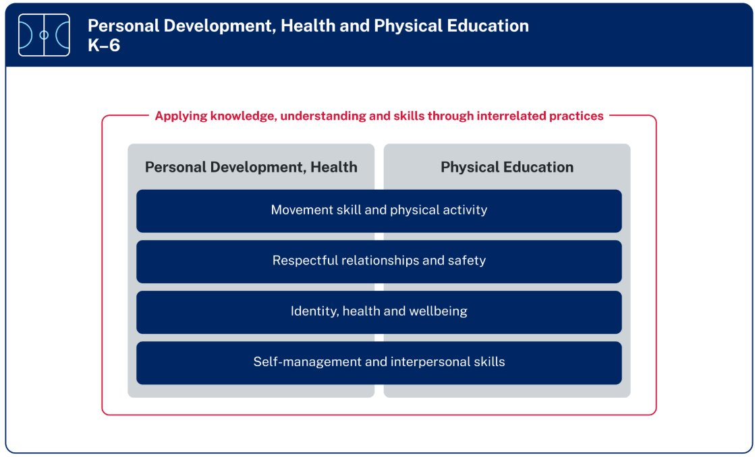
Organisation of PDHPE K–6 Syllabus
Notes:
63. Purpose: Show the four focus areas of PDHPE.
Time: 30 seconds
Presenter notes:
This figure shows the organisation of PDHPE K-6 Syllabus under 4 focus areas:
Movement skill and physical activity
Respectful relationships and safety
Identity, health and wellbeing, and
Self-management and interpersonal skills
Each of the focus areas are represented in the sample units.
[NEXT SLIDE]

Slide 64
PDHPE – unit 1 syllabus outcomes
PHE-MSP-01 demonstrates fundamental movement skills and participates with others in physical activities
PHE-RRS-01 identifies how respectful relationships and safety contribute to wellbeing
PHE-IHW-01 identifies factors that contribute to identity, health and wellbeing
PHE-SMI-01 identifies and demonstrates self-management and interpersonal skills
Notes:
64. Purpose: To outline the outcomes and content in the unit.
Time: 10 seconds
Presenter notes:
These are the syllabus outcomes covered in unit 1.
[NEXT SLIDE]

Slide 65
PDHPE – unit 1 syllabus content (1)
Focus areas and content groups
Movement skill and physical activity:
Participate with others during physical activities
Fundamental movement skills are important for health and wellbeing
Respectful relationships and safety:
Respectful relationships support health and wellbeing
Personal actions support safety
Notes:
65. Purpose: To outline the outcomes and content in the unit.
Time: 1 minute
Presenter notes:
The four focus areas are all covered in Unit 1.
In the focus area Movement skill and physical activity, students are learning to participate with others in physical activities and develop confidence in their movement. They explore and practise fundamental movement skills such as balancing, running, sprinting, and catching. Through games and structured play, students learn how these skills support their health, wellbeing, and enjoyment of being active.
In Respectful relationships and safety, students are learning how respectful relationships and safe behaviours contribute directly to their health and wellbeing. Students explore stories shared by Aboriginal and Torres Strait Islander families and Elders, that teach children how to stay safe on Country and Place. They also learn practical road safety behaviours and reflect on why these actions are important in their daily lives.
[NEXT SLIDE]

Slide 66
PDHPE – unit 1 syllabus content (2)
Identity health and wellbeing:
Caring for the body improves health and wellbeing
Self-management and interpersonal skills:
Self-management skills support actions
Interpersonal skills support positive interactions.
Notes:
66. Purpose: To outline the outcomes and content in the unit.
Time: 30 seconds
Presenter notes:
In the focus area Identity health and wellbeing students are learning to identify factors that contribute to their health and wellbeing. Students identify and practise everyday hygiene strategies that help keep them healthy and safe. This includes routines such as washing hands, brushing teeth, and covering coughs and sneezes. By exploring these simple but important practices, students begin to understand how their daily actions contribute to overall wellbeing. It also sets up lifelong habits that support both their physical health and their sense of responsibility for looking after themselves and others.
In Self-management and interpersonal skills, students are learning how to manage themselves and interact positively with others in a variety of situations. They practise using help-seeking and decision-making skills to ask for support when needed and they co-create goals that support their learning and development. Together, these skills help students develop confidence, resilience, and positive ways of connecting with others.
[NEXT SLIDE]

Slide 67

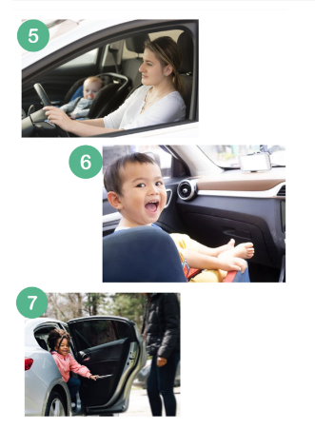

PDHPE – unit 1 skill development (1)
Hygiene practices – brushing, handwashing, coughing/sneezing
Help-seeking and decision-making
Identifying and managing emotions
Respectful communication and friendships
Road safety – pedestrian, passenger, wheels
Understanding Aboriginal & Torres Strait Islander safety stories.
Notes:
67. Purpose: To outline skill development in PDH.
Time: 1 minute
Presenter notes:
This slide highlights the personal development and health skills that students will build throughout the unit.
Students learn and practise everyday hygiene routines such as brushing teeth, washing hands and covering coughs and sneezes. These simple habits are directly linked to overall health and wellbeing.
They also begin developing help-seeking and decision-making skills, learning how and when to ask for assistance and how to make safe and respectful choices. Alongside this, students practise identifying and managing emotions, which supports self-awareness and resilience.
Another focus is on respectful communication and friendships. Students explore how to express themselves clearly, listen to others and interact in ways that build positive relationships.
Safety is embedded through road safety education—covering pedestrian, passenger and wheels safety—as well as Aboriginal and Torres Strait Islander stories that share cultural perspectives on keeping safe.
Together, these skills give students strong foundations for both health and wellbeing in their everyday lives.
[NEXT SLIDE]
Image Credit: Canva Education. 2025. Images via Canva. https://www.canva.com

Slide 68
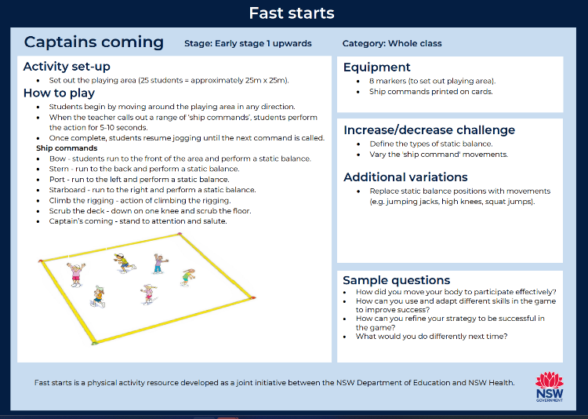
PDHPE – unit 1 skill development (2)
Fast starts
Balance – static balance, partner balances, obstacle courses
Locomotor skills – running, sprinting, spatial awareness
Object control – catching with varied objects and distances
Playing fairly, following rules, safe equipment use
Goal setting for improvement
Enjoyment and motivation in physical activity
Adapted from: Paying for life, Australian Sports Commission
Notes:
68. Purpose: To outline skill development in PE.
Time: 1 minute
Presenter notes:
These are the physical education skills students will develop across the unit.
Students begin with balance activities, such as static balances, partner work and obstacle courses. These activities help build stability and coordination.
They also work on locomotor skills like running and sprinting, with an emphasis on spatial awareness so they can move safely and confidently in shared spaces.
In addition, students practise object control skills, particularly catching, using varied objects and distances to build precision and confidence.
Equally important is the focus on fair play and safe participation. Students learn how to follow rules, share equipment responsibly and encourage each other during activities.
The unit also introduces goal setting as a way for students to reflect on their progress and identify areas for improvement.
Finally, students experience the enjoyment and motivation that comes from being active and working together.
[NEXT SLIDE]

Slide 69



PDHPE – unit 1 spotlight (1)
Lesson 8 – staying safe on Country and/or place
Focus: Students listen to and discuss Aboriginal and/or
Torres Strait Islander stories that share messages about
staying safe on Country and Place.
Learning:
recognise that stories hold important safety messages
connect cultural knowledge and respect for land, animals and people
understand that listening to Elders and stories helps keep communities safe.
Lofts, P. (1999). How the kangaroos got their tails.
Lucas, D. (1997). How the birds got their colours.
Roughsey, D. (1973). The rainbow serpent.
Notes:
69. Purpose: To summarise lesson 8
Time: 1 minute
Presenter notes:
Lesson 8 focuses on learning about safety through Aboriginal and Torres Strait Islander stories. Students explore how stories carry important messages about keeping ourselves, others and Country safe.
We begin by acknowledging Country and talking about how Aboriginal and Torres Strait Islander peoples have shared knowledge through storytelling for generations.
Students listen to stories such as Tiddalick the Frog, which reminds us that water is precious, or The Emu and the Jabiru, which shows how listening and working together keeps us safe. Other stories emphasise themes such as respecting rules and authority (The Story of Tagai), being careful in nature (The Clever Crow), or preparing for natural events like storms (Big Rain Coming).
After hearing these stories, students discuss the key messages and connect them to their own lives. For example, just as Miyanpunu and the Sea Turtles teaches caution around the sea, we talk about how to stay safe near water today.
Differentiation is built in – some students use visuals and sentence starters to express the safety message, while others compare story messages with what they’ve learned at home or in their community.
Assessment focuses on if students can identify the story’s safety message and explain how it helps people stay safe. Students demonstrate their understanding by creating a drawing that shows the message, then share it with the class.
The key takeaway is that stories don’t just entertain – they teach us lessons about respect, safety and caring for ourselves, our community and the land.
[NEXT SLIDE]

Slide 70
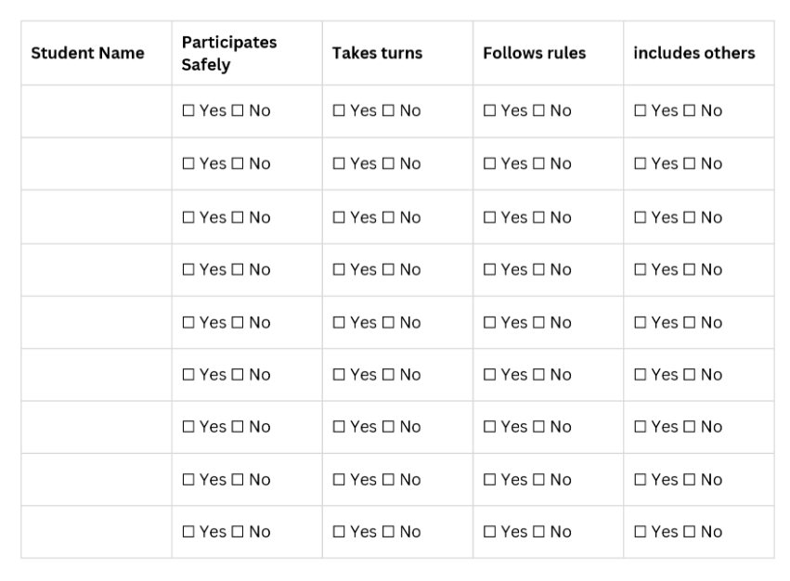
PDHPE – unit 1 spotlight (2)
Lesson 9 – fair play, rules and spatial awareness
Focus: is on developing cooperative behaviours, understanding that rules keep games enjoyable, and recognising how fair play makes everyone feel included and safe.
Learning:
fair play
rule-following
safe use of equipment
spatial awareness.
Notes:
70. Purpose: To summarise Lesson 9
Time: 1 minute
Presenter notes:
Lesson 9 – Fair Play, Rules and Spatial Awareness introduces students to playing fairly, following rules, and keeping themselves and others safe during games. They practise spatial awareness — knowing how their body moves in relation to people and objects.
Activities like Animal Walks and Traffic Lights highlight turn-taking, sharing space, and safe use of equipment.
The focus is on developing cooperative behaviours, understanding that rules keep games enjoyable, and recognising how fair play makes everyone feel included and safe.
Differentiation supports include modelling, markers, and structured routines, while extension involves new movement challenges and student leadership.
Assessment looks for students showing safe use of space, fair play, turn-taking, and rule-following.
[NEXT SLIDE]

Slide 71
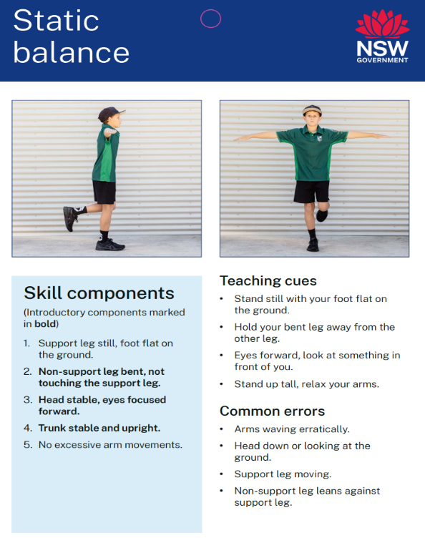
PDHPE – unit 1 spotlight (3)
Lesson 10 – static balance
Focus: is on building coordination, strength, and the confidence to hold still positions.
Learning:
stability
coordination
body control.
NSW Health (n.d.)
Notes:
71. Purpose: To summarise Lesson 10
Time: 1 minute
Presenter notes:
Lesson 10 – Static Balance, shifts the focus to body control and stability. Students learn what static balance means and practise postures such as standing on one leg or heel-to-toe. Through activities like balance circuits and bean bag challenges, they explore how to keep their body steady and upright. The emphasis is on building coordination, strength, and the confidence to hold still positions.
Differentiation ranges from offering handholds and stable positions for support, to adding transitions, balancing on different surfaces, or using props for challenge.
Assessment centres on whether students can hold a balance without movement, demonstrate body control, and reflect on strategies that help them stay steady.
Together, these lessons connect safe, fair participation with the development of fundamental movement skills.
Students learn that respecting rules and others makes play inclusive and enjoyable, while practising balance builds the strength and stability needed for more complex physical activity.
[NEXT SLIDE]

Slide 72
PDHPE – unit 1 reflection
What excites you about these units?
What changes did you notice which you will need to make some considerations about or do some preparation for?
What is still circling that you need some further clarification on?
Notes:
72. Purpose: To reflect on the units presented and take notes.
Time: 5 minutes
Presenter notes:
We will now take time to reflect on what you have seen and heard, make some notes and start to think about what this could look like in your school context.
Please return to your participant workbook reflection section.
You will have 5 minutes to add your notes.
After 5 minutes
Thank you everyone.
[NEXT SLIDE]

Slide 73

Early Stage 1 content
Notes:
73. Purpose: To look at content being covered in Term 1 for ES1
Time: 30 seconds
Presenter notes:
In this next section the content being covered in Term 1 of Early Stage 1 for all 4 CHPS Key Learning Areas will be explored further.
[NEXT SLIDE]

Slide 74
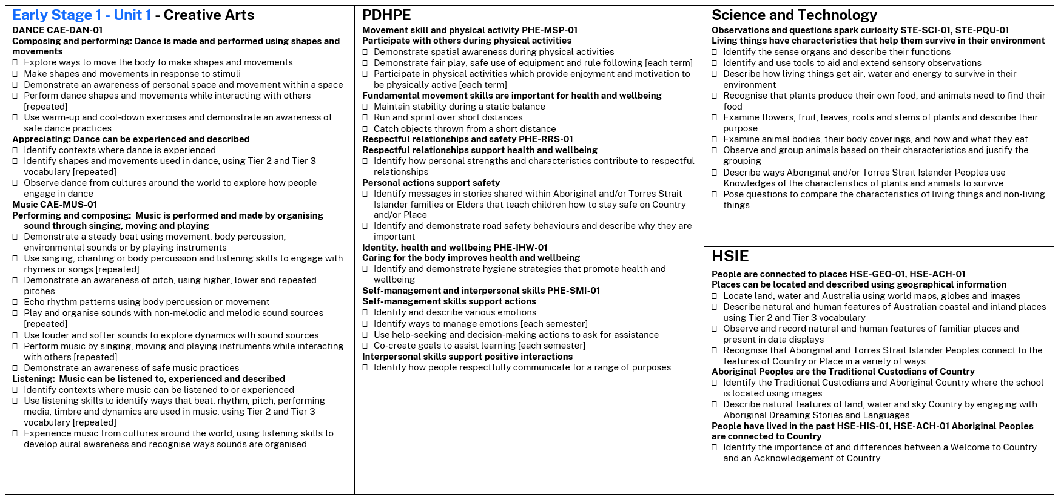
Early Stage 1 - content points
Notes:
74. Purpose: To show content covered in Term 1 of ES1
Time: 6 minutes
Presenter notes:
The image on the screen outlines all syllabus content from the Term 1 Early Stage One CHPS sample units. A copy of this content is in your participant workbook.
The units have been written using the Department’s scope and sequence, which is aligned with the NESA whole school plan.
There is new content in all CHPS key learning areas which Early Stage One teachers will need to prepare for with connections across key learning areas. One example of content which connects is
[CLICK] Aboriginal content and the use of dreaming stories which is being covered in PDHPE and HSIE –
There is also content which is new.
[CLICK] in HSIE Early Stage One students in term one are learning to locate land, water and Australia using world maps, globes and images.
Describe natural and human features of Australian coastal and inland places using Tier 2 and Tier 3 vocabulary and
Observe and record natural and human features of familiar places and present in data displays.
This is a change from what may have taught previously in a Term One unit, typically they focused on the student, their family and the school.
I will give you 4 minutes to find this page in your participant workbook and read through the content points.
After 4 minutes
Let’s look at how Early Stage one learning lays the foundation for future learning and the Scope and Sequence builds on this learning.
[NEXT SLIDE]

Slide 75
Progression of learning
HSIE- Early Stage 1 to Stage 1
ES1-HSE-GEO-01
Content group: Places can be located and described using geographical information
Locate land, water and Australia using world maps, globes and images
Describe natural and human features of Australian coastal and inland places using Tier 2 and Tier 3 vocabulary
Observe and record natural and human features of familiar places and present in data displays
Recognise that Aboriginal and Torres Strait Islander Peoples connect to the features of Country or Place in a variety of ways
S1-HS1-GEO-01
Content group: People show their connection to places using geographical information​
Locate the 7 continents and 5 oceans of the world​
Locate Australia in relation to hemispheres, oceans, continents and neighbouring countries using physical maps, political maps and globes​
Describe the features of Australian urban, rural and remote places and communities by comparing images​
Locate Australian states, territories and capital cities using political maps​
Describe reasons people are connected to places across the world by collecting and organising data in lists, tables or picture graphs​
Distinguish Aboriginal Country from Torres Strait Islander Places using language maps​
Notes:
75. Purpose: To demonstrate the progression of learning which exists in HSIE from ES1 to S1
Time: 1 minute
Presenter notes:
The content on screen shows the progression of the Early Stage 1 geography HSIE syllabus content to Stage 1 geography HSIE syllabus content. The foundation learning in ES1 supports students to continue to build schema in Stage 1.
Take a minute to read the content groups and content points to see the progression in learning.
[NEXT SLIDE}

Slide 76
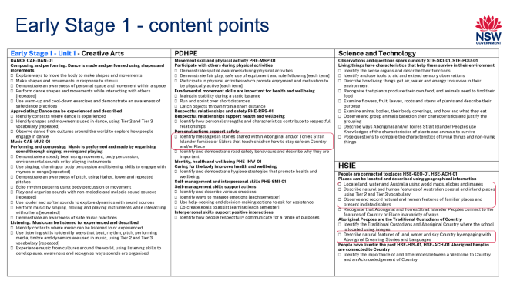
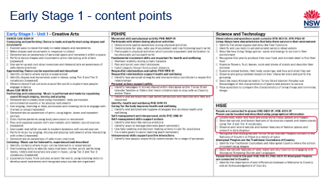
Early Stage 1 – activity
Early Stage 1 content
Look at the Early Stage 1 content page in workbook.
Read content points to look for new content which will need preparation.
Explore connections that can be seen across KLA’s.
Look at how this foundational learning is built upon in following stages.
Notes:
76. Purpose: To provide time for participants to explore Early Stage 1 content for all CHPS units.
Time: 1 minute explanation of task + 20 minutes activity time
Presenter notes:
Let’s explore the Early Stage 1 content covered in all Term 1 sample units.
Return to the Early Stage 1 content in your participant workbook.
You may like to tick or highlight content which will need preparation, as it is new for Early Stage 1.
Look at the connections which exist across the key learning areas.
Use the Scope and Sequence to see how this foundational knowledge builds across the stages.
There is a notes space provided in your workbook to record your thinking.
You have 20 minutes to undertake this activity.
Return after 20 minutes.
Thank you for engaging with the task we hope you found this a useful to build your understanding of the content covered in Term 1 units.
[NEXT SLIDE]

Slide 77

Gap analysis
Notes:
77. Purpose: To explain that there have been some content changes across all CHPS syllabuses and conduct a gap analysis to identify how to support teachers' awareness of these gaps.
Time: 30 seconds
Presenter notes:
Let’s continue to explore the content changes across the new CHPS syllabuses.
We will also introduce the Gap Analysis tool, which supports schools in identifying differences in content, timing, and potential gaps in student knowledge.
This tool can support you and guide future planning and discussions with your teams.
[NEXT SLIDE]

Slide 78

Changes in the CHPS syllabus content (1)
Key updates
the introduction of new content aligned with contemporary needs
shift in timing to ensure learning is developmentally appropriate
the merging and strengthening of existing areas for greater clarity and impact.
Notes:
78. Purpose: To explain why the changes to the CHPS syllabus matters to identifying the gaps in the sequence of learning.
Time: 1 minute
Presenter notes:
The CHPS syllabuses have been updated to better reflect current knowledge, skills, and priorities. The new syllabuses focus on what is essential to know and do for success in education and life.
These changes are designed to create a more streamlined, relevant, and future-focused curriculum. By understanding and engaging with these updates, we can:
adapt and refine teaching programs to reflect current priorities
plan strategically for resourcing across the school
engage in targeted professional learning to build teacher confidence
provide consistent and equitable support for students, ensuring every learner can thrive
[NEXT SLIDE]

Slide 79
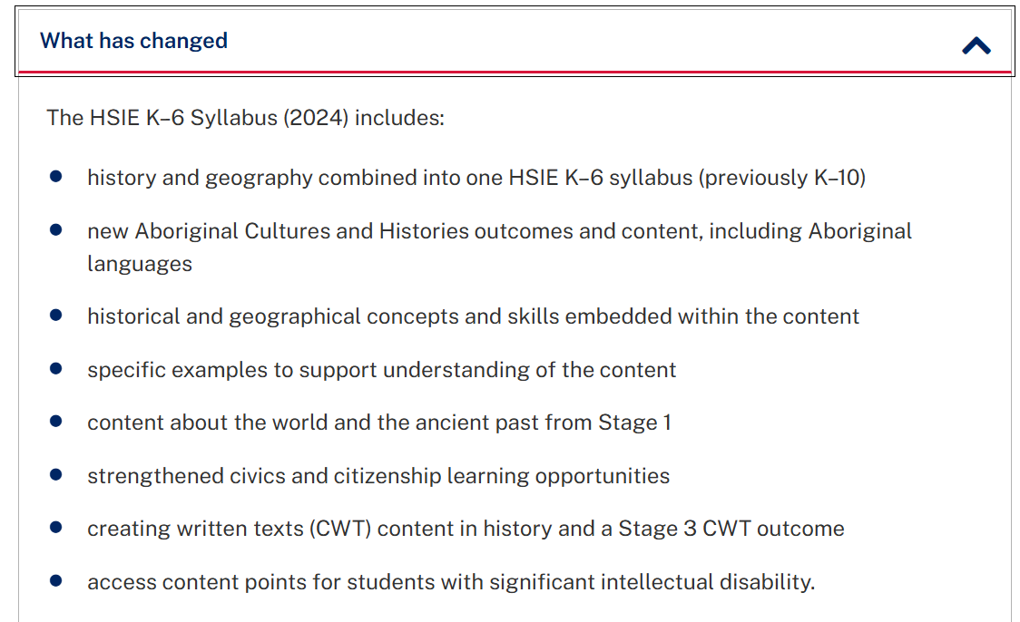
Changes in the CHPS syllabus content (2)
Notes:
79. Purpose: To explain why the changes to the CHPS syllabus matters to identifying the gaps in the sequence of learning.
Time: 1 minute
Presenter notes:
To identify gaps students will have when you implement the new syllabuses you can compare the content with what students were expected to learn in the previous syllabus. Think about your school curriculum, your stage, scope and sequences and class programs. Then cross check whether students have these understandings through assessments, class discussion and observation of their learning.
To support you to identify new syllabus content, you can access information on the NSW department of education intranet page through the curriculum tab. On screen you can see the pathway to find the overview of HSIE content that has changed.
The links to all the CHPS key learning areas overviews can be found on page 23 of your participant workbook.
[NEXT SLIDE]
Leaders' information CHPS
Human Society and its Environment K–6 Syllabus (2024) – information for school leaders
Science and Technology K–6 Syllabus (2024) – information for school leaders
Creative Arts K–6 Syllabus (2024) – information for school leaders
PDHPE K–6 Syllabus (2024) – information for school leaders

Slide 80

Overview of key changes across CHPS (1)
HSIE
Aboriginal Cultures and Histories strengthened from ES1–S3
Ancient Cultures and Histories now in Stage 1 and 2
Resourcing/teacher knowledge of maps and geographical information critical
History + Geography now integrated into one HSIE KLA
Notes:
80. Purpose: To provide an overview of key changes across KLA’s.
Time: 1 minute
Presenter notes:
[CLICK] In HSIE:
Aboriginal Cultures and Histories outcomes and content are strengthened from ES1–S3. The updated syllabus places a stronger emphasis on Aboriginal Cultures and Histories across all stages of learning. This requires teachers to embed Aboriginal perspectives consistently and authentically, not just in isolated units. This will require consultation with local Aboriginal communities to ensure respectful, authentic learning.
[CLICK] Students will now begin exploring Ancient Cultures and Histories earlier in their schooling, from Stage 1 and 2. This shift introduces historical inquiry skills at a younger age, allowing students to engage with the diversity of human experiences and compare past and present societies in more meaningful ways.
[CLICK] There is an increased focus on students using maps and other geographical tools to build spatial awareness and interpret information. Teachers will need to strengthen their own knowledge and confidence with geographical skills, and schools may need to invest in updated resources such as atlases, digital mapping tools, and classroom globes.
[CLICK] Previously taught as separate syllabuses, History and Geography are now combined into one HSIE KLA. This integration encourages teachers to plan more connected units that draw on both historical and geographical perspectives, supporting students to see the links between people, place, and time. It also reduces duplication and provides more flexibility in program design.
[NEXT SLIDE]

Slide 81
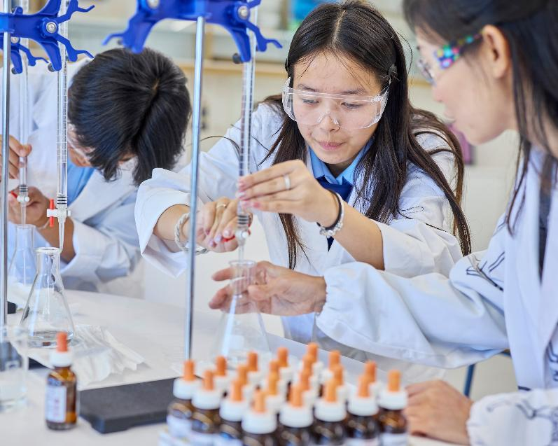
Overview of key changes across CHPS (2)
Science and technology
Human body content is new across K–6, including knowledge of the ear, eyes, digestive system, muscles, and skeleton
Additional practical investigation, demonstration and hands-on learning
Working Scientifically skills are embedded across all years, not treated as a separate component
Notes:
81. Purpose: To provide an overview of key changes across KLA’s.
Time: 1 minute
Presenter notes:
[CLICK] In Science and technology:
Human body content is a new focus across K–6, with students learning about key systems and structures such as the ear, eyes, digestive system, muscles, and skeleton. This development provides a strong foundation for understanding how the body functions, promoting health awareness and scientific literacy from an early age. Integrating this content across all year levels ensures students build progressively deeper knowledge and can make connections between body systems, health, and everyday experiences.
[CLICK] Electricity syllabus content requires additional practical investigation, demonstration, and hands-on learning. This may require additional resources to provide appropriate materials and equipment. Teacher guidance is essential to ensure students can explore concepts safely, engage with experiments, and develop a deep understanding of electrical circuits and energy transfer.
[CLICK] Working Scientifically skills are now embedded across all year levels rather than treated as a separate component. Students consistently develop skills such as questioning, predicting, planning, conducting investigations, collecting and interpreting data, and evaluating results. Embedding these skills throughout the curriculum ensures they are applied in context, strengthening students’ problem-solving, critical thinking, and scientific reasoning capabilities from K–6.
[NEXT SLIDE]

Slide 82

Overview of key changes across CHPS (3)
Creative arts
Dance and music elements have been updated from the previous syllabus
There is a strengthened focus on historical and cultural arts practices globally, including Aboriginal and/or Torres Strait Islander practices
Greater emphasis on vocabulary development, critical and creative writing (CWT)
Digital technology and digital safety are now explicitly referenced in essential content
Notes:
82. Purpose: To provide an overview of key changes across KLA’s.
Time: 2 minutes
Presenter notes:
[CLICK] In Creative Arts:
Dance and music elements have been updated from the previous syllabus, providing students with more contemporary, engaging, and developmentally appropriate learning experiences. These updates support skill progression, creativity, and expression while ensuring alignment with current educational standards.
[CLICK] There is a strengthened focus on historical and cultural arts practices from around the world, including Aboriginal and Torres Strait Islander traditions. This approach enables students to appreciate the diversity of artistic expression, understand cultural contexts, and develop respect for both local and global creative practices.
[CLICK] Through creating written text there is now greater emphasis on vocabulary development, critical and creative writing. Students are encouraged to articulate ideas effectively, analyse artistic works critically, and engage in imaginative and reflective thinking, which strengthens both literacy and cognitive skills in meaningful arts contexts.
[CLICK] Digital technology and digital safety are explicitly referenced in the essential content, ensuring students understand how to use digital tools responsibly, ethically, and safely within arts learning. This inclusion reflects the growing role of technology in creative practice and prepares students to confidently navigate digital spaces.
[NEXT SLIDE]

Slide 83

Overview of key changes across CHPS (4)
PDHPE
Financial wellbeing is now a focus in Stages 1–3
Media literacy is explicitly embedded from Stage 1–3
PE has a stronger focus on small-sided games (requiring new resources and game structures)
PE K–2 includes explicit teaching of all fundamental movement skills to be achieved by the end of Stage 1, which may require targeted PL and resourcing
Notes:
83. Purpose: To provide an overview of key changes across KLA’s.
Time: 1 minute
Presenter notes:
In PDHPE:
Financial wellbeing is now an explicit focus from Stage 1 to Stage 3. Students are supported to develop foundational skills in managing money, such as understanding needs versus wants, making responsible spending and saving choices, and recognising the value of financial planning. Integrating financial literacy from an early age equips students with practical life skills, helping them to make informed decisions and build long-term economic resilience.
[CLICK] Media literacy is explicitly embedded from Stage 1 to Stage 3, recognising the increasingly complex media environment students navigate. Students learn to critically analyse and interpret information, identify bias or misinformation, and respond thoughtfully to media messages across multiple platforms. Early and consistent teaching of media literacy supports informed citizenship and encourages safe, responsible engagement with digital media.
[CLICK] Physical Education now places a stronger emphasis on small-sided games, which promote higher levels of participation, teamwork, spatial awareness, and decision-making compared with traditional large-group formats. Implementing small-sided games requires new teaching approaches, modified resources, and adaptable game structures to ensure all students are actively engaged and developing their skills. This approach also supports differentiation, allowing students of varying abilities to participate meaningfully.
[CLICK] PE for K–2 now includes the explicit teaching of all fundamental movement skills, with the goal that students achieve proficiency by the end of Stage 1. This ensures that students have a strong foundation in core movement patterns such as running, jumping, catching, throwing, balancing, and dodging. Achieving this goal may require targeted professional learning for teachers, additional resources, and structured practice opportunities to provide consistent and effective skill development for all students.
[NEXT SLIDE]

Slide 84
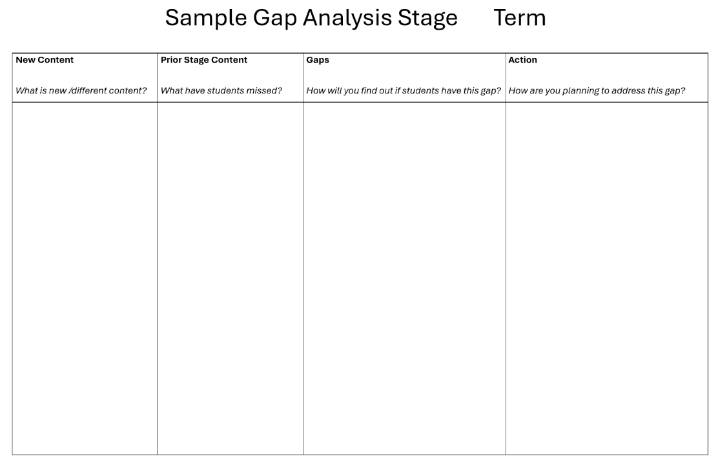
Introducing the gap analysis tool
Notes:
84. Purpose: To introduce the gap analysis tool.
Time: 2 minutes
Presenter notes:
The Gap Analysis tool is designed to help systematically identify differences in content and timing between the old and new syllabuses.
It allows you to map where content has moved, been added, or consolidated, and to identify potential gaps in student knowledge.
To use the tool.
First identify the new content. Look at the updated syllabus for your stage. Record what is new or different compared to the previous syllabus in the New Content column.
Second, check prior stage learning. Consider what students should already know from previous stage/s. Note what they have may have missed or had less exposure to in the Prior Stage Content column. (e.g. due to timing changes, merged content, or new additions).
Third, pinpoint possible gaps. In the Gaps column, outline how you will find out if students have this gap. This could include quick check in activities, pre-assessments/ quizzes, class discussions and observations of student work.
Finally plan your actions, in the Action column, write how you will address the gap through your teaching. Examples could include incorporating revision activities, scaffolding with visuals or hands-on tasks, adjusting the sequence of lessons, small group support or targeted interventions.
On completion of a gap analysis tool, it is important to review and refine. Revisit your gap analysis during and after teaching the new content. Update the actions based on student progress to ensure consistent support across the stage.
Now let us explore an example based on Stage 2 syllabus content. You can replicate this approach across other stages relevant to you.
[NEXT SLIDE]

Slide 85
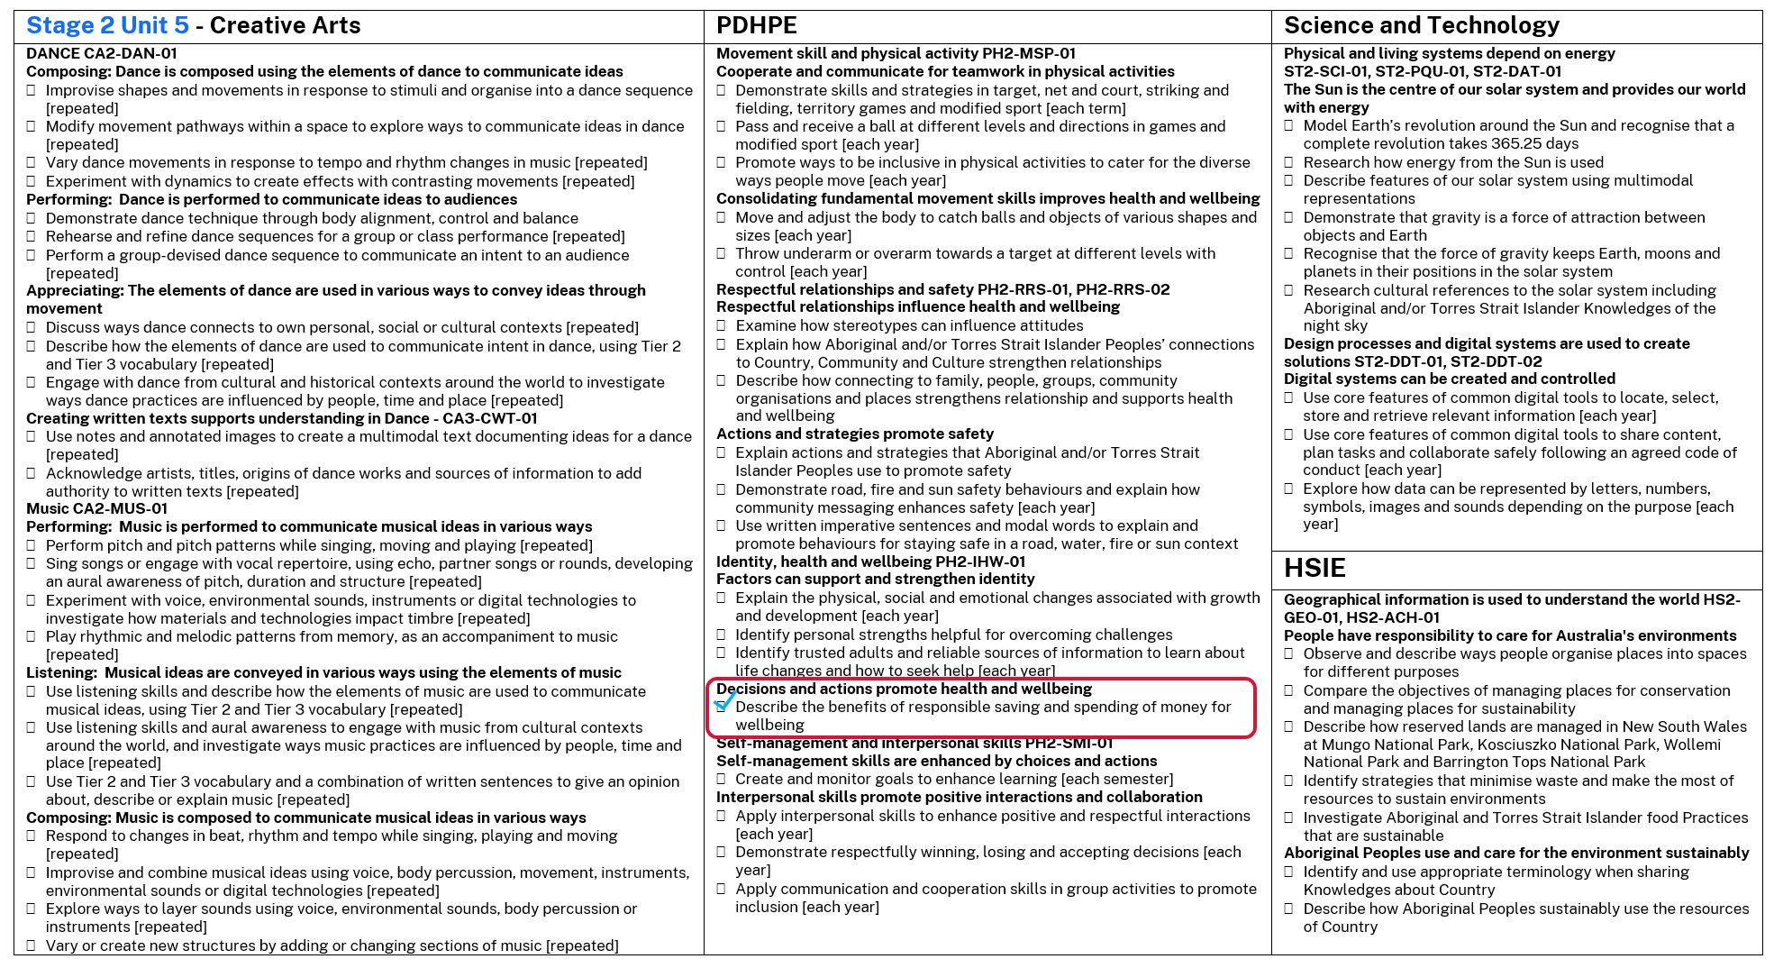
Gap analysis tool – using content points
Notes:
85. Purpose: To model an example to identify gaps in content points.
Time: 30 seconds
Presenter notes:
The image on the screen shows all content covered in Stage 2 Unit 5 for each of the CHPS syllabus. A copy of content for unit 1 and unit 5 has been included in the participant workbook. Our example is based on stage 2 syllabus content, and the process can replicated for other stages.
Considering PDHPE as the example, highlighted is one area of new content.
Looking at the PDHPE syllabus content, financial literacy within the focus area Identity, Health and Wellbeing. The Stage 2 content group – Decisions and actions promote health, and wellbeing has a content point – describe the benefits of responsible saving and spending of money for wellbeing.
This is one area that can now be completed using the gap analysis tool.
[NEXT SLIDE]

Slide 86
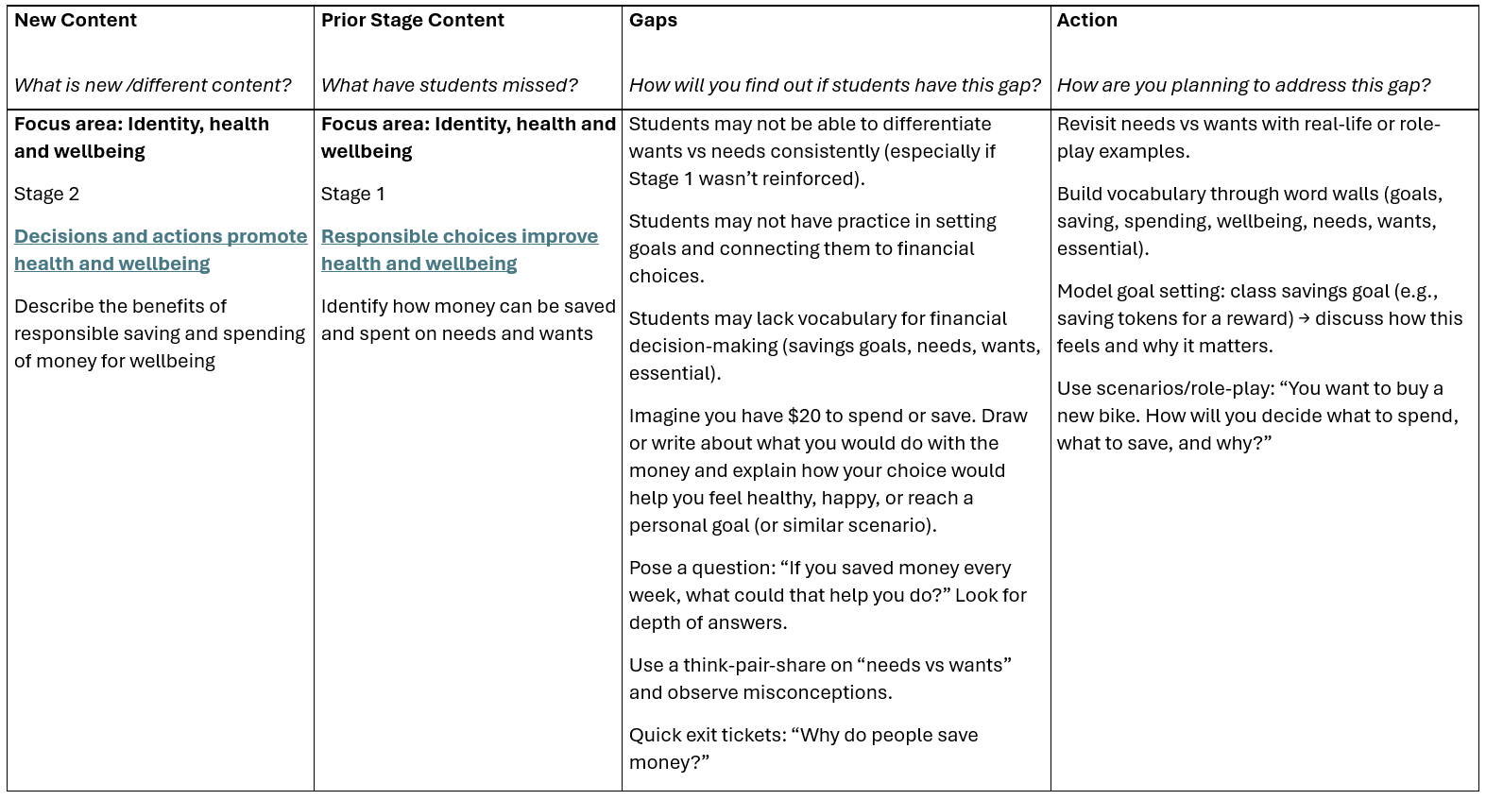
Example of the gap analysis tool
Stage 2 Unit 5
Notes:
86. Purpose: To model an example to identify gaps between the old and new syllabus to support the sequence of learning.
Time: 3 minutes
Presenter notes:
Think of this example from the perspective of a classroom teacher in Stage 2 planning to implement the PDHPE syllabus.
The new content is from PDHPE syllabus, financial literacy within the focus area Identify, Health and Wellbeing. Stage 2 content group –Decisions and actions promote health and wellbeing. Content point – describe the benefits of responsible saving and spending of money for wellbeing.
In Stage 1 it is planned for students to learn the basics, recognising that money can be save or spent on needs and wants.
In Stage 2, they build on this be deciding the benefits of responsible saving and spending, making clearer connections to wellbeing.
The Stage 2 teacher needs to think about the gaps the students will have because they are in Stage 2 and have not experienced the new syllabus until now. The teacher might identify gaps in students' knowledge, that they may not be able to consistently differentiate between needs and wants. They may not yet link money behaviours to wellbeing, for example how saving can reduce stress or support long term goals.
To find these gaps exist the teacher can use pre assessment, observation and check ins. For example, asking students to draw or write what how they would spend or save an imaginary $20 or a similar contextually relevant scenario. The teacher could pose questions, for example ‘If you save money every week, what could that help you do?”
Once the gaps have been identified, the teacher can take deliberate actions, for example building financial vocabulary word wall to help students use and understand key terms. Model goal setting together, create a class savings goal and reflect on how it felt to achieve the goal.
Importantly the teacher should link these activities to wellbeing, making it clear that informed financial decisions help us feel safe, proud and happy. This supports not only money management but embeds it within health and wellbeing helping students see the real-life benefits of their choices.
As you can see, this process helps leaders and teachers identify both content gaps and implications for practice.
[NEXT SLIDE]

Slide 87
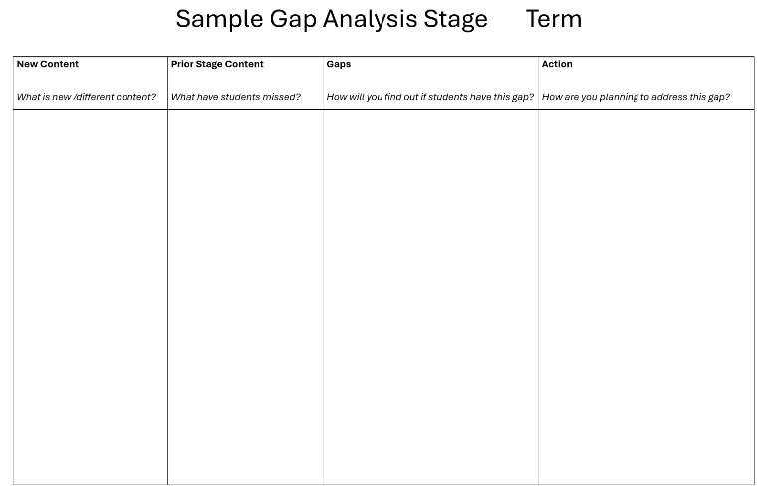
Gap analysis – activity
Choose a key learning area relevant to your current work
List the new content in the tool
Check prior stages of learning to identify gaps
Decide on strategies to assess gaps in student learning
Record how you will address identified gaps
Notes:
87. Purpose: To provide time for participants to choose a KLA of their own preference and use the gap analysis tool.
Time: 3 minutes explanation of task + 20 minutes activity time + 1 minute reflection
Presenter notes:
Now there is time to complete your own gap analysis based on a key learning area you are implementing or planning to implement in 2026 at your school.
Please map key content changes identified in this professional learning and consider implications for your planning and assessment.
Some examples include:
In HSIE, Ancient Cultures and Histories now in Stage 1 and 2
For PDHPE, PE has a stronger focus on small-sided games (requiring new resources and game structures).
In Science, Human body content is new across K–6, including knowledge of the ears, eyes, digestive system, muscles, and skeleton.
Creative arts, dance and music elements have been updated from the previous syllabus.
First, choose a key learning area relevant to your work, open the relevant digital syllabus and identify the new content.
Then check prior stage learning, think about what students should already know from the prior stage/s.
Decide on the strategies that you could use to pinpoint the gaps in students learning.
In the action column record how, you will address any identified gaps through your teaching.
You have 20 minutes to begin your gap analysis in your chosen KLA.
Using this tool will support your team to be able to adapt to the changes with clarity and confidence, ensuring students experience a smooth and consistent transition into the new syllabuses.
[NEXT SLIDE]

Slide 88

Resources
Notes:
88. Purpose: To introduce the resource and vocabulary list for the sample units of work in CHPS
Time: 10 seconds
Presenter notes:
Alongside the CHPS sample units of work are carefully curated resources and vocabulary lists to support your teaching.
[NEXT SLIDE]

Slide 89

Resource and vocabulary toolkit
Resource lists and key vocabulary have been provided, detailing all required materials and including checkboxes to track availability.
Freely available and digital alternatives are included to ensure all schools can access necessary resources.
Vocabulary lists support EAL/D students and consistent teaching of subject-specific terms, making planning and delivery more efficient.
Notes:
89. Purpose: To identify the resources for each KLA to support unit implementation and purchasing of equipment.
Time: 1 minute
Presenter notes:
To support your preparation for implementing the CHPS sample units a suggested resource and vocabulary list for sample unit 1 and unit 5 will be provided in microlearning module 4 which will be available later this term. These resource lists detail materials required for each unit.
Recognising that many schools may not have access to all resources, the units incorporate freely available digital alternatives. For example, in HSIE sample units, when a globe is needed for an activity, a link to a digital version is provided, with similar alternatives for maps and other resources.
Key vocabulary is identified in each sample unit. Vocabulary lists provide teachers with a clear reference to reinforce consistent teaching and learning of subject-specific terms. They support EAL/D students by providing focused language to improve comprehension and communication.
Overall, these resource lists are designed to make your planning and delivery as efficient as possible, allowing you to focus on effectively engaging your students.
[NEXT SLIDE]

Slide 90

Reflect
See – How did the information presented today connect to what you already do?
Think – What will you do with the information you previewed today?
Wonder – What would you like to explore further?
Notes:
90. Purpose: To support participants to make connections between new ideas and prior knowledge.
Time: 5 minutes
Presenter Notes:
See, think, wonder is a great routine to make connections between new learning and prior knowledge. Take a moment to reflect on what has been learned by previewing the sample units today from the CHPS key learning areas.
Take 5 minutes to return to your participant workbook and reflect on these questions.
After 5 minutes
This reflection tool can be used collaboratively with your team or shared with colleagues at school.
[NEXT SLIDE]

Slide 91

Key takeaways
CHPS sample units have a common lesson structure across all four key learning areas
Key sample unit features support explicit teaching, assessment and differentiation
Support materials will be available for teaching and learning in term 1 2026 including resource lists
Vocabulary lists will be available to support EAL/D students and strengthen whole class planning
Consider:
How will you identify next steps for 2026 at year and stage levels including actions for leaders and teachers?
Notes:
91. Purpose: To reflect on the key takeaways of the creative arts presentation.
Time: 1 minute
Presenter notes:
To conclude this professional learning, take a moment to reflect on the key takeaways that you see on screen.
The common lesson structure across CHPS sample units provides a consistent framework that supports explicit teaching, assessment, and differentiation.
The upcoming support materials, including resource and vocabulary lists, will enhance planning and effectively assist EAL/D students.
Moving forward, it will be important to identify next steps at year and stage levels by collaborating with leaders and teachers to implement targeted actions to incorporate these resources into teaching and learning.
[NEXT SLIDE]

Slide 92

Contact us
Primary Curriculum Statewide Staffroom
primarycurriculum@det.nsw.edu.au
Notes:
92. Purpose: Contact details for the Primary Curriculum team
Time: 1 minute
Presenter notes:
If you have any questions or would like to reach out to the Primary Curriculum Team, please contact us via this email address, or through the Statewide Staffroom.
This QR code takes you to the enrolment page to join the primary curriculum statewide staffroom.
[NEXT SLIDE]

Slide 93
References (1)
This presentation contains NSW Curriculum and syllabus content. The NSW Curriculum is developed by the NSW Education Standards Authority. This content is prepared by NESA for and on behalf of the Crown in the right of the State of New South Wales. The material is protected by Crown copyright.
Please refer to the NESA Copyright Disclaimer for more information https://educationstandards.nsw.edu.au/wps/portal/nesa/mini-footer/copyright.
NESA holds the only official and up-to-date versions of the NSW Curriculum and syllabus documents. Please visit the NSW Education Standards Authority (NESA) website https://educationstandards.nsw.edu.au/wps/portal/nesa/home and the NSW Curriculum website https://curriculum.nsw.edu.au.
Creative Arts K–6 Syllabus © NSW Education Standards Authority (NESA) for and on behalf of the Crown in right of the State of New South Wales, 2024.
Human Society and its Environment K–6 Syllabus © NSW Education Standards Authority (NESA) for and on behalf of the Crown in right of the State of New South Wales, 2024.
Personal Development, Health and Physical Education K–6 Syllabus @ NSW Education Standards Authority (NESA) for and on behalf of the Crown in right of the State of New South Wales, 2024.
Science and Technology K–6 Syllabus © NSW Education Standards Authority (NESA) for and on behalf of the Crown in right of the State of New South Wales, 2024.
NSW Education Standards Authority (NESA) (2025) Teaching resources | Syllabus support | NSW Curriculum | NSW Education Standards Authority, NESA website, accessed 7 August 2025.

Slide 94
References (2)
State of New South Wales (Department of Education) (2025) Creative arts K-6 sample scope and sequence [website],accessed on 7 August 2025.
State of New South Wales (Department of Education) (2025) HSIE K-6 sample scope and sequence [website],accessed on 7 August 2025.
State of New South Wales (Department of Education) (2025) PDHPE K-6 sample scope and sequence [website], accessed on 7 August 2025.
State of New South Wales (Department of Education) (2025) Science and technology K-6 sample scope and sequence [website],accessed on 7 August 2025

Slide 95
Copyright
© State of New South Wales (Department of Education), 2025
The copyright material published in this resource is subject to the Copyright Act 1968 (Cth) and is owned by the NSW Department of Education or, where indicated, by a party other than the NSW Department of Education (third-party material).
Copyright material available in this resource and owned by the NSW Department of Education is licensed under a Creative Commons Attribution 4.0 International (CC BY 4.0) license.
This license allows you to share and adapt the material for any purpose, even commercially.
Attribution should be given to © State of New South Wales (Department of Education), 2025.
Material in this resource not available under a Creative Commons license:
the NSW Department of Education logo, other logos and trademark-protected material
Material owned by a third party that has been reproduced with permission. You will need to obtain permission from the third party to reuse its material.
Links to third-party material and websites
Please note that the provided (reading/viewing material/list/links/texts) are a suggestion only and implies no endorsement, by the New South Wales Department of Education, of any author, publisher, or book title. School principals and teachers are best placed to assess the suitability of resources that would complement the curriculum and reflect the needs and interests of their students.
If you use the links provided in this document to access a third-party’s website, you acknowledge that the terms of use, including licence terms set out on the third-party’s website apply to the use which may be made of the materials on that third-party website or where permitted by the Copyright Act 1968 (Cth). The department accepts no responsibility for content on third-party websites.

